Slide 1



An approach to modeling linear and non-linear self-shading losses with pvlib
Will Hobbs¹, Kevin Anderson², Mark Mikofski³, Madison Ghiz³
¹Southern Company, ²Sandia, ³DNV
2024 PV Performance Modeling Workshop, May 6, 2024

Slide 2
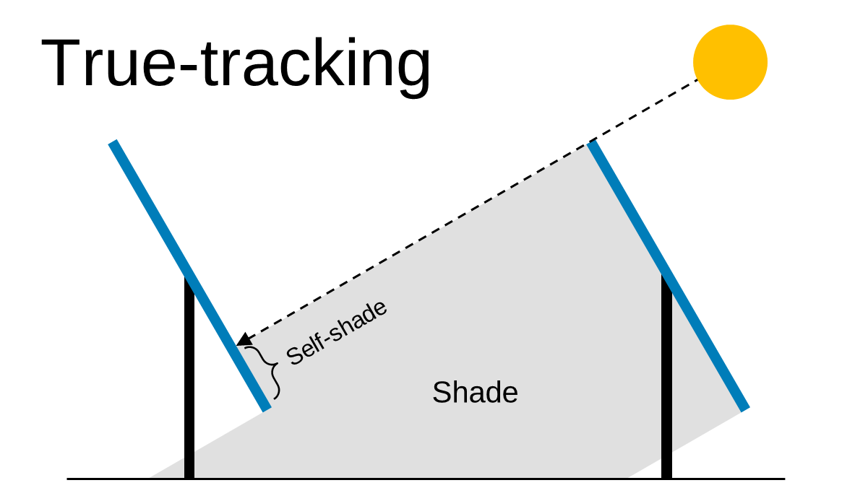
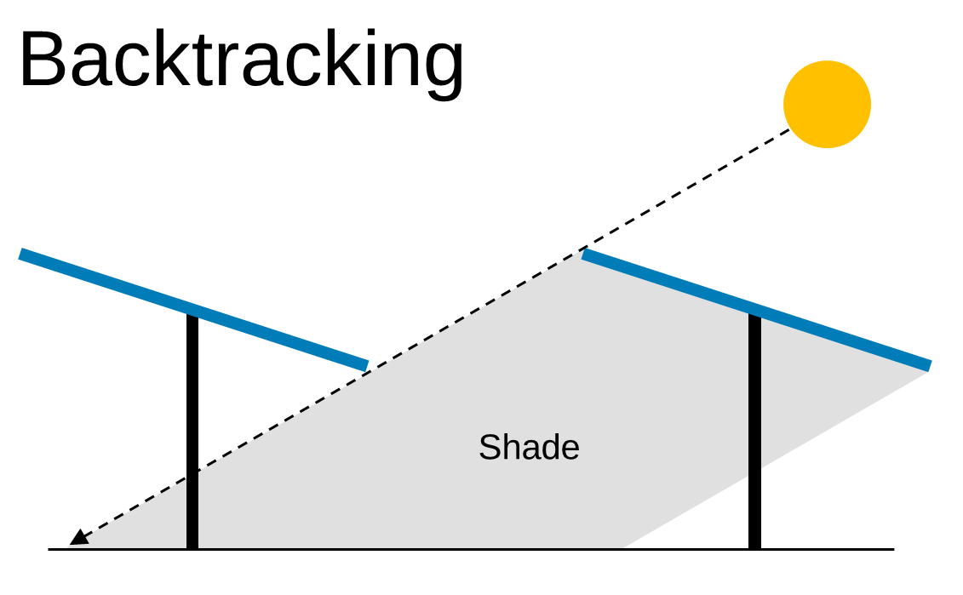

Self-shade (row-to-row shade)
About 40% of US utility-scale solar has self-shade losses
25% thin-film tracking
18% fixed tilt
2/3 (12% of solar) crystalline → has non-linear losses
How do we model all of this?
Non-linearity
Twin modules (w/ half-cut cells)?
Fractional backtracking?
Tracker issues?
Thin-film
Linear
Crystalline
Crystalline, twin
Non-Linear
Non-Linear
Solar stats: Berkely Lab, Utility-Scale Solar 2023, at https://emp.lbl.gov/utility-scale-solar/

Slide 3
For example…

Slide 4
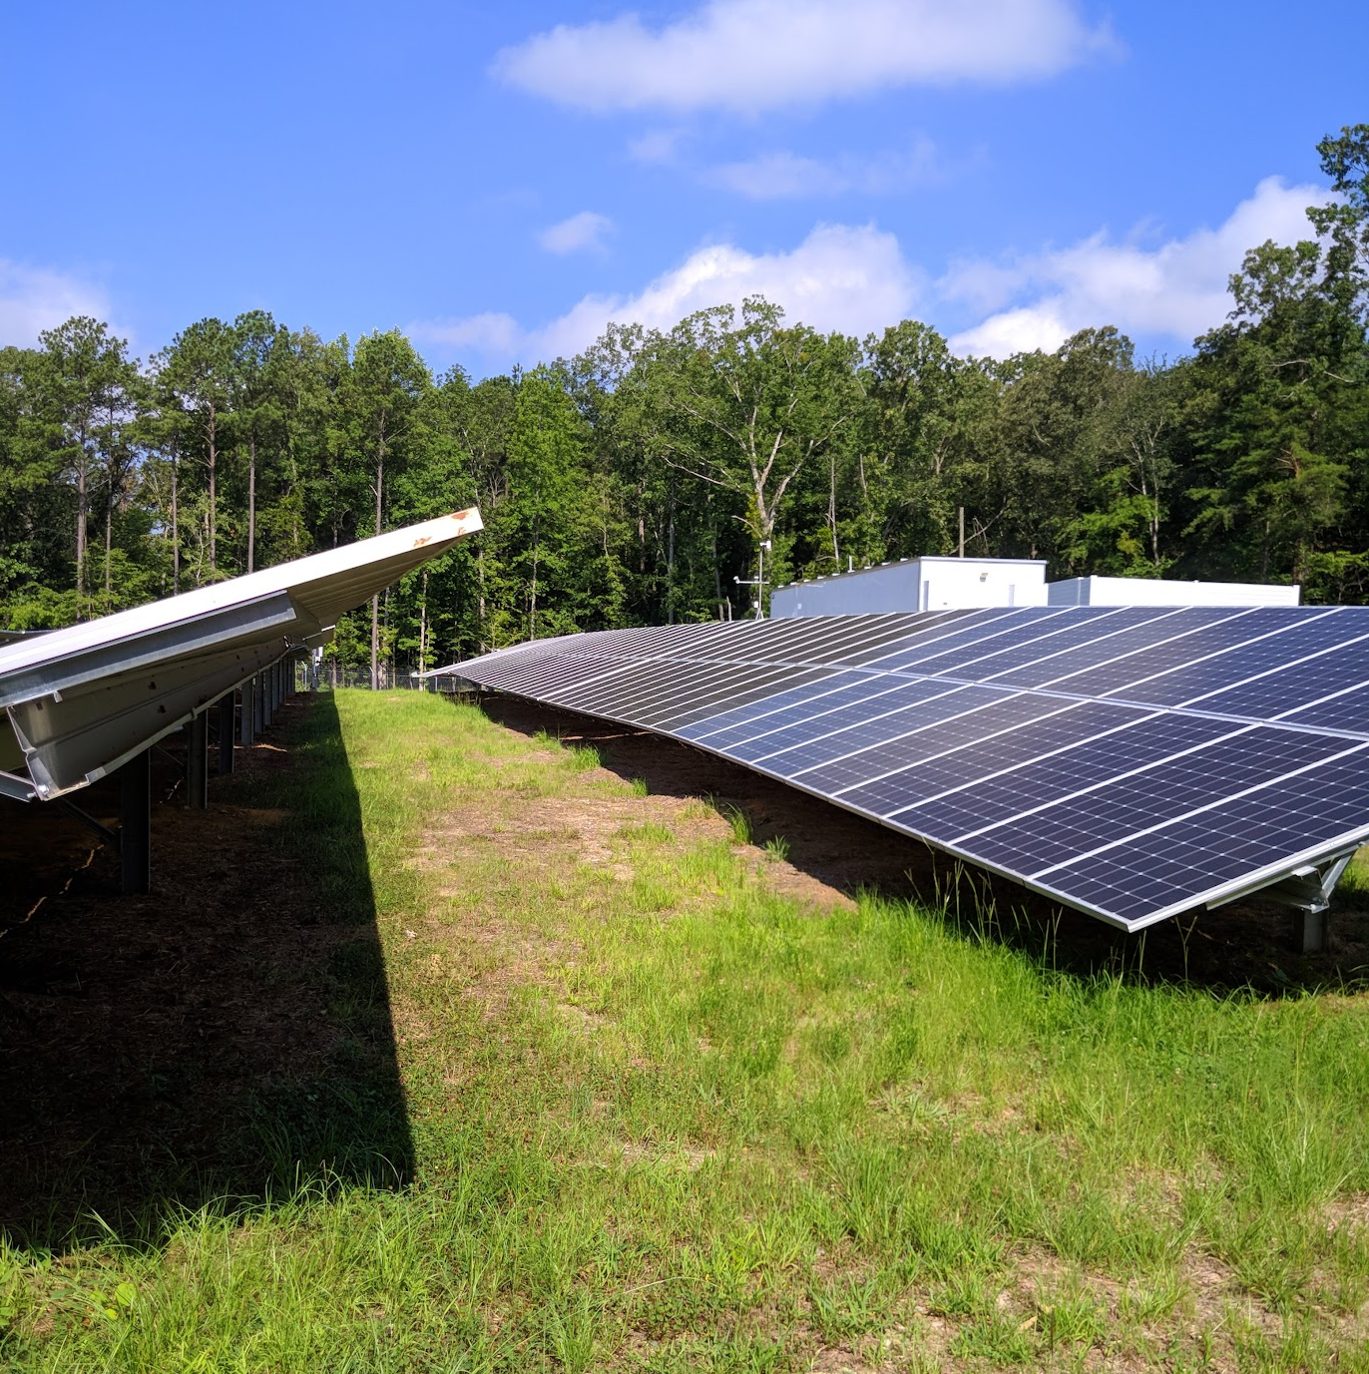
Easy to model:
Fixed crystalline w/ no shade

Slide 5
Hard to model
Lower sun elevation = shade
Non-linear losses
2P, 2P twin, etc…

Slide 6
What does this look like for power?

Slide 7
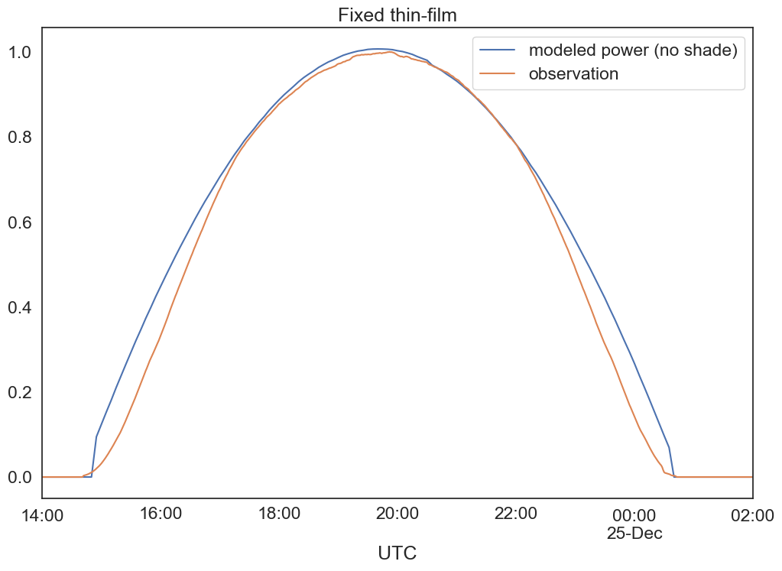
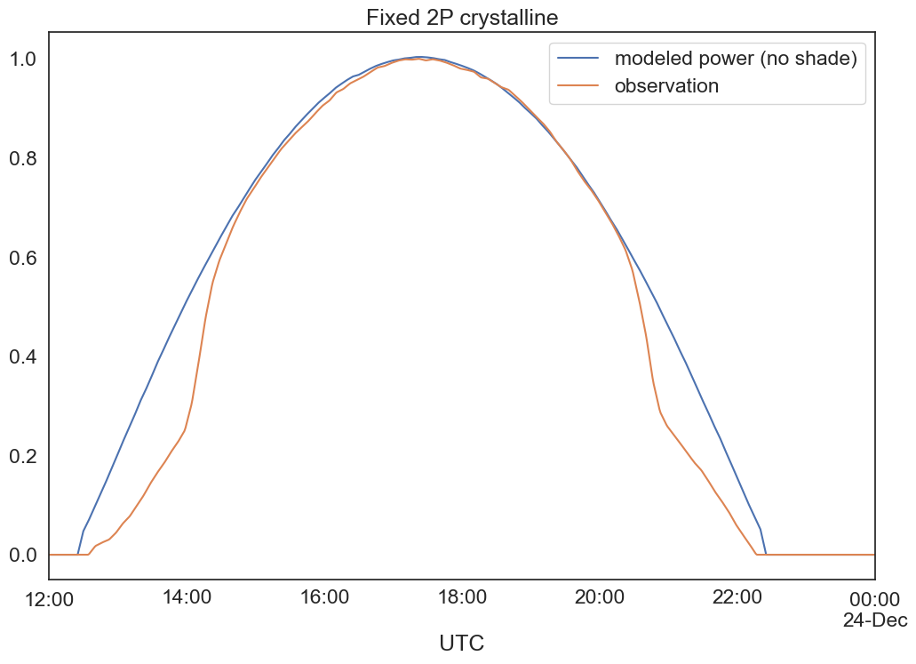
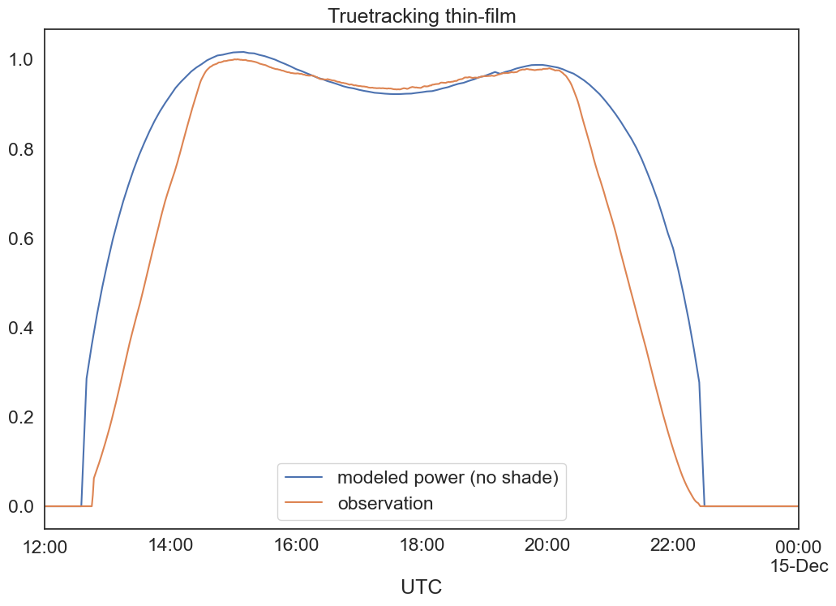
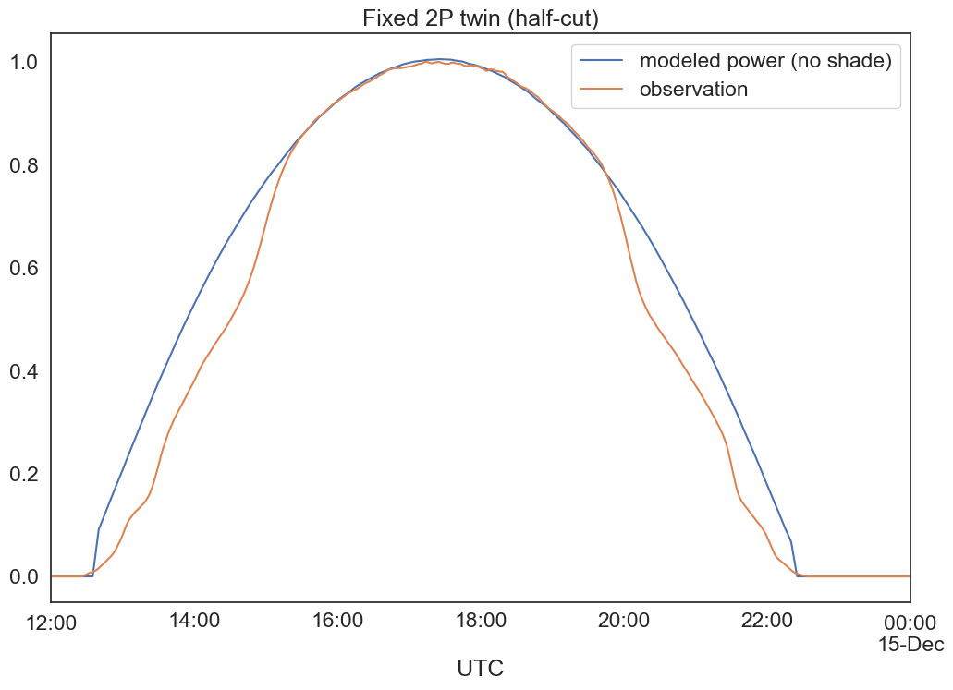







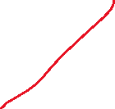


Overestimation at low sun angles:

Slide 8
Solution using pvlib

Slide 9
Steps:
*
Calculate shaded fraction
Calculate power loss
Done!
* Start with array shaded fraction, then calculate for each “course” (i.e., string) of modules
** actually, effective irradiance instead of power loss
**

Slide 10
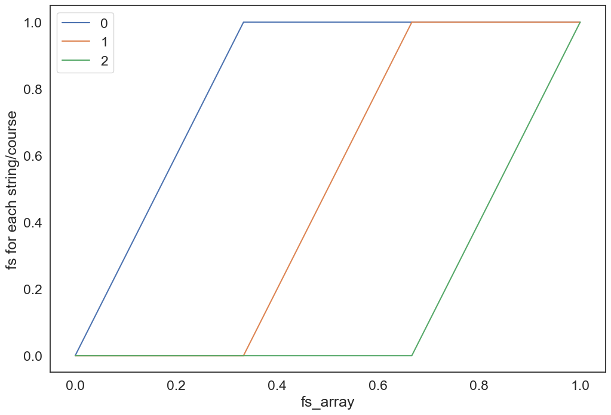

Shaded Fraction
Top-down view of 3P system (2 rows)
Use shaded_fraction_front from infinite_sheds.get_irradiance() for array shaded fraction
Then calculate shaded fraction in each course
* For our model, each string can only be in one course
Course 2
String 2
Course 1
String 1
Course 0
String 0
*
End view of 3P system (2 rows)
Course 2
Course 1
Course 0
Shade
Shaded fraction

Slide 11
Twin modules?
Double the number of effective modules up the side of a row
For example, 2P twin → 4P effective

Slide 12
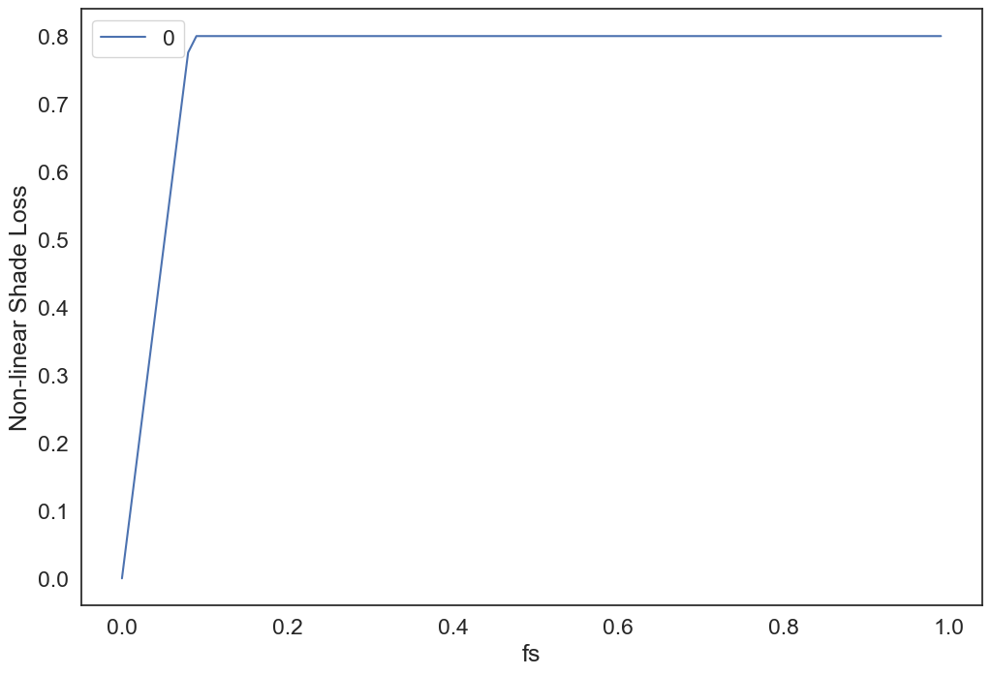

Calculate power (effective irradiance) loss
Thin-film? Loss of direct irradiance linear with shaded fraction, fs
Crystalline? Loss of direct irradiance across the first row of cells
Crystalline (non-linear):
fs = 1/24
POA_{direct} reduced by 1/2
(and treat twin modules as 2 modules)
fs ≥ 1/12
POA_{direct} reduced by 100%
Thin-film (linear):
fs = 1/2
POA_{direct} reduced by 1/2
(For module with 12 cells up the long axis)
Anderson, Kevin. 2020. Maximizing Yield with Improved Single-Axis Backtracking on Cross-Axis Slopes: Preprint. Golden, CO: National Renewable Energy Laboratory. NREL/CP-5K00-76023. https://www.nrel.gov/docs/fy20osti/76023.pdf.

Slide 13
Some results
with observations from 2 inverters per plant

Slide 14
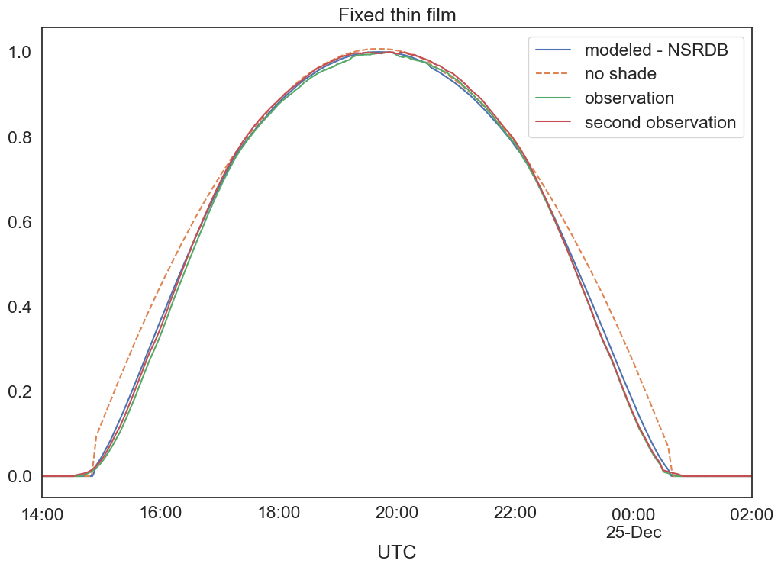
1.9 % annual difference (NSRDB)

Slide 15
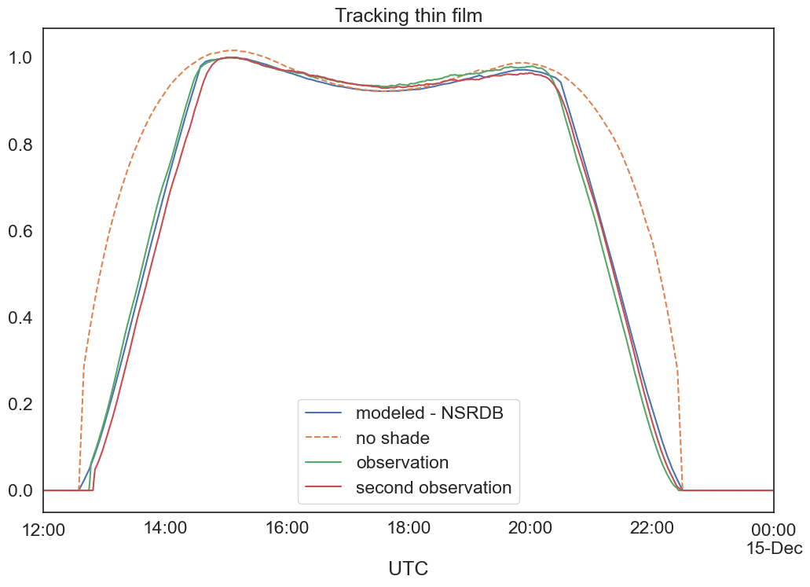
8.5% annual difference (NSRDB)

Slide 16
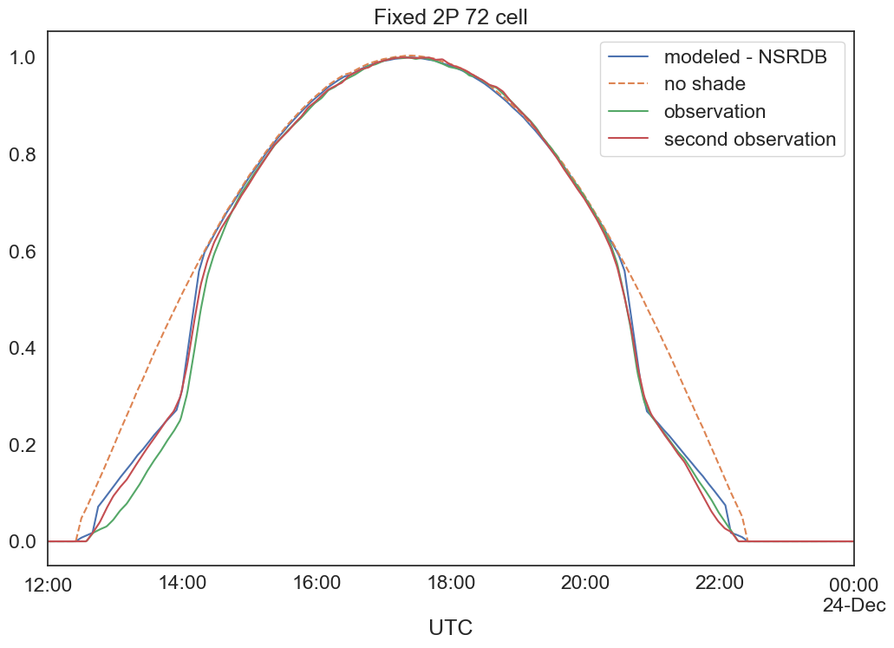
1.9% annual difference (NSRDB)

Slide 17
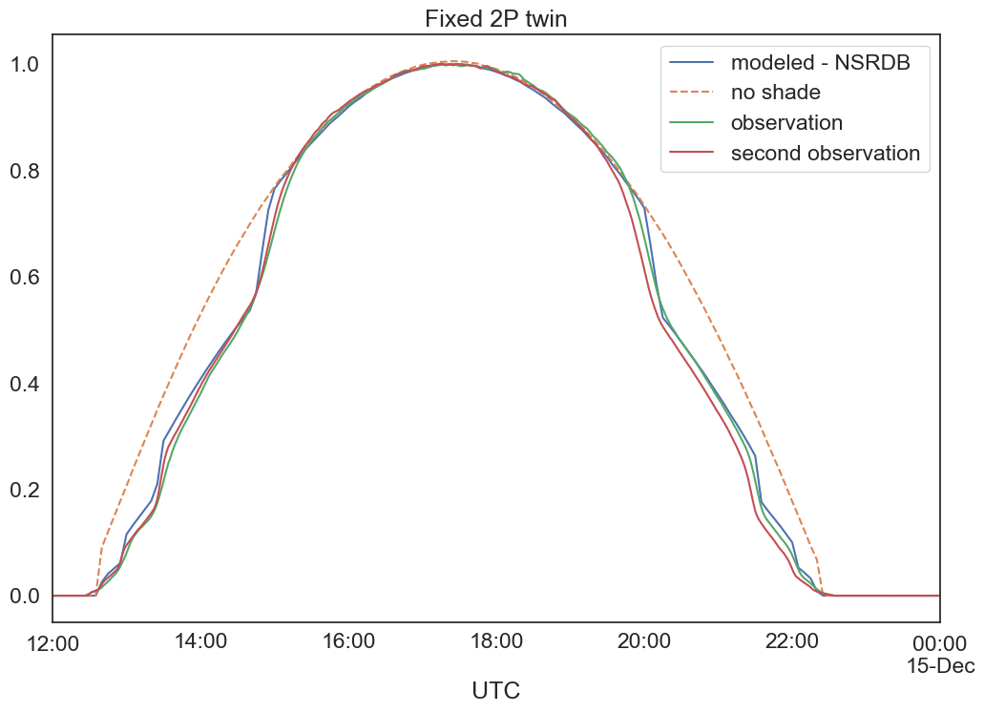
2.5% annual difference (NSRDB)

Slide 18
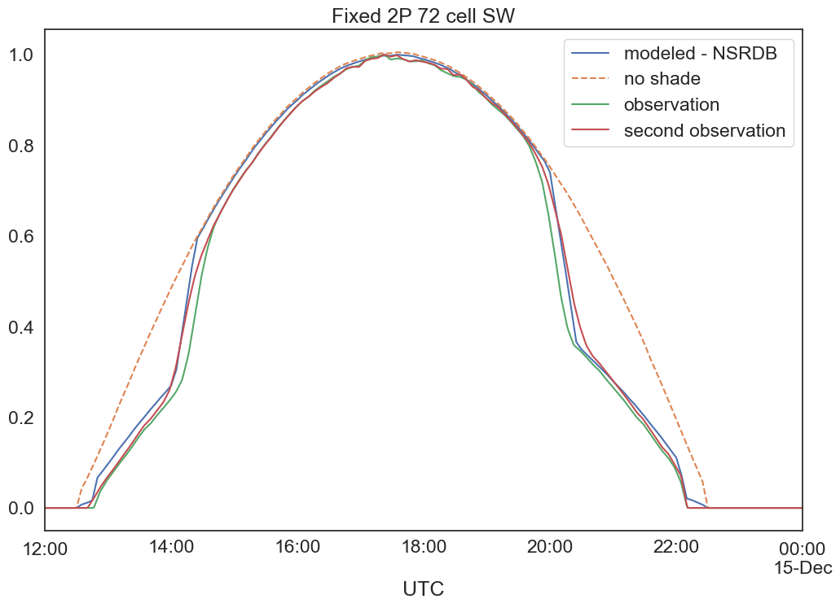
2.7% annual difference (NSRDB)

Slide 19
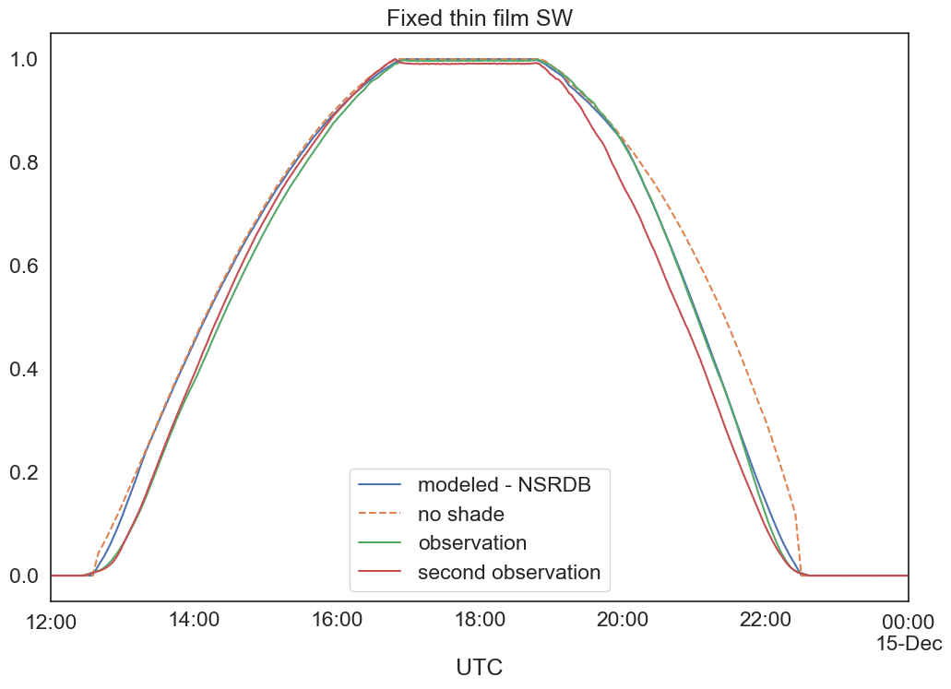
2.3% annual difference (NSRDB)

Slide 20
Back to the 2P twin plant
let’s look at GCR

Slide 21
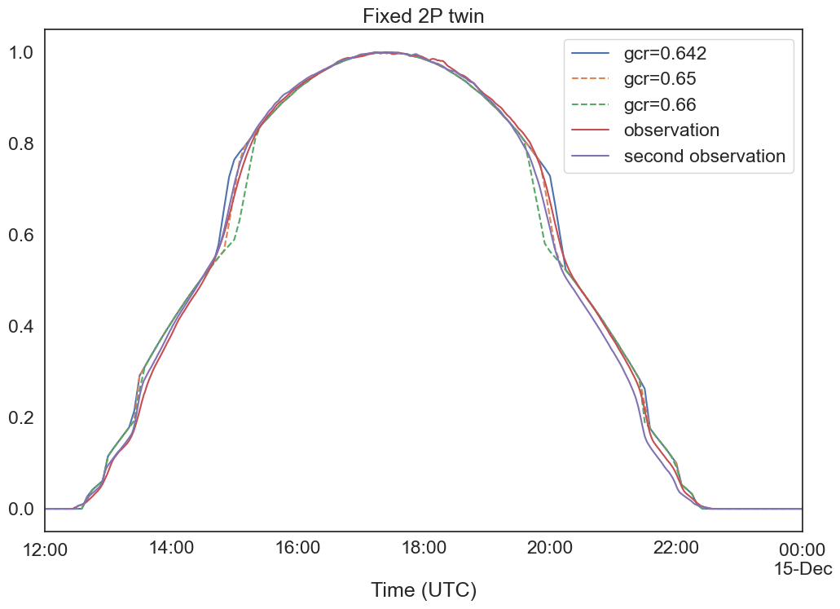


Slide 22
Let’s look at the steps
zoom in on the morning

Slide 23
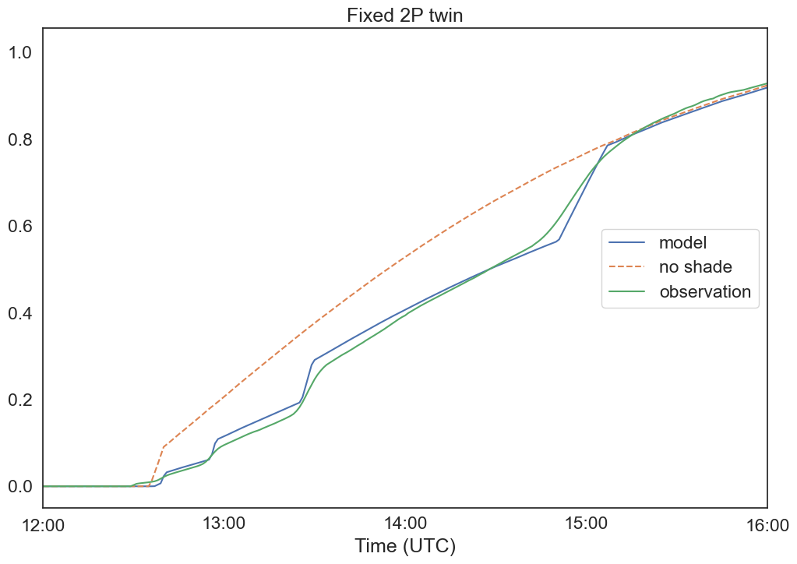

Slide 24
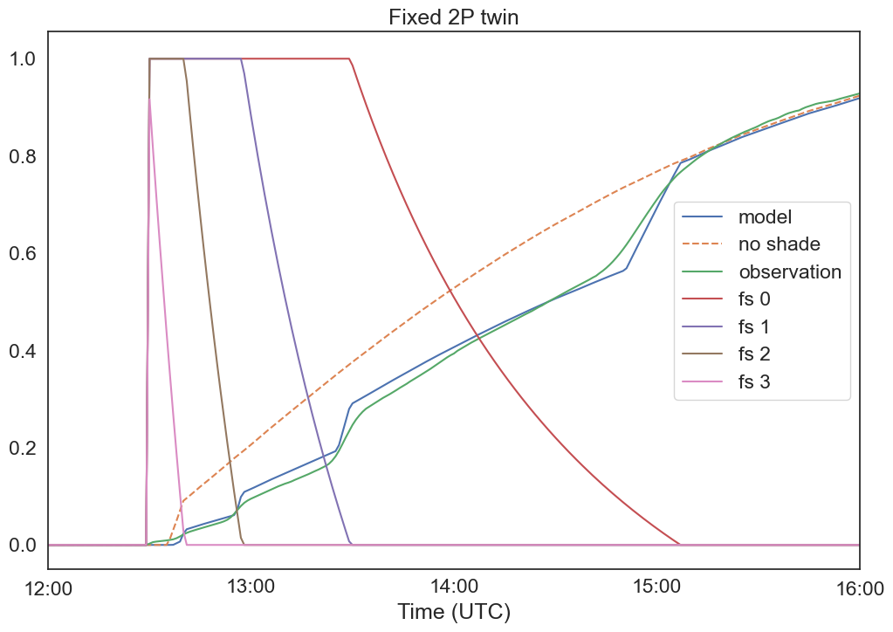
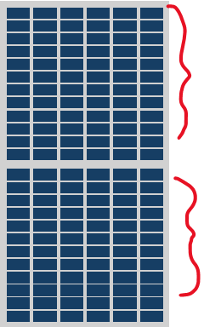

Slide 25
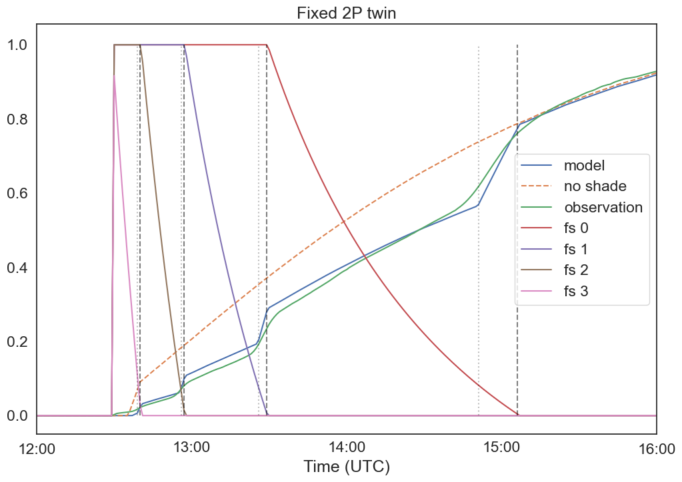


Slide 26
Other applications
fractional backtracking, backtracking faults

Slide 27
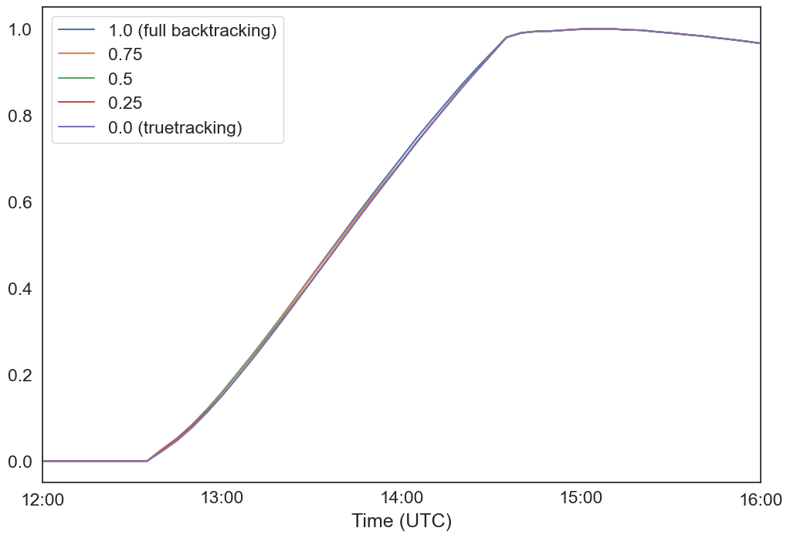

Fractional Backtracking
For twin modules, especially 2P (effectively 4P conventional) backtracking to allow shade for a fraction of the array might make sense (maybe even truetracking)
Let’s model a 2P twin example:
Mode | Annual Energy kWh (NSRDB)
Full backtracking (1.0) | 2058
0.75 backtracking | 2050
0.5 backtracking | 2046
0.25 backtracking | 2044
0.0 (truetracking) | 2043
🤷

Slide 28
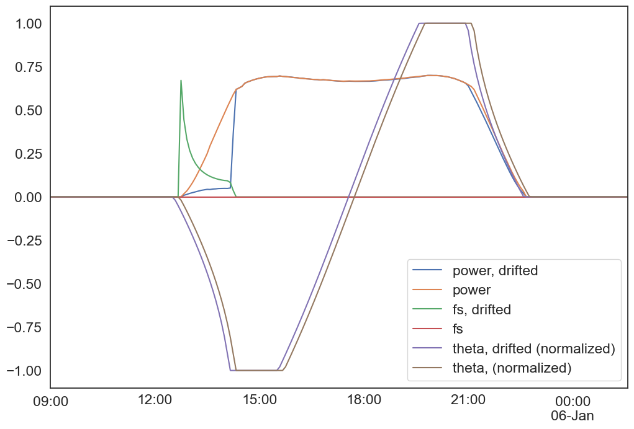
Misaligned trackers (clock drift)
Tracker clock is 10 minutes fast
1P 72-cell crystalline
~5% annual losses! (NSRDB)

Slide 29
Code availability
it’s open-source!

Slide 30

https://github.com/williamhobbs/2024_pvpmc_self_shade
Repo includes everything shown here:
Functions
example notebooks with plots
anonymized observation data and specs

Slide 31

Functions
shade_fractions(fs_array, eff_row_side_num_mods)
non_linear_shade(n_cells_up, fs, fd)
plant_power_with_shade_losses(
resource_data,
**plant_data,
surface_tilt_timeseries,
surface_azimuth_timeseries,
use_measured_poa,
use_measured_temp_module)
(https://github.com/williamhobbs/pv-plant-specifications)

Slide 32
Questions? whobbs@southernco.com
https://github.com/williamhobbs/2024_pvpmc_self_shade

Slide 33
Room for improvement
Account for “inactive bands” at module edges (or, at least, see how much it matters)
Crystalline modules in landscape
Unconventional crystalline module designs (shingled cells, etc.)
Comparison with single diode model
Slopping terrain (https://github.com/pvlib/pvlib-python/pull/1962 by echedey-ls will help)
isotropic looks better than haydavies, even in periods with no direct shade – why?

