Slide 1

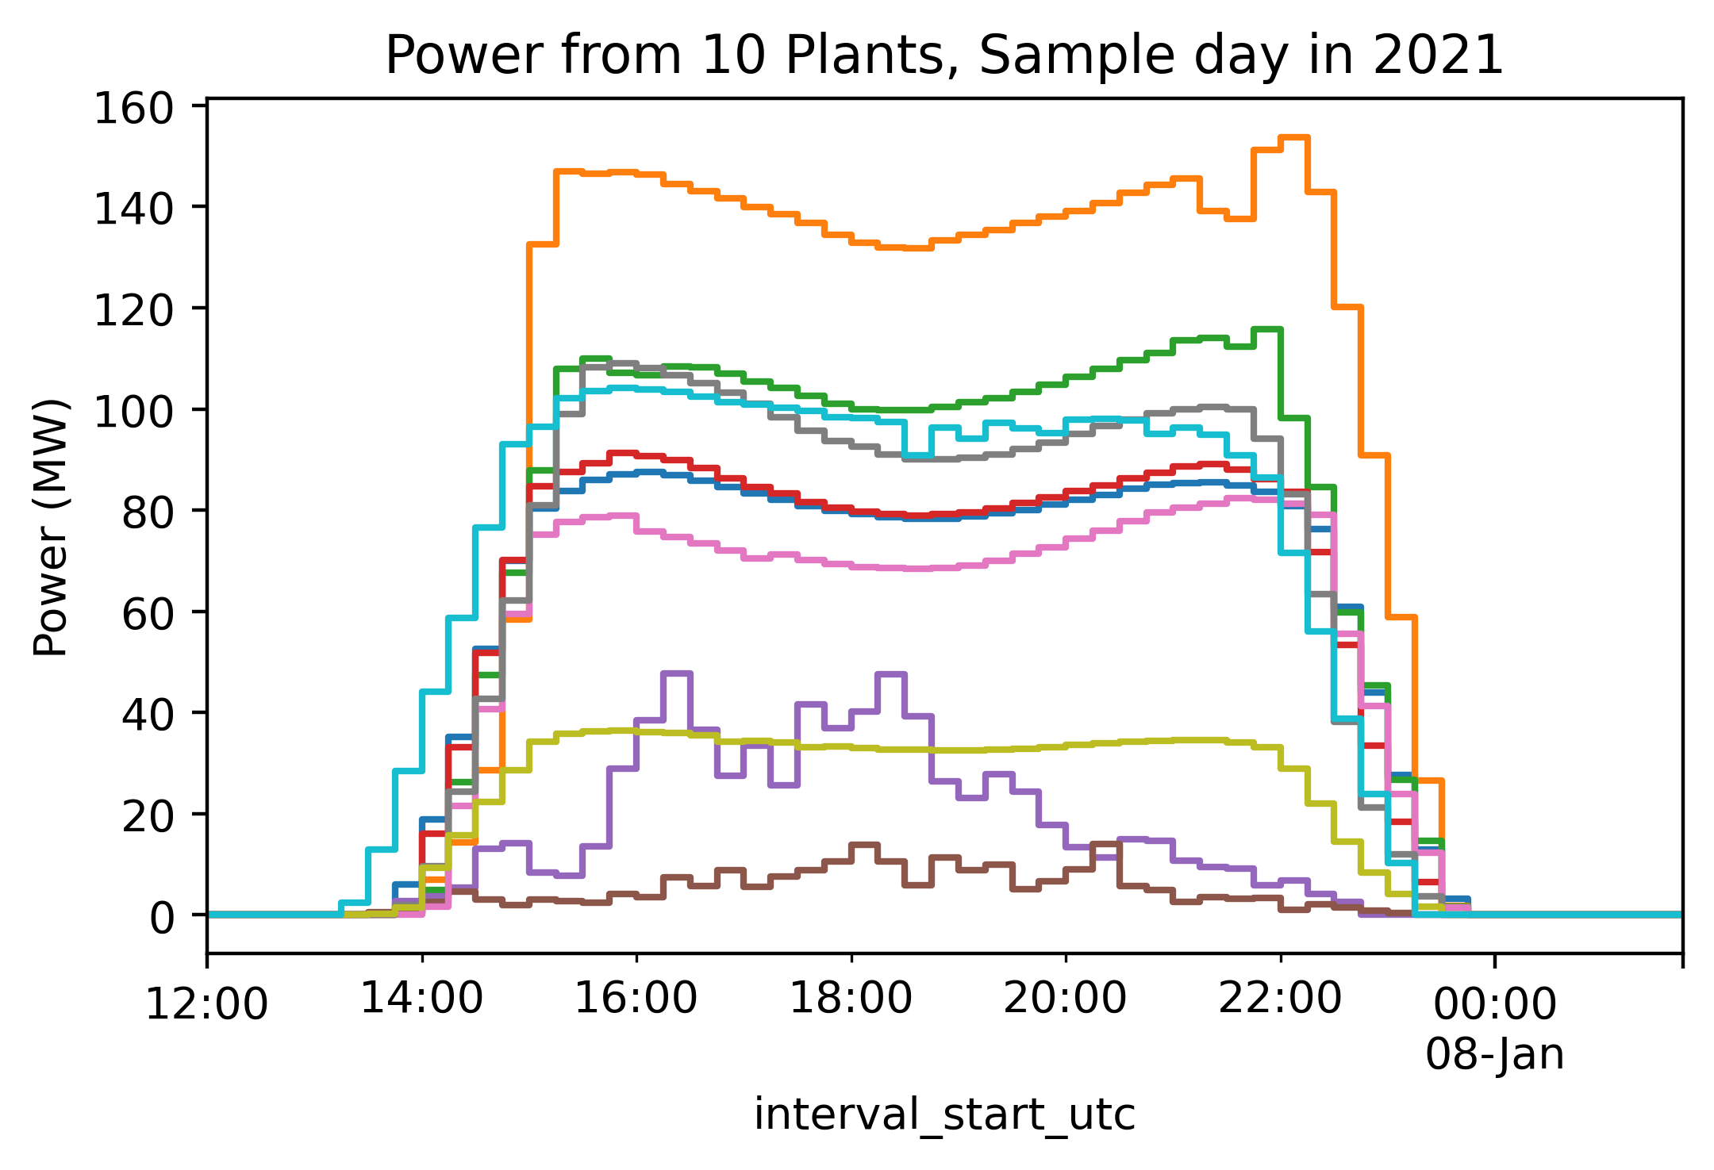
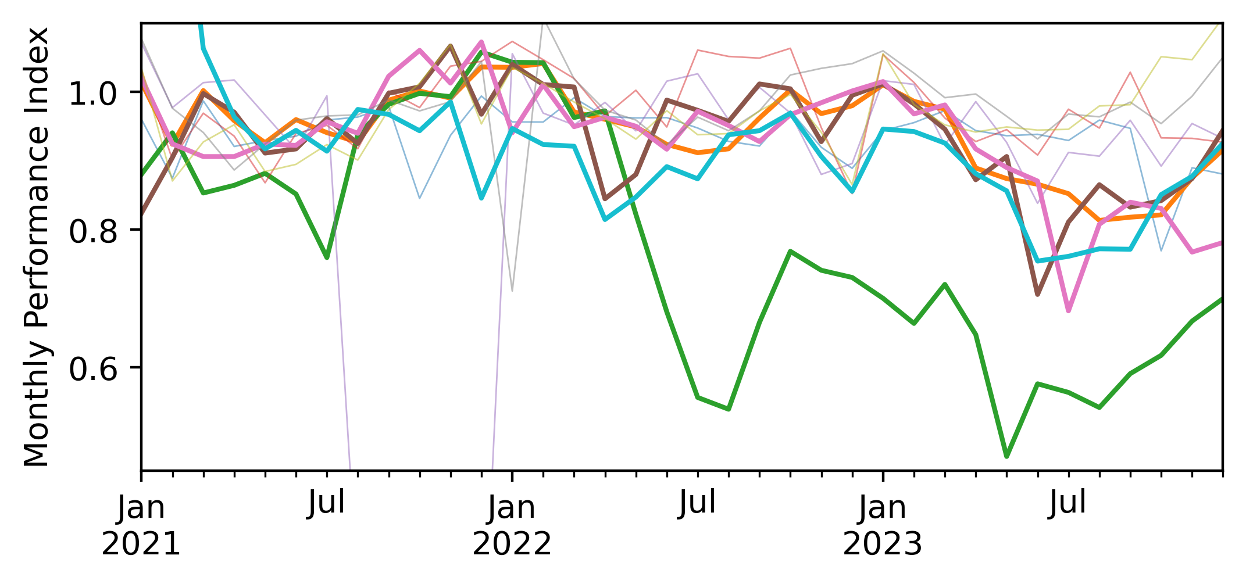
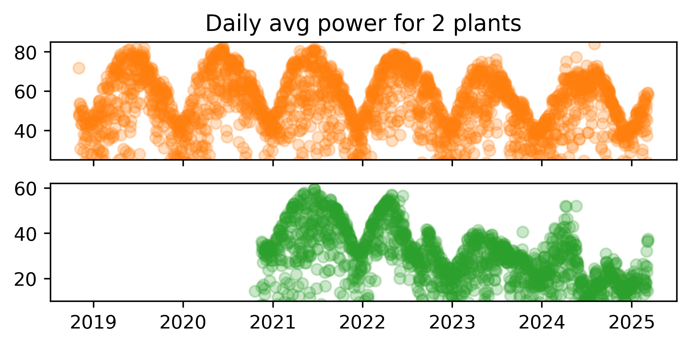



Plant performance analysis with satellite resource data and public power data
Will Hobbs, Southern Company, whobbs@southernco.com
Power data are available for every solar plant in ERCOT at 15-min intervals back to 2012. Someone should analyze it all and publish results. Here is a small preview.
Data: Generation data are published by ERCOT with a 60-day delay [1]. Archive goes back to 2012 [2]. 3rd-party access from gridstatus.io API goes back to 2018 [3] with paid + free options.
Metadata: ERCOT uses abbreviated codes for plant names, matched with ERCOT CDR reports [4] to get full unit names, capacities, and counties, then matched* with EIA 860 data [5] for key modeling specs (lat/lon, fixed/tracking, cell type, tilt, etc.).
*Matching with EIA was not 100% successful due to inconsistent names. I used fuzzy string matching [6] on portions of plant name + county with ~2/3 of sites being matched (no false positives, I don’t think…)
Sample Analysis:
Semi-random sample of 10 plants
Modeled expected power with NSRDB PSM4 [7] and pvlib [8] via pv-system-model [9] to calculate performance index (PI)
Estimated parameters not in EIA 860 (gcr, gamma_pdc, dc_loss_fraction) using scipy.optimize.minimize.
Initial results: 5 of 10 plants appear to have big drops in PI from 2021 to 2023. 1 of 10 looks like 10%/yr power loss rate. What’s going on? Maybe major recurring curtailment? More analysis on more plants is needed.
What’s next? Someone should get all this data, do proper (rigorous) analysis, and publish results, similar to PV Fleets.
😬
References:
[1] https://www.ercot.com/mp/data-products/data-product-details?id=NP3-965-ER
[2] https://data.ercot.com/data-product-archive/NP3-965-ER, free login account needed, 1 .zip file of CSVs per day
[3] https://www.gridstatus.io/datasets/ercot_sced_gen_resource_60_day
[4] https://www.ercot.com/files/docs/2025/02/12/CapacityDemandandReservesReport_December2024.xlsx, from ttps://www.ercot.com/gridinfo/resource,
[5] EIA Form 860, “3_3_Solar_Y2023.xlsx”, in https://www.eia.gov/electricity/data/eia860/xls/eia8602023.zip, from https://www.eia.gov/electricity/data/eia860/
[6] https://github.com/seatgeek/thefuzz
[7] https://developer.nrel.gov/docs/solar/nsrdb/nsrdb-GOES-conus-v4-0-0-download/, available via pvlib alpha release, https://pvlib-python.readthedocs.io/en/latest/reference/generated/pvlib.iotools.get_nsrdb_psm4_conus.html
[8] Anderson, K., Hansen, C., Holmgren, W., Jensen, A., Mikofski, M., and Driesse, A. "pvlib python: 2023 project update." Journal of Open Source Software, 8(92), 5994, (2023). https://doi.org/10.21105/joss.05994
[9] https://github.com/williamhobbs/pv-system-model
Code available:
https://github.com/williamhobbs/PVPMC_2025
Acknowledgements:
Code for pulling from gridstatus.io and matching with EIA was based on code by Drumil Joshi, Southern Power Company.

