Slide 1

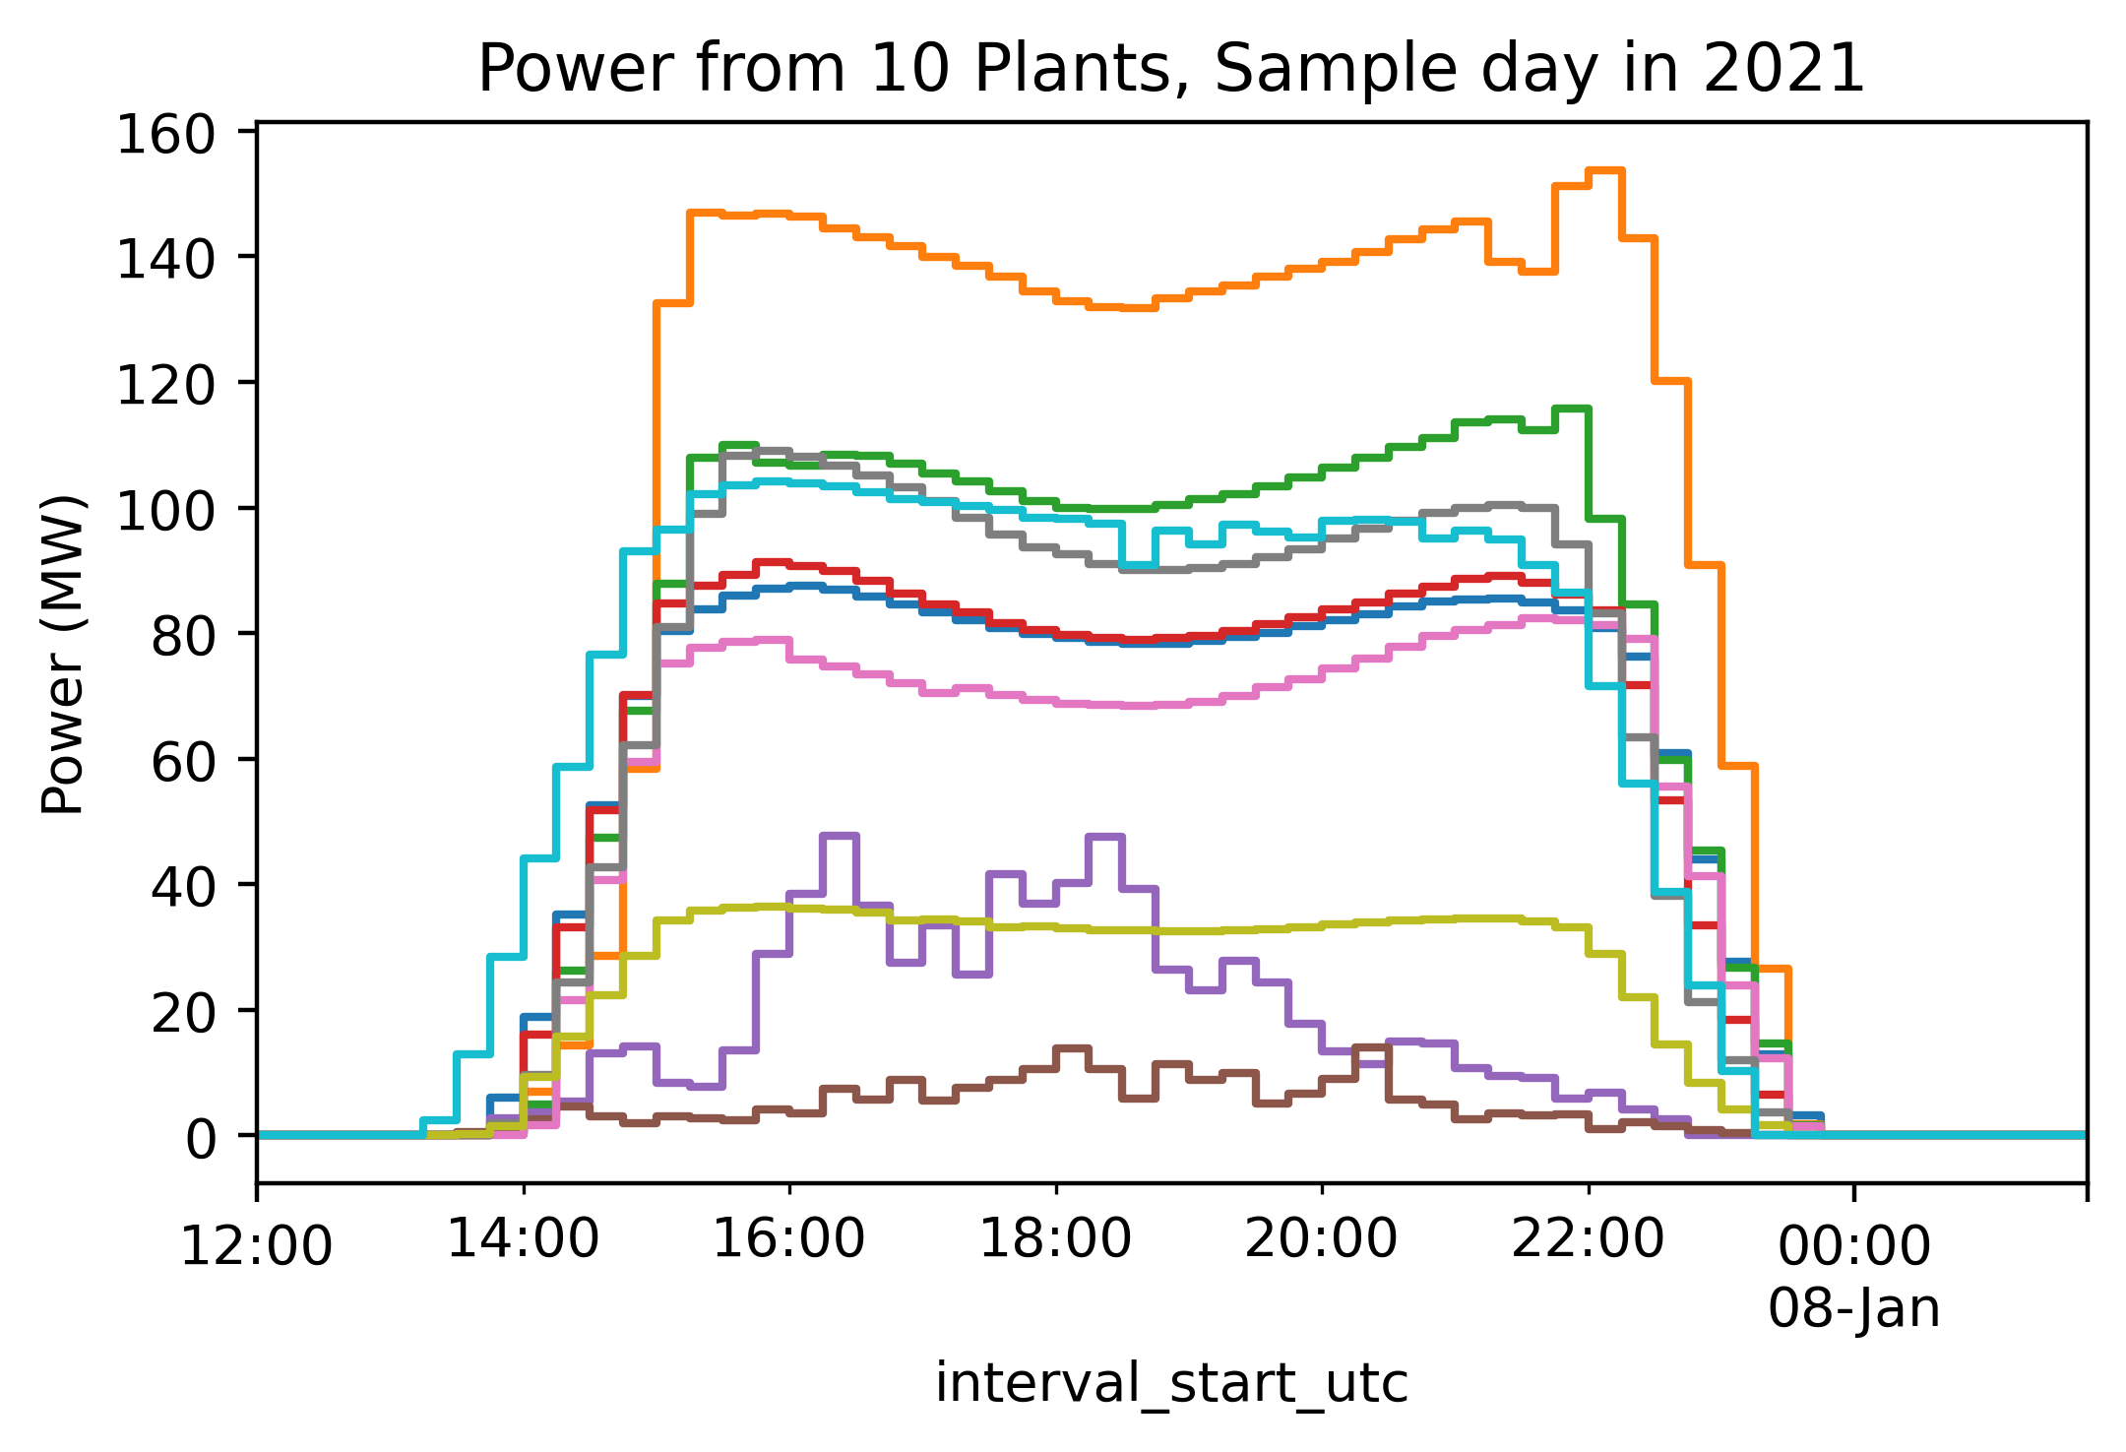
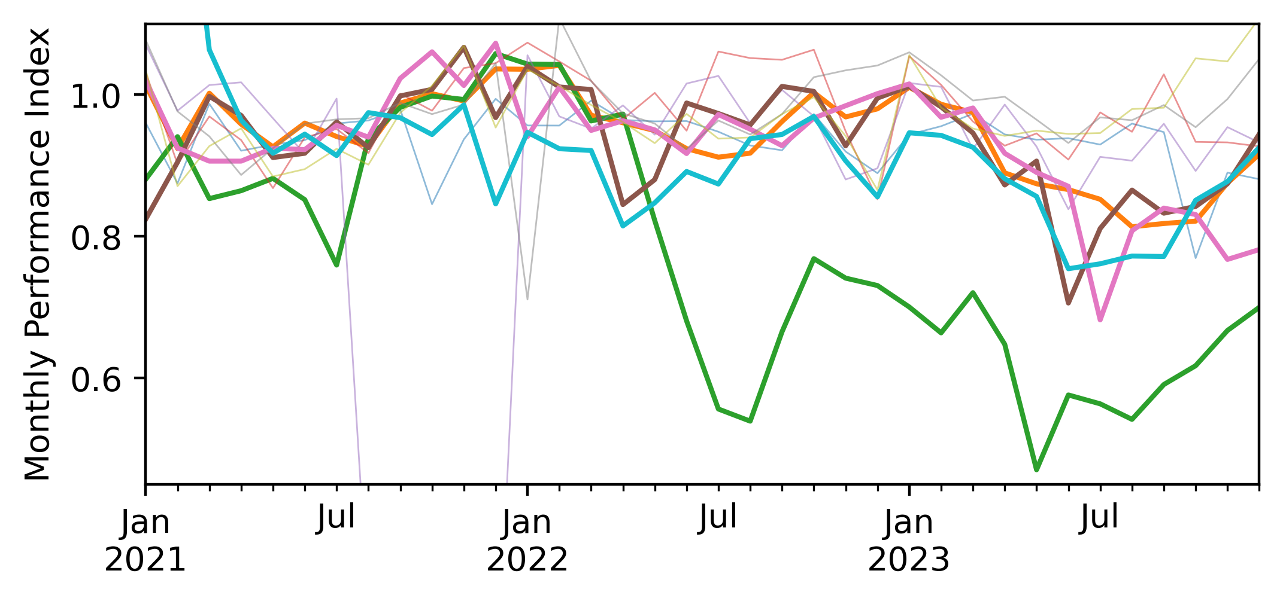
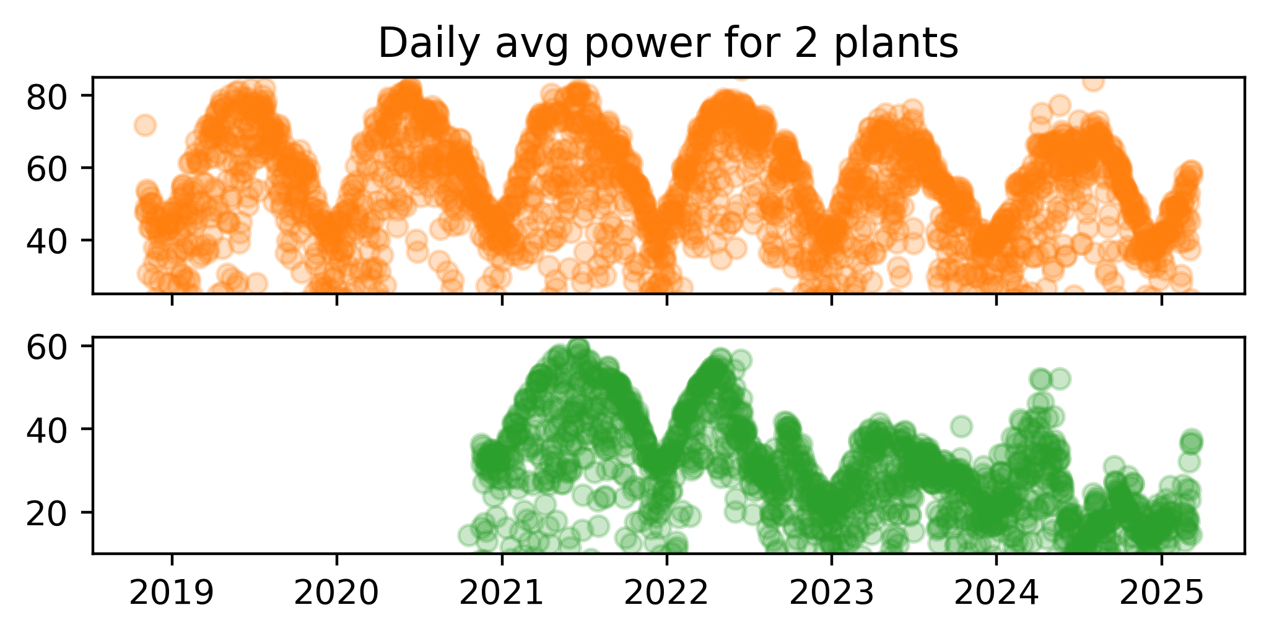
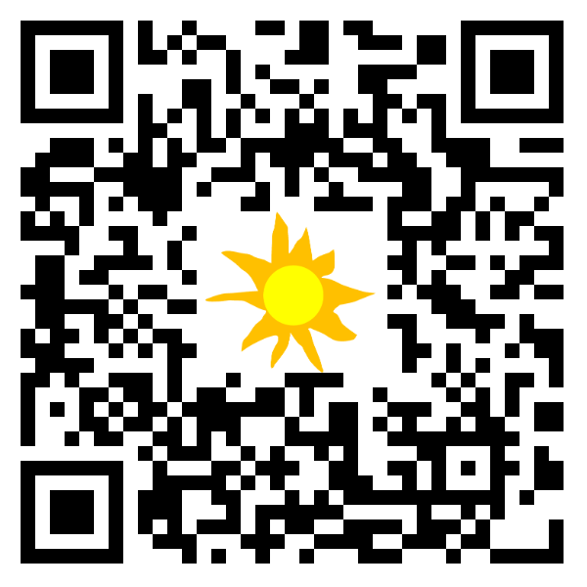


Plant performance analysis with satellite resource data and public power data
Will Hobbs, Southern Company, whobbs@southernco.com
Power data are available for every solar plant in ERCOT at 15-min intervals back to 2012. Someone should analyze it all and publish results. Here is a small preview.
Data: Generation data are published by ERCOT with 60-day delay [1]. Archive goes back to 2012 [2]. 3rd-party access from gridstatus.io via API goes back to 2018 [3] w/ paid + free options.
Metadata: ERCOT uses abbreviated codes for plant names, matched with ERCOT CDR reports [4] to get full unit names, capacities, and counties, then matched* with EIA 860 data [5] for key modeling specs (lat/lon, fixed/tracking, cell type, tilt, etc.).
*Matching with EIA was not 100% successful due to inconsistent names. I used fuzzy string matching [6] on portions of plant name + county with ~2/3 of sites being matched (no false positives, I don’t think…)
Sample Analysis:
Semi-random sample of 10 plants
Modeled expected power with NSRDB PSM4 [7] and pvlib [8] via pv-system-model [9].
Estimated parameters not in EIA 860 (gcr, gamma_pdc, dc_loss_fraction) using scipy.optimize.minimize.
Initial results: 5 of 10 plants appear to have significant drops in performance from 2021 to 2023. 1 of 10 looks like 10%/yr power loss rate. What’s going on? More analysis needed.
What’s next? Someone should get all this data, do proper rigorous analysis, and publish results (similar to PV Fleets work)
😬
References:
[1] https://www.ercot.com/mp/data-products/data-product-details?id=NP3-965-ER
[2] https://data.ercot.com/data-product-archive/NP3-965-ER, free login account needed, 1 .zip file of CSVs per day
[3] https://www.gridstatus.io/datasets/ercot_sced_gen_resource_60_day
[4] https://www.ercot.com/files/docs/2025/02/12/CapacityDemandandReservesReport_December2024.xlsx, from ttps://www.ercot.com/gridinfo/resource,
[5] EIA Form 860, “3_3_Solar_Y2023.xlsx”, in https://www.eia.gov/electricity/data/eia860/xls/eia8602023.zip, from https://www.eia.gov/electricity/data/eia860/
[6] https://github.com/seatgeek/thefuzz
[7] https://developer.nrel.gov/docs/solar/nsrdb/nsrdb-GOES-conus-v4-0-0-download/, available via pvlib alpha release, https://pvlib-python.readthedocs.io/en/latest/reference/generated/pvlib.iotools.get_nsrdb_psm4_conus.html
[8] Anderson, K., Hansen, C., Holmgren, W., Jensen, A., Mikofski, M., and Driesse, A. "pvlib python: 2023 project update." Journal of Open Source Software, 8(92), 5994, (2023). https://doi.org/10.21105/joss.05994
[9] https://github.com/williamhobbs/pv-system-model
Code available:
https://github.com/williamhobbs/PVPMC_2025
Acknowledgements:
Code for pulling from gridstatus.io and matching with EIA was based on code by Drumil Joshi, Southern Power Company.

