Slide 1

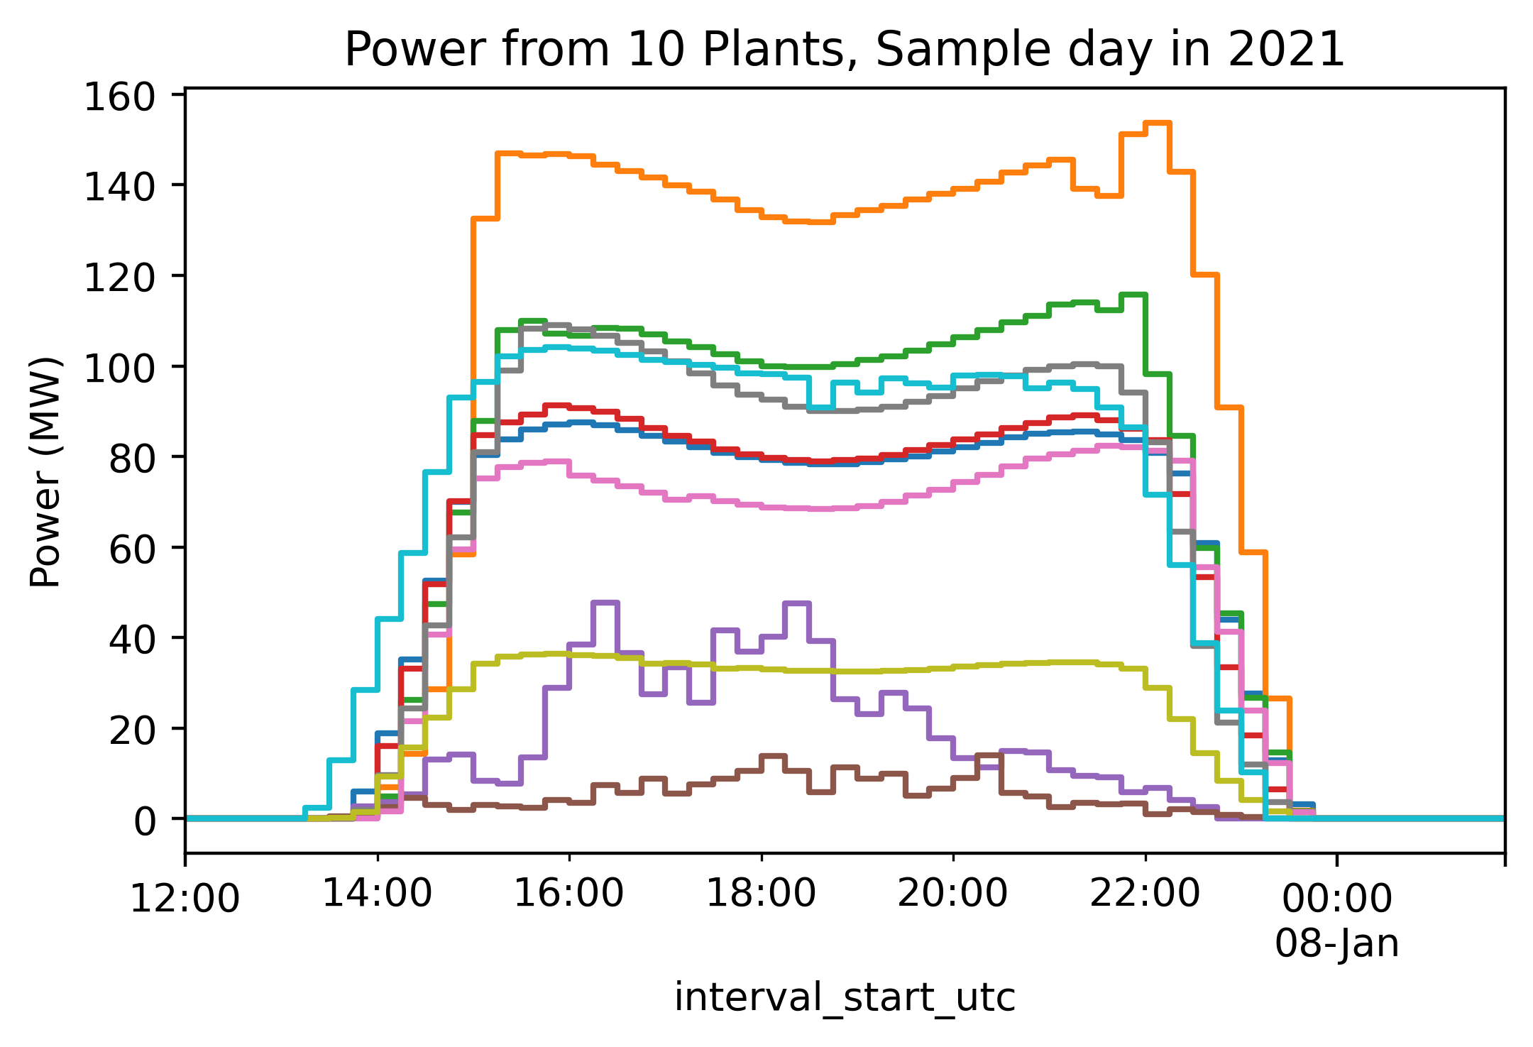
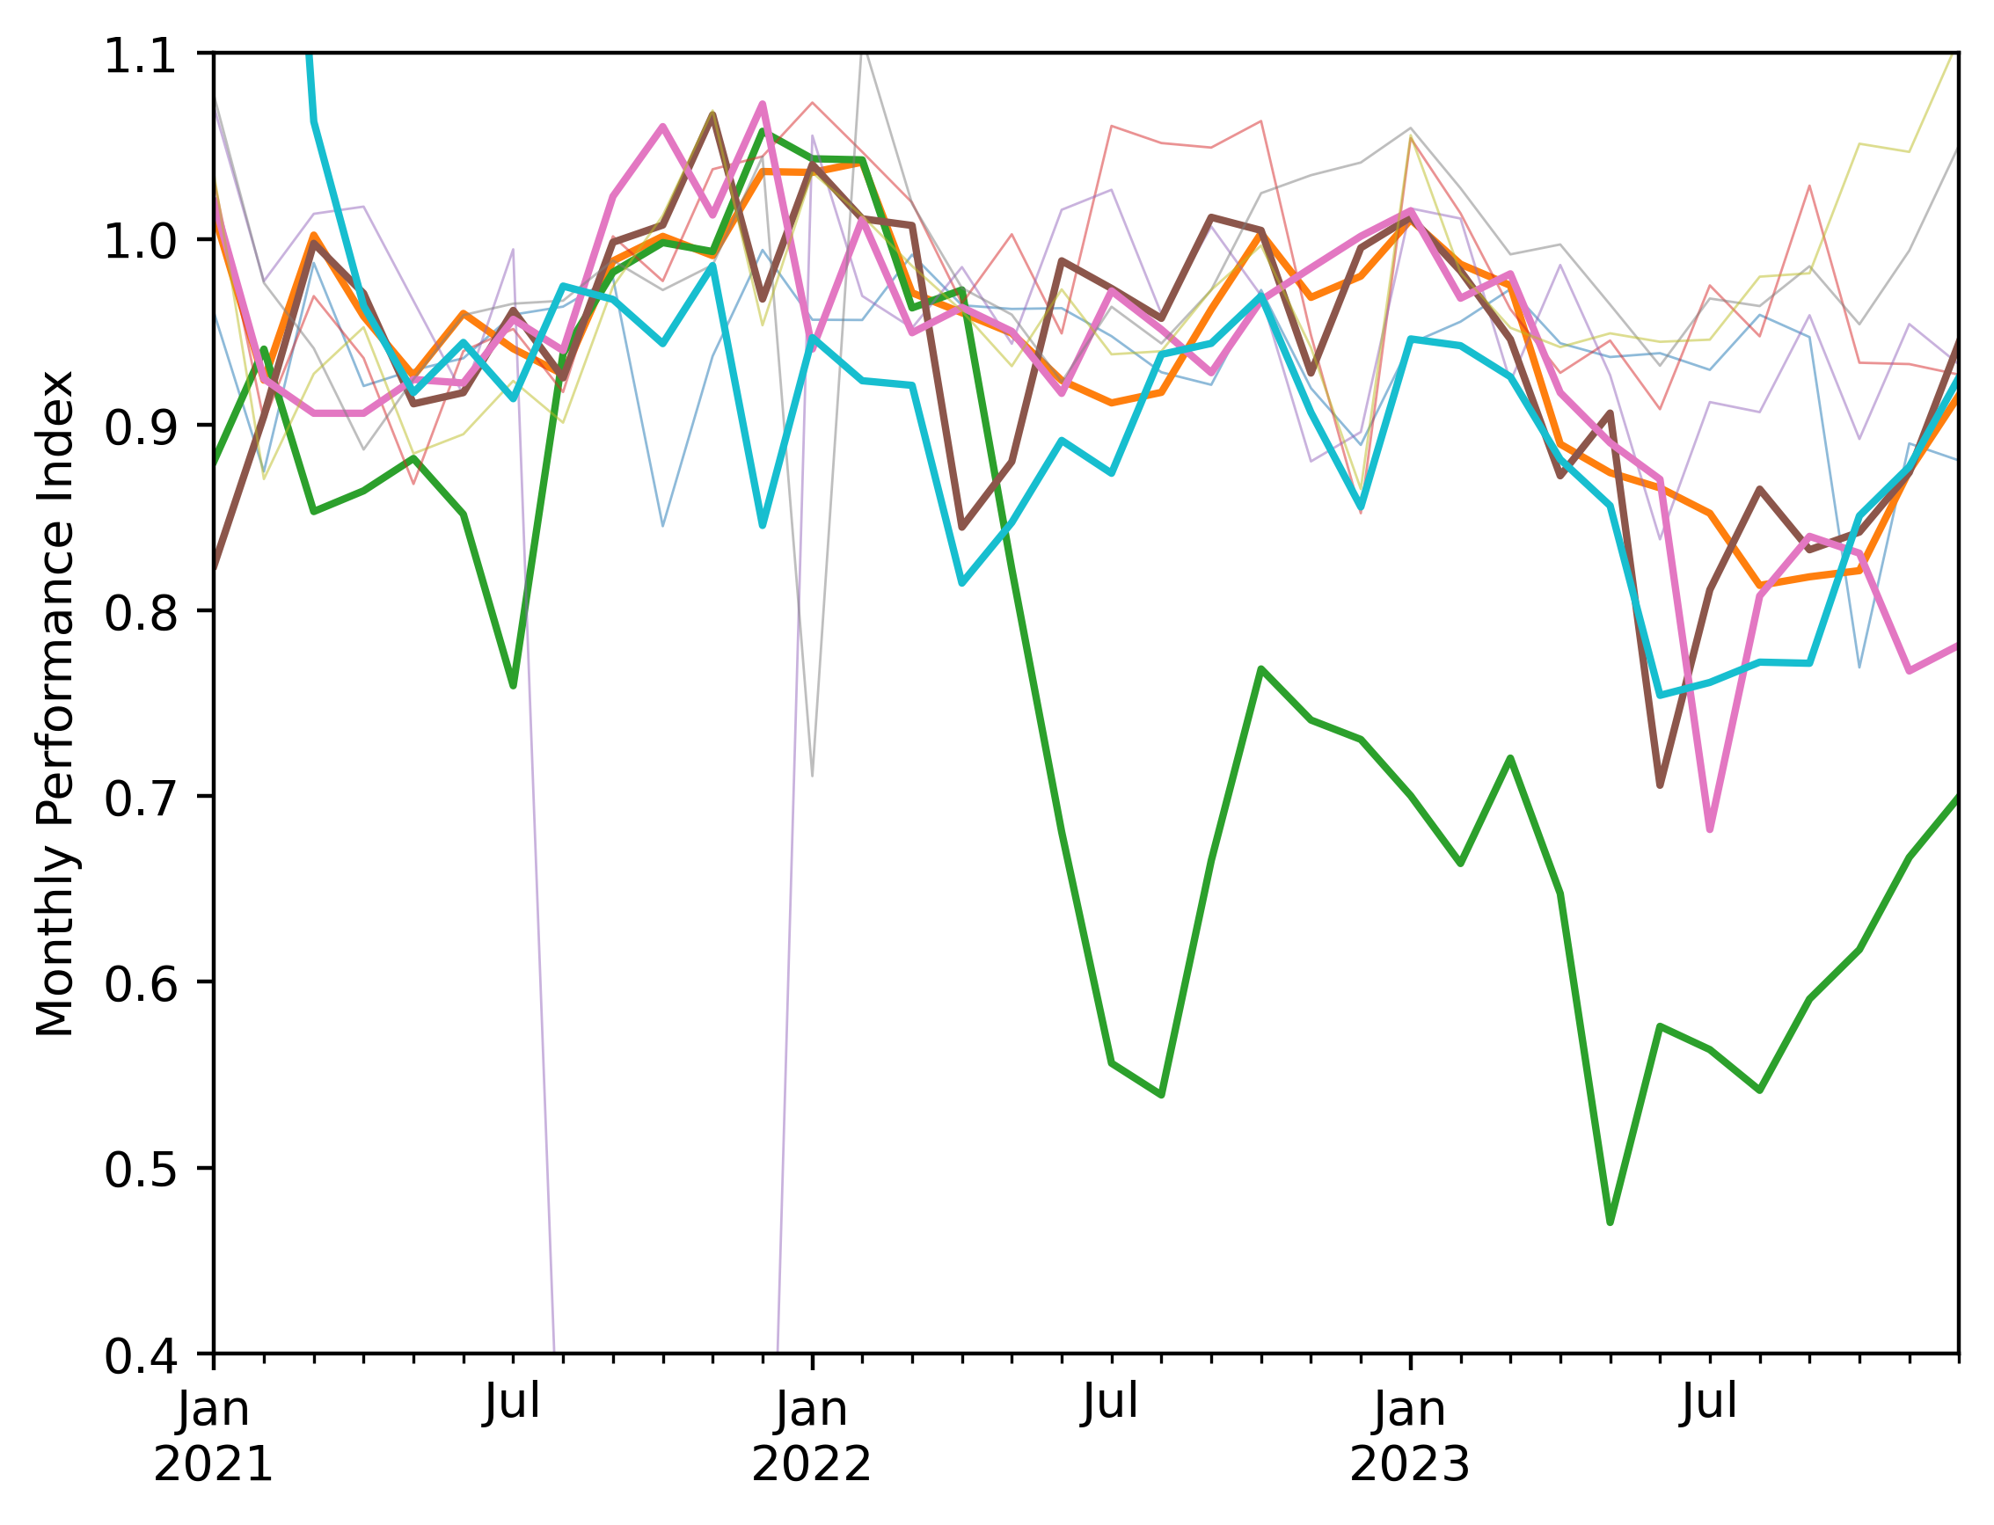
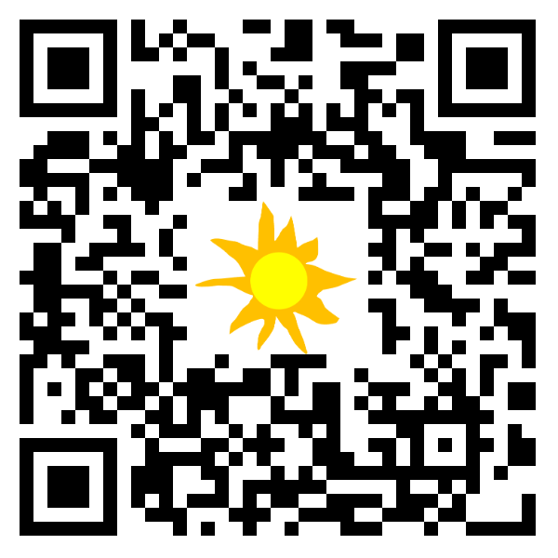

Plant performance analysis with satellite resource data and public power data
Will Hobbs, Southern Company, whobbs@southernco.com
Power data are available for every solar plant in ERCOT at 15-min intervals back to 2012. Someone should analyze it all and publish results. Here is a small preview.
Data: Generation data are published by ERCOT with 60-day delay [1]. Archive goes back to 2012 [2]. 3rd-party access from gridstatus.io via API goes back to 2018 [3] w/ paid + free options.
Metadata: ERCOT uses abbreviated codes for plant names, matched with ERCOT CDR reports [4] to get full unit names, capacities, and counties, then matched* with EIA 860 data [5] for key modeling specs (lat/lon, fixed/tracking, cell type, tilt, etc.).
*Matching with EIA was not 100% successful due to inconsistent names. I used fuzzy string matching [6] on portions of plant name + county with ~2/3 of sites being matched (no false positives, I don’t think…)
Sample Analysis:
Semi-random sample of 10 plants
Modeled expected power with NSRDB PSM4 [7] and pvlib [8] via pv-system-model [9].
Estimated parameters not in EIA 860 (gcr, gamma_pdc, dc_loss_fraction) using scipy.optimize.minimize.
Initial results: 5 of 10 plants appear to have significant drops in performance from 2021 to 2023. What’s going on here? Curtailment is supposed to be excluded…
What’s next? Someone should get all this data, do proper rigorous analysis, and publish results (similar to PV Fleets work)
😬
References:
[1] https://www.ercot.com/mp/data-products/data-product-details?id=NP3-965-ER
[2] https://data.ercot.com/data-product-archive/NP3-965-ER, free login account needed, 1 .zip file of CSVs per day
[3] https://www.gridstatus.io/datasets/ercot_sced_gen_resource_60_day
[4] https://www.ercot.com/files/docs/2025/02/12/CapacityDemandandReservesReport_December2024.xlsx, from ttps://www.ercot.com/gridinfo/resource,
[5] EIA Form 860, “3_3_Solar_Y2023.xlsx”, in https://www.eia.gov/electricity/data/eia860/xls/eia8602023.zip, from https://www.eia.gov/electricity/data/eia860/
[6] https://github.com/seatgeek/thefuzz
[7] https://developer.nrel.gov/docs/solar/nsrdb/nsrdb-GOES-conus-v4-0-0-download/, available via pvlib alpha release, https://pvlib-python.readthedocs.io/en/latest/reference/generated/pvlib.iotools.get_nsrdb_psm4_conus.html
[8] Anderson, K., Hansen, C., Holmgren, W., Jensen, A., Mikofski, M., and Driesse, A. "pvlib python: 2023 project update." Journal of Open Source Software, 8(92), 5994, (2023). https://doi.org/10.21105/joss.05994
[9] https://github.com/williamhobbs/pv-system-model
Code available:
https://github.com/williamhobbs/PVPMC_2025
Acknowledgements:
Code for pulling from gridstatus.io and matching with EIA was based on code by Drumil Joshi, Southern Power Company.

