Slide 1
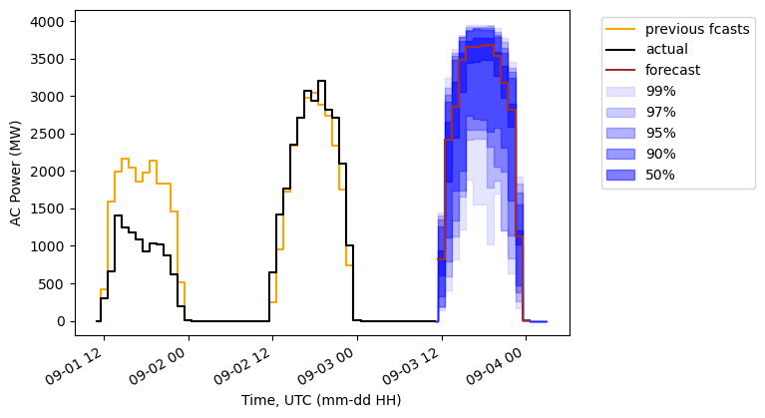
Uncertainty indicators from NOAA NWPs
Deterministic PV forecast
ML models
Historical data
Included here for demonstration
This tool
Prediction intervals from probabilistic forecast

Slide 2
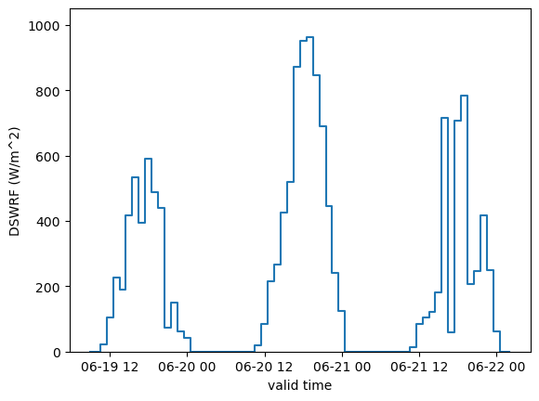
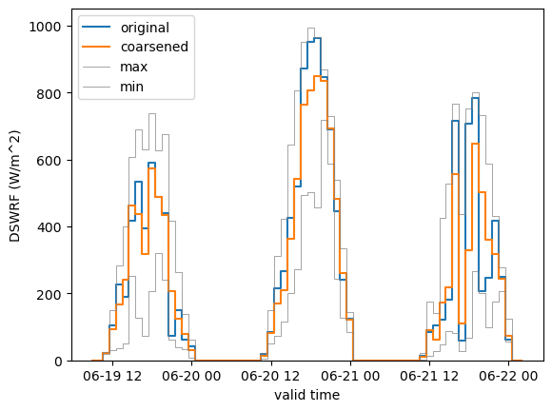
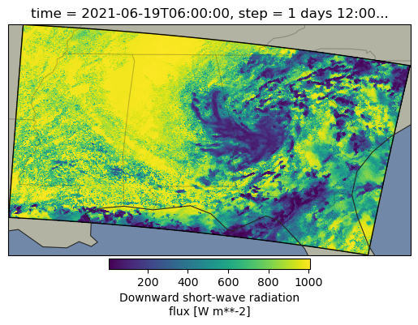



High
uncertainty
Low
uncertainty
Original HRRR
Coarsen to 30 km x 30 mean (also get max and min)

Slide 3
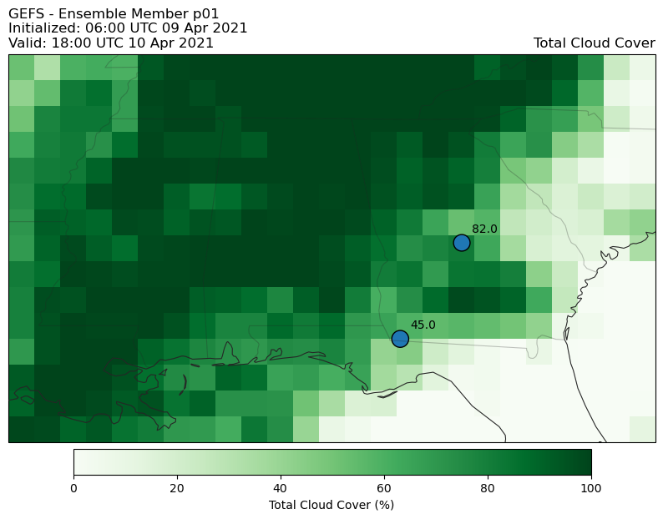
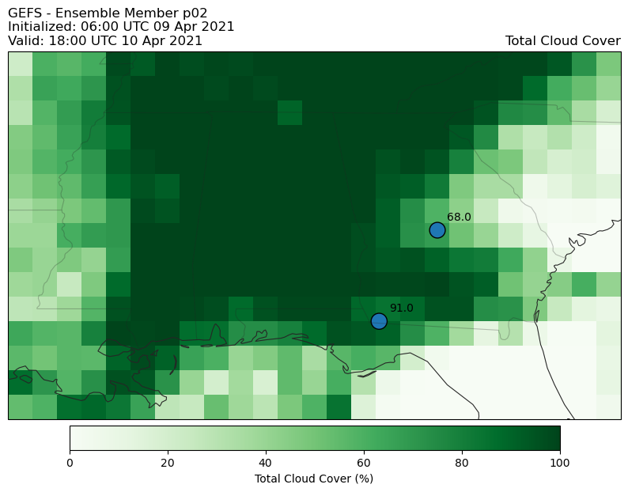
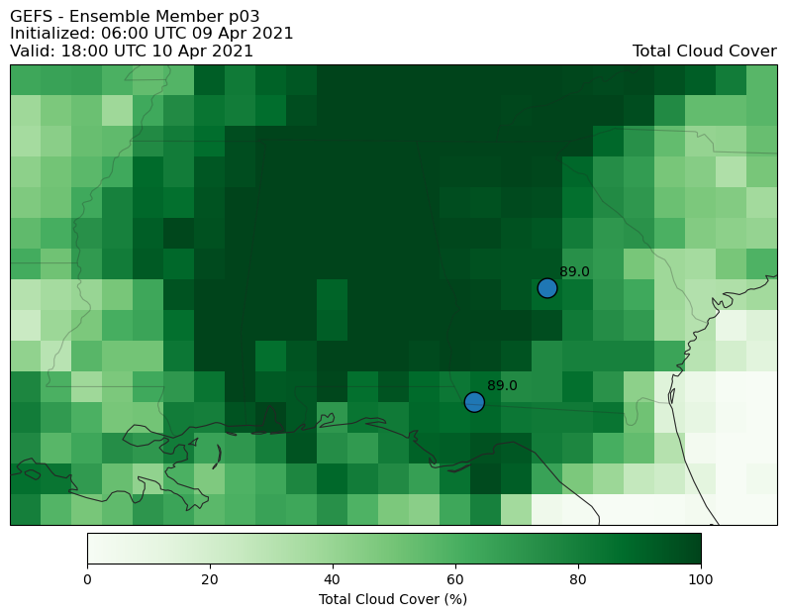
Weighted Avg. TCC:
63.1
79.7
89.0

