Slide 1

CMSC 28100 Introduction to Complexity Theory Spring 2025 Instructor: William Hoza

Slide 2
Which problems can be solved through computation?

Slide 3

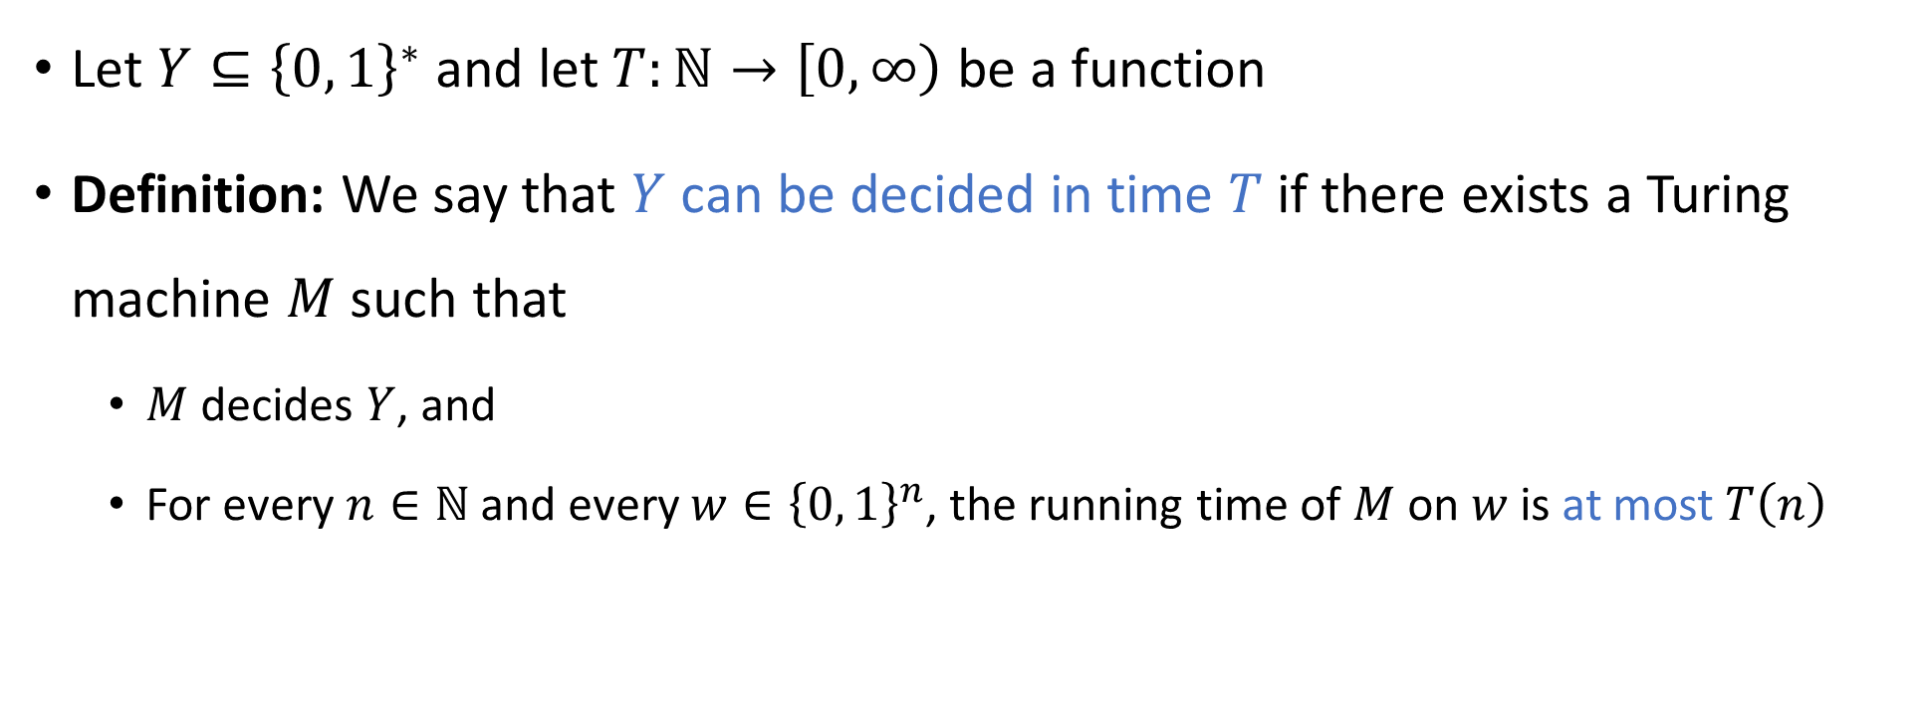

Deciding a language in time $T$
Let $Y⊆{\left\{0, 1\right\}}^{∗}$ and let $T:ℕ→\left[0, ∞\right)$ be a function
Definition: We say that $Y$ can be decided in time $T$ if there exists a Turing machine $M$ such that
$M$ decides $Y$, and
For every $n∈ℕ$ and every $w∈{\left\{0, 1\right\}}^{n}$, the running time of $M$ on $w$ is at most $T\left(n\right)$

Slide 4
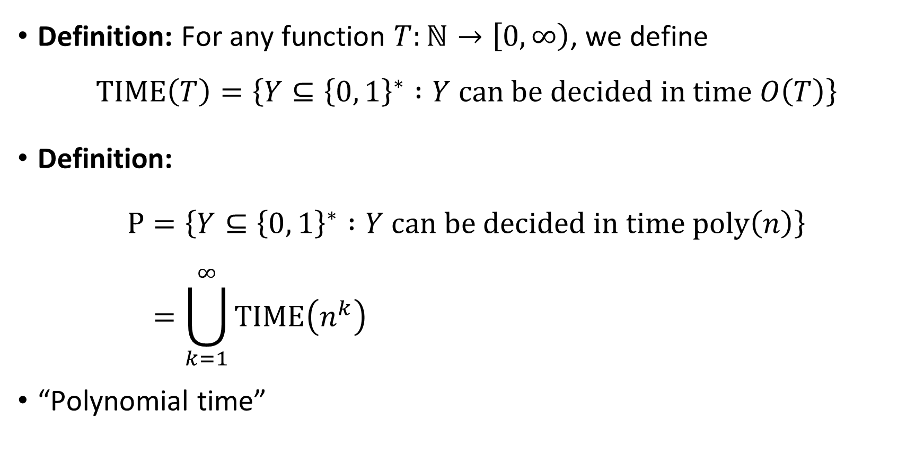

The complexity class $\text{P}$
Definition: For any function $T:ℕ→\left[0, ∞\right)$, we define
$$\text{TIME}\left(T\right)=\left\{Y⊆{\left\{0, 1\right\}}^{∗} :Y \text{can} \text{be} \text{decided} \text{in} \text{time} O\left(T\right)\right\}$$
Definition:
$$\text{P}=\left\{Y⊆{\left\{0, 1\right\}}^{∗} :Y \text{can} \text{be} \text{decided} \text{in} \text{time} \text{poly}\left(n\right)\right\} \\ =\bigcup_{k=1}^{∞}{\text{TIME}\left(n^{k}\right)}$$
“Polynomial time”

Slide 5


$\text{P}$: Our model of tractability
Let $Y⊆{\left\{0, 1\right\}}^{∗}$
If $Y∈\text{P}$, then we will consider $Y$ “tractable”
If $Y∉\text{P}$, then we will consider $Y$ “intractable”

Slide 6
Which problems can be solved through computation?

Slide 7

Which languages are in $\text{P}$?

Slide 8
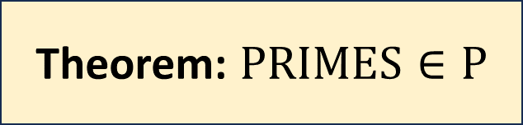
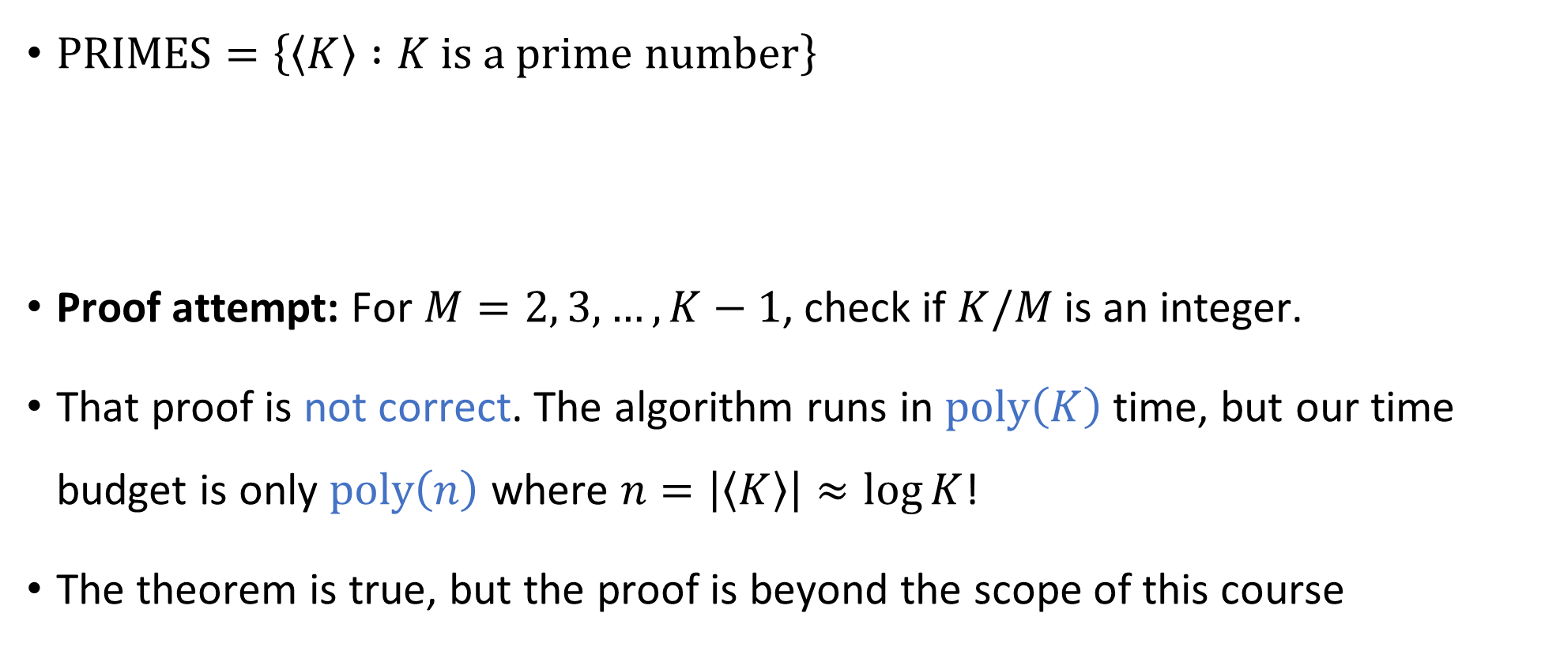
Example 1: Primality testing
$\text{PRIMES}=\left\{\left\langle K\right\rangle :K \text{is} \text{a} \text{prime} \text{number}\right\}$
Proof attempt: For $M=2, 3, …, K−1$, check if $K/M$ is an integer.
That proof is not correct. The algorithm runs in $\text{poly}\left(K\right)$ time, but our time budget is only $\text{poly}\left(n\right)$ where $n=\left|\left\langle K\right\rangle \right|≈\log{K}$!
The theorem is true, but the proof is beyond the scope of this course
Theorem: $\text{PRIMES}∈\text{P}$

Slide 9
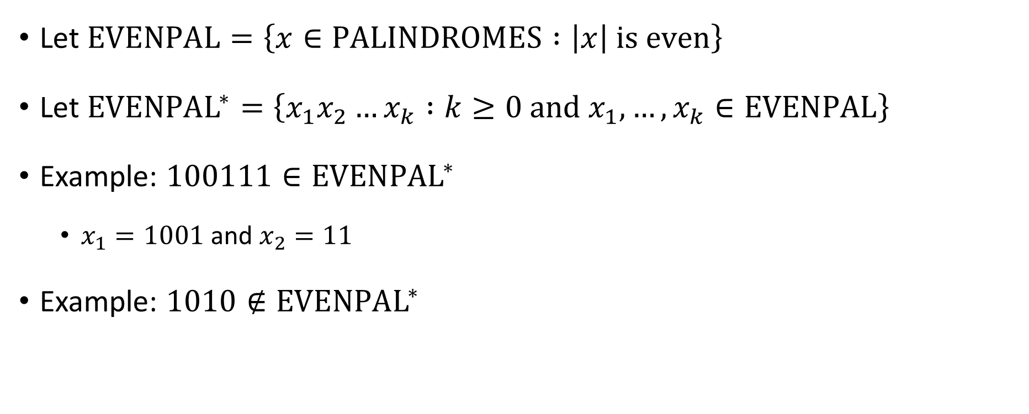

Example 2: The ${\text{EVENPAL}}^{∗}$ problem
Let $\text{EVENPAL}=\left\{x∈\text{PALINDROMES} :\left|x\right| \text{is} \text{even}\right\}$
Let ${\text{EVENPAL}}^{∗}=\left\{x_{1}x_{2}…x_{k} :k≥0 \text{and} x_{1},…, x_{k}∈\text{EVENPAL}\right\}$
Example: $100111∈{\text{EVENPAL}}^{∗}$
$x_{1}=1001$ and $x_{2}=11$
Example: $1010∉{\text{EVENPAL}}^{∗}$

Slide 10


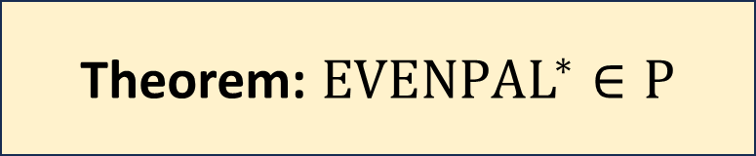
Deciding ${\text{EVENPAL}}^{∗}$ in polynomial time
${\text{EVENPAL}}^{∗}=\left\{x_{1}x_{2}…x_{k} :k≥0 \text{and} x_{1},…, x_{k}∈\text{EVENPAL}\right\}$
Proof attempt 1: Given $w∈{\left\{0, 1\right\}}^{∗}$, try all possible decompositions
$$w=x_{1}x_{2}…x_{k}$$
Time complexity $Ω\left(2^{n}\right)$… ☹️
Theorem: ${\text{EVENPAL}}^{∗}∈\text{P}$

Slide 11
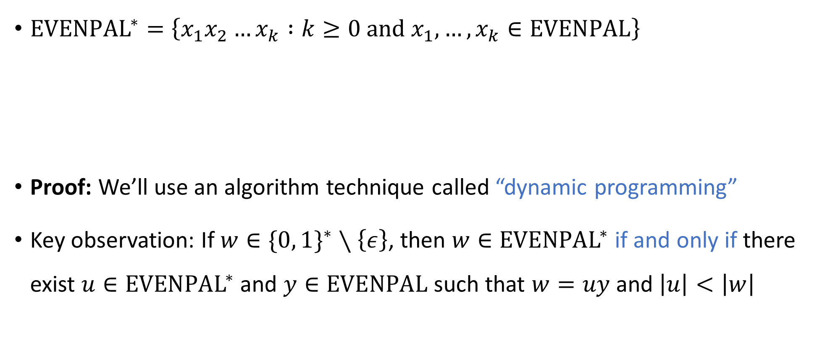

Deciding ${\text{EVENPAL}}^{∗}$ in polynomial time
${\text{EVENPAL}}^{∗}=\left\{x_{1}x_{2}…x_{k} :k≥0 \text{and} x_{1},…, x_{k}∈\text{EVENPAL}\right\}$
Proof: We’ll use an algorithm technique called “dynamic programming”
Key observation: If $w∈\{0, 1\}^{∗}∖\left\{ε\right\}$, then $w∈{\text{EVENPAL}}^{∗}$ if and only if there exist $u∈{\text{EVENPAL}}^{∗}$ and $y∈\text{EVENPAL}$ such that $w=uy$ and $\left|u\right|<\left|w\right|$
Theorem: ${\text{EVENPAL}}^{∗}∈\text{P}$

Slide 12


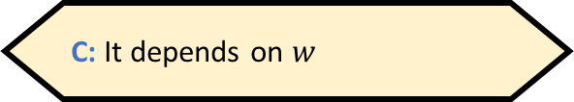
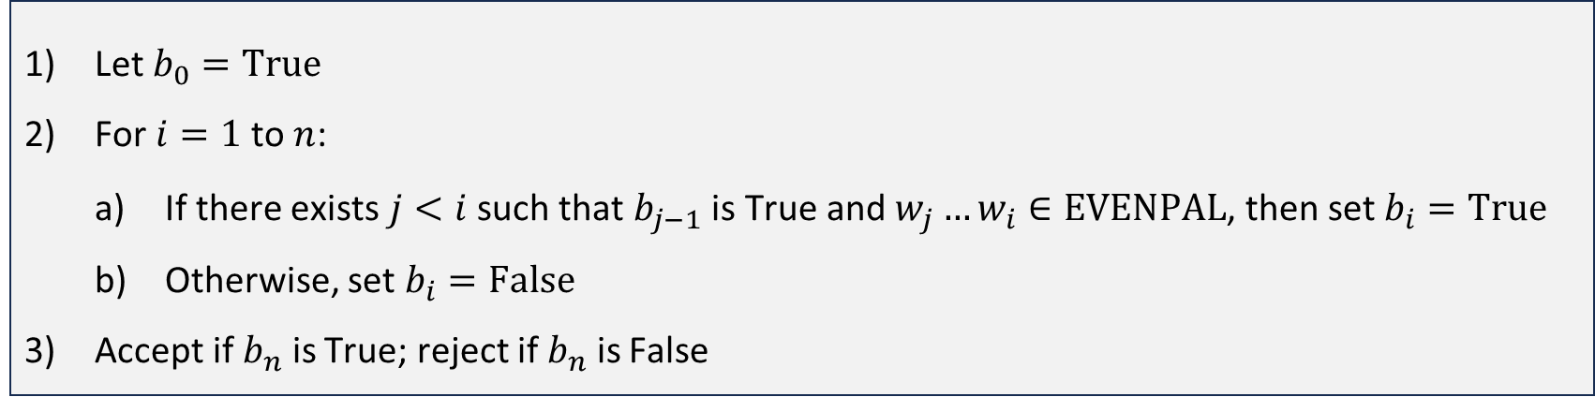
Deciding ${\text{EVENPAL}}^{∗}$ in polynomial time
Let $w$ be the input, $w=w_{1}w_{2}…w_{n}$, where $w_{i}∈\{0, 1\}$
Plan: For each $i∈\{0, 1, …, n\}$, we will compute a Boolean value $b_{i}$ that indicates whether $w_{1}w_{2}…w_{i}∈{\text{EVENPAL}}^{∗}$
Let $b_{0}=\text{True}$
For $i=1$ to $n$:
If there exists $j<i$ such that $b_{j−1}$ is True and $w_{j}…w_{i}∈\text{EVENPAL}$, then set $b_{i}=\text{True}$
Otherwise, set $b_{i}=\text{False}$
Accept if $b_{n}$ is True; reject if $b_{n}$ is False
What should $b_{0}$ be?
A: True
B: False
C: It depends on $w$
D: It’s not well-defined
Respond at PollEv.com/whoza or text “whoza” to 22333

Slide 13
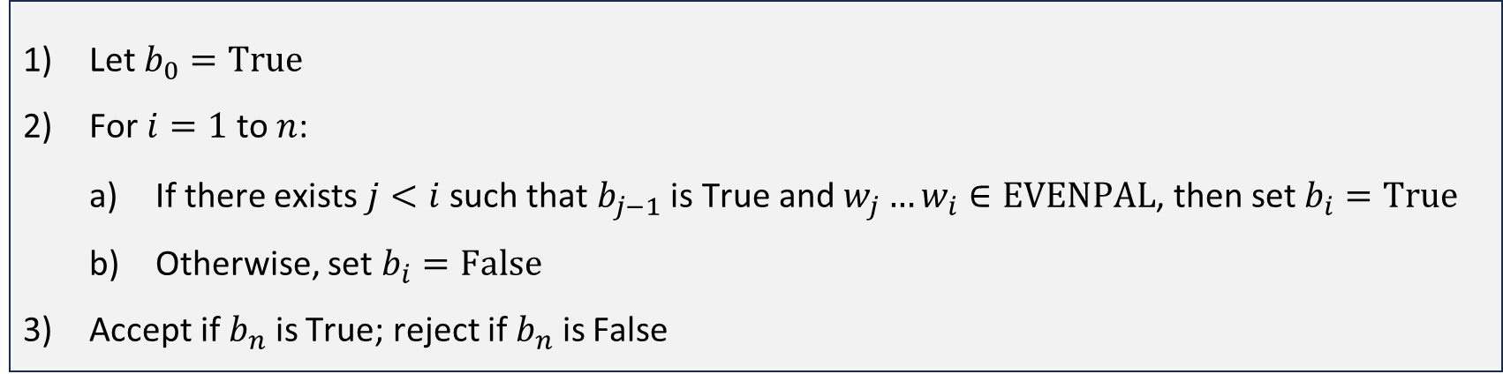




Deciding ${\text{EVENPAL}}^{∗}$ in polynomial time
Let $b_{0}=\text{True}$
For $i=1$ to $n$:
If there exists $j<i$ such that $b_{j−1}$ is True and $w_{j}…w_{i}∈\text{EVENPAL}$, then set $b_{i}=\text{True}$
Otherwise, set $b_{i}=\text{False}$
Accept if $b_{n}$ is True; reject if $b_{n}$ is False
TM implementation: Store $b_{i}$ in $w_{i}$’s cell, and write # in $w_{j}$’s cell
Current job: Check whether this substring is in $\text{EVENPAL}$
#
$$b_{1},…, b_{n}→$$
$$⊔$$
F
T
F
F
F
T
F
F
F
F
F
F
F
F
F
0
0
1
0
0
1
0
1
1
1
0
0
1
1
1
0
1
1
0
$$w_{1},…, w_{n}→$$

Slide 14
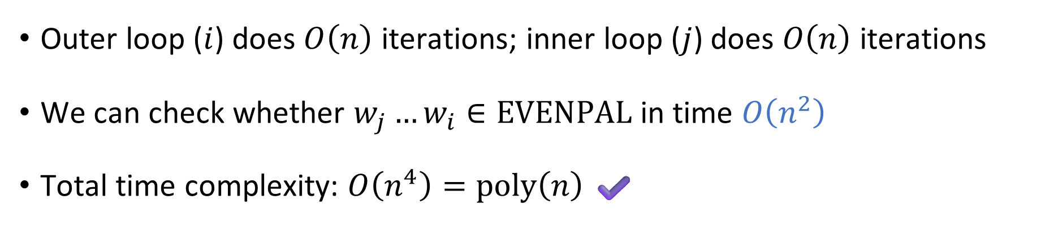


Deciding ${\text{EVENPAL}}^{∗}$ in polynomial time
Let $b_{0}=\text{True}$
For $i=1$ to $n$:
If there exists $j<i$ such that $b_{j−1}$ is True and $w_{j}…w_{i}∈\text{EVENPAL}$, then set $b_{i}=\text{True}$
Otherwise, set $b_{i}=\text{False}$
Accept if $b_{n}$ is True; reject if $b_{n}$ is False
Outer loop ($i$) does $O\left(n\right)$ iterations; inner loop ($j$) does $O\left(n\right)$ iterations
We can check whether $w_{j}…w_{i}∈\text{EVENPAL}$ in time $O\left(n^{2}\right)$
Total time complexity: $O\left(n^{4}\right)=\text{poly}\left(n\right)$ ✔️

Slide 15



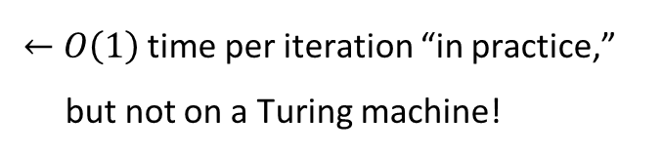
Time complexity: Theory vs. practice
⚠️Caution: It takes time to move the head to a desired location!
E.g., consider an algorithm for deciding $\text{PALINDROMES}$:
Given an array of bits $x$:
For $i=1$ to $n$:
If $x[i]≠x[n−i]$, reject
Accept
$←$ $n$ iterations
$←$ $O\left(1\right)$ time per iteration “in practice,” but not on a Turing machine!

Slide 16
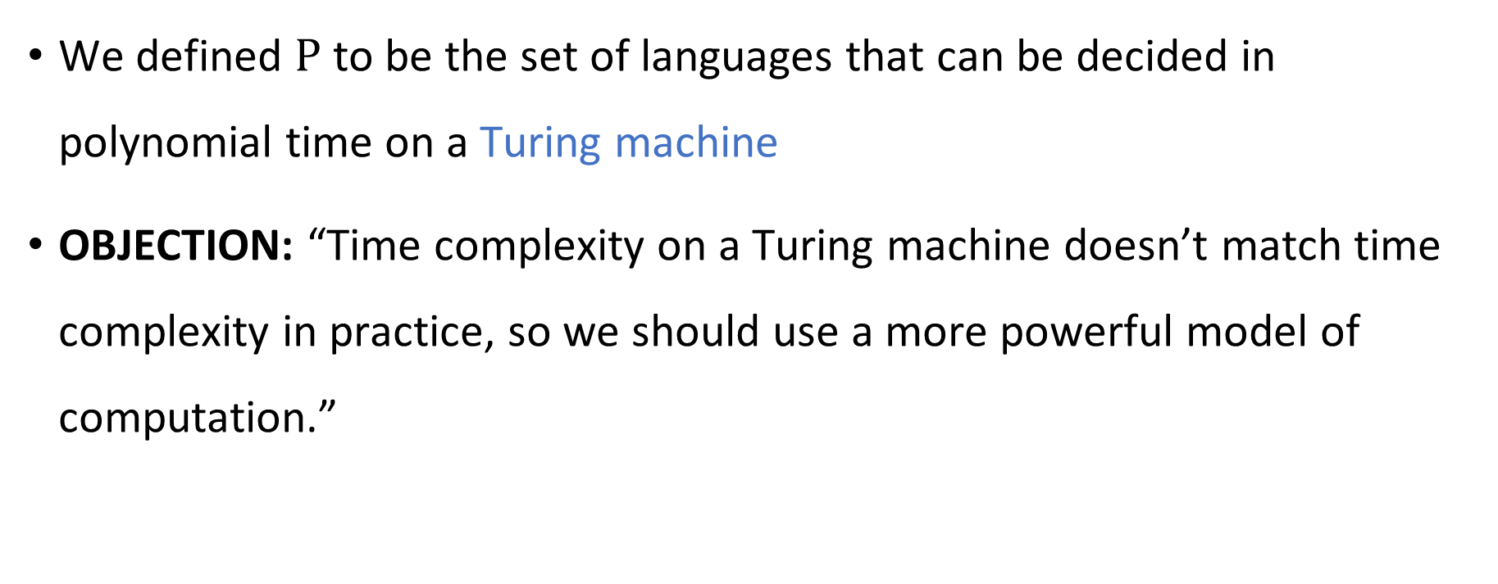
Is the Turing machine model a good model?
We defined $\text{P}$ to be the set of languages that can be decided in polynomial time on a Turing machine
OBJECTION: “Time complexity on a Turing machine doesn’t match time complexity in practice, so we should use a more powerful model of computation.”

Slide 17
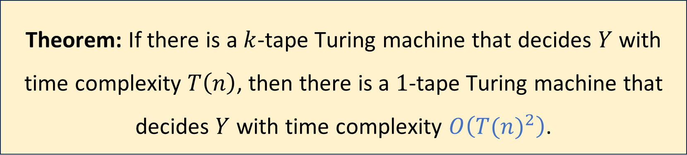

Multi-tape Turing machines, revisited
Let $Y⊆{\left\{0, 1\right\}}^{∗}$, let $k$ be a positive integer, and let $T:ℕ→ℕ$
Theorem: If there is a $k$-tape Turing machine that decides $Y$ with time complexity $T\left(n\right)$, then there is a $1$-tape Turing machine that decides $Y$ with time complexity $O\left({T(n)}^{2}\right)$.

Slide 18

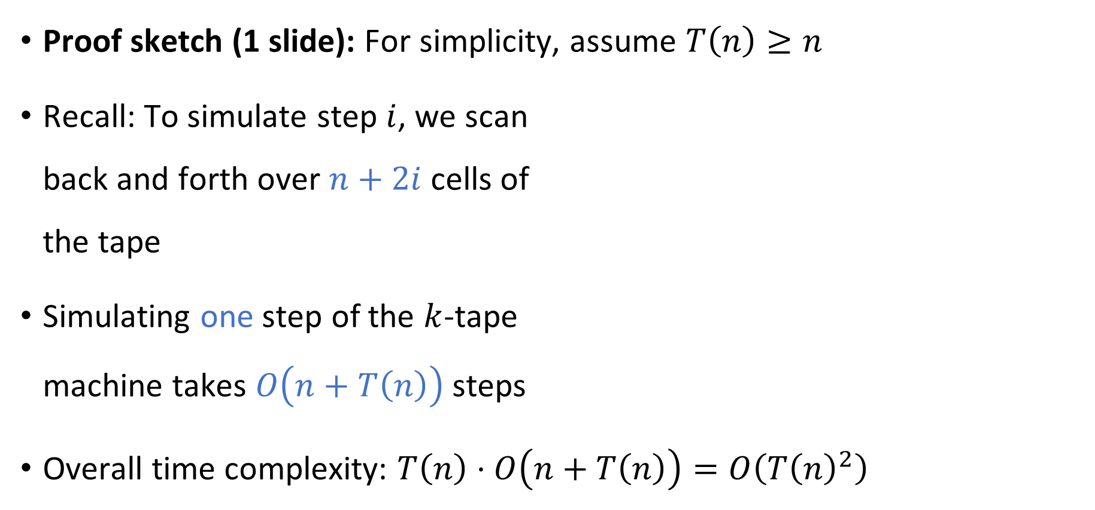






Efficiently simulating $k$ tapes using one tape
Proof sketch (1 slide): For simplicity, assume $T\left(n\right)≥n$
Recall: To simulate step $i$, we scan back and forth over $n+2i$ cells of the tape
Simulating one step of the $k$-tape machine takes $O\left(n+T\left(n\right)\right)$ steps
Overall time complexity: $T\left(n\right)⋅O\left(n+T\left(n\right)\right)=O\left(T{\left(n\right)}^{2}\right)$
0
$$⊔$$
$$⋯$$
1
1
0
$$⊔$$
$$⊔$$
$$⋯$$
0
#
1
$
$$⊔$$

Slide 19

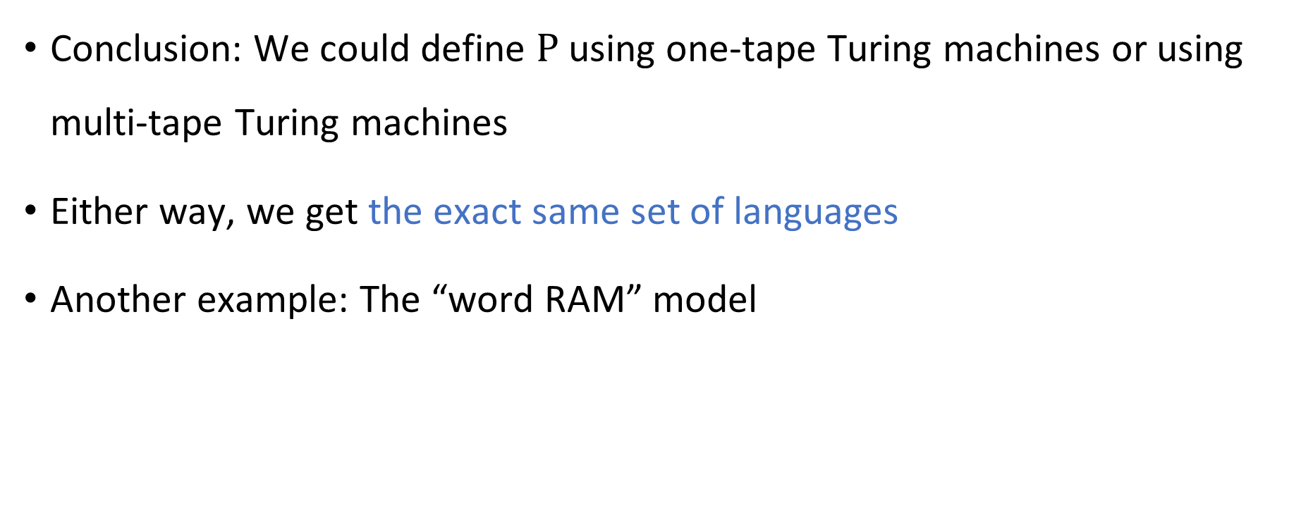
Robustness of $\text{P}$
Conclusion: We could define $\text{P}$ using one-tape Turing machines or using multi-tape Turing machines
Either way, we get the exact same set of languages
Another example: The “word RAM” model

Slide 20
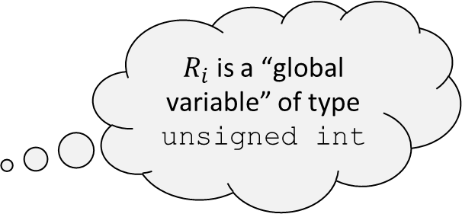
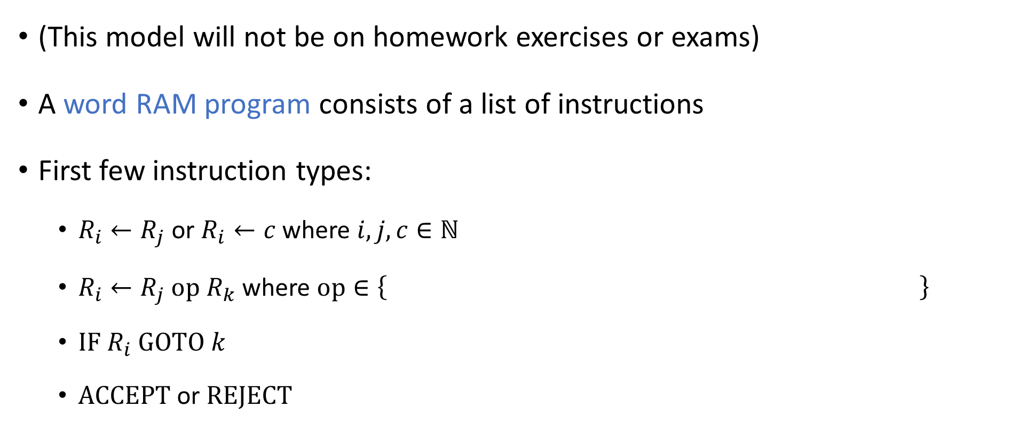
Word RAM model (RAM = Random Access Machine)
(This model will not be on homework exercises or exams)
A word RAM program consists of a list of instructions
First few instruction types:
$R_{i}←R_{j}$ or $R_{i}←c$ where $i,j,c∈ℕ$
$R_{i}←R_{j} \text{op} R_{k}$ where $\text{op}∈\left\{ \right\}$
$\text{IF} R_{i} \text{GOTO} k$
$\text{ACCEPT}$ or $\text{REJECT}$
$R_{i}$ is a “global variable” of type unsigned int
+, -, *, /, %, ==, <, >, &&, ||, &, |, ^, <<, >>
(The details are not completely standardized. This is just one reasonable version of the model)

Slide 21
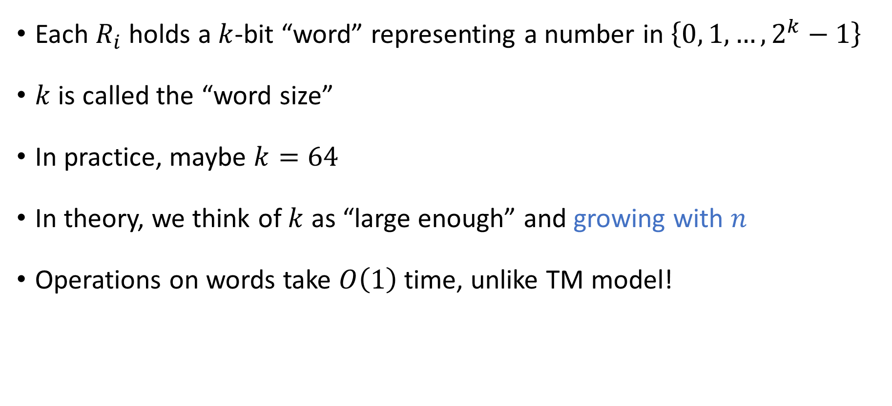
Word RAM model
Each $R_{i}$ holds a $k$-bit “word” representing a number in $\left\{0, 1, …, 2^{k}−1\right\}$
$k$ is called the “word size”
In practice, maybe $k=64$
In theory, we think of $k$ as “large enough” and growing with $n$
Operations on words take $O\left(1\right)$ time, unlike TM model!

Slide 22





Word RAM model
$$\text{MEMORY}$$
010
110
101
110
110
111
000
There is also a large memory (an array of words)
Instructions:
$R_{i}←\text{MEMORY}\left[R_{j}\right]$
$\text{MEMORY}\left[R_{i}\right]←R_{j}$
Instantly access any desired location in memory, unlike the TM model!
$$R_{1}$$
110
Control
$$R_{2}$$
101
Load/Store
$$R_{3}$$
110

Slide 23
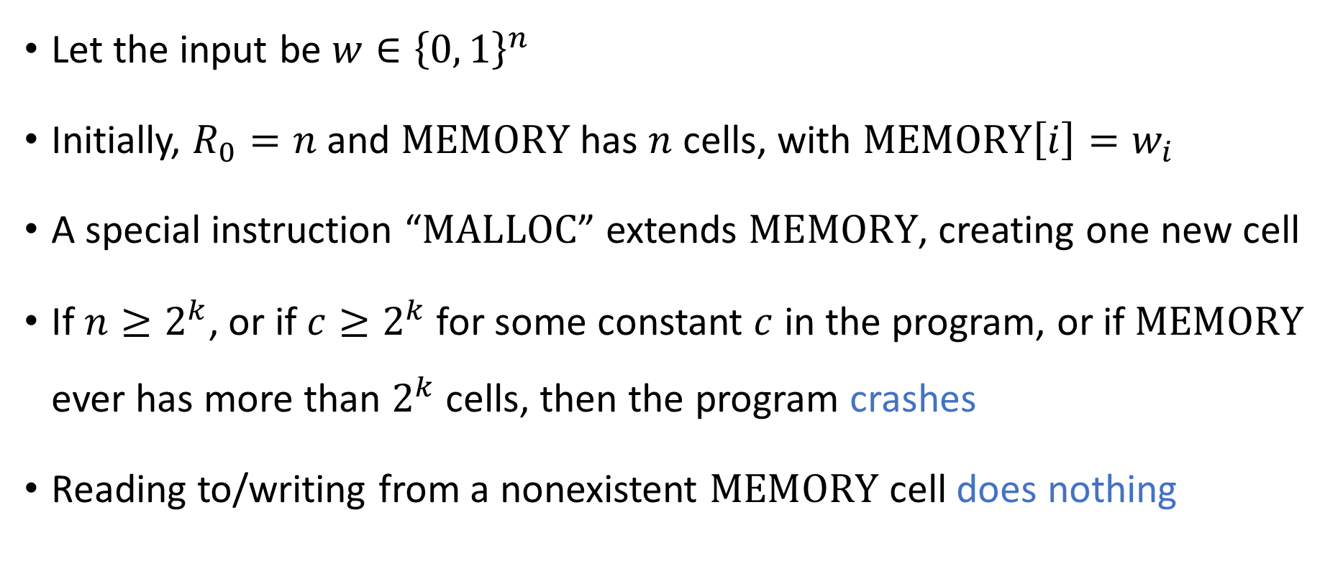
Word RAM model
The version of the word RAM model described here is based on the lecture notes for CS 1200 at Harvard: https://harvard-cs-1200.github.io/cs1200/
Let the input be $w∈{\left\{0, 1\right\}}^{n}$
Initially, $R_{0}=n$ and $\text{MEMORY}$ has $n$ cells, with $\text{MEMORY}\left[i\right]=w_{i}$
A special instruction “$\text{MALLOC}$” extends $\text{MEMORY}$, creating one new cell
If $n≥2^{k}$, or if $c≥2^{k}$ for some constant $c$ in the program, or if $\text{MEMORY}$ ever has more than $2^{k}$ cells, then the program crashes
Reading to/writing from a nonexistent $\text{MEMORY}$ cell does nothing

Slide 24
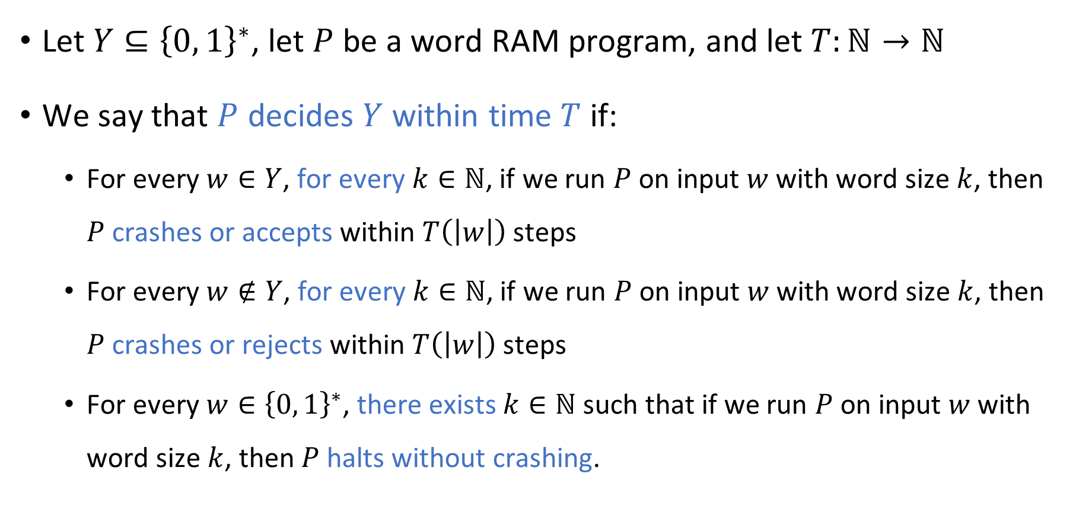
Word RAM model
The version of the word RAM model described here is based on the lecture notes for CS 1200 at Harvard: https://harvard-cs-1200.github.io/cs1200/
Let $Y⊆{\left\{0, 1\right\}}^{∗}$, let $P$ be a word RAM program, and let $T:ℕ→ℕ$
We say that $P$ decides $Y$ within time $T$ if:
For every $w∈Y$, for every $k∈ℕ$, if we run $P$ on input $w$ with word size $k$, then $P$ crashes or accepts within $T\left(\left|w\right|\right)$ steps
For every $w∉Y$, for every $k∈ℕ$, if we run $P$ on input $w$ with word size $k$, then $P$ crashes or rejects within $T\left(\left|w\right|\right)$ steps
For every $w∈{\left\{0, 1\right\}}^{∗}$, there exists $k∈ℕ$ such that if we run $P$ on input $w$ with word size $k$, then $P$ halts without crashing.

Slide 25
Word RAM model
Word RAM time complexity closely matches time complexity “in practice” on ordinary computers
Some version of the word RAM model is typically assumed (implicitly or explicitly) in algorithms courses and the computing industry

Slide 26


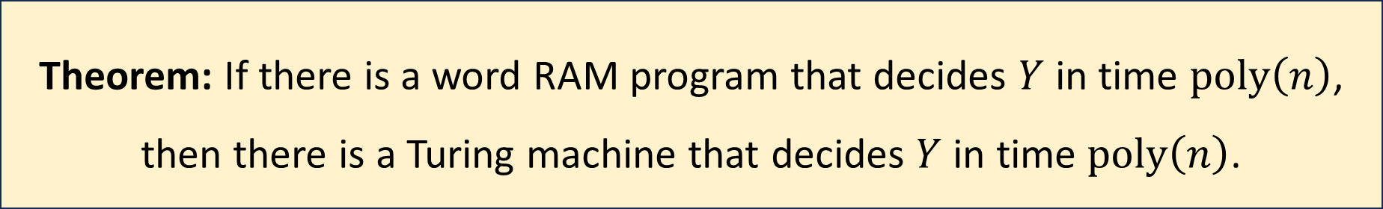
Robustness of $\text{P}$
Let $Y⊆{\left\{0, 1\right\}}^{∗}$
Proof omitted
Theorem: If there is a word RAM program that decides $Y$ in time $\text{poly}\left(n\right)$, then there is a Turing machine that decides $Y$ in time $\text{poly}\left(n\right)$.

