Slide 1

CMSC 28100 Introduction to Complexity Theory Spring 2024 Instructor: William Hoza

Slide 2
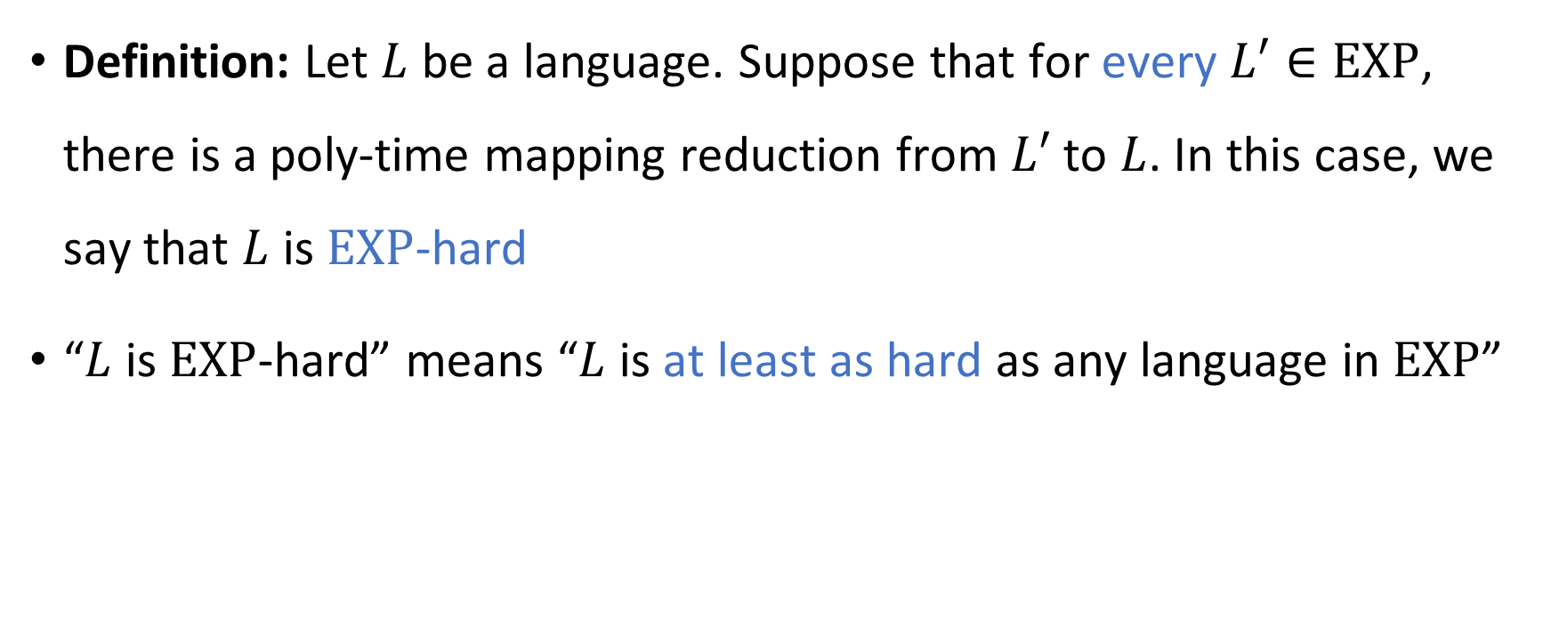
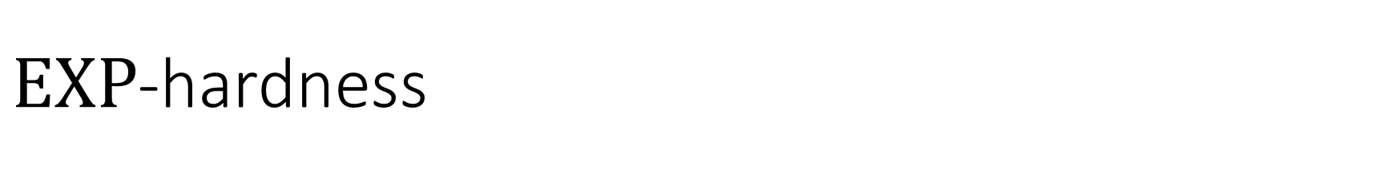
$\text{EXP}$-hardness
Definition: Let $L$ be a language. Suppose that for every $L′∈\text{EXP}$, there is a poly-time mapping reduction from $L′$ to $L$. In this case, we say that $L$ is $\text{EXP}$-hard
“$L$ is $\text{EXP}$-hard” means “$L$ is at least as hard as any language in $\text{EXP}$”

Slide 3
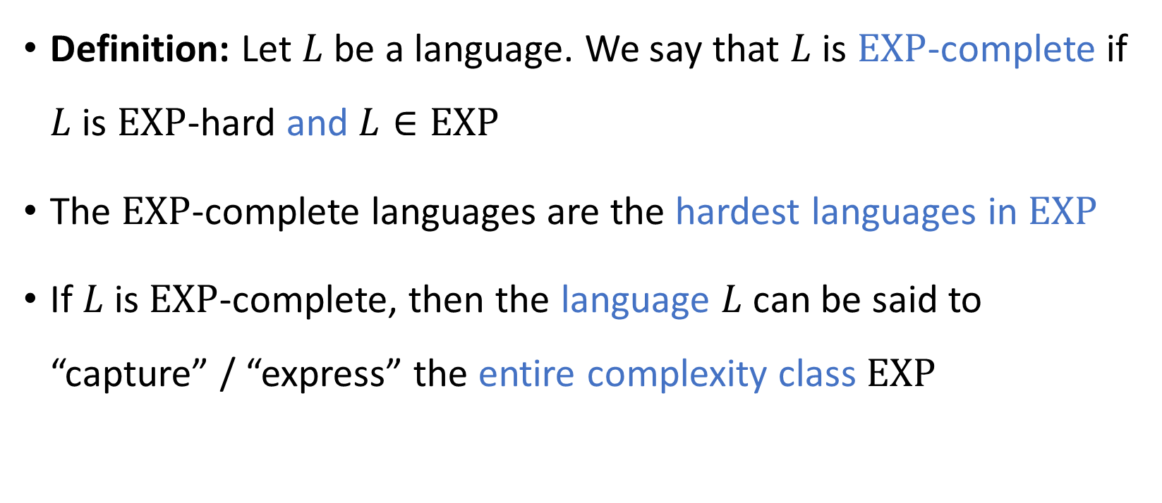

$\text{EXP}$-completeness
Definition: Let $L$ be a language. We say that $L$ is $\text{EXP}$-complete if $L$ is $\text{EXP}$-hard and $L∈\text{EXP}$
The $\text{EXP}$-complete languages are the hardest languages in $\text{EXP}$
If $L$ is $\text{EXP}$-complete, then the language $L$ can be said to “capture” / “express” the entire complexity class $\text{EXP}$

Slide 4




$\text{EXP}$-completeness
$\text{EXP}$-hard
$\text{EXP}$-complete
$$\text{EXP}$$
$$\text{P}$$

Slide 5
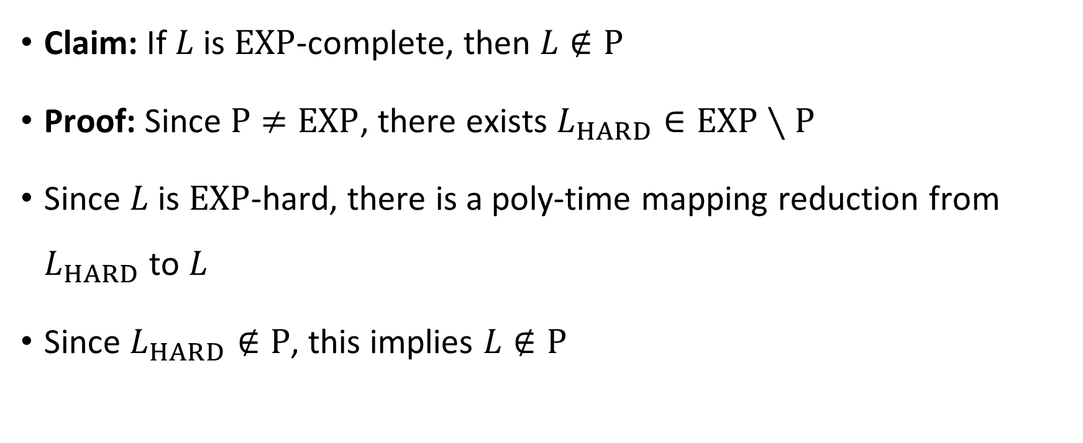

$\text{EXP}$-complete languages are not in $\text{P}$
Claim: If $L$ is $\text{EXP}$-complete, then $L∉\text{P}$
Proof: Since $\text{P}≠\text{EXP}$, there exists $L_{HARD}∈\text{EXP}∖\text{P}$
Since $L$ is $\text{EXP}$-hard, there is a poly-time mapping reduction from $L_{HARD}$ to $L$
Since $L_{HARD}∉\text{P}$, this implies $L∉\text{P}$

Slide 6
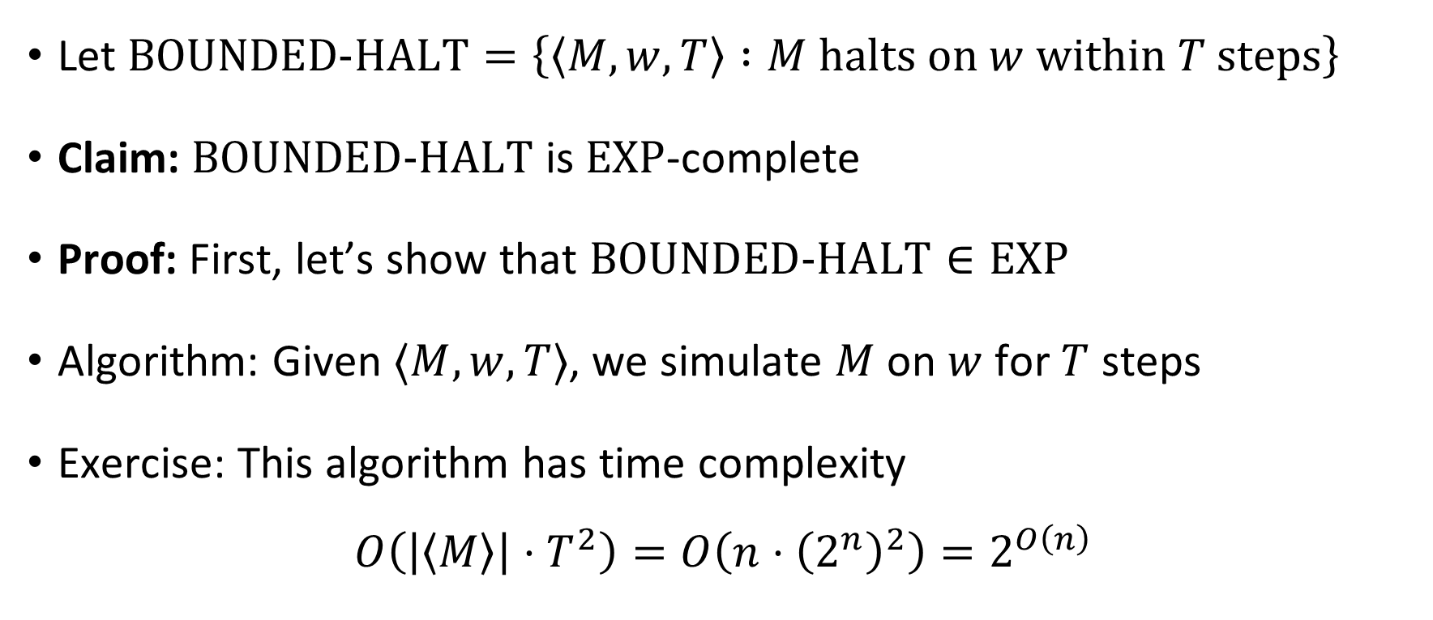

$\text{BOUNDED}\text{‑}\text{HALT}$ is $\text{EXP}$-complete
Let $\text{BOUNDED}\text{‑}\text{HALT}=\left\{\left\langle M,w,T\right\rangle :M \text{halts} \text{on} w \text{within} T \text{steps}\right\}$
Claim: $\text{BOUNDED}\text{‑}\text{HALT}$ is $\text{EXP}$-complete
Proof: First, let’s show that $\text{BOUNDED}\text{‑}\text{HALT}∈\text{EXP}$
Algorithm: Given $⟨M,w,T⟩$, we simulate $M$ on $w$ for $T$ steps
Exercise: This algorithm has time complexity
$$O\left(\left|\left\langle M\right\rangle \right|⋅T^{2}\right)=O\left(n⋅{\left(2^{n}\right)}^{2}\right)=2^{O\left(n\right)}$$

Slide 7
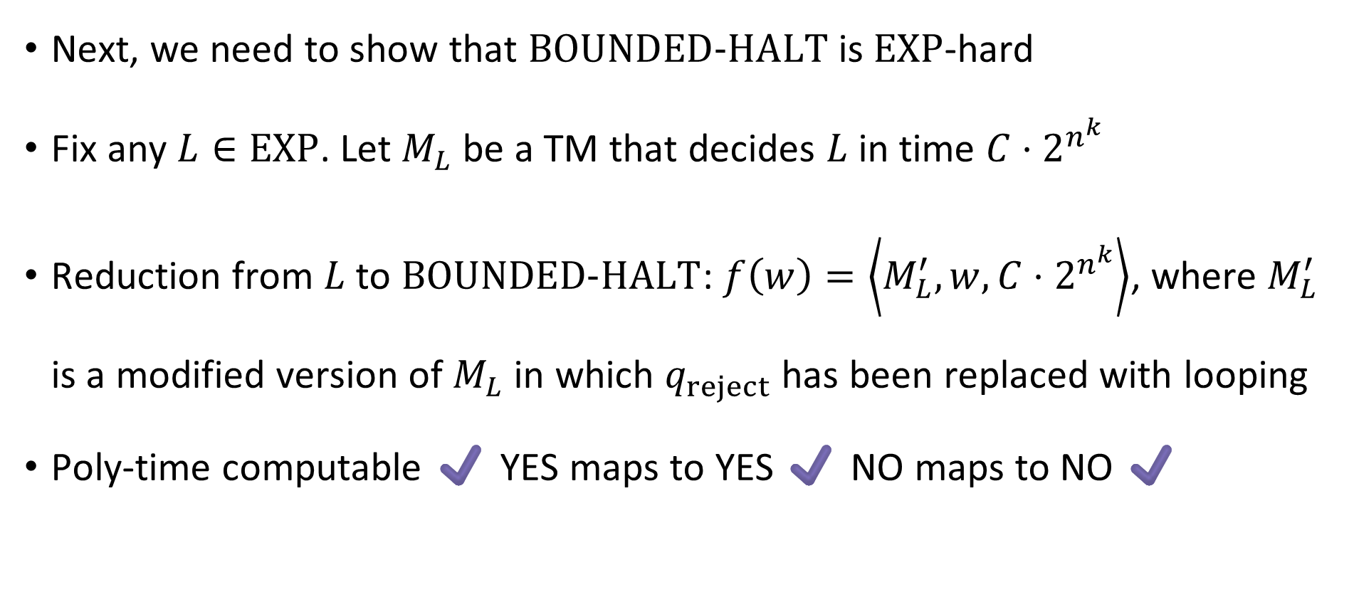

$\text{BOUNDED}\text{‑}\text{HALT}$ is $\text{EXP}$-complete
Next, we need to show that $\text{BOUNDED}\text{‑}\text{HALT}$ is $\text{EXP}$-hard
Fix any $L∈\text{EXP}$. Let $M_{L}$ be a TM that decides $L$ in time ${C⋅2}^{n^{k}}$
Reduction from $L$ to $\text{BOUNDED}\text{‑}\text{HALT}$: $f\left(w\right)=\left\langle M_{L}^{′},w,{C⋅2}^{n^{k}}\right\rangle$, where $M_{L}^{′}$ is a modified version of $M_{L}$ in which $q_{reject}$ has been replaced with looping
Poly-time computable ✔️ YES maps to YES ✔️ NO maps to NO ✔️

Slide 8

$\text{EXP}$-completeness
$\text{EXP}$-hard
$$\text{BOUNDED}\text{‑}\text{HALT}$$
$\text{EXP}$-complete
$$\text{EXP}$$
$$\text{P}$$

Slide 9

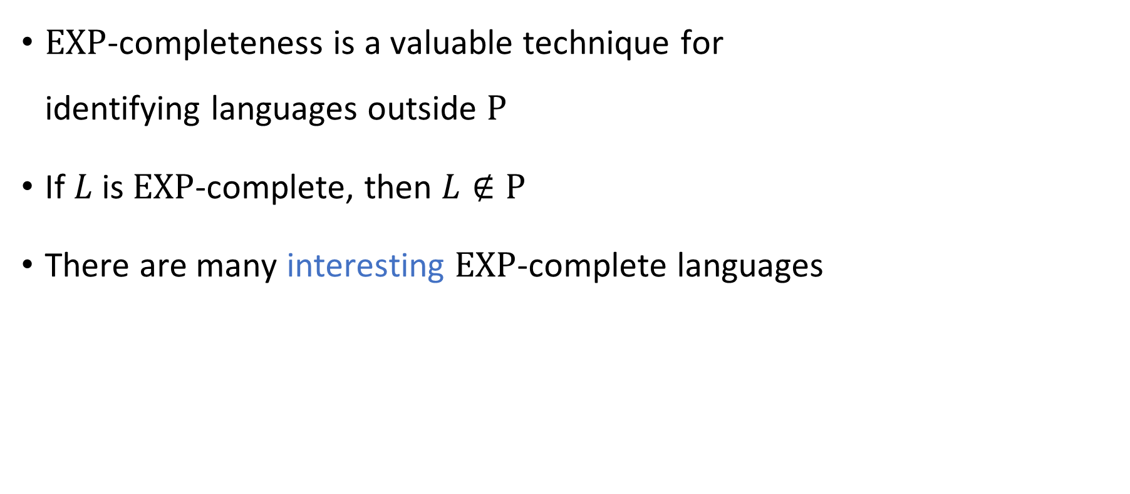

$\text{EXP}$-completeness
$\text{EXP}$-completeness is a valuable technique for identifying languages outside $\text{P}$
If $L$ is $\text{EXP}$-complete, then $L∉\text{P}$
There are many interesting $\text{EXP}$-complete languages

Slide 10
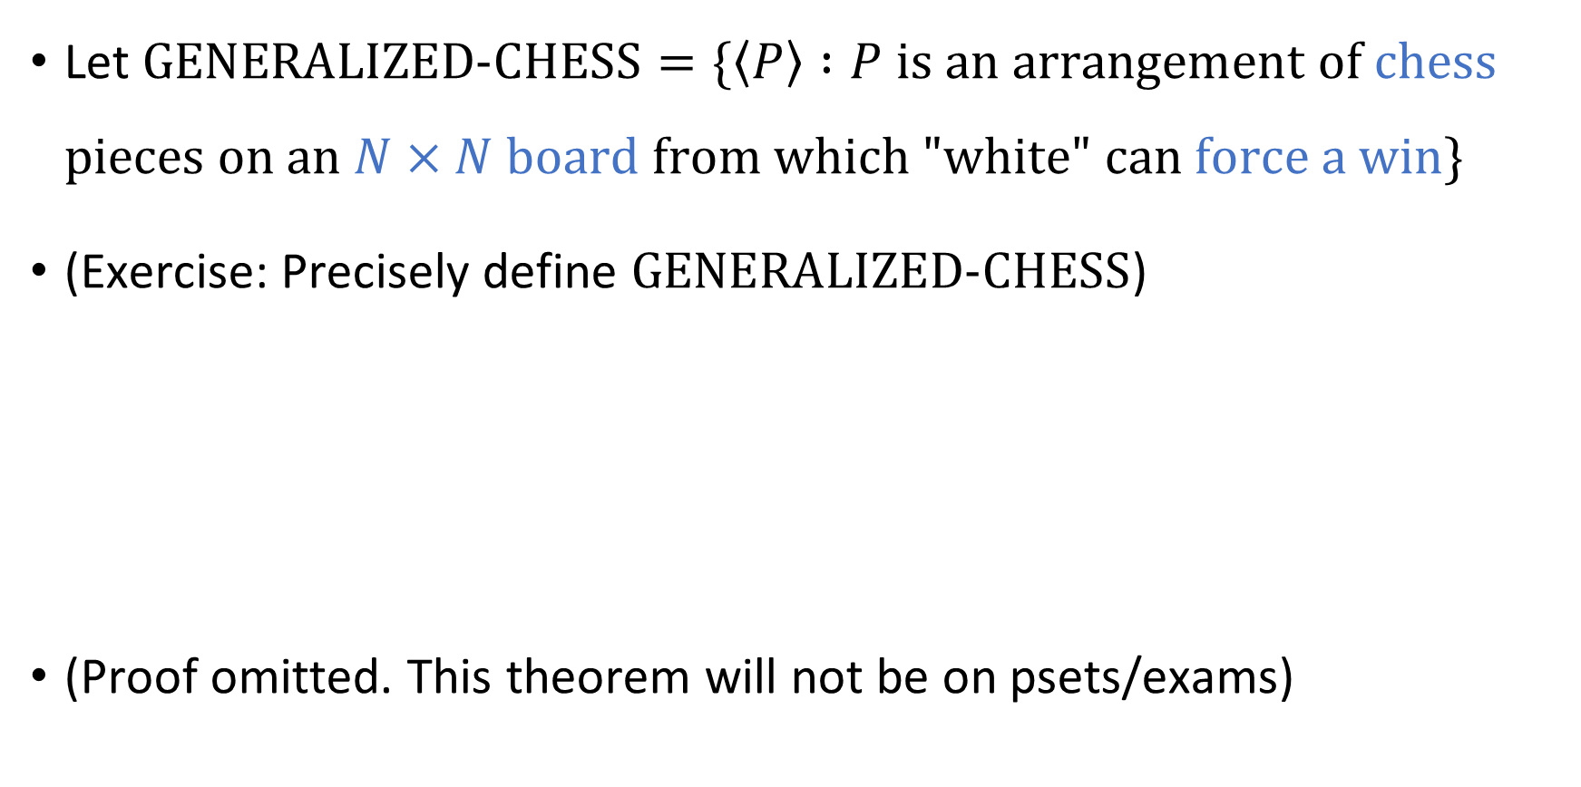


An $\text{EXP}$-complete problem that isn’t about TMs
Let $\text{GENERALIZED}\text{‑}\text{CHESS}=\{\left\langle P\right\rangle :P \text{is} \text{an} \text{arrangement} \text{of} \text{chess} \text{pieces} \text{on} \text{an} N×N \text{board} \text{from} \text{which}\text{ "}\text{white}\text{" }\text{can} \text{force} \text{a} \text{win}\}$
(Exercise: Precisely define $\text{GENERALIZED}\text{‑}\text{CHESS}$)
(Proof omitted. This theorem will not be on psets/exams)
Theorem: $\text{GENERALIZED}\text{‑}\text{CHESS}$ is $\text{EXP}$-complete. Consequently, $\text{GENERALIZED}\text{‑}\text{CHESS}∉\text{P}$.

Slide 11


$\text{EXP}$-completeness
$\text{EXP}$-completeness is a valuable tool for identifying intractability
Is $\text{EXP}$-completeness the only tool we need for identifying intractability?

Slide 12
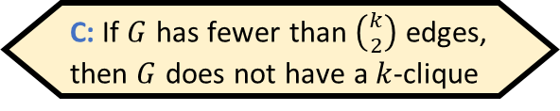

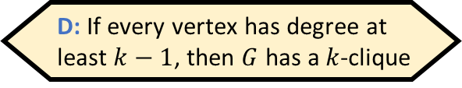
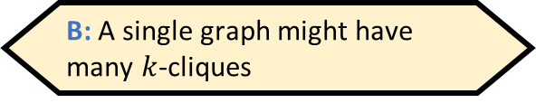
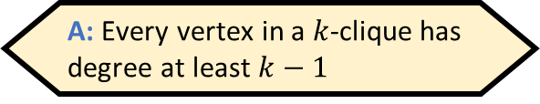
The clique problem
A $k$-clique in a graph $G=\left(V, E\right)$ is a set $S⊆V$ such that $\left|S\right|=k$ and every two vertices in $S$ are connected by an edge
Example: This graph has a $4$-clique
Which of the following statements is false?
A: Every vertex in a $k$-clique has degree at least $k−1$
B: A single graph might have many $k$-cliques
C: If $G$ has fewer than $\left({k \atop 2}\right)$ edges, then $G$ does not have a $k$-clique
D: If every vertex has degree at least $k−1$, then $G$ has a $k$-clique
Respond at PollEv.com/whoza or text “whoza” to 22333

Slide 13

The clique problem
Let $\text{CLIQUE}=\{\left\langle G,k\right\rangle :G \text{has} \text{a} k\text{‑}\text{clique}\}$
Example: Let $G$ be the graph with the following adjacency matrix
Does $G$ have a $4$-clique?
 | a | b | c | d | e | f | g
a | 0 | 1 | 1 | 0 | 0 | 1 | 0
b | 1 | 0 | 0 | 1 | 1 | 0 | 1
c | 1 | 0 | 0 | 0 | 1 | 0 | 1
d | 0 | 1 | 0 | 0 | 1 | 0 | 1
e | 0 | 1 | 1 | 1 | 0 | 1 | 1
f | 1 | 0 | 0 | 0 | 1 | 0 | 1
g | 0 | 1 | 1 | 1 | 1 | 1 | 0

Slide 14

The clique problem
Let $\text{CLIQUE}=\{\left\langle G,k\right\rangle :G \text{has} \text{a} k\text{‑}\text{clique}\}$
Example: Let $G$ be the graph with the following adjacency matrix
Does $G$ have a $4$-clique?
Yes! $S=\{\text{b},\text{d},\text{e},\text{g}\}$
 | a | b | c | d | e | f | g
a | 0 | 1 | 1 | 0 | 0 | 1 | 0
b | 1 | 0 | 0 | 1 | 1 | 0 | 1
c | 1 | 0 | 0 | 0 | 1 | 0 | 1
d | 0 | 1 | 0 | 0 | 1 | 0 | 1
e | 0 | 1 | 1 | 1 | 0 | 1 | 1
f | 1 | 0 | 0 | 0 | 1 | 0 | 1
g | 0 | 1 | 1 | 1 | 1 | 1 | 0

Slide 15
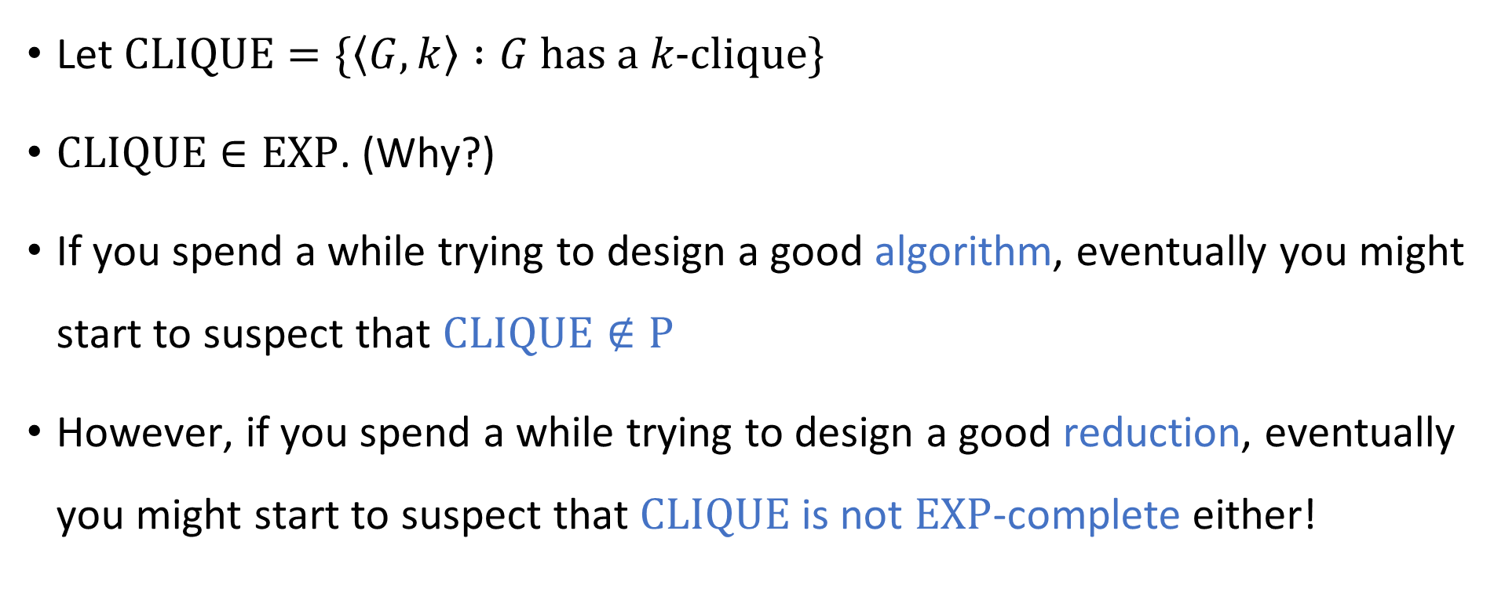
Complexity of the clique problem
Let $\text{CLIQUE}=\{\left\langle G,k\right\rangle :G \text{has} \text{a} k\text{‑}\text{clique}\}$
$\text{CLIQUE}∈\text{EXP}$. (Why?)
If you spend a while trying to design a good algorithm, eventually you might start to suspect that $\text{CLIQUE}∉\text{P}$
However, if you spend a while trying to design a good reduction, eventually you might start to suspect that $\text{CLIQUE}$ is not $\text{EXP}$-complete either!

Slide 16


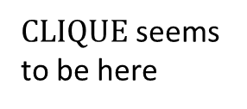


$\text{EXP}$-hard
$\text{EXP}$-complete
$\text{CLIQUE}$ seems to be here
$$\text{EXP}$$
$$\text{P}$$

Slide 17

Complexity of the clique problem
Evidently, to understand the complexity of $\text{CLIQUE}$, we need new conceptual tools

Slide 18
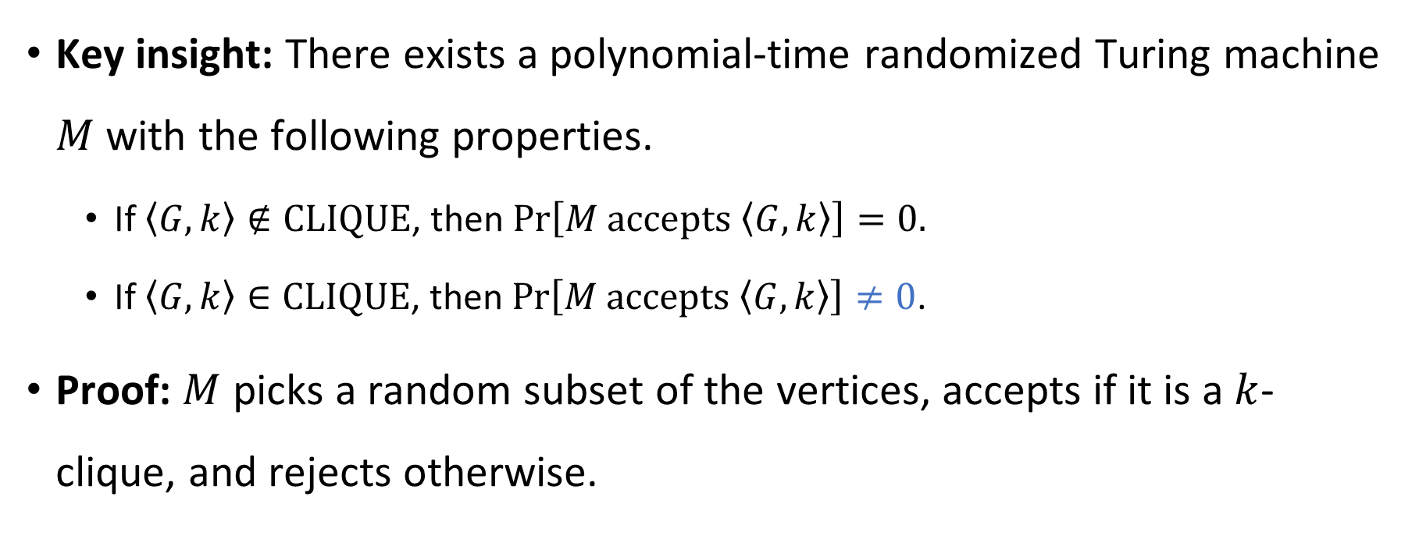
Guessing and checking
Key insight: There exists a polynomial-time randomized Turing machine $M$ with the following properties.
If $\left\langle G,k\right\rangle ∉\text{CLIQUE}$, then $\operatorname{Pr}\left[M \text{accepts} \left\langle G,k\right\rangle \right]=0.$
If $\left\langle G,k\right\rangle ∈\text{CLIQUE}$, then $\operatorname{Pr}\left[M \text{accepts} \left\langle G,k\right\rangle \right]≠0$.
Proof: $M$ picks a random subset of the vertices, accepts if it is a $k$-clique, and rejects otherwise.
“Nondeterministic TM”

Slide 19
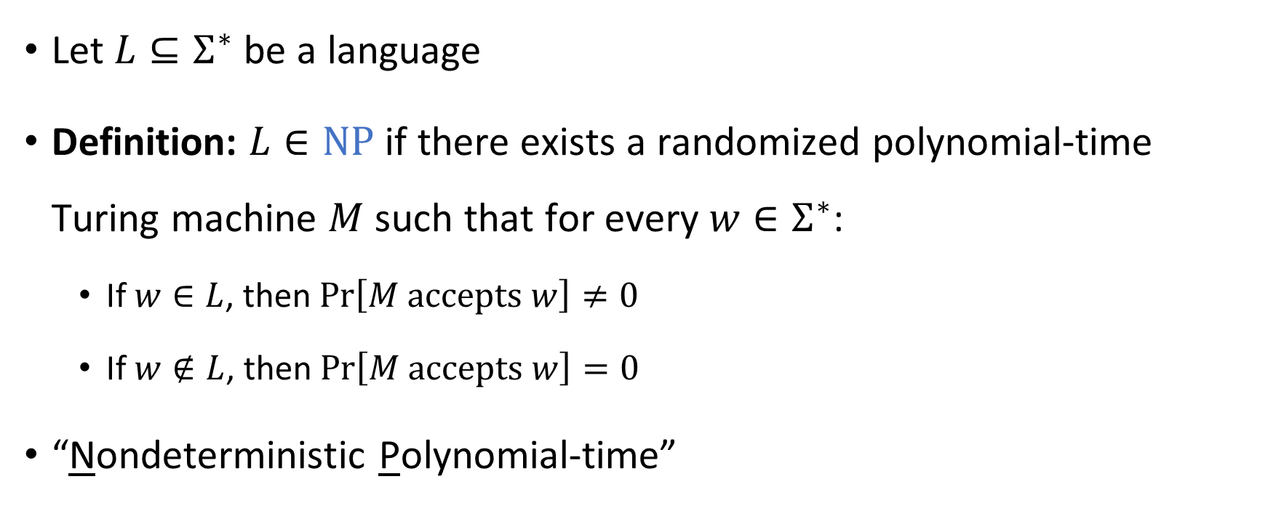

The complexity class $\text{NP}$
Let $L⊆Σ^{∗}$ be a language
Definition: $L∈\text{NP}$ if there exists a randomized polynomial-time Turing machine $M$ such that for every $w∈Σ^{∗}$:
If $w∈L$, then $\operatorname{Pr}\left[M \text{accepts} w\right]≠0$
If $w∉L$, then $\operatorname{Pr}\left[M \text{accepts} w\right]=0$
“Nondeterministic Polynomial-time”

Slide 20
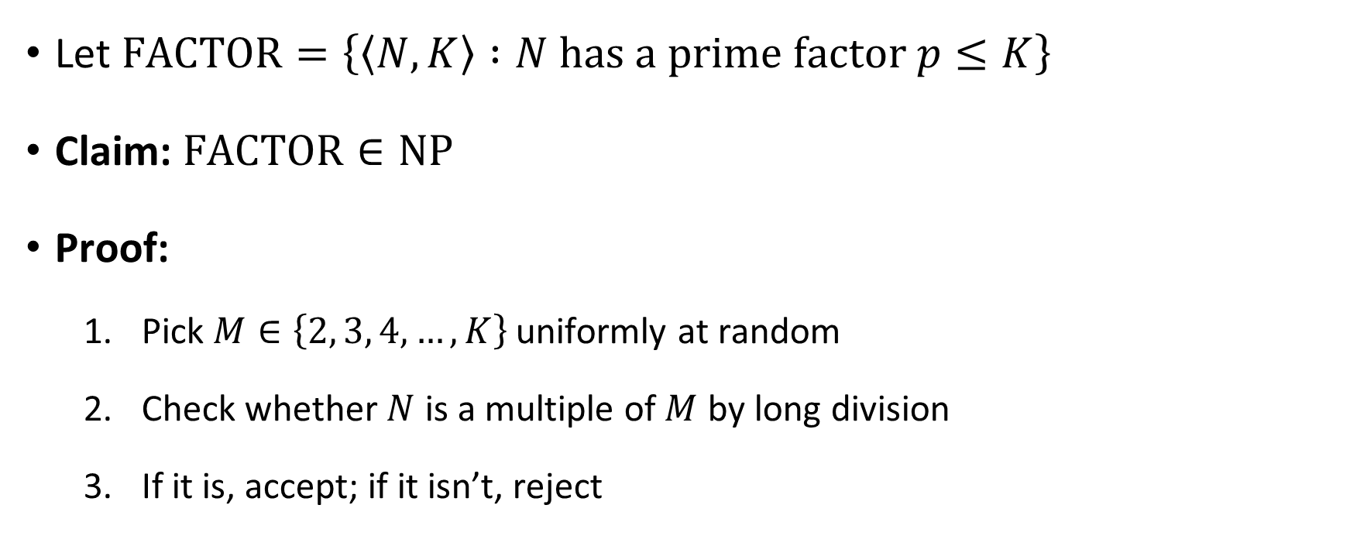

Another example of a language in $\text{NP}$
Let $\text{FACTOR}=\left\{\left\langle N,K\right\rangle :N \text{has} \text{a} \text{prime} \text{factor} p≤K\right\}$
Claim: $\text{FACTOR}∈\text{NP}$
Proof:
Pick $M∈\left\{2, 3, 4, …, K\right\}$ uniformly at random
Check whether $N$ is a multiple of $M$ by long division
If it is, accept; if it isn’t, reject

Slide 21
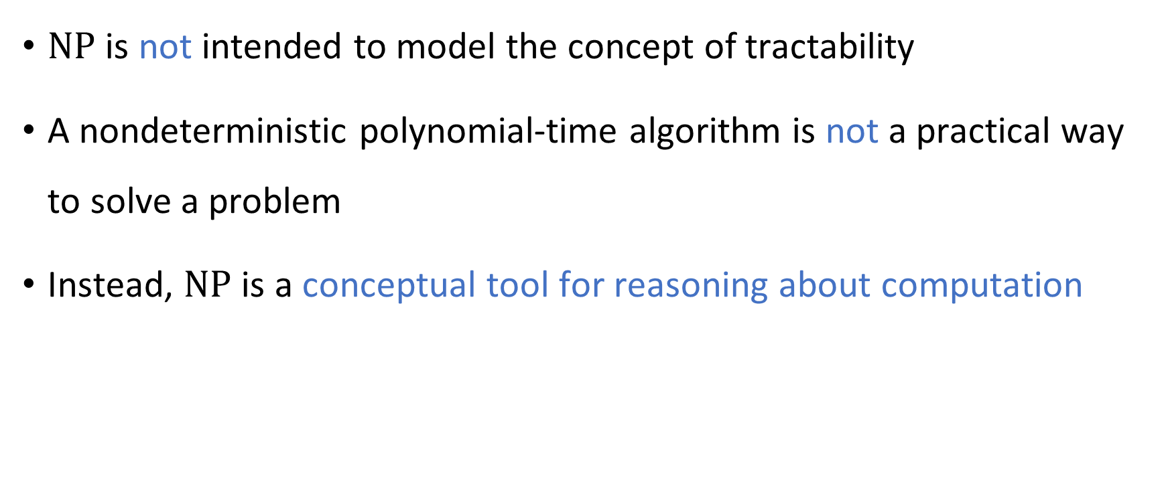

How to interpret $\text{NP}$
$\text{NP}$ is not intended to model the concept of tractability
A nondeterministic polynomial-time algorithm is not a practical way to solve a problem
Instead, $\text{NP}$ is a conceptual tool for reasoning about computation

Slide 22
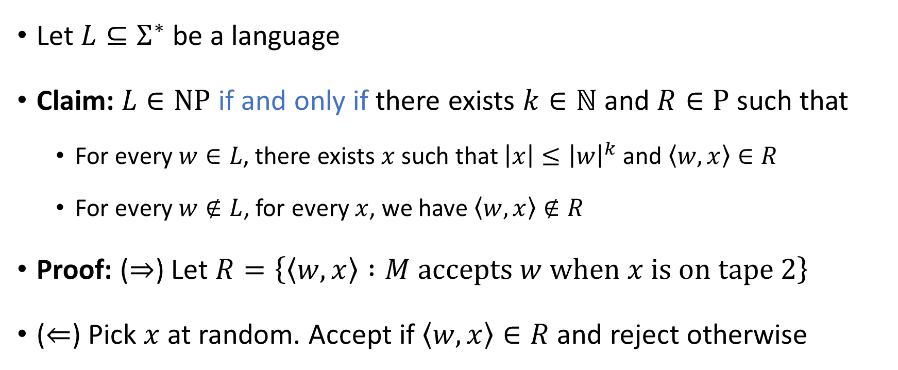
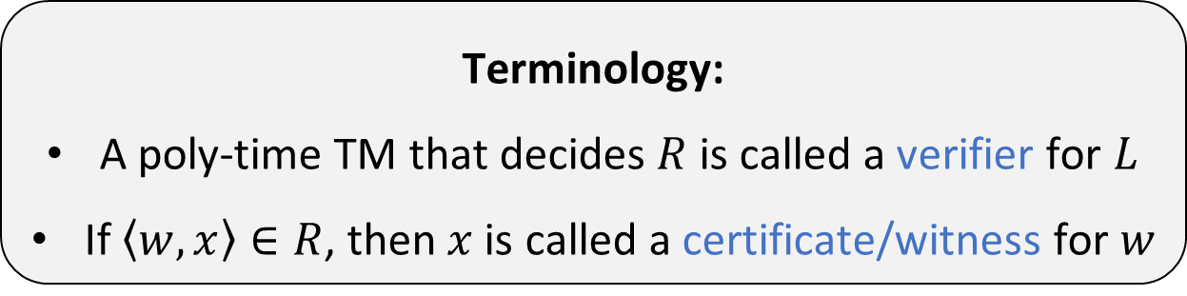
“Verification of certificates” perspective
Terminology:
A poly-time TM that decides $R$ is called a verifier for $L$
If $\left\langle w,x\right\rangle ∈R$, then $x$ is called a certificate/witness for $w$
Let $L⊆Σ^{∗}$ be a language
Claim: $L∈\text{NP}$ if and only if there exists $k∈ℕ$ and $R∈\text{P}$ such that
For every $w∈L$, there exists $x$ such that $\left|x\right|≤{\left|w\right|}^{k}$ and $\left\langle w,x\right\rangle ∈R$
For every $w∉L$, for every $x$, we have $\left\langle w,x\right\rangle ∉R$
Proof: ($⇒$) Let $R=\left\{\left\langle w,x\right\rangle :M \text{accepts} w \text{when} x \text{is} \text{on} \text{tape} 2\right\}$
($⇐$) Pick $x$ at random. Accept if $\left\langle w,x\right\rangle ∈R$ and reject otherwise

Slide 23
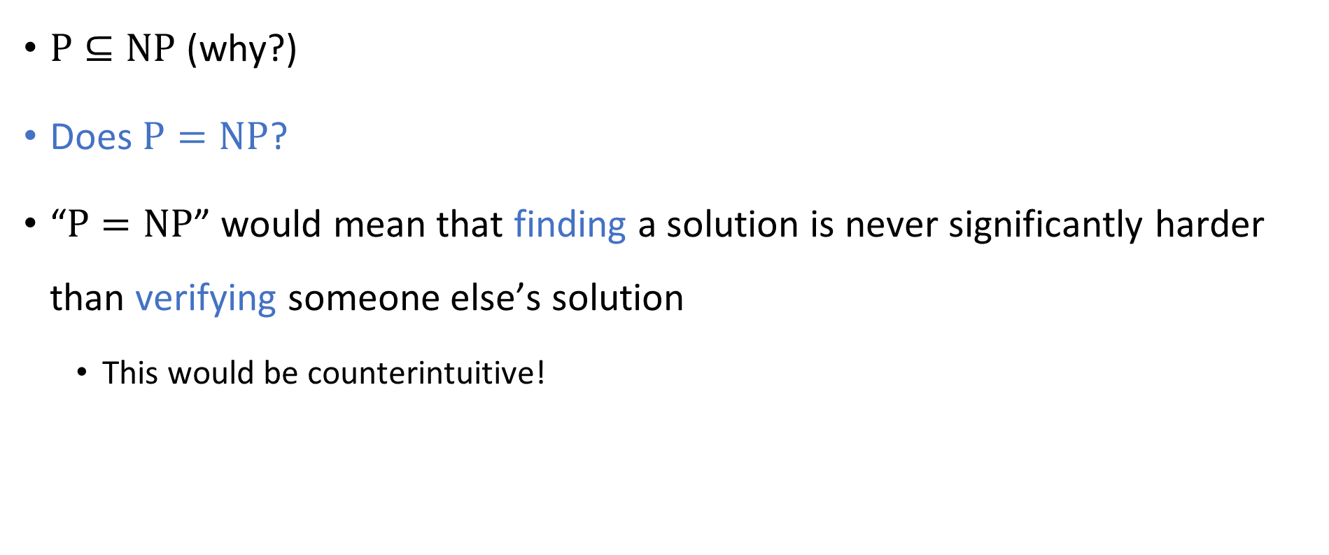



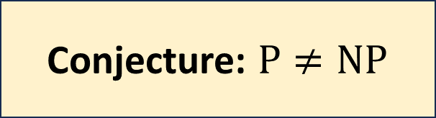
The $\text{P}$ vs. $\text{NP}$ problem
$$\text{NP}$$
$$\text{P}$$
$\text{P}⊆\text{NP}$ (why?)
Does $\text{P}=\text{NP}$?
“$\text{P}=\text{NP}$” would mean that finding a solution is never significantly harder than verifying someone else’s solution
This would be counterintuitive!
Conjecture: $\text{P}≠\text{NP}$

Slide 24
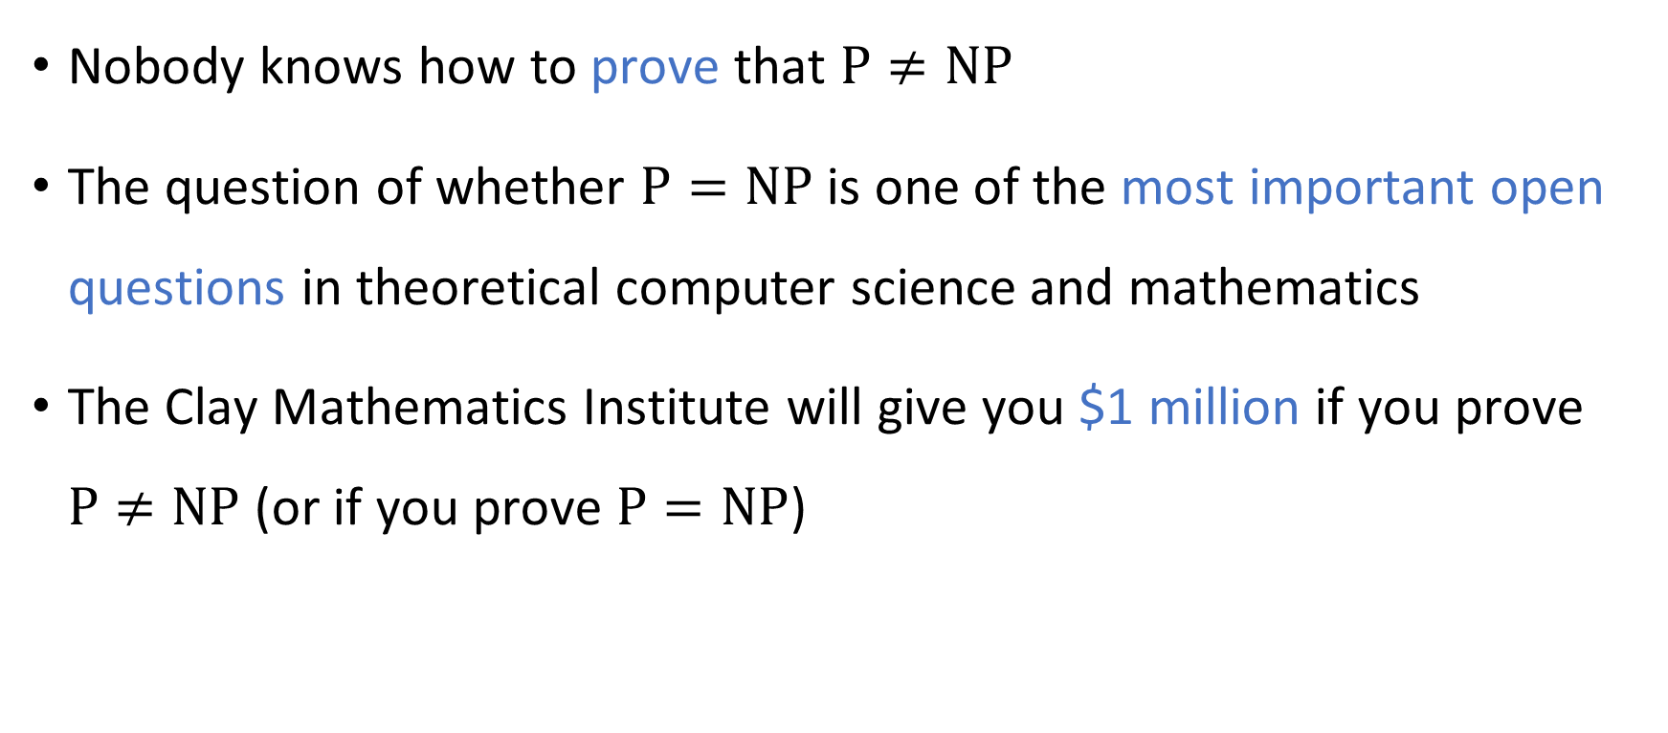
The $\text{P}$ vs. $\text{NP}$ problem
Nobody knows how to prove that $\text{P}≠\text{NP}$
The question of whether $\text{P}=\text{NP}$ is one of the most important open questions in theoretical computer science and mathematics
The Clay Mathematics Institute will give you $1 million if you prove $\text{P}≠\text{NP}$ (or if you prove $\text{P}=\text{NP}$)

Slide 25
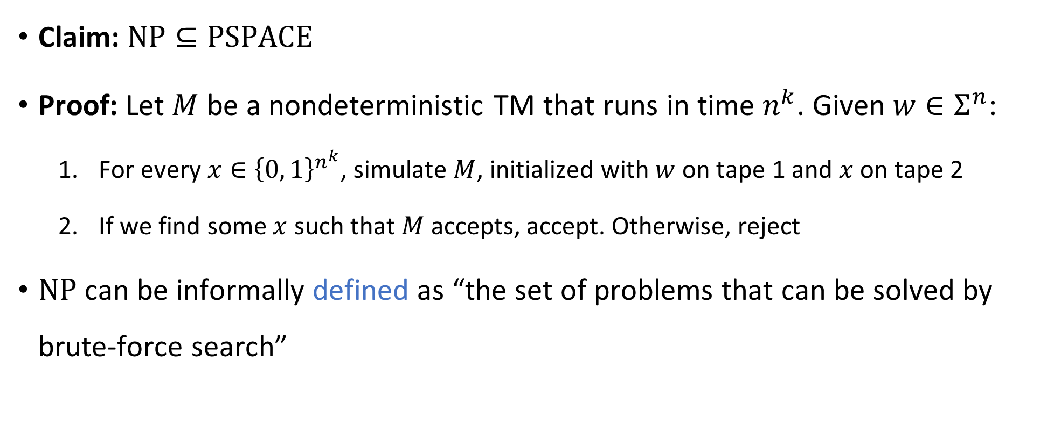

Solving problems in $\text{NP}$ by brute force
Claim: $\text{NP}⊆\text{PSPACE}$
Proof: Let $M$ be a nondeterministic TM that runs in time $n^{k}$. Given $w∈Σ^{n}$:
For every $x∈{\left\{0, 1\right\}}^{n^{k}}$, simulate $M$, initialized with $w$ on tape 1 and $x$ on tape 2
If we find some $x$ such that $M$ accepts, accept. Otherwise, reject
$\text{NP}$ can be informally defined as “the set of problems that can be solved by brute-force search”

Slide 26




$$\text{EXP}$$
$$\text{PSPACE}$$
$$\text{NP}$$
$$\text{P}$$

