Slide 1

CMSC 28100 Introduction to Complexity Theory Spring 2024 Instructor: William Hoza

Slide 2












Post’s Correspondence Problem
Given: a set of “dominos”
Goal: Determine whether it is possible to generate a “match”
in which the sequence of symbols on top equals the sequence of symbols on the bottom
Using the same domino multiple times is permitted
$$\begin{matrix}t_{1} \\ b_{1}\end{matrix}$$
$$\begin{matrix}t_{2} \\ b_{2}\end{matrix}$$
$$\begin{matrix}t_{3} \\ b_{3}\end{matrix}$$
$$\begin{matrix}t_{k} \\ b_{k}\end{matrix}$$
$$⋯$$
$$\begin{matrix}t_{i_{1}} \\ b_{i_{1}}\end{matrix}$$
$$\begin{matrix}t_{i_{2}} \\ b_{i_{2}}\end{matrix}$$
$$\begin{matrix}t_{i_{3}} \\ b_{i_{3}}\end{matrix}$$
$$\begin{matrix}t_{i_{4}} \\ b_{i_{4}}\end{matrix}$$
$$\begin{matrix}t_{i_{5}} \\ b_{i_{5}}\end{matrix}$$
$$\begin{matrix}t_{i_{n}} \\ b_{i_{n}}\end{matrix}$$
$$⋯$$

Slide 3

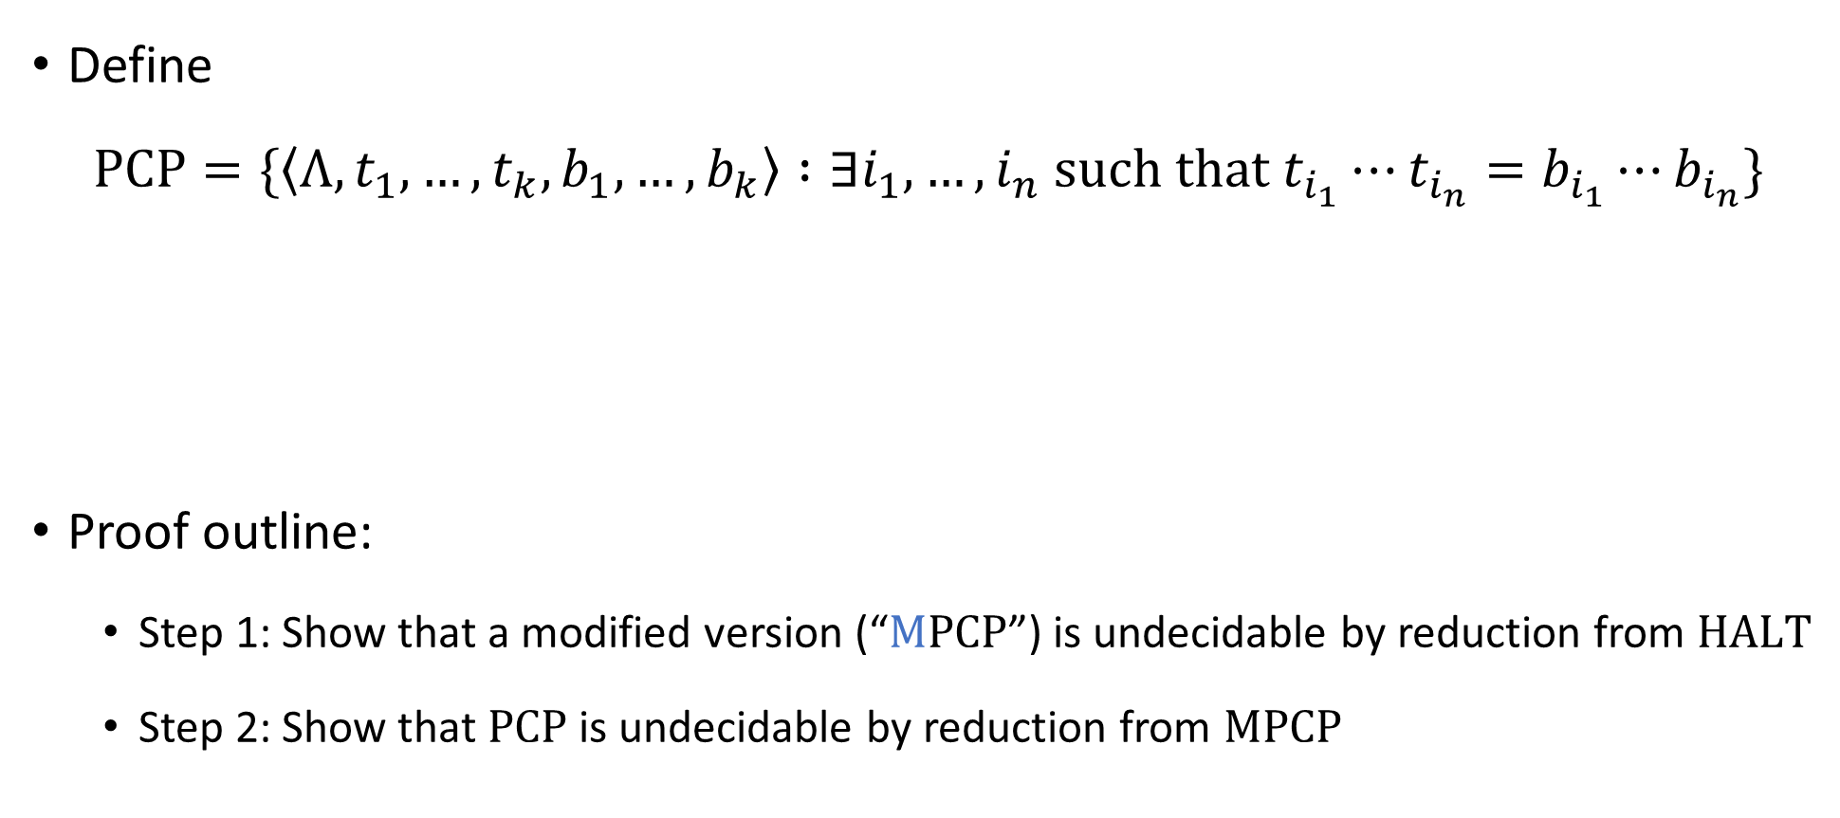
Post’s Correspondence Problem is undecidable
Define
$$\text{PCP}=\{\left\langle Λ, t_{1},…, t_{k}, b_{1},…, b_{k}\right\rangle :∃i_{1},…, i_{n} \text{such} \text{that} t_{i_{1}}⋯t_{i_{n}}=b_{i_{1}}⋯b_{i_{n}}\}$$
Proof outline:
Step 1: Show that a modified version (“$\text{M}\text{PCP}$”) is undecidable by reduction from $\text{HALT}$
Step 2: Show that $\text{PCP}$ is undecidable by reduction from $\text{MPCP}$
Theorem: $\text{PCP}$ is undecidable

Slide 4

Modified PCP
$$\text{MPCP}=\{\left\langle Λ, t_{1},…, t_{k}, b_{1},…, b_{k}\right\rangle :∃i_{1},…, i_{n} \text{such} \text{that} t_{1}t_{i_{1}}⋯t_{i_{n}}=b_{1}b_{i_{1}}⋯b_{i_{n}}\}$$
The difference between $\text{PCP}$ and $\text{MPCP}$: In $\text{MPCP}$, matches must start with the first domino

Slide 5


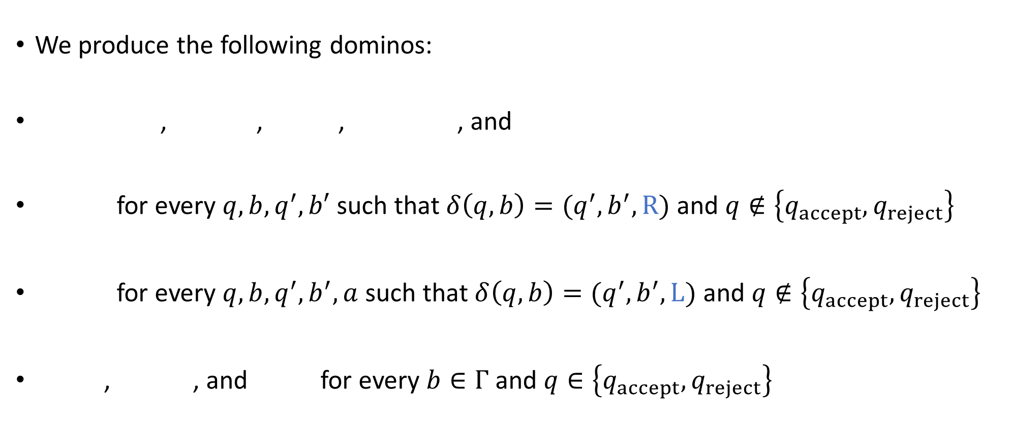









Reduction from $\text{HALT}$ to $\text{MPCP}$
We produce the following dominos:
, , , , and
for every $q,b,q^{′},b′$ such that $δ\left(q,b\right)=(q^{′},b^{′},\text{R})$ and $q∉\left\{q_{accept},q_{reject}\right\}$
for every $q,b,q^{′},b^{′},a$ such that $δ\left(q,b\right)=(q^{′},b^{′},\text{L})$ and $q∉\left\{q_{accept},q_{reject}\right\}$
, , and for every $b∈Γ$ and $q∈\left\{q_{accept},q_{reject}\right\}$
Reduction is computable ✔️
$$\begin{matrix}ε \\ ♢q_{0}w⊔\#\end{matrix}$$
$$\begin{matrix}\# \\ \#\end{matrix}$$
$$\begin{matrix}\# \\ ⊔\#\end{matrix}$$
$$\begin{matrix}q_{accept}\# \\ ε\end{matrix}$$
$$\begin{matrix}q_{reject}\# \\ ε\end{matrix}$$
$$\begin{matrix}qb \\ b^{′}q′\end{matrix}$$
$$\begin{matrix}aqb \\ q^{′}ab′\end{matrix}$$
$$\begin{matrix}b \\ b\end{matrix}$$
$$\begin{matrix}bq \\ q\end{matrix}$$
$$\begin{matrix}qb \\ q\end{matrix}$$

Slide 6



















YES maps to YES
Suppose $M$ halts on $w$
Under this assumption, we showed last time how to construct a match
The construction was based on the computation history of $M$ on $w$:
$$\begin{matrix}ε \\ ♢q_{0}w⊔\#\end{matrix}$$
$$\begin{matrix}C_{0}^{′}⊔ \\ C_{1}^{′}\end{matrix}$$
$$\begin{matrix}\# \\ ⊔\#\end{matrix}$$
$$\begin{matrix}C_{1}^{′}⊔ \\ C_{2}^{′}\end{matrix}$$
$$\begin{matrix}\# \\ ⊔\#\end{matrix}$$
$$\begin{matrix}\# \\ ⊔\#\end{matrix}$$
$$\begin{matrix}C_{T−1}^{′}⊔ \\ C_{T}^{′}\end{matrix}$$
$$\begin{matrix}\# \\ \#\end{matrix}$$
$$\begin{matrix}H_{0} \\ H_{1}\end{matrix}$$
$$\begin{matrix}\# \\ \#\end{matrix}$$
$$\begin{matrix}H_{1} \\ H_{2}\end{matrix}$$
$$\begin{matrix}\# \\ \#\end{matrix}$$
$$\begin{matrix}\# \\ \#\end{matrix}$$
$$\begin{matrix}H_{n−1} \\ H_{n}\end{matrix}$$
$$\begin{matrix}\# \\ \#\end{matrix}$$
$$\begin{matrix}H_{n}\# \\ ε\end{matrix}$$
$$⋯$$
$$⋯$$

Slide 7

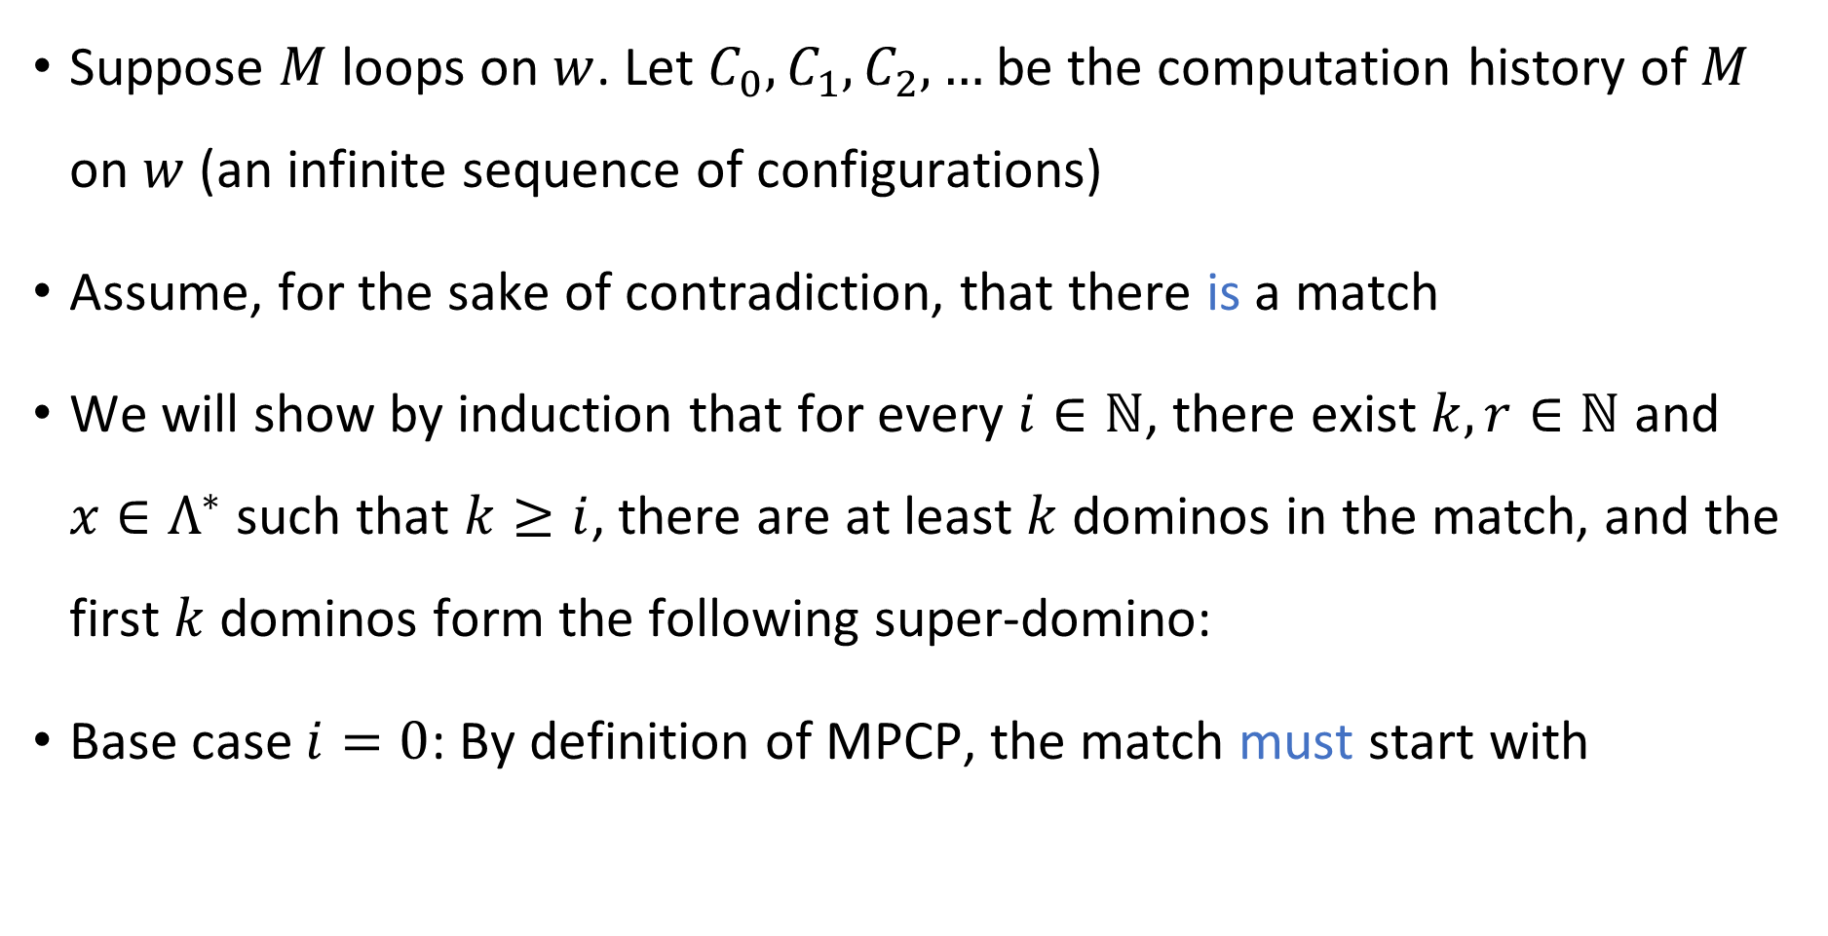

NO maps to NO
Suppose $M$ loops on $w$. Let $C_{0},C_{1},C_{2},…$ be the computation history of $M$ on $w$ (an infinite sequence of configurations)
Assume, for the sake of contradiction, that there is a match
We will show by induction that for every $i∈ℕ$, there exist $k,r∈ℕ$ and $x∈Λ^{∗}$ such that $k≥i$, there are at least $k$ dominos in the match, and the first $k$ dominos form the following super-domino:
Base case $i=0$: By definition of MPCP, the match must start with
$$\begin{matrix}x \\ xC_{i}⊔^{r}\#\end{matrix}$$
$$\begin{matrix}ε \\ ♢q_{0}w⊔\#\end{matrix}$$

Slide 8
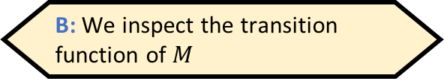







NO maps to NO
When we are computing $f\left(\left\langle M,w\right\rangle \right)$, how do we know whether there is a match?
A: We simulate $M$ on $w$ and observe what happens
B: We inspect the transition function of $M$
Inductive step: Assume that the first $k$ dominos in the match form
Subsequent dominos must spell out $C_{i}⊔^{r}\#$ on top
Exercise: There are only two possible ways to do this, namely
followed by either or
Either way, the inductive step is complete
Consequence: The match is infinitely long, a contradiction
$$\begin{matrix}x \\ xC_{i}⊔^{r}\#\end{matrix}$$
C: We do not know whether there is a match, and that’s okay
D: We do not know whether there is a match, and that’s an issue
Respond at PollEv.com/whoza or text “whoza” to 22333
$$\begin{matrix}C_{i}⊔^{r} \\ C_{i+1}⊔^{r}\end{matrix}$$
$$\begin{matrix}\# \\ \#\end{matrix}$$
$$\begin{matrix}\# \\ ⊔\#\end{matrix}$$

Slide 9

NO maps to NO
This completes the proof that $\text{M}\text{PCP}$ is undecidable
We designed a mapping reduction from $\text{HALT}$ to $\text{MPCP}$
If $\text{MPCP}$ were decidable, then $\text{HALT}$ would be decidable too

Slide 10
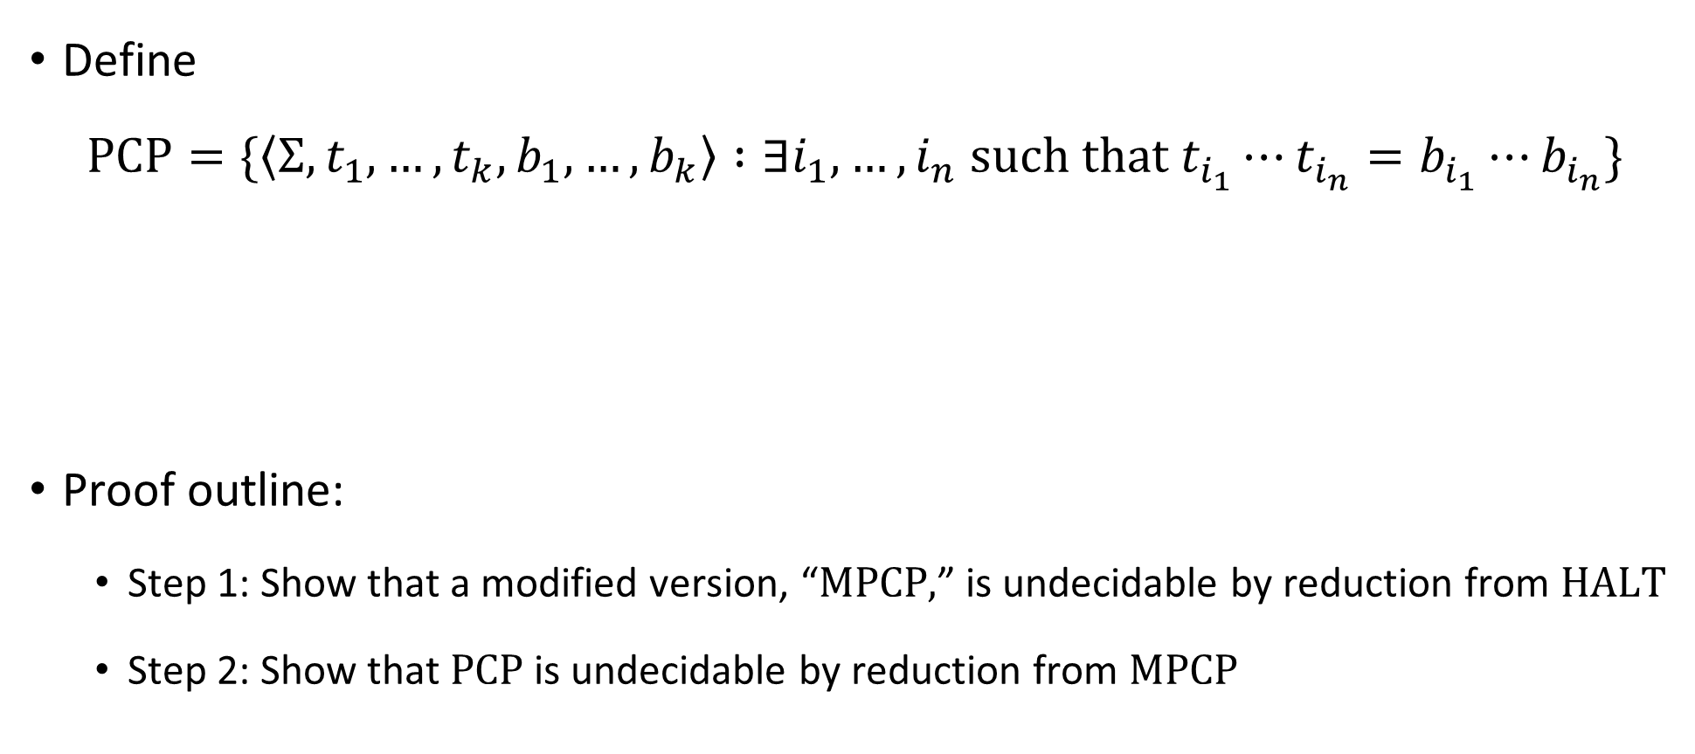
Post’s Correspondence Problem is undecidable
Define
$$\text{PCP}=\{\left\langle Σ, t_{1},…, t_{k}, b_{1},…, b_{k}\right\rangle :∃i_{1},…, i_{n} \text{such} \text{that} t_{i_{1}}⋯t_{i_{n}}=b_{i_{1}}⋯b_{i_{n}}\}$$
Proof outline:
Step 1: Show that a modified version, “$\text{MPCP}\text{,}$” is undecidable by reduction from $\text{HALT}$
Step 2: Show that $\text{PCP}$ is undecidable by reduction from $\text{MPCP}$
Theorem: $\text{PCP}$ is undecidable

Slide 11













Reduction from MPCP to PCP
For each string $u=u_{1}u_{2}…u_{n}$, define $\overline{u}=u_{1}⋆u_{2}⋆⋯⋆u_{n}$
Reduction:
$f\left( \begin{matrix} \\ \end{matrix} \right)=$
Computable ✔️
$$\begin{matrix}t_{1} \\ b_{1}\end{matrix}$$
$$\begin{matrix}t_{2} \\ b_{2}\end{matrix}$$
$$\begin{matrix}t_{3} \\ b_{3}\end{matrix}$$
$$\begin{matrix}t_{k} \\ b_{k}\end{matrix}$$
$$\begin{matrix}⋆\overline{t_{1}} \\ ⋆\overline{b_{1}}⋆\end{matrix}$$
$$\begin{matrix}⋆\overline{t_{1}} \\ \overline{b_{1}}⋆\end{matrix}$$
$$\begin{matrix}⋆\overline{t_{2}} \\ \overline{b_{2}}⋆\end{matrix}$$
$$\begin{matrix}⋆\overline{t_{3}} \\ \overline{b_{3}}⋆\end{matrix}$$
$$\begin{matrix}⋆\overline{t_{k}} \\ \overline{b_{k}}⋆\end{matrix}$$
$$\begin{matrix}⋆ \\ ε\end{matrix}$$
$$⋯$$
$$⋯$$

Slide 12













YES maps to YES
Suppose the MPCP instance has a match
Then the constructed PCP instance also has a match:
$$\begin{matrix}t_{1} \\ b_{1}\end{matrix}$$
$$\begin{matrix}t_{i_{1}} \\ b_{i_{1}}\end{matrix}$$
$$\begin{matrix}t_{i_{2}} \\ b_{i_{2}}\end{matrix}$$
$$\begin{matrix}t_{i_{3}} \\ b_{i_{3}}\end{matrix}$$
$$\begin{matrix}t_{i_{4}} \\ b_{i_{4}}\end{matrix}$$
$$\begin{matrix}t_{i_{n}} \\ b_{i_{n}}\end{matrix}$$
$$⋯$$
$$\begin{matrix}⋆\overline{t_{1}} \\ ⋆\overline{b_{1}}⋆\end{matrix}$$
$$\begin{matrix}⋆\overline{t_{i_{1}}} \\ \overline{b_{i_{1}}}⋆\end{matrix}$$
$$\begin{matrix}⋆\overline{t_{i_{2}}} \\ \overline{b_{i_{2}}}⋆\end{matrix}$$
$$\begin{matrix}⋆\overline{t_{i_{n}}} \\ \overline{b_{i_{n}}}⋆\end{matrix}$$
$$\begin{matrix}⋆ \\ ε\end{matrix}$$
$$⋯$$

Slide 13

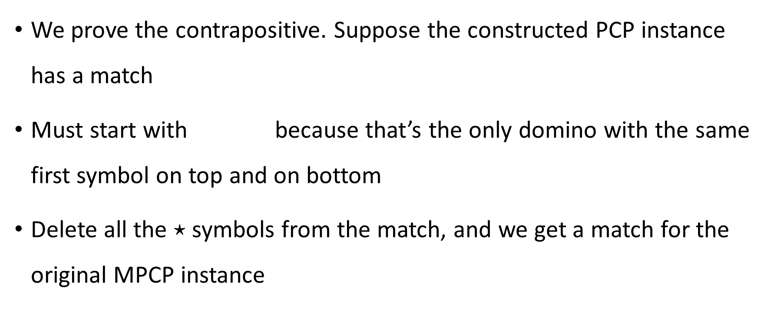
NO maps to NO
We prove the contrapositive. Suppose the constructed PCP instance has a match
Must start with because that’s the only domino with the same first symbol on top and on bottom
Delete all the $⋆$ symbols from the match, and we get a match for the original MPCP instance
$$\begin{matrix}⋆\overline{t_{1}} \\ ⋆\overline{b_{1}}⋆\end{matrix}$$

Slide 14
Using reductions to prove undecidability
OBJECTION: “I don’t like mapping reductions. I preferred our first few undecidability proofs, where we did proofs by contradiction and the concept of a reduction was implicit.”
RESPONSE 1: Mapping reductions help us to reason clearly about undecidability
RESPONSE 2: You should get comfortable with the concept of a mapping reduction now in preparation for what will come later
The concept might feel “optional” now, but later it will be essential

Slide 15
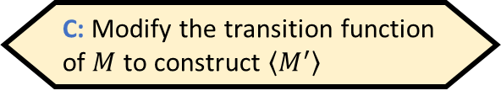
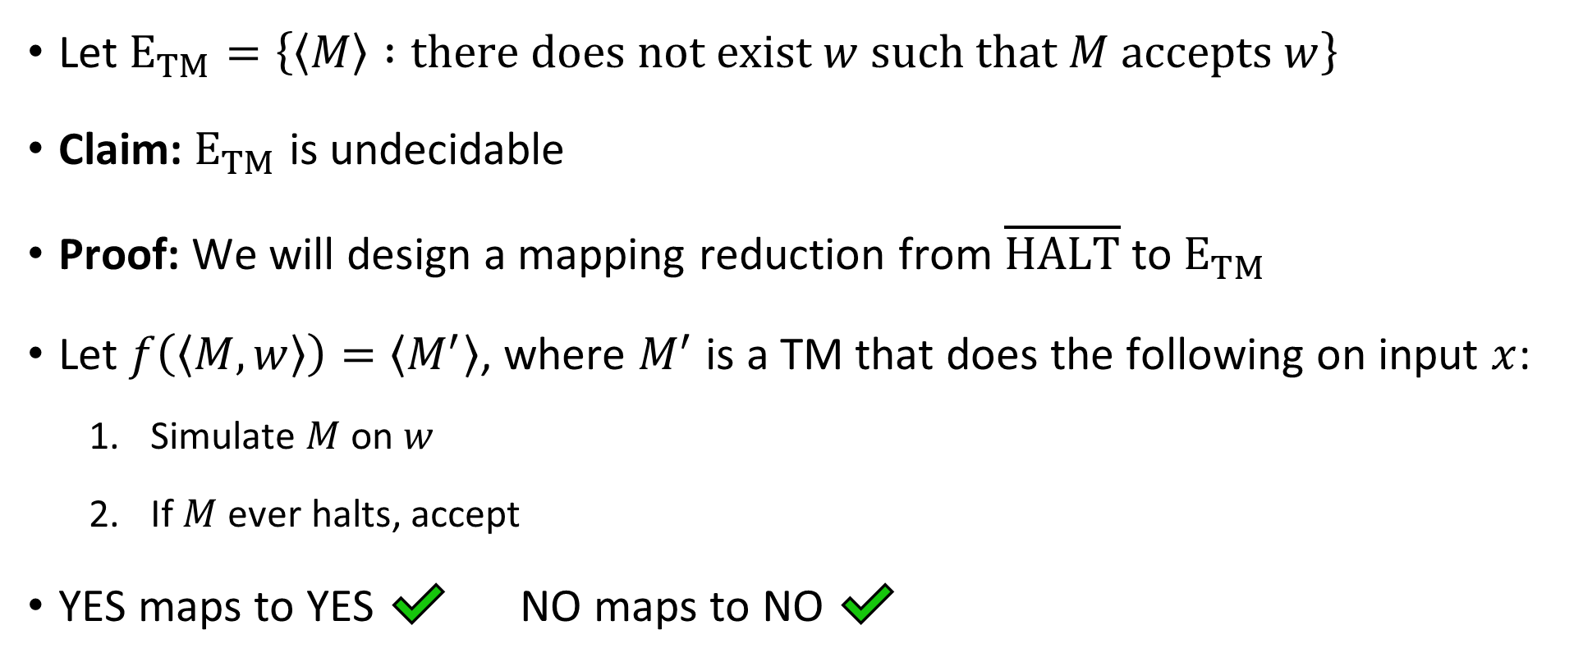
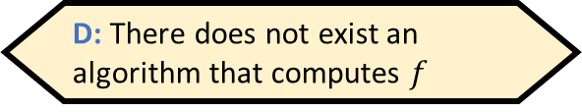
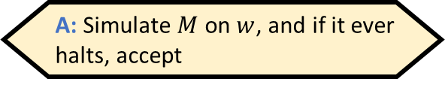
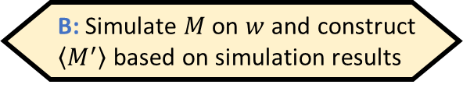
The “emptiness problem”
Given $⟨M,w⟩$, how would we compute $f\left(\left\langle M,w\right\rangle \right)$?
A: Simulate $M$ on $w$, and if it ever halts, accept
B: Simulate $M$ on $w$ and construct $\left\langle M^{′}\right\rangle$ based on simulation results
Let ${\text{E}}_{TM}=\left\{\left\langle M\right\rangle :\text{there} \text{does} \text{not} \text{exist} w \text{such} \text{that} M \text{accepts} w\right\}$
Claim: ${\text{E}}_{TM}$ is undecidable
Proof: We will design a mapping reduction from $\overline{\text{HALT}}$ to ${\text{E}}_{TM}$
Let $f\left(\left\langle M,w\right\rangle \right)=\left\langle M^{′}\right\rangle$, where $M^{′}$ is a TM that does the following on input $x$:
Simulate $M$ on $w$
If $M$ ever halts, accept
YES maps to YES ✔️ NO maps to NO ✔️
C: Modify the transition function of $M$ to construct $\left\langle M^{′}\right\rangle$
D: There does not exist an algorithm that computes $f$
Respond at PollEv.com/whoza or text “whoza” to 22333
Computable ✔️

Slide 16
Which languages are undecidable?

Slide 17
Some more undecidable problems
We have seen several interesting examples of undecidable problems
To wrap up our discussion of undecidability, I’ll mention a few more examples of undecidable problems – but we won’t do the proofs
(This material will not be on problem sets or exams)

Slide 18

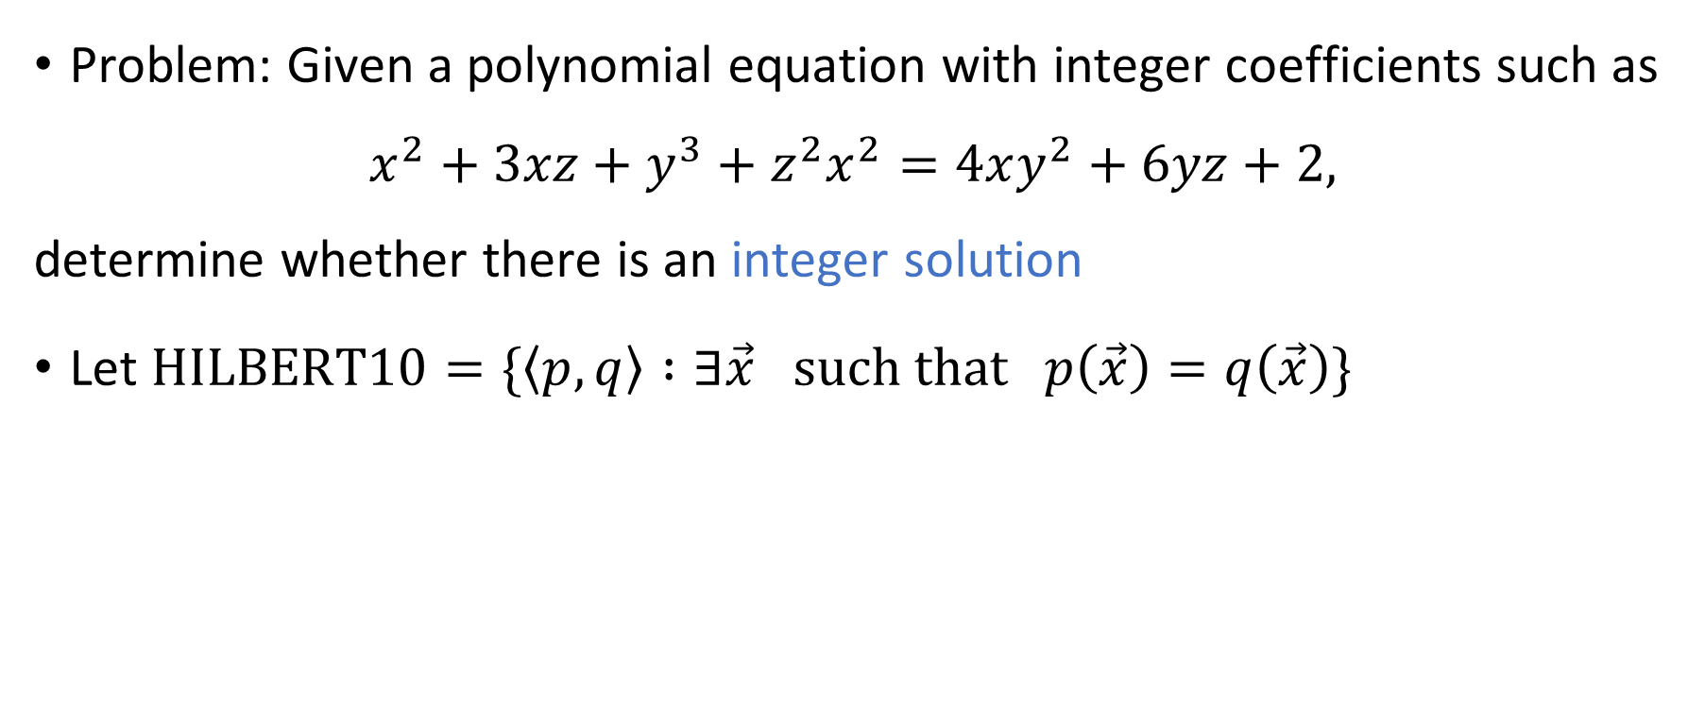
Hilbert’s 10th problem
Problem: Given a polynomial equation with integer coefficients such as
$$x^{2}+3xz+y^{3}+z^{2}x^{2}=4xy^{2}+6yz+2,$$
determine whether there is an integer solution
Let $\text{HILBERT}\text{10}=\{\left\langle p,q\right\rangle :∃\vec{x} \text{such} \text{that} p\left(\vec{x}\right)=q\left(\vec{x}\right)\}$
Theorem: $\text{HILBERT}\text{10}$ is undecidable

Slide 19
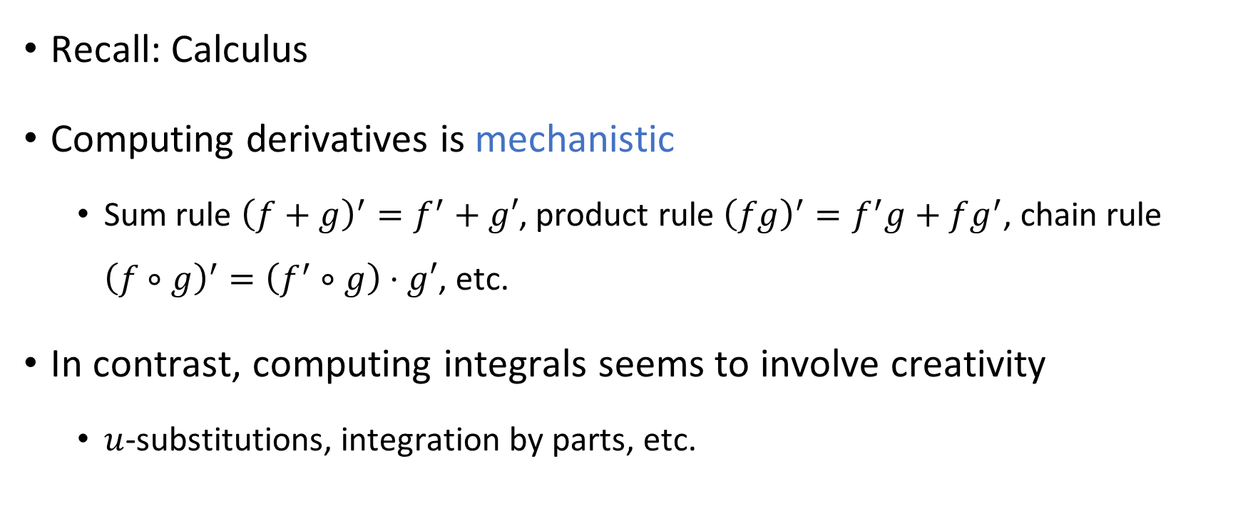
Derivatives vs. Integrals
Recall: Calculus
Computing derivatives is mechanistic
Sum rule ${\left(f+g\right)}^{′}=f^{′}+g′$, product rule ${\left(fg\right)}^{′}=f^{′}g+fg^{′}$, chain rule ${\left(f∘g\right)}^{′}=\left(f^{′}∘g\right)⋅g′$, etc.
In contrast, computing integrals seems to involve creativity
$u$-substitutions, integration by parts, etc.

Slide 20
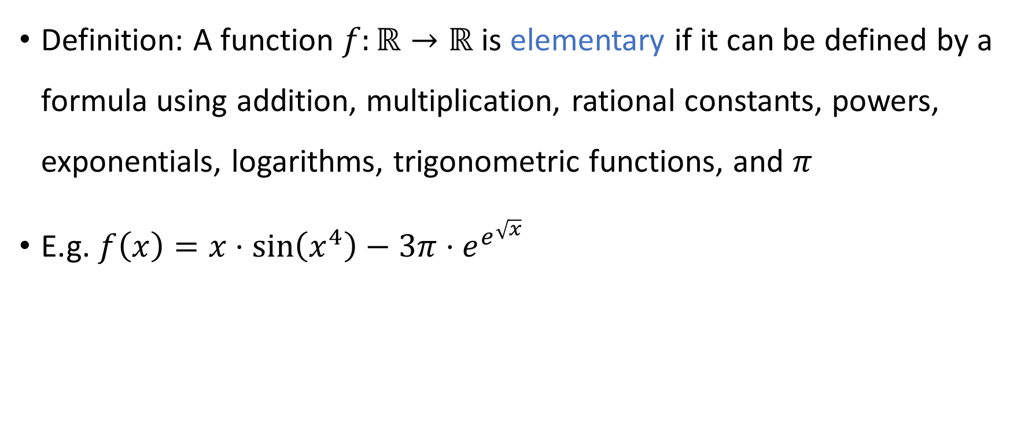
Elementary functions
Definition: A function $f:ℝ→ℝ$ is elementary if it can be defined by a formula using addition, multiplication, rational constants, powers, exponentials, logarithms, trigonometric functions, and $π$
E.g. $f\left(x\right)=x⋅\sin\left(x^{4}\right)−3π⋅e^{e^{\sqrt{x}}}$

Slide 21
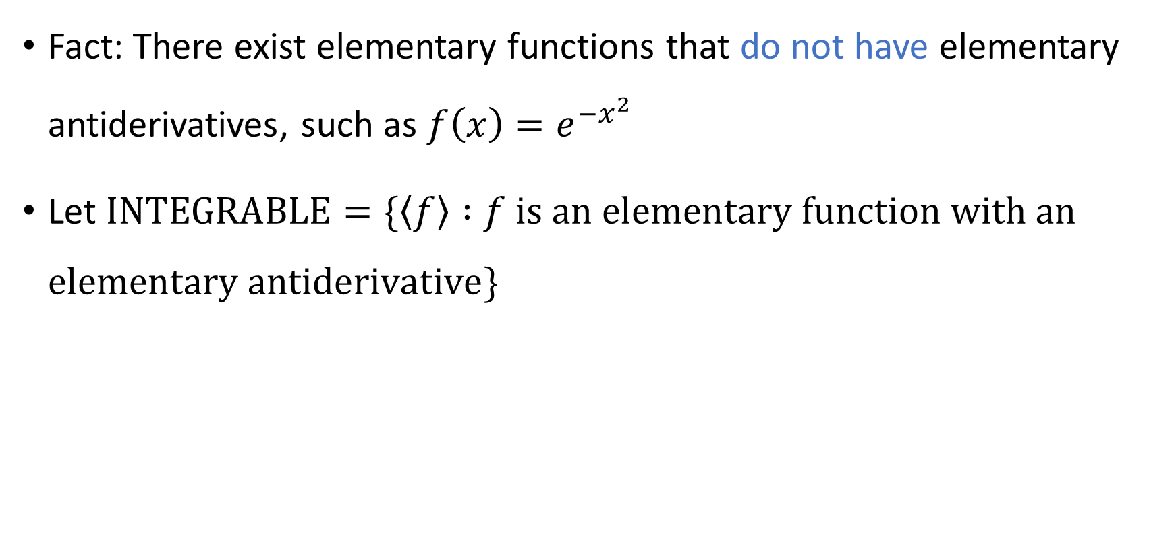

Integration is undecidable
Fact: There exist elementary functions that do not have elementary antiderivatives, such as $f\left(x\right)=e^{−x^{2}}$
Let $\text{INTEGRABLE}=\{\left\langle f\right\rangle :f \text{is} \text{an} \text{elementary} \text{function} \text{with} \text{an} \text{elementary} \text{antiderivative}\}$
Theorem: $\text{INTEGRABLE}$ is undecidable
Notes:
https://en.wikipedia.org/wiki/Richardson%27s_theorem

