Slide 1
CMSC 28100 Introduction to Complexity Theory Winter 2024 Instructor: William Hoza
7 |  |  |  |  |  |  | 5 | 3
 |  |  |  |  |  |  |  | 4
 | 4 | 8 |  | 3 |  | 1 | 2
8 |  | 1 | 3 |  |  | 2 | 7 | 5
 | 9 |  | 1 |  |  |  | 4
 | 5 |  |  |  |  | 3
2 |  | 5 |  | 8 | 4
1 | 3 | 4 |  | 5

Slide 2
Reminder
Problem set 1 is due tomorrow
Office hours today:
10:30am – 12:30pm (hosted by me)
3:30pm – 4:30pm (hosted by Nico and Rohan)

Slide 3
Which problems can be solved through computation?

Slide 4
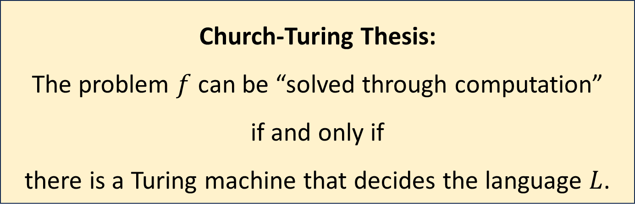
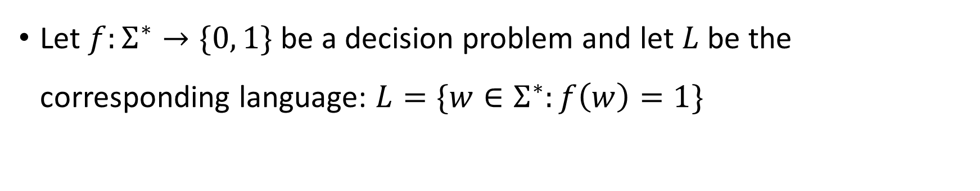
Church-Turing Thesis
Let $f:Σ^{∗}→\{0, 1\}$ be a decision problem and let $L$ be the corresponding language: $L=\{w∈Σ^{∗}:f\left(w\right)=1\}$
Church-Turing Thesis:
The problem $f$ can be “solved through computation”
if and only if
there is a Turing machine that decides the language $L$.
Intuitive notion
Mathematically precise notion

Slide 5
Church-Turing Thesis
The Church-Turing thesis says that the Turing machine model is the “correct” model of arbitrary computation
The thesis says that the informal concept of an “algorithm” is successfully captured by the rigorous definition of a Turing machine

Slide 6

Are Turing machines powerful enough?
OBJECTION: “To encompass all possible algorithms, we should add various bells and whistles to the Turing machine model.”
Example: Turing machine with start-of-tape indicator
input
$$♢$$
1
1
0
1

Slide 7
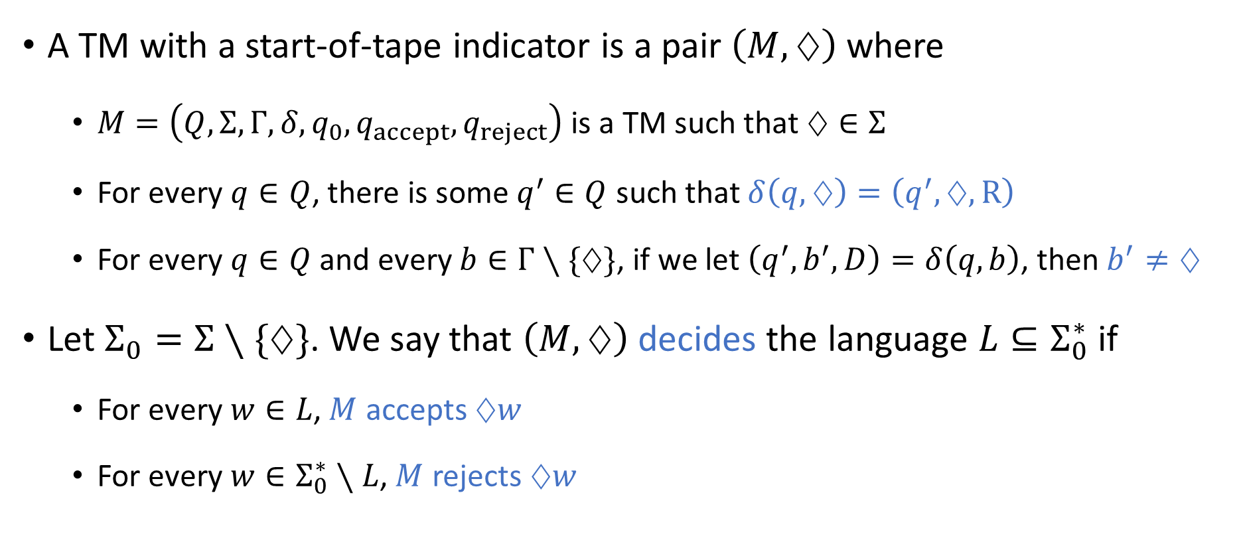
TM with start-of-tape indicator
A TM with a start-of-tape indicator is a pair $\left(M, ♢\right)$ where
$M=\left(Q,Σ,Γ,δ,q_{0},q_{accept},q_{reject}\right)$ is a TM such that $♢∈Σ$
For every $q∈Q$, there is some $q^{′}∈Q$ such that $δ\left(q,♢\right)=\left(q^{′},♢,\text{R}\right)$
For every $q∈Q$ and every $b∈Γ∖\{♢\}$, if we let $\left(q^{′},b^{′},D\right)=δ\left(q,b\right)$, then $b^{′}≠♢$
Let $Σ_{0}=Σ∖\{♢\}$. We say that $\left(M, ♢\right)$ decides the language $L⊆Σ_{0}^{∗}$ if
For every $w∈L$, $M$ accepts $♢w$
For every $w∈Σ_{0}^{∗}∖L$, $M$ rejects $♢w$

Slide 8
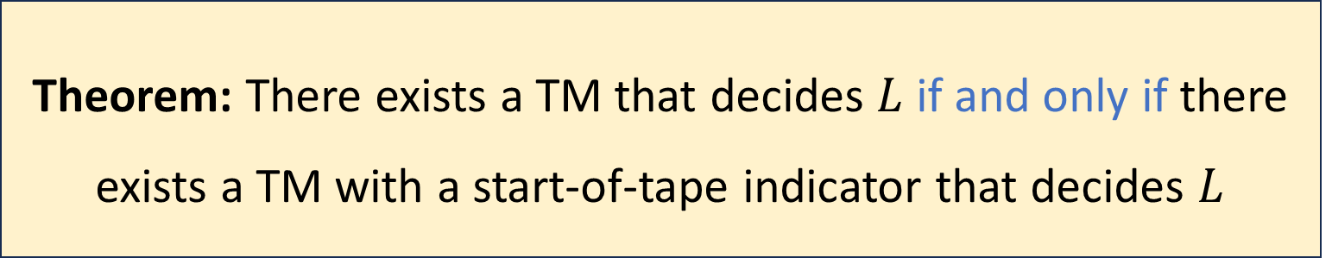

Start-of-tape indicators do not add power
Let $L$ be a language
Theorem: There exists a TM that decides $L$ if and only if there exists a TM with a start-of-tape indicator that decides $L$

Slide 9
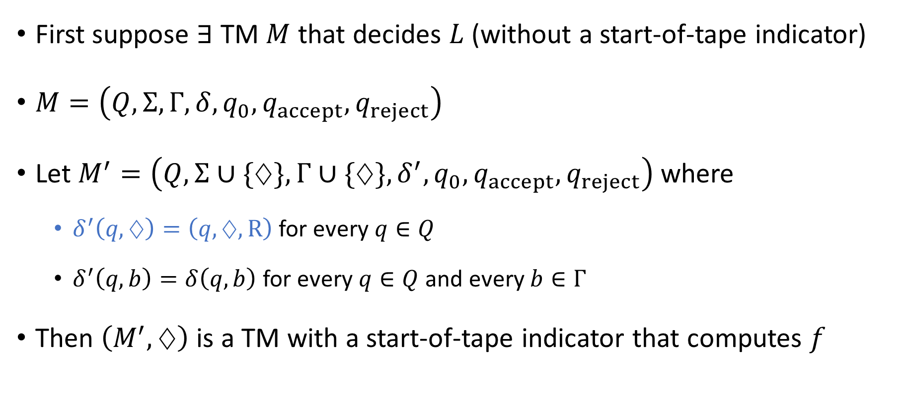
Ignoring the start-of-tape indicator
First suppose $∃$ TM $M$ that decides $L$ (without a start-of-tape indicator)
$M=\left(Q,Σ,Γ,δ,q_{0},q_{accept},q_{reject}\right)$
Let $M^{′}=\left(Q,Σ∪\{♢\},Γ∪\{♢\},δ^{′},q_{0},q_{accept},q_{reject}\right)$ where
$δ^{′}\left(q,♢\right)=\left(q,♢,\text{R}\right)$ for every $q∈Q$
$δ^{′}\left(q,b\right)=δ\left(q,b\right)$ for every $q∈Q$ and every $b∈Γ$
Then $\left(M^{′},♢\right)$ is a TM with a start-of-tape indicator that computes $f$

Slide 10
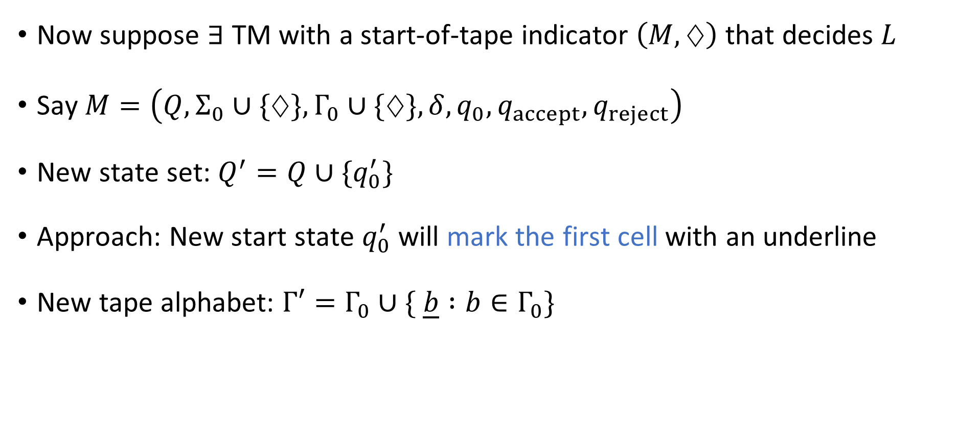
Simulating a start-of-tape indicator
Now suppose $∃$ TM with a start-of-tape indicator $\left(M,♢\right)$ that decides $L$
Say $M=\left(Q,Σ_{0}∪\{♢\},Γ_{0}∪\{♢\},δ, q_{0},q_{accept},q_{reject}\right)$
New state set: $Q^{′}=Q∪\{q_{0}^{′}\}$
Approach: New start state $q_{0}^{′}$ will mark the first cell with an underline
New tape alphabet: $Γ′=Γ_{0}∪\{ \underline{b} :b∈Γ_{0}\}$

Slide 11
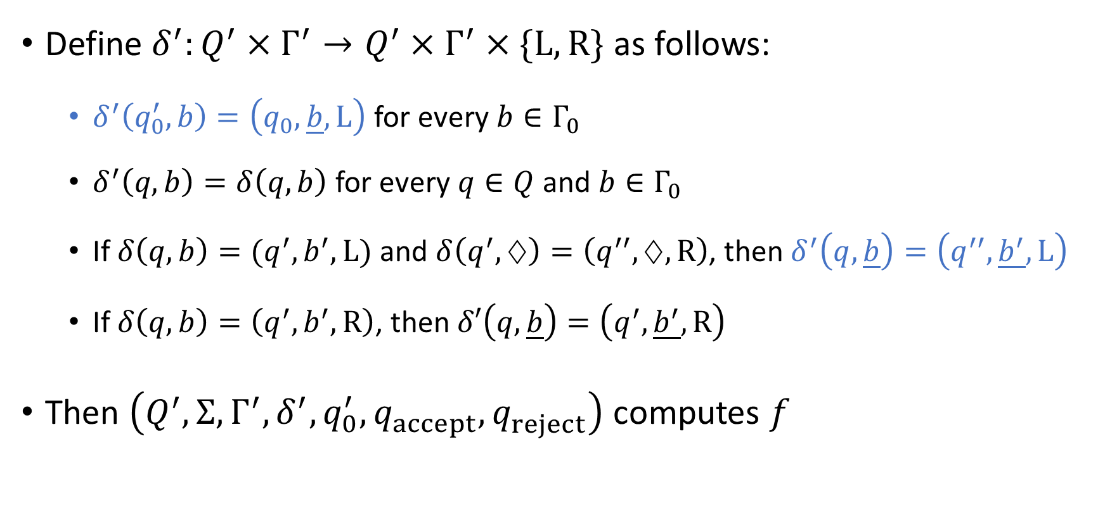
Simulating a start-of-tape indicator
Define $δ^{′}:Q^{′}×Γ^{′}→Q^{′}×Γ^{′}×\{\text{L},\text{R}\}$ as follows:
$δ^{′}\left(q_{0}^{′},b\right)=\left(q_{0},\underline{b},\text{L}\right)$ for every $b∈Γ_{0}$
$δ^{′}\left(q,b\right)=δ\left(q,b\right)$ for every $q∈Q$ and $b∈Γ_{0}$
If $δ\left(q,b\right)=(q^{′},b^{′},\text{L})$ and $δ\left(q^{′},♢\right)=\left(q^{′′},♢,\text{R}\right)$, then $δ^{′}\left(q,\underline{b}\right)=\left(q^{′′},\underline{b^{′}},\text{L}\right)$
If $δ\left(q,b\right)=\left(q^{′},b^{′},\text{R}\right)$, then $δ′\left(q,\underline{b}\right)=\left(q^{′},\underline{b^{′}},\text{R}\right)$
Then $\left(Q^{′},Σ,Γ^{′},δ^{′},q_{0}^{′},q_{accept}^{},q_{reject}^{}\right)$ computes $f$

Slide 12

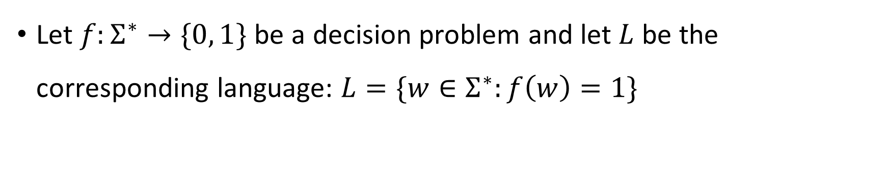
Church-Turing Thesis
Let $f:Σ^{∗}→\{0, 1\}$ be a decision problem and let $L$ be the corresponding language: $L=\{w∈Σ^{∗}:f\left(w\right)=1\}$
Church-Turing Thesis:
The problem $f$ can be “solved through computation”
if and only if
there is a Turing machine that decides the language $L$.
Intuitive notion
Mathematically precise notion

Slide 13
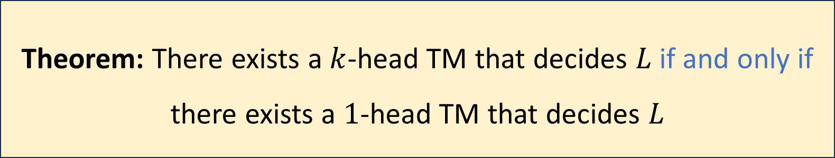
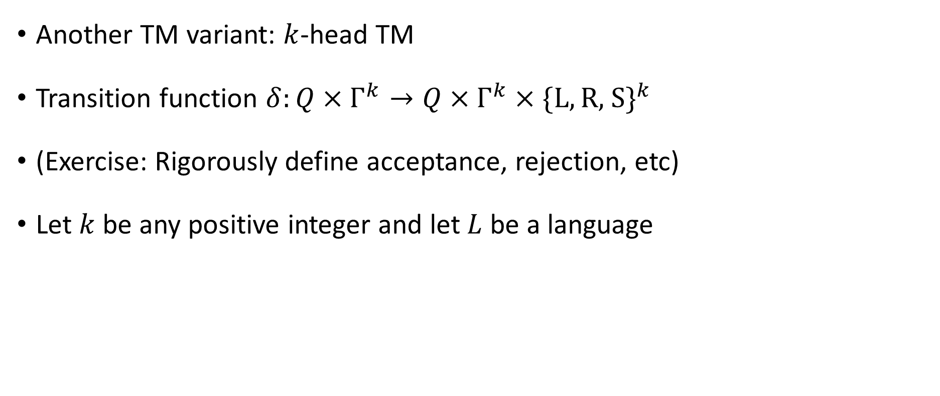
Multi-Head Turing Machine
Another TM variant: $k$-head TM
Transition function $δ:Q×Γ^{k}→Q×Γ^{k}×\{\text{L},\text{R}\text{, }\text{S}\}^{k}$
(Exercise: Rigorously define acceptance, rejection, etc)
Let $k$ be any positive integer and let $L$ be a language
Theorem: There exists a $k$-head TM that decides $L$ if and only if there exists a $1$-head TM that decides $L$

Slide 14


Simulating $k$ heads with $1$ head
New alphabet: $Γ^{′}=Γ×\{0, 1\}^{k}$
If a cell is marked $\left(b, e_{1},e_{2},…, e_{k}\right)$, the interpretation is: The simulated cell is marked $b$, and $e_{i}$ indicates whether head $i$ is at that cell

Slide 15
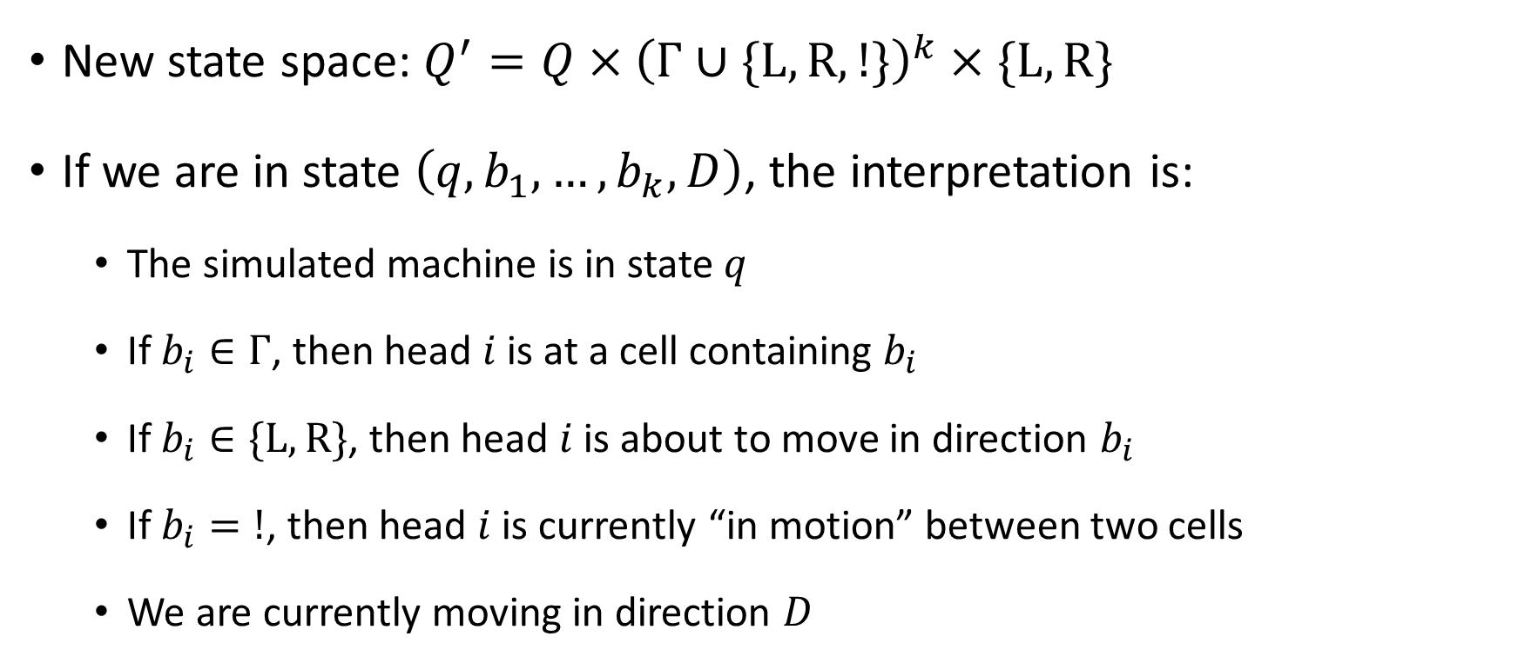
Simulating $k$ heads with $1$ head
New state space: $Q^{′}=Q×{\left(Γ∪\{\text{L},\text{R},!\}\right)}^{k}×\{\text{L}, \text{R}\}$
If we are in state $\left(q,b_{1},…, b_{k},D\right)$, the interpretation is:
The simulated machine is in state $q$
If $b_{i}∈Γ$, then head $i$ is at a cell containing $b_{i}$
If $b_{i}∈\{\text{L},\text{R}\}$, then head $i$ is about to move in direction $b_{i}$
If $b_{i}=!$, then head $i$ is currently “in motion” between two cells
We are currently moving in direction $D$

Slide 16
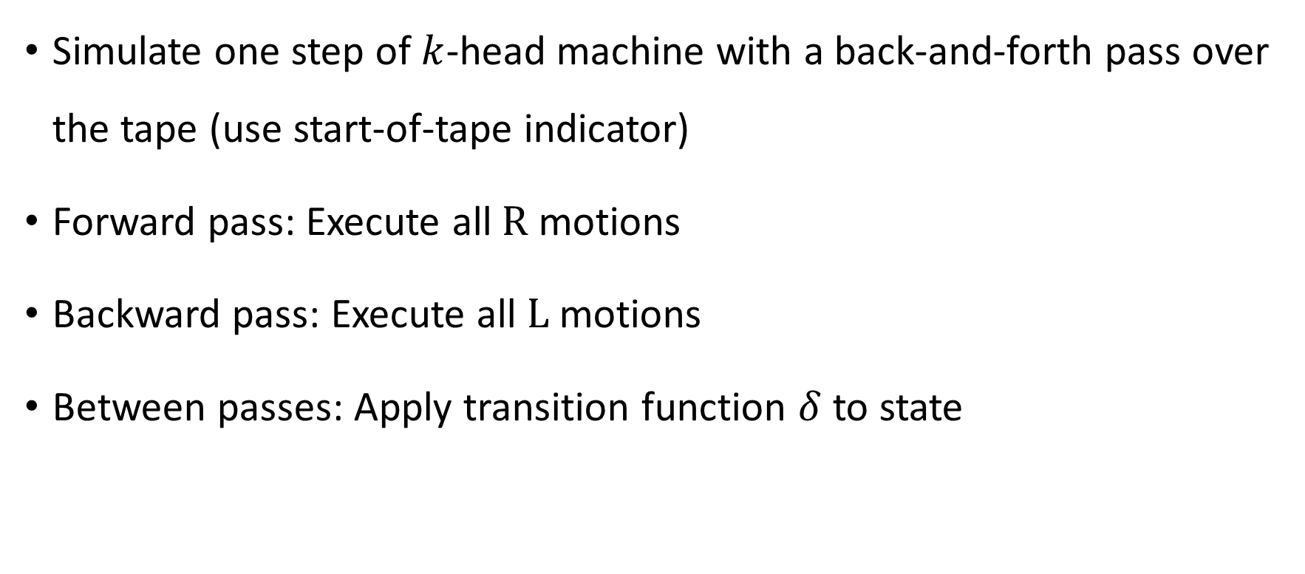
Simulating $k$ heads with $1$ head
Simulate one step of $k$-head machine with a back-and-forth pass over the tape (use start-of-tape indicator)
Forward pass: Execute all $\text{R}$ motions
Backward pass: Execute all $\text{L}$ motions
Between passes: Apply transition function $δ$ to state

