Slide 1

CMSC 28100 Introduction to Complexity Theory Spring 2025 Instructor: William Hoza

Slide 2


$\text{BPP}$ as a model of tractability
Because of the amplification lemma, languages in $\text{BPP}$ should be considered “tractable”
A mistake that occurs with probability $1/3^{100}$ can be safely ignored

Slide 3
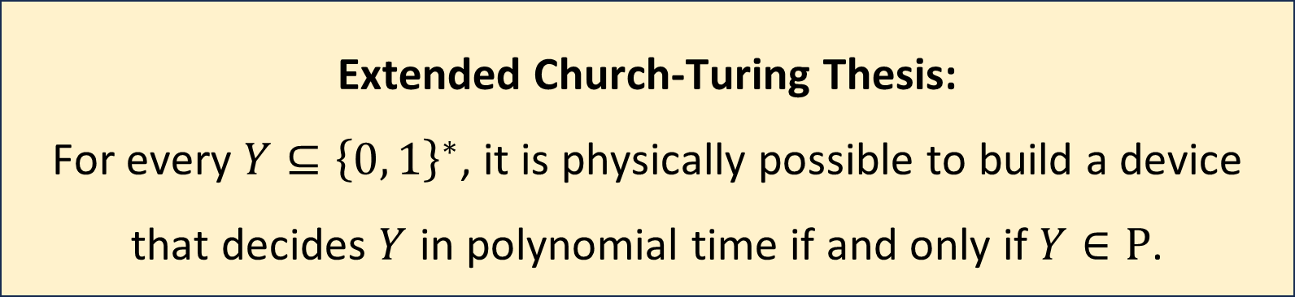
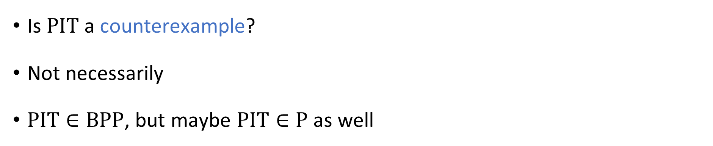
Extended Church-Turing Thesis
Extended Church-Turing Thesis:
For every $Y⊆{\left\{0, 1\right\}}^{∗}$, it is physically possible to build a device that decides $Y$ in polynomial time if and only if $Y∈\text{P}$.
Is $\text{PIT}$ a counterexample?
Not necessarily
$\text{PIT}∈\text{BPP}$, but maybe $\text{PIT}∈\text{P}$ as well

Slide 4
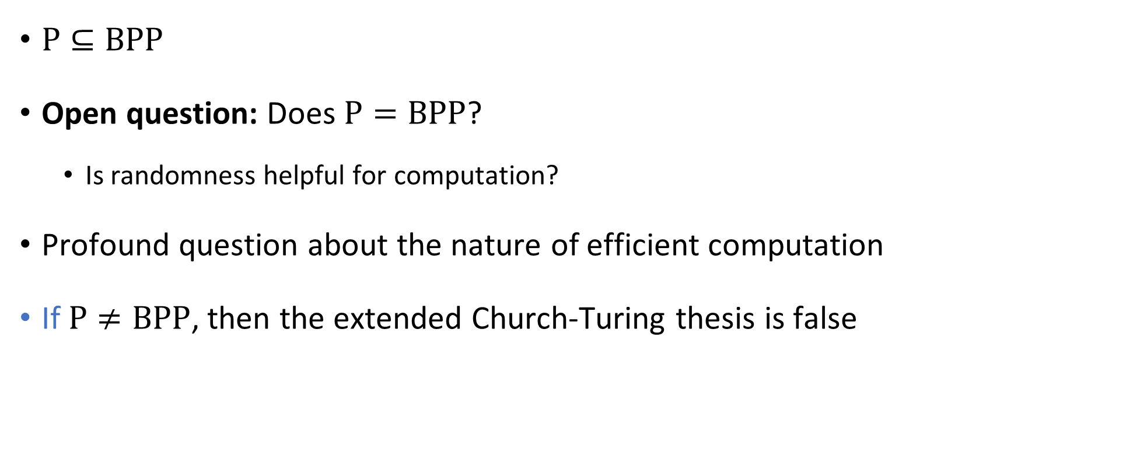
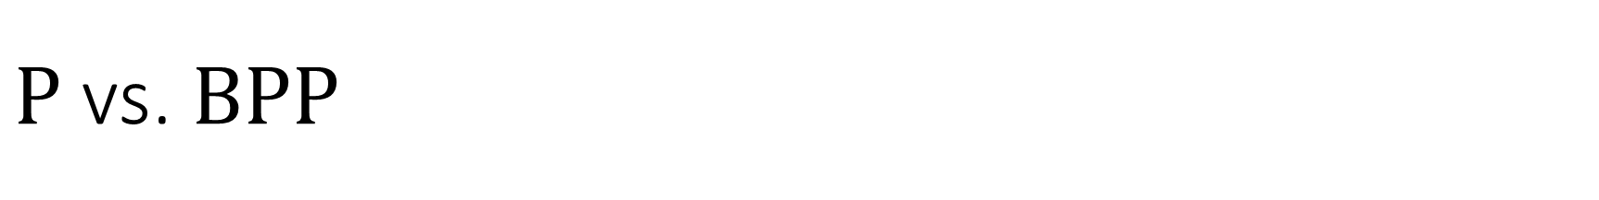


$\text{P}$ vs. $\text{BPP}$
$$\text{BPP}$$
$\text{P}⊆\text{BPP}$
Open question: Does $\text{P}=\text{BPP}$?
Is randomness helpful for computation?
Profound question about the nature of efficient computation
If $\text{P}≠\text{BPP}$, then the extended Church-Turing thesis is false
$$\text{P}$$

Slide 5


$\text{P}$ vs. $\text{BPP}$
$$\text{BPP}$$
What would it take to prove $\text{P}≠\text{BPP}$?
Define a language $Y$
Prove $Y∈\text{BPP}$
Prove $Y∉\text{P}$
Good candidate: $Y=\text{PIT}$
What would it take to prove $\text{P}=\text{BPP}$?
$$\text{P}$$

Slide 6
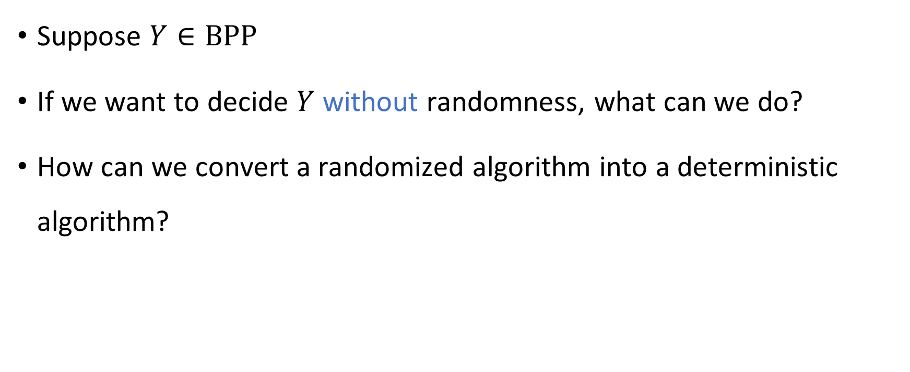
Derandomization
Suppose $Y∈\text{BPP}$
If we want to decide $Y$ without randomness, what can we do?
How can we convert a randomized algorithm into a deterministic algorithm?

Slide 7
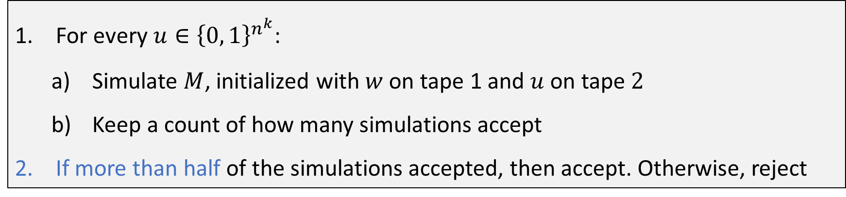

Brute-force derandomization
Let $M$ be a randomized Turing machine that decides $Y$ with error probability $1/3$ and time complexity $n^{k}$
Deterministic algorithm that decides $Y$: Given $w∈{\left\{0, 1\right\}}^{n}$:
For every $u∈{\left\{0, 1\right\}}^{n^{k}}$:
Simulate $M$, initialized with $w$ on tape 1 and $u$ on tape $2$
Keep a count of how many simulations accept
If more than half of the simulations accepted, then accept. Otherwise, reject

Slide 8


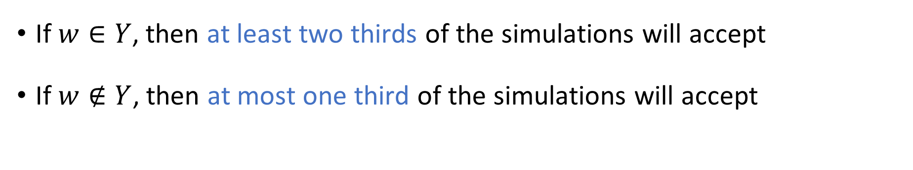



Brute-force derandomization: Correctness
For every $u∈{\left\{0, 1\right\}}^{n^{k}}$:
Simulate $M$, initialized with $w$ on tape 1 and $u$ on tape $2$
Keep a count of how many simulations accept
If more than half of the simulations accepted, then accept. Otherwise, reject
What is the time complexity of the algorithm?
If $w∈Y$, then at least two thirds of the simulations will accept
If $w∉Y$, then at most one third of the simulations will accept
A: $2^{poly\left(n\right)}$
B: $\text{poly}\left(n\right)$
C: $2^{2^{Θ\left(n\right)}}$
D: $∞$
Respond at PollEv.com/whoza or text “whoza” to 22333

Slide 9
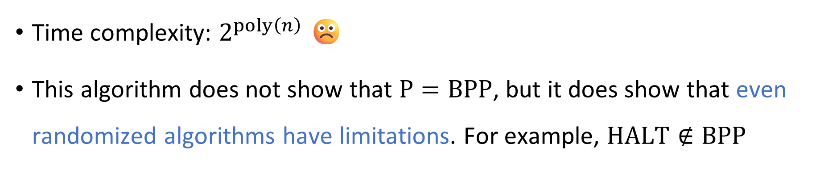
Brute-force derandomization: Time complexity
For every $u∈{\left\{0, 1\right\}}^{n^{k}}$:
Simulate $M$, initialized with $w$ on tape 1 and $u$ on tape $2$
Keep a count of how many simulations accept
If more than half of the simulations accepted, then accept. Otherwise, reject
Time complexity: $2^{poly\left(n\right)}$ ☹️
This algorithm does not show that $\text{P}=\text{BPP}$, but it does show that even randomized algorithms have limitations. For example, $\text{HALT}∉\text{BPP}$

Slide 10
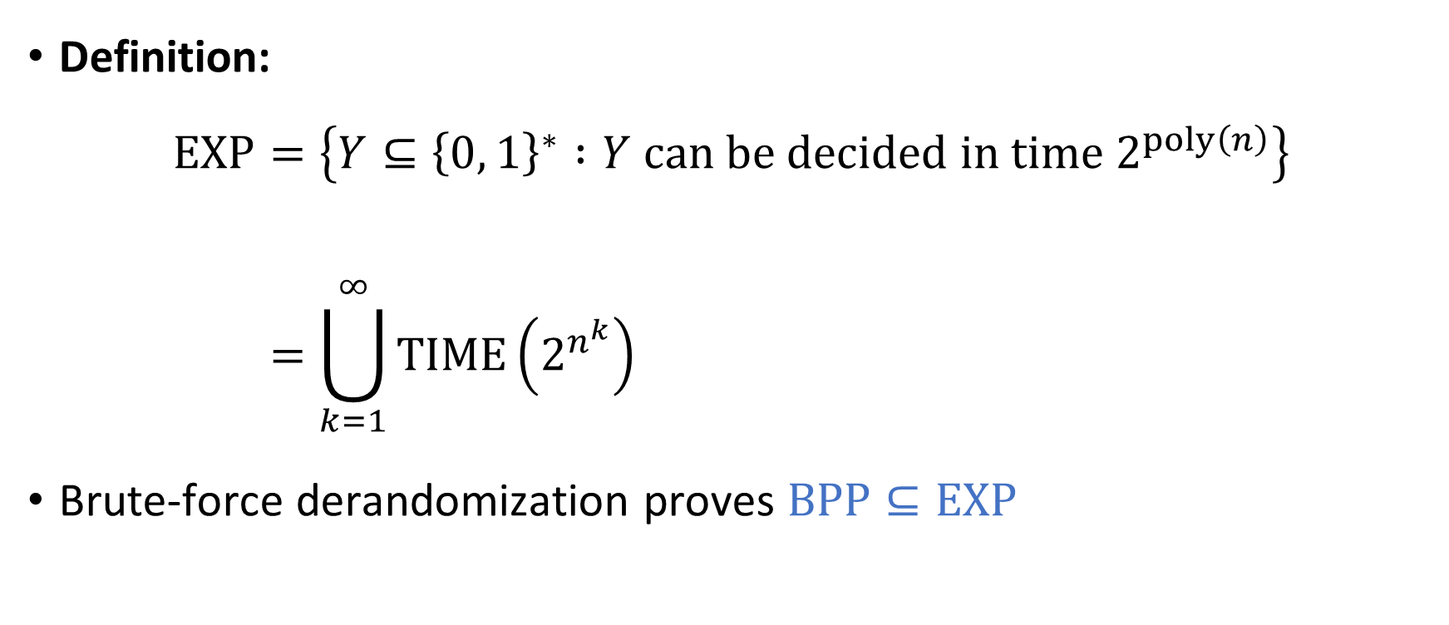

The complexity class $\text{EXP}$
Definition:
$$\text{EXP}=\left\{Y⊆{\left\{0, 1\right\}}^{∗} :Y \text{can} \text{be} \text{decided} \text{in} \text{time} 2^{poly\left(n\right)}\right\} \\ =\bigcup_{k=1}^{∞}{\text{TIME}\left(2^{n^{k}}\right)}$$
Brute-force derandomization proves $\text{BPP}⊆\text{EXP}$

Slide 11







$\text{P}⊆\text{BPP}⊆\text{EXP}$
$$\text{HALT}$$
Decidable languages
$$\text{EXP}$$
$\text{PIT}$ ?
$$\text{BPP}$$
$$\text{P}$$
$$\text{PALINDROMES}$$

Slide 12




Brute-force derandomization: Space complexity
For every $u∈{\left\{0, 1\right\}}^{n^{k}}$:
Simulate $M$, initialized with $w$ on tape 1 and $u$ on tape $2$
Keep a count of how many simulations accept
If more than half of the simulations accepted, then accept. Otherwise, reject
What is the space complexity of the algorithm?
A: $2^{Θ\left(n^{k}\right)}$
B: $\text{poly}\left(n\right)$
C: $2^{2^{Θ\left(n\right)}}$
D: $∞$
Respond at PollEv.com/whoza or text “whoza” to 22333

Slide 13


The complexity class $\text{PSPACE}$
Definition:
$$\text{PSPACE}=\left\{Y⊆{\left\{0, 1\right\}}^{∗} :Y \text{can} \text{be} \text{decided} \text{in} \text{space} \text{poly}\left(n\right)\right\}$$
Brute-force derandomization proves that $\text{BPP}⊆\text{PSPACE}$

Slide 14


$\text{PSPACE}$ vs. $\text{EXP}$
Theorem 1: $\text{BPP}⊆\text{EXP}$
Theorem 2: $\text{BPP}⊆\text{PSPACE}$
Which theorem is stronger?
How does $\text{PSPACE}$ compare to $\text{EXP}$?

Slide 15

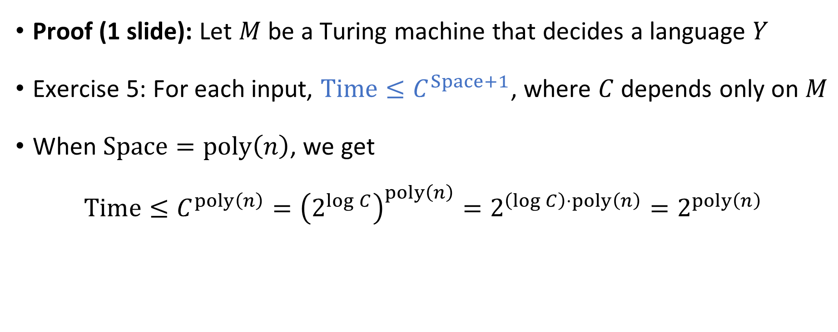
Theorem: $\text{PSPACE}⊆\text{EXP}$
Proof (1 slide): Let $M$ be a Turing machine that decides a language $Y$
Exercise 5: For each input, $\text{Time}≤C^{Space+1}$, where $C$ depends only on $M$
When $\text{Space}=\text{poly}\left(n\right)$, we get
$$\text{Time}≤C^{poly\left(n\right)}={\left(2^{\log{C}}\right)}^{poly\left(n\right)}=2^{\left(\log{C}\right)⋅poly\left(n\right)}=2^{poly\left(n\right)}$$

Slide 16




Decidable languages
$$\text{EXP}$$
$$\text{PSPACE}$$
$$\text{BPP}$$
$$\text{P}$$

Slide 17

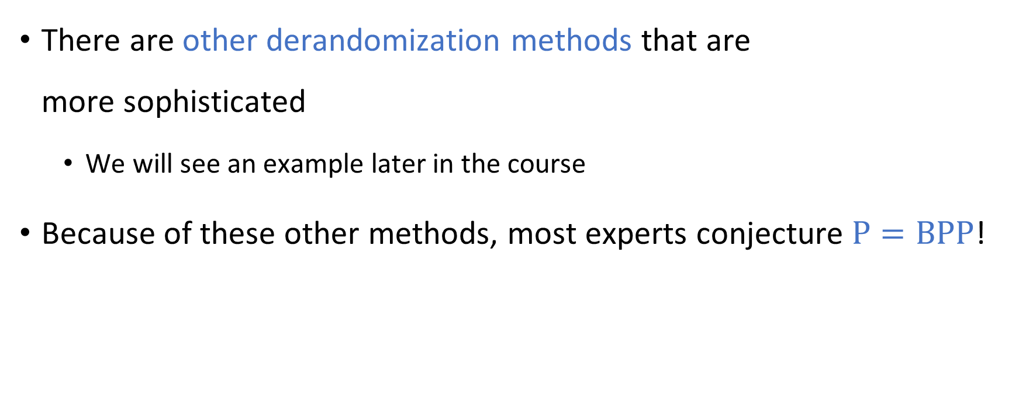


Beyond brute-force derandomization
$$\text{BPP}$$
$$\text{P}=\text{BPP}$$
There are other derandomization methods that are more sophisticated
We will see an example later in the course
Because of these other methods, most experts conjecture $\text{P}=\text{BPP}$!
$$\text{P}$$

Slide 18
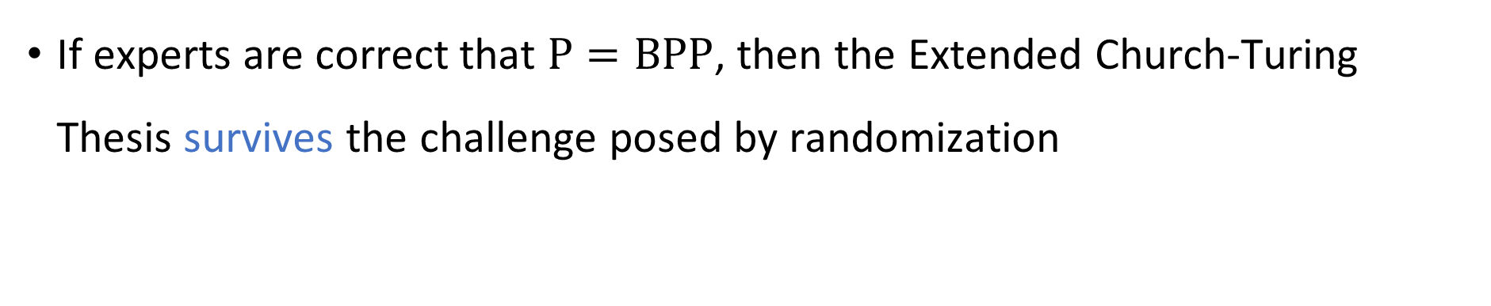

$\text{BPP}$ and the Extended Church-Turing Thesis
Extended Church-Turing Thesis:
For every $Y⊆{\left\{0, 1\right\}}^{∗}$, it is physically possible to build a device that decides $Y$ in polynomial time if and only if $Y∈\text{P}$.
If experts are correct that $\text{P}=\text{BPP}$, then the Extended Church-Turing Thesis survives the challenge posed by randomization

Slide 19
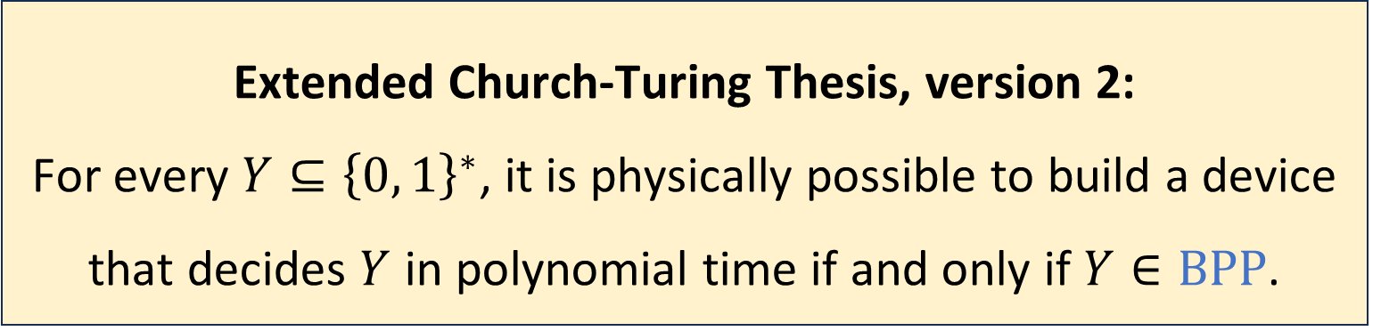

$\text{BPP}$ and the Extended Church-Turing Thesis
Just in case, the thesis is sometimes revised to allow randomization:
This version is immune to the challenge posed by randomization
However, there is a bigger threat: Quantum Computation
Extended Church-Turing Thesis, version 2:
For every $Y⊆{\left\{0, 1\right\}}^{∗}$, it is physically possible to build a device that decides $Y$ in polynomial time if and only if $Y∈\text{BP}\text{P}$.

Slide 20

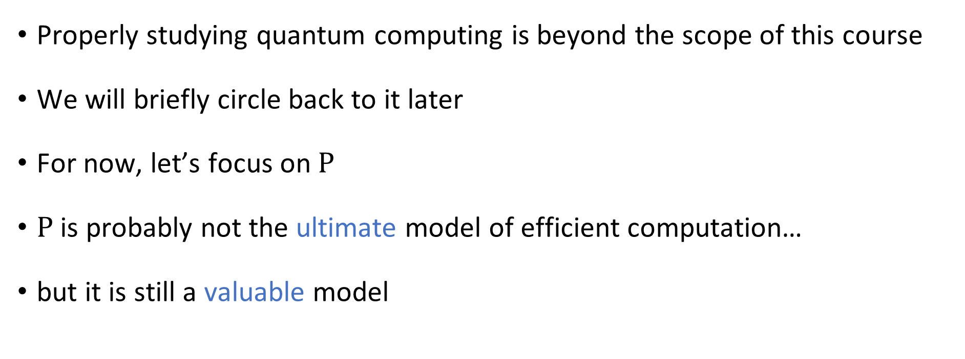
Quantum computing
Properly studying quantum computing is beyond the scope of this course
We will briefly circle back to it later
For now, let’s focus on $\text{P}$
$\text{P}$ is probably not the ultimate model of efficient computation…
but it is still a valuable model

Slide 21
Which problems can be solved through computation?
CLASSICAL

Slide 22

Which languages are in $\text{P}$?

Slide 23

Which languages are not in $\text{P}$?

Slide 24
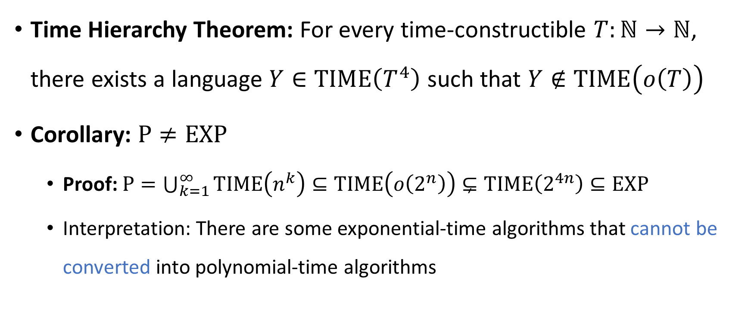

$\text{P}$ vs. $\text{EXP}$
Time Hierarchy Theorem: For every time-constructible $T:ℕ→ℕ$, there exists a language $Y∈\text{TIME}\left(T^{4}\right)$ such that $Y∉\text{TIME}\left(o\left(T\right)\right)$
Corollary: $\text{P}≠\text{EXP}$
Proof: $\text{P}=\bigcup_{k=1}^{∞}{\text{TIME}\left(n^{k}\right)}⊆\text{TIME}\left(o\left(2^{n}\right)\right)⊊\text{TIME}\left(2^{4n}\right)⊆\text{EXP}$
Interpretation: There are some exponential-time algorithms that cannot be converted into polynomial-time algorithms

Slide 25





All languages
$$\text{HALT}$$
Decidable languages
$$\{\left\langle M\right\rangle :M \text{rejects} \left\langle M\right\rangle \text{within} 2^{\left|\left\langle M\right\rangle \right|} \text{steps}\}$$
$$\text{EXP}$$
$$\text{P}$$
$$\text{PALINDROMES}$$

Slide 26


Contrived vs. natural
The language
$$\left\{\left\langle M\right\rangle :M \text{rejects} \left\langle M\right\rangle \text{within} 2^{\left|\left\langle M\right\rangle \right|} \text{steps}\right\}$$ is rather contrived
Are there languages in $\text{EXP}∖\text{P}$ that are interesting / natural / well-motivated?

Slide 27
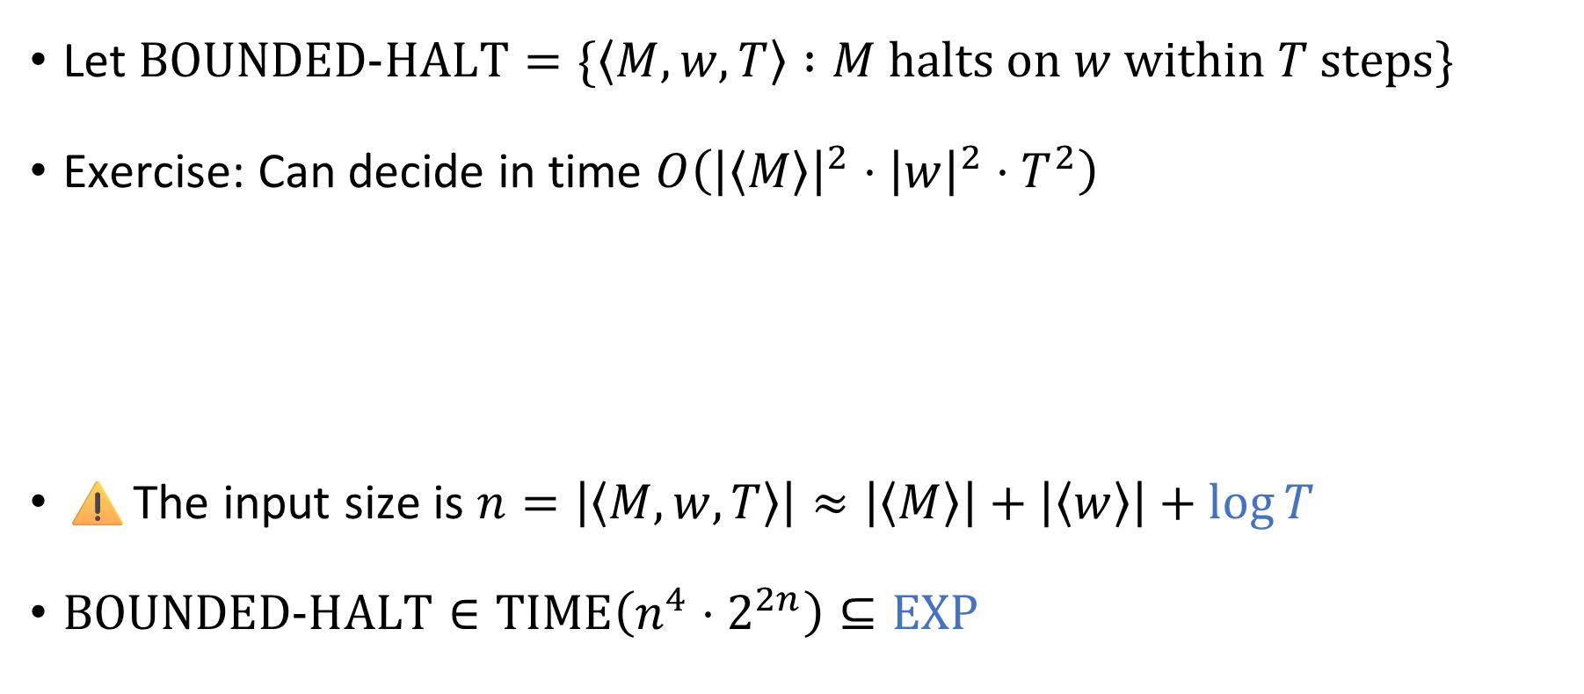
The bounded halting problem
Let $\text{BOUNDED}\text{‑}\text{HALT}=\{\left\langle M, w, T\right\rangle :M \text{halts} \text{on} w \text{within} T \text{steps}\}$
Exercise: Can decide in time $O\left({\left|\left\langle M\right\rangle \right|}^{2}⋅{\left|w\right|}^{2}⋅T^{2}\right)$
⚠️The input size is $n=\left|\left\langle M,w,T\right\rangle \right|≈\left|\left\langle M\right\rangle \right|+\left|\left\langle w\right\rangle \right|+\log{T}$
$\text{BOUNDED}\text{‑}\text{HALT}∈\text{TIME}\left(n^{4}⋅2^{2n}\right)⊆\text{EXP}$
Polynomial time? No!

Slide 28

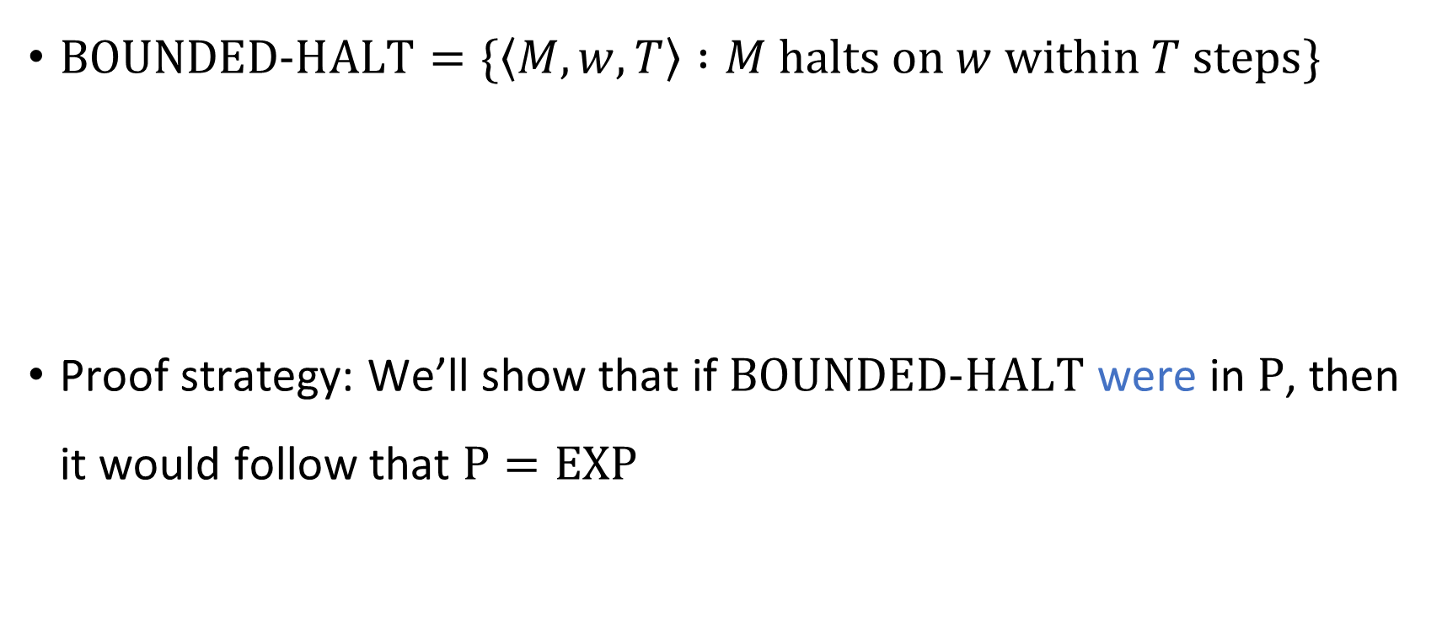
The bounded halting problem
$\text{BOUNDED}\text{‑}\text{HALT}=\{\left\langle M, w, T\right\rangle :M \text{halts} \text{on} w \text{within} T \text{steps}\}$
Proof strategy: We’ll show that if $\text{BOUNDED}\text{‑}\text{HALT}$ were in $\text{P}$, then it would follow that $\text{P}=\text{EXP}$
Theorem: $\text{BOUNDED}\text{‑}\text{HALT}∉\text{P}$

Slide 29







Proof that $\text{BOUNDED}\text{‑}\text{HALT}∉\text{P}$
Assume $B$ is a poly-time TM deciding $\text{BOUNDED}\text{‑}\text{HALT}$
Let $Y∈\text{EXP}$. There is a TM $M$ that $\left\{\begin{aligned} \text{accepts} w \text{within} 2^{{\left|w\right|}^{k}} \text{steps} \text{if} w∈Y \\ \text{loops} \text{if} w∉Y\end{aligned}\right.$
We will construct a poly-time TM $R$ that decides $Y$
Given $w∈{\left\{0, 1\right\}}^{∗}$:
Simulate $B$ on $\left\langle M, w,2^{{\left|w\right|}^{k}} \right\rangle$
If $B$ accepts, accept. If $B$ rejects, reject.
Polynomial time ✔️
If $w∈Y$, then $M$ accepts $w$ within $2^{{\left|w\right|}^{k}}$ steps, so $R$ accepts $w$ ✔️
If $w∉Y$, then $M$ loops on $w$, so $R$ rejects $w$ ✔️
$$R$$

