Slide 1
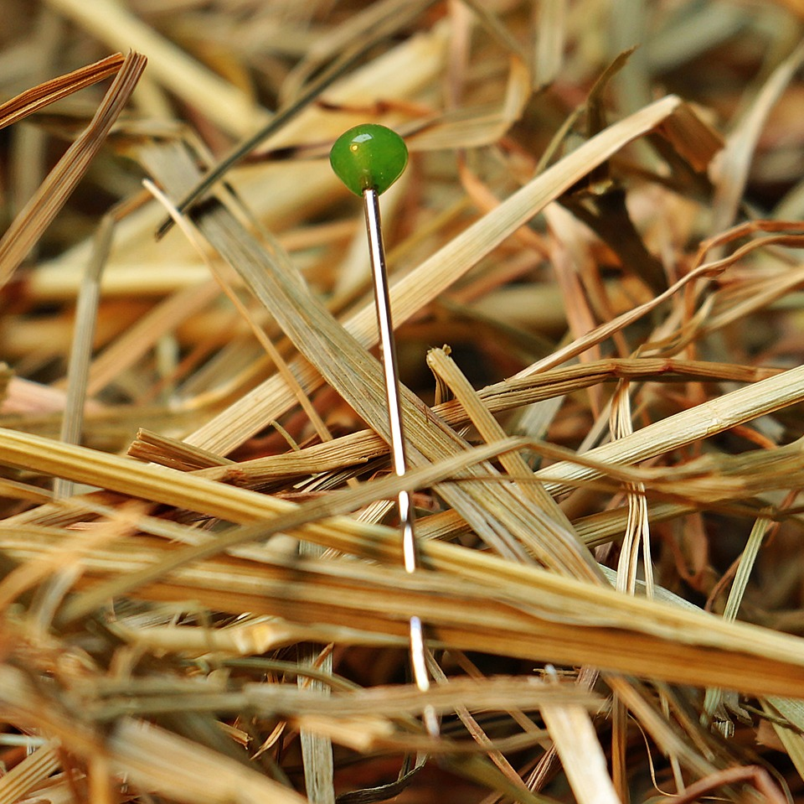
CMSC 28100 Introduction to Complexity Theory Spring 2024 Instructor: William Hoza

Slide 2
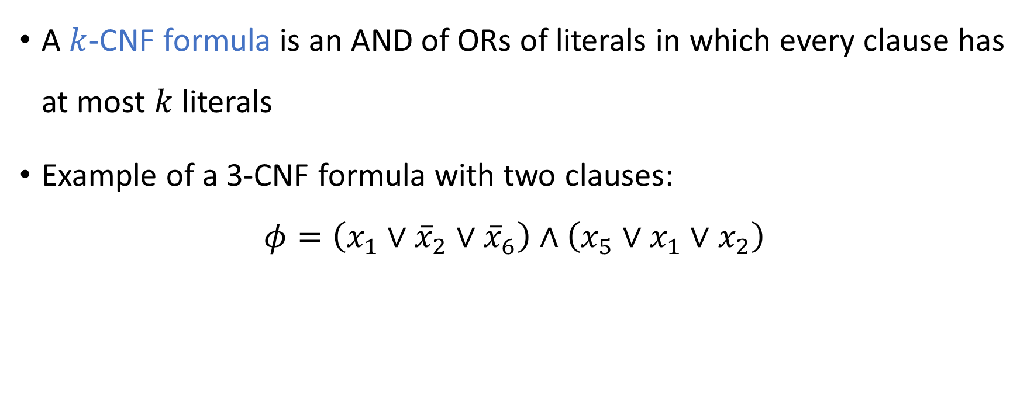
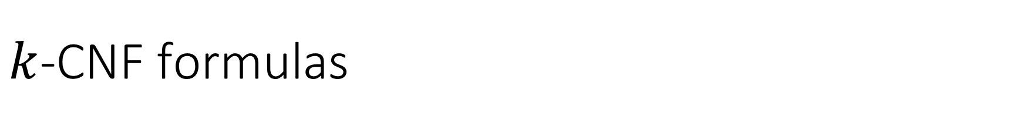
$k$-CNF formulas
A $k$-CNF formula is an AND of ORs of literals in which every clause has at most $k$ literals
Example of a 3-CNF formula with two clauses:
$$φ=\left(x_{1}∨{\overline{x}}_{2}∨{\overline{x}}_{6}\right)∧\left(x_{5}∨x_{1}∨x_{2}\right)$$

Slide 3

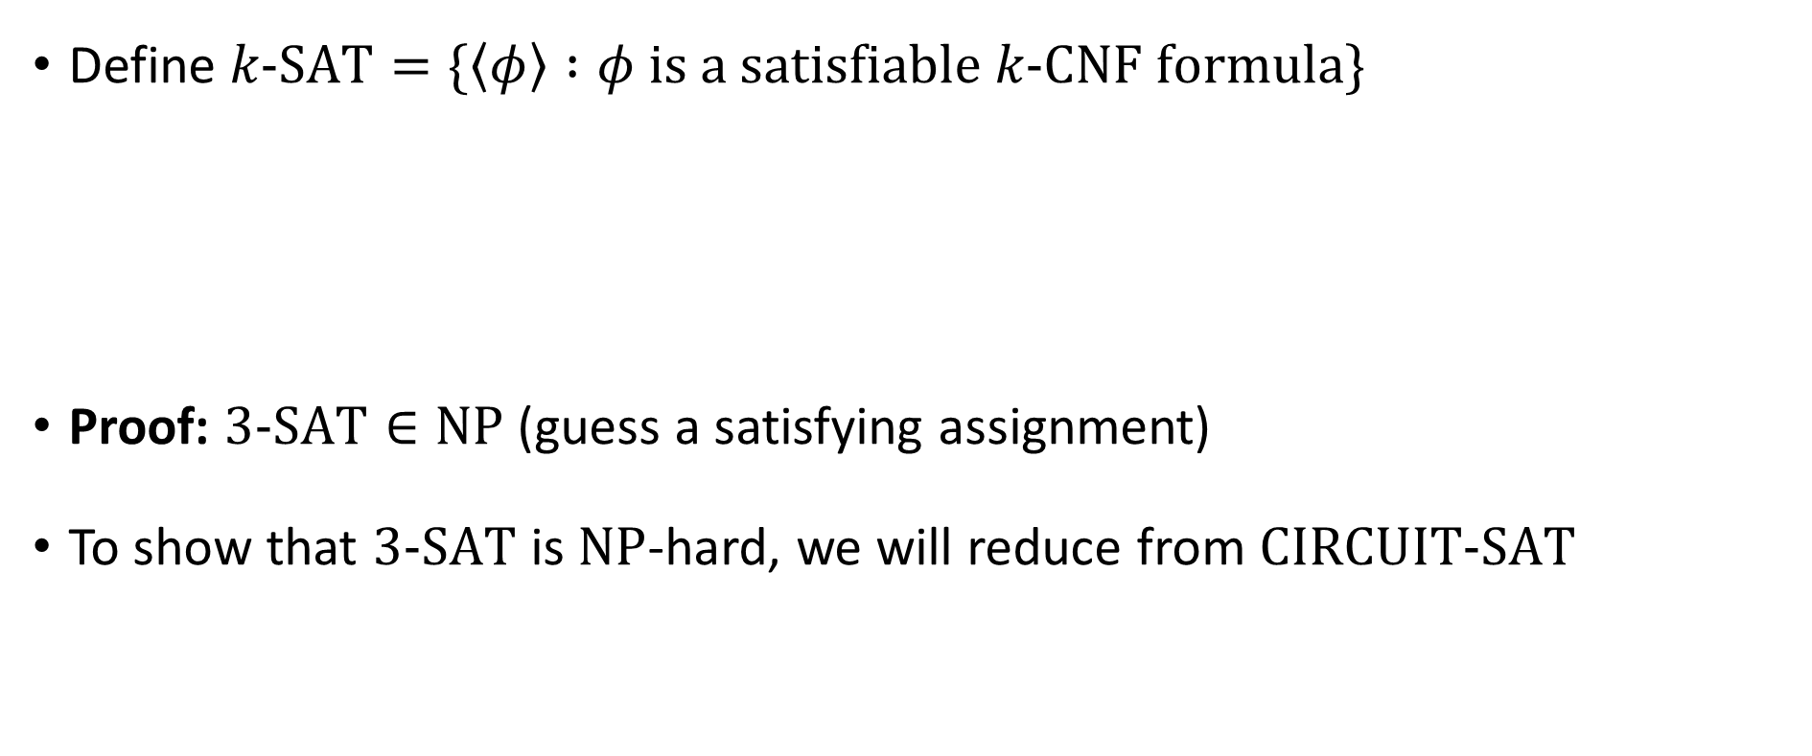
The Cook-Levin Theorem
Define $k\text{‑}\text{SAT}=\{\left\langle φ\right\rangle :φ \text{is} \text{a} \text{satisfiable} k\text{‑}\text{CNF} \text{formula}\}$
Proof: $3\text{‑}\text{SAT}∈\text{NP}$ (guess a satisfying assignment)
To show that $3\text{‑}\text{SAT}$ is $\text{NP}$-hard, we will reduce from $\text{CIRCUIT}\text{‑}\text{SAT}$
The Cook-Levin Theorem: $3\text{‑}\text{SAT}$ is $\text{NP}$-complete

Slide 4
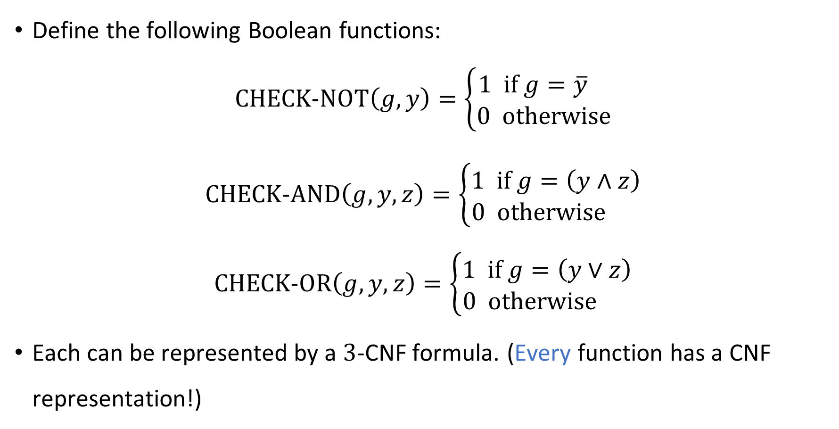
Gate gadgets
Define the following Boolean functions:
$$\text{CHECK}\text{‑}\text{NOT}\left(g, y\right)=\left\{\begin{aligned}1 \text{if} g=\overline{y} \\ 0 \text{otherwise}\end{aligned}\right.$$
$$\text{CHECK}\text{‑}\text{AND}\left(g, y,z\right)=\left\{\begin{aligned}1 \text{if} g=\left(y∧z\right) \\ 0 \text{otherwise} \end{aligned}\right.$$
$$\text{CHECK}\text{‑}\text{OR}\left(g, y,z\right)=\left\{\begin{aligned}1 \text{if} g=\left(y∨z\right) \\ 0 \text{otherwise} \end{aligned}\right.$$
Each can be represented by a $3$-CNF formula. (Every function has a CNF representation!)

Slide 5
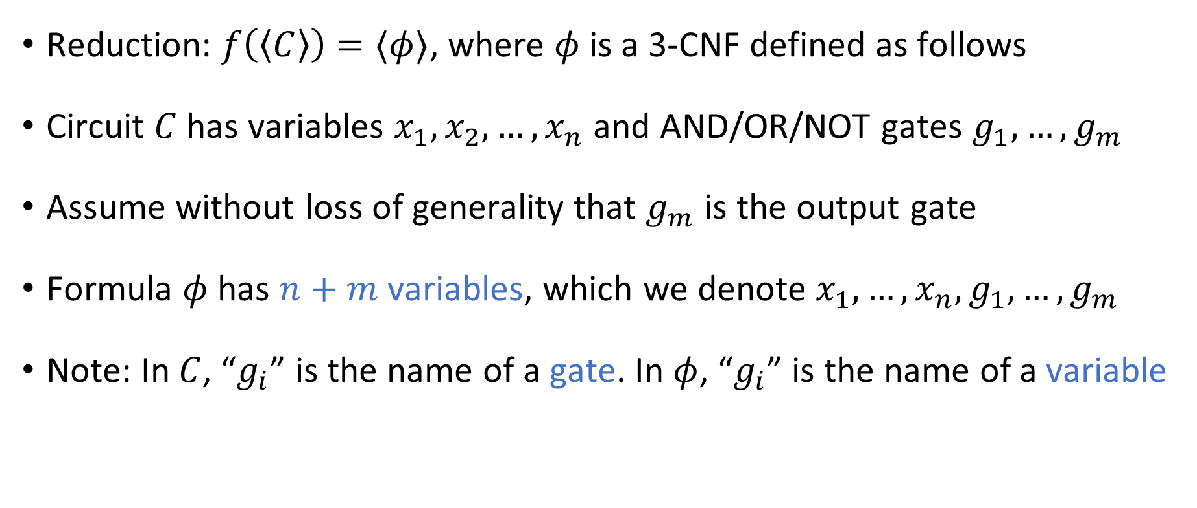

Reduction from $\text{CIRCUIT}\text{‑}\text{SAT}$ to $\text{3‑}\text{SAT}$
Reduction: $f\left(\left\langle C\right\rangle \right)=⟨φ⟩$, where $φ$ is a 3-CNF defined as follows
Circuit $C$ has variables $x_{1},x_{2},…, x_{n}$ and AND/OR/NOT gates $g_{1},…, g_{m}$
Assume without loss of generality that $g_{m}$ is the output gate
Formula $φ$ has $n+m$ variables, which we denote $x_{1},…, x_{n}, g_{1},…, g_{m}$
Note: In $C$, “$g_{i}$” is the name of a gate. In $φ$, “$g_{i}$” is the name of a variable

Slide 6
















Reduction from $\text{CIRCUIT}\text{‑}\text{SAT}$ to $\text{3‑}\text{SAT}$
For each AND/OR/NOT gate $g_{i}$ in the circuit $C$, define a 3-CNF $φ_{i}$:
Reduction produces $φ:=φ_{1}∧φ_{2}∧…∧φ_{m}∧\left(g_{m}\right)$
$$g_{i}$$
$$¬$$
$$g_{i}$$
$$∧$$
$$g_{i}$$
$$∨$$
$$y$$
$$y$$
$$z$$
$$y$$
$$z$$
$$φ_{i}=\text{CHECK}\text{‑}\text{NOT}\left(g_{i}, y\right)$$
$$φ_{i}=\text{CHECK}\text{‑}\text{AND}\left(g_{i}, y, z\right)$$
$$φ_{i}=\text{CHECK}\text{‑}\text{OR}\left(g_{i}, y, z\right)$$

Slide 7





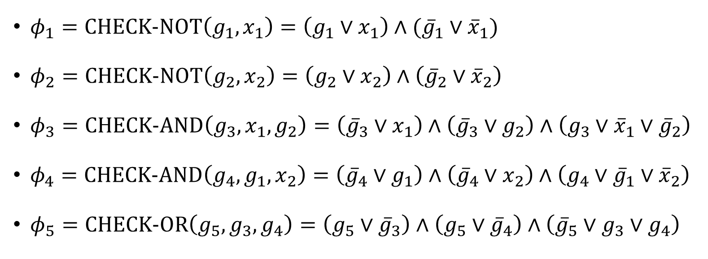



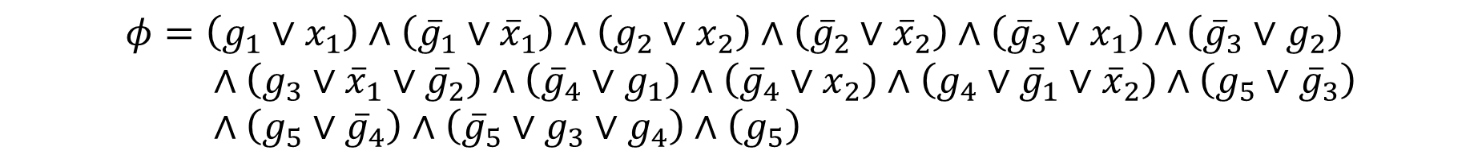




Reduction example
$$g_{5}$$
$φ_{1}=\text{CHECK}\text{‑}\text{NOT}\left(g_{1},x_{1}\right)=\left(g_{1}∨x_{1}\right)∧({\overline{g}}_{1}∨{\overline{x}}_{1})$
$φ_{2}=\text{CHECK}\text{‑}\text{NOT}\left(g_{2},x_{2}\right)=\left(g_{2}∨x_{2}\right)∧\left({\overline{g}}_{2}∨{\overline{x}}_{2}\right)$
$φ_{3}=\text{CHECK}\text{‑}\text{AND}\left(g_{3},x_{1},g_{2}\right)=\left({\overline{g}}_{3}∨x_{1}\right)∧\left({\overline{g}}_{3}∨g_{2}\right)∧\left(g_{3}∨{\overline{x}}_{1}∨{\overline{g}}_{2}\right)$
$φ_{4}=\text{CHECK}\text{‑}\text{AND}\left(g_{4},g_{1},x_{2}\right)=\left({\overline{g}}_{4}∨g_{1}\right)∧\left({\overline{g}}_{4}∨x_{2}\right)∧\left(g_{4}∨{\overline{g}}_{1}∨{\overline{x}}_{2}\right)$
$φ_{5}=\text{CHECK}\text{‑}\text{OR}\left(g_{5},g_{3},g_{4}\right)=\left(g_{5}∨{\overline{g}}_{3}\right)∧\left(g_{5}∨{\overline{g}}_{4}\right)∧\left({\overline{g}}_{5}∨g_{3}∨g_{4}\right)$
$$∨$$
$$g_{3}$$
$$g_{4}$$
$$∧$$
$$∧$$
$$g_{1}$$
$$g_{2}$$
$$¬$$
$$¬$$
$$x_{1}$$
$$x_{2}$$
$$φ=\left(g_{1}∨x_{1}\right)∧\left({\overline{g}}_{1}∨{\overline{x}}_{1}\right)∧\left(g_{2}∨x_{2}\right)∧\left({\overline{g}}_{2}∨{\overline{x}}_{2}\right)∧\left({\overline{g}}_{3}∨x_{1}\right)∧\left({\overline{g}}_{3}∨g_{2}\right) \\ ∧\left(g_{3}∨{\overline{x}}_{1}∨{\overline{g}}_{2}\right)∧\left({\overline{g}}_{4}∨g_{1}\right)∧\left({\overline{g}}_{4}∨x_{2}\right)∧\left(g_{4}∨{\overline{g}}_{1}∨{\overline{x}}_{2}\right)∧\left(g_{5}∨{\overline{g}}_{3}\right) \\ ∧\left(g_{5}∨{\overline{g}}_{4}\right)∧\left({\overline{g}}_{5}∨g_{3}∨g_{4}\right)∧\left(g_{5}\right)$$

Slide 8
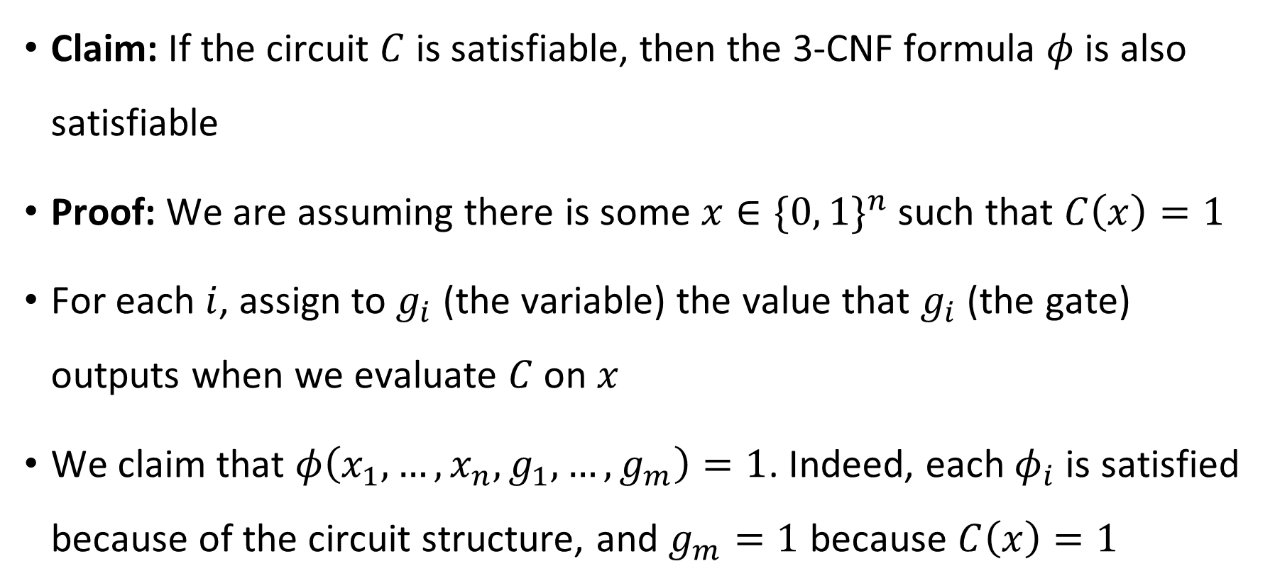
YES maps to YES
Claim: If the circuit $C$ is satisfiable, then the 3-CNF formula $φ$ is also satisfiable
Proof: We are assuming there is some $x∈\{0, 1\}^{n}$ such that $C\left(x\right)=1$
For each $i$, assign to $g_{i}$ (the variable) the value that $g_{i}$ (the gate) outputs when we evaluate $C$ on $x$
We claim that $φ\left(x_{1},…, x_{n}, g_{1}, …, g_{m}\right)=1$. Indeed, each $φ_{i}$ is satisfied because of the circuit structure, and $g_{m}=1$ because $C\left(x\right)=1$

Slide 9
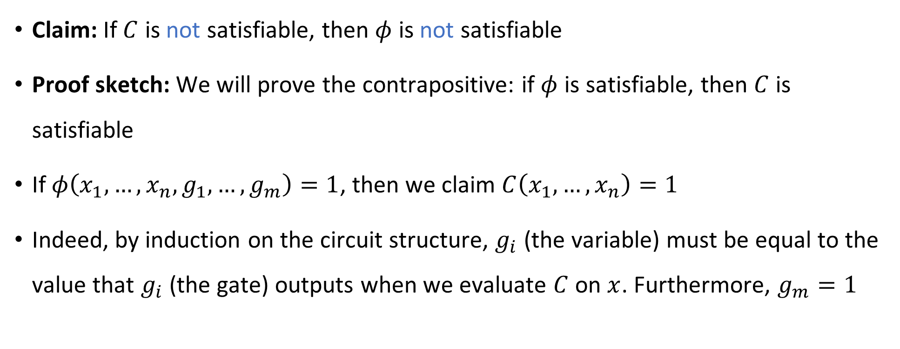
NO maps to NO
Claim: If $C$ is not satisfiable, then $φ$ is not satisfiable
Proof sketch: We will prove the contrapositive: if $φ$ is satisfiable, then $C$ is satisfiable
If $φ\left(x_{1},…, x_{n}, g_{1},…, g_{m}\right)=1$, then we claim $C\left(x_{1},…, x_{n}\right)=1$
Indeed, by induction on the circuit structure, $g_{i}$ (the variable) must be equal to the value that $g_{i}$ (the gate) outputs when we evaluate $C$ on $x$. Furthermore, $g_{m}=1$

Slide 10
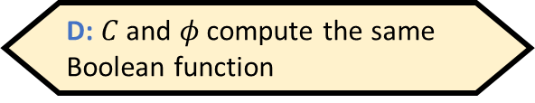


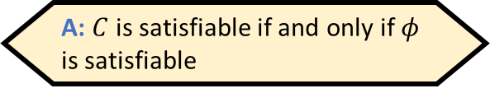
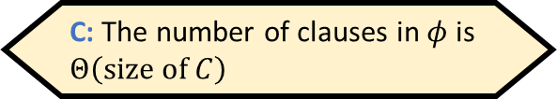
Reduction efficiency
Reduction is computable in polynomial time
For each gate in the circuit, we write down $O\left(1\right)$ clauses, and it is straightforward to compute what they are
Let $\left\langle φ\right\rangle =f\left(\left\langle C\right\rangle \right)$. Which of the following is false?
A: $C$ is satisfiable if and only if $φ$ is satisfiable
B: $\left|\left\langle φ\right\rangle \right|≤\text{poly}\left(\left|\left\langle C\right\rangle \right|\right)$
C: The number of clauses in $φ$ is $Θ\left(\text{size} \text{of} C\right)$
D: $C$ and $φ$ compute the same Boolean function
Respond at PollEv.com/whoza or text “whoza” to 22333

Slide 11






$\text{NP}$-hard
$$\text{CIRCUIT}\text{‑}\text{SAT}$$
$$\text{3‑}\text{SAT}$$
$\text{NP}$-complete
$$\text{NP}$$
$$\text{P}$$

Slide 12


Chaining reductions together
$\text{3‑}\text{SAT}$ is the starting point for many $\text{NP}$-hardness proofs
We are finally ready to use the hardness of $\text{3‑}\text{SAT}$ to prove that $\text{CLIQUE}$ is $\text{NP}$-complete

Slide 13
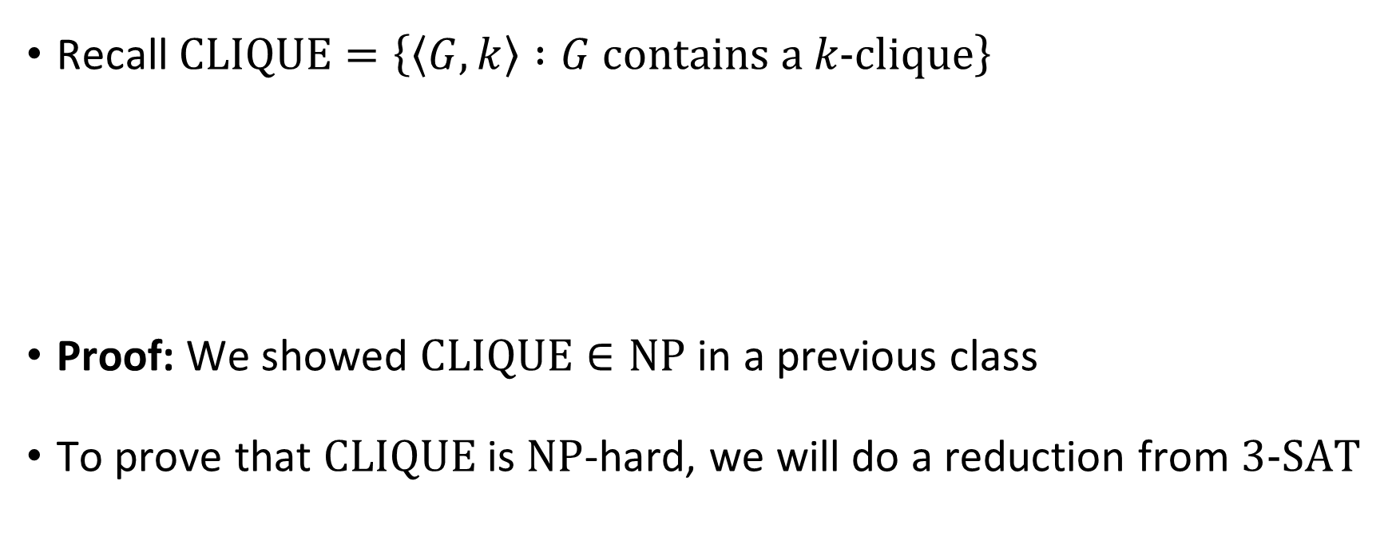


$\text{CLIQUE}$ is $\text{NP}$-complete
Recall $\text{CLIQUE}=\left\{\left\langle G,k\right\rangle :G \text{contains} \text{a} k‑\text{clique}\right\}$
Proof: We showed $\text{CLIQUE}∈\text{NP}$ in a previous class
To prove that $\text{CLIQUE}$ is $\text{NP}$-hard, we will do a reduction from $\text{3‑}\text{SAT}$
Theorem: $\text{CLIQUE}$ is $\text{NP}$-complete

Slide 14


Reduction from $\text{3‑}\text{SAT}$ to $\text{CLIQUE}$
Let $φ$ be a $3$-CNF formula (an instance of $\text{3‑}\text{SAT}$)
Reduction: $f\left(⟨φ⟩\right)=⟨G,k⟩$
$k$ is the number of clauses in $φ$
$G$ is a graph on $≤3k$ vertices defined as follows

Slide 15






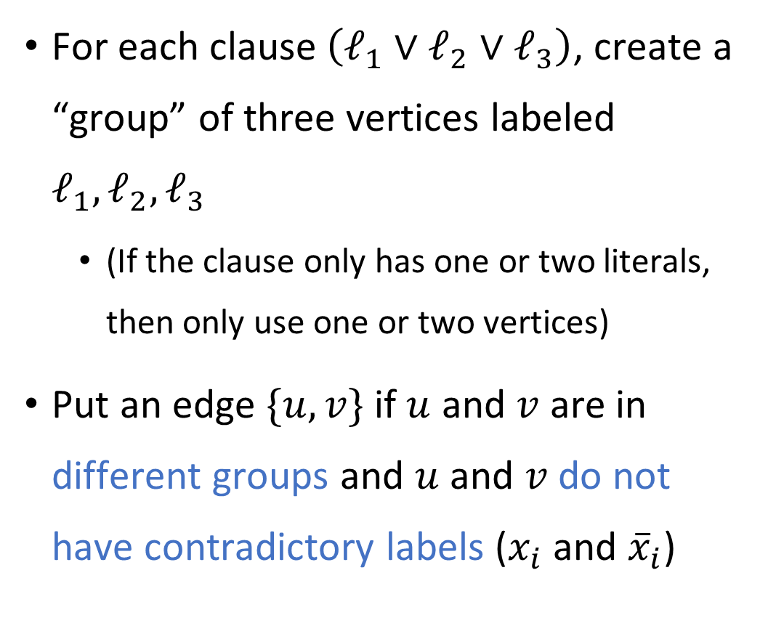








Reduction from $\text{3‑}\text{SAT}$ to $\text{CLIQUE}$
For each clause $\left(ℓ_{1}∨ℓ_{2}∨ℓ_{3}\right)$, create a “group” of three vertices labeled $ℓ_{1},ℓ_{2},ℓ_{3}$
(If the clause only has one or two literals, then only use one or two vertices)
Put an edge $\{u, v\}$ if $u$ and $v$ are in different groups and $u$ and $v$ do not have contradictory labels ($x_{i}$ and ${\overline{x}}_{i}$)
E.g., $φ=\left(x_{1}∨x_{2}∨{\overline{x}}_{5}\right)∧\left({\overline{x}}_{1}∨x_{4}∨x_{6}\right)$ $∧\left(x_{2}∨x_{4}∨{\overline{x}}_{3}\right)∧\left(x_{3}∨{\overline{x}}_{6}∨x_{1}\right)$
$$x_{1}$$
$$x_{2}$$
$${\overline{x}}_{5}$$
$${\overline{x}}_{1}$$
$$x_{2}$$
$$x_{4}$$
$$x_{4}$$
$$x_{6}$$
$${\overline{x}}_{3}$$
$$x_{3}$$
$${\overline{x}}_{6}$$
$$x_{1}$$

Slide 16
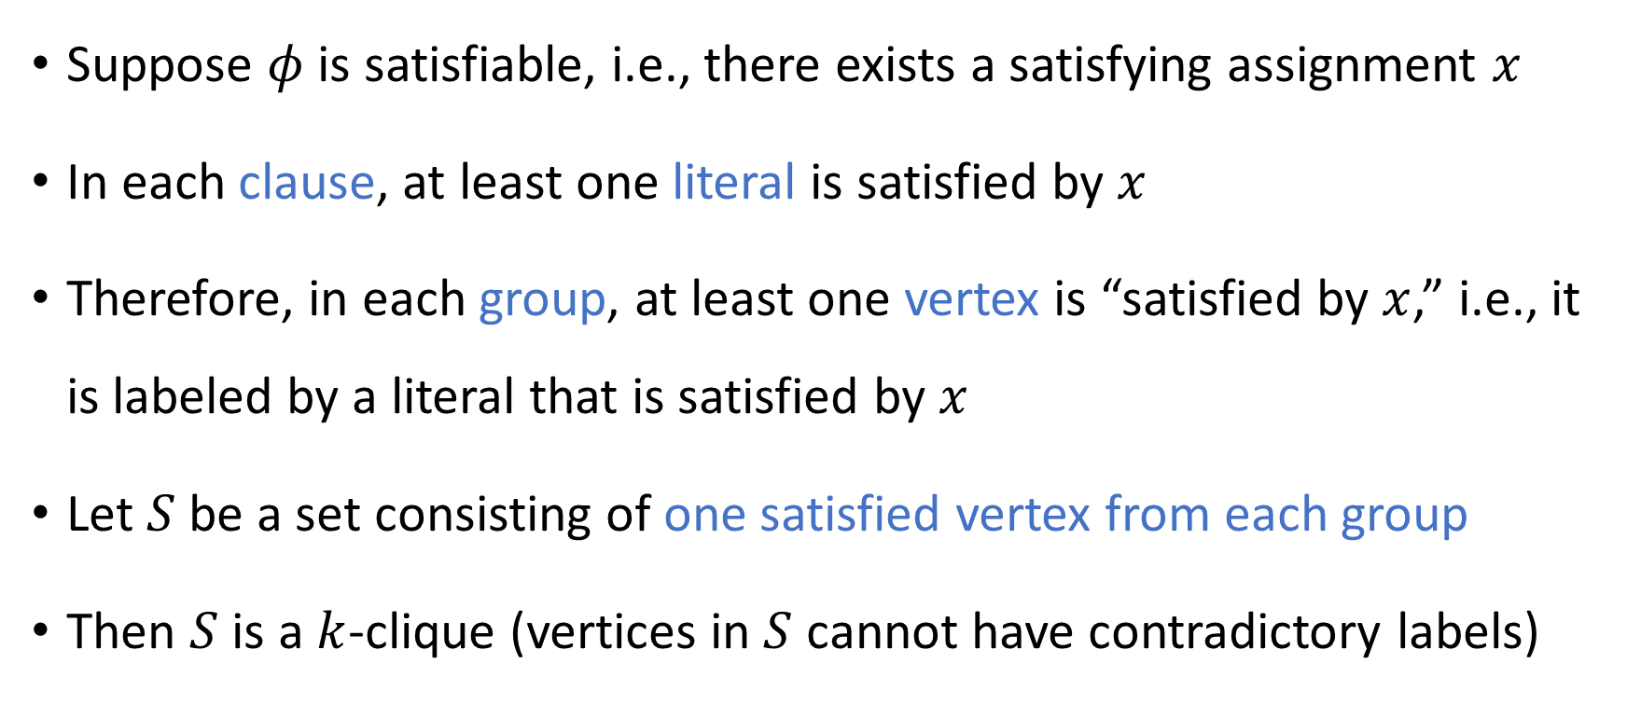
YES maps to YES
Suppose $φ$ is satisfiable, i.e., there exists a satisfying assignment $x$
In each clause, at least one literal is satisfied by $x$
Therefore, in each group, at least one vertex is “satisfied by $x$,” i.e., it is labeled by a literal that is satisfied by $x$
Let $S$ be a set consisting of one satisfied vertex from each group
Then $S$ is a $k$-clique (vertices in $S$ cannot have contradictory labels)

Slide 17
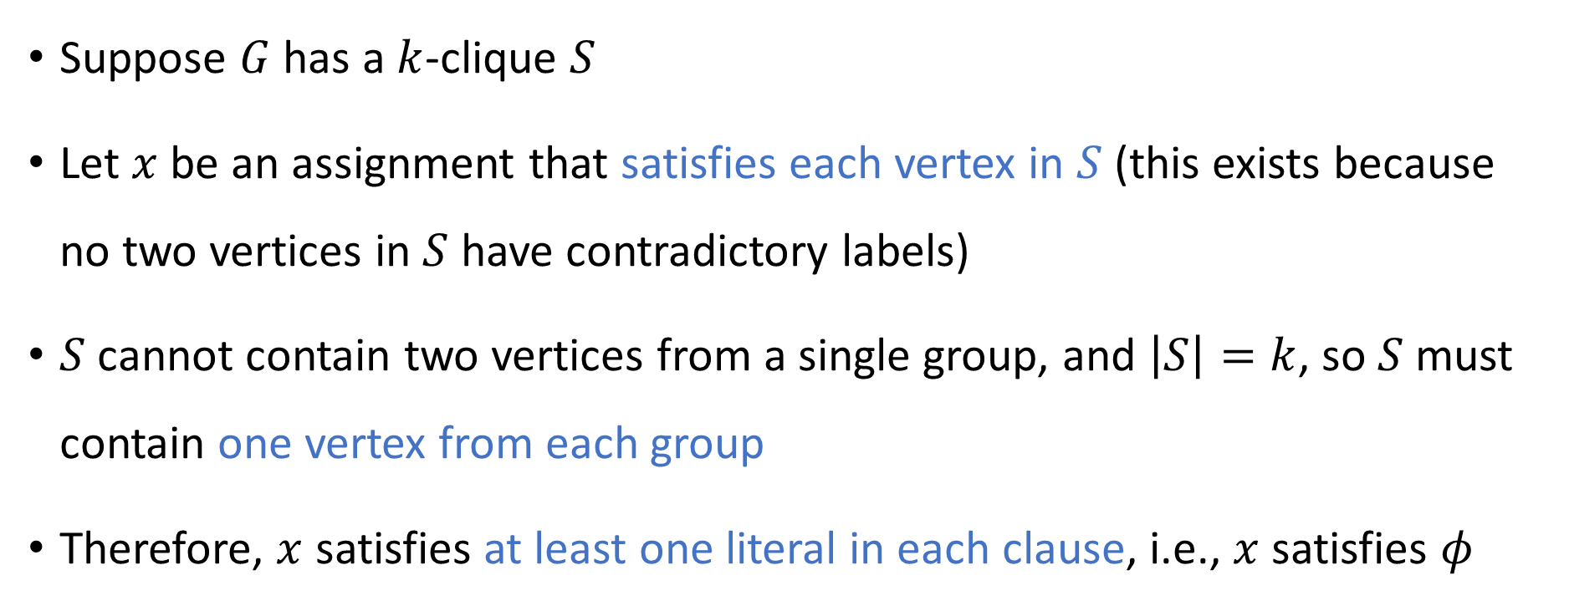
NO maps to NO
Suppose $G$ has a $k$-clique $S$
Let $x$ be an assignment that satisfies each vertex in $S$ (this exists because no two vertices in $S$ have contradictory labels)
$S$ cannot contain two vertices from a single group, and $\left|S\right|=k$, so $S$ must contain one vertex from each group
Therefore, $x$ satisfies at least one literal in each clause, i.e., $x$ satisfies $φ$

Slide 18

Poly-time computable
Hopefully it is clear that the reduction $f\left(\left\langle φ\right\rangle \right)=⟨G,k⟩$ can be computed in polynomial time

Slide 19







$\text{NP}$-hard
$$\text{CIRCUIT}\text{‑}\text{SAT}$$
$$\text{CLIQUE}$$
$\text{NP}$-complete
$$\text{3‑}\text{SAT}$$
$$\text{NP}$$
$$\text{P}$$

Slide 20
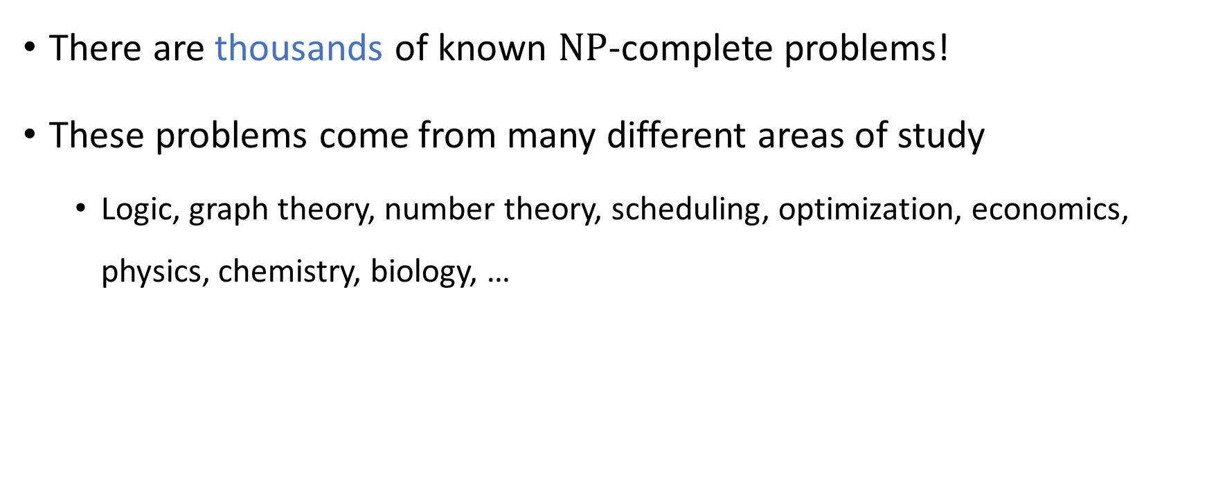
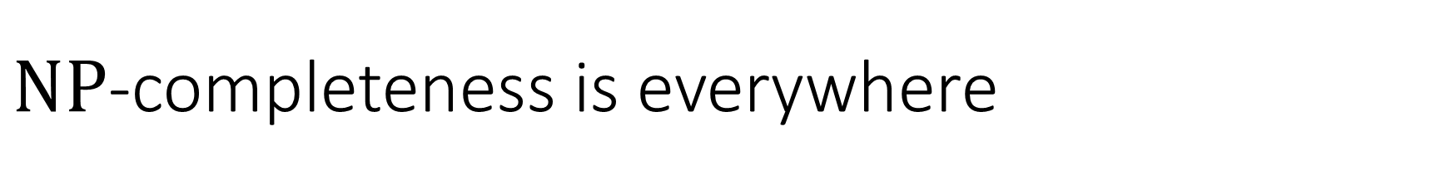
$\text{NP}$-completeness is everywhere
There are thousands of known $\text{NP}$-complete problems!
These problems come from many different areas of study
Logic, graph theory, number theory, scheduling, optimization, economics, physics, chemistry, biology, …

Slide 21
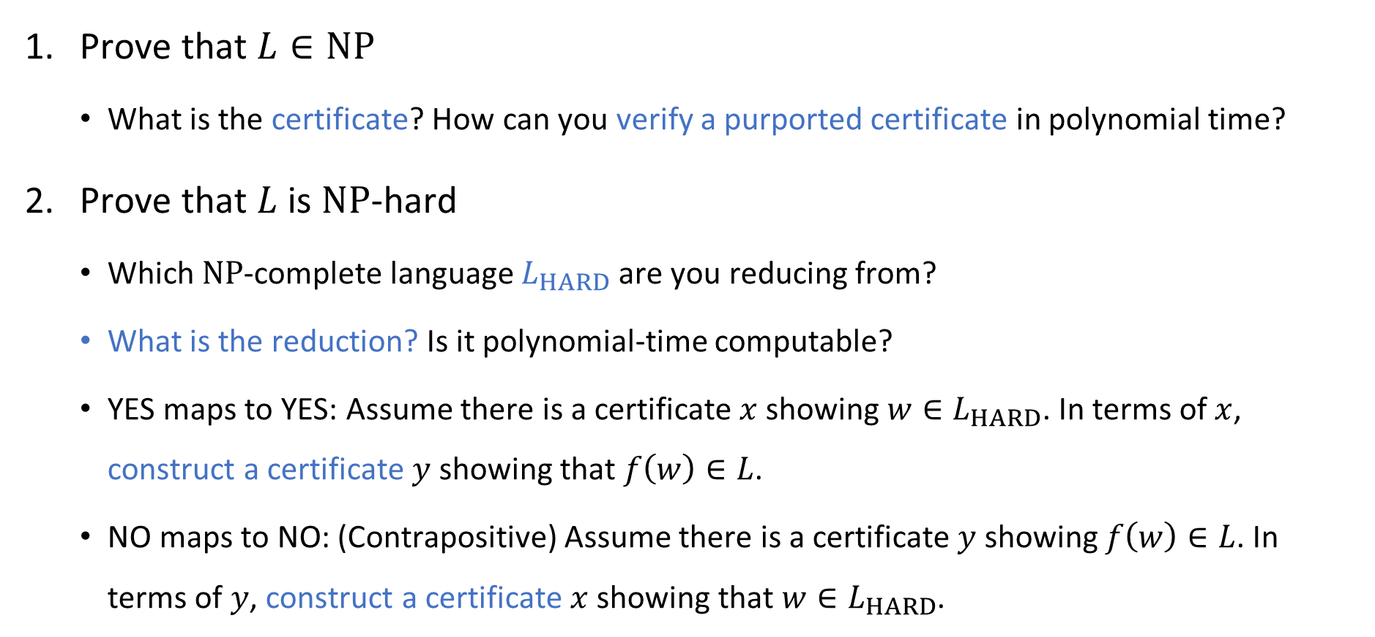

Proving that $L$ is $\text{NP}$-complete (“cheat sheet”)
Prove that $L∈\text{NP}$
What is the certificate? How can you verify a purported certificate in polynomial time?
Prove that $L$ is $\text{NP}$-hard
Which $\text{NP}$-complete language $L_{HARD}$ are you reducing from?
What is the reduction? Is it polynomial-time computable?
YES maps to YES: Assume there is a certificate $x$ showing $w∈L_{HARD}$. In terms of $x$, construct a certificate $y$ showing that $f\left(w\right)∈L$.
NO maps to NO: (Contrapositive) Assume there is a certificate $y$ showing $f\left(w\right)∈L$. In terms of $y$, construct a certificate $x$ showing that $w∈L_{HARD}$.

Slide 22
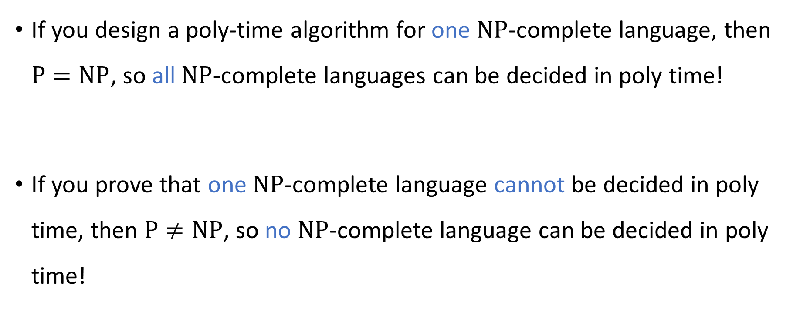

$\text{NP}$-complete languages stand or fall together
If you design a poly-time algorithm for one $\text{NP}$-complete language, then $\text{P}=\text{NP}$, so all $\text{NP}$-complete languages can be decided in poly time!
If you prove that one $\text{NP}$-complete language cannot be decided in poly time, then $\text{P}≠\text{NP}$, so no $\text{NP}$-complete language can be decided in poly time!

Slide 23
Final exam cutoff point
Final exam will be Wednesday, May 22 from 10am to noon in this room (STU 105)
The exam is cumulative
To prepare for the final exam, you only need to study the material up to this point (including problem set 7)

