Slide 1
CMSC 28100 Introduction to Complexity Theory Winter 2024 Instructor: William Hoza
7 |  |  |  |  |  |  | 5 | 3
 |  |  |  |  |  |  |  | 4
 | 4 | 8 |  | 3 |  | 1 | 2
8 |  | 1 | 3 |  |  | 2 | 7 | 5
 | 9 |  | 1 |  |  |  | 4
 | 5 |  |  |  |  | 3
2 |  | 5 |  | 8 | 4
1 | 3 | 4 |  | 5

Slide 2
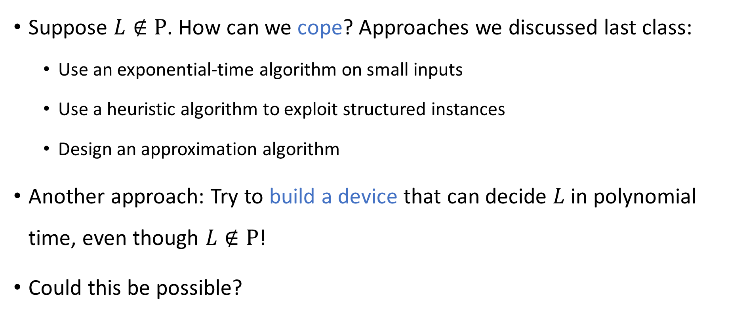
Coping with intractability
Suppose $L∉\text{P}$. How can we cope? Approaches we discussed last class:
Use an exponential-time algorithm on small inputs
Use a heuristic algorithm to exploit structured instances
Design an approximation algorithm
Another approach: Try to build a device that can decide $L$ in polynomial time, even though $L∉\text{P}$!
Could this be possible?

Slide 3
Which problems can be solved through computation?

Slide 4
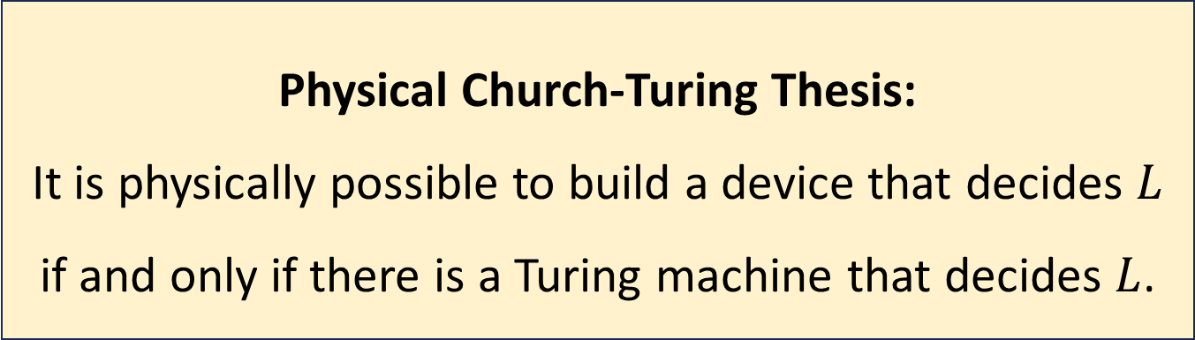

Physical Church-Turing Thesis
Let $L$ be a language
Physical Church-Turing Thesis:
It is physically possible to build a device that decides $L$ if and only if there is a Turing machine that decides $L$.

Slide 5
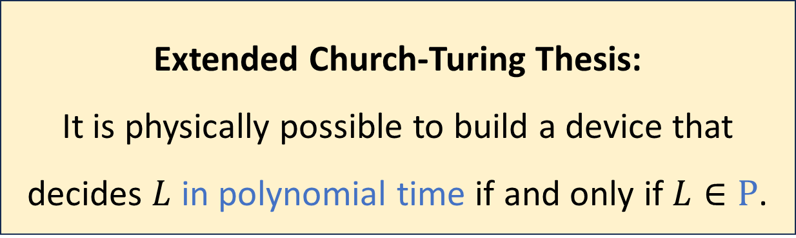

Extended Church-Turing Thesis
Let $L$ be a language
Extended Church-Turing Thesis:
It is physically possible to build a device that decides $L$ in polynomial time if and only if $L∈\text{P}$.

Slide 6
Extended Church-Turing Thesis: Challenges
The extended Church-Turing thesis is plausible
It survives many challenges, such as multi-tape Turing machines
However, it seems increasingly likely that the extended Church-Turing thesis is false!
Two important challenges:
Randomized computation
Quantum computation

Slide 7
Randomized computation
Sometimes, in our efforts to solve problems and figure things out, we want to make random choices
Random sampling for opinion polls
Randomized controlled trials in science and medicine
What happens if we incorporate this ability into our computational model?

Slide 8


Randomized Turing machines
Input tape ➡
#
1
1
0
Randomness tape ➡

Slide 9
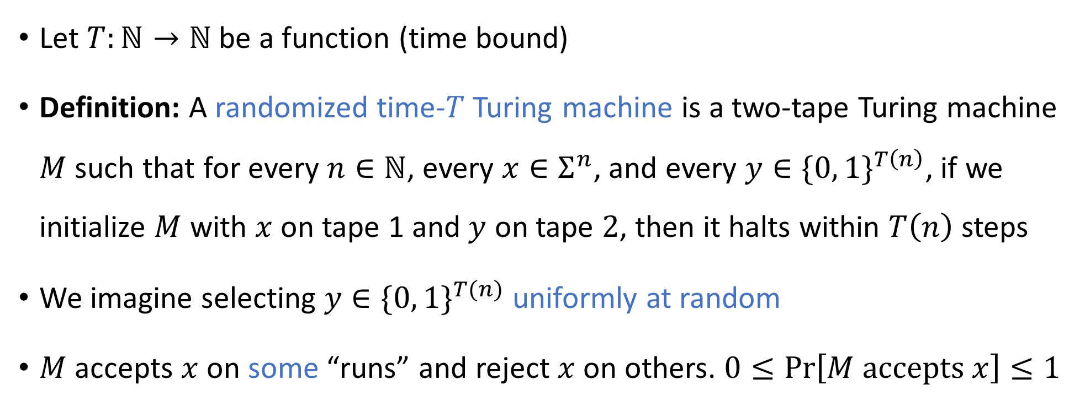
Randomized Turing machines
Let $T:ℕ→ℕ$ be a function (time bound)
Definition: A randomized time-$T$Turing machine is a two-tape Turing machine $M$ such that for every $n∈ℕ$, every $x∈Σ^{n}$, and every $y∈\{0, 1\}^{T\left(n\right)}$, if we initialize $M$ with $x$ on tape 1 and $y$ on tape $2$, then it halts within $T\left(n\right)$ steps
We imagine selecting $y∈\{0, 1\}^{T(n)}$ uniformly at random
$M$ accepts $x$ on some “runs” and reject $x$ on others. $0≤\operatorname{Pr}\left[M \text{accepts} x\right]≤1$

Slide 10
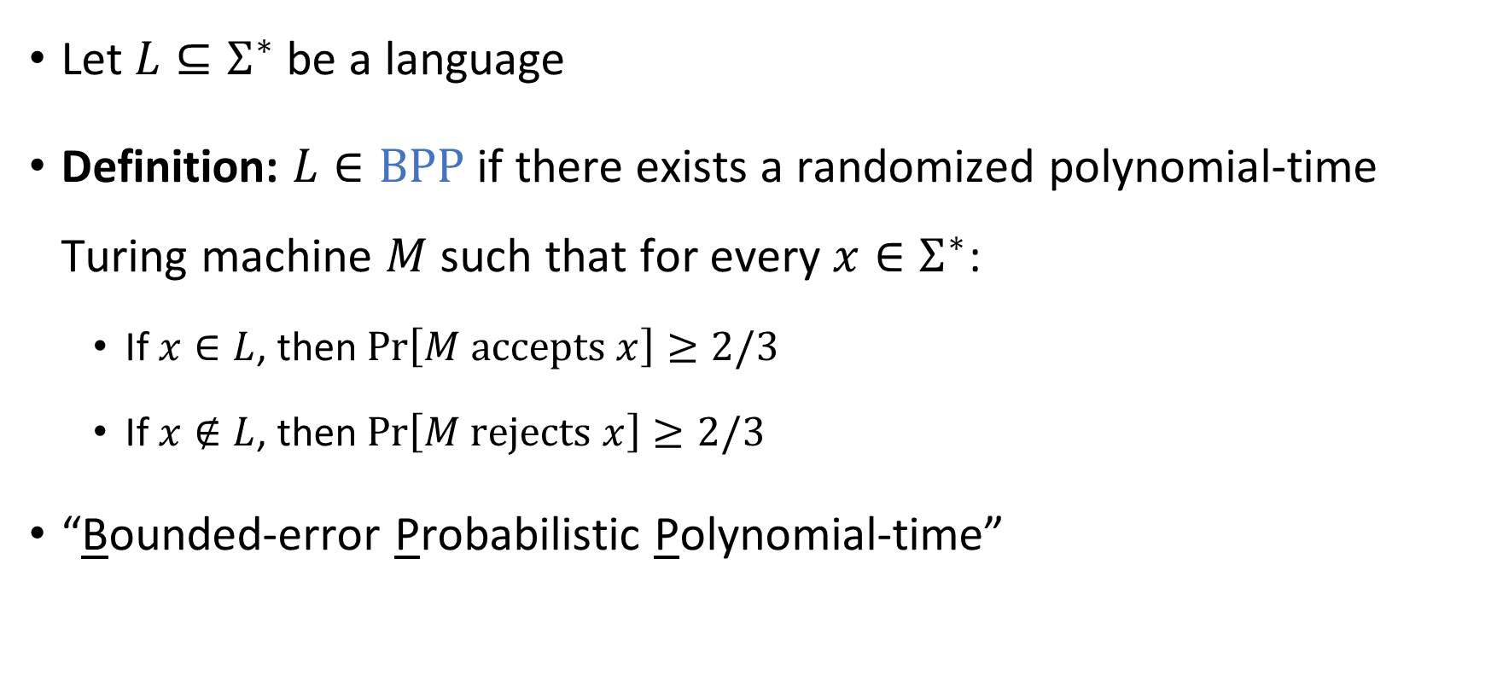

The complexity class $\text{BPP}$
Let $L⊆Σ^{∗}$ be a language
Definition: $L∈\text{BPP}$ if there exists a randomized polynomial-time Turing machine $M$ such that for every $x∈Σ^{∗}$:
If $x∈L$, then $\operatorname{Pr}\left[M \text{accepts} x\right]≥2/3$
If $x∉L$, then $\operatorname{Pr}\left[M \text{rejects} x\right]≥2/3$
“Bounded-error Probabilistic Polynomial-time”

Slide 11
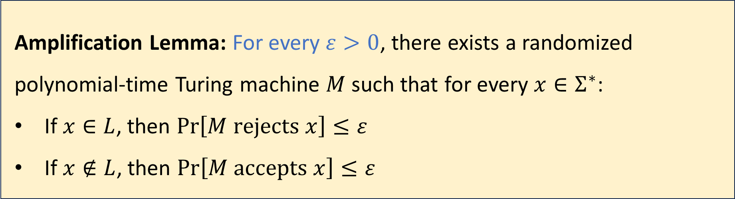

Amplification lemma
Suppose $L⊆Σ^{∗}$ and $L∈\text{BPP}$
Can make the error probability arbitrarily small
Amplification Lemma: For every $ε>0$, there exists a randomized polynomial-time Turing machine $M$ such that for every $x∈Σ^{∗}$:
If $x∈L$, then $\operatorname{Pr}\left[M \text{rejects} x\right]≤ε$
If $x∉L$, then $\operatorname{Pr}\left[M \text{accepts} x\right]≤ε$

Slide 12
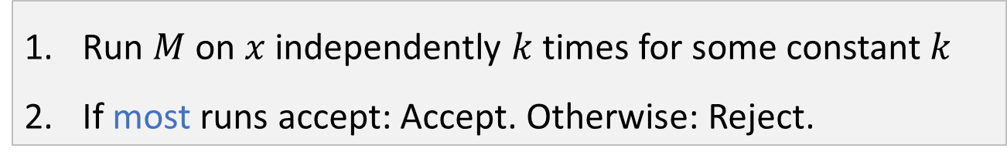
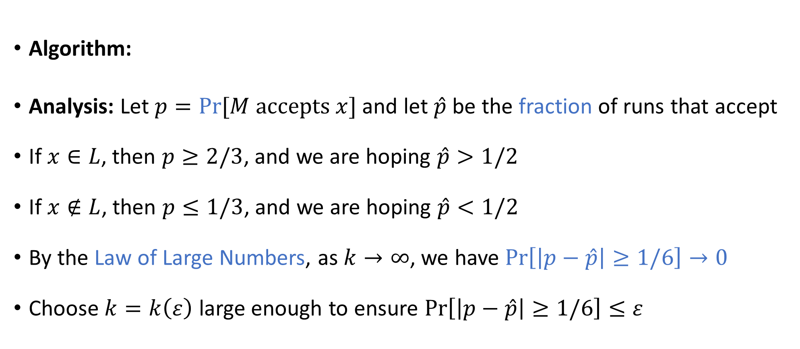
Proof of the amplification lemma
Algorithm:
Analysis: Let $p=Pr⁡[M \text{accepts} x]$ and let $\hat{p}$ be the fraction of runs that accept
If $x∈L$, then $p≥2/3$, and we are hoping $\hat{p}>1/2$
If $x∉L$, then $p≤1/3$, and we are hoping $\hat{p}<1/2$
By the Law of Large Numbers, as $k→∞$, we have $\operatorname{Pr}\left[\left|p−\hat{p}\right|≥1/6\right]→0$
Choose $k=k\left(ε\right)$ large enough to ensure $\operatorname{Pr}\left[\left|p−\hat{p}\right|≥1/6\right]≤ε$
Run $M$ on $x$ independently $k$ times for some constant $k$
If most runs accept: Accept. Otherwise: Reject.

Slide 13
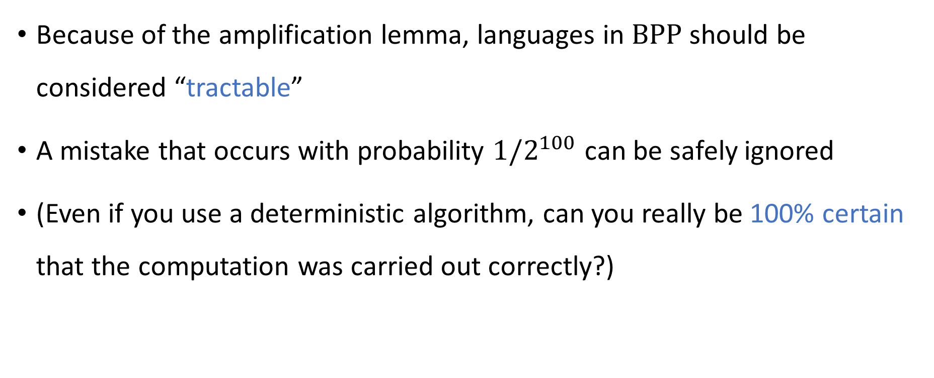
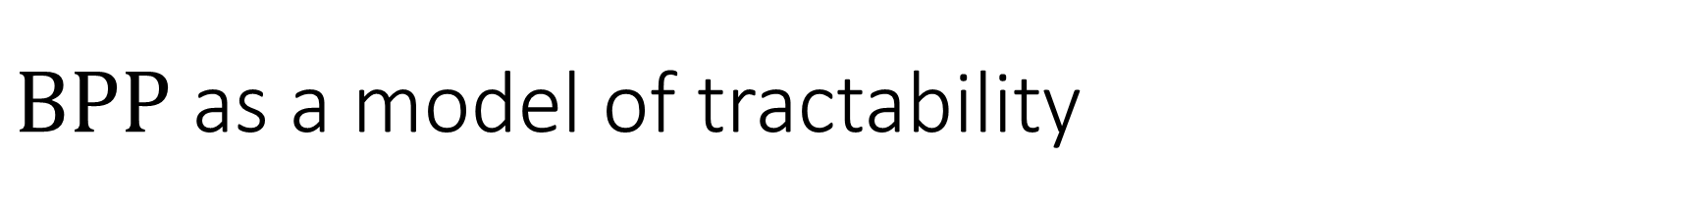
$\text{BPP}$ as a model of tractability
Because of the amplification lemma, languages in $\text{BPP}$ should be considered “tractable”
A mistake that occurs with probability $1/2^{100}$ can be safely ignored
(Even if you use a deterministic algorithm, can you really be 100% certain that the computation was carried out correctly?)

Slide 14
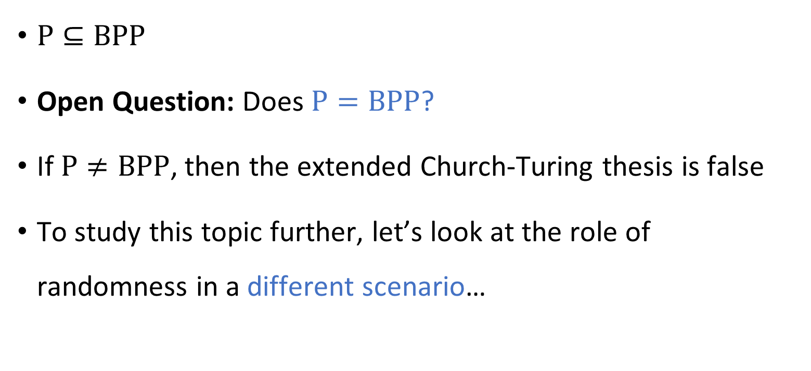
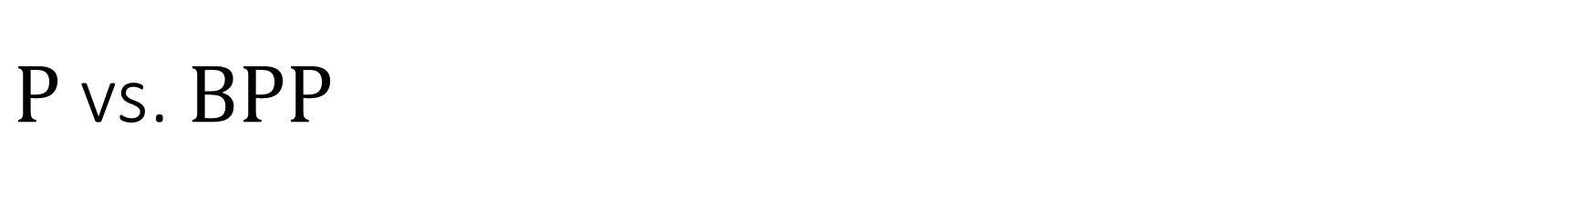
$\text{P}$ vs. $\text{BPP}$
$\text{P}⊆\text{BPP}$
Open Question: Does $\text{P}=\text{BPP}$?
If $\text{P}≠\text{BPP}$, then the extended Church-Turing thesis is false
To study this topic further, let’s look at the role of randomness in a different scenario…

Slide 15
Communication Complexity

Slide 16

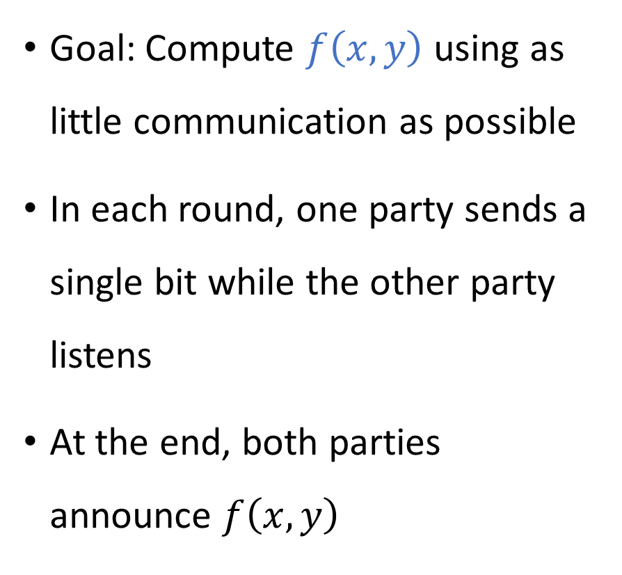


Communication complexity
Goal: Compute $f\left(x, y\right)$ using as little communication as possible
In each round, one party sends a single bit while the other party listens
At the end, both parties announce $f\left(x, y\right)$
Communication channel
Alice holds $x$
Bob holds $y$

Slide 17

The equality function
We will focus on the case $f={\text{EQ}}_{n}$
${\text{EQ}}_{n}:\{0, 1\}^{n}×\{0, 1\}^{n}→\{0, 1\}$
${\text{EQ}}_{n}\left(x, y\right)=1⇔x=y$
“Does your copy of the database match my copy?”

Slide 18
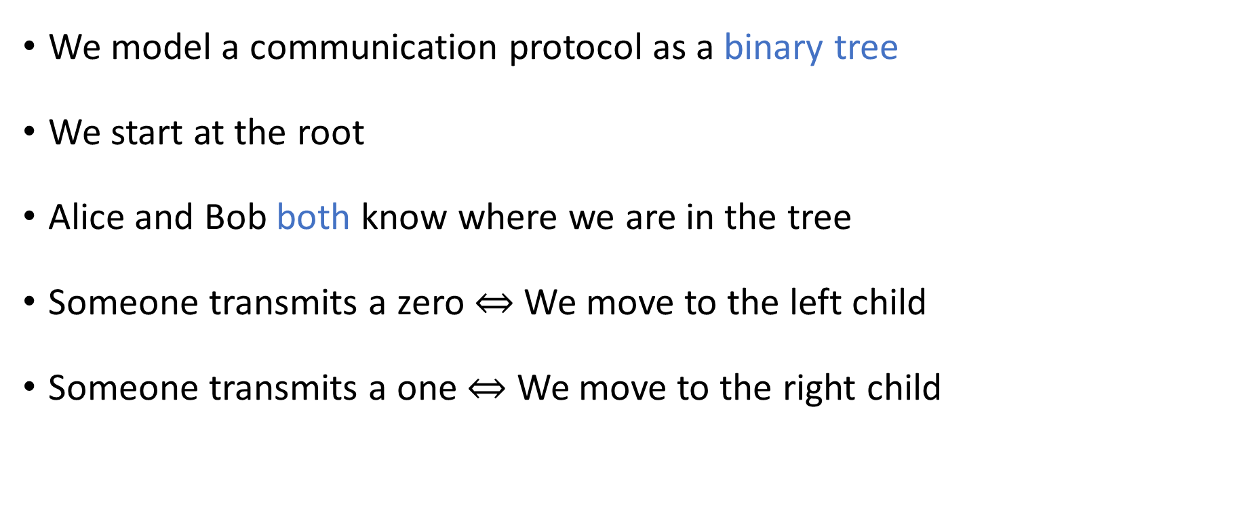
Communication protocol
We model a communication protocol as a binary tree
We start at the root
Alice and Bob both know where we are in the tree
Someone transmits a zero $⇔$ We move to the left child
Someone transmits a one $⇔$ We move to the right child

Slide 19
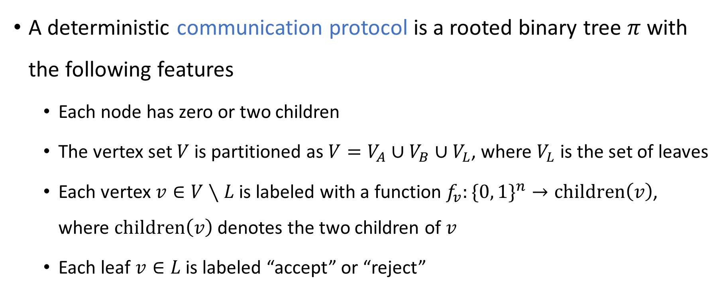
Communication protocol: Rigorous version
A deterministic communication protocol is a rooted binary tree $π$ with the following features
Each node has zero or two children
The vertex set $V$ is partitioned as $V=V_{A}∪V_{B}∪V_{L}$, where $V_{L}$ is the set of leaves
Each vertex $v∈V∖L$ is labeled with a function $f_{v}:\{0, 1\}^{n}→\text{children}\left(v\right)$, where $\text{children}\left(v\right)$ denotes the two children of $v$
Each leaf $v∈L$ is labeled “accept” or “reject”

Slide 20
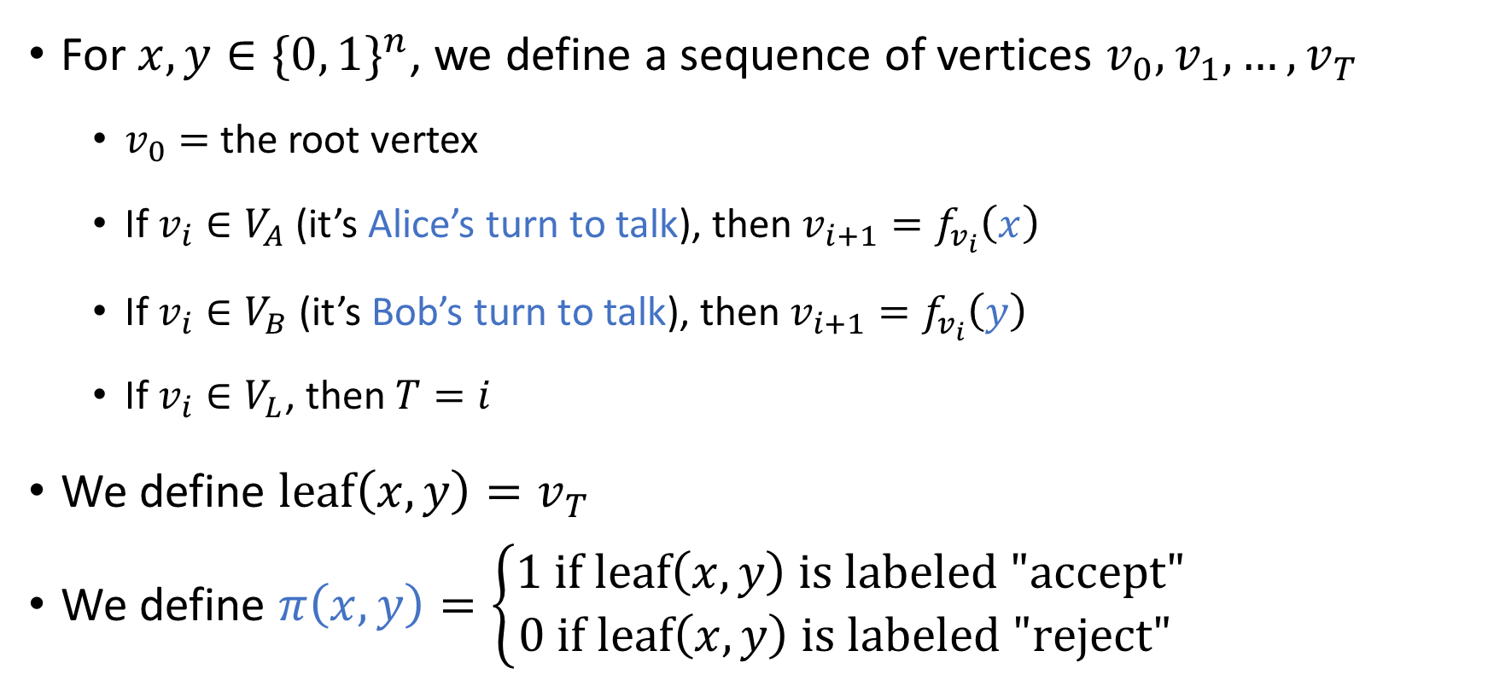
Communication protocol: Rigorous version
For $x, y∈\{0, 1\}^{n}$, we define a sequence of vertices $v_{0},v_{1},…, v_{T}$
$v_{0}=$ the root vertex
If $v_{i}∈V_{A}$ (it’s Alice’s turn to talk), then $v_{i+1}=f_{v_{i}}\left(x\right)$
If $v_{i}∈V_{B}$ (it’s Bob’s turn to talk), then $v_{i+1}=f_{v_{i}}\left(y\right)$
If $v_{i}∈V_{L}$, then $T=i$
We define $\text{leaf}\left(x, y\right)=v_{T}$
We define $π\left(x,y\right)=\left\{\begin{aligned}1 \text{if} \text{leaf}\left(x,y\right) \text{is} \text{labeled}\text{ "}\text{accept}\text{"} \\ 0 \text{if} \text{leaf}\left(x,y\right) \text{is} \text{labeled}\text{ "}\text{reject}\text{"} \end{aligned}\right.$

Slide 21
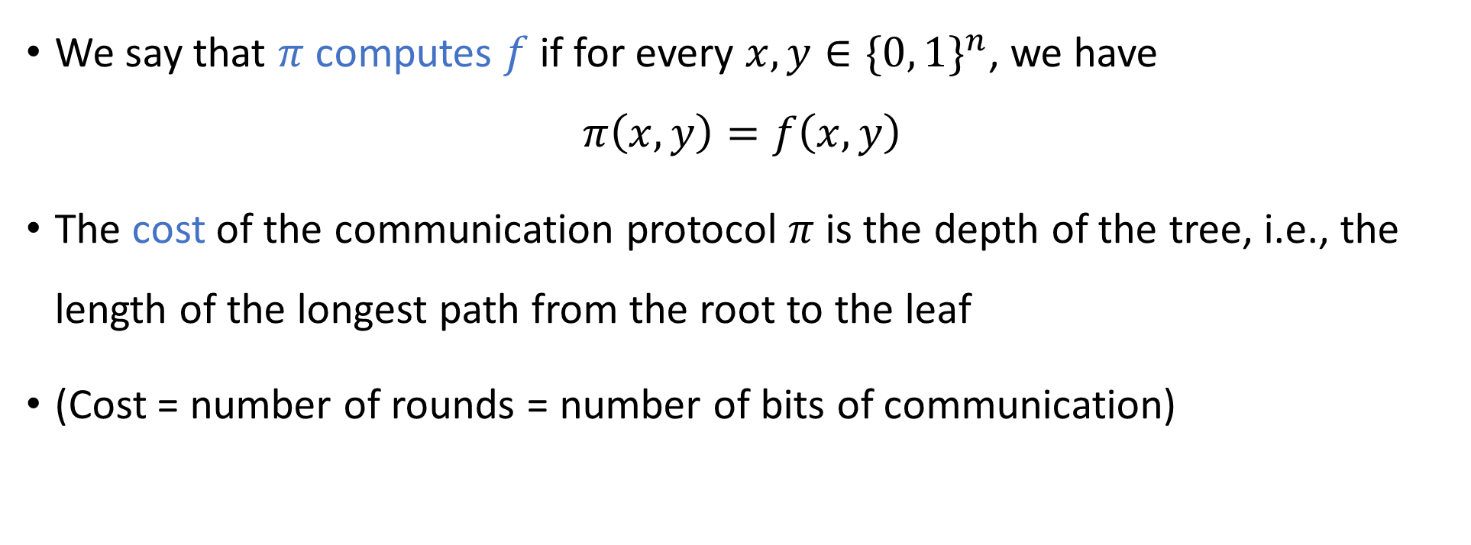
Communication complexity
We say that $π$ computes $f$ if for every $x, y∈\{0, 1\}^{n}$, we have
$$π\left(x,y\right)=f\left(x,y\right)$$
The cost of the communication protocol $π$ is the depth of the tree, i.e., the length of the longest path from the root to the leaf
(Cost = number of rounds = number of bits of communication)

Slide 22


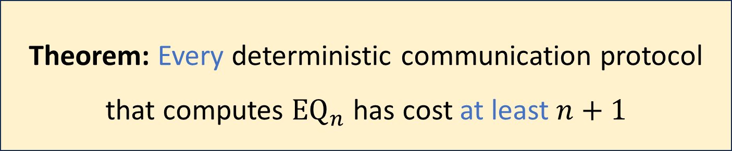
Communication complexity of ${\text{EQ}}_{n}$
Recall: ${\text{EQ}}_{n}\left(x, y\right)=1⇔x=y$
Naïve protocol: Alice sends $x$ to Bob, then Bob sends ${\text{EQ}}_{n}\left(x, y\right)$ to Alice
Naïve protocol has cost $n+1$
Theorem: Every deterministic communication protocol that computes ${\text{EQ}}_{n}$ has cost at least $n+1$

Slide 23
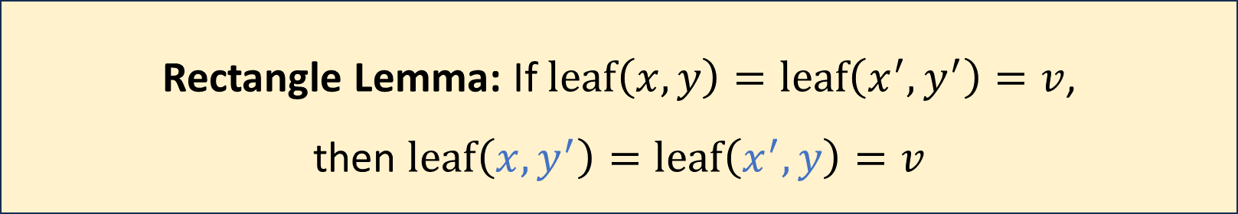

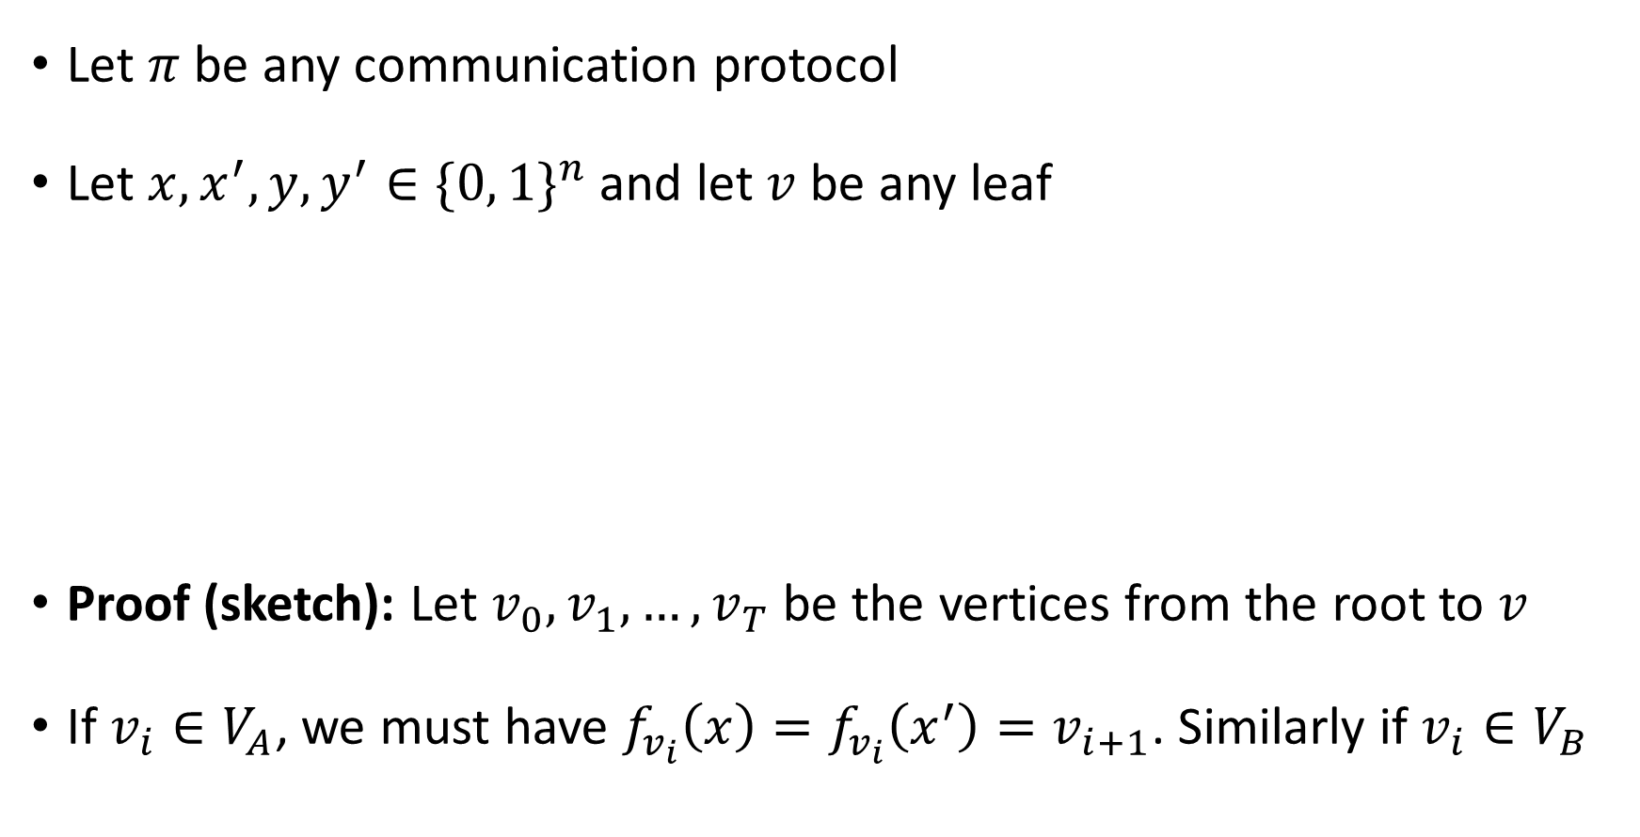



Rectangle lemma
$$\left(x, y\right)$$
$$\left(x′, y\right)$$
Let $π$ be any communication protocol
Let $x, x^{′}, y, y^{′}∈\{0, 1\}^{n}$ and let $v$ be any leaf
Proof (sketch): Let $v_{0},v_{1},…, v_{T}$ be the vertices from the root to $v$
If $v_{i}∈V_{A}$, we must have $f_{v_{i}}\left(x\right)=f_{v_{i}}\left(x^{′}\right)=v_{i+1}$. Similarly if $v_{i}∈V_{B}$
$$\left(x, y′\right)$$
$$\left(x′, y′\right)$$
Rectangle Lemma: If $\text{leaf}\left(x, y\right)=\text{leaf}\left(x^{′},y^{′}\right)=v$, then $\text{leaf}\left(x,y^{′}\right)=\text{leaf}\left(x^{′},y\right)=v$

Slide 24
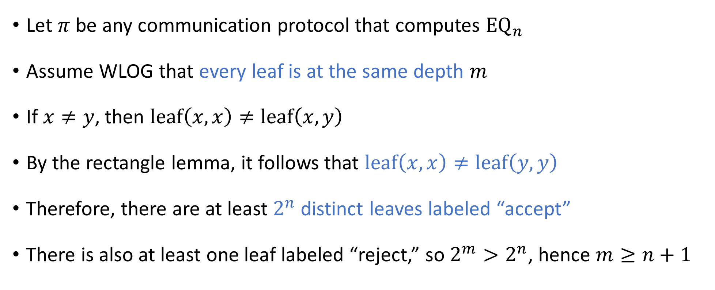





Communication complexity of ${\text{EQ}}_{n}$
$$\left(x, x\right)$$
$$\left(x, y\right)$$
$$\left(y, x\right)$$
$$\left(y, y\right)$$
Let $π$ be any communication protocol that computes ${\text{EQ}}_{n}$
Assume WLOG that every leaf is at the same depth $m$
If $x≠y$, then $\text{leaf}\left(x,x\right)≠\text{leaf}\left(x,y\right)$
By the rectangle lemma, it follows that $\text{leaf}\left(x,x\right)≠\text{leaf}\left(y,y\right)$
Therefore, there are at least $2^{n}$ distinct leaves labeled “accept”
There is also at least one leaf labeled “reject,” so $2^{m}>2^{n}$, hence $m≥n+1$

Slide 25
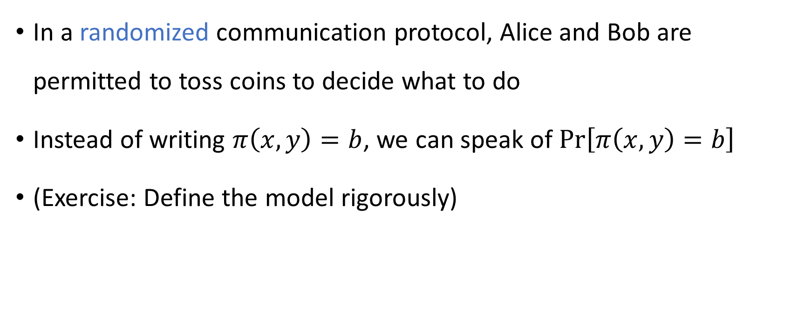
Randomized communication complexity
In a randomized communication protocol, Alice and Bob are permitted to toss coins to decide what to do
Instead of writing $π\left(x, y\right)=b$, we can speak of $\operatorname{Pr}\left[π\left(x, y\right)=b\right]$
(Exercise: Define the model rigorously)

Slide 26
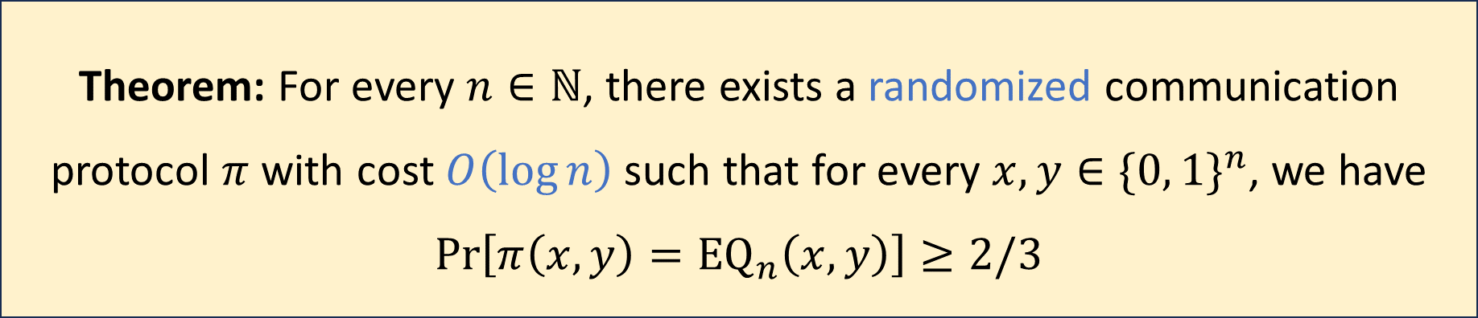
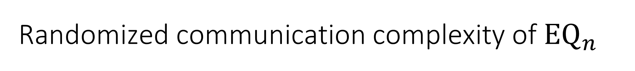
Randomized communication complexity of ${\text{EQ}}_{n}$
Theorem: For every $n∈ℕ$, there exists a randomized communication protocol $π$ with cost $O\left(\log{n}\right)$ such that for every $x,y∈\{0, 1\}^{n}$, we have $\operatorname{Pr}\left[π\left(x,y\right)={\text{EQ}}_{n}\left(x,y\right)\right]≥2/3$
Randomized protocols are exponentially better than deterministic protocols!

