Slide 1
CMSC 28100 Introduction to Complexity Theory Winter 2024 Instructor: William Hoza
7 |  |  |  |  |  |  | 5 | 3
 |  |  |  |  |  |  |  | 4
 | 4 | 8 |  | 3 |  | 1 | 2
8 |  | 1 | 3 |  |  | 2 | 7 | 5
 | 9 |  | 1 |  |  |  | 4
 | 5 |  |  |  |  | 3
2 |  | 5 |  | 8 | 4
1 | 3 | 4 |  | 5

Slide 2
Reminder
Problem set 2 is due tomorrow
Office hours today:
10:30am – 12:30pm (hosted by me)
3:30pm – 4:30pm (hosted by Nico and Rohan)

Slide 3
Universal Turing machines
If you are stranded on an alien planet and you are trying to build a computer, your job is to build a universal Turing machine
A universal Turing machine can be “programmed” to do anything that is computationally possible

Slide 4
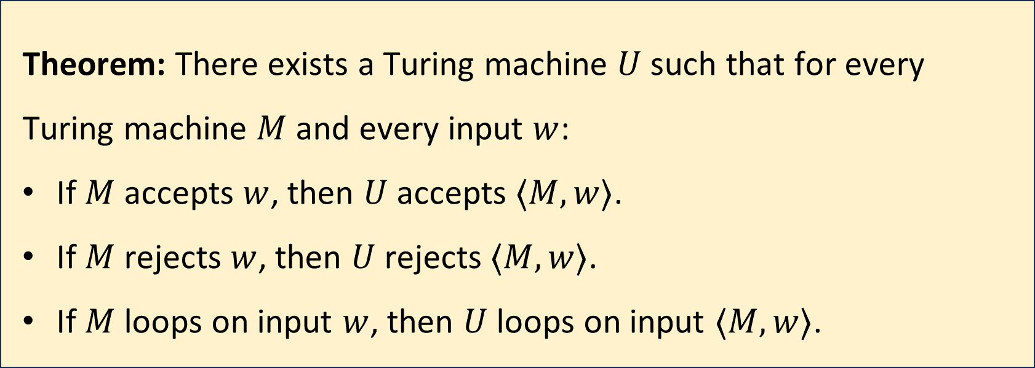
Universal Turing machines
Theorem: There exists a Turing machine $U$ such that for every Turing machine $M$ and every input $w$:
If $M$ accepts $w$, then $U$ accepts $⟨M,w⟩$.
If $M$ rejects $w$, then $U$ rejects $⟨M,w⟩$.
If $M$ loops on input $w$, then $U$ loops on input $⟨M,w⟩$.
Proof omitted. It’s essentially a programming exercise

Slide 5
Church-Turing Thesis:
All computation can be mathematically modeled by Turing machines

Slide 6
Note on standards of rigor
Going forward, when we want to construct a Turing machine (e.g., for an existence proof), we will simply describe what it does in plain English, as if we are giving instructions to a human being
Each plain English description can be formalized as a Turing machine, but this is tedious
You should follow this convention on problem set 3 and beyond
Nevertheless, the Turing machine model is extremely valuable for us, because it tells us what an arbitrary algorithm looks like!

Slide 7
Which problems can be solved through computation?

Slide 8
What are Turing machines capable of?

Slide 9
What are Turing machines NOT capable of?

Slide 10
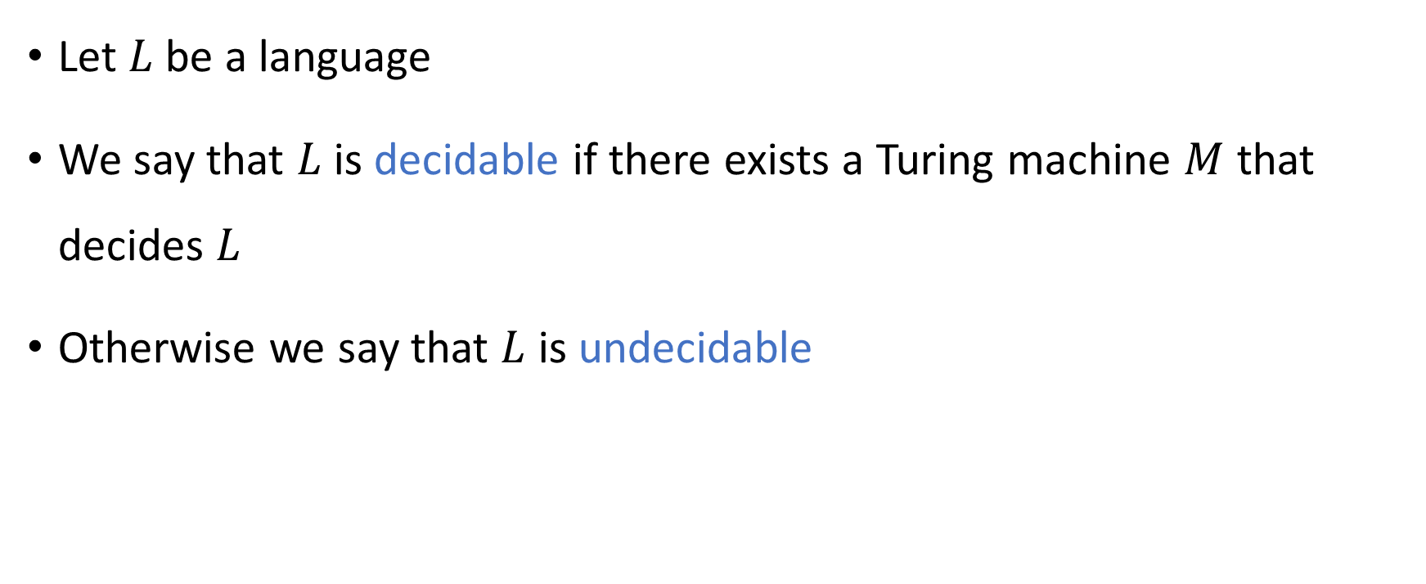
Decidable and undecidable
Let $L$ be a language
We say that $L$ is decidable if there exists a Turing machine $M$ that decides $L$
Otherwise we say that $L$ is undecidable

Slide 11
Is every language decidable?

Slide 12
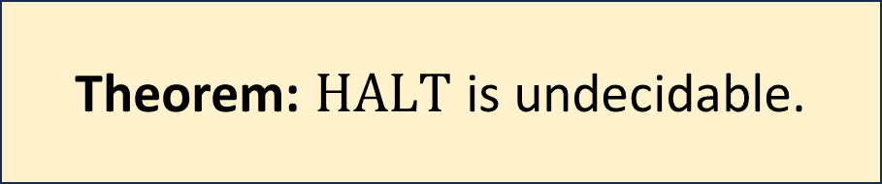

The halting problem
Let $\text{HALT}=\{\left\langle M,w\right\rangle :M \text{is} \text{a} \text{Turing} \text{machine} \text{that} \text{halts} \text{on} \text{input} w\}$
Theorem: $\text{HALT}$ is undecidable.

Slide 13
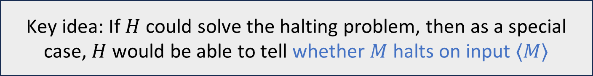
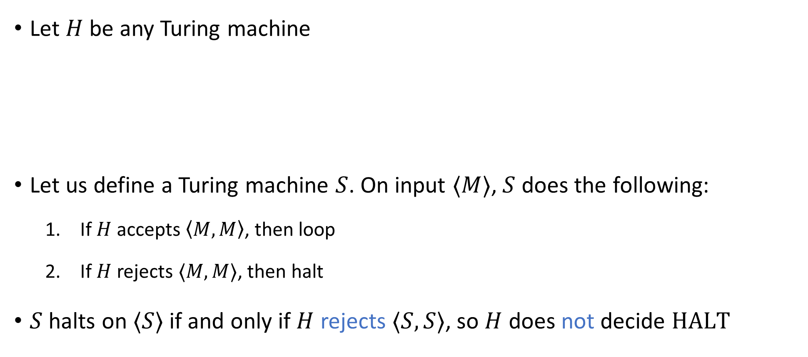
Proof that the halting problem is undecidable
Let $H$ be any Turing machine
Let us define a Turing machine $S$. On input $⟨M⟩$, $S$ does the following:
If $H$ accepts $\left\langle M,M\right\rangle$, then loop
If $H$ rejects $⟨M,M⟩$, then halt
$S$ halts on $⟨S⟩$ if and only if $H$ rejects $⟨S,S⟩$, so $H$ does not decide $\text{HALT}$
Key idea: If $H$ could solve the halting problem, then as a special case, $H$ would be able to tell whether $M$ halts on input $⟨M⟩$

Slide 14
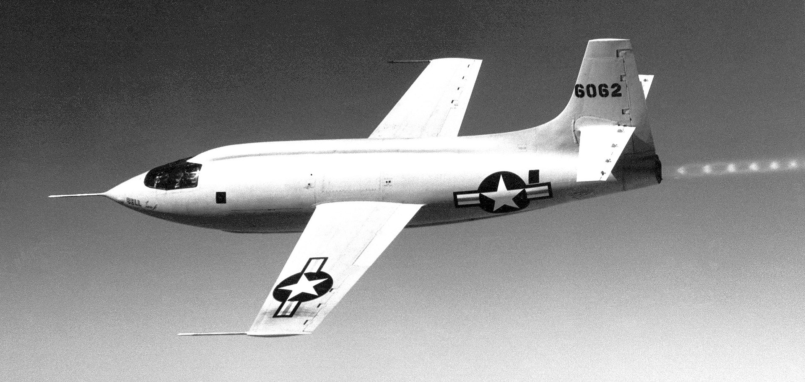
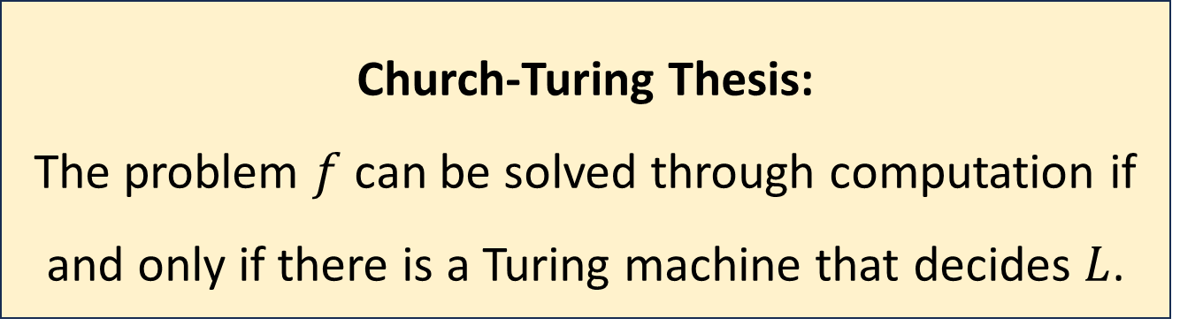

Church-Turing thesis, revisited
Let $f:Σ^{∗}→\{0, 1\}$ be a decision problem and let $L=\{w:f\left(w\right)=1\}$
Computation is an intuitive notion rooted in everyday human experience
Could it be possible to solve the halting problem using science and technology?
Church-Turing Thesis:
The problem $f$ can be solved through computation if and only if there is a Turing machine that decides $L$.

Slide 15
Hypercomputers
A hypercomputer is a hypothetical device that can solve some computational problem that cannot be solved by Turing machines, such as the halting problem
Could it be possible that there are hypercomputers at the centers of stars? Inside black holes?
Could it be possible to build a hypercomputer?

Slide 16


Physical Church-Turing Thesis
Let $f:Σ^{∗}→\{0, 1\}$ be a decision problem and let $L=\{w:f\left(w\right)=1\}$
Physical Church-Turing Thesis:
It is physically possible to build a device that solves $f$
if and only if
there is a Turing machine that decides $L$.

Slide 17
The Physical Church-Turing Thesis
The standard Church-Turing thesis is a philosophical statement
The Physical Church-Turing thesis is a scientific law
Conceivably, it could be disproven by future discoveries… but that would be very surprising
Analogy: Second Law of Thermodynamics
Analogy: Cannot travel faster than the speed of light

Slide 18

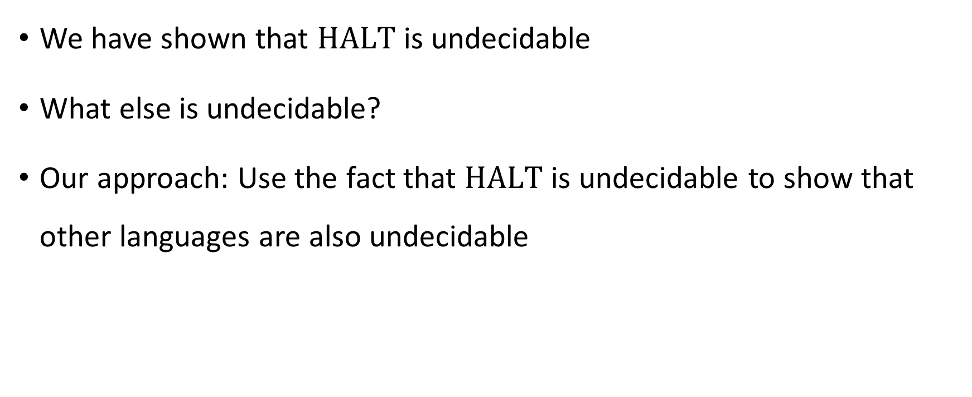
Undecidability
We have shown that $\text{HALT}$ is undecidable
What else is undecidable?
Our approach: Use the fact that $\text{HALT}$ is undecidable to show that other languages are also undecidable

Slide 19
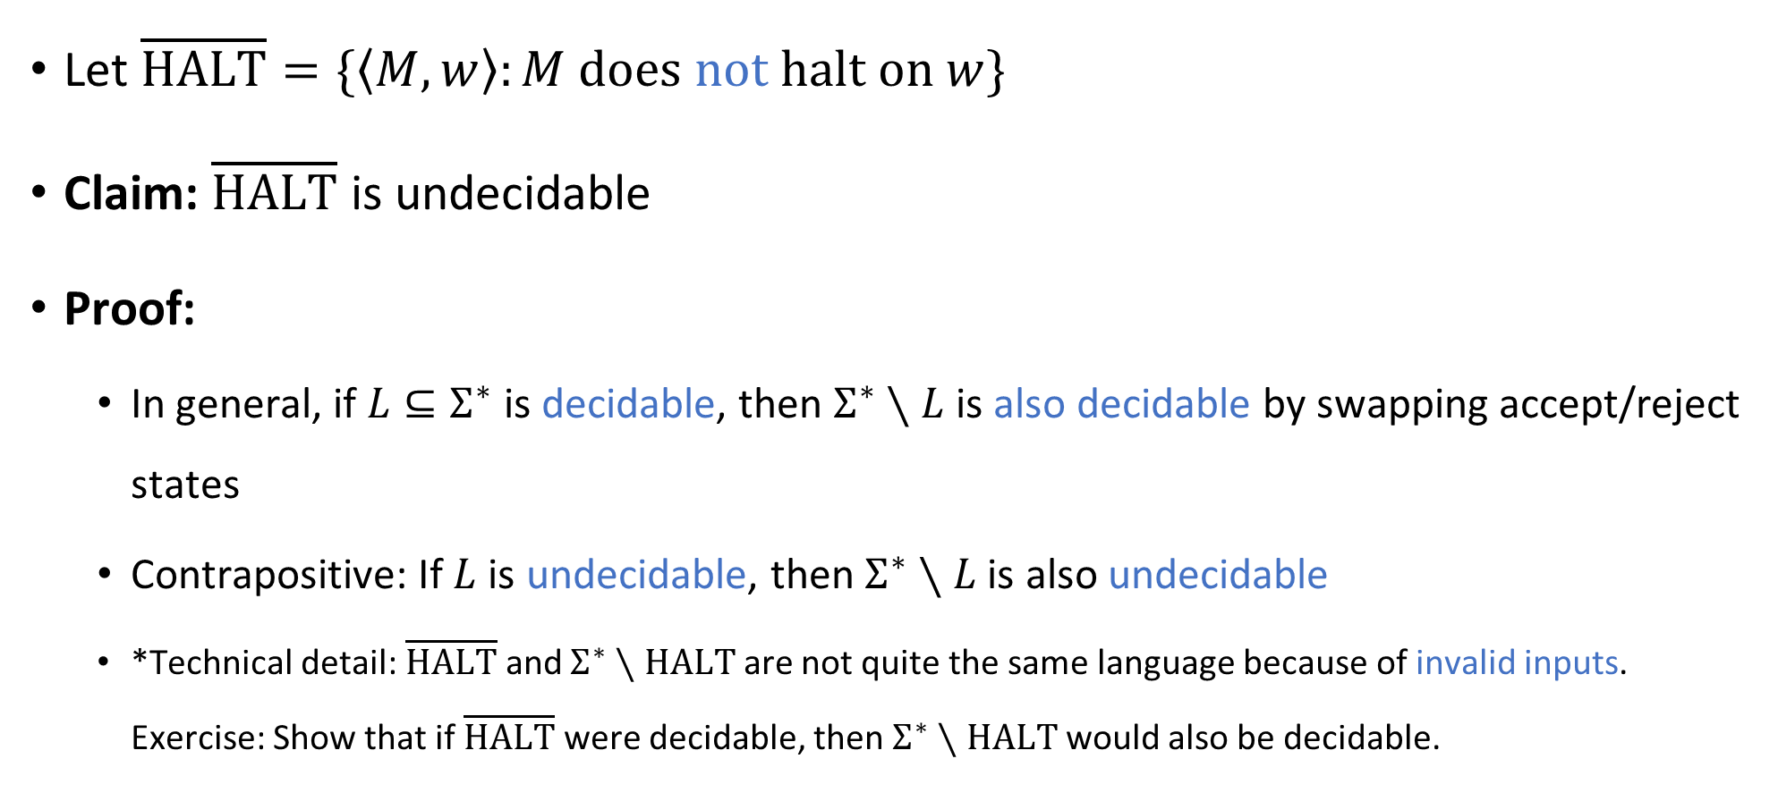
Complement of the halting problem
Let $\overline{\text{HALT}}=\{\left\langle M,w\right\rangle :M \text{does} \text{not} \text{halt} \text{on} w\}$
Claim: $\overline{\text{HALT}}$ is undecidable
Proof:
In general, if $L⊆Σ^{∗}$ is decidable, then $Σ^{∗}∖L$ is also decidable by swapping accept/reject states
Contrapositive: If $L$ is undecidable, then $Σ^{∗}∖L$ is also undecidable
*Technical detail: $\overline{\text{HALT}}$ and $Σ^{∗}∖\text{HALT}$ are not quite the same language because of invalid inputs. Exercise: Show that if $\overline{\text{HALT}}$ were decidable, then $Σ^{∗}∖\text{HALT}$ would also be decidable.

Slide 20
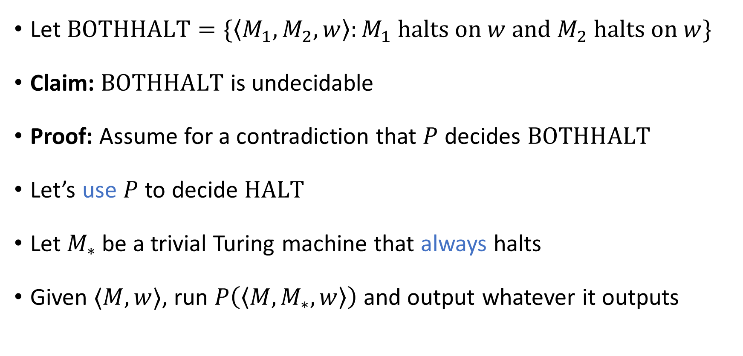
“Both halt” problem
Let $\text{BOTHHALT}=\{\left\langle M_{1},M_{2},w\right\rangle :M_{1} \text{halts} \text{on} w \text{and} M_{2} \text{halts} \text{on} w\}$
Claim: $\text{BOTHHALT}$ is undecidable
Proof: Assume for a contradiction that $P$ decides $\text{BOTHHALT}$
Let’s use $P$ to decide $\text{HALT}$
Let $M_{∗}$ be a trivial Turing machine that always halts
Given $⟨M,w⟩$, run $P\left(\left\langle M,M_{∗},w\right\rangle \right)$ and output whatever it outputs

Slide 21
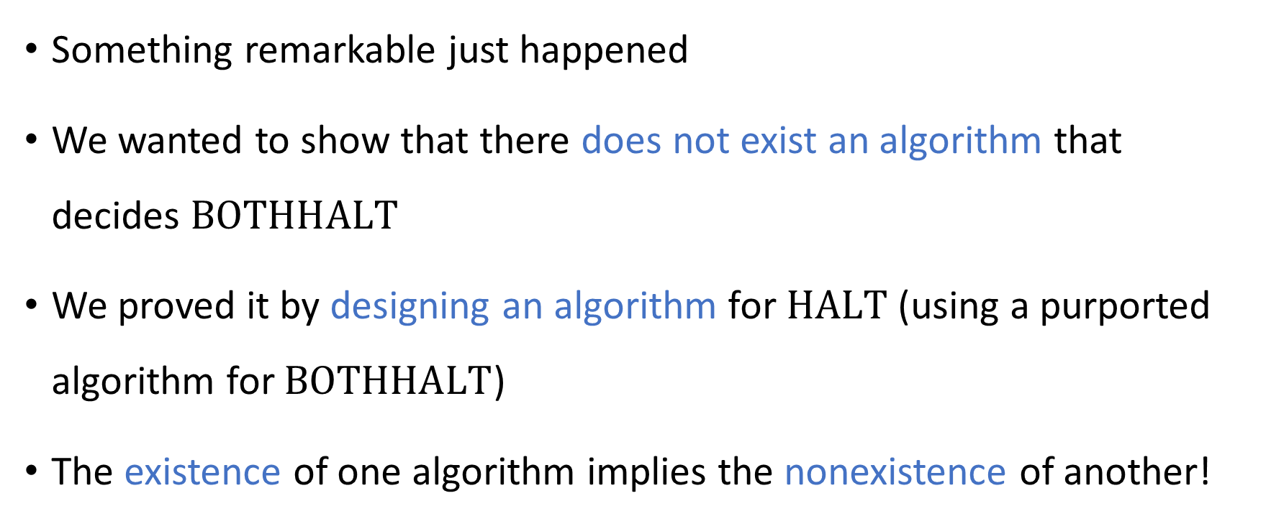
Reductions
Something remarkable just happened
We wanted to show that there does not exist an algorithm that decides $\text{BOTHHALT}$
We proved it by designing an algorithm for $\text{HALT}$ (using a purported algorithm for $\text{BOTHHALT}$)
The existence of one algorithm implies the nonexistence of another!

Slide 22
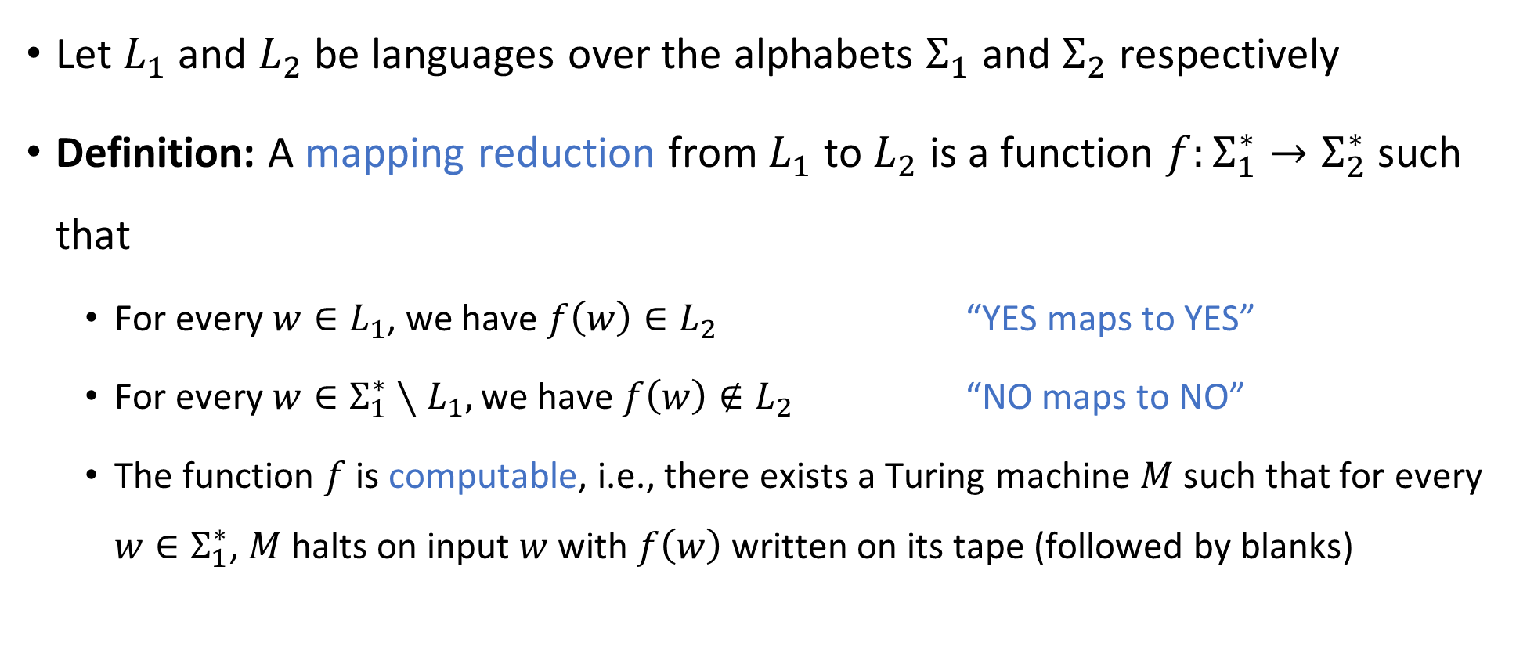
Reductions
Let $L_{1}$ and $L_{2}$ be languages over the alphabets $Σ_{1}$ and $Σ_{2}$ respectively
Definition: A mapping reduction from $L_{1}$ to $L_{2}$ is a function $f:Σ_{1}^{∗}→Σ_{2}^{∗}$ such that
For every $w∈L_{1}$, we have $f\left(w\right)∈L_{2}$ “YES maps to YES”
For every $w∈Σ_{1}^{∗}∖L_{1},$ we have $f\left(w\right)∉L_{2}$ “NO maps to NO”
The function $f$ is computable, i.e., there exists a Turing machine $M$ such that for every $w∈Σ_{1}^{∗}$, $M$ halts on input $w$ with $f\left(w\right)$ written on its tape (followed by blanks)

Slide 23





Reductions
Informally, a mapping reduction from $L_{1}$ to $L_{2}$ is a way of converting instances of $L_{1}$ into equivalent instances of $L_{2}$
Note: Any string $w∈Σ^{∗}$ is called an “instance” of $L⊆Σ^{∗}$
$$L_{2}$$
$$L_{1}$$
$$Σ_{1}^{∗}$$
$$Σ_{2}^{∗}$$

