Slide 1
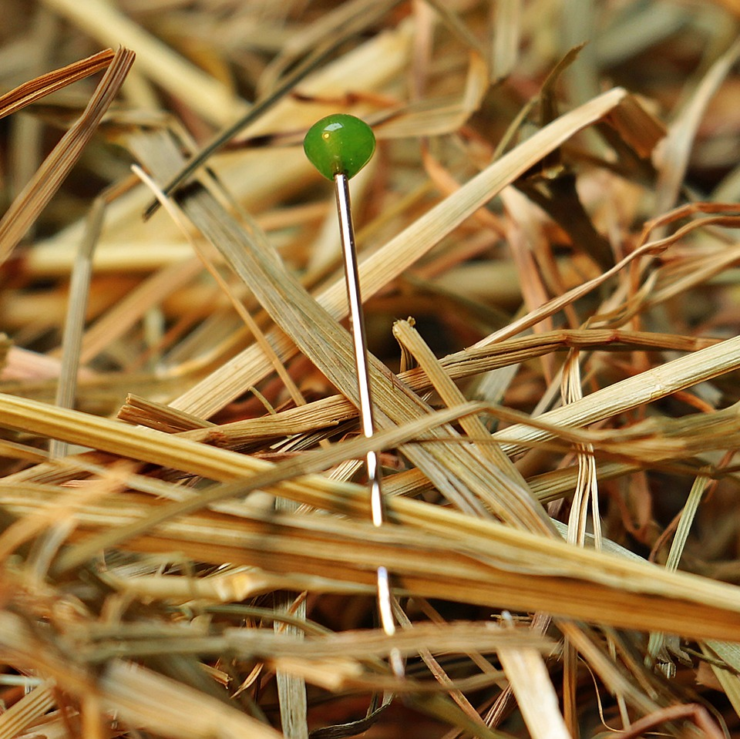
CMSC 28100 Introduction to Complexity Theory Spring 2025 Instructor: William Hoza

Slide 2
Which problems can be solved through computation?

Slide 3
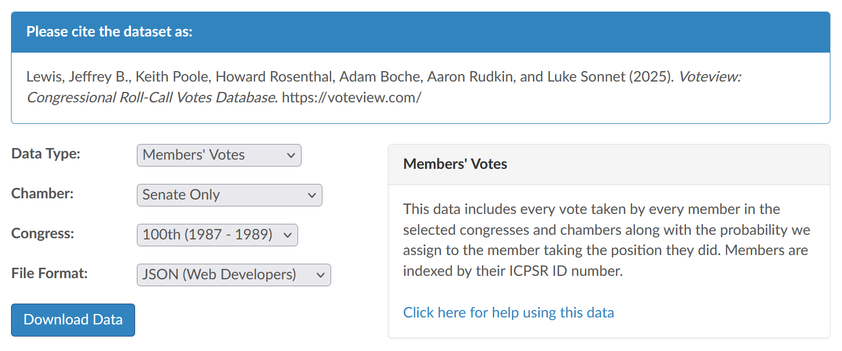
Applying our theory
Question: In the year 1988, were there 50 U.S. senators, every pair of which voted the same way more than 50% of the time?
Step 1: Gather data

Slide 4
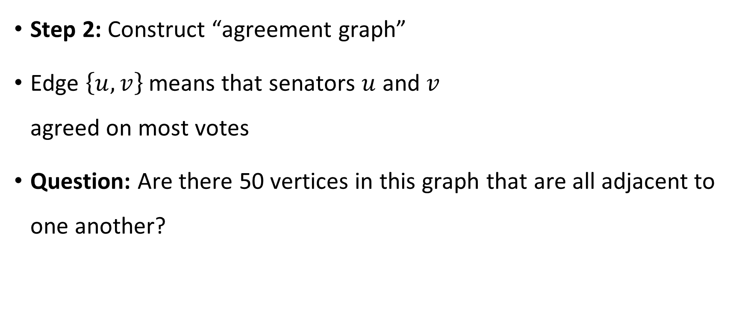
Agreement graph
Senator 1
Senator 2
Step 2: Construct “agreement graph”
Edge $\left\{u, v\right\}$ means that senators $u$ and $v$ agreed on most votes
Question: Are there 50 vertices in this graph that are all adjacent to one another?
Senator 3
Senator 4

Slide 5

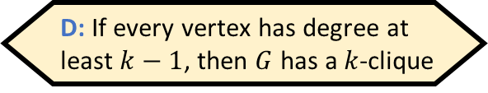
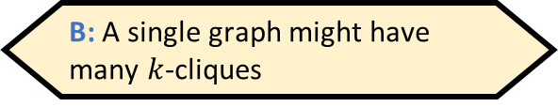
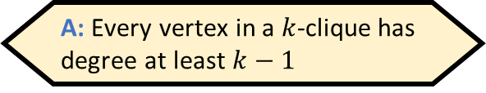
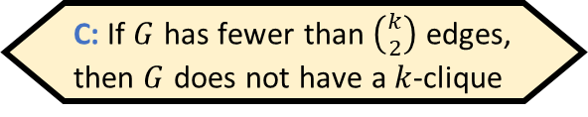
The clique problem
A $k$-clique in a graph $G=\left(V, E\right)$ is a set $S⊆V$ such that $\left|S\right|=k$ and every two vertices in $S$ are connected by an edge
Example: This graph has a $4$-clique
Which of the following statements is false?
A: Every vertex in a $k$-clique has degree at least $k−1$
B: A single graph might have many $k$-cliques
C: If $G$ has fewer than $\left({k \atop 2}\right)$ edges, then $G$ does not have a $k$-clique
D: If every vertex has degree at least $k−1$, then $G$ has a $k$-clique
Respond at PollEv.com/whoza or text “whoza” to 22333
Notes:
A cycle on n > 3 vertices does not have a 3-clique

Slide 6

The clique problem
Let $\text{CLIQUE}=\{\left\langle G,k\right\rangle :G \text{has} \text{a} k\text{‑}\text{clique}\}$
Example: Let $G$ be the graph with the following adjacency matrix
Does $G$ have a $4$-clique?
 | a | b | c | d | e | f | g
a | 0 | 1 | 1 | 0 | 0 | 1 | 0
b | 1 | 0 | 0 | 1 | 1 | 0 | 1
c | 1 | 0 | 0 | 0 | 1 | 0 | 1
d | 0 | 1 | 0 | 0 | 1 | 0 | 1
e | 0 | 1 | 1 | 1 | 0 | 1 | 1
f | 1 | 0 | 0 | 0 | 1 | 0 | 1
g | 0 | 1 | 1 | 1 | 1 | 1 | 0

Slide 7

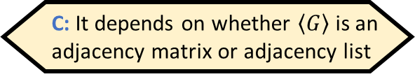
The clique problem
Let $\text{CLIQUE}=\{\left\langle G,k\right\rangle :G \text{has} \text{a} k\text{‑}\text{clique}\}$
Example: Let $G$ be the graph with the following adjacency matrix
Does $G$ have a $4$-clique?
Yes! $S=\{\text{b},\text{d},\text{e},\text{g}\}$
 | a | b | c | d | e | f | g
a | 0 | 1 | 1 | 0 | 0 | 1 | 0
b | 1 | 0 | 0 | 1 | 1 | 0 | 1
c | 1 | 0 | 0 | 0 | 1 | 0 | 1
d | 0 | 1 | 0 | 0 | 1 | 0 | 1
e | 0 | 1 | 1 | 1 | 0 | 1 | 1
f | 1 | 0 | 0 | 0 | 1 | 0 | 1
g | 0 | 1 | 1 | 1 | 1 | 1 | 0
Is $\text{CLIQUE}$ decidable?
A: Yes
B: No
C: It depends on whether $\left\langle G\right\rangle$ is an adjacency matrix or adjacency list
D: It’s not a language, so the question doesn’t make sense
Respond at PollEv.com/whoza or text “whoza” to 22333

Slide 8
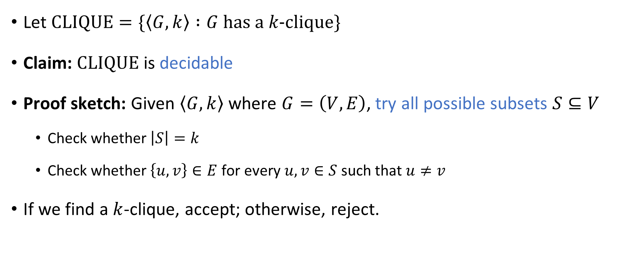
The clique problem
Let $\text{CLIQUE}=\{\left\langle G,k\right\rangle :G \text{has} \text{a} k\text{‑}\text{clique}\}$
Claim: $\text{CLIQUE}$ is decidable
Proof sketch: Given $\left\langle G,k\right\rangle$ where $G=\left(V,E\right)$, try all possible subsets $S⊆V$
Check whether $\left|S\right|=k$
Check whether $\left\{u, v\right\}∈E$ for every $u,v∈S$ such that $u≠v$
If we find a $k$-clique, accept; otherwise, reject.

Slide 9
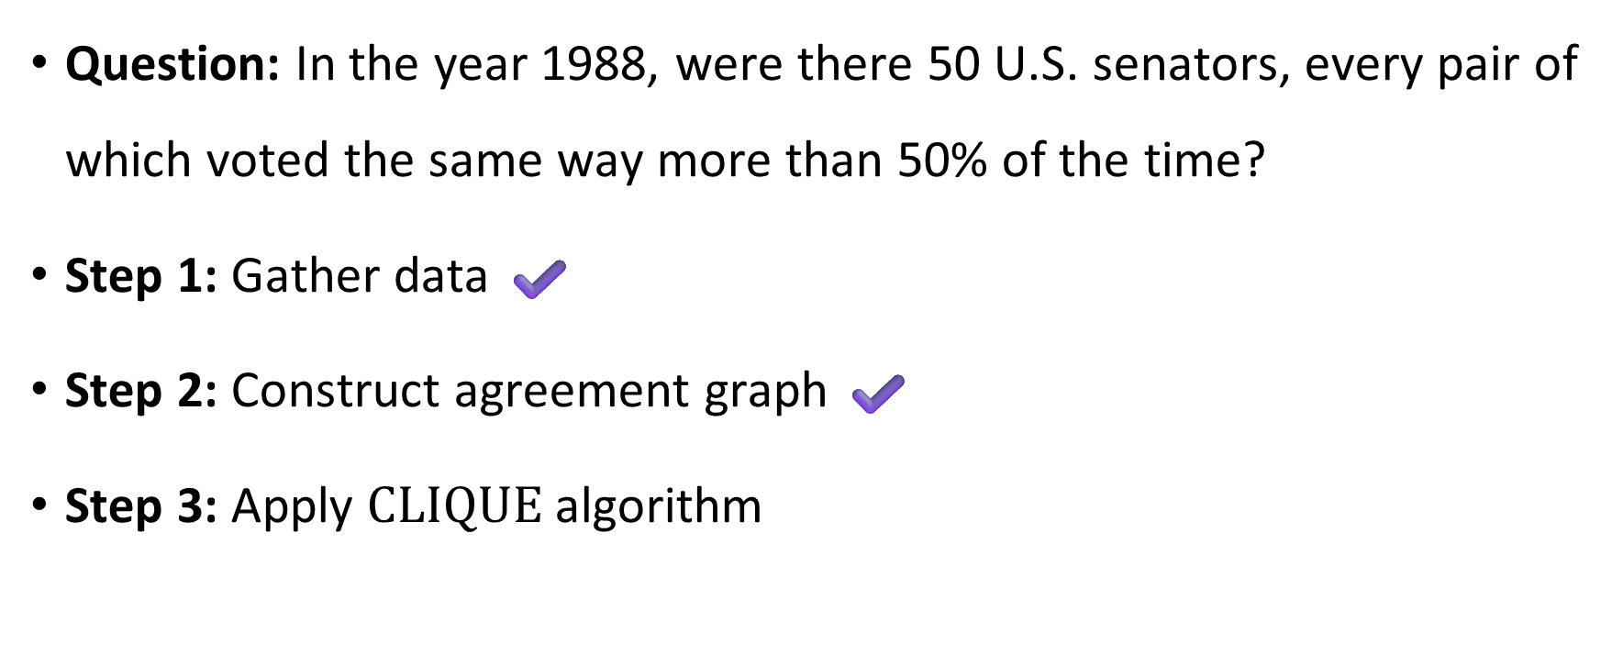
The clique problem
Question: In the year 1988, were there 50 U.S. senators, every pair of which voted the same way more than 50% of the time?
Step 1: Gather data ✔️
Step 2: Construct agreement graph ✔️
Step 3: Apply $\text{CLIQUE}$ algorithm

Slide 10

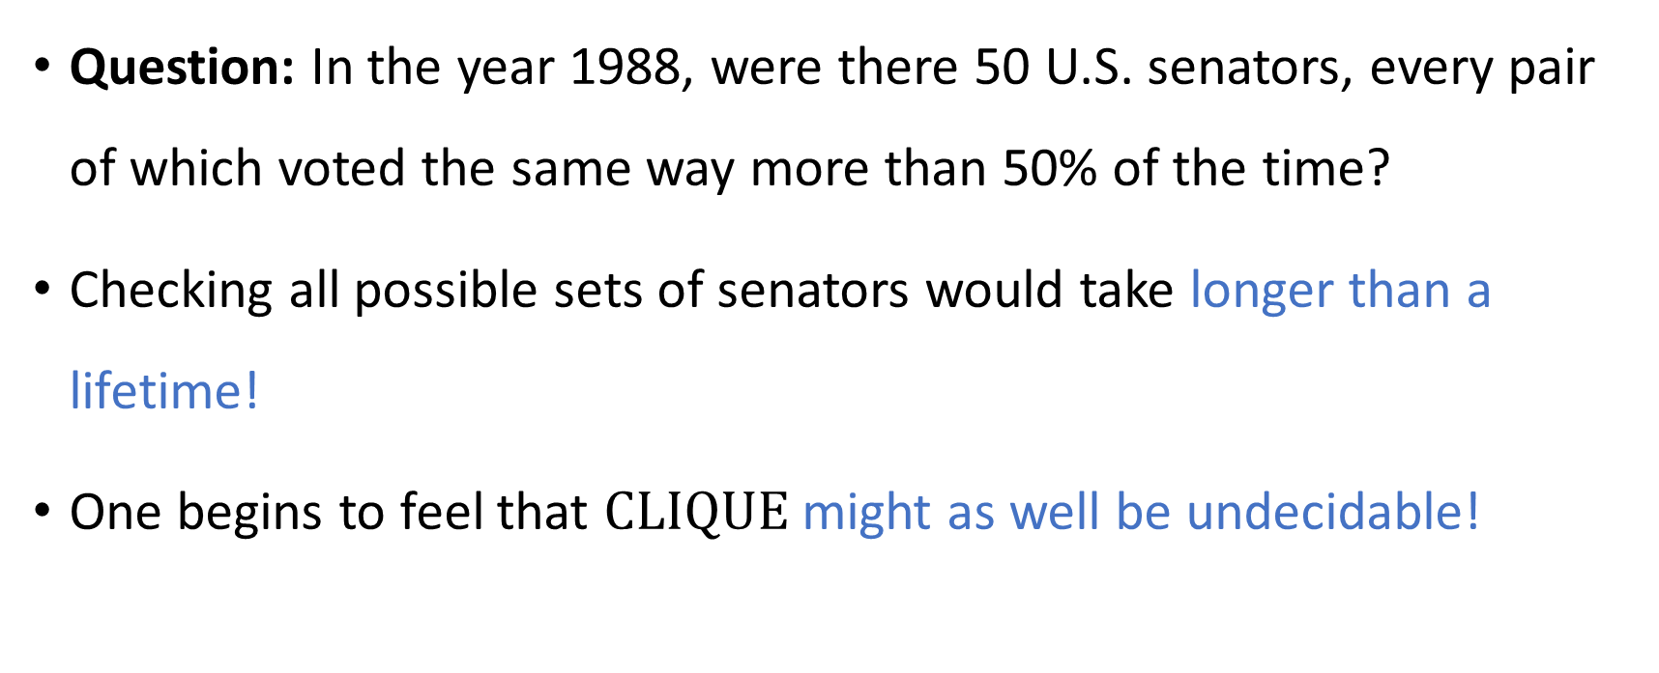
Our algorithm is so slow that it’s worthless
Question: In the year 1988, were there 50 U.S. senators, every pair of which voted the same way more than 50% of the time?
Checking all possible sets of senators would take longer than a lifetime!
One begins to feel that $\text{CLIQUE}$ might as well be undecidable!

Slide 11
Which problems can be solved through computation?

Slide 12
Refining our model
Our model so far: Decidable vs. undecidable
Now we will refine our model to account for the fact that we only have a limited amount of time (and other resources)
“Complexity theory” vs. “Computability theory”

Slide 13

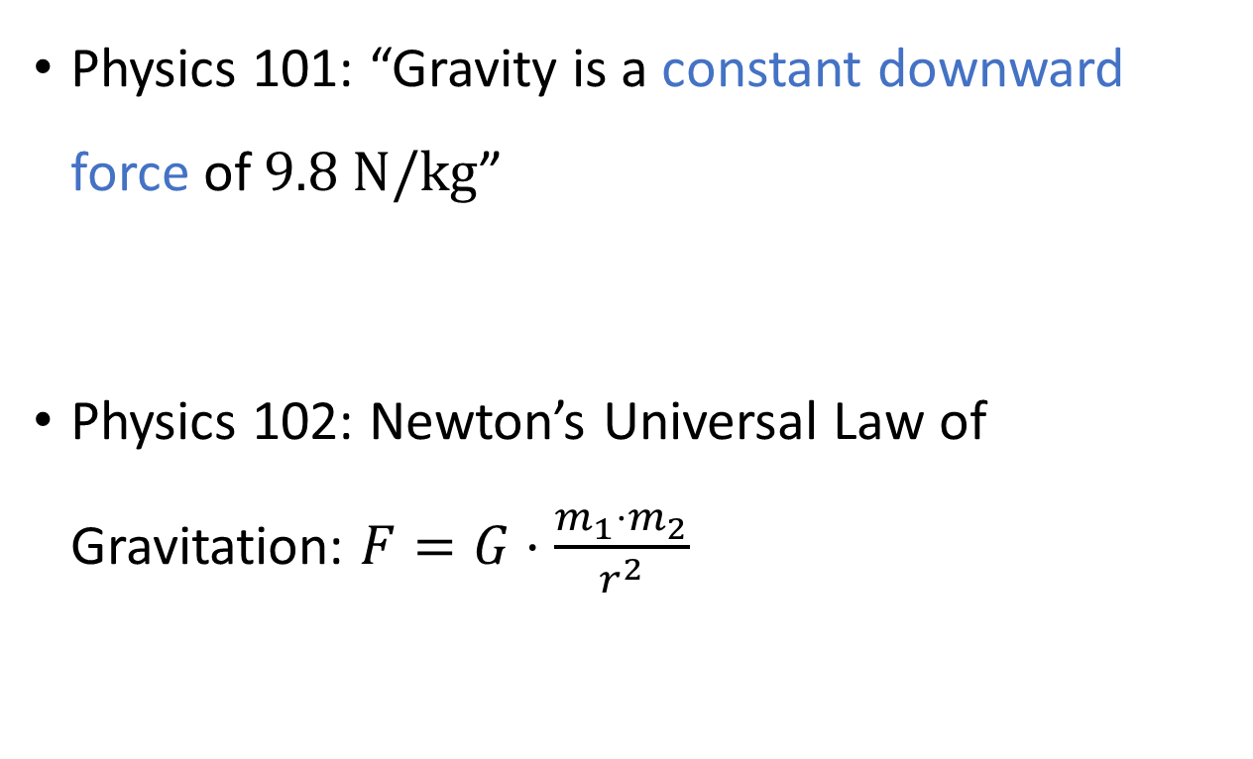
Analogy: Gravity
Physics 101: “Gravity is a constant downward force of $9.8 \text{N}/\text{kg}$”
Physics 102: Newton’s Universal Law of Gravitation: $F=G⋅\frac{m_{1}⋅m_{2}}{r^{2}}$

Slide 14
Theory vs. practice
Disclaimer: Our theoretical model will still not be perfectly accurate!
Occasionally, we might categorize a problem as “tractable” even though it is not actually “solvable in practice”
Other times, we might categorize a problem as “intractable” even though it is actually “solvable in practice”

Slide 15
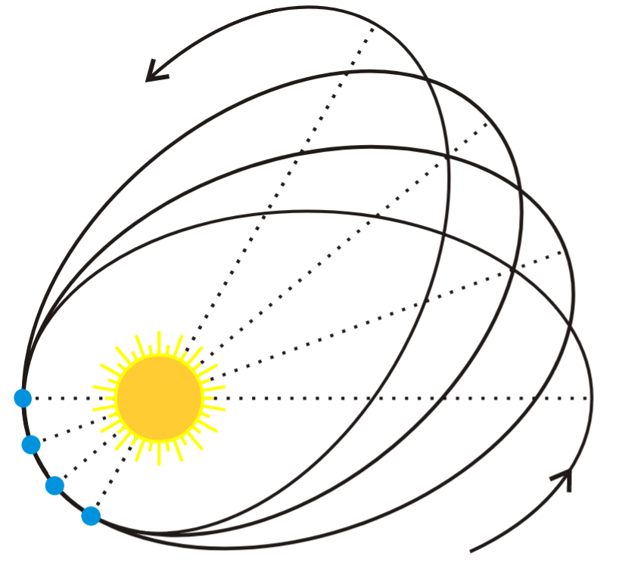
Theory vs. practice
Physics analogy: Newton’s Universal Law of Gravitation is great, but it does not correctly predict Mercury’s motion around the sun!
“…all models are wrong, but some are useful.” –George Box
Even though our model of tractability will not be 100% accurate, it will still give us real insights into the nature of computation

Slide 16
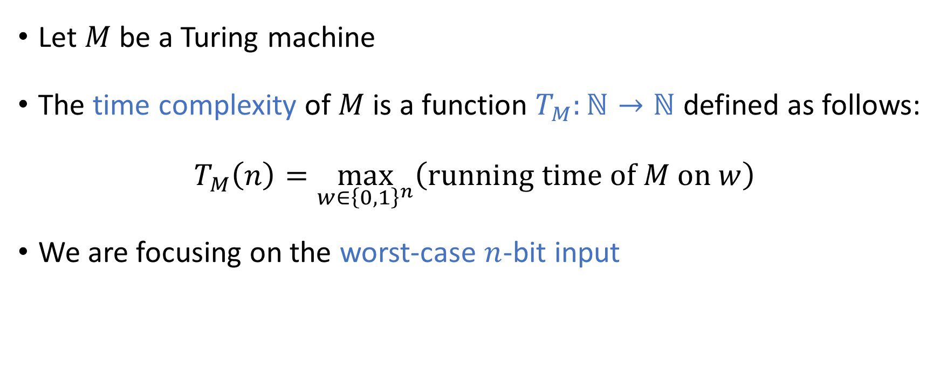
Time complexity
Let $M$ be a Turing machine
The time complexity of $M$ is a function $T_{M}:ℕ→ℕ$ defined as follows:
$$T_{M}\left(n\right)=\max_{w∈{\left\{0, 1\right\}}^{n}}\left(\text{running} \text{time} \text{of} M \text{on} w\right)$$
We are focusing on the worst-case $n$-bit input

Slide 17

Scaling behavior
We will mainly focus on the limiting behavior of $T_{M}\left(n\right)$ as $n→∞$
How “quickly” does the time complexity $T_{M}\left(n\right)$ increase when we increase the input length $n$?

Slide 18
Asymptotic analysis

Slide 19
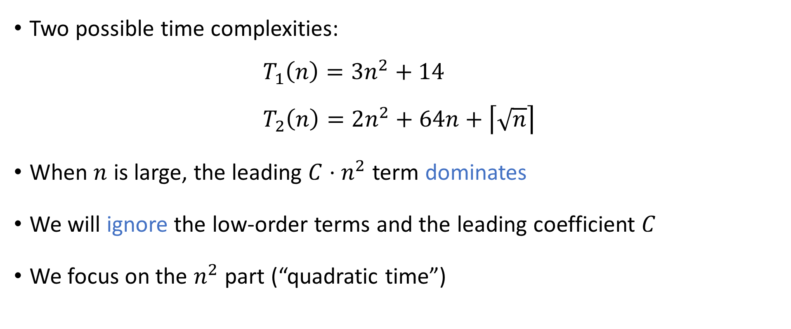
Asymptotic analysis
Two possible time complexities:
$$T_{1}\left(n\right)=3n^{2}+14 \\ T_{2}\left(n\right)=2n^{2}+64n+\left\lceil \sqrt{n}\right\rceil$$
When $n$ is large, the leading ${C⋅n}^{2}$ term dominates
We will ignore the low-order terms and the leading coefficient $C$
We focus on the $n^{2}$ part (“quadratic time”)

Slide 20
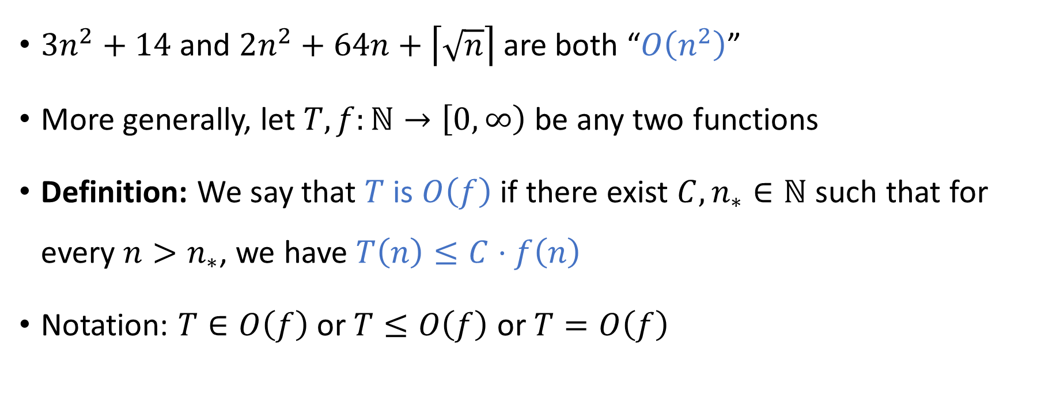

Big-$O$ notation
$3n^{2}+14$ and $2n^{2}+64n+\left\lceil \sqrt{n}\right\rceil$are both “$O\left(n^{2}\right)$”
More generally, let $T,f:ℕ→\left[0, ∞\right)$ be any two functions
Definition: We say that $T$ is $O\left(f\right)$ if there exist ${C,n}_{∗}∈ℕ$ such that for every $n>n_{∗}$, we have $T\left(n\right)≤C⋅f\left(n\right)$
Notation: $T∈O\left(f\right)$ or $T≤O\left(f\right)$ or $T=O\left(f\right)$

Slide 21


Big-$O$ notation examples
$3n^{2}+14$ is $O\left(n^{2}\right)$
$3n^{2}+14$ is $O\left(n^{2}+n\right)$
$3n^{2}+14$ is $O\left(n^{3}\right)$
$3n^{2}+14$ is not $O\left(n^{1.9}\right)$

Slide 22
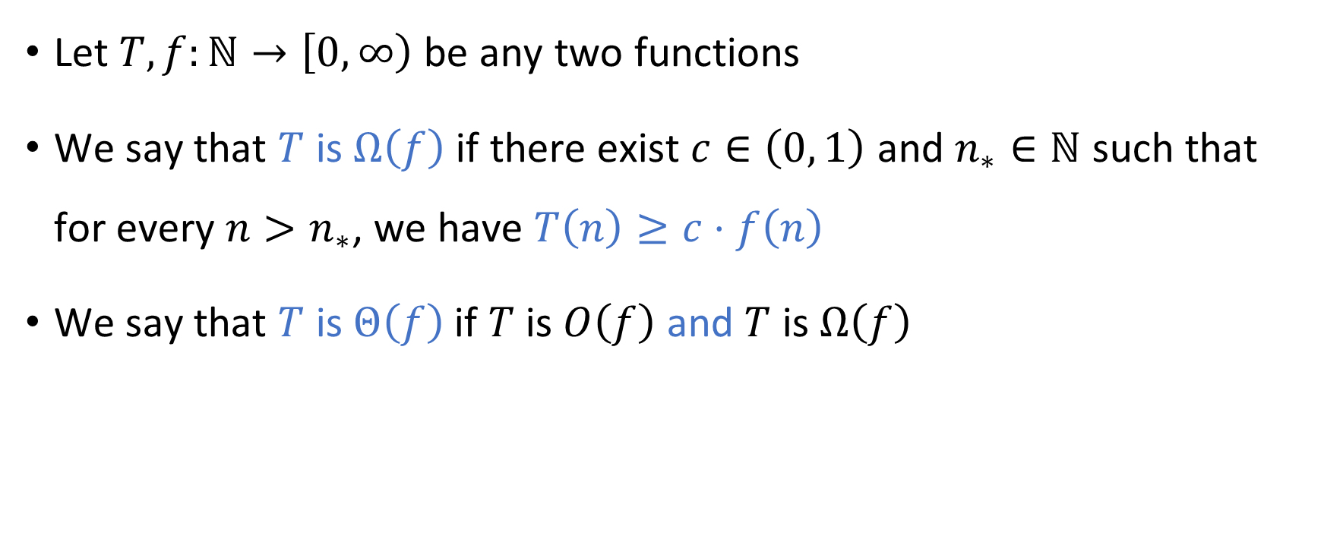
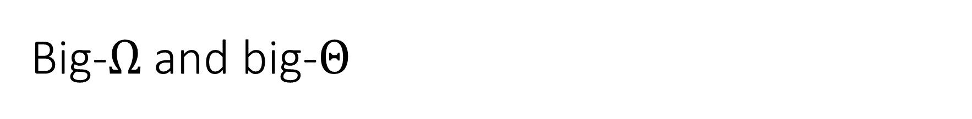
Big-$Ω$ and big-$Θ$
Let $T,f:ℕ→\left[0, ∞\right)$ be any two functions
We say that $T$ is $Ω\left(f\right)$ if there exist $c∈\left(0, 1\right)$ and $n_{∗}∈ℕ$ such that for every $n>n_{∗}$, we have $T\left(n\right)≥c⋅f\left(n\right)$
We say that $T$ is $Θ\left(f\right)$ if $T$ is $O\left(f\right)$ and $T$ is $Ω\left(f\right)$

Slide 23
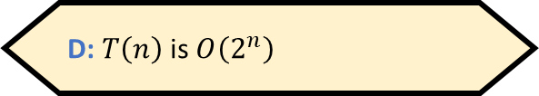

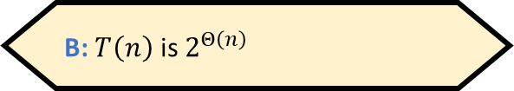
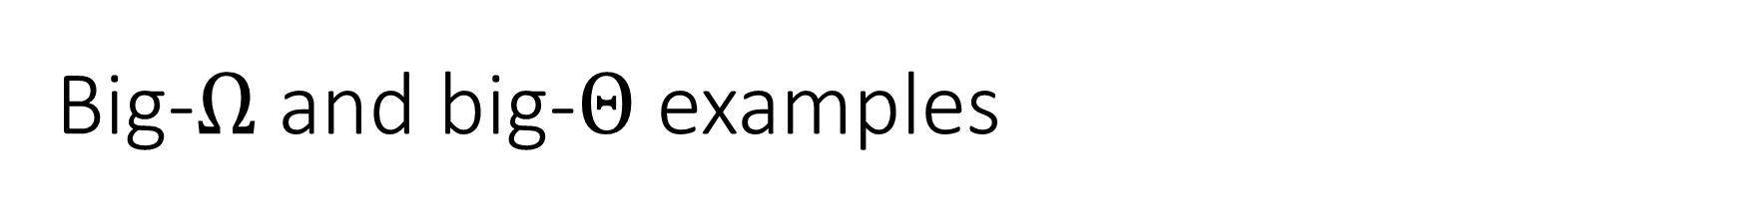
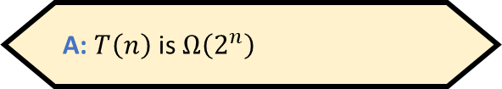
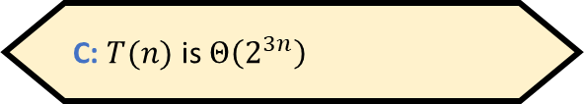
Big-$Ω$ and big-$Θ$ examples
$0.1n^{2}+14$ is $Ω\left(n^{2}\right)$ and $Ω\left(n\right)$, but not $Ω\left(n^{3}\right)$
$0.1n^{2}+14$ is $Θ\left(n^{2}\right)$ and $Θ\left(n^{2}+2n^{1.4}\right)$, but not $Θ\left(n\right)$
Let $T\left(n\right)=2^{3n+4}$. Which of the following statements is false?
A: $T\left(n\right)$ is $Ω\left(2^{n}\right)$
B: $T\left(n\right)$ is $2^{Θ\left(n\right)}$
C: $T(n)$ is $Θ\left(2^{3n}\right)$
D: $T\left(n\right)$ is $O\left(2^{n}\right)$
Respond at PollEv.com/whoza or text “whoza” to 22333

Slide 24
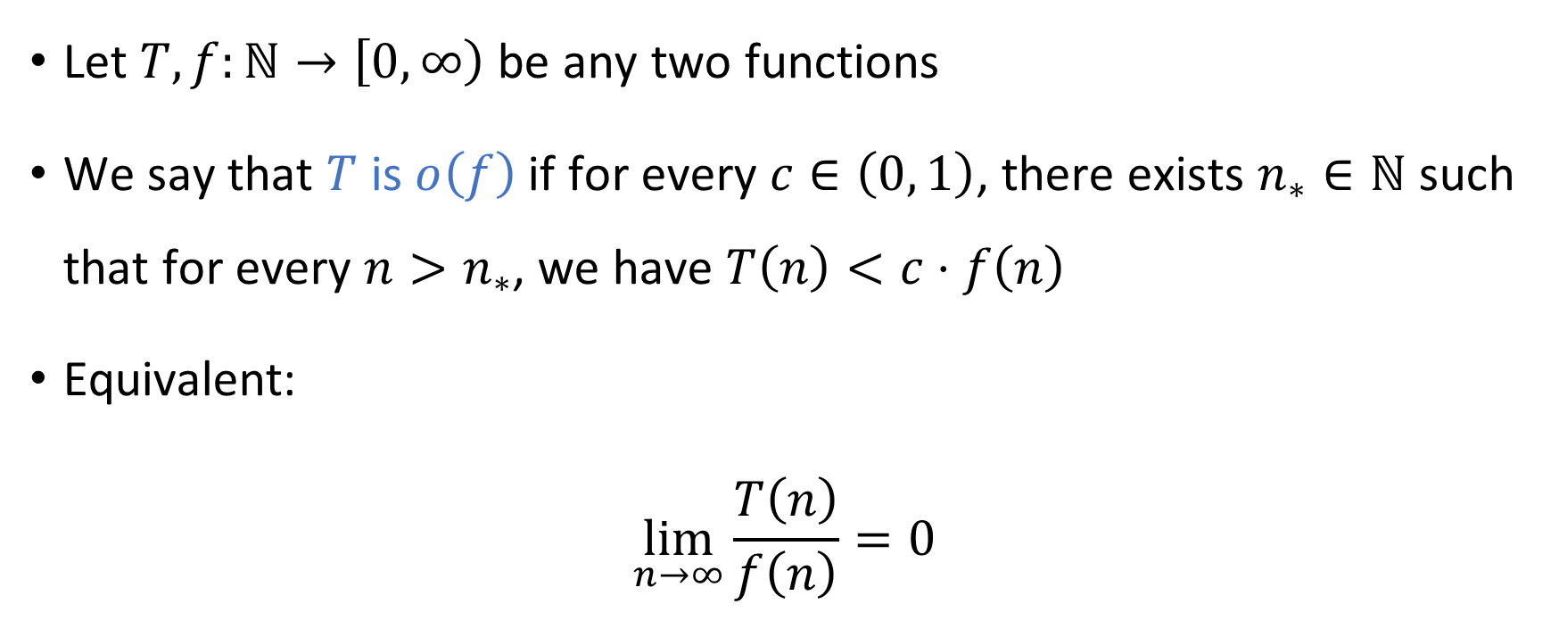

Little-$o$ notation
Let $T,f:ℕ→\left[0, ∞\right)$ be any two functions
We say that $T$ is $o\left(f\right)$ if for every $c∈\left(0, 1\right)$, there exists $n_{∗}∈ℕ$ such that for every $n>n_{∗}$, we have $T\left(n\right)<c⋅f\left(n\right)$
Equivalent:
$$\lim_{n→∞}{\frac{T\left(n\right)}{f\left(n\right)}}=0$$

Slide 25
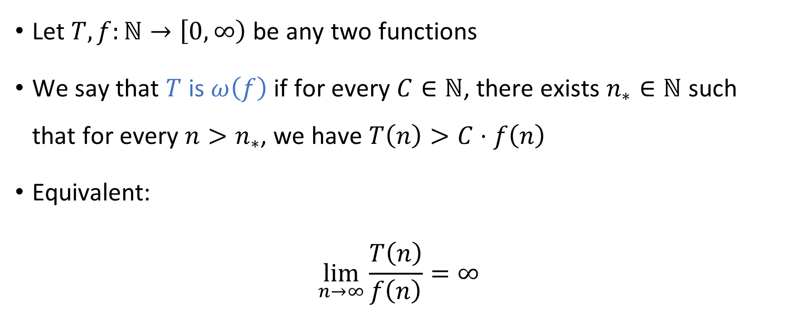

Little-$ω$ notation
Let $T,f:ℕ→\left[0, ∞\right)$ be any two functions
We say that $T$ is $ω\left(f\right)$ if for every $C∈ℕ$, there exists $n_{∗}∈ℕ$ such that for every $n>n_{∗}$, we have $T\left(n\right)>C⋅f\left(n\right)$
Equivalent:
$$\lim_{n→∞}{\frac{T\left(n\right)}{f\left(n\right)}}=∞$$

Slide 26
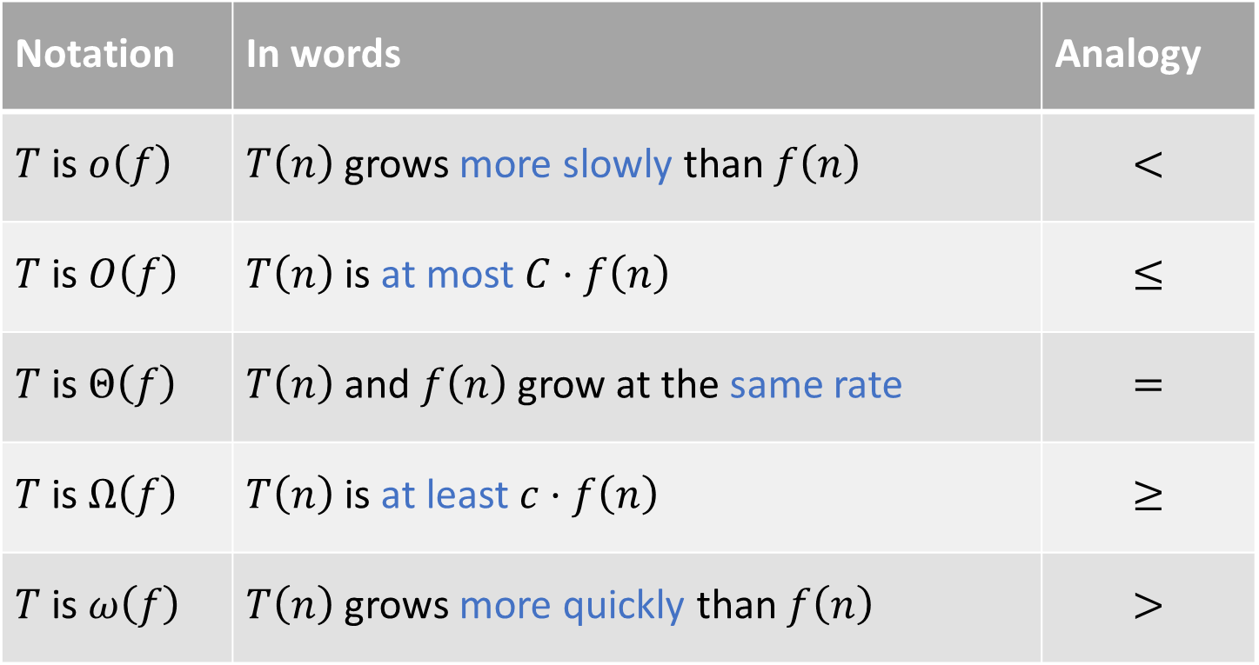
Summary of asymptotic notation
Notation | In words | Analogy
$T$ is $o\left(f\right)$ | $T\left(n\right)$ grows more slowly than $f\left(n\right)$ | $$<$$
$T$ is $O\left(f\right)$ | $T\left(n\right)$ is at most $C⋅f\left(n\right)$ | $$≤$$
$T$ is $Θ\left(f\right)$ | $T\left(n\right)$ and $f\left(n\right)$ grow at the same rate | $$=$$
$T$ is $Ω\left(f\right)$ | $T\left(n\right)$ is at least $c⋅f\left(n\right)$ | $$≥$$
$T$ is $ω\left(f\right)$ | $T\left(n\right)$ grows more quickly than $f\left(n\right)$ | $$>$$

Slide 27
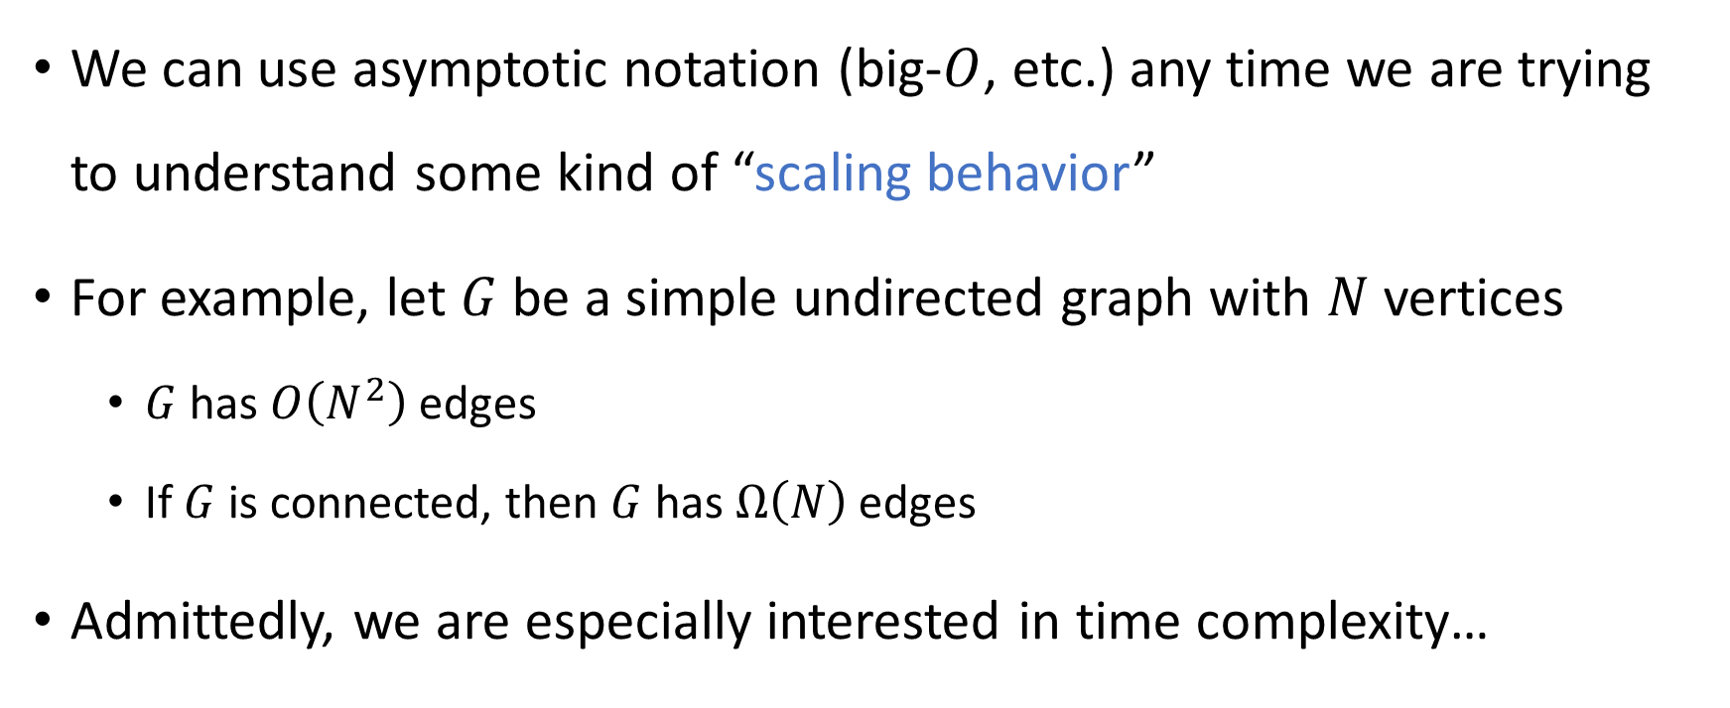

Note: Big-$O$ is not just for time complexity!
We can use asymptotic notation (big-$O$, etc.) any time we are trying to understand some kind of “scaling behavior”
For example, let $G$ be a simple undirected graph with $N$ vertices
$G$ has $O\left(N^{2}\right)$ edges
If $G$ is connected, then $G$ has $Ω\left(N\right)$ edges
Admittedly, we are especially interested in time complexity…

Slide 28
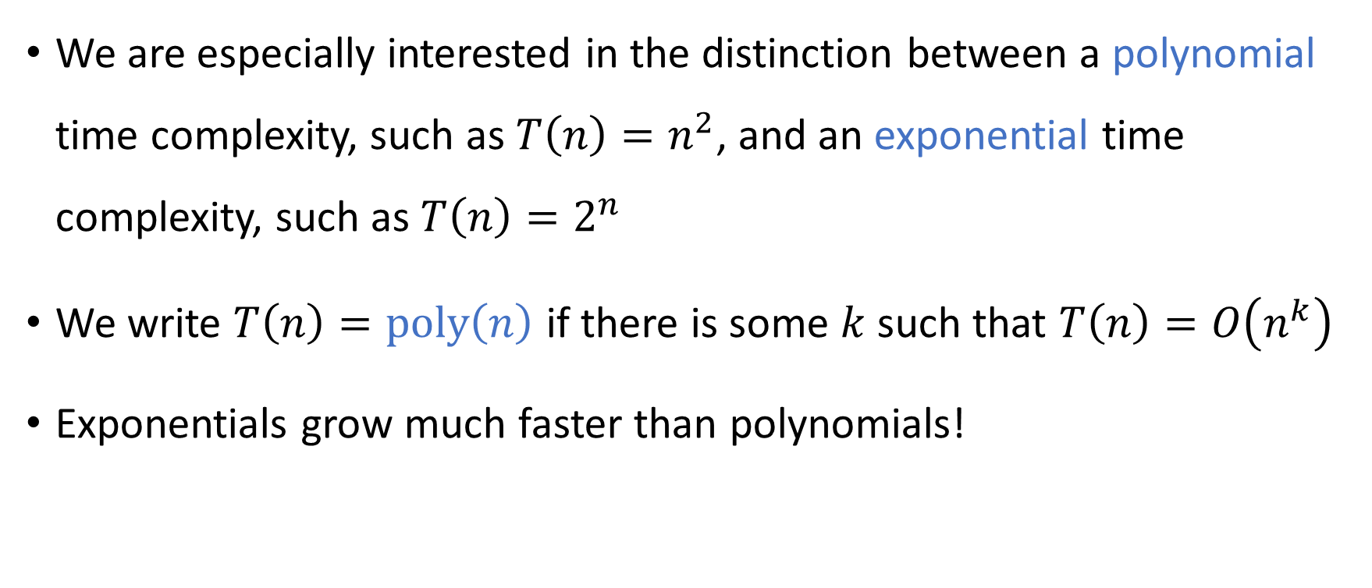
Exponential vs. polynomial
We are especially interested in the distinction between a polynomial time complexity, such as ${T\left(n\right)=n}^{2}$, and an exponential time complexity, such as $T\left(n\right)=2^{n}$
We write $T\left(n\right)=\text{poly}\left(n\right)$ if there is some $k$ such that $T\left(n\right)=O\left(n^{k}\right)$
Exponentials grow much faster than polynomials!

Slide 29
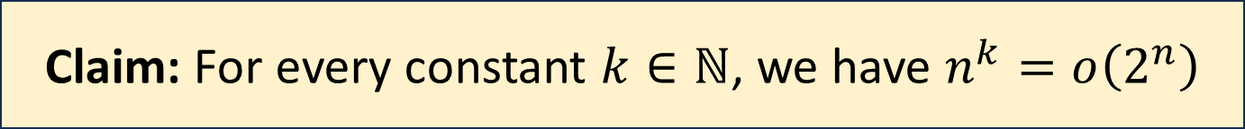
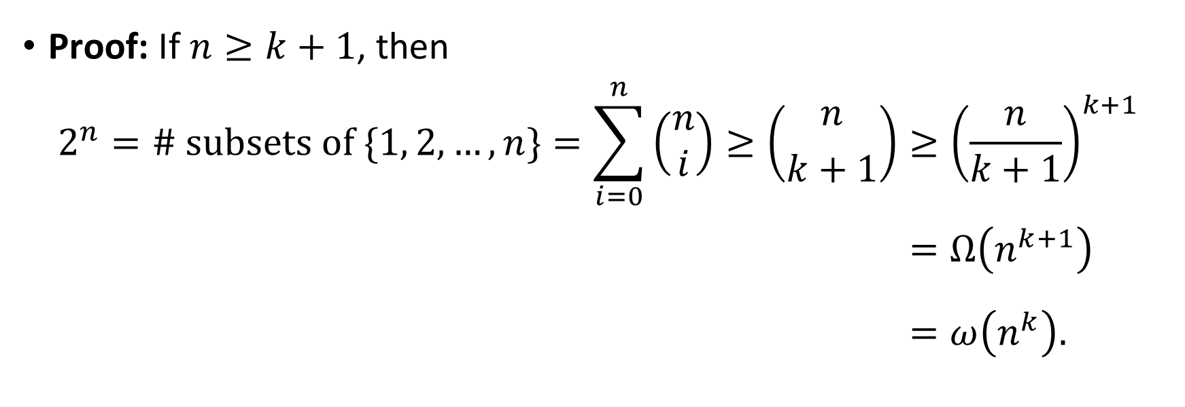
Exponential vs. polynomial
Claim: For every constant $k∈ℕ$, we have $n^{k}=o\left(2^{n}\right)$
Proof: If $n≥k+1$, then
$$2^{n}=\# \text{subsets} \text{of} \{1, 2, …, n\}=\sum_{i=0}^{n}{\left(\begin{aligned}n \\ i\end{aligned}\right)}≥\left({n \atop k+1}\right)≥{\left(\frac{n}{k+1}\right)}^{k+1} \\ =Ω\left(n^{k+1}\right)\begin{matrix} \\ \end{matrix} \\ =ω\left(n^{k}\right).\begin{matrix} \\ \end{matrix}$$

