Slide 1

CMSC 28100 Introduction to Complexity Theory Spring 2025 Instructor: William Hoza

Slide 2
Which problems can be solved through computation?

Slide 3




Word RAM model
$$\text{MEMORY}$$
010
110
101
110
110
111
000
Word RAM time complexity closely matches time complexity “in practice” on ordinary computers
Some version of the word RAM model is typically assumed (implicitly or explicitly) in algorithms courses and the computing industry
$$R_{1}$$
110
Control
$$R_{2}$$
101
Load/Store
$$R_{3}$$
110

Slide 4


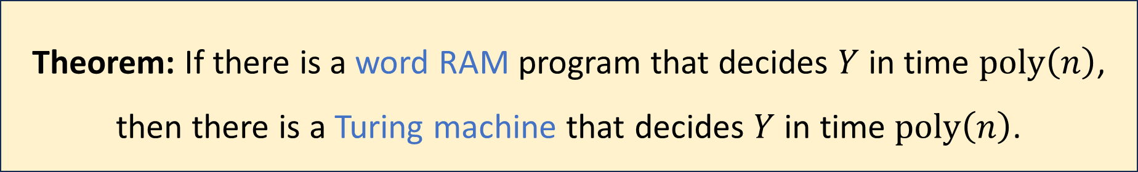
Robustness of $\text{P}$
Let $Y⊆{\left\{0, 1\right\}}^{∗}$
Proof omitted
Theorem: If there is a word RAM program that decides $Y$ in time $\text{poly}\left(n\right)$, then there is a Turing machine that decides $Y$ in time $\text{poly}\left(n\right)$.

Slide 5
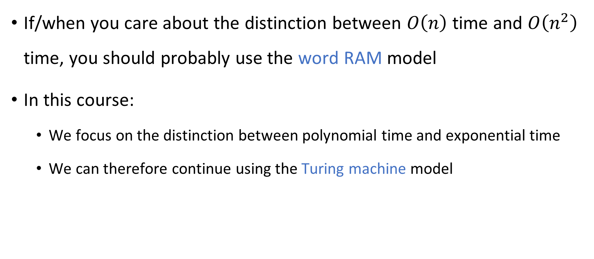
Fine-grained vs. coarse-grained complexity
If/when you care about the distinction between $O\left(n\right)$ time and $O\left(n^{2}\right)$ time, you should probably use the word RAM model
In this course:
We focus on the distinction between polynomial time and exponential time
We can therefore continue using the Turing machine model

Slide 6
Which problems can be solved through computation?

Slide 7

Which languages are in $\text{P}$?

Slide 8

Which languages are not in $\text{P}$?

Slide 9

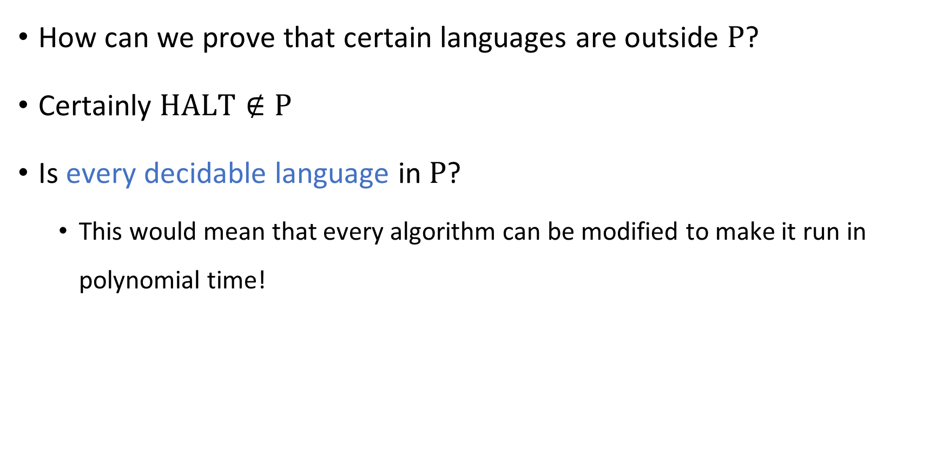
Intractability
How can we prove that certain languages are outside $\text{P}$?
Certainly $\text{HALT}∉\text{P}$
Is every decidable language in $\text{P}$?
This would mean that every algorithm can be modified to make it run in polynomial time!

Slide 10



Intractability vs. undecidability
All languages
$$\text{HALT}$$
Decidable languages
???
$$\text{P}$$
$$\text{PALINDROMES}$$

Slide 11
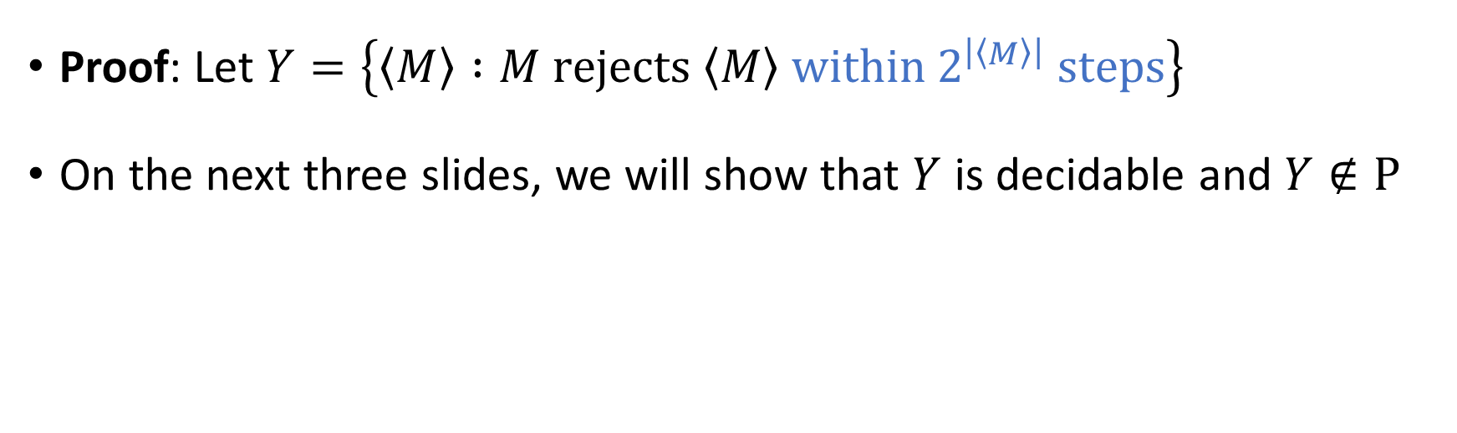
Intractability vs. undecidability
Theorem: There exists $Y⊆{\left\{0, 1\right\}}^{∗}$ such that $Y$ is decidable, but $Y∉\text{P}$.
Proof: Let $Y=\left\{\left\langle M\right\rangle :M \text{rejects} \left\langle M\right\rangle \text{within} 2^{\left|\left\langle M\right\rangle \right|} \text{steps}\right\}$
On the next three slides, we will show that $Y$ is decidable and $Y∉\text{P}$

Slide 12

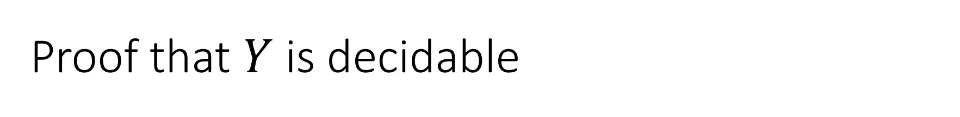
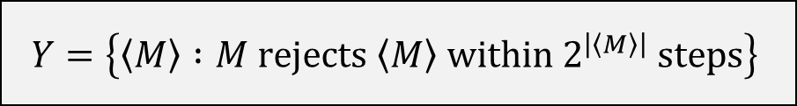

Proof that $Y$ is decidable
$$Y=\left\{\left\langle M\right\rangle :M \text{rejects} \left\langle M\right\rangle \text{within} 2^{\left|\left\langle M\right\rangle \right|} \text{steps}\right\}$$
An algorithm that decides $Y$:
Given the input $\left\langle M\right\rangle$:
Simulate $M$ on $\left\langle M\right\rangle$ for $2^{\left|\left\langle M\right\rangle \right|}$ steps
If it rejects within that time, accept
Otherwise, reject

Slide 13
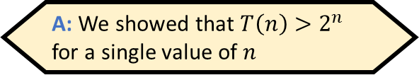
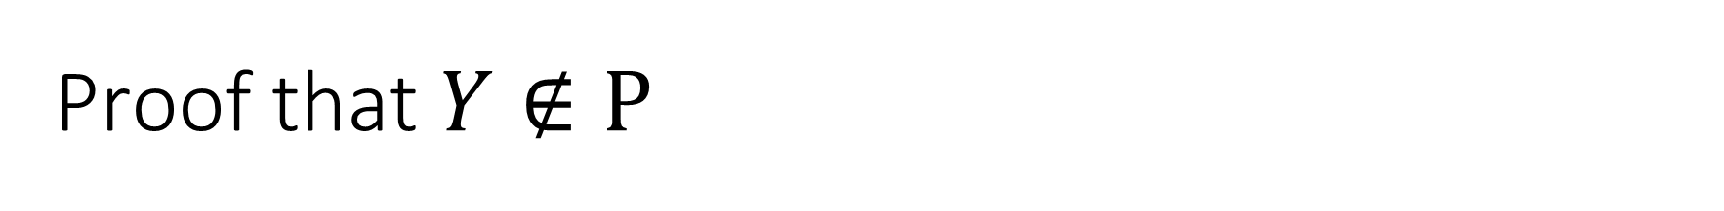

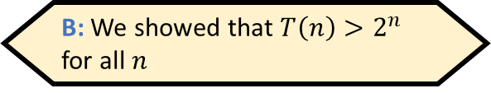
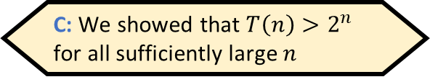
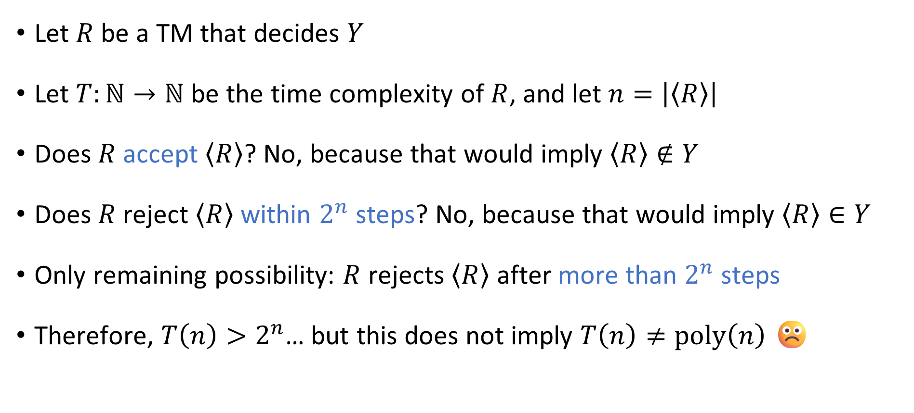
Proof that $Y∉\text{P}$
Which of the following best describes what we’ve proven?
$$Y=\left\{\left\langle M\right\rangle :M \text{rejects} \left\langle M\right\rangle \text{within} 2^{\left|\left\langle M\right\rangle \right|} \text{steps}\right\}$$
A: We showed that $T\left(n\right)>2^{n}$ for a single value of $n$
B: We showed that $T\left(n\right)>2^{n}$ for all $n$
C: We showed that $T\left(n\right)>2^{n}$ for all sufficiently large $n$
D: We showed that $T\left(n\right)>2^{n}$ for infinitely many $n$
Let $R$ be a TM that decides $Y$
Let $T:ℕ→ℕ$ be the time complexity of $R$, and let $n=\left|\left\langle R\right\rangle \right|$
Does $R$ accept $\left\langle R\right\rangle$? No, because that would imply $\left\langle R\right\rangle ∉Y$
Does $R$ reject $\left\langle R\right\rangle$ within $2^{n}$ steps? No, because that would imply $\left\langle R\right\rangle ∈Y$
Only remaining possibility: $R$ rejects $\left\langle R\right\rangle$ after more than $2^{n}$ steps
Therefore, $T\left(n\right)>2^{n}$… but this does not imply $T\left(n\right)≠\text{poly}\left(n\right)$ ☹️
Respond at PollEv.com/whoza or text “whoza” to 22333

Slide 14
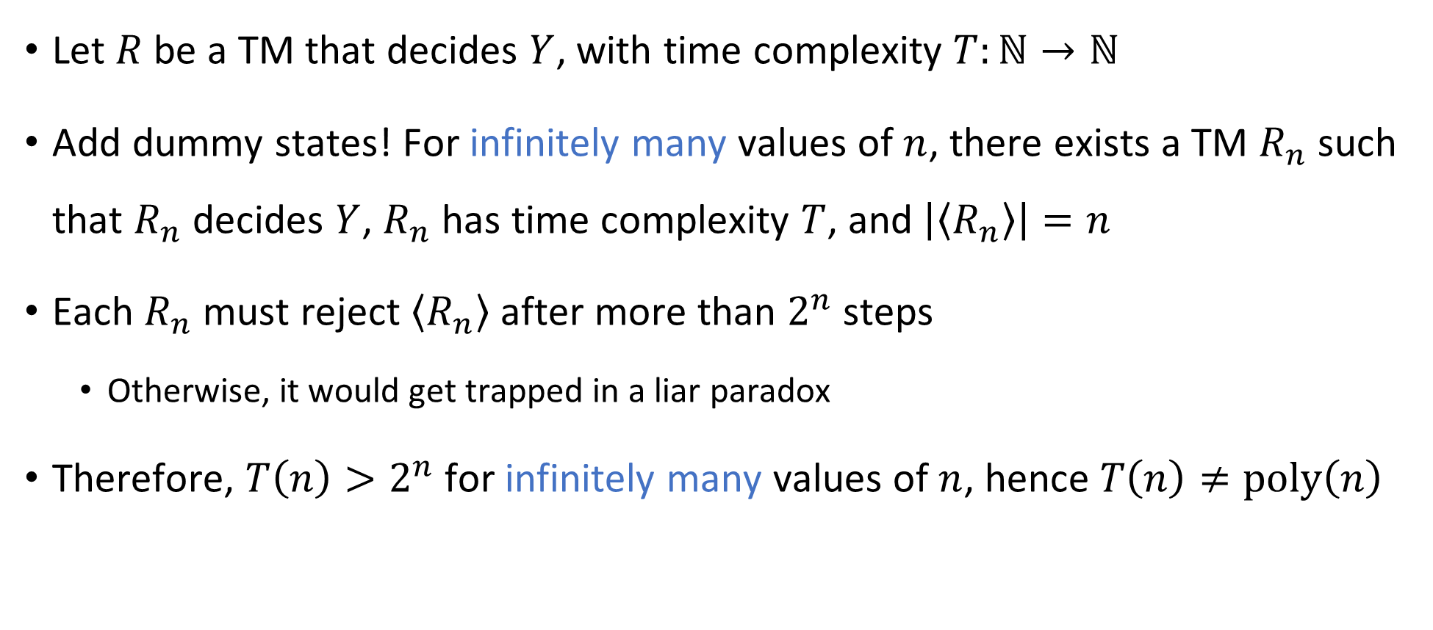
Proof that $Y∉\text{P}$
$$Y=\left\{\left\langle M\right\rangle :M \text{rejects} \left\langle M\right\rangle \text{within} 2^{\left|\left\langle M\right\rangle \right|} \text{steps}\right\}$$
Let $R$ be a TM that decides $Y$, with time complexity $T:ℕ→ℕ$
Add dummy states! For infinitely many values of $n$, there exists a TM $R_{n}$ such that $R_{n}$ decides $Y$, $R_{n}$ has time complexity $T$, and $\left|\left\langle R_{n}\right\rangle \right|=n$
Each $R_{n}$ must reject $\left\langle R_{n}\right\rangle$ after more than $2^{n}$ steps
Otherwise, it would get trapped in a liar paradox
Therefore, $T\left(n\right)>2^{n}$ for infinitely many values of $n$, hence $T\left(n\right)≠\text{poly}\left(n\right)$

Slide 15
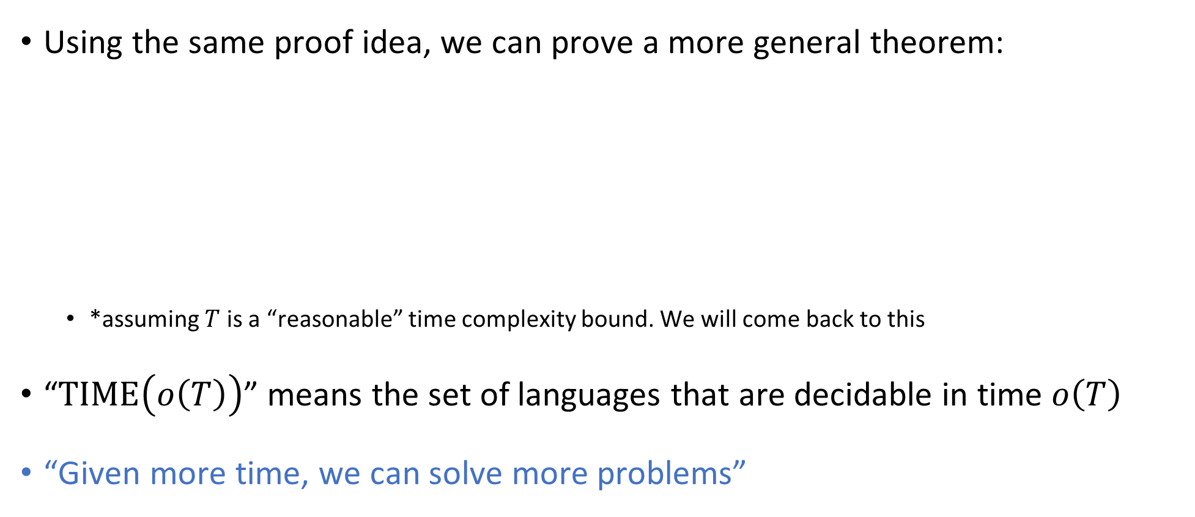
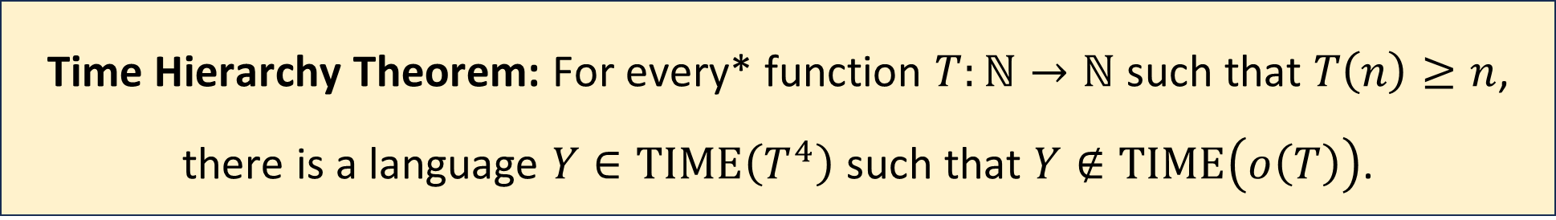
The Time Hierarchy Theorem
Using the same proof idea, we can prove a more general theorem:
*assuming $T$ is a “reasonable” time complexity bound. We will come back to this
“$\text{TIME}\left(o\left(T\right)\right)$” means the set of languages that are decidable in time $o\left(T\right)$
“Given more time, we can solve more problems”
Time Hierarchy Theorem: For every* function $T:ℕ→ℕ$ such that $T\left(n\right)≥n$, there is a language $Y∈\text{TIME}\left(T^{4}\right)$ such that $Y∉\text{TIME}\left(o\left(T\right)\right)$.
Notes:
See the textbook for a tighter version of the theorem, where the bound is T log T instead of T^4

Slide 16

Proof of the Time Hierarchy Theorem
Let $Y=\left\{\left\langle M\right\rangle :M \text{rejects} \left\langle M\right\rangle \text{within} T\left(\left|\left\langle M\right\rangle \right|\right) \text{steps}\right\}$
On the next four slides, we will prove:
$Y∈\text{TIME}\left(T^{4}\right)$
$Y∉\text{TIME}\left(o\left(T\right)\right)$

Slide 17



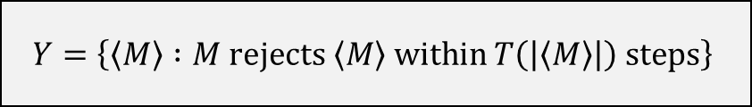
Proof that $Y∈\text{TIME}\left(T^{4}\right)$
$$Y=\left\{\left\langle M\right\rangle :M \text{rejects} \left\langle M\right\rangle \text{within} T\left(\left|\left\langle M\right\rangle \right|\right) \text{steps}\right\}$$
An algorithm that decides $Y$:
Time complexity in the TM model?
Given the input $\left\langle M\right\rangle$:
Simulate $M$ on $\left\langle M\right\rangle$ for $T\left(\left|\left\langle M\right\rangle \right|\right)$ steps
If it rejects within that time, accept
Otherwise, reject

Slide 18

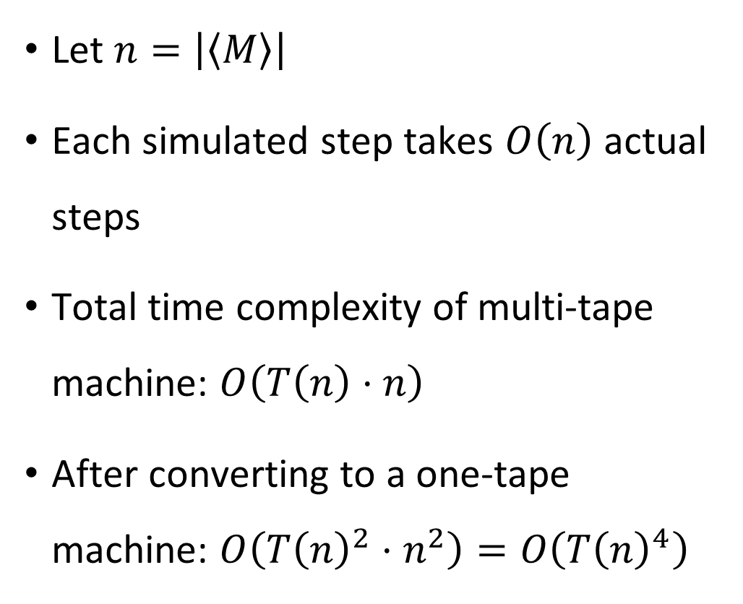

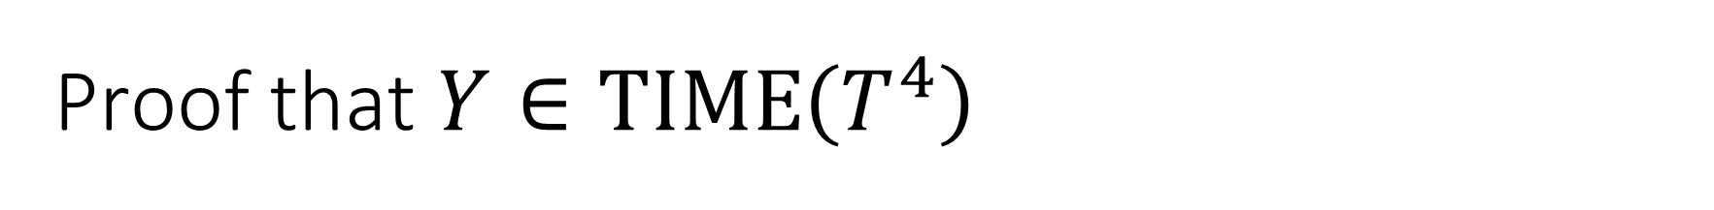



Proof that $Y∈\text{TIME}\left(T^{4}\right)$
$$Y=\left\{\left\langle M\right\rangle :M \text{rejects} \left\langle M\right\rangle \text{within} T\left(\left|\left\langle M\right\rangle \right|\right) \text{steps}\right\}$$
Let $n=\left|\left\langle M\right\rangle \right|$
Each simulated step takes $O\left(n\right)$ actual steps
Total time complexity of multi-tape machine: $O\left(T\left(n\right)⋅n\right)$
After converting to a one-tape machine: $O\left(T{\left(n\right)}^{2}⋅n^{2}\right)=O\left(T{\left(n\right)}^{4}\right)$
$$1^{k}0\left\langle δ\right\rangle$$
$$q$$
$$\left\langle δ\right\rangle$$
$$…\left\langle b_{i−2}\right\rangle \left\langle b_{i−1}\right\rangle \left\langle b_{i}\right\rangle \left\langle b_{i+1}\right\rangle \left\langle b_{i+2}\right\rangle …$$
$$1^{T\left(\left|\left\langle M\right\rangle \right|\right)}$$

Slide 19
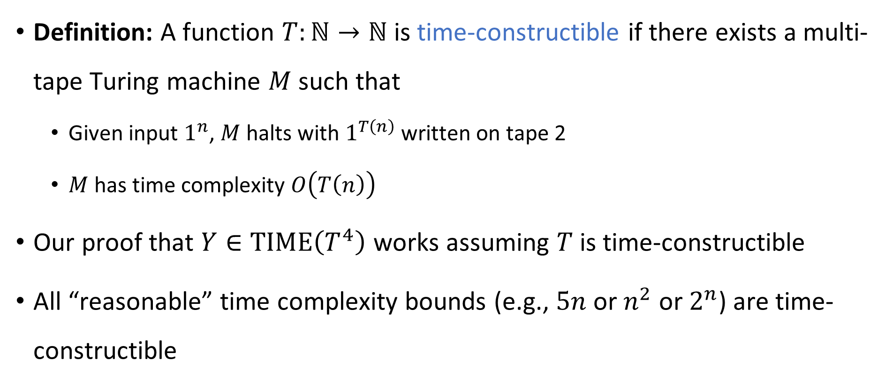
Time-constructible functions
Definition: A function $T:ℕ→ℕ$ is time-constructible if there exists a multi-tape Turing machine $M$ such that
Given input $1^{n}$, $M$ halts with $1^{T\left(n\right)}$ written on tape 2
$M$ has time complexity $O\left(T\left(n\right)\right)$
Our proof that $Y∈\text{TIME}\left(T^{4}\right)$ works assuming $T$ is time-constructible
All “reasonable” time complexity bounds (e.g., $5n$ or $n^{2}$ or $2^{n}$) are time-constructible

Slide 20
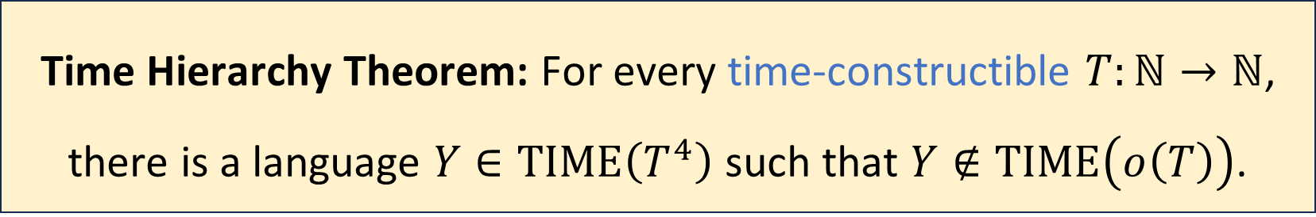
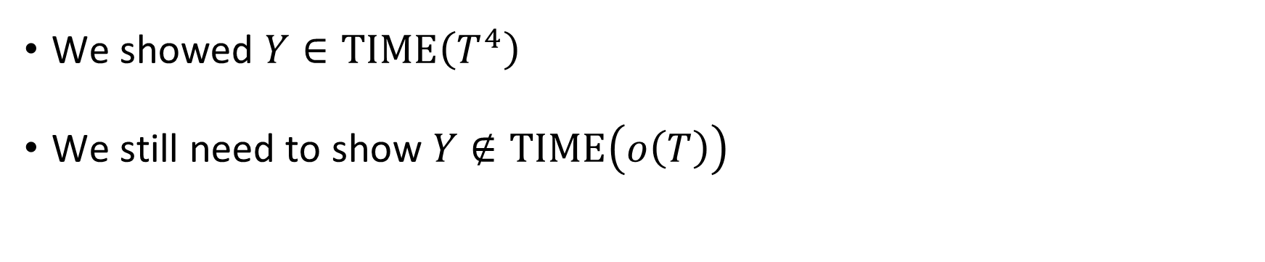

Time Hierarchy Theorem
$$Y=\left\{\left\langle M\right\rangle :M \text{rejects} \left\langle M\right\rangle \text{within} T\left(\left|\left\langle M\right\rangle \right|\right) \text{steps}\right\}$$
Time Hierarchy Theorem: For every time-constructible $T:ℕ→ℕ$, there is a language $Y∈\text{TIME}\left(T^{4}\right)$ such that $Y∉\text{TIME}\left(o\left(T\right)\right)$.
We showed $Y∈\text{TIME}\left(T^{4}\right)$
We still need to show $Y∉\text{TIME}\left(o\left(T\right)\right)$

Slide 21
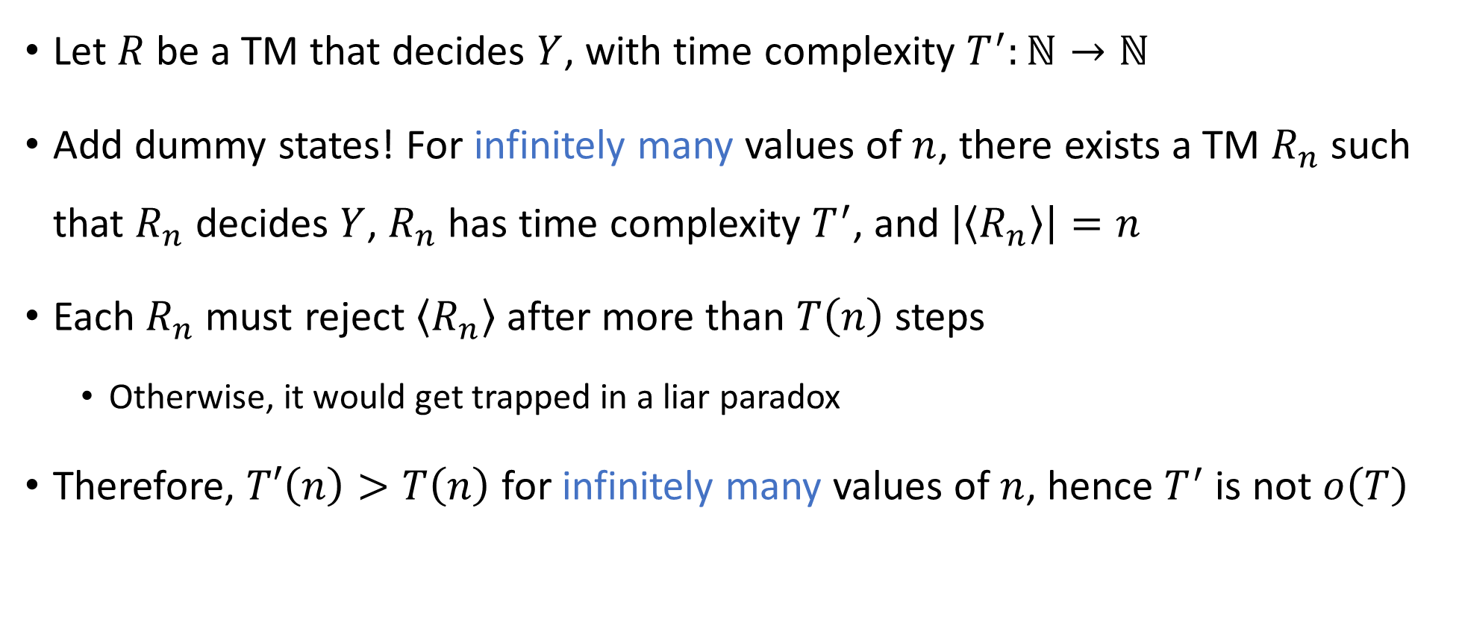
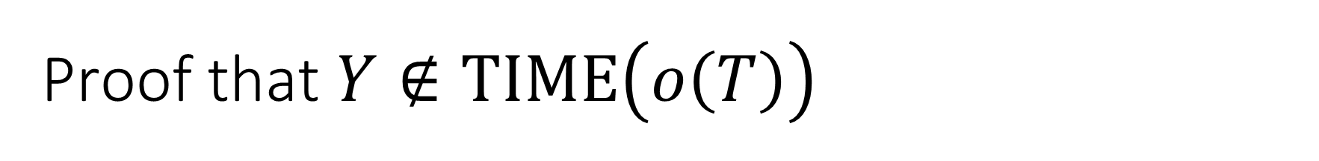
Proof that $Y∉\text{TIME}\left(o\left(T\right)\right)$
$$Y=\left\{\left\langle M\right\rangle :M \text{rejects} \left\langle M\right\rangle \text{within} T\left(\left|\left\langle M\right\rangle \right|\right) \text{steps}\right\}$$
Let $R$ be a TM that decides $Y$, with time complexity $T^{′}:ℕ→ℕ$
Add dummy states! For infinitely many values of $n$, there exists a TM $R_{n}$ such that $R_{n}$ decides $Y$, $R_{n}$ has time complexity $T^{′}$, and $\left|\left\langle R_{n}\right\rangle \right|=n$
Each $R_{n}$ must reject $\left\langle R_{n}\right\rangle$ after more than $T\left(n\right)$ steps
Otherwise, it would get trapped in a liar paradox
Therefore, $T′\left(n\right)>T\left(n\right)$ for infinitely many values of $n$, hence $T^{′}$ is not $o\left(T\right)$

