Slide 1
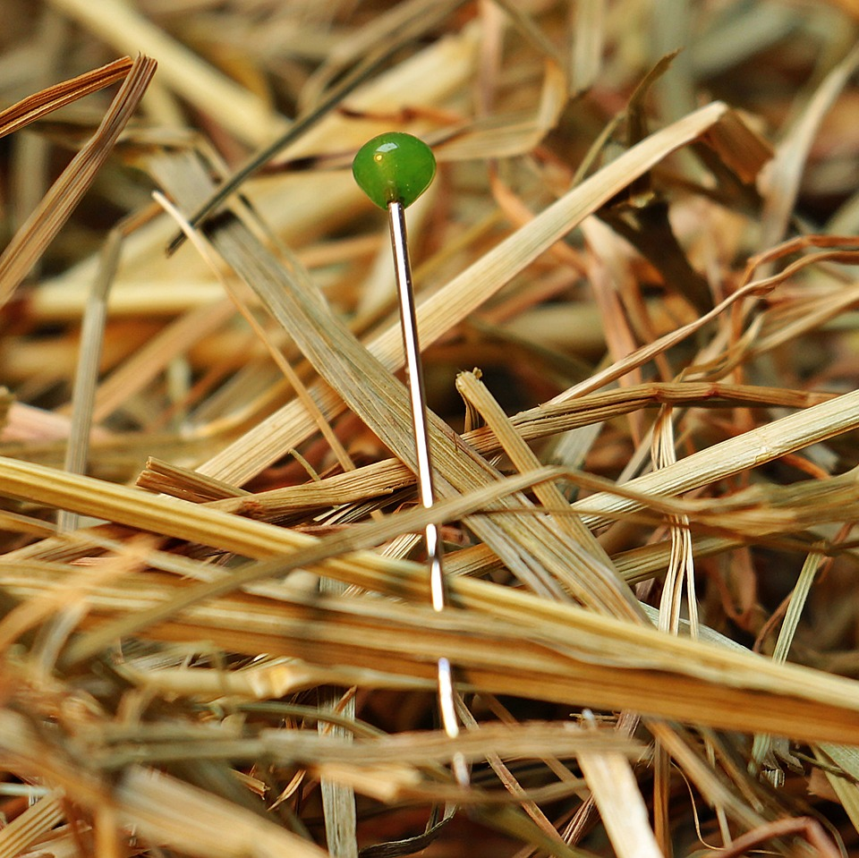
CMSC 28100 Introduction to Complexity Theory Spring 2025 Instructor: William Hoza

Slide 2



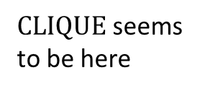


$$\text{CLIQUE}=\{\left\langle G,k\right\rangle :G \text{has} \text{a} k\text{‑}\text{clique}\}$$
$\text{EXP}$-hard
$\text{EXP}$-complete
$\text{CLIQUE}$ seems to be here
$$\text{EXP}$$
$$\text{P}$$

Slide 3

Complexity of the clique problem
Evidently, to understand the complexity of $\text{CLIQUE}$, we need new conceptual tools

Slide 4
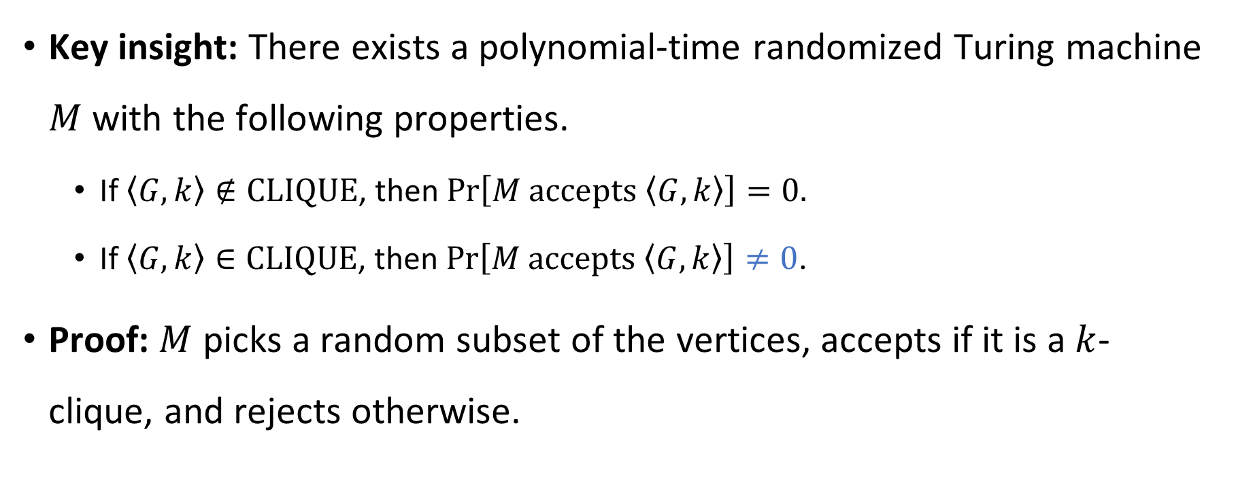
Guessing and checking
Key insight: There exists a polynomial-time randomized Turing machine $M$ with the following properties.
If $\left\langle G,k\right\rangle ∉\text{CLIQUE}$, then $\operatorname{Pr}\left[M \text{accepts} \left\langle G,k\right\rangle \right]=0.$
If $\left\langle G,k\right\rangle ∈\text{CLIQUE}$, then $\operatorname{Pr}\left[M \text{accepts} \left\langle G,k\right\rangle \right]≠0$.
Proof: $M$ picks a random subset of the vertices, accepts if it is a $k$-clique, and rejects otherwise.
“Nondeterministic TM”

Slide 5
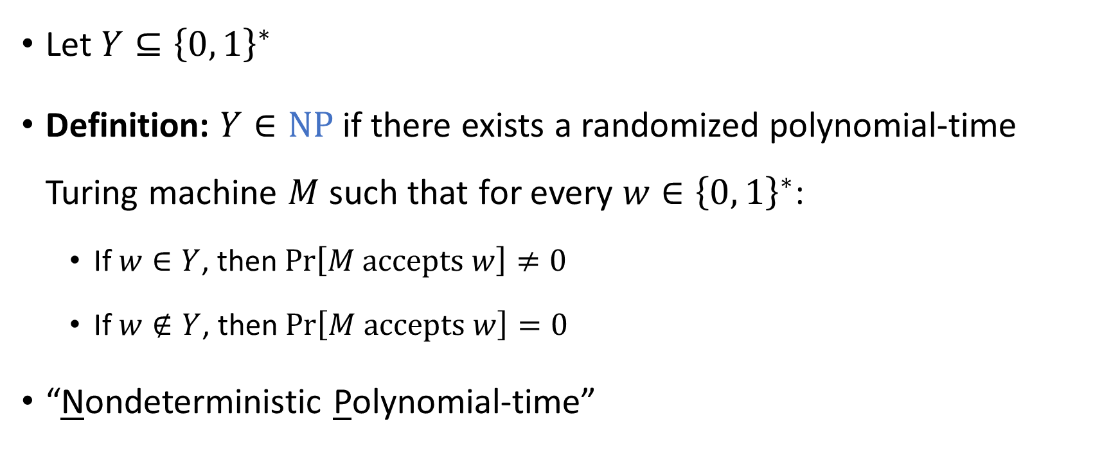

The complexity class $\text{NP}$
Let $Y⊆{\left\{0, 1\right\}}^{∗}$
Definition: $Y∈\text{NP}$ if there exists a randomized polynomial-time Turing machine $M$ such that for every $w∈{\left\{0, 1\right\}}^{∗}$:
If $w∈Y$, then $\operatorname{Pr}\left[M \text{accepts} w\right]≠0$
If $w∉Y$, then $\operatorname{Pr}\left[M \text{accepts} w\right]=0$
“Nondeterministic Polynomial-time”

Slide 6
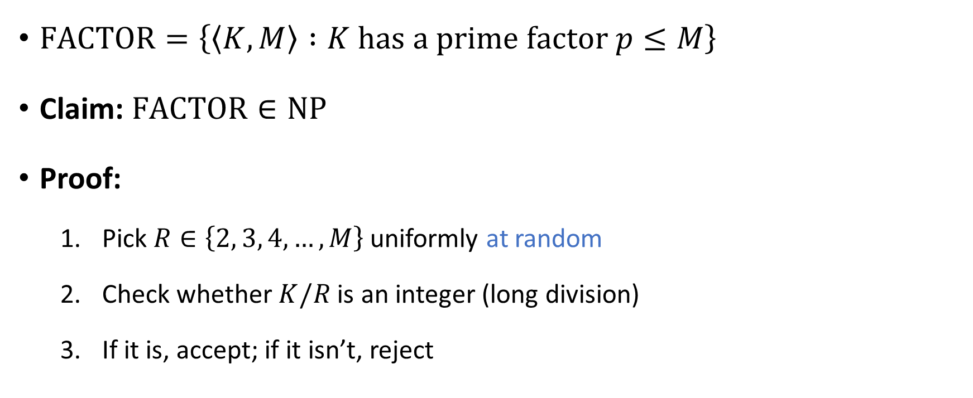

Another example of a language in $\text{NP}$
$\text{FACTOR}=\left\{\left\langle K,M\right\rangle :K \text{has} \text{a} \text{prime} \text{factor} p≤M\right\}$
Claim: $\text{FACTOR}∈\text{NP}$
Proof:
Pick $R∈\left\{2, 3, 4, …, M\right\}$ uniformly at random
Check whether $K/R$ is an integer (long division)
If it is, accept; if it isn’t, reject

Slide 7
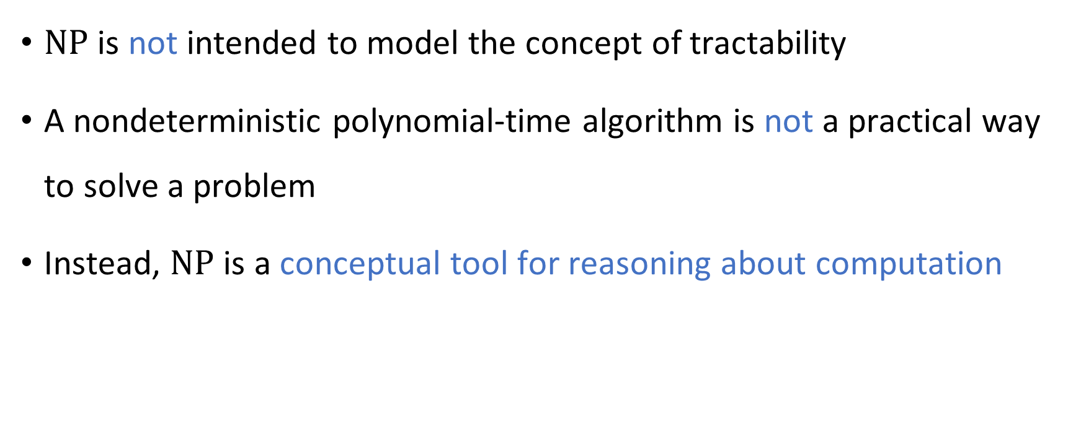

How to interpret $\text{NP}$
$\text{NP}$ is not intended to model the concept of tractability
A nondeterministic polynomial-time algorithm is not a practical way to solve a problem
Instead, $\text{NP}$ is a conceptual tool for reasoning about computation

Slide 8
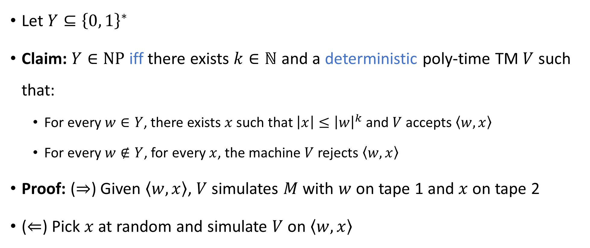
“Verification of certificates” perspective
Let $Y⊆{\left\{0, 1\right\}}^{∗}$
Claim: $Y∈\text{NP}$ iff there exists $k∈ℕ$ and a deterministic poly-time TM $V$ such that:
For every $w∈Y$, there exists $x$ such that $\left|x\right|≤{\left|w\right|}^{k}$ and $V$ accepts $\left\langle w,x\right\rangle$
For every $w∉Y$, for every $x$, the machine $V$ rejects $\left\langle w,x\right\rangle$
Proof: ($⇒$) Given $\left\langle w,x\right\rangle$, $V$ simulates $M$ with $w$ on tape 1 and $x$ on tape 2
($⇐$) Pick $x$ at random and simulate $V$ on $\left\langle w,x\right\rangle$
“Verifier”
“Certificate” / “Witness”

Slide 9




The $\text{P}$ vs. $\text{NP}$ problem
$$\text{NP}$$
$$\text{P}$$
$\text{P}⊆\text{NP}$ (why?)
Open question: Does $\text{P}=\text{NP}$?
Let $Y∈\text{NP}$
What can we do if we want to decide $Y$ deterministically?

Slide 10
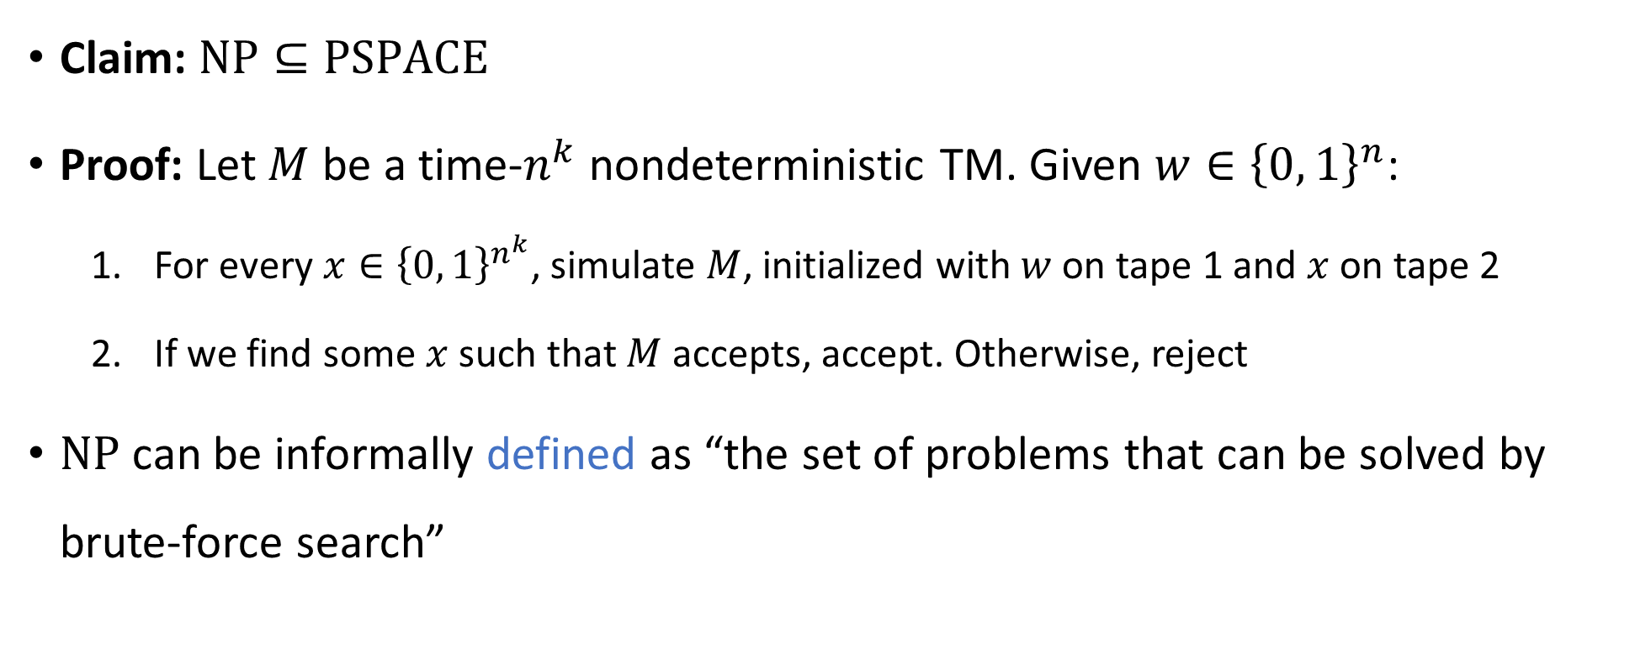

Solving problems in $\text{NP}$ by brute force
Claim: $\text{NP}⊆\text{PSPACE}$
Proof: Let $M$ be a time-$n^{k}$ nondeterministic TM. Given $w∈{\left\{0, 1\right\}}^{n}$:
For every $x∈{\left\{0, 1\right\}}^{n^{k}}$, simulate $M$, initialized with $w$ on tape 1 and $x$ on tape 2
If we find some $x$ such that $M$ accepts, accept. Otherwise, reject
$\text{NP}$ can be informally defined as “the set of problems that can be solved by brute-force search”

Slide 11




$$\text{EXP}$$
$$\text{PSPACE}$$
$$\text{NP}$$
$$\text{P}$$

Slide 12

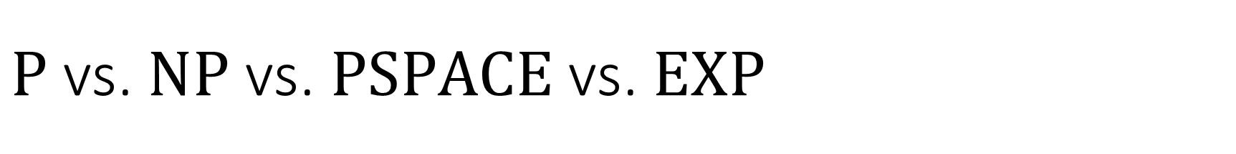
$\text{P}$ vs. $\text{NP}$ vs. $\text{PSPACE}$ vs. $\text{EXP}$
$\text{P}⊆\text{NP}⊆\text{PSPACE}⊆\text{EXP}$
What we expect: All of these containments are strict
What we can prove: At least one of these containments is strict. (Why?)

Slide 13
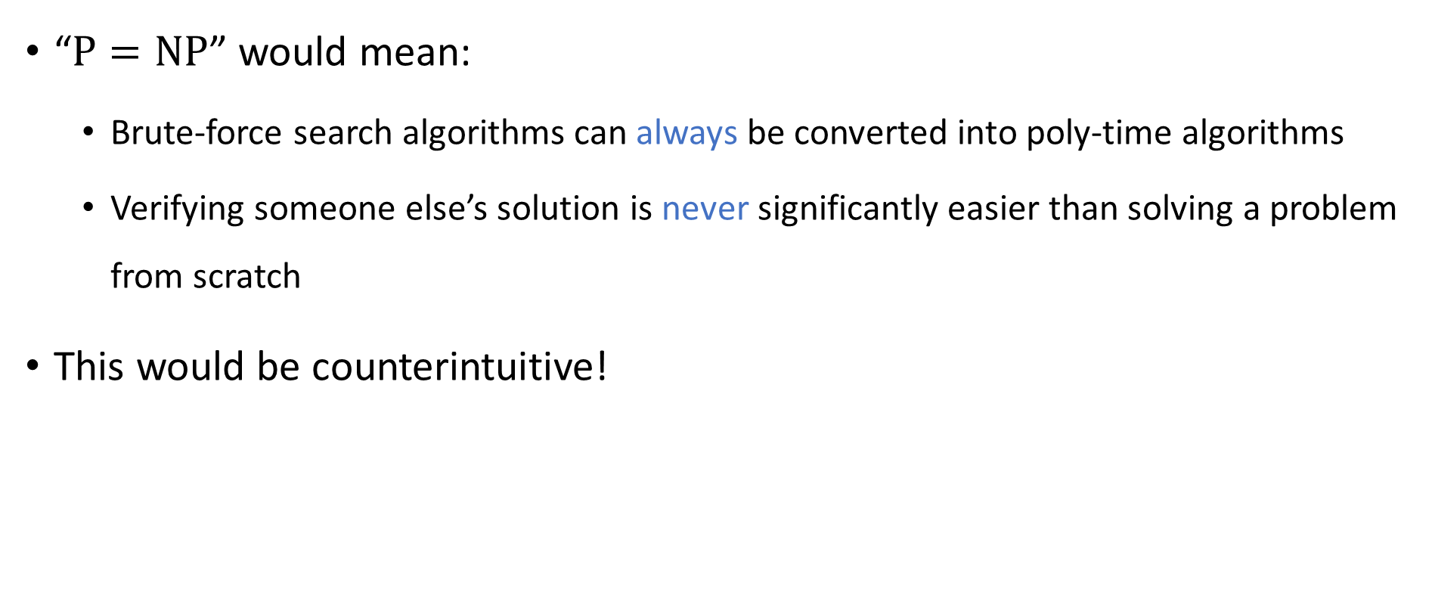



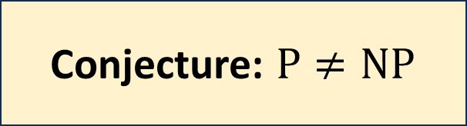
The $\text{P}$ vs. $\text{NP}$ problem
$$\text{NP}$$
$$\text{P}$$
“$\text{P}=\text{NP}$” would mean:
Brute-force search algorithms can always be converted into poly-time algorithms
Verifying someone else’s solution is never significantly easier than solving a problem from scratch
This would be counterintuitive!
Conjecture: $\text{P}≠\text{NP}$

Slide 14


Comparing $\text{NP}$ and $\text{BPP}$
Conjecture: $\text{P}≠\text{NP}$
It’s hard to find a needle in a haystack
Conjecture: $\text{P}=\text{BPP}$
It’s easy to find hay in a haystack!

Slide 15

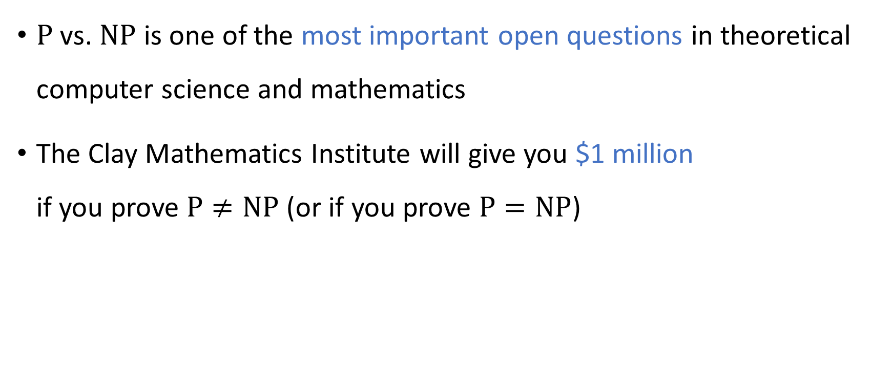
The $\text{P}$ vs. $\text{NP}$ problem
$\text{P}$ vs. $\text{NP}$ is one of the most important open questions in theoretical computer science and mathematics
The Clay Mathematics Institute will give you $1 million if you prove $\text{P}≠\text{NP}$ (or if you prove $\text{P}=\text{NP}$)

Slide 16
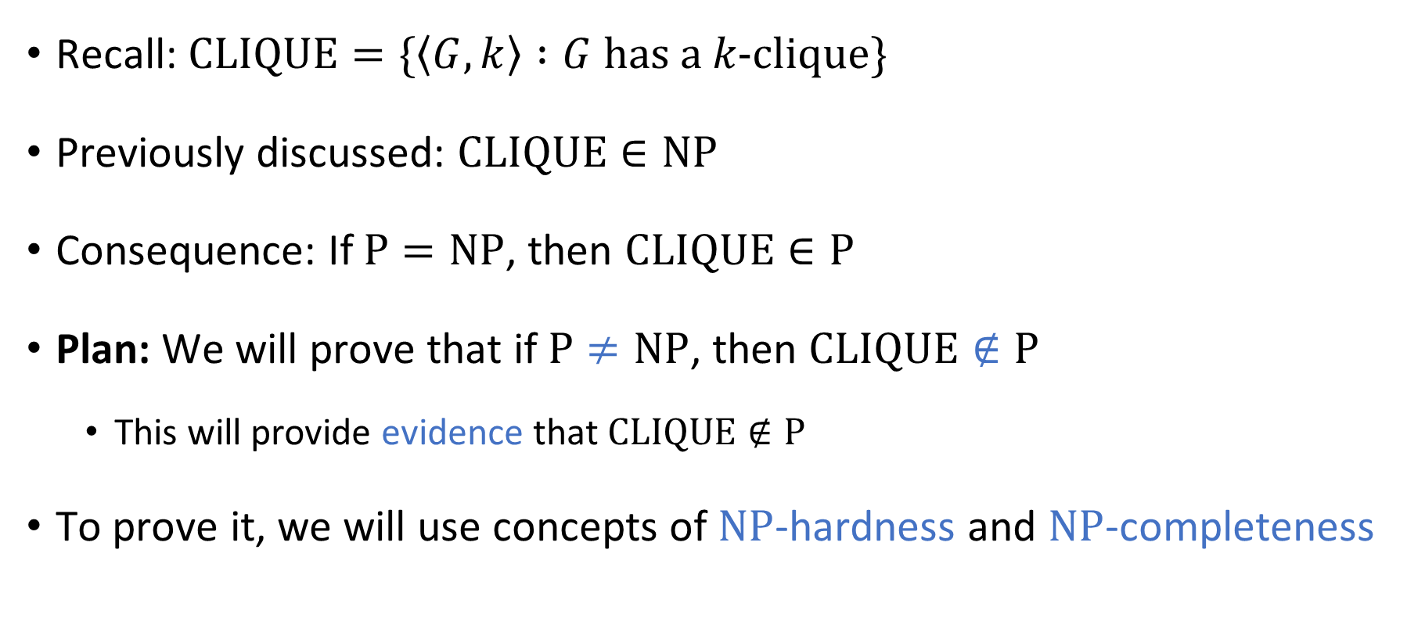

Complexity of $\text{CLIQUE}$
Recall: $\text{CLIQUE}=\{\left\langle G,k\right\rangle :G \text{has} \text{a} k\text{‑}\text{clique}\}$
Previously discussed: $\text{CLIQUE}∈\text{NP}$
Consequence: If $\text{P}=\text{NP}$, then $\text{CLIQUE}∈\text{P}$
Plan: We will prove that if $\text{P}≠\text{NP}$, then $\text{CLIQUE}∉\text{P}$
This will provide evidence that $\text{CLIQUE}∉\text{P}$
To prove it, we will use concepts of $\text{NP}$-hardness and $\text{NP}$-completeness

Slide 17
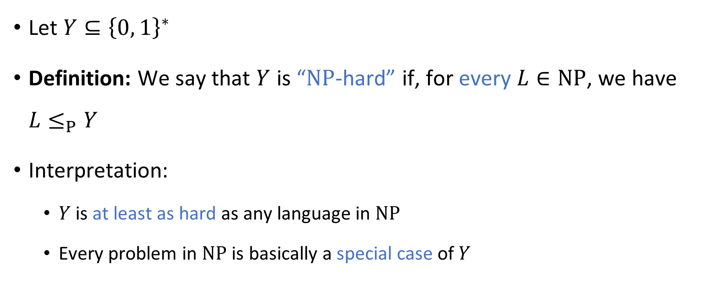
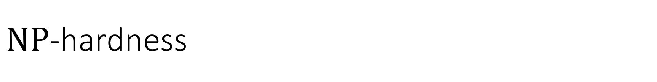
$\text{NP}$-hardness
Let $Y⊆{\left\{0, 1\right\}}^{∗}$
Definition: We say that $Y$ is “$\text{NP}$-hard” if, for every $L∈\text{NP}$, we have $L≤_{P}Y$
Interpretation:
$Y$ is at least as hard as any language in $\text{NP}$
Every problem in $\text{NP}$ is basically a special case of $Y$

Slide 18
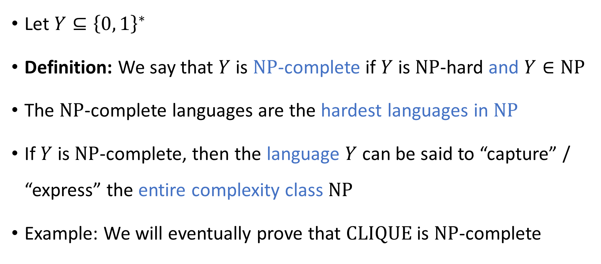
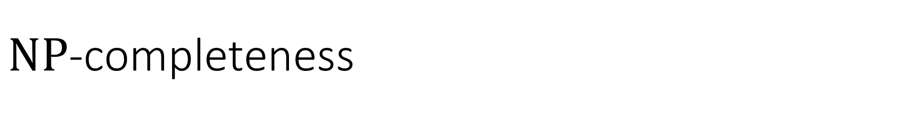
$\text{NP}$-completeness
Let $Y⊆{\left\{0, 1\right\}}^{∗}$
Definition: We say that $Y$ is $\text{NP}$-complete if $Y$ is $\text{NP}$-hard and $Y∈\text{NP}$
The $\text{NP}$-complete languages are the hardest languages in $\text{NP}$
If $Y$ is $\text{NP}$-complete, then the language $Y$ can be said to “capture” / “express” the entire complexity class $\text{NP}$
Example: We will eventually prove that $\text{CLIQUE}$ is $\text{NP}$-complete

Slide 19


$\text{NP}$-complete languages are probably not in $\text{P}$
Let $Y$ be an $\text{NP}$-complete language
Claim: $Y∈\text{P}$ if and only if $\text{P}=\text{NP}$
Proof:
$\left(⇐\right)$ This holds because $Y∈\text{NP}$ ✔️
$\left(⇒\right)$ This holds because $Y$ is $\text{NP}$-hard ✔️

Slide 20

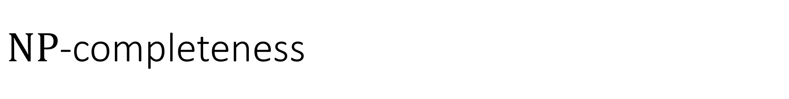



$\text{NP}$-completeness
$\text{NP}$-hard
$\text{NP}$-complete
$$\text{NP}$$
$$\text{P}$$

Slide 21
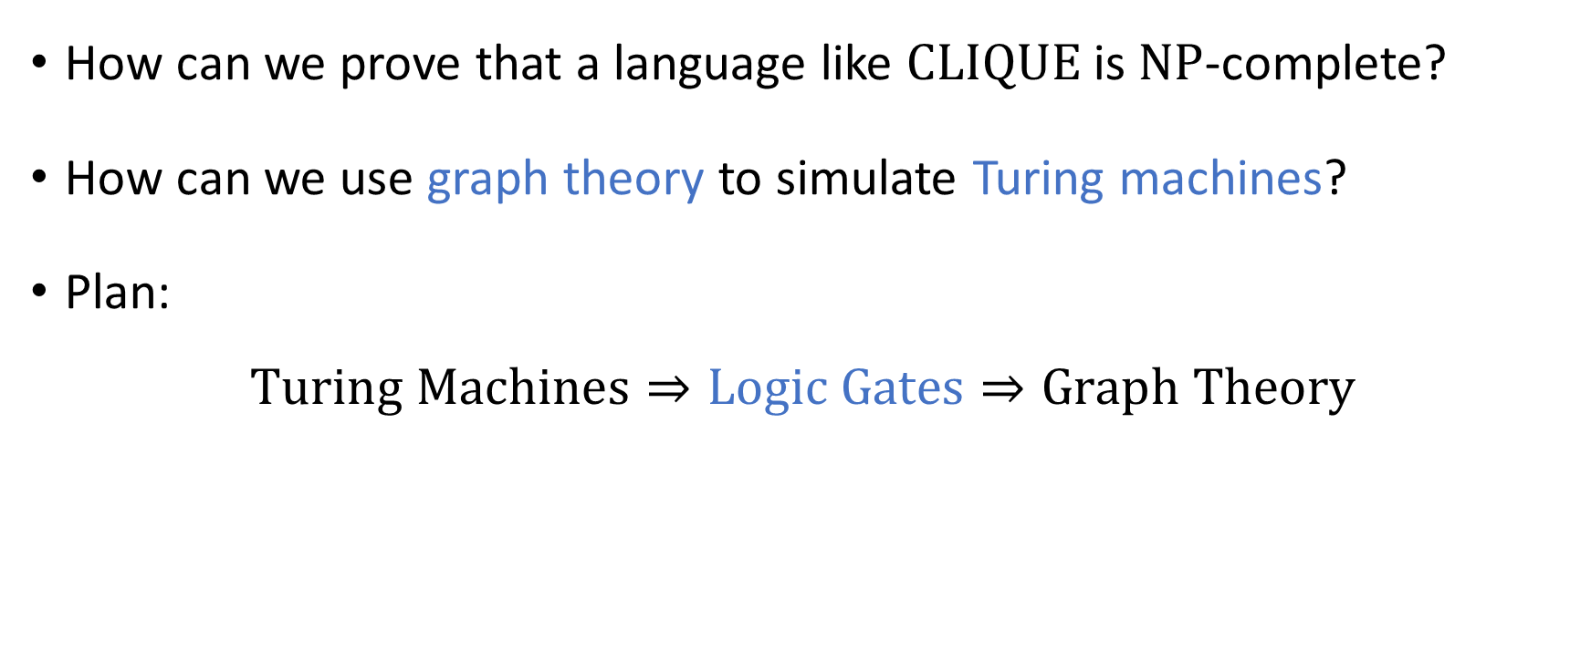

Proving $\text{NP}$-completeness
How can we prove that a language like $\text{CLIQUE}$ is $\text{NP}$-complete?
How can we use graph theory to simulate Turing machines?
Plan:
$$\text{Turing} \text{Machines}⇒\text{Logic} \text{Gates}⇒\text{Graph} \text{Theory}$$

Slide 22

Logic gates
AND: $a∧b$
OR: $a∨b$
NOT: $¬a$

Slide 23



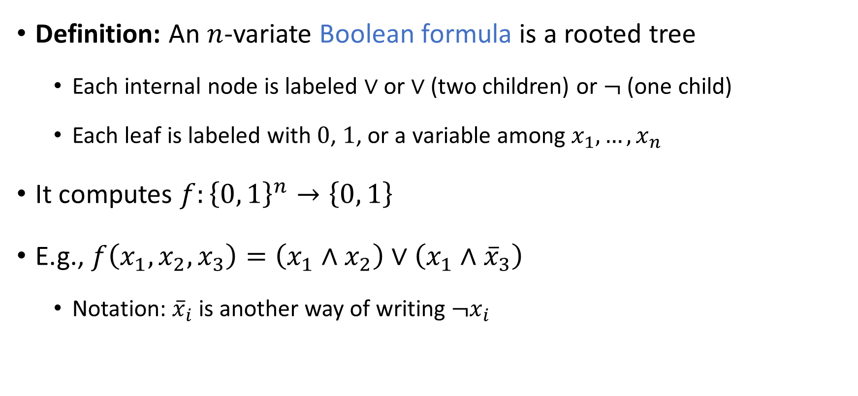





Boolean formulas
Compare to arithmetic formulas
Definition: An $n$-variate Boolean formula is a rooted tree
Each internal node is labeled $∨$ or $∨$ (two children) or $¬$ (one child)
Each leaf is labeled with $0$, $1$, or a variable among $x_{1},…,x_{n}$
It computes $f:{\left\{0, 1\right\}}^{n}→\left\{0, 1\right\}$
E.g., $f\left(x_{1},x_{2},x_{3}\right)=\left(x_{1}∧x_{2}\right)∨\left(x_{1}∧{\overline{x}}_{3}\right)$
Notation: ${\overline{x}}_{i}$ is another way of writing $¬x_{i}$
$$∨$$
$$∧$$
$$∧$$
$$x_{1}$$
$$x_{2}$$
$$x_{1}$$
$$¬$$
$$x_{3}$$

Slide 24



















Boolean circuits
1
$$∨$$
1
0
A Boolean circuit is like a Boolean formula, except that we permit vertices to have multiple outgoing wires
$$∧$$
$$∧$$
0
1
0
1
$$¬$$
$$¬$$
1
0
$$∨$$
$$∨$$
0
1
0
0
$$∧$$
$$∧$$
$$∧$$
$$∧$$
0
1
0
1
1
0
0
1
$$¬$$
$$¬$$
$$¬$$
$$¬$$
0
1
1
1
$$x_{1}$$
$$x_{2}$$
$$x_{3}$$
$$x_{4}$$
0
1
1
1

Slide 25
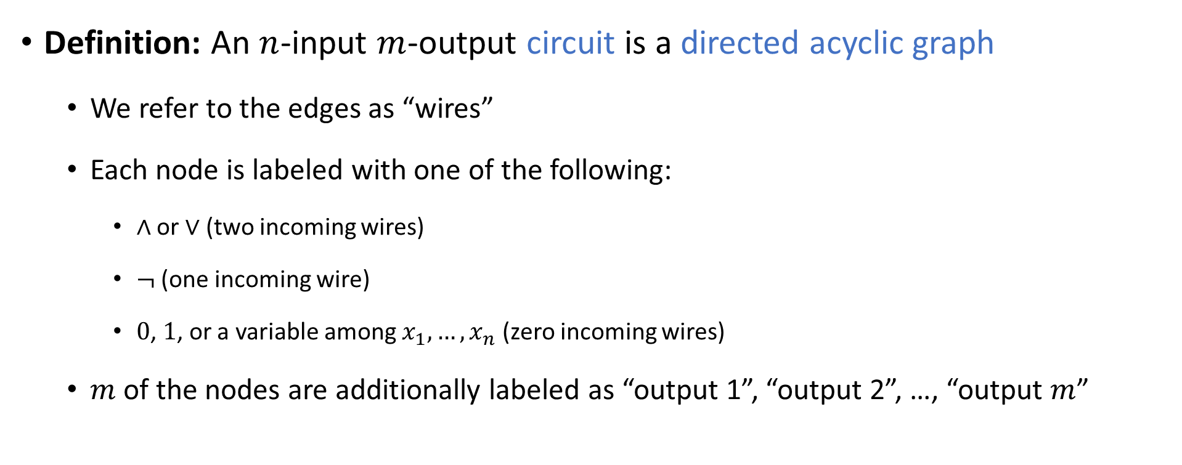
Boolean circuits: Rigorous definition
Definition: An $n$-input $m$-output circuit is a directed acyclic graph
We refer to the edges as “wires”
Each node is labeled with one of the following:
$∧$ or $∨$ (two incoming wires)
$¬$ (one incoming wire)
$0$, $1$, or a variable among $x_{1},…, x_{n}$ (zero incoming wires)
$m$ of the nodes are additionally labeled as “output 1”, “output 2”, …, “output $m$”
“gates”

Slide 26
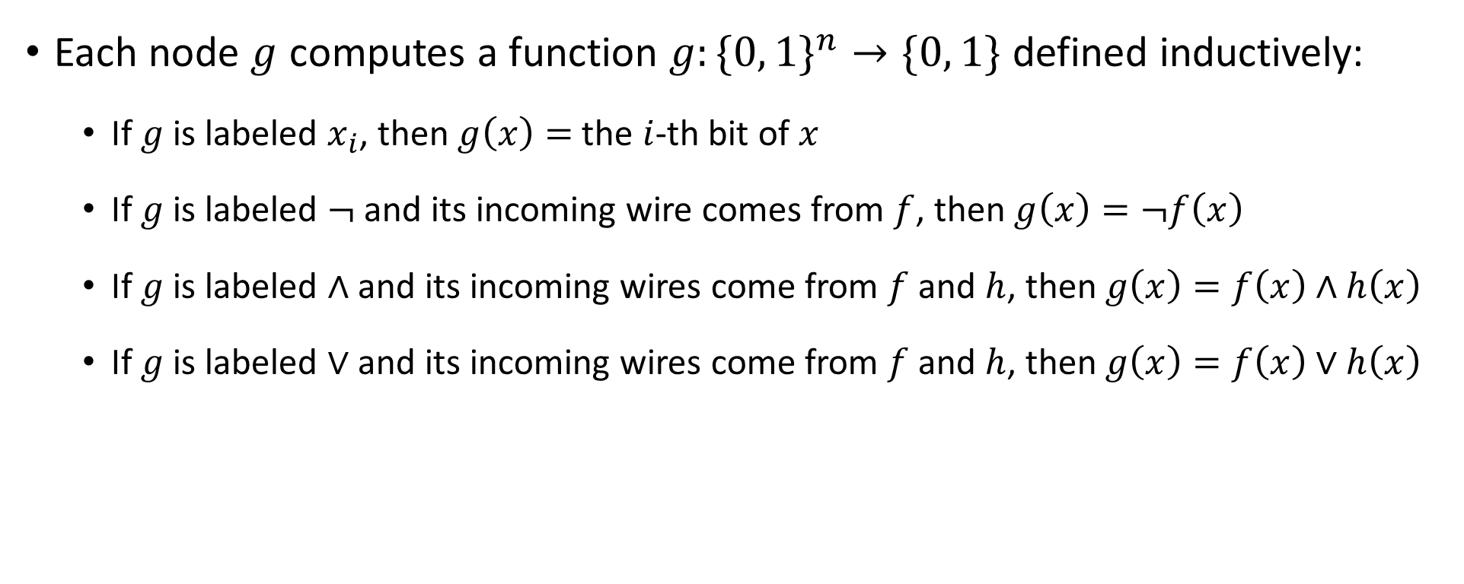
Boolean circuits: Rigorous definition
Each node $g$ computes a function $g:\{0, 1\}^{n}→\{0, 1\}$ defined inductively:
If $g$ is labeled $x_{i}$, then $g\left(x\right)=$ the $i$-th bit of $x$
If $g$ is labeled $¬$ and its incoming wire comes from $f$, then $g\left(x\right)=¬f\left(x\right)$
If $g$ is labeled $∧$ and its incoming wires come from $f$ and $h$, then $g\left(x\right)=f\left(x\right)∧h\left(x\right)$
If $g$ is labeled $∨$ and its incoming wires come from $f$ and $h$, then $g\left(x\right)=f\left(x\right)∨h\left(x\right)$

Slide 27

Boolean circuits
Let the output nodes be $g_{1},…, g_{m}$
As a whole, the circuit computes $C:{\left\{0, 1\right\}}^{n}→{\left\{0, 1\right\}}^{m}$ defined by
$$C\left(x\right)=\left(g_{1}\left(x\right),…, g_{m}\left(x\right)\right)$$

Slide 28



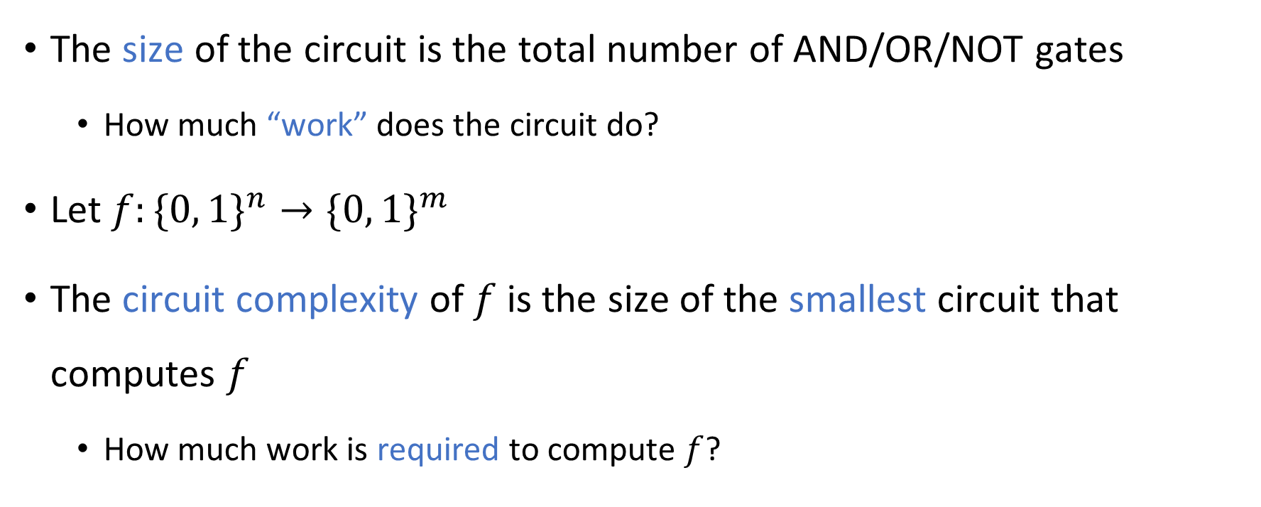




Circuit complexity
$$∨$$
$$∧$$
$$∧$$
$$¬$$
$$¬$$
$$x_{1}$$
$$x_{2}$$
The size of the circuit is the total number of AND/OR/NOT gates
How much “work” does the circuit do?
Let $f:\{0, 1\}^{n}→\{0, 1\}^{m}$
The circuit complexity of $f$ is the size of the smallest circuit that computes $f$
How much work is required to compute $f$?

Slide 29
















Circuit complexity example 1
$$∨$$
$$∨$$
$$∨$$
$$∨$$
$$∨$$
$$∨$$
$$∨$$
Let $f\left(x\right)=x_{1}∨x_{2}∨…∨x_{n}$
Circuit complexity: $Θ\left(n\right)$
$$x_{1}$$
$$x_{2}$$
$$x_{3}$$
$$x_{4}$$
$$x_{5}$$
$$x_{6}$$
$$x_{7}$$
$$x_{8}$$

Slide 30
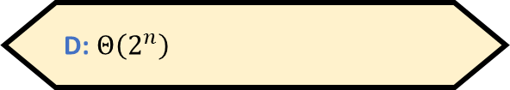


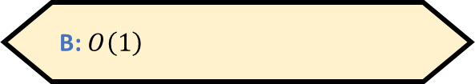

Circuit complexity example 2
Let $f\left(x\right)=x_{1}⊕x_{2}⊕…⊕x_{n}$
What is the circuit complexity of $f$?
A: $Θ\left(n^{2}\right)$
B: $O\left(1\right)$
C: $Θ\left(n\right)$
D: $Θ\left(2^{n}\right)$
Respond at PollEv.com/whoza or text “whoza” to 22333

