Slide 1
CMSC 28100 Introduction to Complexity Theory Winter 2024 Instructor: William Hoza
7 |  |  |  |  |  |  | 5 | 3
 |  |  |  |  |  |  |  | 4
 | 4 | 8 |  | 3 |  | 1 | 2
8 |  | 1 | 3 |  |  | 2 | 7 | 5
 | 9 |  | 1 |  |  |  | 4
 | 5 |  |  |  |  | 3
2 |  | 5 |  | 8 | 4
1 | 3 | 4 |  | 5

Slide 2
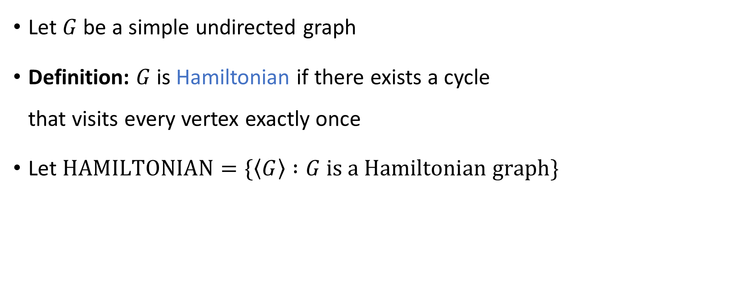
Hamiltonian graphs
Let $G$ be a simple undirected graph
Definition: $G$ is Hamiltonian if there exists a cycle that visits every vertex exactly once
Let $\text{HAMILTONIAN}=\{\left\langle G\right\rangle :G \text{is} \text{a} \text{Hamiltonian} \text{graph}\}$

Slide 3
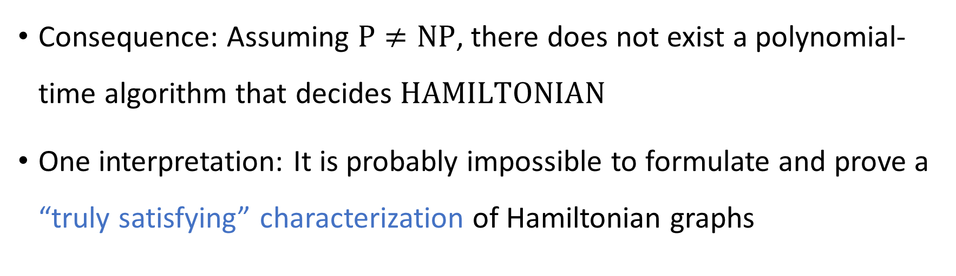


$\text{HAMILTONIAN}$ is NP-complete
Theorem: $\text{HAMILTONIAN}$ is $\text{NP}$-complete
Consequence: Assuming $\text{P}≠\text{NP}$, there does not exist a polynomial-time algorithm that decides $\text{HAMILTONIAN}$
One interpretation: It is probably impossible to formulate and prove a “truly satisfying” characterization of Hamiltonian graphs

Slide 4
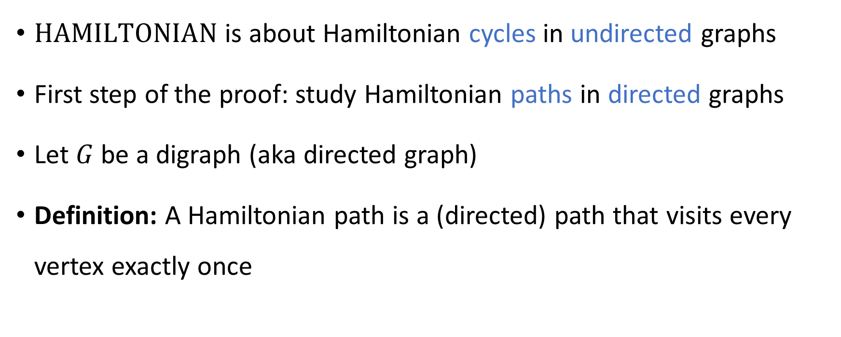
Directed Hamiltonian paths
$\text{HAMILTONIAN}$ is about Hamiltonian cycles in undirected graphs
First step of the proof: study Hamiltonian paths in directed graphs
Let $G$ be a digraph (aka directed graph)
Definition: A Hamiltonian path is a (directed) path that visits every vertex exactly once

Slide 5
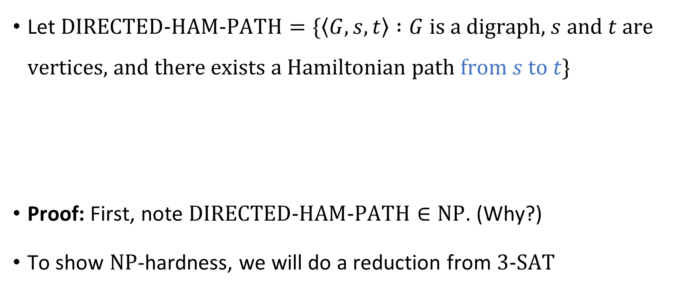


$\text{DIRECTED}\text{‑}\text{HAM}\text{‑}\text{PATH}$ is $\text{NP}$-complete
Let $\text{DIRECTED}\text{‑}\text{HAM}\text{‑}\text{PATH}=\{\left\langle G, s, t\right\rangle :G \text{is} \text{a} \text{digraph}\text{, }s \text{and} t \text{are} \text{vertices}\text{, }\text{and} \text{there} \text{exists} \text{a} \text{Hamiltonian} \text{path} \text{from} s \text{to} t\}$
Proof: First, note $\text{DIRECTED}\text{‑}\text{HAM}\text{‑}\text{PATH}∈\text{NP}$. (Why?)
To show $\text{NP}$-hardness, we will do a reduction from $\text{3‑}\text{SAT}$
Theorem: $\text{DIRECTED}\text{‑}\text{HAM}\text{‑}\text{PATH}$ is $\text{NP}$-complete

Slide 6


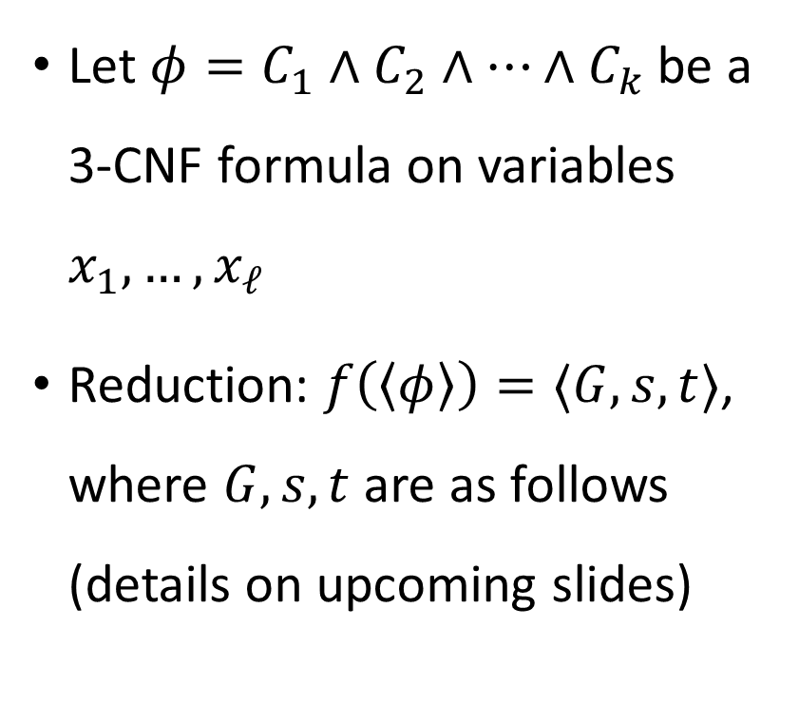










Reducing $\text{3‑}\text{SAT}$ to $\text{DIRECTED}\text{‑}\text{HAM}\text{‑}\text{PATH}$
$$s$$
Let $φ=C_{1}∧C_{2}∧…∧C_{k}$ be a 3-CNF formula on variables $x_{1},…, x_{ℓ}$
Reduction: $f\left(\left\langle φ\right\rangle \right)=⟨G,s,t⟩$, where $G,s,t$ are as follows (details on upcoming slides)
$$C_{1}$$
$$x_{1}$$
$$C_{2}$$
$$x_{2}$$
$$C_{3}$$
$$⋮$$
$$⋮$$
$$x_{ℓ}$$
$$C_{k}$$
$$t$$
“variable gadgets”
“clause nodes”

Slide 7





Reducing $\text{3‑}\text{SAT}$ to $\text{DIRECTED}\text{‑}\text{HAM}\text{‑}\text{PATH}$
Poly-time computable ✔️
“positive detour”
FALSE ➡
$$C_{j}=(x_{i}∨…$$
⬅ TRUE
$$x_{i}$$
$$⋯$$
$$C_{j^{′}}=({\overline{x}}_{i}∨…$$
“detour separators”
“negative detour”
$6k−1$ nodes inside diamond (enough for all possible detours)

Slide 8



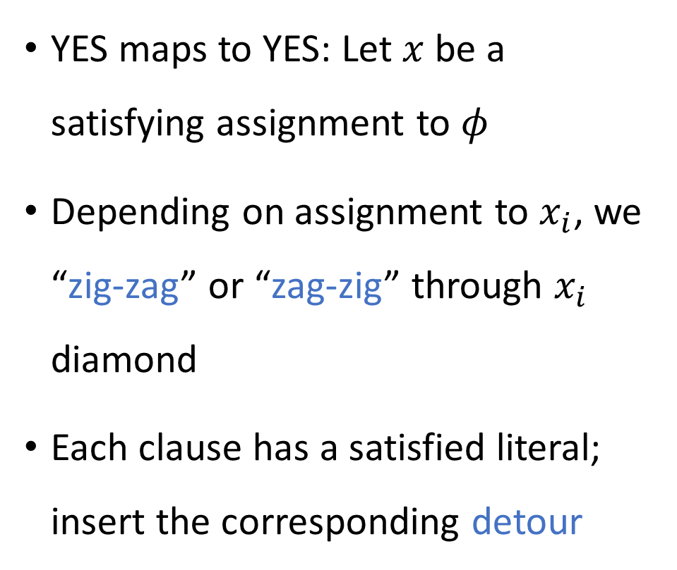













Reducing $\text{3‑}\text{SAT}$ to $\text{DIRECTED}\text{‑}\text{HAM}\text{‑}\text{PATH}$
$$s$$
YES maps to YES: Let $x$ be a satisfying assignment to $φ$
Depending on assignment to $x_{i}$, we “zig-zag” or “zag-zig” through $x_{i}$ diamond
Each clause has a satisfied literal; insert the corresponding detour
$$C_{1}$$
$$1$$
$$x_{1}$$
$$⋯$$
$$C_{2}$$
$$0$$
$$x_{2}$$
$$⋯$$
$$C_{3}$$
$$⋮$$
$$⋮$$
$$1$$
$$x_{ℓ}$$
$$⋯$$
$$C_{k}$$
$$t$$

Slide 9
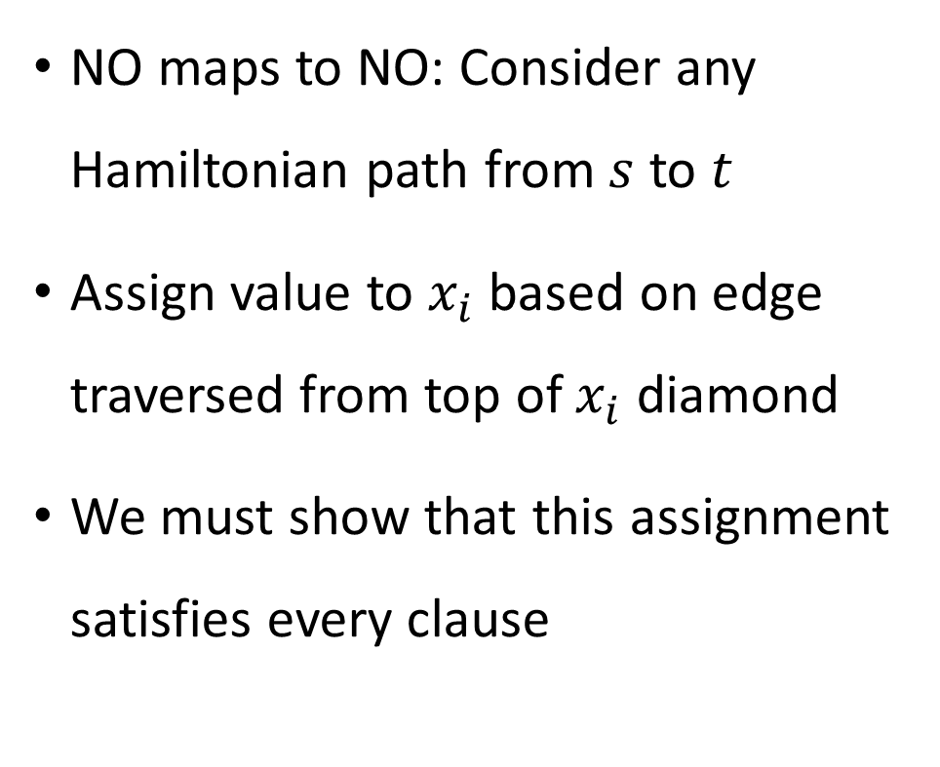
Reducing $\text{3‑}\text{SAT}$ to $\text{DIRECTED}\text{‑}\text{HAM}\text{‑}\text{PATH}$
$$s$$
NO maps to NO: Consider any Hamiltonian path from $s$ to $t$
Assign value to $x_{i}$ based on edge traversed from top of $x_{i}$ diamond
We must show that this assignment satisfies every clause
$$C_{1}$$
$$1$$
$$x_{1}$$
$$⋯$$
$$C_{2}$$
$$0$$
$$x_{2}$$
$$⋯$$
$$C_{3}$$
$$⋮$$
$$⋮$$
$$1$$
$$x_{ℓ}$$
$$⋯$$
$$C_{k}$$
$$t$$

Slide 10






Reducing $\text{3‑}\text{SAT}$ to $\text{DIRECTED}\text{‑}\text{HAM}\text{‑}\text{PATH}$
Consider any clause node $C_{j}$. Path visits $C_{j}$ from some $x_{i}$ diamond. WLOG, $C_{j}=(x_{i}∨…)$
Claim: The path goes from $C_{j}$ back to that same diamond ($x_{i}$)
Proof: The path must enter $a$ from the left. Therefore, the path must exit $a$ to the right. Therefore, the path must exit $c$ to the right, so the path must enter $c$ from $C_{j}$
$$C_{j}$$
$$⋯$$
$$a$$
$$b$$
$$c$$

Slide 11

Reducing $\text{3‑}\text{SAT}$ to $\text{DIRECTED}\text{‑}\text{HAM}\text{‑}\text{PATH}$
$$s$$
Consequence: If we traverse a “TRUE” edge, then we can only take “positive detours” in that diamond
If we traverse a “FALSE” edge, then we can only take “negative detours” in that diamond
Therefore, every clause is satisfied
$$C_{1}$$
$$x_{1}$$
$$⋯$$
$$C_{2}$$
$$x_{2}$$
$$⋯$$
$$C_{3}$$
$$⋮$$
$$⋮$$
$$x_{ℓ}$$
$$⋯$$
$$C_{k}$$
$$t$$

Slide 12

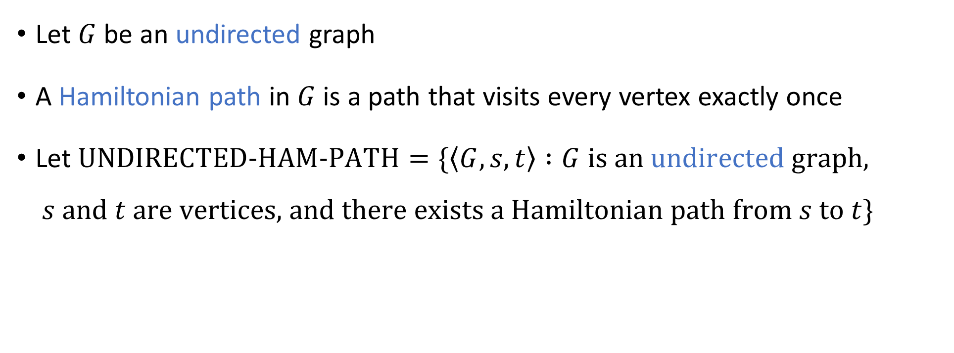
Undirected Hamiltonian path
Let $G$ be an undirected graph
A Hamiltonian path in $G$ is a path that visits every vertex exactly once
Let $\text{UNDIRECTED}\text{‑}\text{HAM}\text{‑}\text{PATH}=\{\left\langle G, s, t\right\rangle :G \text{is} \text{an} \text{undirected} \text{graph}\text{,}$ $s \text{and} t \text{are} \text{vertices}\text{, }\text{and} \text{there} \text{exists} \text{a} \text{Hamiltonian} \text{path} \text{from} s \text{to} t\}$
Theorem: $\text{UNDIRECTED}\text{‑}\text{HAM}\text{‑}\text{PATH}$ is $\text{NP}$-complete

Slide 13


$\text{UNDIRECTED}\text{‑}\text{HAM}\text{‑}\text{PATH}$ is $\text{NP}$-complete
First, note that $\text{UNDIRECTED}\text{‑}\text{HAM}\text{‑}\text{PATH}∈\text{NP}$ (why?)
To prove that $\text{UNDIRECTED}\text{‑}\text{HAM}\text{‑}\text{PATH}$ is $\text{NP}$-hard, we will do a reduction from $\text{DIRECTED}\text{‑}\text{HAM}\text{‑}\text{PATH}$

Slide 14





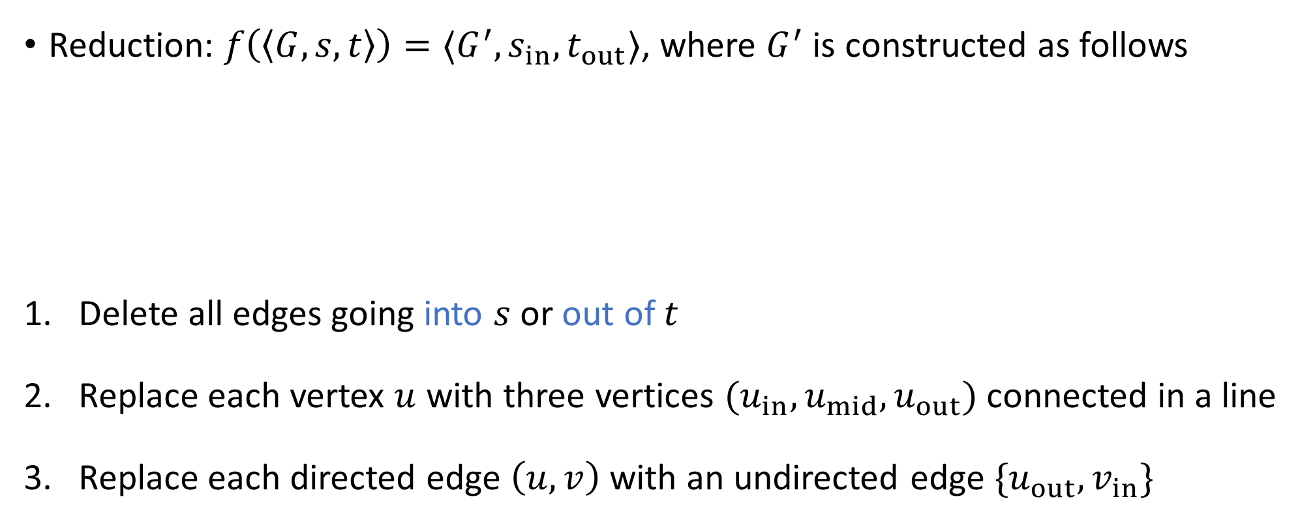









From directed graphs to undirected graphs
Poly-time computable ✔️
Reduction: $f\left(\left\langle G,s,t\right\rangle \right)=⟨G^{′},s_{in},t_{out}⟩$, where $G^{′}$ is constructed as follows
Delete all edges going into $s$ or out of $t$
Replace each vertex $u$ with three vertices $(u_{in},u_{mid},u_{out})$ connected in a line
Replace each directed edge $\left(u,v\right)$ with an undirected edge $\{u_{out},v_{in}\}$
$$a$$
$$d$$
$$a_{out}$$
$$d_{in}$$
$$b$$
$$b_{out}$$
$$c$$
$$e$$
$$c_{out}$$
$$e_{in}$$
$$u$$
$$u_{in}$$
$$u_{mid}$$
$$u_{out}$$

Slide 15

From directed graphs to undirected graphs
YES maps to YES: Suppose $s→u_{1}→u_{2}→…u_{k}→t$ is a Hamiltonian path
New Hamiltonian path in $G′$:
$$s_{in}∼s_{mid}∼s_{out}∼{\left(u_{1}\right)}_{in}∼{\left(u_{1}\right)}_{mid}∼{\left(u_{1}\right)}_{out}∼{\left(u_{2}\right)}_{in}∼⋯∼{\left(u_{k}\right)}_{out}∼t_{in}∼t_{mid}∼t_{out}$$

Slide 16
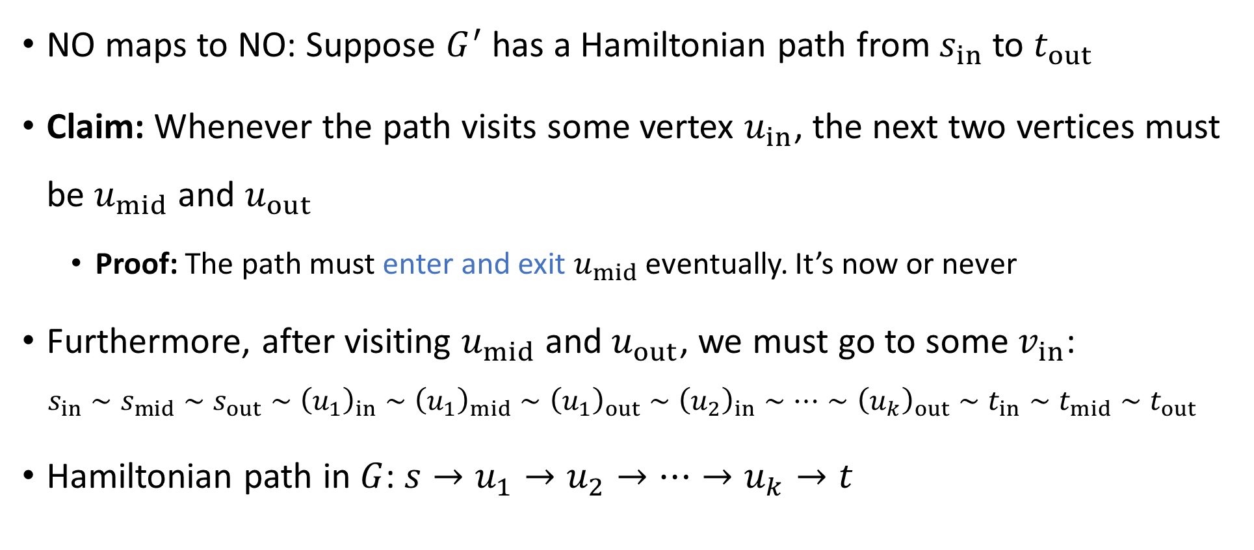
From directed graphs to undirected graphs
NO maps to NO: Suppose $G^{′}$ has a Hamiltonian path from $s_{in}$ to $t_{out}$
Claim: Whenever the path visits some vertex $u_{in}$, the next two vertices must be $u_{mid}$ and $u_{out}$
Proof: The path must enter and exit $u_{mid}$ eventually. It’s now or never
Furthermore, after visiting $u_{mid}$ and $u_{out}$, we must go to some $v_{in}$:
$$s_{in}∼s_{mid}∼s_{out}∼{\left(u_{1}\right)}_{in}∼{\left(u_{1}\right)}_{mid}∼{\left(u_{1}\right)}_{out}∼{\left(u_{2}\right)}_{in}∼⋯∼{\left(u_{k}\right)}_{out}∼t_{in}∼t_{mid}∼t_{out}$$
Hamiltonian path in $G$: $s→u_{1}→u_{2}→…→u_{k}→t$

Slide 17

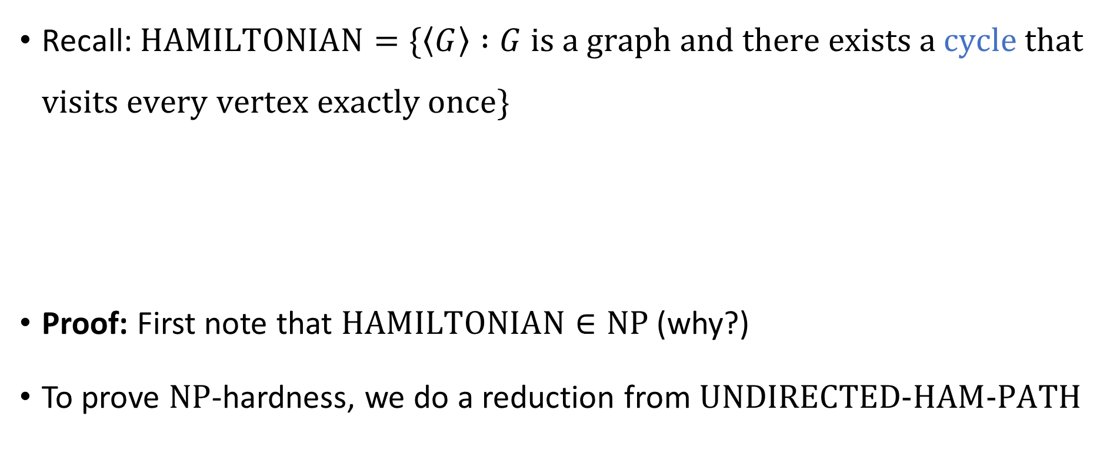
Hamiltonian cycles
Recall: $\text{HAMILTONIAN}=\{\left\langle G\right\rangle :G \text{is} \text{a} \text{graph} \text{and} \text{there} \text{exists} \text{a} \text{cycle} \text{that} \text{visits} \text{every} \text{vertex} \text{exactly} \text{once}\}$
Proof: First note that $\text{HAMILTONIAN}∈\text{NP}$ (why?)
To prove $\text{NP}$-hardness, we do a reduction from $\text{UNDIRECTED}\text{‑}\text{HAM}\text{‑}\text{PATH}$
Theorem: $\text{HAMILTONIAN}$ is $\text{NP}$-complete

Slide 18












From paths to cycles
$$G$$
$$s$$
$$v_{∗}$$
Reduction: $f\left(\left\langle G,s,t\right\rangle \right)=⟨G^{′}⟩$
To construct $G^{′}$, add one new vertex $v_{∗}$ and two new edges $\{s, v_{∗}\}$ and $\{t, v_{∗}\}$
Poly-time computable ✔️
$$t$$
YES maps to YES
$$s$$
$$s$$
$$⋯$$
$$v_{∗}$$
$$⋯$$
NO maps to NO
$$t$$
$$t$$

Slide 19








$\text{NP}$-hard
$$\text{CIRCUIT}\text{‑}\text{SAT}$$
$$\text{CLIQUE}$$
$$\text{HAMILTONIAN}$$
$\text{NP}$-complete
$$\text{3‑}\text{SAT}$$
$$\text{NP}$$
$$\text{P}$$

Slide 20
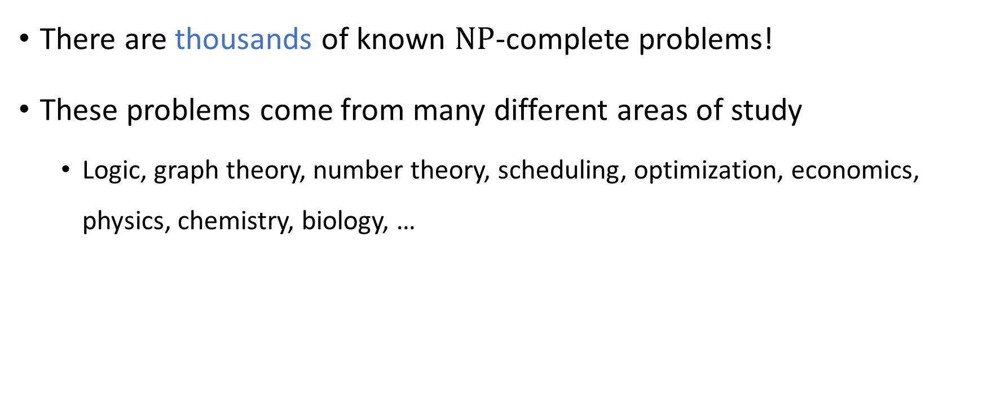

$\text{NP}$-completeness is everywhere
There are thousands of known $\text{NP}$-complete problems!
These problems come from many different areas of study
Logic, graph theory, number theory, scheduling, optimization, economics, physics, chemistry, biology, …

Slide 21
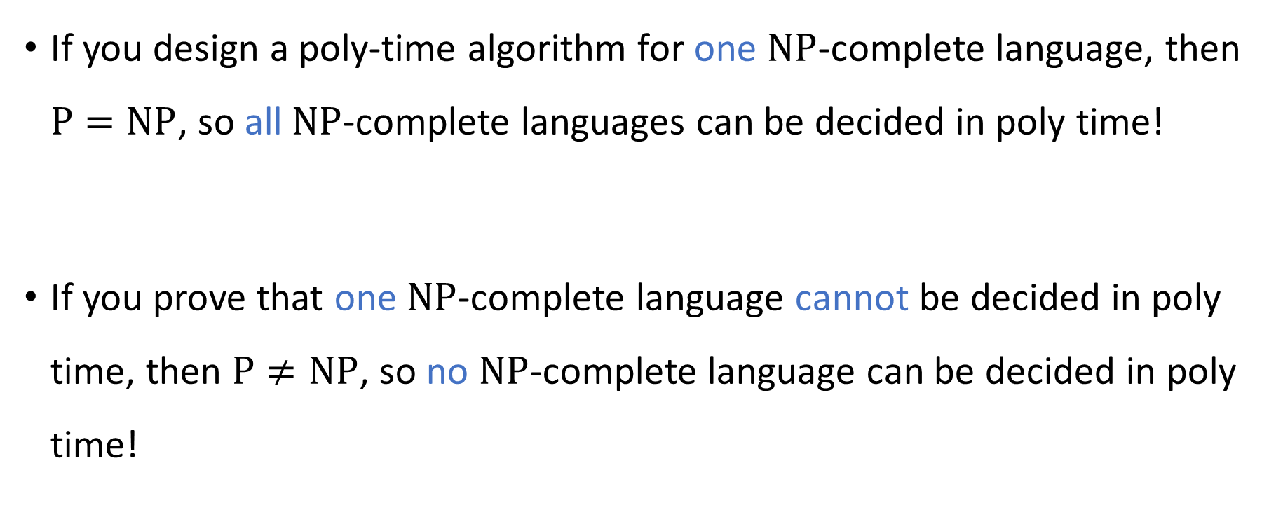

$\text{NP}$-complete languages stand or fall together
If you design a poly-time algorithm for one $\text{NP}$-complete language, then $\text{P}=\text{NP}$, so all $\text{NP}$-complete languages can be decided in poly time!
If you prove that one $\text{NP}$-complete language cannot be decided in poly time, then $\text{P}≠\text{NP}$, so no $\text{NP}$-complete language can be decided in poly time!

Slide 22
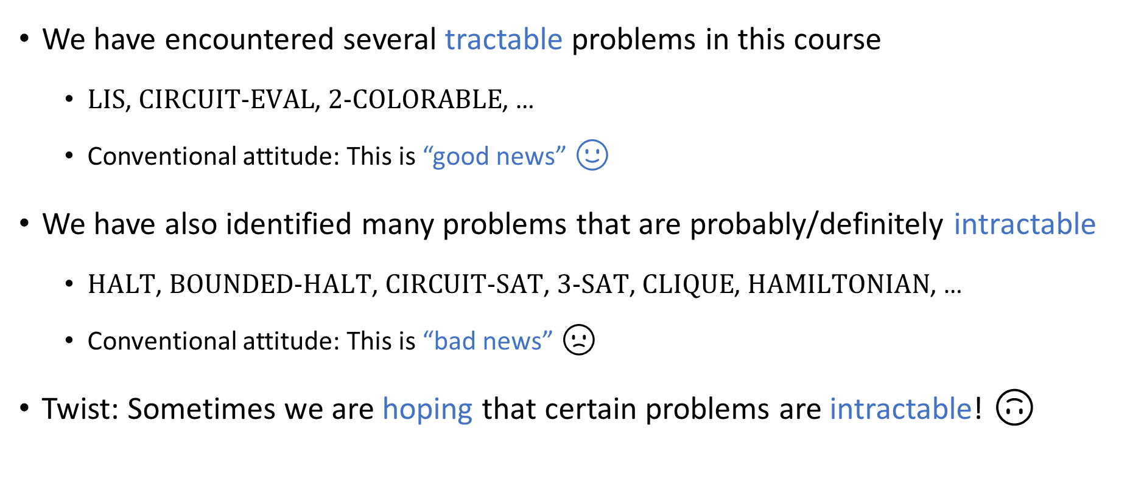
How to feel about intractability
We have encountered several tractable problems in this course
$\text{LIS}$, $\text{CIRCUIT}\text{‑}\text{EVAL}$, $\text{2‑}\text{COLORABLE}$, …
Conventional attitude: This is “good news” 🙂
We have also identified many problems that are probably/definitely intractable
$\text{HALT}$, $\text{BOUNDED}\text{‑}\text{HALT}$, $\text{CIRCUIT}\text{‑}\text{SAT}$, $\text{3‑}\text{SAT}$, $\text{CLIQUE}$, $\text{HAMILTONIAN}$, …
Conventional attitude: This is “bad news” 🙁
Twist: Sometimes we are hoping that certain problems are intractable! 🙃

Slide 23
Cryptography

Slide 24

Secure communication
Public communication channel
😈
How can Bob send a private message to Alice?
E.g., credit card number
It seems impossible, because Alice and Eve receive all the same information from Bob!
A clever approach: Try to force Eve to solve an intractable problem
Online
store
Customer
Eve
Alice
Bob

