Slide 1

CMSC 28100 Introduction to Complexity Theory Spring 2025 Instructor: William Hoza

Slide 2
Which problems can be solved through computation?
CLASSICAL

Slide 3

Which languages are in $\text{P}$?

Slide 4

Which languages are not in $\text{P}$?

Slide 5

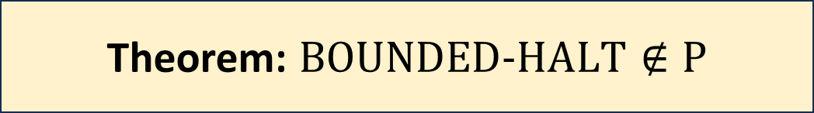
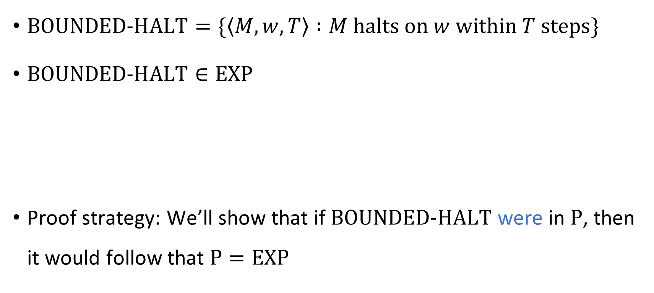
The bounded halting problem
$\text{BOUNDED}\text{‑}\text{HALT}=\{\left\langle M, w, T\right\rangle :M \text{halts} \text{on} w \text{within} T \text{steps}\}$
$\text{BOUNDED}\text{‑}\text{HALT}∈\text{EXP}$
Proof strategy: We’ll show that if $\text{BOUNDED}\text{‑}\text{HALT}$ were in $\text{P}$, then it would follow that $\text{P}=\text{EXP}$
Theorem: $\text{BOUNDED}\text{‑}\text{HALT}∉\text{P}$

Slide 6







Proof that $\text{BOUNDED}\text{‑}\text{HALT}∉\text{P}$
Assume $B$ is a poly-time TM deciding $\text{BOUNDED}\text{‑}\text{HALT}$
Let $Y∈\text{EXP}$. There is a TM $M$ that $\left\{\begin{aligned} \text{accepts} w \text{within} 2^{{\left|w\right|}^{k}} \text{steps} \text{if} w∈Y \\ \text{loops} \text{if} w∉Y\end{aligned}\right.$
We will construct a poly-time TM $R$ that decides $Y$
Given $w∈{\left\{0, 1\right\}}^{∗}$:
Simulate $B$ on $\left\langle M, w,2^{{\left|w\right|}^{k}} \right\rangle$
If $B$ accepts, accept. If $B$ rejects, reject.
Polynomial time ✔️
If $w∈Y$, then $M$ accepts $w$ within $2^{{\left|w\right|}^{k}}$ steps, so $R$ accepts $w$ ✔️
If $w∉Y$, then $M$ loops on $w$, so $R$ rejects $w$ ✔️
$$R$$

Slide 7
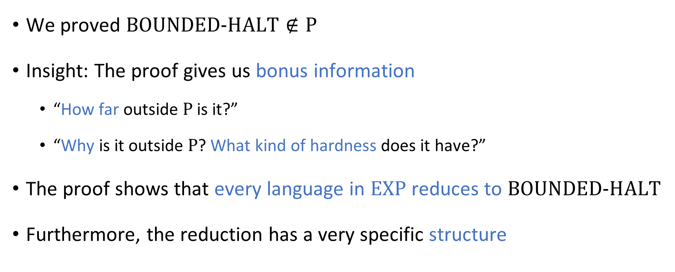

Beyond “it’s not in $\text{P}$”
We proved $\text{BOUNDED}\text{‑}\text{HALT}∉\text{P}$
Insight: The proof gives us bonus information
“How far outside $\text{P}$ is it?”
“Why is it outside $\text{P}$? What kind of hardness does it have?”
The proof shows that every language in $\text{EXP}$ reduces to $\text{BOUNDED}\text{‑}\text{HALT}$
Furthermore, the reduction has a very specific structure

Slide 8
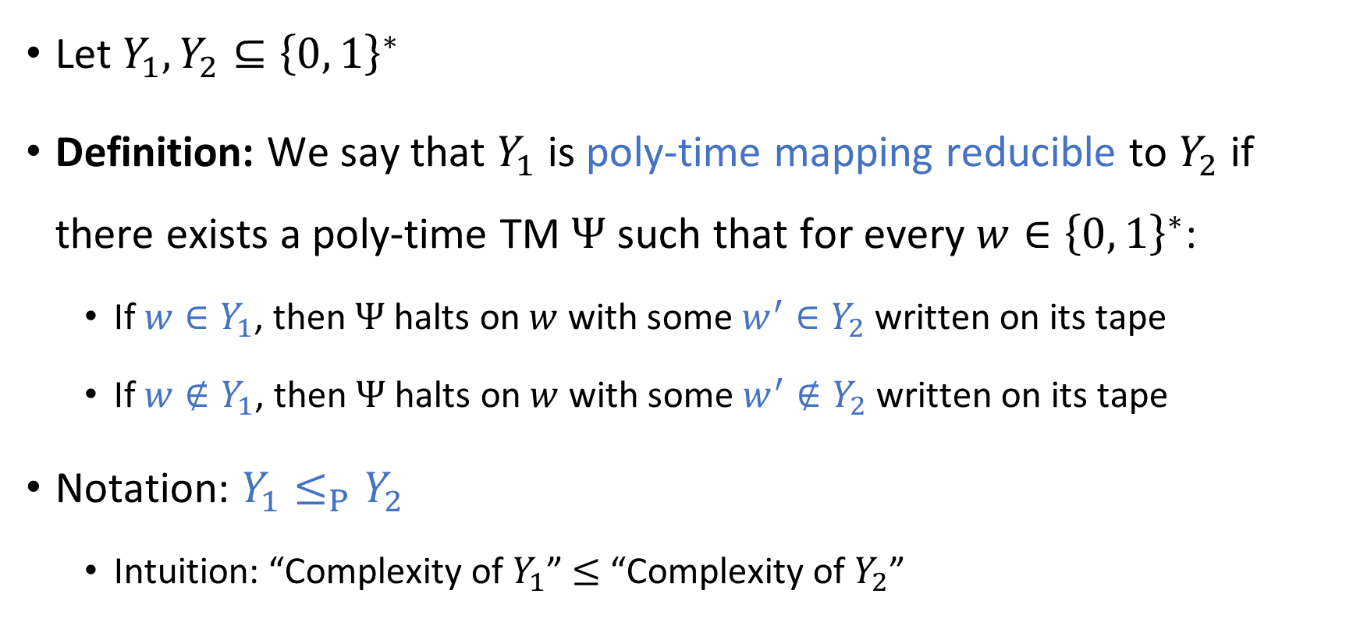
Mapping reductions
Let $Y_{1},Y_{2}⊆{\left\{0, 1\right\}}^{∗}$
Definition: We say that $Y_{1}$ is poly-time mapping reducible to $Y_{2}$ if there exists a poly-time TM $Ψ$ such that for every $w∈{\left\{0, 1\right\}}^{∗}$:
If $w∈Y_{1}$, then $Ψ$ halts on $w$ with some $w^{′}∈Y_{2}$ written on its tape
If $w∉Y_{1}$, then $Ψ$ halts on $w$ with some $w^{′}∉Y_{2}$ written on its tape
Notation: $Y_{1}≤_{P}Y_{2}$
Intuition: “Complexity of $Y_{1}$” $≤$ “Complexity of $Y_{2}$”

Slide 9







Mapping reductions
$Y_{1}≤_{P}Y_{2}$ means there is an efficient way to convert questions of the form “is $w∈Y_{1}$?” into questions of the form “is $w^{′}∈Y_{2}$?”
$$Ψ$$
$$Y_{2}$$
$$Y_{1}$$
$$Ψ$$
$${\left\{0, 1\right\}}^{∗}$$
$${\left\{0, 1\right\}}^{∗}$$

Slide 10
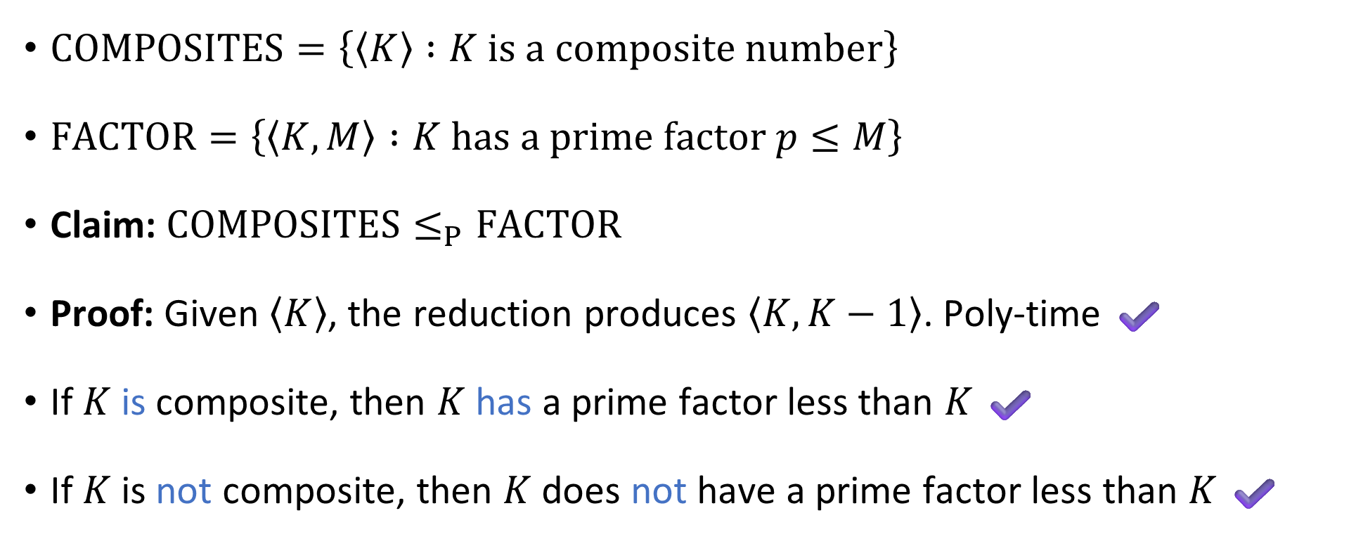
Mapping reduction example
$\text{COMPOSITES}=\left\{\left\langle K\right\rangle :K \text{is} \text{a} \text{composite} \text{number}\right\}$
$\text{FACTOR}=\left\{\left\langle K,M\right\rangle :K \text{has} \text{a} \text{prime} \text{factor} p≤M\right\}$
Claim: $\text{COMPOSITES}≤_{P}\text{FACTOR}$
Proof: Given $\left\langle K\right\rangle$, the reduction produces $\left\langle K,K−1\right\rangle$. Poly-time ✔️
If $K$ is composite, then $K$ has a prime factor less than $K$ ✔️
If $K$ is not composite, then $K$ does not have a prime factor less than $K$ ✔️

Slide 11



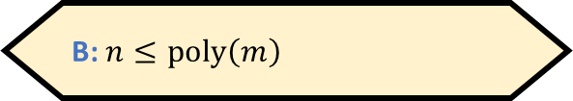

Reductions: Proving that a language is in $\text{P}$
Let $n=\left|w\right|$ and $m=\left|w^{′}\right|$. What is the relationship between $n$ and $m$?
A: $m≤\text{poly}\left(n\right)$
B: $n≤\text{poly}\left(m\right)$
Let $Y_{1},Y_{2}⊆{\left\{0, 1\right\}}^{∗}$
Claim: If $Y_{1}≤_{P}Y_{2}$ and $Y_{2}∈\text{P}$, then $Y_{1}∈\text{P}$.
Proof: Given $w∈{\left\{0, 1\right\}}^{∗}$:
Simulate $Ψ$ to produce $w^{′}$ (this takes $O\left(n^{k_{1}}\right)$ time)
Check whether $w^{′}∈Y_{2}$ (this takes $O\left(m^{k_{2}}\right)$ time where $m=\left|w^{′}\right|$)
If so, accept; otherwise, reject.
$m≤O\left(n^{k_{1}}\right)$, so the total time is $O\left(n^{k_{1}}+n^{k_{1}⋅k_{2}}\right)=\text{poly}\left(n\right)$
C: $n=m$
D: Not enough information
Respond at PollEv.com/whoza or text “whoza” to 22333

Slide 12

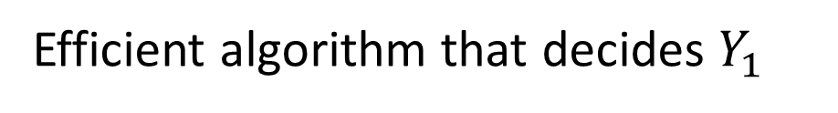



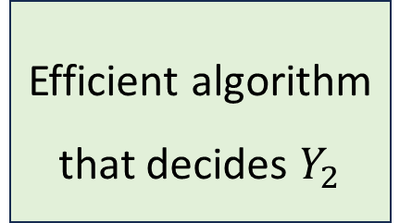
Reductions: Proving that a language is in $\text{P}$
Efficient algorithm that decides $Y_{1}$
$$Ψ$$
$$w^{′}$$
Efficient algorithm that decides $Y_{2}$
$$w$$
Acc/Rej
“The mapping reduction”

Slide 13


Reductions: Proving that a language is not in $\text{P}$
Let $Y_{1},Y_{2}⊆{\left\{0, 1\right\}}^{∗}$
Claim: If $Y_{1}≤_{P}Y_{2}$ and $Y_{1}∉\text{P}$, then $Y_{2}∉\text{P}$
Proof: If $Y_{2}$ were in $\text{P}$, then $Y_{1}$ would also be in $\text{P}$

Slide 14
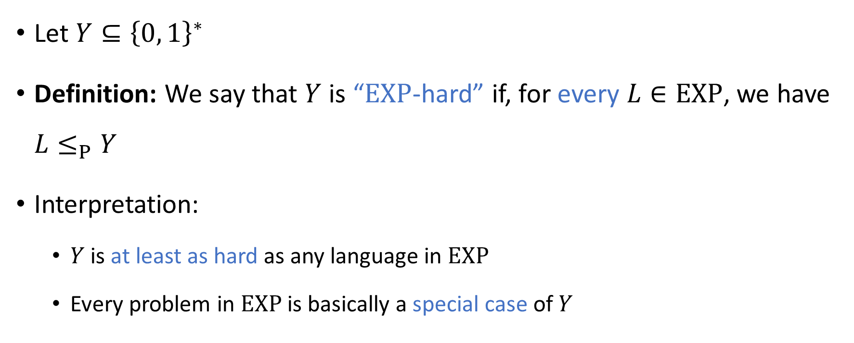
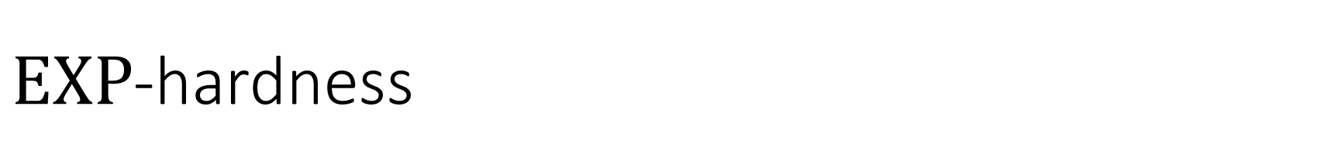
$\text{EXP}$-hardness
Let $Y⊆{\left\{0, 1\right\}}^{∗}$
Definition: We say that $Y$ is “$\text{EXP}$-hard” if, for every $L∈\text{EXP}$, we have $L≤_{P}Y$
Interpretation:
$Y$ is at least as hard as any language in $\text{EXP}$
Every problem in $\text{EXP}$ is basically a special case of $Y$

Slide 15
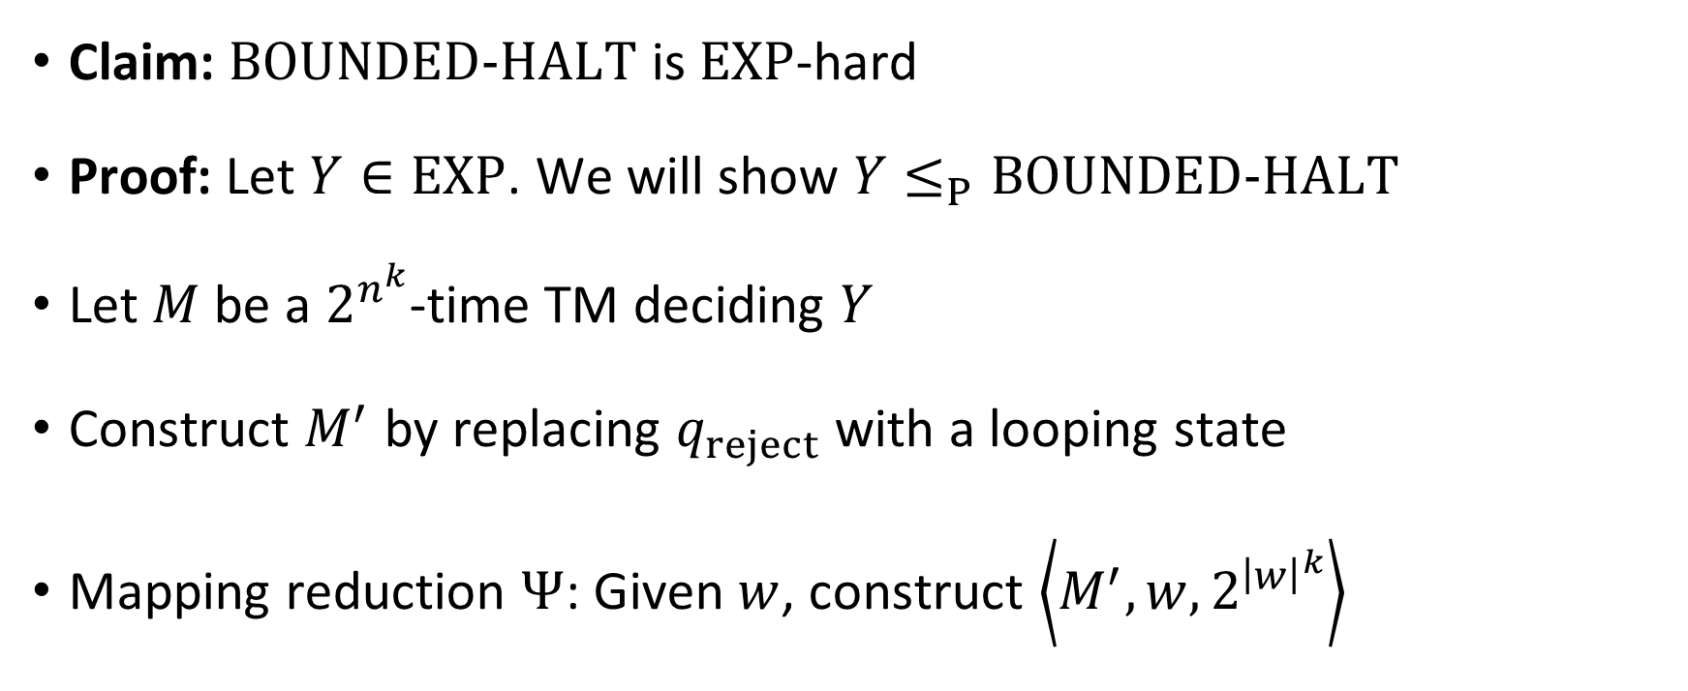

Example: $\text{BOUNDED}\text{‑}\text{HALT}$ is $\text{EXP}$-hard
Claim: $\text{BOUNDED}‑\text{HALT}$ is $\text{EXP}$-hard
Proof: Let $Y∈\text{EXP}$. We will show $Y≤_{P}\text{BOUNDED}‑\text{HALT}$
Let $M$ be a $2^{n^{k}}$-time TM deciding $Y$
Construct $M^{′}$ by replacing $q_{reject}$ with a looping state
Mapping reduction $Ψ$: Given $w$, construct $\left\langle M^{′},w,2^{{\left|w\right|}^{k}}\right\rangle$

Slide 16
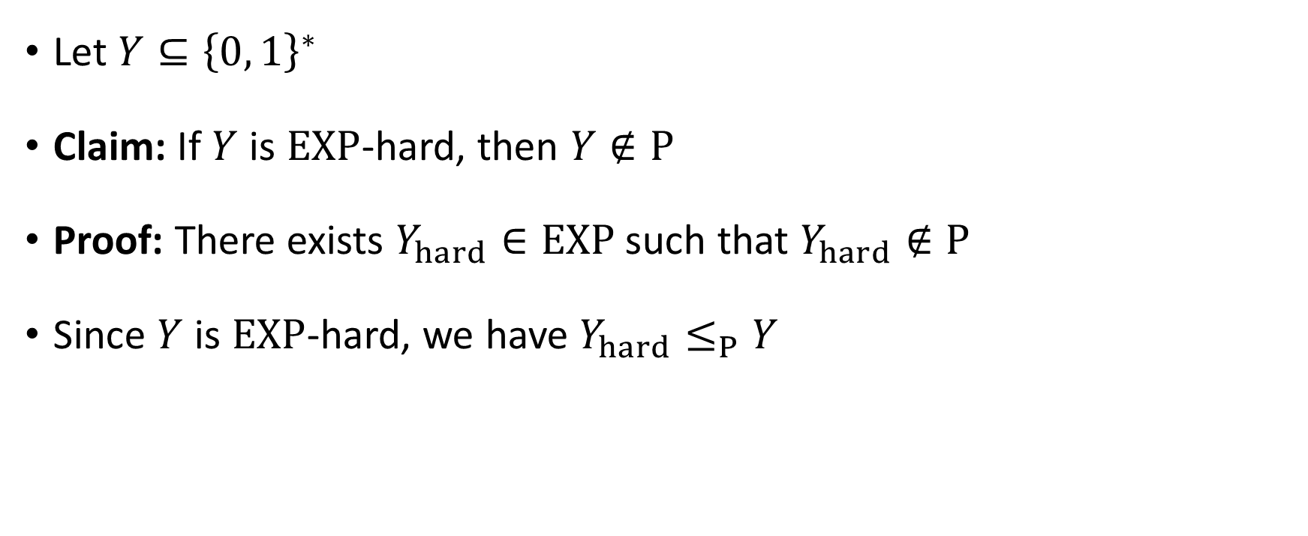
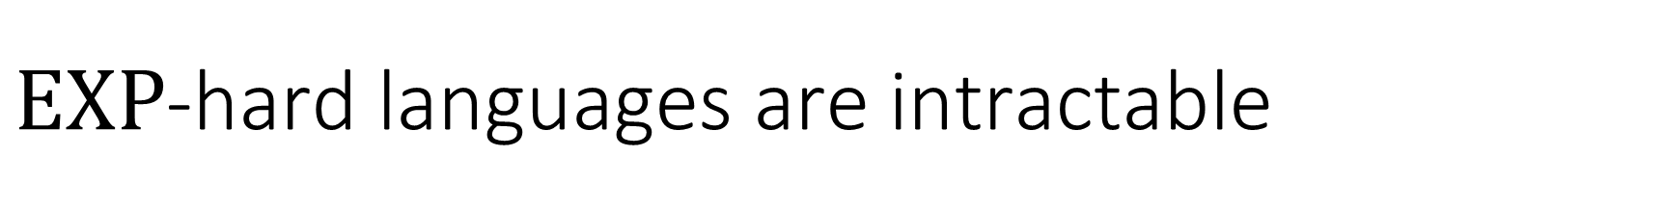
$\text{EXP}$-hard languages are intractable
Let $Y⊆{\left\{0, 1\right\}}^{∗}$
Claim: If $Y$ is $\text{EXP}$-hard, then $Y∉\text{P}$
Proof: There exists $Y_{hard}∈\text{EXP}$ such that $Y_{hard}∉\text{P}$
Since $Y$ is $\text{EXP}$-hard, we have $Y_{hard}≤_{P}Y$

Slide 17
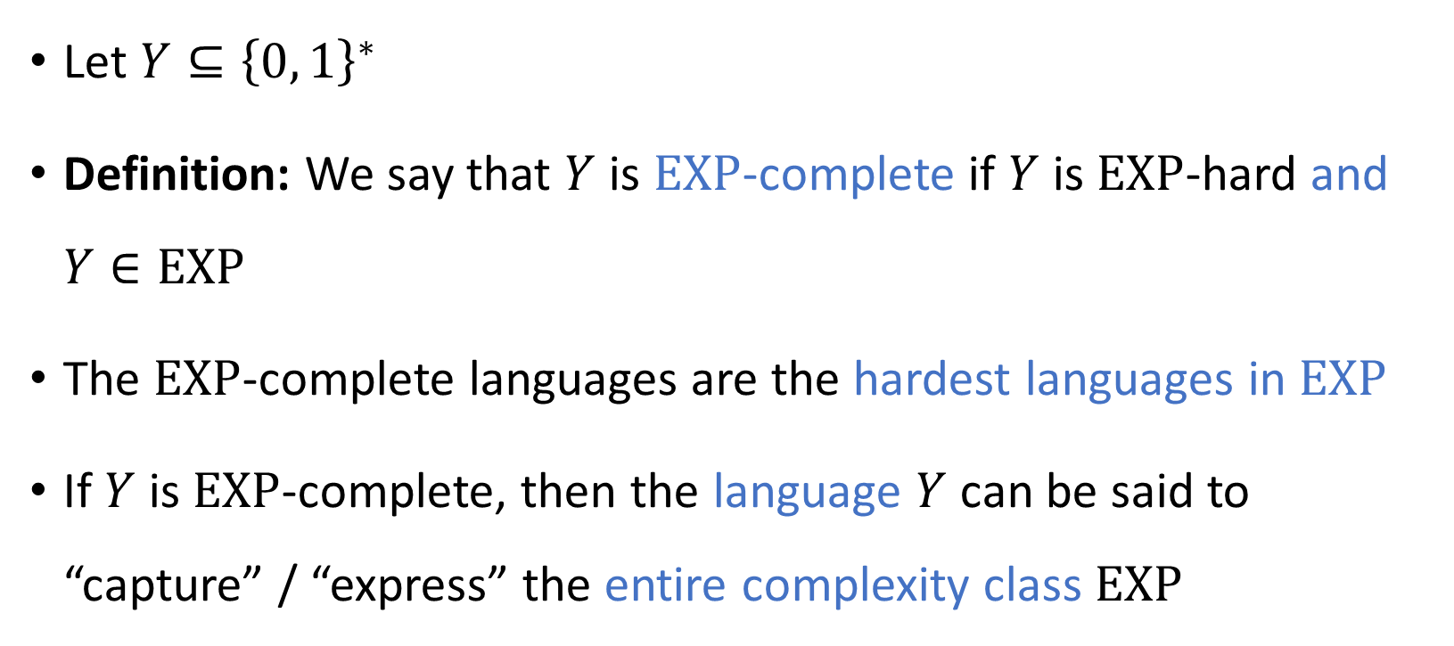
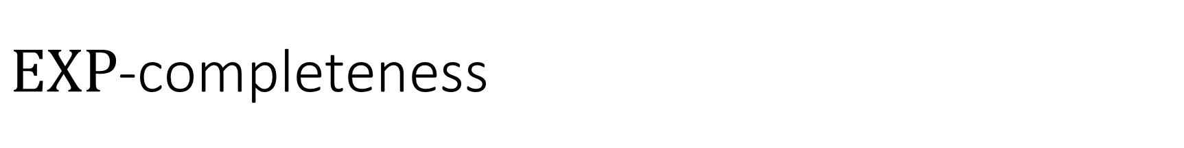
$\text{EXP}$-completeness
Let $Y⊆{\left\{0, 1\right\}}^{∗}$
Definition: We say that $Y$ is $\text{EXP}$-complete if $Y$ is $\text{EXP}$-hard and $Y∈\text{EXP}$
The $\text{EXP}$-complete languages are the hardest languages in $\text{EXP}$
If $Y$ is $\text{EXP}$-complete, then the language $Y$ can be said to “capture” / “express” the entire complexity class $\text{EXP}$

Slide 18
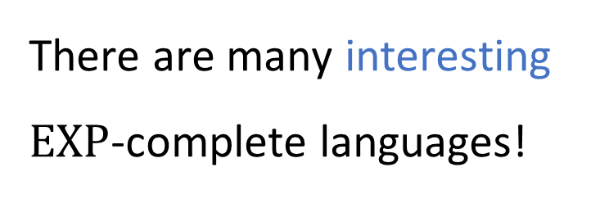





$\text{EXP}$-completeness
$\text{EXP}$-hard
$$\text{BOUNDED}\text{‑}\text{HALT}$$
$\text{EXP}$-complete
There are many interesting $\text{EXP}$-complete languages!
$$\text{EXP}$$
$$\text{P}$$

Slide 19
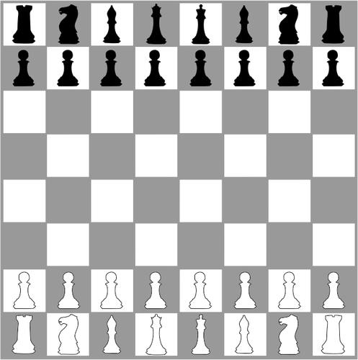
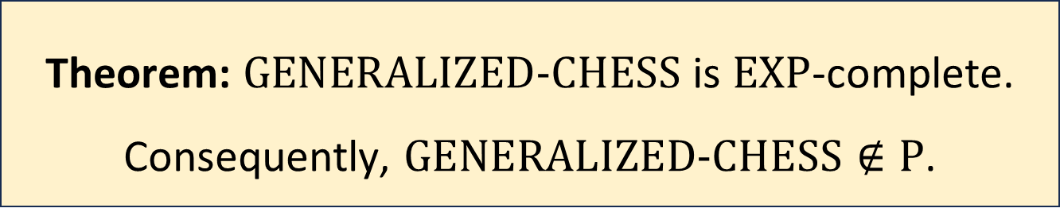
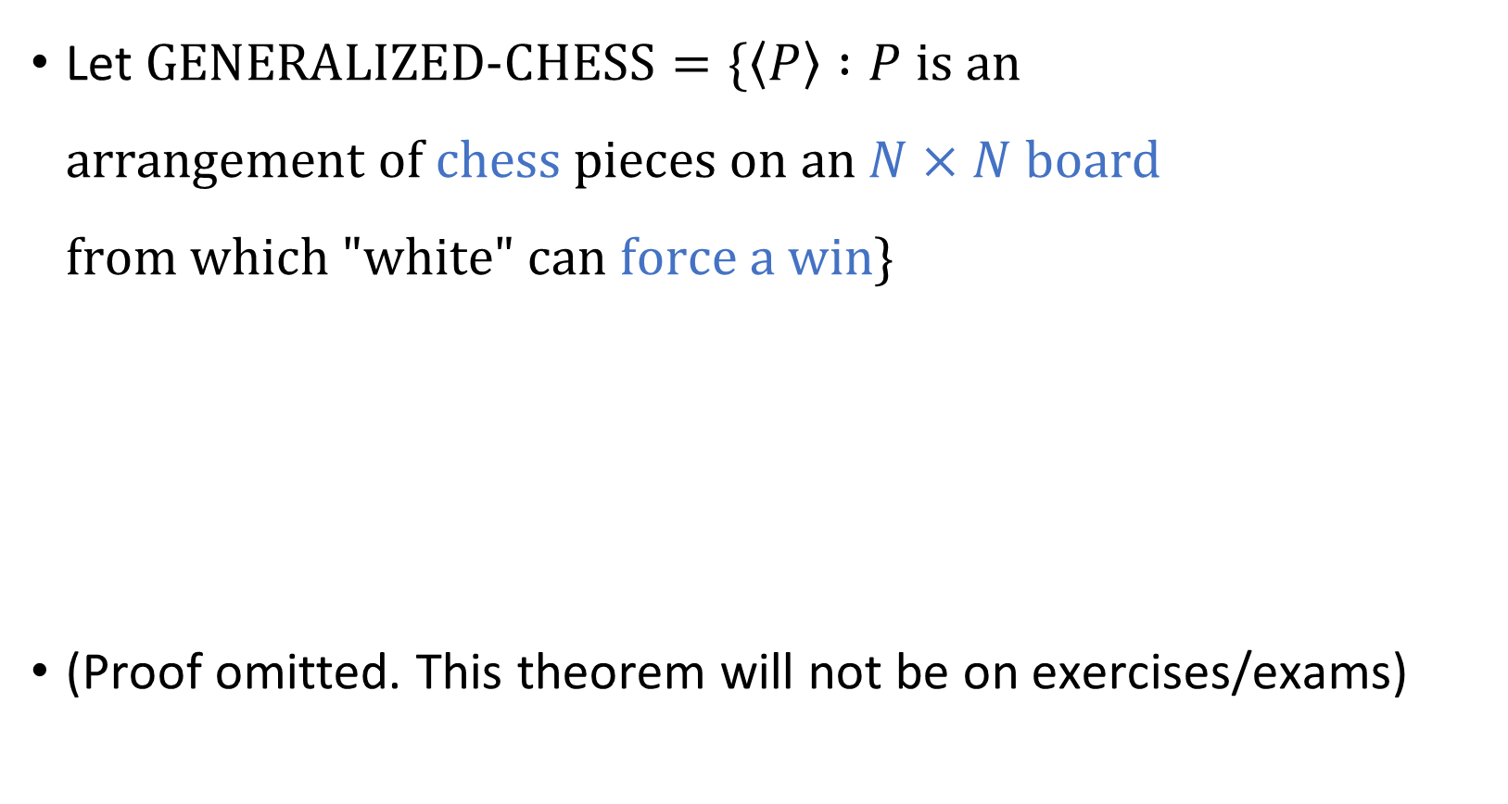
Example: Chess
Let $\text{GENERALIZED}\text{‑}\text{CHESS}=\{\left\langle P\right\rangle :P \text{is} \text{an}$ $\text{arrangement} \text{of} \text{chess} \text{pieces} \text{on} \text{an} N×N \text{board}$ $\text{from} \text{which}\text{ "}\text{white}\text{" }\text{can} \text{force} \text{a} \text{win}\}$
(Proof omitted. This theorem will not be on exercises/exams)
Theorem: $\text{GENERALIZED}\text{‑}\text{CHESS}$ is $\text{EXP}$-complete. Consequently, $\text{GENERALIZED}\text{‑}\text{CHESS}∉\text{P}$.

Slide 20


The power of $\text{EXP}$-hardness
$\text{EXP}$-hardness is a valuable tool for identifying intractability
Is $\text{EXP}$-hardness the only tool we need for identifying intractability?

Slide 21
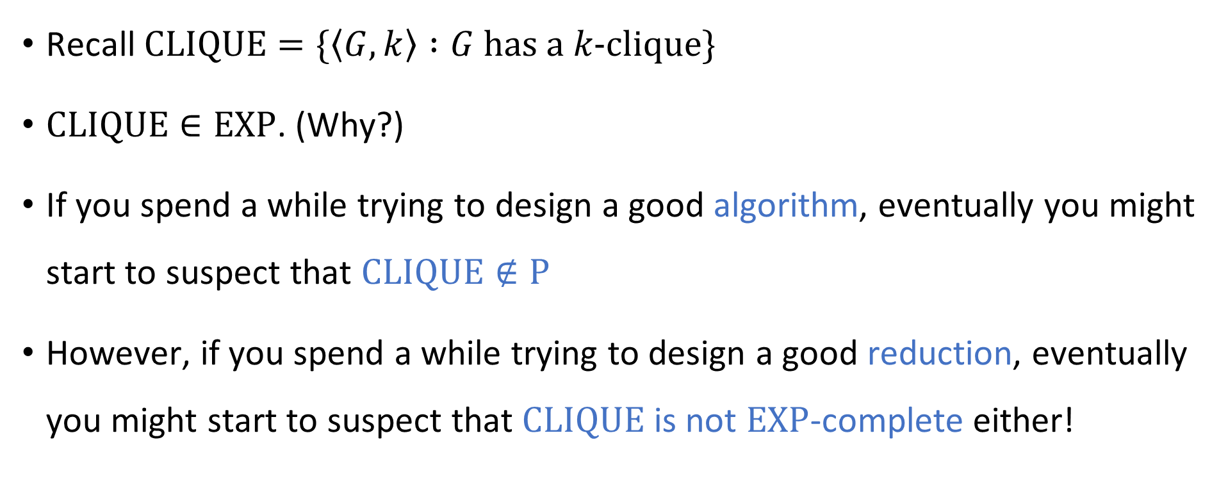
Complexity of the clique problem
Recall $\text{CLIQUE}=\{\left\langle G,k\right\rangle :G \text{has} \text{a} k\text{‑}\text{clique}\}$
$\text{CLIQUE}∈\text{EXP}$. (Why?)
If you spend a while trying to design a good algorithm, eventually you might start to suspect that $\text{CLIQUE}∉\text{P}$
However, if you spend a while trying to design a good reduction, eventually you might start to suspect that $\text{CLIQUE}$ is not $\text{EXP}$-complete either!

Slide 22


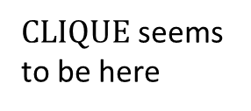


$\text{EXP}$-hard
$\text{EXP}$-complete
$\text{CLIQUE}$ seems to be here
$$\text{EXP}$$
$$\text{P}$$

Slide 23

Complexity of the clique problem
Evidently, to understand the complexity of $\text{CLIQUE}$, we need new conceptual tools

Slide 24
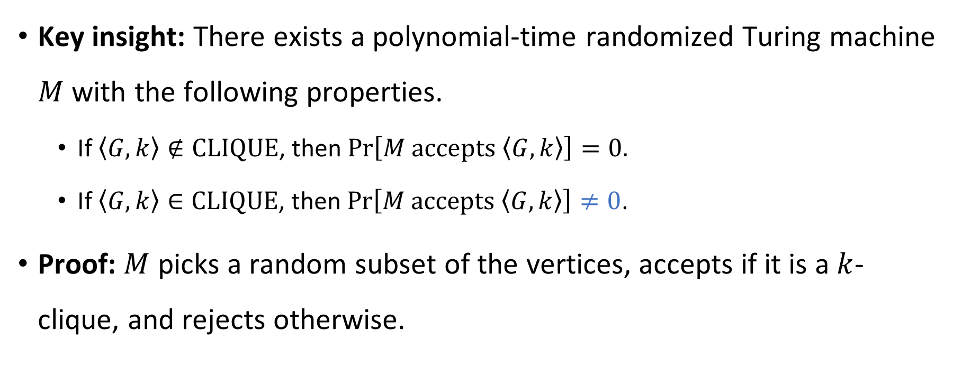
Guessing and checking
Key insight: There exists a polynomial-time randomized Turing machine $M$ with the following properties.
If $\left\langle G,k\right\rangle ∉\text{CLIQUE}$, then $\operatorname{Pr}\left[M \text{accepts} \left\langle G,k\right\rangle \right]=0.$
If $\left\langle G,k\right\rangle ∈\text{CLIQUE}$, then $\operatorname{Pr}\left[M \text{accepts} \left\langle G,k\right\rangle \right]≠0$.
Proof: $M$ picks a random subset of the vertices, accepts if it is a $k$-clique, and rejects otherwise.
“Nondeterministic TM”

