Slide 1
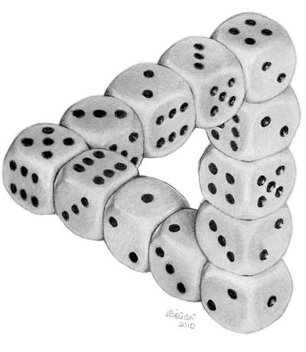
Better Pseudodistributions and Derandomization for Space-Bounded Computation
RANDOM 2021
William M. Hoza
Simons Institute
williamhoza@berkeley.edu
“Dice Illusion” by DeviantArt user Moko-m. (License: CC BY-NC-ND 3.0)
Based on research conducted while the author was a graduate student at the University of Texas at Austin, supported by the NSF GRFP under Grant DGE-1610403 and by a Harrington Fellowship from UT Austin.

Slide 2



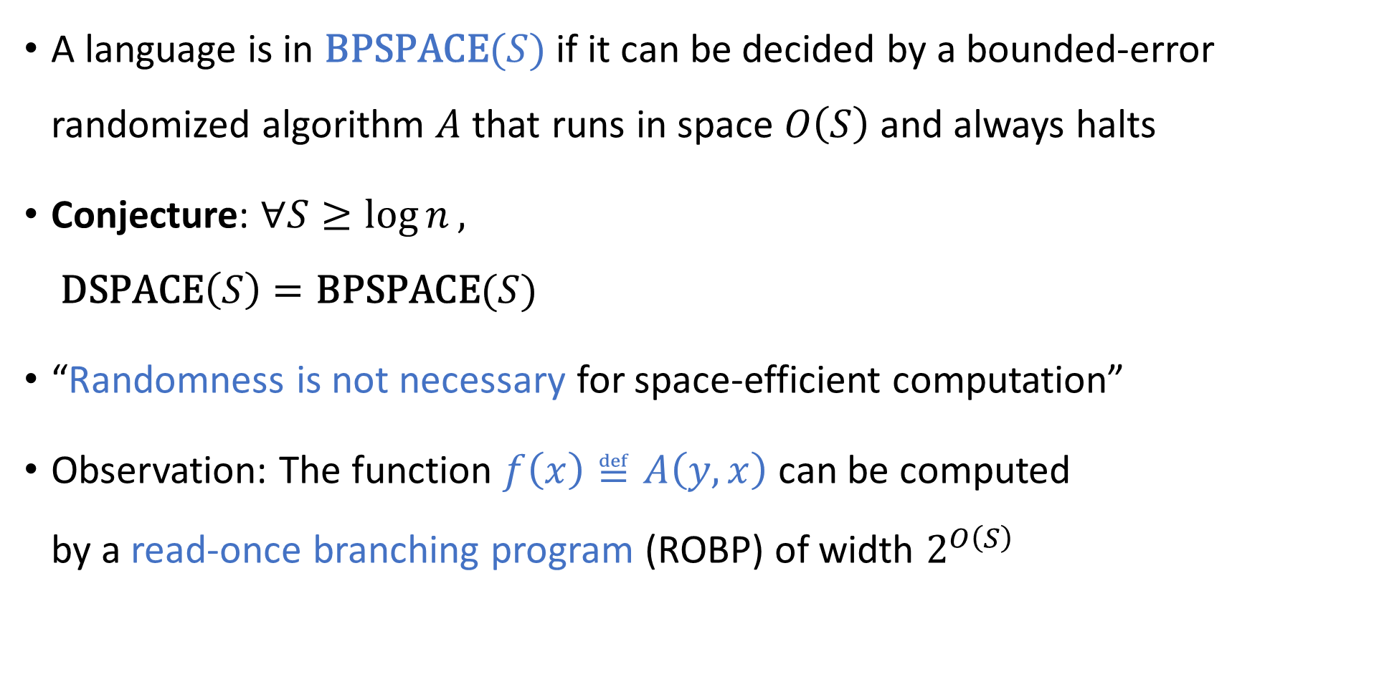
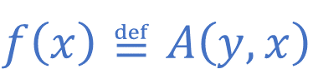
Randomness and space complexity
A language is in $\text{BPSPACE}(S)$ if it can be decided by a bounded-error randomized algorithm $A$ that runs in space $O\left(S\right)$ and always halts
Conjecture: $∀S≥\log{n},$ $\text{DSPACE}\left(S\right)=\text{BPSPACE}(S)$
“Randomness is not necessary for space-efficient computation”
Observation: The function $f\left(x\right)≝A\left(y,x\right)$ can be computed by a read-once branching program (ROBP) of width $2^{O\left(S\right)}$
$$f\left(x\right)≝A\left(y,x\right)$$

Slide 3
Read-once branching programs (ROBPs)
$$x=$$
$$1$$
$$0$$
$$0$$
$$1$$
$$0$$
$$1$$
0
1
$$v_{\text{acc}}$$
$$v_{\text{start}}$$
1
0
1
Computes
$$f:\{0, 1\}^{n}→\{0, 1\}$$
Width
0
1
1
0
0
0
1
$n+1$ layers ($n=$ length)

Slide 4
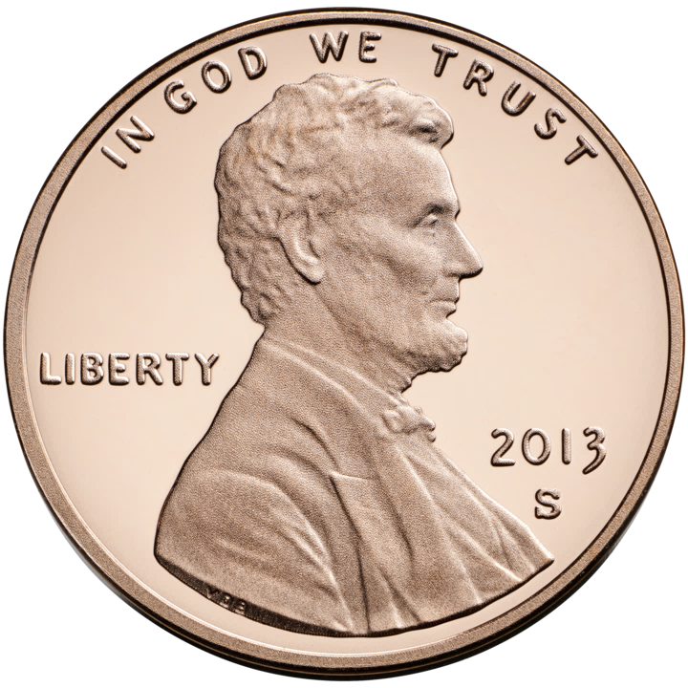

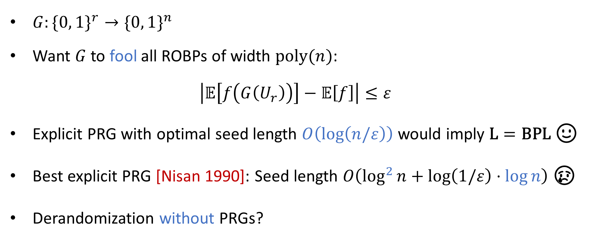
Pseudorandom generators (PRGs)
$G:\{0, 1\}^{r}→\{0, 1\}^{n}$
Want $G$ to fool all ROBPs of width $\text{poly}(n)$:
$$\left|𝔼\left[f\left(G\left(U_{r}\right)\right)\right]−𝔼\left[f\right]\right|≤ε$$
Explicit PRG with optimal seed length $O\left(\log\left(n/ε\right)\right)$ would imply $\text{L}=\text{BPL}$ 🙂
Best explicit PRG [Nisan 1990]: Seed length $O\left(\log^{2}{n}+\log\left(1/ε\right)⋅\log{n}\right)$ 😢
Derandomization without PRGs?

Slide 5
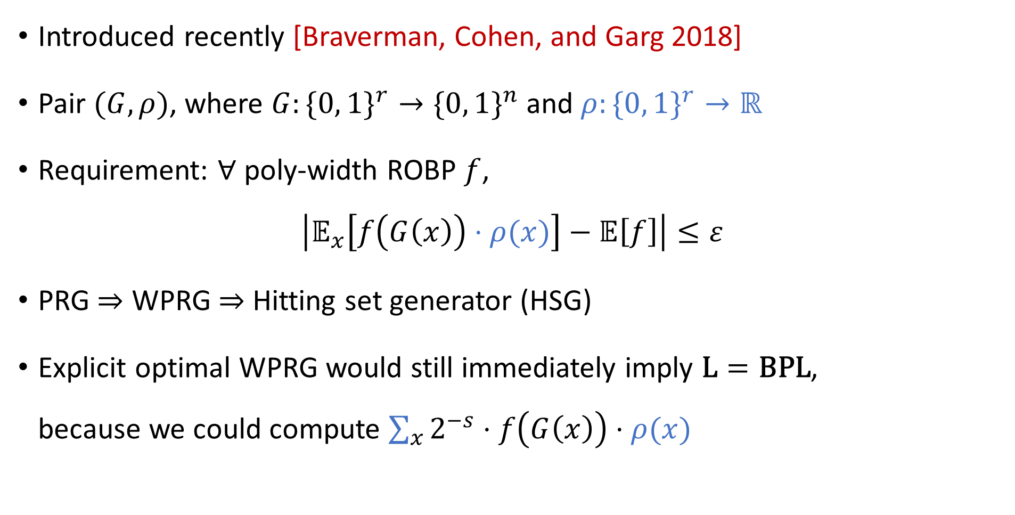
Weighted PRGs (WPRGs)
Introduced recently [Braverman, Cohen, and Garg 2018]
Pair $(G, ρ)$, where $G:\{0, 1\}^{r}→\{0, 1\}^{n}$ and $ρ:\{0, 1\}^{r}→ℝ$
Requirement: $∀$ poly-width ROBP $f$,
$$\left|𝔼_{x}\left[f\left(G\left(x\right)\right)⋅ρ(x)\right]−𝔼\left[f\right]\right|≤ε$$
PRG $⇒$ WPRG $⇒$ Hitting set generator (HSG)
Explicit optimal WPRG would still immediately imply $\text{L}=\text{BPL}$, because we could compute $\sum_{x}{2^{−s}⋅f\left(G\left(x\right)\right)⋅ρ(x)}$
HSG
WPRG
PRG

Slide 6
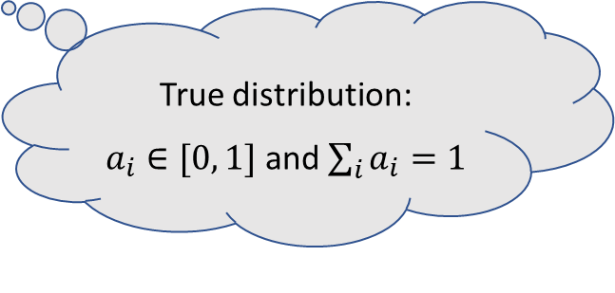
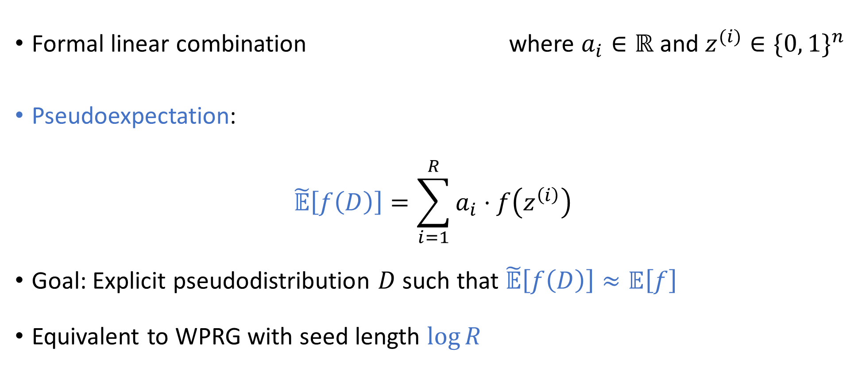

Alternative formalism: Pseudodistributions
“Pseudoprobability”
$$D=\sum_{i=1}^{R}{a_{i}⋅z^{(i)}}$$
Formal linear combination where $a_{i}∈ℝ$ and $z^{(i)}∈\{0, 1\}^{n}$
Pseudoexpectation:
$$\tilde{𝔼}\left[f\left(D\right)\right]=\sum_{i=1}^{R}{a_{i}⋅f\left(z^{\left(i\right)}\right)}$$
Goal: Explicit pseudodistribution $D$ such that $\tilde{𝔼}\left[f\left(D\right)\right]≈𝔼\left[f\right]$
Equivalent to WPRG with seed length $\log{R}$
True distribution: $a_{i}∈[0, 1]$ and $\sum_{i}{a_{i}}=1$

Slide 7





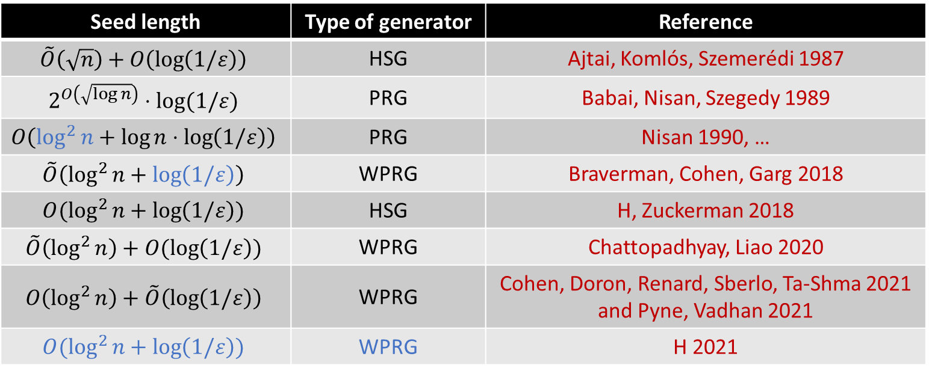
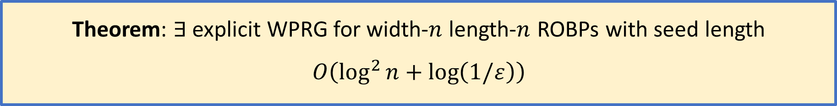
Generators for width-$n$ length-$n$ ROBPs
Seed length | Type of generator | Reference
$$\tilde{O}\left(\sqrt{n}\right)+O\left(\log\left(1/ε\right)\right)$$ | HSG | Ajtai, Komlós, Szemerédi 1987
$$2^{O\left(\sqrt{\log{n}}\right)}⋅log⁡(1/ε)$$ | PRG | Babai, Nisan, Szegedy 1989
$$O\left(\log^{2}{n}+\log{n}⋅\log\left(1/ε\right)\right)$$ | PRG | Nisan 1990, …
$$\tilde{O}\left(\log^{2}{n}+\log\left(1/ε\right)\right)$$ | WPRG | Braverman, Cohen, Garg 2018
$$O(\log^{2}{n}+\log\left(1/ε\right))$$ | HSG | H, Zuckerman 2018
$$\tilde{O}\left(\log^{2}{n}\right)+O(\log\left(1/ε\right))$$ | WPRG | Chattopadhyay, Liao 2020
$$O\left(\log^{2}{n}\right)+\tilde{O}\left(\log\left(1/ε\right)\right)$$ | WPRG | Cohen, Doron, Renard, Sberlo, Ta-Shma 2021 and Pyne, Vadhan 2021
$$O(\log^{2}{n}+\log\left(1/ε\right))$$ | WPRG | H 2021
Theorem: $∃$ explicit WPRG for width-$n$ length-$n$ ROBPs with seed length
$$O\left(\log^{2}{n}+\log\left(1/ε\right)\right)$$

Slide 8

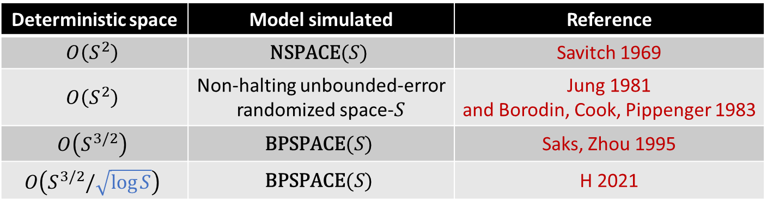
Application: Better derandomization of $\text{BPL}$
Deterministic space | Model simulated | Reference
$$O\left(S^{2}\right)$$ | $$\text{NSPACE}(S)$$ | Savitch 1969
$$O\left(S^{2}\right)$$ | Non-halting unbounded-error randomized space-$S$ | Jung 1981 and Borodin, Cook, Pippenger 1983
$$O\left(S^{3/2}\right)$$ | $$\text{BPSPACE}(S)$$ | Saks, Zhou 1995
$$O\left(S^{3/2}/\sqrt{\log{S}}\right)$$ | $$\text{BPSPACE}(S)$$ | H 2021
Theorem: $∀S=S\left(n\right)≥\log{n}$, $\text{BPSPACE}(S)⊆\text{DSPACE}\left(S^{3/2}/\sqrt{\log{S}}\right)$
Proof builds on Saks-Zhou framework using recent prior results on WPRGs [Chattopadhyay, Liao 2020] [Cohen, Doron, Renard, Sberlo, Ta-Shma 2021] [Pyne, Vadhan 2021]
(Our improved WPRG construction is not necessary)

Slide 9
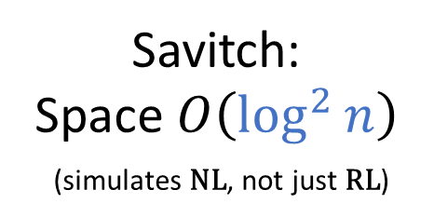

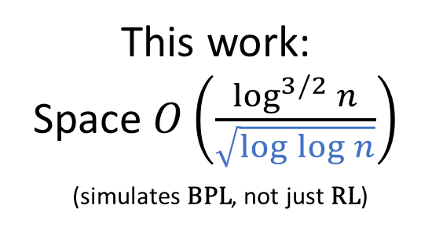
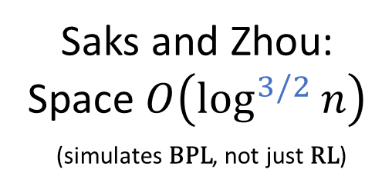
Timeline of derandomizing $\text{RL}$
This work: Space $O\left(\frac{\log^{3/2}{n}}{\sqrt{\log{\log{n}}}}\right)$ (simulates $\text{BPL}$, not just $\text{RL}$)
Savitch: Space $O\left(\log^{2}{n}\right)$ (simulates $\text{NL}$, not just $\text{RL}$)
Saks and Zhou: Space $O\left(\log^{3/2}{n}\right)$ (simulates $\text{BPL}$, not just $\text{RL}$)
STOC 1969
FOCS 1995
RANDOM 2021
26 years
26 years
I’m looking forward to 2047! 😁

Slide 10
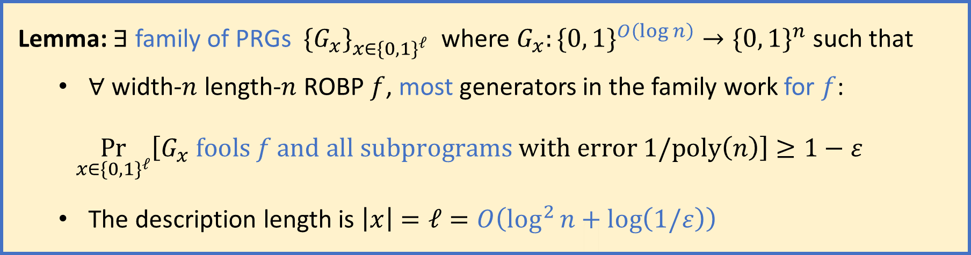
WPRG step 1: Family of log-seed PRGs
Recall goal: WPRG with seed length $O\left(\log^{2}{n}+\log\left(1/ε\right)\right)$
Lemma: $∃$ family of PRGs $\{G_{x}\}_{x∈\{0, 1\}^{ℓ}}$ where $G_{x}:\{0, 1\}^{O\left(\log{n}\right)}→\{0, 1\}^{n}$ such that
$∀$ width-$n$ length-$n$ ROBP $f$, most generators in the family work for $f$:
$$\underset{x∈\{0, 1\}^{ℓ}}{Pr}\left[G_{x} \text{fools} f \text{and} \text{all} \text{subprograms} \text{with} \text{error} 1/\text{poly}\left(n\right)\right]≥1−ε$$
The description length is $\left|x\right|=ℓ=O\left(\log^{2}{n}+\log\left(1/ε\right)\right)$
(Similar lemmas used in prior works [Nisan 1994] [Armoni 1998] …)
Construction: $G_{x}\left(y\right)=G\left(\text{Samp}\left(x, y\right)\right)$, where $G=$ Nisan’s PRG and $\text{Samp}$ is a sampler

Slide 11



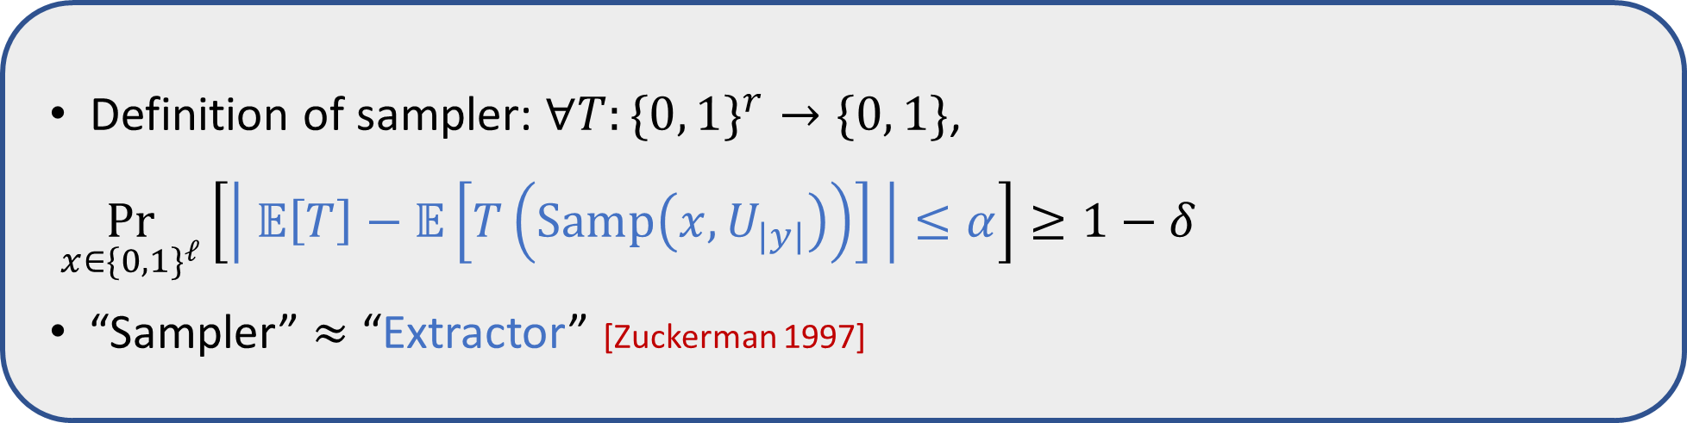
PRG family based on sampler
Construction: $G_{x}\left(y\right)=G\left(\text{Samp}\left(x, y\right)\right)$, where $G=$ Nisan’s PRG and $\text{Samp}$ is a sampler
Proof of correctness: ($∀f$, w.h.p. over $x$, the generator $G_{x}$ fools $f$ and its subprograms)
For a fixed ROBP $f$, we can look at $T\left(z\right)≝f\left(G\left(z\right)\right)$
Union bound over subprograms ✔
Definition of sampler: $∀T:\{0, 1\}^{r}→\{0, 1\}$,
$\underset{x∈\{0, 1\}^{ℓ}}{Pr}\left[\left| 𝔼\left[T\right]−𝔼\left[T\left(\text{Samp}\left(x,U_{|y|}\right)\right)\right] \right|≤α\right]≥1−δ$
“Sampler” $≈$ “Extractor” [Zuckerman 1997]
$$x$$
$$T$$

Slide 12
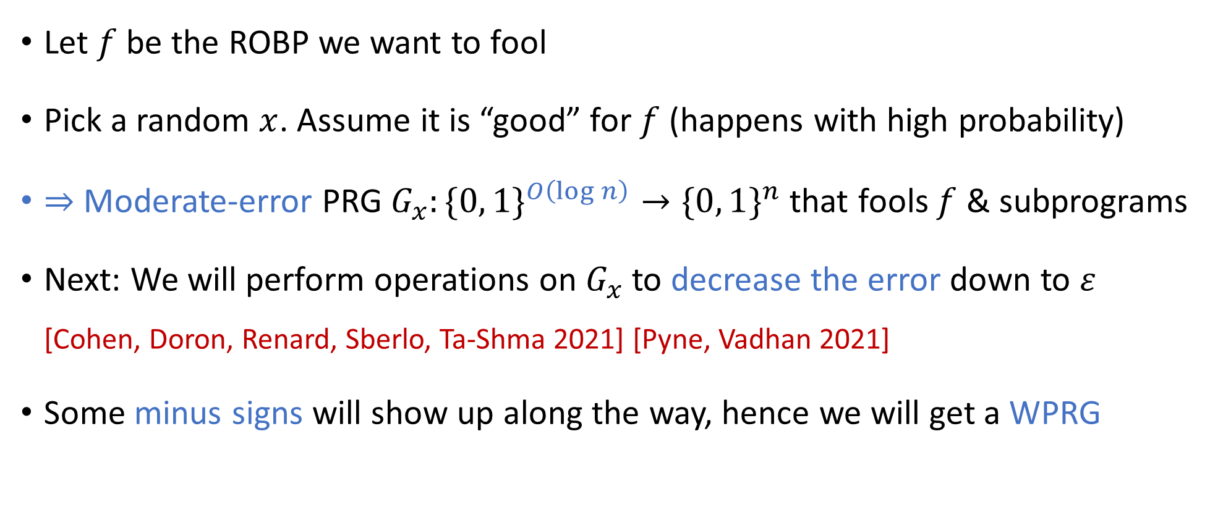
Remaining plan for WPRG construction
Let $f$ be the ROBP we want to fool
Pick a random $x$. Assume it is “good” for $f$ (happens with high probability)
$⇒$ Moderate-error PRG $G_{x}:\{0, 1\}^{O\left(\log{n}\right)}→\{0, 1\}^{n}$ that fools $f$ & subprograms
Next: We will perform operations on $G_{x}$ to decrease the error down to $ε$ [Cohen, Doron, Renard, Sberlo, Ta-Shma 2021] [Pyne, Vadhan 2021]
Some minus signs will show up along the way, hence we will get a WPRG

Slide 13
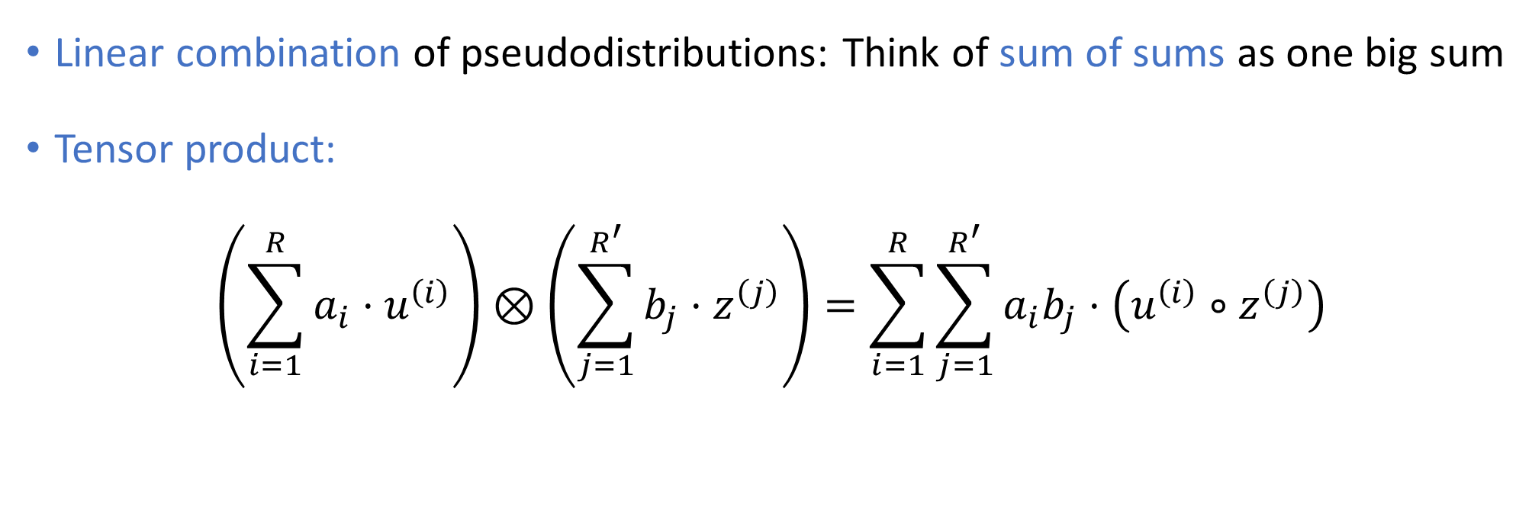
Operations on pseudodistributions
Linear combination of pseudodistributions: Think of sum of sums as one big sum
Tensor product:
$$\left(\sum_{i=1}^{R}{a_{i}⋅u^{\left(i\right)}}\right)⊗\left(\sum_{j=1}^{R^{′}}{b_{j}⋅z^{\left(j\right)}}\right)=\sum_{i=1}^{R}{\sum_{j=1}^{R^{′}}{a_{i}b_{j}⋅\left(u^{\left(i\right)}∘z^{\left(j\right)}\right)}}$$
String concatenation

Slide 14
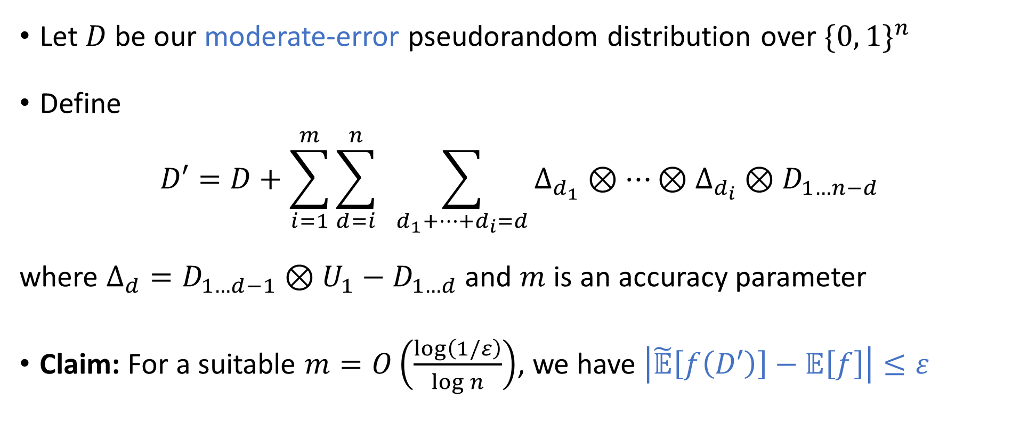
Final pseudodistribution construction
[Cohen, Doron, Renard, Sberlo, Ta-Shma 2021] [Pyne, Vadhan 2021]
Let $D$ be our moderate-error pseudorandom distribution over $\{0, 1\}^{n}$
Define
$$D′=D+\sum_{i=1}^{m}{\sum_{d=i}^{n}{ \sum_{d_{1}+…+d_{i}=d}{Δ_{d_{1}}⊗⋯⊗Δ_{d_{i}}⊗D_{1…n−d}}}}$$
where $Δ_{d}=D_{1…d−1}⊗U_{1}−D_{1…d}$ and $m$ is an accuracy parameter
Claim: For a suitable $m=O\left(\frac{\log\left(1/ε\right)}{\log{n}}\right)$, we have $\left|\tilde{𝔼}\left[f\left(D′\right)\right]−𝔼\left[f\right]\right|≤ε$

Slide 15
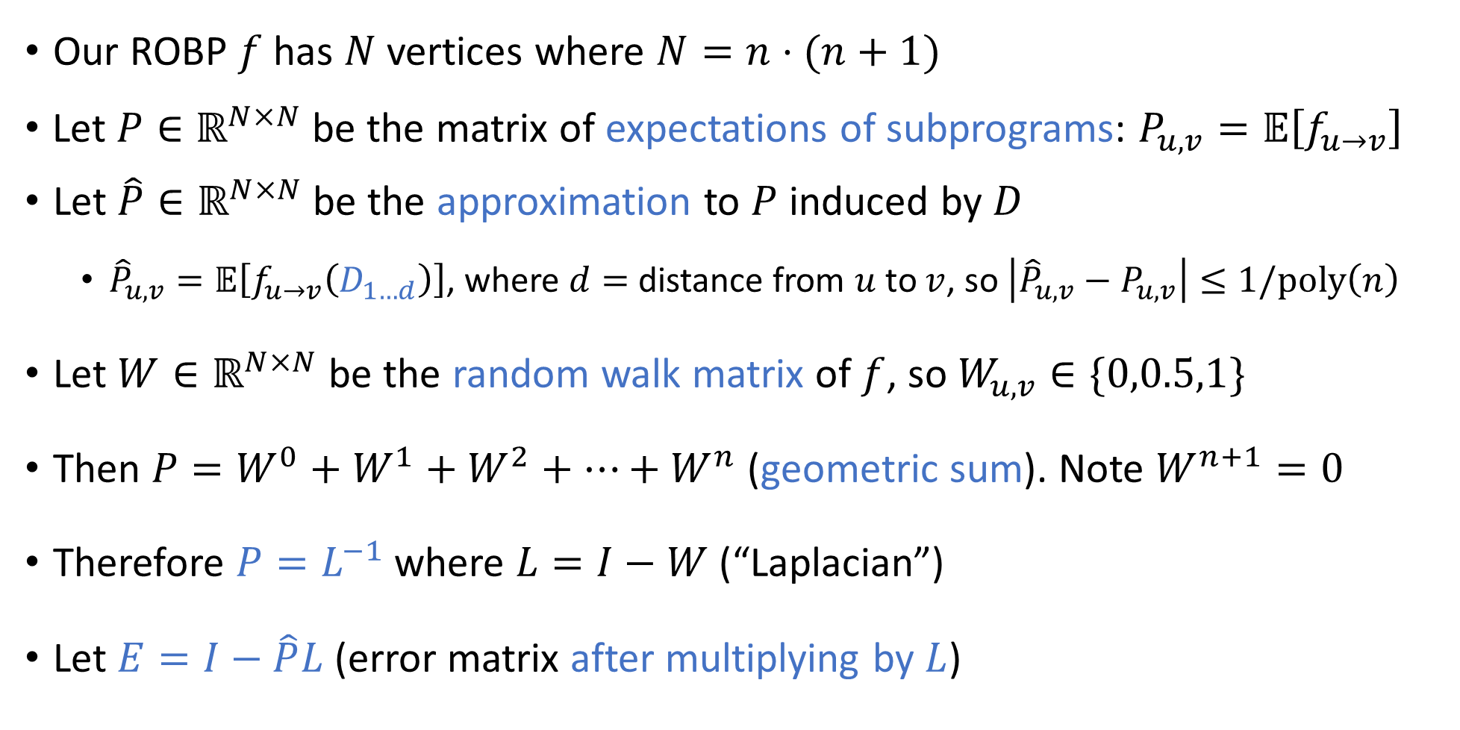
Analysis: Laplacian Matrix
[Ahmadinejad, Kelner, Murtagh,
Peebles, Sidford, Vadhan 2020]
Our ROBP $f$ has $N$ vertices where $N=n⋅(n+1)$
Let $P∈ℝ^{N×N}$ be the matrix of expectations of subprograms: $P_{u,v}=𝔼\left[f_{u→v}\right]$
Let $\hat{P}∈ℝ^{N×N}$ be the approximation to $P$ induced by $D$
${\hat{P}}_{u,v}=𝔼\left[f_{u→v}\left(D_{1…d}\right)\right]$, where $d=$ distance from $u$ to $v$, so $\left|{\hat{P}}_{u,v}−P_{u,v}\right|≤1/\text{poly}\left(n\right)$
Let $W∈ℝ^{N×N}$ be the random walk matrix of $f$, so $W_{u,v}∈\{0,0.5,1\}$
Then $P=W^{0}+W^{1}+W^{2}+⋯+W^{n}$ (geometric sum). Note $W^{n+1}=0$
Therefore $P=L^{−1}$ where $L=I−W$ (“Laplacian”)
Let $E=I−\hat{P}L$ (error matrix after multiplying by $L$)

Slide 16
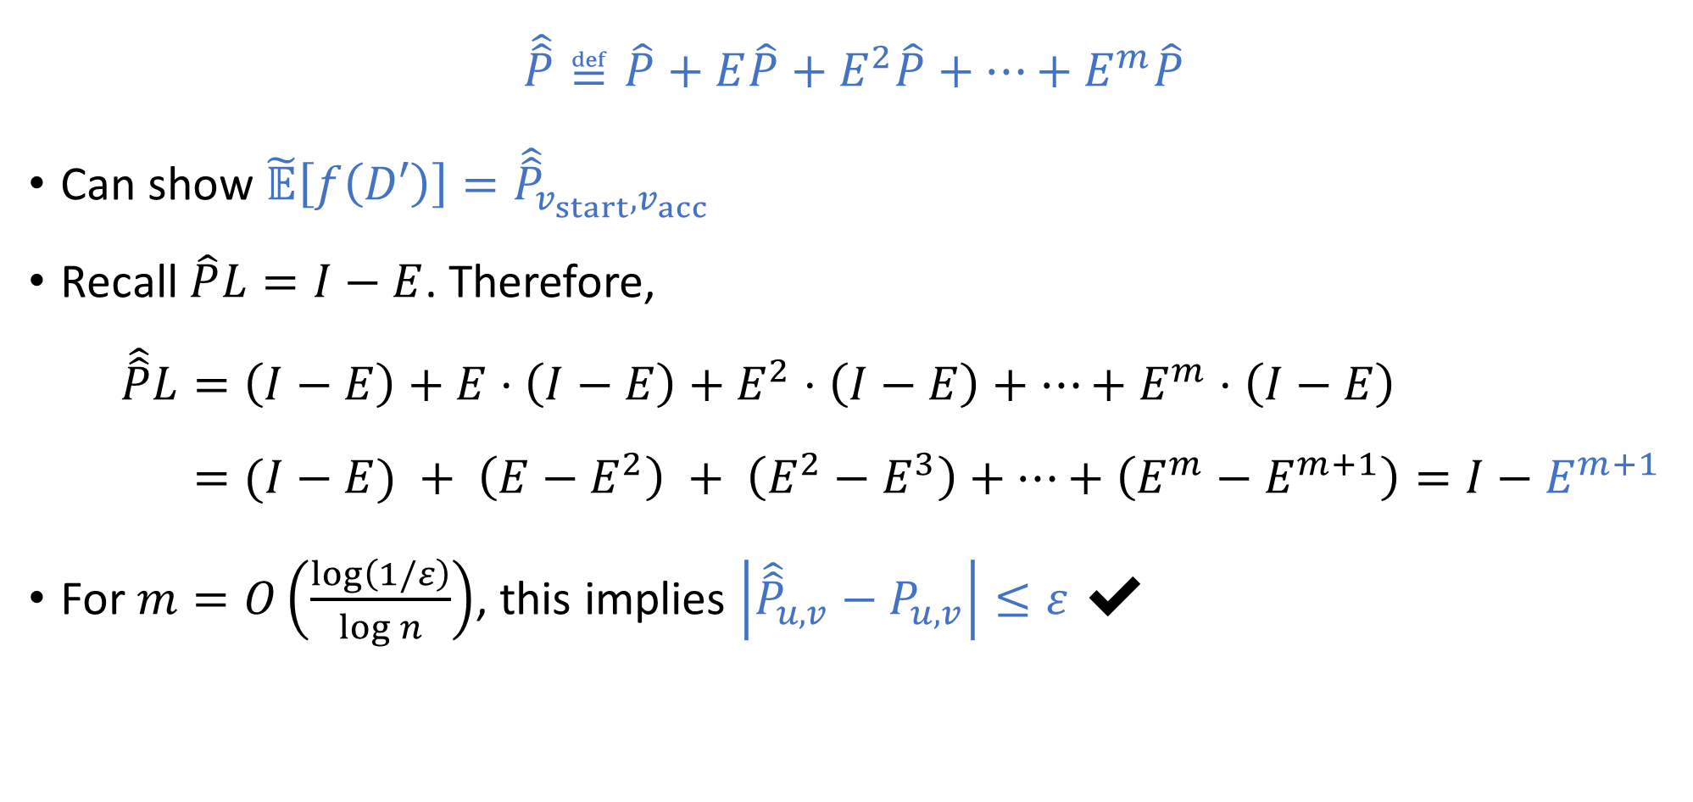
Preconditioned Richardson iteration
[CDRSTS 2021] [PV 2021] [AKMPSV 2020]
$$\hat{\hat{P}}≝\hat{P}+E\hat{P}+E^{2}\hat{P}+⋯+E^{m}\hat{P}$$
Can show $\tilde{𝔼}\left[f\left(D′\right)\right]={\hat{\hat{P}}}_{v_{start},v_{acc}}$
Recall $\hat{P}L=I−E$. Therefore,
$$\hat{\hat{P}}L=\left(I−E\right)+E⋅\left(I−E\right)+E^{2}⋅\left(I−E\right)+⋯+E^{m}⋅\left(I−E\right) \\ =(I−E) + \left(E−E^{2}\right) + \left(E^{2}−E^{3}\right)+⋯+\left(E^{m}−E^{m+1}\right)=I−E^{m+1}$$
For $m=O\left(\frac{\log\left(1/ε\right)}{\log{n}}\right)$, this implies $\left|{\hat{\hat{P}}}_{u,v}−P_{u,v}\right|≤ε$ ✔

Slide 17
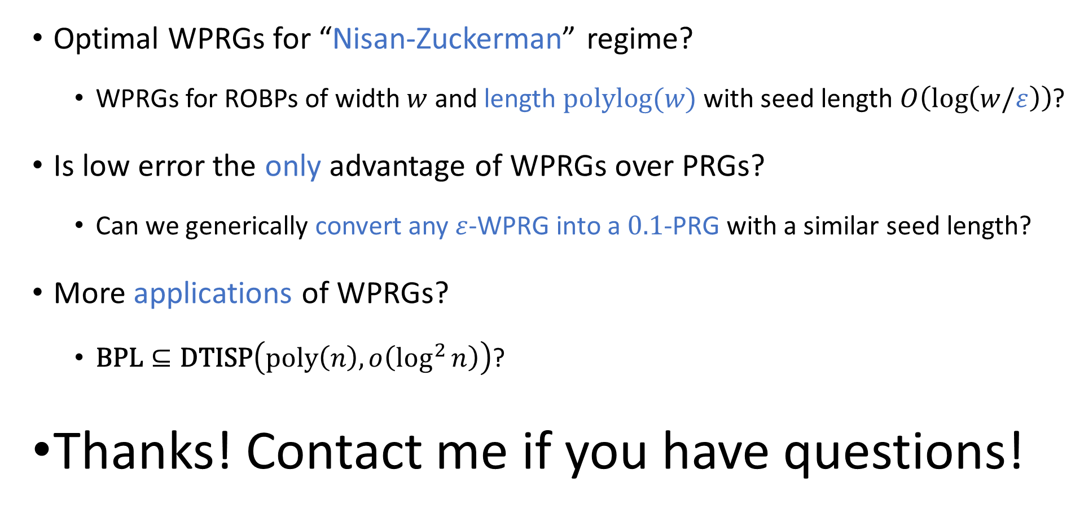
Open problems
Optimal WPRGs for “Nisan-Zuckerman” regime?
WPRGs for ROBPs of width $w$ and length $\text{polylog}(w)$ with seed length $O\left(\log\left(w/ε\right)\right)$?
Is low error the only advantage of WPRGs over PRGs?
Can we generically convert any $ε$-WPRG into a $0.1$-PRG with a similar seed length?
More applications of WPRGs?
$\text{BPL}⊆\text{DTISP}\left(\text{poly}\left(n\right), o\left(\log^{2}{n}\right)\right)$?
Thanks! Contact me if you have questions!

