Slide 1
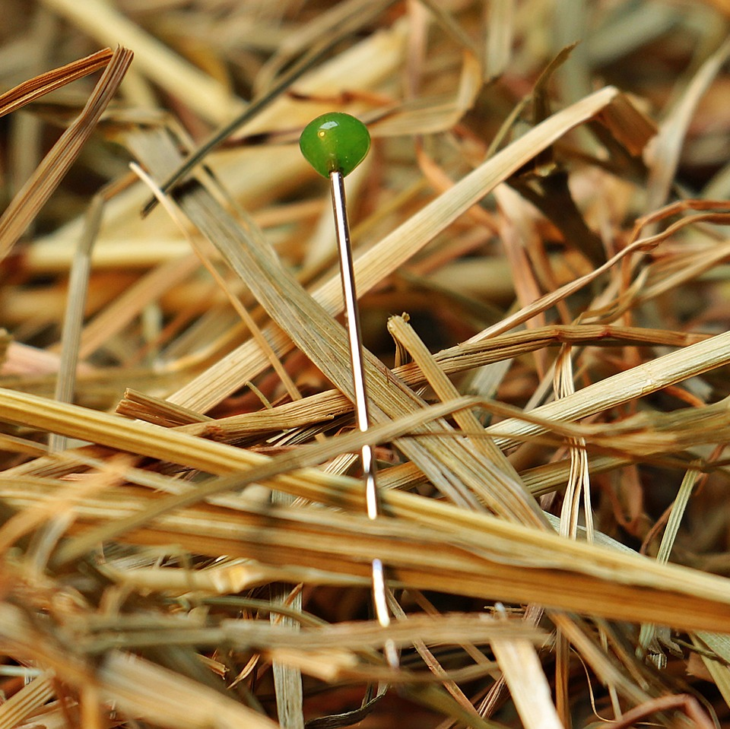
CMSC 28100 Introduction to Complexity Theory Spring 2025 Instructor: William Hoza

Slide 2
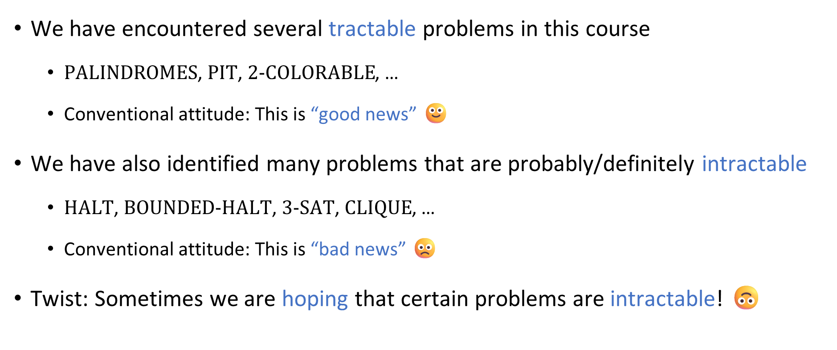
How to feel about intractability
We have encountered several tractable problems in this course
$\text{PALINDROMES}$, $\text{PIT}$, $\text{2}\text{‑}\text{COLORABLE}$, …
Conventional attitude: This is “good news” 🙂
We have also identified many problems that are probably/definitely intractable
$\text{HALT}$, $\text{BOUNDED}\text{‑}\text{HALT}$, $\text{3}\text{‑}\text{SAT}$, $\text{CLIQUE}$, …
Conventional attitude: This is “bad news” 🙁
Twist: Sometimes we are hoping that certain problems are intractable! 🙃

Slide 3
Cryptography

Slide 4

Secure communication
Public communication channel
😈
How can Bob send a private message to Alice?
E.g., credit card number
It seems impossible, because Alice and Eve receive all the same information from Bob!
A clever approach: Try to force Eve to solve an intractable problem
Online
store
Customer
Eve
Alice
Bob

Slide 5
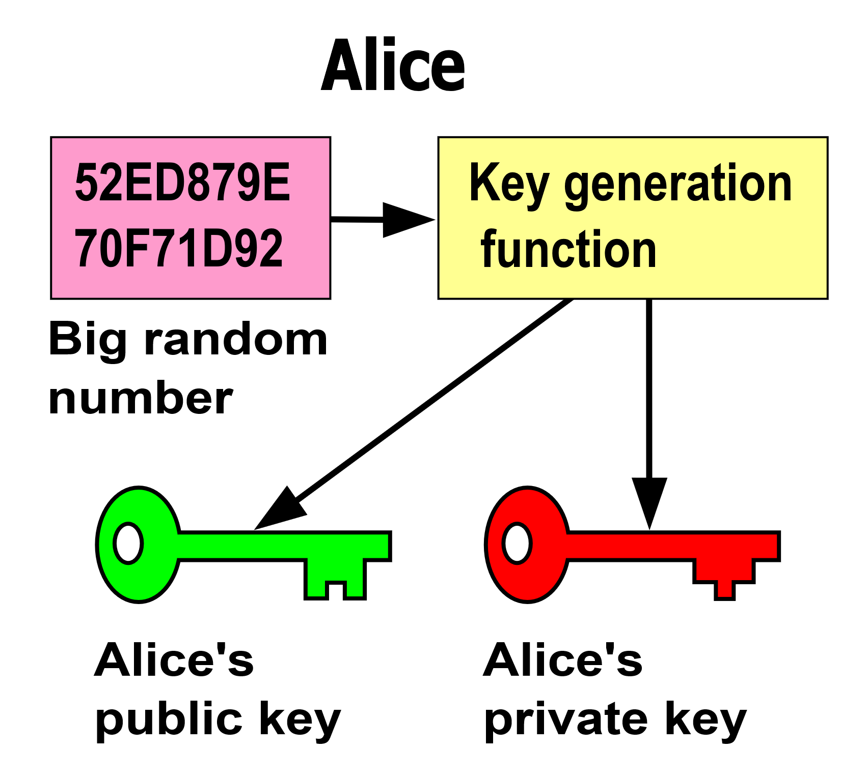
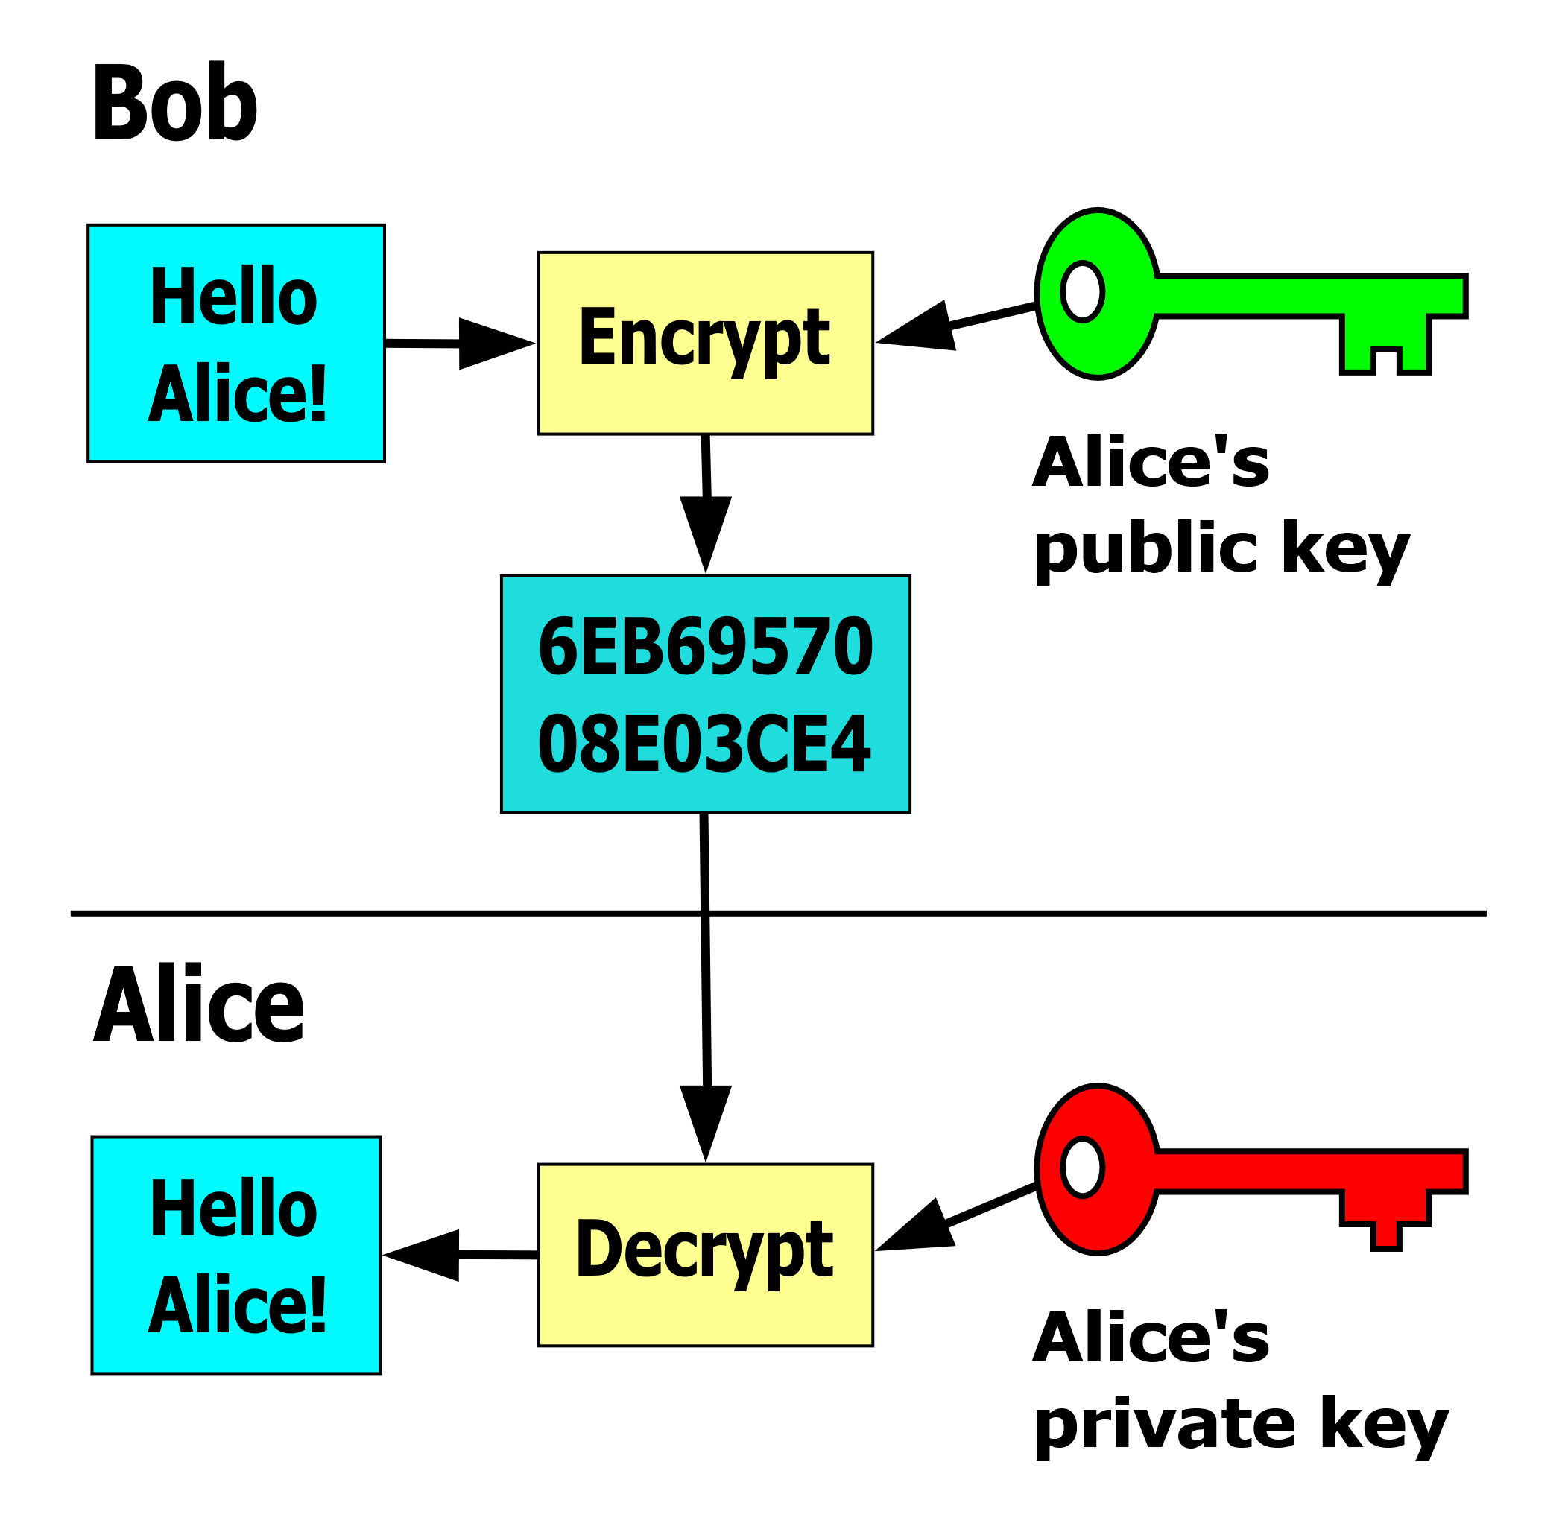
Public-key encryption
Alice’s advantage over Eve: Alice knows the private key and Eve doesn’t

Slide 6
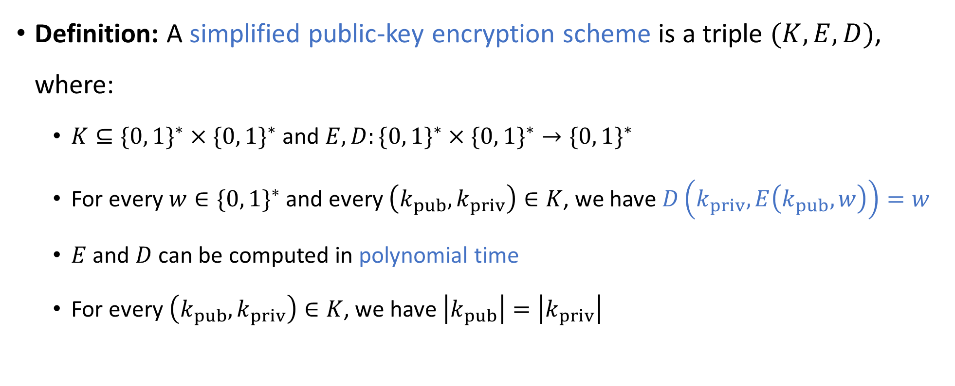
Public-key encryption scheme
“encrypt”
“keys”
“decrypt”
Definition: A simplified public-key encryption scheme is a triple $(K,E,D)$, where:
$K⊆\{0, 1\}^{∗}×\{0, 1\}^{∗}$ and $E,D:\{0, 1\}^{∗}×\{0, 1\}^{∗}→\{0, 1\}^{∗}$
For every $w∈\{0, 1\}^{∗}$ and every $\left(k_{pub},k_{priv}\right)∈K$, we have $D\left(k_{priv},E\left(k_{pub},w\right)\right)=w$
$E$ and $D$ can be computed in polynomial time
For every $\left(k_{pub},k_{priv}\right)∈K$, we have $\left|k_{pub}\right|=\left|k_{priv}\right|$
Notes:
Justification for the last condition: This means that E and D have the same time budget

Slide 7
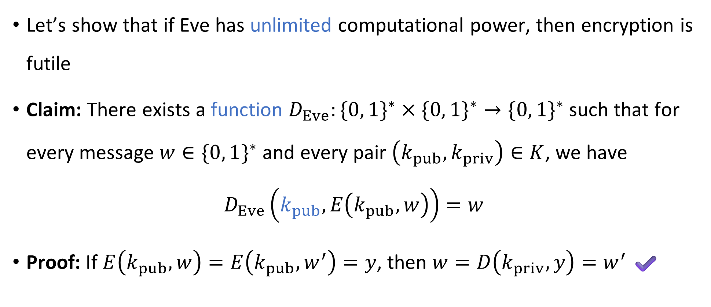
If Eve is computationally unbounded
Let’s show that if Eve has unlimited computational power, then encryption is futile
Claim: There exists a function $D_{Eve}:\{0, 1\}^{∗}×\{0, 1\}^{∗}→\{0, 1\}^{∗}$ such that for every message $w∈\{0, 1\}^{∗}$ and every pair $\left(k_{pub},k_{priv}\right)∈K$, we have
$$D_{Eve}\left(k_{pub},E\left(k_{pub},w\right)\right)=w$$
Proof: If $E\left(k_{pub},w\right)=E\left(k_{pub},w^{′}\right)=y$, then $w=D\left(k_{priv},y\right)=w^{′}$ ✔️

Slide 8
What if Eve is computationally bounded?
Amazing fact: There are known public-key encryption schemes such that decrypting without the private key seems to be intractable!
(*Better: There are schemes such that it is apparently intractable to “occasionally” “partially” decrypt without the private key. Making this precise is beyond the scope of our course)
Example: “RSA”
These amazing encryption schemes make our modern internet experience possible! Can we prove that they are secure?

Slide 9


Cryptography and $\text{P}$ vs. $\text{NP}$
Let $\left(K, E, D\right)$ be a simplified public-key encryption scheme
There is a function $D_{Eve}$ such that $D_{Eve}\left(k_{pub}, E\left(k_{pub},w\right)\right)=w$
Theorem: If $\text{P}=\text{NP}$, then $D_{Eve}$ can be computed in polynomial time ☹️
Notes:
A technicality: D_Eve isn’t completely well-defined, due to invalid public keys. The meaning of the theorem is that there exists a poly-time algorithm that computes D_Eve in the cases where it is well-defined.

Slide 10

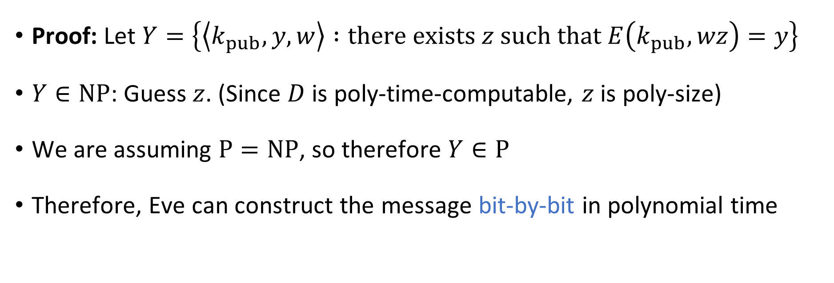
Cryptography and $\text{P}$ vs. $\text{NP}$
Theorem: If $\text{P}=\text{NP}$, then $D_{Eve}$ can be computed in polynomial time ☹️
Proof: Let $Y=\left\{\left\langle k_{pub},y,w\right\rangle :\text{there} \text{exists} z \text{such} \text{that} E\left(k_{pub},wz\right)=y\right\}$
$Y∈\text{NP}$: Guess $z$. (Since $D$ is poly-time-computable, $z$ is poly-size)
We are assuming $\text{P}=\text{NP}$, so therefore $Y∈\text{P}$
Therefore, Eve can construct the message bit-by-bit in polynomial time

Slide 11

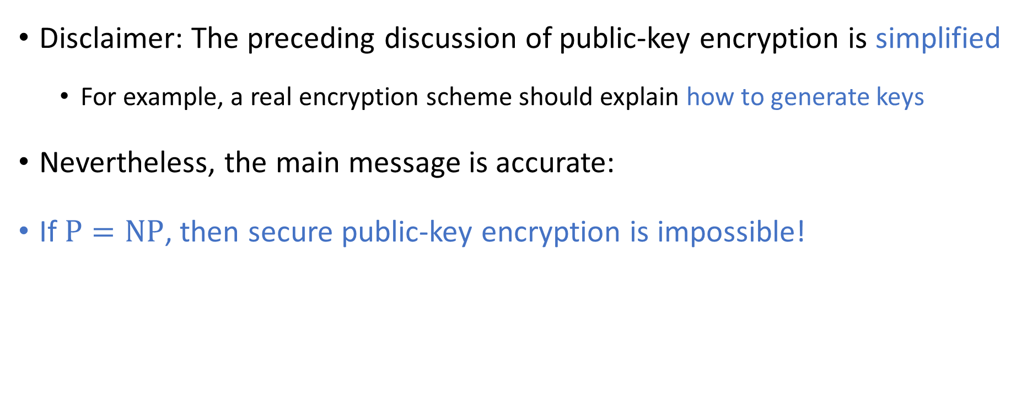
Cryptography and $\text{P}$ vs. $\text{NP}$
Disclaimer: The preceding discussion of public-key encryption is simplified
For example, a real encryption scheme should explain how to generate keys
Nevertheless, the main message is accurate:
If $\text{P}=\text{NP}$, then secure public-key encryption is impossible!
Notes:
See, e.g., “Introduction to Modern Cryptography” by Katz and Lindell if you want to see a proper definition of a secure public-key encryption scheme.

Slide 12
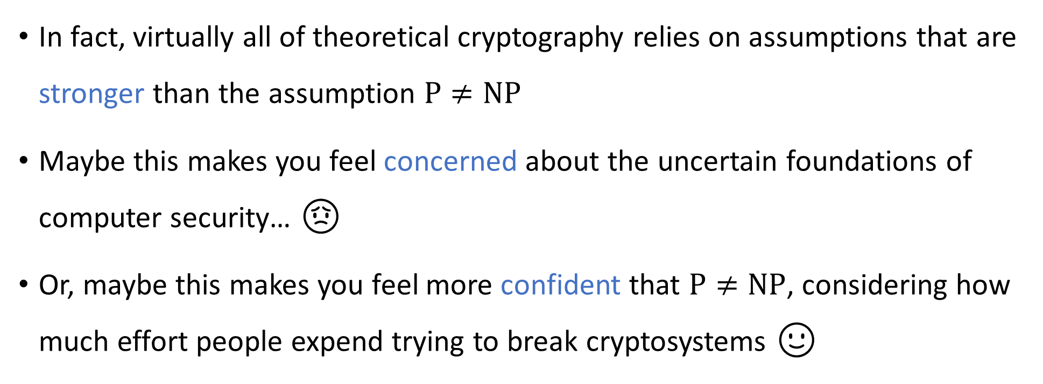
Cryptography and $\text{P}$ vs. $\text{NP}$
In fact, virtually all of theoretical cryptography relies on assumptions that are stronger than the assumption $\text{P}≠\text{NP}$
Maybe this makes you feel concerned about the uncertain foundations of computer security… 😟
Or, maybe this makes you feel more confident that $\text{P}≠\text{NP}$, considering how much effort people expend trying to break cryptosystems 🙂

Slide 13
Which problems can be solved through computation?

Slide 14
Complexity theory: The study of computational resources

Slide 15

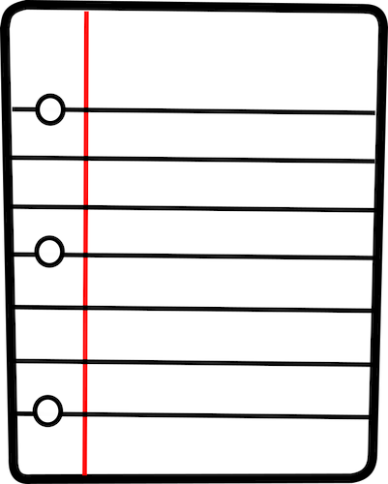





Computational resources: Fuel for algorithms
TIME
SPACE
RANDOMNESS
COMMUNICATION
QUANTUM PHYSICS
PARALLELISM

Slide 16

Sublinear-space computation
Can we solve any interesting problems using $o\left(n\right)$ space?
The one-tape Turing machine is the not the right model of computation for studying sublinear-space algorithms

Slide 17




Sublinear-space computation
Read-only input tape ➡
$$⊔$$
1
1
1
0
$$⊔$$
$$⊔$$
Read-write work tape ➡
$$⊔$$
1
0
#
1
$
0

Slide 18
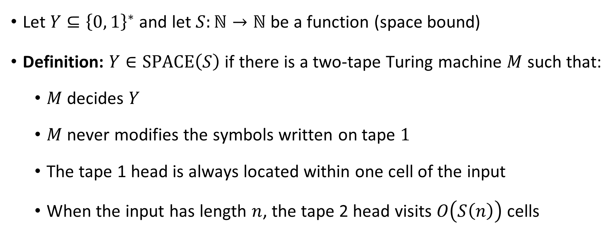

The complexity class $\text{SPACE}\left(S\right)$
Let $Y⊆{\left\{0, 1\right\}}^{∗}$ and let $S:ℕ→ℕ$ be a function (space bound)
Definition: $Y∈\text{SPACE}\left(S\right)$ if there is a two-tape Turing machine $M$ such that:
$M$ decides $Y$
$M$ never modifies the symbols written on tape $1$
The tape 1 head is always located within one cell of the input
When the input has length $n$, the tape 2 head visits $O\left(S\left(n\right)\right)$ cells

Slide 19
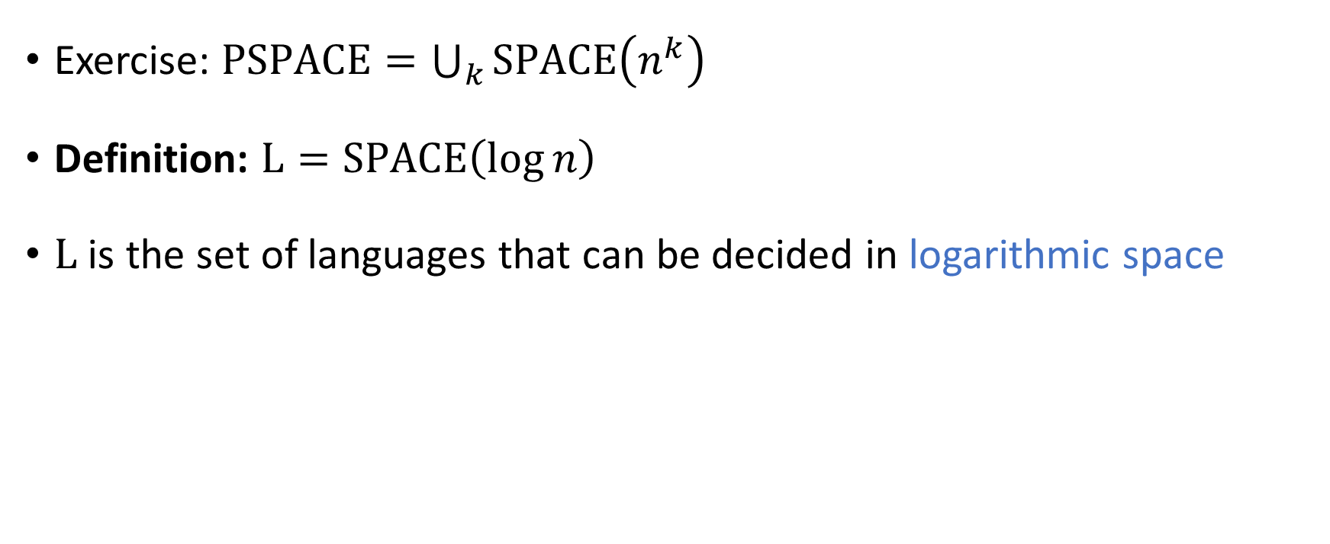

The complexity class $\text{L}$
Exercise: $\text{PSPACE}=\bigcup_{k}{\text{SPACE}\left(n^{k}\right)}$
Definition: $\text{L}=\text{SPACE}\left(\log{n}\right)$
$\text{L}$ is the set of languages that can be decided in logarithmic space

Slide 20
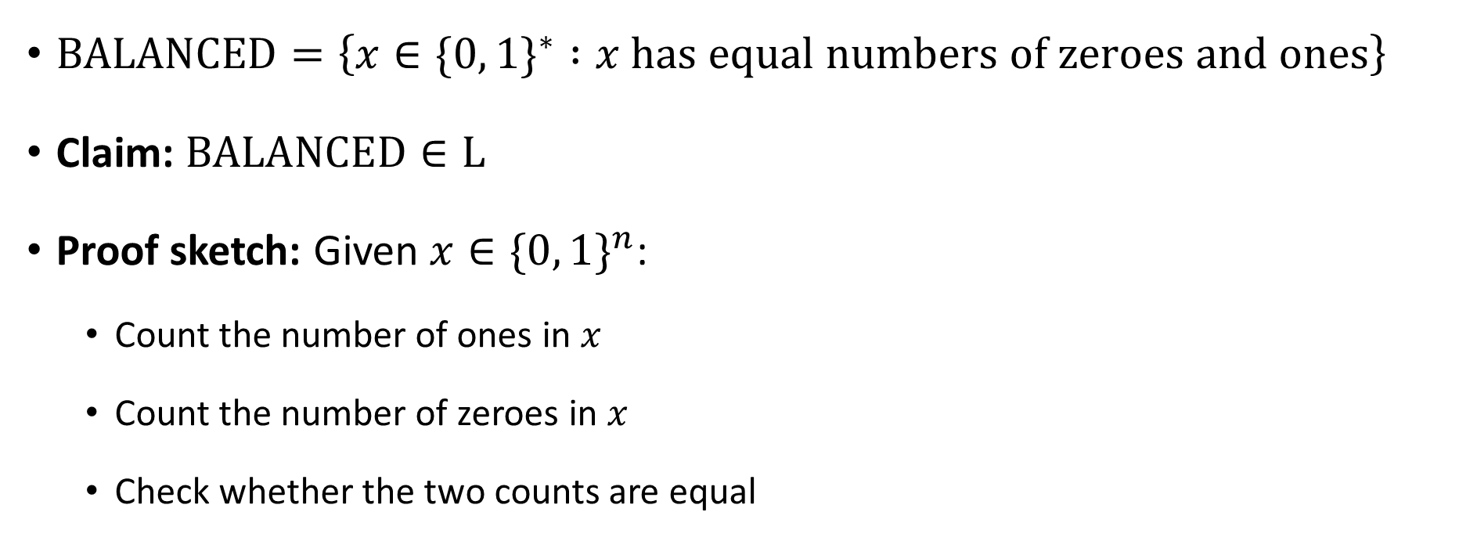


$\text{BALANCED}∈\text{L}$
$\text{BALANCED}=\left\{x∈\{0, 1\}^{∗} :x \text{has} \text{equal} \text{numbers} \text{of} \text{zeroes} \text{and} \text{ones}\right\}$
Claim: $\text{BALANCED}∈\text{L}$
Proof sketch: Given $x∈\{0, 1\}^{n}$:
Count the number of ones in $x$
Count the number of zeroes in $x$
Check whether the two counts are equal
These counters are only $\log{n}$ bits each!

Slide 21


$\text{L}⊆\text{P}$
Exercise: Show that $\text{L}⊆\text{P}$
(Similar to the proof that $\text{PSPACE}⊆\text{EXP}$)

Slide 22





$$\text{EXP}$$
$$\text{PSPACE}$$
$$\text{NP}$$
$$\text{P}$$
$$\text{L}$$

Slide 23


The $\text{L}$ vs. $\text{P}$ problem
We expect that $\text{L}≠\text{P}$, but we don’t know how to prove it
$\text{L}=\text{P}$ would mean that every efficient algorithm can be modified so that it only uses a tiny amount of work space

Slide 24

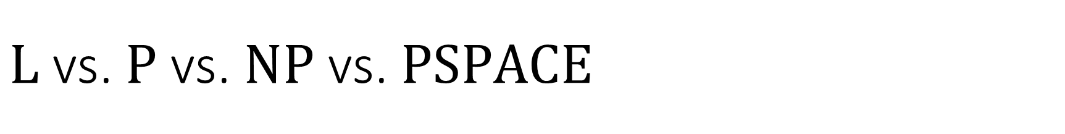

$\text{L}$ vs. $\text{P}$ vs. $\text{NP}$ vs. $\text{PSPACE}$
$\text{L}⊆\text{P}⊆\text{NP}⊆\text{PSPACE}$
What we expect: All of these containments are strict
What we can prove: At least one of these containments is strict:
Theorem: $\text{L}≠\text{PSPACE}$

Slide 25
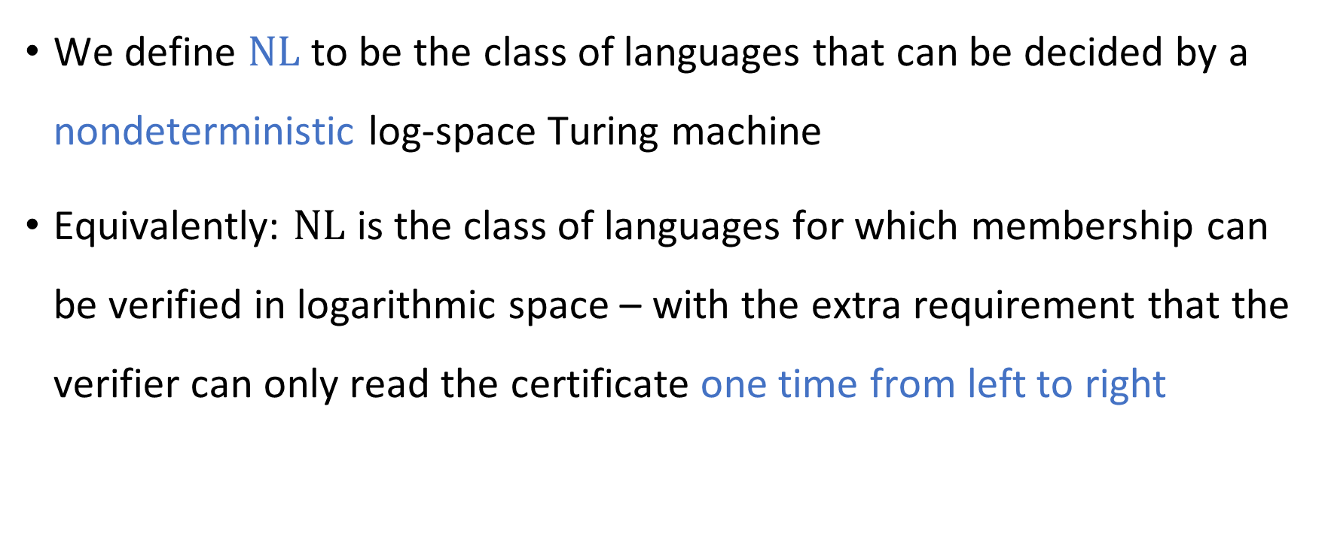
Nondeterministic log space computation
We define $\text{NL}$ to be the class of languages that can be decided by a nondeterministic log-space Turing machine
Equivalently: $\text{NL}$ is the class of languages for which membership can be verified in logarithmic space – with the extra requirement that the verifier can only read the certificate one time from left to right

