Slide 1
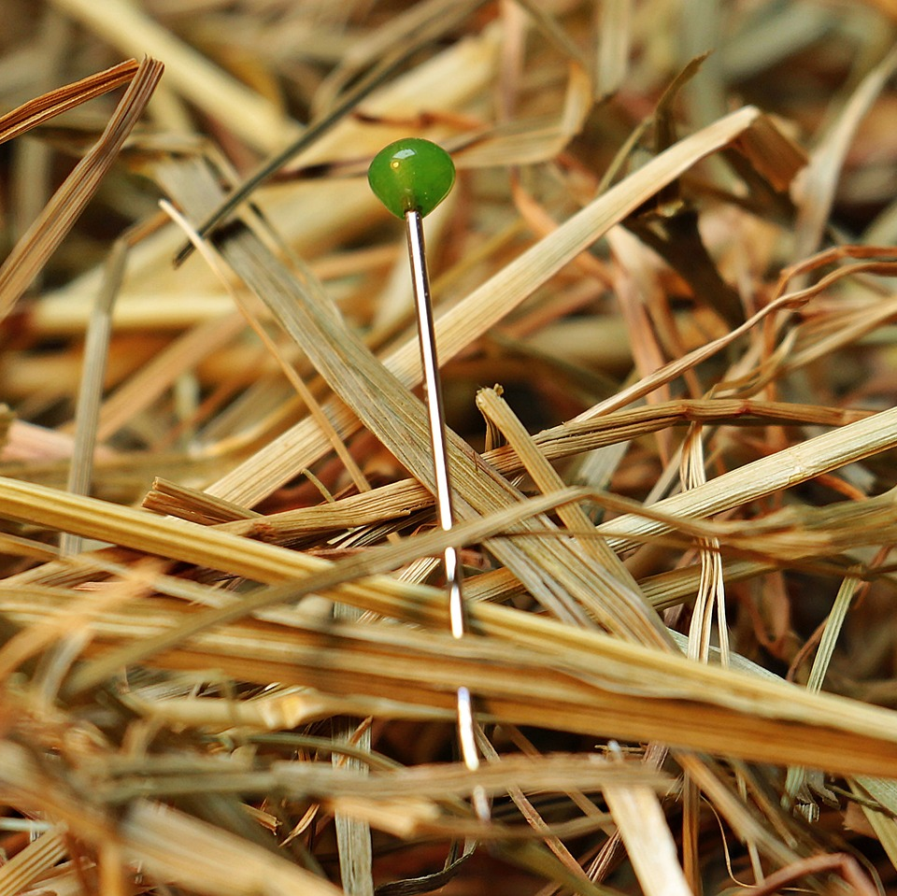
CMSC 28100 Introduction to Complexity Theory Spring 2025 Instructor: William Hoza

Slide 2
Communication Complexity

Slide 3




Communication complexity
Goal: Compute $f\left(x, y\right)$ using as little communication as possible
Communication channel
Alice holds $x$
Bob holds $y$

Slide 4
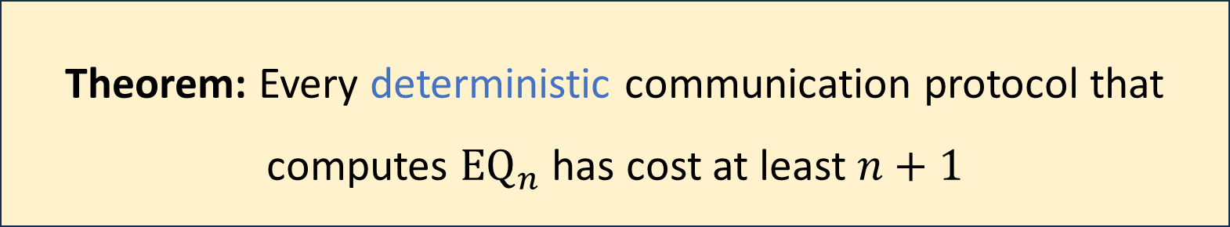

Communication complexity of equality
${\text{EQ}}_{n}:{\left\{0, 1\right\}}^{n}×{\left\{0, 1\right\}}^{n}→\{0, 1\}$
$${\text{EQ}}_{n}\left(x, y\right)=\left\{\begin{aligned}1 \text{if} x=y \\ 0 \text{if} x≠y\end{aligned}\right.$$
Theorem: Every deterministic communication protocol that computes ${\text{EQ}}_{n}$ has cost at least $n+1$

Slide 5


Randomized communication complexity
Communication channel
Alice holds $x$
Bob holds $y$

Slide 6

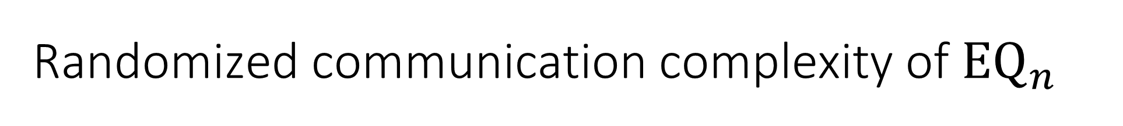
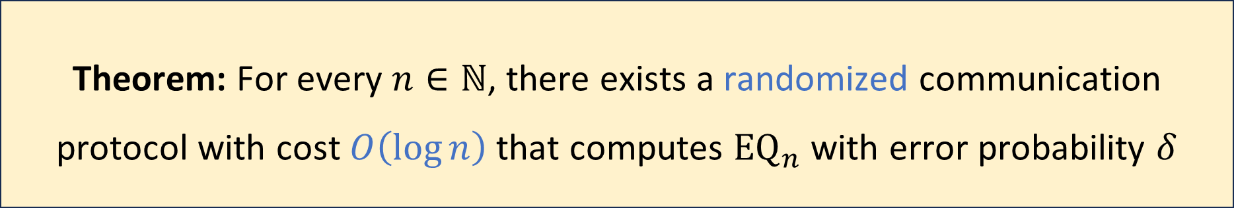
Randomized communication complexity of ${\text{EQ}}_{n}$
Let $δ>0$ be any constant
Randomized protocols are exponentially better than deterministic protocols!
Proof: Next five slides
Theorem: For every $n∈ℕ$, there exists a randomized communication protocol with cost $O\left(\log{n}\right)$ that computes ${\text{EQ}}_{n}$ with error probability $δ$

Slide 7
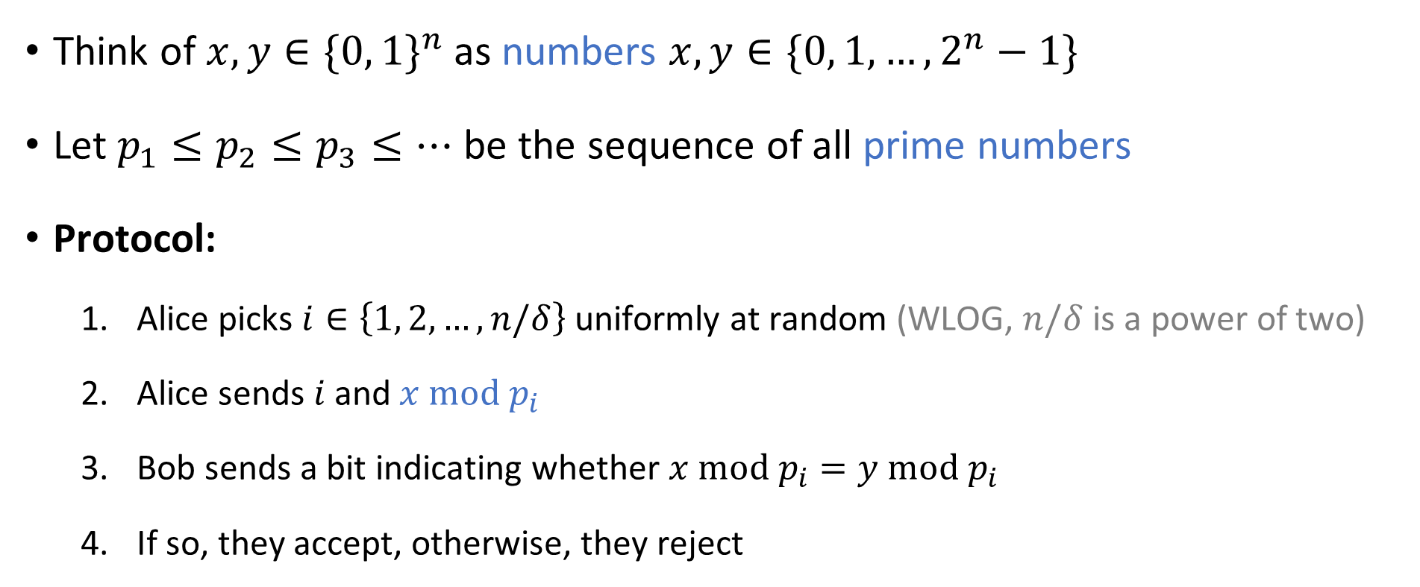

Randomized protocol for ${\text{EQ}}_{n}$
Think of $x,y∈\{0, 1\}^{n}$ as numbers $x,y∈\{0, 1, …, 2^{n}−1\}$
Let $p_{1}≤p_{2}≤p_{3}≤…$ be the sequence of all prime numbers
Protocol:
Alice picks $i∈\left\{1, 2, …, n/δ\right\}$ uniformly at random (WLOG, $n/δ$ is a power of two)
Alice sends $i$ and$x \text{mod} p_{i}$
Bob sends a bit indicating whether $x \text{mod} p_{i}=y \text{mod} p_{i}$
If so, they accept, otherwise, they reject

Slide 8

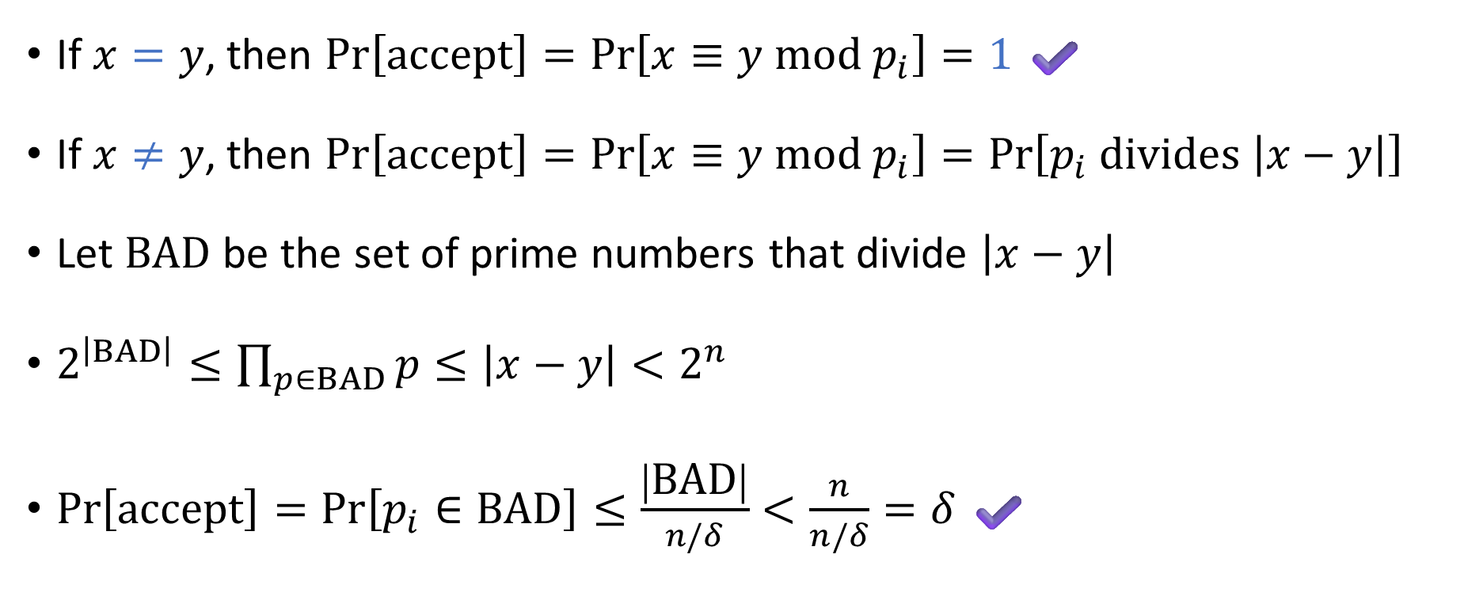
Analysis of the protocol: Correctness
Protocol:
Pick $i∈\left\{1, 2, …, n/δ\right\}$ u.a.r.
Send $i$ and $x \text{mod} p_{i}$
Check whether $x≡y \text{mod} p_{i}$
If $x=y$, then $Pr\left[\text{accept}\right]=\operatorname{Pr}\left[x≡y \text{mod} p_{i}\right]=1$ ✔️
If $x≠y$, then $\operatorname{Pr}\left[\text{accept}\right]=\operatorname{Pr}\left[x≡y \text{mod} p_{i}\right]=\operatorname{Pr}\left[p_{i} \text{divides} \left|x−y\right|\right]$
Let $\text{BAD}$ be the set of prime numbers that divide $\left|x−y\right|$
$2^{\left|BAD\right|}≤\prod_{p∈BAD}{p}≤\left|x−y\right|<2^{n}$
$\operatorname{Pr}\left[\text{accept}\right]=\operatorname{Pr}\left[p_{i}∈\text{BAD}\right]≤\frac{\left|\text{BAD}\right|}{n/δ}<\frac{n}{n/δ}=δ$ ✔️

Slide 9
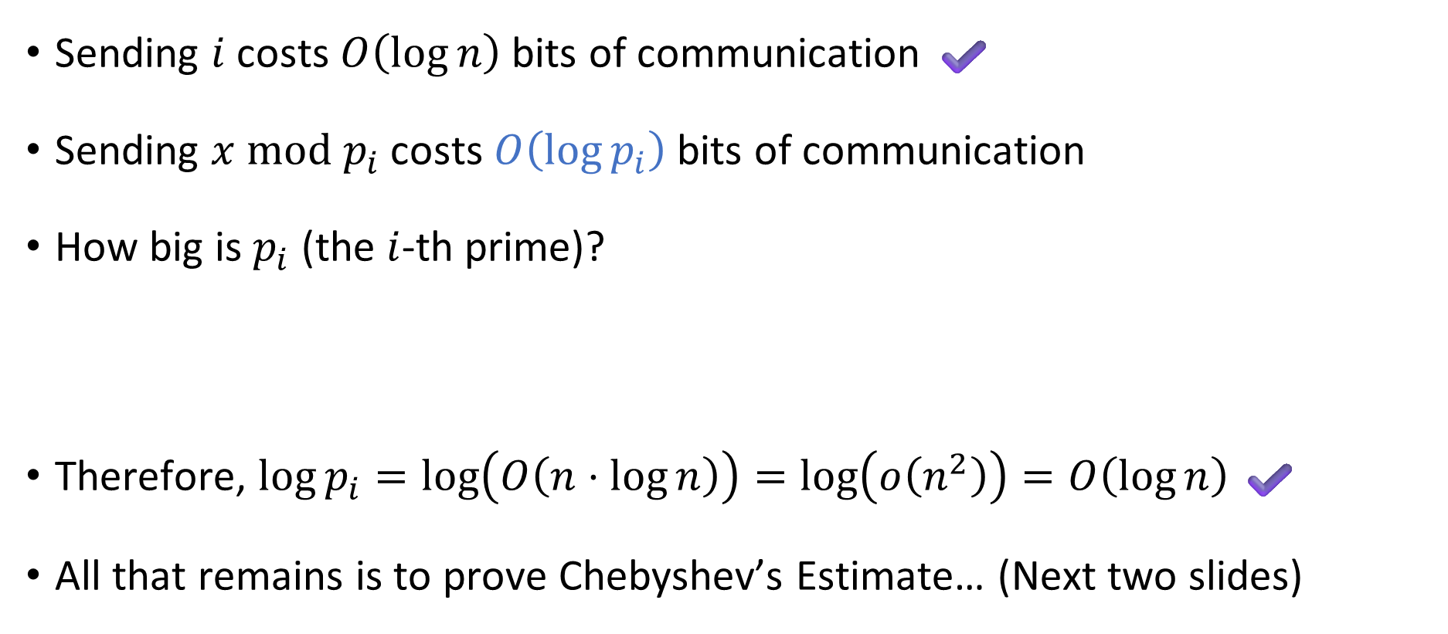
Analysis of the protocol: Efficiency
Protocol:
Pick $i∈\left\{1, 2, …, n/δ\right\}$ u.a.r.
Send $i$ and $x \text{mod} p_{i}$
Check whether $x≡y \text{mod} p_{i}$
Sending $i$ costs $O\left(\log{n}\right)$ bits of communication ✔️
Sending $x \text{mod} p_{i}$ costs $O\left(\log{p_{i}}\right)$ bits of communication
How big is $p_{i}$ (the $i$-th prime)?
Therefore, $\log{p_{i}}=\log\left(O\left(n⋅\log{n}\right)\right)=\log\left(o\left(n^{2}\right)\right)=O\left(\log{n}\right)$ ✔️
All that remains is to prove Chebyshev’s Estimate… (Next two slides)
Chebyshev’s Estimate: Let $p_{k}$ be the $k$-th prime. Then $p_{k}=O\left(k⋅\log{k}\right)$.
Notes:
The “Prime Number Theorem” is a famous, more refined variant of Chebyshev’s Estimate. https://en.wikipedia.org/wiki/Prime_number_theorem

Slide 10
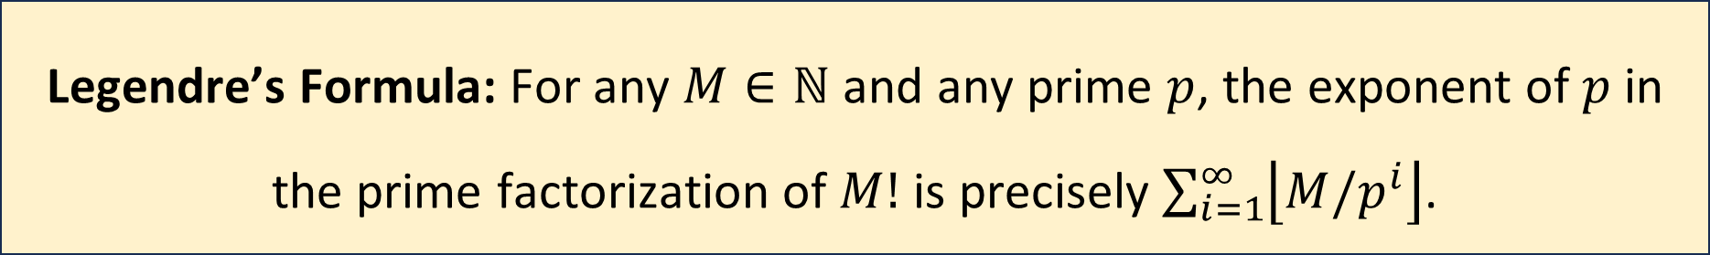
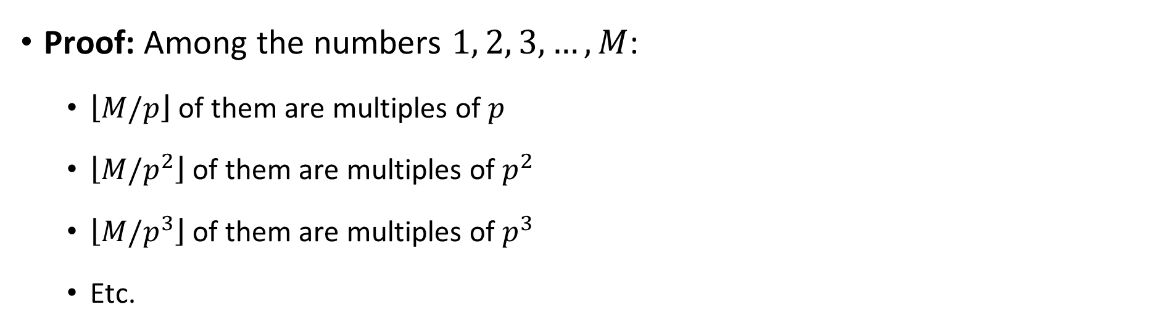
Step 1: Legendre’s Formula
Legendre’s Formula: For any $M∈ℕ$ and any prime $p$, the exponent of $p$ in the prime factorization of $M!$ is precisely $\sum_{i=1}^{∞}{\left\lfloor M/p^{i}\right\rfloor }$.
Proof: Among the numbers $1, 2, 3, …, M$:
$\left\lfloor M/p\right\rfloor$ of them are multiples of $p$
$\left\lfloor M/p^{2}\right\rfloor$ of them are multiples of $p^{2}$
$\left\lfloor M/p^{3}\right\rfloor$ of them are multiples of $p^{3}$
Etc.

Slide 11
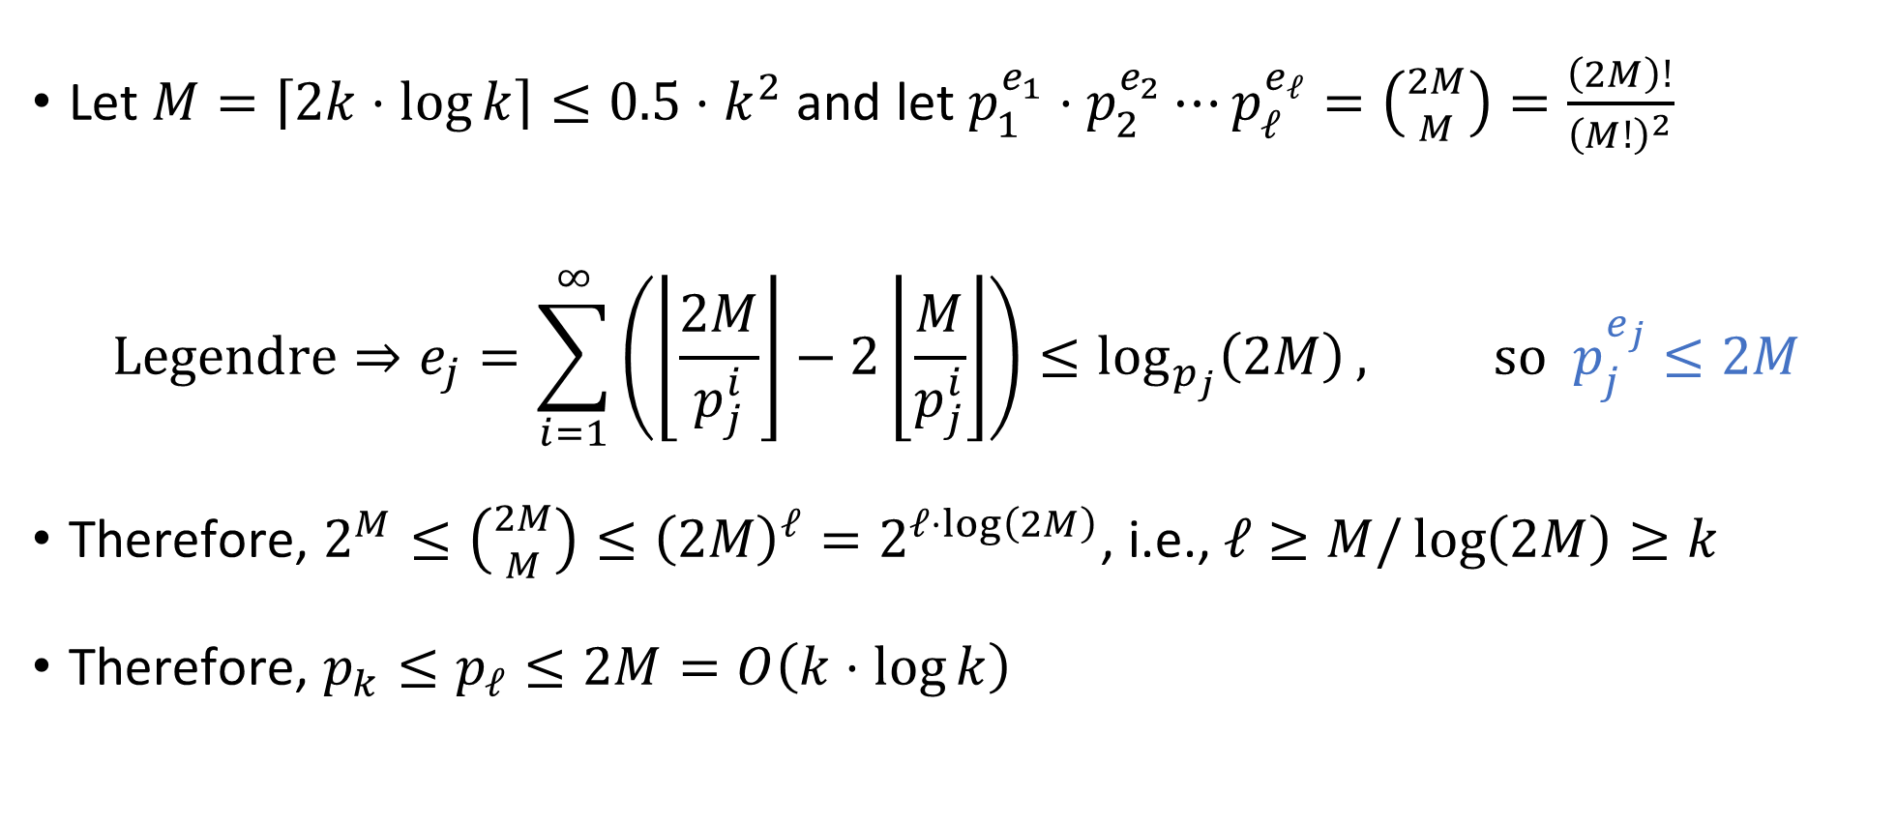
Proof of Chebyshev’s Estimate
Let $M=\left\lceil 2k⋅\log{k}\right\rceil ≤0.5⋅k^{2}$ and let $p_{1}^{e_{1}}⋅p_{2}^{e_{2}}⋯p_{ℓ}^{e_{ℓ}}=\left({2M \atop M}\right)=\frac{\left(2M\right)!}{{\left(M!\right)}^{2}}$
$$\text{Legendre}⇒e_{j}=\sum_{i=1}^{∞}{\left(\left\lfloor \frac{2M}{p_{j}^{i}}\right\rfloor −2\left\lfloor \frac{M}{p_{j}^{i}}\right\rfloor \right)}≤\log_{p_{j}}\left(2M\right), \text{so} p_{j}^{e_{j}}≤2M$$
Therefore, $2^{M}≤\left({2M \atop M}\right)≤{\left(2M\right)}^{ℓ}=2^{ℓ⋅\log\left(2M\right)}$, i.e., $ℓ≥M/\log\left(2M\right)≥k$
Therefore, $p_{k}≤p_{ℓ}≤2M=O\left(k⋅\log{k}\right)$

Slide 12

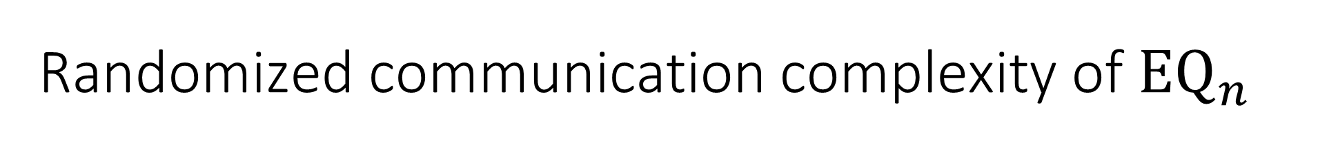
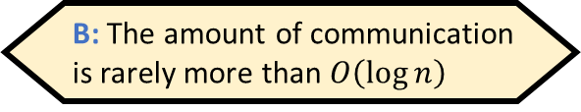
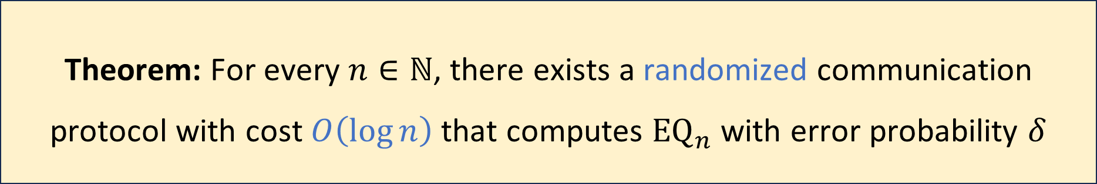
Randomized communication complexity of ${\text{EQ}}_{n}$
Which of the following best describes the protocol?
A: The protocol succeeds on most pairs of inputs
B: The amount of communication is rarely more than $O\left(\log{n}\right)$
C: For every pair of inputs, the protocol is likely to succeed
D: It is likely that for every pair of inputs, the protocol succeeds
Let $δ>0$ be any constant
Randomized protocols are exponentially better than deterministic protocols!
Respond at PollEv.com/whoza or text “whoza” to 22333
Theorem: For every $n∈ℕ$, there exists a randomized communication protocol with cost $O\left(\log{n}\right)$ that computes ${\text{EQ}}_{n}$ with error probability $δ$

Slide 13
Which problems can be solved through computation?

Slide 14




Randomized Turing machines
Input tape ➡
$$⊔$$
1
1
1
0
$$⊔$$
$$⊔$$
Randomness tape ➡
$$⊔$$

Slide 15

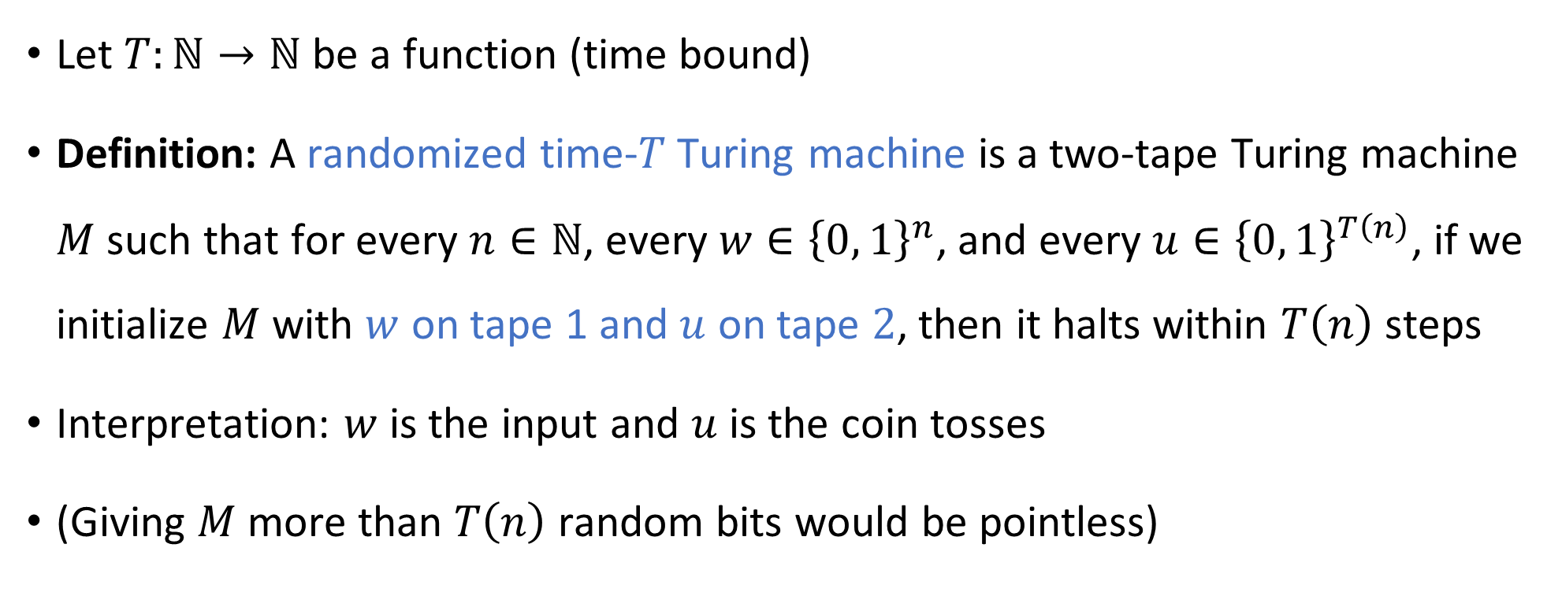
Randomized Turing machines
Let $T:ℕ→ℕ$ be a function (time bound)
Definition: A randomized time-$T$Turing machine is a two-tape Turing machine $M$ such that for every $n∈ℕ$, every $w∈{\left\{0, 1\right\}}^{n}$, and every $u∈{\left\{0, 1\right\}}^{T\left(n\right)}$, if we initialize $M$ with $w$ on tape 1 and $u$ on tape $2$, then it halts within $T\left(n\right)$ steps
Interpretation: $w$ is the input and $u$ is the coin tosses
(Giving $M$ more than $T\left(n\right)$ random bits would be pointless)

Slide 16
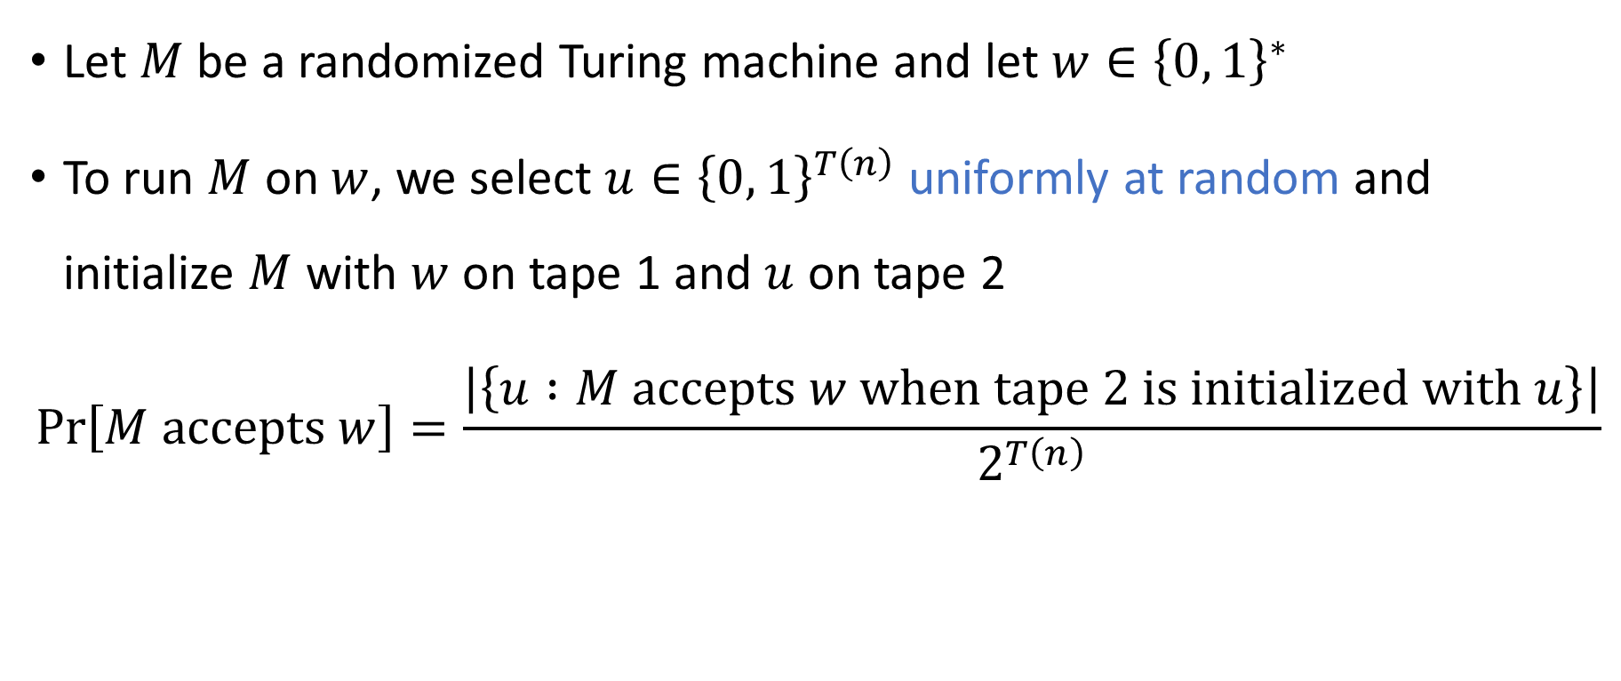
Acceptance probability
Let $M$ be a randomized Turing machine and let $w∈{\left\{0, 1\right\}}^{∗}$
To run $M$ on $w$, we select $u∈{\left\{0, 1\right\}}^{T\left(n\right)}$ uniformly at random and initialize $M$ with $w$ on tape 1 and $u$ on tape 2
$$\operatorname{Pr}\left[M \text{accepts} w\right]=\frac{\left|\left\{u :M \text{accepts} w \text{when} \text{tape} \text{2 }\text{is} \text{initialized} \text{with} u\right\}\right|}{2^{T\left(n\right)}}$$

Slide 17
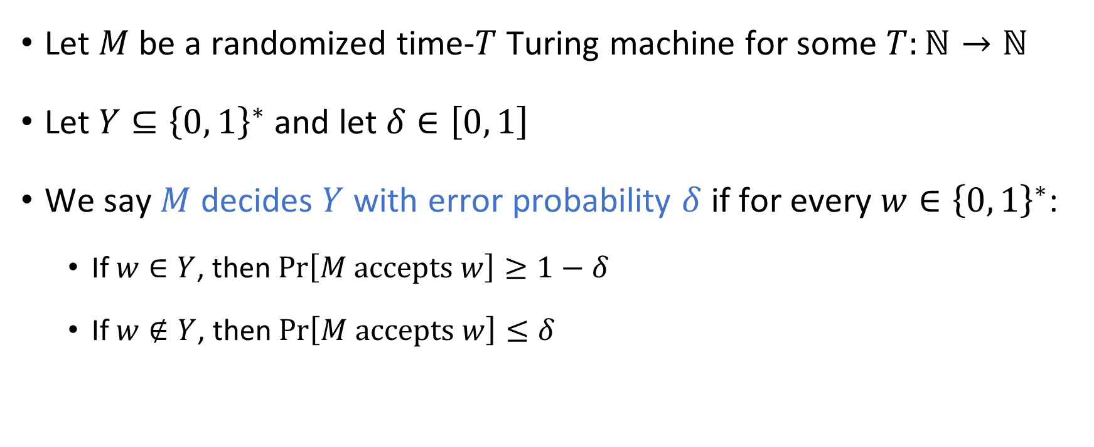
Randomized TMs: Deciding a language
Let $M$ be a randomized time-$T$ Turing machine for some $T:ℕ→ℕ$
Let $Y⊆{\left\{0, 1\right\}}^{∗}$ and let $δ∈\left[0, 1\right]$
We say $M$ decides $Y$ with error probability $δ$ if for every $w∈{\left\{0, 1\right\}}^{∗}$:
If $w∈Y$, then $\operatorname{Pr}\left[M \text{accepts} w\right]≥1−δ$
If $w∉Y$, then $\operatorname{Pr}\left[M \text{accepts} w\right]≤δ$

Slide 18
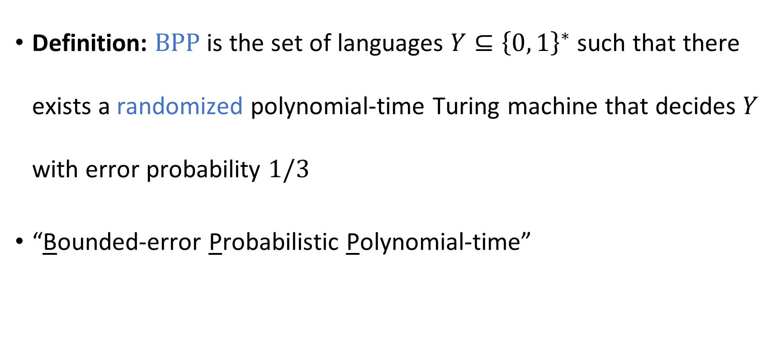

The complexity class $\text{BPP}$
Definition: $\text{BPP}$ is the set of languages $Y⊆{\left\{0, 1\right\}}^{∗}$ such that there exists a randomized polynomial-time Turing machine that decides $Y$ with error probability $1/3$
“Bounded-error Probabilistic Polynomial-time”

Slide 19

Example: High school algebra
“Expand and simplify: $\left(x+1\right)⋅\left(x−1\right)$”
How difficult is this type of exercise?
This type of expression is called an arithmetic formula

Slide 20



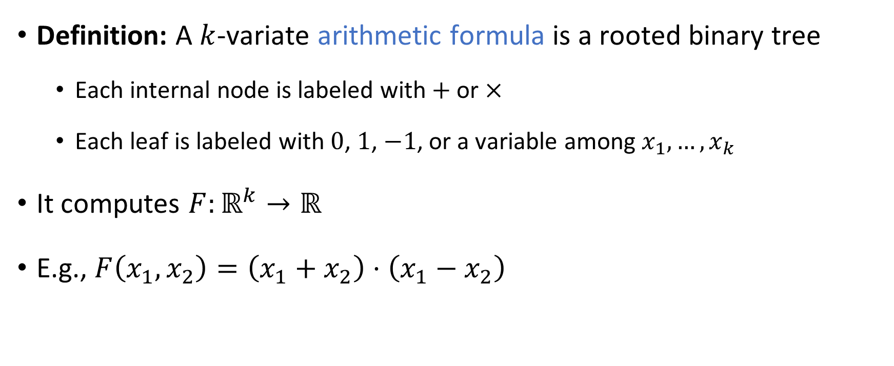






Arithmetic formulas
Definition: A $k$-variate arithmetic formula is a rooted binary tree
Each internal node is labeled with $+$ or $×$
Each leaf is labeled with $0$, $1$, $−1$, or a variable among $x_{1},…, x_{k}$
It computes $F:ℝ^{k}→ℝ$
E.g., $F\left(x_{1},x_{2}\right)=\left(x_{1}+x_{2}\right)⋅\left(x_{1}−x_{2}\right)$
$$×$$
$$+$$
$$+$$
$$x_{1}$$
$$x_{2}$$
$$x_{1}$$
$$×$$
$$−1$$
$$x_{2}$$

Slide 21










Arithmetic formulas
Definition: A $k$-variate arithmetic formula is a rooted binary tree
Each internal node is labeled with $+$ or $×$
Each leaf is labeled with $0$, $1$, $−1$, or a variable among $x_{1},…, x_{k}$
It computes $F:ℝ^{k}→ℝ$
E.g., $F\left(x_{1},x_{2}\right)=\left(x_{1}−x_{2}\right)⋅\left(x_{1}+x_{2}\right)$
$$×$$
$$+$$
$$+$$
$$x_{1}$$
$$×$$
$$x_{1}$$
$$x_{2}$$
$$−1$$
$$x_{2}$$

Slide 22

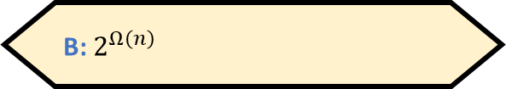
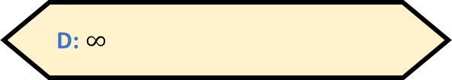
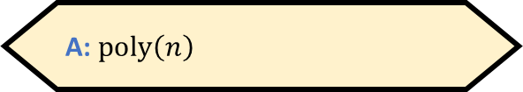

Polynomial identity testing
Problem: Given an arithmetic formula $F$, determine whether $F≡0$
As a language: $\text{PIT}=\left\{\left\langle F\right\rangle :F \text{is} \text{an} \text{arithmetic} \text{formula} \text{and} F≡0\right\}$
High school algorithm: Expand $F$ into monomials, then simplify by canceling like terms
What is the time complexity of this algorithm?
A: $\text{poly}\left(n\right)$
B: $2^{Ω\left(n\right)}$
C: $O\left(1\right)$
D: $∞$
Respond at PollEv.com/whoza or text “whoza” to 22333
Notes:
PIT is more commonly defined in terms of arithmetic *circuits* rather than arithmetic formulas, but the distinction is not important for our purposes

Slide 23
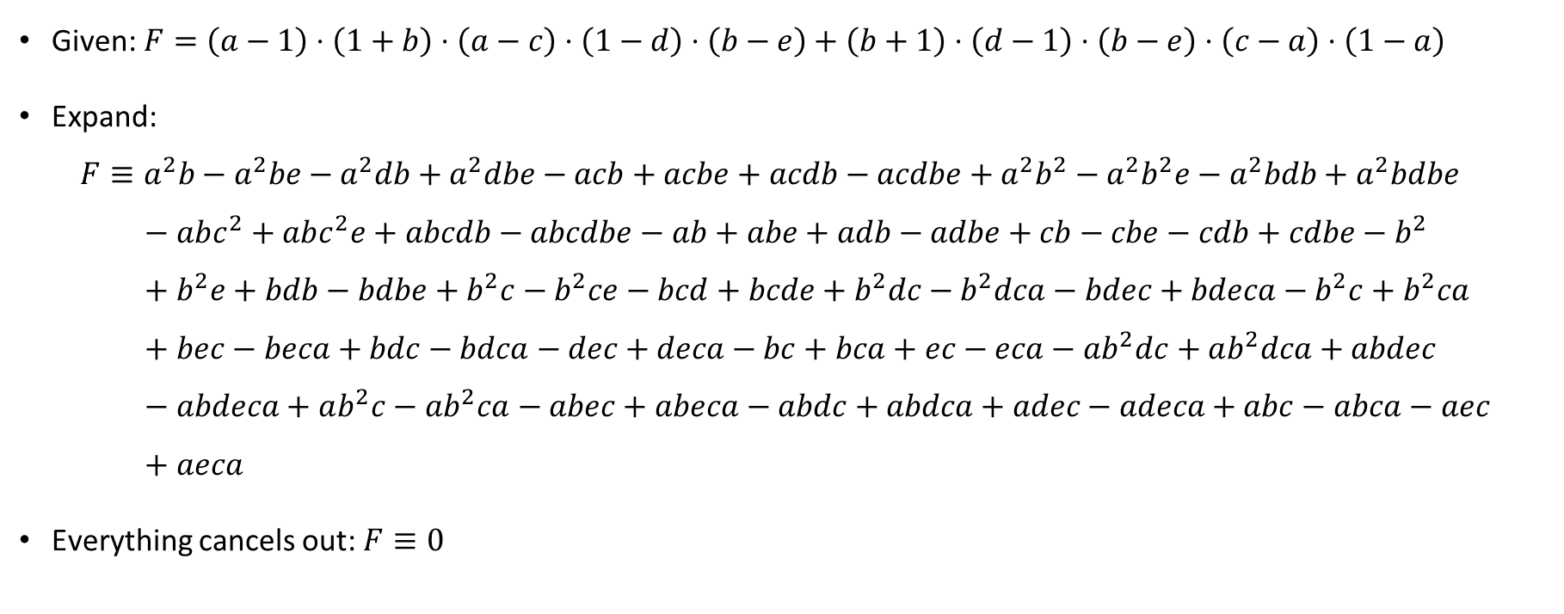
Example: Polynomial identity testing
Given: $F=\left(a−1\right)⋅\left(1+b\right)⋅\left(a−c\right)⋅\left(1−d\right)⋅\left(b−e\right)+\left(b+1\right)⋅\left(d−1\right)⋅\left(b−e\right)⋅\left(c−a\right)⋅\left(1−a\right)$
Expand:
$$F≡a^{2}b−a^{2}be−a^{2}db+a^{2}dbe−acb+acbe+acdb−acdbe+a^{2}b^{2}−a^{2}b^{2}e−a^{2}bdb+a^{2}bdbe \\ − abc^{2}+abc^{2}e+abcdb−abcdbe−ab+abe+adb−adbe+cb−cbe−cdb+cdbe−b^{2} \\ + b^{2}e+bdb−bdbe+b^{2}c−b^{2}ce−bcd+bcde+b^{2}dc−b^{2}dca−bdec+bdeca−b^{2}c+b^{2}ca \\ + bec−beca+bdc−bdca−dec+deca−bc+bca+ec−eca−ab^{2}dc+ab^{2}dca+abdec \\ − abdeca+ab^{2}c−ab^{2}ca−abec+abeca−abdc+abdca+adec−adeca+abc−abca−aec \\ + aeca$$
Everything cancels out: $F≡0$

Slide 24
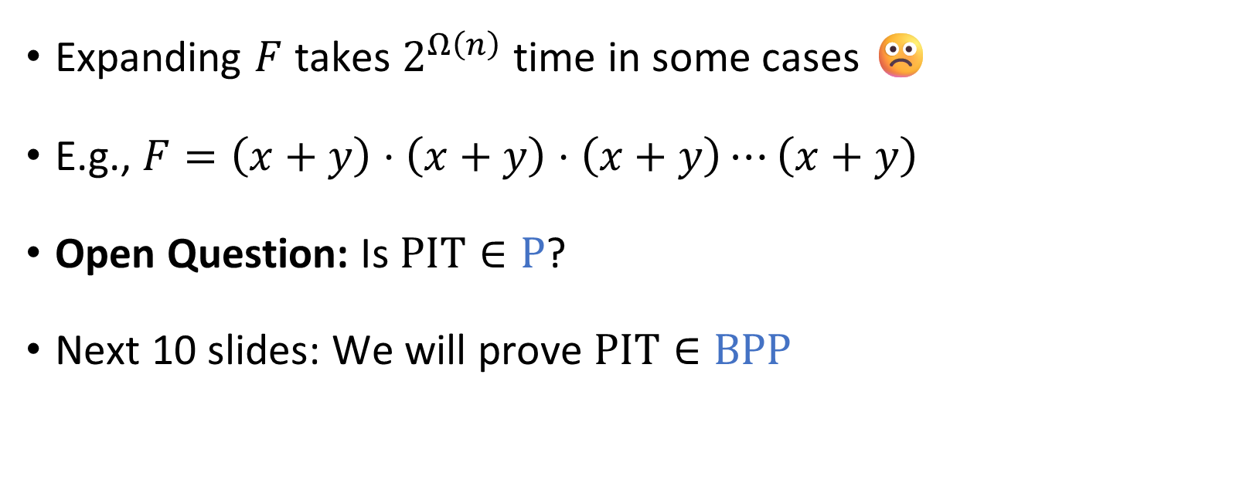
Polynomial identity testing
Expanding $F$ takes $2^{Ω\left(n\right)}$ time in some cases ☹️
E.g., $F=\left(x+y\right)⋅\left(x+y\right)⋅\left(x+y\right)⋯\left(x+y\right)$
Open Question: Is $\text{PIT}∈\text{P}$?
Next 10 slides: We will prove $\text{PIT}∈\text{BPP}$

Slide 25



















Evaluating an arithmetic formula
Let $F$ be a $k$-variate arithmetic formula and let $\vec{x}∈ℤ^{k}$
Lemma: Given $\left\langle F,\vec{x}\right\rangle$, one can compute $F\left(\vec{x}\right)∈ℤ$ in polynomial time.
$$−12$$
$x_{1}=2$
$x_{2}=−4$
$F\left(x_{1},x_{2}\right)=−12$ ✔️
$$×$$
$$6$$
$$−2$$
$$+$$
$$+$$
$$4$$
$$x_{1}$$
$$×$$
$$x_{1}$$
$$x_{2}$$
$$2$$
$$2$$
$$−4$$
$$−1$$
$$x_{2}$$
$$−4$$

