Slide 1
Derandomizing Space-Bounded Computation Winter 2025 Course Summary & Review
Instructor: William Hoza
The University of Chicago

Slide 2




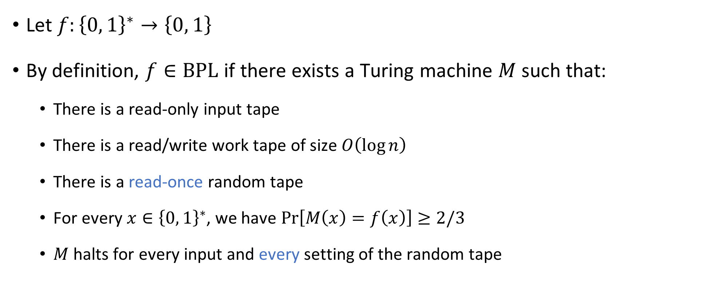

The complexity class $\text{BPL}$
Let $f:{\left\{0, 1\right\}}^{∗}→\left\{0, 1\right\}$
By definition, $f∈\text{BPL}$ if there exists a Turing machine $M$ such that:
There is a read-only input tape
There is a read/write work tape of size $O\left(\log{n}\right)$
There is a read-once random tape
For every $x∈{\left\{0, 1\right\}}^{∗}$, we have $\operatorname{Pr}\left[M\left(x\right)=f\left(x\right)\right]≥2/3$
$M$ halts for every input and every setting of the random tape

Slide 3
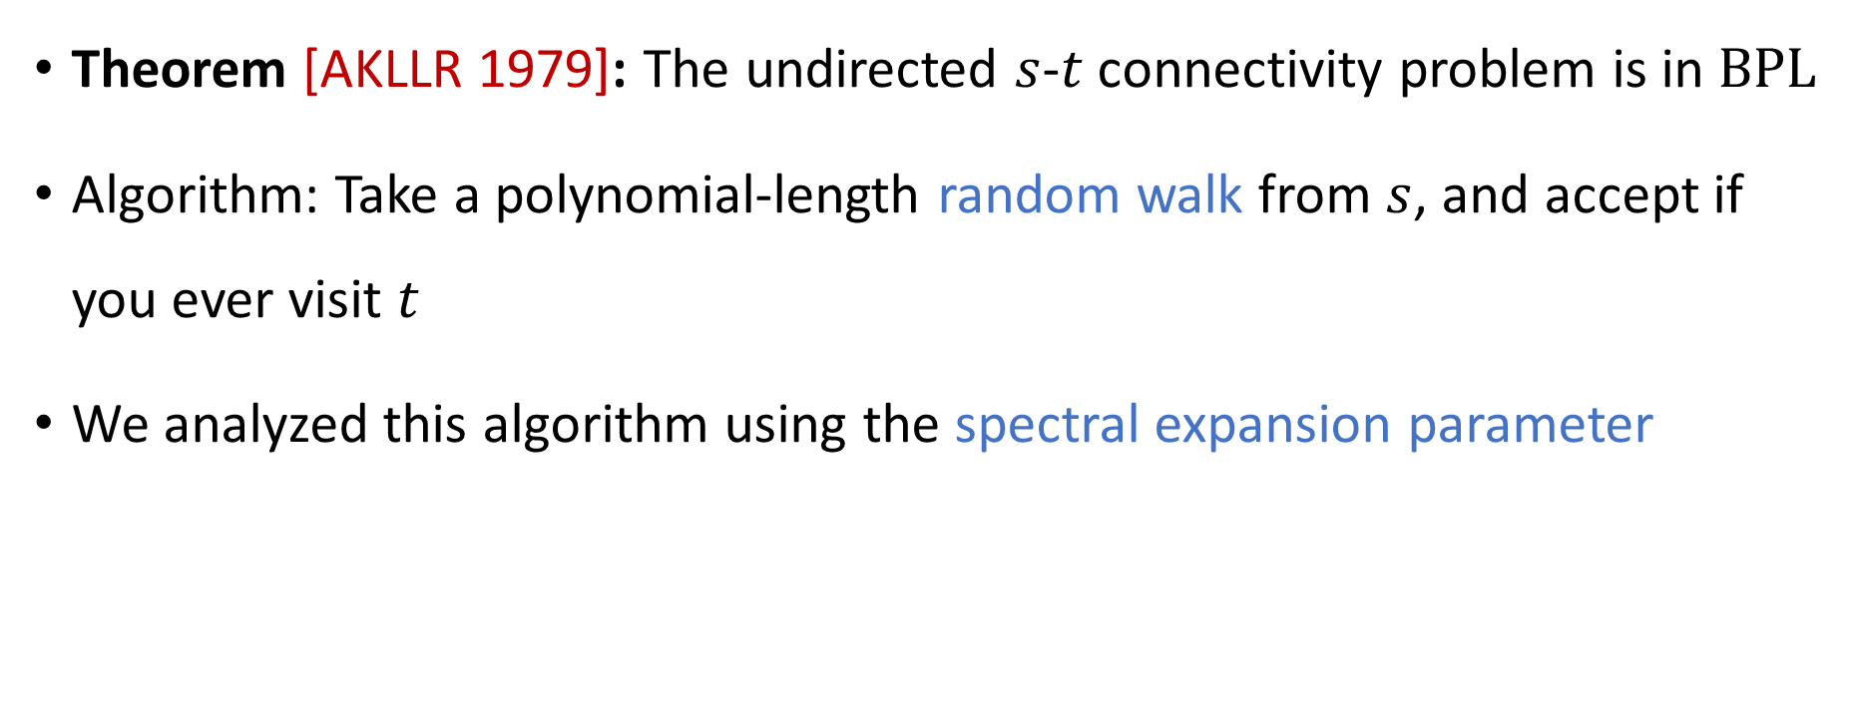

Undirected $s$-$t$ connectivity
Theorem [AKLLR 1979]: The undirected $s$-$t$ connectivity problem is in $\text{BPL}$
Algorithm: Take a polynomial-length random walk from $s$, and accept if you ever visit $t$
We analyzed this algorithm using the spectral expansion parameter

Slide 4
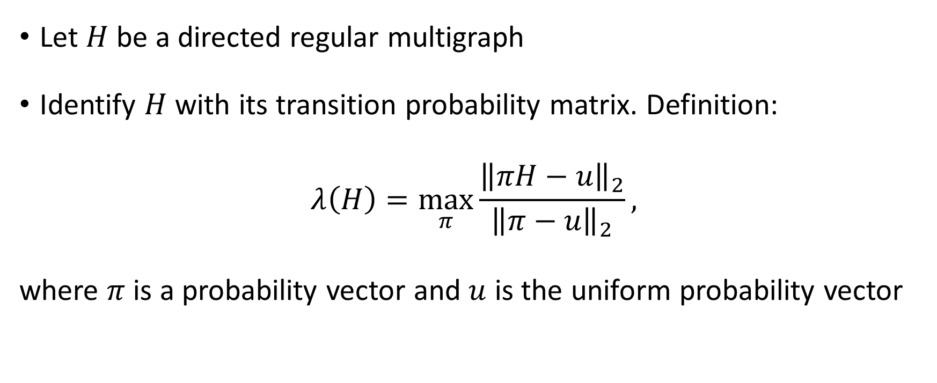
Spectral expansion parameter
Let $H$ be a directed regular multigraph
Identify $H$ with its transition probability matrix. Definition:
$$λ\left(H\right)=\max_{π}{\frac{{\left\|πH−u\right\|}_{2}}{{\left\|π−u\right\|}_{2}}},$$
where $π$ is a probability vector and $u$ is the uniform probability vector

Slide 5
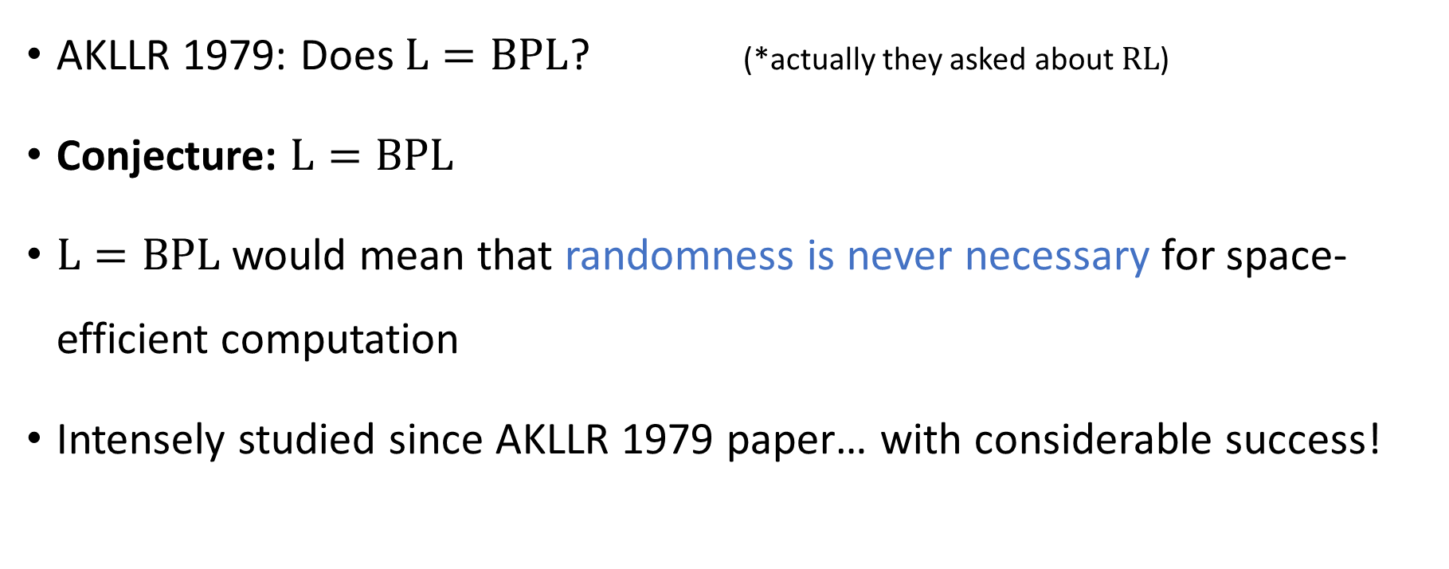
Derandomization
AKLLR 1979: Does $\text{L}=\text{BPL}$? (*actually they asked about $\text{RL}$)
Conjecture: $\text{L}=\text{BPL}$
$\text{L}=\text{BPL}$ would mean that randomness is never necessary for space-efficient computation
Intensely studied since AKLLR 1979 paper… with considerable success!

Slide 6
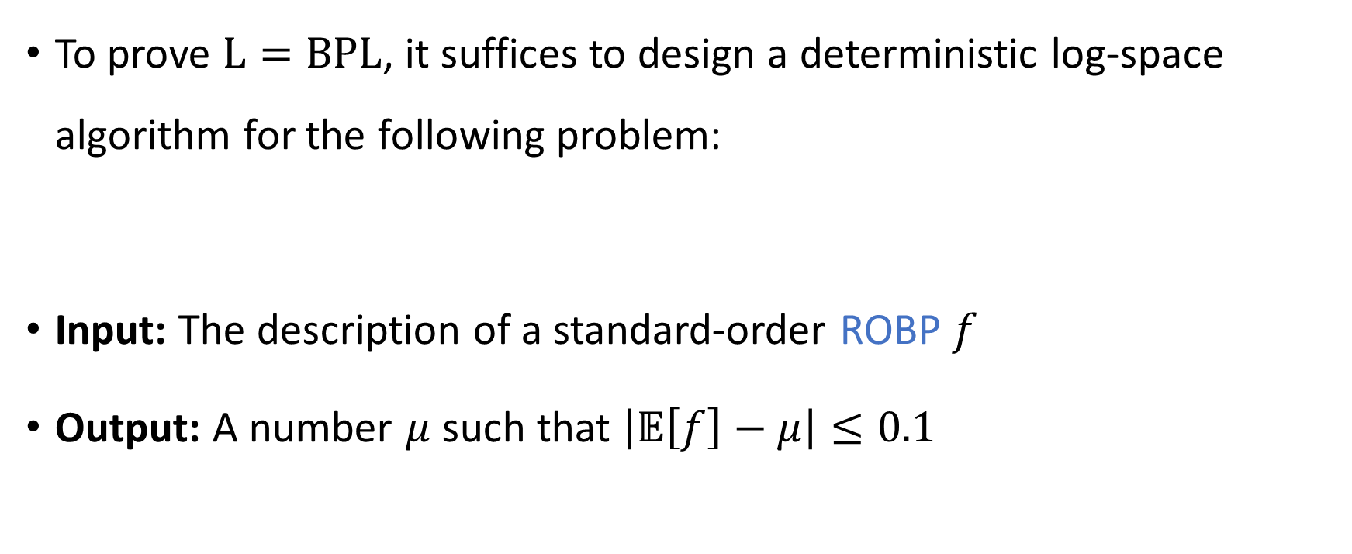
Read-once branching programs (ROBPs)
To prove $\text{L}=\text{BPL}$, it suffices to design a deterministic log-space algorithm for the following problem:
Input: The description of a standard-order ROBP $f$
Output: A number $μ$ such that $\left|𝔼\left[f\right]−μ\right|≤0.1$

Slide 7


Read-once branching programs (ROBPs)
$$x=$$
$$1$$
$$0$$
$$0$$
$$1$$
$$0$$
$$1$$
0
1
$$v_{\text{start}}$$
✔️
1
0
1
❌
Computes
$$f:\{0, 1\}^{n}→\{0, 1\}$$
Width $w$
0
1
1
✔️
0
0
0
❌
1
❌
$n+1$ layers ($n=$ length)

Slide 8
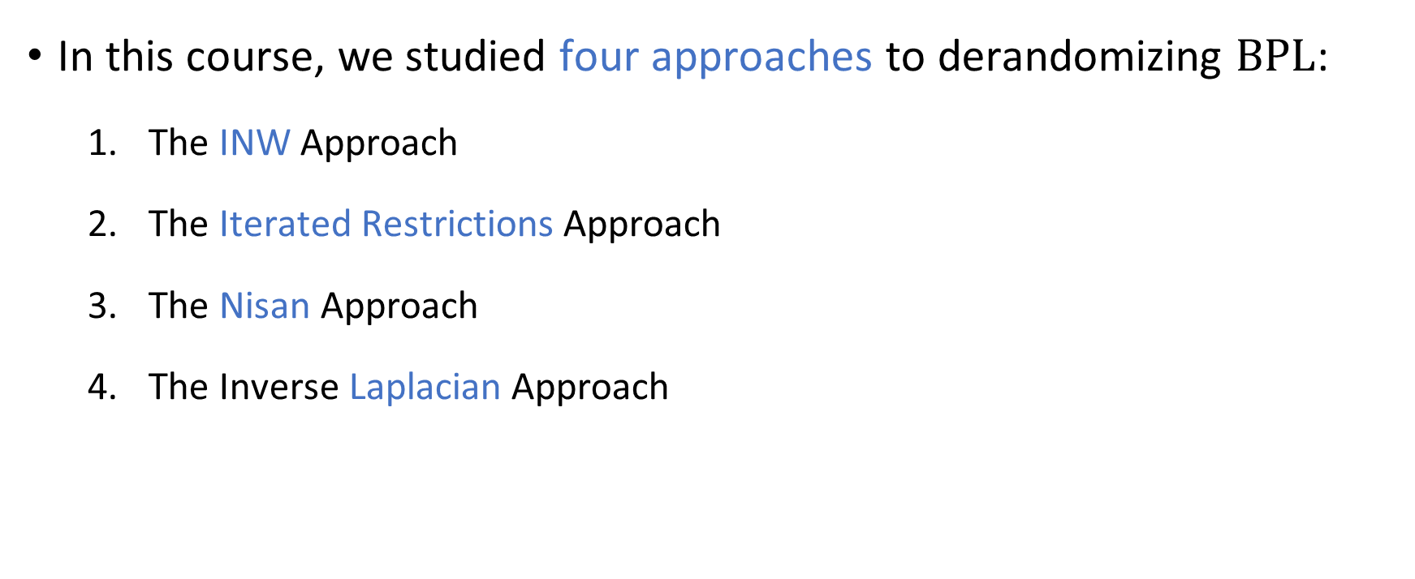
Four approaches
In this course, we studied four approaches to derandomizing $\text{BPL}$:
The INW Approach
The Iterated Restrictions Approach
The Nisan Approach
The Inverse Laplacian Approach

Slide 9
1. The INW Approach

Slide 10

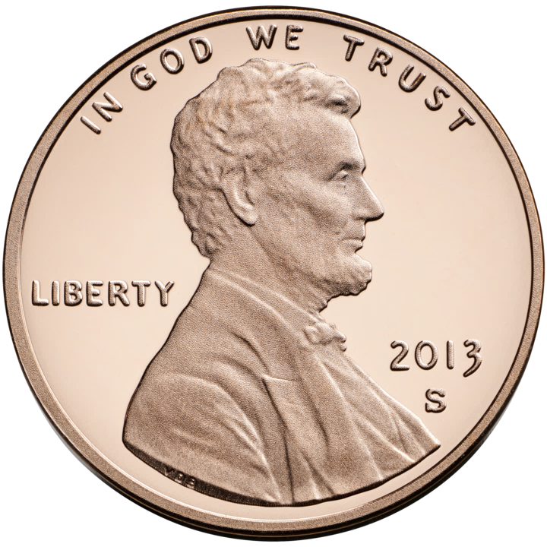


Pseudorandom generators
A pseudorandom generator (PRG) is a function $G:{\left\{0, 1\right\}}^{s}→{\left\{0, 1\right\}}^{n}$
The PRG fools $f:{\left\{0, 1\right\}}^{n}→\left\{0, 1\right\}$ with error $ε$ if
$\left|𝔼\left[f\right]−𝔼[f\left(G\left(U_{s}\right)\right)\right|≤ε$
$$G$$

Slide 11
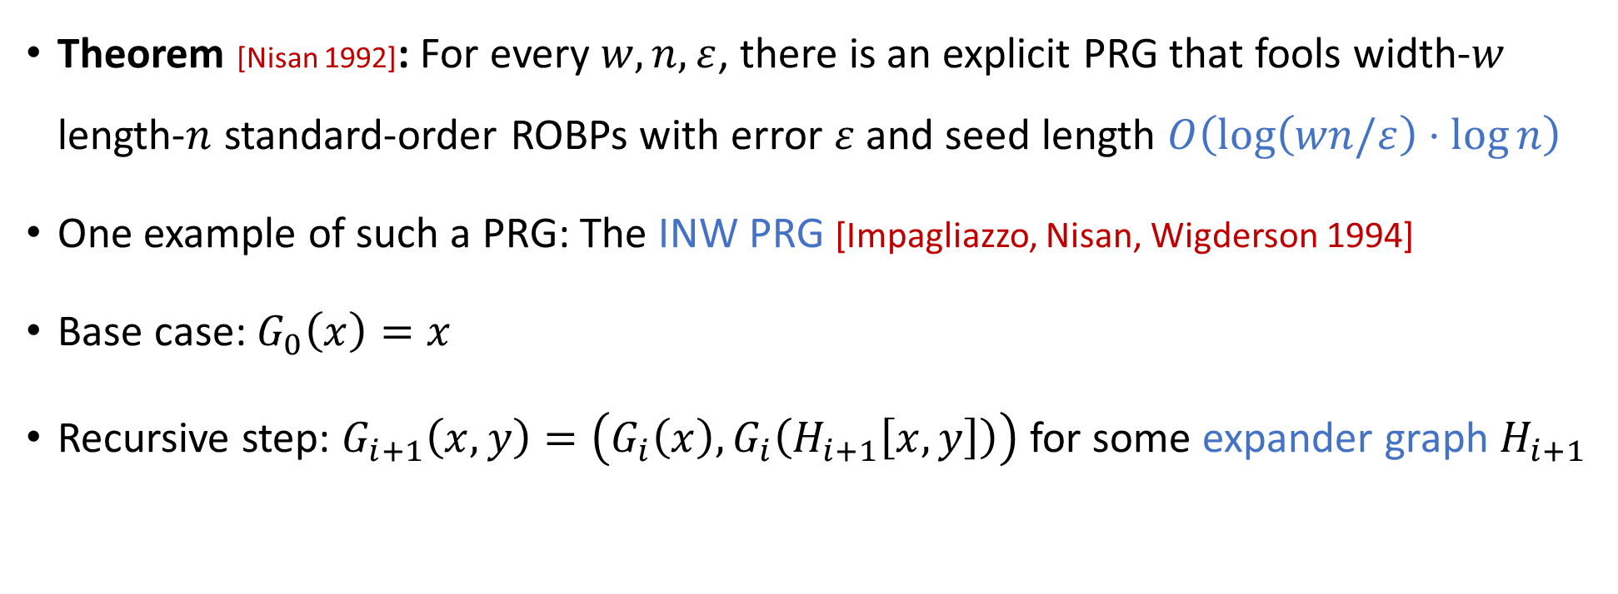
The INW PRG
Theorem [Nisan 1992]: For every $w,n,ε$, there is an explicit PRG that fools width-$w$ length-$n$ standard-order ROBPs with error $ε$ and seed length $O\left(\log\left(wn/ε\right)⋅\log{n}\right)$
One example of such a PRG: The INW PRG [Impagliazzo, Nisan, Wigderson 1994]
Base case: $G_{0}\left(x\right)=x$
Recursive step: $G_{i+1}\left(x,y\right)=\left(G_{i}\left(x\right),G_{i}\left(H_{i+1}\left[x,y\right]\right)\right)$ for some expander graph $H_{i+1}$

Slide 12
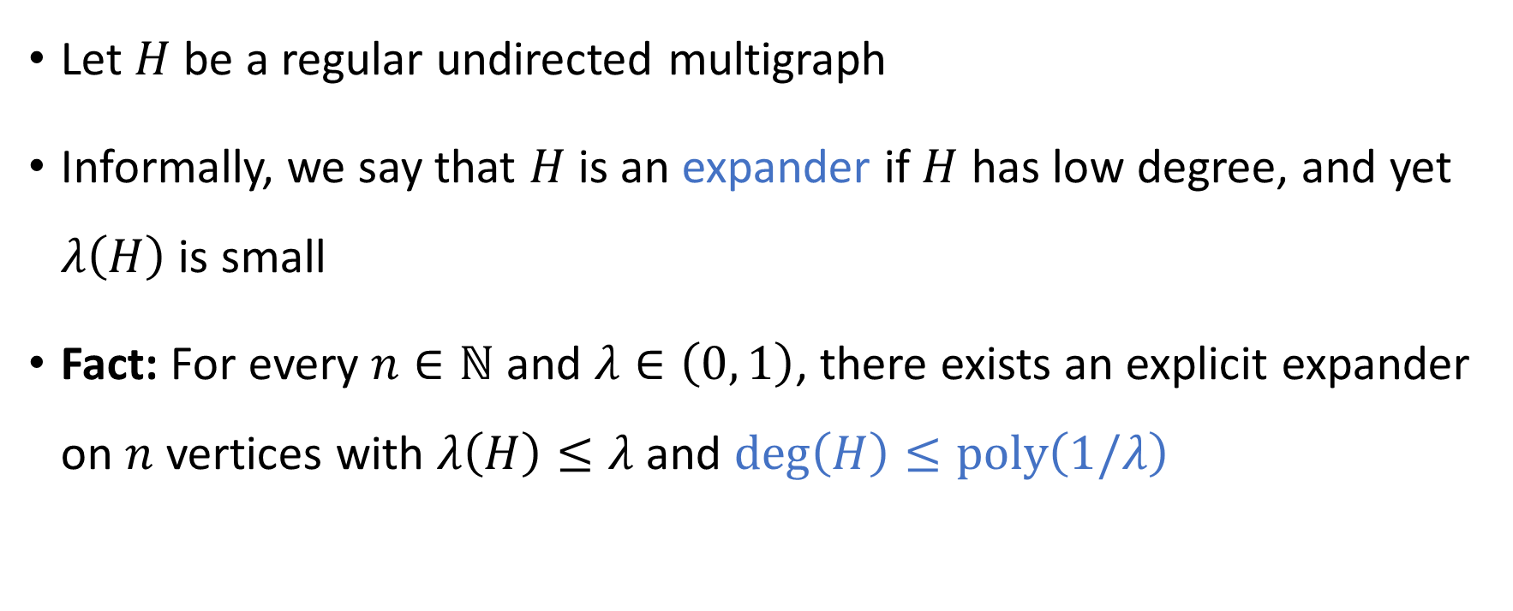
Expander graphs
Let $H$ be a regular undirected multigraph
Informally, we say that $H$ is an expander if $H$ has low degree, and yet $λ\left(H\right)$ is small
Fact: For every $n∈ℕ$ and $λ∈\left(0, 1\right)$, there exists an explicit expander on $n$ vertices with $λ\left(H\right)≤λ$ and $\text{deg}\left(H\right)≤\text{poly}\left(1/λ\right)$

Slide 13
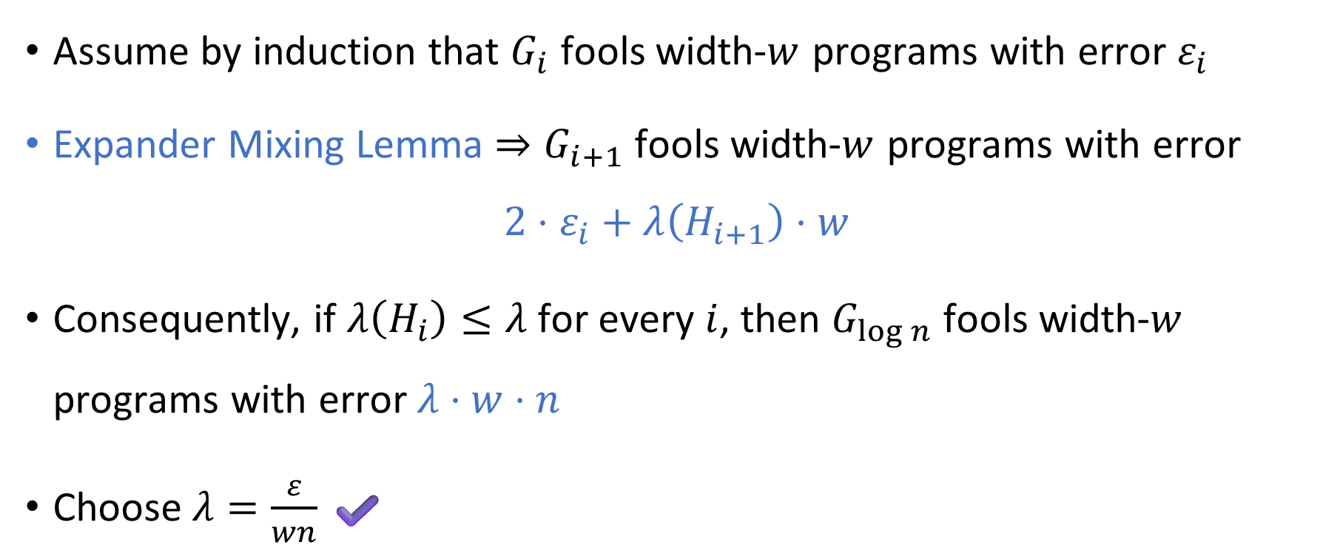
Analysis of the INW PRG
Assume by induction that $G_{i}$ fools width-$w$ programs with error $ε_{i}$
Expander Mixing Lemma $⇒G_{i+1}$ fools width-$w$ programs with error
$$2⋅ε_{i}+λ\left(H_{i+1}\right)⋅w$$
Consequently, if $λ\left(H_{i}\right)≤λ$ for every $i$, then $G_{\log{n}}$ fools width-$w$ programs with error $λ⋅w⋅n$
Choose $λ=\frac{ε}{wn}$ ✔️

Slide 14
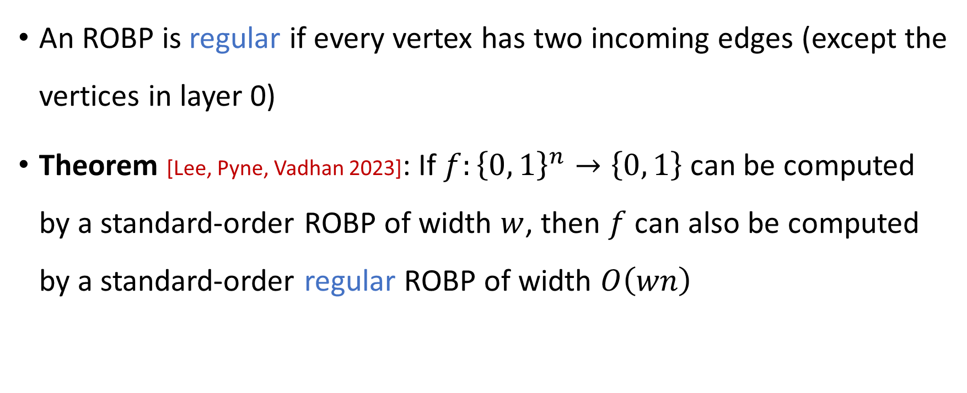
Regular ROBPs
An ROBP is regular if every vertex has two incoming edges (except the vertices in layer 0)
Theorem [Lee, Pyne, Vadhan 2023]: If $f:{\left\{0, 1\right\}}^{n}→\left\{0, 1\right\}$ can be computed by a standard-order ROBP of width $w$, then $f$ can also be computed by a standard-order regular ROBP of width $O\left(wn\right)$

Slide 15
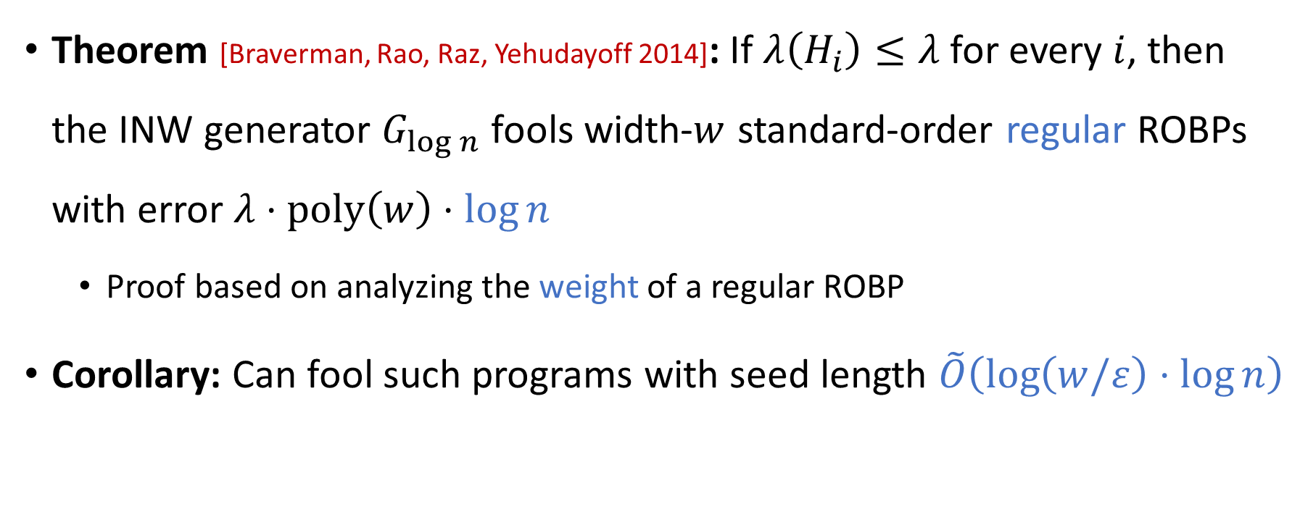
Fooling regular ROBPs
Theorem [Braverman, Rao, Raz, Yehudayoff 2014]: If $λ\left(H_{i}\right)≤λ$ for every $i$, then the INW generator $G_{\log{n}}$ fools width-$w$ standard-order regular ROBPs with error $λ⋅\text{poly}\left(w\right)⋅\log{n}$
Proof based on analyzing the weight of a regular ROBP
Corollary: Can fool such programs with seed length $\tilde{O}\left(\log\left(w/ε\right)⋅\log{n}\right)$

Slide 16
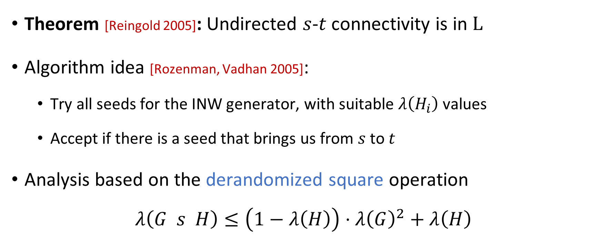
Reingold’s theorem
Theorem [Reingold 2005]: Undirected $s$-$t$ connectivity is in $\text{L}$
Algorithm idea [Rozenman, Vadhan 2005]:
Try all seeds for the INW generator, with suitable $λ\left(H_{i}\right)$ values
Accept if there is a seed that brings us from $s$ to $t$
Analysis based on the derandomized square operation
$$λ\left(G s H\right)≤\left(1−λ\left(H\right)\right)⋅λ{\left(G\right)}^{2}+λ\left(H\right)$$

Slide 17
2. The Iterated Restrictions Approach

Slide 18
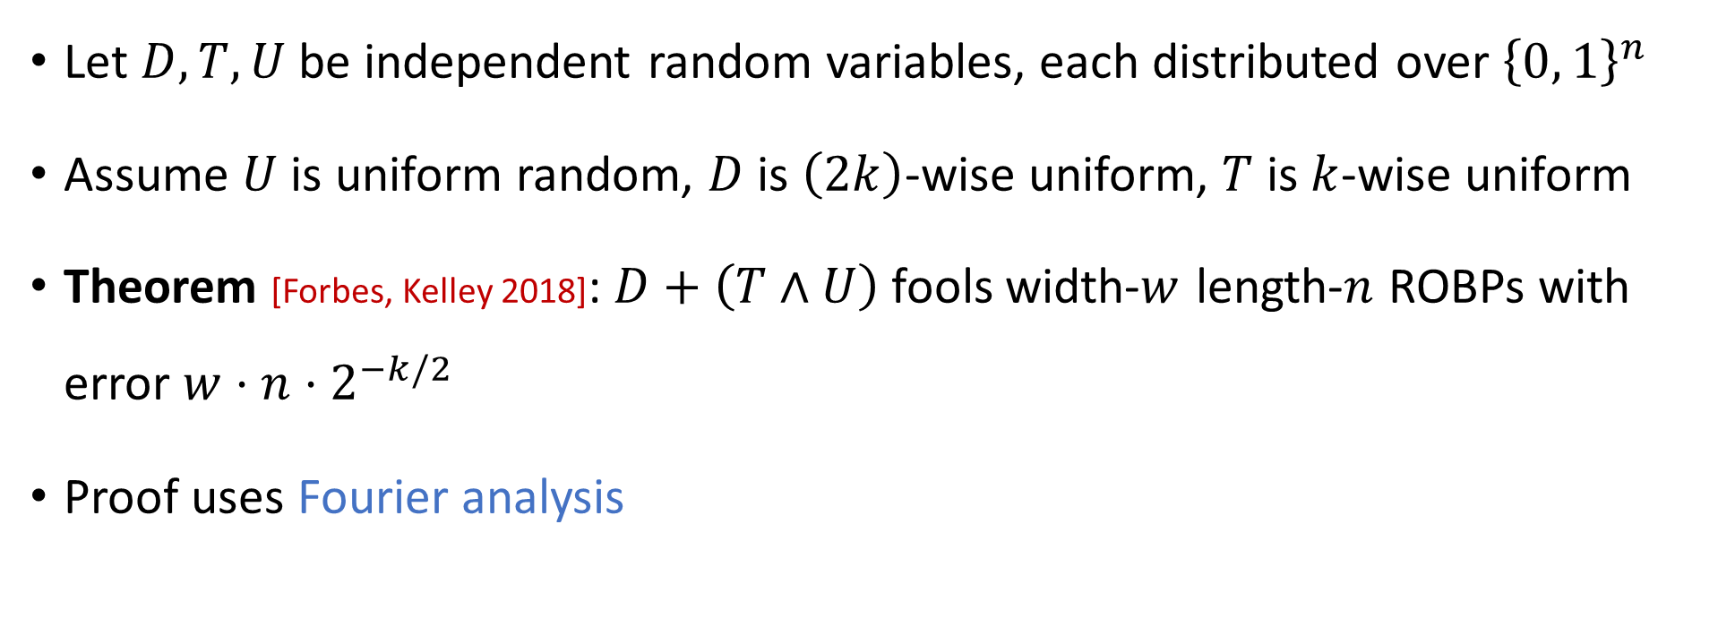
The Forbes-Kelley PRG
Let $D,T,U$ be independent random variables, each distributed over ${\left\{0, 1\right\}}^{n}$
Assume $U$ is uniform random, $D$ is $\left(2k\right)$-wise uniform, $T$ is $k$-wise uniform
Theorem [Forbes, Kelley 2018]: $D+\left(T∧U\right)$ fools width-$w$ length-$n$ ROBPs with error $w⋅n⋅2^{−k/2}$
Proof uses Fourier analysis

Slide 19
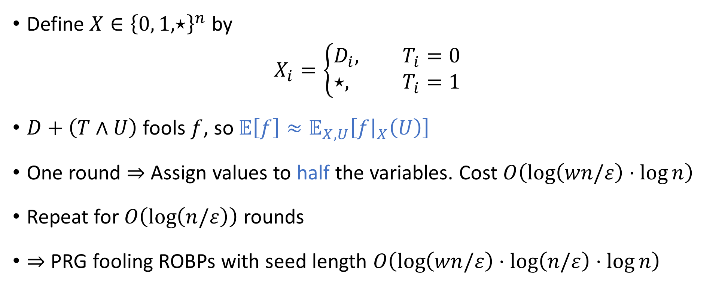
Iterated restrictions
Define $X∈{\left\{0, 1, ⋆\right\}}^{n}$ by
$$X_{i}=\left\{\begin{aligned}D_{i}, T_{i}=0 \\ &⋆, T_{i}=1\end{aligned}\right.$$
$D+\left(T∧U\right)$ fools $f$, so $𝔼\left[f\right]≈𝔼_{X,U}\left[f{\left.​\right|}_{X}\left(U\right)\right]$
One round $⇒$ Assign values to half the variables. Cost $O\left(\log\left(wn/ε\right)⋅\log{n}\right)$
Repeat for $O\left(\log\left(n/ε\right)\right)$ rounds
$⇒$ PRG fooling ROBPs with seed length $O\left(\log\left(wn/ε\right)⋅\log\left(n/ε\right)⋅\log{n}\right)$

Slide 20
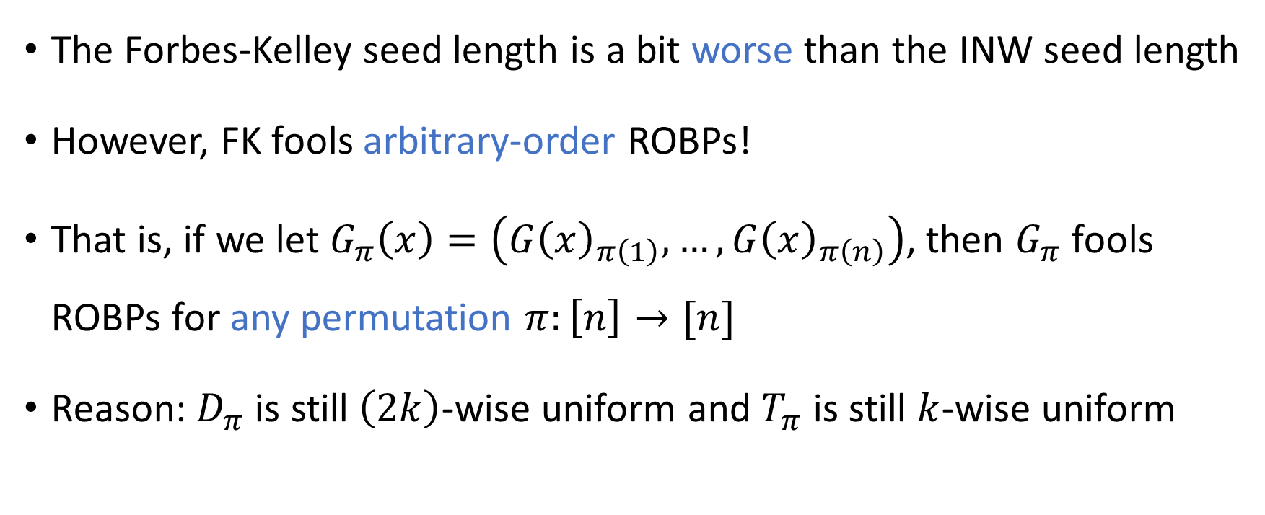
Arbitrary-order ROBPs
The Forbes-Kelley seed length is a bit worse than the INW seed length
However, FK fools arbitrary-order ROBPs!
That is, if we let $G_{π}\left(x\right)=\left(G{\left(x\right)}_{π\left(1\right)},…, G{\left(x\right)}_{π\left(n\right)}\right)$, then $G_{π}$ fools ROBPs for any permutation $π:\left[n\right]→[n]$
Reason: $D_{π}$ is still $\left(2k\right)$-wise uniform and $T_{π}$ is still $k$-wise uniform

Slide 21
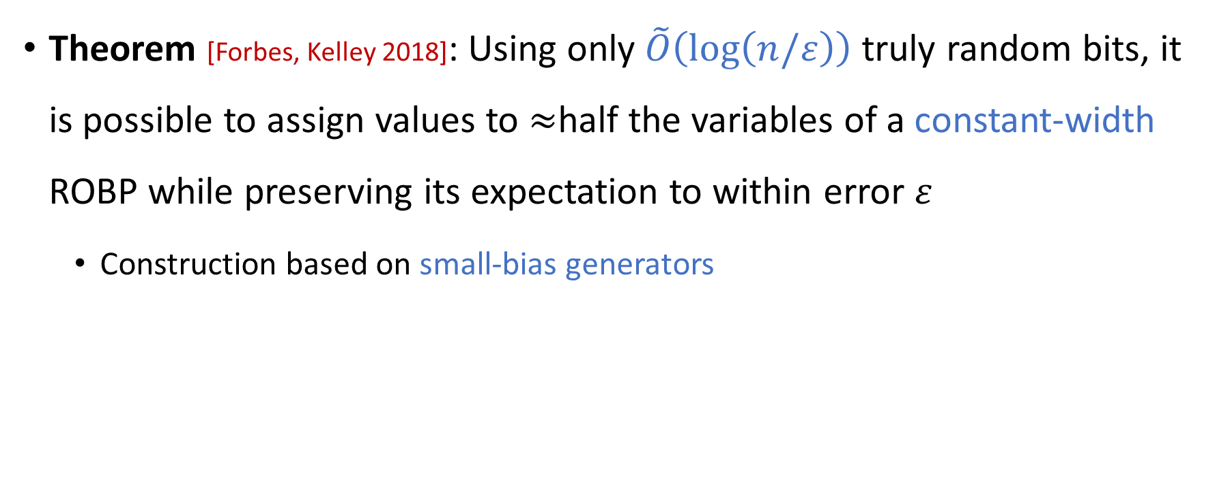
The constant-width case
Theorem [Forbes, Kelley 2018]: Using only $\tilde{O}\left(\log\left(n/ε\right)\right)$ truly random bits, it is possible to assign values to $≈$half the variables of a constant-width ROBP while preserving its expectation to within error $ε$
Construction based on small-bias generators

Slide 22
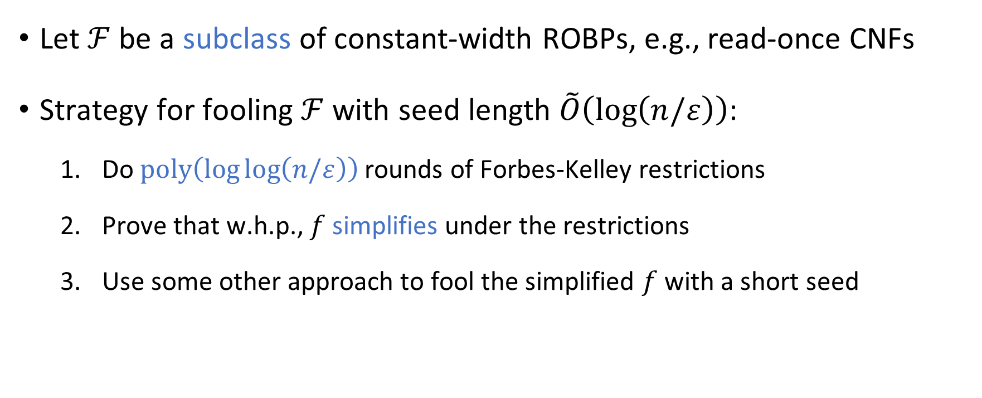
Iterated restrictions with early termination
Let $ℱ$ be a subclass of constant-width ROBPs, e.g., read-once CNFs
Strategy for fooling $ℱ$ with seed length $\tilde{O}\left(\log\left(n/ε\right)\right)$:
Do $\text{poly}\left(\log{\log\left(n/ε\right)}\right)$ rounds of Forbes-Kelley restrictions
Prove that w.h.p., $f$ simplifies under the restrictions
Use some other approach to fool the simplified $f$ with a short seed

Slide 23
3. The Nisan Approach

Slide 24
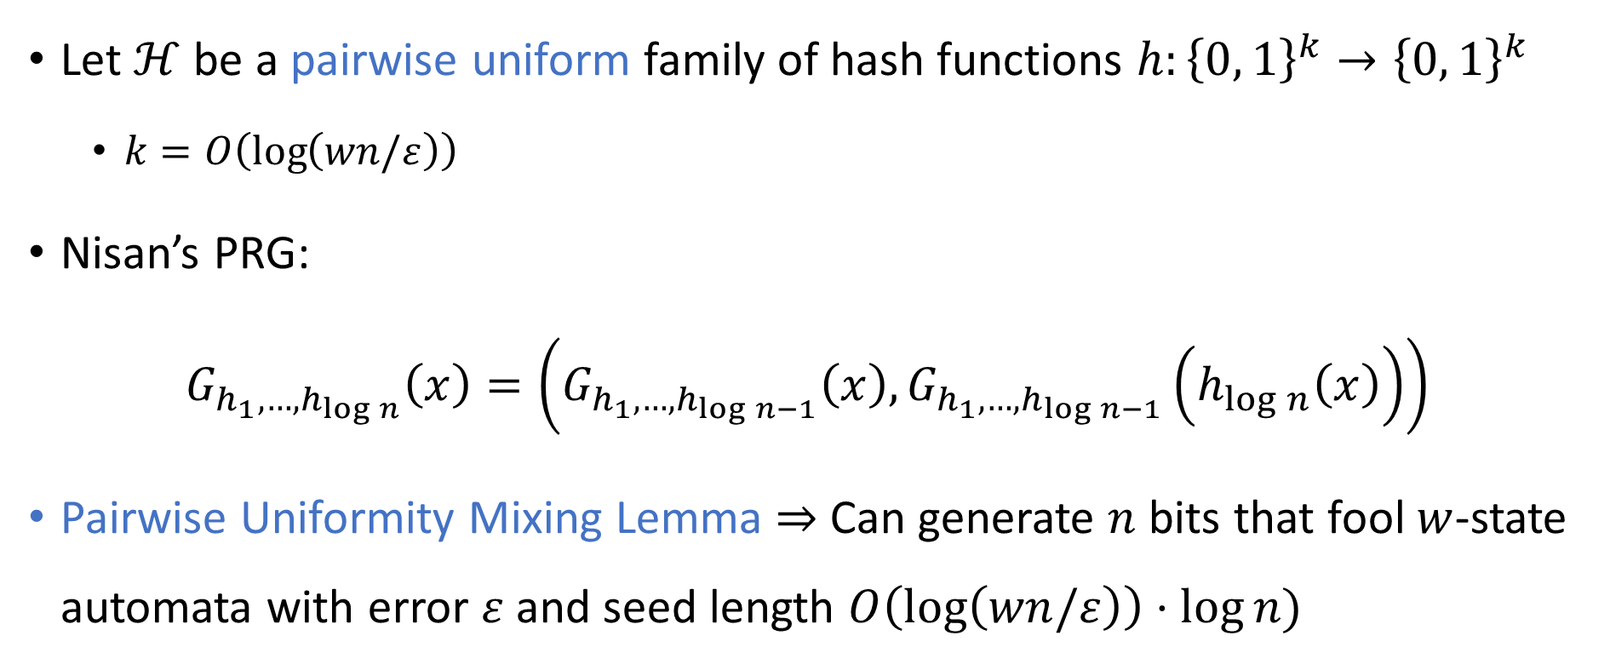
Nisan’s PRG
Let $ℋ$ be a pairwise uniform family of hash functions $h:{\left\{0, 1\right\}}^{k}→{\left\{0, 1\right\}}^{k}$
$k=O\left(\log\left(wn/ε\right)\right)$
Nisan’s PRG:
$$G_{h_{1},…, h_{\log{n}}}\left(x\right)=\left(G_{h_{1},…, h_{\log{n}−1}}\left(x\right), G_{h_{1},…, h_{\log{n}−1}}\left(h_{\log{n}}\left(x\right)\right)\right)$$
Pairwise Uniformity Mixing Lemma $⇒$ Can generate $n$ bits that fool $w$-state automata with error $ε$ and seed length $O\left(\log\left(wn/ε\right)\right)⋅\log{n})$

Slide 25
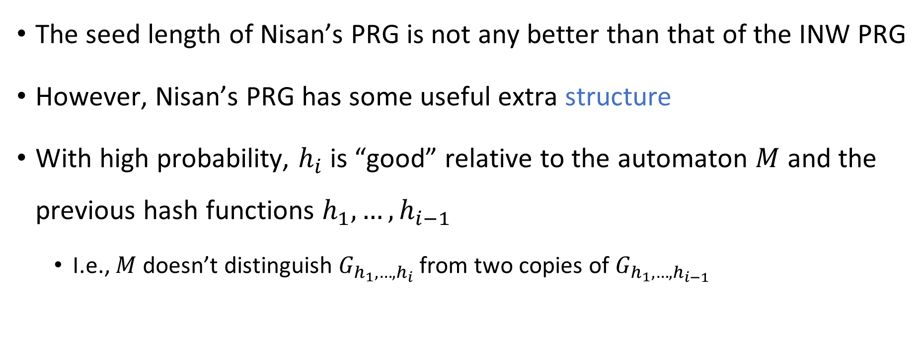
Good hash functions
The seed length of Nisan’s PRG is not any better than that of the INW PRG
However, Nisan’s PRG has some useful extra structure
With high probability, $h_{i}$ is “good” relative to the automaton $M$ and the previous hash functions $h_{1},…, h_{i−1}$
I.e., $M$ doesn’t distinguish $G_{h_{1},…, h_{i}}$ from two copies of $G_{h_{1},…, h_{i−1}}$

Slide 26
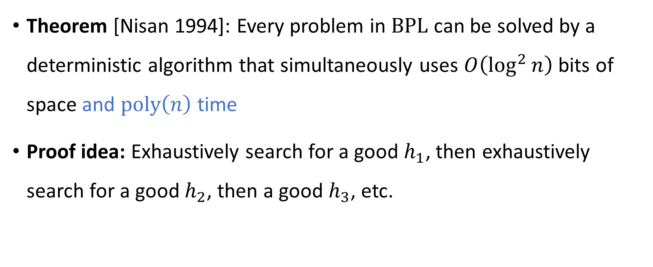

$\text{BPL}⊆\text{SC}$
Theorem [Nisan 1994]: Every problem in $\text{BPL}$ can be solved by a deterministic algorithm that simultaneously uses $O\left(\log^{2}{n}\right)$ bits of space and $\text{poly}\left(n\right)$ time
Proof idea: Exhaustively search for a good $h_{1}$, then exhaustively search for a good $h_{2}$, then a good $h_{3}$, etc.

Slide 27
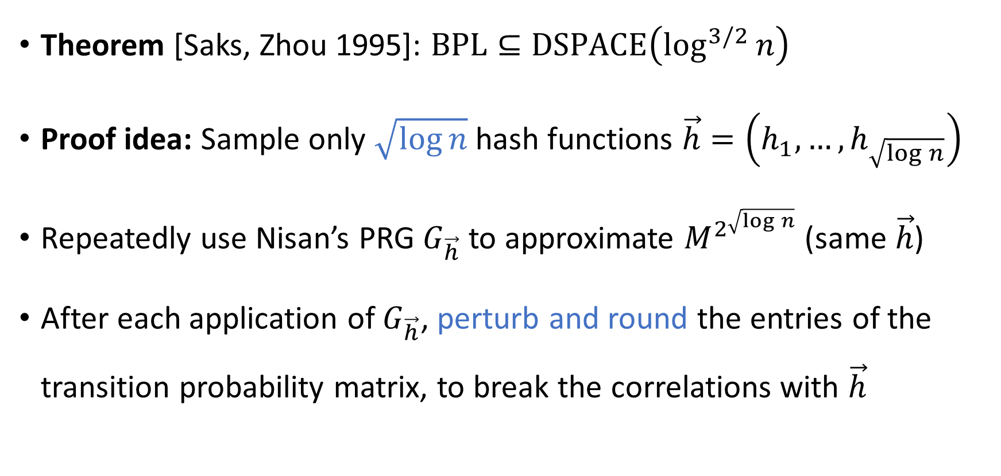

$\text{BPL}⊆{\text{L}}^{1.5}$
Theorem [Saks, Zhou 1995]: $\text{BPL}⊆\text{DSPACE}\left(\log^{3/2}{n}\right)$
Proof idea: Sample only $\sqrt{\log{n}}$ hash functions $\vec{h}=\left(h_{1},…, h_{\sqrt{\log{n}}}\right)$
Repeatedly use Nisan’s PRG $G_{\vec{h}}$ to approximate $M^{2^{\sqrt{\log{n}}}}$ (same $\vec{h}$)
After each application of $G_{\vec{h}}$, perturb and round the entries of the transition probability matrix, to break the correlations with $\vec{h}$

Slide 28
4. The Inverse Laplacian Approach

Slide 29
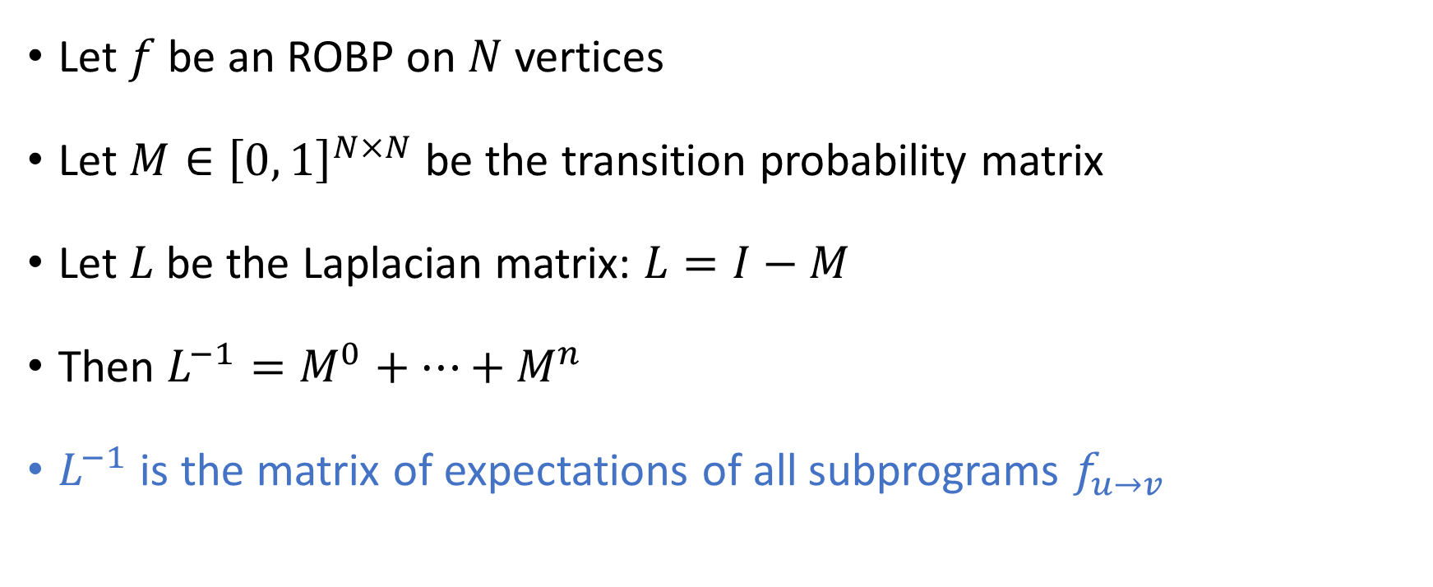
Inverse Laplacian of an ROBP
Let $f$ be an ROBP on $N$ vertices
Let $M∈{\left[0, 1\right]}^{N×N}$ be the transition probability matrix
Let $L$ be the Laplacian matrix: $L=I−M$
Then $L^{−1}=M^{0}+…+M^{n}$
$L^{−1}$ is the matrix of expectations of all subprograms $f_{u→v}$

Slide 30
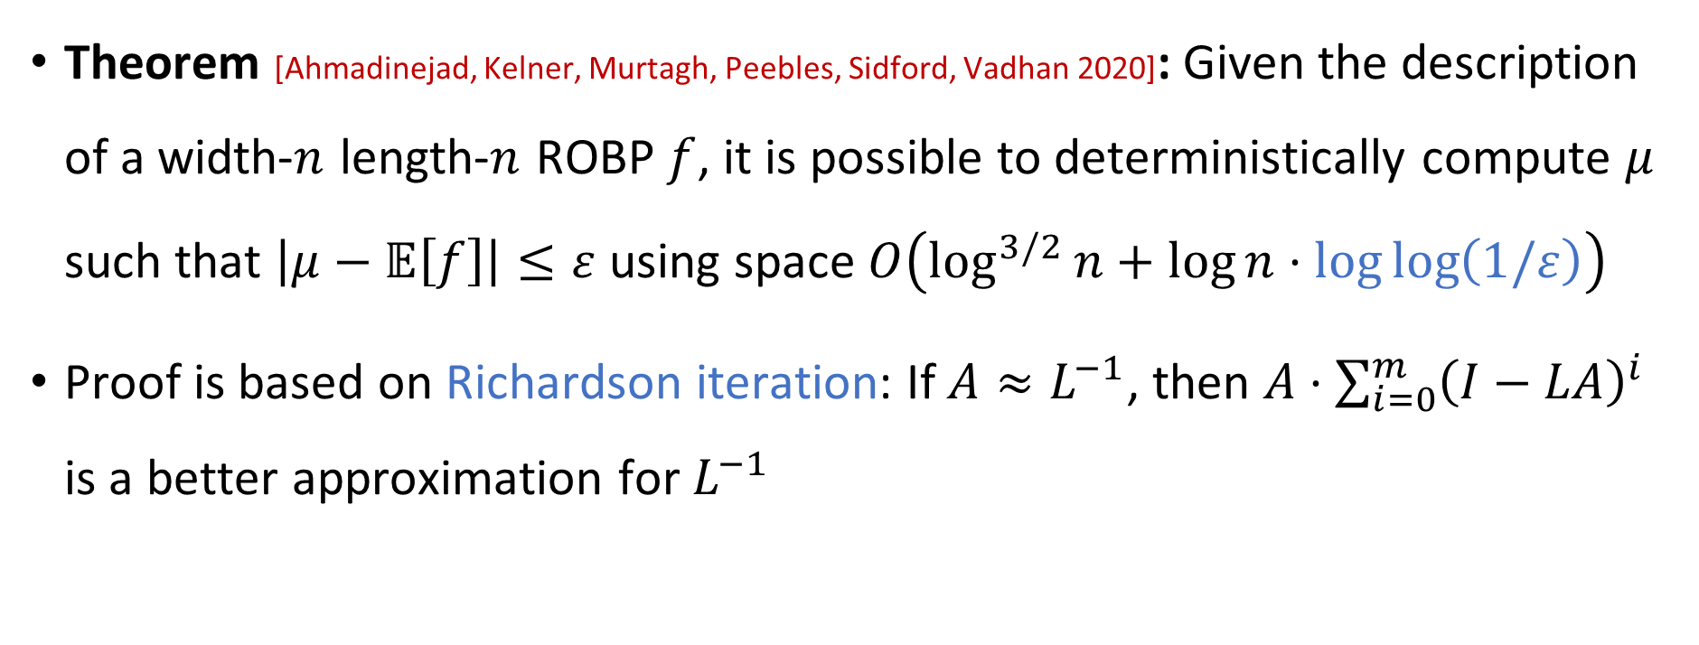
Non-black-box error reduction
Theorem [Ahmadinejad, Kelner, Murtagh, Peebles, Sidford, Vadhan 2020]: Given the description of a width-$n$ length-$n$ ROBP $f$, it is possible to deterministically compute $μ$ such that $\left|μ−𝔼\left[f\right]\right|≤ε$ using space $O\left(\log^{3/2}{n}+\log{n}⋅\log{\log\left(1/ε\right)}\right)$
Proof is based on Richardson iteration: If $A≈L^{−1}$, then $A⋅\sum_{i=0}^{m}{{\left(I−LA\right)}^{i}}$ is a better approximation for $L^{−1}$

Slide 31

Weighted PRGs
A WPRG is a pair $\left(G, ρ\right)$ where $G:{\left\{0, 1\right\}}^{s}→{\left\{0, 1\right\}}^{n}$ and $ρ:{\left\{0, 1\right\}}^{s}→ℝ$
We say that the WPRG fools $f:{\left\{0, 1\right\}}^{n}→\left\{0, 1\right\}$ with error $ε$ if
$$\left|𝔼\left[f\right]−𝔼_{x∈{\left\{0, 1\right\}}^{s}}\left[f\left(G\left(x\right)\right)⋅ρ\left(x\right)\right]\right|≤ε$$

Slide 32
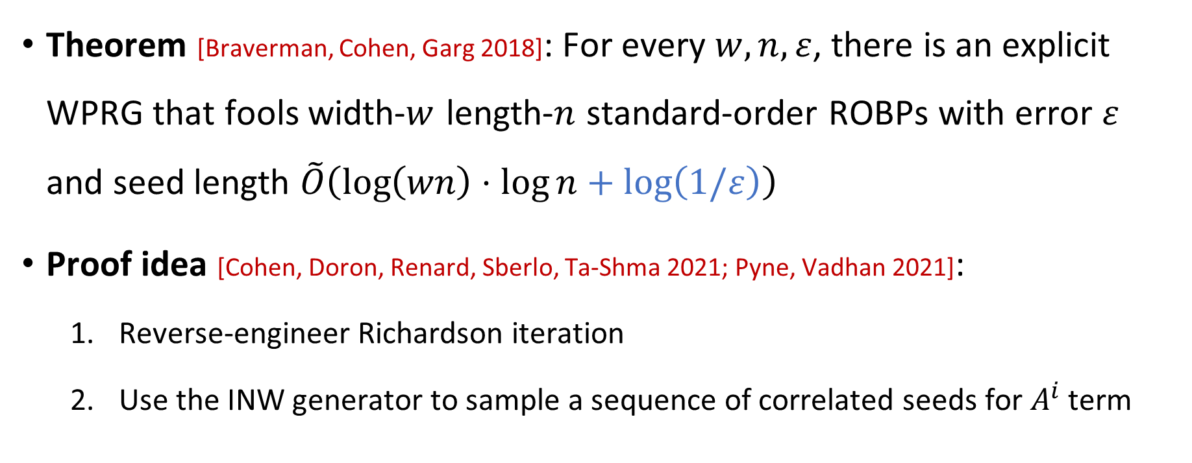
Low-error WPRGs
Theorem [Braverman, Cohen, Garg 2018]: For every $w,n,ε$, there is an explicit WPRG that fools width-$w$ length-$n$ standard-order ROBPs with error $ε$ and seed length $\tilde{O}\left(\log\left(wn\right)⋅\log{n}+\log\left(1/ε\right)\right)$
Proof idea [Cohen, Doron, Renard, Sberlo, Ta-Shma 2021; Pyne, Vadhan 2021]:
Reverse-engineer Richardson iteration
Use the INW generator to sample a sequence of correlated seeds for $A^{i}$ term

Slide 33
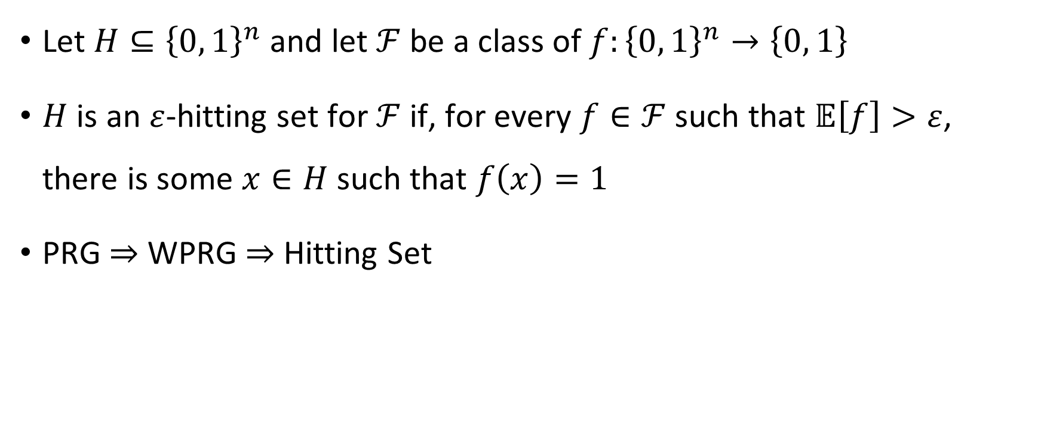
Hitting sets
Let $H⊆{\left\{0, 1\right\}}^{n}$ and let $ℱ$ be a class of $f:{\left\{0, 1\right\}}^{n}→\left\{0, 1\right\}$
$H$ is an $ε$-hitting set for $ℱ$ if, for every $f∈ℱ$ such that $𝔼\left[f\right]>ε$, there is some $x∈H$ such that $f\left(x\right)=1$
PRG $⇒$ WPRG $⇒$ Hitting Set

Slide 34
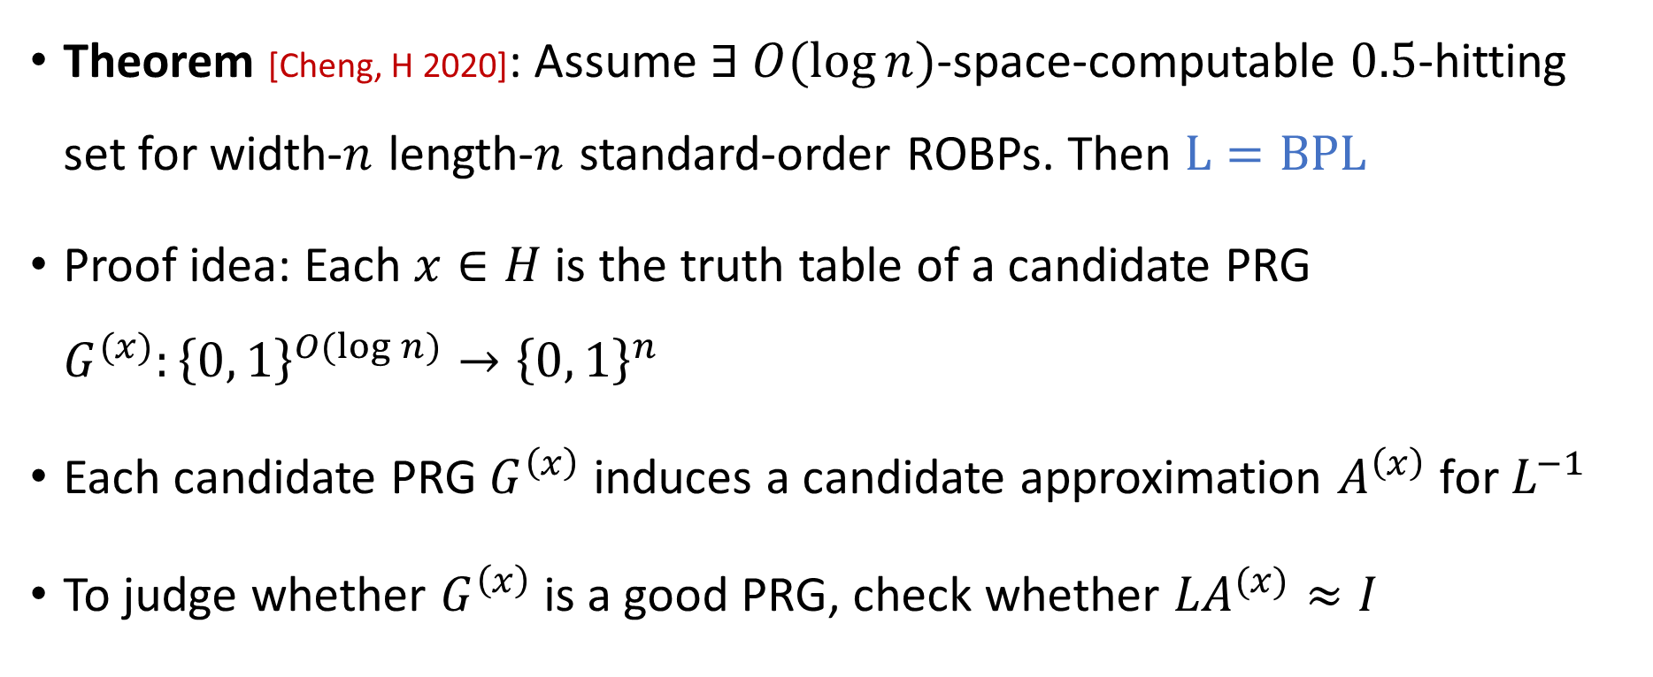

Using hitting sets to derandomize $\text{BPL}$
Theorem [Cheng, H 2020]: Assume $∃$ $O(\log{n})$-space-computable $0.5$-hitting set for width-$n$ length-$n$ standard-order ROBPs. Then $\text{L}=\text{BPL}$
Proof idea: Each $x∈H$ is the truth table of a candidate PRG $G^{(x)}:{\left\{0, 1\right\}}^{O(\log{n})}→{\left\{0, 1\right\}}^{n}$
Each candidate PRG $G^{\left(x\right)}$ induces a candidate approximation $A^{\left(x\right)}$ for $L^{−1}$
To judge whether $G^{\left(x\right)}$ is a good PRG, check whether ${LA}^{(x)}≈I$

Slide 35

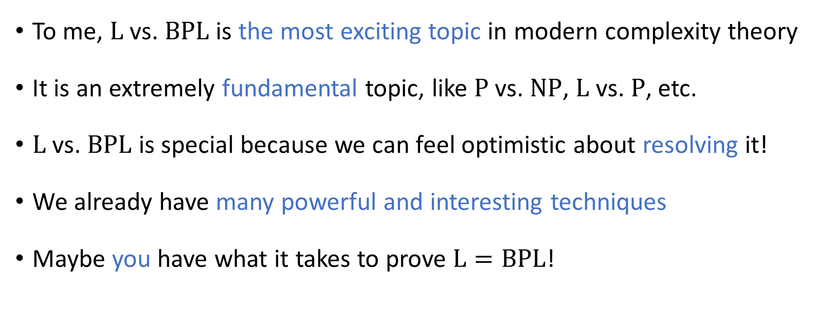
Conclusions
To me, $\text{L}$ vs. $\text{BPL}$ is the most exciting topic in modern complexity theory
It is an extremely fundamental topic, like $\text{P}$ vs. $\text{NP}$, $\text{L}$ vs. $\text{P}$, etc.
$\text{L}$ vs. $\text{BPL}$ is special because we can feel optimistic about resolving it!
We already have many powerful and interesting techniques
Maybe you have what it takes to prove $\text{L}=\text{BPL}$!

Slide 36
Thank you!
Being your instructor has been a privilege
Please fill out the Graduate Course Feedback Form using My.UChicago (deadline is Sunday, March 16)

