Slide 1
CMSC 28100 Introduction to Complexity Theory Winter 2024 Instructor: William Hoza
7 |  |  |  |  |  |  | 5 | 3
 |  |  |  |  |  |  |  | 4
 | 4 | 8 |  | 3 |  | 1 | 2
8 |  | 1 | 3 |  |  | 2 | 7 | 5
 | 9 |  | 1 |  |  |  | 4
 | 5 |  |  |  |  | 3
2 |  | 5 |  | 8 | 4
1 | 3 | 4 |  | 5

Slide 2












Post’s Correspondence Problem
We are given a set of “dominos”
Goal: Determine whether it is possible to generate a “match”
in which the sequence of symbols on top equals the sequence of symbols on the bottom
Using the same domino multiple times is permitted
$$\begin{matrix}t_{1} \\ b_{1}\end{matrix}$$
$$\begin{matrix}t_{2} \\ b_{2}\end{matrix}$$
$$\begin{matrix}t_{3} \\ b_{3}\end{matrix}$$
$$\begin{matrix}t_{k} \\ b_{k}\end{matrix}$$
$$⋯$$
$$\begin{matrix}t_{i_{1}} \\ b_{i_{1}}\end{matrix}$$
$$\begin{matrix}t_{i_{2}} \\ b_{i_{2}}\end{matrix}$$
$$\begin{matrix}t_{i_{3}} \\ b_{i_{3}}\end{matrix}$$
$$\begin{matrix}t_{i_{4}} \\ b_{i_{4}}\end{matrix}$$
$$\begin{matrix}t_{i_{5}} \\ b_{i_{5}}\end{matrix}$$
$$\begin{matrix}t_{i_{n}} \\ b_{i_{n}}\end{matrix}$$
$$⋯$$

Slide 3
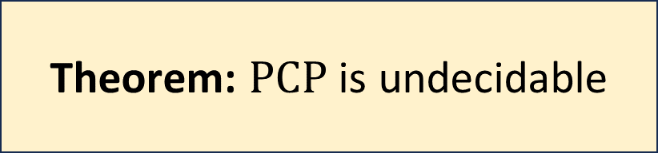
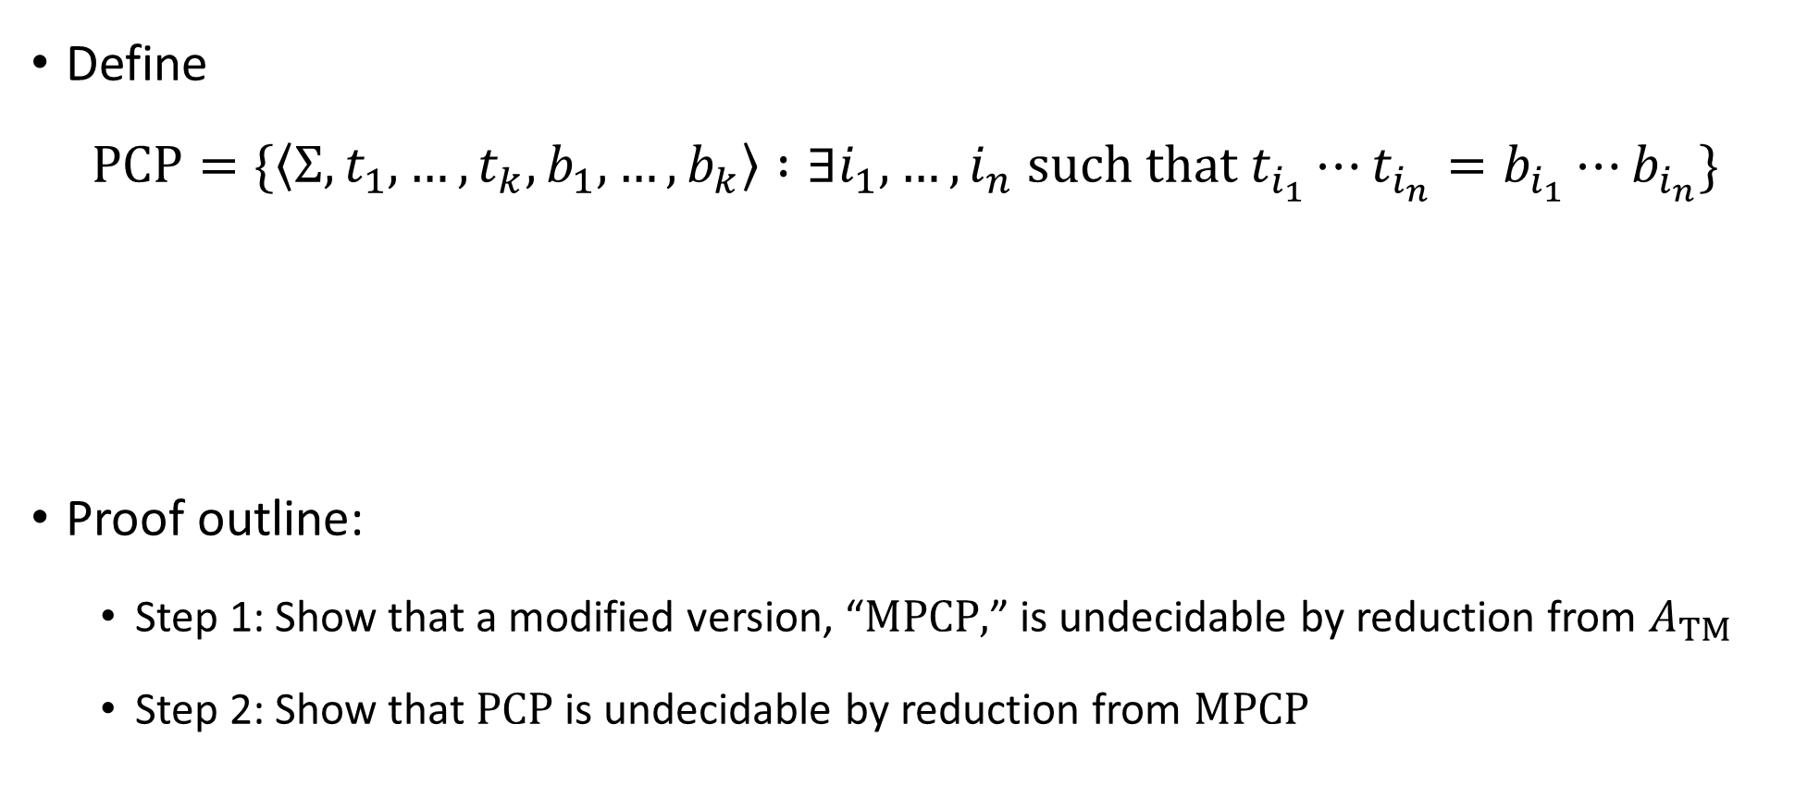
Post’s Correspondence Problem is undecidable
Define
$$\text{PCP}=\{\left\langle Σ, t_{1},…, t_{k}, b_{1},…, b_{k}\right\rangle :∃i_{1},…, i_{n} \text{such} \text{that} t_{i_{1}}⋯t_{i_{n}}=b_{i_{1}}⋯b_{i_{n}}\}$$
Proof outline:
Step 1: Show that a modified version, “$\text{MPCP}\text{,}$” is undecidable by reduction from $A_{TM}$
Step 2: Show that $\text{PCP}$ is undecidable by reduction from $\text{MPCP}$
Theorem: $\text{PCP}$ is undecidable

Slide 4

Modified PCP
Define
$$\text{MPCP}=\{\left\langle Σ, t_{1},…, t_{k}, b_{1},…, b_{k}\right\rangle :∃i_{1},…, i_{n} \text{such} \text{that} t_{1}t_{i_{1}}⋯t_{i_{n}}=b_{1}b_{i_{1}}⋯b_{i_{n}}\}$$
(Must start with first domino)

Slide 5





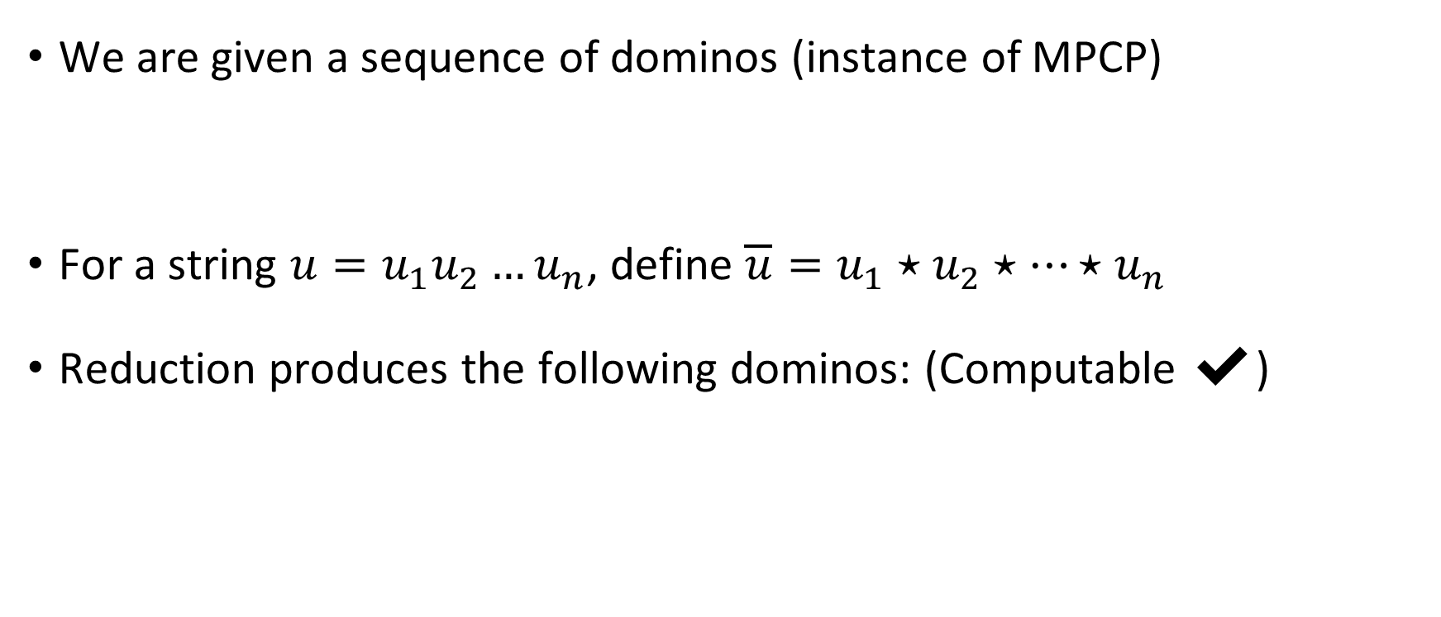







Reduction from MPCP to PCP
We are given a sequence of dominos (instance of MPCP)
For a string $u=u_{1}u_{2}…u_{n}$, define $\overline{u}=u_{1}⋆u_{2}⋆⋯⋆u_{n}$
Reduction produces the following dominos: (Computable ✔️)
$$\begin{matrix}t_{1} \\ b_{1}\end{matrix}$$
$$\begin{matrix}t_{2} \\ b_{2}\end{matrix}$$
$$\begin{matrix}t_{3} \\ b_{3}\end{matrix}$$
$$\begin{matrix}t_{k} \\ b_{k}\end{matrix}$$
$$⋯$$
$$\begin{matrix}⋆\overline{t_{1}} \\ ⋆\overline{b_{1}}⋆\end{matrix}$$
$$\begin{matrix}⋆\overline{t_{1}} \\ \overline{b_{1}}⋆\end{matrix}$$
$$\begin{matrix}⋆\overline{t_{2}} \\ \overline{b_{2}}⋆\end{matrix}$$
$$\begin{matrix}⋆\overline{t_{3}} \\ \overline{b_{3}}⋆\end{matrix}$$
$$\begin{matrix}⋆\overline{t_{k}} \\ \overline{b_{k}}⋆\end{matrix}$$
$$\begin{matrix}⋆ \\ ε\end{matrix}$$
$$⋯$$

Slide 6













YES maps to YES
Suppose the MPCP instance has a match
Then the constructed PCP instance also has a match:
$$\begin{matrix}t_{1} \\ b_{1}\end{matrix}$$
$$\begin{matrix}t_{i_{1}} \\ b_{i_{1}}\end{matrix}$$
$$\begin{matrix}t_{i_{2}} \\ b_{i_{2}}\end{matrix}$$
$$\begin{matrix}t_{i_{3}} \\ b_{i_{3}}\end{matrix}$$
$$\begin{matrix}t_{i_{4}} \\ b_{i_{4}}\end{matrix}$$
$$\begin{matrix}t_{i_{n}} \\ b_{i_{n}}\end{matrix}$$
$$⋯$$
$$\begin{matrix}⋆\overline{t_{1}} \\ ⋆\overline{b_{1}}⋆\end{matrix}$$
$$\begin{matrix}⋆\overline{t_{i_{1}}} \\ \overline{b_{i_{1}}}⋆\end{matrix}$$
$$\begin{matrix}⋆\overline{t_{i_{2}}} \\ \overline{b_{i_{2}}}⋆\end{matrix}$$
$$\begin{matrix}⋆\overline{t_{i_{n}}} \\ \overline{b_{i_{n}}}⋆\end{matrix}$$
$$\begin{matrix}⋆ \\ ε\end{matrix}$$
$$⋯$$

Slide 7

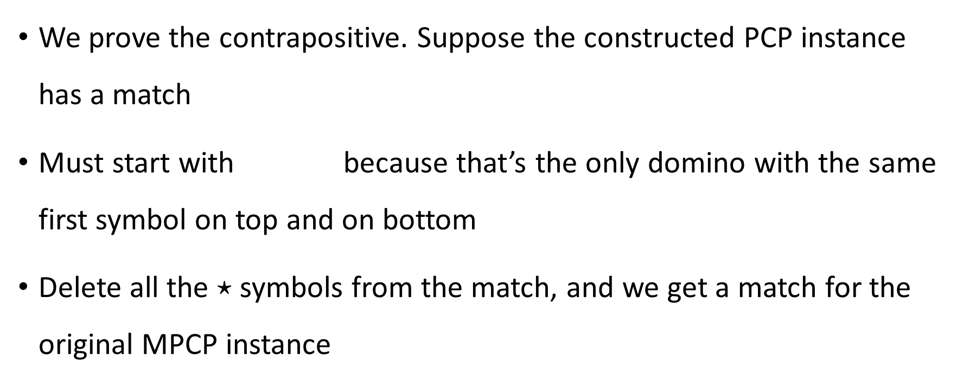
NO maps to NO
We prove the contrapositive. Suppose the constructed PCP instance has a match
Must start with because that’s the only domino with the same first symbol on top and on bottom
Delete all the $⋆$ symbols from the match, and we get a match for the original MPCP instance
$$\begin{matrix}⋆\overline{t_{1}} \\ ⋆\overline{b_{1}}⋆\end{matrix}$$

Slide 8
Which languages are undecidable?

Slide 9
Some more undecidable problems
We have seen many interesting examples of undecidable problems
To wrap up our discussion of undecidability, I’ll mention a few more examples of undecidable problems – but we won’t do the proofs
(This material will not be on problem sets or exams)

Slide 10

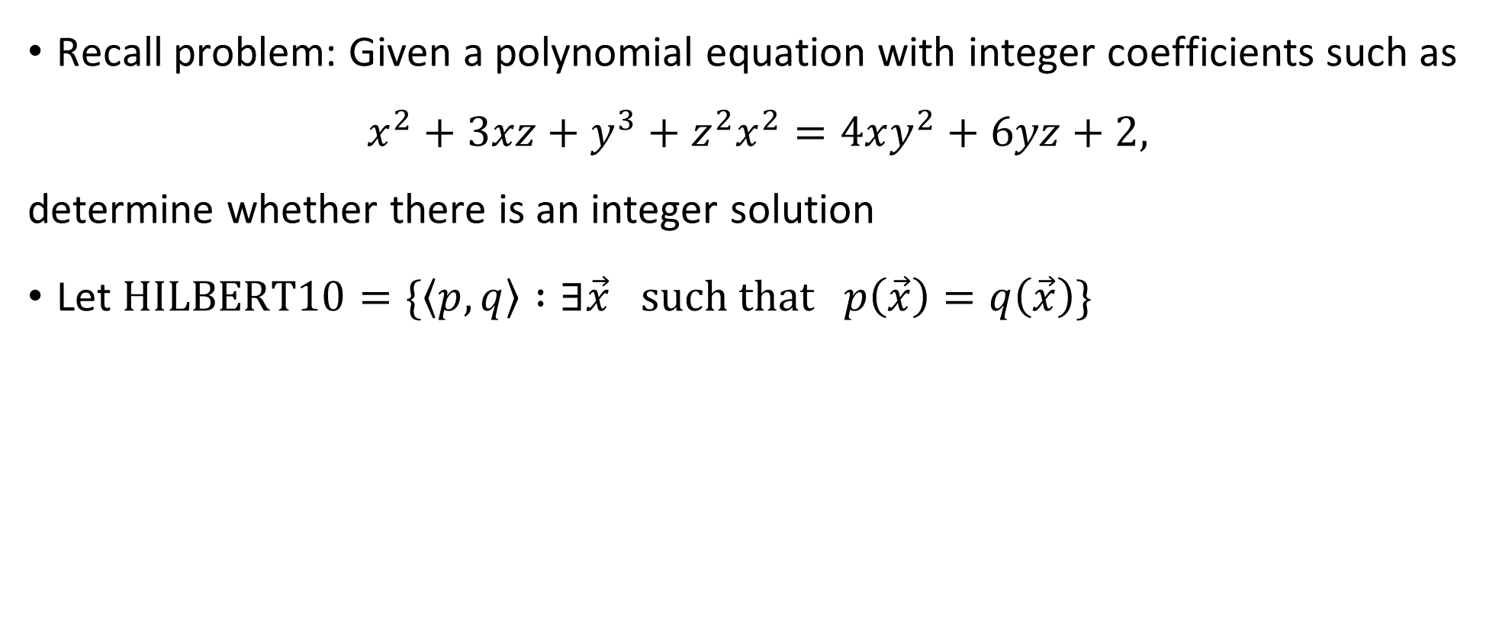
Hilbert’s 10th problem
Recall problem: Given a polynomial equation with integer coefficients such as
$$x^{2}+3xz+y^{3}+z^{2}x^{2}=4xy^{2}+6yz+2,$$
determine whether there is an integer solution
Let $\text{HILBERT}\text{10}=\{\left\langle p,q\right\rangle :∃\vec{x} \text{such} \text{that} p\left(\vec{x}\right)=q\left(\vec{x}\right)\}$
Theorem: $\text{HILBERT}\text{10}$ is undecidable

Slide 11
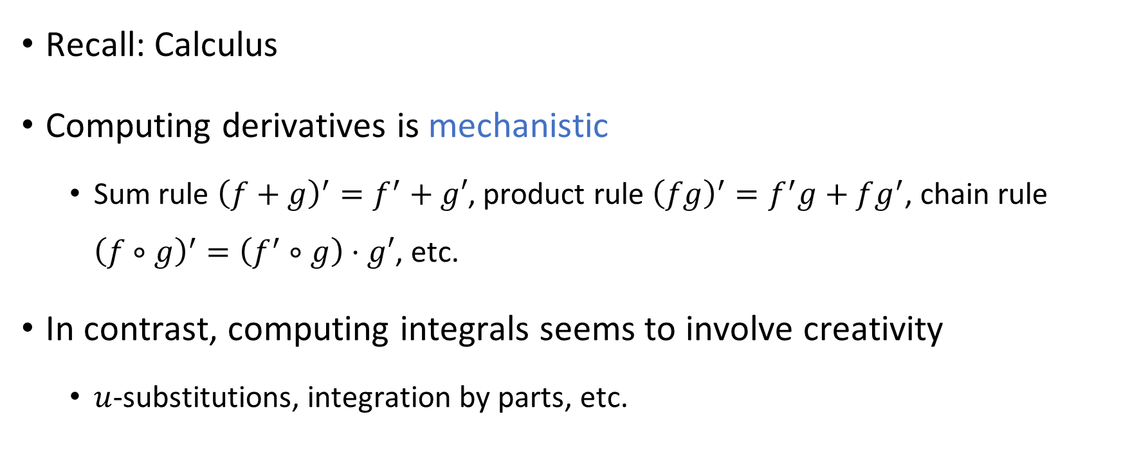
Derivatives vs. Integrals
Recall: Calculus
Computing derivatives is mechanistic
Sum rule ${\left(f+g\right)}^{′}=f^{′}+g′$, product rule ${\left(fg\right)}^{′}=f^{′}g+fg^{′}$, chain rule ${\left(f∘g\right)}^{′}=\left(f^{′}∘g\right)⋅g′$, etc.
In contrast, computing integrals seems to involve creativity
$u$-substitutions, integration by parts, etc.

Slide 12
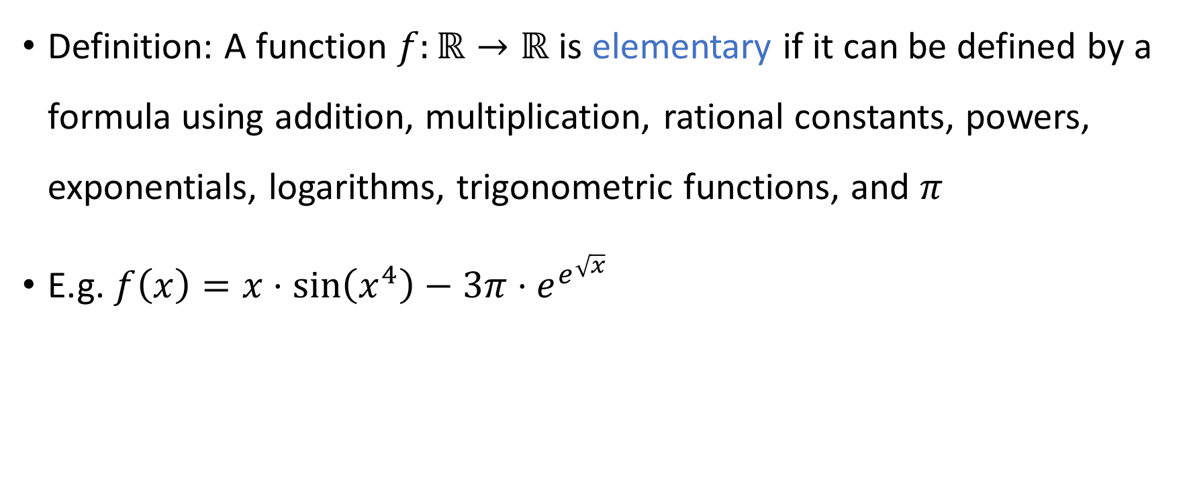
Elementary functions
Definition: A function $f:ℝ→ℝ$ is elementary if it can be defined by a formula using addition, multiplication, rational constants, powers, exponentials, logarithms, trigonometric functions, and $π$
E.g. $f\left(x\right)=x⋅\sin\left(x^{4}\right)−3π⋅e^{e^{\sqrt{x}}}$

Slide 13

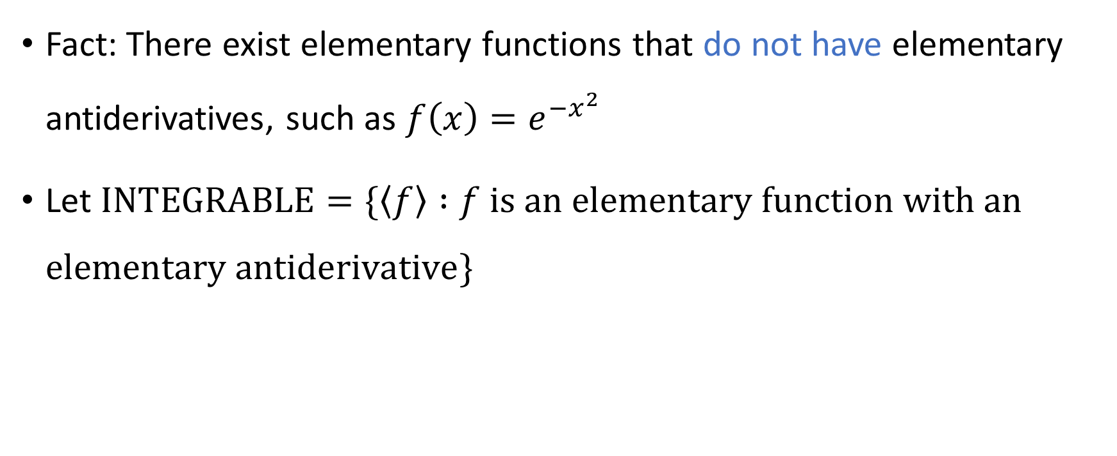
Integration is undecidable
Fact: There exist elementary functions that do not have elementary antiderivatives, such as $f\left(x\right)=e^{−x^{2}}$
Let $\text{INTEGRABLE}=\{\left\langle f\right\rangle :f \text{is} \text{an} \text{elementary} \text{function} \text{with} \text{an} \text{elementary} \text{antiderivative}\}$
Theorem: $\text{INTEGRABLE}$ is undecidable

Slide 14

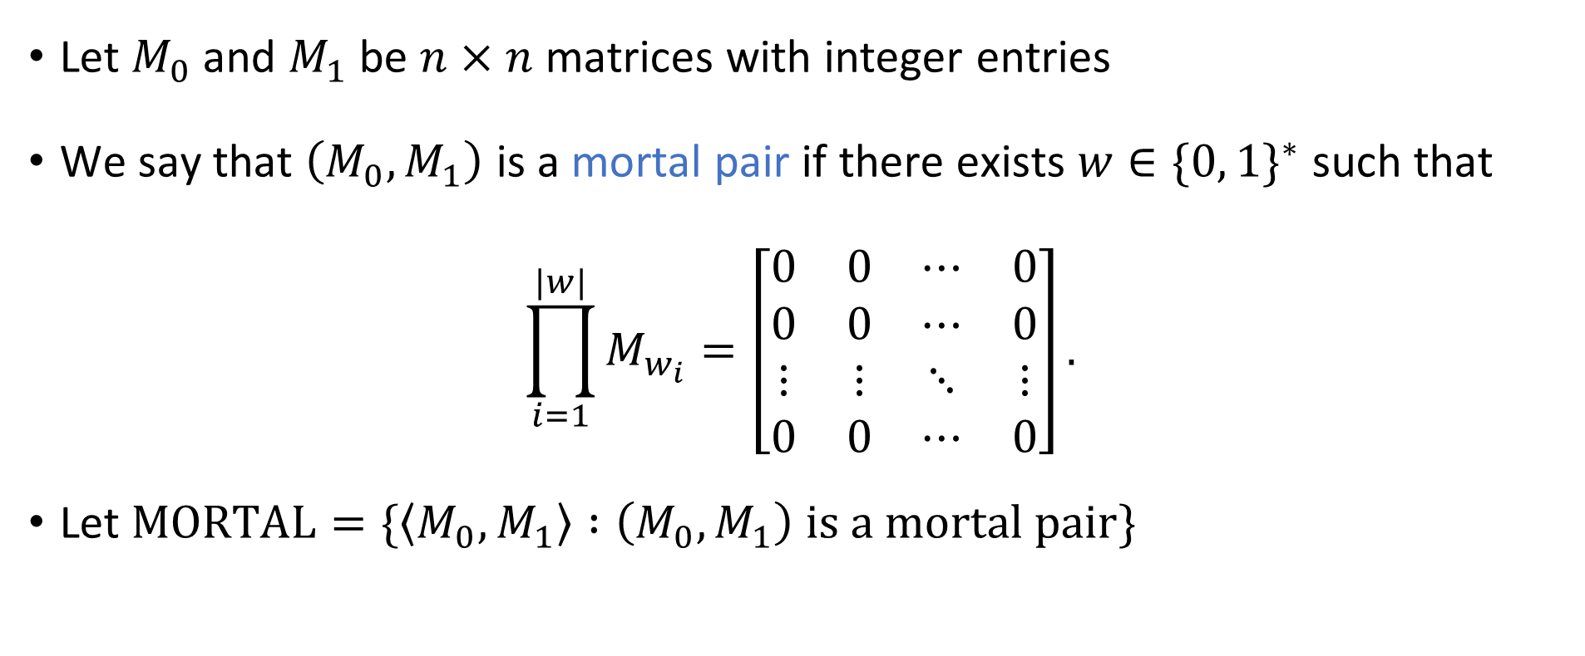
Matrix mortality
Let $M_{0}$ and $M_{1}$ be $n×n$ matrices with integer entries
We say that $\left(M_{0},M_{1}\right)$ is a mortal pair if there exists $w∈\{0, 1\}^{∗}$ such that
$$\prod_{i=1}^{|w|}{M_{w_{i}}}=\left[\begin{matrix}0 & 0 & ⋯ & 0 \\ 0 & 0 & ⋯ & 0 \\ ⋮ & ⋮ & ⋱ & ⋮ \\ 0 & 0 & ⋯ & 0\end{matrix}\right].$$
Let $\text{MORTAL}=\{\left\langle M_{0},M_{1}\right\rangle :\left(M_{0},M_{1}\right) \text{is} \text{a} \text{mortal} \text{pair}\}$
Theorem: $\text{MORTAL}$ is undecidable

Slide 15
Computability theory: Conclusions

Slide 16
Undecidability
For some problems, including some natural and interesting problems, there does not exist an algorithm that solves the problem
Key example: The halting problem

Slide 17
Computability theory beyond undecidability
We have only scratched the surface of computability theory
For example, which languages would be decidable if we had access to a device that solved the halting problem?
If you want to learn more about these subjects, consider taking MATH 30200-30300-30400

Slide 18
Midterm cutoff point
Midterm exam will be in class on Friday, February 2
To prepare for the midterm, you only need to study the material up to this point

Slide 19
Which problems can be solved through computation?

Slide 20
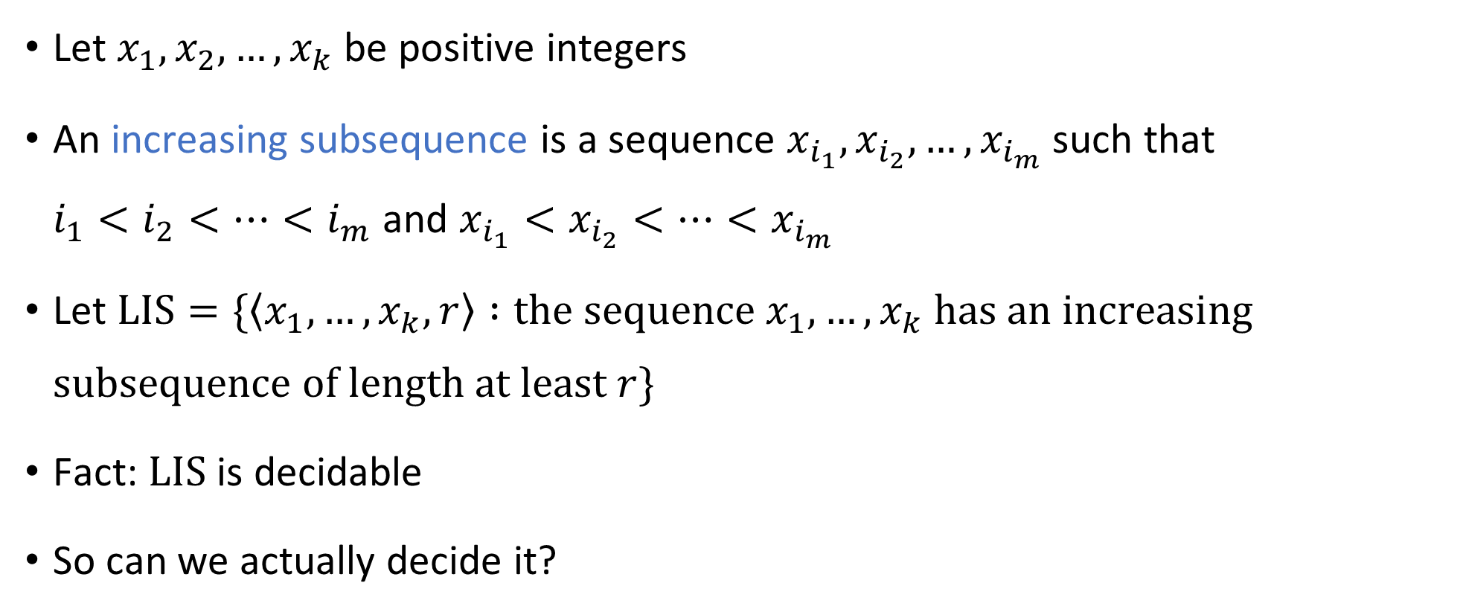
Longest increasing subsequence
Let $x_{1},x_{2},…, x_{k}$ be positive integers
An increasing subsequence is a sequence $x_{i_{1}}, x_{i_{2}},…,x_{i_{m}}$ such that $i_{1}<i_{2}<⋯<i_{m}$ and $x_{i_{1}}<x_{i_{2}}<⋯<x_{i_{m}}$
Let $\text{LIS}=\{\left\langle x_{1},…, x_{k},r\right\rangle :\text{the} \text{sequence} x_{1},…,x_{k} \text{has} \text{an} \text{increasing} \text{subsequence} \text{of} \text{length} \text{at} \text{least} r\}$
Fact: $\text{LIS}$ is decidable
So can we actually decide it?

Slide 21
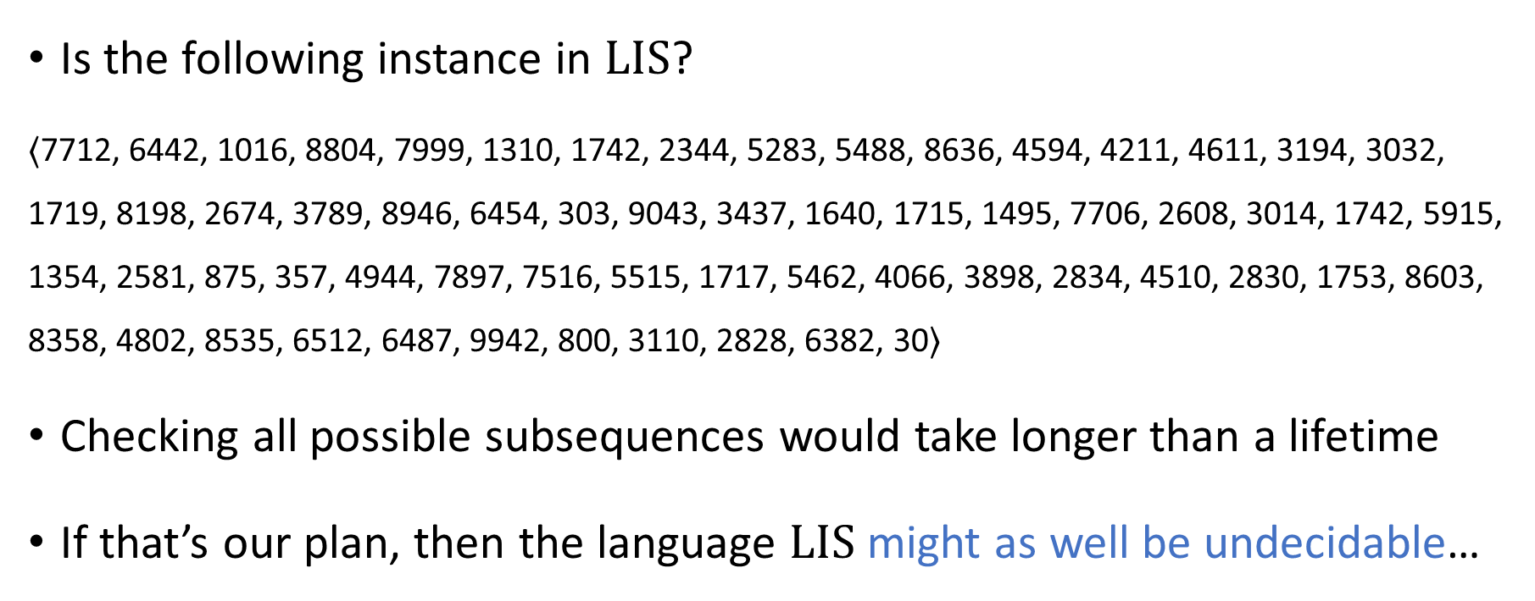
Naïve algorithm is so slow that it’s worthless
Is the following instance in $\text{LIS}$?
$⟨$7712, 6442, 1016, 8804, 7999, 1310, 1742, 2344, 5283, 5488, 8636, 4594, 4211, 4611, 3194, 3032, 1719, 8198, 2674, 3789, 8946, 6454, 303, 9043, 3437, 1640, 1715, 1495, 7706, 2608, 3014, 1742, 5915, 1354, 2581, 875, 357, 4944, 7897, 7516, 5515, 1717, 5462, 4066, 3898, 2834, 4510, 2830, 1753, 8603, 8358, 4802, 8535, 6512, 6487, 9942, 800, 3110, 2828, 6382, 30$⟩$
Checking all possible subsequences would take longer than a lifetime
If that’s our plan, then the language $\text{LIS}$ might as well be undecidable…

Slide 22
Which problems can be solved through computation?

Slide 23

Refining our model
The mathematical model we have studied so far: Decidable vs. undecidable
Now we will refine our model to take into account the fact that in real life, we only have a limited amount of time (and other resources)
“Complexity theory”

Slide 24

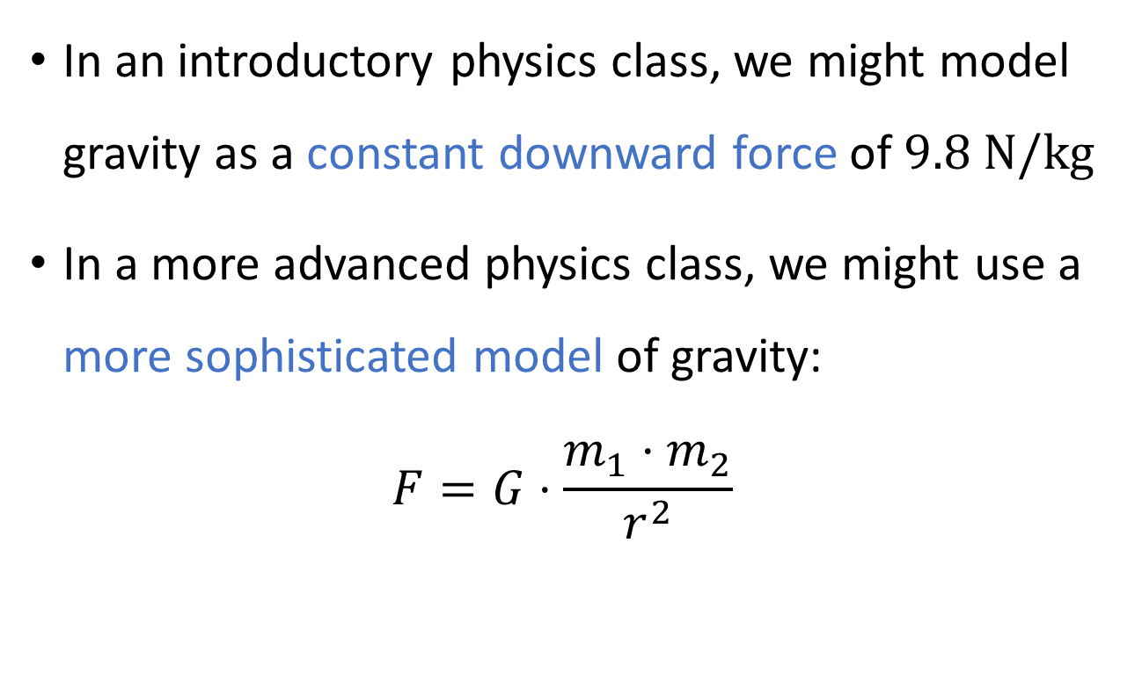
Analogy: Gravity
In an introductory physics class, we might model gravity as a constant downward force of $9.8 \text{N}/\text{kg}$
In a more advanced physics class, we might use a more sophisticated model of gravity: $F=G⋅\frac{m_{1}⋅m_{2}}{r^{2}}$

Slide 25
Theory vs. practice
Disclaimer: Our theoretical model will still not be perfectly accurate!
Sometimes, we might categorize a problem as “tractable” even though it is not actually “solvable in practice”
Other times, we might categorize a problem as “intractable” even though it is actually “solvable in practice”

Slide 26
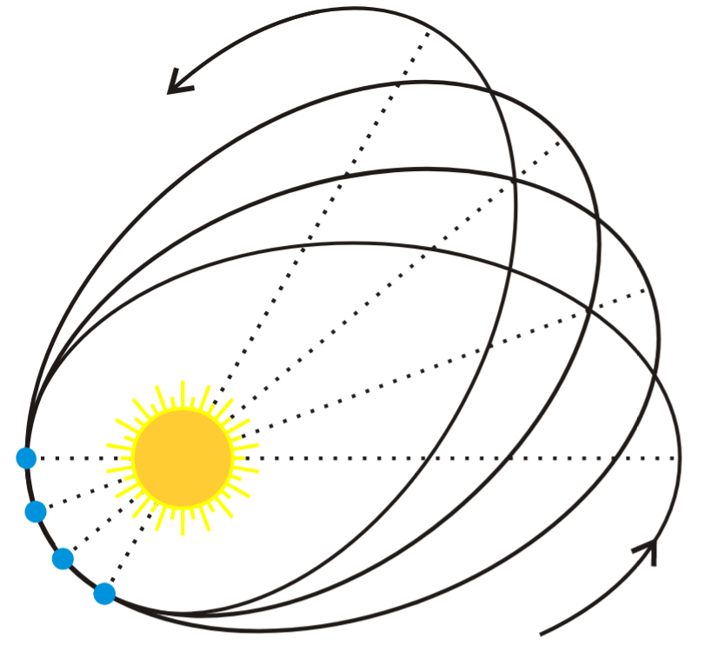
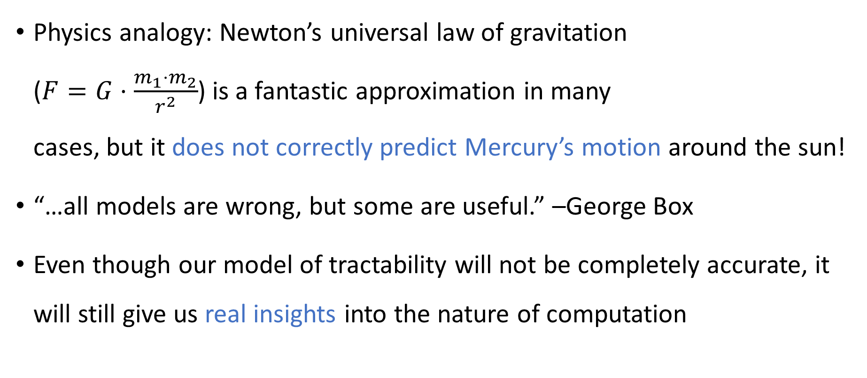
Theory vs. practice
Physics analogy: Newton’s universal law of gravitation ($F=G⋅\frac{m_{1}⋅m_{2}}{r^{2}}$) is a fantastic approximation in many cases, but it does not correctly predict Mercury’s motion around the sun!
“…all models are wrong, but some are useful.” –George Box
Even though our model of tractability will not be completely accurate, it will still give us real insights into the nature of computation

Slide 27
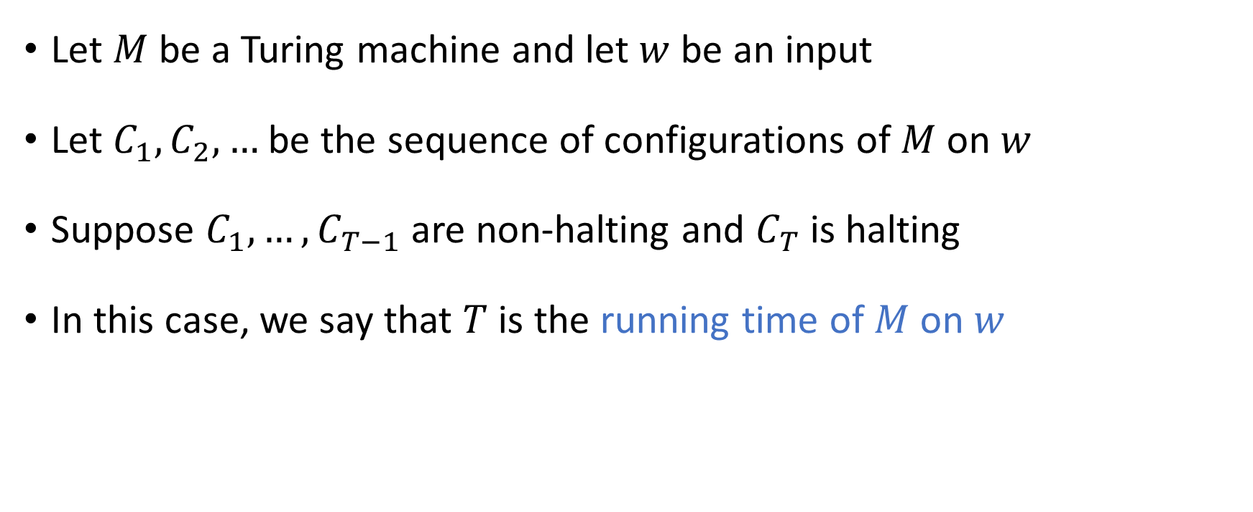
Time complexity
Let $M$ be a Turing machine and let $w$ be an input
Let $C_{1},C_{2},…$ be the sequence of configurations of $M$ on $w$
Suppose $C_{1},…, C_{T−1}$ are non-halting and $C_{T}$ is halting
In this case, we say that $T$ is the running time of $M$ on $w$

Slide 28
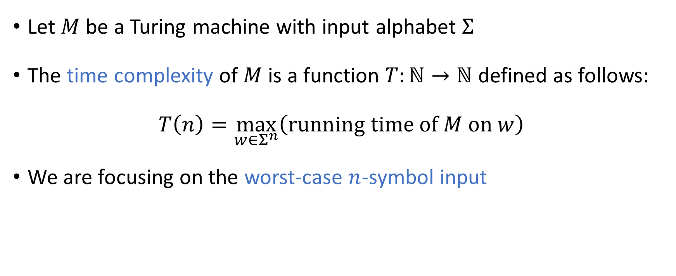
Time complexity
Let $M$ be a Turing machine with input alphabet $Σ$
The time complexity of $M$ is a function $T:ℕ→ℕ$ defined as follows:
$$T\left(n\right)=\max_{w∈Σ^{n}}\left(\text{running} \text{time} \text{of} M \text{on} w\right)$$
We are focusing on the worst-case $n$-symbol input

Slide 29
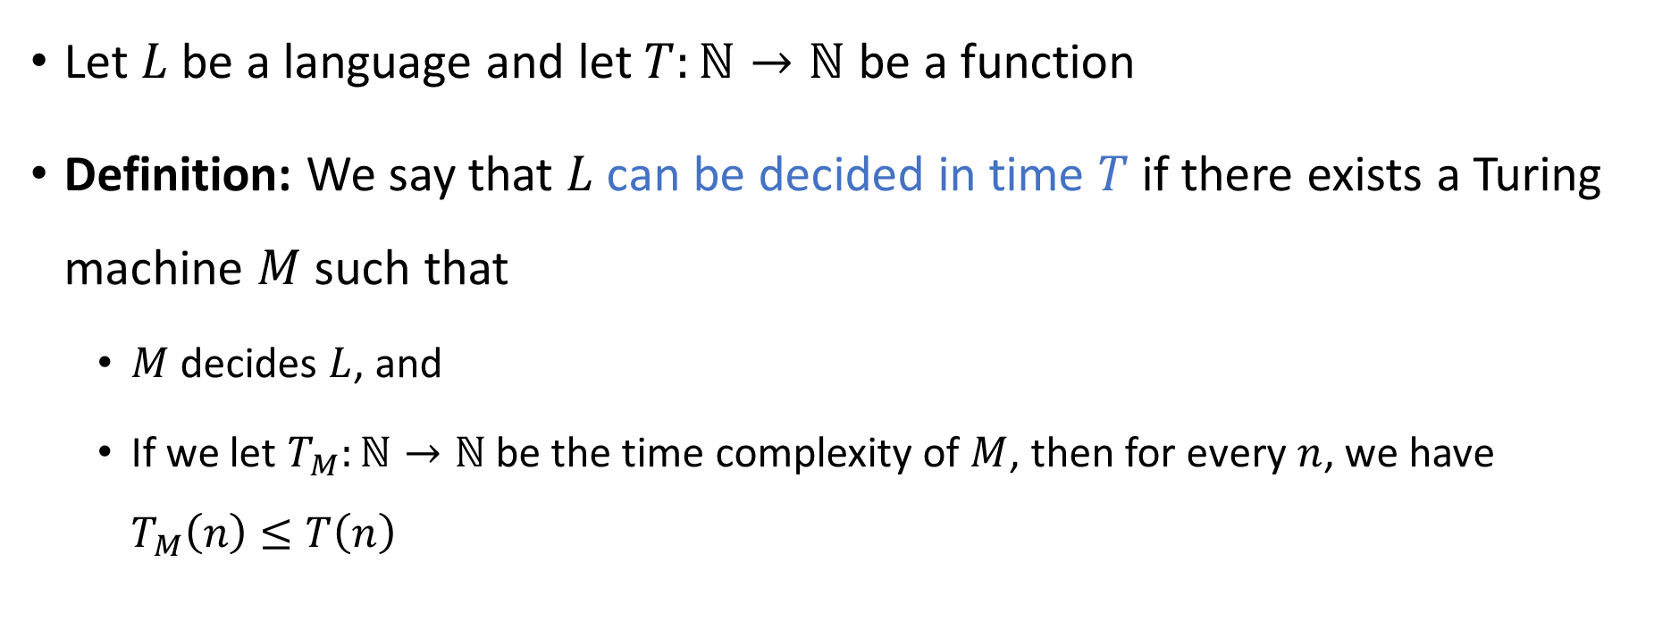

Deciding a language in time $T$
Let $L$ be a language and let $T:ℕ→ℕ$ be a function
Definition: We say that $L$ can be decided in time $T$ if there exists a Turing machine $M$ such that
$M$ decides $L$, and
If we let $T_{M}:ℕ→ℕ$ be the time complexity of $M$, then for every $n$, we have $T_{M}\left(n\right)≤T\left(n\right)$

Slide 30

Scaling behavior
We will mainly focus on the limiting behavior of $T\left(n\right)$ as $n→∞$
How “quickly” does the time complexity $T\left(n\right)$ increase when we increase the input length $n$?

Slide 31
Asymptotic analysis

Slide 32
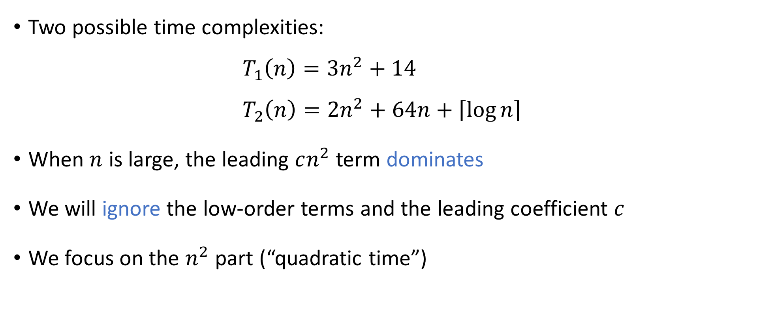
Asymptotic analysis
Two possible time complexities:
$$T_{1}\left(n\right)=3n^{2}+14 \\ T_{2}\left(n\right)=2n^{2}+64n+\left\lceil \log{n}\right\rceil$$
When $n$ is large, the leading $cn^{2}$ term dominates
We will ignore the low-order terms and the leading coefficient $c$
We focus on the $n^{2}$ part (“quadratic time”)

Slide 33
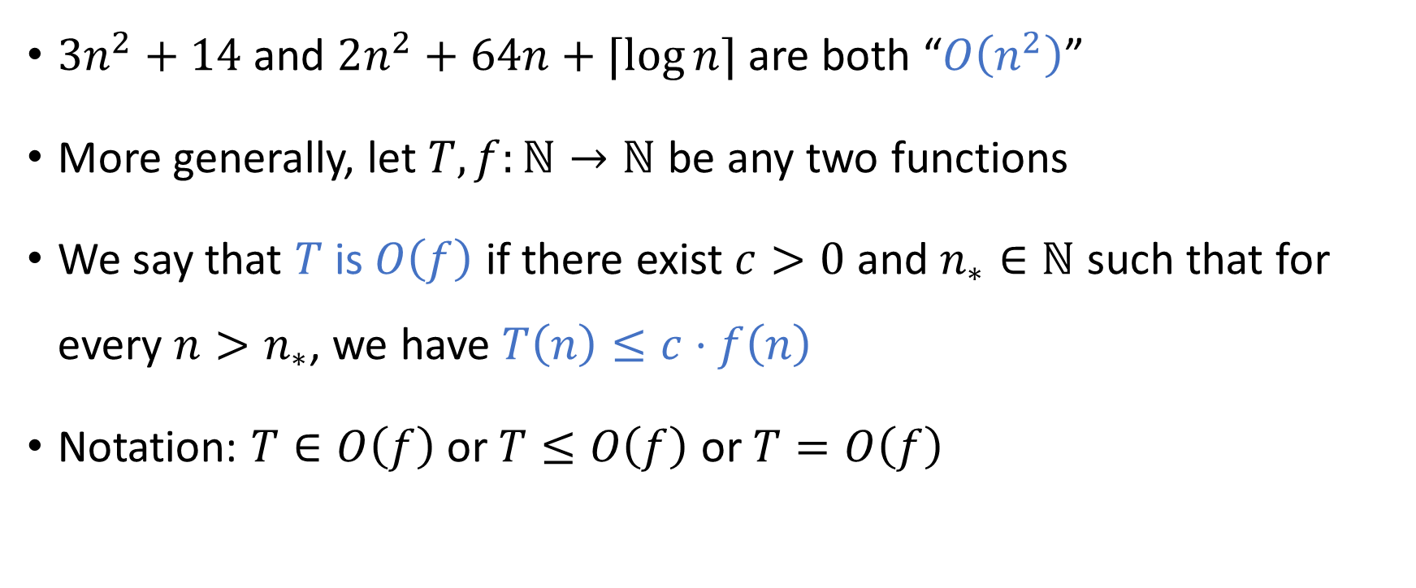

Big-$O$ notation
$3n^{2}+14$ and $2n^{2}+64n+⌈\log{n}⌉$ are both “$O\left(n^{2}\right)$”
More generally, let $T,f:ℕ→ℕ$ be any two functions
We say that $T$ is $O\left(f\right)$ if there exist $c>0$ and $n_{∗}∈ℕ$ such that for every $n>n_{∗}$, we have $T\left(n\right)≤c⋅f\left(n\right)$
Notation: $T∈O\left(f\right)$ or $T≤O\left(f\right)$ or $T=O\left(f\right)$

Slide 34


Big-$O$ notation examples
$3n^{2}+14$ is $O\left(n^{2}\right)$
$3n^{2}+14$ is $O\left(n^{2}+n\right)$
$3n^{2}+14$ is $O\left(n^{3}\right)$

Slide 35
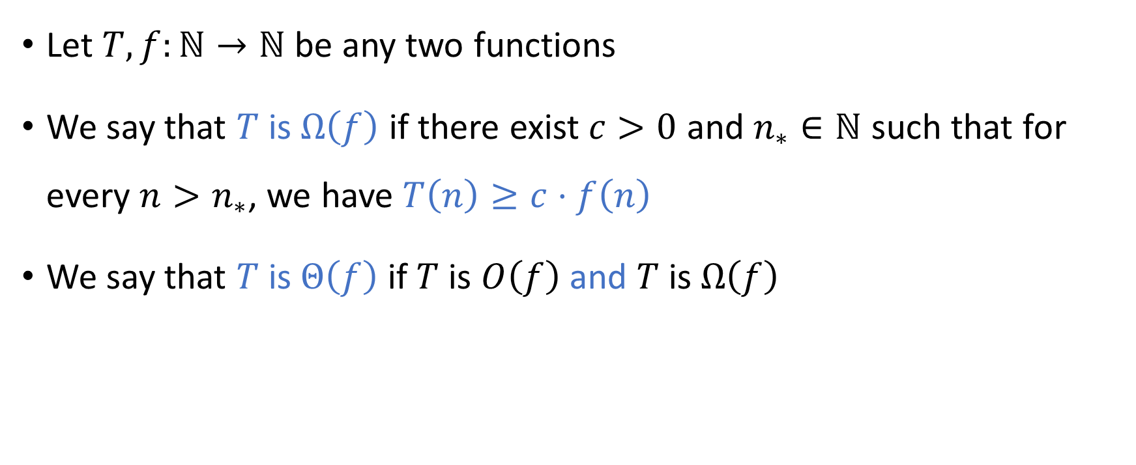

Big-$Ω$ and big-$Θ$
Let $T,f:ℕ→ℕ$ be any two functions
We say that $T$ is $Ω\left(f\right)$ if there exist $c>0$ and $n_{∗}∈ℕ$ such that for every $n>n_{∗}$, we have $T\left(n\right)≥c⋅f\left(n\right)$
We say that $T$ is $Θ\left(f\right)$ if $T$ is $O\left(f\right)$ and $T$ is $Ω\left(f\right)$

