Slide 1

CMSC 28100 Introduction to Complexity Theory Spring 2024 Instructor: William Hoza

Slide 2
Which problems can be solved through computation?

Slide 3
Which languages are decidable?

Slide 4
Is every language decidable?

Slide 5
The liar paradox
Are you selecting option B as your answer to this question?
A: Yes
B: No
C: Yes
D: Yes
Respond at PollEv.com/whoza or text “whoza” to 22333

Slide 6
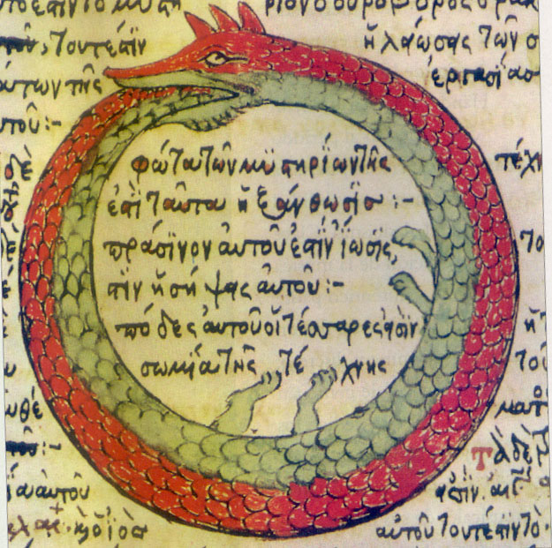
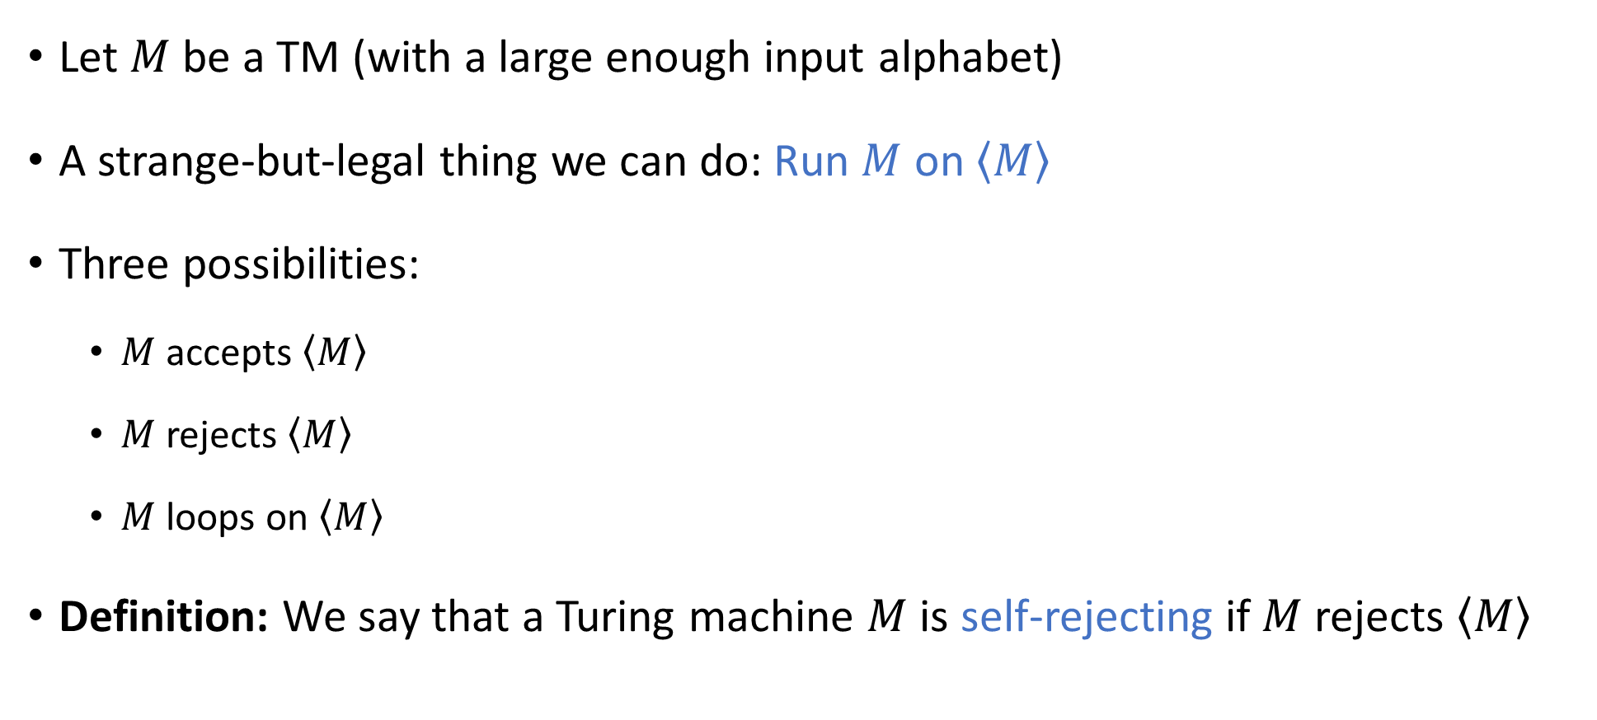
Self-rejecting Turing machines
Let $M$ be a TM (with a large enough input alphabet)
A strange-but-legal thing we can do: Run $M$ on $\left\langle M\right\rangle$
Three possibilities:
$M$ accepts $\left\langle M\right\rangle$
$M$ rejects $\left\langle M\right\rangle$
$M$ loops on $\left\langle M\right\rangle$
Definition: We say that a Turing machine $M$ is self-rejecting if $M$ rejects $\left\langle M\right\rangle$

Slide 7

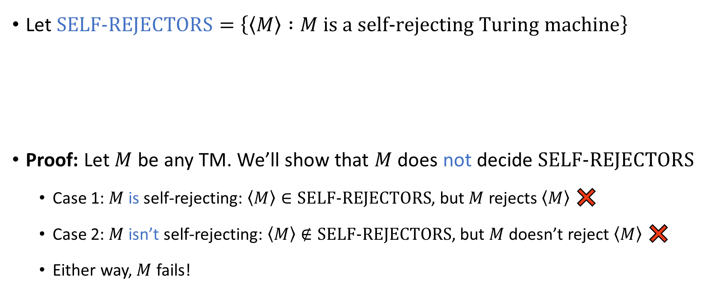
Self-rejecting Turing machines
Let $\text{SELF}‑\text{REJECTORS}=\left\{\left\langle M\right\rangle :M \text{is} \text{a} \text{self}‑\text{rejecting} \text{Turing} \text{machine}\right\}$
Proof: Let $M$ be any TM. We’ll show that $M$ does not decide $\text{SELF}‑\text{REJECTORS}$
Case 1: $M$ is self-rejecting: $\left\langle M\right\rangle ∈\text{SELF}‑\text{REJECTORS}$, but $M$ rejects $\left\langle M\right\rangle$ ❌
Case 2: $M$ isn’t self-rejecting: $\left\langle M\right\rangle ∉\text{SELF}‑\text{REJECTORS}$, but $M$ doesn’t reject $\left\langle M\right\rangle$ ❌
Either way, $M$ fails!
Lemma: $\text{SELF}‑\text{REJECTORS}$ is undecidable

Slide 8
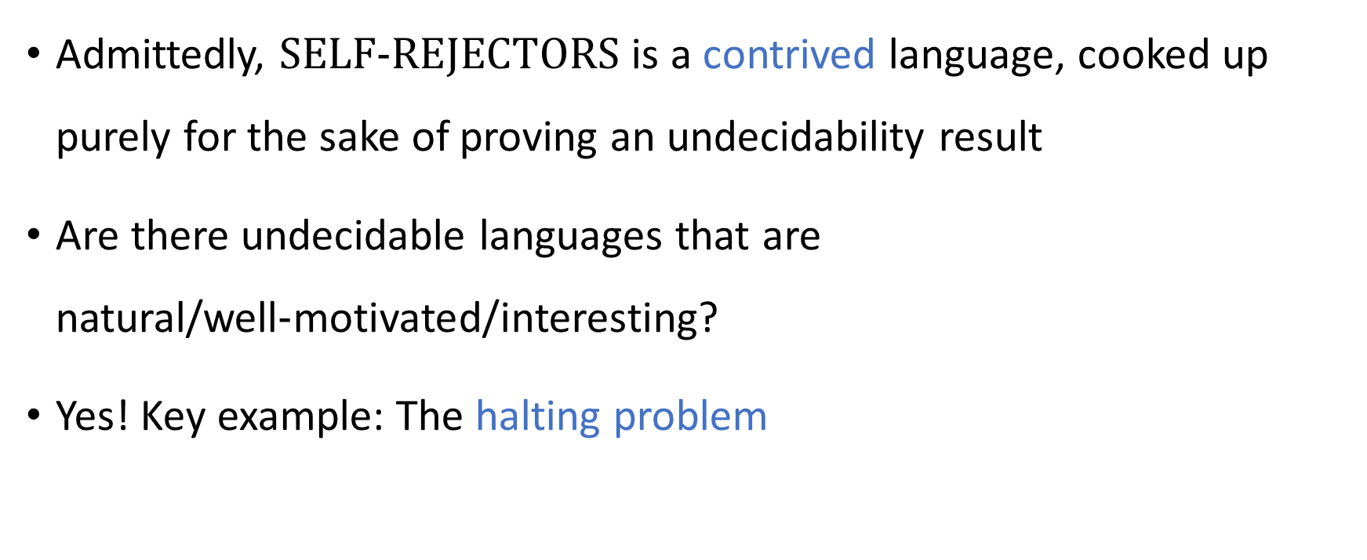
Contrived vs. natural
Admittedly, $\text{SELF}‑\text{REJECTORS}$ is a contrived language, cooked up purely for the sake of proving an undecidability result
Are there undecidable languages that are natural/well‑motivated/interesting?
Yes! Key example: The halting problem

Slide 9
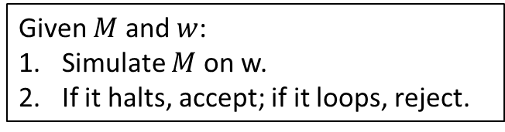

The halting problem
Here is an attempt at designing an algorithm that solves the halting problem:
Given $M$ and $w$:
Simulate $M$ on w.
If it halts, accept; if it loops, reject.
Problem: Given a Turing machine $M$ and an input $w$, determine whether $M$ halts on $w$.
Roughly speaking, this is the problem of identifying bugs in someone else’s code! 🐞
Does the proposed algorithm work?
A: No. Step 1 isn’t legal, so the algorithm isn’t well-defined
B: No. Step 2 isn’t legal, so the algorithm isn’t well-defined
C: Yes
D: No. The algorithm behaves incorrectly in some cases
Respond at PollEv.com/whoza or text “whoza” to 22333

Slide 10

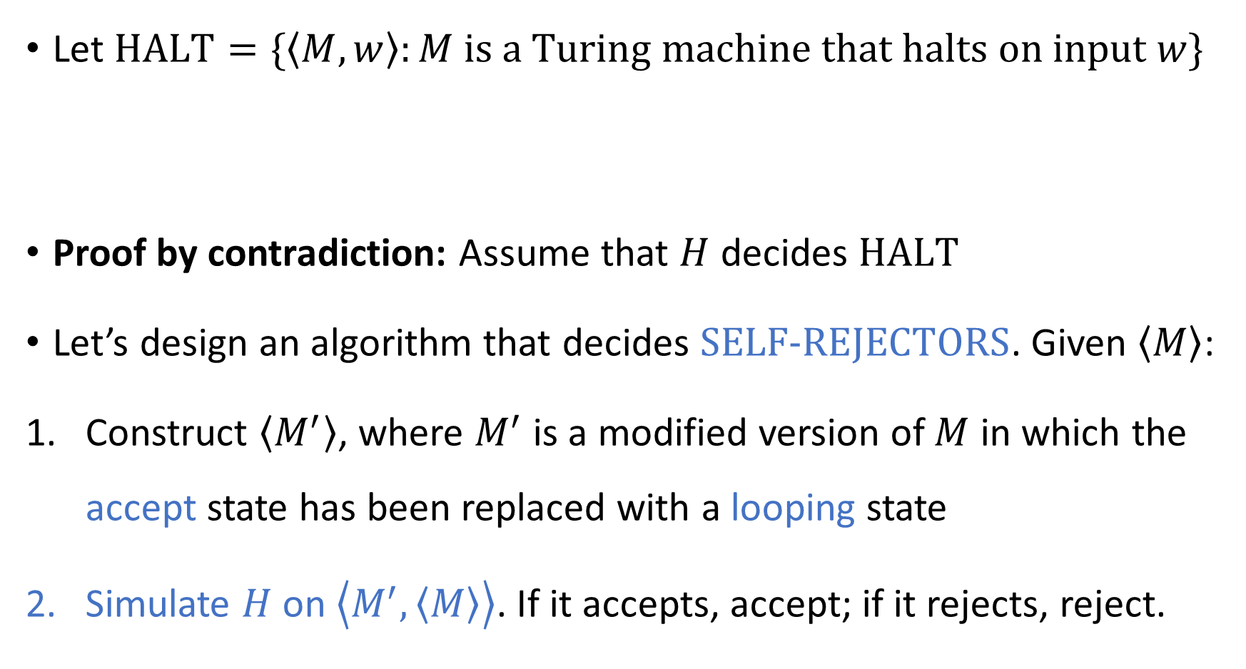
The halting problem is undecidable
Let $\text{HALT}=\{\left\langle M,w\right\rangle :M \text{is} \text{a} \text{Turing} \text{machine} \text{that} \text{halts} \text{on} \text{input} w\}$
Proof by contradiction: Assume that $H$ decides $\text{HALT}$
Let’s design an algorithm that decides $\text{SELF}‑\text{REJECTORS}$. Given $\left\langle M\right\rangle$:
Construct $\left\langle M^{′}\right\rangle$, where $M^{′}$ is a modified version of $M$ in which the accept state has been replaced with a looping state
Simulate $H$ on $\left\langle M^{′},\left\langle M\right\rangle \right\rangle$. If it accepts, accept; if it rejects, reject.
Theorem: $\text{HALT}$ is undecidable.

Slide 11
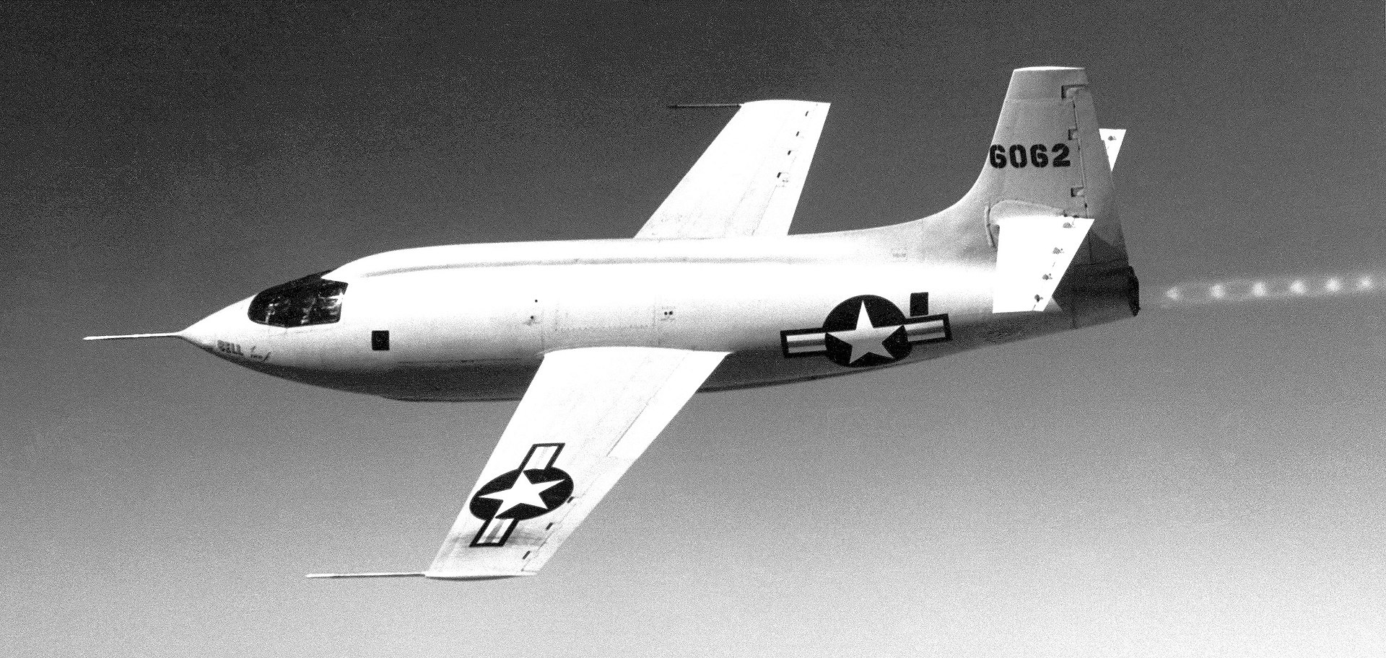
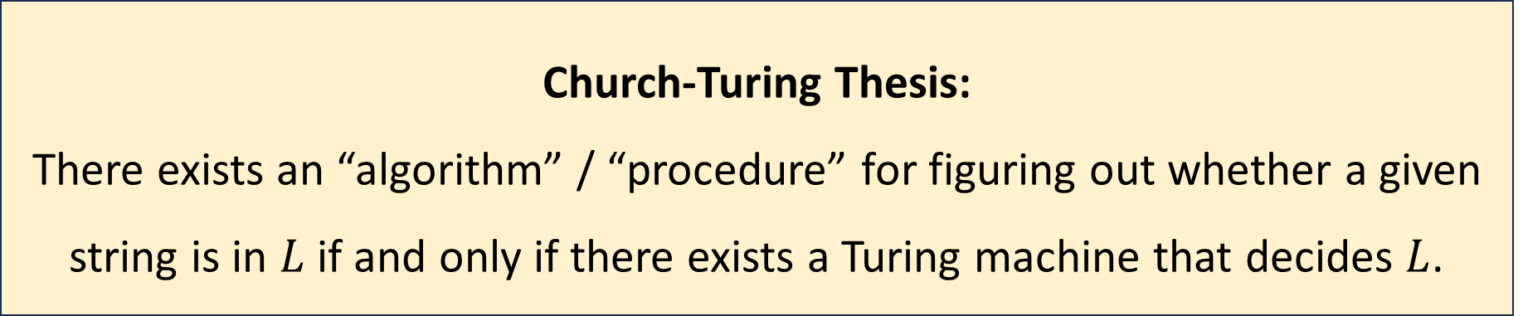

The Church-Turing thesis, revisited
Let $L$ be a language
Computation is an intuitive notion rooted in everyday human experience
Could it be possible to solve the halting problem using science and technology?
Church-Turing Thesis:
There exists an “algorithm” / “procedure” for figuring out whether a given string is in $L$ if and only if there exists a Turing machine that decides $L$.

Slide 12
Hypercomputers
A hypercomputer is a hypothetical device that can solve some computational problem that cannot be solved by Turing machines, such as the halting problem
Could it be possible that there are hypercomputers at the centers of stars? Inside black holes?
Could it be possible to build a hypercomputer?

Slide 13
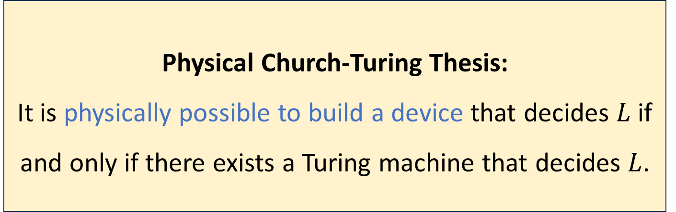
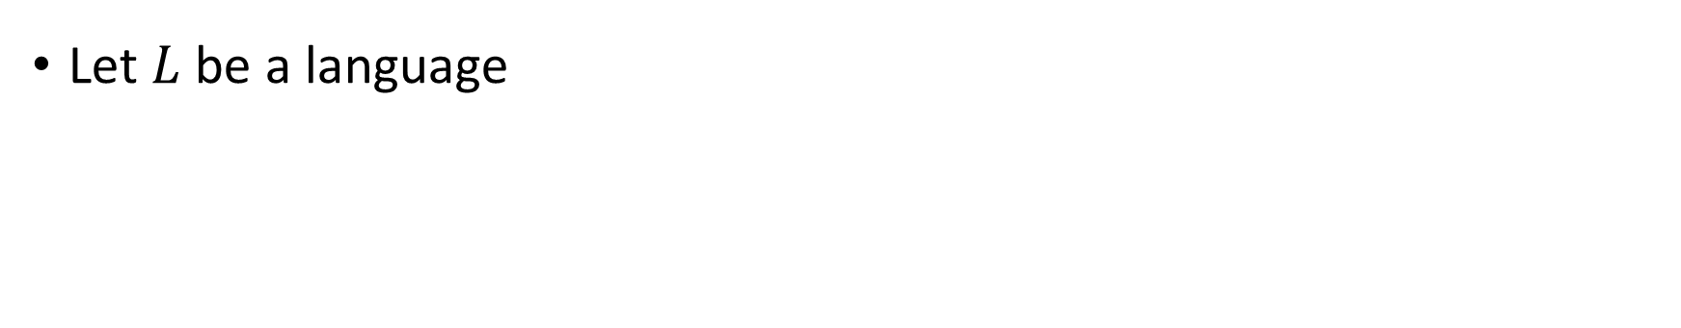
The Physical Church-Turing Thesis
Let $L$ be a language
Physical Church-Turing Thesis:
It is physically possible to build a device that decides $L$ if and only if there exists a Turing machine that decides $L$.

Slide 14
The Physical Church-Turing Thesis
The standard Church-Turing thesis is a philosophical statement
The Physical Church-Turing thesis is a scientific law
Conceivably, it could be disproven by future discoveries… but that would be very surprising
Analogy: Second Law of Thermodynamics
Analogy: Cannot travel faster than the speed of light

Slide 15

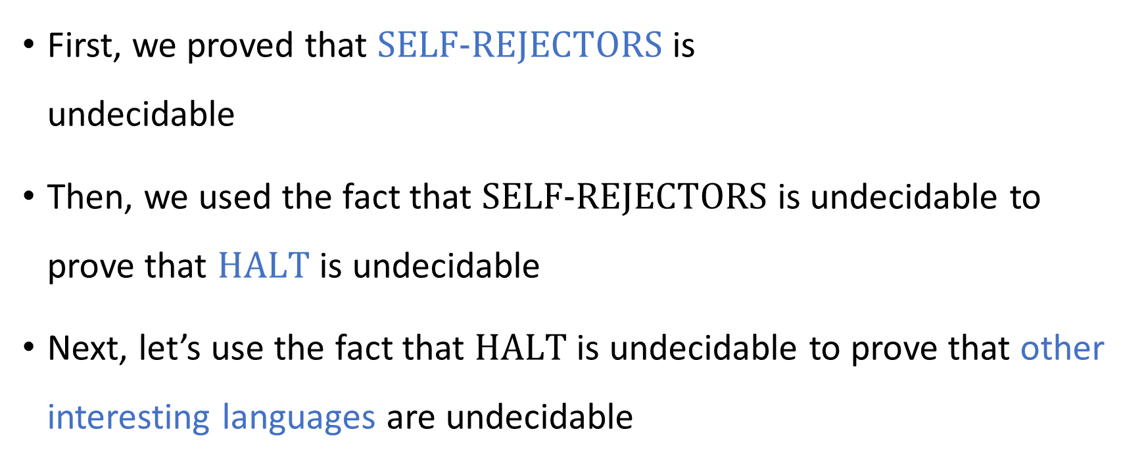
Undecidability
First, we proved that $\text{SELF}‑\text{REJECTORS}$ is undecidable
Then, we used the fact that $\text{SELF}‑\text{REJECTORS}$ is undecidable to prove that $\text{HALT}$ is undecidable
Next, let’s use the fact that $\text{HALT}$ is undecidable to prove that other interesting languages are undecidable

Slide 16

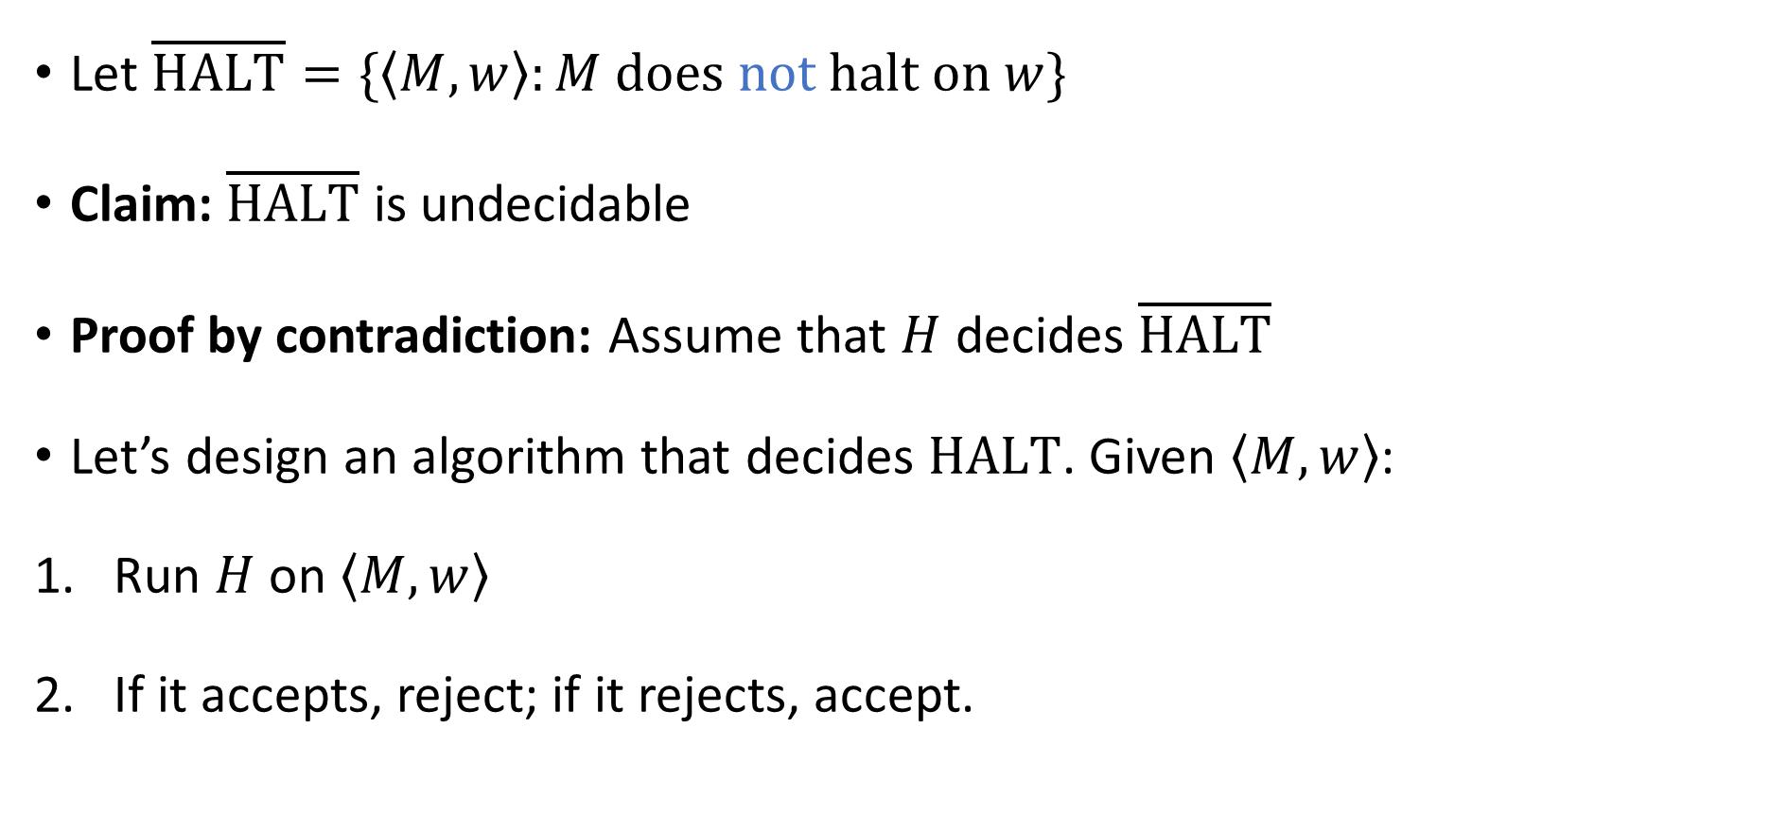
Complement of the halting problem
Let $\overline{\text{HALT}}=\{\left\langle M,w\right\rangle :M \text{does} \text{not} \text{halt} \text{on} w\}$
Claim: $\overline{\text{HALT}}$ is undecidable
Proof by contradiction: Assume that $H$ decides $\overline{\text{HALT}}$
Let’s design an algorithm that decides $\text{HALT}$. Given $\left\langle M,w\right\rangle$:
Run $H$ on $\left\langle M,w\right\rangle$
If it accepts, reject; if it rejects, accept.
Technicality: The first step of our algorithm should be to confirm that the input is “valid,” i.e., confirm that the input has the form $\left\langle M,w\right\rangle$ for some Turing machine $M$ and some input $w$ to $M$

Slide 17
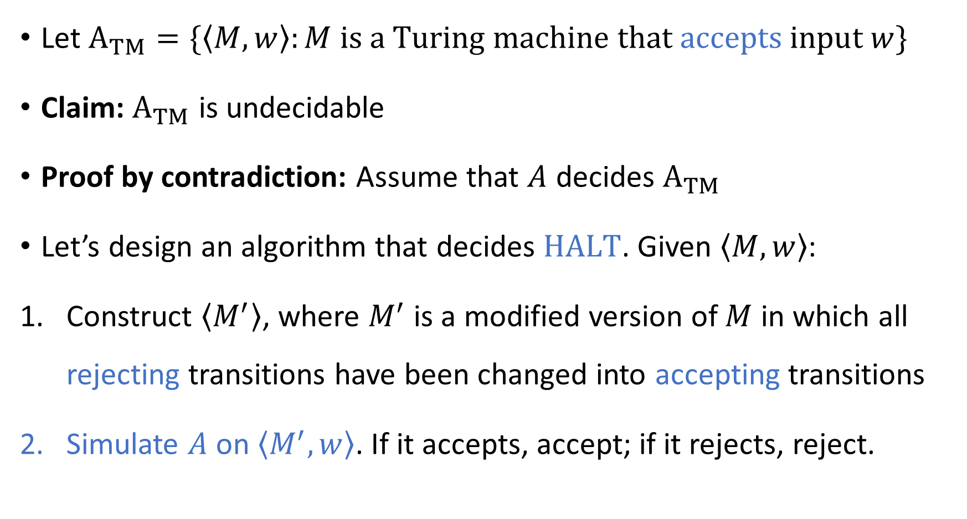
The “acceptance problem”
Let ${\text{A}}_{TM}=\{\left\langle M,w\right\rangle :M \text{is} \text{a} \text{Turing} \text{machine} \text{that} \text{accepts} \text{input} w\}$
Claim: ${\text{A}}_{TM}$ is undecidable
Proof by contradiction: Assume that $A$ decides ${\text{A}}_{TM}$
Let’s design an algorithm that decides $\text{HALT}$. Given $\left\langle M,w\right\rangle$:
Construct $\left\langle M^{′}\right\rangle$, where $M^{′}$ is a modified version of $M$ in which all rejecting transitions have been changed into accepting transitions
Simulate $A$ on $\left\langle M^{′},w\right\rangle$. If it accepts, accept; if it rejects, reject.

