Slide 1
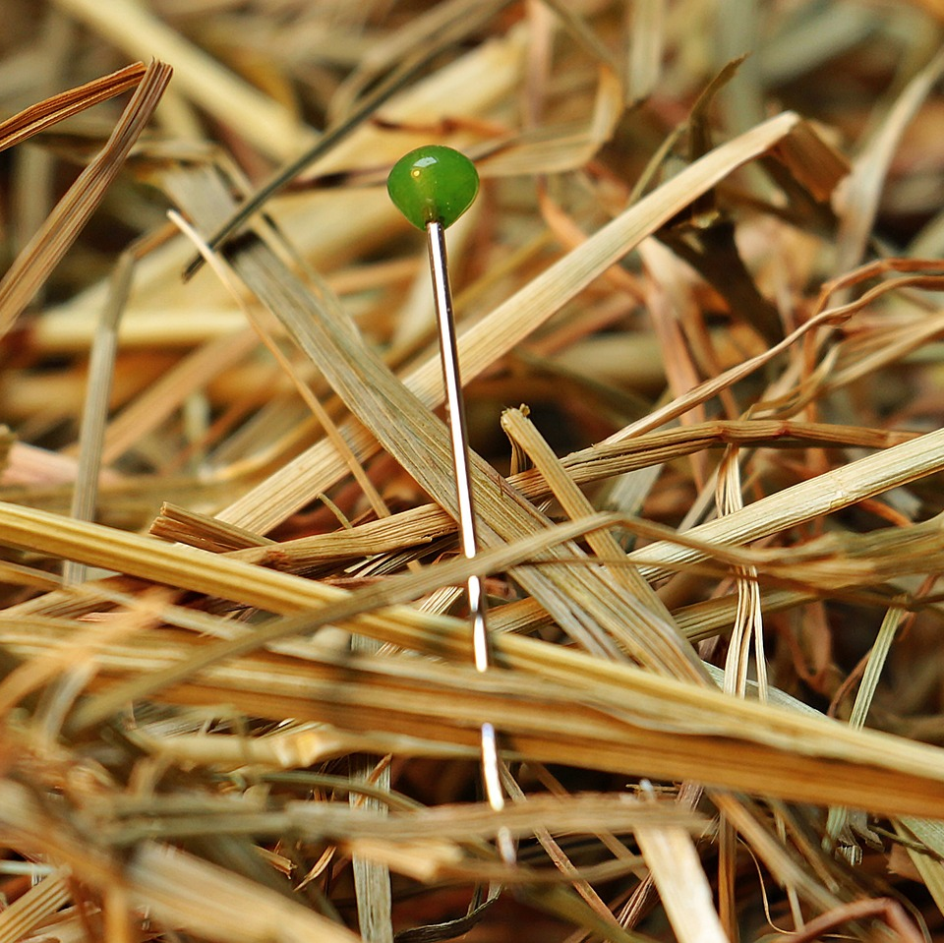
CMSC 28100 Introduction to Complexity Theory Spring 2024 Instructor: William Hoza

Slide 2
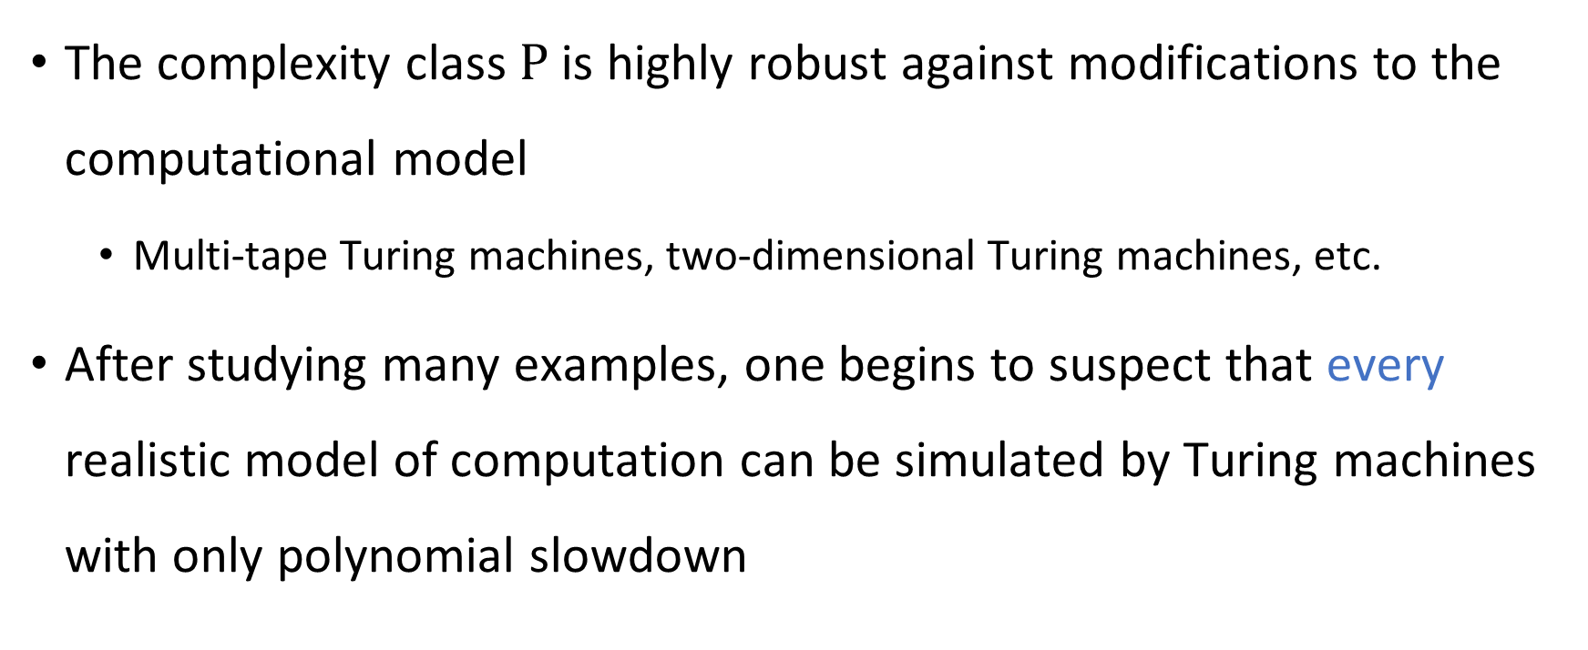

Robustness of $\text{P}$
The complexity class $\text{P}$ is highly robust against modifications to the computational model
Multi-tape Turing machines, two-dimensional Turing machines, etc.
After studying many examples, one begins to suspect that every realistic model of computation can be simulated by Turing machines with only polynomial slowdown

Slide 3
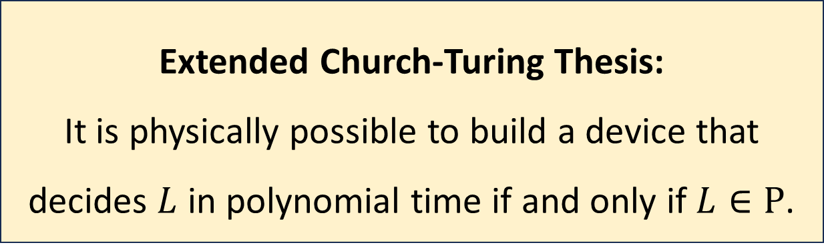

Extended Church-Turing Thesis
Let $L$ be a language
Extended Church-Turing Thesis:
It is physically possible to build a device that decides $L$ in polynomial time if and only if $L∈\text{P}$.

Slide 4
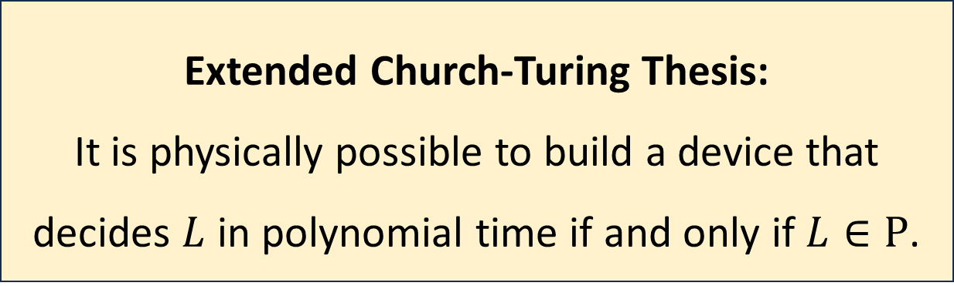
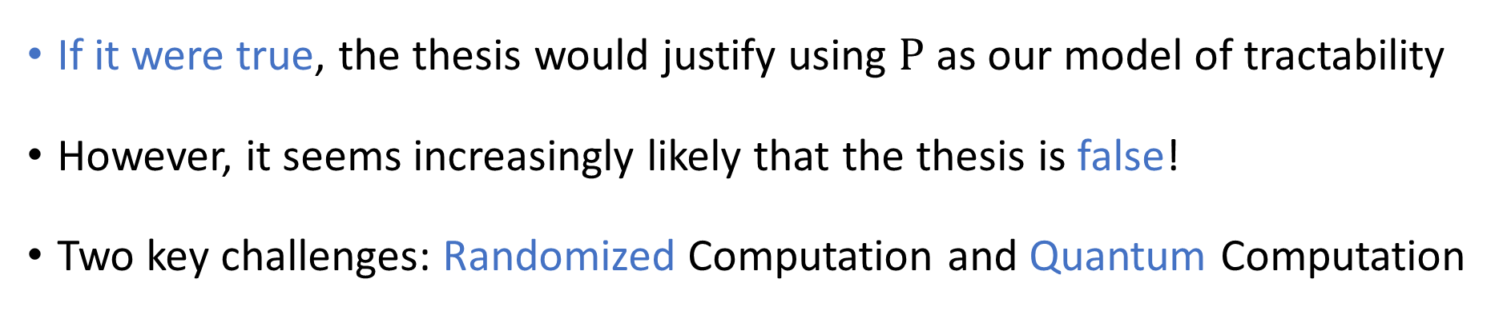
Extended Church-Turing Thesis
Extended Church-Turing Thesis:
It is physically possible to build a device that decides $L$ in polynomial time if and only if $L∈\text{P}$.
If it were true, the thesis would justify using $\text{P}$ as our model of tractability
However, it seems increasingly likely that the thesis is false!
Two key challenges: Randomized Computation and Quantum Computation

Slide 5
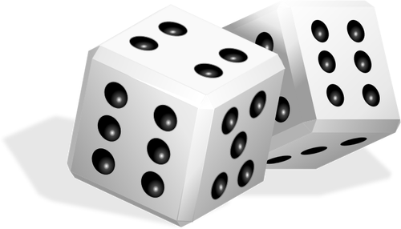
Randomized computation
Sometimes, in our efforts to solve problems and figure things out, we want to make random choices
Random sampling for opinion polls
Randomized controlled trials in science/medicine
What happens if we incorporate this ability into our computational model?

Slide 6
Randomized computation
To properly study the role of randomness in computing, we ought to define and study a randomized variant of the Turing machine model
However, let’s temporarily set Turing machines aside – we will circle back to them later
To build intuition, let’s study the role of randomness in a different situation first

Slide 7
Communication Complexity

Slide 8

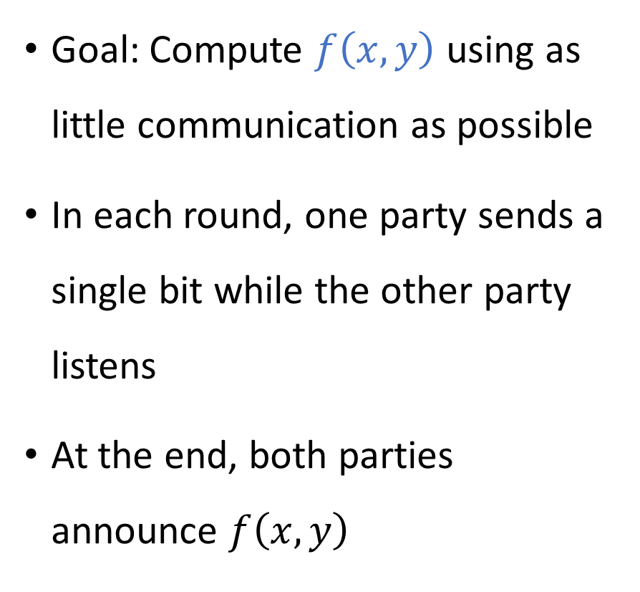


Communication complexity
Goal: Compute $f\left(x, y\right)$ using as little communication as possible
In each round, one party sends a single bit while the other party listens
At the end, both parties announce $f\left(x, y\right)$
Communication channel
Alice holds $x$
Bob holds $y$

Slide 9
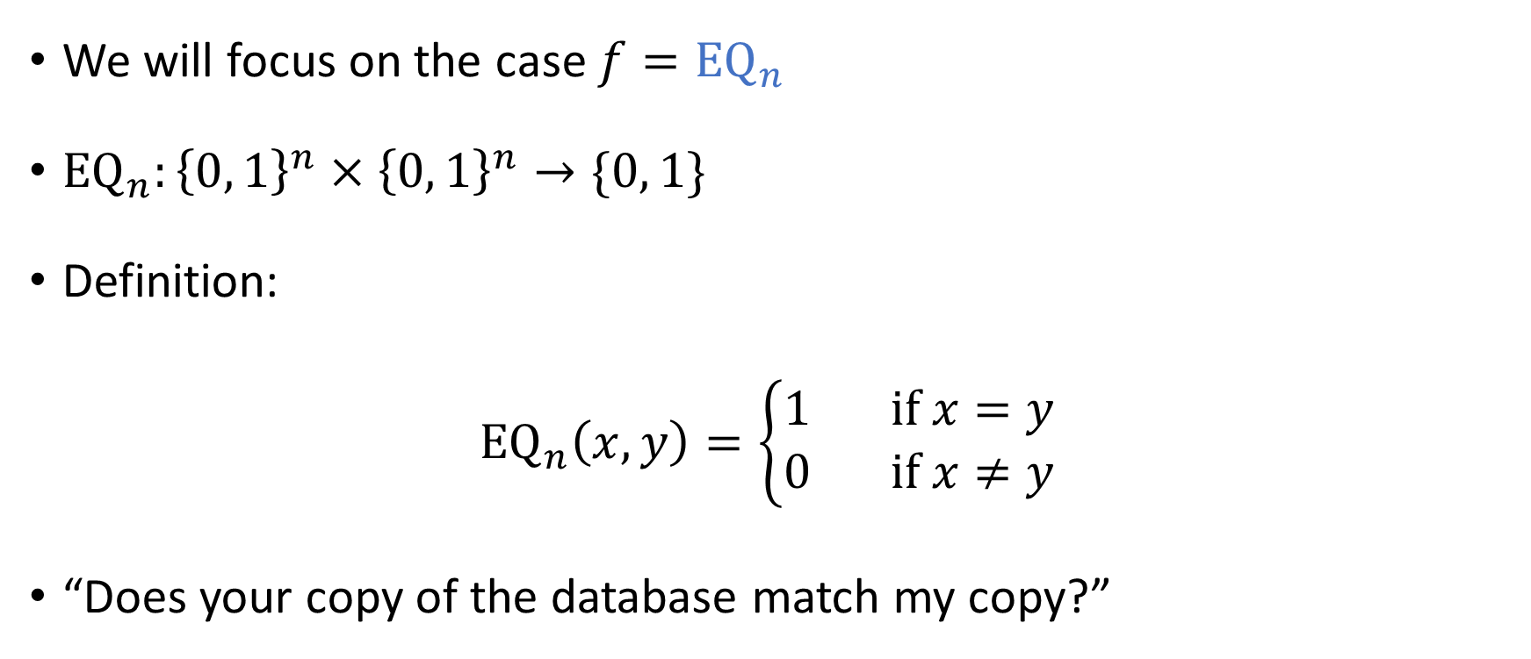
The equality function
We will focus on the case $f={\text{EQ}}_{n}$
${\text{EQ}}_{n}:{\left\{0, 1\right\}}^{n}×{\left\{0, 1\right\}}^{n}→\{0, 1\}$
Definition:
$${\text{EQ}}_{n}\left(x, y\right)=\left\{\begin{aligned}1 \text{if} x=y \\ 0 \text{if} x≠y\end{aligned}\right.$$
“Does your copy of the database match my copy?”

Slide 10
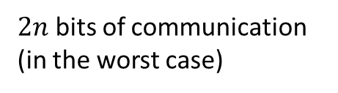


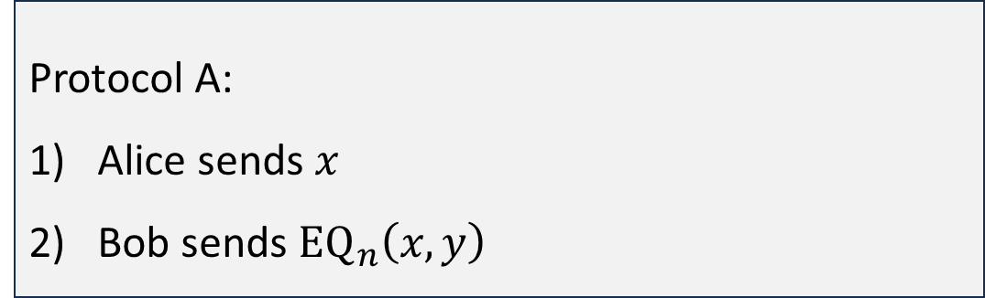
Protocols for equality
Protocol A:
Alice sends $x$
Bob sends ${\text{EQ}}_{n}\left(x, y\right)$
$n+1$ bits of communication
Protocol B:
For $i=1$ to $n$:
Alice sends $x_{i}$
Bob sends a bit indicating whether $x_{i}=y_{i}$
$2n$ bits of communication (in the worst case)

Slide 11
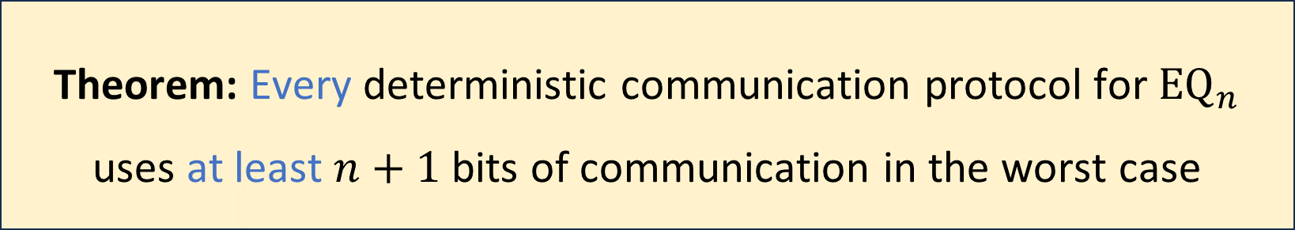
Communication complexity of equality
Is there a better protocol?
Before we can prove it, we must clarify how we model communication protocols mathematically
Theorem: Every deterministic communication protocol for ${\text{EQ}}_{n}$ uses at least $n+1$ bits of communication in the worst case

Slide 12
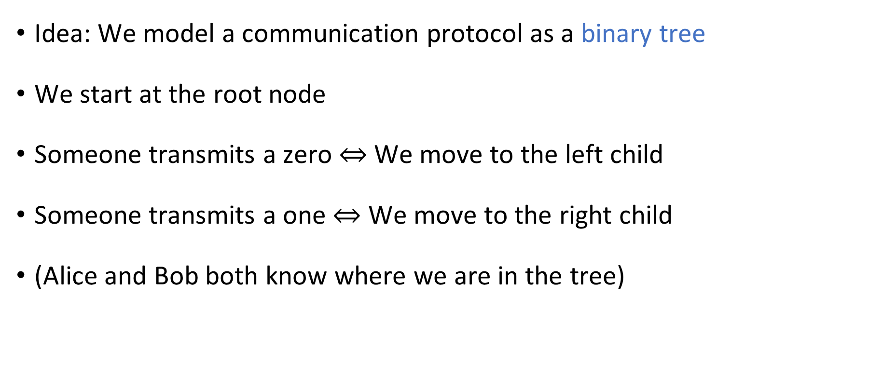
Communication protocol model
Idea: We model a communication protocol as a binary tree
We start at the root node
Someone transmits a zero $⇔$ We move to the left child
Someone transmits a one $⇔$ We move to the right child
(Alice and Bob both know where we are in the tree)

Slide 13

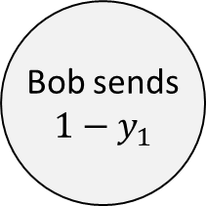

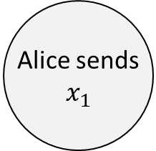

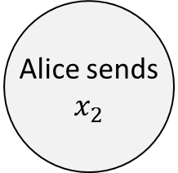

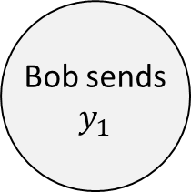

Example protocol tree
Alice sends $$x_{1}$$
0
1
Bob sends $$1−y_{1}$$
Bob sends
$$y_{1}$$
0
1
0
1
Reject
Alice sends $$x_{2}$$
Reject
Alice sends $$x_{2}$$
$$⋮$$
$$⋮$$
$$⋮$$
$$⋮$$

Slide 14
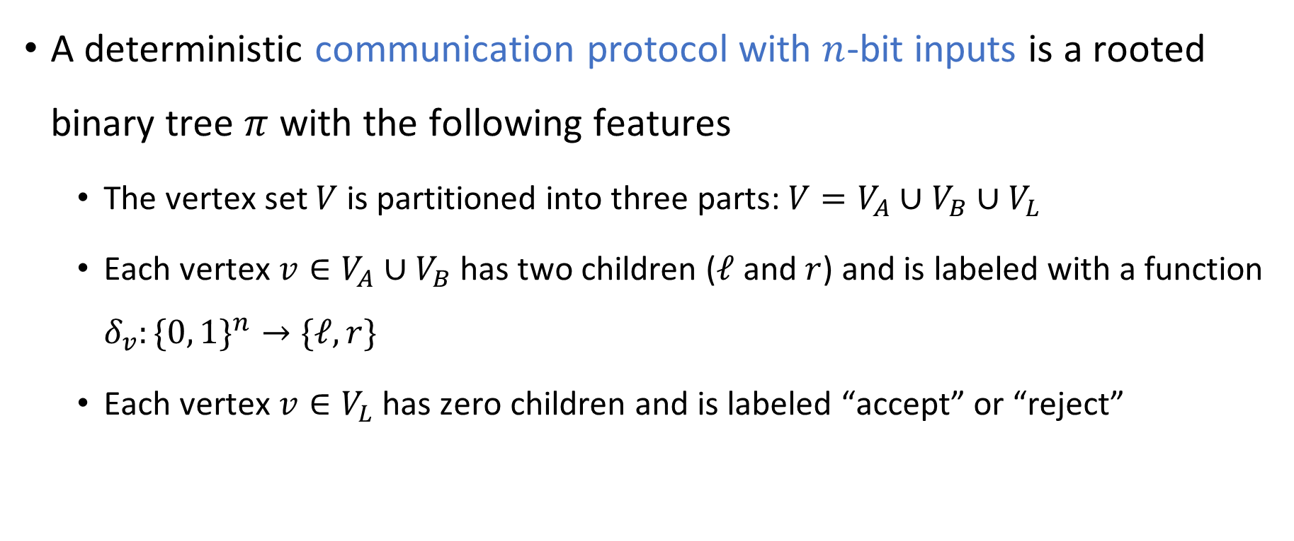
Rigorously defining communication protocols
A deterministic communication protocol with $n$-bit inputs is a rooted binary tree $π$ with the following features
The vertex set $V$ is partitioned into three parts: $V=V_{A}∪V_{B}∪V_{L}$
Each vertex $v∈V_{A}∪V_{B}$ has two children ($ℓ$ and $r$) and is labeled with a function $δ_{v}:\{0, 1\}^{n}→\text{\{}ℓ, r\}$
Each vertex $v∈V_{L}$ has zero children and is labeled “accept” or “reject”

Slide 15
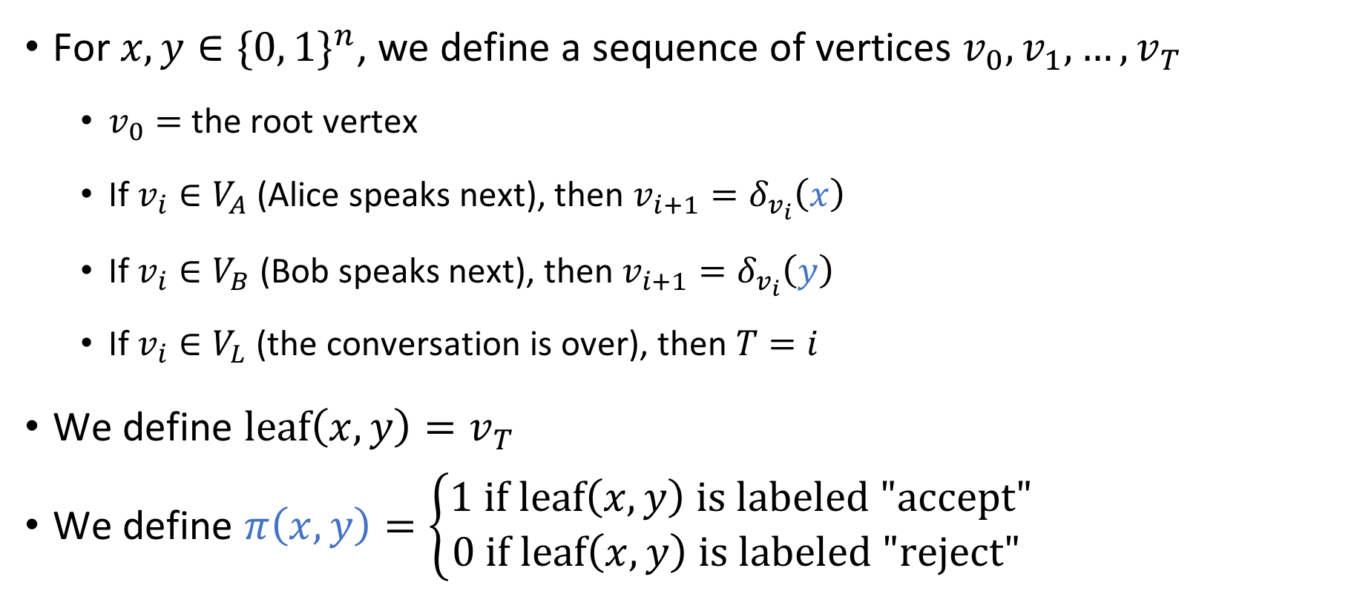
Rigorously defining communication protocols
For $x, y∈\{0, 1\}^{n}$, we define a sequence of vertices $v_{0},v_{1},…, v_{T}$
$v_{0}=$ the root vertex
If $v_{i}∈V_{A}$ (Alice speaks next), then $v_{i+1}=δ_{v_{i}}\left(x\right)$
If $v_{i}∈V_{B}$ (Bob speaks next), then $v_{i+1}=δ_{v_{i}}\left(y\right)$
If $v_{i}∈V_{L}$ (the conversation is over), then $T=i$
We define $\text{leaf}\left(x, y\right)=v_{T}$
We define $π\left(x,y\right)=\left\{\begin{aligned}1 \text{if} \text{leaf}\left(x,y\right) \text{is} \text{labeled}\text{ "}\text{accept}\text{"} \\ 0 \text{if} \text{leaf}\left(x,y\right) \text{is} \text{labeled}\text{ "}\text{reject}\text{"} \end{aligned}\right.$

Slide 16

Communication complexity
We say that $π$ computes $f$ if for every $x, y∈\{0, 1\}^{n}$, we have
$$π\left(x,y\right)=f\left(x,y\right)$$
The cost of the communication protocol $π$ is the depth of the tree, i.e., the length of the longest path from the root to the leaf
(Cost = number of rounds = number of bits of communication)
In this model, what happens if Alice and Bob speak at the same time?
A: Trick question. In this model, they never speak simultaneously
B: Only one of the messages is successfully transmitted
C: Both of the messages are successfully transmitted
D: Neither message is successfully transmitted
Respond at PollEv.com/whoza or text “whoza” to 22333

Slide 17
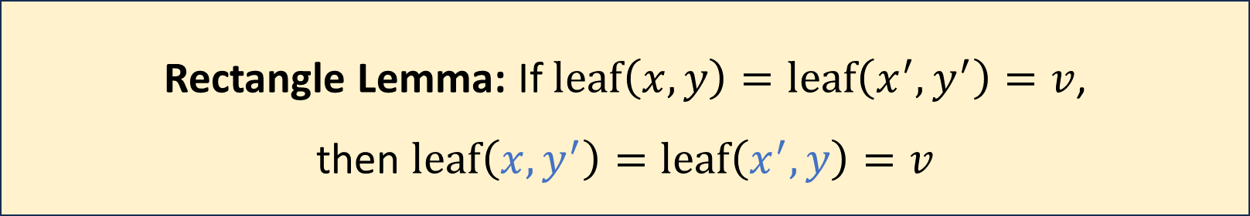

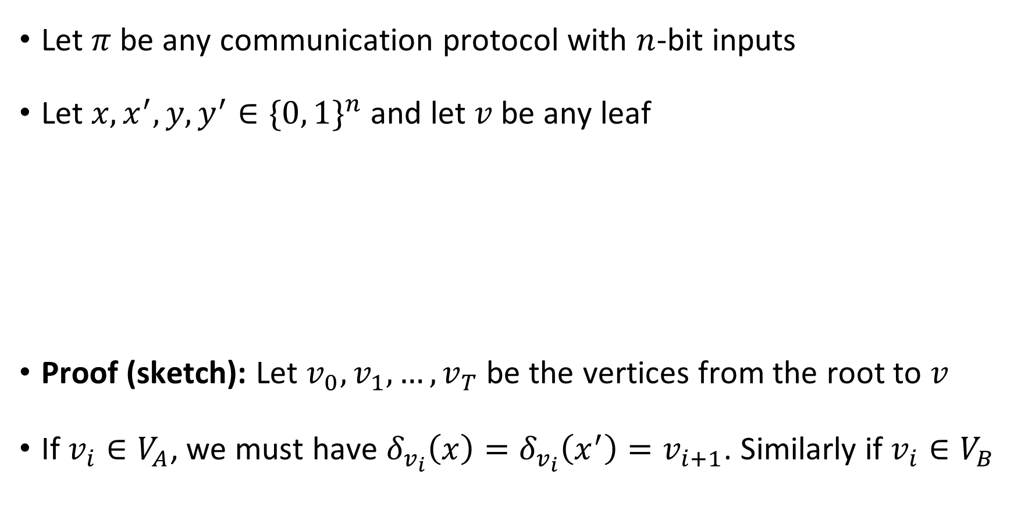



Rectangle lemma
$$\left(x, y\right)$$
$$\left(x′, y\right)$$
Let $π$ be any communication protocol with $n$-bit inputs
Let $x, x^{′}, y, y^{′}∈\{0, 1\}^{n}$ and let $v$ be any leaf
Proof (sketch): Let $v_{0},v_{1},…, v_{T}$ be the vertices from the root to $v$
If $v_{i}∈V_{A}$, we must have $δ_{v_{i}}\left(x\right)=δ_{v_{i}}\left(x^{′}\right)=v_{i+1}$. Similarly if $v_{i}∈V_{B}$
$$\left(x, y′\right)$$
$$\left(x′, y′\right)$$
Rectangle Lemma: If $\text{leaf}\left(x, y\right)=\text{leaf}\left(x^{′},y^{′}\right)=v$, then $\text{leaf}\left(x,y^{′}\right)=\text{leaf}\left(x^{′},y\right)=v$

Slide 18
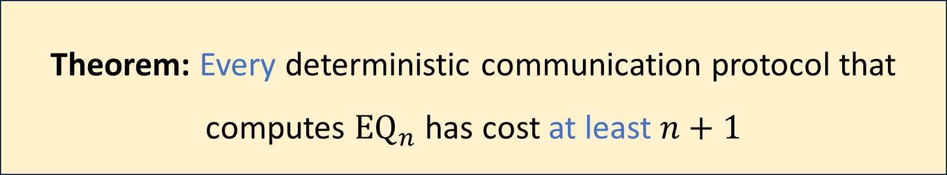
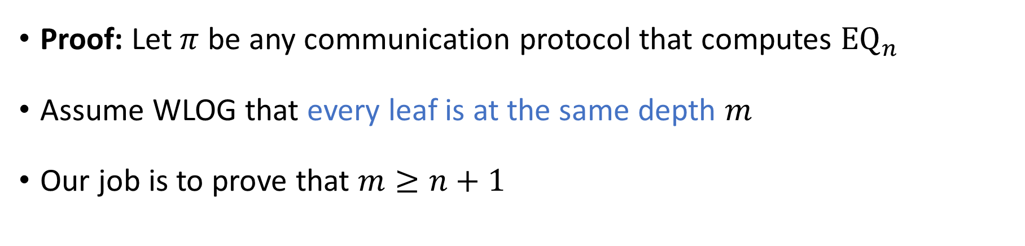
Communication complexity of equality
Theorem: Every deterministic communication protocol that computes ${\text{EQ}}_{n}$ has cost at least $n+1$
Proof: Let $π$ be any communication protocol that computes ${\text{EQ}}_{n}$
Assume WLOG that every leaf is at the same depth $m$
Our job is to prove that $m≥n+1$

Slide 19
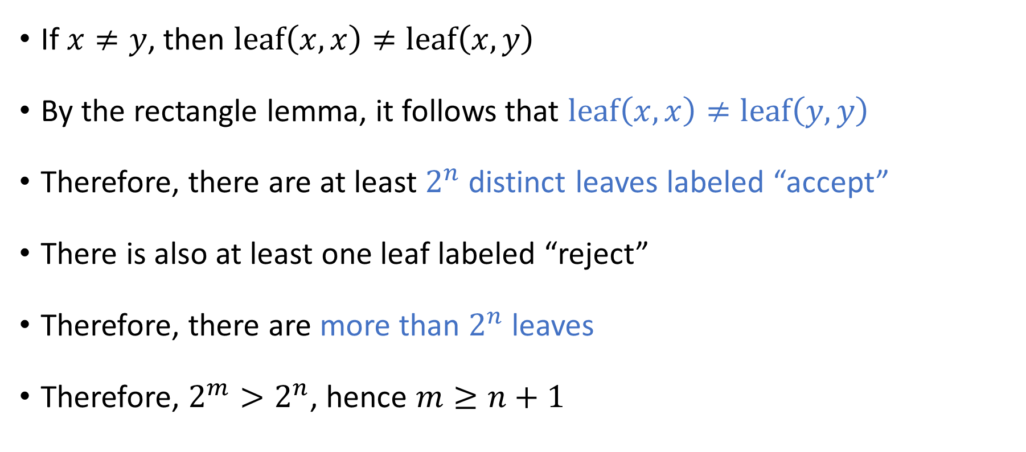





Communication complexity of ${\text{EQ}}_{n}$
$$\left(x, x\right)$$
$$\left(x, y\right)$$
$$\left(y, x\right)$$
$$\left(y, y\right)$$
If $x≠y$, then $\text{leaf}\left(x,x\right)≠\text{leaf}\left(x,y\right)$
By the rectangle lemma, it follows that $\text{leaf}\left(x,x\right)≠\text{leaf}\left(y,y\right)$
Therefore, there are at least $2^{n}$ distinct leaves labeled “accept”
There is also at least one leaf labeled “reject”
Therefore, there are more than $2^{n}$ leaves
Therefore, $2^{m}>2^{n}$, hence $m≥n+1$

Slide 20
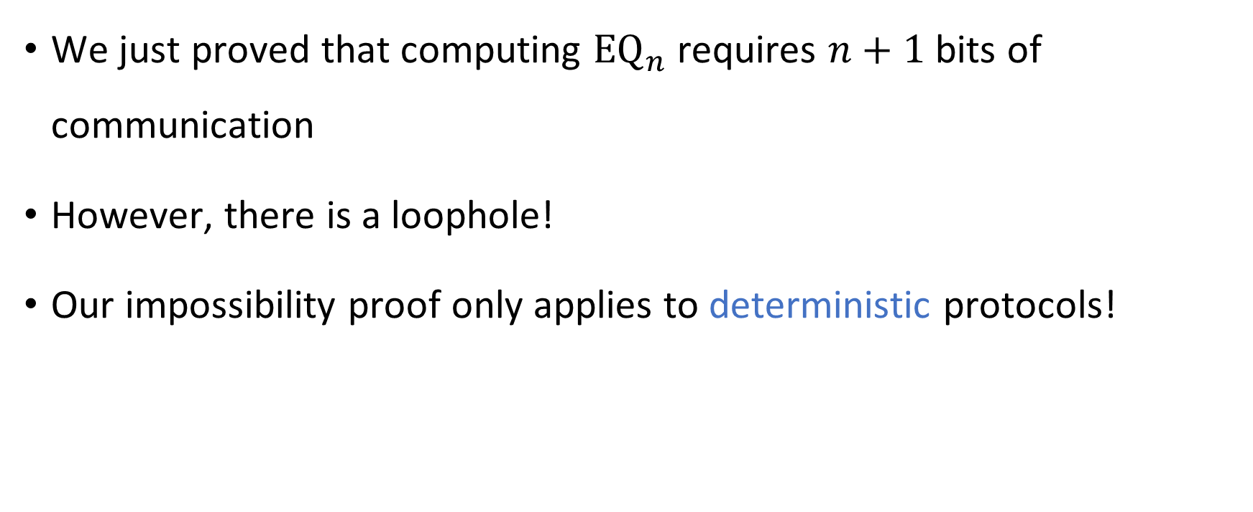

Communication complexity of ${\text{EQ}}_{n}$
We just proved that computing ${\text{EQ}}_{n}$ requires $n+1$ bits of communication
However, there is a loophole!
Our impossibility proof only applies to deterministic protocols!

Slide 21


Randomized communication complexity
In a randomized communication protocol, Alice and Bob are permitted to make decisions based on coin tosses
Communication channel
Alice holds $x$
Bob holds $y$

Slide 22
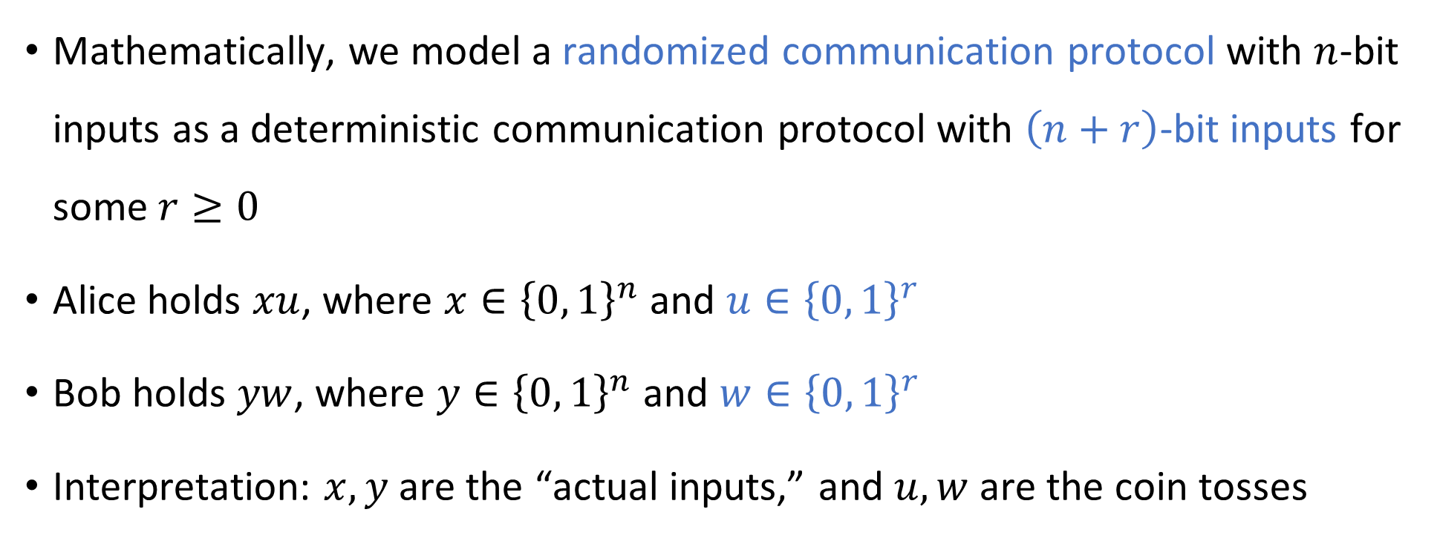
Randomized communication protocols
Mathematically, we model a randomized communication protocol with $n$-bit inputs as a deterministic communication protocol with $\left(n+r\right)$-bit inputs for some $r≥0$
Alice holds $xu$, where $x∈{\left\{0, 1\right\}}^{n}$ and $u∈{\left\{0, 1\right\}}^{r}$
Bob holds $yw$, where $y∈{\left\{0, 1\right\}}^{n}$ and $w∈{\left\{0, 1\right\}}^{r}$
Interpretation: $x, y$ are the “actual inputs,” and $u, w$ are the coin tosses

