Slide 1
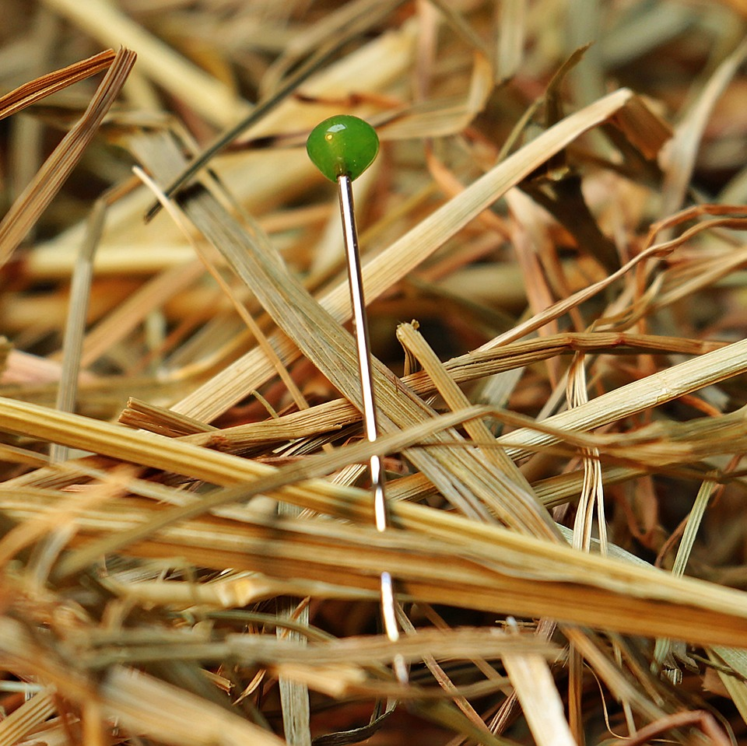
CMSC 28100 Introduction to Complexity Theory Spring 2025 Instructor: William Hoza

Slide 2












Post’s Correspondence Problem
Given: a set of “dominos”
Goal: Determine whether it is possible to generate a “match”
in which the sequence of symbols on top equals the sequence of symbols on the bottom
Using the same domino multiple times is permitted
$$\begin{matrix}t_{1} \\ b_{1}\end{matrix}$$
$$\begin{matrix}t_{2} \\ b_{2}\end{matrix}$$
$$\begin{matrix}t_{3} \\ b_{3}\end{matrix}$$
$$\begin{matrix}t_{k} \\ b_{k}\end{matrix}$$
$$⋯$$
$$\begin{matrix}t_{i_{1}} \\ b_{i_{1}}\end{matrix}$$
$$\begin{matrix}t_{i_{2}} \\ b_{i_{2}}\end{matrix}$$
$$\begin{matrix}t_{i_{3}} \\ b_{i_{3}}\end{matrix}$$
$$\begin{matrix}t_{i_{4}} \\ b_{i_{4}}\end{matrix}$$
$$\begin{matrix}t_{i_{5}} \\ b_{i_{5}}\end{matrix}$$
$$\begin{matrix}t_{i_{n}} \\ b_{i_{n}}\end{matrix}$$
$$⋯$$

Slide 3

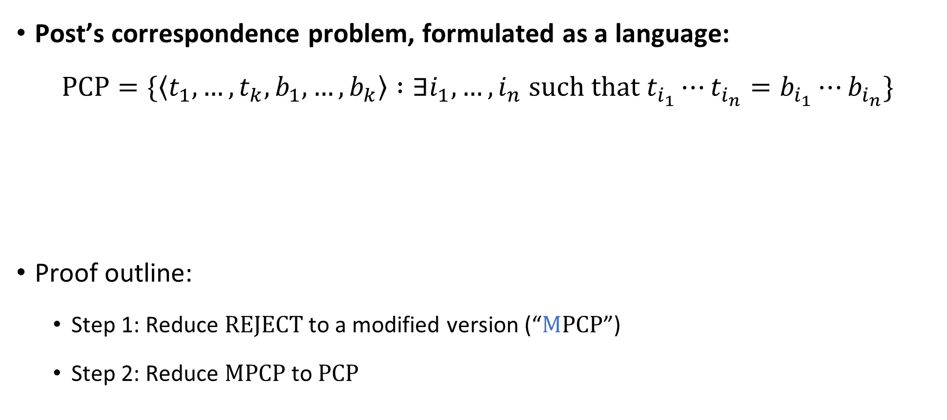
Post’s Correspondence Problem is undecidable
Post’s correspondence problem, formulated as a language:
$$\text{PCP}=\{\left\langle t_{1},…, t_{k}, b_{1},…, b_{k}\right\rangle :∃i_{1},…, i_{n} \text{such} \text{that} t_{i_{1}}⋯t_{i_{n}}=b_{i_{1}}⋯b_{i_{n}}\}$$
Proof outline:
Step 1: Reduce $\text{REJECT}$ to a modified version (“$\text{M}\text{PCP}$”)
Step 2: Reduce $\text{MPCP}$ to $\text{PCP}$
Theorem: $\text{PCP}$ is undecidable

Slide 4

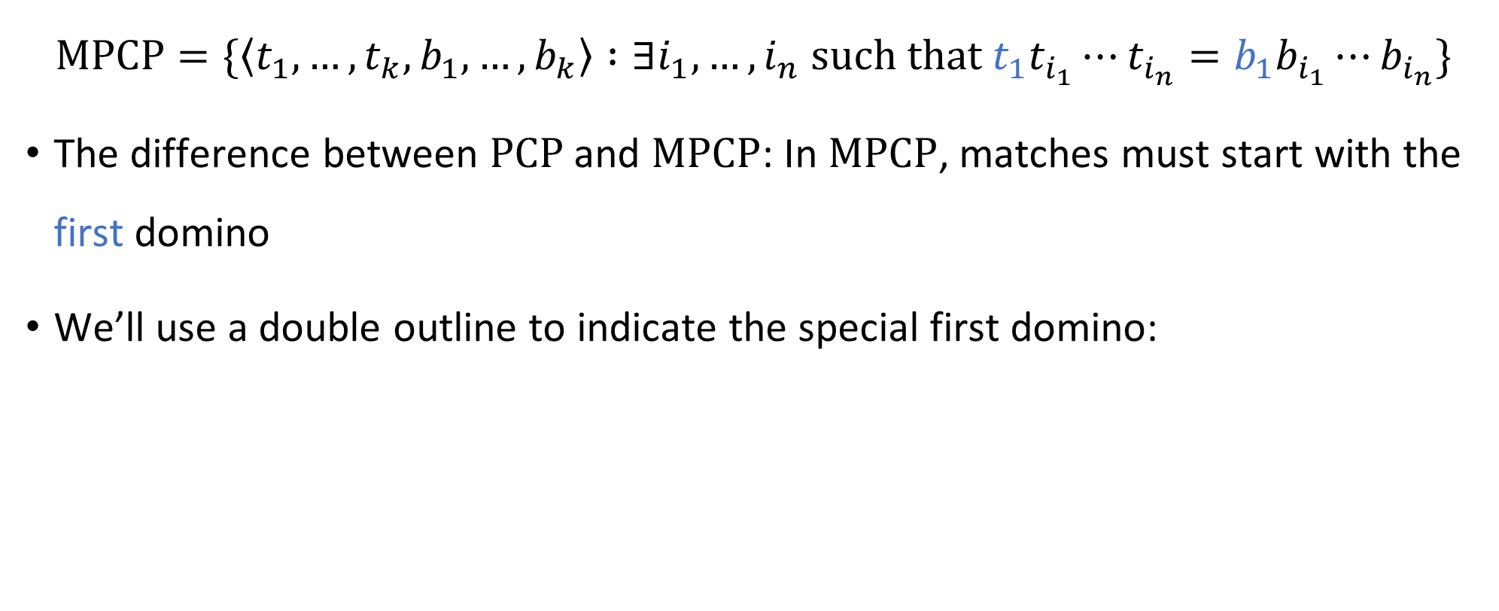

Modified PCP
$$\text{MPCP}=\{\left\langle t_{1},…, t_{k}, b_{1},…, b_{k}\right\rangle :∃i_{1},…, i_{n} \text{such} \text{that} t_{1}t_{i_{1}}⋯t_{i_{n}}=b_{1}b_{i_{1}}⋯b_{i_{n}}\}$$
The difference between $\text{PCP}$ and $\text{MPCP}$: In $\text{MPCP}$, matches must start with the first domino
We’ll use a double outline to indicate the special first domino:
$$\begin{matrix}t_{1} \\ b_{1}\end{matrix}$$
Lemma: $M\text{PCP}$ is undecidable

Slide 5






Proof that $\text{MPCP}$ is undecidable
Assume there is a TM $P$ that decides $\text{MPCP}$
Let’s construct a new TM $R$ that decides $\text{REJECT}$
Given $\left\langle M,w\right\rangle$:
Construct dominos $t_{1},…, t_{k},b_{1},…b_{k}$ based on $M$ and $w$ (details on next slide)
Simulate $P$ on $\left\langle t_{1},…, t_{k},b_{1},…, b_{k}\right\rangle$
If $P$ accepts, accept. If $P$ rejects, reject.
$$R$$

Slide 6


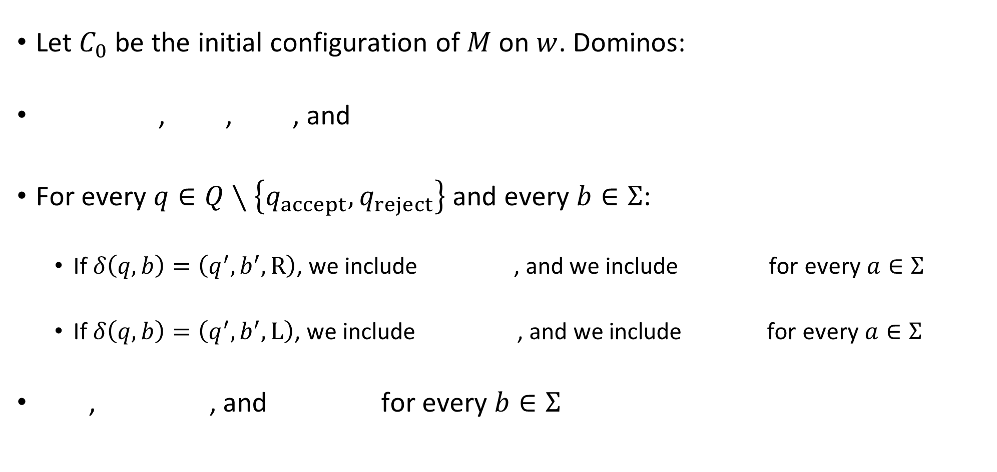
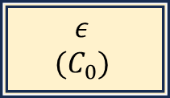









Reducing $\text{REJECT}$ to $\text{MPCP}$
Let $C_{0}$ be the initial configuration of $M$ on $w$. Dominos:
, , , and
For every $q∈Q∖\left\{q_{accept},q_{reject}\right\}$ and every $b∈Σ$:
If $δ\left(q,b\right)=\left(q^{′},b^{′},\text{R}\right)$, we include , and we include for every $a∈Σ$
If $δ\left(q,b\right)=\left(q^{′},b^{′},\text{L}\right)$, we include , and we include for every $a∈Σ$
, , and for every $b∈Σ$
$$\begin{matrix}ε \\ (C_{0})\end{matrix}$$
$$\begin{matrix}( \\ (\end{matrix}$$
$$\begin{matrix}) \\ )\end{matrix}$$
$$\begin{matrix}(q_{reject}) \\ ε\end{matrix}$$
$$\begin{matrix}qb) \\ b^{′}q^{′}⊔)\end{matrix}$$
$$\begin{matrix}qba \\ b^{′}q^{′}a\end{matrix}$$
$$\begin{matrix}(qb \\ (q^{′}⊔b′\end{matrix}$$
$$\begin{matrix}aqb \\ q^{′}ab′\end{matrix}$$
$$\begin{matrix}b \\ b\end{matrix}$$
$$\begin{matrix}bq_{reject} \\ q_{reject}\end{matrix}$$
$$\begin{matrix}q_{reject}b \\ q_{reject}\end{matrix}$$

Slide 7


Proof that $\text{MPCP}$ is undecidable
Assume there is a TM $P$ that decides $\text{MPCP}$
Let’s construct a new TM $R$ that decides $\text{REJECT}$
Given $\left\langle M,w\right\rangle$:
Construct dominos $t_{1},…, t_{k},b_{1},…b_{k}$ based on $M$ and $w$ (details on previous slide)
Simulate $P$ on $\left\langle t_{1},…, t_{k},b_{1},…, b_{k}\right\rangle$
If $P$ accepts, accept. If $P$ rejects, reject.
Last class:
If $M$ rejects $w$, then there is a match ✔️
If there is a match, then $M$ rejects $w$ ✔️
$$R$$

Slide 8

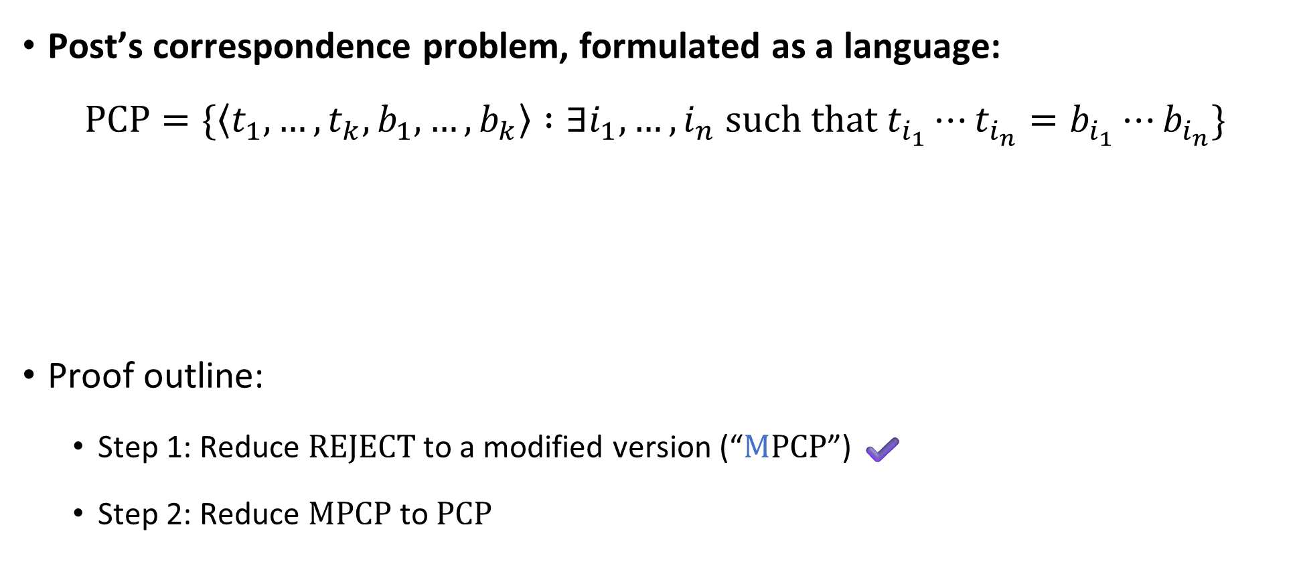
Post’s Correspondence Problem is undecidable
Post’s correspondence problem, formulated as a language:
$$\text{PCP}=\{\left\langle t_{1},…, t_{k}, b_{1},…, b_{k}\right\rangle :∃i_{1},…, i_{n} \text{such} \text{that} t_{i_{1}}⋯t_{i_{n}}=b_{i_{1}}⋯b_{i_{n}}\}$$
Proof outline:
Step 1: Reduce $\text{REJECT}$ to a modified version (“$\text{M}\text{PCP}$”) ✔️
Step 2: Reduce $\text{MPCP}$ to $\text{PCP}$
Theorem: $\text{PCP}$ is undecidable

Slide 9




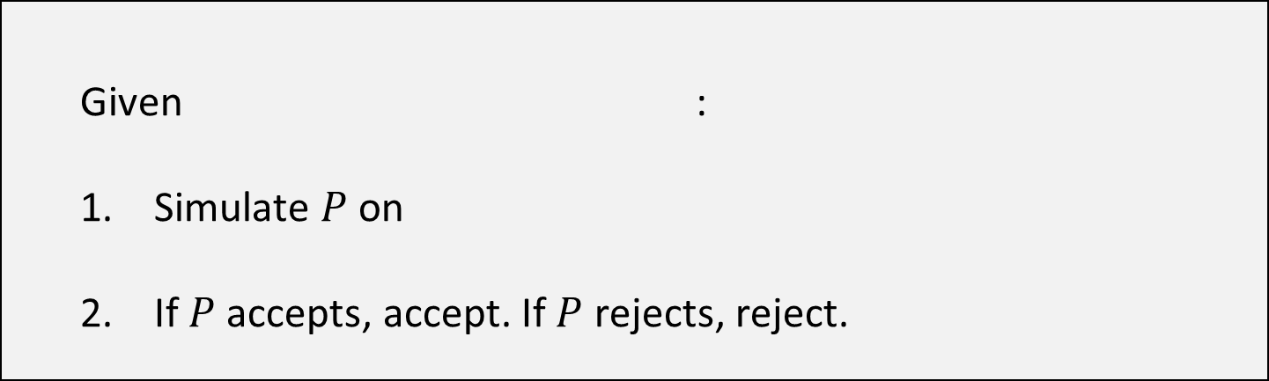











Proof that $\text{PCP}$ is undecidable
Assume there is a TM $P$ that decides $\text{PCP}$
Let’s construct a new TM $M$ that decides $\text{MPCP}$
For a string $u=u_{1}u_{2}…u_{n}$, define $\overline{u}=u_{1}⋆u_{2}⋆⋯⋆u_{n}$
Given :
Simulate $P$ on
If $P$ accepts, accept. If $P$ rejects, reject.
$$\begin{matrix}t_{1} \\ b_{1}\end{matrix}$$
$$\begin{matrix}t_{2} \\ b_{2}\end{matrix}$$
$$\begin{matrix}t_{3} \\ b_{3}\end{matrix}$$
$$\begin{matrix}t_{k} \\ b_{k}\end{matrix}$$
$$⋯$$
$$M$$
$$\begin{matrix}⋆\overline{t_{1}} \\ ⋆\overline{b_{1}}⋆\end{matrix}$$
$$\begin{matrix}⋆\overline{t_{1}} \\ \overline{b_{1}}⋆\end{matrix}$$
$$\begin{matrix}⋆\overline{t_{2}} \\ \overline{b_{2}}⋆\end{matrix}$$
$$\begin{matrix}⋆\overline{t_{3}} \\ \overline{b_{3}}⋆\end{matrix}$$
$$\begin{matrix}⋆\overline{t_{k}} \\ \overline{b_{k}}⋆\end{matrix}$$
$$\begin{matrix}⋆ \\ ε\end{matrix}$$
$$⋯$$

Slide 10


























Given :
Simulate $P$ on
If $P$ accepts, accept. If $P$ rejects, reject.
$$\begin{matrix}t_{1} \\ b_{1}\end{matrix}$$
$$\begin{matrix}t_{2} \\ b_{2}\end{matrix}$$
$$\begin{matrix}t_{3} \\ b_{3}\end{matrix}$$
$$\begin{matrix}t_{k} \\ b_{k}\end{matrix}$$
$$⋯$$
$$\begin{matrix}⋆\overline{t_{1}} \\ ⋆\overline{b_{1}}⋆\end{matrix}$$
$$\begin{matrix}⋆\overline{t_{1}} \\ \overline{b_{1}}⋆\end{matrix}$$
$$\begin{matrix}⋆\overline{t_{2}} \\ \overline{b_{2}}⋆\end{matrix}$$
$$\begin{matrix}⋆\overline{t_{3}} \\ \overline{b_{3}}⋆\end{matrix}$$
$$\begin{matrix}⋆\overline{t_{k}} \\ \overline{b_{k}}⋆\end{matrix}$$
$$\begin{matrix}⋆ \\ ε\end{matrix}$$
$$⋯$$
Suppose the MPCP instance has a match:
Then the PCP instance also has a match:
$$\begin{matrix}t_{1} \\ b_{1}\end{matrix}$$
$$\begin{matrix}t_{i_{1}} \\ b_{i_{1}}\end{matrix}$$
$$\begin{matrix}t_{i_{2}} \\ b_{i_{2}}\end{matrix}$$
$$\begin{matrix}t_{i_{3}} \\ b_{i_{3}}\end{matrix}$$
$$\begin{matrix}t_{i_{4}} \\ b_{i_{4}}\end{matrix}$$
$$\begin{matrix}t_{i_{n}} \\ b_{i_{n}}\end{matrix}$$
$$⋯$$
$$\begin{matrix}⋆\overline{t_{1}} \\ ⋆\overline{b_{1}}⋆\end{matrix}$$
$$\begin{matrix}⋆\overline{t_{i_{1}}} \\ \overline{b_{i_{1}}}⋆\end{matrix}$$
$$\begin{matrix}⋆\overline{t_{i_{2}}} \\ \overline{b_{i_{2}}}⋆\end{matrix}$$
$$\begin{matrix}⋆\overline{t_{i_{n}}} \\ \overline{b_{i_{n}}}⋆\end{matrix}$$
$$\begin{matrix}⋆ \\ ε\end{matrix}$$
$$⋯$$

Slide 11
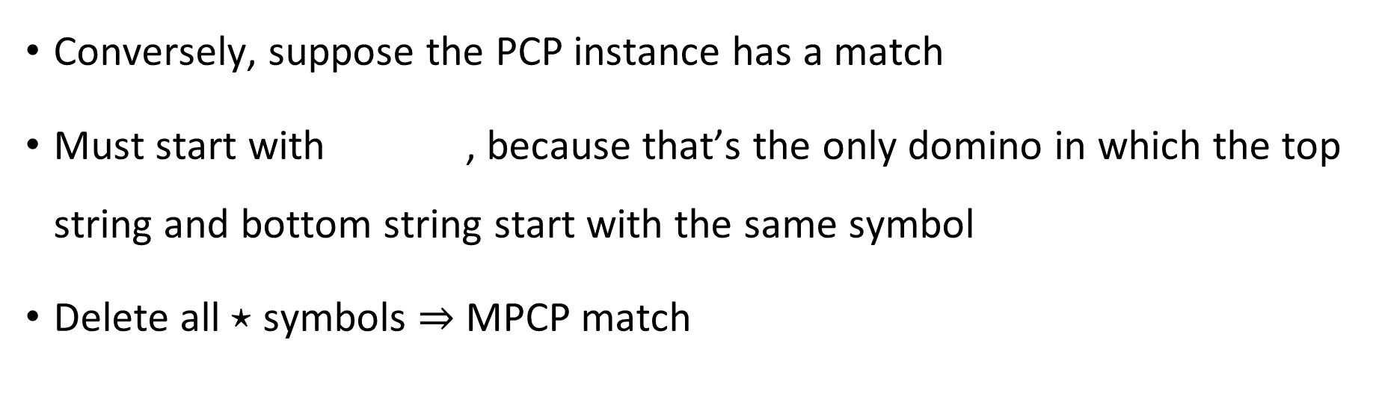

Given :
Simulate $P$ on
If $P$ accepts, accept. If $P$ rejects, reject.
$$\begin{matrix}t_{1} \\ b_{1}\end{matrix}$$
$$\begin{matrix}t_{2} \\ b_{2}\end{matrix}$$
$$\begin{matrix}t_{3} \\ b_{3}\end{matrix}$$
$$\begin{matrix}t_{k} \\ b_{k}\end{matrix}$$
$$⋯$$
$$\begin{matrix}⋆\overline{t_{1}} \\ ⋆\overline{b_{1}}⋆\end{matrix}$$
$$\begin{matrix}⋆\overline{t_{1}} \\ \overline{b_{1}}⋆\end{matrix}$$
$$\begin{matrix}⋆\overline{t_{2}} \\ \overline{b_{2}}⋆\end{matrix}$$
$$\begin{matrix}⋆\overline{t_{3}} \\ \overline{b_{3}}⋆\end{matrix}$$
$$\begin{matrix}⋆\overline{t_{k}} \\ \overline{b_{k}}⋆\end{matrix}$$
$$\begin{matrix}⋆ \\ ε\end{matrix}$$
$$⋯$$
Conversely, suppose the PCP instance has a match
Must start with , because that’s the only domino in which the top string and bottom string start with the same symbol
Delete all $⋆$ symbols $⇒$ MPCP match
$$\begin{matrix}⋆\overline{t_{1}} \\ ⋆\overline{b_{1}}⋆\end{matrix}$$

Slide 12
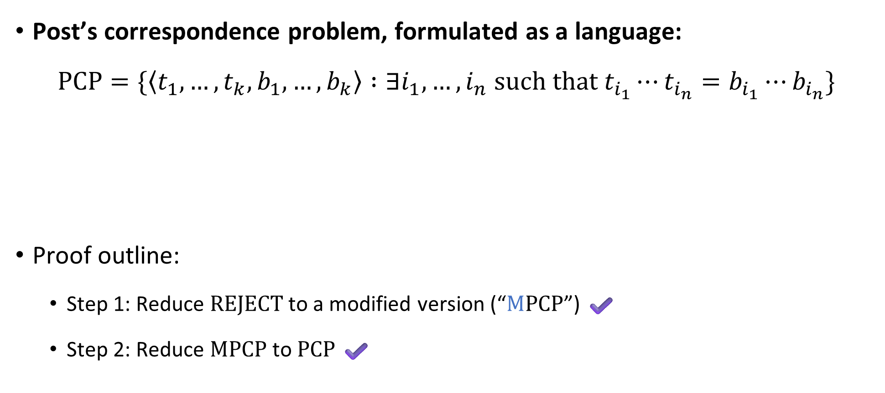
Post’s Correspondence Problem is undecidable
Post’s correspondence problem, formulated as a language:
$$\text{PCP}=\{\left\langle t_{1},…, t_{k}, b_{1},…, b_{k}\right\rangle :∃i_{1},…, i_{n} \text{such} \text{that} t_{i_{1}}⋯t_{i_{n}}=b_{i_{1}}⋯b_{i_{n}}\}$$
Proof outline:
Step 1: Reduce $\text{REJECT}$ to a modified version (“$\text{M}\text{PCP}$”) ✔️
Step 2: Reduce $\text{MPCP}$ to $\text{PCP}$ ✔️
Theorem: $\text{PCP}$ is undecidable

Slide 13
Post’s Correspondence Problem: Recap
Post’s Correspondence Problem seems like “just a domino puzzle”
However, we showed how to build a computer out of dominos!
PCP was secretly a problem about Turing machines all along!

Slide 14


Undecidability
Known undecidable languages:
$\text{SELF}‑\text{REJECTORS}$
$\text{REJECT}$
$\text{PCP}$ and $\text{MPCP}$
Next: The “halting problem”

Slide 15

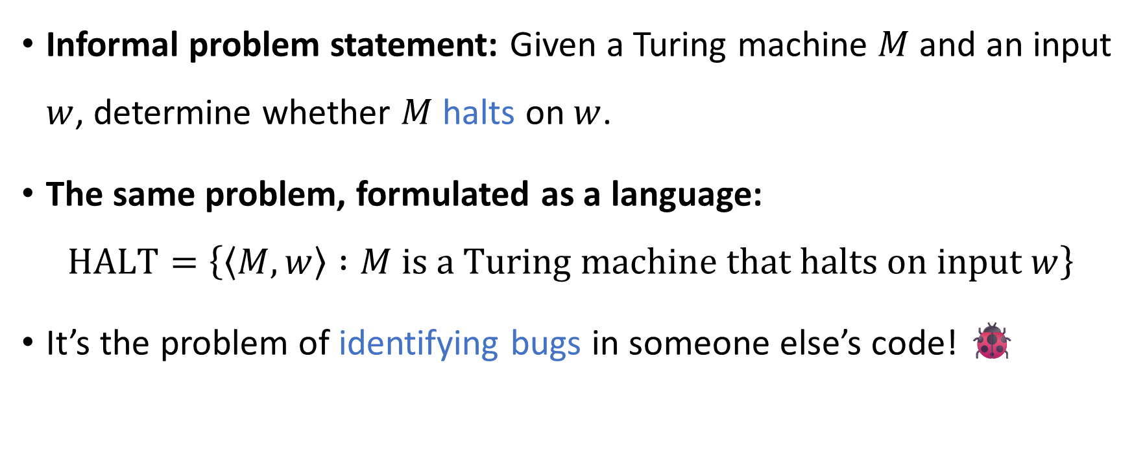
The halting problem
Informal problem statement: Given a Turing machine $M$ and an input $w$, determine whether $M$ halts on $w$.
The same problem, formulated as a language:
$$\text{HALT}=\left\{\left\langle M,w\right\rangle :M \text{is} \text{a} \text{Turing} \text{machine} \text{that} \text{halts} \text{on} \text{input} w\right\}$$
It’s the problem of identifying bugs in someone else’s code! 🐞
Theorem: $\text{HALT}$ is undecidable

Slide 16

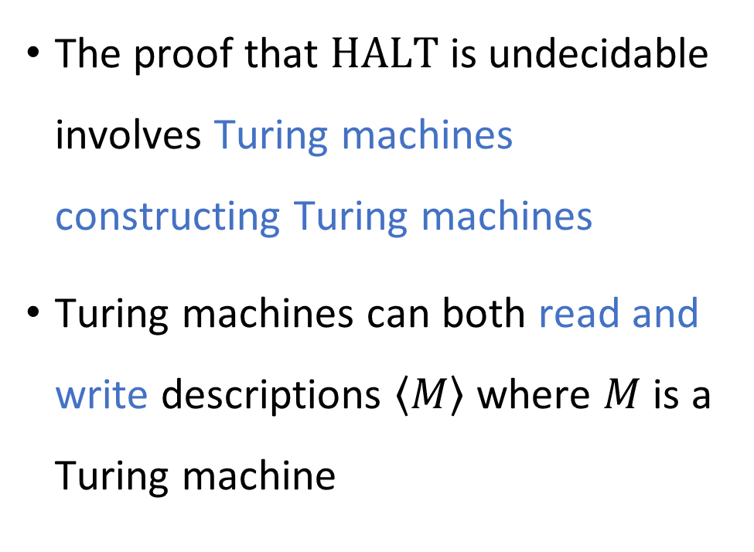
Code as data II
The proof that $\text{HALT}$ is undecidable involves Turing machines constructing Turing machines
Turing machines can both read and write descriptions $\left\langle M\right\rangle$ where $M$ is a Turing machine
“Drawing Hands.”
(1948 lithograph by M. C. Escher)

Slide 17





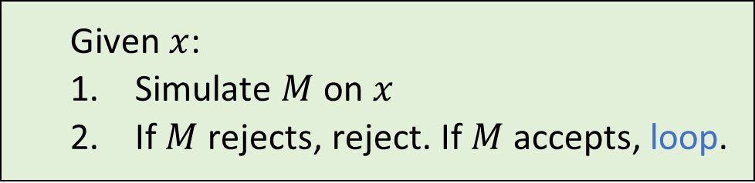

Proof that $\text{HALT}$ is undecidable
Assume there is a TM $H$ that decides $\text{HALT}$
Let’s construct a new TM $R$ that decides $\text{REJECT}$
Given $\left\langle M,w\right\rangle$:
Construct $\left\langle M^{′}\right\rangle$, where $M^{′}$ is the following TM:
Simulate $H$ on $\left\langle M′,w\right\rangle$
If $H$ accepts, accept. If $H$ rejects, reject.
If $M$ rejects $w$…
Then $M^{′}$ rejects $w$
Therefore, $H$ accepts $\left\langle M^{′},w\right\rangle$
Therefore, $R$ accepts $\left\langle M,w\right\rangle$ ✔️
If $M$ does not reject $w$…
Then $M^{′}$ loops on $w$
Therefore, $H$ rejects $\left\langle M^{′},w\right\rangle$
Therefore, $R$ rejects $\left\langle M,w\right\rangle$ ✔️
Given $x$:
Simulate $M$ on $x$
If $M$ rejects, reject. If $M$ accepts, loop.
$$R$$
$$M′$$

Slide 18
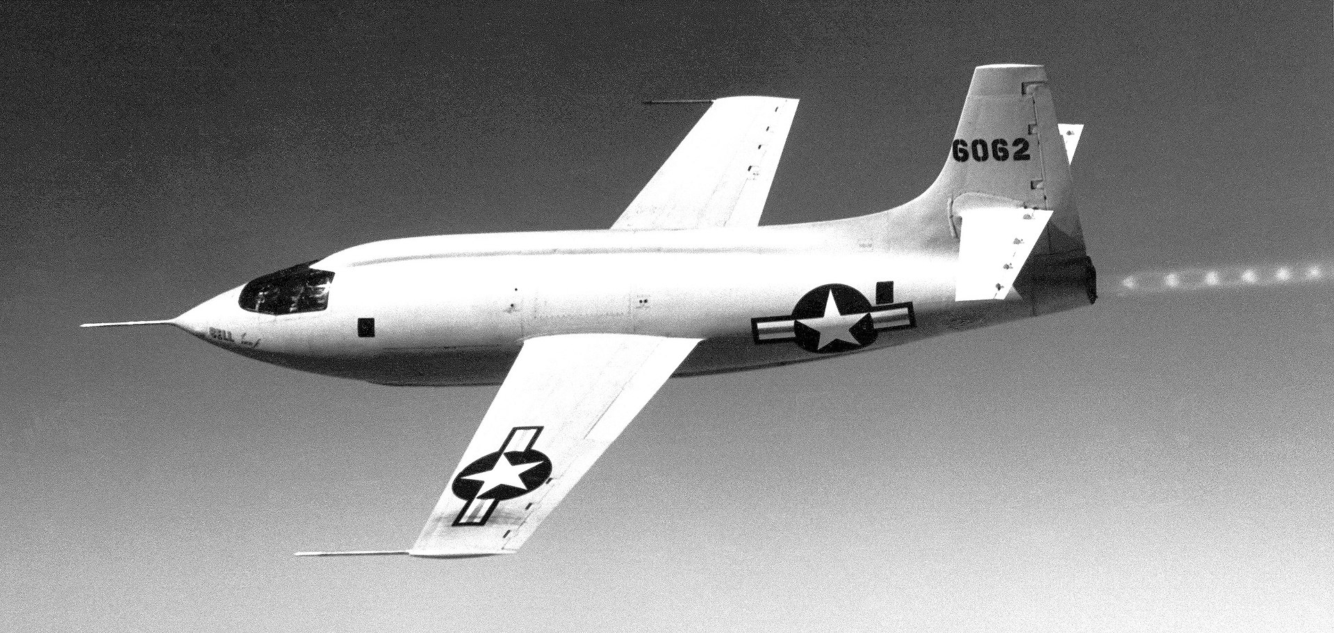
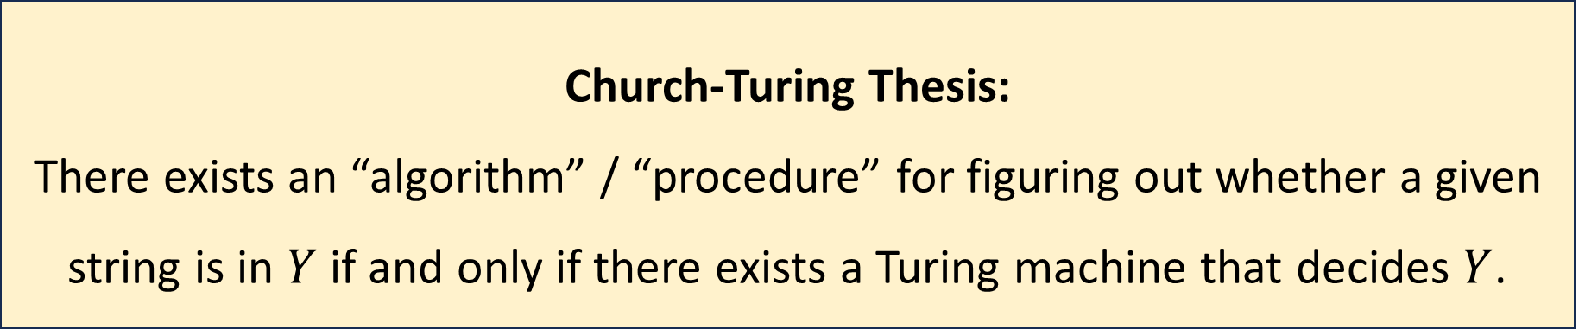

The Church-Turing thesis, revisited
Let $Y⊆\{0, 1\}^{∗}$
Computation is an intuitive notion rooted in everyday human experience
Could it be possible to solve the halting problem using science and technology?
Church-Turing Thesis:
There exists an “algorithm” / “procedure” for figuring out whether a given string is in $Y$ if and only if there exists a Turing machine that decides $Y$.

Slide 19

Hypercomputers
A hypercomputer is a hypothetical device that can solve some computational problem that cannot be solved by Turing machines, such as the halting problem
Could it be possible to build a hypercomputer?
We could try using quantum physics, antimatter, black holes, dark energy, superconductors, wormholes, closed timelike curves, …

Slide 20
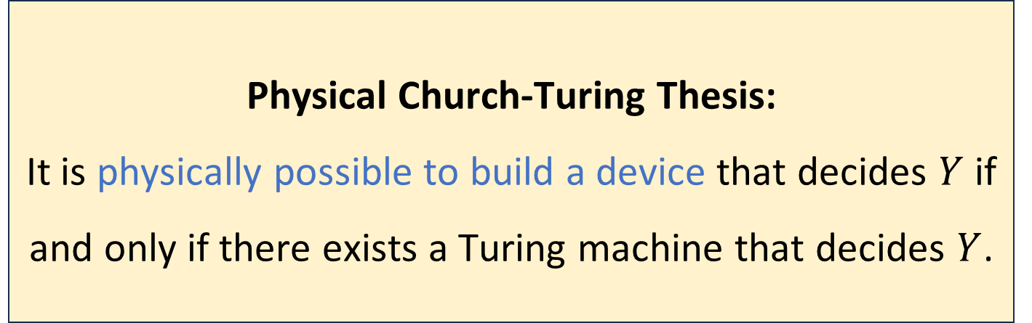

The Physical Church-Turing Thesis
Let $Y$ be a language
Physical Church-Turing Thesis:
It is physically possible to build a device that decides $Y$ if and only if there exists a Turing machine that decides $Y$.

Slide 21
The Physical Church-Turing Thesis
The standard Church-Turing thesis is a philosophical statement
The Physical Church-Turing thesis is a scientific law
Conceivably, it could be disproven by future discoveries… but that would be very surprising
Analogy: Second Law of Thermodynamics
Analogy: Cannot travel faster than the speed of light

Slide 22
Which problems can be solved through computation?

Slide 23
Which languages are decidable?

Slide 24
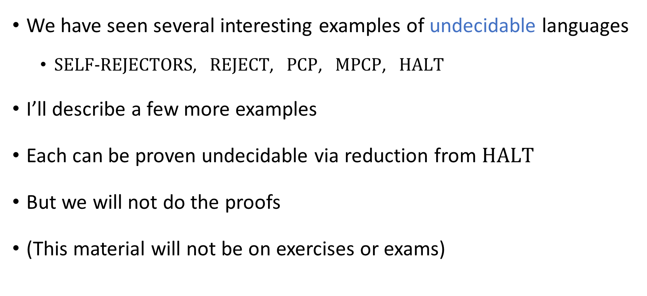
Some more undecidable problems
We have seen several interesting examples of undecidable languages
$\text{SELF}‑\text{REJECTORS}$, $\text{REJECT}$, $\text{PCP}$, $\text{MPCP}$, $\text{HALT}$
I’ll describe a few more examples
Each can be proven undecidable via reduction from $\text{HALT}$
But we will not do the proofs
(This material will not be on exercises or exams)

Slide 25

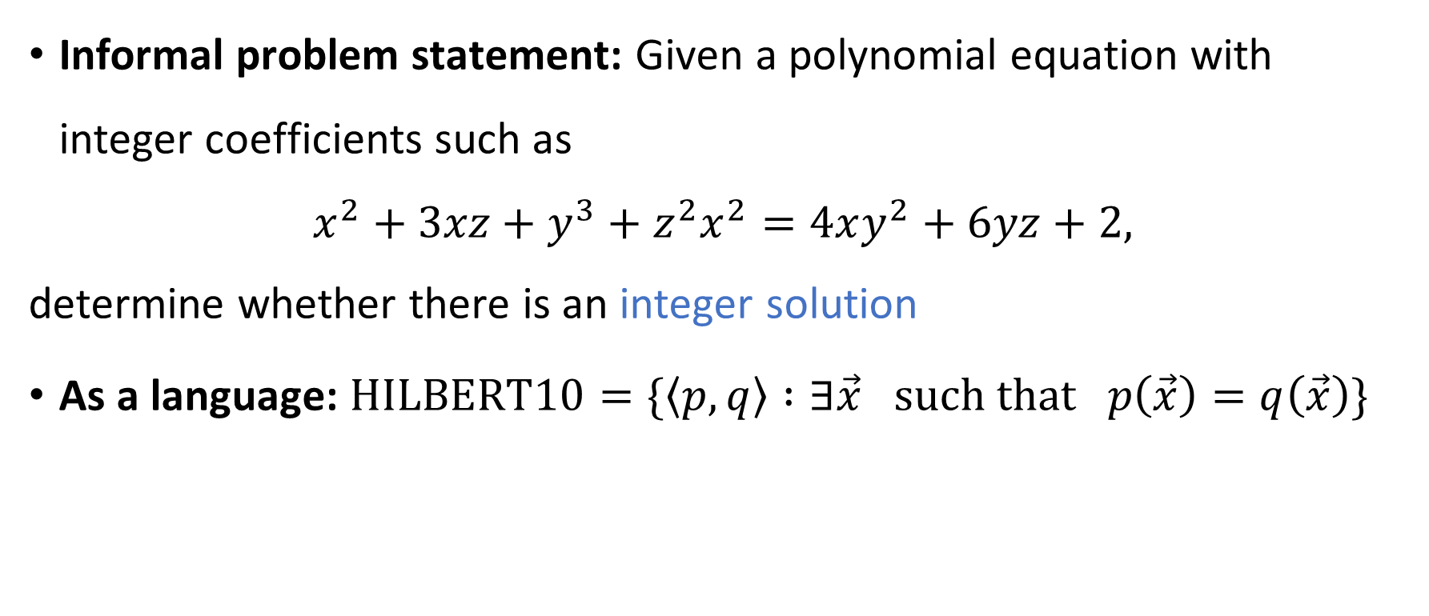
Hilbert’s 10th problem
Informal problem statement: Given a polynomial equation with integer coefficients such as
$$x^{2}+3xz+y^{3}+z^{2}x^{2}=4xy^{2}+6yz+2,$$
determine whether there is an integer solution
As a language: $\text{HILBERT}\text{10}=\{\left\langle p,q\right\rangle :∃\vec{x} \text{such} \text{that} p\left(\vec{x}\right)=q\left(\vec{x}\right)\}$
Theorem: $\text{HILBERT}\text{10}$ is undecidable

Slide 26


Matrix mortality
Let $M_{0}$ and $M_{1}$ be $n×n$ matrices with integer entries
We say that $\left(M_{0},M_{1}\right)$ is a mortal pair if there exists $k∈ℕ$ and there exist $i_{1},…, i_{k}∈\left\{0, 1\right\}$ such that $M_{i_{1}}⋅M_{i_{2}}⋅⋯⋅M_{i_{k}}=0$ (the all-zeroes matrix).
Let $\text{MORTAL}=\{\left\langle M_{0},M_{1}\right\rangle :\left(M_{0},M_{1}\right) \text{is} \text{a} \text{mortal} \text{pair}\}$
Theorem: $\text{MORTAL}$ is undecidable

Slide 27

Derivatives vs. Integrals
Recall: Calculus
Computing derivatives is mechanistic
Sum rule ${\left(f+g\right)}^{′}=f^{′}+g′$, product rule ${\left(fg\right)}^{′}=f^{′}g+fg^{′}$, chain rule ${\left(f∘g\right)}^{′}=\left(f^{′}∘g\right)⋅g′$, etc.
In contrast, computing integrals seems to involve creativity
$u$-substitutions, integration by parts, etc.

Slide 28

Elementary functions
Definition: A function $f:ℝ→ℝ$ is elementary if it can be defined by a formula using addition, multiplication, rational constants, powers, exponentials, logarithms, trigonometric functions, and $π$
E.g. $f\left(x\right)=x⋅\sin\left(x^{4}\right)−3π⋅e^{e^{\sqrt{x}}}$

Slide 29


Integration is undecidable
Fact: There exist elementary functions that do not have elementary antiderivatives, such as $f\left(x\right)=e^{−x^{2}}$
Let $\text{INTEGRABLE}=\{\left\langle f\right\rangle :f \text{is} \text{an} \text{elementary} \text{function} \text{with} \text{an} \text{elementary} \text{antiderivative}\}$
Theorem: $\text{INTEGRABLE}$ is undecidable
Notes:
https://en.wikipedia.org/wiki/Richardson%27s_theorem

