Slide 1

CMSC 28100 Introduction to Complexity Theory Spring 2025 Instructor: William Hoza

Slide 2








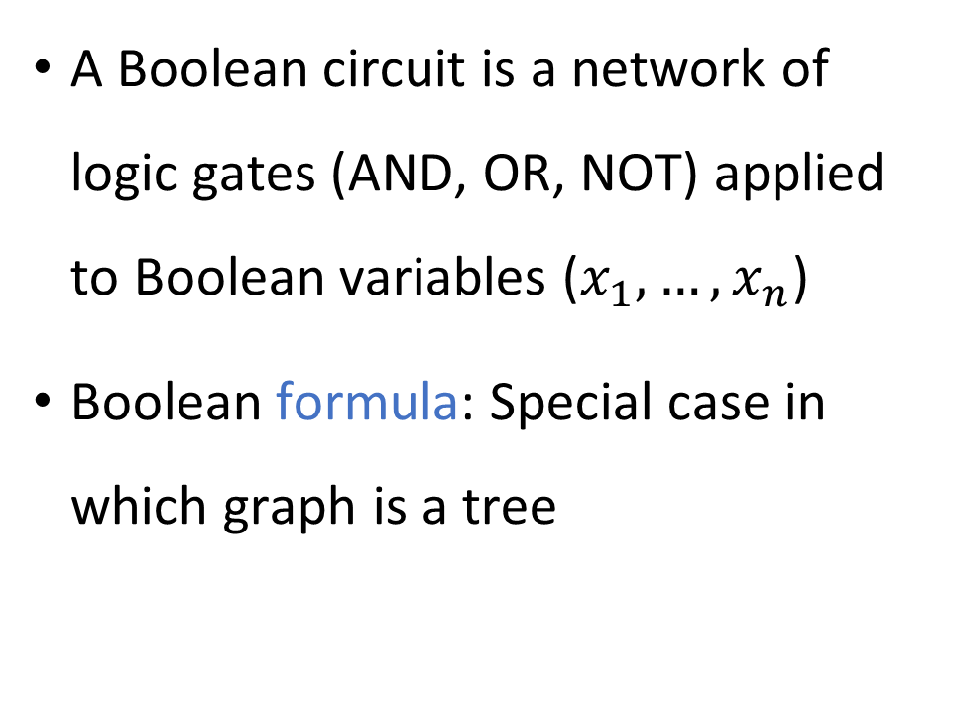











Boolean circuits
$$∨$$
A Boolean circuit is a network of logic gates (AND, OR, NOT) applied to Boolean variables ($x_{1},…, x_{n}$)
Boolean formula: Special case in which graph is a tree
$$∧$$
$$∧$$
$$¬$$
$$¬$$
$$∨$$
$$∨$$
$$∧$$
$$∧$$
$$∧$$
$$∧$$
$$¬$$
$$¬$$
$$¬$$
$$¬$$
$$x_{1}$$
$$x_{2}$$
$$x_{3}$$
$$x_{4}$$

Slide 3



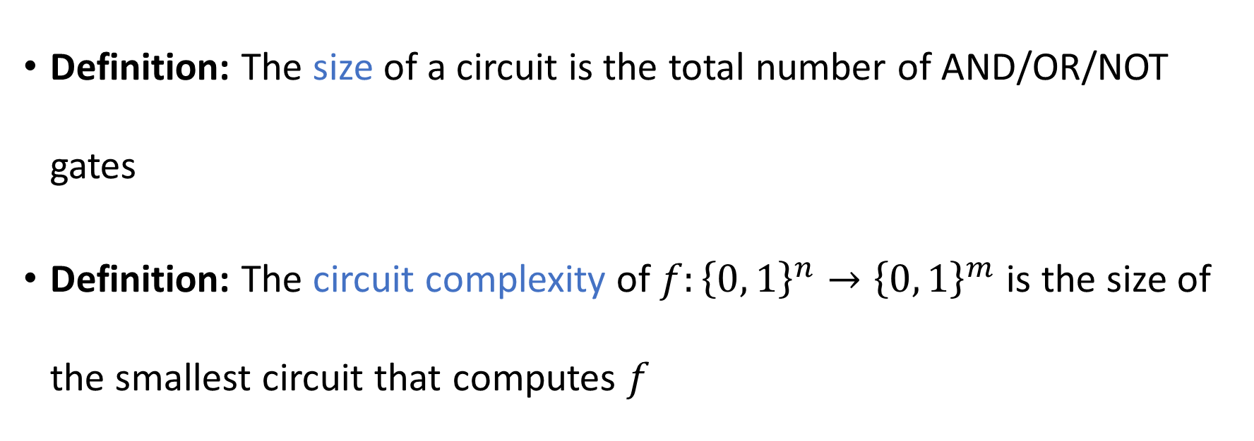




Circuit complexity
$$∨$$
$$∧$$
$$∧$$
$$¬$$
$$¬$$
$$x_{1}$$
$$x_{2}$$
Definition: The size of a circuit is the total number of AND/OR/NOT gates
Definition: The circuit complexity of $f:{\left\{0, 1\right\}}^{n}→{\left\{0, 1\right\}}^{m}$ is the size of the smallest circuit that computes $f$

Slide 4
















Circuit complexity example 1
$$∨$$
$$∨$$
$$∨$$
$$∨$$
$$∨$$
$$∨$$
$$∨$$
Let $f\left(x\right)=x_{1}∨x_{2}∨…∨x_{n}$
Circuit complexity: $Θ\left(n\right)$
$$x_{1}$$
$$x_{2}$$
$$x_{3}$$
$$x_{4}$$
$$x_{5}$$
$$x_{6}$$
$$x_{7}$$
$$x_{8}$$

Slide 5












Circuit complexity example 2
$$⊕$$
$$⊕$$
$$⊕$$
$$⊕$$
$$⊕$$
$$⊕$$
$$⊕$$
Let $f\left(x\right)=x_{1}⊕x_{2}⊕…⊕x_{n}$
Circuit complexity: $Θ\left(n\right)$
Each “$⊕$ gate” can be implemented using $O\left(1\right)$ many $∧$, $∨$, $¬$ gates
$$x_{1}$$
$$x_{2}$$
$$x_{3}$$
$$x_{4}$$
$$x_{5}$$
$$x_{6}$$
$$x_{7}$$
$$x_{8}$$
What is the circuit complexity of $f$?
A: $Θ\left(n^{2}\right)$
B: $O\left(1\right)$
C: $Θ\left(n\right)$
D: $Θ\left(2^{n}\right)$
Respond at PollEv.com/whoza or text “whoza” to 22333

Slide 6
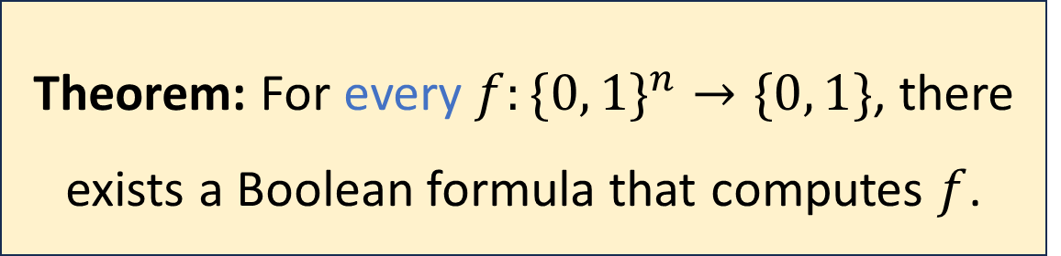
The power of Boolean circuits
Recall: Some languages cannot be decided by algorithms
Are there functions that cannot be computed by circuits?
Theorem: For every $f:\{0, 1\}^{n}→\{0, 1\}$, there exists a Boolean formula that computes $f$.

Slide 7
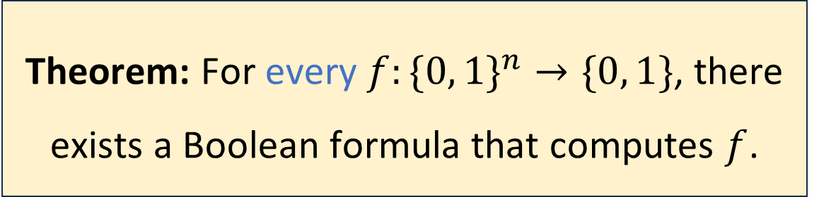
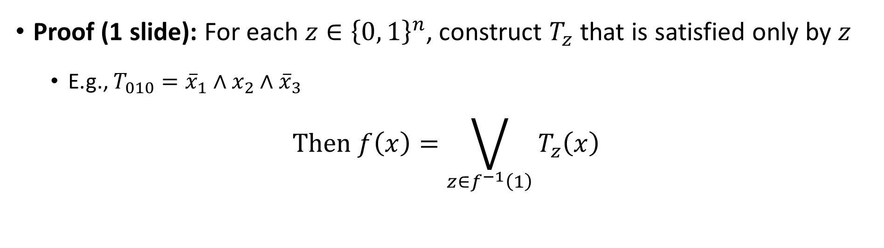
Theorem: For every $f:\{0, 1\}^{n}→\{0, 1\}$, there exists a Boolean formula that computes $f$.
Proof (1 slide): For each $z∈{\left\{0, 1\right\}}^{n}$, construct $T_{z}$ that is satisfied only by $z$
E.g., $T_{010}={\overline{x}}_{1}∧x_{2}∧{\overline{x}}_{3}$
$$\text{Then} f\left(x\right)=\bigvee_{z∈f^{−1}\left(1\right)}{T_{z}\left(x\right)}$$

Slide 8
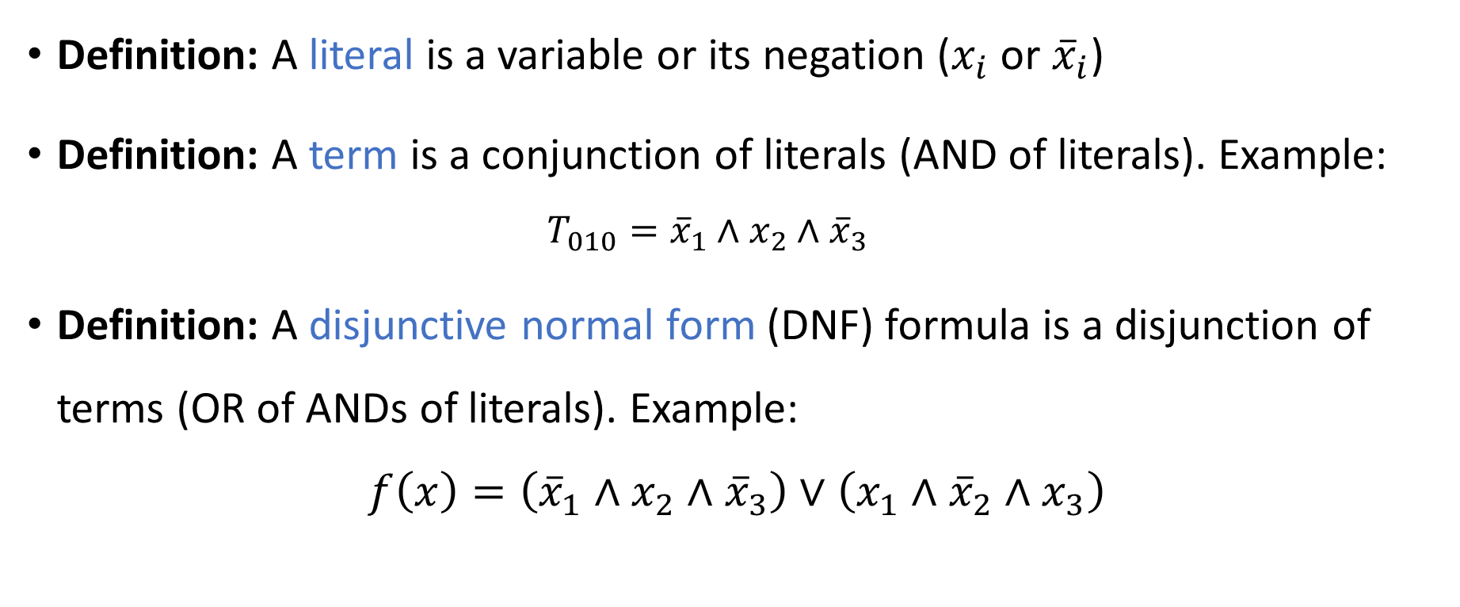
DNF formulas
Definition: A literal is a variable or its negation ($x_{i}$ or ${\overline{x}}_{i}$)
Definition: A term is a conjunction of literals (AND of literals). Example:
$$T_{010}={\overline{x}}_{1}∧x_{2}∧{\overline{x}}_{3}$$
Definition: A disjunctive normal form (DNF) formula is a disjunction of terms (OR of ANDs of literals). Example:
$$f\left(x\right)=\left({\overline{x}}_{1}∧x_{2}∧{\overline{x}}_{3}\right)∨\left(x_{1}∧{\overline{x}}_{2}∧x_{3}\right)$$

Slide 9
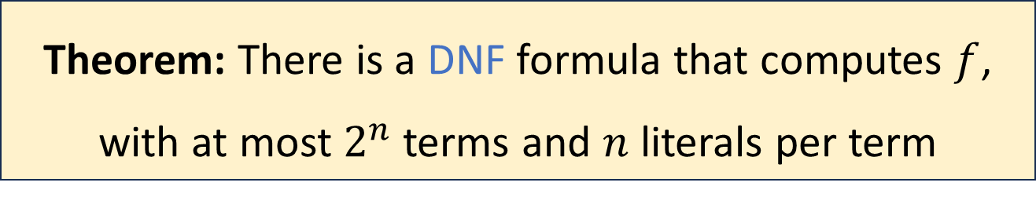

Every function has a DNF formula
Let $f:{\left\{0, 1\right\}}^{n}→\left\{0, 1\right\}$ be any function
Proof: For each $z∈{\left\{0, 1\right\}}^{n}$, construct a term $T_{z}$ that is satisfied only by $z$
$$\text{Then} f\left(x\right)=\bigvee_{z∈f^{−1}\left(1\right)}{T_{z}\left(x\right)}$$
Theorem: There is a DNF formula that computes $f$, with at most $2^{n}$ terms and $n$ literals per term

Slide 10
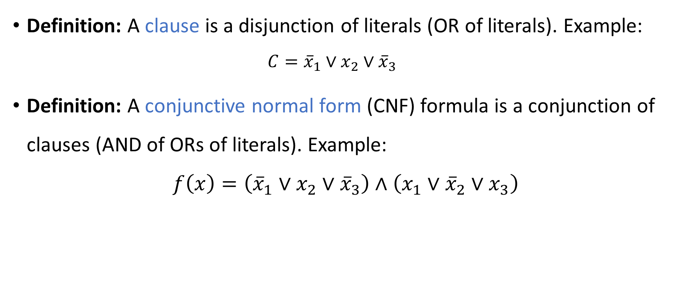
CNF formulas
Definition: A clause is a disjunction of literals (OR of literals). Example:
$$C={\overline{x}}_{1}∨x_{2}∨{\overline{x}}_{3}$$
Definition: A conjunctive normal form (CNF) formula is a conjunction of clauses (AND of ORs of literals). Example:
$$f\left(x\right)=\left({\overline{x}}_{1}∨x_{2}∨{\overline{x}}_{3}\right)∧\left(x_{1}∨{\overline{x}}_{2}∨x_{3}\right)$$

Slide 11
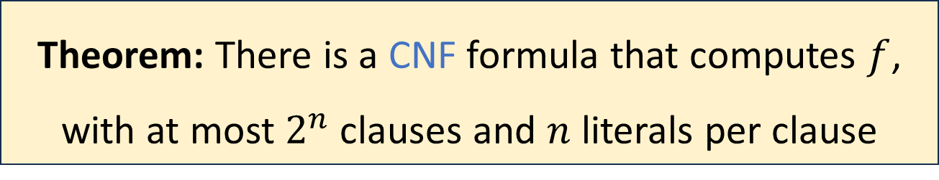

Every function has a CNF formula
Let $f:{\left\{0, 1\right\}}^{n}→\left\{0, 1\right\}$ be any function
Proof: For each $z∈{\left\{0, 1\right\}}^{n}$, construct a clause $C_{z}$ that is violated only by $z$
E.g., $T_{010}=x_{1}∨{\overline{x}}_{2}∨x_{3}$
$$\text{Then} f\left(x\right)=\bigwedge_{z∈f^{−1}\left(0\right)}{C_{z}\left(x\right)}$$
Theorem: There is a CNF formula that computes $f$, with at most $2^{n}$ clauses and $n$ literals per clause

Slide 12
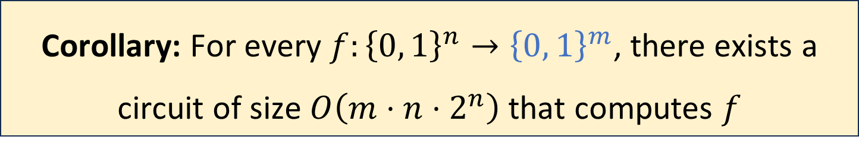
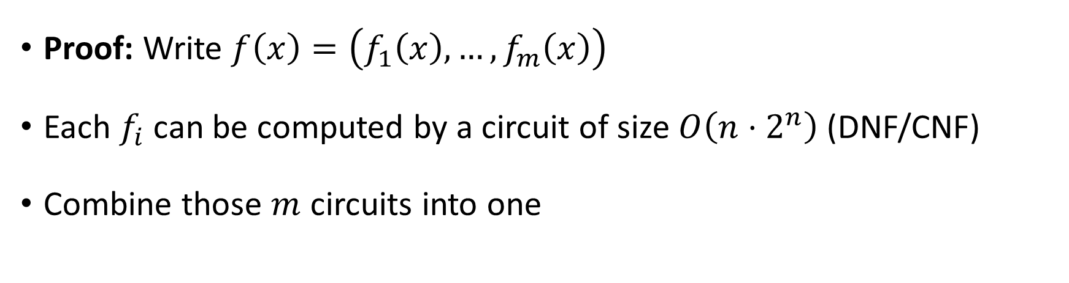
Multi-output functions
Corollary: For every $f:{\left\{0, 1\right\}}^{n}→{\left\{0, 1\right\}}^{m}$, there exists a circuit of size $O\left(m⋅n⋅2^{n}\right)$ that computes $f$
Proof: Write $f\left(x\right)=\left(f_{1}\left(x\right),…,f_{m}\left(x\right)\right)$
Each $f_{i}$ can be computed by a circuit of size $O\left(n⋅2^{n}\right)$ (DNF/CNF)
Combine those $m$ circuits into one

Slide 13
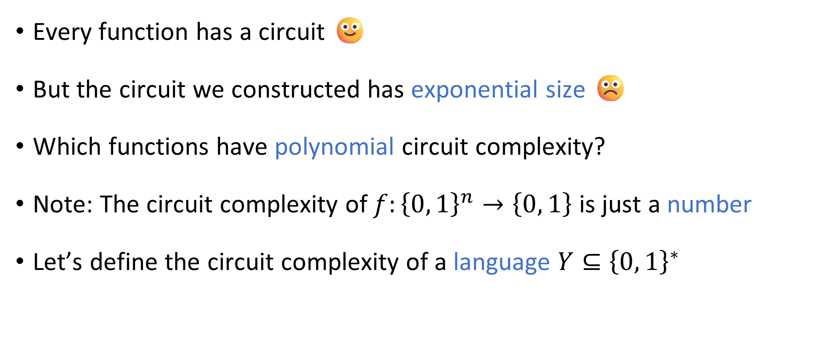
Polynomial-size circuits
Every function has a circuit 🙂
But the circuit we constructed has exponential size ☹️
Which functions have polynomial circuit complexity?
Note: The circuit complexity of $f:{\left\{0, 1\right\}}^{n}→\left\{0, 1\right\}$ is just a number
Let’s define the circuit complexity of a language $Y⊆{\left\{0, 1\right\}}^{∗}$

Slide 14
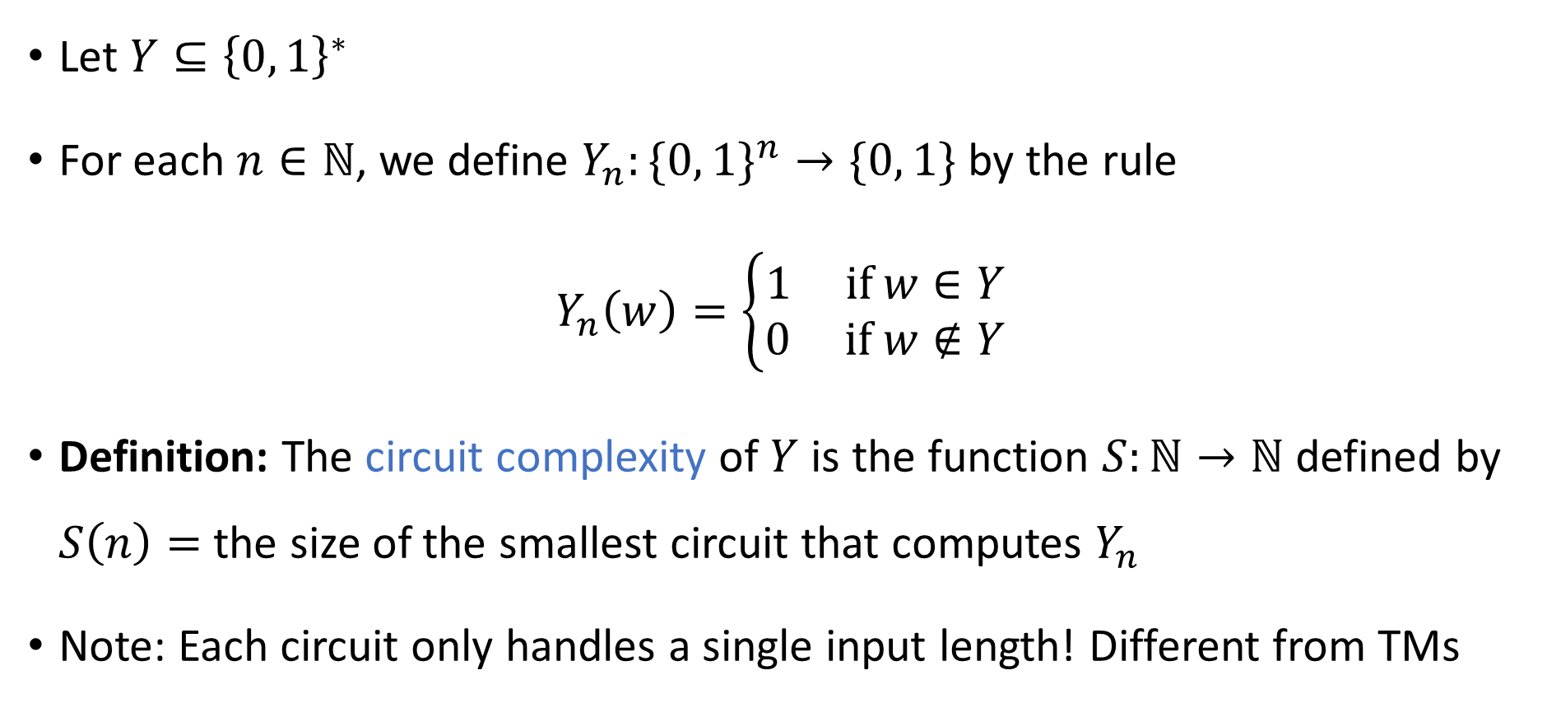
Circuit complexity of a binary language
Let $Y⊆{\left\{0, 1\right\}}^{∗}$
For each $n∈ℕ$, we define $Y_{n}:\{0, 1\}^{n}→\{0, 1\}$ by the rule
$$Y_{n}\left(w\right)=\left\{\begin{aligned}1 \text{if} w∈Y \\ 0 \text{if} w∉Y\end{aligned}\right.$$
Definition: The circuit complexity of $Y$ is the function $S:ℕ→ℕ$ defined by $S\left(n\right)=$ the size of the smallest circuit that computes $Y_{n}$
Note: Each circuit only handles a single input length! Different from TMs

Slide 15
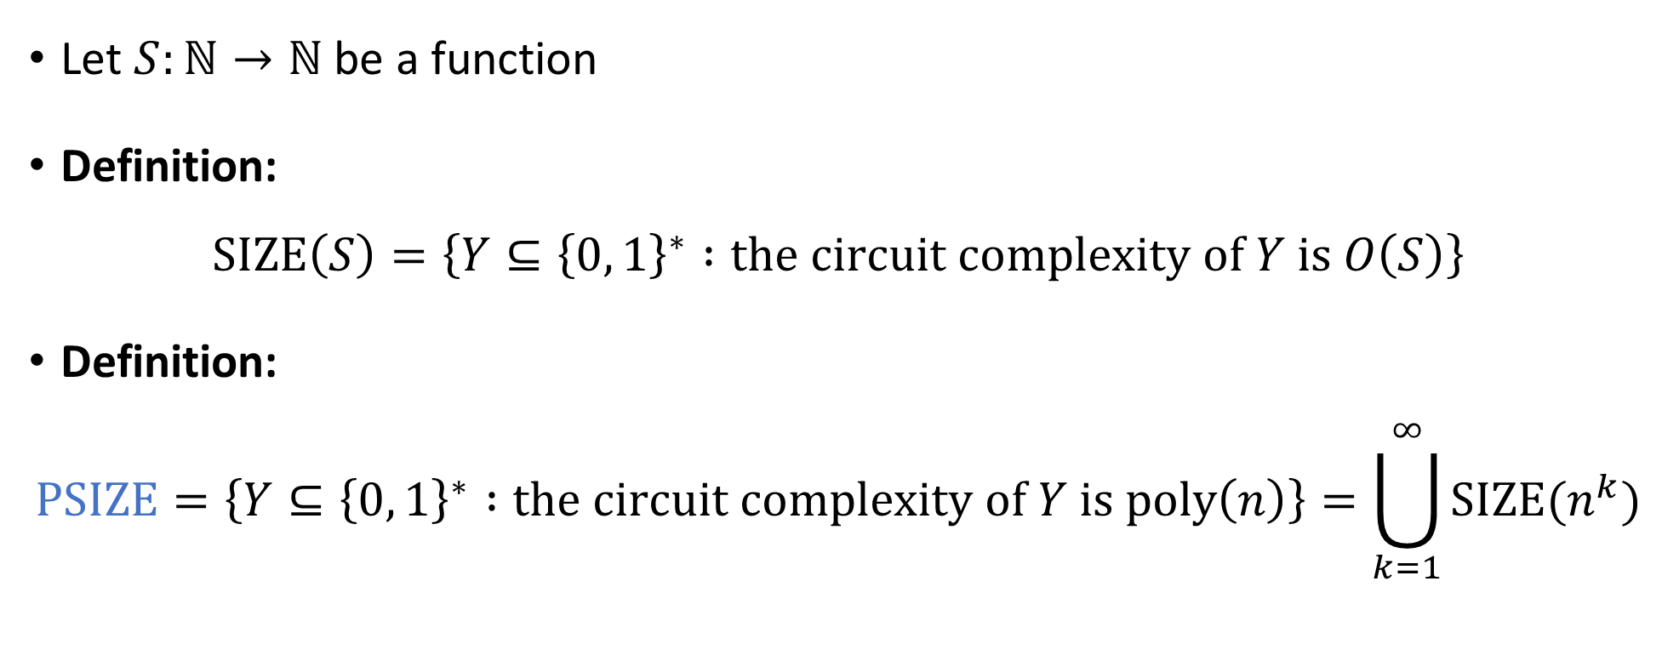

The complexity class $\text{PSIZE}$
Let $S:ℕ→ℕ$ be a function
Definition:
$$\text{SIZE}\left(S\right)=\left\{Y⊆{\left\{0, 1\right\}}^{∗} :\text{the} \text{circuit} \text{complexity} \text{of} Y \text{is} O\left(S\right)\right\}$$
Definition:
$$\text{PSIZE}=\left\{Y⊆{\left\{0, 1\right\}}^{∗} :\text{the} \text{circuit} \text{complexity} \text{of} Y \text{is} \text{poly}\left(n\right)\right\}=\bigcup_{k=1}^{∞}{\text{SIZE}(n^{k}})$$

Slide 16
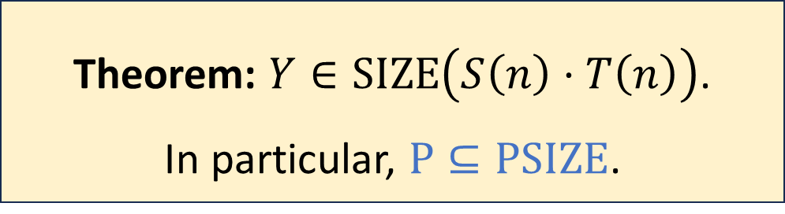



Turing machines vs. circuits
Let $M$ be a Turing machine that decides a language $Y$
Let $T\left(n\right)$ be $M$’s time complexity; let $S\left(n\right)$ be $M$’s space complexity
Proof (next 6 slides) is based on computation histories
Theorem: $Y∈\text{SIZE}\left(S\left(n\right)⋅T\left(n\right)\right)$. In particular, $\text{P}⊆\text{PSIZE}$.
$$\text{PSIZE}$$
$$\text{P}$$

Slide 17

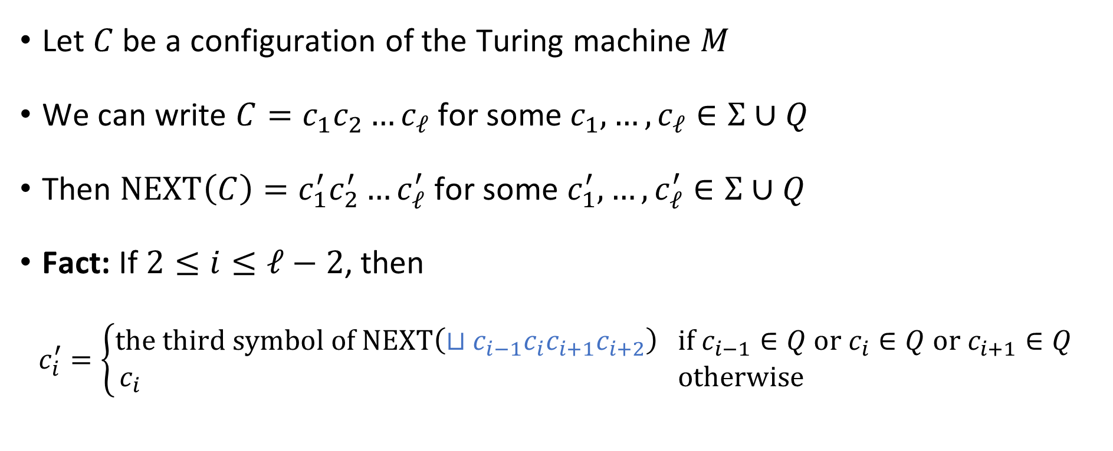



Locality of computation
To figure out $c_{206}^{′}$, which symbols of $C$ do we need to inspect?
A: All of them ($c_{1},c_{2},…, c_{ℓ}$)
B: Only $c_{206}$
C: $c_{205}$, $c_{206}$, and $c_{207}$
D: $c_{205}$, $c_{206}$, $c_{207}$, and $c_{208}$
Let $C$ be a configuration of the Turing machine $M$
We can write $C=c_{1}c_{2}…c_{ℓ}$ for some $c_{1},…, c_{ℓ}∈Σ∪Q$
Then $\text{NEXT}\left(C\right)=c_{1}^{′}c_{2}^{′}…c_{ℓ}^{′}$ for some $c_{1}^{′},…, c_{ℓ}^{′}∈Σ∪Q$
Fact: If $2≤i≤ℓ−2$, then
$$c_{i}^{′}=\left\{\begin{aligned}\text{the} \text{third} \text{symbol} \text{of} \text{NEXT}\left(⊔c_{i−1}c_{i}c_{i+1}c_{i+2}\right) \text{if} c_{i−1}∈Q \text{or} c_{i}∈Q \text{or} c_{i+1}∈Q \\ c_{i} \text{otherwise} \end{aligned}\right.$$
Respond at PollEv.com/whoza or text “whoza” to 22333
For simplicity, assume the head is not at beginning/end

Slide 18
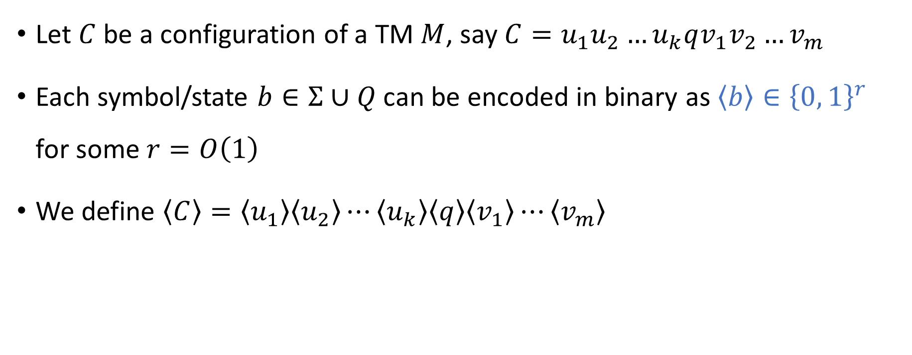
Encoding configurations in binary
Let $C$ be a configuration of a TM $M$, say $C=u_{1}u_{2}…u_{k}qv_{1}v_{2}…v_{m}$
Each symbol/state $b∈Σ∪Q$ can be encoded in binary as $\left\langle b\right\rangle ∈{\left\{0, 1\right\}}^{r}$ for some $r=O\left(1\right)$
We define $\left\langle C\right\rangle =\left\langle u_{1}\right\rangle \left\langle u_{2}\right\rangle ⋯\left\langle u_{k}\right\rangle \left\langle q\right\rangle \left\langle v_{1}\right\rangle ⋯\left\langle v_{m}\right\rangle$

Slide 19





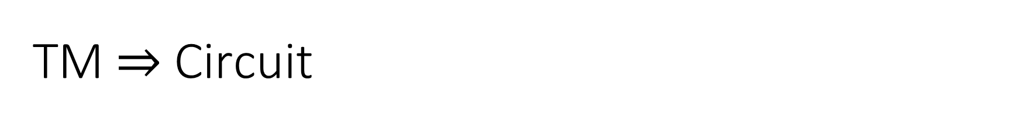








TM $⇒$ Circuit
There is a circuit $C_{M}$ that computes $\left\langle c_{i}^{′}\right\rangle$ given $\left\langle c_{i−1}\right\rangle$, $\left\langle c_{i}\right\rangle$, $\left\langle c_{i+1}\right\rangle$, $\left\langle c_{i+2}\right\rangle$
$$⟨c_{i}^{′}⟩$$
$$∨$$
$$∨$$
$$∧$$
$$∨$$
$$∧$$
$$∨$$
$$∧$$
$$¬$$
$$∨$$
$$∧$$
$$∨$$
$$∧$$
$$⟨c_{i−1}⟩$$
$${⟨c}_{i}⟩$$
$$⟨c_{i+1}⟩$$
$$\left\langle c_{i+2}\right\rangle$$

Slide 20

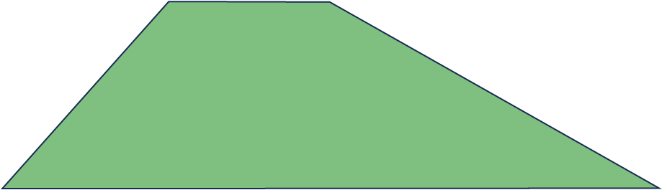
TM $⇒$ Circuit
There is a circuit $C_{M}$ that computes $\left\langle c_{i}^{′}\right\rangle$ given $\left\langle c_{i−1}\right\rangle$, $\left\langle c_{i}\right\rangle$, $\left\langle c_{i+1}\right\rangle$, $\left\langle c_{i+2}\right\rangle$
$$⟨c_{i}^{′}⟩$$
$$⟨c_{i−1}⟩$$
$${⟨c}_{i}⟩$$
$$⟨c_{i+1}⟩$$
$$\left\langle c_{i+2}\right\rangle$$

Slide 21
















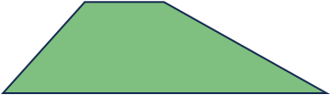










TM $⇒$ Circuit
$$⟨c_{i}^{′}⟩$$
There is a circuit $C_{M}$ that computes $\left\langle c_{i}^{′}\right\rangle$ given $\left\langle c_{i−1}\right\rangle$, $\left\langle c_{i}\right\rangle$, $\left\langle c_{i+1}\right\rangle$, $\left\langle c_{i+2}\right\rangle$
Now let’s combine many copies of $C_{M}$ in parallel:
$$⟨c_{i−1}⟩$$
$${⟨c}_{i}⟩$$
$$⟨c_{i+1}⟩$$
$$\left\langle c_{i+2}\right\rangle$$
$$\left\langle \text{NEXT}\left(C\right)\right\rangle$$
$$\left\langle c_{1}^{′}\right\rangle$$
$$\left\langle c_{2}^{′}\right\rangle$$
$$\left\langle c_{3}^{′}\right\rangle$$
$$\left\langle c_{4}^{′}\right\rangle$$
$$\left\langle c_{5}^{′}\right\rangle$$
$$\left\langle c_{6}^{′}\right\rangle$$
$$\left\langle c_{7}^{′}\right\rangle$$
$$\left\langle ⊔\right\rangle$$
$$\left\langle c_{1}\right\rangle$$
$$\left\langle c_{2}\right\rangle$$
$$\left\langle c_{3}\right\rangle$$
$$\left\langle c_{4}\right\rangle$$
$$\left\langle c_{5}\right\rangle$$
$$\left\langle c_{6}\right\rangle$$
$$\left\langle c_{7}\right\rangle$$
$$\left\langle ⊔\right\rangle$$
$$\left\langle ⊔\right\rangle$$
$$\left\langle C\right\rangle$$

Slide 22











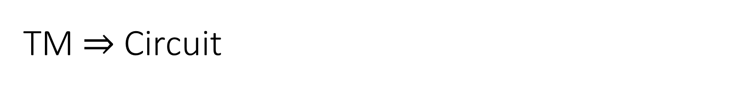





















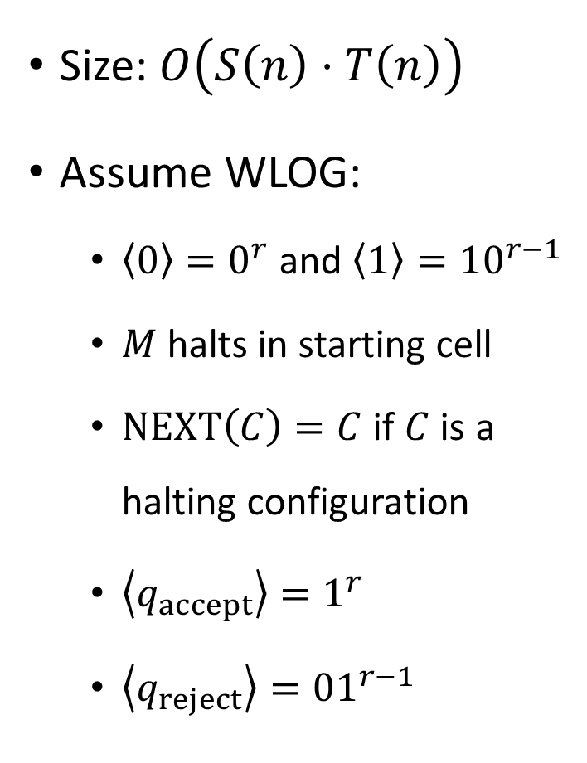




















TM $⇒$ Circuit
Encoding of final configuration of $M$ on $w$
$$Y_{n}\left(w\right)$$
Size: $O\left(S\left(n\right)⋅T\left(n\right)\right)$
Assume WLOG:
$\left\langle 0\right\rangle =0^{r}$ and $\left\langle 1\right\rangle ={10}^{r−1}$
$M$ halts in starting cell
$\text{NEXT}\left(C\right)=C$ if $C$ is a halting configuration
$\left\langle q_{accept}\right\rangle =1^{r}$
$\left\langle q_{reject}\right\rangle ={01}^{r−1}$
$$\left\langle ⊔\right\rangle$$
$$\left\langle ⊔\right\rangle$$
$$\left\langle ⊔\right\rangle$$
$$\left\langle ⊔\right\rangle$$
$$\left\langle ⊔\right\rangle$$
$$\left\langle ⊔\right\rangle$$
$$\left\langle ⊔\right\rangle$$
$$\left\langle ⊔\right\rangle$$
$$\left\langle ⊔\right\rangle$$
$$\left\langle ⊔\right\rangle$$
$$\left\langle ⊔\right\rangle$$
$$\left\langle ⊔\right\rangle$$
$$T(n)$$
$$\left\langle ⊔\right\rangle$$
$$\left\langle ⊔\right\rangle$$
$$\left\langle ⊔\right\rangle$$
$$\left\langle ⊔\right\rangle$$
$$\left\langle ⊔\right\rangle$$
$$\left\langle ⊔\right\rangle$$
$$\left\langle ⊔\right\rangle$$
$$\left\langle ⊔\right\rangle$$
$$\left\langle ⊔\right\rangle$$
$$\left\langle ⊔\right\rangle$$
$$\left\langle ⊔\right\rangle$$
$$\left\langle ⊔\right\rangle$$
$$\left\langle ⊔\right\rangle$$
$$\left\langle ⊔\right\rangle$$
$$\left\langle ⊔\right\rangle$$
$$\left\langle ⊔\right\rangle$$
$$\left\langle ⊔\right\rangle$$
$$\left\langle ⊔\right\rangle$$
$$\left\langle ⊔\right\rangle$$
$$\left\langle ⊔\right\rangle$$
$$\left\langle ⊔\right\rangle$$
$$\left\langle ⊔\right\rangle$$
$$\left\langle q_{0}\right\rangle$$
$$\left\langle w_{1}\right\rangle$$
$$\left\langle w_{2}\right\rangle$$
$$\left\langle w_{3}\right\rangle$$
$$\left\langle ⊔\right\rangle$$
$$\left\langle ⊔\right\rangle$$
$$\left\langle ⊔\right\rangle$$
$$\left\langle ⊔\right\rangle$$
$$0$$
$$0$$
$$0$$
$$0$$
$$0$$
$$0$$
$$w_{1}$$
$$w_{2}$$
$$w_{3}$$
$$O\left(S\left(n\right)\right)$$

Slide 23


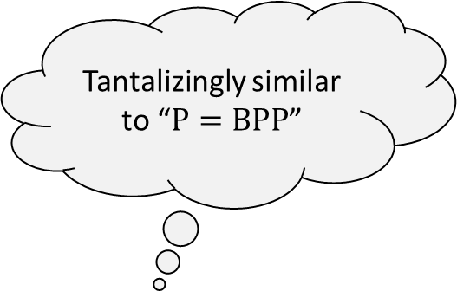




Adleman’s theorem
$$\text{PSIZE}$$
Tantalizingly similar to “$\text{P}=\text{BPP}$”
$$\text{BPP}$$
We just showed that $\text{P}⊆\text{PSIZE}$
Next, we will prove a stronger theorem:
Note: The circuit model is a deterministic model of computation!
Proof of Adleman’s theorem: Next 8 slides
$$\text{P}$$
Adleman’s Theorem: $\text{BPP}⊆\text{PSIZE}$

