Slide 1
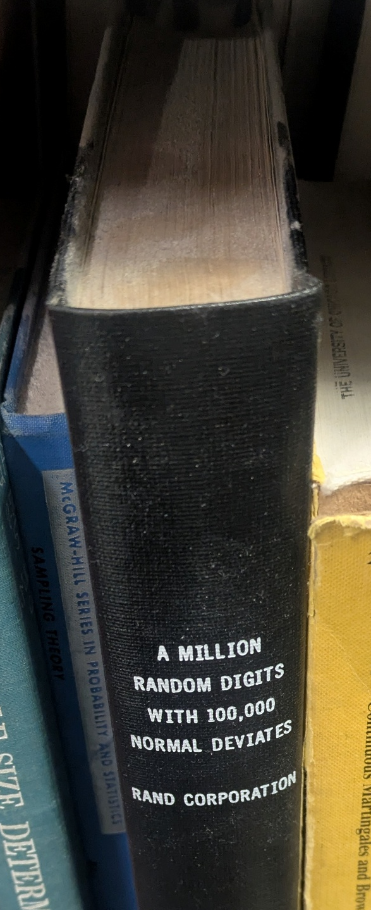
Multi-Access Randomness
Saves Space,
Even for Halting Algorithms
William Hoza
The University of Chicago

Slide 2
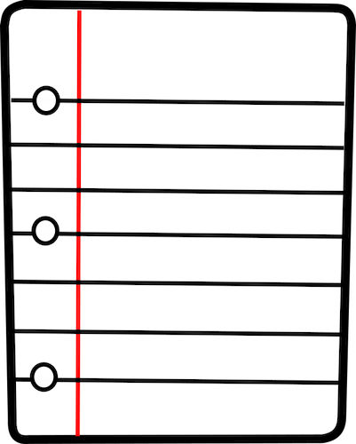

Randomness and space complexity
Question: Is randomness useful for log-space computation?
Answer: It depends!
There are multiple reasonable models of randomized log-space computation

Slide 3






The standard model
$n$ bits
Read-only
input tape
0 | 1 | 1 | 0 | 0 | 0 | 1 | 0 | 1 | 0 | 1 | 0 | 1
$O\left(\log{n}\right)$ bits
Read-write
work tape
1 | 0 | 0 | 1 | 1
Read-once
random tape
1 | 1 | 1 | 0 | 1 | 0 | 0 | 1 | 0 | 1 | 0 | 0 | 0 | 1

Slide 4

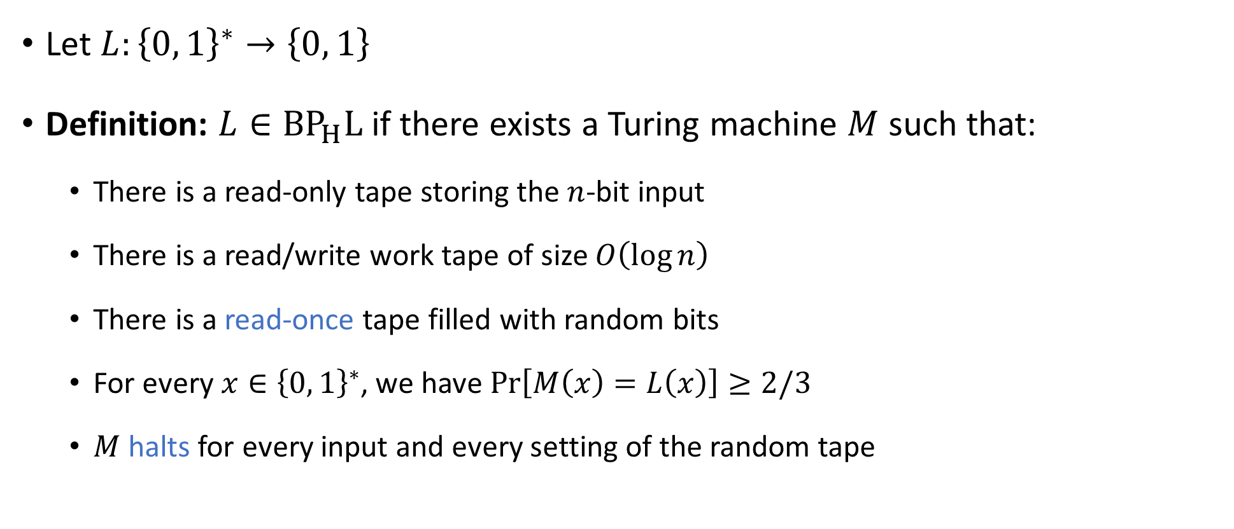
The standard model
Usually denoted $\text{BPL}$
Let $L:{\left\{0, 1\right\}}^{∗}→\left\{0, 1\right\}$
Definition: $L∈{\text{BP}}_{H}\text{L}$ if there exists a Turing machine $M$ such that:
  There is a read-only tape storing the $n$-bit input
  There is a read/write work tape of size $O\left(\log{n}\right)$
  There is a read-once tape filled with random bits
  For every $x∈{\left\{0, 1\right\}}^{∗}$, we have $\operatorname{Pr}\left[M\left(x\right)=L\left(x\right)\right]≥2/3$
  $M$ halts for every input and every setting of the random tape

Slide 5



Derandomizing the standard model
Theorem [OpenAI 2026]: $\text{L}={\text{BP}}_{H}\text{L}$
Culmination of several decades of intense research
Interpretation: In the standard model of randomized log-space computation, randomness is not useful

Slide 6
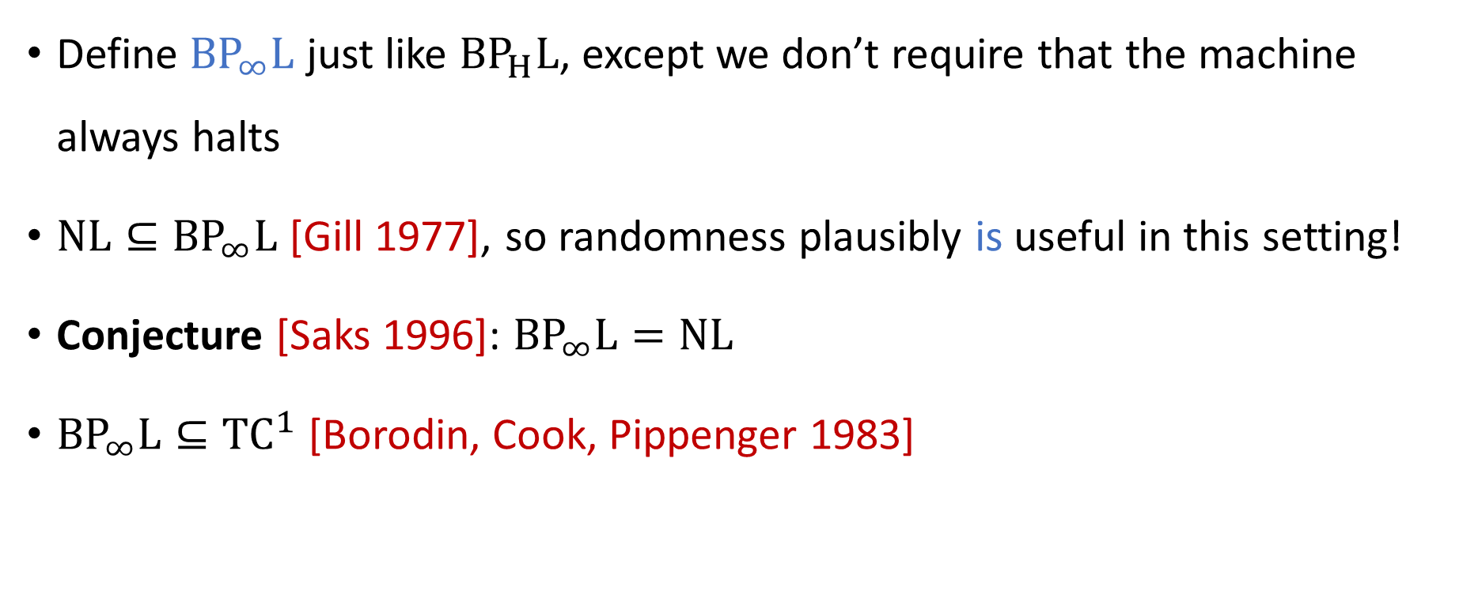
Non-halting model
Define ${\text{BP}}_{∞}\text{L}$ just like ${\text{BP}}_{H}\text{L}$, except we don’t require that the machine always halts
$\text{NL}⊆{\text{BP}}_{∞}\text{L}$ [Gill 1977], so randomness plausibly is useful in this setting!
Conjecture [Saks 1996]: ${\text{BP}}_{∞}\text{L}=\text{NL}$
${\text{BP}}_{∞}\text{L}⊆{\text{TC}}^{1}$ [Borodin, Cook, Pippenger 1983]

Slide 7
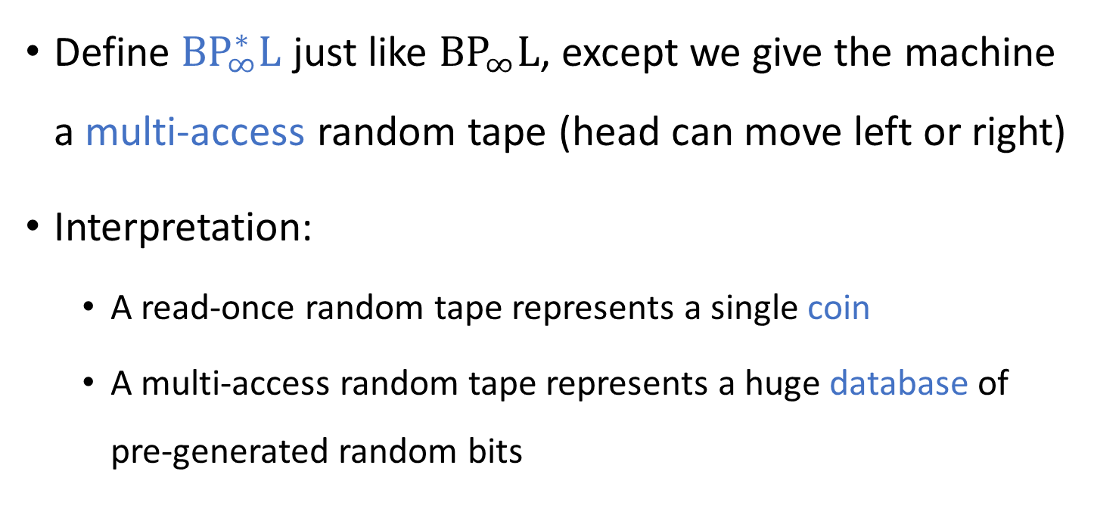
Multi-access randomness
Define ${\text{BP}}_{∞}^{∗}\text{L}$ just like ${\text{BP}}_{∞}\text{L}$, except we give the machine a multi-access random tape (head can move left or right)
Interpretation:
  A read-once random tape represents a single coin
  A multi-access random tape represents a huge database of pre-generated random bits

Slide 8
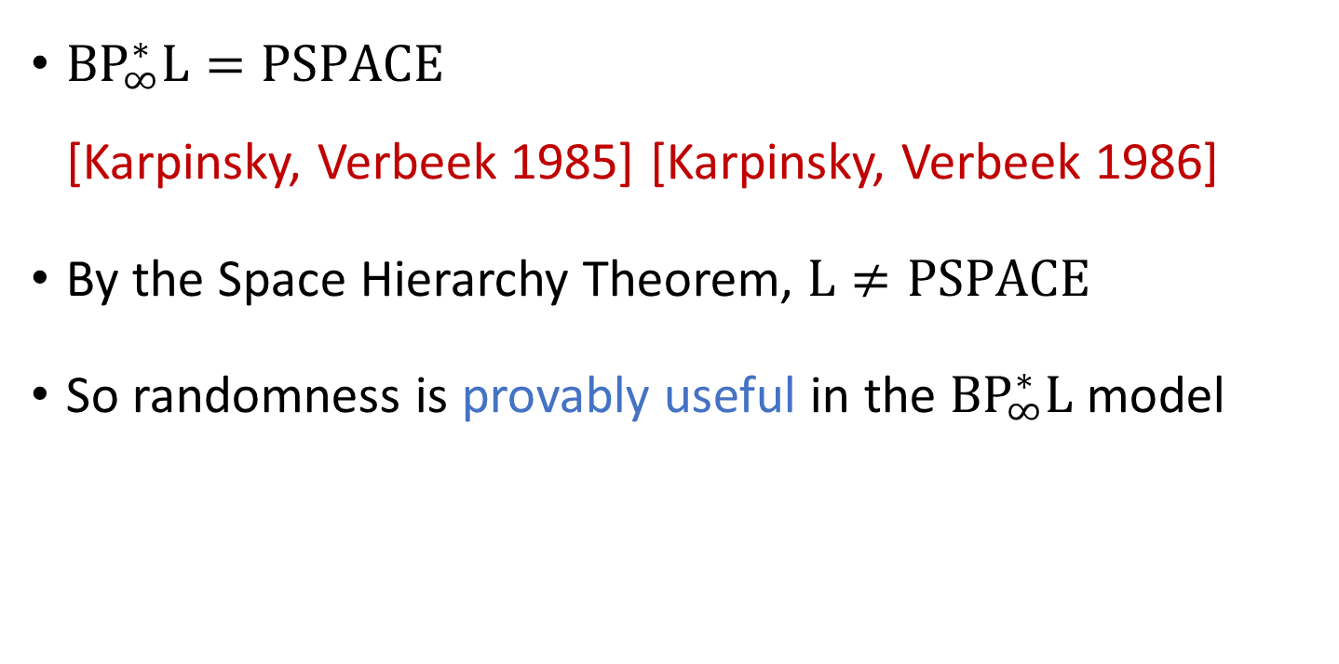
Multi-access randomness
${\text{BP}}_{∞}^{∗}\text{L}=\text{PSPACE}$
[Karpinsky, Verbeek 1985] [Karpinsky, Verbeek 1986]
By the Space Hierarchy Theorem, $\text{L}≠\text{PSPACE}$
So randomness is provably useful in the ${\text{BP}}_{∞}^{∗}\text{L}$ model

Slide 9
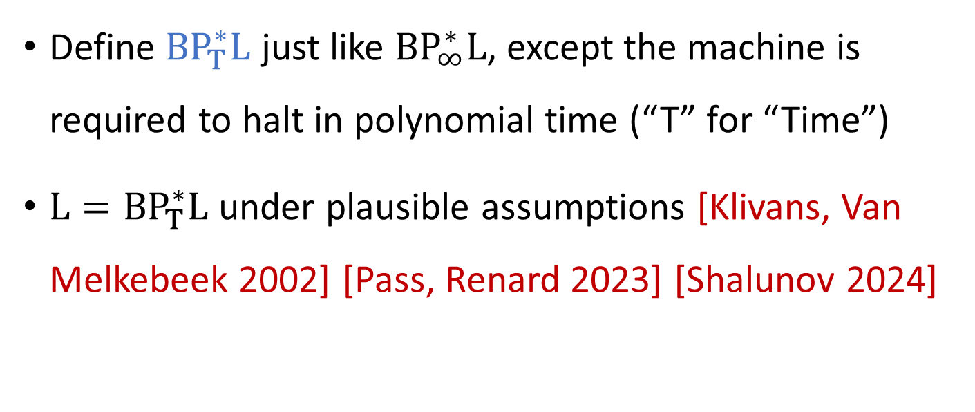
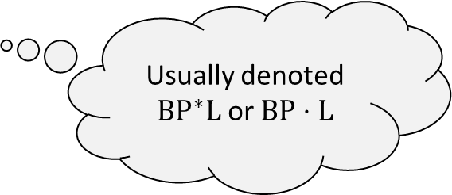
Polynomial-time computation
⏳
Define ${\text{BP}}_{T}^{∗}\text{L}$ just like ${\text{BP}}_{∞}^{∗}\text{L}$, except the machine is required to halt in polynomial time (“T” for “Time”)
$\text{L}={\text{BP}}_{T}^{∗}\text{L}$ under plausible assumptions [Klivans, Van Melkebeek 2002] [Pass, Renard 2023] [Shalunov 2024]
Usually denoted ${\text{BP}}^{∗}\text{L}$ or $\text{BP}⋅\text{L}$

Slide 10
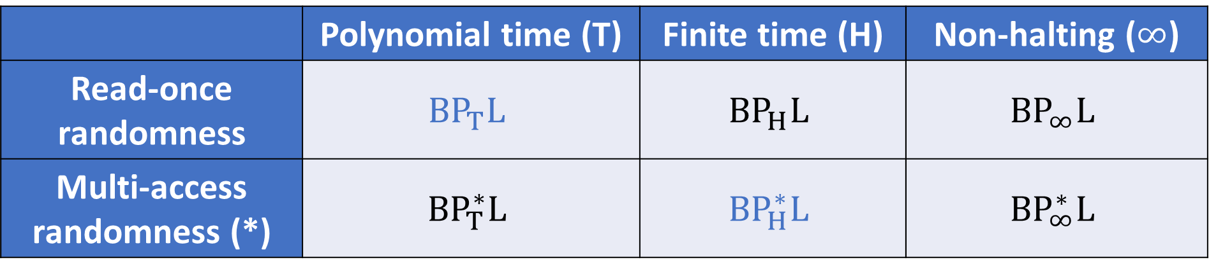
Six models of randomized log-space
 | Polynomial time (T) | Finite time (H) | Non-halting ($∞$)
Read-once randomness | $${\text{BP}}_{T}\text{L}$$ | $${\text{BP}}_{H}\text{L}$$ | $${\text{BP}}_{∞}\text{L}$$
Multi-access randomness (*) | $${\text{BP}}_{T}^{∗}\text{L}$$ | $${\text{BP}}_{H}^{∗}\text{L}$$ | $${\text{BP}}_{∞}^{∗}\text{L}$$

Slide 11
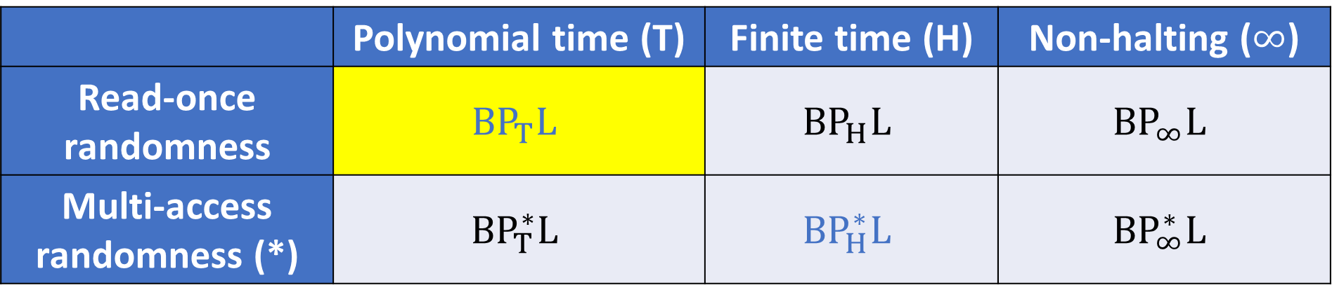
Six models of randomized log-space
 | Polynomial time (T) | Finite time (H) | Non-halting ($∞$)
Read-once randomness | $${\text{BP}}_{T}\text{L}$$ | $${\text{BP}}_{H}\text{L}$$ | $${\text{BP}}_{∞}\text{L}$$
Multi-access randomness (*) | $${\text{BP}}_{T}^{∗}\text{L}$$ | $${\text{BP}}_{H}^{∗}\text{L}$$ | $${\text{BP}}_{∞}^{∗}\text{L}$$

Slide 12
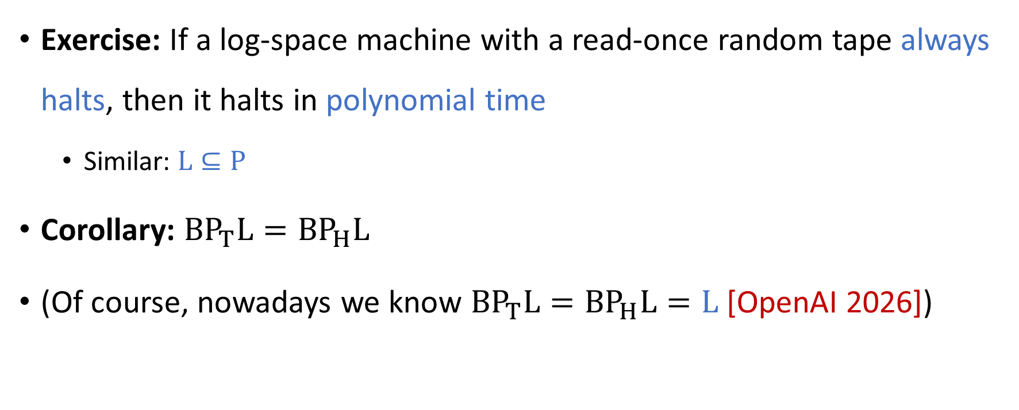
Time complexity in read-once model
⏳
Exercise: If a log-space machine with a read-once random tape always halts, then it halts in polynomial time
  Similar: $\text{L}⊆\text{P}$
Corollary: ${\text{BP}}_{T}\text{L}={\text{BP}}_{H}\text{L}$
(Of course, nowadays we know ${\text{BP}}_{T}\text{L}={\text{BP}}_{H}\text{L}=\text{L}$ [OpenAI 2026])

Slide 13

Six models of randomized log-space
 | Polynomial time (T) | Finite time (H) | Non-halting ($∞$)
Read-once randomness | $${\text{BP}}_{T}\text{L}$$ | $${\text{BP}}_{H}\text{L}$$ | $${\text{BP}}_{∞}\text{L}$$
Multi-access randomness (*) | $${\text{BP}}_{T}^{∗}\text{L}$$ | $${\text{BP}}_{H}^{∗}\text{L}$$ | $${\text{BP}}_{∞}^{∗}\text{L}$$

Slide 14
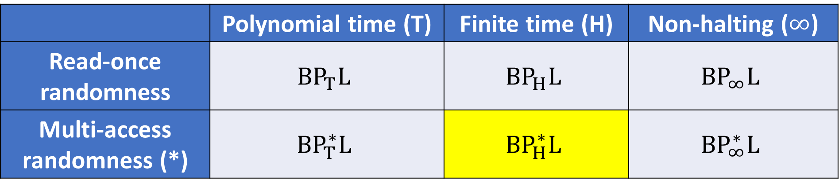
Six models of randomized log-space
 | Polynomial time (T) | Finite time (H) | Non-halting ($∞$)
Read-once randomness | $${\text{BP}}_{T}\text{L}$$ | $${\text{BP}}_{H}\text{L}$$ | $${\text{BP}}_{∞}\text{L}$$
Multi-access randomness (*) | $${\text{BP}}_{T}^{∗}\text{L}$$ | $${\text{BP}}_{H}^{∗}\text{L}$$ | $${\text{BP}}_{∞}^{∗}\text{L}$$

Slide 15

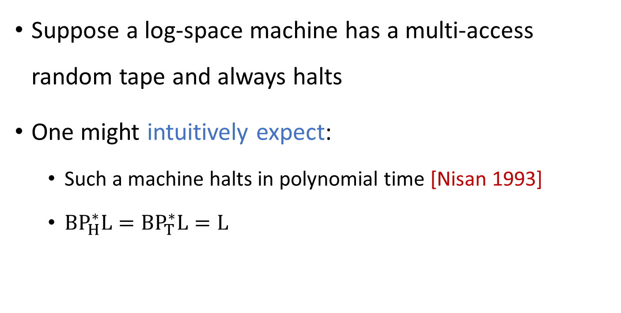
The complexity class ${\text{BP}}_{H}^{∗}\text{L}$
Suppose a log-space machine has a multi-access random tape and always halts
One might intuitively expect:
  Such a machine halts in polynomial time [Nisan 1993]
  ${\text{BP}}_{H}^{∗}\text{L}={\text{BP}}_{T}^{∗}\text{L}=\text{L}$

Slide 16


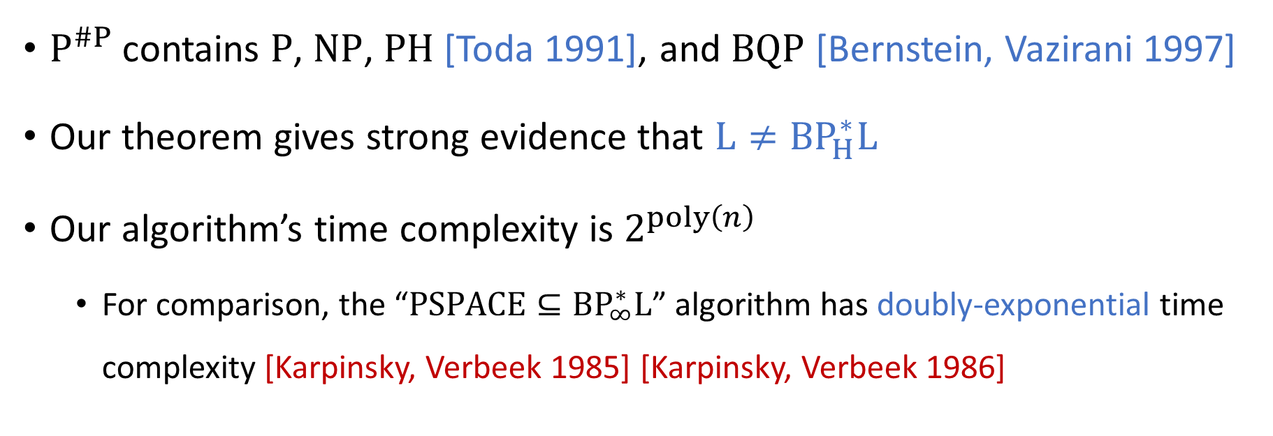
This work: The surprising power of ${\text{BP}}_{H}^{∗}\text{L}$
Main Theorem: ${\text{P}}^{\#P}⊆{\text{BP}}_{H}^{∗}\text{L}$
${\text{P}}^{\#P}$ contains $\text{P}$, $\text{NP}$, $\text{PH}$ [Toda 1991], and $\text{BQP}$ [Bernstein, Vazirani 1997]
Our theorem gives strong evidence that $\text{L}≠{\text{BP}}_{H}^{∗}\text{L}$
Our algorithm’s time complexity is $2^{poly\left(n\right)}$
  For comparison, the “$\text{PSPACE}⊆{\text{BP}}_{∞}^{∗}\text{L}$” algorithm has doubly-exponential time complexity [Karpinsky, Verbeek 1985] [Karpinsky, Verbeek 1986]

Slide 17
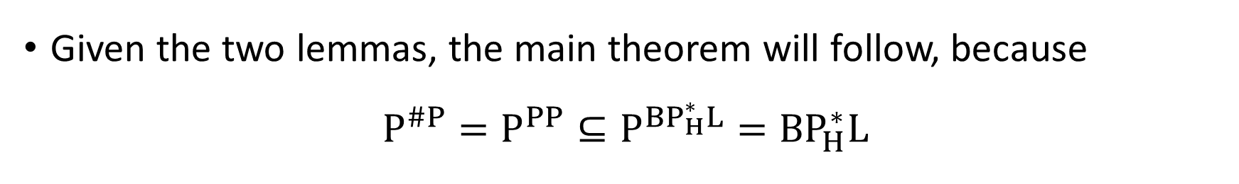
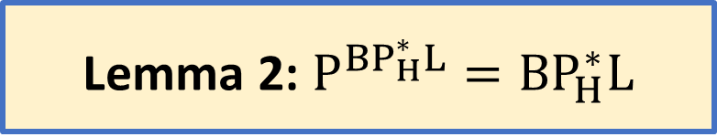

Proof overview
Lemma 1: $\text{PP}⊆{\text{BP}}_{H}^{∗}\text{L}$
Lemma 2: ${\text{P}}^{BP_{H}^{∗}L}={\text{BP}}_{H}^{∗}\text{L}$
Given the two lemmas, the main theorem will follow, because
$${\text{P}}^{\#P}={\text{P}}^{PP}⊆{\text{P}}^{BP_{H}^{∗}L}={\text{BP}}_{H}^{∗}\text{L}$$
[Gill 1977]
Lemma 1
Lemma 2

Slide 18
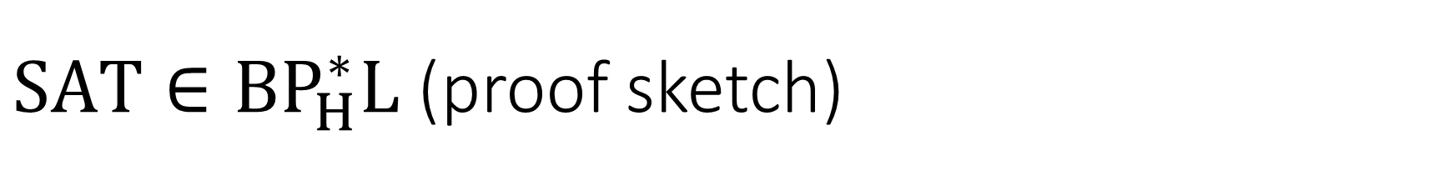
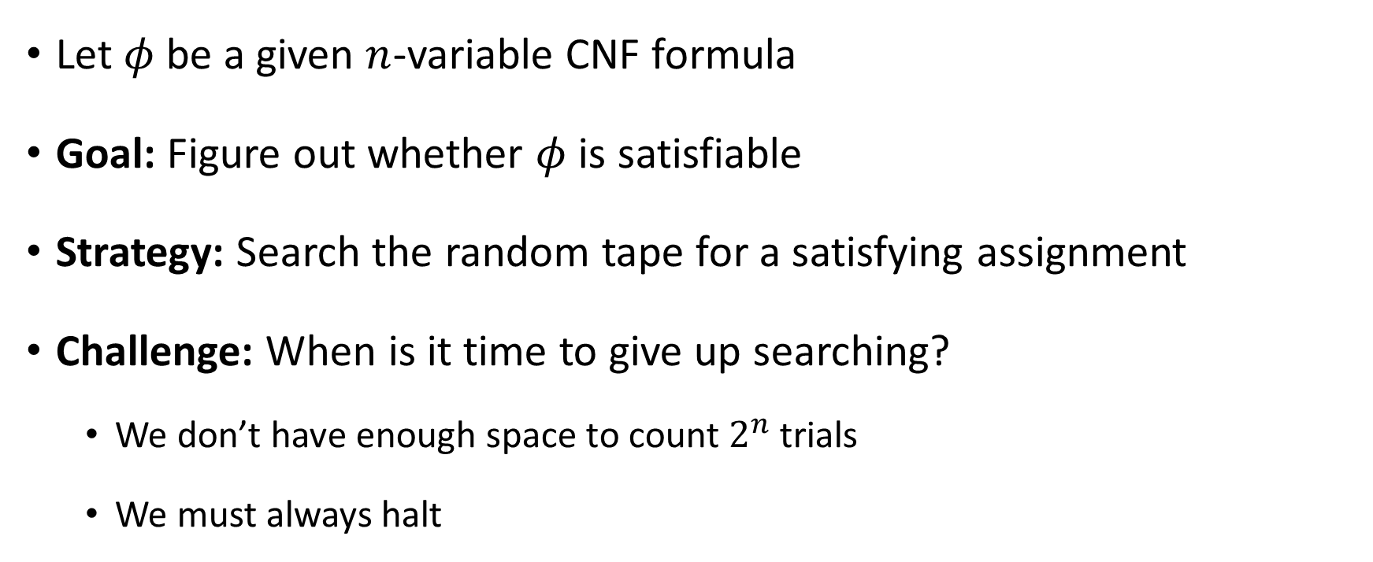
$\text{SAT}∈{\text{BP}}_{H}^{∗}\text{L}$ (proof sketch)
Let $φ$ be a given $n$-variable CNF formula
Goal: Figure out whether $φ$ is satisfiable
Strategy: Search the random tape for a satisfying assignment
Challenge: When is it time to give up searching?
  We don’t have enough space to count $2^{n}$ trials
  We must always halt

Slide 19
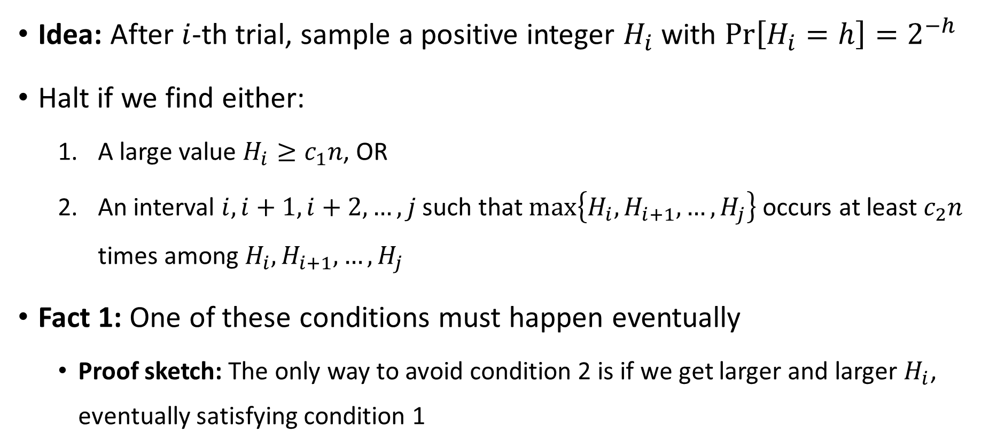
A probabilistic timer
⏳
Idea: After $i$-th trial, sample a positive integer $H_{i}$ with $\operatorname{Pr}\left[H_{i}=h\right]=2^{−h}$
Halt if we find either:
  A large value $H_{i}≥c_{1}n$, OR
  An interval $i,i+1,i+2,…, j$ such that $\max\left\{H_{i},H_{i+1},…, H_{j}\right\}$ occurs at least $c_{2}n$ times among $H_{i},H_{i+1},…, H_{j}$
Fact 1: One of these conditions must happen eventually
  Proof sketch: The only way to avoid condition 2 is if we get larger and larger $H_{i}$, eventually satisfying condition 1

Slide 20
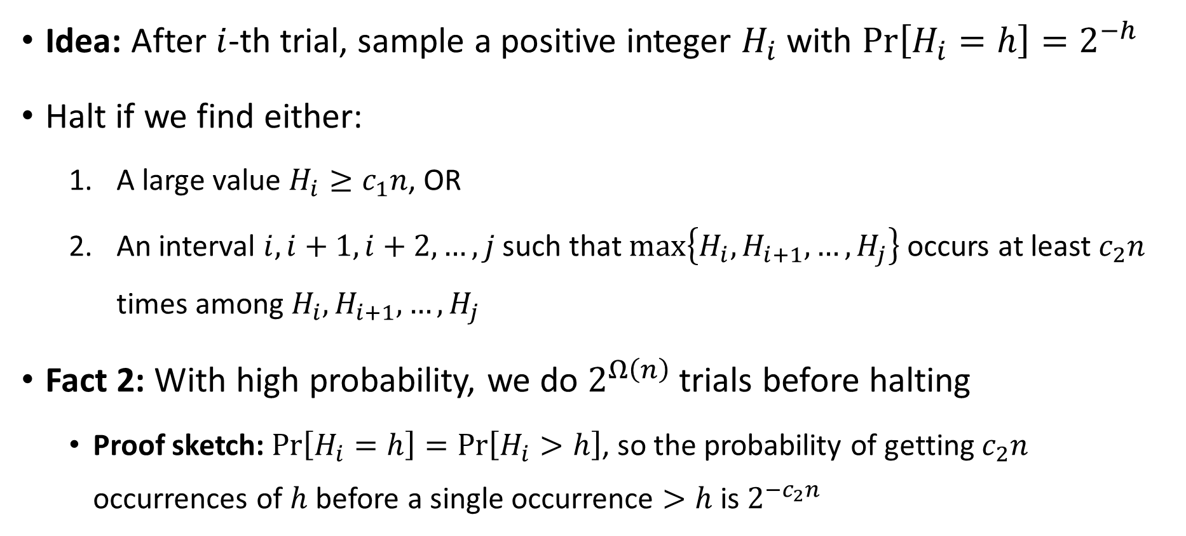
A probabilistic timer
⏳
Idea: After $i$-th trial, sample a positive integer $H_{i}$ with $\operatorname{Pr}\left[H_{i}=h\right]=2^{−h}$
Halt if we find either:
  A large value $H_{i}≥c_{1}n$, OR
  An interval $i,i+1,i+2,…, j$ such that $\max\left\{H_{i},H_{i+1},…, H_{j}\right\}$ occurs at least $c_{2}n$ times among $H_{i},H_{i+1},…, H_{j}$
Fact 2: With high probability, we do $2^{Ω\left(n\right)}$ trials before halting
  Proof sketch: $\operatorname{Pr}\left[H_{i}=h\right]=\operatorname{Pr}\left[H_{i}>h\right]$, so the probability of getting $c_{2}n$ occurrences of $h$ before a single occurrence $>h$ is $2^{−c_{2}n}$

Slide 21
Lemma 1: $\text{PP}⊆{\text{BP}}_{H}^{∗}\text{L}$
Lemma 2: ${\text{P}}^{BP_{H}^{∗}L}={\text{BP}}_{H}^{∗}\text{L}$
Strategy for proving Lemma 2: We will show how to use the (read-only!) random tape to implement a stack

Slide 22
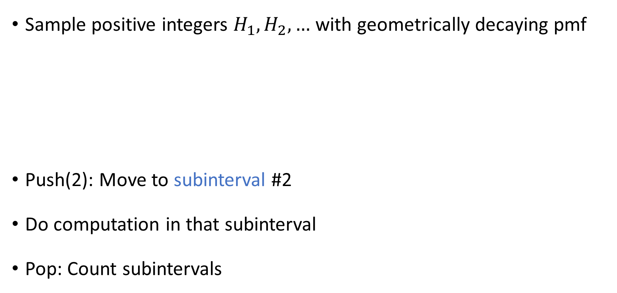
Implementing a stack
Cf. skip list [Pugh 1990]
Cf. [Küçük, Say, and Yakaryilmaz 2014]
Sample positive integers $H_{1},H_{2},…$ with geometrically decaying pmf
Push(2): Move to subinterval #2
Do computation in that subinterval
Pop: Count subintervals
1
1
2
2
Notes:
Pronunciations: “k’chook” “say” “yah-kahr-yuhl-mahz”

Slide 23
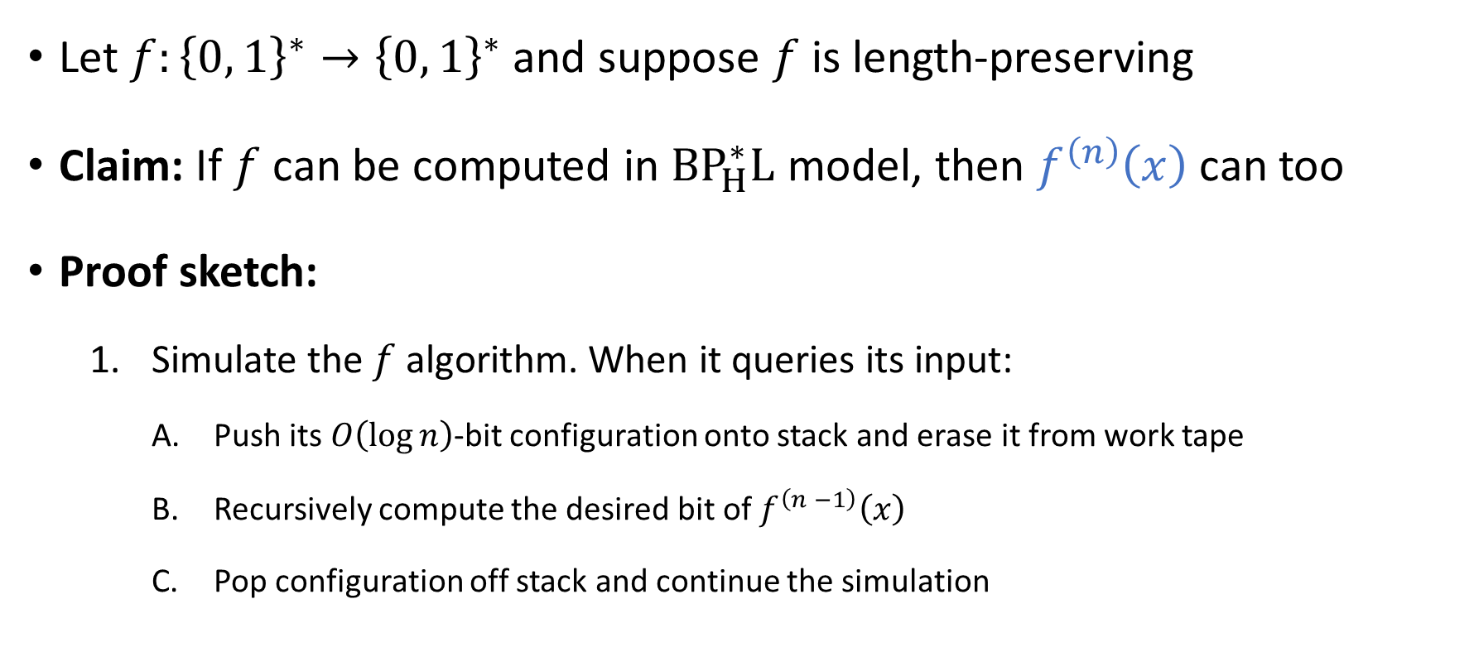
Using the stack to compose algorithms
Let $f:{\left\{0, 1\right\}}^{∗}→{\left\{0, 1\right\}}^{∗}$ and suppose $f$ is length-preserving
Claim: If $f$ can be computed in ${\text{BP}}_{H}^{∗}\text{L}$ model, then $f^{\left(n\right)}\left(x\right)$ can too
Proof sketch:
  Simulate the $f$ algorithm. When it queries its input:
    Push its $O\left(\log{n}\right)$-bit configuration onto stack and erase it from work tape
    Recursively compute the desired bit of $f^{\left(n −1\right)}\left(x\right)$
    Pop configuration off stack and continue the simulation

Slide 24
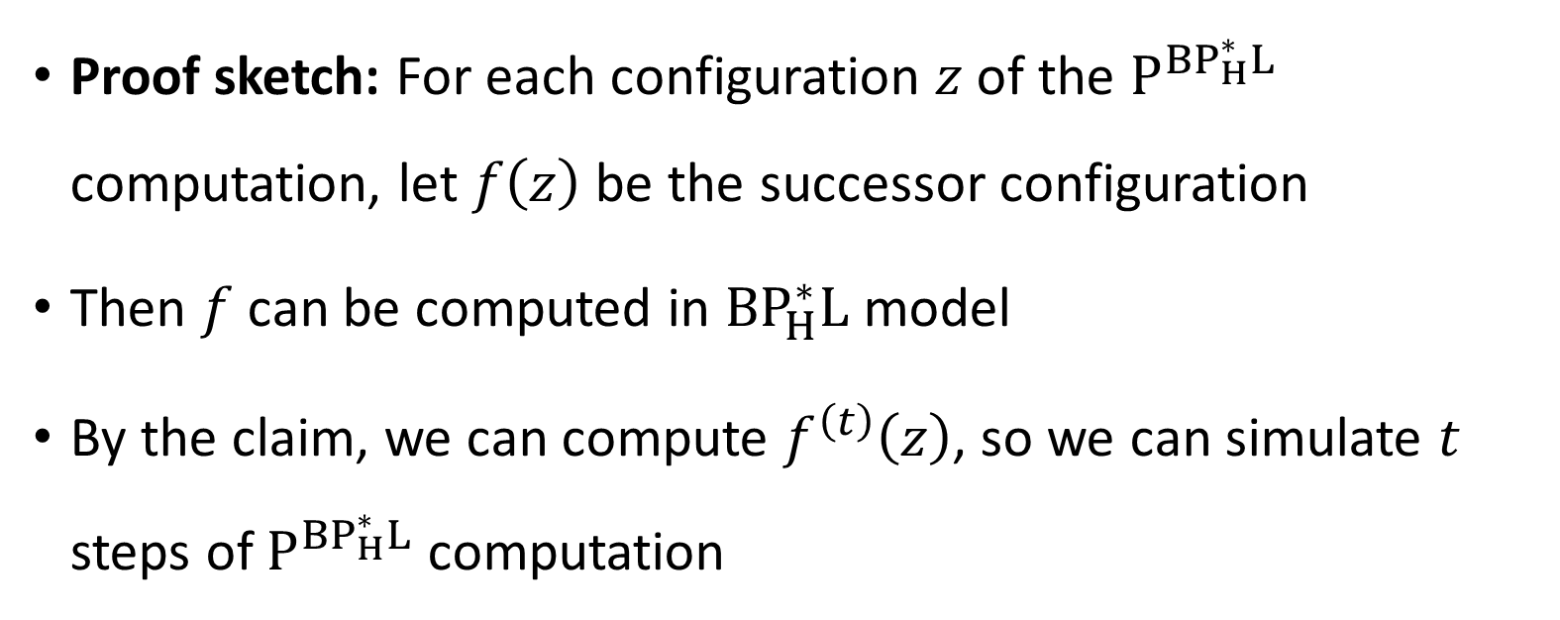

Finishing the proof of the lemma
Lemma 2: ${\text{P}}^{BP_{H}^{∗}L}={\text{BP}}_{H}^{∗}\text{L}$
Proof sketch: For each configuration $z$ of the ${\text{P}}^{BP_{H}^{∗}L}$ computation, let $f\left(z\right)$ be the successor configuration
Then $f$ can be computed in ${\text{BP}}_{H}^{∗}\text{L}$ model
By the claim, we can compute $f^{\left(t\right)}\left(z\right)$, so we can simulate $t$ steps of ${\text{P}}^{BP_{H}^{∗}L}$ computation

Slide 25
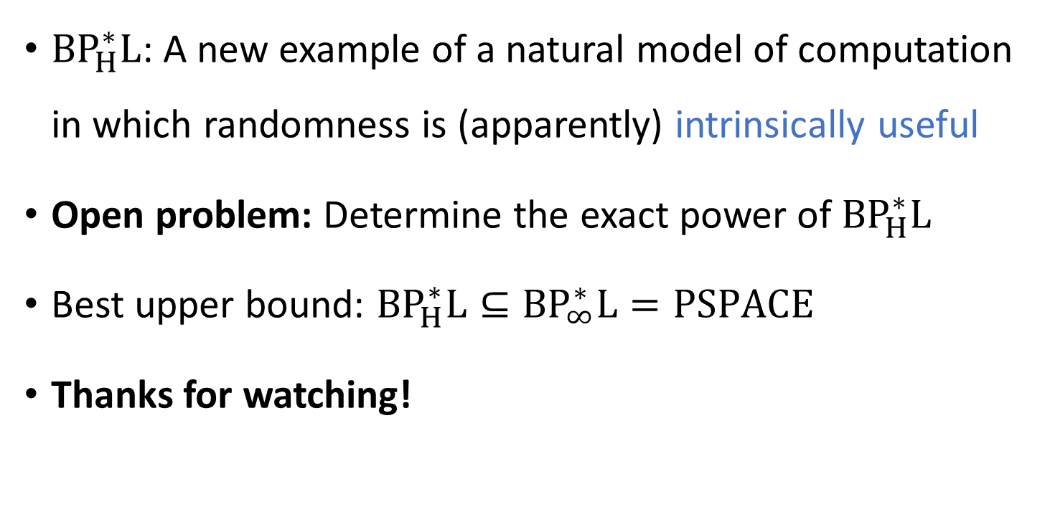
Conclusions
${\text{BP}}_{H}^{∗}\text{L}$: A new example of a natural model of computation in which randomness is (apparently) intrinsically useful
Open problem: Determine the exact power of ${\text{BP}}_{H}^{∗}\text{L}$
Best upper bound: ${\text{BP}}_{H}^{∗}\text{L}⊆{\text{BP}}_{∞}^{∗}\text{L}=\text{PSPACE}$
Thanks for watching!

