Slide 1

CMSC 28100 Introduction to Complexity Theory Spring 2024 Instructor: William Hoza

Slide 2
Which problems can be solved through computation?

Slide 3
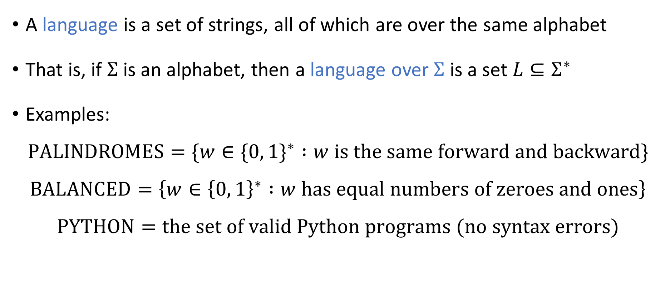
Languages
A language is a set of strings, all of which are over the same alphabet
That is, if $Σ$ is an alphabet, then a language over $Σ$ is a set $L⊆Σ^{∗}$
Examples:
$$\text{PALINDROMES}=\{w∈\{0, 1\}^{∗} :w \text{is} \text{the} \text{same} \text{forward} \text{and} \text{backward}\}$$
$$\text{BALANCED}=\left\{w∈{\left\{0, 1\right\}}^{∗} :w \text{has} \text{equal} \text{numbers} \text{of} \text{zeroes} \text{and} \text{ones}\right\}$$
$$\text{PYTHON}=\text{the} \text{set} \text{of} \text{valid} \text{Python} \text{programs}\text{ (}\text{no} \text{syntax} \text{errors}\text{)}$$

Slide 4
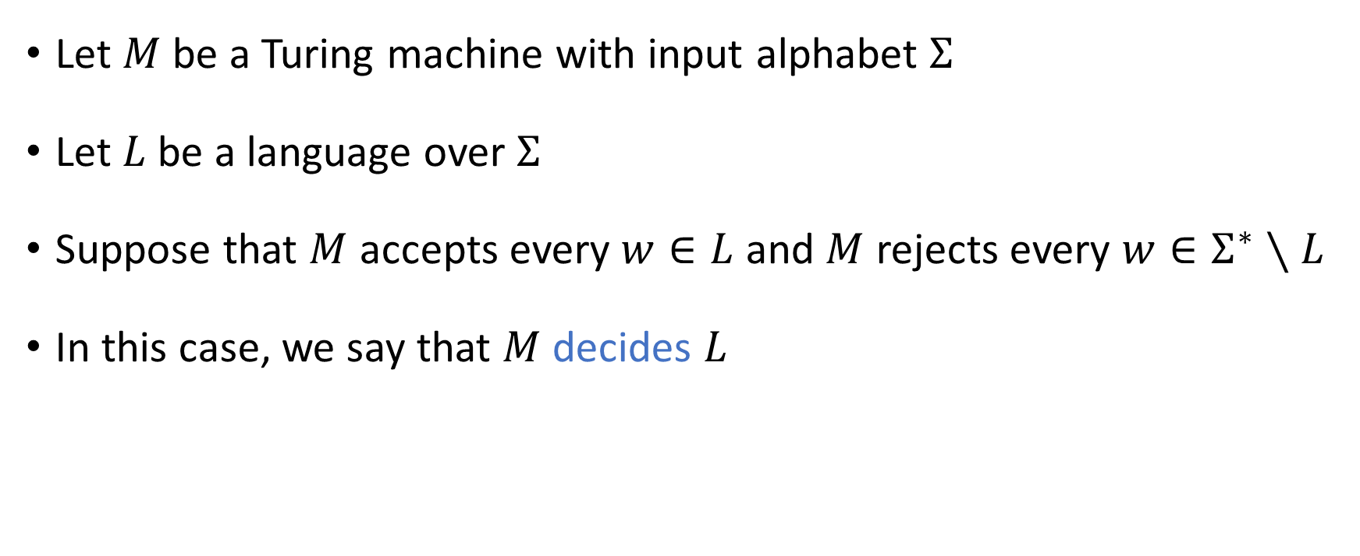
Deciding a language
Let $M$ be a Turing machine with input alphabet $Σ$
Let $L$ be a language over $Σ$
Suppose that $M$ accepts every $w∈L$ and $M$ rejects every $w∈Σ^{∗}∖L$
In this case, we say that $M$ decides $L$

Slide 5

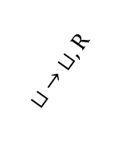
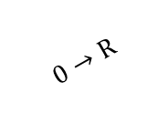



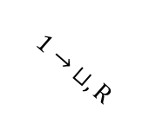
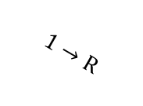


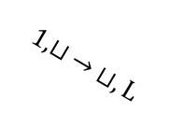

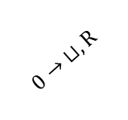


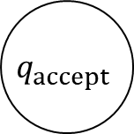
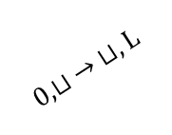

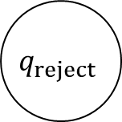


Example: A TM that decides $\text{PALINDROMES}$
$$0,1→\text{R}$$
$$r_{0}$$
$$⊔ →\text{L}$$
$$ℓ_{0}$$
$$0→ ⊔,\text{R}$$
$$0,⊔ → ⊔,\text{L}$$
$$1→\text{R}$$
$$q_{reject}$$
$$q_{0}$$
$$⊔ →\text{R}$$
$$ℓ$$
$$0,1←\text{L}$$
$$⊔ → ⊔,\text{R}$$
$$1→ ⊔,\text{R}$$
$$1,⊔ → ⊔,\text{L}$$
$$0→\text{R}$$
$$r_{1}$$
$$⊔ →\text{L}$$
$$ℓ_{1}$$
$$q_{accept}$$
$$0,1→\text{R}$$

Slide 6

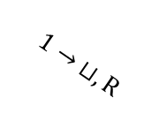

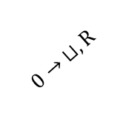


Example: This TM does not decide any language
$$q_{accept}$$
$$0→ ⊔,\text{R}$$
$$q_{0}$$
$$1→ ⊔,\text{R}$$
$$⊔ → ⊔,\text{R}$$
$$q_{reject}$$

Slide 7
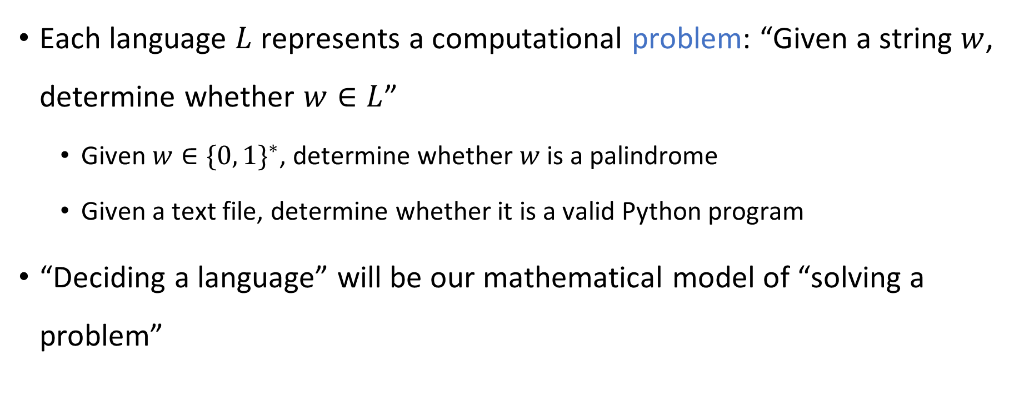
Languages as a model of problems
Each language $L$ represents a computational problem: “Given a string $w$, determine whether $w∈L$”
Given $w∈\{0, 1\}^{∗}$, determine whether $w$ is a palindrome
Given a text file, determine whether it is a valid Python program
“Deciding a language” will be our mathematical model of “solving a problem”

Slide 8
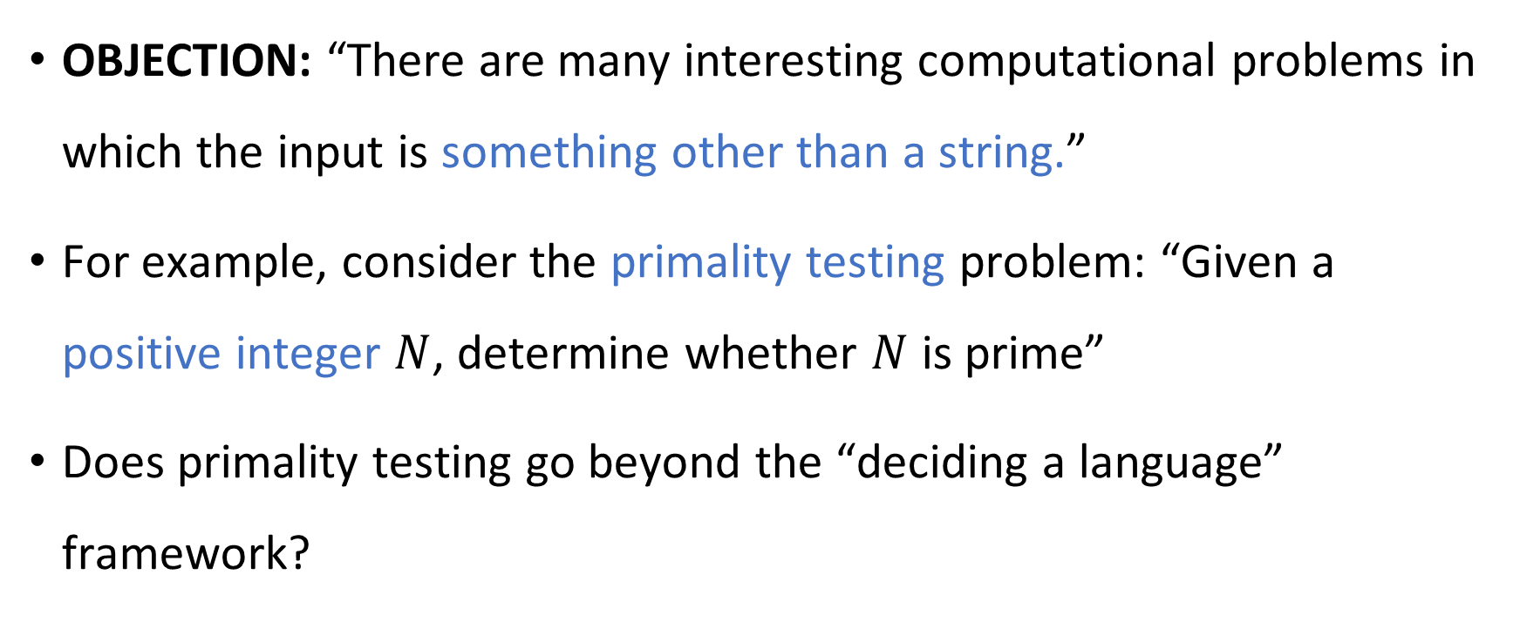
Problems about things other than strings
OBJECTION: “There are many interesting computational problems in which the input is something other than a string.”
For example, consider the primality testing problem: “Given a positive integer $N$, determine whether $N$ is prime”
Does primality testing go beyond the “deciding a language” framework?

Slide 9
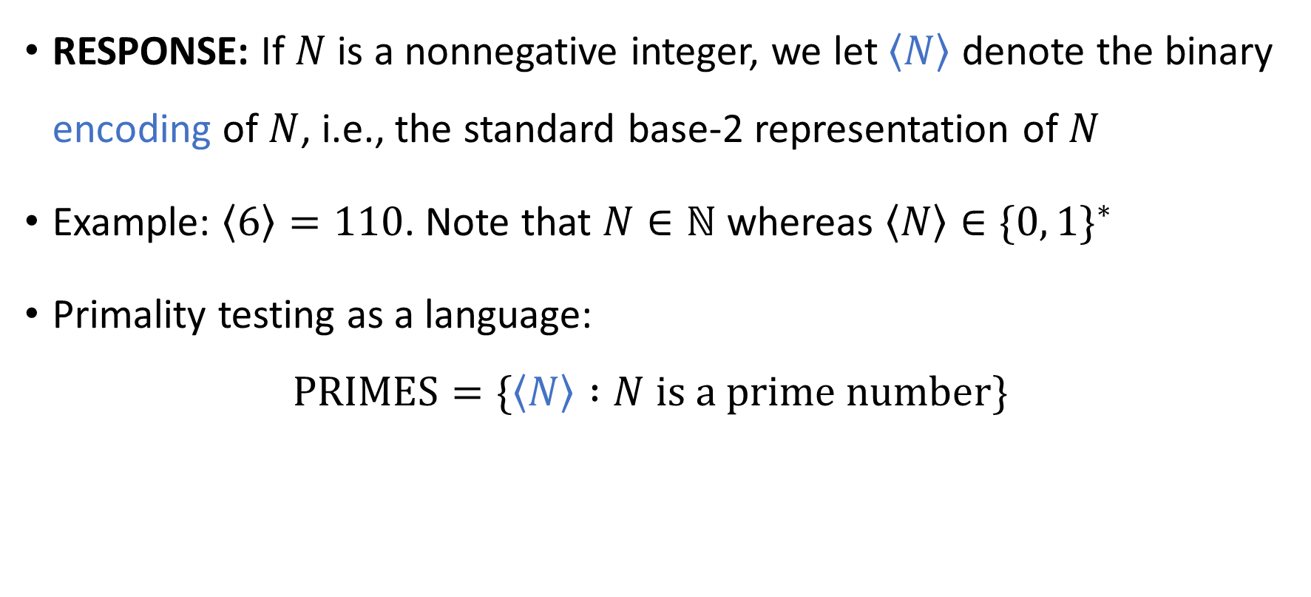
Encoding numbers as strings
RESPONSE: If $N$ is a nonnegative integer, we let $\left\langle N\right\rangle$ denote the binary encoding of $N$, i.e., the standard base-2 representation of $N$
Example: $\left\langle 6\right\rangle =110$. Note that $N∈ℕ$ whereas $\left\langle N\right\rangle ∈\{0, 1\}^{∗}$
Primality testing as a language:
$$\text{PRIMES}=\{\left\langle N\right\rangle :N \text{is} \text{a} \text{prime} \text{number}\}$$

Slide 10
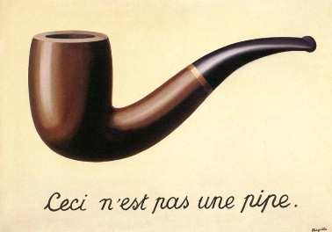
Encoding the input as a string
If we want to give something to a Turing machine, we must first “encode” it as a string
The same is true of human computation!
We say, “Given a positive integer, determine whether it is prime,” but is it truly possible to “give” someone an abstract concept such as an integer?
Being pedantic, we could speak more precisely and say, “Given a piece of text, determine whether it represents/encodes a prime number”
“This is not a pipe.”
(1929 painting by René Magritte)

Slide 11
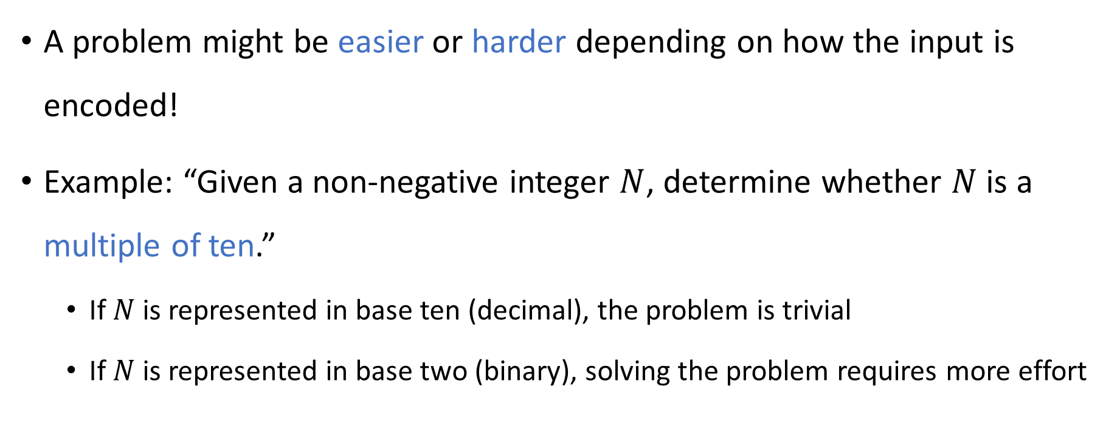
Multiple possible encodings
A problem might be easier or harder depending on how the input is encoded!
Example: “Given a non-negative integer $N$, determine whether $N$ is a multiple of ten.”
If $N$ is represented in base ten (decimal), the problem is trivial
If $N$ is represented in base two (binary), solving the problem requires more effort

Slide 12
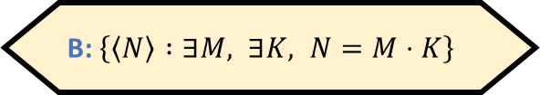

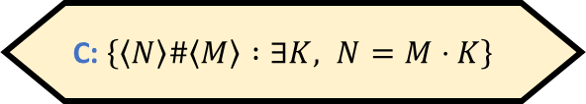
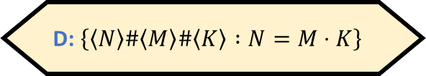

Integer divisibility
Here’s another problem: “Given two positive integers, $N$ and $M$, determine whether $N$ is a multiple of $M$.”
How can we model this problem as a language?
A: $\left\{\left\langle N\right\rangle \left\langle M\right\rangle :∃K, N=M⋅K\right\}$
B: $\left\{\left\langle N\right\rangle :∃M, ∃K, N=M⋅K\right\}$
C: $\left\{\left\langle N\right\rangle \#\left\langle M\right\rangle :∃K, N=M⋅K\right\}$
D: $\left\{\left\langle N\right\rangle \#\left\langle M\right\rangle \#\left\langle K\right\rangle :N=M⋅K\right\}$
Respond at PollEv.com/whoza or text “whoza” to 22333

Slide 13

Encoding a pair of integers as a string
If $N$ and $M$ are nonnegative integers, then we define
$$\left\langle N,M\right\rangle =\left\langle N\right\rangle \#⟨M⟩∈{\left\{0, 1, \#\right\}}^{∗}$$

Slide 14

“Invalid” inputs
Problem: “Given nonnegative integers $N,M$, determine whether $N$ is a multiple of $M$.”
$L=\{\left\langle N,M\right\rangle :N, M \text{are} \text{nonnegative} \text{integers} \text{and} N \text{is} \text{a} \text{multiple} \text{of} M\}$
Convention: We always formulate the language to exclude “invalid” inputs
Input | Correct Output | Explanation
100#10 | Accept | 4 is a multiple of 2
101#11 | Reject | 5 is not a multiple of 3
1#1#0### | Reject | “Invalid” input

Slide 15

Encoding graphs as strings
If $G$ is a graph on $N$ vertices, we let $⟨G⟩$ denote its adjacency matrix, unraveled into a string, so $\left\langle G\right\rangle ∈\{0, 1\}^{N^{2}}$

Slide 16
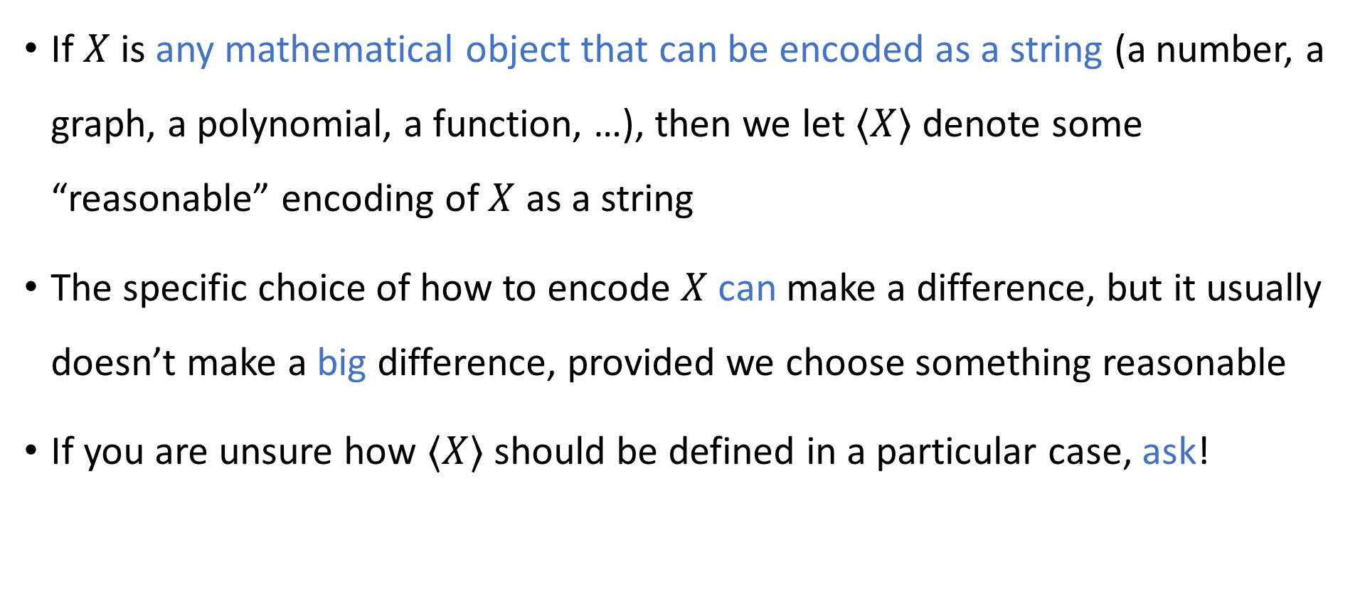
Encoding other things as strings
If $X$ is any mathematical object that can be encoded as a string (a number, a graph, a polynomial, a function, …), then we let $⟨X⟩$ denote some “reasonable” encoding of $X$ as a string
The specific choice of how to encode $X$ can make a difference, but it usually doesn’t make a big difference, provided we choose something reasonable
If you are unsure how $⟨X⟩$ should be defined in a particular case, ask!

Slide 17
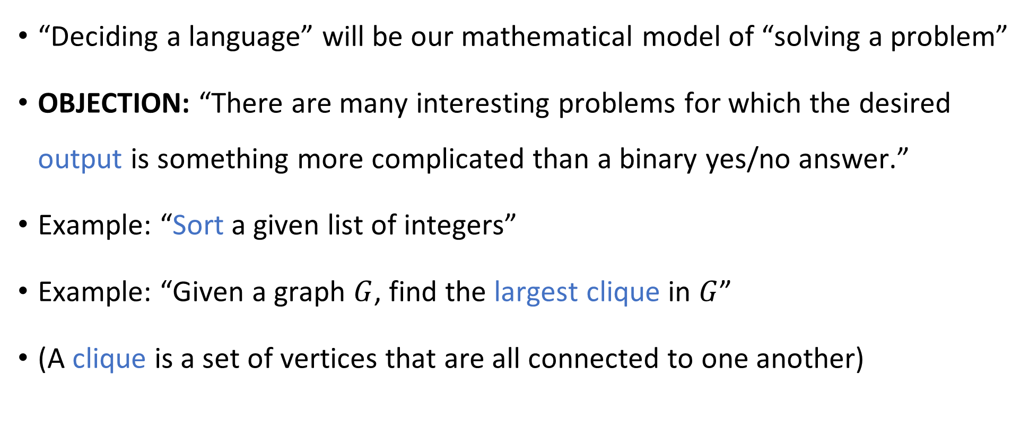
Beyond decision problems
“Deciding a language” will be our mathematical model of “solving a problem”
OBJECTION: “There are many interesting problems for which the desired output is something more complicated than a binary yes/no answer.”
Example: “Sort a given list of integers”
Example: “Given a graph $G$, find the largest clique in $G$”
(A clique is a set of vertices that are all connected to one another)

Slide 18
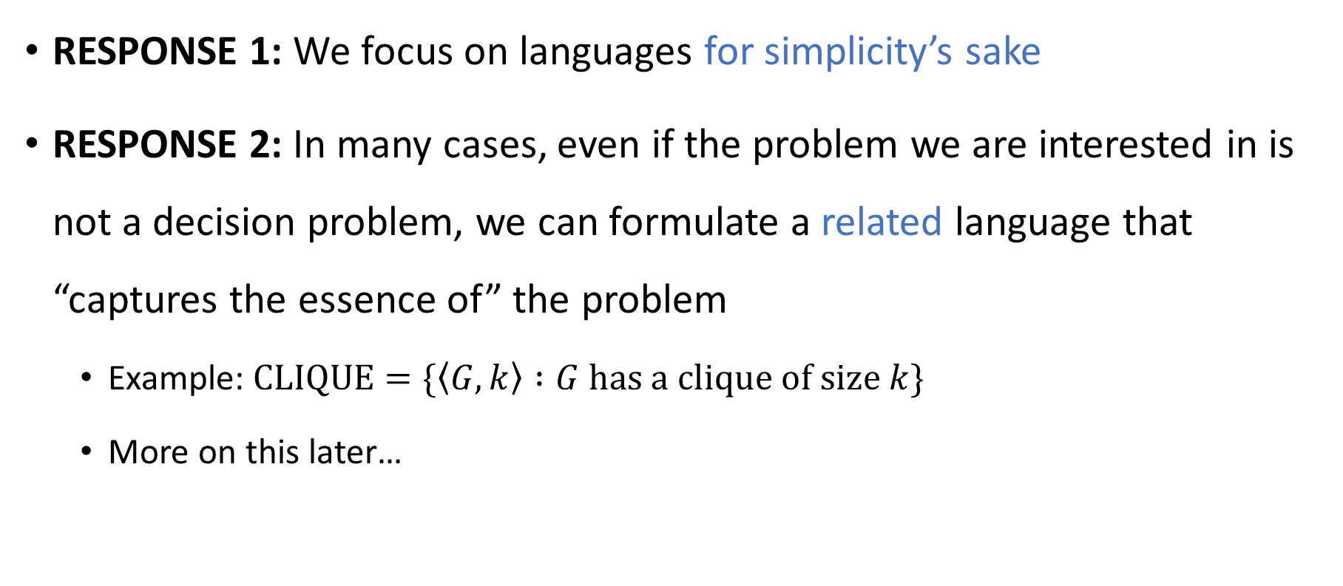
Beyond decision problems
RESPONSE 1: We focus on languages for simplicity’s sake
RESPONSE 2: In many cases, even if the problem we are interested in is not a decision problem, we can formulate a related language that “captures the essence of” the problem
Example: $\text{CLIQUE}=\{\left\langle G,k\right\rangle :G \text{has} \text{a} \text{clique} \text{of} \text{size} k\}$
More on this later…

Slide 19
Which problems can be solved through computation?

Slide 20
Mathematical models
Model of “solving a problem:” deciding a language
It’s a pretty good model, but admittedly, it does not encompass all possible computational problems
Model of “computation:” the Turing machine
Does this model encompass all possible algorithms?

Slide 21
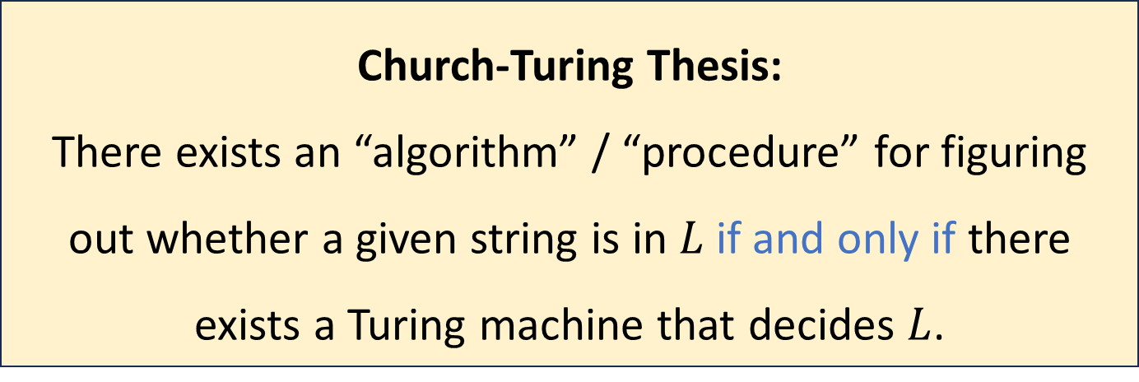
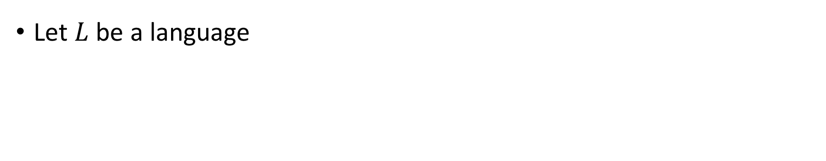
The Church-Turing Thesis
Let $L$ be a language
Church-Turing Thesis:
There exists an “algorithm” / “procedure” for figuring out whether a given string is in $L$ if and only if there exists a Turing machine that decides $L$.
Intuitive notion
Mathematically precise notion

Slide 22
Church-Turing Thesis
The Church-Turing thesis says that the Turing machine model is the “correct” model of arbitrary computation
The thesis says that the informal concept of an “algorithm” is successfully captured by the rigorous definition of a Turing machine

Slide 23
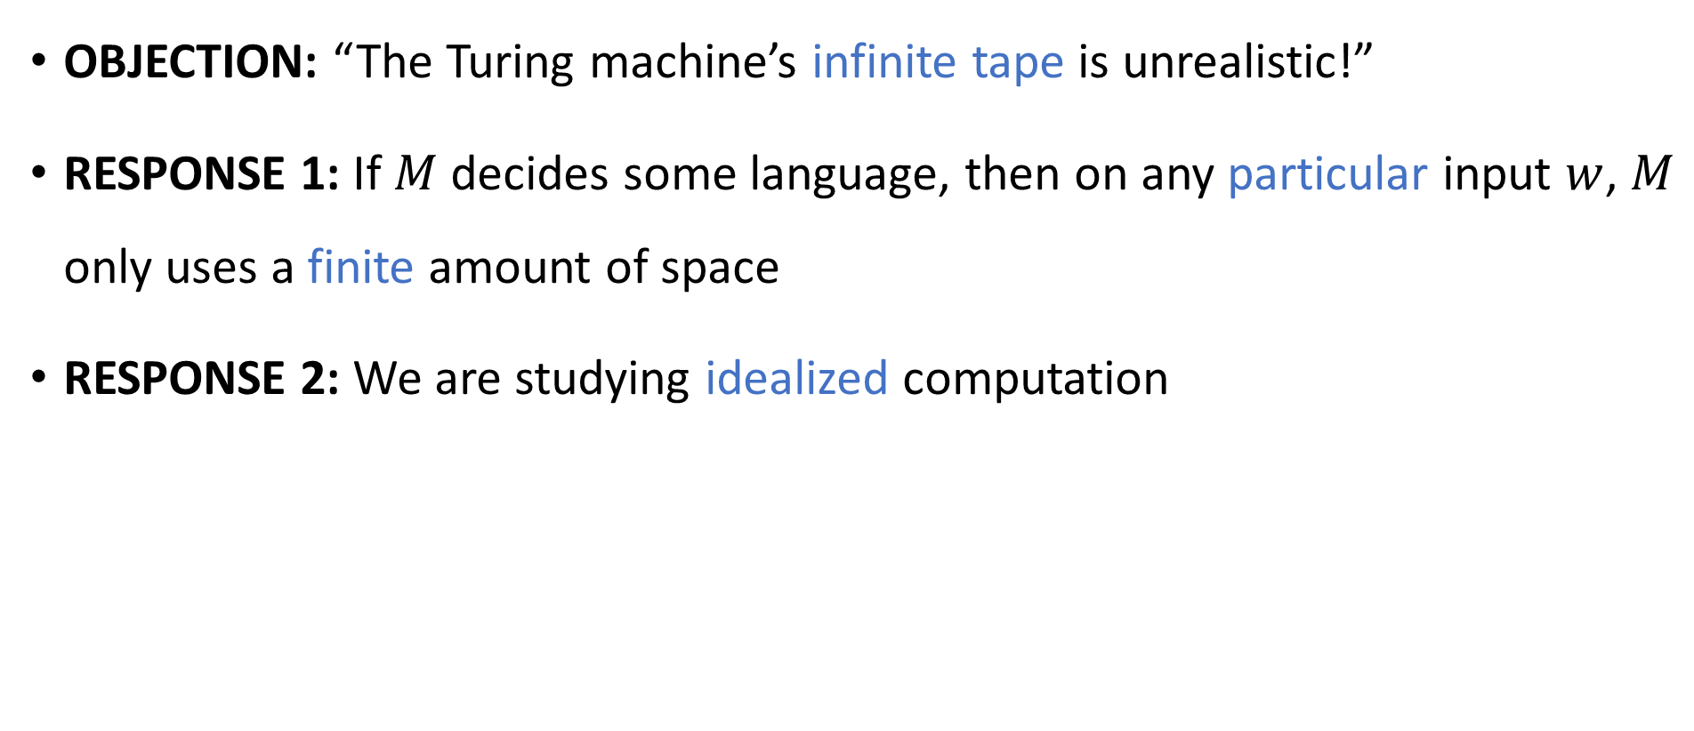
Are Turing machines too powerful?
OBJECTION: “The Turing machine’s infinite tape is unrealistic!”
RESPONSE 1: If $M$ decides some language, then on any particular input $w$, $M$ only uses a finite amount of space
RESPONSE 2: We are studying idealized computation

