Slide 1
CMSC 28100 Introduction to Complexity Theory Winter 2024 Instructor: William Hoza
7 |  |  |  |  |  |  | 5 | 3
 |  |  |  |  |  |  |  | 4
 | 4 | 8 |  | 3 |  | 1 | 2
8 |  | 1 | 3 |  |  | 2 | 7 | 5
 | 9 |  | 1 |  |  |  | 4
 | 5 |  |  |  |  | 3
2 |  | 5 |  | 8 | 4
1 | 3 | 4 |  | 5

Slide 2


The complexity class $\text{coNP}$
$\text{coNP}$ is the set of complements of languages in $\text{NP}$
That is, $L∈\text{coNP}$ if and only if $\overline{L}∈\text{NP}$, where $\overline{L}=Σ^{∗}∖L$

Slide 3
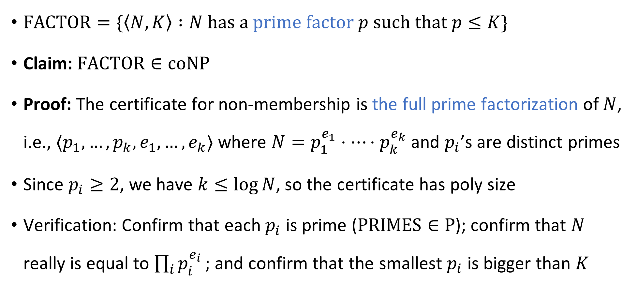

$\text{FACTOR}∈\text{coNP}$
$\text{FACTOR}=\{\left\langle N,K\right\rangle :N \text{has} \text{a} \text{prime} \text{factor} p \text{such} \text{that} p≤K\}$
Claim: $\text{FACTOR}∈\text{coNP}$
Proof: The certificate for non-membership is the full prime factorization of $N$, i.e., $⟨p_{1}, …, p_{k}, e_{1}, …, e_{k}⟩$ where $N=p_{1}^{e_{1}}⋅⋯⋅p_{k}^{e_{k}}$ and $p_{i}$’s are distinct primes
Since $p_{i}≥2$, we have $k≤\log{N}$, so the certificate has poly size
Verification: Confirm that each $p_{i}$ is prime ($\text{PRIMES}∈\text{P}$); confirm that $N$ really is equal to $\prod_{i}{p_{i}^{e_{i}}};$ and confirm that the smallest $p_{i}$ is bigger than $K$

Slide 4
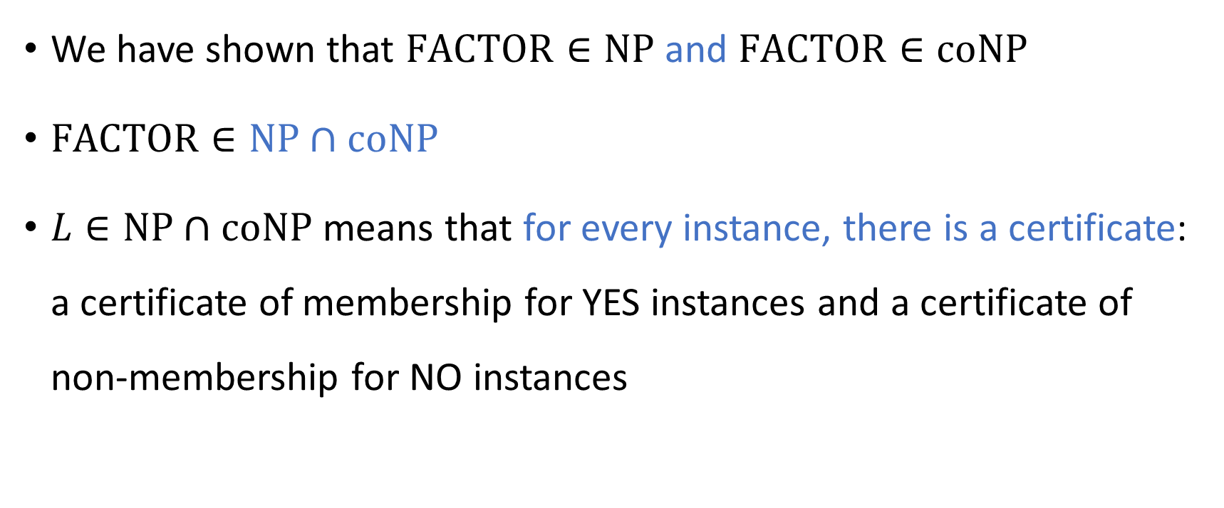

The complexity class $\text{NP}∩\text{coNP}$
We have shown that $\text{FACTOR}∈\text{NP}$ and $\text{FACTOR}∈\text{coNP}$
$\text{FACTOR}∈\text{NP}∩\text{coNP}$
$L∈\text{NP}∩\text{coNP}$ means that for every instance, there is a certificate: a certificate of membership for YES instances and a certificate of non-membership for NO instances

Slide 5
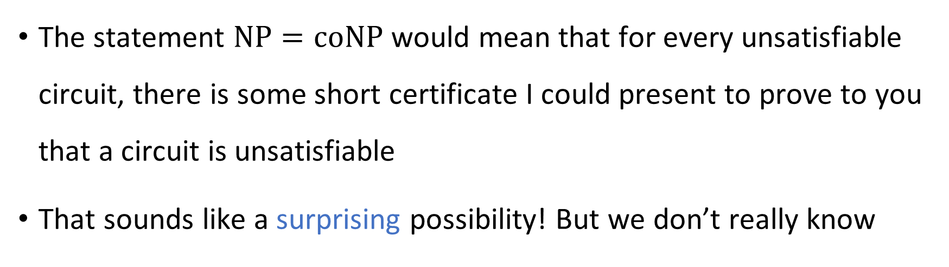


The $\text{NP}$ vs. $\text{coNP}$ problem
Conjecture: $\text{NP}≠\text{coNP}$
The statement $\text{NP}=\text{coNP}$ would mean that for every unsatisfiable circuit, there is some short certificate I could present to prove to you that a circuit is unsatisfiable
That sounds like a surprising possibility! But we don’t really know

Slide 6






$$\text{EXP}$$
$$\text{coNP}$$
$$\text{NP}$$
$$\text{FACTOR}$$
$$\text{NP}∩\text{coNP}$$
$$\text{P}$$

Slide 7

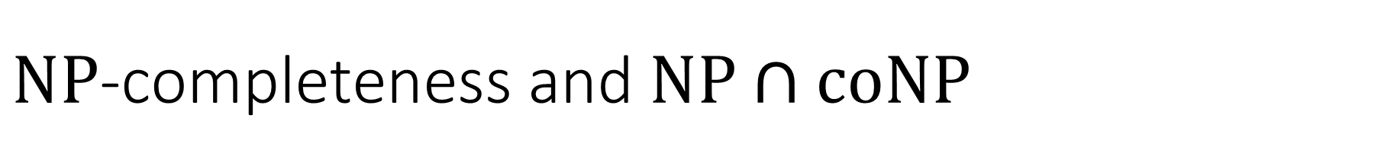
$\text{NP}$-completeness and $\text{NP}∩\text{coNP}$
Let $L∈\text{NP}∩\text{coNP}$
This theorem gives us evidence that $\text{FACTOR}$ is not $\text{NP}$-complete
Theorem: Assuming $\text{NP}≠\text{coNP}$, the language $L$ is not $\text{NP}$-complete

Slide 8







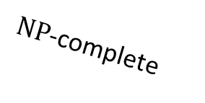

$\text{coNP}$-hard
$\text{NP}$-hard
$\text{coNP}$-complete
$\text{NP}$-complete
$$\text{coNP}$$
$$\text{NP}$$
$$\text{FACTOR}$$
$$\text{NP}∩\text{coNP}$$
$$\text{P}$$

Slide 9
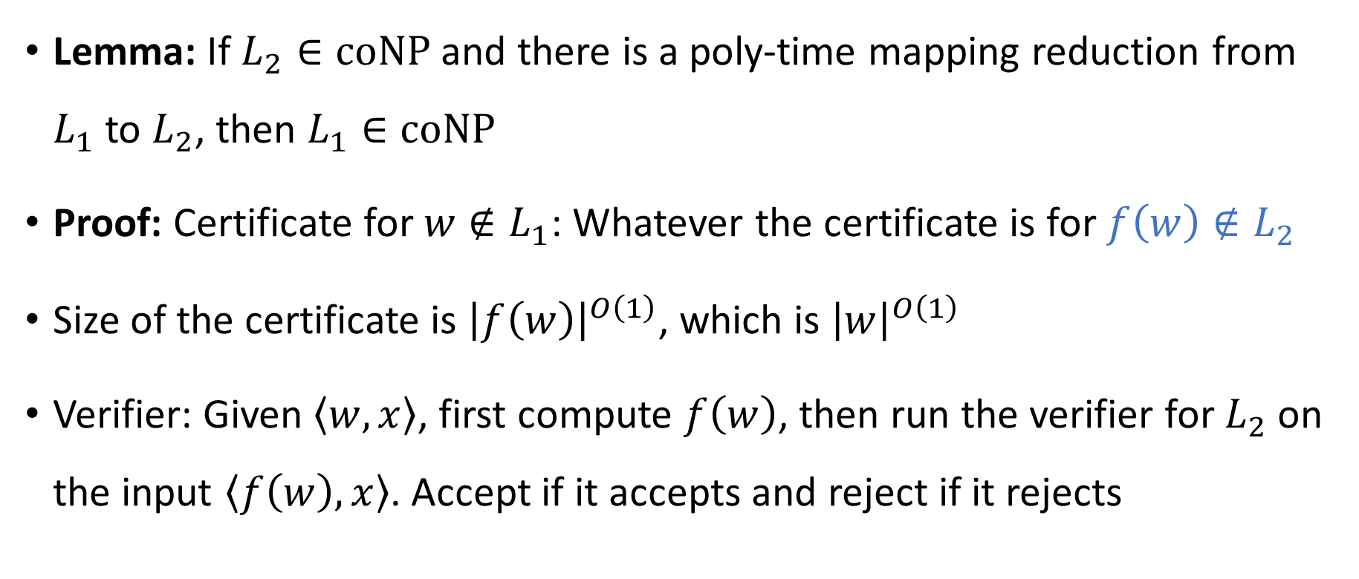
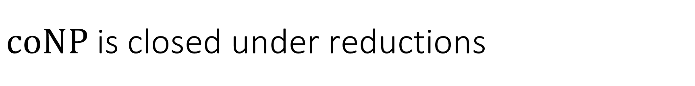
$\text{coNP}$ is closed under reductions
Lemma: If $L_{2}∈\text{coNP}$ and there is a poly-time mapping reduction from $L_{1}$ to $L_{2}$, then $L_{1}∈\text{coNP}$
Proof: Certificate for $w∉L_{1}$: Whatever the certificate is for $f\left(w\right)∉L_{2}$
Size of the certificate is ${\left|f\left(w\right)\right|}^{O\left(1\right)}$, which is ${\left|w\right|}^{O\left(1\right)}$
Verifier: Given $\left\langle w,x\right\rangle$, first compute $f\left(w\right)$, then run the verifier for $L_{2}$ on the input $\left\langle f\left(w\right), x\right\rangle$. Accept if it accepts and reject if it rejects

Slide 10
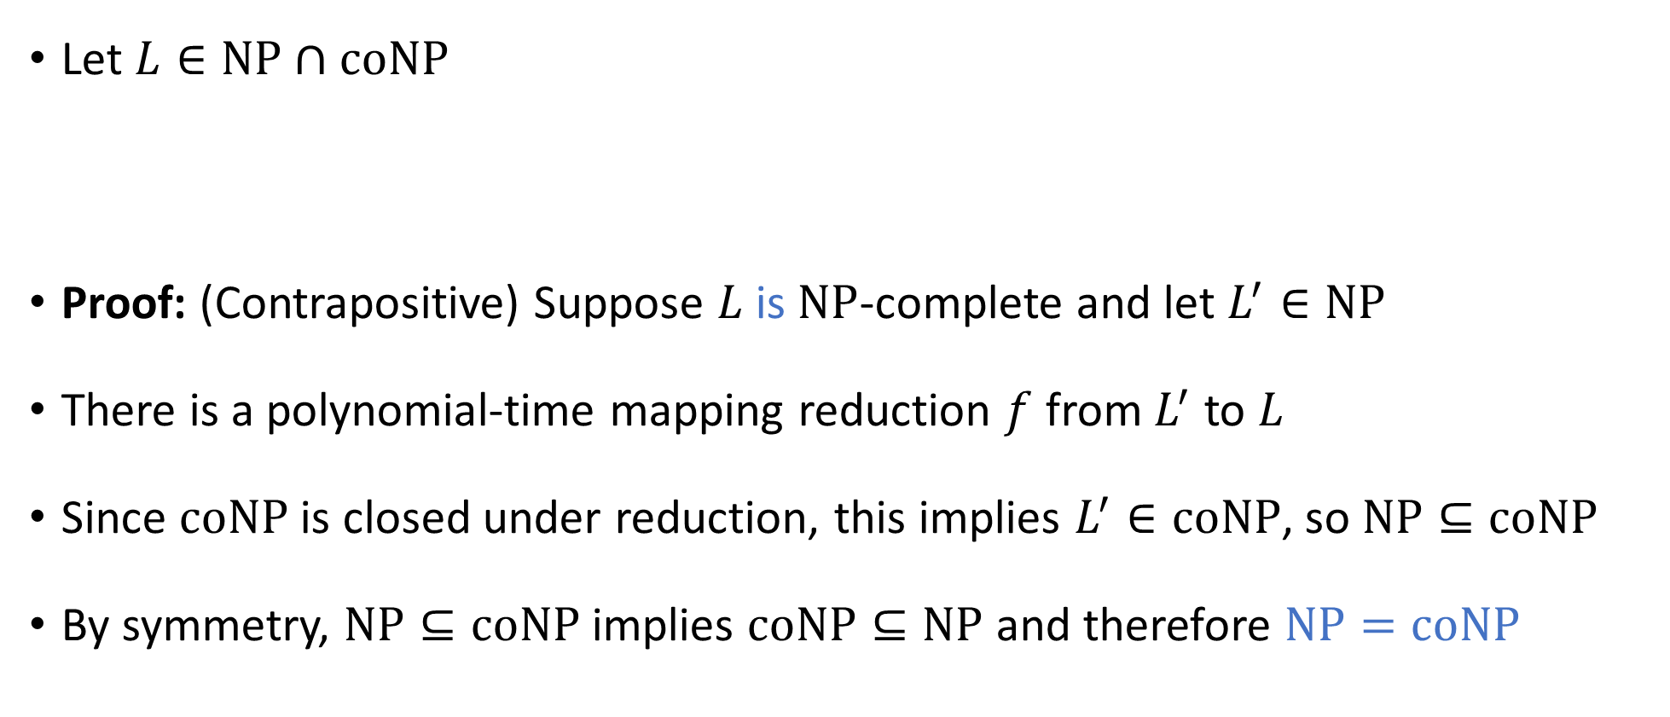
$\text{NP}$-completeness and $\text{NP}∩\text{coNP}$
Let $L∈\text{NP}∩\text{coNP}$
Proof: (Contrapositive) Suppose $L$ is $\text{NP}$-complete and let $L^{′}∈\text{NP}$
There is a polynomial-time mapping reduction $f$ from $L^{′}$ to $L$
Since $\text{coNP}$ is closed under reduction, this implies $L^{′}∈\text{coNP}$, so $\text{NP}⊆\text{coNP}$
By symmetry, $\text{NP}⊆\text{coNP}$ implies $\text{coNP}⊆\text{NP}$ and therefore $\text{NP}=\text{coNP}$
Theorem: Assuming $\text{NP}≠\text{coNP}$, the language $L$ is not $\text{NP}$-complete

Slide 11
Which problems can be solved through computation?

Slide 12
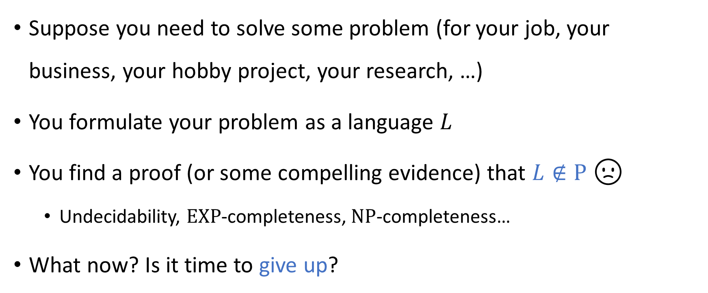
Facing intractability
Suppose you need to solve some problem (for your job, your business, your hobby project, your research, …)
You formulate your problem as a language $L$
You find a proof (or some compelling evidence) that $L∉\text{P}$ 🙁
Undecidability, $\text{EXP}$-completeness, $\text{NP}$-completeness…
What now? Is it time to give up?

Slide 13

Coping with intractability
The fact that $L∉\text{P}$ does not necessarily mean that you cannot solve your problem
There are, in fact, several approaches for coping with the fact that $L∉\text{P}$

Slide 14
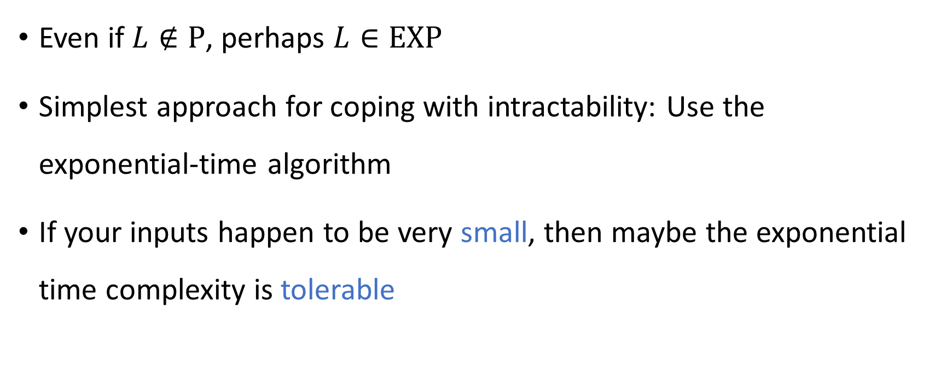
Small inputs
Even if $L∉\text{P}$, perhaps $L∈\text{EXP}$
Simplest approach for coping with intractability: Use the exponential-time algorithm
If your inputs happen to be very small, then maybe the exponential time complexity is tolerable

Slide 15
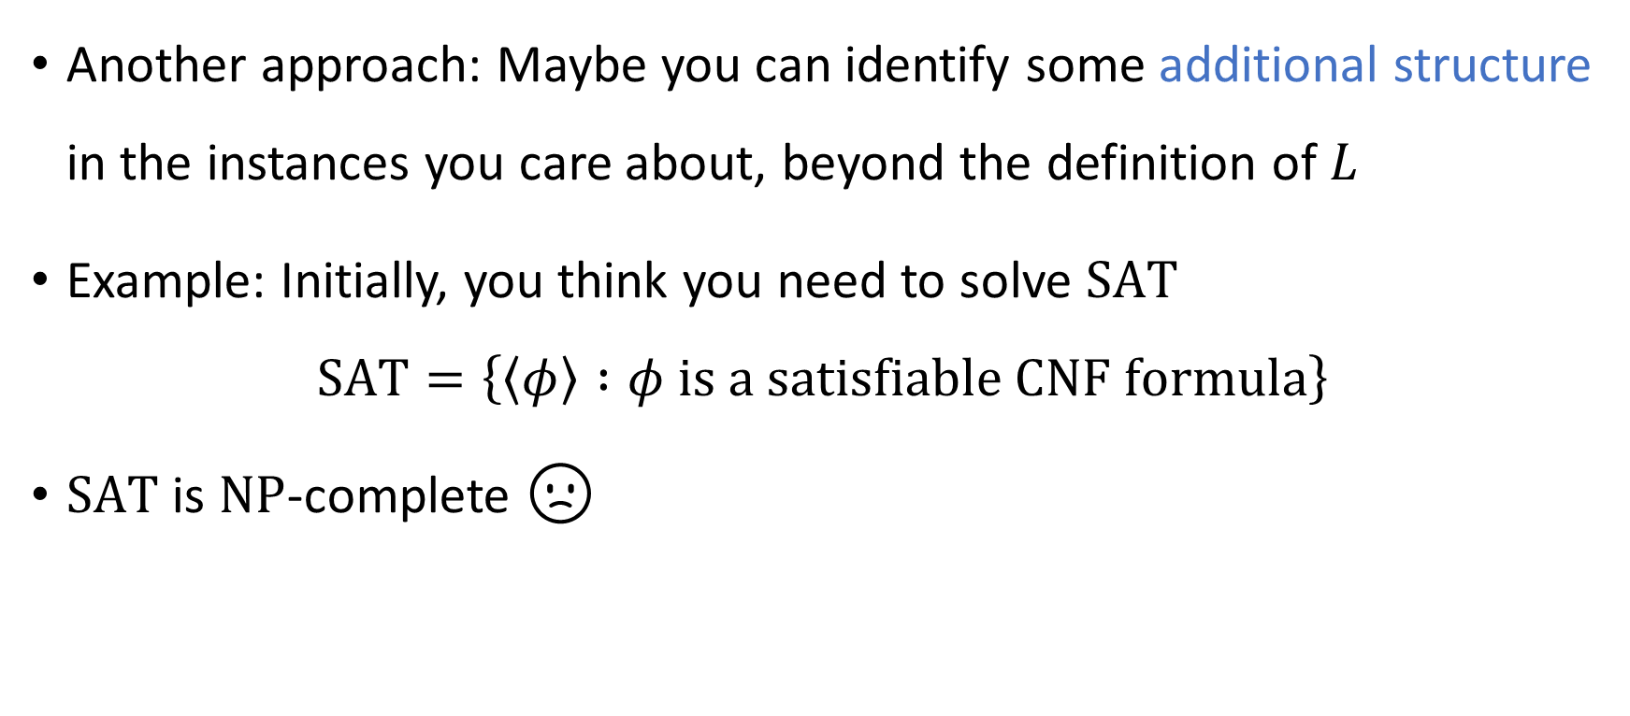
Structured inputs
Another approach: Maybe you can identify some additional structure in the instances you care about, beyond the definition of $L$
Example: Initially, you think you need to solve $\text{SAT}$
$$\text{SAT}=\left\{\left\langle φ\right\rangle :φ \text{is} \text{a} \text{satisfiable} \text{CNF} \text{formula}\right\}$$
$\text{SAT}$ is $\text{NP}$-complete 🙁

Slide 16
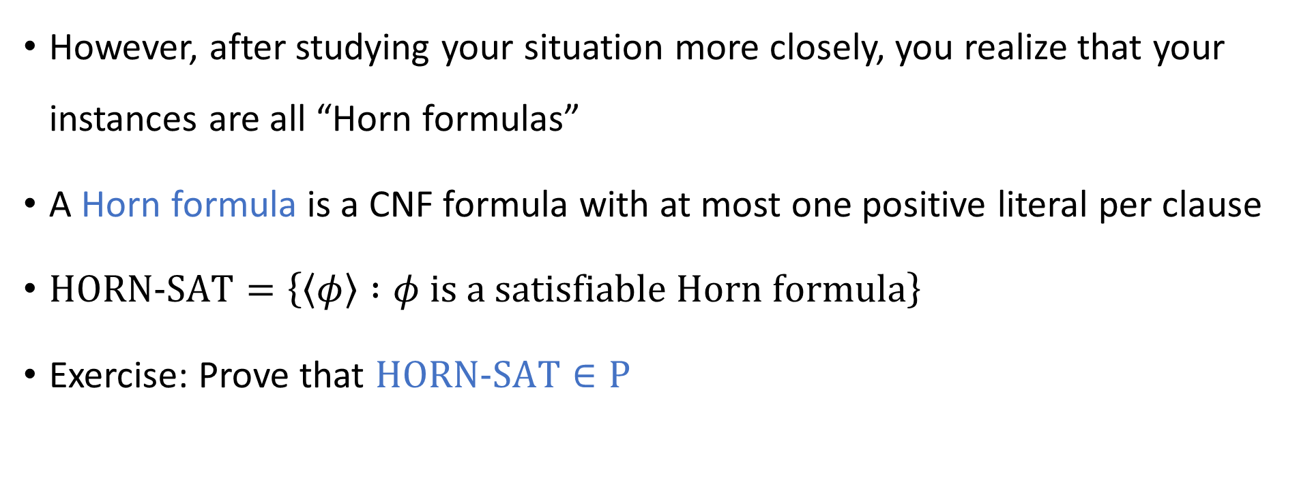
Structured inputs
However, after studying your situation more closely, you realize that your instances are all “Horn formulas”
A Horn formula is a CNF formula with at most one positive literal per clause
$\text{HORN}\text{‑}\text{SAT}=\left\{\left\langle φ\right\rangle :φ \text{is} \text{a} \text{satisfiable} \text{Horn} \text{formula}\right\}$
Exercise: Prove that $\text{HORN}\text{‑}\text{SAT}∈\text{P}$

Slide 17
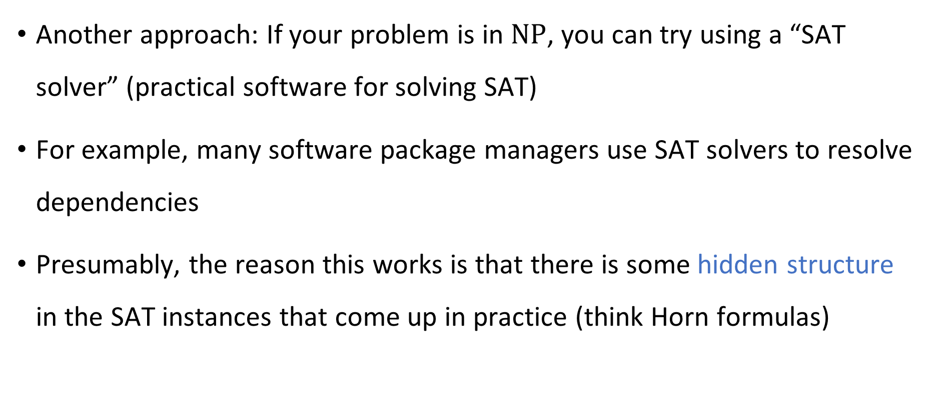
SAT solvers
Another approach: If your problem is in $\text{NP}$, you can try using a “SAT solver” (practical software for solving SAT)
For example, many software package managers use SAT solvers to resolve dependencies
Presumably, the reason this works is that there is some hidden structure in the SAT instances that come up in practice (think Horn formulas)

Slide 18
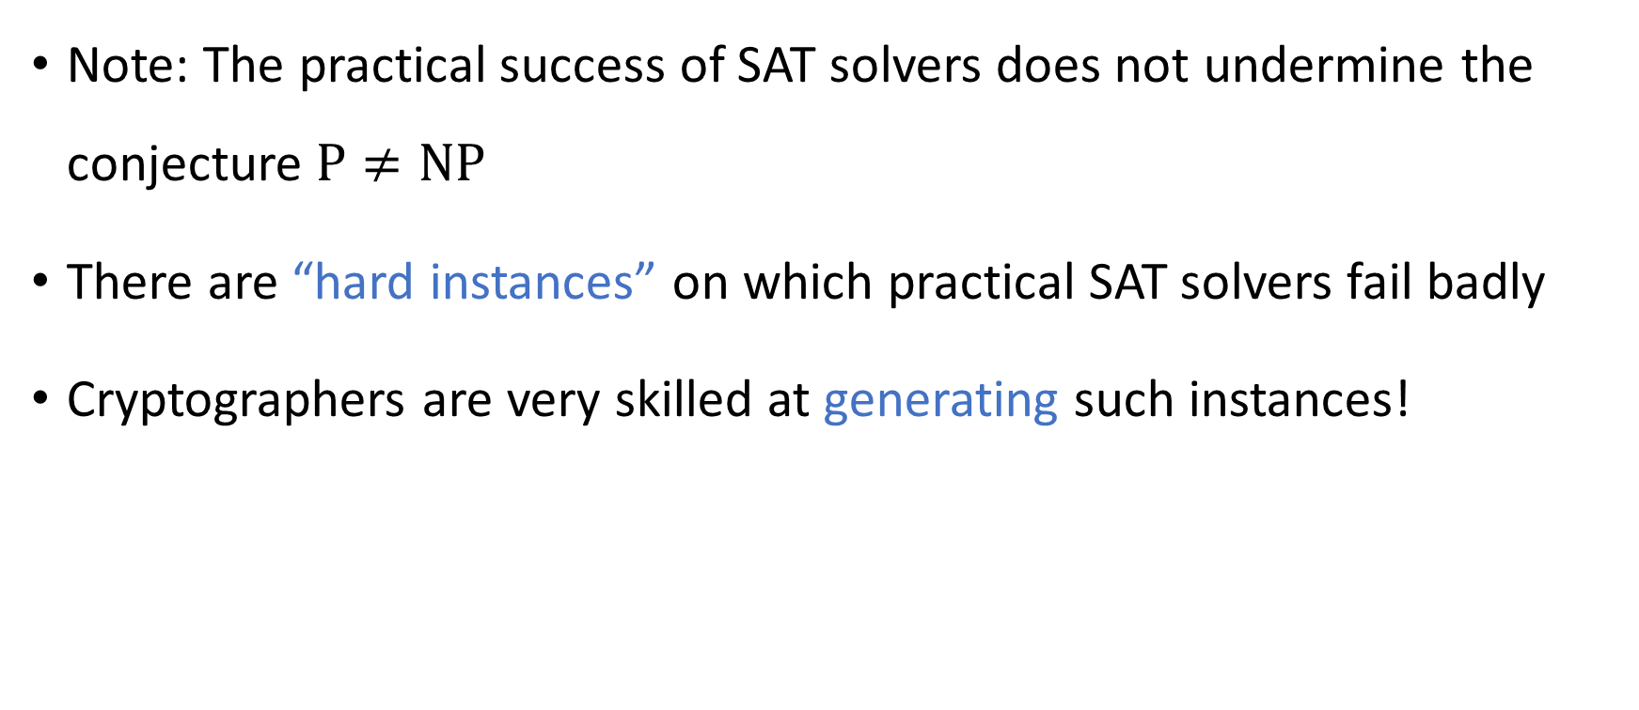
SAT solvers are not a panacea
Note: The practical success of SAT solvers does not undermine the conjecture $\text{P}≠\text{NP}$
There are “hard instances” on which practical SAT solvers fail badly
Cryptographers are very skilled at generating such instances!

Slide 19
Approximation algorithms
The next approach that we will discuss for coping with intractability is approximation algorithms
This approach only makes sense if you are trying to solve an optimization problem
Example: the Knapsack problem

Slide 20

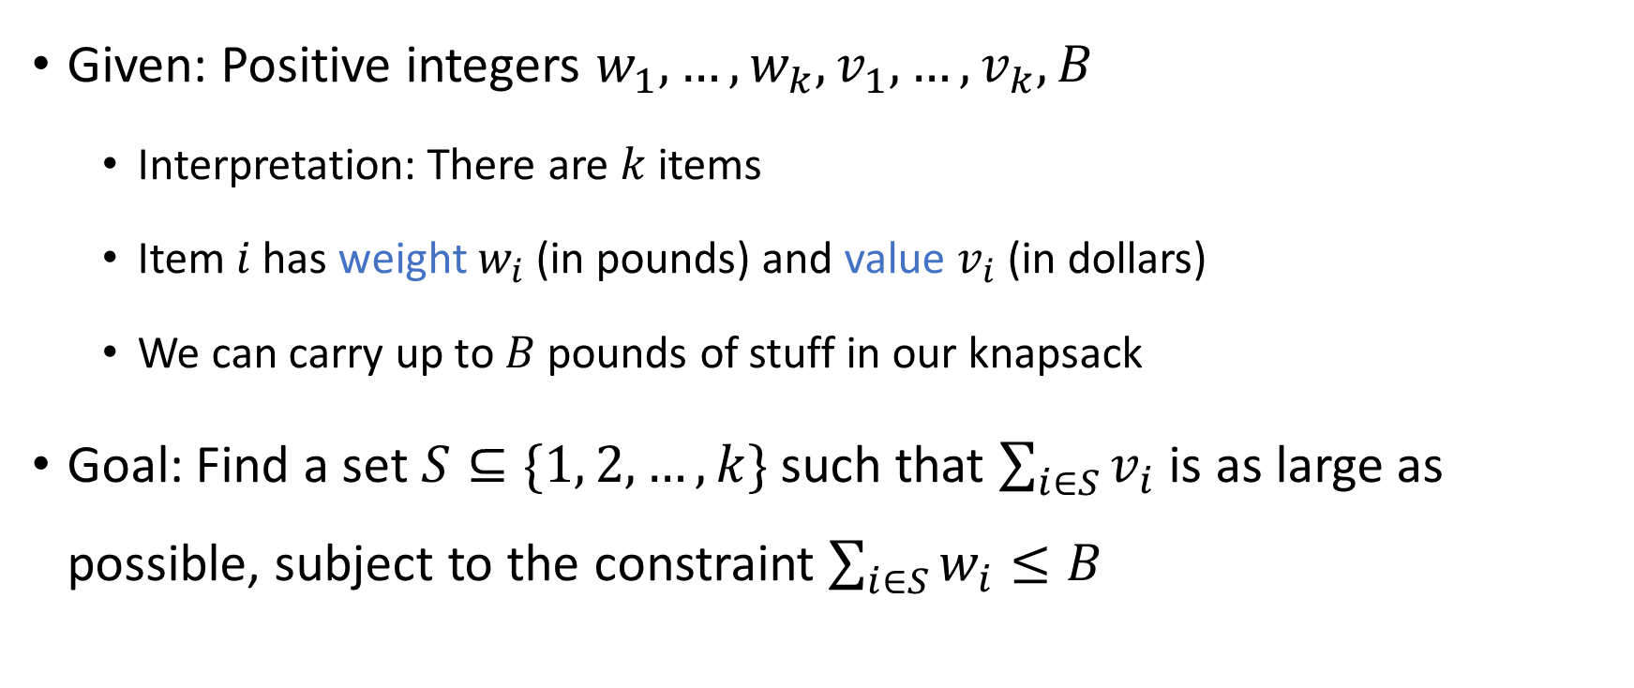
The Knapsack problem
Given: Positive integers $w_{1},…, w_{k}, v_{1},…, v_{k},B$
Interpretation: There are $k$ items
Item $i$ has weight $w_{i}$ (in pounds) and value $v_{i}$ (in dollars)
We can carry up to $B$ pounds of stuff in our knapsack
Goal: Find a set $S⊆\{1, 2, …, k\}$ such that $\sum_{i∈S}{v_{i}}$ is as large as possible, subject to the constraint $\sum_{i∈S}{w_{i}}≤B$

Slide 21


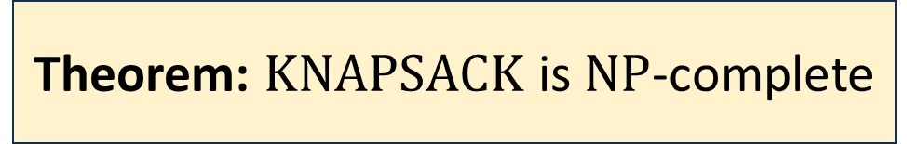
$\text{KNAPSACK}$ is $\text{NP}$-complete
$$\text{KNAPSACK}=\{\left\langle w_{1},…, w_{k}, v_{1},…, v_{k}, B, V\right\rangle :\text{there} \text{exists} S⊆\{1, 2, …, k\} \\ \text{such} \text{that} Σ_{i∈S} w_{i}≤B \text{and} Σ_{i∈S} v_{i}≥V\}$$
(Proof omitted)
Theorem: $\text{KNAPSACK}$ is $\text{NP}$-complete

Slide 22
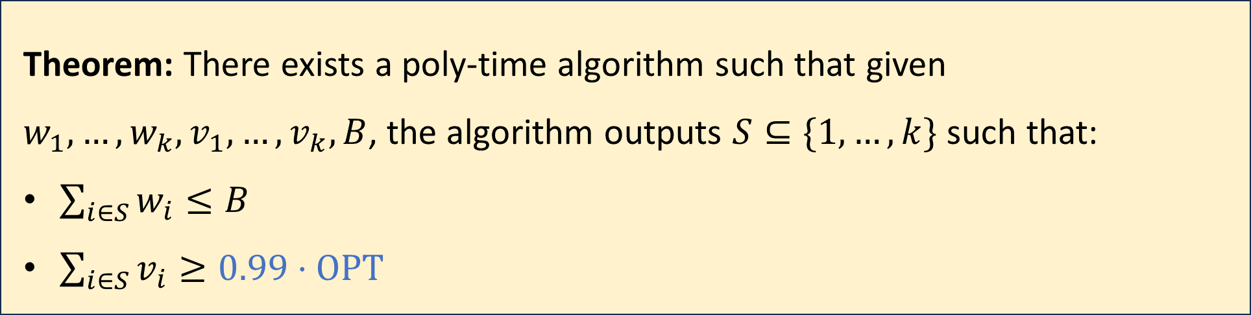
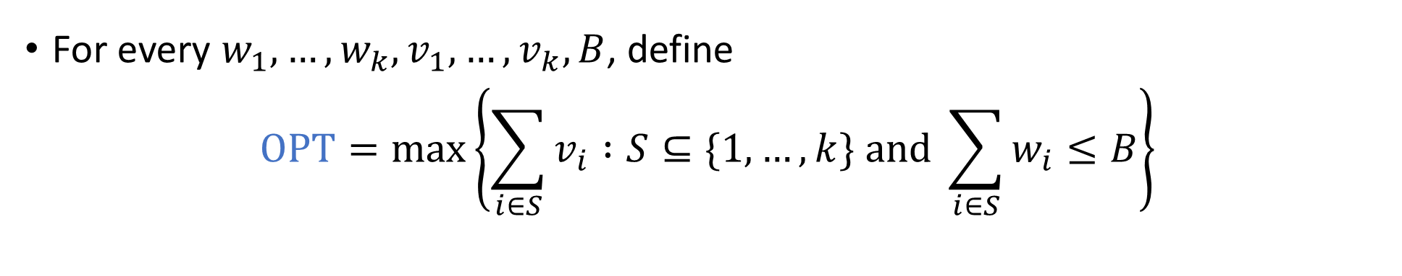
Approximation algorithms for Knapsack
For every $w_{1},…, w_{k}, v_{1},…, v_{k},B$, define
$$\text{OPT}=\max\left\{\sum_{i∈S}{v_{i}} :S⊆\{1, …, k\} \text{and} \sum_{i∈S}{w_{i}}≤B\right\}$$
Theorem: There exists a poly-time algorithm such that given $w_{1},…, w_{k}, v_{1},…, v_{k}, B$, the algorithm outputs $S⊆\{1, …, k\}$ such that:
$\sum_{i∈S}{w_{i}}≤B$
$\sum_{i∈S}{v_{i}}≥0.99⋅\text{OPT}$

Slide 23
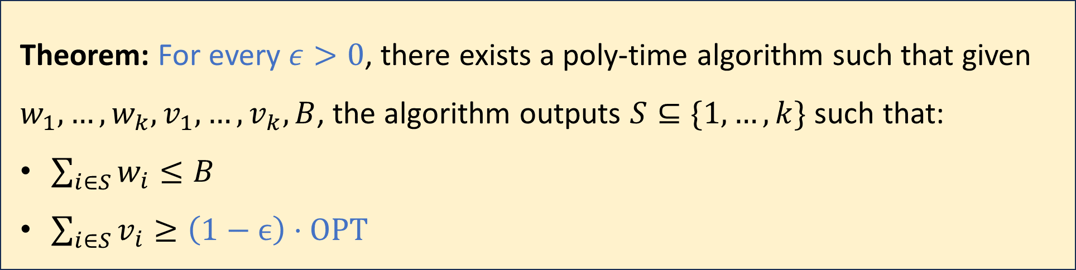

Approximation algorithms for Knapsack
For every $w_{1},…, w_{k}, v_{1},…, v_{k},B$, define
$$\text{OPT}=\max\left\{\sum_{i∈S}{v_{i}} :S⊆\{1, …, k\} \text{and} \sum_{i∈S}{w_{i}}≤B\right\}$$
Theorem: For every $ε>0$, there exists a poly-time algorithm such that given $w_{1},…, w_{k}, v_{1},…, v_{k}, B$, the algorithm outputs $S⊆\{1, …, k\}$ such that:
$\sum_{i∈S}{w_{i}}≤B$
$\sum_{i∈S}{v_{i}}≥\left(1−ϵ\right)⋅\text{OPT}$
(Proof omitted. Theorem won’t be on exam)

Slide 24

Approximation algorithms are not a panacea
In some cases, approximation algorithms take some of the sting out of $\text{NP}$-completeness
However, in other cases, approximation algorithms are unhelpful!

Slide 25
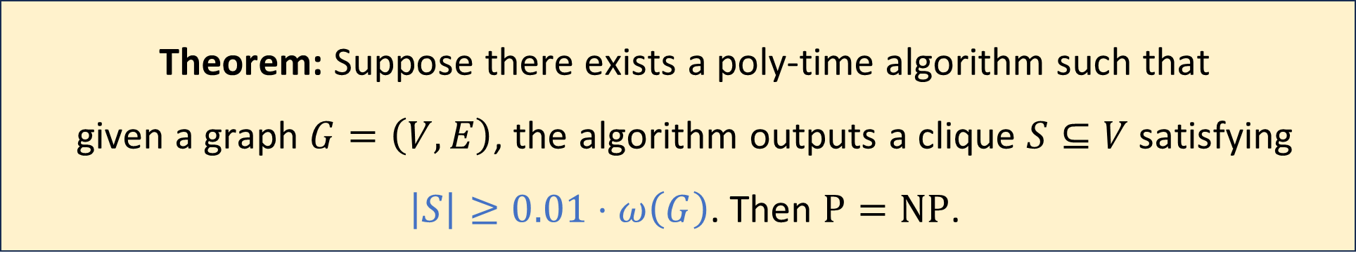

Inapproximability of the clique problem
For a graph $G$, let $ω\left(G\right)$ be the size of the largest clique in $G$
Theorem: Suppose there exists a poly-time algorithm such that given a graph $G=\left(V, E\right)$, the algorithm outputs a clique $S⊆V$ satisfying $\left|S\right|≥0.01⋅ω\left(G\right)$. Then $\text{P}=\text{NP}$.

Slide 26
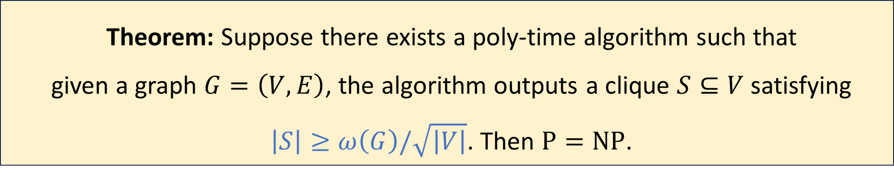
Inapproximability of the clique problem
For a graph $G$, let $ω\left(G\right)$ be the size of the largest clique in $G$
Theorem: Suppose there exists a poly-time algorithm such that given a graph $G=\left(V, E\right)$, the algorithm outputs a clique $S⊆V$ satisfying $\left|S\right|≥ω\left(G\right)/\sqrt{\left|V\right|}$. Then $\text{P}=\text{NP}$.

Slide 27
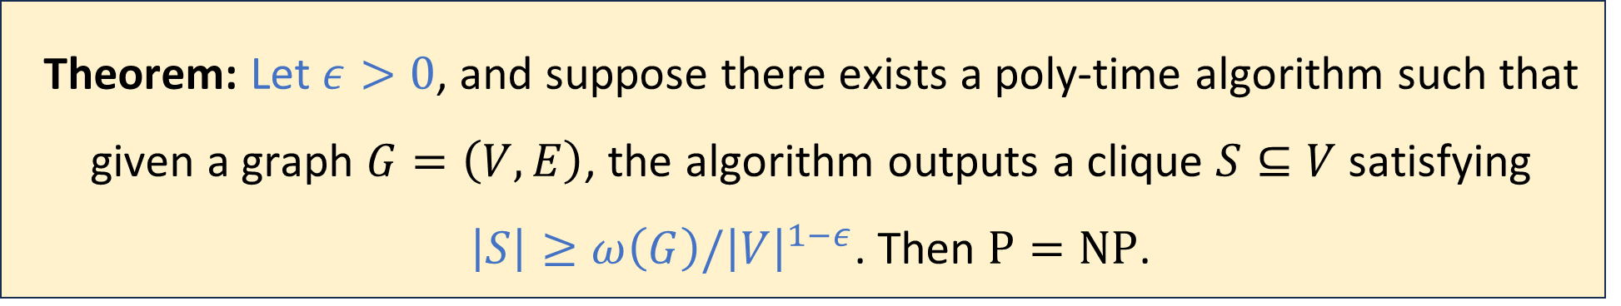

Inapproximability of the clique problem
For a graph $G$, let $ω\left(G\right)$ be the size of the largest clique in $G$
(Proof is beyond the scope of this course)
(This theorem won’t be on the exam)
Theorem: Let $ε>0$, and suppose there exists a poly-time algorithm such that given a graph $G=\left(V, E\right)$, the algorithm outputs a clique $S⊆V$ satisfying $\left|S\right|≥ω\left(G\right)/{\left|V\right|}^{1−ε}$. Then $\text{P}=\text{NP}$.

