Slide 1
CMSC 28100 Introduction to Complexity Theory Winter 2024 Instructor: William Hoza
7 |  |  |  |  |  |  | 5 | 3
 |  |  |  |  |  |  |  | 4
 | 4 | 8 |  | 3 |  | 1 | 2
8 |  | 1 | 3 |  |  | 2 | 7 | 5
 | 9 |  | 1 |  |  |  | 4
 | 5 |  |  |  |  | 3
2 |  | 5 |  | 8 | 4
1 | 3 | 4 |  | 5

Slide 2

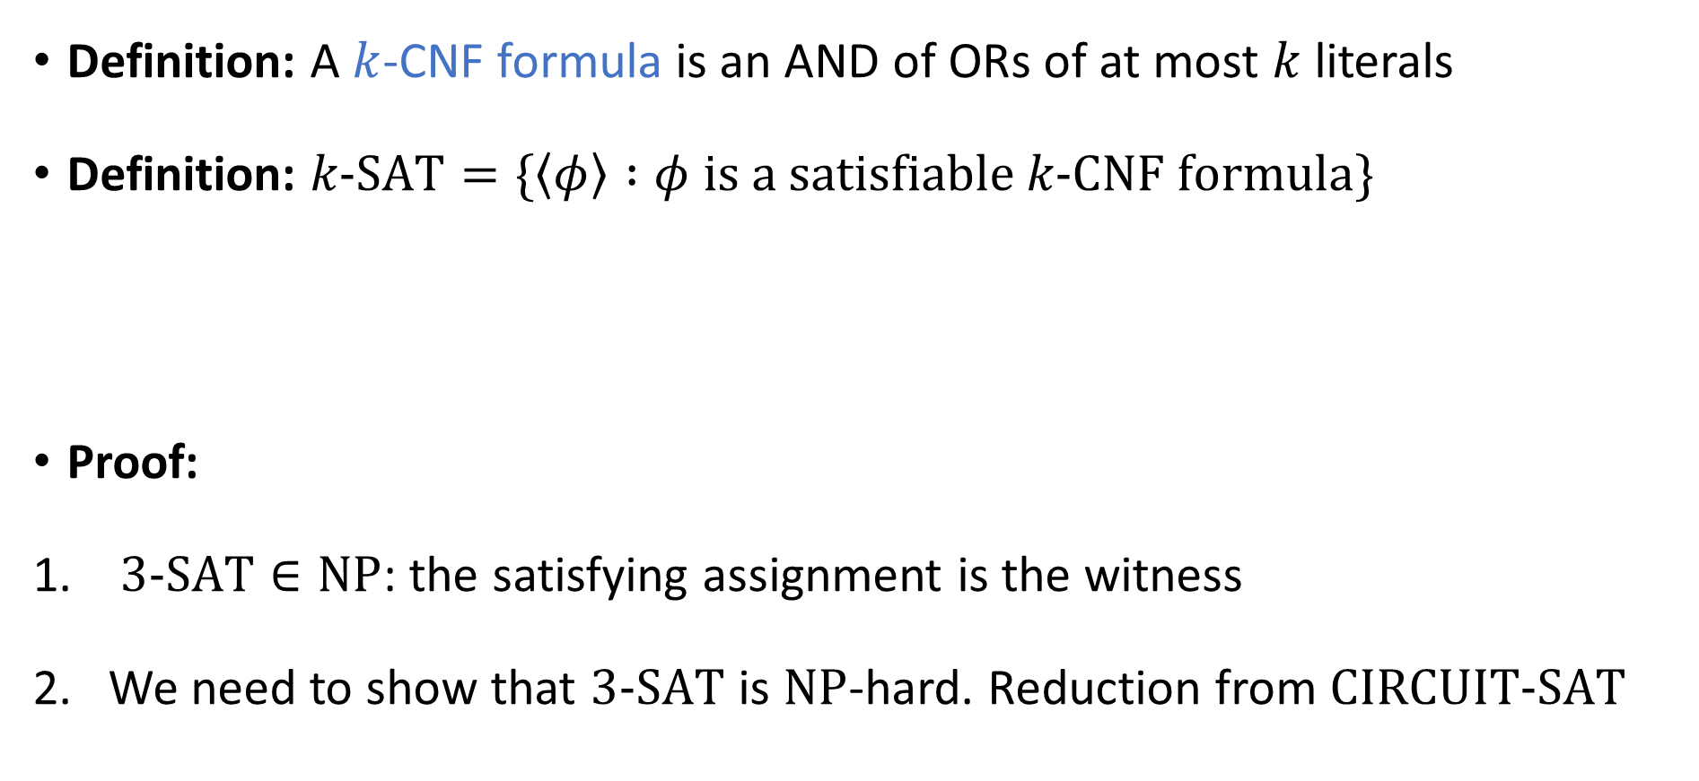
The Cook-Levin Theorem
Definition: A $k$-CNF formula is an AND of ORs of at most $k$ literals
Definition: $k\text{‑}\text{SAT}=\{\left\langle φ\right\rangle :φ \text{is} \text{a} \text{satisfiable} k\text{‑}\text{CNF} \text{formula}\}$
Proof:
$3\text{‑}\text{SAT}∈\text{NP}$: the satisfying assignment is the witness
We need to show that $3\text{‑}\text{SAT}$ is $\text{NP}$-hard. Reduction from $\text{CIRCUIT}\text{‑}\text{SAT}$
The Cook-Levin Theorem: $3\text{‑}\text{SAT}$ is $\text{NP}$-complete

Slide 3
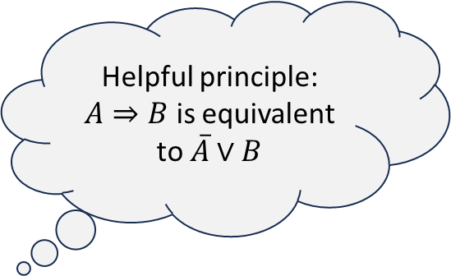
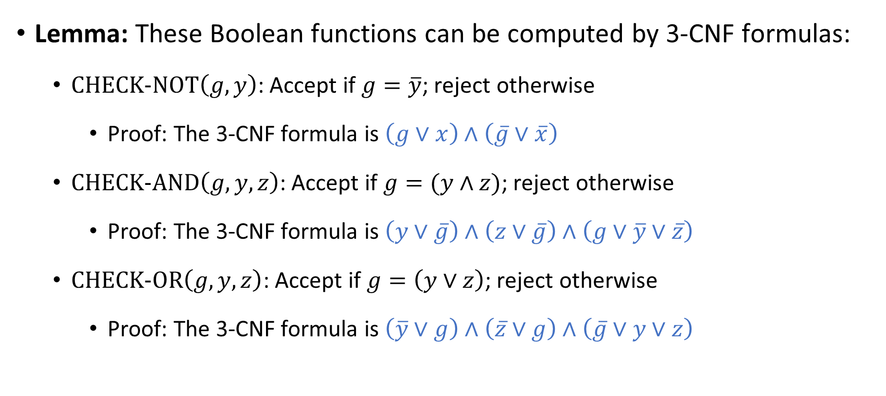
Gate gadgets
Lemma: These Boolean functions can be computed by 3-CNF formulas:
$\text{CHECK}\text{‑}\text{NOT}\left(g, y\right)$: Accept if $g=\overline{y}$; reject otherwise
Proof: The 3-CNF formula is $\left(g∨x\right)∧\left(\overline{g}∨\overline{x}\right)$
$\text{CHECK}\text{‑}\text{AND}\left(g, y,z\right)$: Accept if $g=(y∧z)$; reject otherwise
Proof: The 3-CNF formula is $\left(y∨\overline{g}\right)∧\left(z∨\overline{g}\right)∧\left(g∨\overline{y}∨\overline{z}\right)$
$\text{CHECK}\text{‑}\text{OR}\left(g, y, z\right)$: Accept if $g=\left(y∨z\right)$; reject otherwise
Proof: The 3-CNF formula is $\left(\overline{y}∨g\right)∧\left(\overline{z}∨g\right)∧\left(\overline{g}∨y∨z\right)$
Helpful principle: $A⇒B$ is equivalent to $\overline{A}∨B$

Slide 4
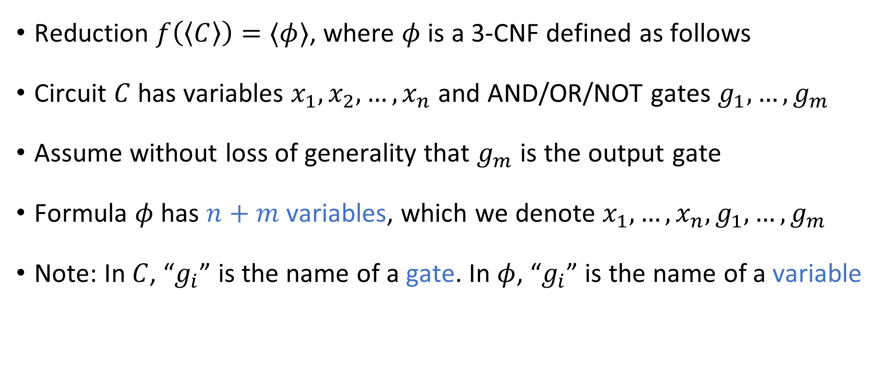

Reduction from $\text{CIRCUIT}\text{‑}\text{SAT}$ to $\text{3‑}\text{SAT}$
Reduction $f\left(\left\langle C\right\rangle \right)=⟨φ⟩$, where $φ$ is a 3-CNF defined as follows
Circuit $C$ has variables $x_{1},x_{2},…, x_{n}$ and AND/OR/NOT gates $g_{1},…, g_{m}$
Assume without loss of generality that $g_{m}$ is the output gate
Formula $φ$ has $n+m$ variables, which we denote $x_{1},…, x_{n}, g_{1},…, g_{m}$
Note: In $C$, “$g_{i}$” is the name of a gate. In $φ$, “$g_{i}$” is the name of a variable

Slide 5
















Reduction from $\text{CIRCUIT}\text{‑}\text{SAT}$ to $\text{3‑}\text{SAT}$
For each AND/OR/NOT gate $g_{i}$ in the circuit $C$, define a 3-CNF $φ_{i}$:
Reduction produces $φ:=φ_{1}∧φ_{2}∧…∧φ_{m}∧\left(g_{m}\right)$
$$g_{i}$$
$$¬$$
$$g_{i}$$
$$∧$$
$$g_{i}$$
$$∨$$
$$y$$
$$y$$
$$z$$
$$y$$
$$z$$
$$φ_{i}=\text{CHECK}\text{‑}\text{NOT}\left(g_{i}, y\right)$$
$$φ_{i}=\text{CHECK}\text{‑}\text{AND}\left(g_{i}, y, z\right)$$
$$φ_{i}=\text{CHECK}\text{‑}\text{OR}\left(g_{i}, y, z\right)$$

Slide 6





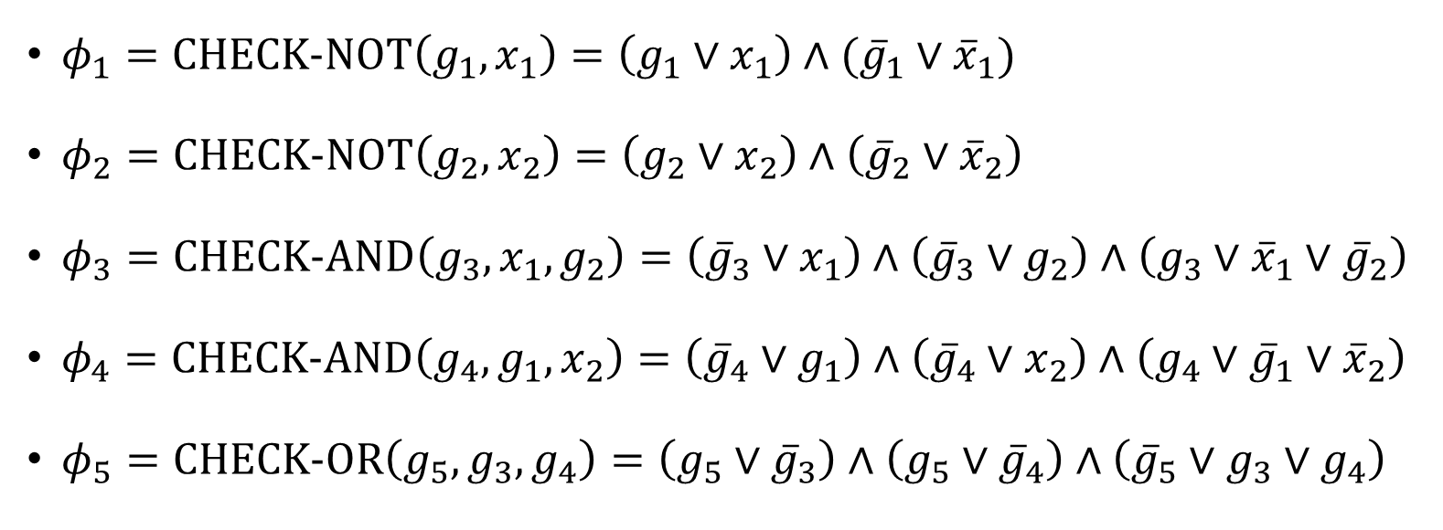



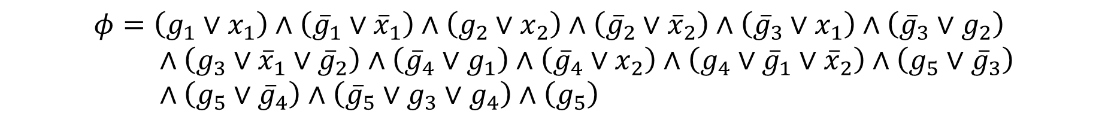




Reduction example
$$g_{5}$$
$φ_{1}=\text{CHECK}\text{‑}\text{NOT}\left(g_{1},x_{1}\right)=\left(g_{1}∨x_{1}\right)∧({\overline{g}}_{1}∨{\overline{x}}_{1})$
$φ_{2}=\text{CHECK}\text{‑}\text{NOT}\left(g_{2},x_{2}\right)=\left(g_{2}∨x_{2}\right)∧\left({\overline{g}}_{2}∨{\overline{x}}_{2}\right)$
$φ_{3}=\text{CHECK}\text{‑}\text{AND}\left(g_{3},x_{1},g_{2}\right)=\left({\overline{g}}_{3}∨x_{1}\right)∧\left({\overline{g}}_{3}∨g_{2}\right)∧\left(g_{3}∨{\overline{x}}_{1}∨{\overline{g}}_{2}\right)$
$φ_{4}=\text{CHECK}\text{‑}\text{AND}\left(g_{4},g_{1},x_{2}\right)=\left({\overline{g}}_{4}∨g_{1}\right)∧\left({\overline{g}}_{4}∨x_{2}\right)∧\left(g_{4}∨{\overline{g}}_{1}∨{\overline{x}}_{2}\right)$
$φ_{5}=\text{CHECK}\text{‑}\text{OR}\left(g_{5},g_{3},g_{4}\right)=\left(g_{5}∨{\overline{g}}_{3}\right)∧\left(g_{5}∨{\overline{g}}_{4}\right)∧\left({\overline{g}}_{5}∨g_{3}∨g_{4}\right)$
$$∨$$
$$g_{3}$$
$$g_{4}$$
$$∧$$
$$∧$$
$$g_{1}$$
$$g_{2}$$
$$¬$$
$$¬$$
$$x_{1}$$
$$x_{2}$$
$$φ=\left(g_{1}∨x_{1}\right)∧\left({\overline{g}}_{1}∨{\overline{x}}_{1}\right)∧\left(g_{2}∨x_{2}\right)∧\left({\overline{g}}_{2}∨{\overline{x}}_{2}\right)∧\left({\overline{g}}_{3}∨x_{1}\right)∧\left({\overline{g}}_{3}∨g_{2}\right) \\ ∧\left(g_{3}∨{\overline{x}}_{1}∨{\overline{g}}_{2}\right)∧\left({\overline{g}}_{4}∨g_{1}\right)∧\left({\overline{g}}_{4}∨x_{2}\right)∧\left(g_{4}∨{\overline{g}}_{1}∨{\overline{x}}_{2}\right)∧\left(g_{5}∨{\overline{g}}_{3}\right) \\ ∧\left(g_{5}∨{\overline{g}}_{4}\right)∧\left({\overline{g}}_{5}∨g_{3}∨g_{4}\right)∧\left(g_{5}\right)$$

Slide 7
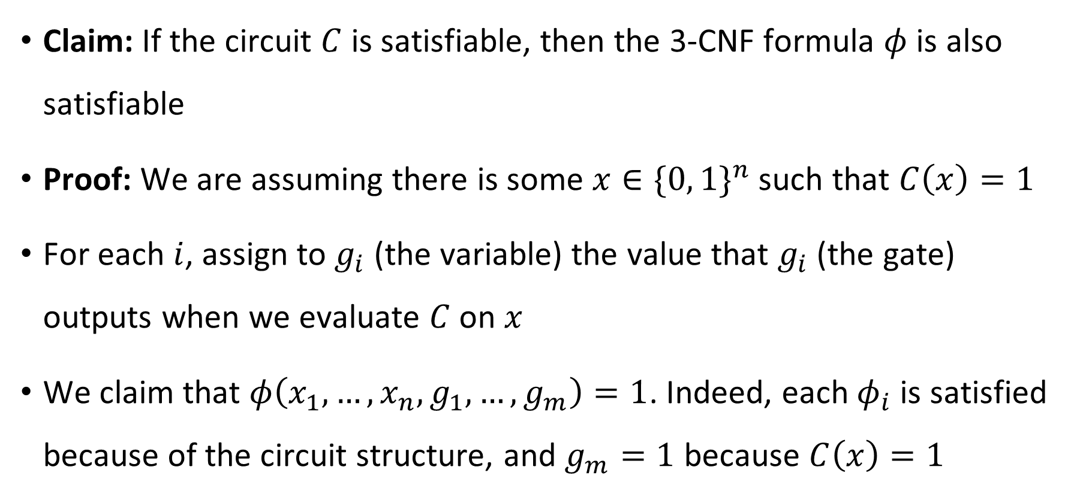
YES maps to YES
Claim: If the circuit $C$ is satisfiable, then the 3-CNF formula $φ$ is also satisfiable
Proof: We are assuming there is some $x∈\{0, 1\}^{n}$ such that $C\left(x\right)=1$
For each $i$, assign to $g_{i}$ (the variable) the value that $g_{i}$ (the gate) outputs when we evaluate $C$ on $x$
We claim that $φ\left(x_{1},…, x_{n}, g_{1}, …, g_{m}\right)=1$. Indeed, each $φ_{i}$ is satisfied because of the circuit structure, and $g_{m}=1$ because $C\left(x\right)=1$

Slide 8
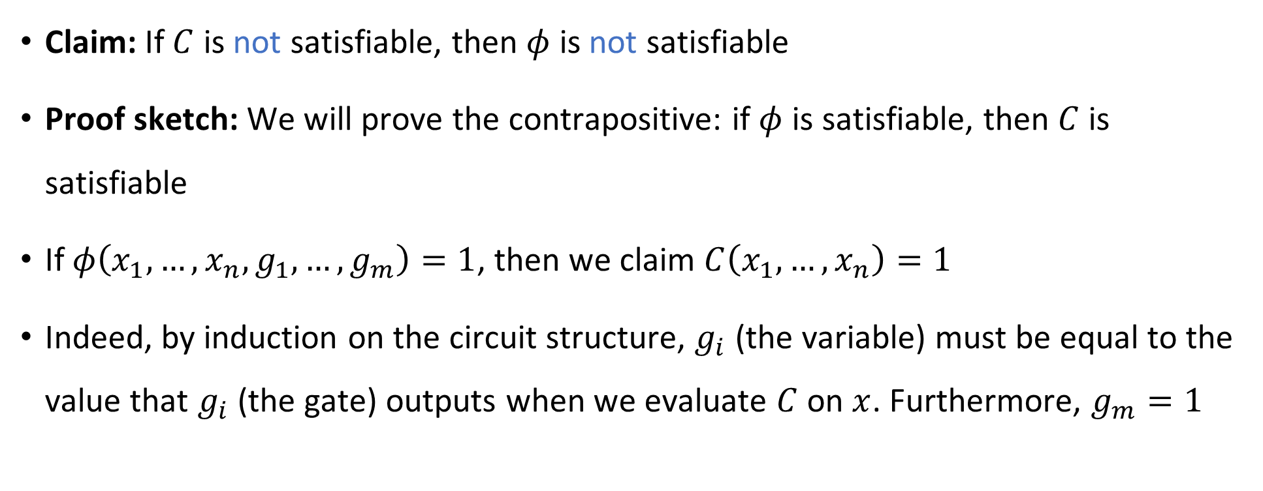
NO maps to NO
Claim: If $C$ is not satisfiable, then $φ$ is not satisfiable
Proof sketch: We will prove the contrapositive: if $φ$ is satisfiable, then $C$ is satisfiable
If $φ\left(x_{1},…, x_{n}, g_{1},…, g_{m}\right)=1$, then we claim $C\left(x_{1},…, x_{n}\right)=1$
Indeed, by induction on the circuit structure, $g_{i}$ (the variable) must be equal to the value that $g_{i}$ (the gate) outputs when we evaluate $C$ on $x$. Furthermore, $g_{m}=1$

Slide 9

Reduction efficiency
Reduction is computable in polynomial time
For each gate in the circuit, we write down $O\left(1\right)$ clauses, and it is straightforward to compute what they are

Slide 10






$\text{NP}$-hard
$$\text{CIRCUIT}\text{‑}\text{SAT}$$
$$\text{3‑}\text{SAT}$$
$\text{NP}$-complete
$$\text{NP}$$
$$\text{P}$$

Slide 11
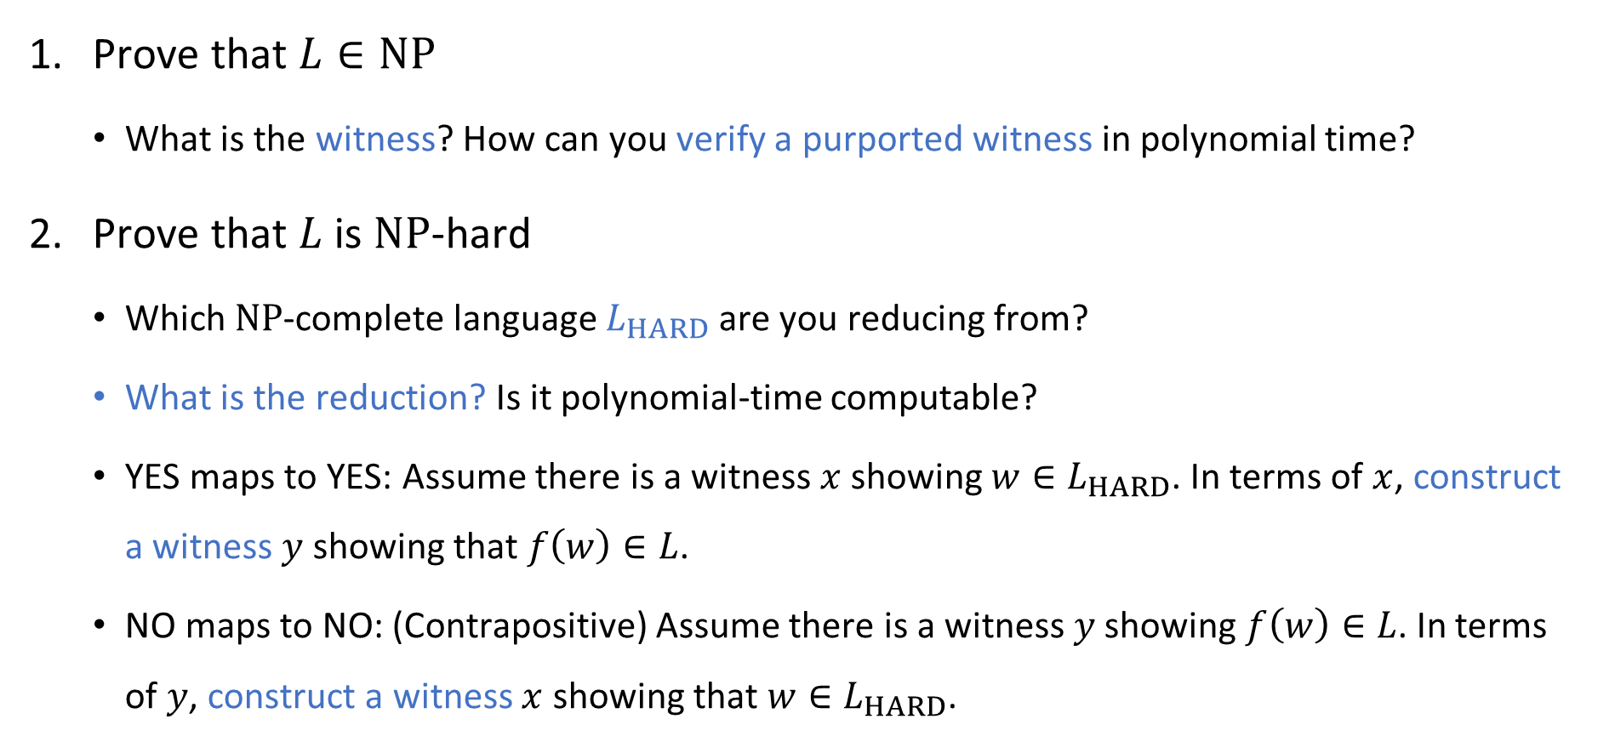

Proving that $L$ is $\text{NP}$-complete (“cheat sheet”)
Prove that $L∈\text{NP}$
What is the witness? How can you verify a purported witness in polynomial time?
Prove that $L$ is $\text{NP}$-hard
Which $\text{NP}$-complete language $L_{HARD}$ are you reducing from?
What is the reduction? Is it polynomial-time computable?
YES maps to YES: Assume there is a witness $x$ showing $w∈L_{HARD}$. In terms of $x$, construct a witness $y$ showing that $f\left(w\right)∈L$.
NO maps to NO: (Contrapositive) Assume there is a witness $y$ showing $f\left(w\right)∈L$. In terms of $y$, construct a witness $x$ showing that $w∈L_{HARD}$.

Slide 12


The $\text{CLIQUE}$ problem
Recall $\text{CLIQUE}=\{\left\langle G,k\right\rangle :G \text{has} \text{a} k\text{‑}\text{clique}\}$
Example: Let $G$ be the graph with the following adjacency matrix
Does $G$ have a $4$-clique?
 | a | b | c | d | e | f | g
a | 0 | 1 | 1 | 0 | 0 | 1 | 0
b | 1 | 0 | 0 | 1 | 1 | 0 | 1
c | 1 | 0 | 0 | 0 | 1 | 0 | 1
d | 0 | 1 | 0 | 0 | 1 | 0 | 1
e | 0 | 1 | 1 | 1 | 0 | 1 | 1
f | 1 | 0 | 0 | 0 | 1 | 0 | 1
g | 0 | 1 | 1 | 1 | 1 | 1 | 0

Slide 13


The $\text{CLIQUE}$ problem
Recall $\text{CLIQUE}=\{\left\langle G,k\right\rangle :G \text{has} \text{a} k\text{‑}\text{clique}\}$
Let $G$ be the graph with the following adjacency matrix
Does $G$ have a $4$-clique?
Yes! $S=\{\text{b},\text{d},\text{e},\text{g}\}$
 | a | b | c | d | e | f | g
a | 0 | 1 | 1 | 0 | 0 | 1 | 0
b | 1 | 0 | 0 | 1 | 1 | 0 | 1
c | 1 | 0 | 0 | 0 | 1 | 0 | 1
d | 0 | 1 | 0 | 0 | 1 | 0 | 1
e | 0 | 1 | 1 | 1 | 0 | 1 | 1
f | 1 | 0 | 0 | 0 | 1 | 0 | 1
g | 0 | 1 | 1 | 1 | 1 | 1 | 0

Slide 14
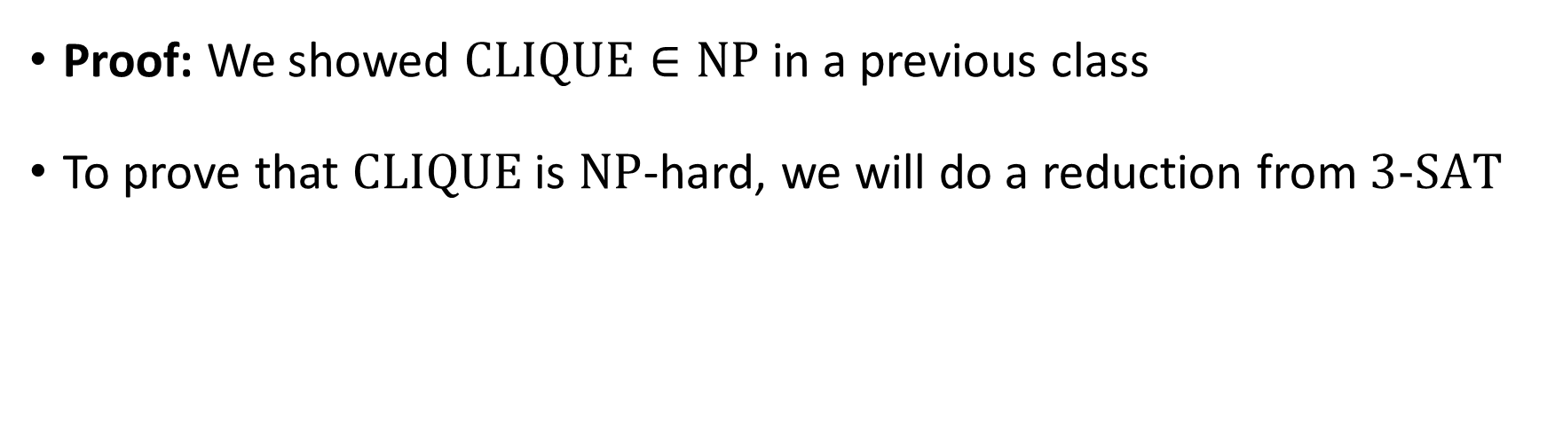


$\text{CLIQUE}$ is $\text{NP}$-complete
Theorem: $\text{CLIQUE}$ is $\text{NP}$-complete
Proof: We showed $\text{CLIQUE}∈\text{NP}$ in a previous class
To prove that $\text{CLIQUE}$ is $\text{NP}$-hard, we will do a reduction from $\text{3‑}\text{SAT}$

Slide 15


Reduction from $\text{3‑}\text{SAT}$ to $\text{CLIQUE}$
Let $φ$ be a $3$-CNF formula (an instance of $\text{3‑}\text{SAT}$)
Reduction: $f\left(⟨φ⟩\right)=⟨G,k⟩$
$k$ is the number of clauses in $φ$
$G$ is a graph on $3k$ vertices defined as follows

Slide 16






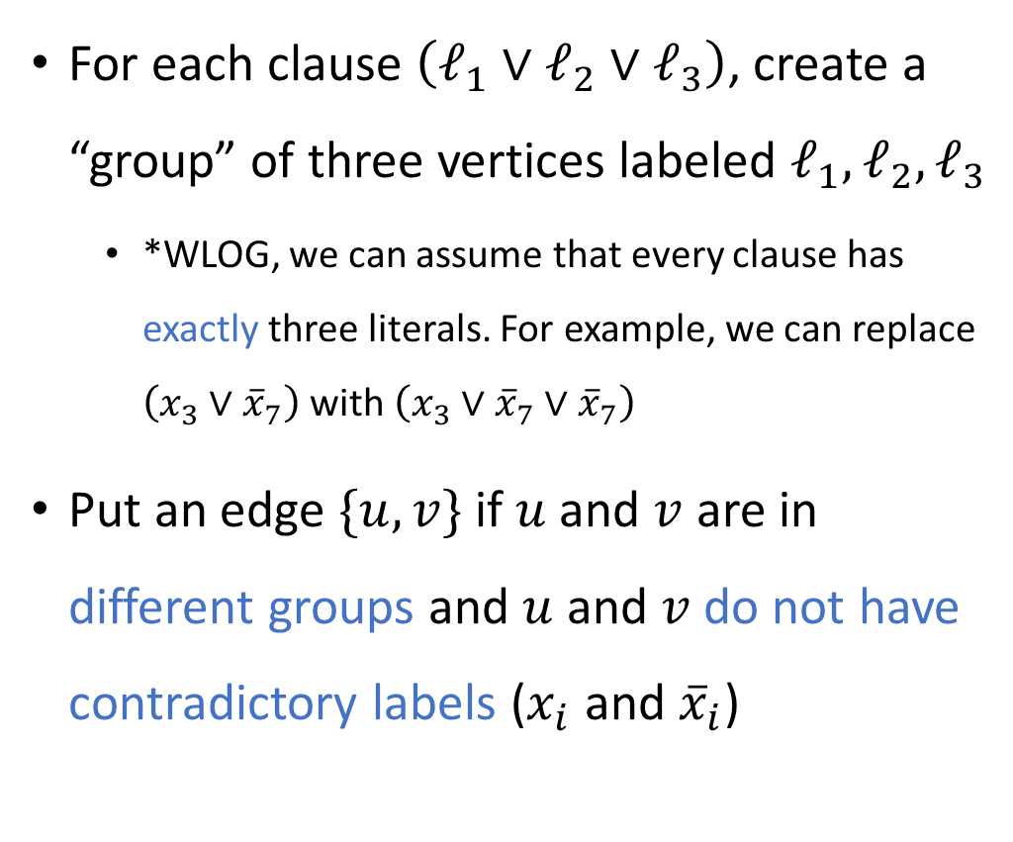








Reduction from $\text{3}\text{‑}\text{SAT}$ to $\text{CLIQUE}$
For each clause $\left(ℓ_{1}∨ℓ_{2}∨ℓ_{3}\right)$, create a “group” of three vertices labeled $ℓ_{1},ℓ_{2},ℓ_{3}$
*WLOG, we can assume that every clause has exactly three literals. For example, we can replace $\left(x_{3}∨{\overline{x}}_{7}\right)$ with $\left(x_{3}∨{\overline{x}}_{7}∨{\overline{x}}_{7}\right)$
Put an edge $\{u, v\}$ if $u$ and $v$ are in different groups and $u$ and $v$ do not have contradictory labels ($x_{i}$ and ${\overline{x}}_{i}$)
E.g., $φ=\left(x_{1}∨x_{2}\right)∧\left({\overline{x}}_{1}∨x_{4}\right)$ $∧\left(x_{2}∨x_{4}∨{\overline{x}}_{3}\right)∧\left(x_{3}\right)$
$$x_{1}$$
$$x_{2}$$
$$x_{2}$$
$${\overline{x}}_{1}$$
$$x_{2}$$
$$x_{4}$$
$$x_{4}$$
$$x_{4}$$
$${\overline{x}}_{3}$$
$$x_{3}$$
$$x_{3}$$
$$x_{3}$$

Slide 17
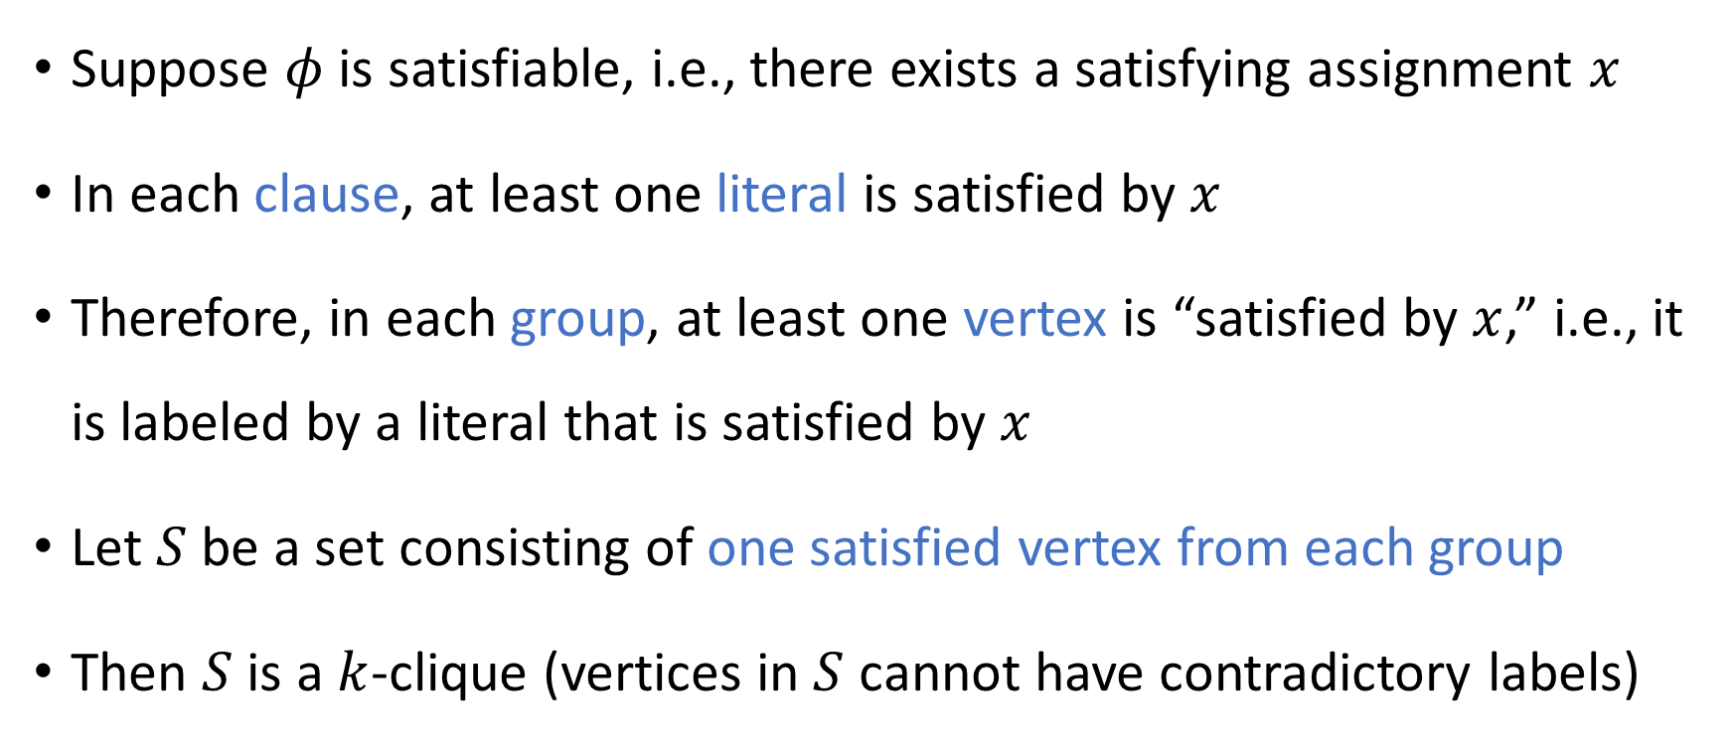
YES maps to YES
Suppose $φ$ is satisfiable, i.e., there exists a satisfying assignment $x$
In each clause, at least one literal is satisfied by $x$
Therefore, in each group, at least one vertex is “satisfied by $x$,” i.e., it is labeled by a literal that is satisfied by $x$
Let $S$ be a set consisting of one satisfied vertex from each group
Then $S$ is a $k$-clique (vertices in $S$ cannot have contradictory labels)

Slide 18
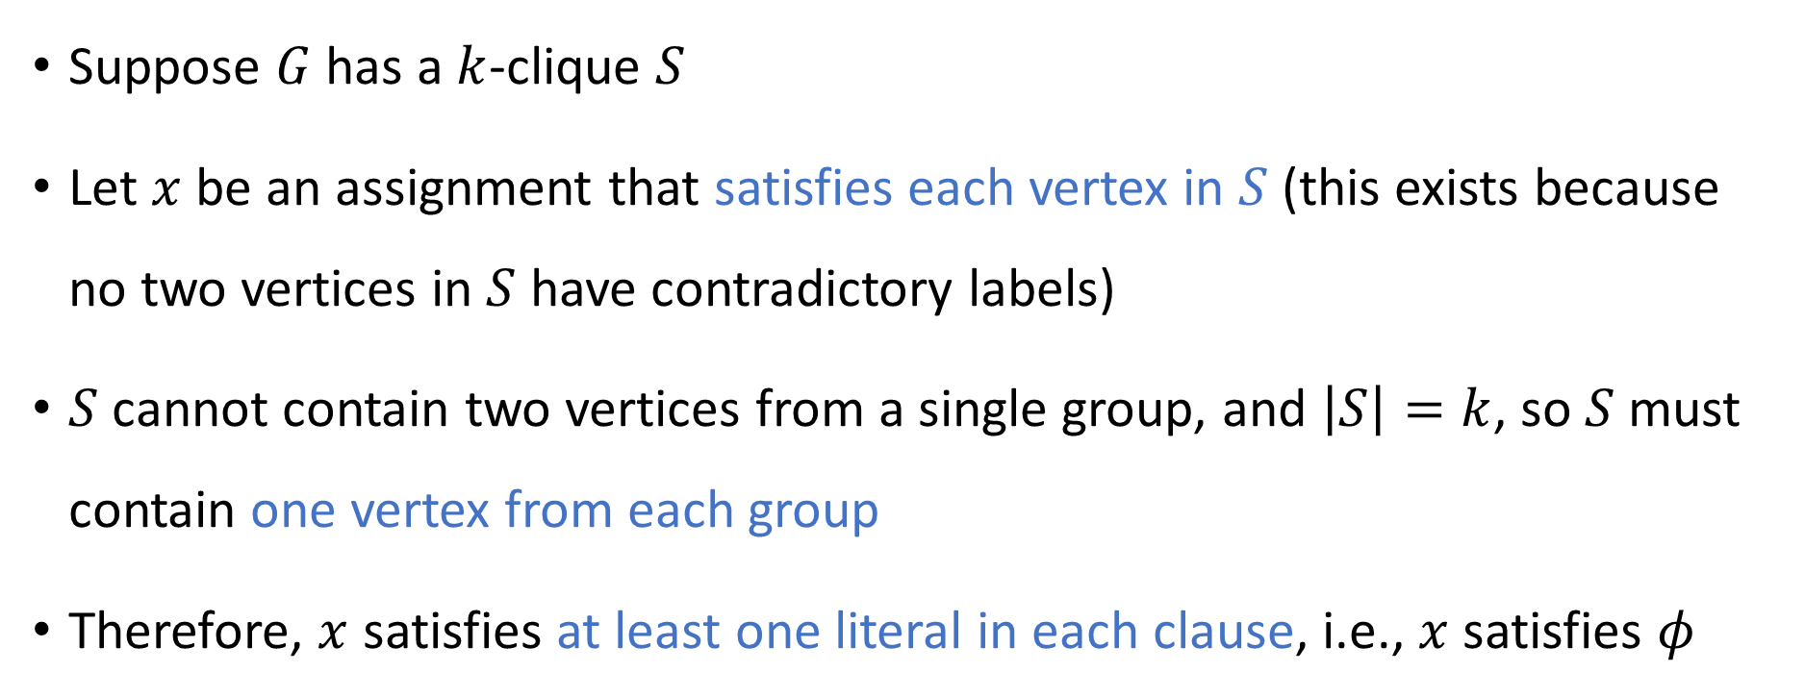
NO maps to NO
Suppose $G$ has a $k$-clique $S$
Let $x$ be an assignment that satisfies each vertex in $S$ (this exists because no two vertices in $S$ have contradictory labels)
$S$ cannot contain two vertices from a single group, and $\left|S\right|=k$, so $S$ must contain one vertex from each group
Therefore, $x$ satisfies at least one literal in each clause, i.e., $x$ satisfies $φ$

Slide 19

Poly-time computable
Hopefully it is clear that the reduction $f\left(\left\langle φ\right\rangle \right)=⟨G,k⟩$ can be computed in polynomial time

Slide 20







$\text{NP}$-hard
$$\text{CIRCUIT}\text{‑}\text{SAT}$$
$$\text{CLIQUE}$$
$\text{NP}$-complete
$$\text{3‑}\text{SAT}$$
$$\text{NP}$$
$$\text{P}$$

Slide 21
Detour: A little bit of graph theory

Slide 22
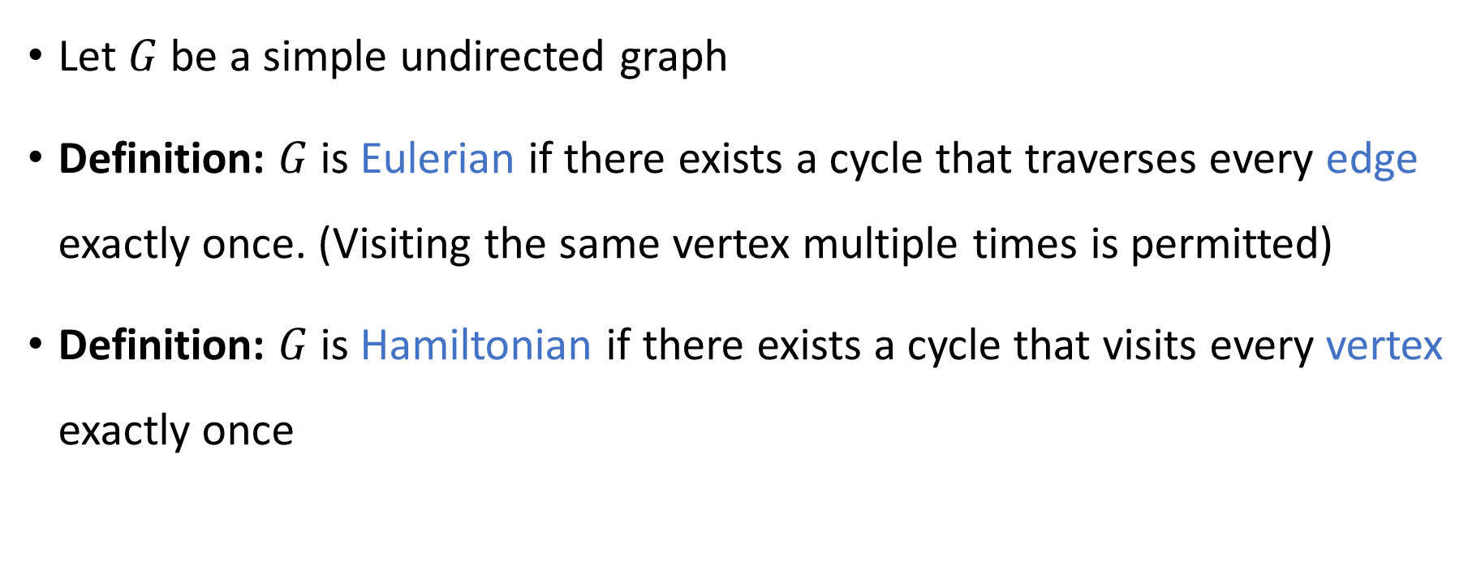
Eulerian and Hamiltonian graphs
Let $G$ be a simple undirected graph
Definition: $G$ is Eulerian if there exists a cycle that traverses every edge exactly once. (Visiting the same vertex multiple times is permitted)
Definition: $G$ is Hamiltonian if there exists a cycle that visits every vertex exactly once

Slide 23
Examples of Eulerian and Hamiltonian graphs
This graph is Eulerian
This graph is Hamiltonian

Slide 24

Euler’s theorem
Let $G$ be a simple, undirected, connected graph
It’s a very satisfying/pleasing characterization of Eulerian graphs
(Proof omitted)
Euler’s Theorem: $G$ is Eulerian if and only if every vertex has even degree

Slide 25
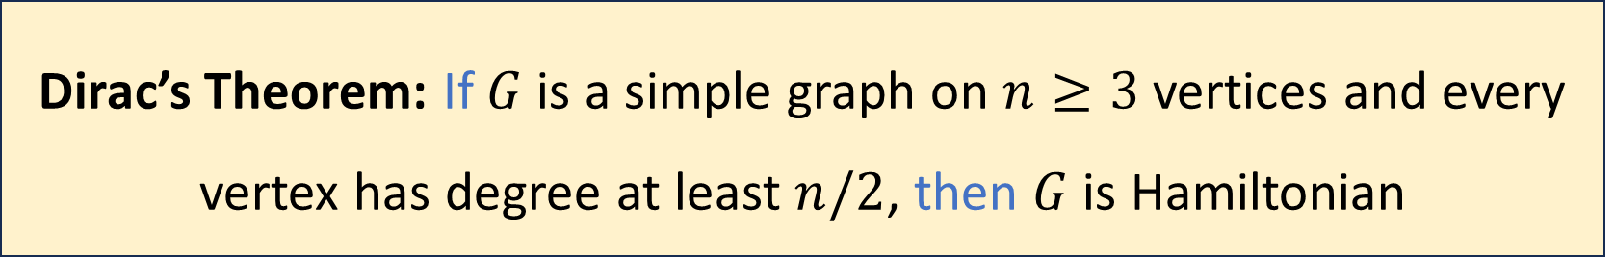
Characterizing Hamiltonian graphs?
Which graphs are Hamiltonian? Can we prove a similarly satisfying characterization?
(Proof omitted)
It’s a nice theorem, but the implication only goes one direction…
Dirac’s Theorem: If $G$ is a simple graph on $n≥3$ vertices and every vertex has degree at least $n/2$, then $G$ is Hamiltonian

Slide 26
Characterizing Hamiltonian graphs?
Fact: A graph is Hamiltonian if and only if it has a spanning subgraph that is a cycle
This is an exact characterization of Hamiltonian graphs, but it is very unsatisfying…
It’s just a trivial reformulation of the definition

Slide 27
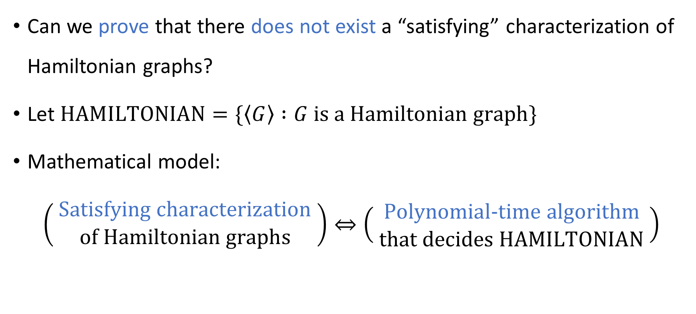
“Satisfying characterization”
Can we prove that there does not exist a “satisfying” characterization of Hamiltonian graphs?
Let $\text{HAMILTONIAN}=\{\left\langle G\right\rangle :G \text{is} \text{a} \text{Hamiltonian} \text{graph}\}$
Mathematical model:
$$\left( \begin{matrix}\text{S}\text{atisfying} \text{characterization} \\ \text{of} \text{Hamiltonian} \text{graphs}\end{matrix} \right)⇔\left( \begin{matrix}\text{P}\text{olynomial}\text{‑}\text{time} \text{algorithm} \\ \text{that} \text{decides} \text{HAMILTONIAN}\end{matrix} \right)$$

Slide 28
The purpose of algorithm design
Why design an algorithm? So we can run it on a computer? Not necessarily...
Sometimes, we design an algorithm so that we can understand a mathematical topic better!
Graph algorithms teach us about graph theory, arithmetic algorithms teach us about number theory, etc.
A polynomial-time algorithm typically gives us an especially deep understanding of the relevant topic

