Slide 1

CMSC 28100 Introduction to Complexity Theory Spring 2024 Instructor: William Hoza

Slide 2
Which problems can be solved through computation?
CLASSICAL

Slide 3

Which languages are in $\text{P}$?

Slide 4

Which languages are not in $\text{P}$?

Slide 5


The Time Hierarchy Theorem
Let $T:ℕ→ℕ$ be a “reasonable” time complexity bound (we will come back to this)
Given a little more time, we can solve more problems
Theorem: $\text{TIME}\left(o\left(T\right)\right)≠\text{TIME}\left(T^{3}\right)$
Notes:
See the textbook for a tighter version of the theorem, where we have T log T instead of T^3

Slide 6


Proof of the Time Hierarchy Theorem
Let $L=\{\left\langle M\right\rangle :M \text{rejects} 〈M⟩ \text{within} T\left(\left|⟨M⟩\right|\right) \text{steps}\}$
Claim 1: $L∉\text{TIME}\left(o\left(T\right)\right)$
Proof: Last class

Slide 7
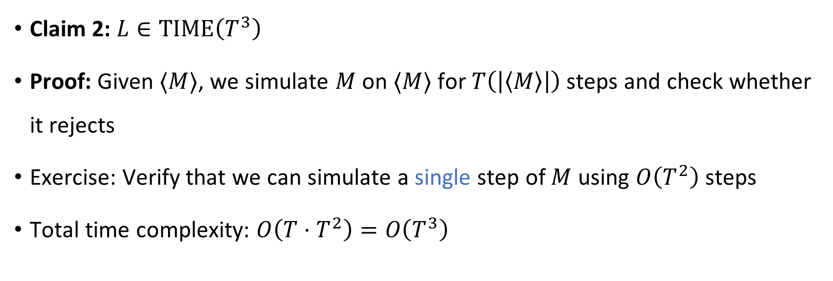
Proof of the Time Hierarchy Theorem
Let $L=\{\left\langle M\right\rangle :M \text{rejects} 〈M⟩ \text{within} T\left(\left|⟨M⟩\right|\right) \text{steps}\}$
Claim 2: $L∈\text{TIME}\left(T^{3}\right)$
Proof: Given $⟨M⟩$, we simulate $M$ on $⟨M⟩$ for $T\left(\left|\left\langle M\right\rangle \right|\right)$ steps and check whether it rejects
Exercise: Verify that we can simulate a single step of $M$ using $O\left(T^{2}\right)$ steps
Total time complexity: $O\left(T⋅T^{2}\right)=O\left(T^{3}\right)$
Subtle point: How do we know when we’re done?
Notes:
The function f(<M>#<C>) = <NEXT(C)> can be computed in time O(|<M>| * |<C>|)

Slide 8
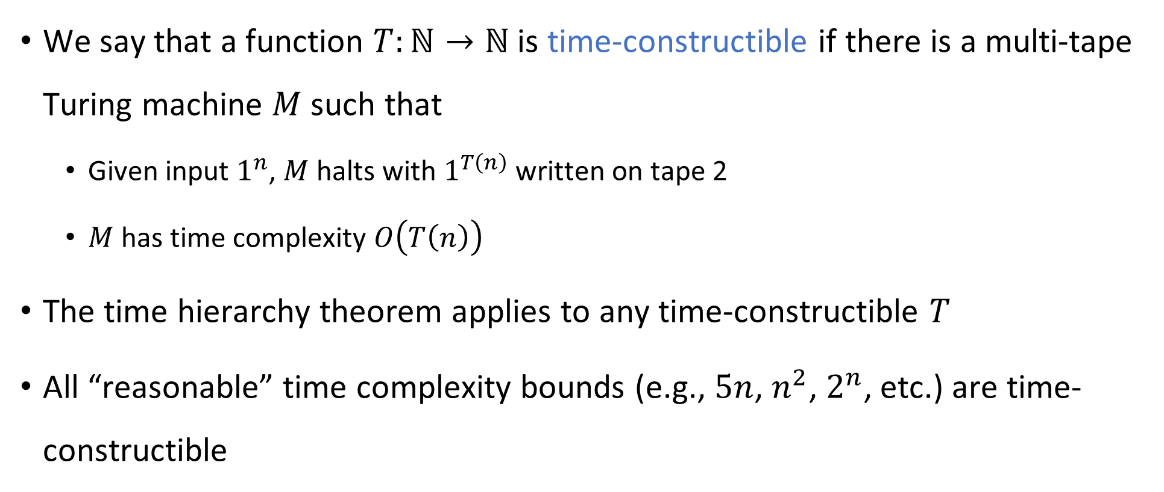
Time-constructible functions
We say that a function $T:ℕ→ℕ$ is time-constructible if there is a multi-tape Turing machine $M$ such that
Given input $1^{n}$, $M$ halts with $1^{T\left(n\right)}$ written on tape 2
$M$ has time complexity $O\left(T\left(n\right)\right)$
The time hierarchy theorem applies to any time-constructible $T$
All “reasonable” time complexity bounds (e.g., $5n$, $n^{2}$, $2^{n}$, etc.) are time-constructible

Slide 9
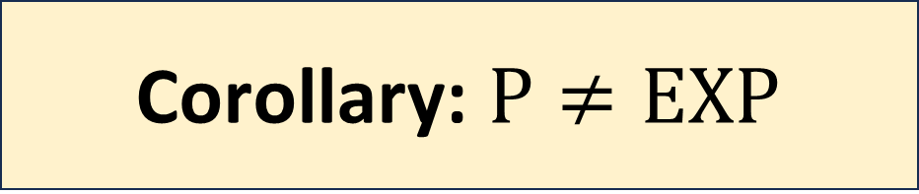
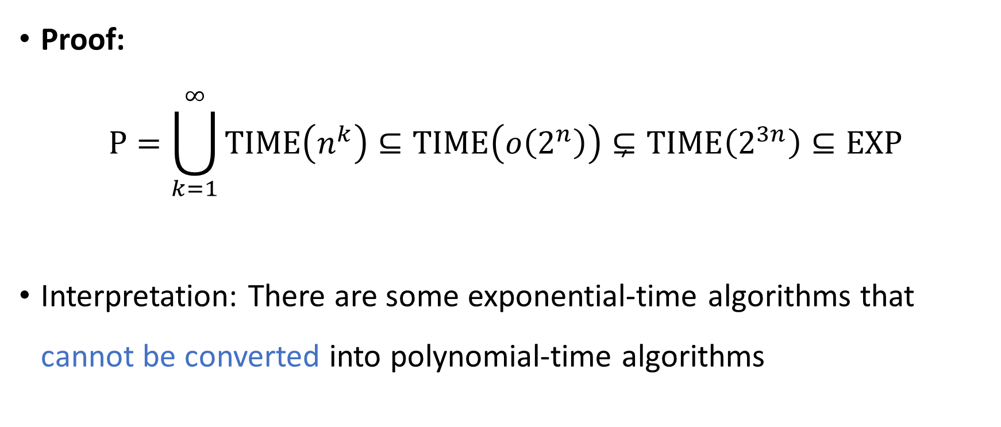
Corollary: $\text{P}≠\text{EXP}$
Proof:
$$\text{P}=\bigcup_{k=1}^{∞}{\text{TIME}\left(n^{k}\right)}⊆\text{TIME}\left(o\left(2^{n}\right)\right)⊊\text{TIME}\left(2^{3n}\right)⊆\text{EXP}$$
Interpretation: There are some exponential-time algorithms that cannot be converted into polynomial-time algorithms

Slide 10





All languages
$$\text{HALT}$$
Decidable languages
$$\{\left\langle M\right\rangle :M \text{rejects} \left\langle M\right\rangle \text{within} 2^{\left|\left\langle M\right\rangle \right|} \text{steps}\}$$
$$\text{EXP}$$
$$\text{P}$$
$$\text{PALINDROMES}$$

Slide 11

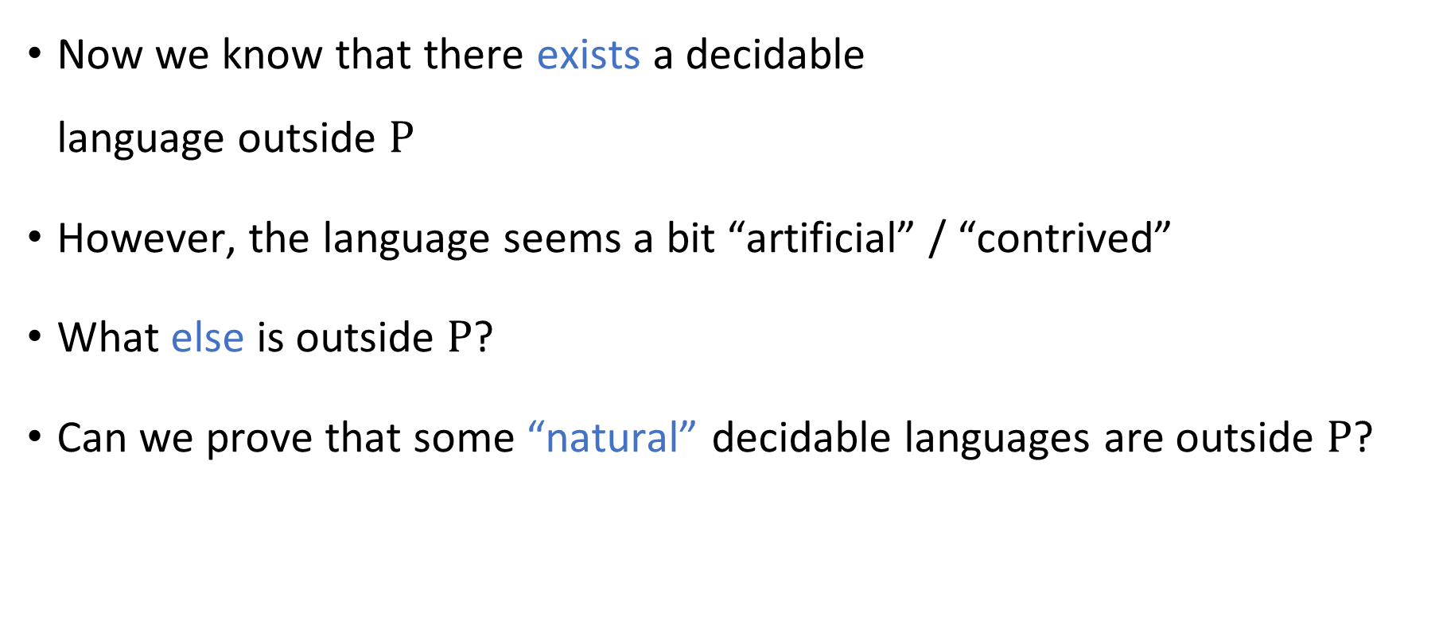

“Natural” languages outside $\text{P}$
Now we know that there exists a decidable language outside $\text{P}$
However, the language seems a bit “artificial” / “contrived”
What else is outside $\text{P}$?
Can we prove that some “natural” decidable languages are outside $\text{P}$?

Slide 12
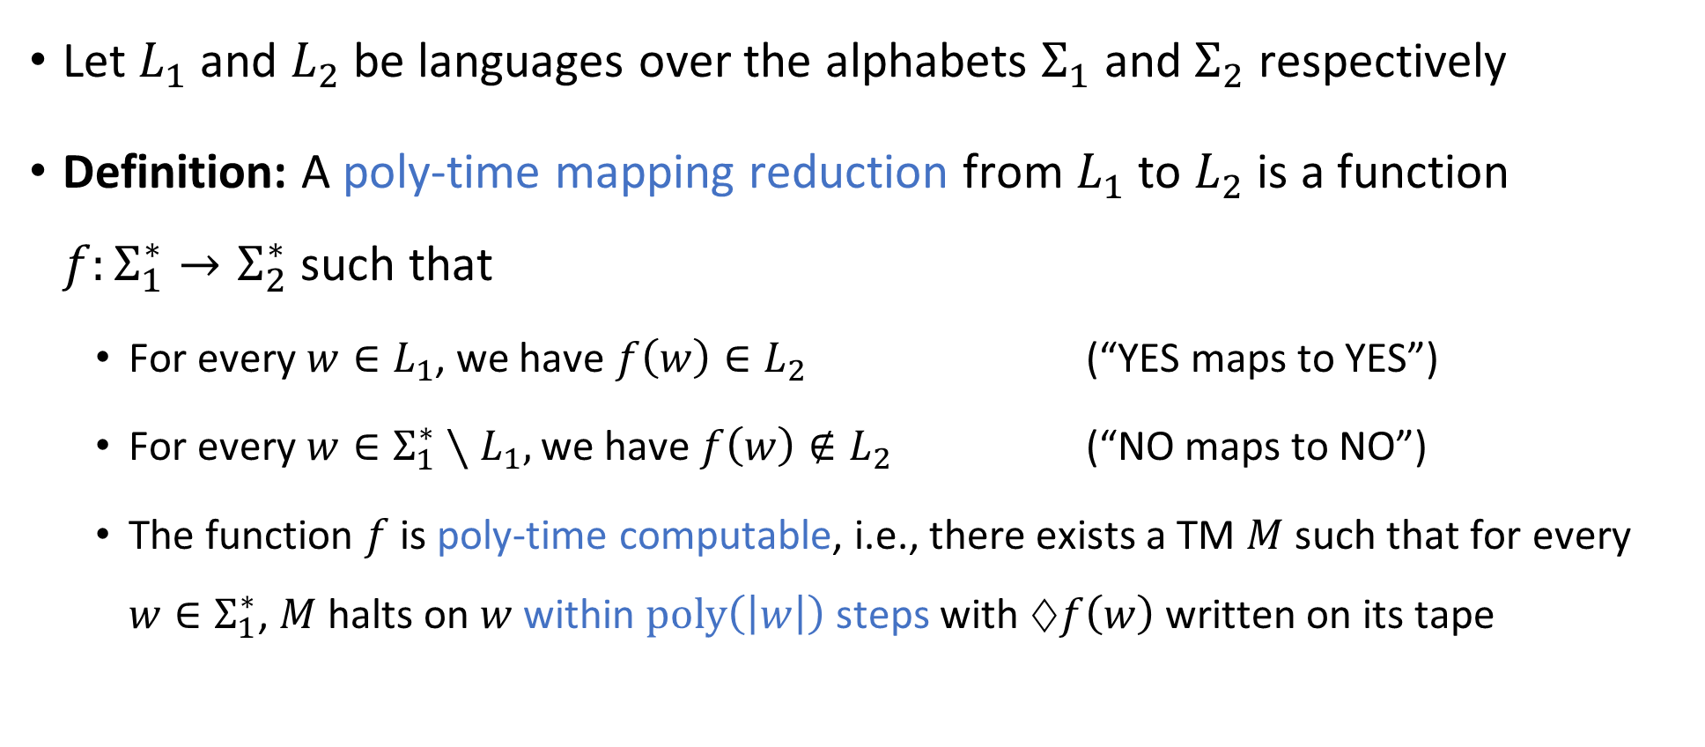
Polynomial-time reductions
Let $L_{1}$ and $L_{2}$ be languages over the alphabets $Σ_{1}$ and $Σ_{2}$ respectively
Definition: A poly-time mapping reduction from $L_{1}$ to $L_{2}$ is a function $f:Σ_{1}^{∗}→Σ_{2}^{∗}$ such that
For every $w∈L_{1}$, we have $f\left(w\right)∈L_{2}$ (“YES maps to YES”)
For every $w∈Σ_{1}^{∗}∖L_{1},$ we have $f\left(w\right)∉L_{2}$ (“NO maps to NO”)
The function $f$ is poly-time computable, i.e., there exists a TM $M$ such that for every $w∈Σ_{1}^{∗}$, $M$ halts on $w$ within $\text{poly}\left(\left|w\right|\right)$ steps with $♢f\left(w\right)$ written on its tape

Slide 13

Polynomial-time reductions
A poly-time mapping reduction from $L_{1}$ to $L_{2}$ is a way of efficiently converting instances of $L_{1}$ into equivalent instances of $L_{2}$
$$L_{2}$$
$$L_{1}$$
$$Σ_{1}^{∗}$$
$$Σ_{2}^{∗}$$

Slide 14



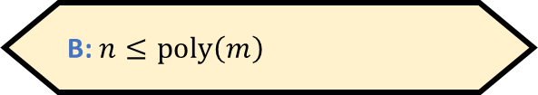


Reductions: Proving that a language is in $\text{P}$
Suppose there exists a poly-time mapping reduction $f$ from $L_{1}$ to $L_{2}$
Claim: If $L_{2}∈\text{P}$, then $L_{1}∈\text{P}$
Proof: Given $w∈Σ_{1}^{∗}$:
Compute $f\left(w\right)∈Σ_{2}^{∗}$ (this takes $O\left(n^{k_{1}}\right)$ time)
Check whether $f\left(w\right)∈L_{2}$ (this takes $O\left(m^{k_{2}}\right)$ time where $m=\left|f\left(w\right)\right|$)
If so, accept; otherwise, reject.
$m≤O\left(n^{k_{1}}\right)$, so the total time is $O\left(n^{k_{1}}+n^{k_{1}⋅k_{2}}\right)=\text{poly}\left(n\right)$
Let $n=\left|w\right|$ and $m=\left|f\left(w\right)\right|$. What can we say about the relationship between $n$ and $m$?
A: $m≤\text{poly}\left(n\right)$
B: $n≤\text{poly}\left(m\right)$
C: $n=m$
D: We cannot say anything
Respond at PollEv.com/whoza or text “whoza” to 22333

Slide 15

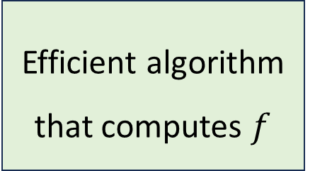
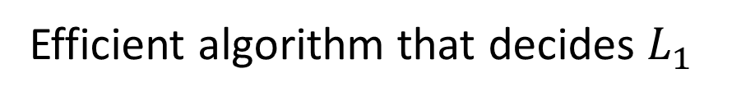



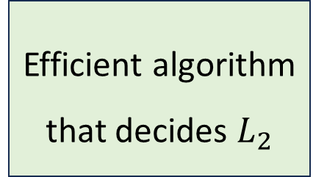
Reductions: Proving that a language is in $\text{P}$
Efficient algorithm that decides $L_{1}$
Efficient algorithm that computes $f$
$$f\left(w\right)$$
Efficient algorithm that decides $L_{2}$
$$w$$
Acc/Rej
The “mapping reduction” is $f$

Slide 16


Reductions: Proving that a language is not in $\text{P}$
Suppose there exists a poly-time mapping reduction $f$ from $L_{1}$ to $L_{2}$
Claim: If $L_{1}∉\text{P}$, then $L_{2}∉\text{P}$
Proof: If $L_{2}$ were in $\text{P}$, then $L_{1}$ would be in $\text{P}$

Slide 17
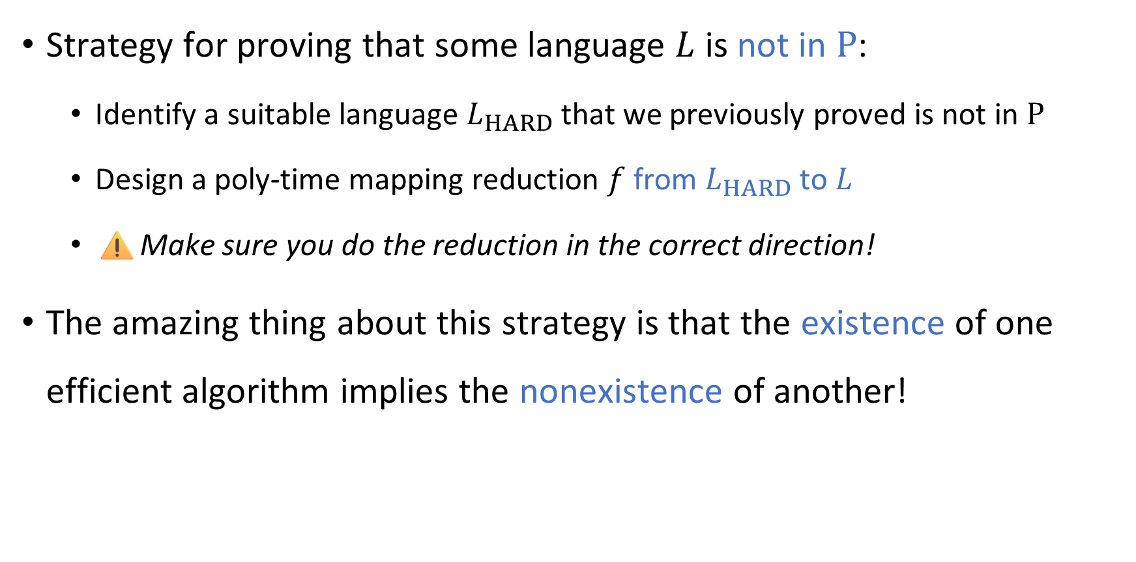
Using reductions to prove intractability
Strategy for proving that some language $L$ is not in $\text{P}$:
Identify a suitable language $L_{HARD}$ that we previously proved is not in $\text{P}$
Design a poly-time mapping reduction $f$ from $L_{HARD}$ to $L$
⚠️Make sure you do the reduction in the correct direction!
The amazing thing about this strategy is that the existence of one efficient algorithm implies the nonexistence of another!

Slide 18
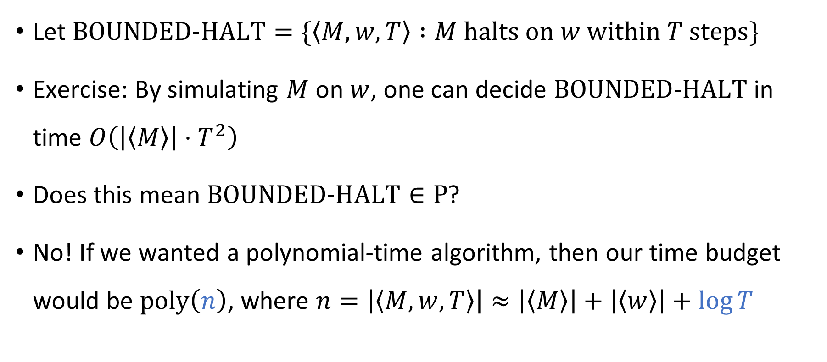
The time-bounded halting problem
Let $\text{BOUNDED}\text{‑}\text{HALT}=\{\left\langle M, w, T\right\rangle :M \text{halts} \text{on} w \text{within} T \text{steps}\}$
Exercise: By simulating $M$ on $w$, one can decide $\text{BOUNDED}\text{‑}\text{HALT}$ in time $O\left(\left|\left\langle M\right\rangle \right|⋅T^{2}\right)$
Does this mean $\text{BOUNDED}\text{‑}\text{HALT}∈\text{P}$?
No! If we wanted a polynomial-time algorithm, then our time budget would be $\text{poly}\left(n\right)$, where $n=\left|\left\langle M,w,T\right\rangle \right|≈\left|\left\langle M\right\rangle \right|+\left|\left\langle w\right\rangle \right|+\log{T}$

Slide 19
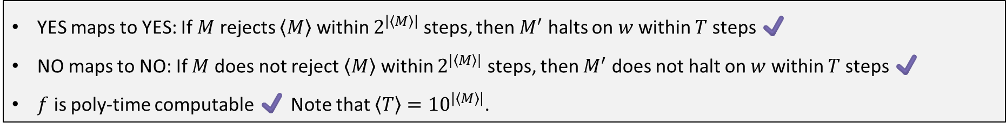
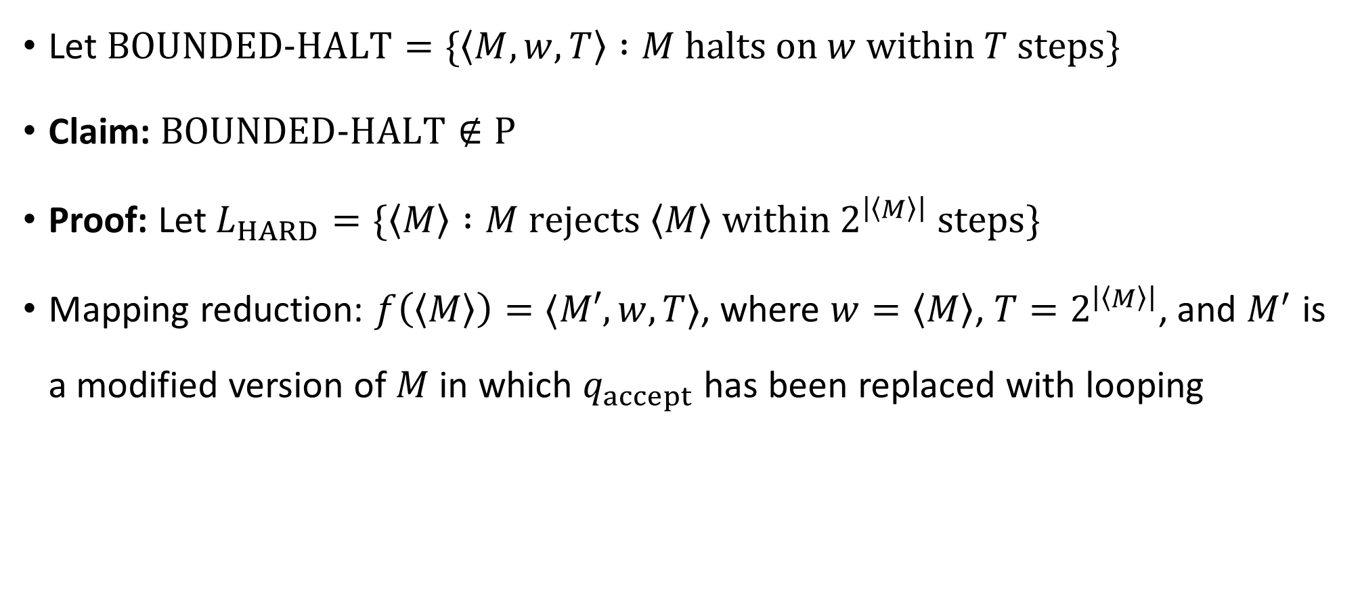
Time-bounded halting problem
Let $\text{BOUNDED}\text{‑}\text{HALT}=\{\left\langle M, w, T\right\rangle :M \text{halts} \text{on} w \text{within} T \text{steps}\}$
Claim: $\text{BOUNDED}\text{‑}\text{HALT}∉\text{P}$
Proof: Let $L_{HARD}=\{\left\langle M\right\rangle :M \text{rejects} \left\langle M\right\rangle \text{within} 2^{\left|\left\langle M\right\rangle \right|} \text{steps}\}$
Mapping reduction: $f\left(\left\langle M\right\rangle \right)=⟨M′,w,T⟩$, where $w=\left\langle M\right\rangle$, $T=2^{\left|\left\langle M\right\rangle \right|}$, and $M^{′}$ is a modified version of $M$ in which $q_{accept}$ has been replaced with looping
YES maps to YES: If $M$ rejects $\left\langle M\right\rangle$ within $2^{\left|\left\langle M\right\rangle \right|}$ steps, then $M^{′}$ halts on $w$ within $T$ steps ✔️
NO maps to NO: If $M$ does not reject $\left\langle M\right\rangle$ within $2^{|\left\langle M\right\rangle |}$ steps, then $M^{′}$ does not halt on $w$ within $T$ steps ✔️
$f$ is poly-time computable ✔️ Note that $\left\langle T\right\rangle ={10}^{\left|\left\langle M\right\rangle \right|}$.

Slide 20

How hard is hard?
We can say more than merely “$\text{BOUNDED}\text{‑}\text{HALT}∉\text{P}$”
We can more precisely characterize the complexity of $\text{BOUNDED}\text{‑}\text{HALT}$

Slide 21
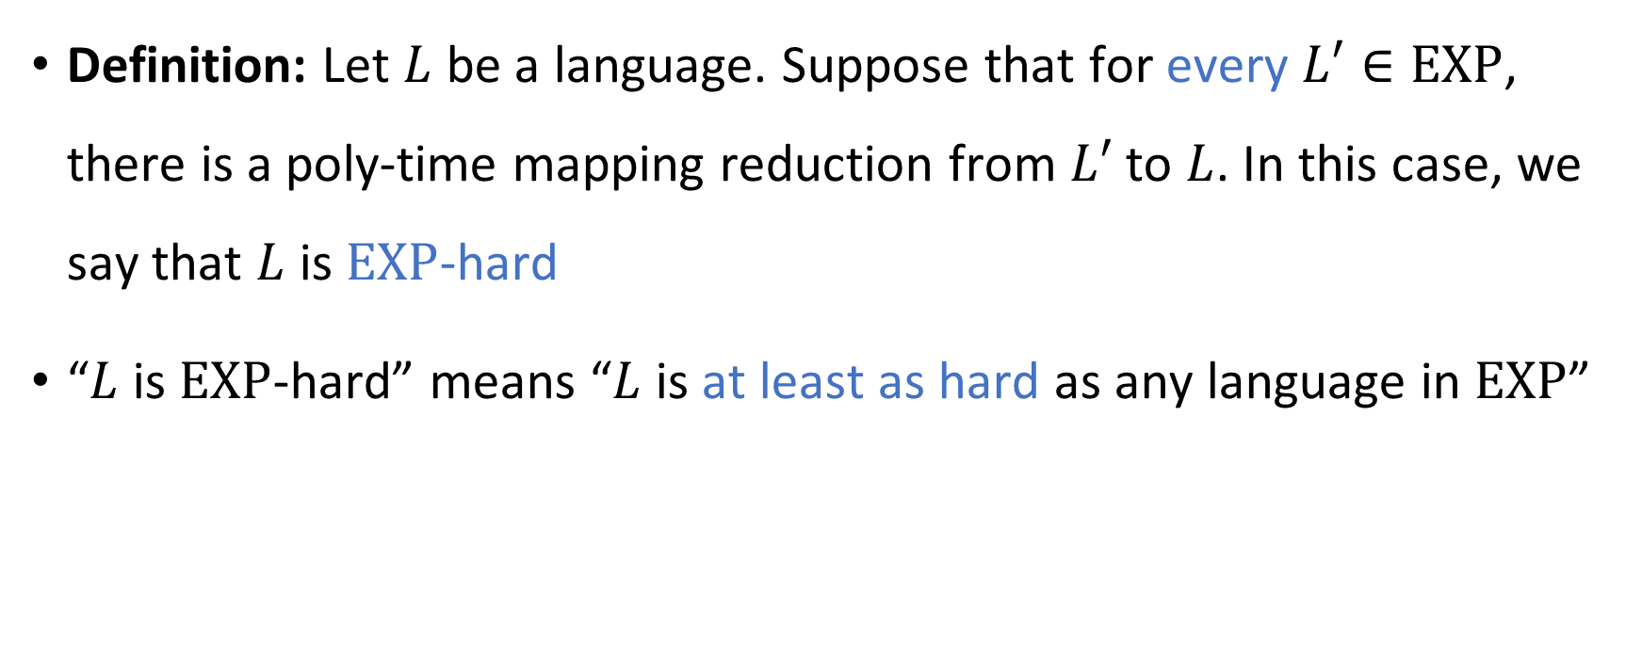
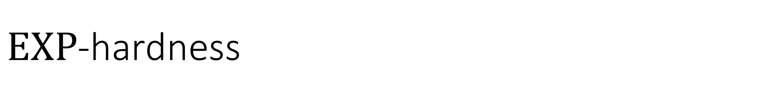
$\text{EXP}$-hardness
Definition: Let $L$ be a language. Suppose that for every $L′∈\text{EXP}$, there is a poly-time mapping reduction from $L′$ to $L$. In this case, we say that $L$ is $\text{EXP}$-hard
“$L$ is $\text{EXP}$-hard” means “$L$ is at least as hard as any language in $\text{EXP}$”

Slide 22
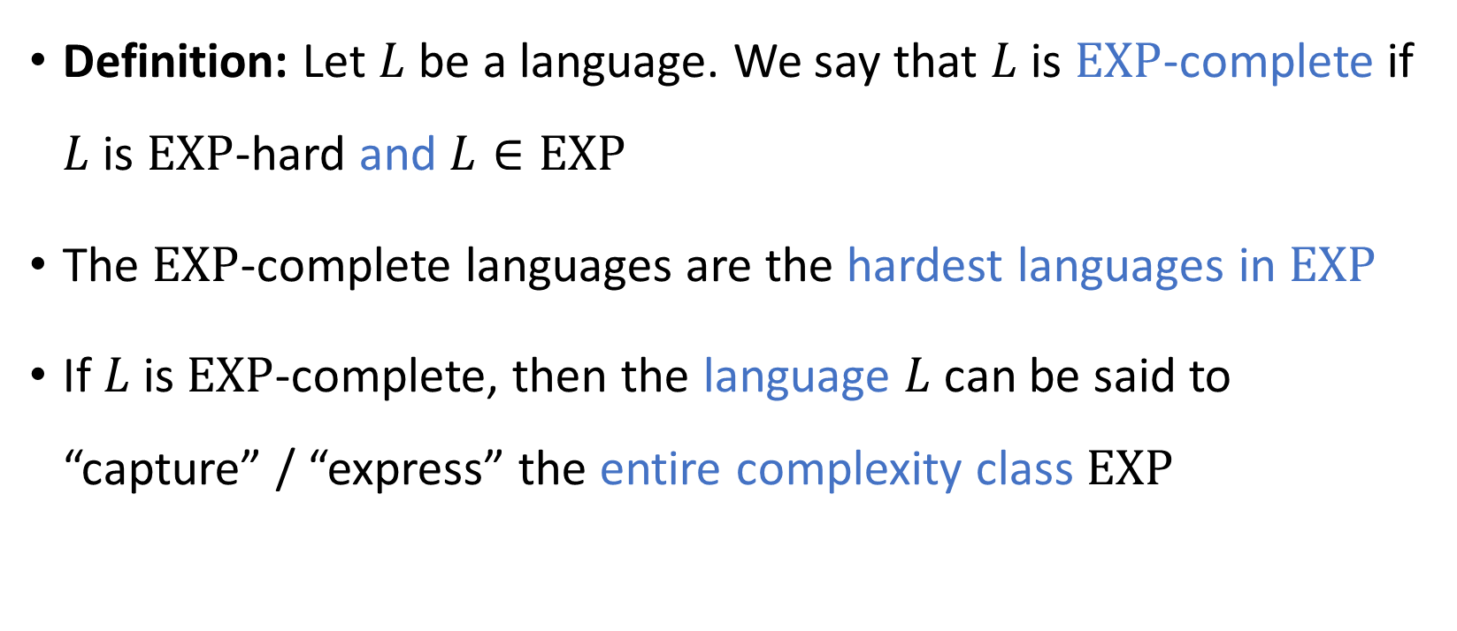
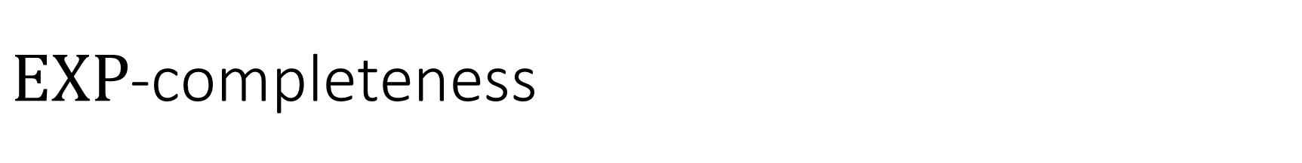
$\text{EXP}$-completeness
Definition: Let $L$ be a language. We say that $L$ is $\text{EXP}$-complete if $L$ is $\text{EXP}$-hard and $L∈\text{EXP}$
The $\text{EXP}$-complete languages are the hardest languages in $\text{EXP}$
If $L$ is $\text{EXP}$-complete, then the language $L$ can be said to “capture” / “express” the entire complexity class $\text{EXP}$

Slide 23
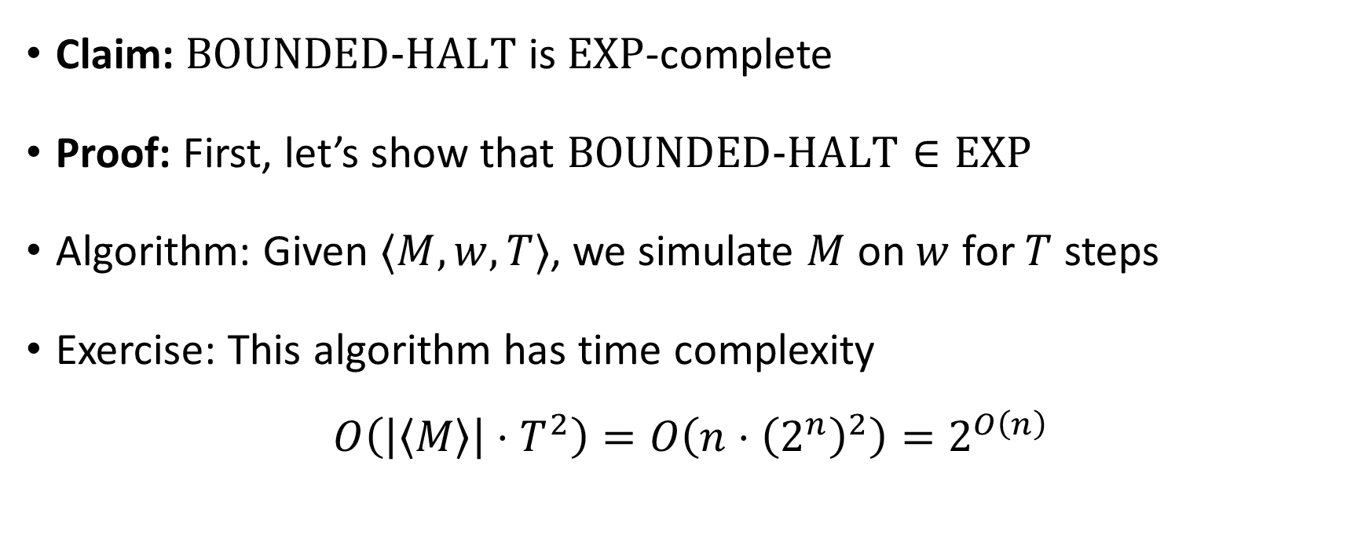

$\text{BOUNDED}\text{‑}\text{HALT}$ is $\text{EXP}$-complete
Claim: $\text{BOUNDED}\text{‑}\text{HALT}$ is $\text{EXP}$-complete
Proof: First, let’s show that $\text{BOUNDED}\text{‑}\text{HALT}∈\text{EXP}$
Algorithm: Given $⟨M,w,T⟩$, we simulate $M$ on $w$ for $T$ steps
Exercise: This algorithm has time complexity
$$O\left(\left|\left\langle M\right\rangle \right|⋅T^{2}\right)=O\left(n⋅{\left(2^{n}\right)}^{2}\right)=2^{O\left(n\right)}$$

