Slide 1
CMSC 28100 Introduction to Complexity Theory Autumn 2025 Instructor: William Hoza
⏳

Slide 2
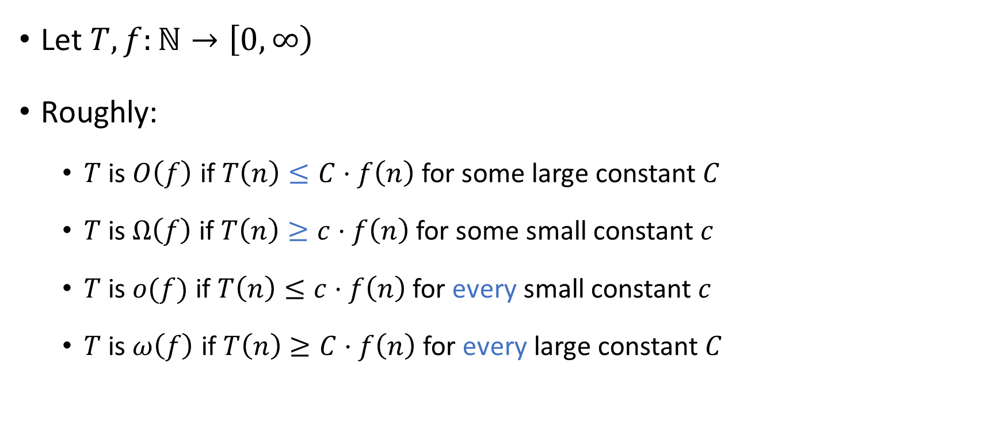
Asymptotic notation
Let $T,f:ℕ→\left[0, ∞\right)$
Roughly:
$T$ is $O\left(f\right)$ if $T\left(n\right)≤C⋅f\left(n\right)$ for some large constant $C$
$T$ is $Ω\left(f\right)$ if $T\left(n\right)≥c⋅f\left(n\right)$ for some small constant $c$
$T$ is $o(f)$ if $T\left(n\right)≤c⋅f\left(n\right)$ for every small constant $c$
$T$ is $ω\left(f\right)$ if $T\left(n\right)≥C⋅f\left(n\right)$ for every large constant $C$

Slide 3

Exponential vs. polynomial
Proved last time: For every constant $k∈ℕ$, we have $n^{k}=o\left(2^{n}\right)$
We say $T\left(n\right)$ is $\text{poly}\left(n\right)$ if there is some constant $k$ such that $T\left(n\right)$ is $O\left(n^{k}\right)$

Slide 4
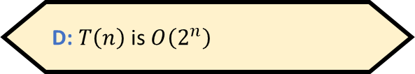

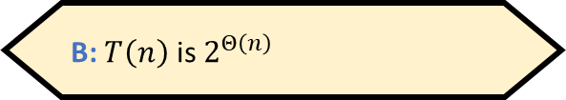
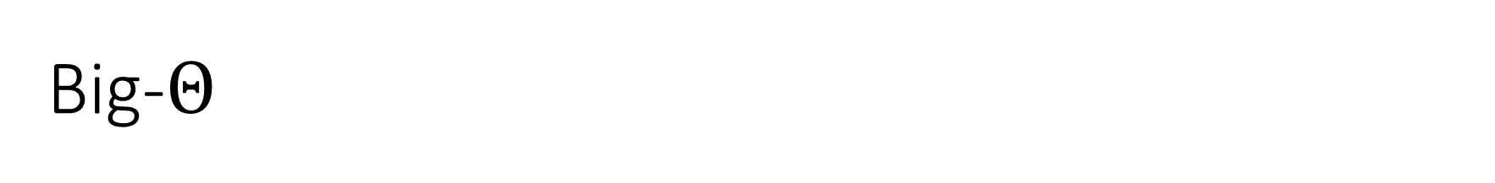
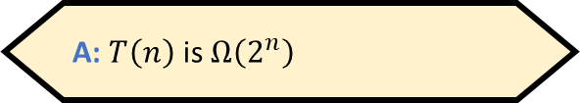
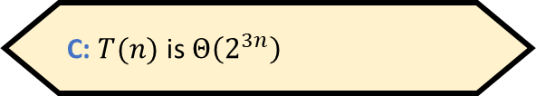
Big-$Θ$
Let $T,f:ℕ→\left[0, ∞\right)$ be any two functions
We say that $T$ is $Θ\left(f\right)$ if $T$ is $O\left(f\right)$ and $T$ is $Ω\left(f\right)$
Example: $0.1n^{2}+14$ is $Θ\left(n^{2}\right)$ and $Θ\left(n^{2}+2n^{1.4}\right)$, but not $Θ\left(n\right)$
Let $T\left(n\right)=2^{3n+4}$. Which of the following statements is false?
A: $T\left(n\right)$ is $Ω\left(2^{n}\right)$
B: $T\left(n\right)$ is $2^{Θ\left(n\right)}$
C: $T(n)$ is $Θ\left(2^{3n}\right)$
D: $T\left(n\right)$ is $O\left(2^{n}\right)$
Respond at PollEv.com/whoza or text “whoza” to 22333

Slide 5
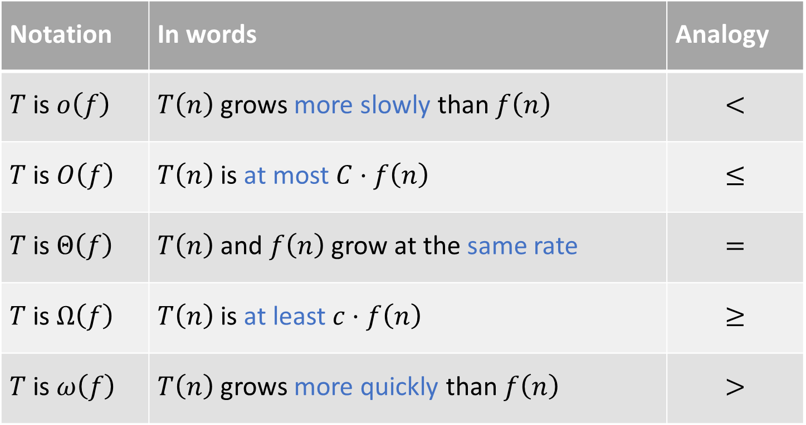
Summary of asymptotic notation
Notation | In words | Analogy
$T$ is $o\left(f\right)$ | $T\left(n\right)$ grows more slowly than $f\left(n\right)$ | $$<$$
$T$ is $O\left(f\right)$ | $T\left(n\right)$ is at most $C⋅f\left(n\right)$ | $$≤$$
$T$ is $Θ\left(f\right)$ | $T\left(n\right)$ and $f\left(n\right)$ grow at the same rate | $$=$$
$T$ is $Ω\left(f\right)$ | $T\left(n\right)$ is at least $c⋅f\left(n\right)$ | $$≥$$
$T$ is $ω\left(f\right)$ | $T\left(n\right)$ grows more quickly than $f\left(n\right)$ | $$>$$

Slide 6
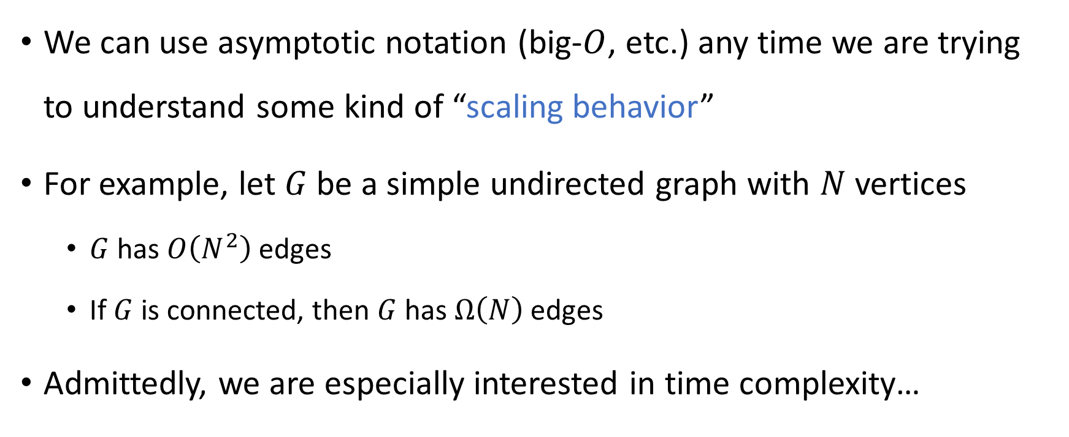
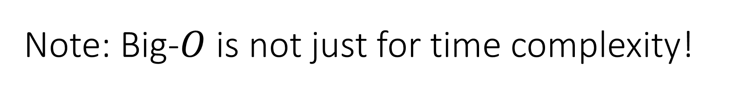
Note: Big-$O$ is not just for time complexity!
We can use asymptotic notation (big-$O$, etc.) any time we are trying to understand some kind of “scaling behavior”
For example, let $G$ be a simple undirected graph with $N$ vertices
$G$ has $O\left(N^{2}\right)$ edges
If $G$ is connected, then $G$ has $Ω\left(N\right)$ edges
Admittedly, we are especially interested in time complexity…

Slide 7
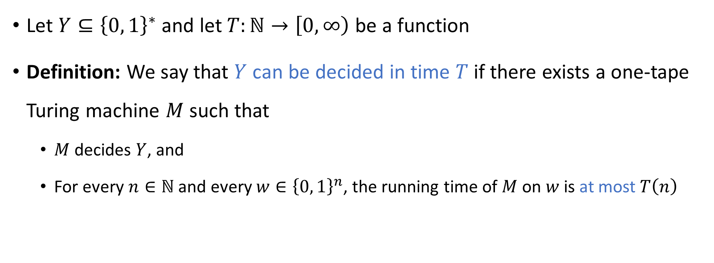

Deciding a language in time $T$
⏳
Let $Y⊆{\left\{0, 1\right\}}^{∗}$ and let $T:ℕ→\left[0, ∞\right)$ be a function
Definition: We say that $Y$ can be decided in time $T$ if there exists a one-tape Turing machine $M$ such that
$M$ decides $Y$, and
For every $n∈ℕ$ and every $w∈{\left\{0, 1\right\}}^{n}$, the running time of $M$ on $w$ is at most $T\left(n\right)$

Slide 8
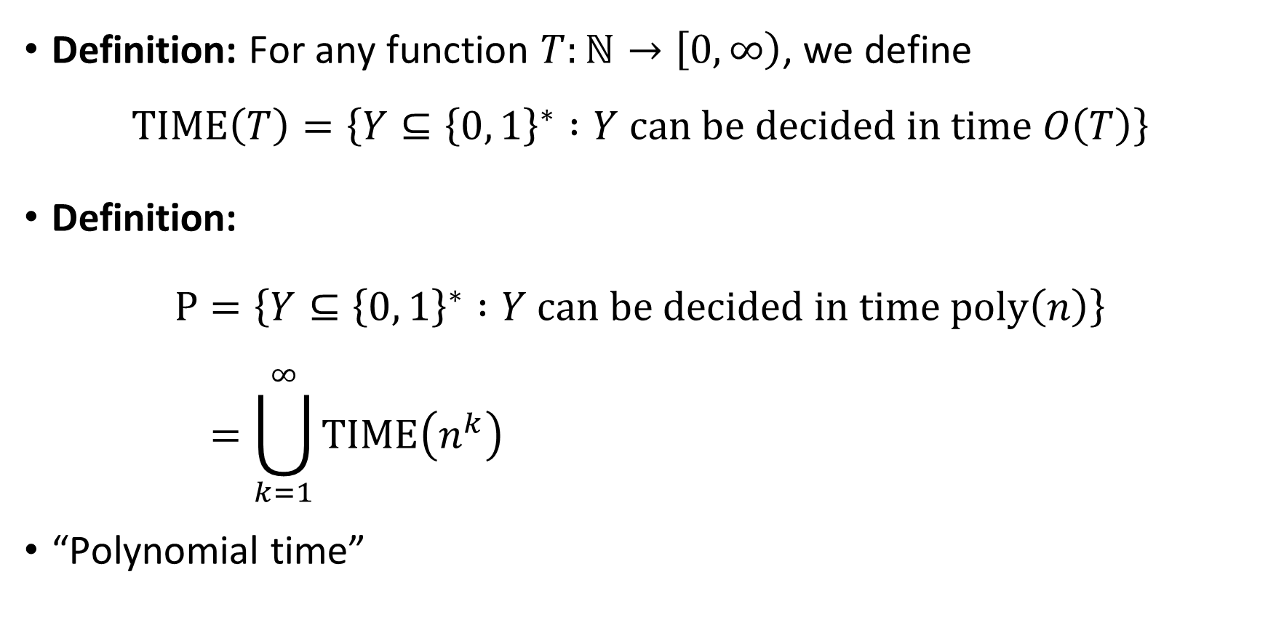

The complexity class $\text{P}$
⏳
Definition: For any function $T:ℕ→\left[0, ∞\right)$, we define
$$\text{TIME}\left(T\right)=\left\{Y⊆{\left\{0, 1\right\}}^{∗} :Y \text{can} \text{be} \text{decided} \text{in} \text{time} O\left(T\right)\right\}$$
Definition:
$$\text{P}=\left\{Y⊆{\left\{0, 1\right\}}^{∗} :Y \text{can} \text{be} \text{decided} \text{in} \text{time} \text{poly}\left(n\right)\right\} \\ =\bigcup_{k=1}^{∞}{\text{TIME}\left(n^{k}\right)}$$
“Polynomial time”

Slide 9
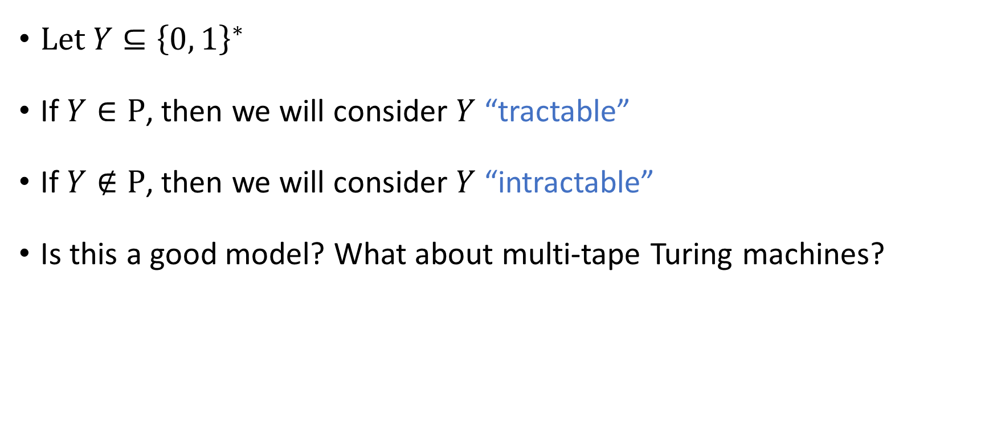
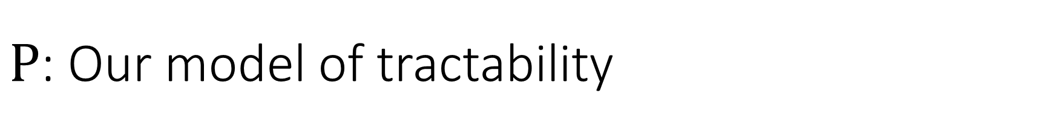
$\text{P}$: Our model of tractability
⏳
Let $Y⊆{\left\{0, 1\right\}}^{∗}$
If $Y∈\text{P}$, then we will consider $Y$ “tractable”
If $Y∉\text{P}$, then we will consider $Y$ “intractable”
Is this a good model? What about multi-tape Turing machines?

Slide 10
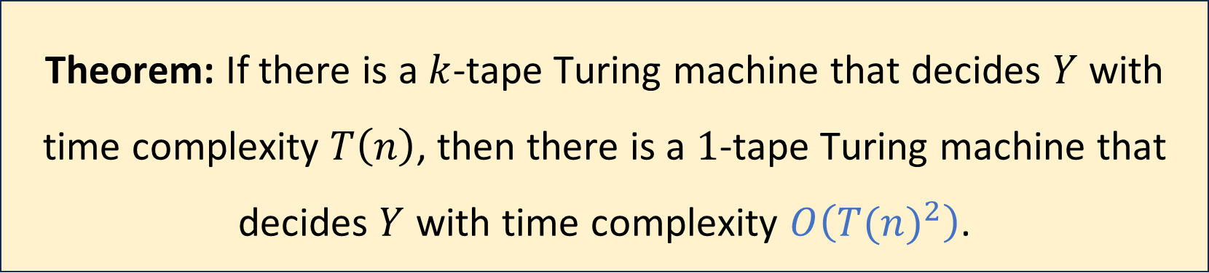

Multi-tape Turing machines, revisited
Let $Y⊆{\left\{0, 1\right\}}^{∗}$, let $k$ be a positive integer, and let $T:ℕ→ℕ$
Theorem: If there is a $k$-tape Turing machine that decides $Y$ with time complexity $T\left(n\right)$, then there is a $1$-tape Turing machine that decides $Y$ with time complexity $O\left({T(n)}^{2}\right)$.

Slide 11

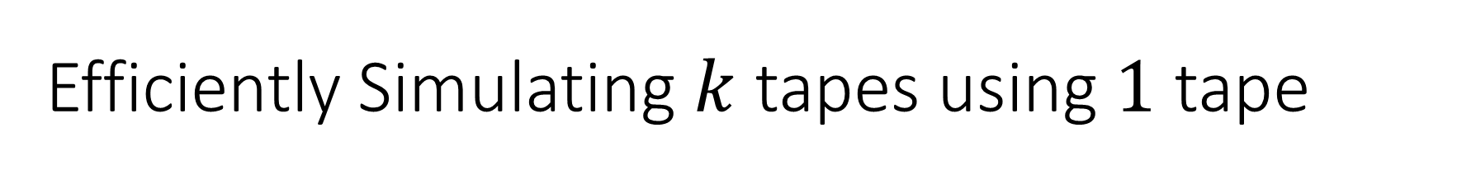

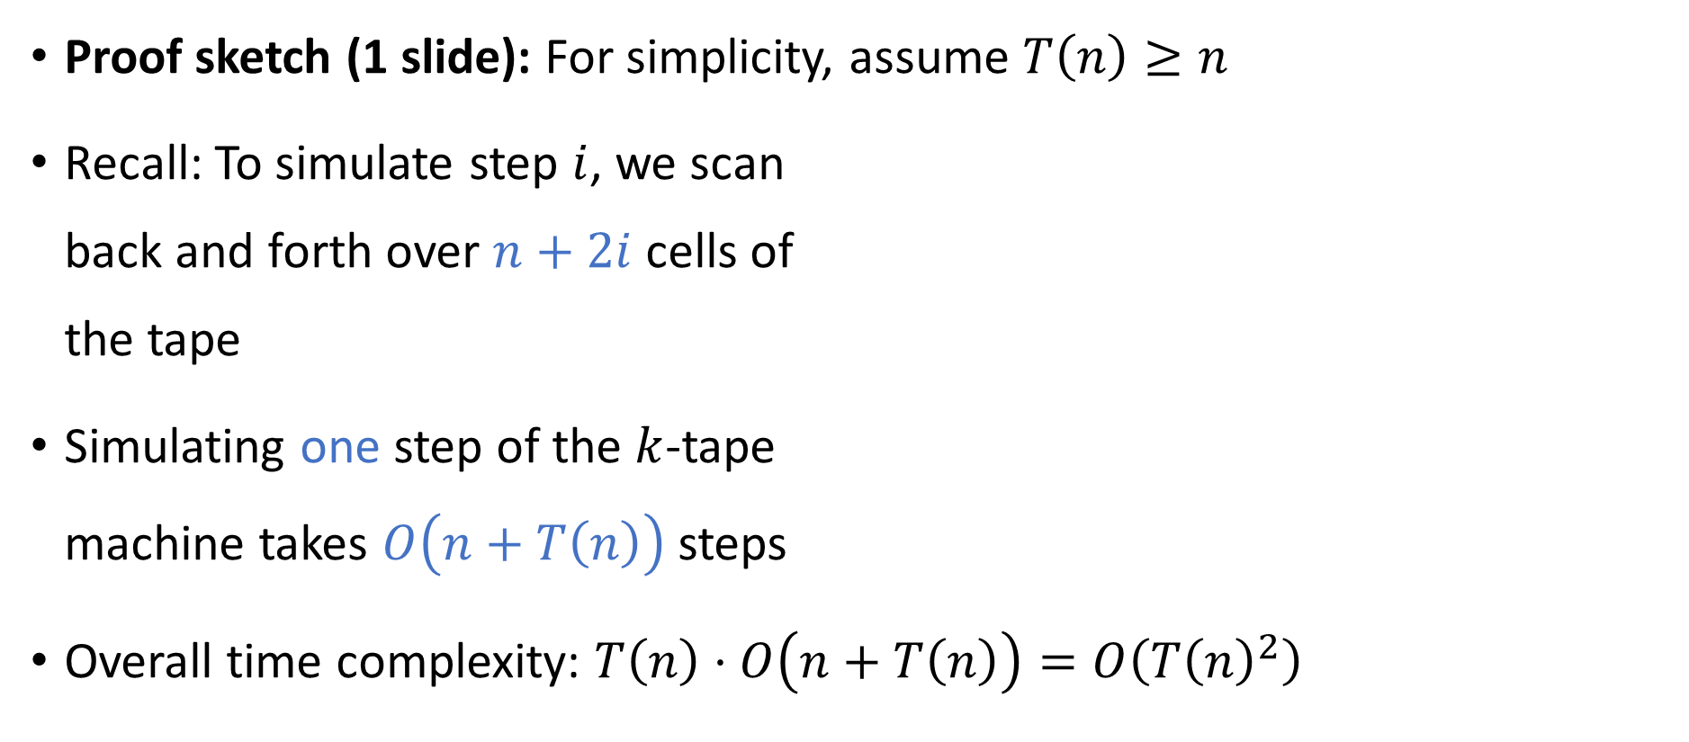




Efficiently Simulating $k$ tapes using $1$ tape
Proof sketch (1 slide): For simplicity, assume $T\left(n\right)≥n$
Recall: To simulate step $i$, we scan back and forth over $n+2i$ cells of the tape
Simulating one step of the $k$-tape machine takes $O\left(n+T\left(n\right)\right)$ steps
Overall time complexity: $T\left(n\right)⋅O\left(n+T\left(n\right)\right)=O\left(T{\left(n\right)}^{2}\right)$
0
$$⊔$$
$$⋯$$
1
1
0
$$⊔$$
$$⊔$$
$$⋯$$
0
#
1
$
$$⊔$$

Slide 12


Robustness of $\text{P}$
Conclusion: We could define $\text{P}$ using one-tape Turing machines or using multi-tape Turing machines
Either way, we get the exact same set of languages

Slide 13
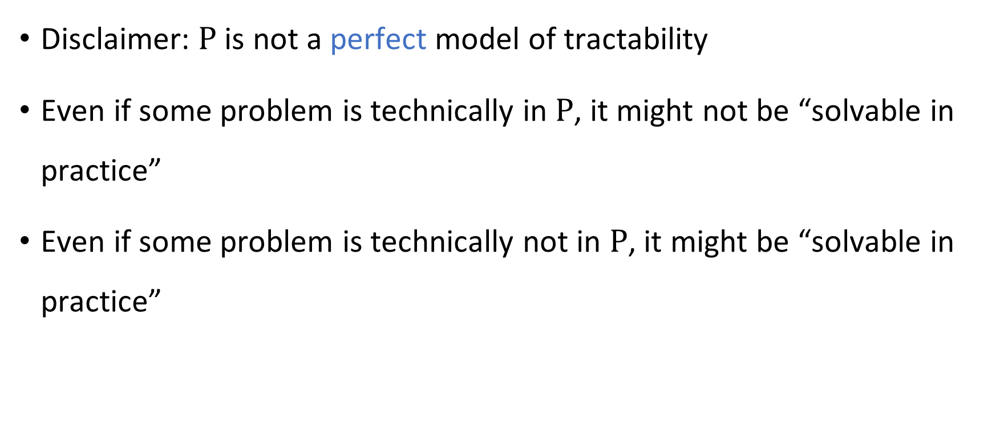
Theory vs. practice
Disclaimer: $\text{P}$ is not a perfect model of tractability
Even if some problem is technically in $\text{P}$, it might not be “solvable in practice”
Even if some problem is technically not in $\text{P}$, it might be “solvable in practice”

Slide 14

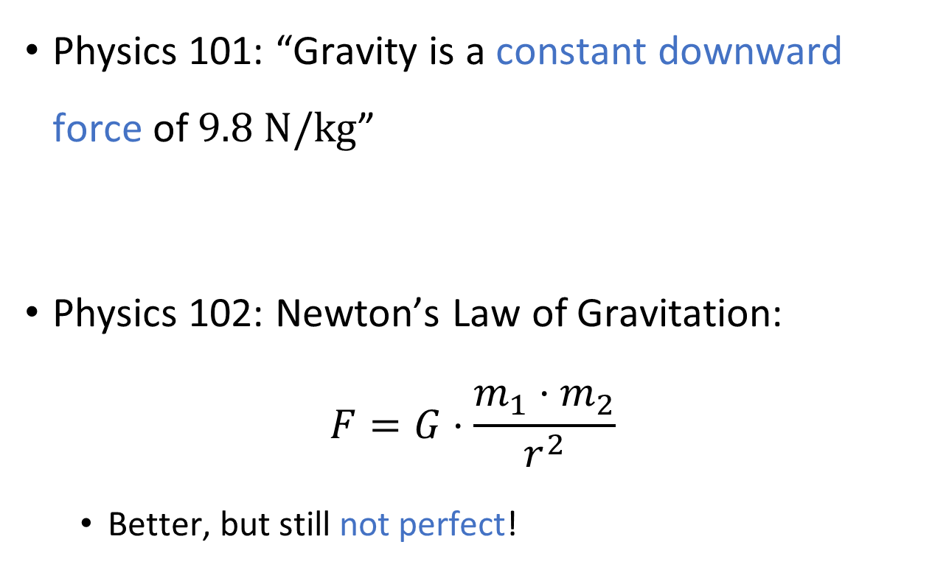
Analogy: Gravity
Physics 101: “Gravity is a constant downward force of $9.8 \text{N}/\text{kg}$”
Physics 102: Newton’s Law of Gravitation:
$$F=G⋅\frac{m_{1}⋅m_{2}}{r^{2}}$$
Better, but still not perfect!

Slide 15
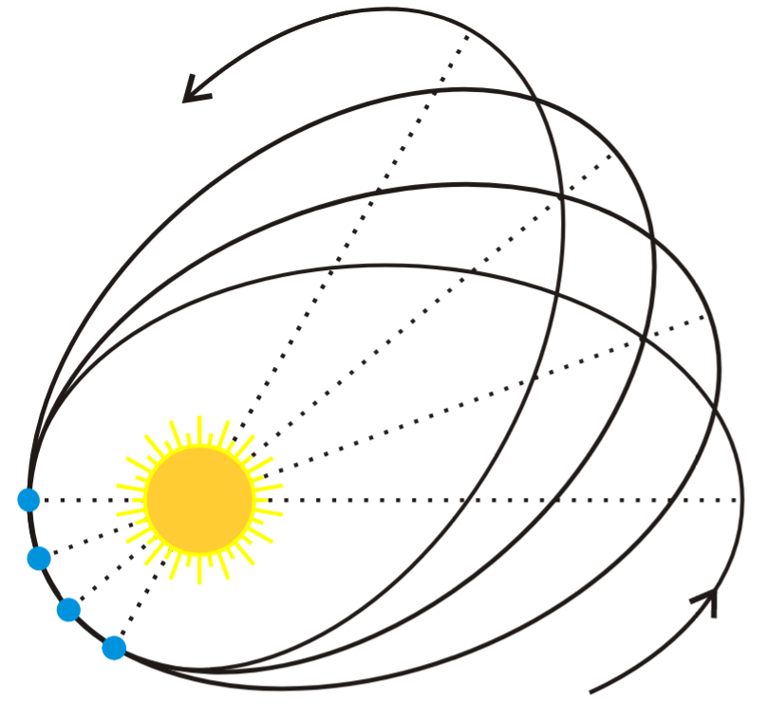
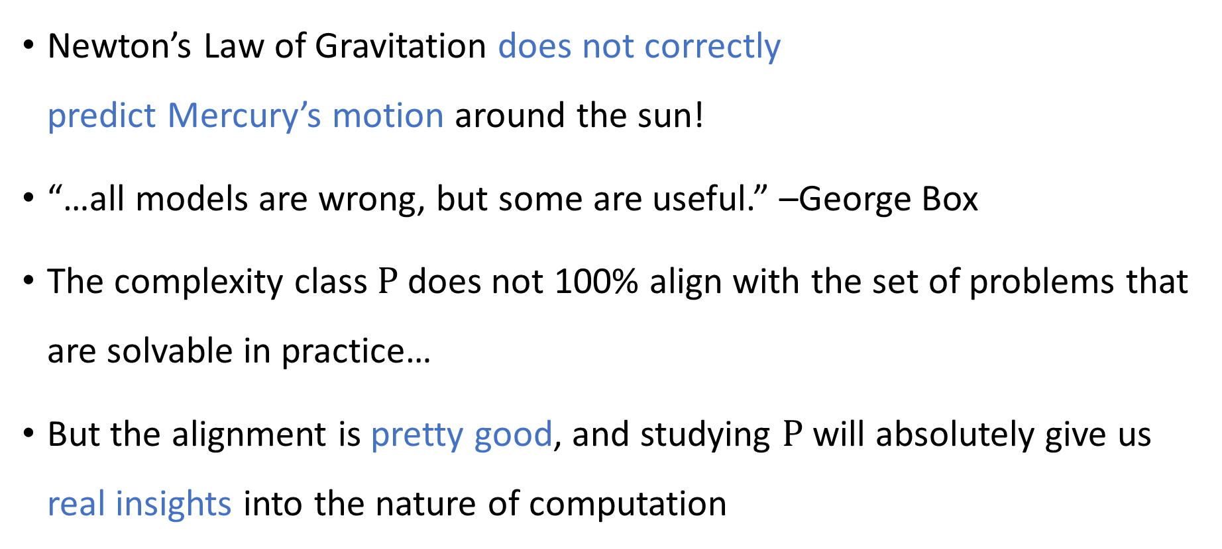
Analogy: Gravity
Newton’s Law of Gravitation does not correctly predict Mercury’s motion around the sun!
“…all models are wrong, but some are useful.” –George Box
The complexity class $\text{P}$ does not 100% align with the set of problems that are solvable in practice…
But the alignment is pretty good, and studying $\text{P}$ will absolutely give us real insights into the nature of computation

Slide 16
Which problems can be solved through computation?

Slide 17

Which languages are in $\text{P}$?

Slide 18
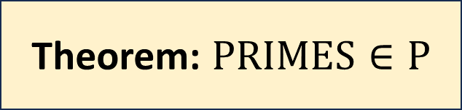
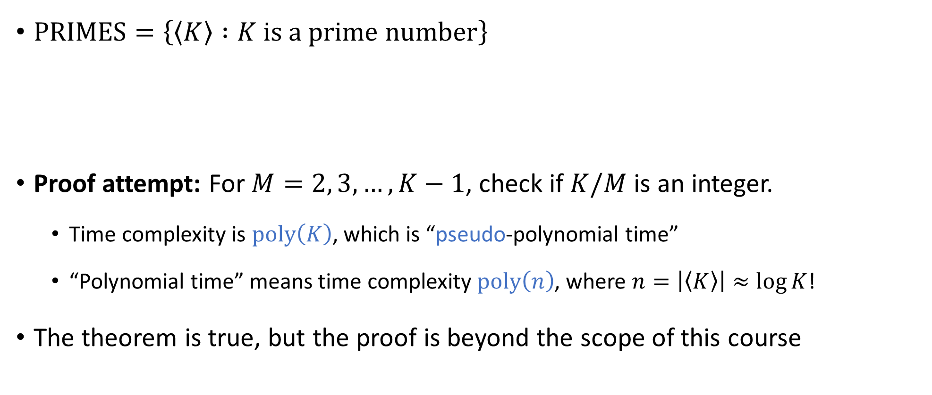
Example: Primality testing
$\text{PRIMES}=\left\{\left\langle K\right\rangle :K \text{is} \text{a} \text{prime} \text{number}\right\}$
Proof attempt: For $M=2, 3, …, K−1$, check if $K/M$ is an integer.
Time complexity is $\text{poly}\left(K\right)$, which is “pseudo-polynomial time”
“Polynomial time” means time complexity $\text{poly}\left(n\right)$, where $n=\left|\left\langle K\right\rangle \right|≈\log{K}$!
The theorem is true, but the proof is beyond the scope of this course
Theorem: $\text{PRIMES}∈\text{P}$

Slide 19
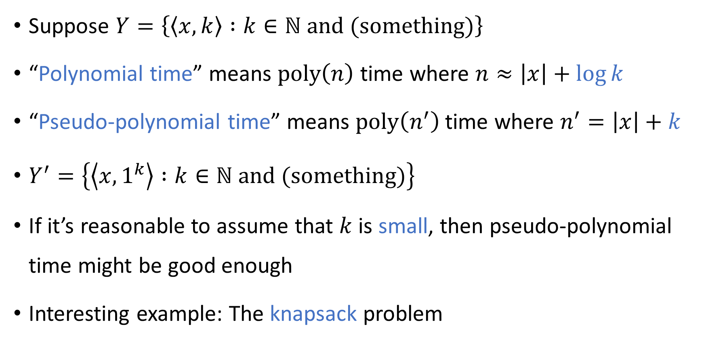
Pseudo-polynomial time
Suppose $Y=\left\{\left\langle x,k\right\rangle :k∈ℕ \text{and} \text{(}\text{something}\text{)}\right\}$
“Polynomial time” means $\text{poly}\left(n\right)$ time where $n≈\left|x\right|+\log{k}$
“Pseudo-polynomial time” means $\text{poly}\left(n^{′}\right)$ time where $n^{′}=\left|x\right|+k$
$Y^{′}=\left\{\left\langle x,1^{k}\right\rangle :k∈ℕ \text{and}\text{ (}\text{something}\text{)}\right\}$
If it’s reasonable to assume that $k$ is small, then pseudo-polynomial time might be good enough
Interesting example: The knapsack problem

Slide 20

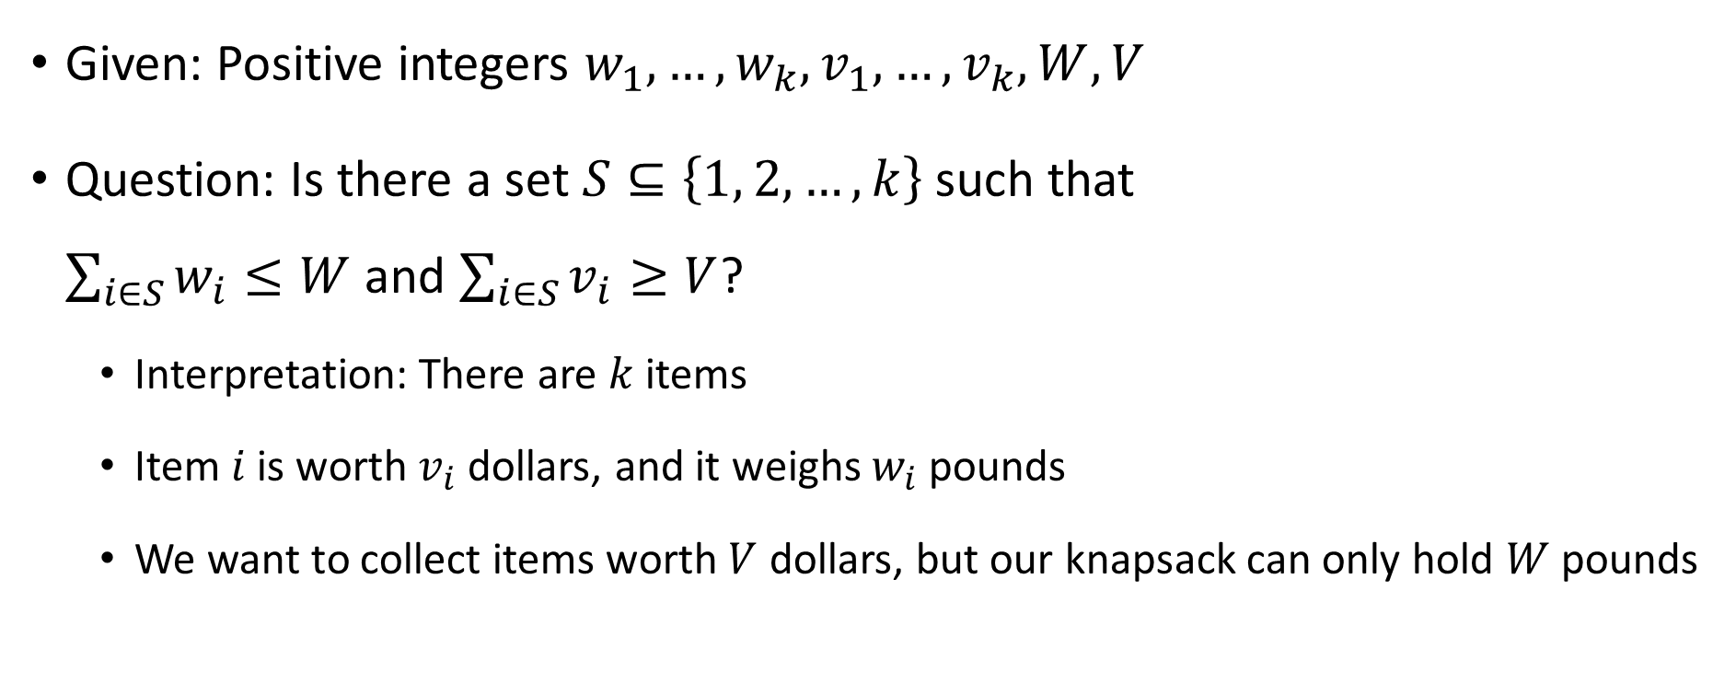
The knapsack problem
Given: Positive integers $w_{1},…, w_{k}, v_{1},…, v_{k},W,V$
Question: Is there a set $S⊆\left\{1, 2, …, k\right\}$ such that $\sum_{i∈S}{w_{i}}≤W$ and $\sum_{i∈S}{v_{i}≥V}$?
Interpretation: There are $k$ items
Item $i$ is worth $v_{i}$ dollars, and it weighs $w_{i}$ pounds
We want to collect items worth $V$ dollars, but our knapsack can only hold $W$ pounds

Slide 21
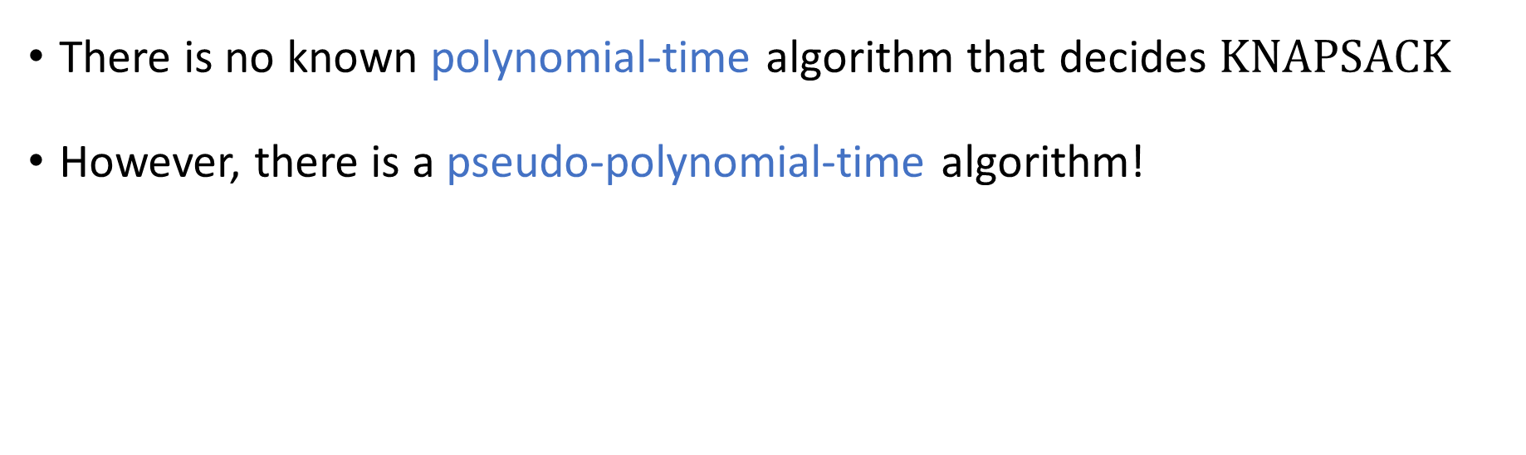
The knapsack problem
There is no known polynomial-time algorithm that decides $\text{KNAPSACK}$
However, there is a pseudo-polynomial-time algorithm!

Slide 22
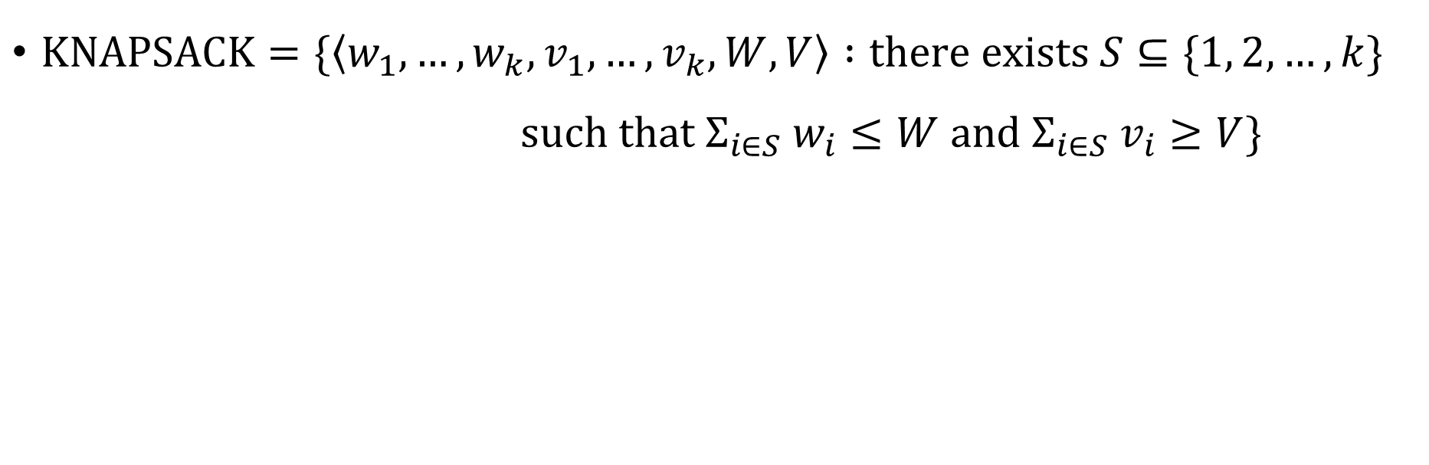
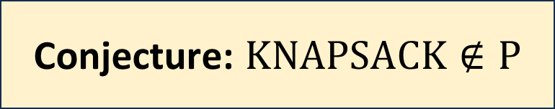
The knapsack problem
$\text{KNAPSACK}=\{\left\langle w_{1},…, w_{k}, v_{1},…, v_{k}, W, V\right\rangle :\text{there} \text{exists} S⊆\{1, 2, …, k\}$ $\text{such} \text{that} Σ_{i∈S} w_{i}≤W \text{and} Σ_{i∈S} v_{i}≥V\}$
Conjecture: $\text{K}\text{NAPSACK}∉\text{P}$

Slide 23

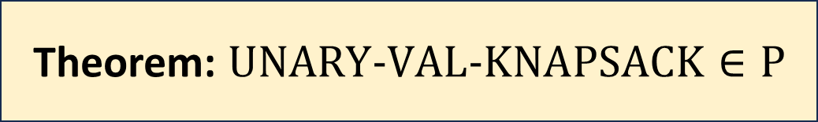
The knapsack problem
$\text{UNARY}‑\text{VAL}‑\text{KNAPSACK}=\{\left\langle w_{1},…, w_{k}, 1^{v_{1}},…, 1^{v_{k}}, W, 1^{V}\right\rangle :\text{there}$ $\text{exists} S⊆\{1, 2, …, k\} \text{such} \text{that}$ $Σ_{i∈S} w_{i}≤W \text{and} Σ_{i∈S} v_{i}≥V\}$
Theorem: $\text{UNARY}‑\text{VAL}‑\text{KNAPSACK}∈\text{P}$

