Slide 1
CMSC 28100 Introduction to Complexity Theory Autumn 2025 Instructor: William Hoza
⏳

Slide 2
Homework reminder
Exercises 1-3 are due today at 11:59pm
If you joined the course late and you need an extension, send me an email

Slide 3
Which problems can be solved through computation?

Slide 4

Deciding a language
Let $M$ be a Turing machine and let $Y⊆{\left\{0, 1\right\}}^{∗}$
We say that $M$ decides $Y$ if
$M$ accepts every $w∈Y$, and
$M$ rejects every $w∈{\left\{0, 1\right\}}^{∗}∖Y$

Slide 5

Decidable and undecidable
Let $Y⊆{\left\{0, 1\right\}}^{∗}$
We say that $Y$ is decidable if there exists a Turing machine $M$ that decides $Y$
Otherwise, we say that $Y$ is undecidable

Slide 6
Which problems can be solved through computation?

Slide 7
Which languages are decidable?

Slide 8

Examples
$\text{PALINDROMES}=\left\{w∈{\left\{0, 1\right\}}^{∗} :w \text{is} \text{the} \text{same} \text{forward} \text{and} \text{backward}\right\}$
$\text{PARITY}=\left\{w∈{\left\{0, 1\right\}}^{∗} :w \text{has} \text{an} \text{odd} \text{number} \text{of} \text{ones}\right\}$
$Y=\left\{0^{K}\left\langle K\right\rangle :K \text{is} \text{a} \text{positive} \text{integer}\right\}$
Out of those three languages, how many are decidable?
A: Zero
B: One
C: Two
D: Three
Respond at PollEv.com/whoza or text “whoza” to 22333

Slide 9
Is every language decidable?

Slide 10
Undecidability
Theorem: There exists an undecidable language.
To prove this theorem, we need to rule out all possible Turing machines!
How can we possibly do this?

Slide 11
The liar paradox
Are you selecting option B as your answer to this question?
A: Yes
B: No
C: Yes
D: Yes
Respond at PollEv.com/whoza or text “whoza” to 22333

Slide 12
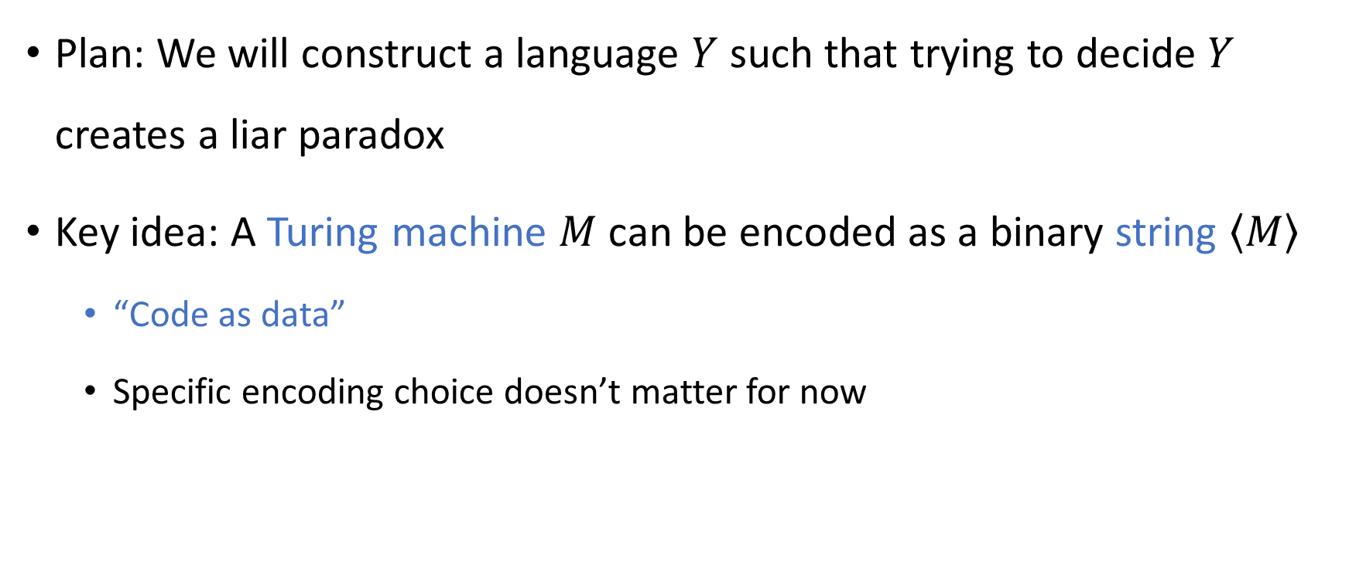
Code as data
Plan: We will construct a language $Y$ such that trying to decide $Y$ creates a liar paradox
Key idea: A Turing machine $M$ can be encoded as a binary string $\left\langle M\right\rangle$
“Code as data”
Specific encoding choice doesn’t matter for now

Slide 13

Turing machines analyzing Turing machines
If $M$ is a Turing machine…
Then $\left\langle M\right\rangle$ can be the input for another Turing machine!
Compilers, syntax highlighting, linters…

Slide 14
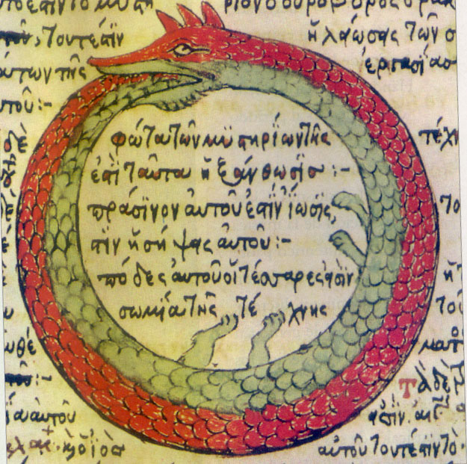
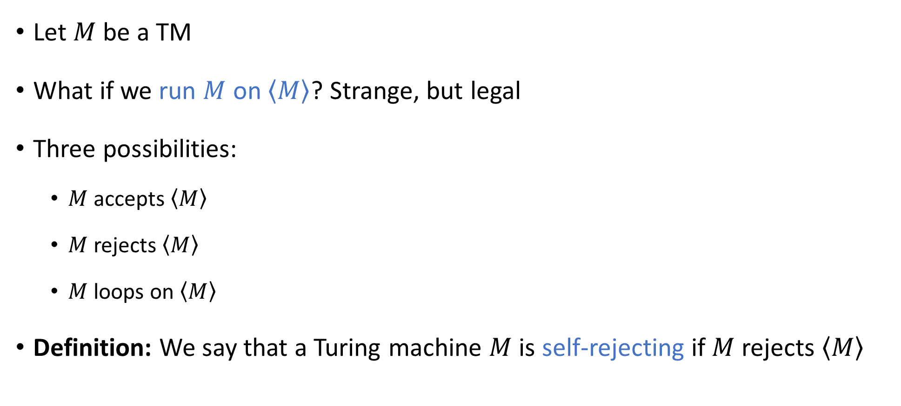
Self-rejecting Turing machines
Let $M$ be a TM
What if we run $M$ on $\left\langle M\right\rangle$? Strange, but legal
Three possibilities:
$M$ accepts $\left\langle M\right\rangle$
$M$ rejects $\left\langle M\right\rangle$
$M$ loops on $\left\langle M\right\rangle$
Definition: We say that a Turing machine $M$ is self-rejecting if $M$ rejects $\left\langle M\right\rangle$

Slide 15
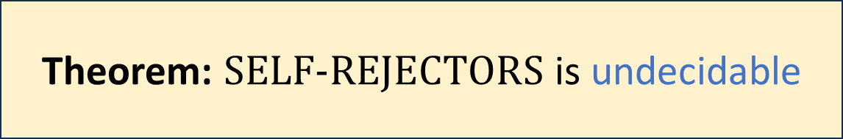

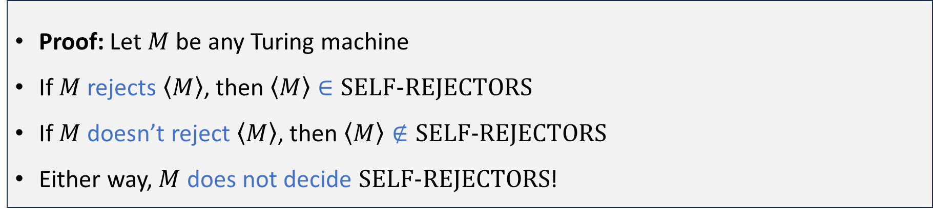
Self-rejecting Turing machines
Let $\text{SELF}‑\text{REJECTORS}=\left\{\left\langle M\right\rangle :M \text{is} \text{a} \text{self}‑\text{rejecting} \text{Turing} \text{machine}\right\}$
Theorem: $\text{SELF}‑\text{REJECTORS}$ is undecidable
Proof: Let $M$ be any Turing machine
If $M$ rejects $\left\langle M\right\rangle$, then $\left\langle M\right\rangle ∈\text{SELF}‑\text{REJECTORS}$
If $M$ doesn’t reject $\left\langle M\right\rangle$, then $\left\langle M\right\rangle ∉\text{SELF}‑\text{REJECTORS}$
Either way, $M$ does not decide $\text{SELF}‑\text{REJECTORS}$!

Slide 16
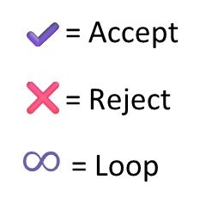
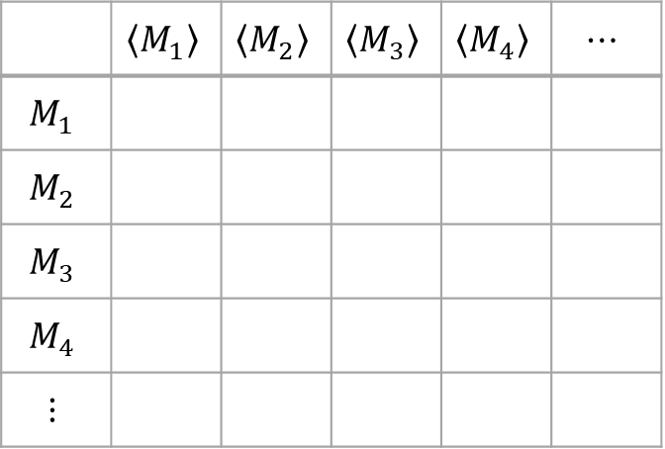
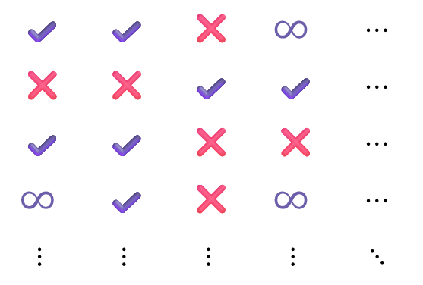
Visualizing the proof: “Diagonalization”
What happens when we run this Turing machine…
…on this input?
 | $$\left\langle M_{1}\right\rangle$$ | $$\left\langle M_{2}\right\rangle$$ | $$\left\langle M_{3}\right\rangle$$ | $$\left\langle M_{4}\right\rangle$$ | $$⋯$$
$$M_{1}$$
$$M_{2}$$
$$M_{3}$$
$$M_{4}$$
$$⋮$$
✔️ | ✔️ | ❌ | $$∞$$ | $$⋯$$
❌ | ❌ | ✔️ | ✔️ | $$⋯$$
✔️ | ✔️ | ❌ | ❌ | $$⋯$$
$$∞$$ | ✔️ | ❌ | $$∞$$ | $$⋯$$
$$⋮$$ | $$⋮$$ | $$⋮$$ | $$⋮$$ | $$⋱$$
✔️= Accept
❌= Reject
$∞$ = Loop

Slide 17
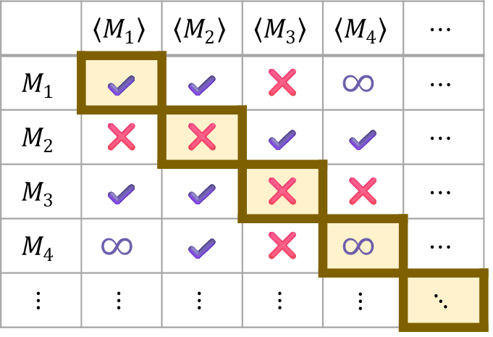

Visualizing the proof: “Diagonalization”
What happens when we run this Turing machine…
…on this input?
 | $$\left\langle M_{1}\right\rangle$$ | $$\left\langle M_{2}\right\rangle$$ | $$\left\langle M_{3}\right\rangle$$ | $$\left\langle M_{4}\right\rangle$$ | $$⋯$$
$$M_{1}$$ | ✔️ | ✔️ | ❌ | $$∞$$ | $$⋯$$
$$M_{2}$$ | ❌ | ❌ | ✔️ | ✔️ | $$⋯$$
$$M_{3}$$ | ✔️ | ✔️ | ❌ | ❌ | $$⋯$$
$$M_{4}$$ | $$∞$$ | ✔️ | ❌ | $$∞$$ | $$⋯$$
$$⋮$$ | $$⋮$$ | $$⋮$$ | $$⋮$$ | $$⋮$$ | $$⋱$$
✔️= Accept
❌= Reject
$∞$ = Loop
Undecidable language:
 | ❌ | ✔️ | ✔️ | ❌ | $$⋯$$

Slide 18
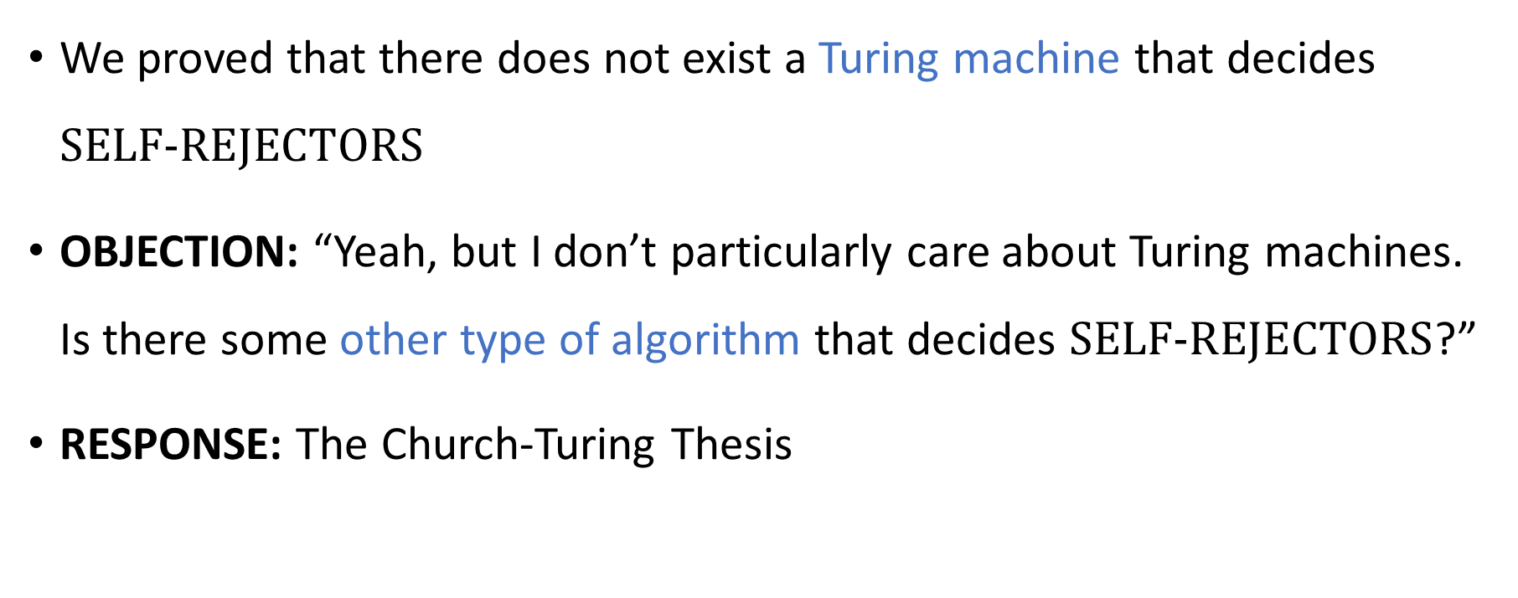
Interpreting the theorem
We proved that there does not exist a Turing machine that decides $\text{SELF}‑\text{REJECTORS}$
OBJECTION: “Yeah, but I don’t particularly care about Turing machines. Is there some other type of algorithm that decides $\text{SELF}‑\text{REJECTORS}$?”
RESPONSE: The Church-Turing Thesis

Slide 19
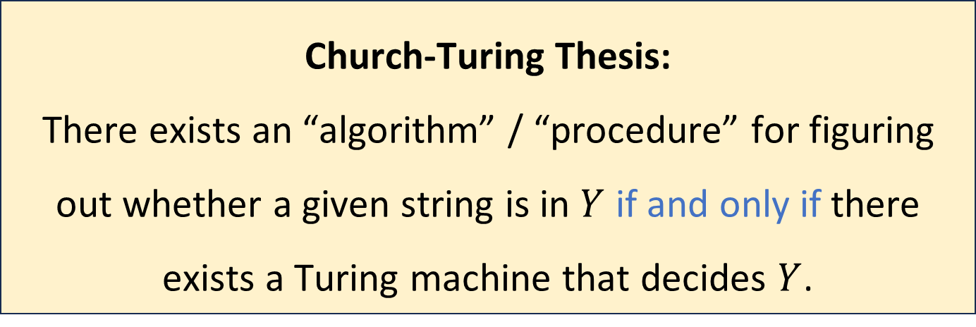
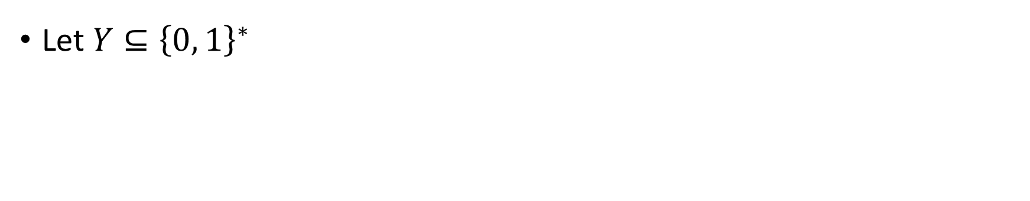
The Church-Turing Thesis
Let $Y⊆{\left\{0, 1\right\}}^{∗}$
Church-Turing Thesis:
There exists an “algorithm” / “procedure” for figuring out whether a given string is in $Y$ if and only if there exists a Turing machine that decides $Y$.
Intuitive notion
Mathematically precise notion

Slide 20
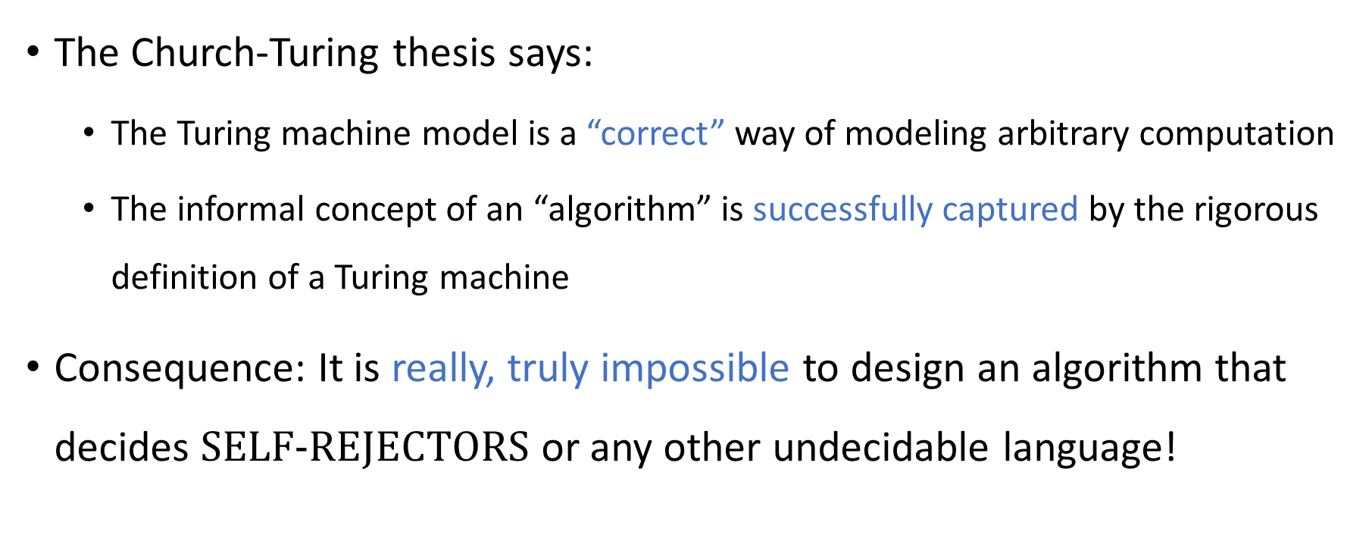
The Church-Turing Thesis
The Church-Turing thesis says:
The Turing machine model is a “correct” way of modeling arbitrary computation
The informal concept of an “algorithm” is successfully captured by the rigorous definition of a Turing machine
Consequence: It is really, truly impossible to design an algorithm that decides $\text{SELF}‑\text{REJECTORS}$ or any other undecidable language!

Slide 21

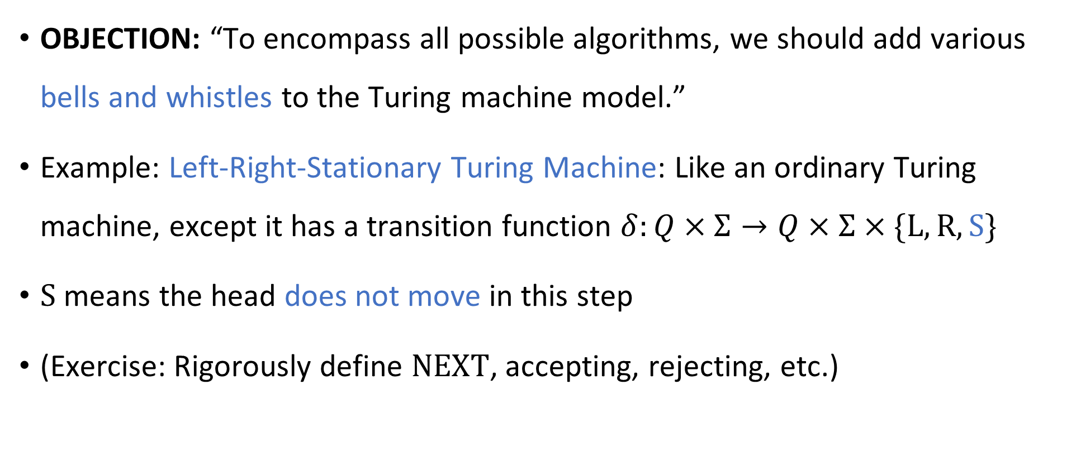
Are Turing machines powerful enough?
🔔
OBJECTION: “To encompass all possible algorithms, we should add various bells and whistles to the Turing machine model.”
Example: Left-Right-Stationary Turing Machine: Like an ordinary Turing machine, except it has a transition function $δ:Q×Σ→Q×Σ×\{\text{L},\text{R},\text{S}\}$
$\text{S}$ means the head does not move in this step
(Exercise: Rigorously define $\text{NEXT}$, accepting, rejecting, etc.)

Slide 22
Left-right-stationary Turing machines
🔔
The model is still realistic, even though we added an extra feature
Is it a counterexample to the Church-Turing thesis?
No!
Let’s prove that the left-right-stationary Turing machine model is equivalent to the original Turing machine model

Slide 23
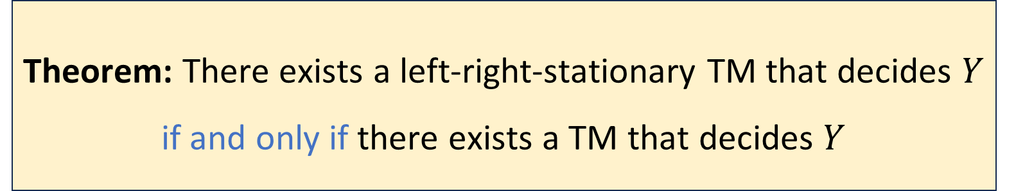

Left-right-stationary Turing machines
🔔
Let $Y$ be a language
Proof: (3 slides) The “$⇐$” direction is trivial
Theorem: There exists a left-right-stationary TM that decides $Y$ if and only if there exists a TM that decides $Y$

Slide 24
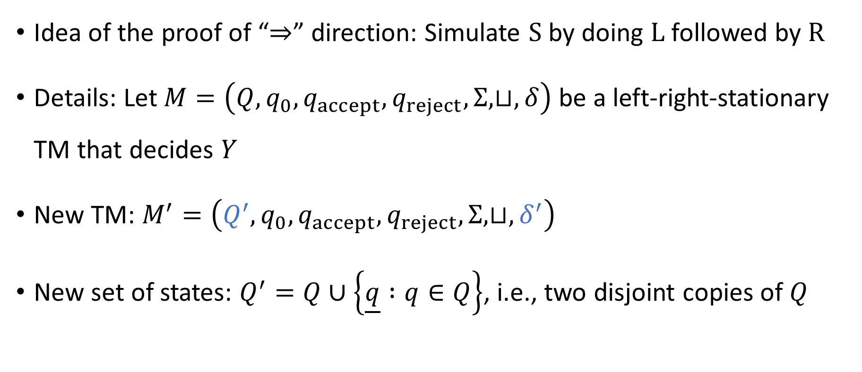
Left-right-stationary Turing machines
🔔
Idea of the proof of “$⇒$” direction: Simulate $\text{S}$ by doing $\text{L}$ followed by $\text{R}$
Details: Let $M=\left(Q, q_{0},q_{accept},q_{reject},Σ,⊔,δ\right)$ be a left‑right‑stationary TM that decides $Y$
New TM: $M^{′}=\left(Q^{′},q_{0},q_{accept},q_{reject},Σ,⊔,δ^{′}\right)$
New set of states: $Q^{′}=Q∪\left\{\underline{q} :q∈Q\right\}$, i.e., two disjoint copies of $Q$

Slide 25
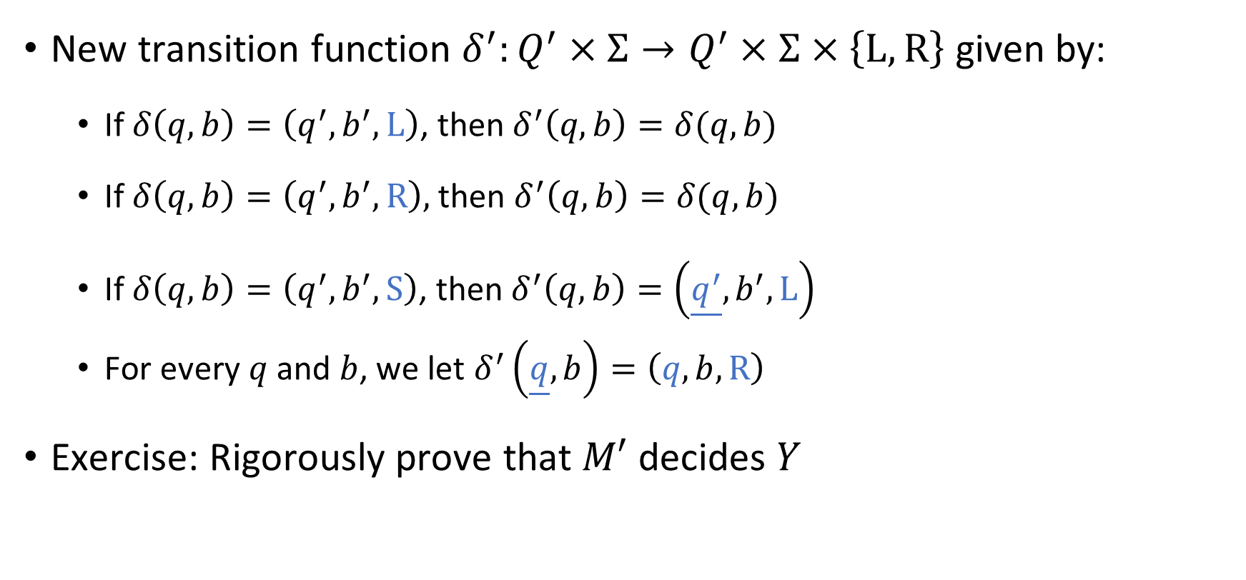
Left-right-stationary Turing machines
🔔
New transition function $δ^{′}:Q^{′}×Σ→Q^{′}×Σ×\left\{\text{L},\text{R}\right\}$ given by:
If $δ\left(q, b\right)=\left(q^{′},b^{′},\text{L}\right)$, then $δ^{′}\left(q,b\right)=δ(q, b)$
If $δ\left(q,b\right)=\left(q^{′},b^{′},\text{R}\right),$ then $δ^{′}\left(q,b\right)=δ(q,b)$
If $δ\left(q,b\right)=\left(q^{′},b^{′},\text{S}\right)$, then $δ^{′}\left(q,b\right)=\left(\underline{q^{′}},b^{′},\text{L}\right)$
For every $q$ and $b$, we let $δ^{′}\left(\underline{q},b\right)=\left(q,b,\text{R}\right)$
Exercise: Rigorously prove that $M′$ decides $Y$

Slide 26

The Church-Turing Thesis
Let $Y⊆{\left\{0, 1\right\}}^{∗}$
Church-Turing Thesis:
There exists an “algorithm” / “procedure” for figuring out whether a given string is in $Y$ if and only if there exists a Turing machine that decides $Y$.
Intuitive notion
Mathematically precise notion

Slide 27

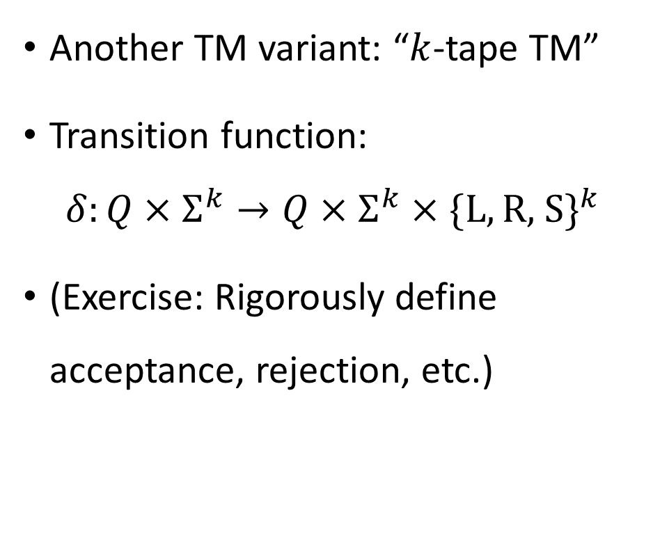





Multi-tape Turing machines
In each step, what determines the actions of head 1?
🔔
A: Head 1’s state and the symbol observed by head 1
B: The machine’s state and the symbols observed by all heads
Another TM variant: “$k$-tape TM”
Transition function:
$$δ:Q×Σ^{k}→Q×Σ^{k}×\{\text{L},\text{R}\text{, }\text{S}\}^{k}$$
(Exercise: Rigorously define acceptance, rejection, etc.)
C: Head 1’s state and the symbols observed by all heads
D: The machine’s state and the symbol observed by head 1
Respond at PollEv.com/whoza or text “whoza” to 22333
$$⋯$$
1
1
0
$$⊔$$
$$⊔$$
$$⋯$$
0
#
1
$
$$⊔$$
$$q$$

