Slide 1
CMSC 28100 Introduction to Complexity Theory Autumn 2025 Instructor: William Hoza
⏳

Slide 2
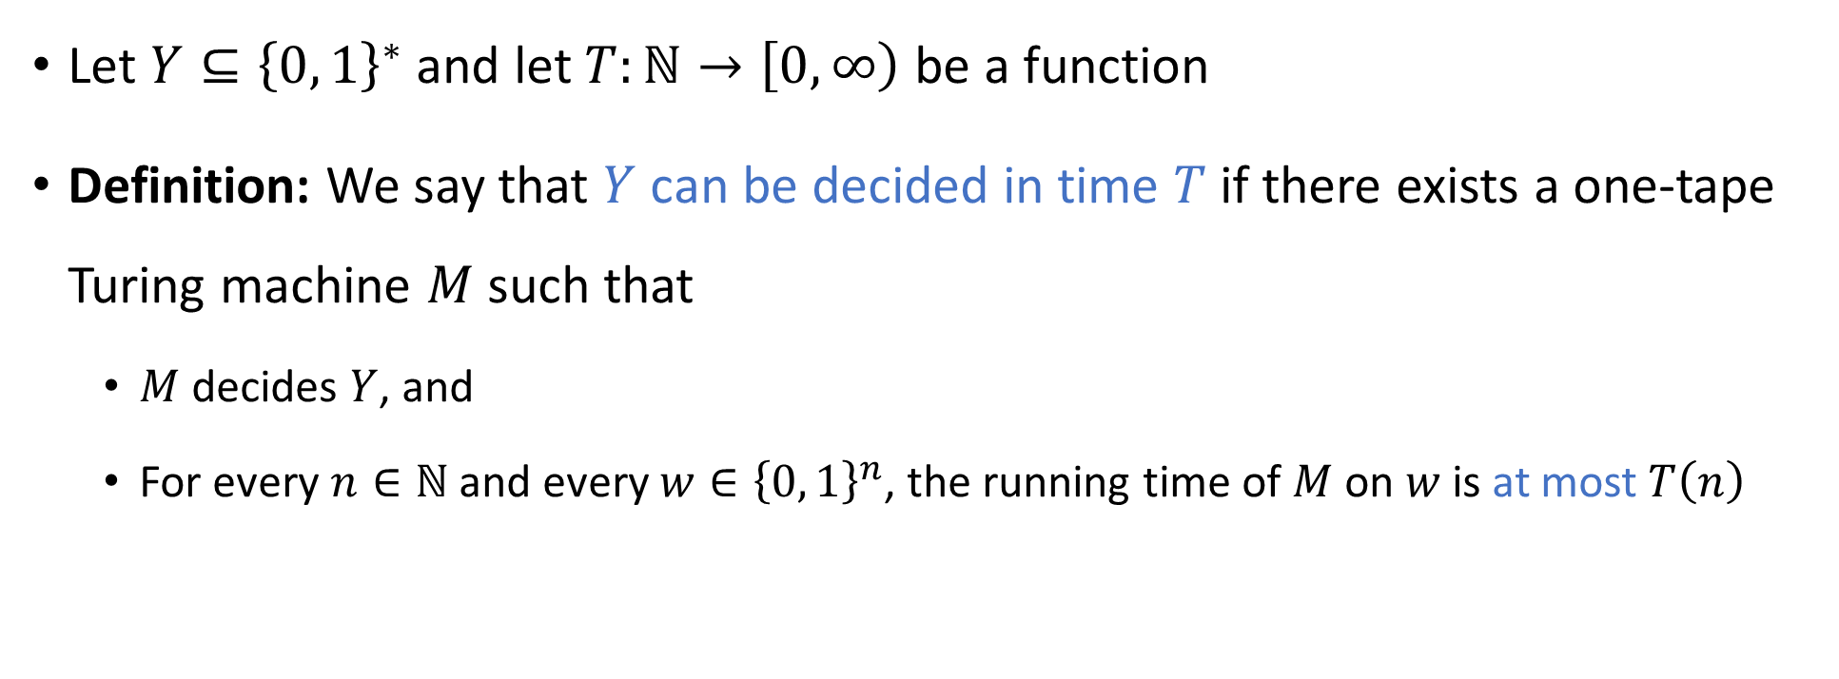

Deciding a language in time $T$
⏳
Let $Y⊆{\left\{0, 1\right\}}^{∗}$ and let $T:ℕ→\left[0, ∞\right)$ be a function
Definition: We say that $Y$ can be decided in time $T$ if there exists a one-tape Turing machine $M$ such that
$M$ decides $Y$, and
For every $n∈ℕ$ and every $w∈{\left\{0, 1\right\}}^{n}$, the running time of $M$ on $w$ is at most $T\left(n\right)$

Slide 3
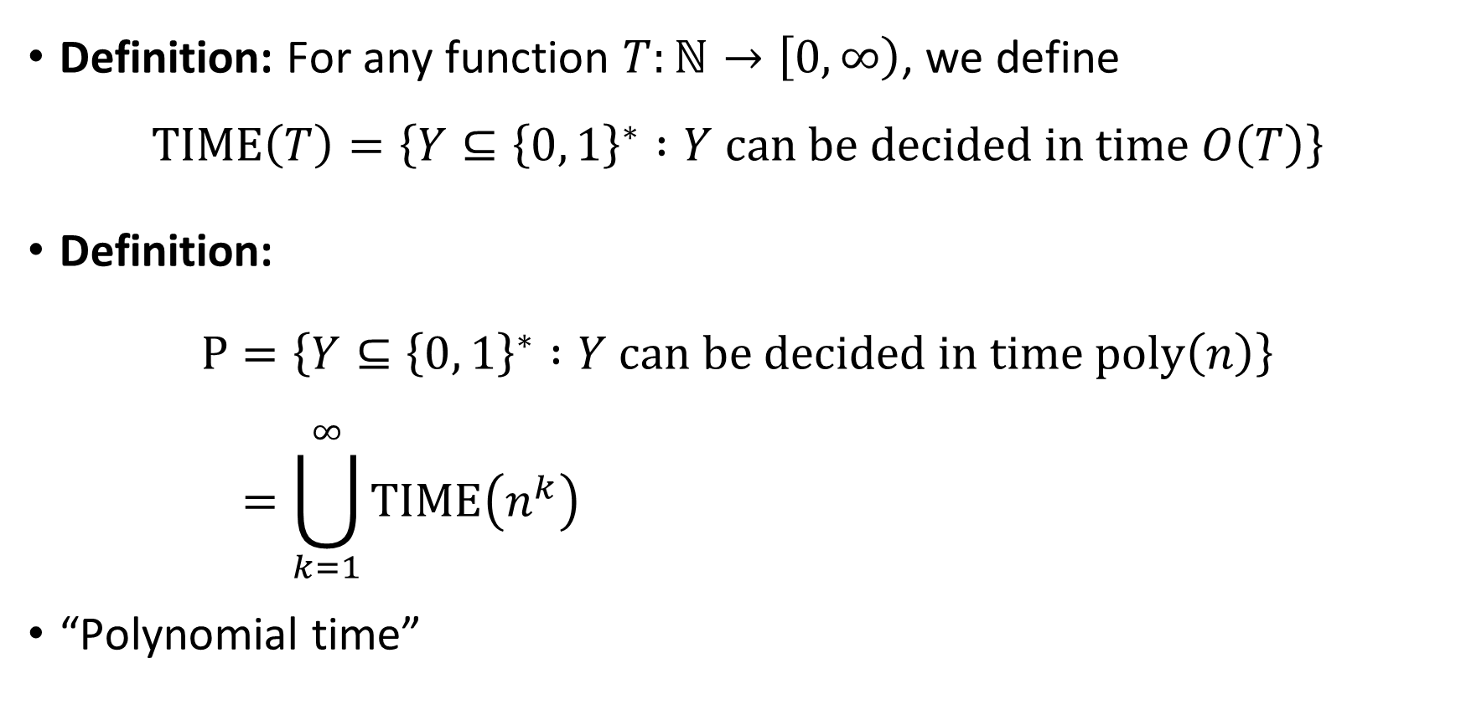

The complexity class $\text{P}$
⏳
Definition: For any function $T:ℕ→\left[0, ∞\right)$, we define
$$\text{TIME}\left(T\right)=\left\{Y⊆{\left\{0, 1\right\}}^{∗} :Y \text{can} \text{be} \text{decided} \text{in} \text{time} O\left(T\right)\right\}$$
Definition:
$$\text{P}=\left\{Y⊆{\left\{0, 1\right\}}^{∗} :Y \text{can} \text{be} \text{decided} \text{in} \text{time} \text{poly}\left(n\right)\right\} \\ =\bigcup_{k=1}^{∞}{\text{TIME}\left(n^{k}\right)}$$
“Polynomial time”

Slide 4

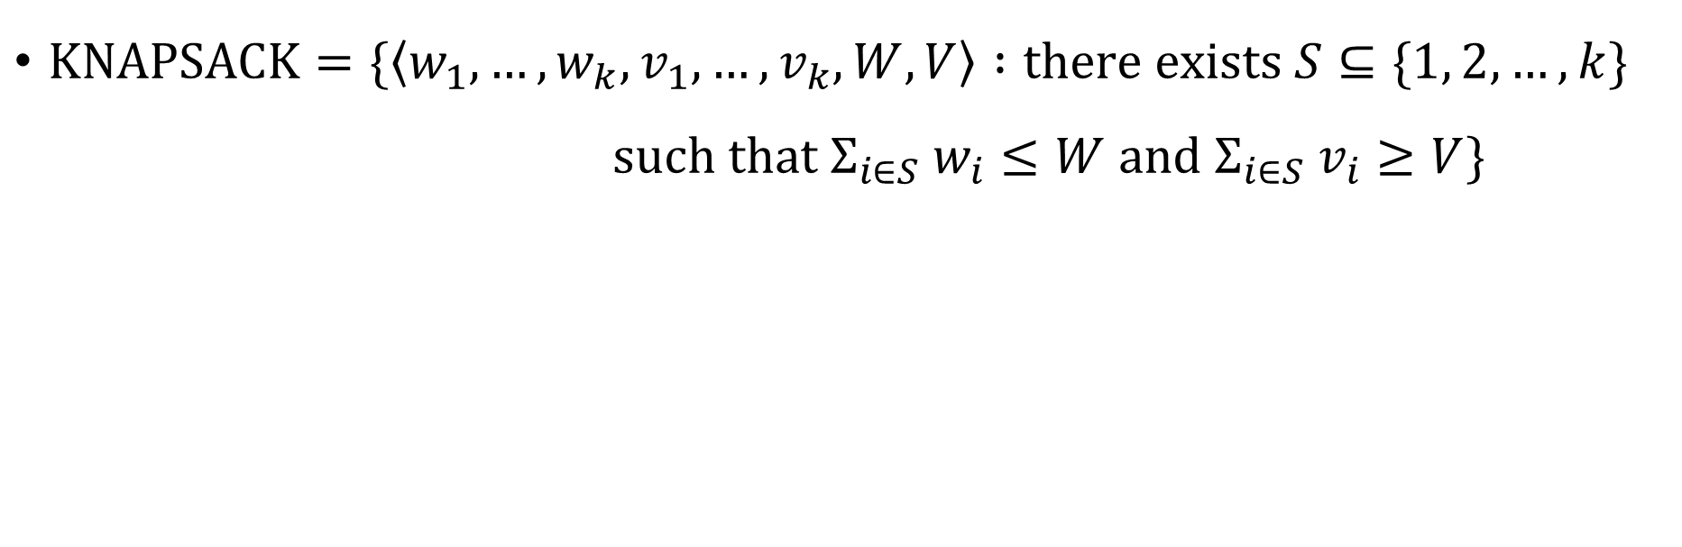
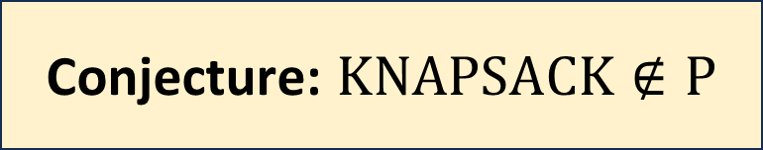
The knapsack problem
$\text{KNAPSACK}=\{\left\langle w_{1},…, w_{k}, v_{1},…, v_{k}, W, V\right\rangle :\text{there} \text{exists} S⊆\{1, 2, …, k\}$ $\text{such} \text{that} Σ_{i∈S} w_{i}≤W \text{and} Σ_{i∈S} v_{i}≥V\}$
Conjecture: $\text{K}\text{NAPSACK}∉\text{P}$

Slide 5
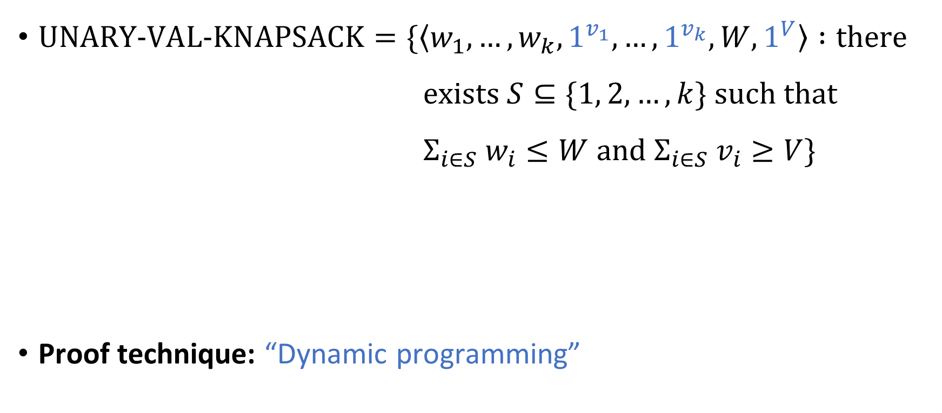
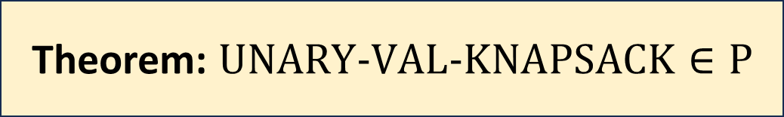
The knapsack problem
$\text{UNARY}‑\text{VAL}‑\text{KNAPSACK}=\{\left\langle w_{1},…, w_{k}, 1^{v_{1}},…, 1^{v_{k}}, W, 1^{V}\right\rangle :\text{there}$ $\text{exists} S⊆\{1, 2, …, k\} \text{such} \text{that}$ $Σ_{i∈S} w_{i}≤W \text{and} Σ_{i∈S} v_{i}≥V\}$
Proof technique: “Dynamic programming”
Theorem: $\text{UNARY}‑\text{VAL}‑\text{KNAPSACK}∈\text{P}$

Slide 6
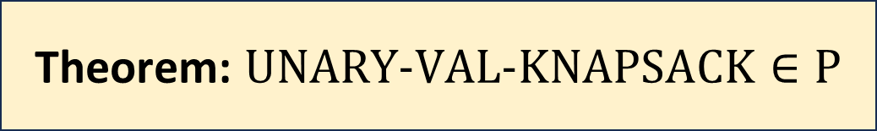
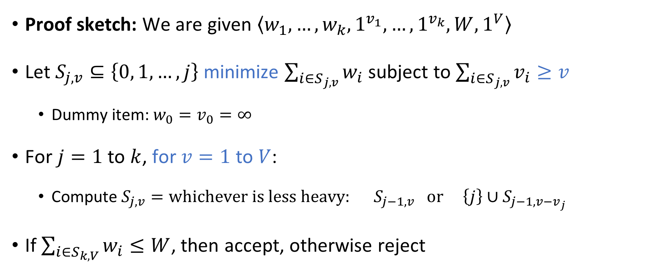
Theorem: $\text{UNARY}‑\text{VAL}‑\text{KNAPSACK}∈\text{P}$
Proof sketch: We are given $\left\langle w_{1},…, w_{k},1^{v_{1}},…, 1^{v_{k}}, W,1^{V}\right\rangle$
Let $S_{j,v}⊆\left\{0, 1,…, j\right\}$ minimize $\sum_{i∈S_{j,v}}{w_{i}}$ subject to $\sum_{i∈S_{j,v}}{v_{i}}≥v$
Dummy item: $w_{0}=v_{0}=∞$
For $j=1$ to $k$, for $v=1$ to $V$:
Compute $S_{j,v}=\text{whichever} \text{is} \text{less} \text{heavy}\text{: }S_{j−1,v} \text{or} \left\{j\right\}∪S_{j−1,v−v_{j}}$
If $\sum_{i∈S_{k,V}}{w_{i}}≤W$, then accept, otherwise reject
Exercise: Rigorously analyze time complexity

Slide 7
Note on standards of rigor
Going forward, when we analyze specific algorithms, we will often assert that they run in polynomial time without a rigorous proof
In each case, one can rigorously prove the time bound by describing a TM implementation and reasoning about the motions of the heads…
But this is tedious
Note: We still prove correctness whenever it is nontrivial, just not efficiency
You should follow this convention on exercise 13 and beyond

Slide 8

Which languages are in $\text{P}$?

Slide 9


Examples of languages in $\text{P}$
$\text{PALINDROMES}$
$\text{PARITY}$
$\text{UNARY}‑\text{VAL}‑\text{KNAPSACK}$
$\text{PRIMES}$

Slide 10

Which languages are not in $\text{P}$?

Slide 11


Examples of languages that are not in $\text{P}$
Maybe $\text{CLIQUE}$ ?
No proof…
Maybe $\text{KNAPSACK}$ ?
No proof…
$\text{HALT}$

Slide 12

Intractability vs. undecidability
Maybe every decidable language is in $\text{P}$???
Can every algorithm be modified to make it run in polynomial time??? 🤯

Slide 13



Intractability vs. undecidability
All languages
$$\text{HALT}$$
Decidable languages
???
$$\text{P}$$
$$\text{PALINDROMES}$$

Slide 14
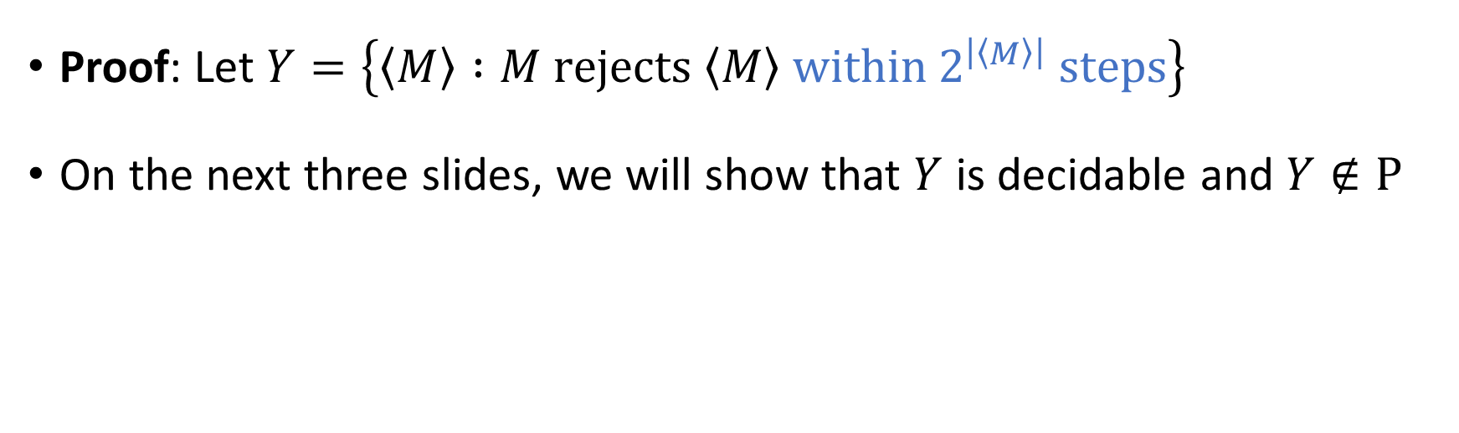
Intractability vs. undecidability
Theorem: There exists $Y⊆{\left\{0, 1\right\}}^{∗}$ such that $Y$ is decidable, but $Y∉\text{P}$.
Proof: Let $Y=\left\{\left\langle M\right\rangle :M \text{rejects} \left\langle M\right\rangle \text{within} 2^{\left|\left\langle M\right\rangle \right|} \text{steps}\right\}$
On the next three slides, we will show that $Y$ is decidable and $Y∉\text{P}$

Slide 15


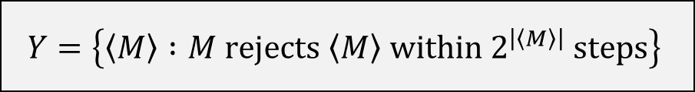

Proof that $Y$ is decidable
$$Y=\left\{\left\langle M\right\rangle :M \text{rejects} \left\langle M\right\rangle \text{within} 2^{\left|\left\langle M\right\rangle \right|} \text{steps}\right\}$$
An algorithm that decides $Y$:
Given the input $\left\langle M\right\rangle$:
Simulate $M$ on $\left\langle M\right\rangle$ for $2^{\left|\left\langle M\right\rangle \right|}$ steps
If it rejects within that time, accept
Otherwise, reject

Slide 16
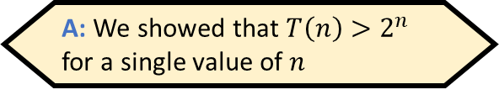


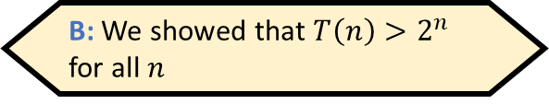
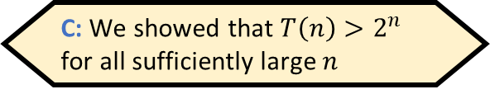
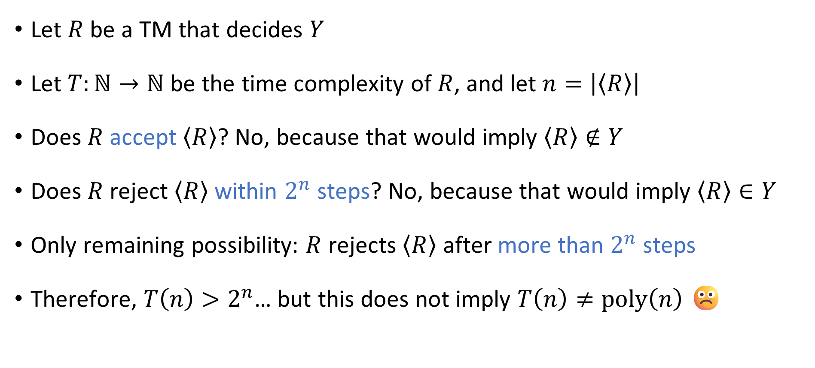
Proof that $Y∉\text{P}$
Which of the following best describes what we’ve proven?
$$Y=\left\{\left\langle M\right\rangle :M \text{rejects} \left\langle M\right\rangle \text{within} 2^{\left|\left\langle M\right\rangle \right|} \text{steps}\right\}$$
A: We showed that $T\left(n\right)>2^{n}$ for a single value of $n$
B: We showed that $T\left(n\right)>2^{n}$ for all $n$
C: We showed that $T\left(n\right)>2^{n}$ for all sufficiently large $n$
D: We showed that $T\left(n\right)>2^{n}$ for infinitely many $n$
Let $R$ be a TM that decides $Y$
Let $T:ℕ→ℕ$ be the time complexity of $R$, and let $n=\left|\left\langle R\right\rangle \right|$
Does $R$ accept $\left\langle R\right\rangle$? No, because that would imply $\left\langle R\right\rangle ∉Y$
Does $R$ reject $\left\langle R\right\rangle$ within $2^{n}$ steps? No, because that would imply $\left\langle R\right\rangle ∈Y$
Only remaining possibility: $R$ rejects $\left\langle R\right\rangle$ after more than $2^{n}$ steps
Therefore, $T\left(n\right)>2^{n}$… but this does not imply $T\left(n\right)≠\text{poly}\left(n\right)$ ☹️
Respond at PollEv.com/whoza or text “whoza” to 22333

Slide 17
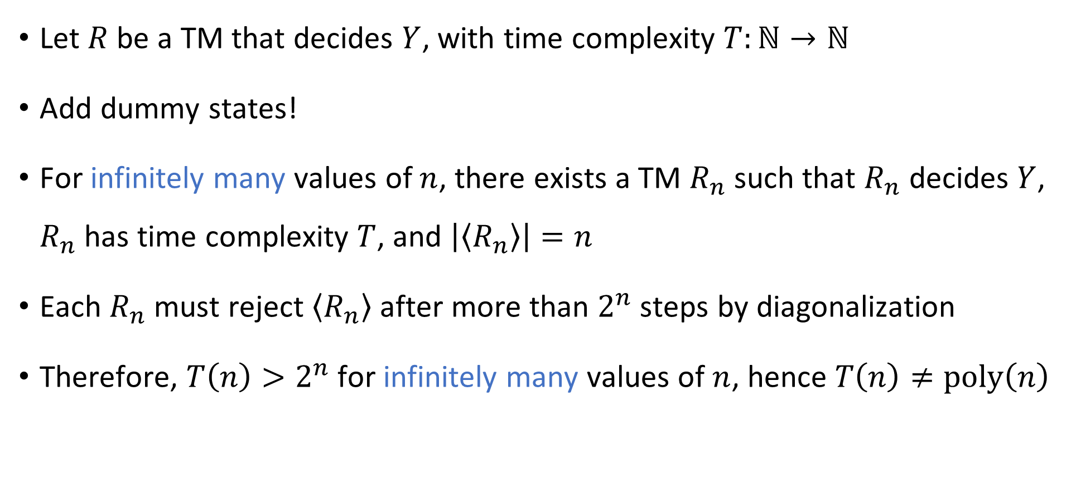
Proof that $Y∉\text{P}$
$$Y=\left\{\left\langle M\right\rangle :M \text{rejects} \left\langle M\right\rangle \text{within} 2^{\left|\left\langle M\right\rangle \right|} \text{steps}\right\}$$
Let $R$ be a TM that decides $Y$, with time complexity $T:ℕ→ℕ$
Add dummy states!
For infinitely many values of $n$, there exists a TM $R_{n}$ such that $R_{n}$ decides $Y$, $R_{n}$ has time complexity $T$, and $\left|\left\langle R_{n}\right\rangle \right|=n$
Each $R_{n}$ must reject $\left\langle R_{n}\right\rangle$ after more than $2^{n}$ steps by diagonalization
Therefore, $T\left(n\right)>2^{n}$ for infinitely many values of $n$, hence $T\left(n\right)≠\text{poly}\left(n\right)$

Slide 18
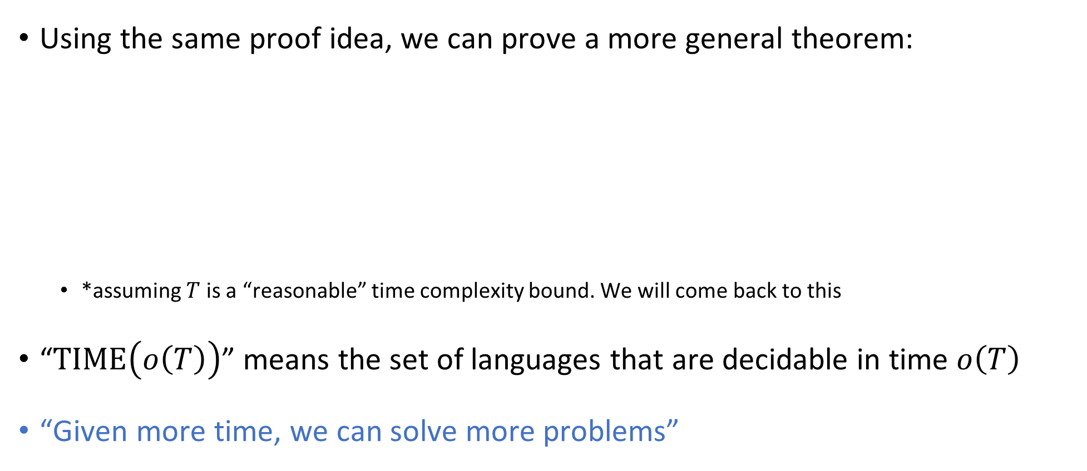
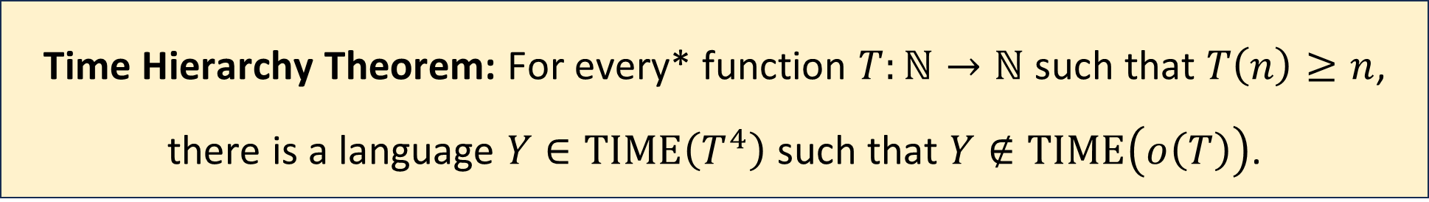
The Time Hierarchy Theorem
Using the same proof idea, we can prove a more general theorem:
*assuming $T$ is a “reasonable” time complexity bound. We will come back to this
“$\text{TIME}\left(o\left(T\right)\right)$” means the set of languages that are decidable in time $o\left(T\right)$
“Given more time, we can solve more problems”
Time Hierarchy Theorem: For every* function $T:ℕ→ℕ$ such that $T\left(n\right)≥n$, there is a language $Y∈\text{TIME}\left(T^{4}\right)$ such that $Y∉\text{TIME}\left(o\left(T\right)\right)$.
Notes:
See the textbook for a tighter version of the theorem, where the bound is T log T instead of T^4

Slide 19

Proof of the Time Hierarchy Theorem
Let $Y=\left\{\left\langle M\right\rangle :M \text{rejects} \left\langle M\right\rangle \text{within} T\left(\left|\left\langle M\right\rangle \right|\right) \text{steps}\right\}$
On the next four slides, we will prove:
$Y∈\text{TIME}\left(T^{4}\right)$
$Y∉\text{TIME}\left(o\left(T\right)\right)$

Slide 20



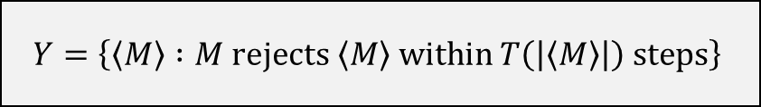
Proof that $Y∈\text{TIME}\left(T^{4}\right)$
$$Y=\left\{\left\langle M\right\rangle :M \text{rejects} \left\langle M\right\rangle \text{within} T\left(\left|\left\langle M\right\rangle \right|\right) \text{steps}\right\}$$
An algorithm that decides $Y$:
Time complexity in the TM model?
Given the input $\left\langle M\right\rangle$:
Simulate $M$ on $\left\langle M\right\rangle$ for $T\left(\left|\left\langle M\right\rangle \right|\right)$ steps
If it rejects within that time, accept
Otherwise, reject

Slide 21

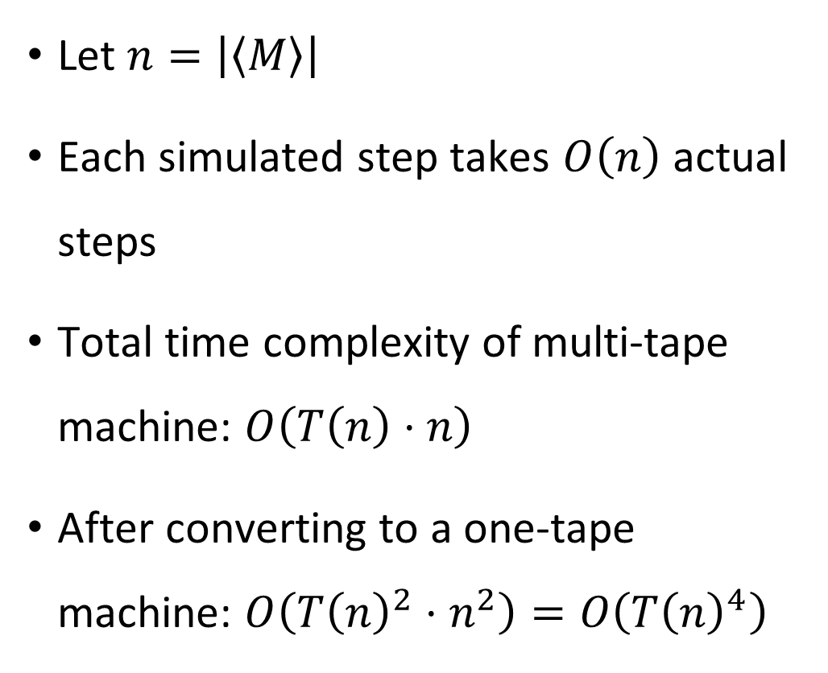





Proof that $Y∈\text{TIME}\left(T^{4}\right)$
$$Y=\left\{\left\langle M\right\rangle :M \text{rejects} \left\langle M\right\rangle \text{within} T\left(\left|\left\langle M\right\rangle \right|\right) \text{steps}\right\}$$
Let $n=\left|\left\langle M\right\rangle \right|$
Each simulated step takes $O\left(n\right)$ actual steps
Total time complexity of multi-tape machine: $O\left(T\left(n\right)⋅n\right)$
After converting to a one-tape machine: $O\left(T{\left(n\right)}^{2}⋅n^{2}\right)=O\left(T{\left(n\right)}^{4}\right)$
$$1^{k}0\left\langle δ\right\rangle$$
$$q$$
$$\left\langle δ\right\rangle$$
$$…\left\langle b_{i−2}\right\rangle \left\langle b_{i−1}\right\rangle \left\langle b_{i}\right\rangle \left\langle b_{i+1}\right\rangle \left\langle b_{i+2}\right\rangle …$$
$$1^{T\left(\left|\left\langle M\right\rangle \right|\right)}$$

Slide 22
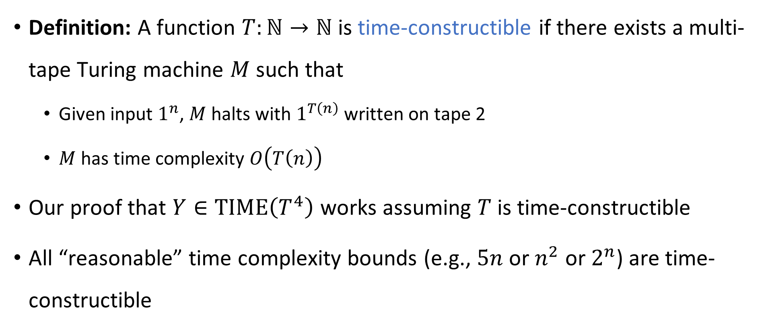
Time-constructible functions
Definition: A function $T:ℕ→ℕ$ is time-constructible if there exists a multi-tape Turing machine $M$ such that
Given input $1^{n}$, $M$ halts with $1^{T\left(n\right)}$ written on tape 2
$M$ has time complexity $O\left(T\left(n\right)\right)$
Our proof that $Y∈\text{TIME}\left(T^{4}\right)$ works assuming $T$ is time-constructible
All “reasonable” time complexity bounds (e.g., $5n$ or $n^{2}$ or $2^{n}$) are time-constructible

