Slide 1

CMSC 28100 Introduction to Complexity Theory Spring 2024 Instructor: William Hoza

Slide 2
Which languages are decidable?

Slide 3

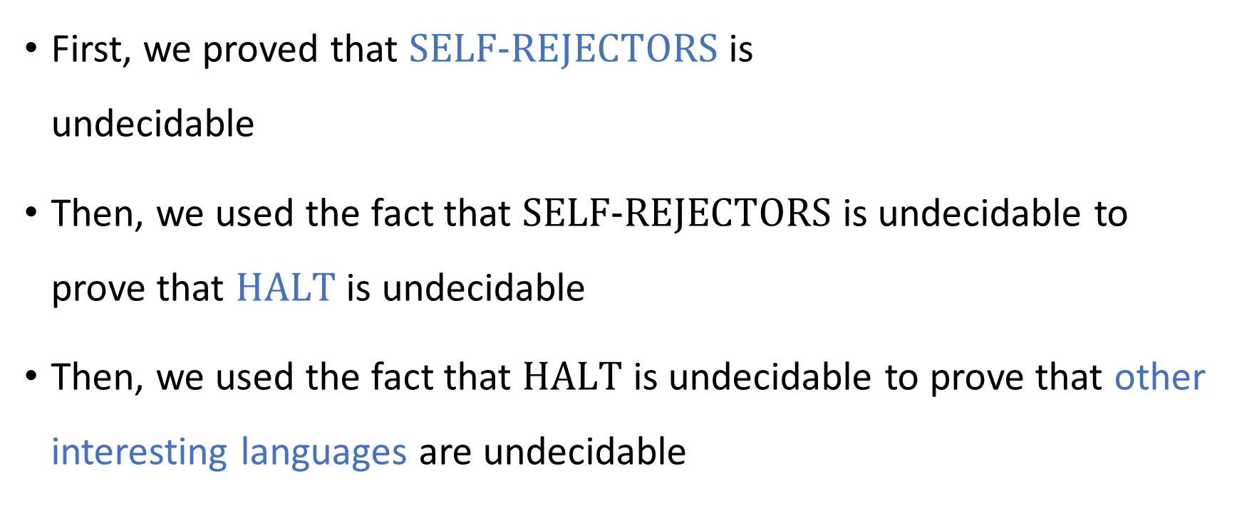
Undecidability
First, we proved that $\text{SELF}‑\text{REJECTORS}$ is undecidable
Then, we used the fact that $\text{SELF}‑\text{REJECTORS}$ is undecidable to prove that $\text{HALT}$ is undecidable
Then, we used the fact that $\text{HALT}$ is undecidable to prove that other interesting languages are undecidable

Slide 4
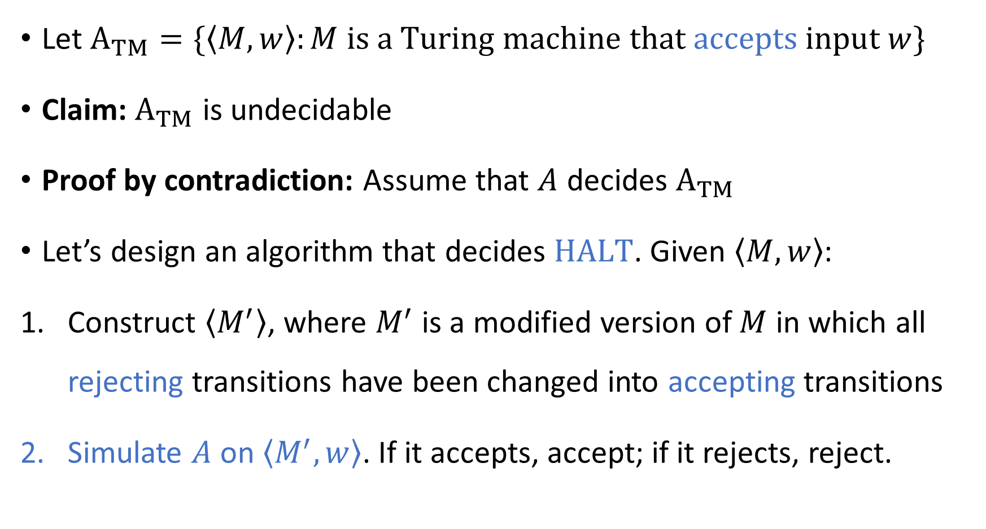
The “acceptance problem”
Let ${\text{A}}_{TM}=\{\left\langle M,w\right\rangle :M \text{is} \text{a} \text{Turing} \text{machine} \text{that} \text{accepts} \text{input} w\}$
Claim: ${\text{A}}_{TM}$ is undecidable
Proof by contradiction: Assume that $A$ decides ${\text{A}}_{TM}$
Let’s design an algorithm that decides $\text{HALT}$. Given $\left\langle M,w\right\rangle$:
Construct $\left\langle M^{′}\right\rangle$, where $M^{′}$ is a modified version of $M$ in which all rejecting transitions have been changed into accepting transitions
Simulate $A$ on $\left\langle M^{′},w\right\rangle$. If it accepts, accept; if it rejects, reject.

Slide 5
Reductions
The proof strategy we have been using is called a reduction
A reduction is a way of relating one problem to another problem
Informal definition:
“Problem A reduces to problem B” means “A solution to problem B would imply a solution to problem A”

Slide 6
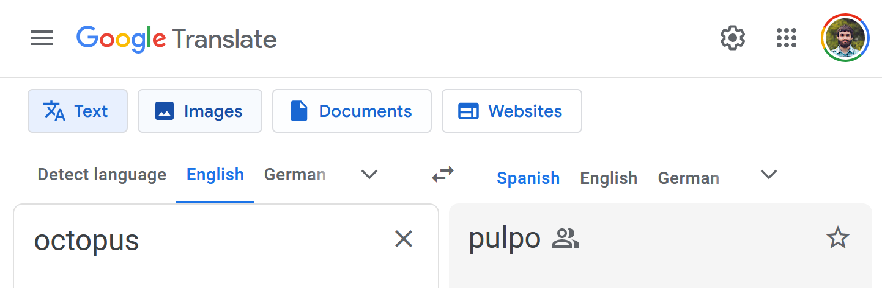
Reductions
🐙 🐪 🦍
Example: Suppose I bring my daughter to a zoo in Mexico. She asks, “Do they have octopuses? Do they have camels? Do they have gorillas? Do they have …”
My job is to solve problem A: “Given an animal name in English, determine whether it’s at the zoo”
A helpful zoo employee can solve problem B: “Given an animal name in Spanish, determine whether it’s at the zoo”
We can reduce problem A to problem B by translating from English to Spanish

Slide 7
Mapping reductions
There are multiple kinds of reductions in computer science
In this course, we will focus on a kind of reduction called a “mapping reduction”

Slide 8
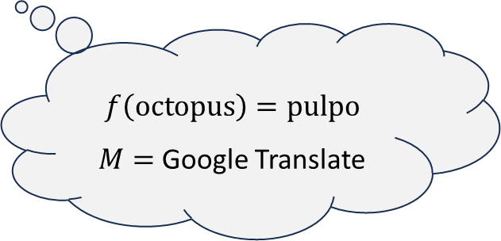
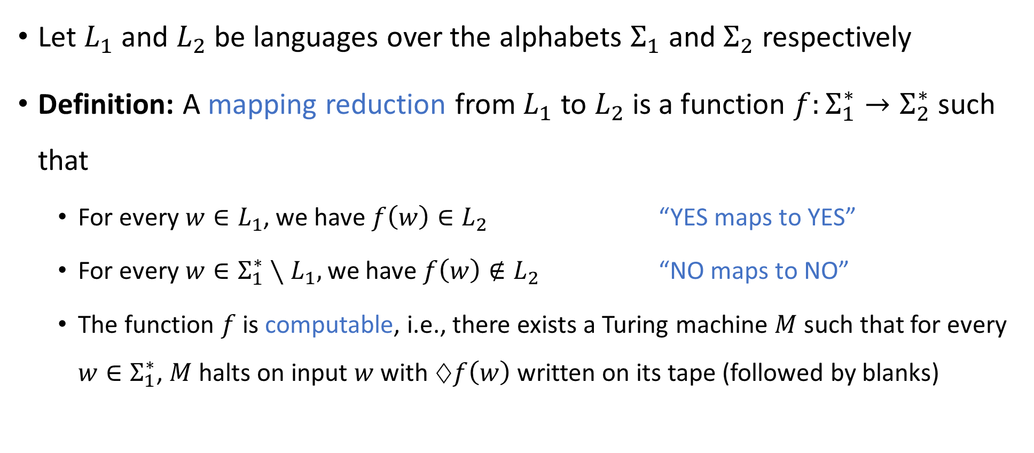
Mapping reductions
$$f\left(\text{octopus}\right)=\text{pulpo}$$
$M=$ Google Translate
Let $L_{1}$ and $L_{2}$ be languages over the alphabets $Σ_{1}$ and $Σ_{2}$ respectively
Definition: A mapping reduction from $L_{1}$ to $L_{2}$ is a function $f:Σ_{1}^{∗}→Σ_{2}^{∗}$ such that
For every $w∈L_{1}$, we have $f\left(w\right)∈L_{2}$ “YES maps to YES”
For every $w∈Σ_{1}^{∗}∖L_{1},$ we have $f\left(w\right)∉L_{2}$ “NO maps to NO”
The function $f$ is computable, i.e., there exists a Turing machine $M$ such that for every $w∈Σ_{1}^{∗}$, $M$ halts on input $w$ with $♢f\left(w\right)$ written on its tape (followed by blanks)

Slide 9





Mapping reductions
Informally, a mapping reduction from $L_{1}$ to $L_{2}$ is a way of converting instances of $L_{1}$ into equivalent instances of $L_{2}$
Note: Any string $w∈Σ^{∗}$ is called an “instance” of $L⊆Σ^{∗}$
$$L_{2}$$
$$L_{1}$$
$$Σ_{1}^{∗}$$
$$Σ_{2}^{∗}$$

Slide 10
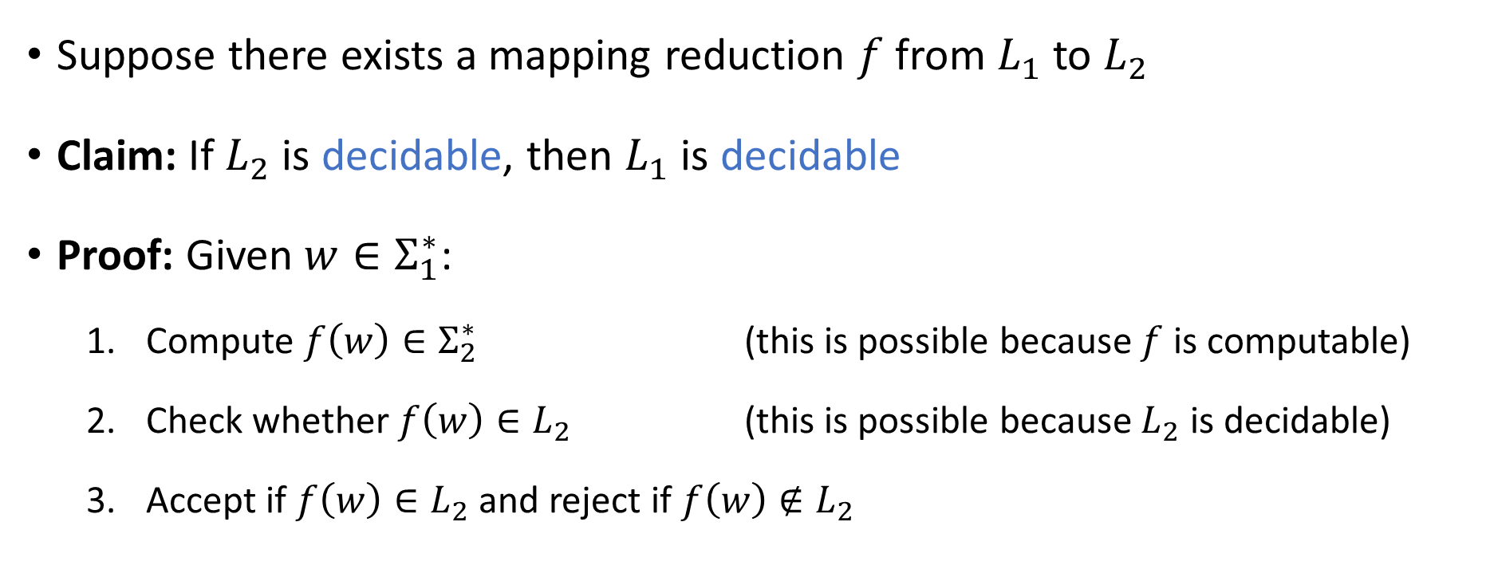
Using reductions to prove decidability
Suppose there exists a mapping reduction $f$ from $L_{1}$ to $L_{2}$
Claim: If $L_{2}$ is decidable, then $L_{1}$ is decidable
Proof: Given $w∈Σ_{1}^{∗}$:
Compute $f\left(w\right)∈Σ_{2}^{∗}$ (this is possible because $f$ is computable)
Check whether $f\left(w\right)∈L_{2}$ (this is possible because $L_{2}$ is decidable)
Accept if $f\left(w\right)∈L_{2}$ and reject if $f\left(w\right)∉L_{2}$

Slide 11



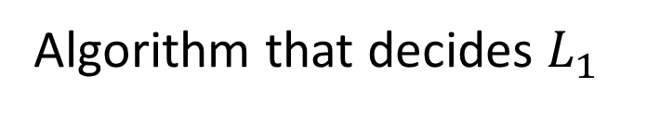


Using reductions to prove decidability
Algorithm that decides $L_{1}$
Algorithm that computes $f$
$$f\left(w\right)$$
Algorithm that decides $L_{2}$
$$w$$
Acc/Rej
The “mapping reduction” is $f$

Slide 12

Using reductions to prove undecidability
Suppose there exists a mapping reduction $f$ from $L_{1}$ to $L_{2}$
Claim: If $L_{1}$ is undecidable, then $L_{2}$ is undecidable
Proof: If $L_{2}$ were decidable, then $L_{1}$ would be decidable

Slide 13
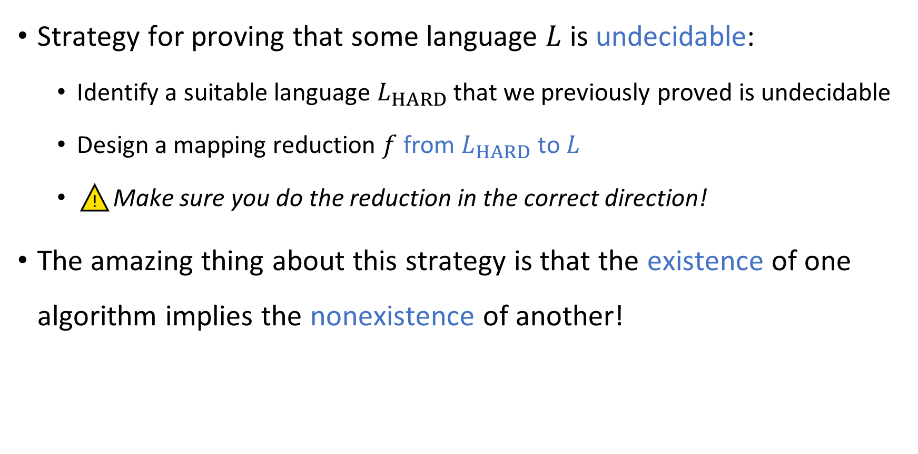
Using reductions to prove undecidability
Strategy for proving that some language $L$ is undecidable:
Identify a suitable language $L_{HARD}$ that we previously proved is undecidable
Design a mapping reduction $f$ from $L_{HARD}$ to $L$
⚠️Make sure you do the reduction in the correct direction!
The amazing thing about this strategy is that the existence of one algorithm implies the nonexistence of another!

Slide 14
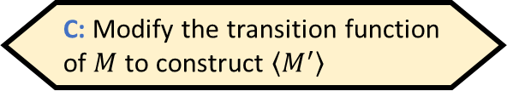
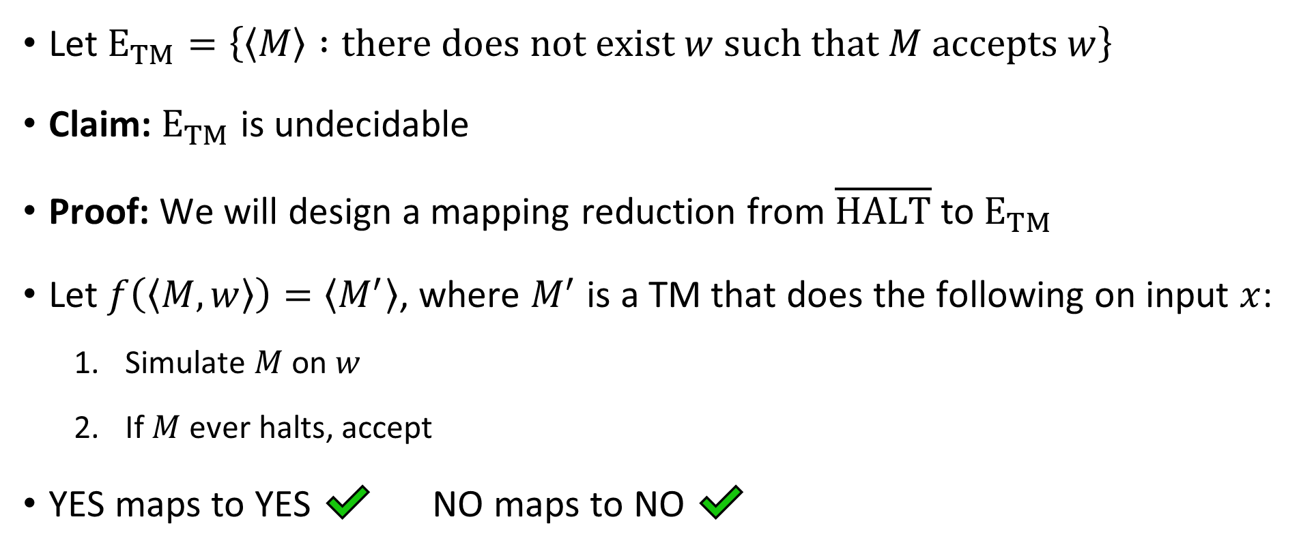
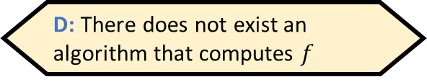
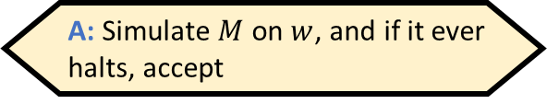
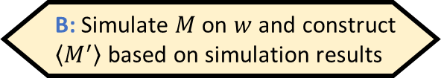
The “emptiness problem”
Given $⟨M,w⟩$, how would we compute $f\left(\left\langle M,w\right\rangle \right)$?
A: Simulate $M$ on $w$, and if it ever halts, accept
B: Simulate $M$ on $w$ and construct $\left\langle M^{′}\right\rangle$ based on simulation results
Let ${\text{E}}_{TM}=\left\{\left\langle M\right\rangle :\text{there} \text{does} \text{not} \text{exist} w \text{such} \text{that} M \text{accepts} w\right\}$
Claim: ${\text{E}}_{TM}$ is undecidable
Proof: We will design a mapping reduction from $\overline{\text{HALT}}$ to ${\text{E}}_{TM}$
Let $f\left(\left\langle M,w\right\rangle \right)=\left\langle M^{′}\right\rangle$, where $M^{′}$ is a TM that does the following on input $x$:
Simulate $M$ on $w$
If $M$ ever halts, accept
YES maps to YES ✔️ NO maps to NO ✔️
C: Modify the transition function of $M$ to construct $\left\langle M^{′}\right\rangle$
D: There does not exist an algorithm that computes $f$
Respond at PollEv.com/whoza or text “whoza” to 22333
Computable ✔️

