Slide 1
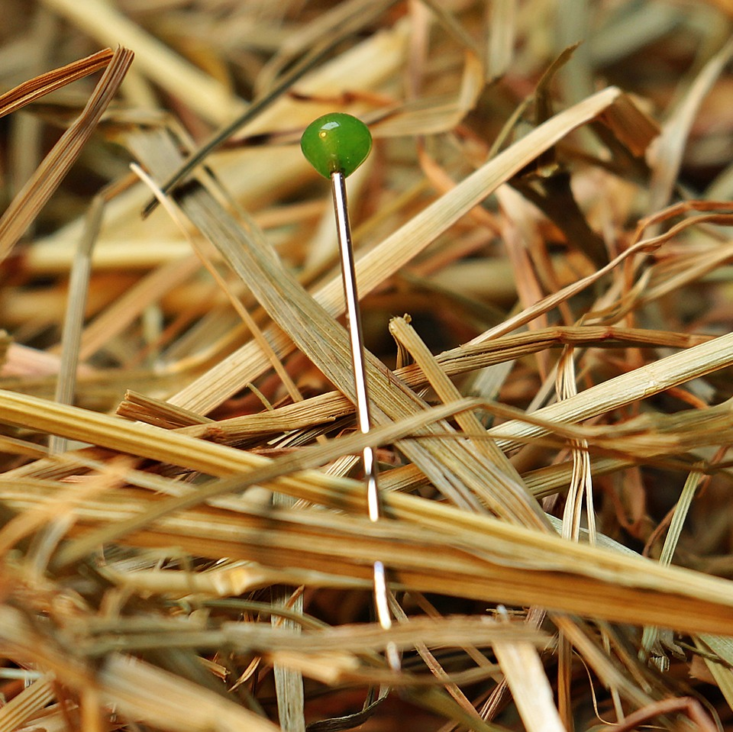
CMSC 28100 Introduction to Complexity Theory Spring 2024 Instructor: William Hoza

Slide 2
Problem set 1
Problem set 1 is available in Canvas
If you aren’t officially enrolled in the course, send me an email. I’ll add you to Canvas so you can access the homework
Office hours (Thursday, Friday, Monday) are a good place to find study partners / homework collaborators

Slide 3
Which problems can be solved through computation?

Slide 4
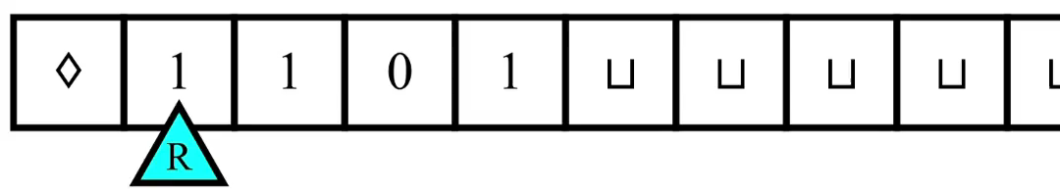
Turing machines
In each step, the machine decides
What to write
Which direction to move the head (left or right)
The new state
The decision is based only on the current state and the observed symbol

Slide 5
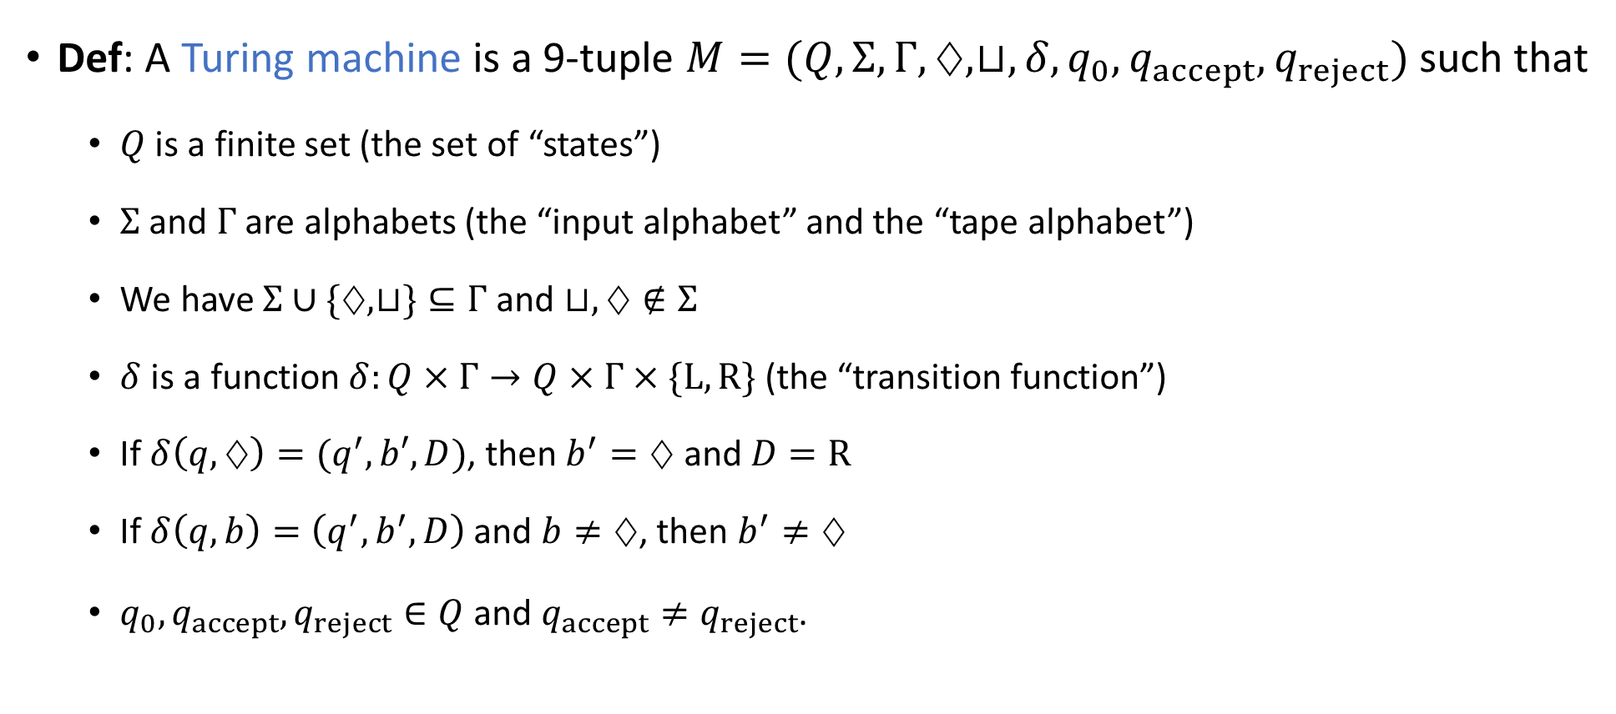
Defining Turing machines rigorously
Def: A Turing machine is a 9-tuple $M=(Q, Σ, Γ,♢, ⊔,δ, q_{0},q_{accept},q_{reject})$ such that
$Q$ is a finite set (the set of “states”)
$Σ$ and $Γ$ are alphabets (the “input alphabet” and the “tape alphabet”)
We have $Σ∪\{♢,⊔\}⊆Γ$ and $⊔,♢∉Σ$
$δ$ is a function $δ:Q×Γ→Q×Γ×\{\text{L}, \text{R}\}$ (the “transition function”)
If $δ\left(q,♢\right)=(q^{′},b′,D)$, then $b^{′}=♢$ and $D=\text{R}$
If $δ\left(q, b\right)=\left(q^{′},b^{′},D\right)$ and $b≠♢$, then $b^{′}≠♢$
$q_{0},q_{accept},q_{reject}∈Q$ and $q_{accept}≠q_{reject}$.
⚠️Warning: The definition in the textbook is slightly different. Sorry! (The two models are equivalent.)

Slide 6

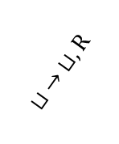
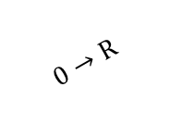



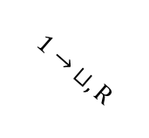
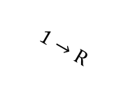
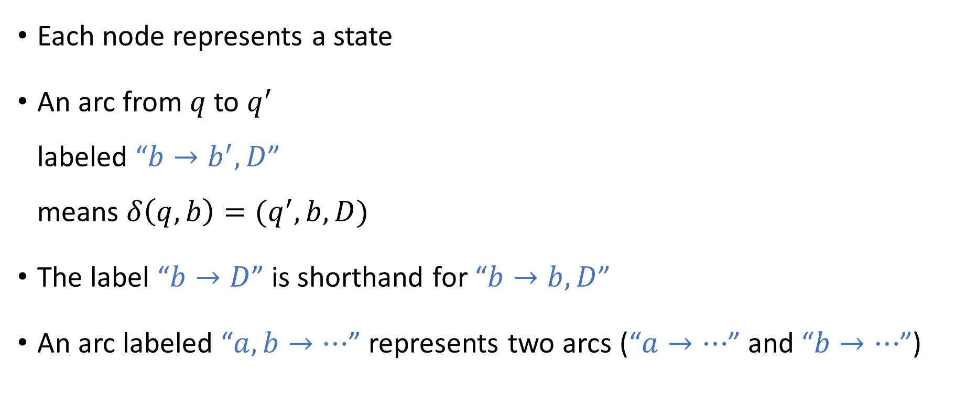

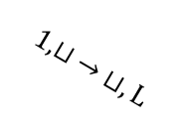

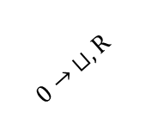



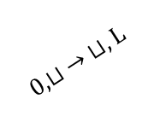




State diagram
$$0,1→\text{R}$$
$$r_{0}$$
$$⊔ →\text{L}$$
$$ℓ_{0}$$
$$0→ ⊔,\text{R}$$
$$0,⊔ → ⊔,\text{L}$$
$$1→\text{R}$$
$$q_{reject}$$
Each node represents a state
An arc from $q$ to $q^{′}$ labeled “$b→b^{′},D$” means $δ\left(q,b\right)=(q^{′},b,D)$
The label “$b→D$” is shorthand for “$b→b,D$”
An arc labeled “$a,b→⋯$” represents two arcs (“$a→⋯$” and “$b→⋯$”)
$$q_{0}$$
$$⊔ →\text{R}$$
$$ℓ$$
$$0,1→\text{L}$$
$$⊔ → ⊔,\text{R}$$
$$1→ ⊔,\text{R}$$
$$1,⊔ → ⊔,\text{L}$$
$$0→\text{R}$$
$$r_{1}$$
$$⊔ →\text{L}$$
$$ℓ_{1}$$
$$q_{accept}$$
$$0,1→\text{R}$$

Slide 7

Defining TM computation rigorously
The transition function $δ$ describes the local evolution of the computation
Now let’s precisely describe the global evolution of the computation

Slide 8





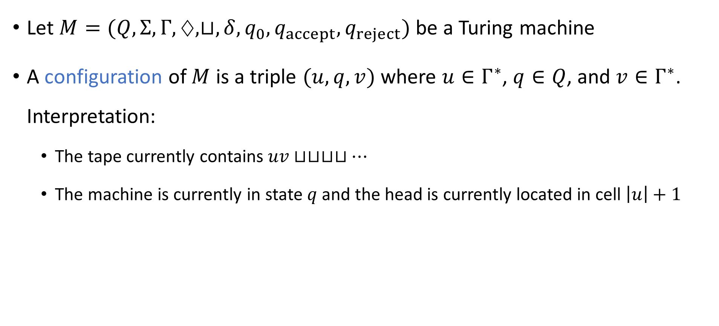








Configurations of a Turing machine
Let $M=(Q, Σ, Γ, ♢, ⊔,δ, q_{0},q_{accept}, q_{reject})$ be a Turing machine
A configuration of $M$ is a triple $(u, q, v)$ where $u∈Γ^{∗}$, $q∈Q$, and $v∈Γ^{∗}$. Interpretation:
The tape currently contains $uv⊔⊔⊔⊔…$
The machine is currently in state $q$ and the head is currently located in cell $\left|u\right|+1$
$$u_{1}$$
$$u_{2}$$
$$u_{3}$$
$$⋯$$
$$u_{n}$$
$$v_{1}$$
$$v_{2}$$
$$⋯$$
$$v_{m}$$
$$⊔$$
$$⊔$$
$$⊔$$
$$q$$

Slide 9
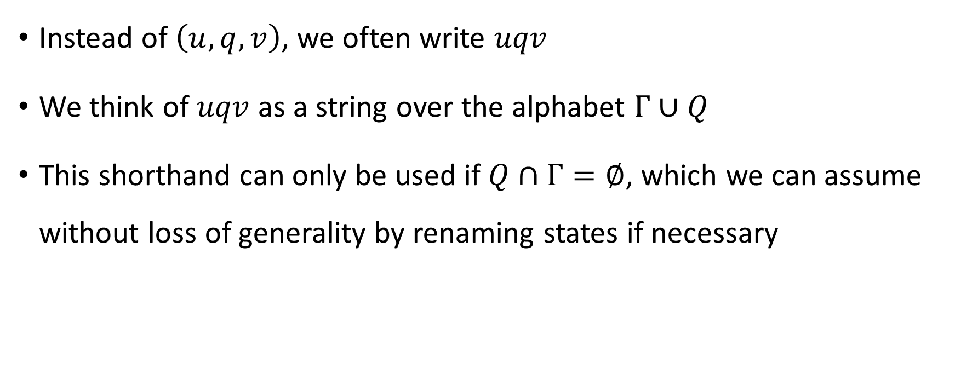
Configuration shorthand
Instead of $\left(u,q,v\right)$, we often write $uqv$
We think of $uqv$ as a string over the alphabet $Γ∪Q$
This shorthand can only be used if $Q∩Γ=∅$, which we can assume without loss of generality by renaming states if necessary

Slide 10
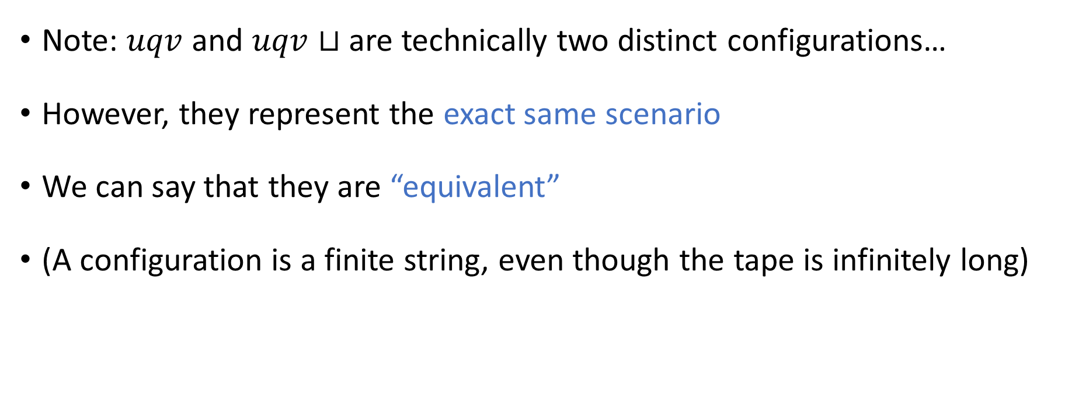
Equivalent configurations
Note: $uqv$ and $uqv⊔$ are technically two distinct configurations…
However, they represent the exact same scenario
We can say that they are “equivalent”
(A configuration is a finite string, even though the tape is infinitely long)

Slide 11

The initial configuration
Let $w∈Σ^{∗}$ be an input
The initial configuration of $M$ on $w$ is $♢q_{0}w$

Slide 12
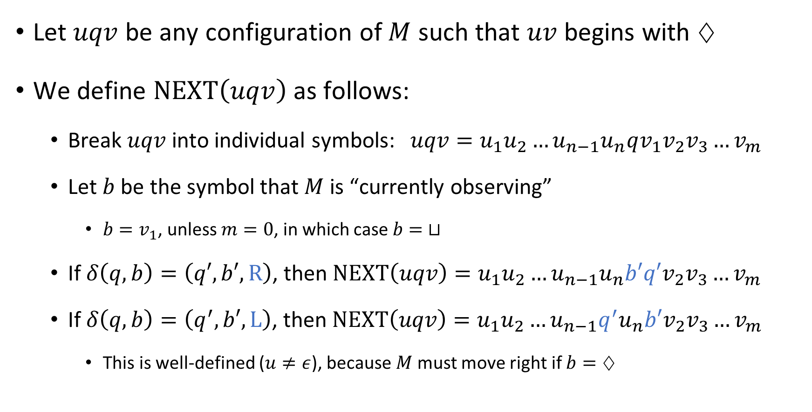
The “next” configuration
Let $uqv$ be any configuration of $M$ such that $uv$ begins with $♢$
We define $\text{NEXT}\left(uqv\right)$ as follows:
Break $uqv$ into individual symbols: $uqv=u_{1}u_{2}…u_{n−1}u_{n}qv_{1}v_{2}v_{3}…v_{m}$
Let $b$ be the symbol that $M$ is “currently observing”
$b=v_{1}$, unless $m=0$, in which case $b= ⊔$
If $δ\left(q,b\right)=\left(q′,b′,\text{R}\right)$, then $\text{NEXT}\left(uqv\right)=u_{1}u_{2}…u_{n−1}u_{n}b′q′v_{2}v_{3}…v_{m}$
If $δ\left(q, b\right)=\left(q^{′},b′,\text{L}\right)$, then $\text{NEXT}\left(uqv\right)=u_{1}u_{2}…u_{n−1}q^{′}u_{n}b′v_{2}v_{3}…v_{m}$
This is well-defined ($u≠ε$), because $M$ must move right if $b=♢$

Slide 13
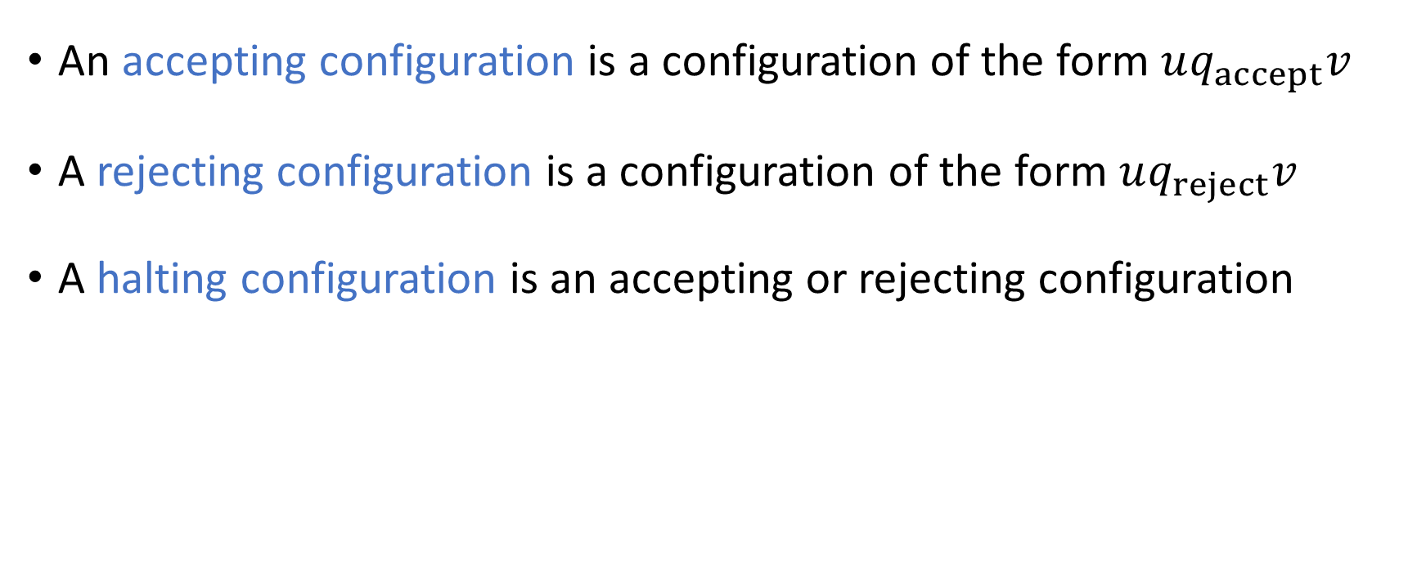
Halting configurations
An accepting configuration is a configuration of the form $uq_{accept}v$
A rejecting configuration is a configuration of the form $uq_{reject}v$
A halting configuration is an accepting or rejecting configuration

Slide 14
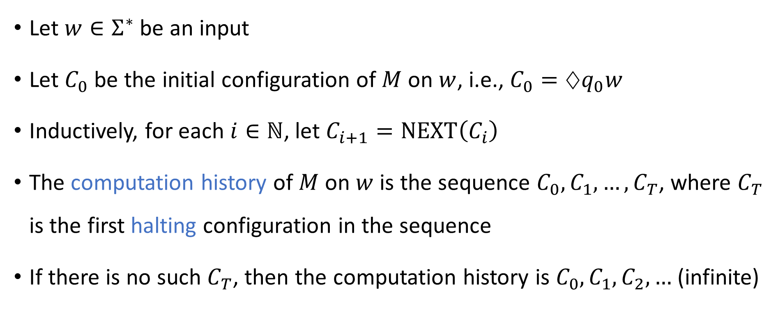
Computation history
Let $w∈Σ^{∗}$ be an input
Let $C_{0}$ be the initial configuration of $M$ on $w$, i.e., $C_{0}=♢q_{0}w$
Inductively, for each $i∈ℕ$, let $C_{i+1}=\text{NEXT}\left(C_{i}\right)$
The computation history of $M$ on $w$ is the sequence $C_{0},C_{1},…, C_{T}$, where $C_{T}$ is the first halting configuration in the sequence
If there is no such $C_{T}$, then the computation history is $C_{0},C_{1},C_{2},…$ (infinite)

Slide 15
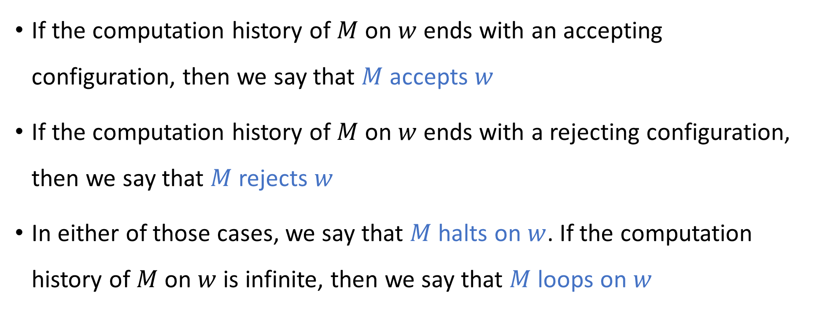
Accepting, rejecting, and looping
If the computation history of $M$ on $w$ ends with an accepting configuration, then we say that $M$ accepts $w$
If the computation history of $M$ on $w$ ends with a rejecting configuration, then we say that $M$ rejects $w$
In either of those cases, we say that $M$ halts on $w$. If the computation history of $M$ on $w$ is infinite, then we say that $M$ loops on $w$

Slide 16

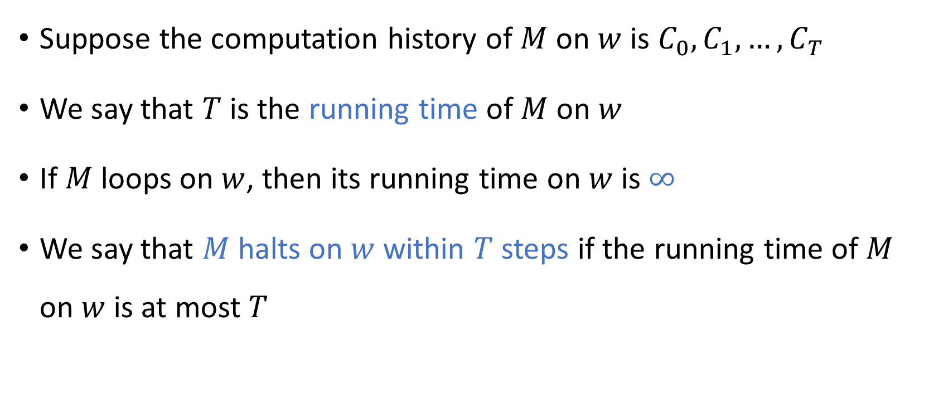
Time
Suppose the computation history of $M$ on $w$ is $C_{0},C_{1},…, C_{T}$
We say that $T$ is the running time of $M$ on $w$
If $M$ loops on $w$, then its running time on $w$ is $∞$
We say that $M$ halts on $w$ within $T$ steps if the running time of $M$ on $w$ is at most $T$

Slide 17
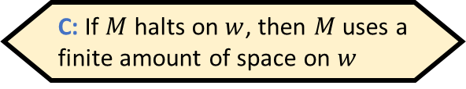
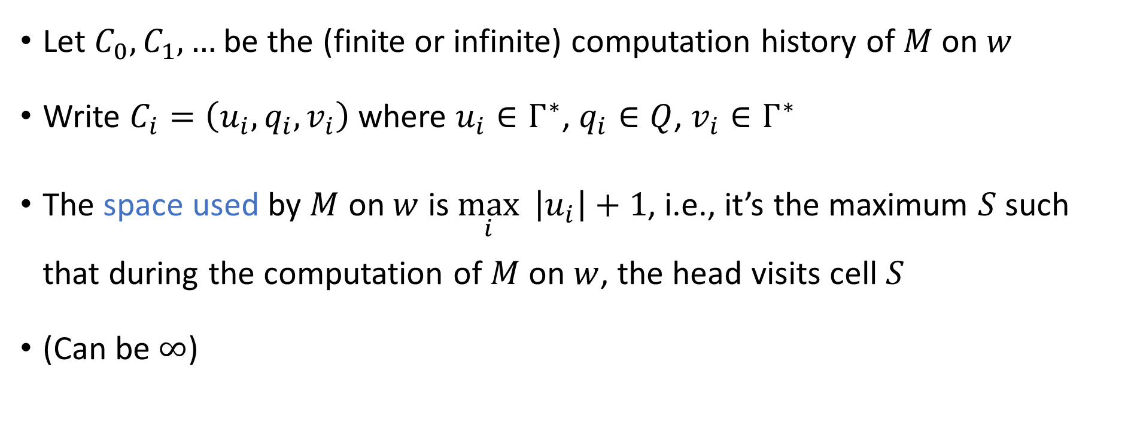
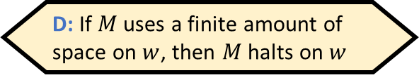
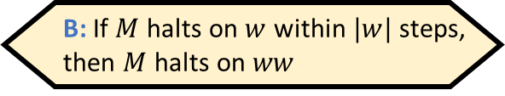
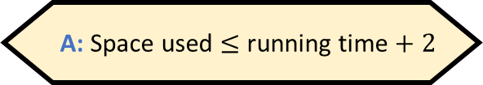
Space
Which of the following statements is false?
A: Space used $≤$ running time $+ 2$
B: If $M$ halts on $w$ within $|w|$ steps, then $M$ halts on $ww$
C: If $M$ halts on $w$, then $M$ uses a finite amount of space on $w$
D: If $M$ uses a finite amount of space on $w$, then $M$ halts on $w$
Let $C_{0},C_{1},…$ be the (finite or infinite) computation history of $M$ on $w$
Write $C_{i}=\left(u_{i},q_{i},v_{i}\right)$ where $u_{i}∈Γ^{∗}$, $q_{i}∈Q$, $v_{i}∈Γ^{∗}$
The space used by $M$ on $w$ is $\max_{i}{ \left|u_{i}\right|}+1$, i.e., it’s the maximum $S$ such that during the computation of $M$ on $w$, the head visits cell $S$
(Can be $∞$)
Respond at PollEv.com/whoza or text “whoza” to 22333

