Slide 1

CMSC 28100 Introduction to Complexity Theory Spring 2024 Instructor: William Hoza

Slide 2




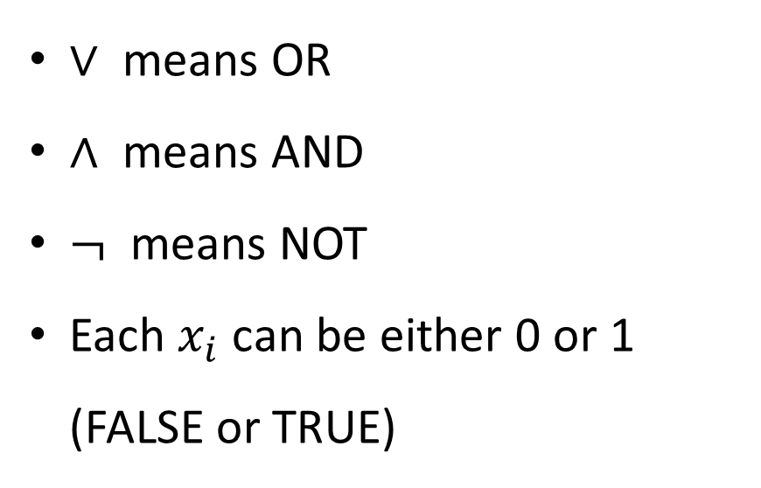















Boolean circuits
For us, a “circuit” is a network of logic gates applied to Boolean variables
1
$$∨$$
$∨$ means OR
$∧$ means AND
$¬$ means NOT
Each $x_{i}$ can be either 0 or 1 (FALSE or TRUE)
1
0
$$∧$$
$$∧$$
0
1
0
1
$$¬$$
$$¬$$
1
0
$$∨$$
$$∨$$
0
1
0
0
$$∧$$
$$∧$$
$$∧$$
$$∧$$
0
1
0
1
1
0
0
1
$$¬$$
$$¬$$
$$¬$$
$$¬$$
0
1
1
1
$$x_{1}$$
$$x_{2}$$
$$x_{3}$$
$$x_{4}$$
0
1
1
1

Slide 3
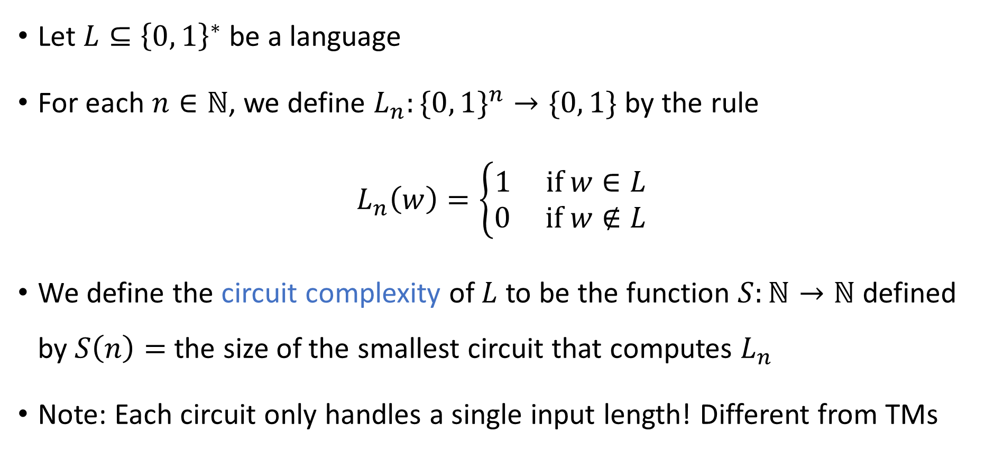
Circuit complexity of a binary language
Let $L⊆{\left\{0, 1\right\}}^{∗}$ be a language
For each $n∈ℕ$, we define $L_{n}:\{0, 1\}^{n}→\{0, 1\}$ by the rule
$$L_{n}\left(w\right)=\left\{\begin{aligned}1 \text{if} w∈L \\ 0 \text{if} w∉L\end{aligned}\right.$$
We define the circuit complexity of $L$ to be the function $S:ℕ→ℕ$ defined by $S\left(n\right)=$ the size of the smallest circuit that computes $L_{n}$
Note: Each circuit only handles a single input length! Different from TMs

Slide 4
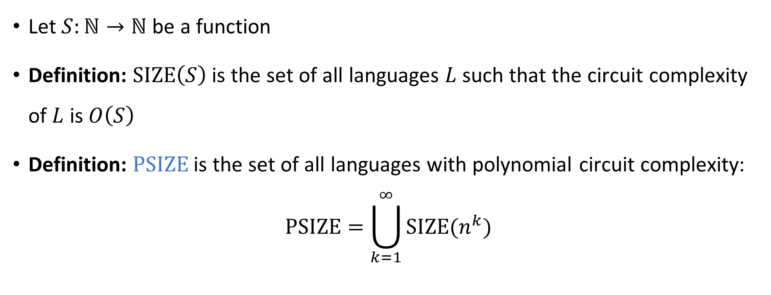

The complexity class $\text{PSIZE}$
Let $S:ℕ→ℕ$ be a function
Definition: $\text{SIZE}\left(S\right)$ is the set of all languages $L$ such that the circuit complexity of $L$ is $O\left(S\right)$
Definition: $\text{PSIZE}$ is the set of all languages with polynomial circuit complexity:
$$\text{PSIZE}=\bigcup_{k=1}^{∞}{\text{SIZE}(n^{k}})$$

Slide 5


Circuit complexity vs. time complexity
Let $T:ℕ→ℕ$ be any function (time bound)
Polynomial Time Algorithm $⇒$ Polynomial Size Circuits
The proof is based on computation histories
Theorem: $\text{TIME}\left(T\right)⊆\text{SIZE}\left(T^{2}\right)$. In particular, $\text{P}⊆\text{PSIZE}$.

Slide 6
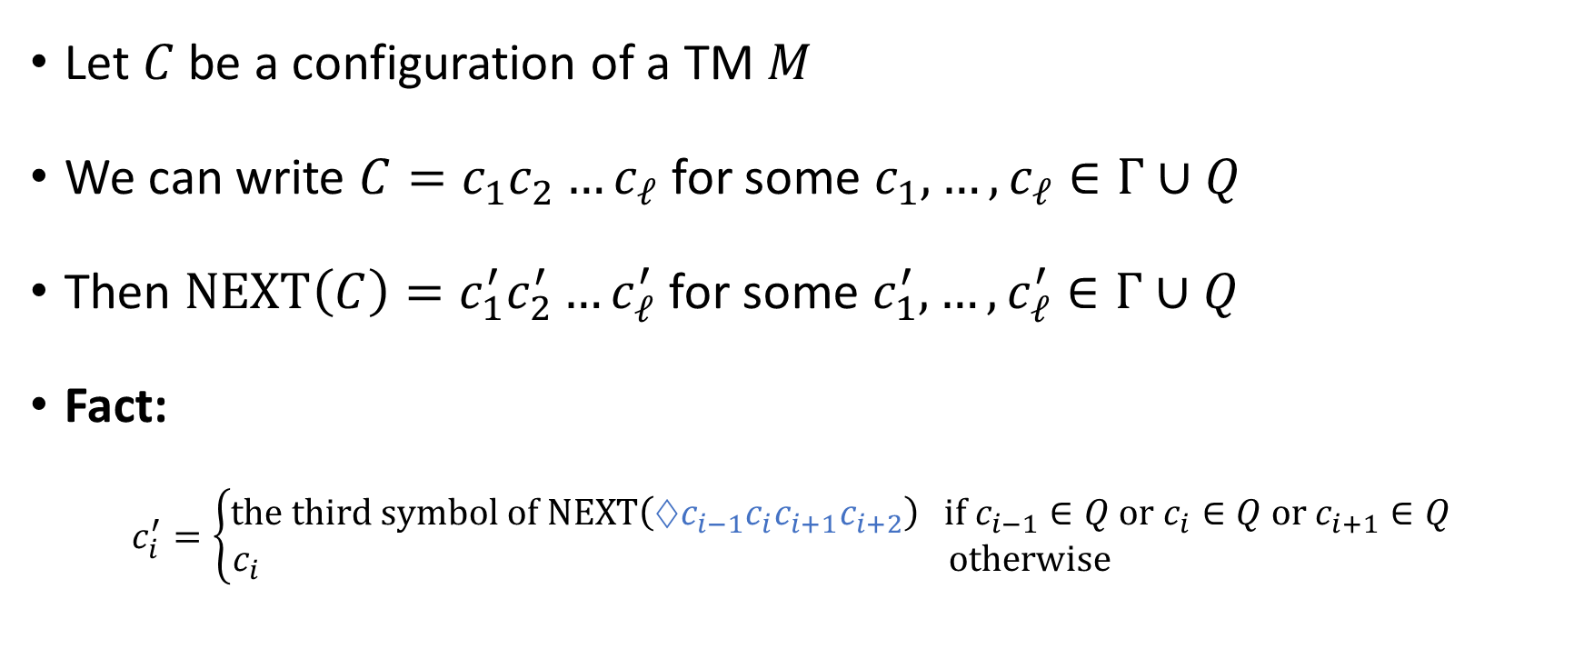
Locality of computation
Let $C$ be a configuration of a TM $M$
We can write $C=c_{1}c_{2}…c_{ℓ}$ for some $c_{1},…, c_{ℓ}∈Γ∪Q$
Then $\text{NEXT}\left(C\right)=c_{1}^{′}c_{2}^{′}…c_{ℓ}^{′}$ for some $c_{1}^{′},…, c_{ℓ}^{′}∈Γ∪Q$
Fact:
$$c_{i}^{′}=\left\{\begin{aligned}\text{the} \text{third} \text{symbol} \text{of} \text{NEXT}\left(♢c_{i−1}c_{i}c_{i+1}c_{i+2}\right) \text{if} c_{i−1}∈Q \text{or} c_{i}∈Q \text{or} c_{i+1}∈Q \\ c_{i} \text{otherwise} \end{aligned}\right.$$

Slide 7
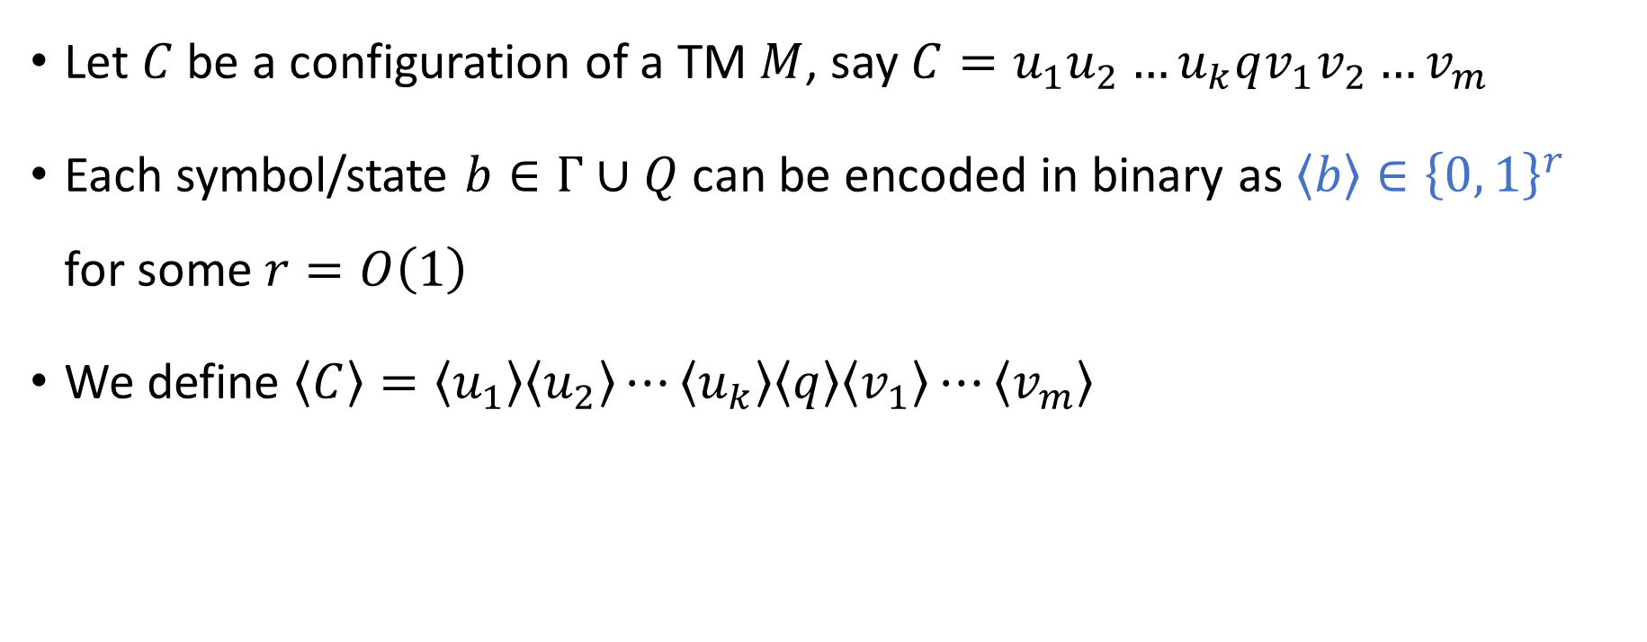
Encoding configurations in binary
Let $C$ be a configuration of a TM $M$, say $C=u_{1}u_{2}…u_{k}qv_{1}v_{2}…v_{m}$
Each symbol/state $b∈Γ∪Q$ can be encoded in binary as $\left\langle b\right\rangle ∈{\left\{0, 1\right\}}^{r}$ for some $r=O\left(1\right)$
We define $\left\langle C\right\rangle =\left\langle u_{1}\right\rangle \left\langle u_{2}\right\rangle ⋯\left\langle u_{k}\right\rangle \left\langle q\right\rangle \left\langle v_{1}\right\rangle ⋯\left\langle v_{m}\right\rangle$

Slide 8




From one configuration to the next
Suppose $\left\langle C\right\rangle =B_{1}B_{2}⋯B_{ℓ}$ where $B_{i}∈{\left\{0, 1\right\}}^{r}$
Suppose $\left\langle \text{NEXT}\left(C\right)\right\rangle =B_{1}^{′}B_{2}^{′}⋯B_{ℓ}^{′}$ where $B_{i}^{′}∈{\left\{0, 1\right\}}^{r}$
If we want to know $B_{i}^{′}$, which blocks of $⟨C⟩$ do we need to look at?
A: All of them
B: Only $B_{i}$
C: $B_{i}$ and $B_{i+1}$
D: $B_{i−1}$, $B_{i}$, $B_{i+1}$, and $B_{i+2}$
Respond at PollEv.com/whoza or text “whoza” to 22333

Slide 9
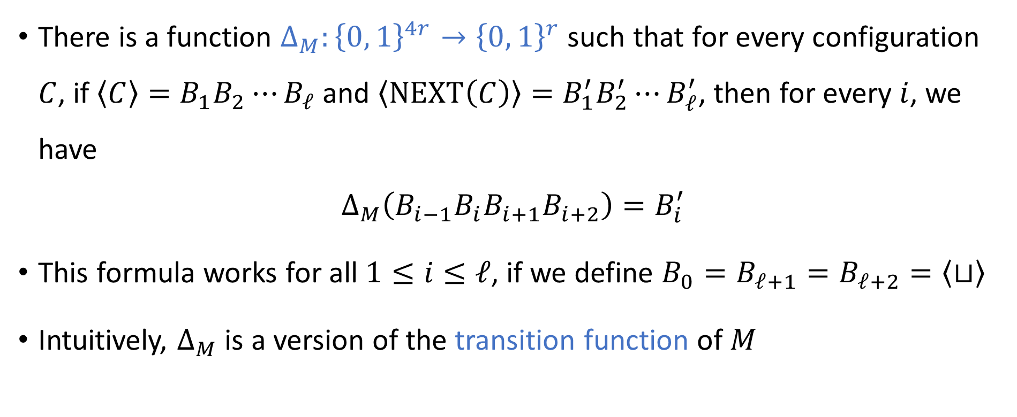
From one configuration to the next
There is a function $Δ_{M}:{\left\{0, 1\right\}}^{4r}→{\left\{0, 1\right\}}^{r}$ such that for every configuration $C$, if $\left\langle C\right\rangle =B_{1}B_{2}⋯B_{ℓ}$ and $\left\langle \text{NEXT}\left(C\right)\right\rangle =B_{1}^{′}B_{2}^{′}⋯B_{ℓ}^{′}$, then for every $i$, we have
$$Δ_{M}\left(B_{i−1}B_{i}B_{i+1}B_{i+2}\right)=B_{i}^{′}$$
This formula works for all $1≤i≤ℓ$, if we define $B_{0}=B_{ℓ+1}=B_{ℓ+2}=\left\langle ⊔\right\rangle$
Intuitively, $Δ_{M}$ is a version of the transition function of $M$

Slide 10



























From one configuration to the next
$$B_{i}^{′}$$
There is a circuit of size $O\left(1\right)$ that computes $Δ_{M}$
Now let’s combine many copies of that circuit in parallel:
$$B_{i−1}$$
$$B_{i}$$
$$B_{i+1}$$
$$B_{i+2}$$
$$\left\langle \text{NEXT}\left(C\right)\right\rangle$$
$$B_{1}^{′}$$
$$B_{2}^{′}$$
$$B_{3}^{′}$$
$$B_{4}^{′}$$
$$B_{5}^{′}$$
$$B_{6}^{′}$$
$$B_{7}^{′}$$
$$\left\langle ⊔\right\rangle$$
$$B_{1}$$
$$B_{2}$$
$$B_{3}$$
$$B_{4}$$
$$B_{5}$$
$$B_{6}$$
$$B_{7}$$
$$\left\langle ⊔\right\rangle$$
$$\left\langle ⊔\right\rangle$$
$$\left\langle C\right\rangle$$

Slide 11

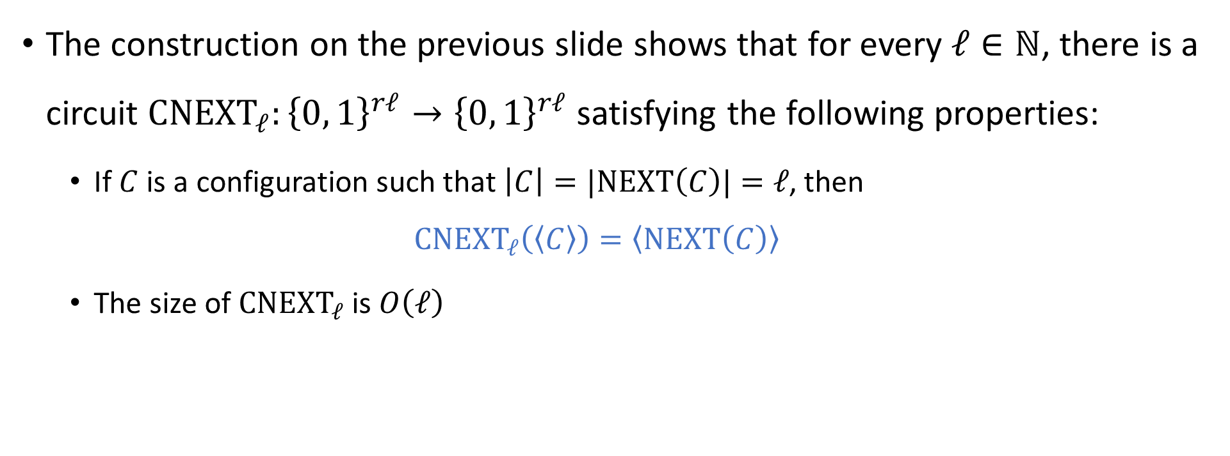
From one configuration to the next
The construction on the previous slide shows that for every $ℓ∈ℕ$, there is a circuit ${\text{CNEXT}}_{ℓ}:{\left\{0, 1\right\}}^{rℓ}→{\left\{0, 1\right\}}^{rℓ}$ satisfying the following properties:
If $C$ is a configuration such that $\left|C\right|=\text{|}\text{NEXT}\left(C\right)|=ℓ$, then
$${\text{CNEXT}}_{ℓ}\left(\left\langle C\right\rangle \right)=\left\langle \text{NEXT}\left(C\right)\right\rangle$$
The size of ${\text{CNEXT}}_{ℓ}$ is $O\left(ℓ\right)$
$${\text{CNEXT}}_{ℓ}$$

Slide 12

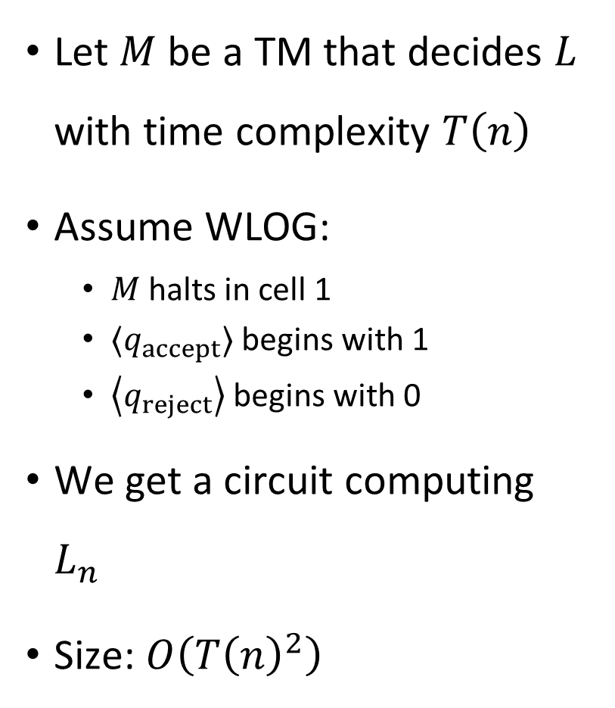



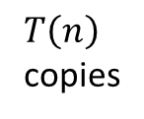



Machine $⇒$ circuit
Output wire
$${\text{CNEXT}}_{T\left(n\right)+2}$$
Let $M$ be a TM that decides $L$ with time complexity $T\left(n\right)$
Assume WLOG:
$M$ halts in cell 1
$⟨q_{accept}⟩$ begins with 1
$\left\langle q_{reject}\right\rangle$ begins with 0
We get a circuit computing $L_{n}$
Size: $O\left(T{\left(n\right)}^{2}\right)$
$$⋮$$
$${\text{CNEXT}}_{T\left(n\right)+2}$$
$T\left(n\right)$ copies
$${\text{CNEXT}}_{T\left(n\right)+2}$$
$${\text{CNEXT}}_{T\left(n\right)+2}$$
$${\text{CNEXT}}_{T\left(n\right)+2}$$
$\left\langle ♢\right\rangle \left\langle q_{0}\right\rangle \left\langle w_{1}\right\rangle \left\langle w_{2}\right\rangle ⋯ \left\langle w_{n}\right\rangle \left\langle ⊔\right\rangle \left\langle ⊔\right\rangle \left\langle ⊔\right\rangle ⟨⊔⟩ ⋯⟨⊔⟩$
Input wires

Slide 13

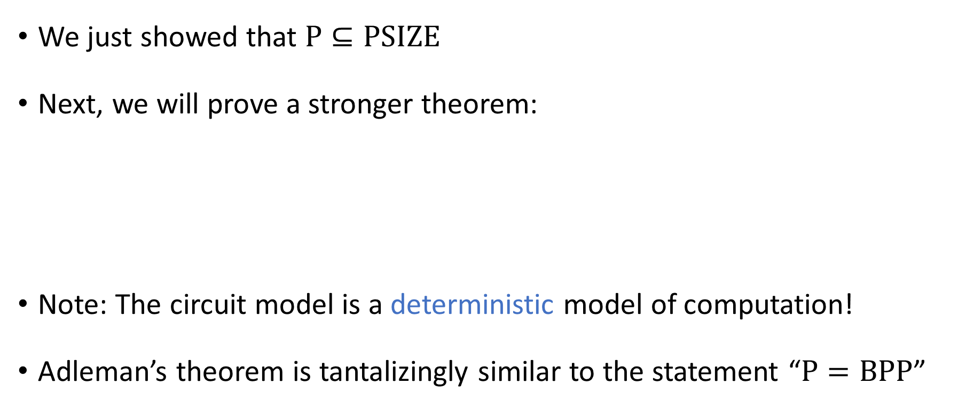



Adleman’s theorem
$$\text{PSIZE}$$
$$\text{BPP}$$
We just showed that $\text{P}⊆\text{PSIZE}$
Next, we will prove a stronger theorem:
Note: The circuit model is a deterministic model of computation!
Adleman’s theorem is tantalizingly similar to the statement “$\text{P}=\text{BPP}$”
$$\text{P}$$
Adleman’s Theorem: $\text{BPP}⊆\text{PSIZE}$

Slide 14
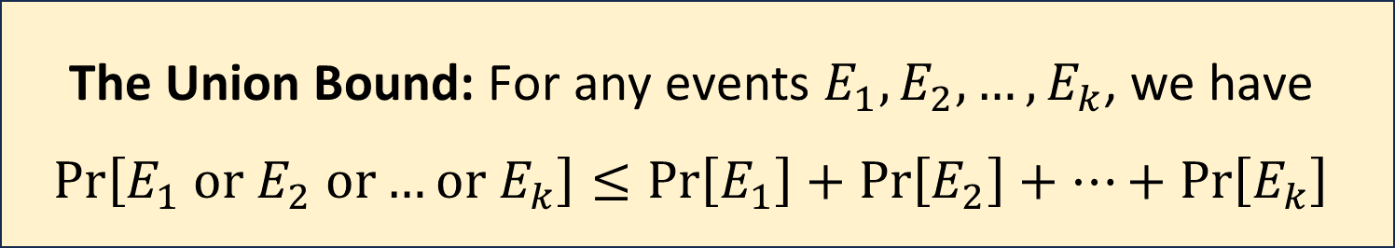

The union bound
The proof of Adleman’s theorem uses a key fact from probability theory:
Example: Suppose $\operatorname{Pr}\left[\text{ice} \text{on} \text{floor}\right]=0.3$ and $\operatorname{Pr}\left[\text{liquid} \text{water} \text{on} \text{floor}\right]=0.4$
Then $\operatorname{Pr}\left[\text{water} \text{on} \text{floor}\right]≤0.3+0.4=0.7$
The Union Bound: For any events $E_{1},E_{2},…, E_{k}$, we have $$\operatorname{Pr}\left[E_{1} \text{or} E_{2} \text{or}…\text{or} E_{k}\right]≤\operatorname{Pr}\left[E_{1}\right]+\operatorname{Pr}\left[E_{2}\right]+…+\operatorname{Pr}\left[E_{k}\right]$$

Slide 15
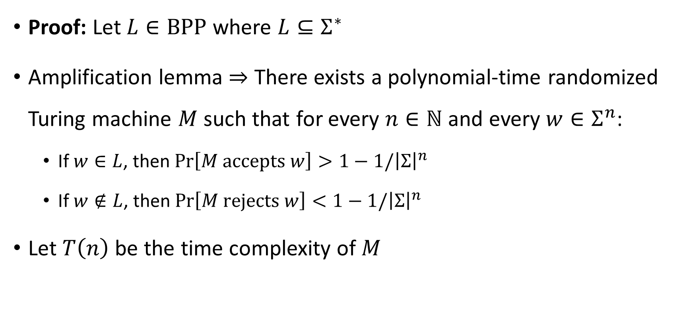

Proof of Adleman’s theorem ($\text{BPP}⊆\text{PSIZE}$)
Proof: Let $L∈\text{BPP}$ where $L⊆Σ^{∗}$
Amplification lemma $⇒$ There exists a polynomial-time randomized Turing machine $M$ such that for every $n∈ℕ$ and every $w∈Σ^{n}$:
If $w∈L$, then $\operatorname{Pr}\left[M \text{accepts} w\right]>1−1/{\left|Σ\right|}^{n}$
If $w∉L$, then $\operatorname{Pr}\left[M \text{rejects} w\right]<1−1/{\left|Σ\right|}^{n}$
Let $T\left(n\right)$ be the time complexity of $M$

Slide 16
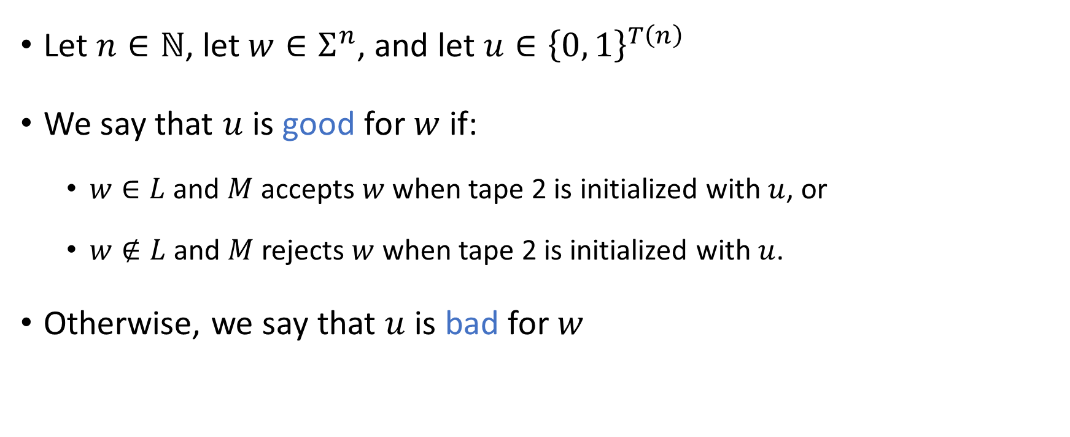
“Good” random bits
Let $n∈ℕ$, let $w∈Σ^{n}$, and let $u∈{\left\{0, 1\right\}}^{T\left(n\right)}$
We say that $u$ is good for $w$ if:
$w∈L$ and $M$ accepts $w$ when tape 2 is initialized with $u$, or
$w∉L$ and $M$ rejects $w$ when tape 2 is initialized with $u$.
Otherwise, we say that $u$ is bad for $w$

Slide 17
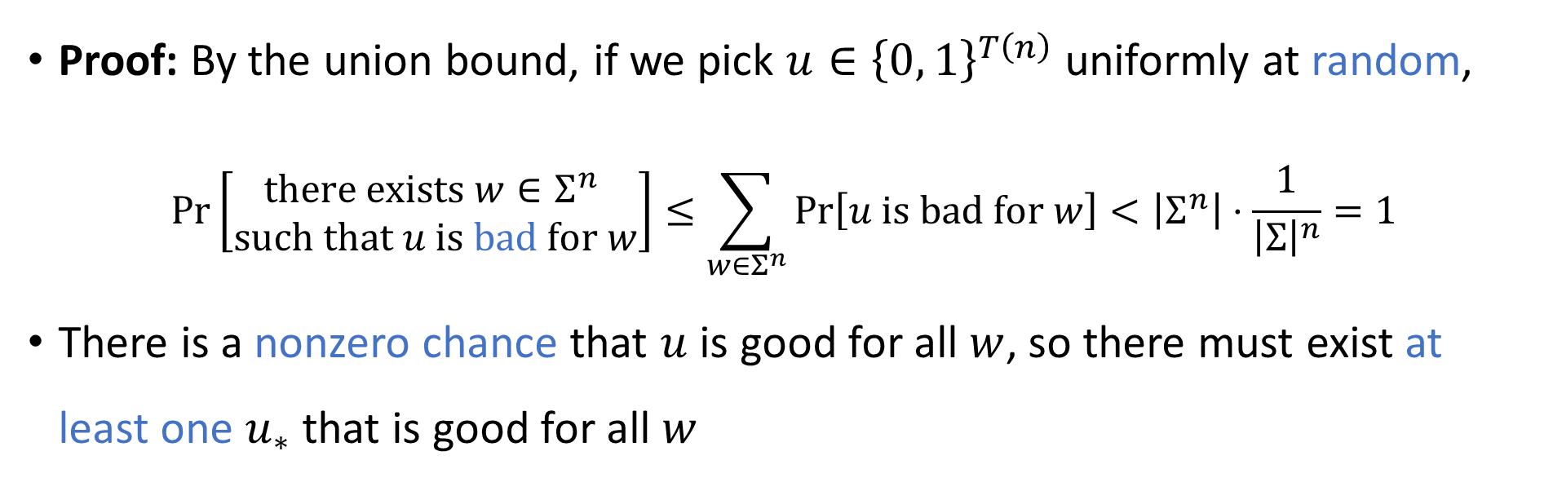
Random bits: Good for all inputs simultaneously
Claim: For every $n$, there exists $u_{∗}∈{\left\{0, 1\right\}}^{T\left(n\right)}$ that is good for all $w∈Σ^{n}$
Proof: By the union bound, if we pick $u∈{\left\{0, 1\right\}}^{T\left(n\right)}$ uniformly at random,
$$\operatorname{Pr}\left[\begin{matrix}\text{there} \text{exists} w∈Σ^{n} \\ \text{such} \text{that} u \text{is} \text{bad} \text{for} w\end{matrix}\right]≤\sum_{w∈Σ^{n}}{\operatorname{Pr}\left[u \text{is} \text{bad} \text{for} w\right]}<\left|Σ^{n}\right|⋅\frac{1}{{\left|Σ\right|}^{n}}=1$$
There is a nonzero chance that $u$ is good for all $w$, so there must exist at least one $u_{∗}$ that is good for all $w$

