Slide 1
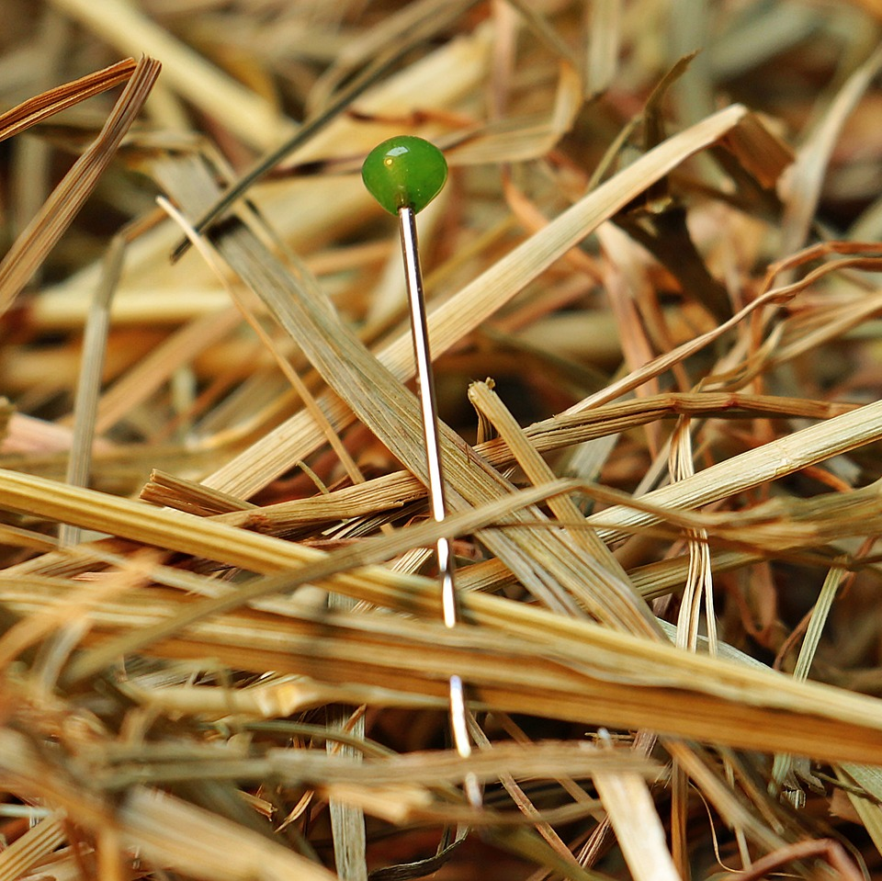
CMSC 28100 Introduction to Complexity Theory Spring 2025 Instructor: William Hoza

Slide 2
Which problems can be solved through computation?

Slide 3
Which languages are decidable?

Slide 4


The rejection problem is undecidable
$\text{REJECT}=\{\left\langle M,w\right\rangle :M \text{is} \text{a} \text{Turing} \text{machine} \text{that} \text{rejects} w\}$
Theorem: $\text{REJECT}$ is undecidable.

Slide 5






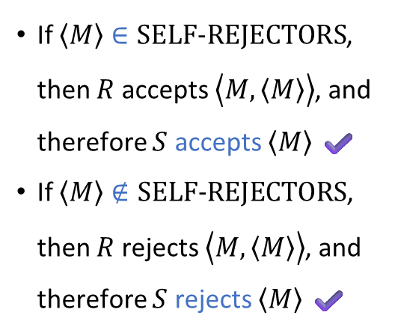
Proof that $\text{REJECT}$ is undecidable
Assume for the sake of contradiction that there is some Turing machine $R$ that decides $\text{REJECT}$
Let’s construct a new TM $S$ that decides $\text{SELF}‑\text{REJECTORS}$
Given the input $\left\langle M\right\rangle$:
“Copy and paste” to construct the string $\left\langle M, \left\langle M\right\rangle \right\rangle$
Simulate $R$ on $\left\langle M,\left\langle M\right\rangle \right\rangle$
If $R$ accepts, accept. If $R$ rejects, reject.
If $\left\langle M\right\rangle ∈\text{SELF}‑\text{REJECTORS}$, then $R$ accepts $\left\langle M,\left\langle M\right\rangle \right\rangle$, and therefore $S$ accepts $\left\langle M\right\rangle$ ✔️
If $\left\langle M\right\rangle ∉\text{SELF}‑\text{REJECTORS}$, then $R$ rejects $\left\langle M,\left\langle M\right\rangle \right\rangle$, and therefore $S$ rejects $\left\langle M\right\rangle$ ✔️
$$S$$

Slide 6
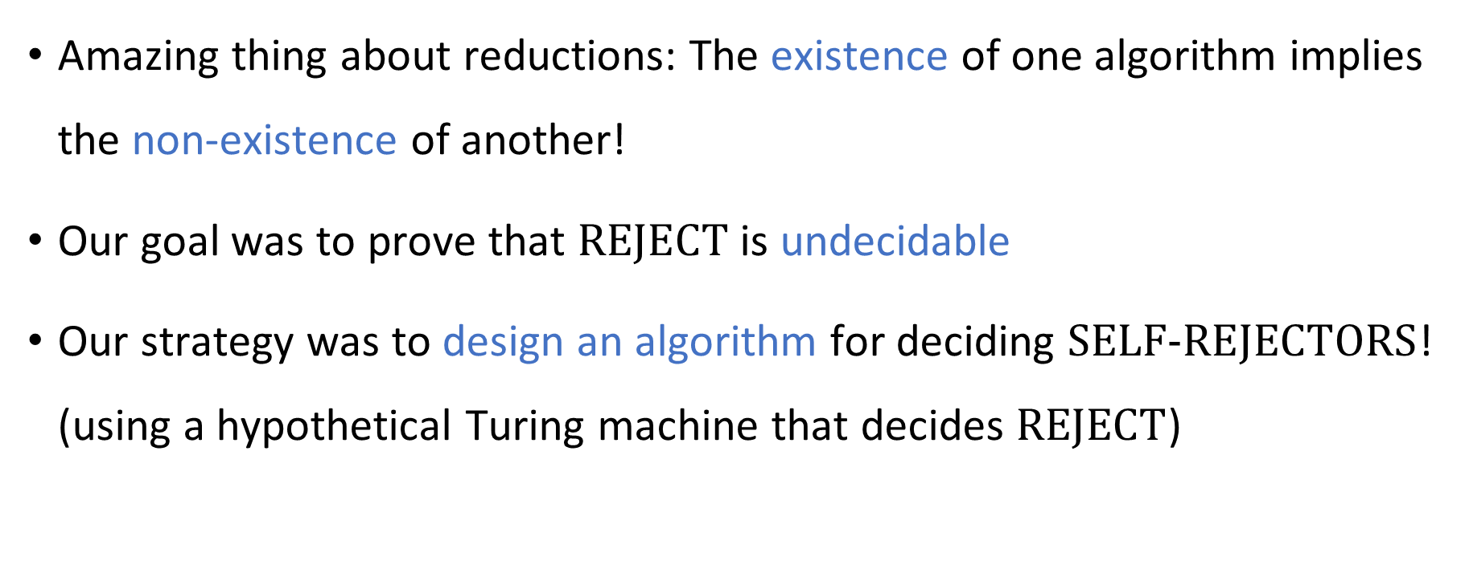
Reductions
Amazing thing about reductions: The existence of one algorithm implies the non-existence of another!
Our goal was to prove that $\text{REJECT}$ is undecidable
Our strategy was to design an algorithm for deciding $\text{SELF}‑\text{REJECTORS}$! (using a hypothetical Turing machine that decides $\text{REJECT}$)

Slide 7
Note on standards of rigor
Going forward, when we want to construct a Turing machine (e.g., for a reduction), we will simply describe what it does in plain English
As if we were giving instructions to a human being
Each plain English description can be formalized as a Turing machine, but this is tedious
You should follow this convention on Exercise 9 and beyond

Slide 8

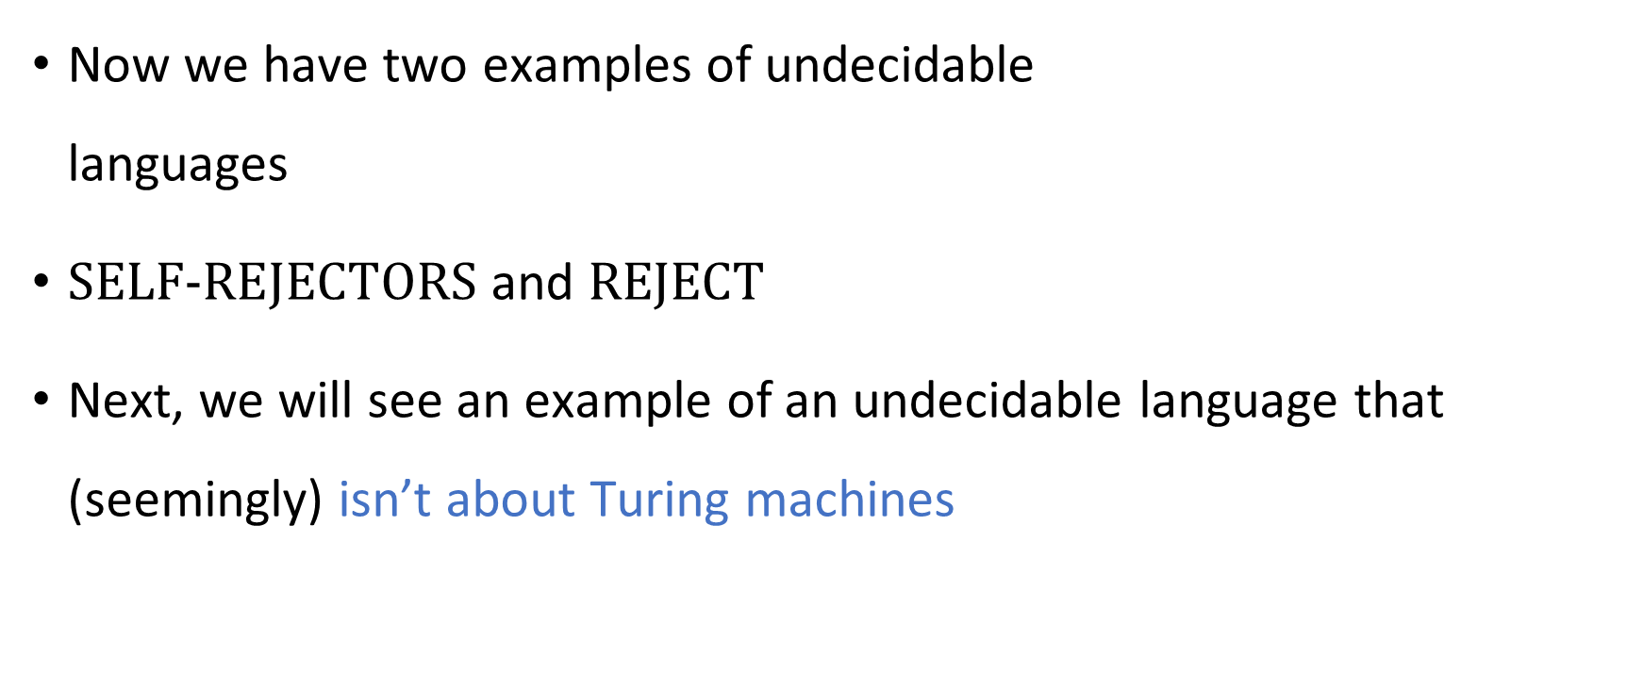
Undecidability
Now we have two examples of undecidable languages
$\text{SELF}‑\text{REJECTORS}$ and $\text{REJECT}$
Next, we will see an example of an undecidable language that (seemingly) isn’t about Turing machines

Slide 9
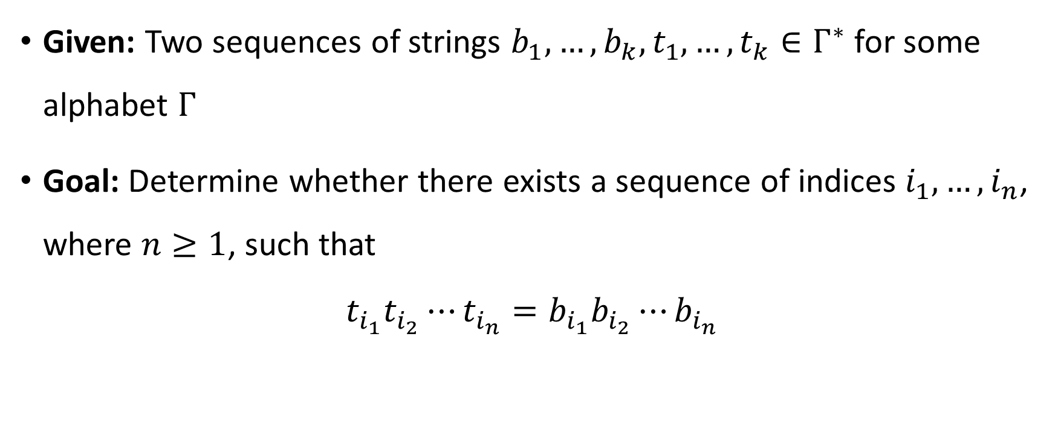
Post’s Correspondence Problem
Given: Two sequences of strings $b_{1},…, b_{k}, t_{1},…, t_{k}∈Γ^{∗}$ for some alphabet $Γ$
Goal: Determine whether there exists a sequence of indices $i_{1},…, i_{n}$, where $n≥1$, such that
$$t_{i_{1}}t_{i_{2}}⋯t_{i_{n}}=b_{i_{1}}b_{i_{2}}⋯b_{i_{n}}$$

Slide 10












Post’s Correspondence Problem
Helpful picture: We are given a set of “dominos”
Goal: Determine whether it is possible to generate a “match”
in which the sequence of symbols on top equals the sequence of symbols on the bottom
Using the same domino multiple times is permitted
$$\begin{matrix}t_{1} \\ b_{1}\end{matrix}$$
$$\begin{matrix}t_{2} \\ b_{2}\end{matrix}$$
$$\begin{matrix}t_{3} \\ b_{3}\end{matrix}$$
$$\begin{matrix}t_{k} \\ b_{k}\end{matrix}$$
$$⋯$$
$$\begin{matrix}t_{i_{1}} \\ b_{i_{1}}\end{matrix}$$
$$\begin{matrix}t_{i_{2}} \\ b_{i_{2}}\end{matrix}$$
$$\begin{matrix}t_{i_{3}} \\ b_{i_{3}}\end{matrix}$$
$$\begin{matrix}t_{i_{4}} \\ b_{i_{4}}\end{matrix}$$
$$\begin{matrix}t_{i_{5}} \\ b_{i_{5}}\end{matrix}$$
$$\begin{matrix}t_{i_{n}} \\ b_{i_{n}}\end{matrix}$$
$$⋯$$

Slide 11









Post’s Correspondence Problem: Example 1
Suppose we are given
This is a YES case. Match:
$$\begin{matrix}\text{0} \\ \text{1}\end{matrix}$$
$$\begin{matrix}\text{1} \\ \text{0}\end{matrix}$$
$$\begin{matrix}\text{1}\text{1} \\ ϵ\end{matrix}$$
$$\begin{matrix}ϵ \\ 00\end{matrix}$$
$$\begin{matrix}\text{1}\text{1} \\ ϵ\end{matrix}$$
$$\begin{matrix}\text{0} \\ \text{1}\end{matrix}$$
$$\begin{matrix}\text{0} \\ \text{1}\end{matrix}$$
$$\begin{matrix}ϵ \\ 00\end{matrix}$$
$←$1100
$←$1100

Slide 12


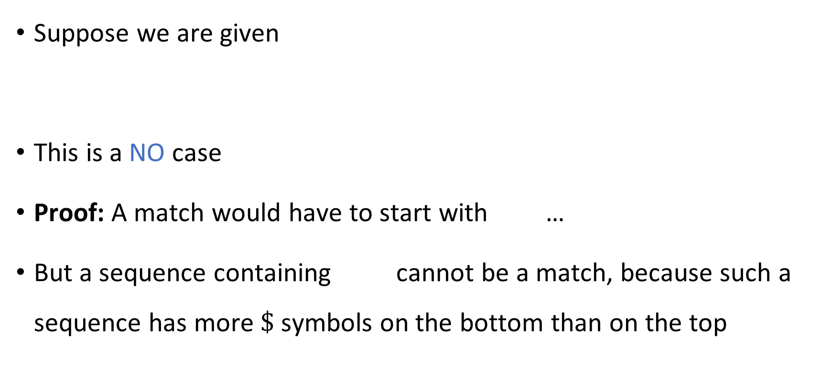



Post’s Correspondence Problem: Example 2
Suppose we are given
This is a NO case
Proof: A match would have to start with …
But a sequence containing cannot be a match, because such a sequence has more $\$$ symbols on the bottom than on the top
$$\begin{matrix}\text{\#} \\ \text{\#\$}\end{matrix}$$
$$\begin{matrix}\text{\#}\text{\$\#} \\ \text{\$\#}\end{matrix}$$
$$\begin{matrix}\text{\$} \\ \text{\#\$}\end{matrix}$$
$$\begin{matrix}\text{\#} \\ \text{\#\$}\end{matrix}$$
$$\begin{matrix}\text{\#} \\ \text{\#\$}\end{matrix}$$

Slide 13

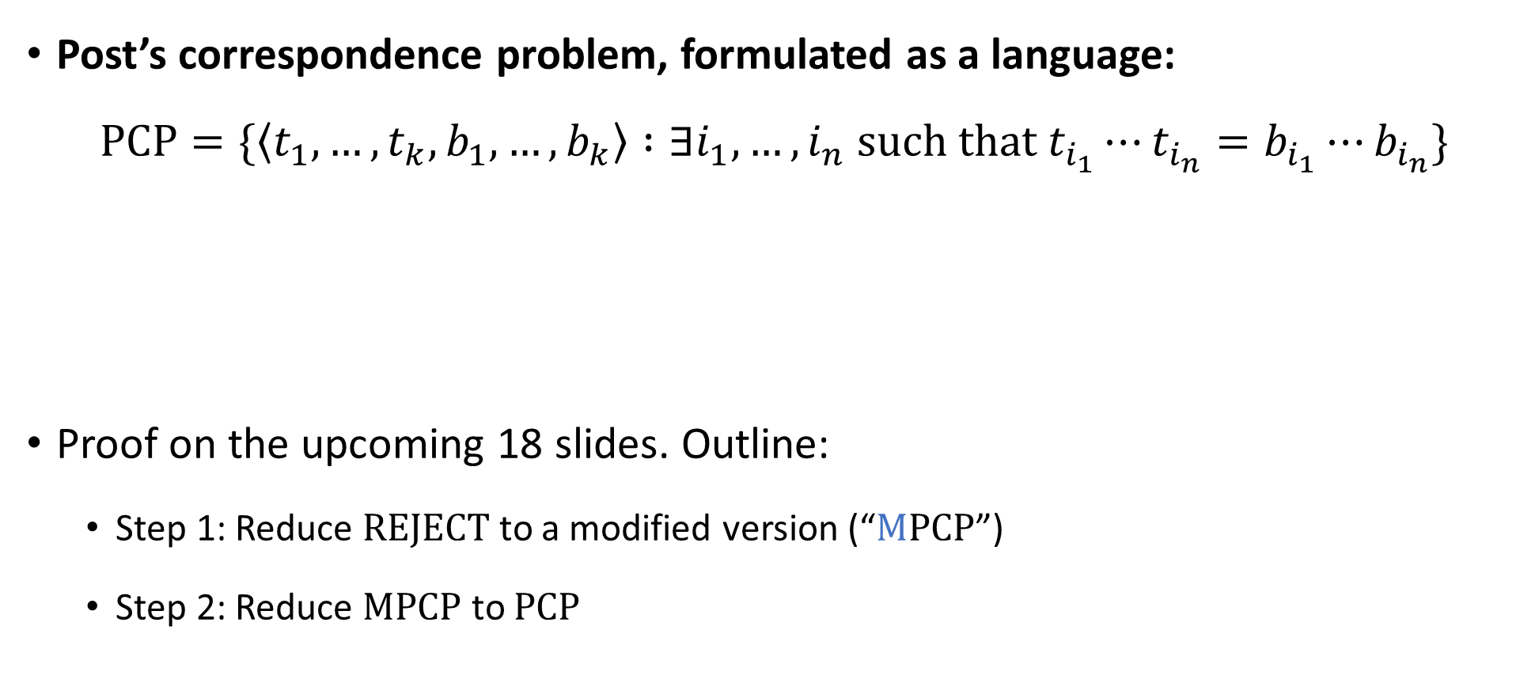
Post’s Correspondence Problem is undecidable
Post’s correspondence problem, formulated as a language:
$$\text{PCP}=\{\left\langle t_{1},…, t_{k}, b_{1},…, b_{k}\right\rangle :∃i_{1},…, i_{n} \text{such} \text{that} t_{i_{1}}⋯t_{i_{n}}=b_{i_{1}}⋯b_{i_{n}}\}$$
Proof on the upcoming 18 slides. Outline:
Step 1: Reduce $\text{REJECT}$ to a modified version (“$\text{M}\text{PCP}$”)
Step 2: Reduce $\text{MPCP}$ to $\text{PCP}$
Theorem: $\text{PCP}$ is undecidable

Slide 14

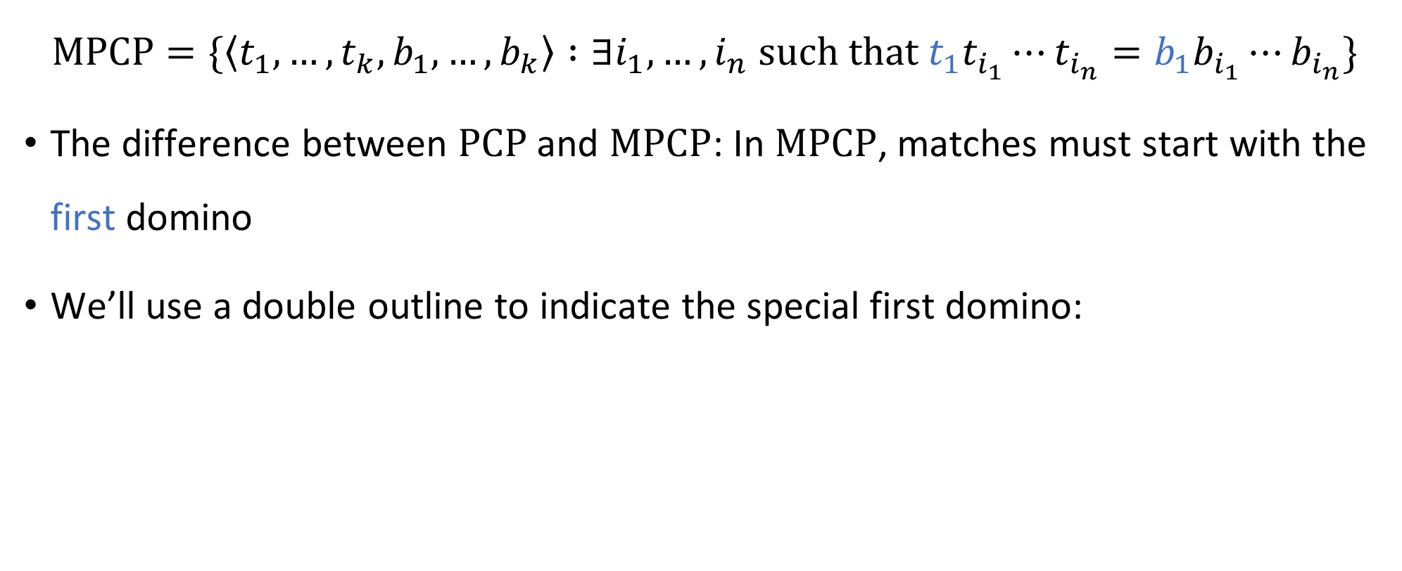
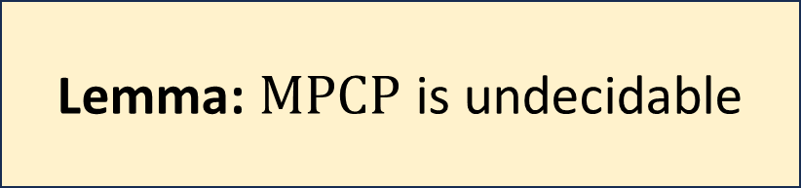
Modified PCP
$$\text{MPCP}=\{\left\langle t_{1},…, t_{k}, b_{1},…, b_{k}\right\rangle :∃i_{1},…, i_{n} \text{such} \text{that} t_{1}t_{i_{1}}⋯t_{i_{n}}=b_{1}b_{i_{1}}⋯b_{i_{n}}\}$$
The difference between $\text{PCP}$ and $\text{MPCP}$: In $\text{MPCP}$, matches must start with the first domino
We’ll use a double outline to indicate the special first domino:
$$\begin{matrix}t_{1} \\ b_{1}\end{matrix}$$
Lemma: $M\text{PCP}$ is undecidable

Slide 15




Proof that $\text{MPCP}$ is undecidable
Assume there is a TM $P$ that decides $\text{MPCP}$
Let’s construct a new TM $R$ that decides $\text{REJECT}$
Given $\left\langle M,w\right\rangle$:
Construct dominos $t_{1},…, t_{k},b_{1},…b_{k}$ based on $M$ and $w$ (details on upcoming slides)
Simulate $P$ on $\left\langle t_{1},…, t_{k},b_{1},…, b_{k}\right\rangle$
If $P$ accepts, accept. If $P$ rejects, reject.
$$R$$

Slide 16
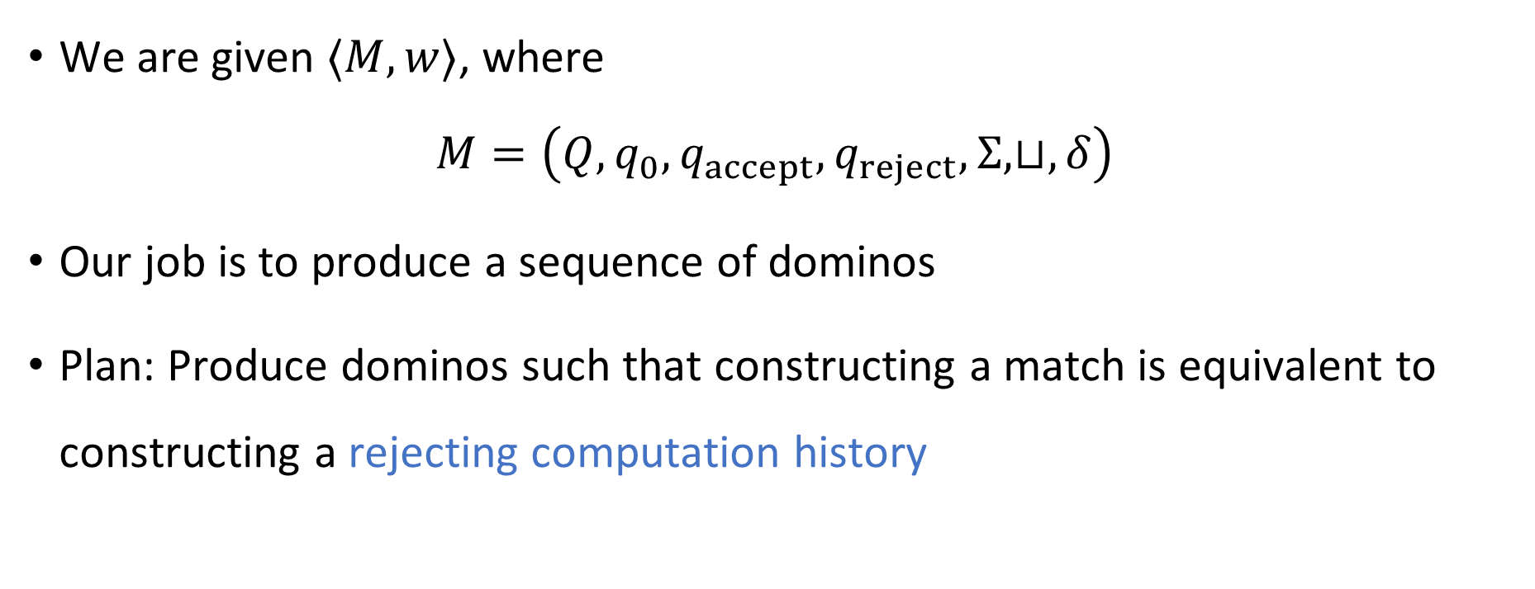

Reducing $\text{REJECT}$ to $\text{MPCP}$
We are given $⟨M,w⟩$, where $M=\left(Q, q_{0},q_{accept},q_{reject},Σ,⊔,δ\right)$
Our job is to produce a sequence of dominos
Plan: Produce dominos such that constructing a match is equivalent to constructing a rejecting computation history

Slide 17


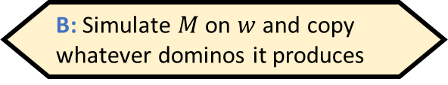

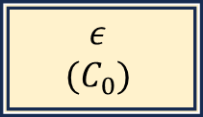

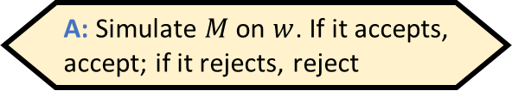

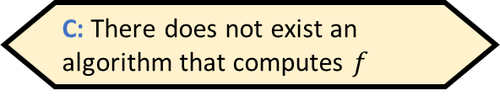




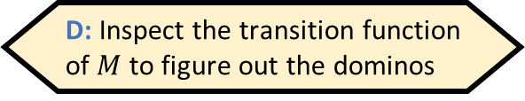



Reducing $\text{REJECT}$ to $\text{MPCP}$
Given $⟨M,w⟩$, how does one construct these dominos?
Let $C_{0}$ be the initial configuration of $M$ on $w$. Dominos:
, , , and
For every $q∈Q∖\left\{q_{accept},q_{reject}\right\}$ and every $b∈Σ$:
If $δ\left(q,b\right)=\left(q^{′},b^{′},\text{R}\right)$, we include , and we include for every $a∈Σ$
If $δ\left(q,b\right)=\left(q^{′},b^{′},\text{L}\right)$, we include , and we include for every $a∈Σ$
, , and for every $b∈Σ$
A: Simulate $M$ on $w$. If it accepts, accept; if it rejects, reject
B: Simulate $M$ on $w$ and copy whatever dominos it produces
C: There does not exist an algorithm that computes $f$
D: Inspect the transition function of $M$ to figure out the dominos
$$\begin{matrix}ε \\ (C_{0})\end{matrix}$$
$$\begin{matrix}( \\ (\end{matrix}$$
$$\begin{matrix}) \\ )\end{matrix}$$
$$\begin{matrix}(q_{reject}) \\ ε\end{matrix}$$
Respond at PollEv.com/whoza or text “whoza” to 22333
$$\begin{matrix}qb) \\ b^{′}q^{′}⊔)\end{matrix}$$
$$\begin{matrix}qba \\ b^{′}q^{′}a\end{matrix}$$
$$\begin{matrix}(qb \\ (q^{′}⊔b′\end{matrix}$$
$$\begin{matrix}aqb \\ q^{′}ab′\end{matrix}$$
$$\begin{matrix}b \\ b\end{matrix}$$
$$\begin{matrix}bq_{reject} \\ q_{reject}\end{matrix}$$
$$\begin{matrix}q_{reject}b \\ q_{reject}\end{matrix}$$

Slide 18



Proof that $\text{MPCP}$ is undecidable
Assume there is a TM $P$ that decides $\text{MPCP}$
Let’s construct a new TM $R$ that decides $\text{REJECT}$
Given $\left\langle M,w\right\rangle$:
Construct dominos $t_{1},…, t_{k},b_{1},…b_{k}$ based on $M$ and $w$ (details on preceding slides)
Simulate $P$ on $\left\langle t_{1},…, t_{k},b_{1},…, b_{k}\right\rangle$
If $P$ accepts, accept. If $P$ rejects, reject.
Need to show:
If $M$ rejects $w$, then there is a match
If there is a match, then $M$ rejects $w$
$$R$$

Slide 19




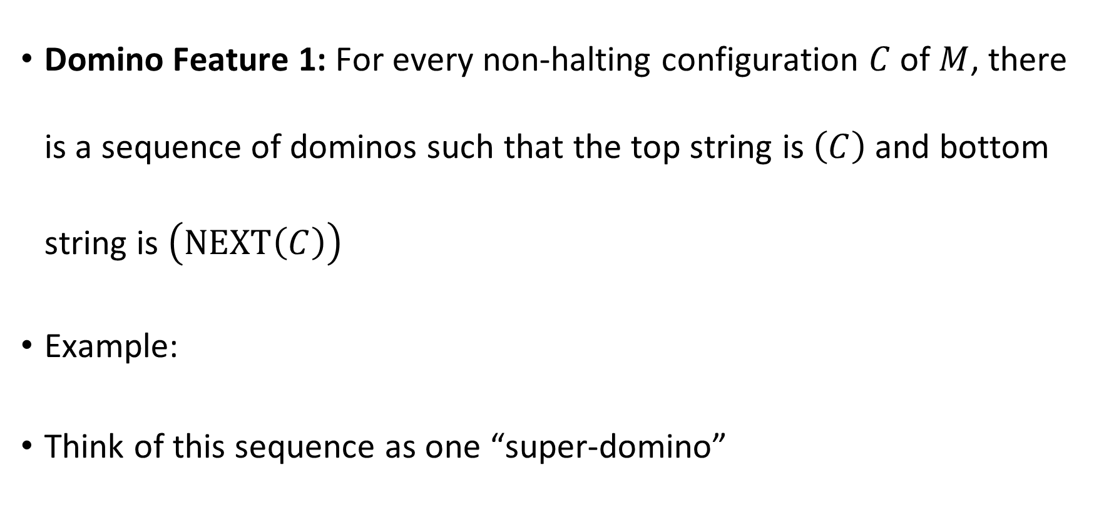






Domino Feature 1
Domino Feature 1: For every non-halting configuration $C$ of $M$, there is a sequence of dominos such that the top string is $\left(C\right)$ and bottom string is $\left(\text{NEXT}\left(C\right)\right)$
Example:
Think of this sequence as one “super-domino”
$$\begin{matrix}( \\ (\end{matrix}$$
$$\begin{matrix}0 \\ 0\end{matrix}$$
$$\begin{matrix}1 \\ 1\end{matrix}$$
$$\begin{matrix}\# \\ \#\end{matrix}$$
$$\begin{matrix}0 \\ 0\end{matrix}$$
$$\begin{matrix}0q_{1}0 \\ q_{2}01\end{matrix}$$
$$\begin{matrix}0 \\ 1\end{matrix}$$
$$\begin{matrix}⊔ \\ ⊔\end{matrix}$$
$$\begin{matrix}) \\ )\end{matrix}$$
$$\begin{matrix}\left(C\right) \\ \left(\text{NEXT}\left(C\right)\right)\end{matrix}$$

Slide 20
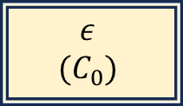






If $M$ rejects $w$, then there is a match
Let $C_{0},…, C_{T}$ be the rejecting computation history of $M$ on $w$
Partial match:
At this point, we have an extra $\left(C_{T}\right)$ on the bottom
$$\begin{matrix}ε \\ (C_{0})\end{matrix}$$
$$\begin{matrix}(C_{0}) \\ \left(C_{1}\right)\end{matrix}$$
$$\begin{matrix}(C_{1}) \\ \left(C_{2}\right)\end{matrix}$$
$$\begin{matrix}(C_{T−1}) \\ \left(C_{T}\right)\end{matrix}$$
$$⋯$$

Slide 21




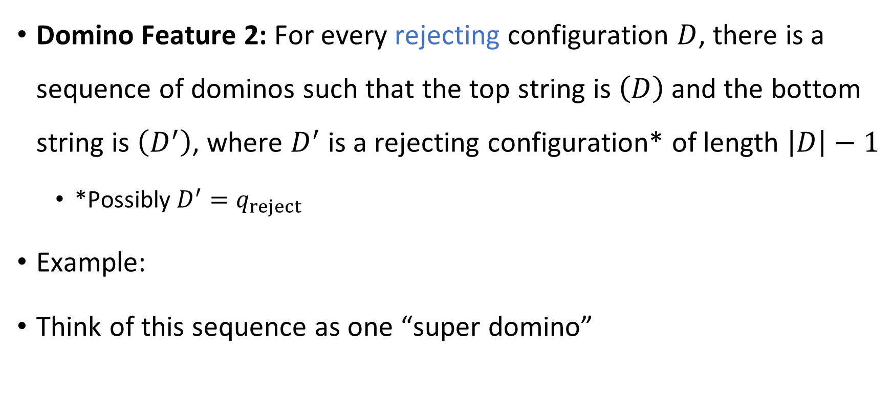






Domino Feature 2
Domino Feature 2: For every rejecting configuration $D$, there is a sequence of dominos such that the top string is $\left(D\right)$ and the bottom string is $\left(D^{′}\right)$, where $D^{′}$ is a rejecting configuration* of length $\left|D\right|−1$
*Possibly $D^{′}=q_{reject}$
Example:
Think of this sequence as one “super domino”
$$\begin{matrix}( \\ (\end{matrix}$$
$$\begin{matrix}0 \\ 0\end{matrix}$$
$$\begin{matrix}1 \\ 1\end{matrix}$$
$$\begin{matrix}\# \\ \#\end{matrix}$$
$$\begin{matrix}0 \\ 0\end{matrix}$$
$$\begin{matrix}0q_{reject} \\ q_{reject}\end{matrix}$$
$$\begin{matrix}0 \\ 1\end{matrix}$$
$$\begin{matrix}⊔ \\ ⊔\end{matrix}$$
$$\begin{matrix}) \\ )\end{matrix}$$
$$\begin{matrix}\left(D\right) \\ \left(D^{′}\right)\end{matrix}$$

Slide 22


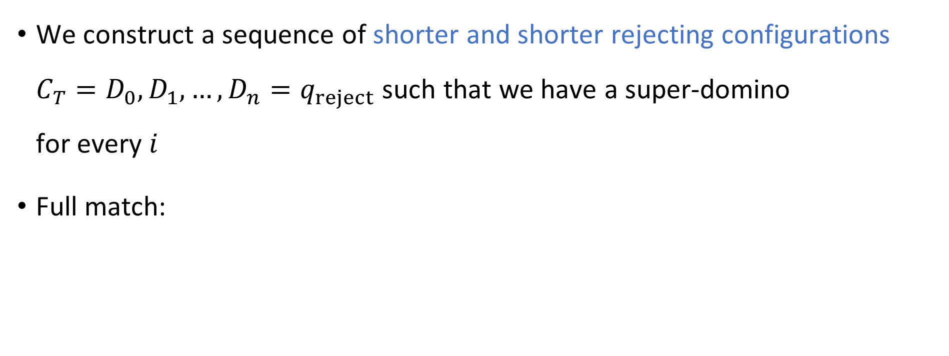











If $M$ rejects $w$, then there is a match
We construct a sequence of shorter and shorter rejecting configurations ${C_{T}=D}_{0},D_{1},…, D_{n}=q_{reject}$ such that we have a super-domino for every $i$
Full match:
$$\begin{matrix}{(D}_{i−1}) \\ \left(D_{i}\right)\end{matrix}$$
$$\begin{matrix}ε \\ (C_{0})\end{matrix}$$
$$\begin{matrix}(C_{0}) \\ \left(C_{1}\right)\end{matrix}$$
$$\begin{matrix}(C_{1}) \\ \left(C_{2}\right)\end{matrix}$$
$$\begin{matrix}(C_{T−1}) \\ \left(C_{T}\right)\end{matrix}$$
$$\begin{matrix}(C_{T}) \\ (D_{1})\end{matrix}$$
$$\begin{matrix}(D_{1}) \\ (D_{2})\end{matrix}$$
$$\begin{matrix}(D_{2}) \\ (D_{3})\end{matrix}$$
$$\begin{matrix}(D_{n−1}) \\ (q_{reject})\end{matrix}$$
$$\begin{matrix}(q_{reject}) \\ ε\end{matrix}$$
$$⋯$$
$$⋯$$

Slide 23

Proof that $\text{MPCP}$ is undecidable
Assume there is a TM $P$ that decides $\text{MPCP}$
Let’s construct a new TM $R$ that decides $\text{REJECT}$
Given $\left\langle M,w\right\rangle$:
Construct dominos $t_{1},…, t_{k},b_{1},…b_{k}$ based on $M$ and $w$ (details on preceding slides)
Simulate $P$ on $\left\langle t_{1},…, t_{k},b_{1},…, b_{k}\right\rangle$
If $P$ accepts, accept. If $P$ rejects, reject.
Need to show:
If $M$ rejects $w$, then there is a match ✔️
If there is a match, then $M$ rejects $w$
$$R$$

Slide 24


Domino Features 3 and 4
Domino Feature 3: If $C$ is a non-halting configuration, then every sequence of dominos in which the top string starts with $\left(C\right)$ must begin with the following super-domino:
Domino Feature 4: If $C$ is an accepting configuration, then there does not exist a sequence of dominos in which the top string begins with $\left(C\right)$
$$\begin{matrix}\left(C\right) \\ \left(\text{NEXT}\left(C\right)\right)\end{matrix}$$

Slide 25








If there is a match, then $M$ rejects $w$
Assume there is a match
By Domino Feature 3, it must have the form
where $C_{T}$ is a halting configuration and $x∈Γ^{∗}$
By Domino Feature 4, $C_{T}$ cannot be accepting, so it must be rejecting
$$\begin{matrix}ε \\ (C_{0})\end{matrix}$$
$$\begin{matrix}(C_{0}) \\ \left(C_{1}\right)\end{matrix}$$
$$\begin{matrix}(C_{1}) \\ \left(C_{2}\right)\end{matrix}$$
$$\begin{matrix}(C_{T−1}) \\ \left(C_{T}\right)\end{matrix}$$
$$\begin{matrix}\left(C_{T}\right)x \\ x\end{matrix}$$
$$⋯$$

Slide 26

Proof that $\text{MPCP}$ is undecidable
Assume there is a TM $P$ that decides $\text{MPCP}$
Let’s construct a new TM $R$ that decides $\text{REJECT}$
Given $\left\langle M,w\right\rangle$:
Construct dominos $t_{1},…, t_{k},b_{1},…b_{k}$ based on $M$ and $w$ (details on preceding slides)
Simulate $P$ on $\left\langle t_{1},…, t_{k},b_{1},…, b_{k}\right\rangle$
If $P$ accepts, accept. If $P$ rejects, reject.
Need to show:
If $M$ rejects $w$, then there is a match ✔️
If there is a match, then $M$ rejects $w$ ✔️
$$R$$

Slide 27


Post’s Correspondence Problem is undecidable
Post’s correspondence problem, formulated as a language:
$$\text{PCP}=\{\left\langle t_{1},…, t_{k}, b_{1},…, b_{k}\right\rangle :∃i_{1},…, i_{n} \text{such} \text{that} t_{i_{1}}⋯t_{i_{n}}=b_{i_{1}}⋯b_{i_{n}}\}$$
Proof outline:
Step 1: Reduce $\text{REJECT}$ to a modified version (“$\text{M}\text{PCP}$”) ✔️
Step 2: Reduce $\text{MPCP}$ to $\text{PCP}$
Theorem: $\text{PCP}$ is undecidable

