Slide 1
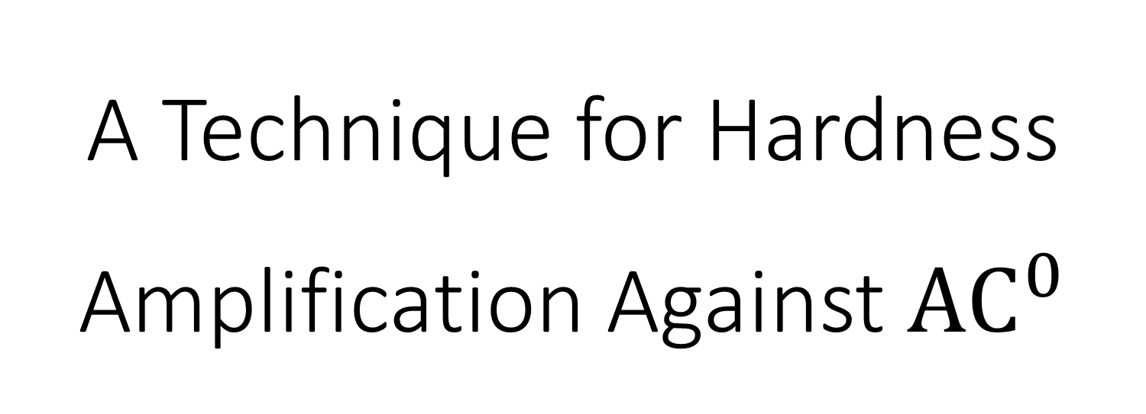
A Technique for Hardness Amplification Against ${\text{AC}}^{0}$
@UChicago CS Theory Lunch
January 31, 2024
William M. Hoza¹
¹Part of this work was done while the author was visiting the Simons Institute for the Theory of Computing.

Slide 2
The art of converting hard functions into harder functions
Hardness amplification:

Slide 3

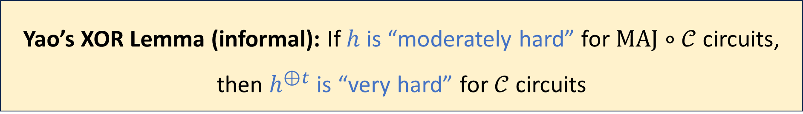
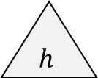





Example: Yao’s XOR Lemma
$$⨁$$
$$h$$
$$h$$
$$h$$
$$⋯$$
$$h$$
Let $h:\{0, 1\}^{n}→\{0, 1\}$ be a function
Define $h^{⊕t}:\{0, 1\}^{nt}→\{0, 1\}$ by $h^{⊕t}\left(x^{\left(1\right)},…, x^{\left(t\right)}\right)=⨁_{i=1}^{t}{h\left(x^{\left(i\right)}\right)}$
Let $𝒞$ be any circuit class
Yao’s XOR Lemma (informal): If $h$ is “moderately hard” for $\text{MAJ}∘𝒞$ circuits, then $h^{⊕t}$ is “very hard” for $𝒞$ circuits

Slide 4
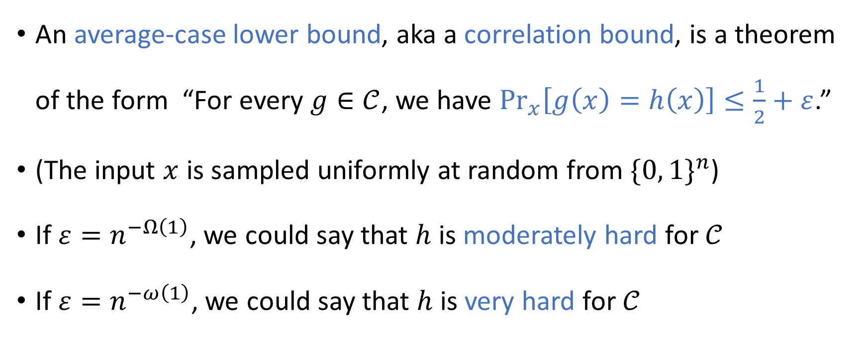
How we are quantifying hardness
An average-case lower bound, aka a correlation bound, is a theorem of the form “For every $g∈𝒞$, we have $\underset{x}{Pr}\left[g\left(x\right)=h\left(x\right)\right]≤\frac{1}{2}+ε$.”
(The input $x$ is sampled uniformly at random from $\{0, 1\}^{n}$)
If $ε=n^{−Ω\left(1\right)}$, we could say that $h$ is moderately hard for $𝒞$
If $ε=n^{−ω\left(1\right)}$, we could say that $h$ is very hard for $𝒞$

Slide 5
Why amplify hardness?
Maybe you think of a hardness result as “bad news”
If a problem is “very hard,” maybe you think of this as “very bad news”
Why would we try to manufacture such a situation?
One possible answer: Sometimes, we wish to exploit hardness!
Pseudorandom generators
Cryptography
Reductions

Slide 6


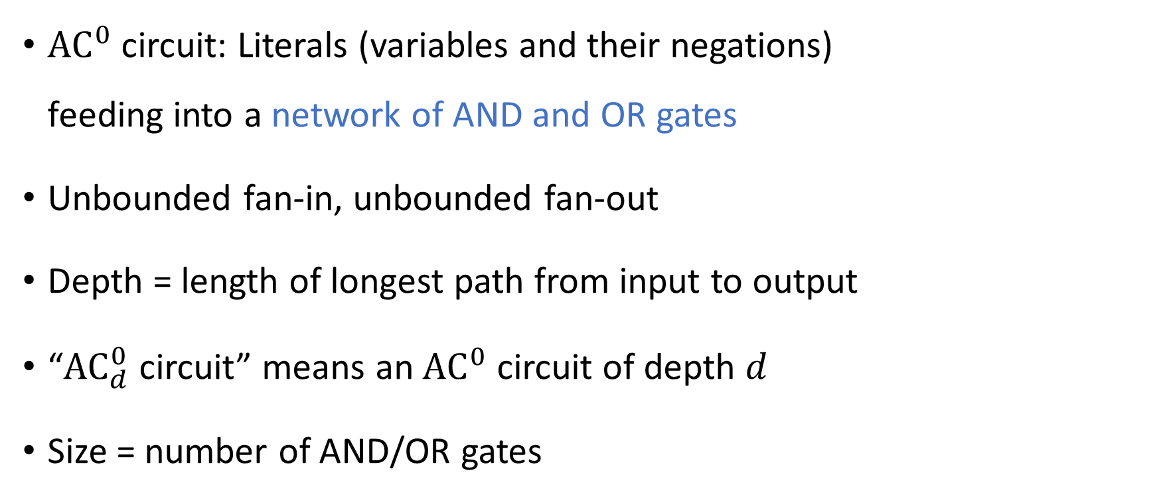


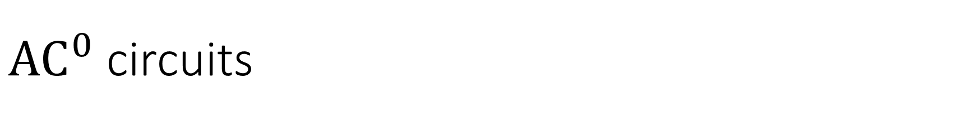









${\text{AC}}^{0}$ circuits
$$∧$$
$$∨$$
$$∨$$
$$∨$$
$$∨$$
${\text{AC}}^{0}$ circuit: Literals (variables and their negations) feeding into a network of AND and OR gates
Unbounded fan-in, unbounded fan-out
Depth = length of longest path from input to output
“${\text{AC}}_{d}^{0}$ circuit” means an ${\text{AC}}^{0}$ circuit of depth $d$
Size = number of AND/OR gates
$$∧$$
$$∧$$
$$∧$$
$$x_{1}$$
$$x_{4}$$
$$x_{2}$$
$$¬x_{1}$$
$$x_{3}$$

Slide 7
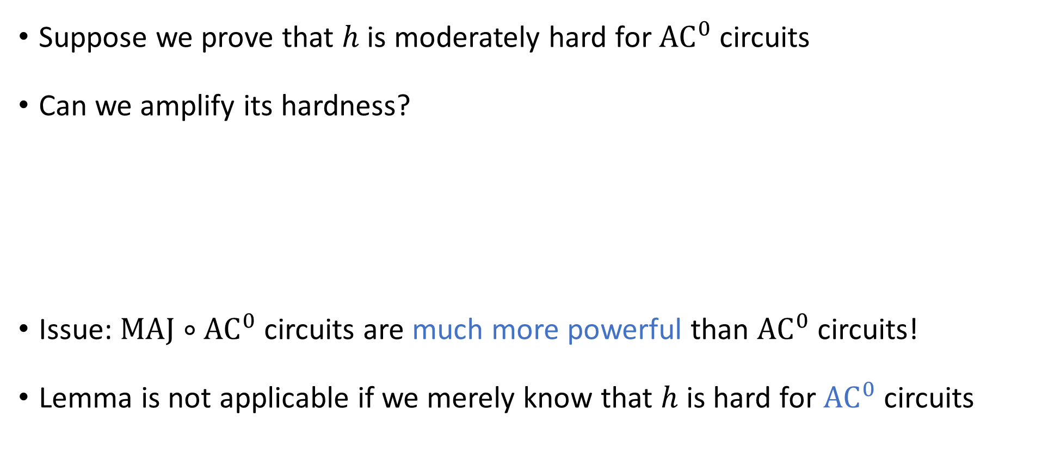
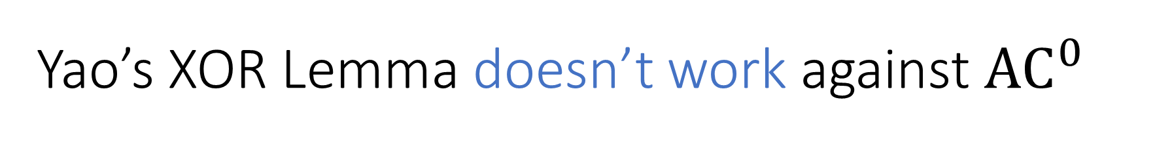
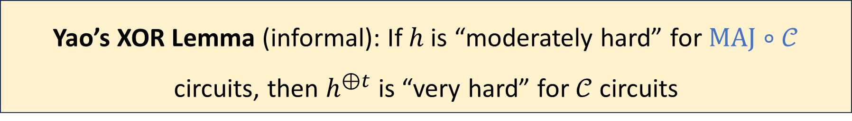
Yao’s XOR Lemma doesn’t work against ${\text{AC}}^{0}$
Suppose we prove that $h$ is moderately hard for ${\text{AC}}^{0}$ circuits
Can we amplify its hardness?
Issue: $\text{MAJ}∘{\text{AC}}^{0}$ circuits are much more powerful than ${\text{AC}}^{0}$ circuits!
Lemma is not applicable if we merely know that $h$ is hard for ${\text{AC}}^{0}$ circuits
Yao’s XOR Lemma (informal): If $h$ is “moderately hard” for $\text{MAJ}∘𝒞$ circuits, then $h^{⊕t}$ is “very hard” for $𝒞$ circuits

Slide 8
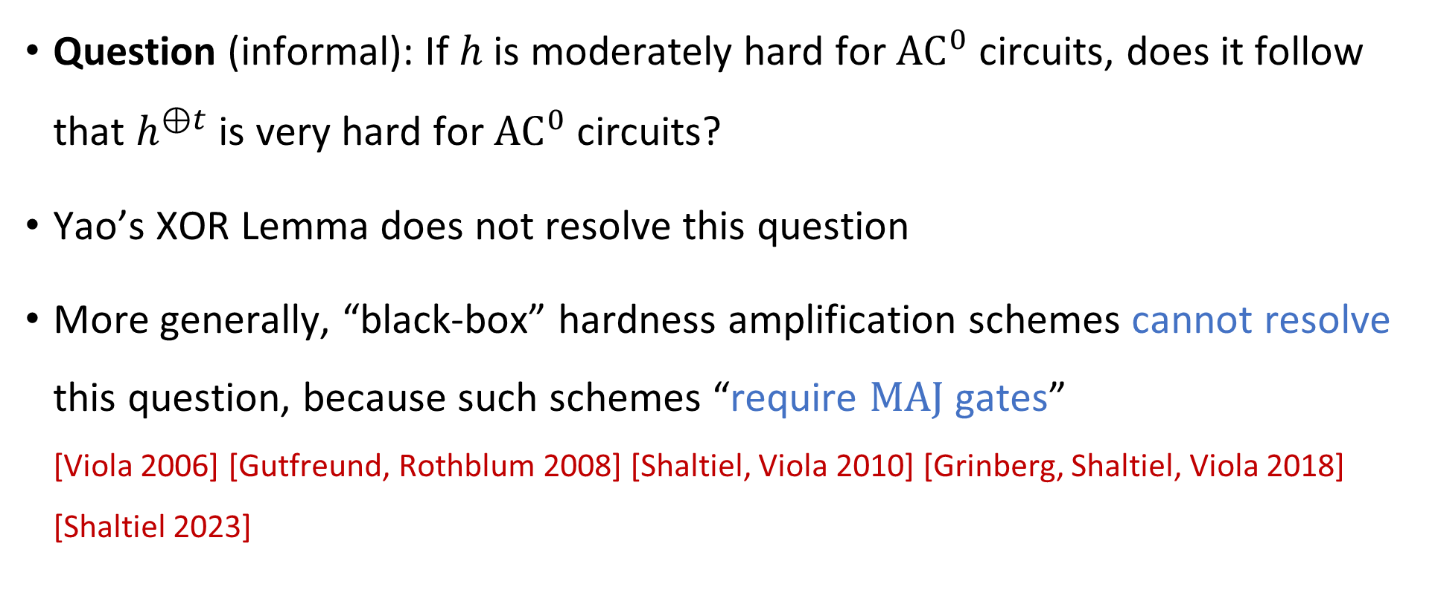

Does XORing amplify hardness against ${\text{AC}}^{0}$?
Question (informal): If $h$ is moderately hard for ${\text{AC}}^{0}$ circuits, does it follow that $h^{⊕t}$ is very hard for ${\text{AC}}^{0}$ circuits?
Yao’s XOR Lemma does not resolve this question
More generally, “black-box” hardness amplification schemes cannot resolve this question, because such schemes “require $\text{MAJ}$ gates” [Viola 2006] [Gutfreund, Rothblum 2008] [Shaltiel, Viola 2010] [Grinberg, Shaltiel, Viola 2018] [Shaltiel 2023]

Slide 9
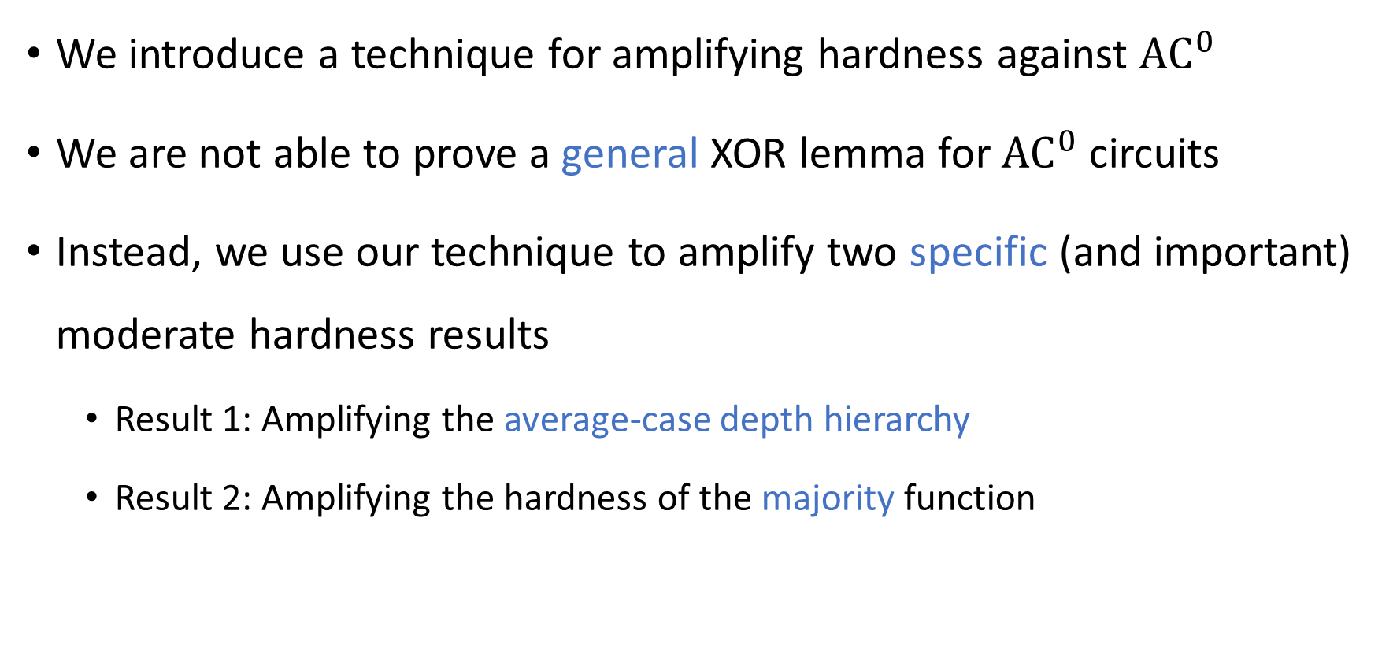
Our contributions
We introduce a technique for amplifying hardness against ${\text{AC}}^{0}$
We are not able to prove a general XOR lemma for ${\text{AC}}^{0}$ circuits
Instead, we use our technique to amplify two specific (and important) moderate hardness results
Result 1: Amplifying the average-case depth hierarchy
Result 2: Amplifying the hardness of the majority function

Slide 10
The average-case depth hierarchy theorem
To what extent are deeper circuits more powerful than shallower circuits?
What is the marginal utility of time for parallel computation?

Slide 11
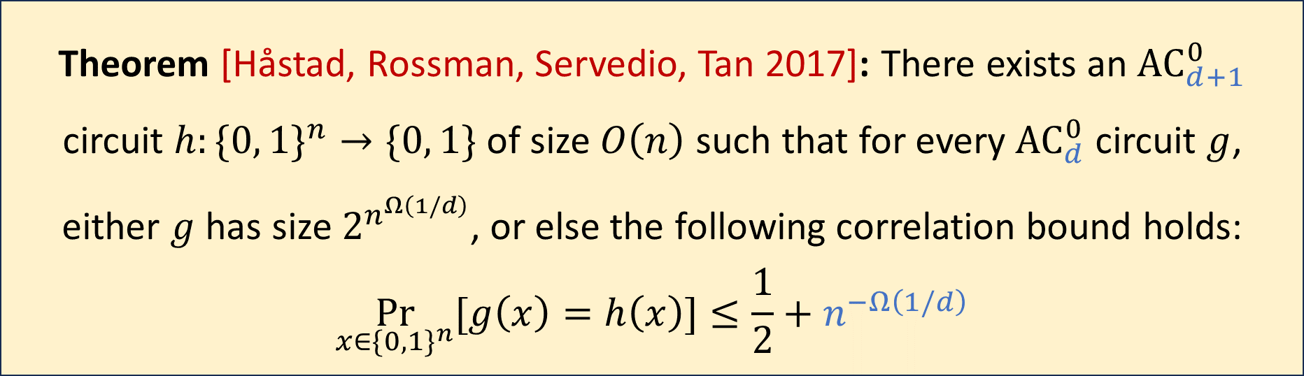

The average-case depth hierarchy theorem
Let $n, d∈ℕ$ with $d=o\left(\frac{\log{n}}{\log{\log{n}}}\right)$
$h$ is moderately hard for ${\text{AC}}_{d}^{0}$ circuits
Theorem [Håstad, Rossman, Servedio, Tan 2017]: There exists an ${\text{AC}}_{d+1}^{0}$ circuit $h:\{0, 1\}^{n}→\{0, 1\}$ of size $O\left(n\right)$ such that for every ${\text{AC}}_{d}^{0}$ circuit $g$, either $g$ has size $2^{n^{Ω\left(1/d\right)}}$, or else the following correlation bound holds:
$$\underset{x∈\{0, 1\}^{n}}{Pr}{[g\left(x\right)=h\left(x\right)]}≤\frac{1}{2}+n^{−Ω\left(1/d\right)}$$

Slide 12
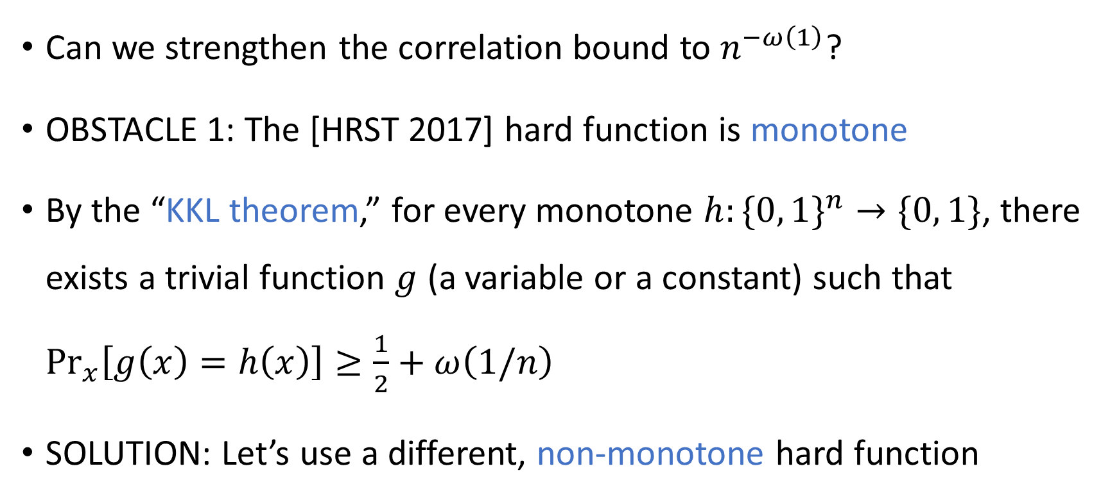
Stronger correlation bounds: Obstacles
Can we strengthen the correlation bound to $n^{−ω\left(1\right)}$?
OBSTACLE 1: The [HRST 2017] hard function is monotone
By the “KKL theorem,” for every monotone $h:\{0, 1\}^{n}→\{0, 1\}$, there exists a trivial function $g$ (a variable or a constant) such that $\underset{x}{Pr}\left[g\left(x\right)=h\left(x\right)\right]≥\frac{1}{2}+ω\left(1/n\right)$
SOLUTION: Let’s use a different, non-monotone hard function

Slide 13
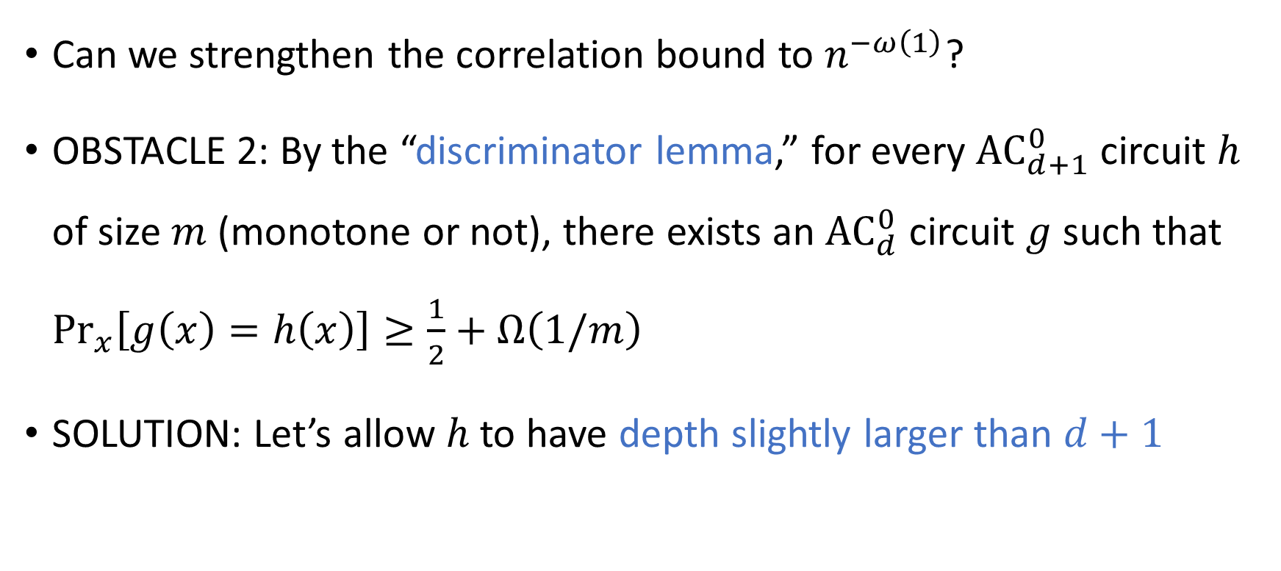
Stronger correlation bounds: Obstacles
Can we strengthen the correlation bound to $n^{−ω\left(1\right)}$?
OBSTACLE 2: By the “discriminator lemma,” for every ${\text{AC}}_{d+1}^{0}$ circuit $h$ of size $m$ (monotone or not), there exists an ${\text{AC}}_{d}^{0}$ circuit $g$ such that $\underset{x}{Pr}\left[g\left(x\right)=h\left(x\right)\right]≥\frac{1}{2}+Ω\left(1/m\right)$
SOLUTION: Let’s allow $h$ to have depth slightly larger than $d+1$

Slide 14
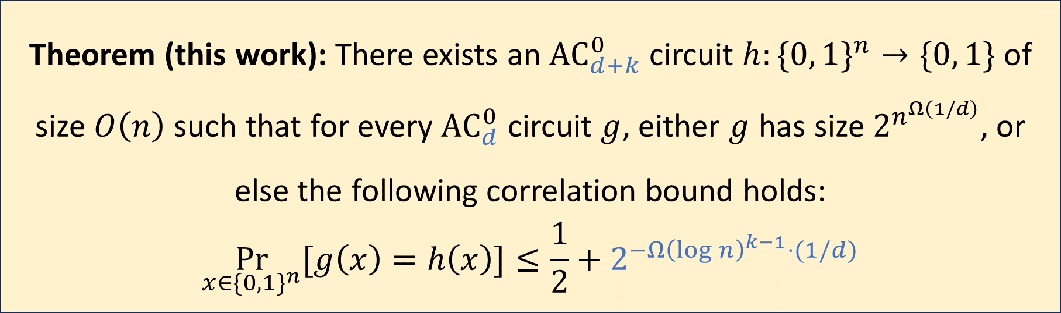

Our correlation bound for depth reduction
Let $n,d,k∈ℕ$ with $k≥3$ and $dk=o\left(\frac{\log{n}}{\log{\log{n}}}\right)$
Our hard function: $h=h_{HRST}^{⊕t}$ where $t≈\log^{k−2}{n}$
Theorem (this work): There exists an ${\text{AC}}_{d+k}^{0}$ circuit $h:\{0, 1\}^{n}→\{0, 1\}$ of size $O\left(n\right)$ such that for every ${\text{AC}}_{d}^{0}$ circuit $g$, either $g$ has size $2^{n^{Ω\left(1/d\right)}}$, or else the following correlation bound holds:
$$\underset{x∈\{0, 1\}^{n}}{Pr}{[g\left(x\right)=h\left(x\right)]}≤\frac{1}{2}+2^{−Ω{\left(\log{n}\right)}^{k−1}⋅(1/d)}$$

Slide 15


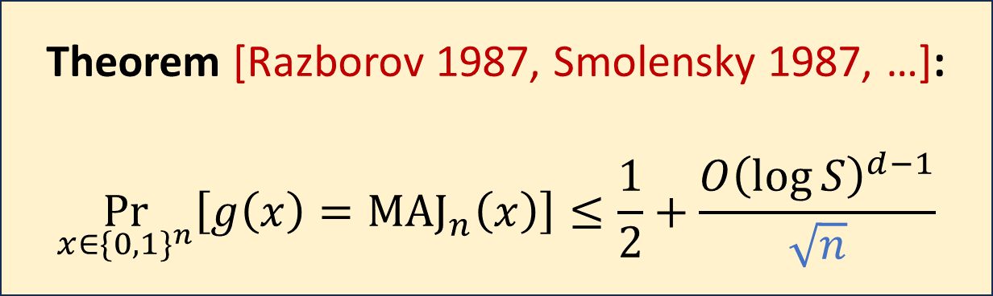
Majority is moderately hard for ${\text{AC}}^{0}$ circuits
Let $g:\{0, 1\}^{n}→\{0, 1\}$ be any ${\text{AC}}_{d}^{0}$ circuit of size $S≥n$
The majority function is moderately hard for ${\text{AC}}^{0}$ circuits
Theorem [Razborov 1987, Smolensky 1987, …]:
$$\underset{x∈\{0, 1\}^{n}}{Pr}\left[g\left(x\right)={\text{MAJ}}_{n}\left(x\right)\right]≤\frac{1}{2}+\frac{O{\left(\log{S}\right)}^{d−1}}{\sqrt{n}}$$

Slide 16


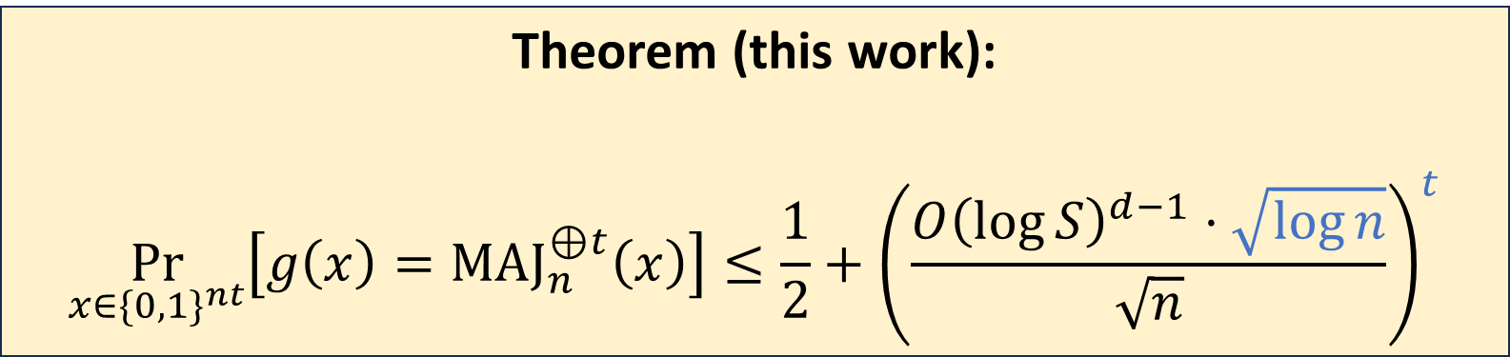
Our correlation bound for ${\text{MAJ}}_{n}^{⊕t}$
Let $g:\{0, 1\}^{nt}→\{0, 1\}$ be any ${\text{AC}}_{d}^{0}$ circuit of size $S$
The XOR-of-majority function is very hard for ${\text{AC}}^{0}$ circuits
Theorem (this work):
$$\underset{x∈\{0, 1\}^{nt}}{Pr}\left[g\left(x\right)={\text{MAJ}}_{n}^{⊕t}\left(x\right)\right]≤\frac{1}{2}+{\left(\frac{O{\left(\log{S}\right)}^{d−1}⋅\sqrt{\log{n}}}{\sqrt{n}}\right)}^{t}$$

Slide 17
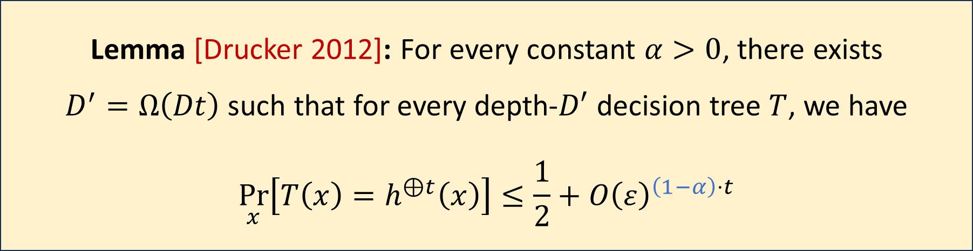

XOR lemmas for decision trees
Our technique is based on XOR lemmas for decision trees
Let $h:\{0, 1\}^{n}→\{0, 1\}$, and assume that for every depth-$D$ decision tree $T$, we have $\underset{x}{Pr}\left[T\left(x\right)=h\left(x\right)\right]≤\frac{1}{2}+ε$
Lemma [Drucker 2012]: For every constant $α>0$, there exists $D^{′}=Ω\left(Dt\right)$ such that for every depth-$D′$ decision tree $T$, we have
$$\underset{x}{Pr}\left[T\left(x\right)=h^{⊕t}\left(x\right)\right]≤\frac{1}{2}+O{\left(ε\right)}^{\left(1−α\right)⋅t}$$

Slide 18
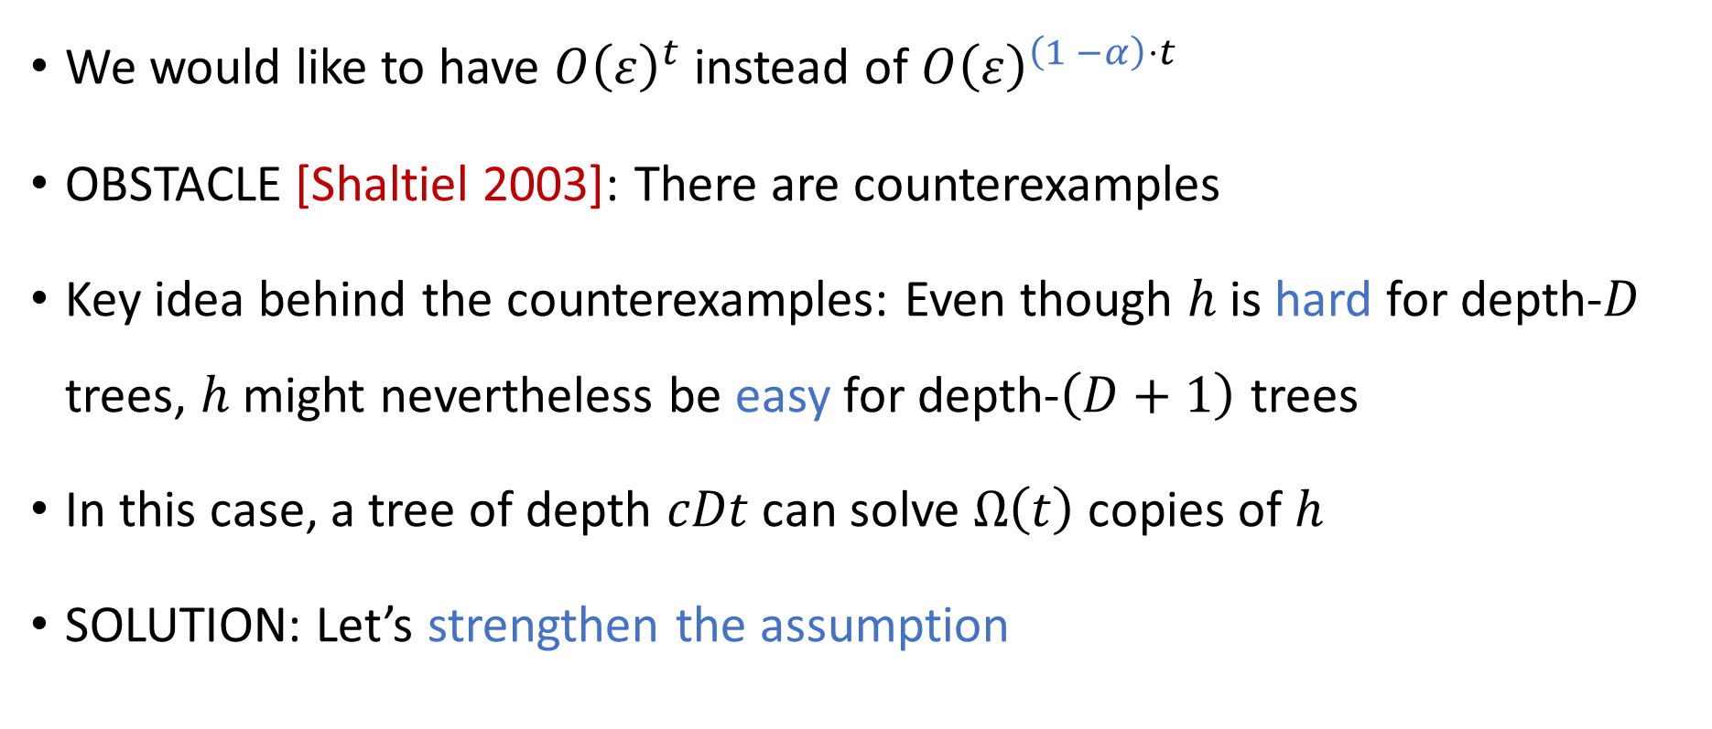
XOR lemmas for decision trees
We would like to have $O{\left(ε\right)}^{t}$ instead of $O{\left(ε\right)}^{\left(1 −α\right)⋅t}$
OBSTACLE [Shaltiel 2003]: There are counterexamples
Key idea behind the counterexamples: Even though $h$ is hard for depth-$D$ trees, $h$ might nevertheless be easy for depth-$\left(D+1\right)$ trees
In this case, a tree of depth $cDt$can solve $Ω\left(t\right)$ copies of $h$
SOLUTION: Let’s strengthen the assumption

Slide 19
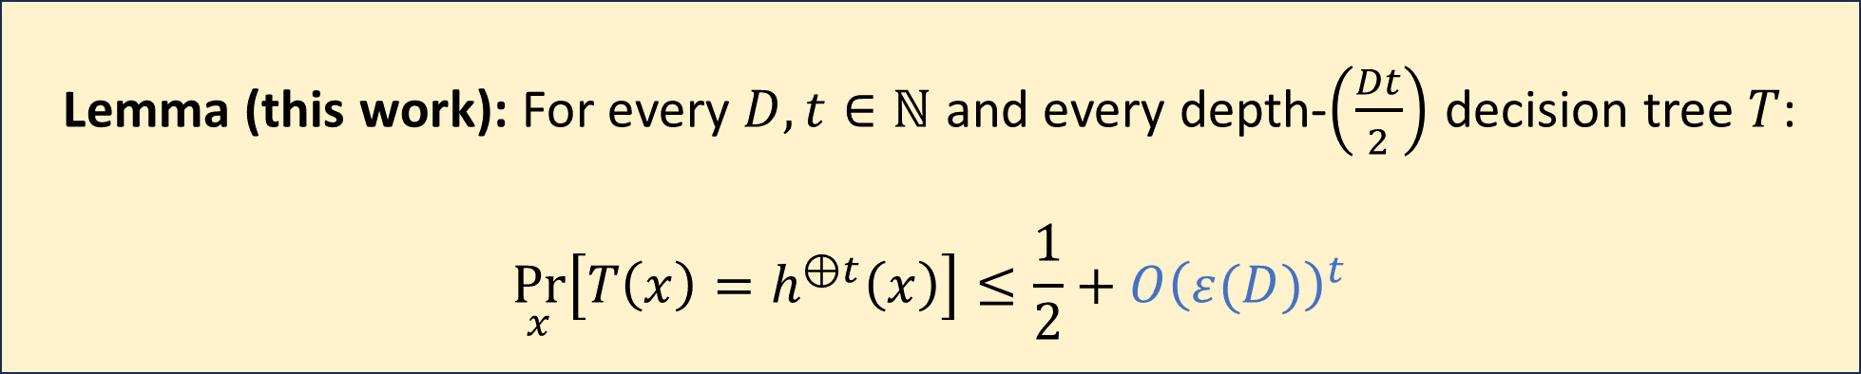

Our new XOR lemma for decision trees
Let $h:\{0, 1\}^{n}→\{0, 1\}$
Assume that for every $D∈ℕ$ and every depth-$D$ decision tree $T$, we have $\underset{x}{Pr}{[T\left(x\right)=h\left(x\right)}]≤\frac{1}{2}+ε\left(D\right)$, where $ε:\left[0, ∞\right)→\left(0, ∞\right)$ is log-concave
Lemma (this work): For every $D, t∈ℕ$ and every depth-$\left(\frac{Dt}{2}\right)$ decision tree $T$:
$$\underset{x}{Pr}\left[T\left(x\right)=h^{⊕t}\left(x\right)\right]≤\frac{1}{2}+O{\left(ε(D)\right)}^{t}$$

Slide 20
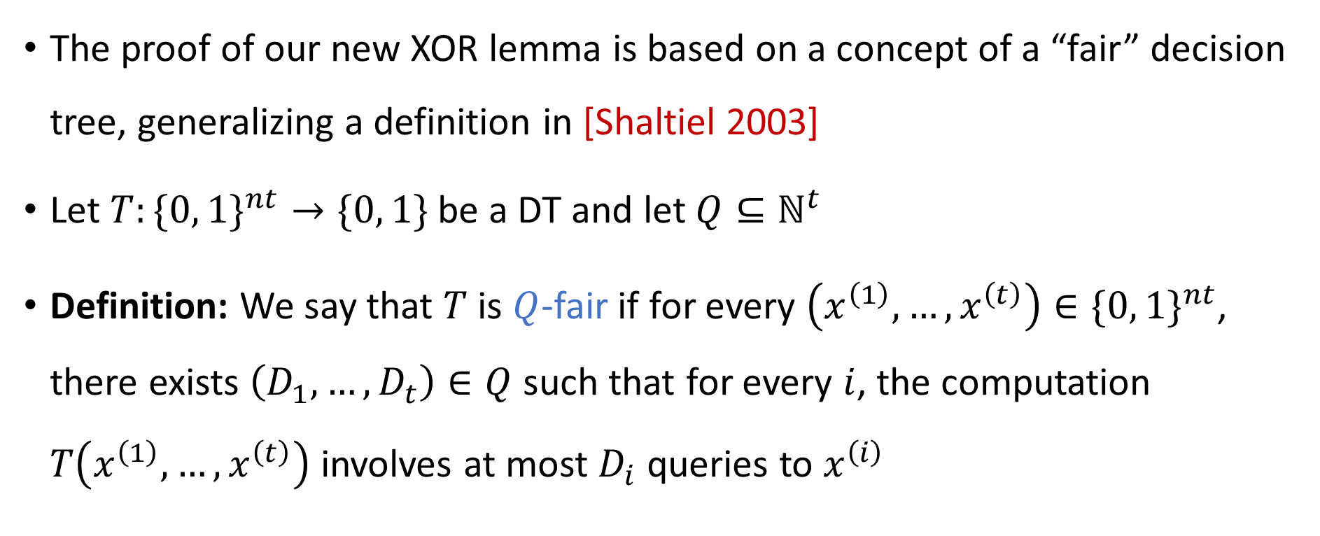
“Fair” decision trees
The proof of our new XOR lemma is based on a concept of a “fair” decision tree, generalizing a definition in [Shaltiel 2003]
Let $T:\{0, 1\}^{nt}→\{0, 1\}$ be a DT and let $Q⊆ℕ^{t}$
Definition: We say that $T$ is $Q$-fair if for every $\left(x^{\left(1\right)}, …, x^{\left(t\right)}\right)∈\{0, 1\}^{nt}$, there exists $\left(D_{1},…, D_{t}\right)∈Q$ such that for every $i$, the computation $T\left(x^{\left(1\right)},…, x^{\left(t\right)}\right)$ involves at most $D_{i}$ queries to $x^{\left(i\right)}$

Slide 21
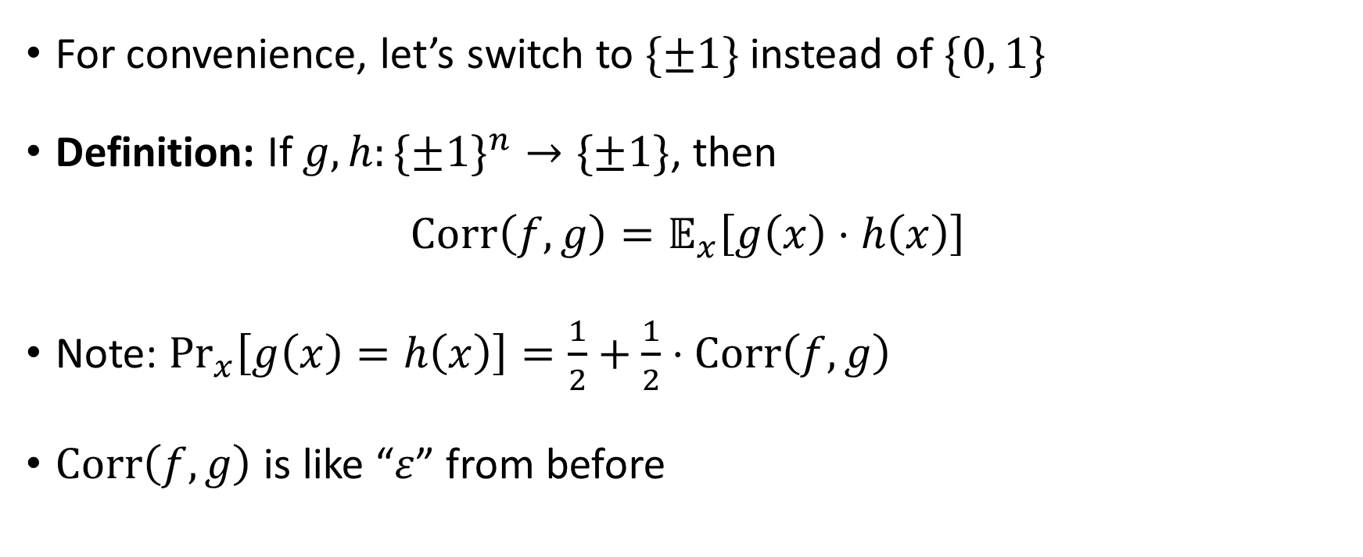
Correlation
For convenience, let’s switch to $\{±1\}$ instead of $\{0, 1\}$
Definition: If $g, h:\{±1\}^{n}→\{±1\}$, then
$$\text{Corr}\left(f, g\right)=𝔼_{x}\left[g\left(x\right)⋅h\left(x\right)\right]$$
Note: $\underset{x}{Pr}\left[g\left(x\right)=h\left(x\right)\right]=\frac{1}{2}+\frac{1}{2}⋅\text{Corr}\left(f, g\right)$
$\text{Corr}\left(f, g\right)$ is like “$ε$” from before

Slide 22


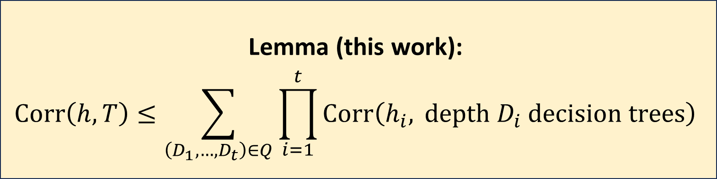
XOR lemma for $Q$-fair decision trees
Let $h_{1},…, h_{t}:\{±1\}^{n}→\{±1\}$ and let $h\left(x^{\left(1\right)},…, x^{\left(t\right)}\right)=\prod_{i=1}^{t}{h_{i}\left(x^{\left(i\right)}\right)}$
Let $T:\{±1\}^{nt}→\{±1\}$ be a $Q$-fair decision tree
Proof is a straightforward induction on depth
Lemma (this work):
$$\text{Corr}\left(h, T\right)≤\sum_{\left(D_{1},…, D_{t}\right)∈Q}{\prod_{i=1}^{t}{\text{Corr}\left(h_{i}, \text{depth} D_{i} \text{decision} \text{trees}\right)}}$$

Slide 23
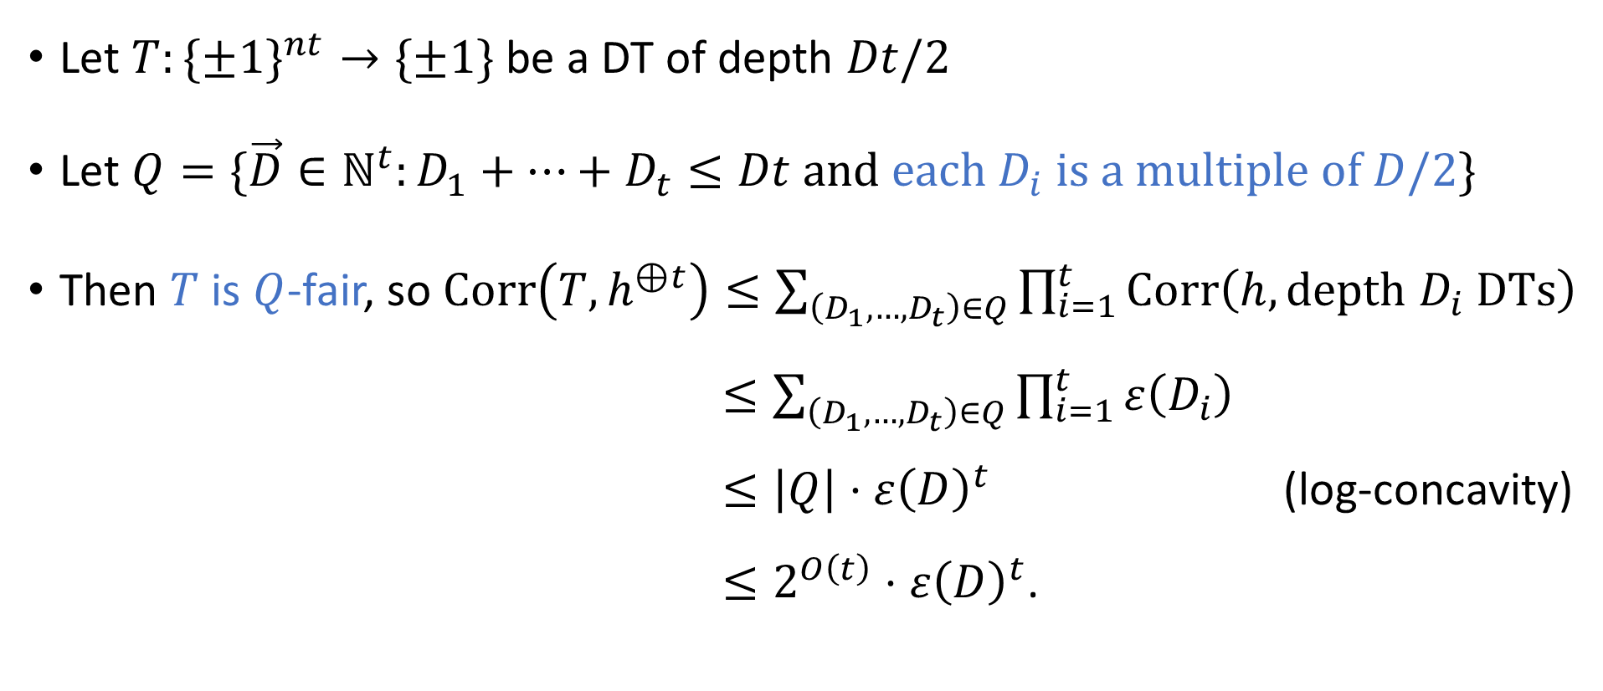
Proof of our main XOR lemma for DTs
Let $T:\{±1\}^{nt}→\{±1\}$ be a DT of depth $Dt/2$
Let $Q=\{\vec{D}∈ℕ^{t}:D_{1}+…+D_{t}≤Dt \text{and} \text{each} D_{i} \text{is} \text{a} \text{multiple} \text{of} D/2\}$
Then $T$ is $Q$-fair, so $\text{Corr}\left(T,h^{⊕t}\right)≤\sum_{\left(D_{1},…, D_{t}\right)∈Q}{\prod_{i=1}^{t}{\text{Corr}\left(h, \text{depth} D_{i} \text{DTs}\right)}}$ $≤\sum_{\left(D_{1},…, D_{t}\right)∈Q}{\prod_{i=1}^{t}{ε\left(D_{i}\right)}}$ $≤\left|Q\right|⋅ε{\left(D\right)}^{t}$ (log-concavity) $≤2^{O\left(t\right)}⋅ε{\left(D\right)}^{t}$.

Slide 24
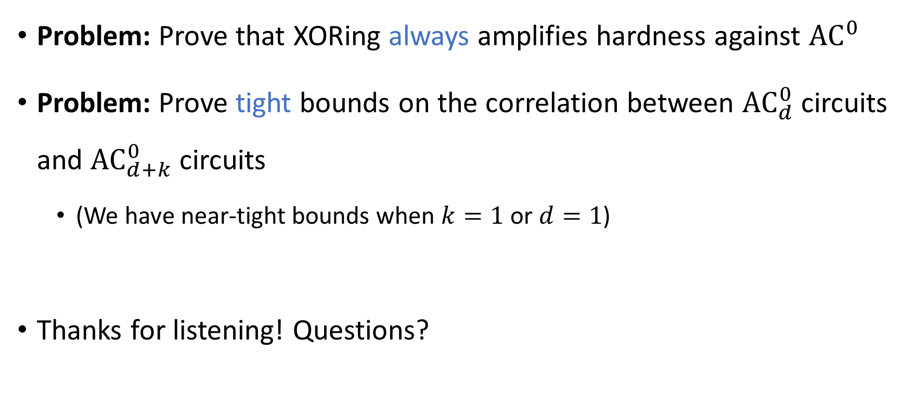
Open problems
Problem: Prove that XORing always amplifies hardness against ${\text{AC}}^{0}$
Problem: Prove tight bounds on the correlation between ${\text{AC}}_{d}^{0}$ circuits and ${\text{AC}}_{d+k}^{0}$ circuits
(We have near-tight bounds when $k=1$ or $d=1$)
Thanks for listening! Questions?

