Slide 1

CMSC 28100 Introduction to Complexity Theory Spring 2025 Instructor: William Hoza

Slide 2
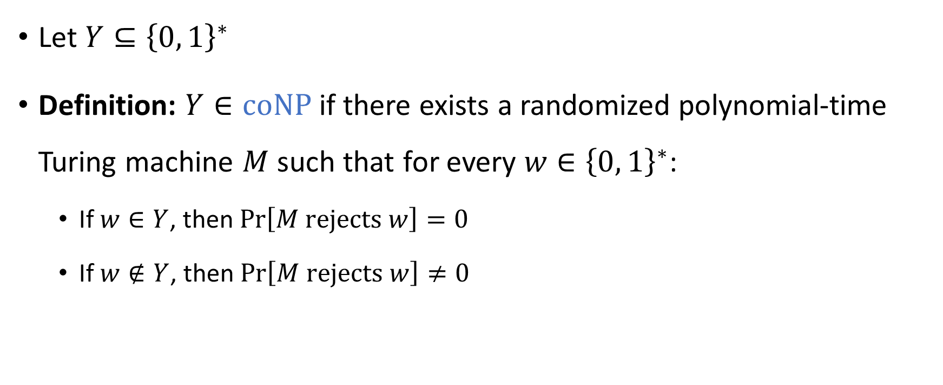

The complexity class $co\text{NP}$
Let $Y⊆{\left\{0, 1\right\}}^{∗}$
Definition: $Y∈\text{coNP}$ if there exists a randomized polynomial-time Turing machine $M$ such that for every $w∈{\left\{0, 1\right\}}^{∗}$:
If $w∈Y$, then $\operatorname{Pr}\left[M \text{rejects} w\right]=0$
If $w∉Y$, then $\operatorname{Pr}\left[M \text{rejects} w\right]≠0$

Slide 3
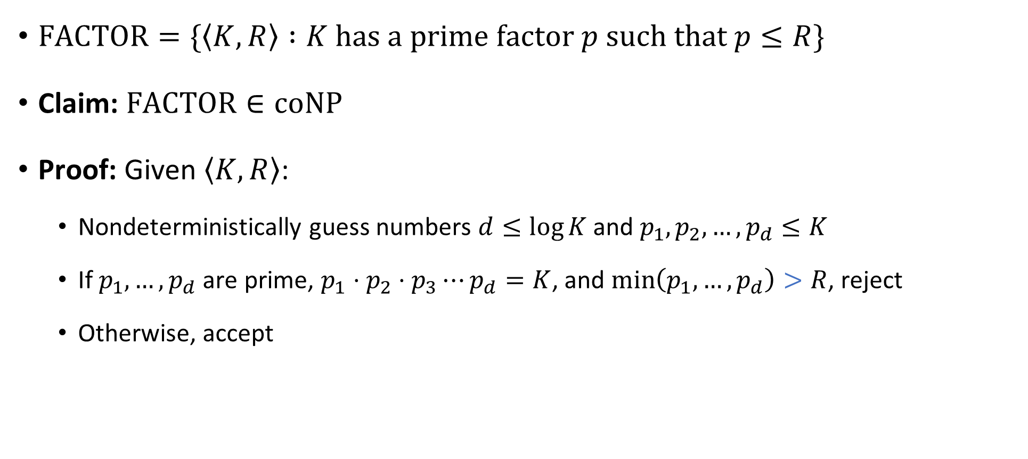


$\text{FACTOR}∈\text{coNP}$
$\text{FACTOR}=\{\left\langle K,R\right\rangle :K \text{has} \text{a} \text{prime} \text{factor} p \text{such} \text{that} p≤R\}$
Claim: $\text{FACTOR}∈\text{coNP}$
Proof: Given $\left\langle K,R\right\rangle$:
Nondeterministically guess numbers $d≤\log{K}$ and $p_{1},p_{2},…, p_{d}≤K$
If $p_{1},…, p_{d}$ are prime, $p_{1}⋅p_{2}⋅p_{3}⋯p_{d}=K$, and $\min\left(p_{1},…, p_{d}\right)>R$, reject
Otherwise, accept
$$\text{PRIMES}∈\text{P}$$

Slide 4
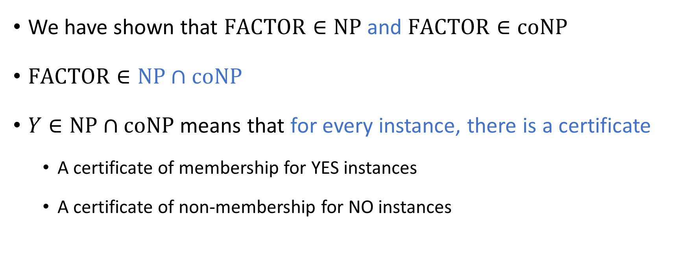

The complexity class $\text{NP}∩\text{coNP}$
We have shown that $\text{FACTOR}∈\text{NP}$ and $\text{FACTOR}∈\text{coNP}$
$\text{FACTOR}∈\text{NP}∩\text{coNP}$
$Y∈\text{NP}∩\text{coNP}$ means that for every instance, there is a certificate
A certificate of membership for YES instances
A certificate of non-membership for NO instances

Slide 5
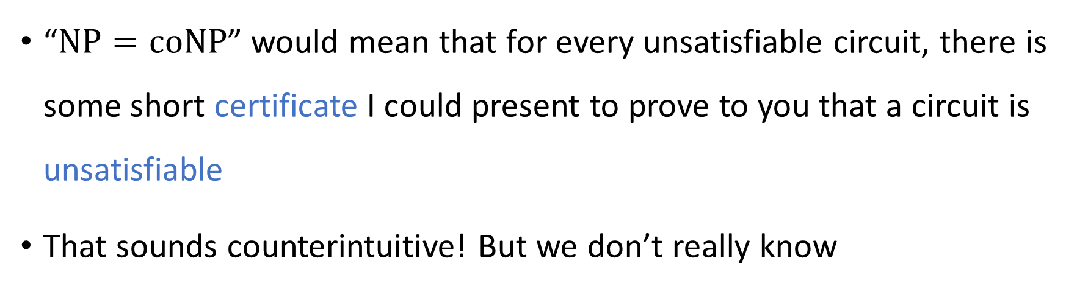


The $\text{NP}$ vs. $\text{coNP}$ problem
Conjecture: $\text{NP}≠\text{coNP}$
“$\text{NP}=\text{coNP}$” would mean that for every unsatisfiable circuit, there is some short certificate I could present to prove to you that a circuit is unsatisfiable
That sounds counterintuitive! But we don’t really know

Slide 6






$$\text{PSPACE}$$
$$\text{coNP}$$
$$\text{NP}$$
$$\text{FACTOR}$$
$$\text{NP}∩\text{coNP}$$
$$\text{P}$$

Slide 7
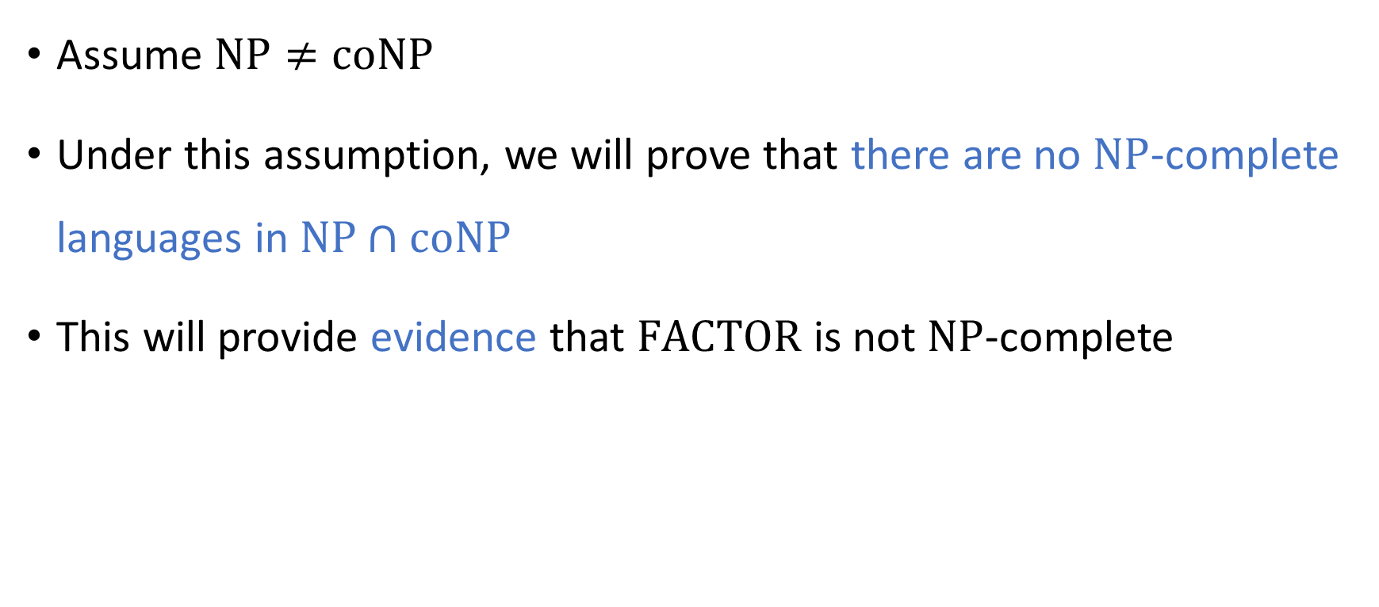
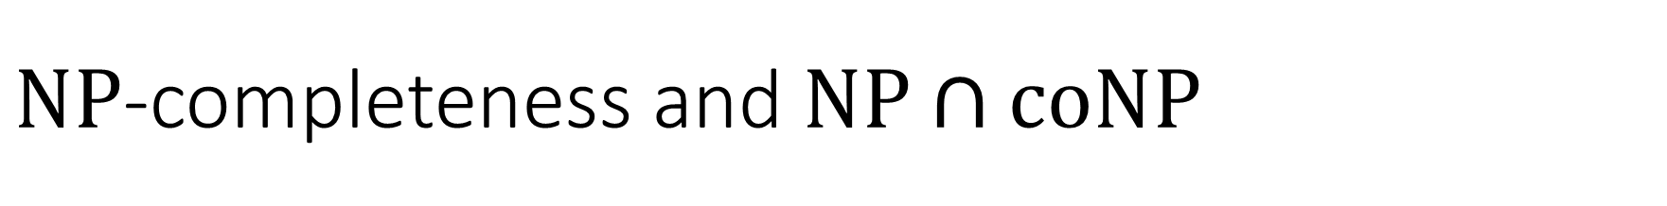
$\text{NP}$-completeness and $\text{NP}∩\text{coNP}$
Assume $\text{NP}≠\text{coNP}$
Under this assumption, we will prove that there are no $\text{NP}$-complete languages in $\text{NP}∩\text{coNP}$
This will provide evidence that $\text{FACTOR}$ is not $\text{NP}$-complete

Slide 8







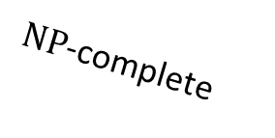

$\text{coNP}$-hard
$\text{NP}$-hard
$\text{coNP}$-complete
$\text{NP}$-complete
$$\text{coNP}$$
$$\text{NP}$$
$$\text{FACTOR}$$
$$\text{NP}∩\text{coNP}$$
$$\text{P}$$

Slide 9
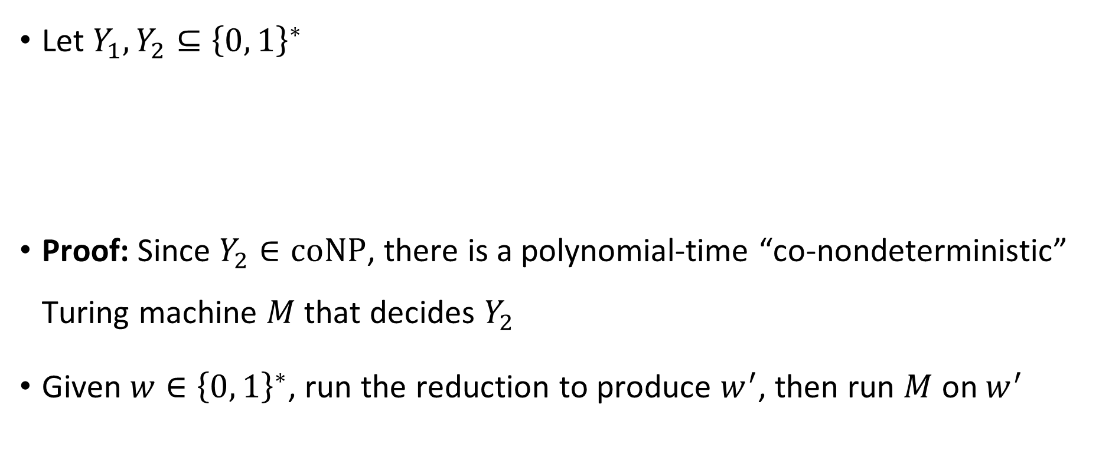

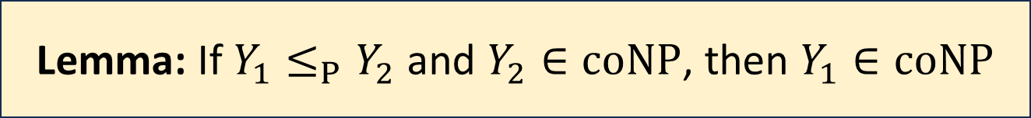
$\text{coNP}$ is closed under reductions
Let $Y_{1},Y_{2}⊆{\left\{0, 1\right\}}^{∗}$
Proof: Since $Y_{2}∈\text{coNP}$, there is a polynomial-time “co-nondeterministic” Turing machine $M$ that decides $Y_{2}$
Given $w∈{\left\{0, 1\right\}}^{∗}$, run the reduction to produce $w^{′}$, then run $M$ on $w^{′}$
Lemma: If $Y_{1}≤_{P}Y_{2}$ and $Y_{2}∈\text{coNP}$, then $Y_{1}∈\text{coNP}$

Slide 10

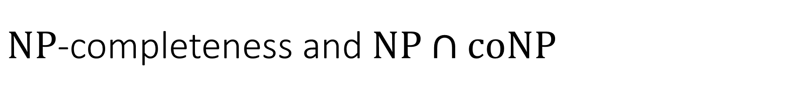

$\text{NP}$-completeness and $\text{NP}∩\text{coNP}$
Let $Y∈\text{NP}∩\text{coNP}$
Proof: For any $Z∈\text{NP}$, we have $Z≤_{P}Y$ and $Y∈\text{coNP}$
By the lemma, $Z∈\text{coNP}$, so $\text{NP}⊆\text{coNP}$
By symmetry, we also have $\text{coNP}⊆\text{NP}$
Claim: If $Y$ is $\text{NP}$-complete, then $\text{NP}=\text{coNP}$

Slide 11
Intractability
This course so far: How to identify intractability
Up next: How to cope with intractability

Slide 12
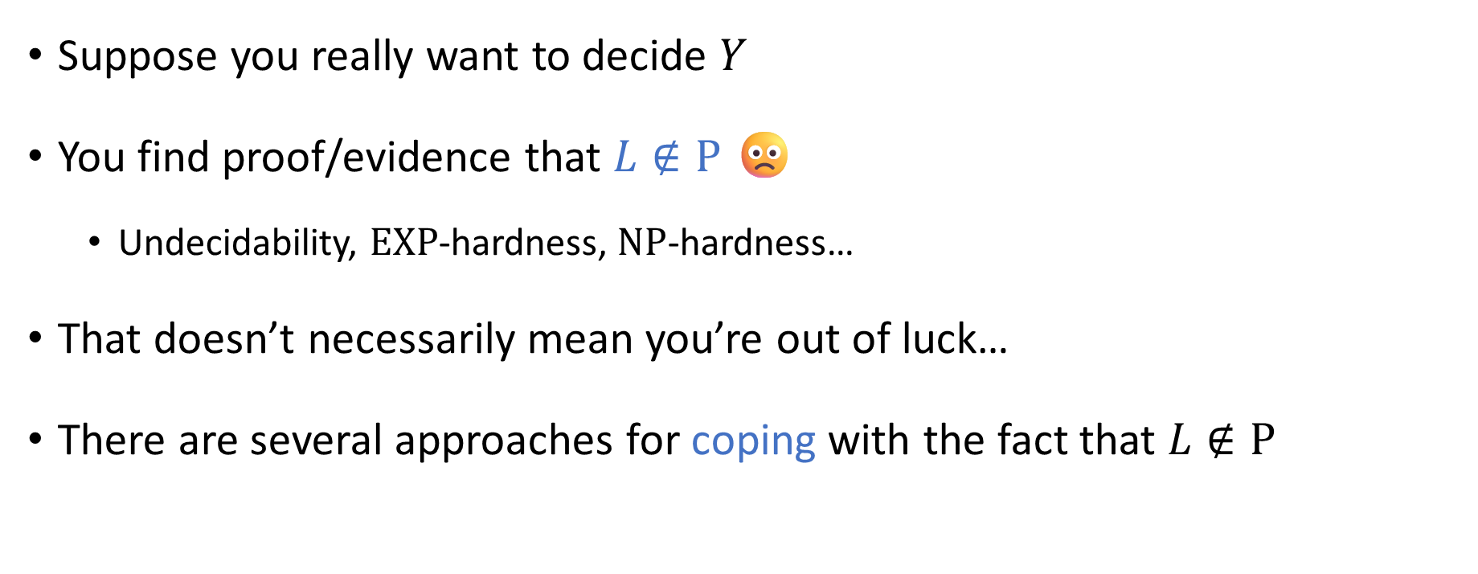
Coping with intractability
Suppose you really want to decide $Y$
You find proof/evidence that $L∉\text{P}$ 🙁
Undecidability, $\text{EXP}$-hardness, $\text{NP}$-hardness…
That doesn’t necessarily mean you’re out of luck…
There are several approaches for coping with the fact that $L∉\text{P}$

Slide 13
Coping with intractability

Slide 14
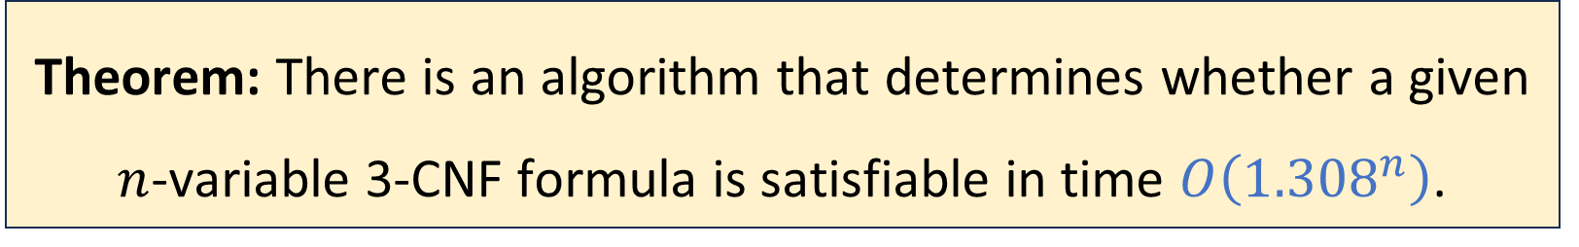
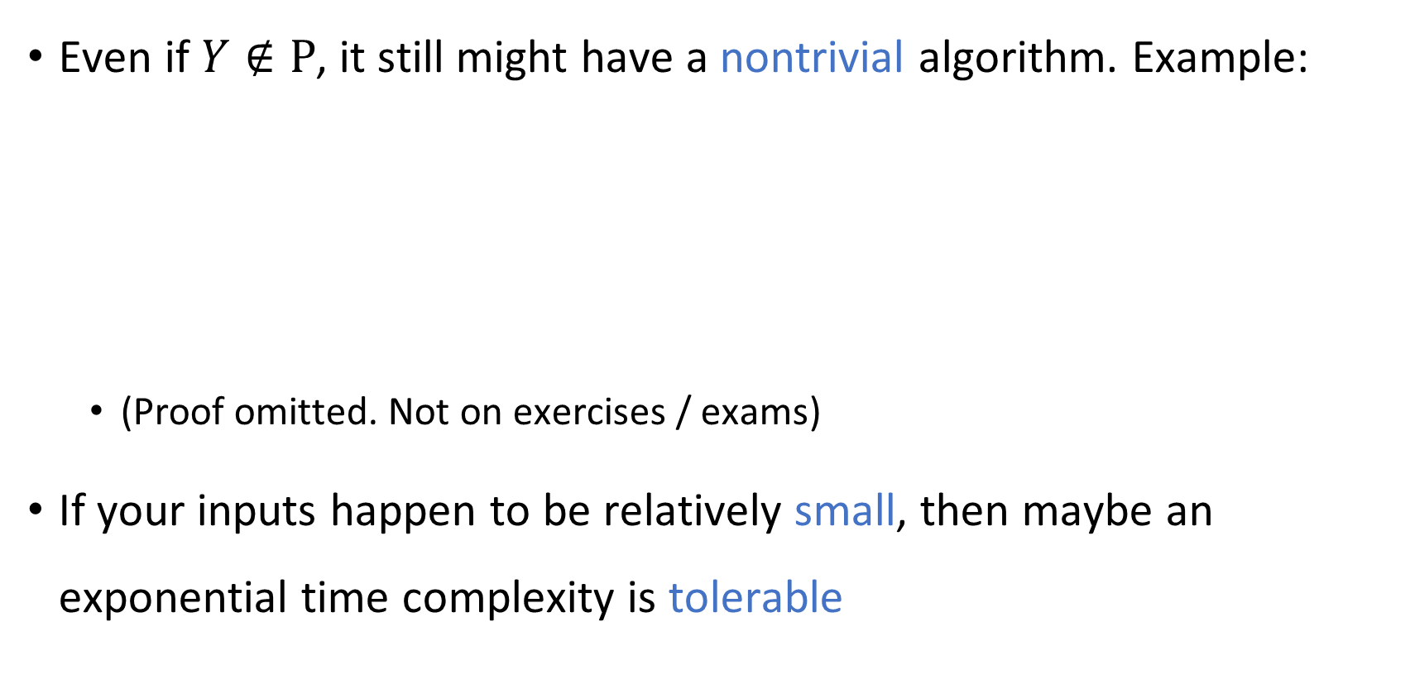
Nontrivial exponential-time algorithms
Even if $Y∉\text{P}$, it still might have a nontrivial algorithm. Example:
(Proof omitted. Not on exercises / exams)
If your inputs happen to be relatively small, then maybe an exponential time complexity is tolerable
Theorem: There is an algorithm that determines whether a given $n$-variable 3-CNF formula is satisfiable in time $O\left({1.308}^{n}\right)$.

Slide 15
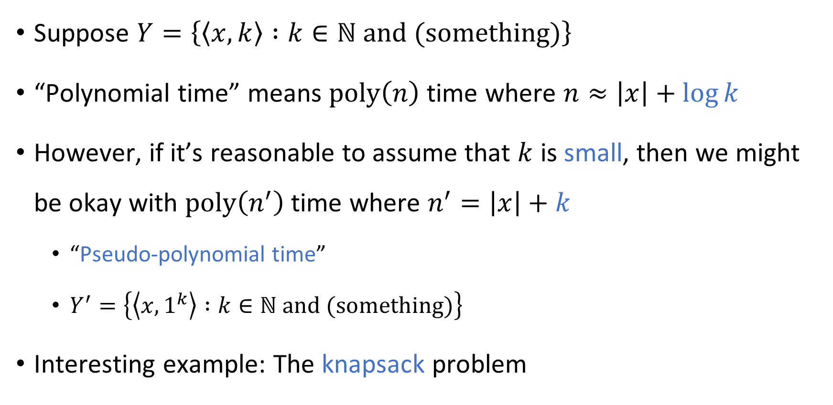
Pseudo-polynomial time algorithms
Suppose $Y=\left\{\left\langle x,k\right\rangle :k∈ℕ \text{and} \text{(}\text{something}\text{)}\right\}$
“Polynomial time” means $\text{poly}\left(n\right)$ time where $n≈\left|x\right|+\log{k}$
However, if it’s reasonable to assume that $k$ is small, then we might be okay with $\text{poly}\left(n^{′}\right)$ time where $n^{′}=\left|x\right|+k$
“Pseudo-polynomial time”
$Y^{′}=\left\{\left\langle x,1^{k}\right\rangle :k∈ℕ \text{and}\text{ (}\text{something}\text{)}\right\}$
Interesting example: The knapsack problem

Slide 16

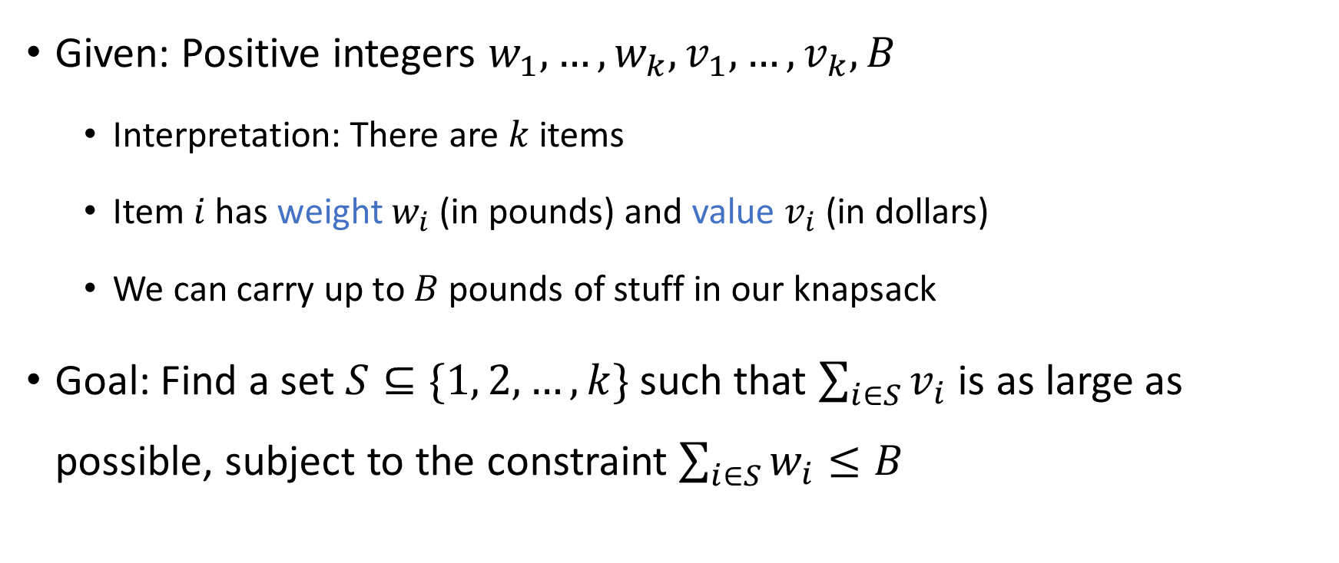
The knapsack problem
Given: Positive integers $w_{1},…, w_{k}, v_{1},…, v_{k},B$
Interpretation: There are $k$ items
Item $i$ has weight $w_{i}$ (in pounds) and value $v_{i}$ (in dollars)
We can carry up to $B$ pounds of stuff in our knapsack
Goal: Find a set $S⊆\{1, 2, …, k\}$ such that $\sum_{i∈S}{v_{i}}$ is as large as possible, subject to the constraint $\sum_{i∈S}{w_{i}}≤B$

Slide 17
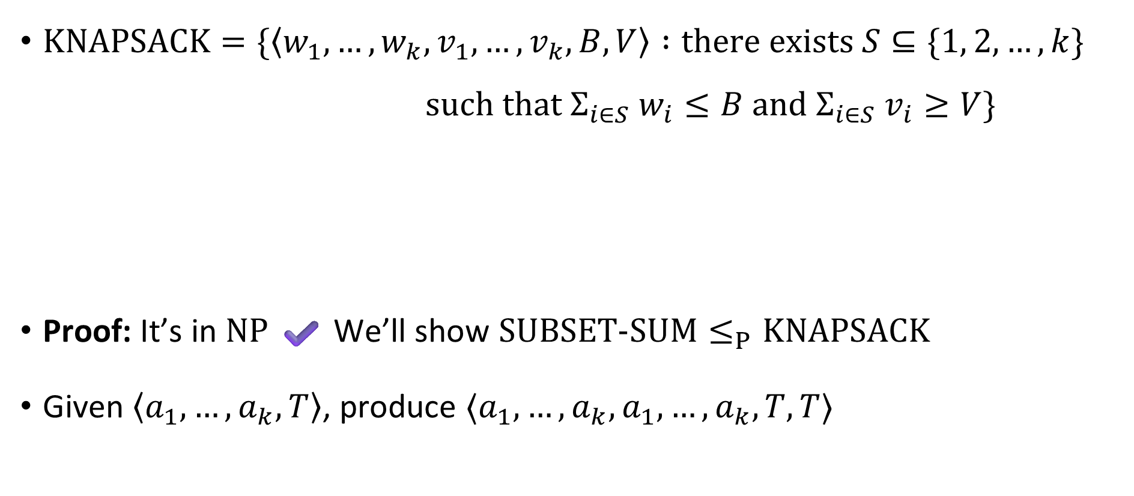

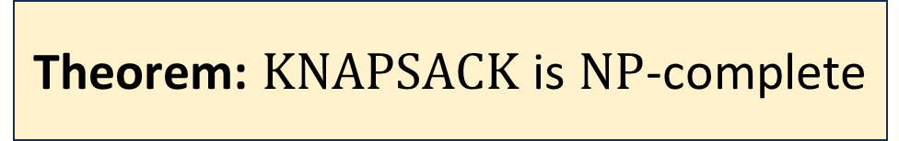
$\text{KNAPSACK}$ is $\text{NP}$-complete
$\text{KNAPSACK}=\{\left\langle w_{1},…, w_{k}, v_{1},…, v_{k}, B, V\right\rangle :\text{there} \text{exists} S⊆\{1, 2, …, k\}$ $\text{such} \text{that} Σ_{i∈S} w_{i}≤B \text{and} Σ_{i∈S} v_{i}≥V\}$
Proof: It’s in $\text{NP}$ ✔️ We’ll show $\text{SUBSET}‑\text{SUM}≤_{P}\text{KNAPSACK}$
Given $\left\langle a_{1},…, a_{k},T\right\rangle$, produce $⟨a_{1},…, a_{k}, a_{1},…, a_{k}, T,T⟩$
Theorem: $\text{KNAPSACK}$ is $\text{NP}$-complete

Slide 18
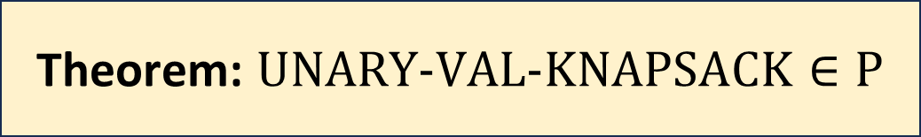
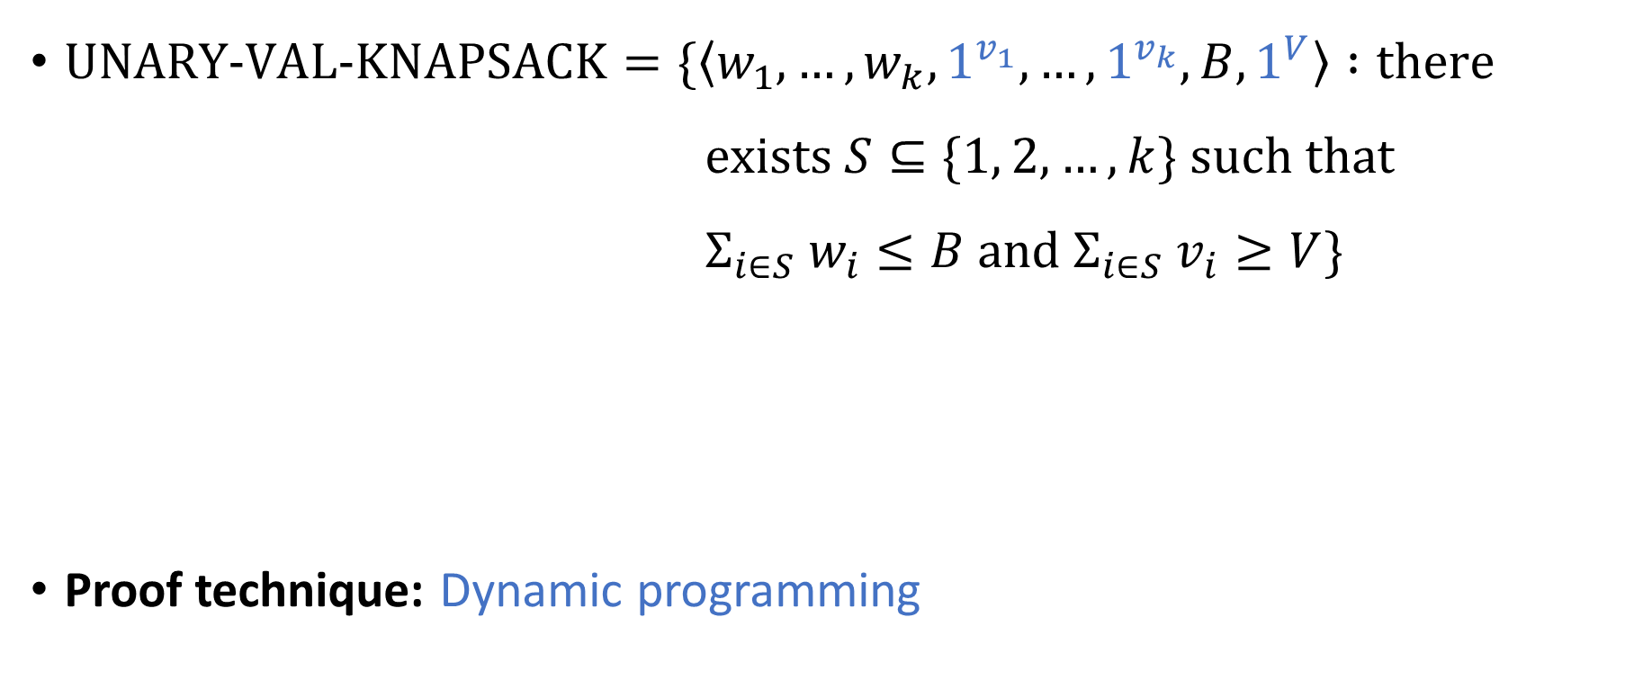
Knapsack in pseudo-polynomial time
$\text{UNARY}‑\text{VAL}‑\text{KNAPSACK}=\{\left\langle w_{1},…, w_{k}, 1^{v_{1}},…, 1^{v_{k}}, B, 1^{V}\right\rangle :\text{there}$ $\text{exists} S⊆\{1, 2, …, k\} \text{such} \text{that}$ $Σ_{i∈S} w_{i}≤B \text{and} Σ_{i∈S} v_{i}≥V\}$
Proof technique: Dynamic programming
Theorem: $\text{UNARY}‑\text{VAL}‑\text{KNAPSACK}∈\text{P}$

Slide 19
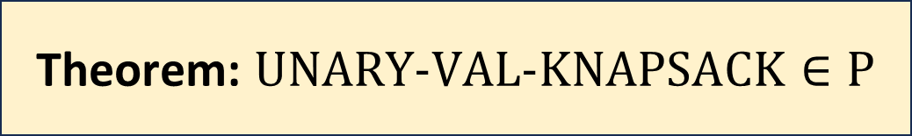
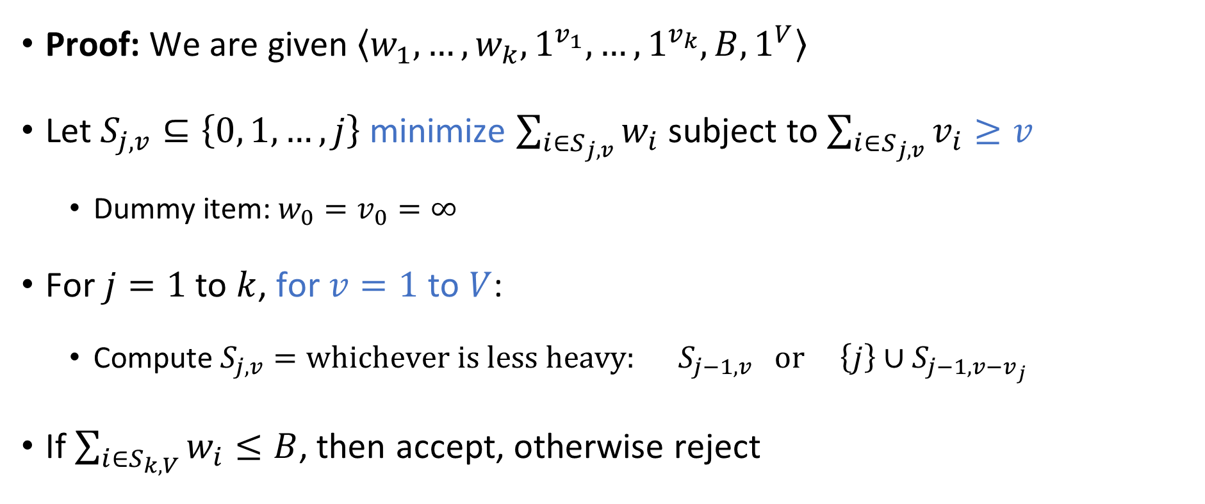
Theorem: $\text{UNARY}‑\text{VAL}‑\text{KNAPSACK}∈\text{P}$
Proof: We are given $\left\langle w_{1},…, w_{k},1^{v_{1}},…, 1^{v_{k}}, B,1^{V}\right\rangle$
Let $S_{j,v}⊆\left\{0, 1,…, j\right\}$ minimize $\sum_{i∈S_{j,v}}{w_{i}}$ subject to $\sum_{i∈S_{j,v}}{v_{i}}≥v$
Dummy item: $w_{0}=v_{0}=∞$
For $j=1$ to $k$, for $v=1$ to $V$:
Compute $S_{j,v}=\text{whichever} \text{is} \text{less} \text{heavy}\text{: }S_{j−1,v} \text{or} \left\{j\right\}∪S_{j−1,v−v_{j}}$
If $\sum_{i∈S_{k,V}}{w_{i}}≤B$, then accept, otherwise reject

Slide 20
Approximation algorithms
Next approach for coping with intractability: approximation algorithms
Example: Knapsack

Slide 21
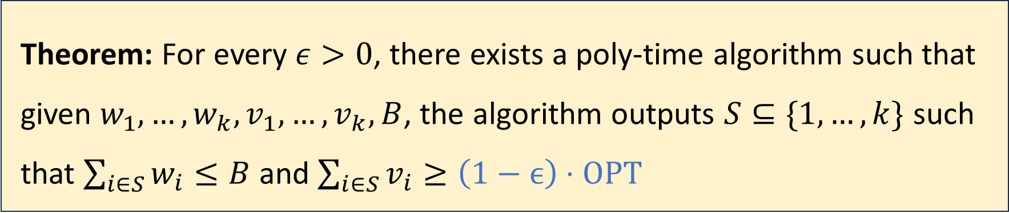
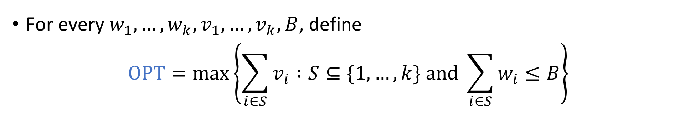
Approximation algorithm for Knapsack
For every $w_{1},…, w_{k}, v_{1},…, v_{k},B$, define
$$\text{OPT}=\max\left\{\sum_{i∈S}{v_{i}} :S⊆\{1, …, k\} \text{and} \sum_{i∈S}{w_{i}}≤B\right\}$$
Theorem: For every $ε>0$, there exists a poly-time algorithm such that given $w_{1},…, w_{k}, v_{1},…, v_{k}, B$, the algorithm outputs $S⊆\{1, …, k\}$ such that $\sum_{i∈S}{w_{i}}≤B$ and $\sum_{i∈S}{v_{i}}≥\left(1−ϵ\right)⋅\text{OPT}$

