Slide 1

CMSC 28100 Introduction to Complexity Theory Spring 2024 Instructor: William Hoza

Slide 2
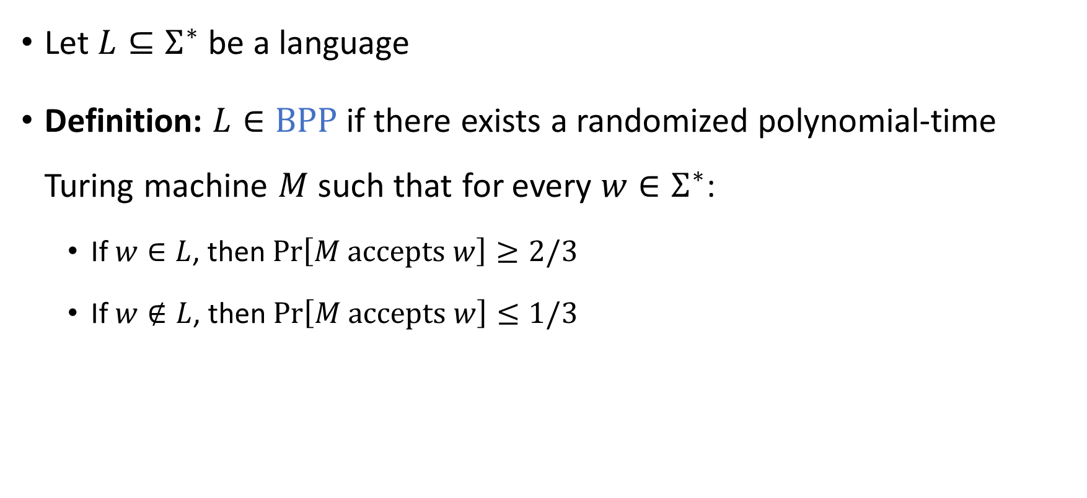

The complexity class $\text{BPP}$
Let $L⊆Σ^{∗}$ be a language
Definition: $L∈\text{BPP}$ if there exists a randomized polynomial-time Turing machine $M$ such that for every $w∈Σ^{∗}$:
If $w∈L$, then $\operatorname{Pr}\left[M \text{accepts} w\right]≥2/3$
If $w∉L$, then $\operatorname{Pr}\left[M \text{accepts} w\right]≤1/3$

Slide 3




Decidable languages
$$\text{EXP}$$
$$\text{PSPACE}$$
$$\text{BPP}$$
$$\text{P}$$

Slide 4
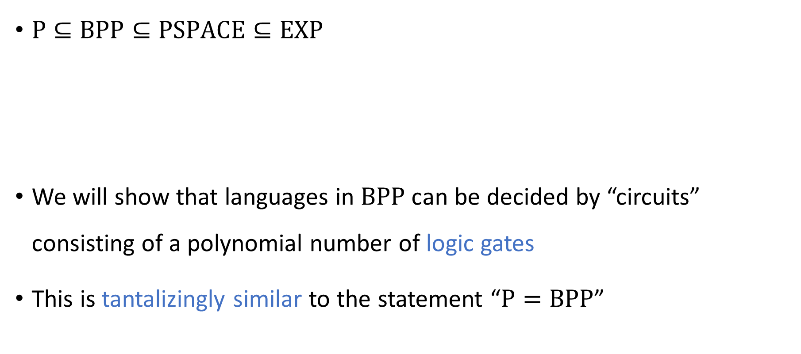
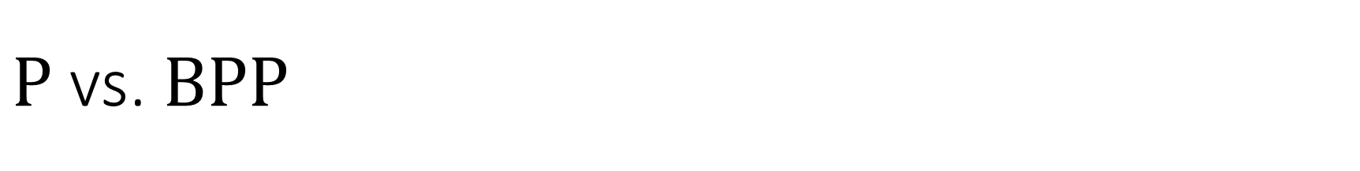
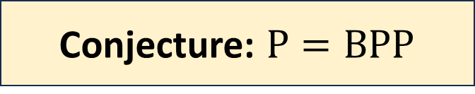
$\text{P}$ vs. $\text{BPP}$
$\text{P}⊆\text{BPP}⊆\text{PSPACE}⊆\text{EXP}$
We will show that languages in $\text{BPP}$ can be decided by “circuits” consisting of a polynomial number of logic gates
This is tantalizingly similar to the statement “$\text{P}=\text{BPP}$”
Conjecture: $\text{P}=\text{BPP}$

Slide 5




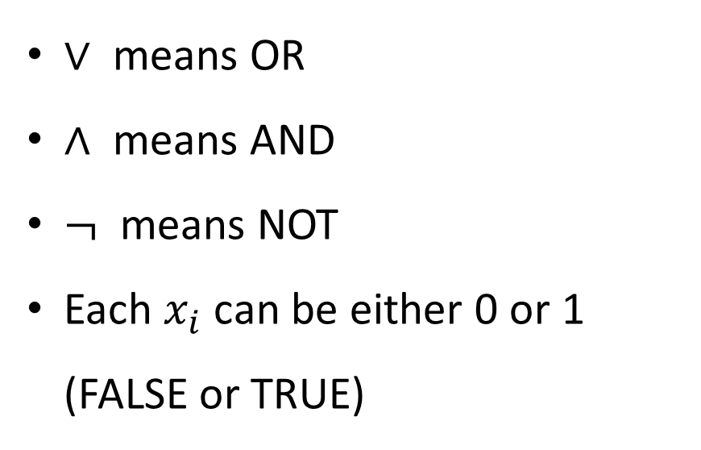















Boolean circuits
For us, a “circuit” is a network of logic gates applied to Boolean variables
1
$$∨$$
$∨$ means OR
$∧$ means AND
$¬$ means NOT
Each $x_{i}$ can be either 0 or 1 (FALSE or TRUE)
1
0
$$∧$$
$$∧$$
0
1
0
1
$$¬$$
$$¬$$
1
0
$$∨$$
$$∨$$
0
1
0
0
$$∧$$
$$∧$$
$$∧$$
$$∧$$
0
1
0
1
1
0
0
1
$$¬$$
$$¬$$
$$¬$$
$$¬$$
0
1
1
1
$$x_{1}$$
$$x_{2}$$
$$x_{3}$$
$$x_{4}$$
0
1
1
1

Slide 6
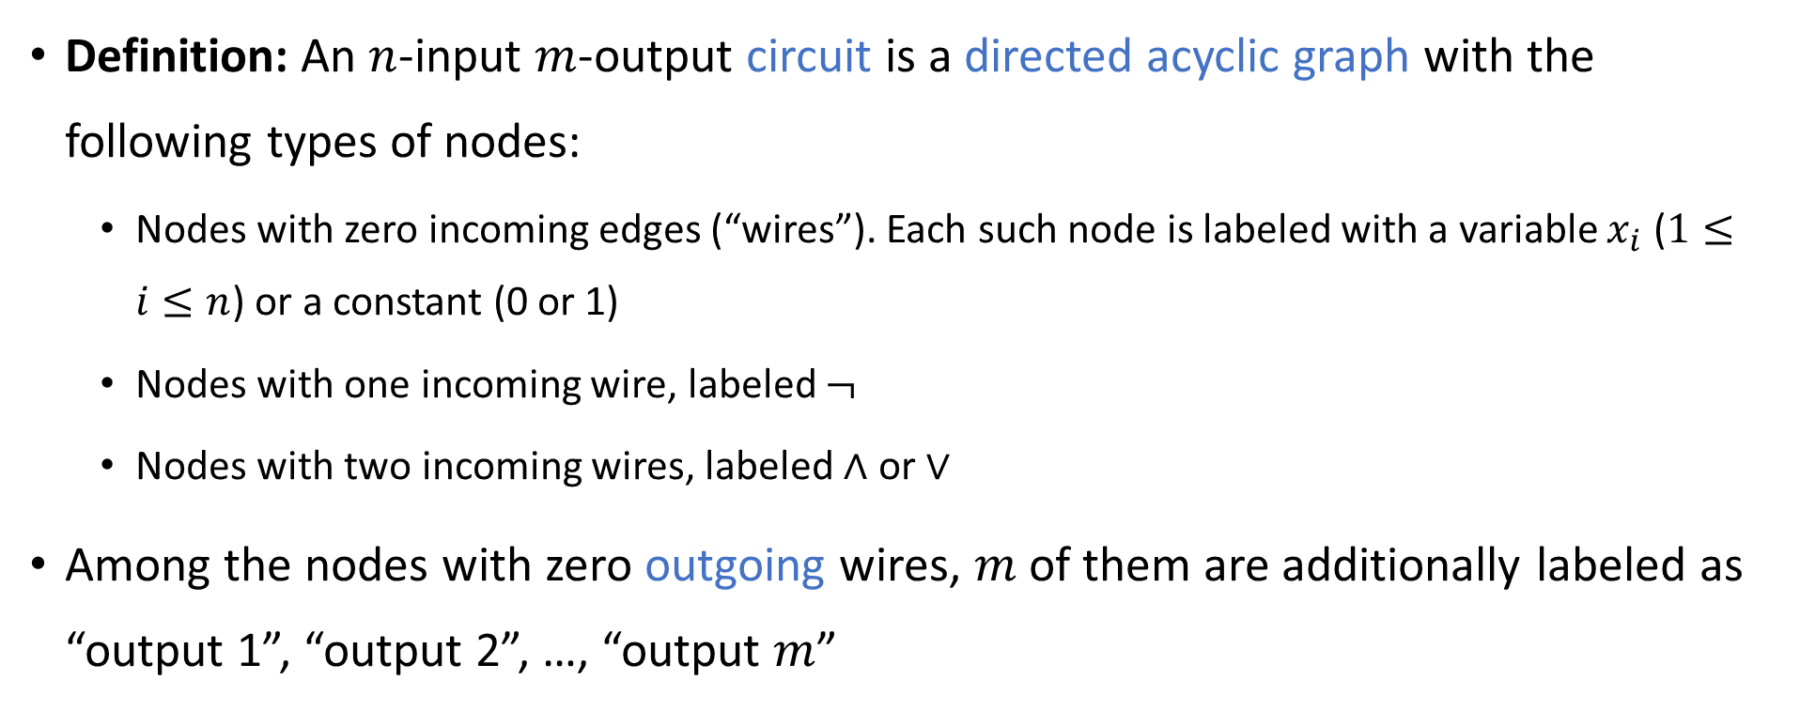
Boolean circuits
Definition: An $n$-input $m$-output circuit is a directed acyclic graph with the following types of nodes:
Nodes with zero incoming edges (“wires”). Each such node is labeled with a variable $x_{i}$ ($1≤i≤n$) or a constant (0 or 1)
Nodes with one incoming wire, labeled $¬$
Nodes with two incoming wires, labeled $∧$ or $∨$
Among the nodes with zero outgoing wires, $m$ of them are additionally labeled as “output 1”, “output 2”, …, “output $m$”
“gates”

Slide 7
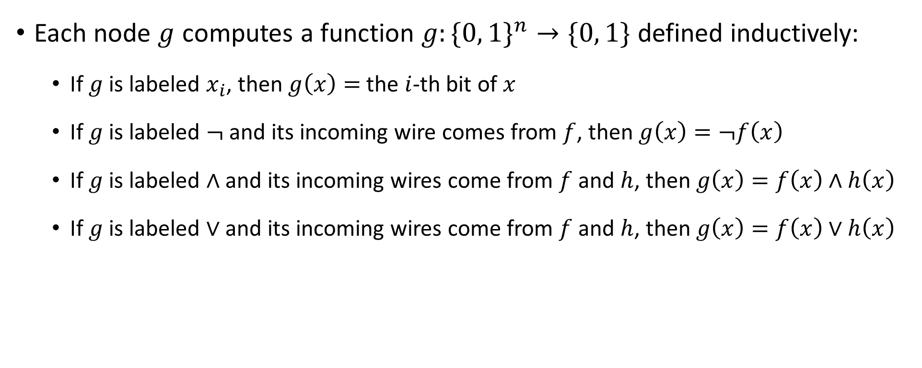
Boolean circuits
Each node $g$ computes a function $g:\{0, 1\}^{n}→\{0, 1\}$ defined inductively:
If $g$ is labeled $x_{i}$, then $g\left(x\right)=$ the $i$-th bit of $x$
If $g$ is labeled $¬$ and its incoming wire comes from $f$, then $g\left(x\right)=¬f\left(x\right)$
If $g$ is labeled $∧$ and its incoming wires come from $f$ and $h$, then $g\left(x\right)=f\left(x\right)∧h\left(x\right)$
If $g$ is labeled $∨$ and its incoming wires come from $f$ and $h$, then $g\left(x\right)=f\left(x\right)∨h\left(x\right)$

Slide 8

Boolean circuits
Let the output nodes be $g_{1},…, g_{m}$
As a whole, the circuit computes $C:{\left\{0, 1\right\}}^{n}→{\left\{0, 1\right\}}^{m}$ defined by
$$C\left(x\right)=\left(g_{1}\left(x\right),…, g_{m}\left(x\right)\right)$$

Slide 9
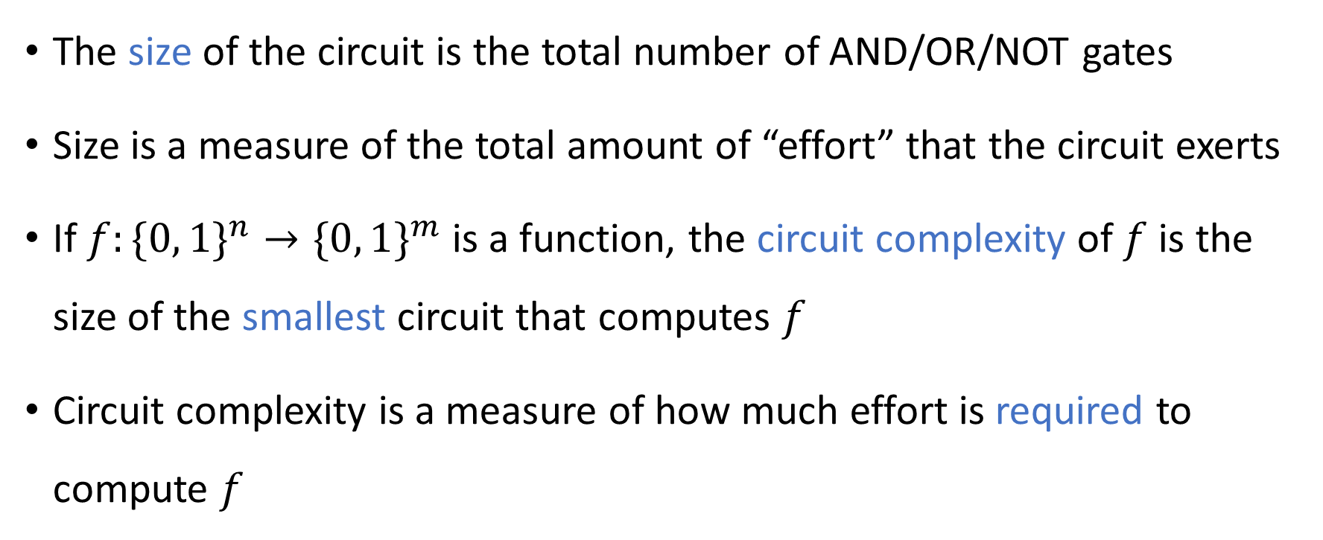
Circuit size
The size of the circuit is the total number of AND/OR/NOT gates
Size is a measure of the total amount of “effort” that the circuit exerts
If $f:\{0, 1\}^{n}→\{0, 1\}^{m}$ is a function, the circuit complexity of $f$ is the size of the smallest circuit that computes $f$
Circuit complexity is a measure of how much effort is required to compute $f$

Slide 10




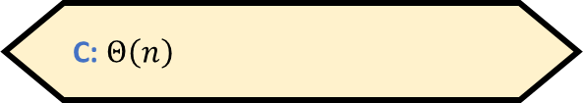





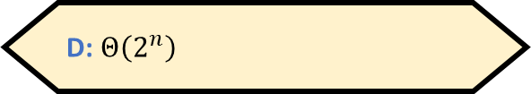

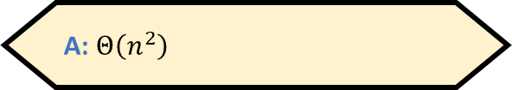



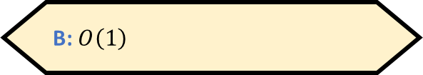



Circuit complexity example 1
$$∨$$
$$∨$$
$$∨$$
$$∨$$
$$∨$$
$$∨$$
$$∨$$
Let $f\left(x\right)=x_{1}∨x_{2}∨…∨x_{n}$
$$x_{1}$$
$$x_{2}$$
$$x_{3}$$
$$x_{4}$$
$$x_{5}$$
$$x_{6}$$
$$x_{7}$$
$$x_{8}$$
What is the circuit complexity of $f$?
A: $Θ\left(n^{2}\right)$
B: $O\left(1\right)$
C: $Θ\left(n\right)$
D: $Θ\left(2^{n}\right)$
Respond at PollEv.com/whoza or text “whoza” to 22333

Slide 11




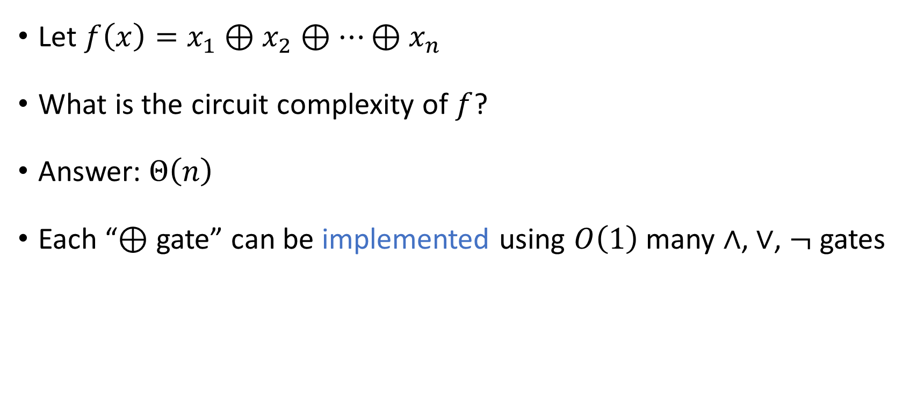



Circuit complexity example 2
$$⊕$$
$$⊕$$
$$⊕$$
$$⊕$$
$$⊕$$
$$⊕$$
$$⊕$$
Let $f\left(x\right)=x_{1}⊕x_{2}⊕…⊕x_{n}$
What is the circuit complexity of $f$?
Answer: $Θ\left(n\right)$
Each “$⊕$ gate” can be implemented using $O\left(1\right)$ many $∧$, $∨$, $¬$ gates
$$x_{1}$$
$$x_{2}$$
$$x_{3}$$
$$x_{4}$$
$$x_{5}$$
$$x_{6}$$
$$x_{7}$$
$$x_{8}$$

Slide 12
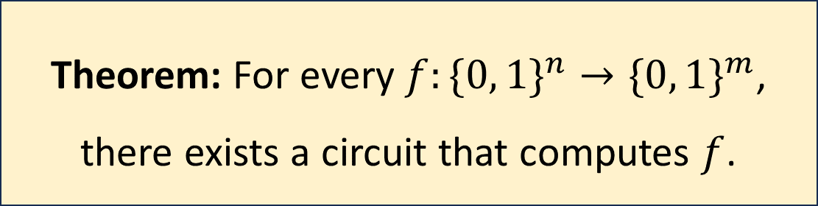
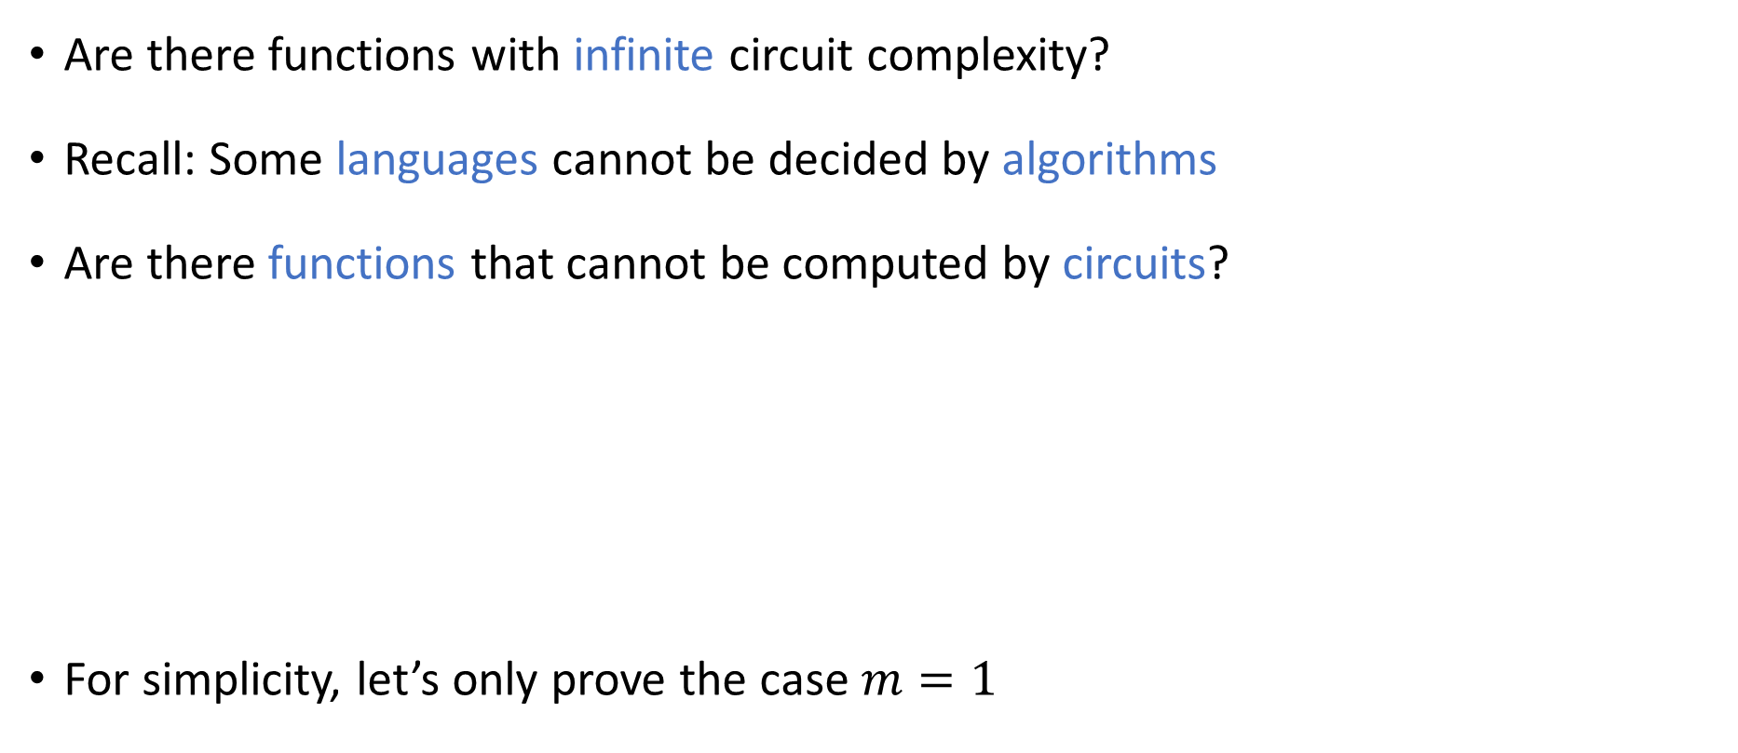
Every function has a circuit
Are there functions with infinite circuit complexity?
Recall: Some languages cannot be decided by algorithms
Are there functions that cannot be computed by circuits?
For simplicity, let’s only prove the case $m=1$
Theorem: For every $f:\{0, 1\}^{n}→\{0, 1\}^{m}$, there exists a circuit that computes $f$.

Slide 13
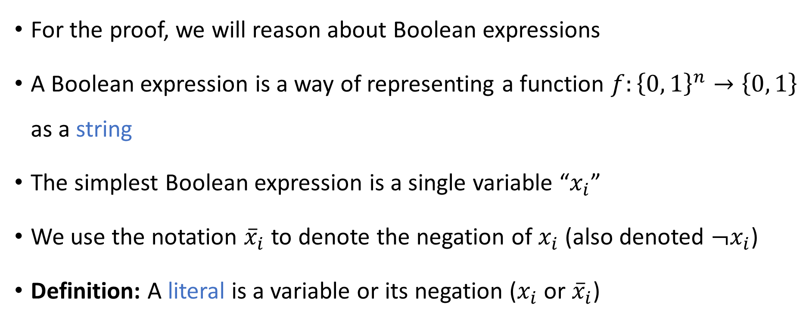
Boolean expressions: Literals
For the proof, we will reason about Boolean expressions
A Boolean expression is a way of representing a function $f:{\left\{0, 1\right\}}^{n}→\left\{0, 1\right\}$ as a string
The simplest Boolean expression is a single variable “$x_{i}$”
We use the notation ${\overline{x}}_{i}$ to denote the negation of $x_{i}$ (also denoted $¬x_{i}$)
Definition: A literal is a variable or its negation ($x_{i}$ or ${\overline{x}}_{i}$)

Slide 14
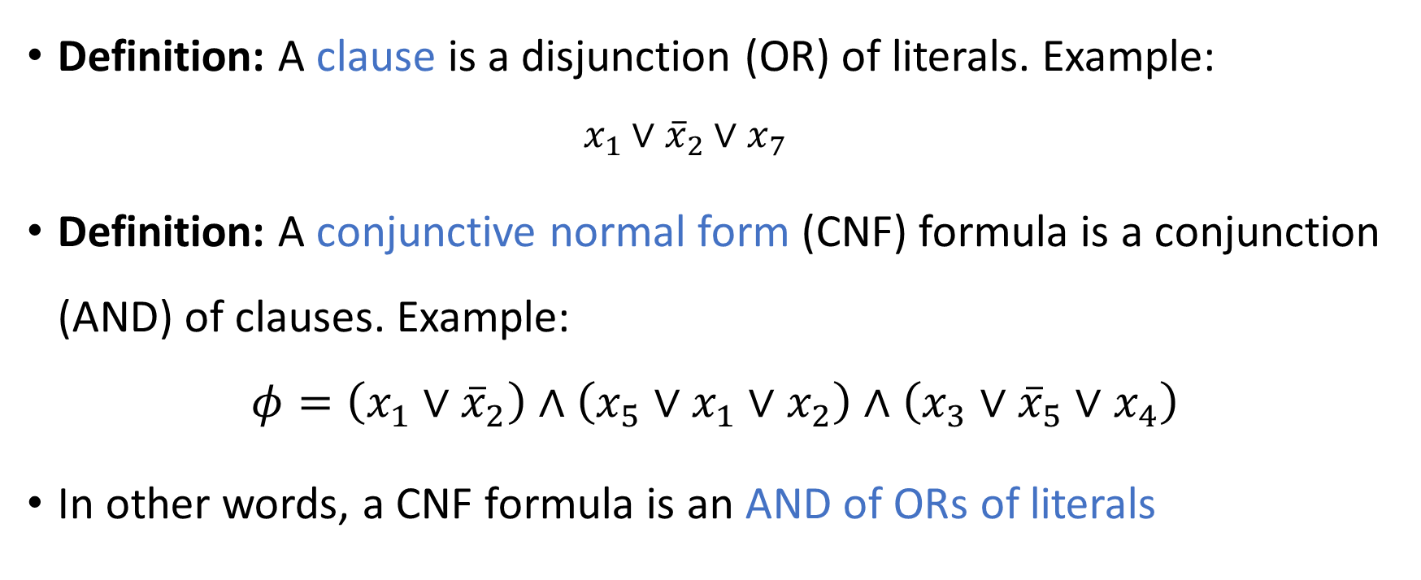
Conjunctive normal form formulas
Definition: A clause is a disjunction (OR) of literals. Example:
$$x_{1}∨{\overline{x}}_{2}∨x_{7}$$
Definition: A conjunctive normal form (CNF) formula is a conjunction (AND) of clauses. Example:
$$φ=\left(x_{1}∨{\overline{x}}_{2}\right)∧\left(x_{5}∨x_{1}∨x_{2}\right)∧\left(x_{3}∨{\overline{x}}_{5}∨x_{4}\right)$$
In other words, a CNF formula is an AND of ORs of literals

Slide 15
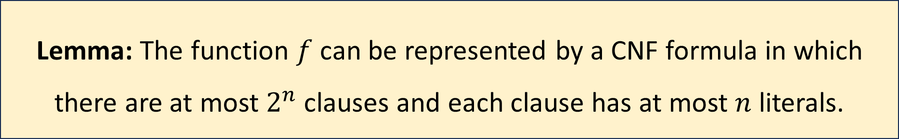

Every function has a CNF formula
Let $f:{\left\{0, 1\right\}}^{n}→\left\{0, 1\right\}$ be any function
Proof: For each $z∈{\left\{0, 1\right\}}^{n}$ such that $f\left(z\right)=0$, we make a clause $C_{z}$ asserting that $x≠z$
Example: $f\left(x_{1}, x_{2}\right)=x_{1}⊕x_{2}=\left(x_{1}∨x_{2}\right)∧\left({\overline{x}}_{1}∨{\overline{x}}_{2}\right)$
Lemma: The function $f$ can be represented by a CNF formula in which there are at most $2^{n}$ clauses and each clause has at most $n$ literals.

Slide 16
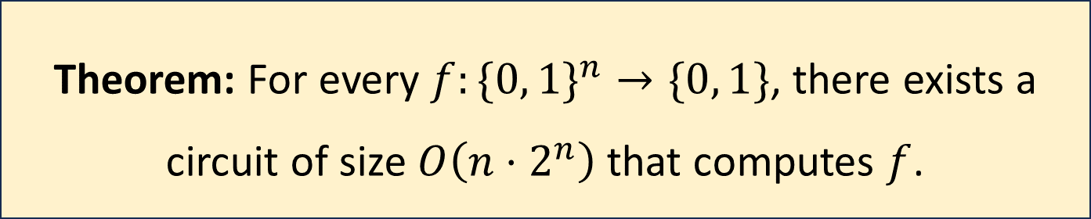
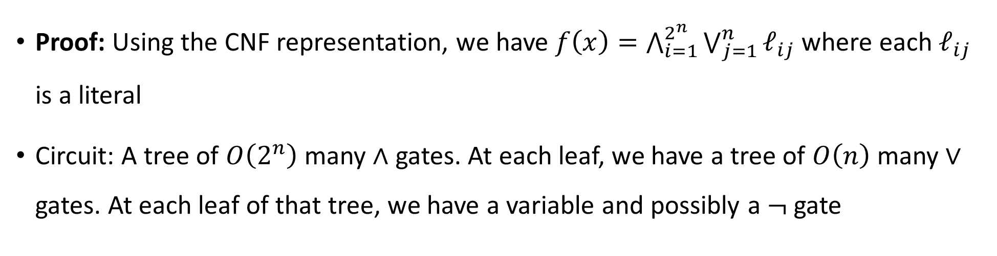
Every function has a circuit
Theorem: For every $f:\{0, 1\}^{n}→\{0, 1\}$, there exists a circuit of size $O\left(n⋅2^{n}\right)$ that computes $f$.
Proof: Using the CNF representation, we have $f\left(x\right)=\bigwedge_{i=1}^{2^{n}}{\bigvee_{j=1}^{n}{ℓ_{ij}}}$ where each $ℓ_{ij}$ is a literal
Circuit: A tree of $O\left(2^{n}\right)$ many $∧$ gates. At each leaf, we have a tree of $O\left(n\right)$ many $∨$ gates. At each leaf of that tree, we have a variable and possibly a $¬$ gate

Slide 17
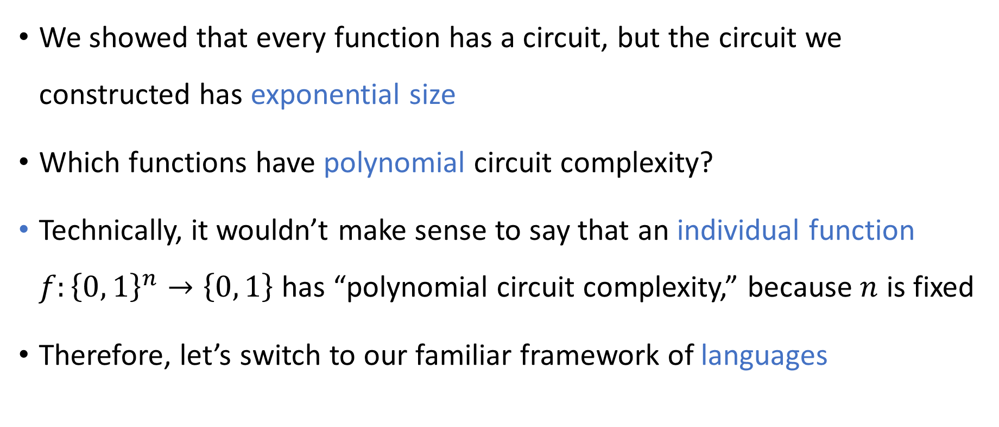
Polynomial-size circuits
We showed that every function has a circuit, but the circuit we constructed has exponential size
Which functions have polynomial circuit complexity?
Technically, it wouldn’t make sense to say that an individual function $f:{\left\{0, 1\right\}}^{n}→\left\{0, 1\right\}$ has “polynomial circuit complexity,” because $n$ is fixed
Therefore, let’s switch to our familiar framework of languages

Slide 18
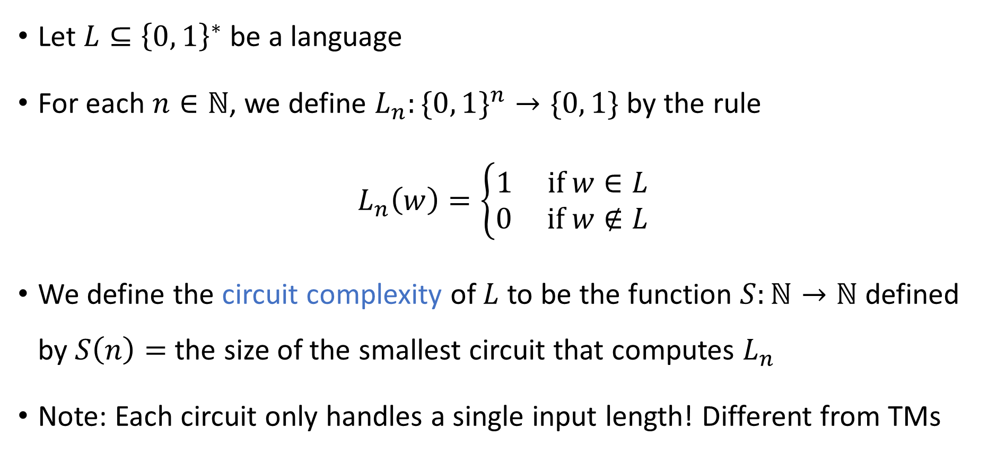
Circuit complexity of a binary language
Let $L⊆{\left\{0, 1\right\}}^{∗}$ be a language
For each $n∈ℕ$, we define $L_{n}:\{0, 1\}^{n}→\{0, 1\}$ by the rule
$$L_{n}\left(w\right)=\left\{\begin{aligned}1 \text{if} w∈L \\ 0 \text{if} w∉L\end{aligned}\right.$$
We define the circuit complexity of $L$ to be the function $S:ℕ→ℕ$ defined by $S\left(n\right)=$ the size of the smallest circuit that computes $L_{n}$
Note: Each circuit only handles a single input length! Different from TMs

Slide 19
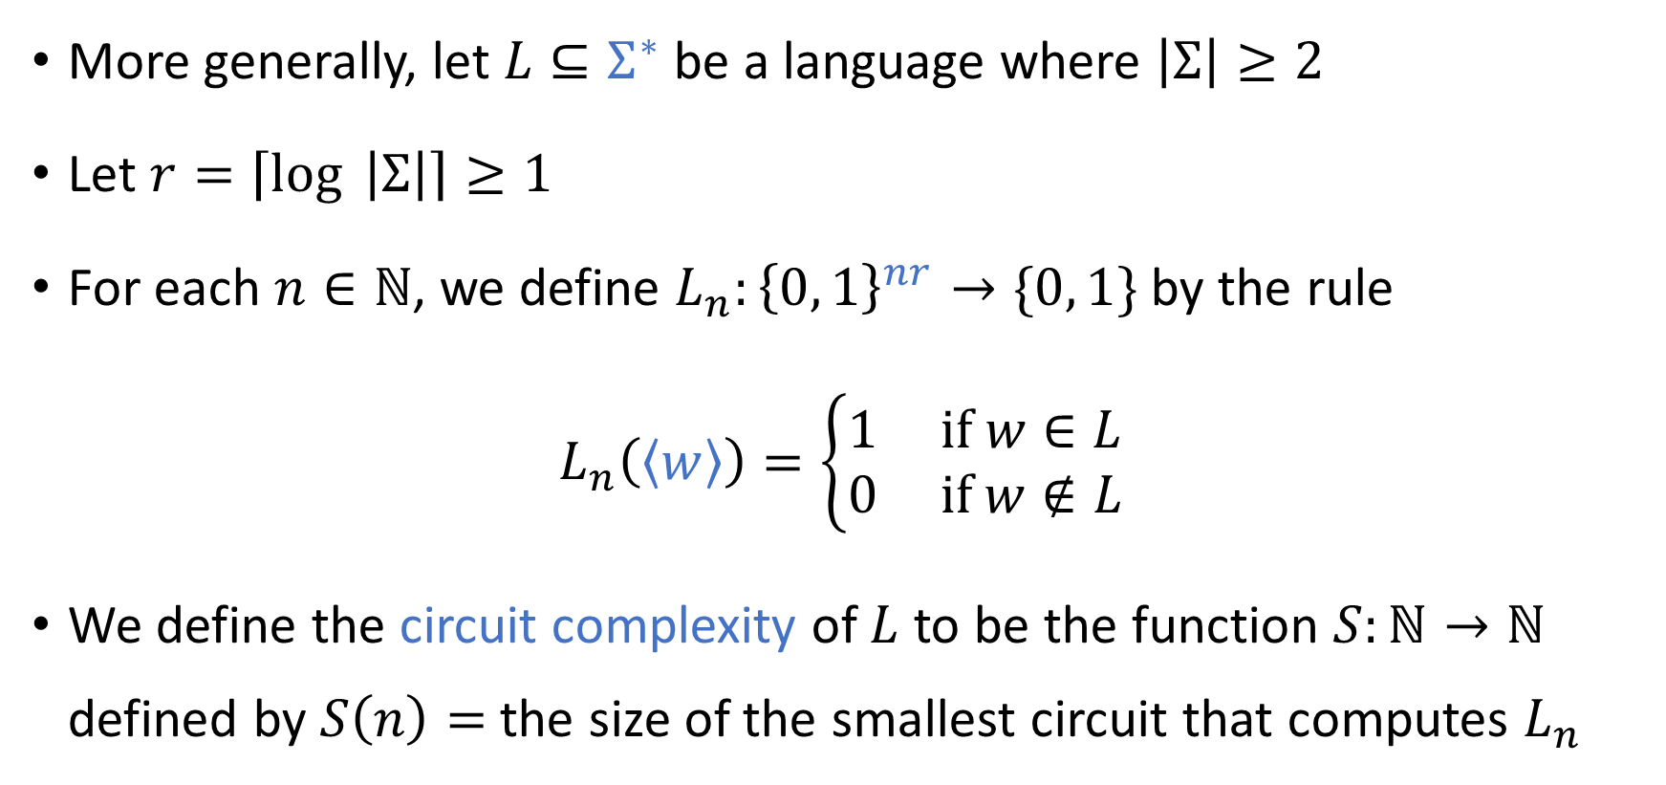
Circuit complexity of an arbitrary language
More generally, let $L⊆Σ^{∗}$ be a language where $\left|Σ\right|≥2$
Let $r=\left\lceil \log{ \left|Σ\right|}\right\rceil ≥1$
For each $n∈ℕ$, we define $L_{n}:{\left\{0, 1\right\}}^{nr}→\{0, 1\}$ by the rule
$$L_{n}\left(\left\langle w\right\rangle \right)=\left\{\begin{aligned}1 \text{if} w∈L \\ 0 \text{if} w∉L\end{aligned}\right.$$
We define the circuit complexity of $L$ to be the function $S:ℕ→ℕ$ defined by $S\left(n\right)=$ the size of the smallest circuit that computes $L_{n}$

Slide 20
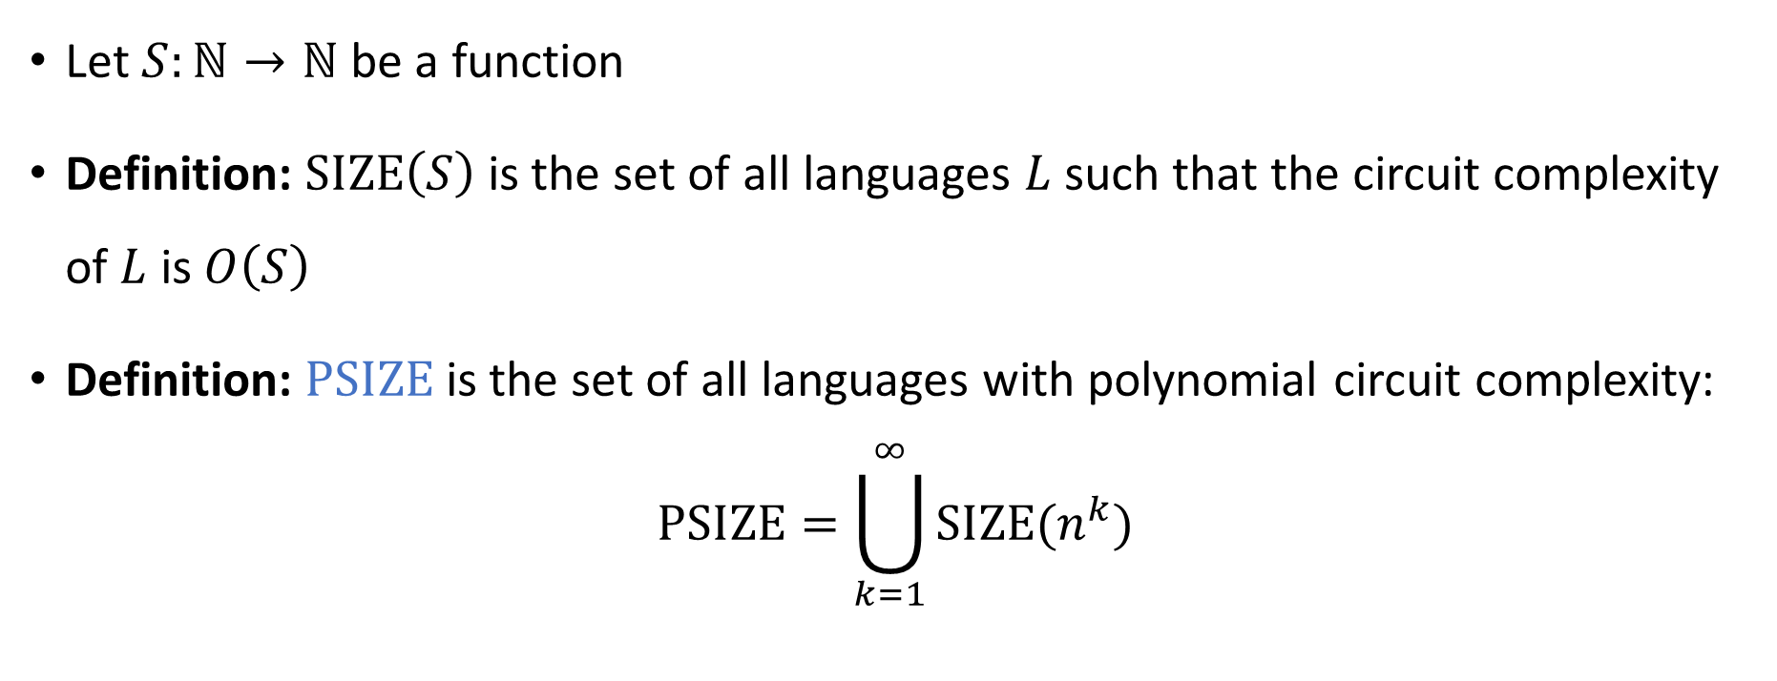

The complexity class $\text{PSIZE}$
Let $S:ℕ→ℕ$ be a function
Definition: $\text{SIZE}\left(S\right)$ is the set of all languages $L$ such that the circuit complexity of $L$ is $O\left(S\right)$
Definition: $\text{PSIZE}$ is the set of all languages with polynomial circuit complexity:
$$\text{PSIZE}=\bigcup_{k=1}^{∞}{\text{SIZE}(n^{k}})$$

