Slide 1

CMSC 28100 Introduction to Complexity Theory Spring 2024 Instructor: William Hoza

Slide 2
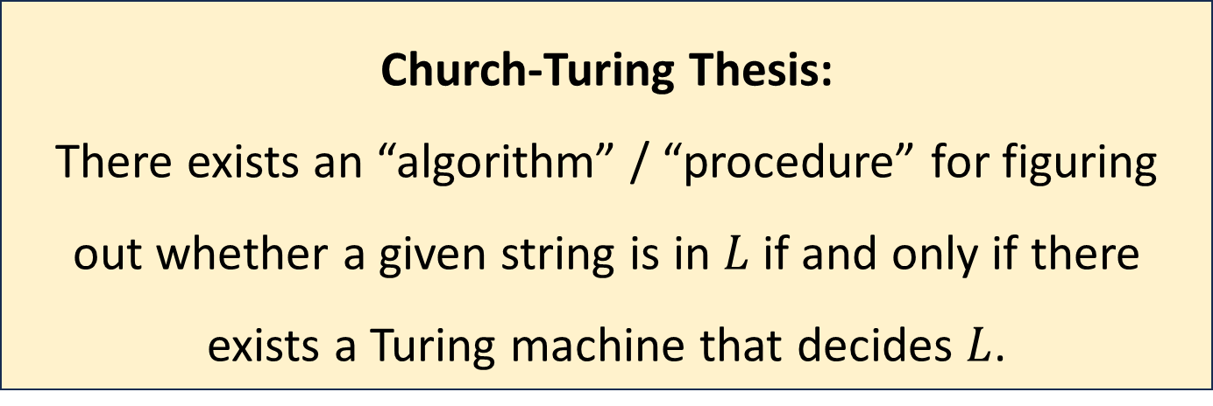
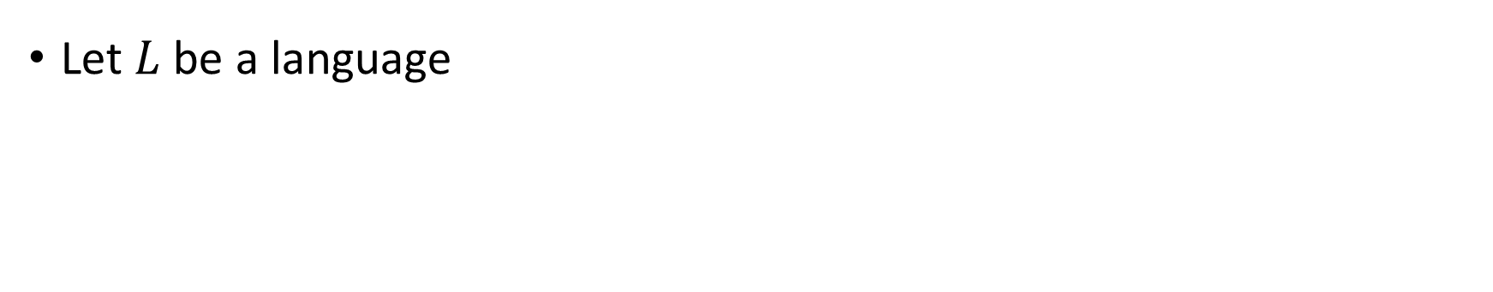
The Church-Turing Thesis
Let $L$ be a language
Church-Turing Thesis:
There exists an “algorithm” / “procedure” for figuring out whether a given string is in $L$ if and only if there exists a Turing machine that decides $L$.
Intuitive notion
Mathematically precise notion

Slide 3







Multi-tape Turing machines
“$k$-tape TM”
Transition function:
$$δ:Q×Γ^{k}→Q×Γ^{k}×\{\text{L},\text{R}\text{, }\text{S}\}^{k}$$
$$♢$$
1
1
0
$$⊔$$
$$⊔$$
$$♢$$
0
#
1
$
$$⊔$$
$$q$$

Slide 4
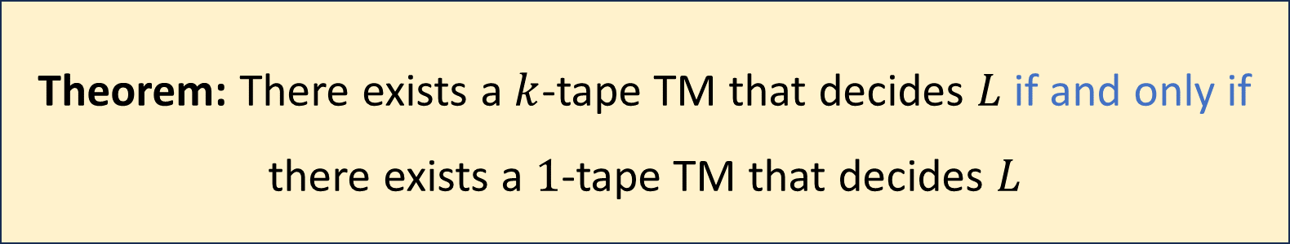

Multi-tape Turing machines
Let $k$ be any positive integer and let $L$ be a language
Theorem: There exists a $k$-tape TM that decides $L$ if and only if there exists a $1$-tape TM that decides $L$

Slide 5


Simulating $k$ tapes with $1$ tape
Idea: Pack a bunch of data into each cell
Store “simulated heads” on the tape, along with $k$ “simulated symbols” in each cell
$$♢$$
1
1
0
$$⊔$$
$$⊔$$
$$♢$$
0
#
1
$
$$⊔$$
$$q$$

Slide 6


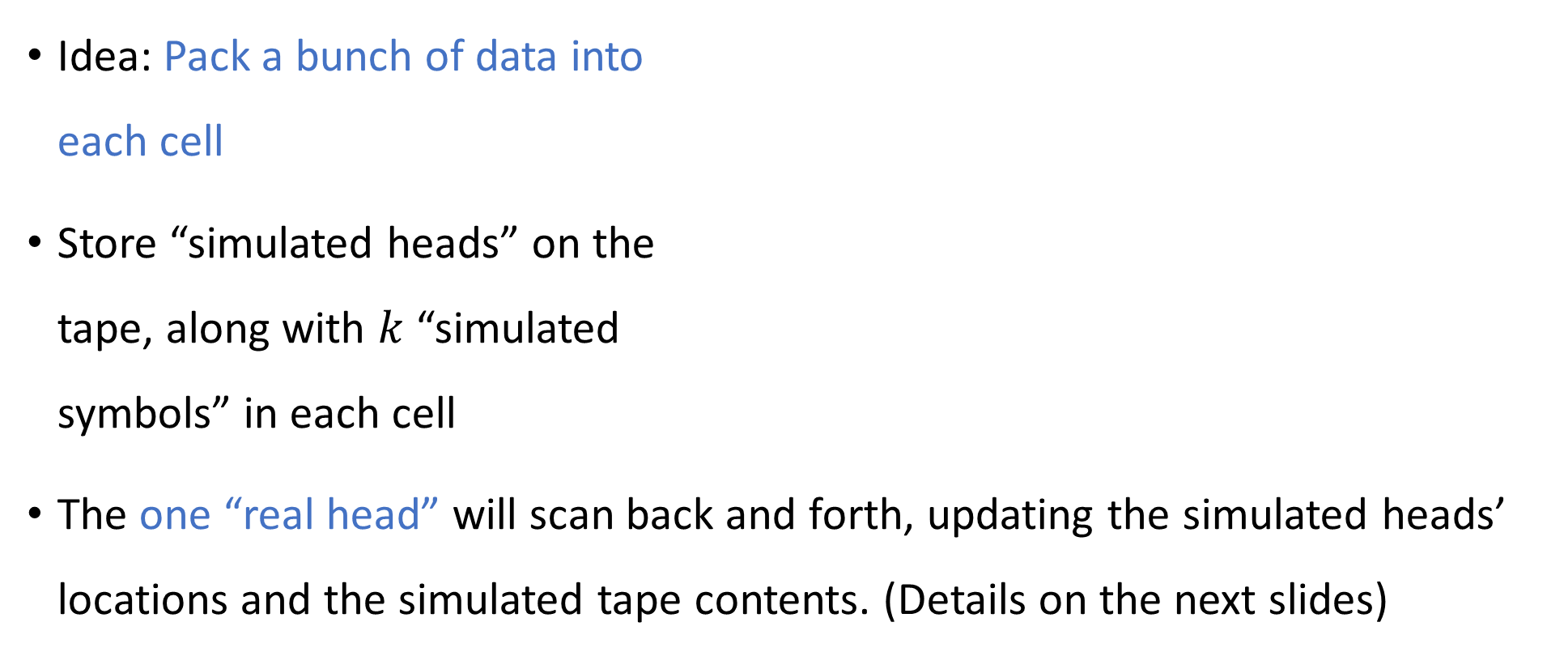

Simulating $k$ tapes with $1$ tape
Idea: Pack a bunch of data into each cell
Store “simulated heads” on the tape, along with $k$ “simulated symbols” in each cell
The one “real head” will scan back and forth, updating the simulated heads’ locations and the simulated tape contents. (Details on the next slides)
0
$$⊔$$
$$♢$$
1
1
0
$$⊔$$
$$⊔$$
$$♢$$
0
#
1
$
$$⊔$$

Slide 7
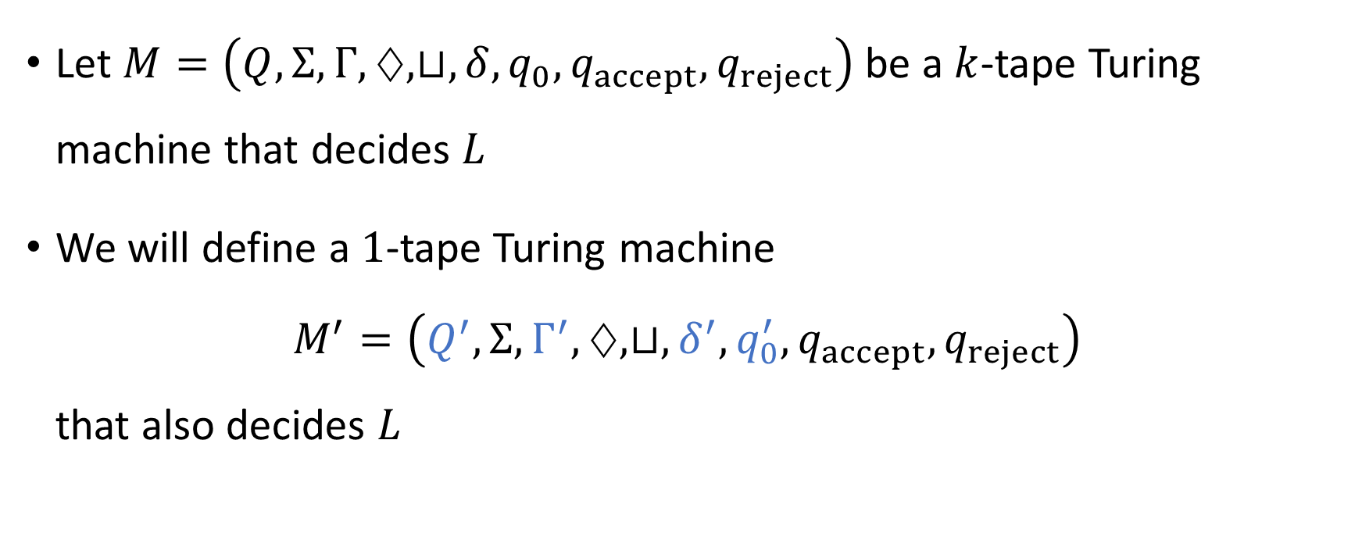
Simulating $k$ tapes with $1$ tape
Let $M=\left(Q,Σ, Γ,♢, ⊔, δ, q_{0},q_{accept},q_{reject}\right)$ be a $k$-tape Turing machine that decides $L$
We will define a $1$-tape Turing machine $M^{′}=\left(Q^{′},Σ, Γ^{′},♢, ⊔, δ^{′},q_{0}^{′},q_{accept},q_{reject}\right)$ that also decides $L$

Slide 8
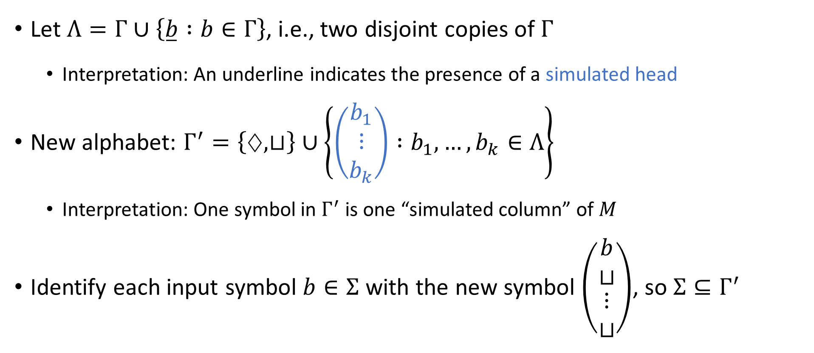
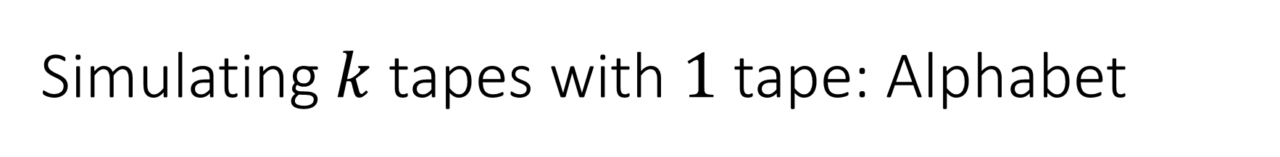
Simulating $k$ tapes with $1$ tape: Alphabet
Let $Λ=Γ∪\left\{\overset{̲}{b} :b∈Γ\right\}$, i.e., two disjoint copies of $Γ$
Interpretation: An underline indicates the presence of a simulated head
New alphabet: $Γ^{′}=\left\{♢, ⊔\right\}∪\left\{\left(\begin{matrix}b_{1} \\ ⋮ \\ b_{k}\end{matrix}\right) :b_{1},…, b_{k}∈Λ\right\}$
Interpretation: One symbol in $Γ^{′}$ is one “simulated column” of $M$
Identify each input symbol $b∈Σ$ with the new symbol $\left(\begin{matrix}b \\ ⊔ \\ \begin{aligned}⋮ \\ ⊔\end{aligned}\end{matrix}\right)$, so $Σ⊆Γ^{′}$

Slide 9
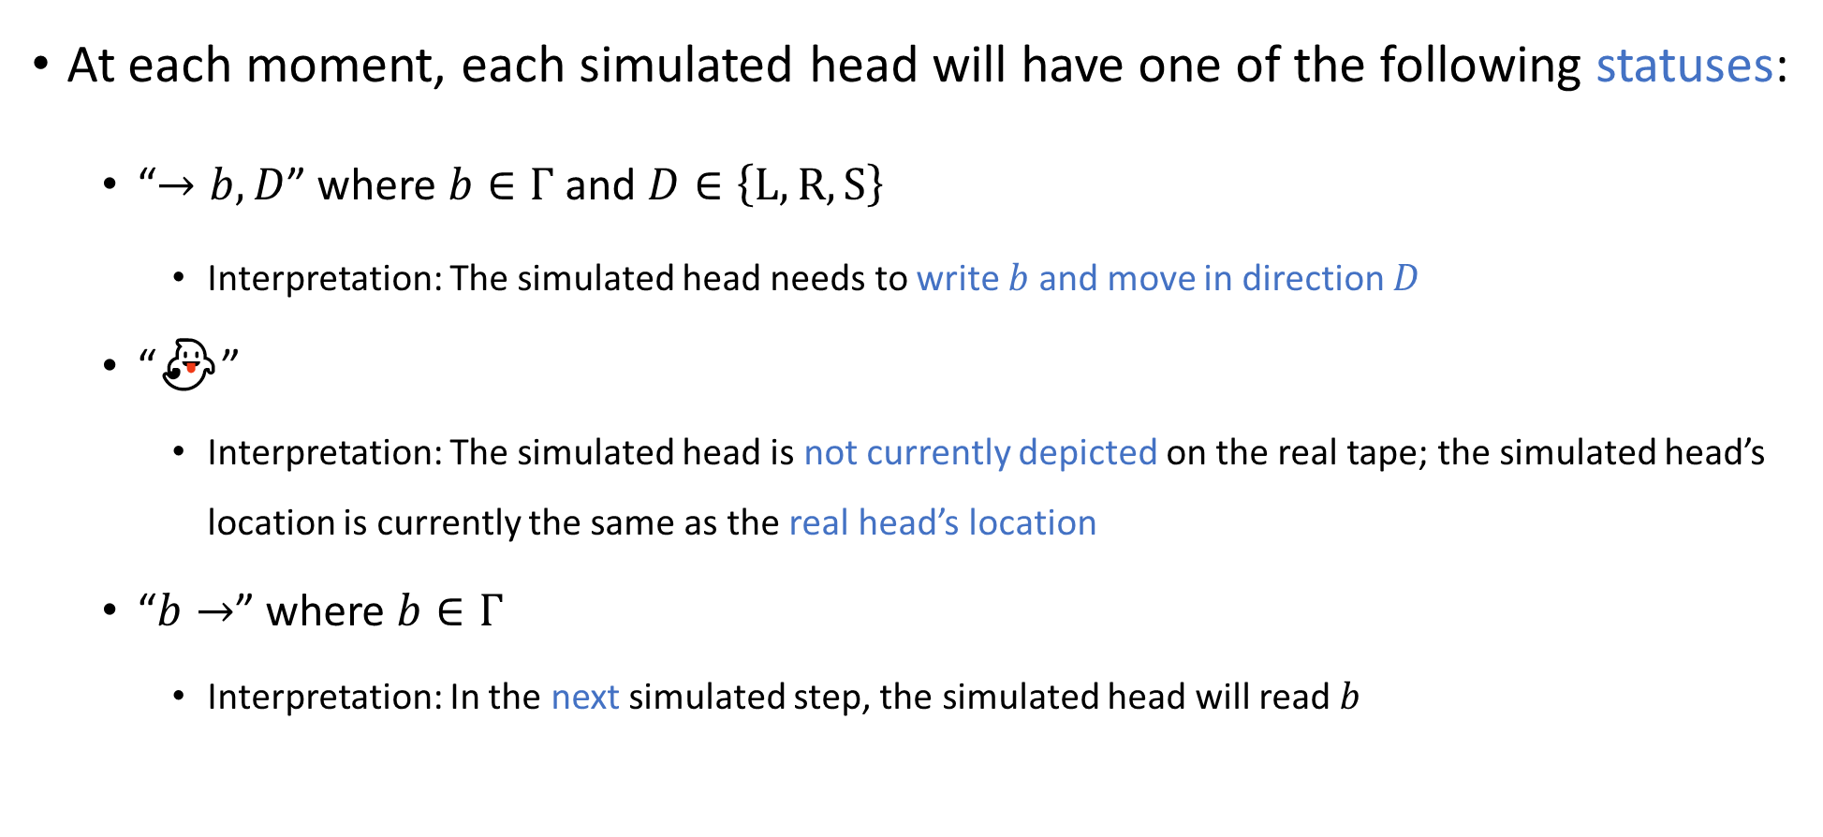

Simulating $k$ tapes with $1$ tape: Head statuses
At each moment, each simulated head will have one of the following statuses:
“$→b,D$” where $b∈Γ$ and $D∈\left\{\text{L},\text{R},\text{S}\right\}$
Interpretation: The simulated head needs to write $b$ and move in direction $D$
“👻”
Interpretation: The simulated head is not currently depicted on the real tape; the simulated head’s location is currently the same as the real head’s location
“$b→$” where $b∈Γ$
Interpretation: In the next simulated step, the simulated head will read $b$

Slide 10


Simulating $k$ tapes with $1$ tape: Head statuses
Let $Ω$ be the set of all possible statuses for a single simulated head:
$$Ω=\left\{“→b,D” :b∈Γ, D∈\left\{\text{L}, \text{R}, \text{S}\right\}\right\} \\ ∪\left\{“\text{👻}”\right\} \\ ∪\left\{“b→” :b∈Γ\right\}$$

Slide 11
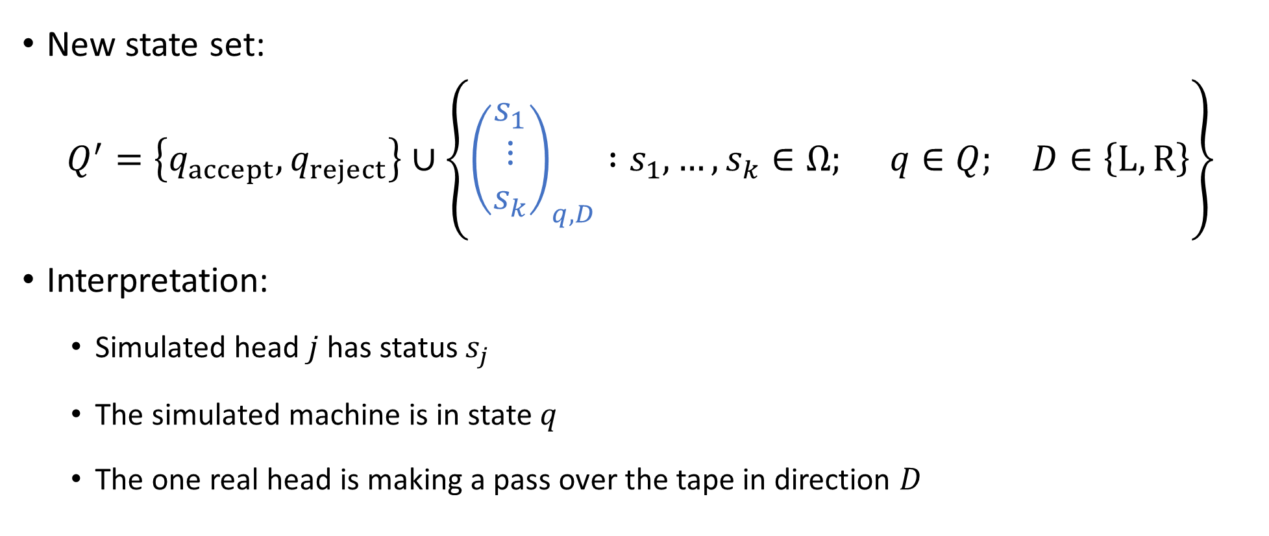

Simulating $k$ tapes with $1$ tape: States
New state set:
$$Q^{′}=\left\{q_{accept},q_{reject}\right\}∪\left\{{\left(\begin{aligned}s_{1} \\ ⋮ \\ s_{k}\end{aligned}\right)}_{q,D} :s_{1},…, s_{k}∈Ω; q∈Q; D∈\left\{\text{L},\text{R}\right\}\right\}$$
Interpretation:
Simulated head $j$ has status $s_{j}$
The simulated machine is in state $q$
The one real head is making a pass over the tape in direction $D$

Slide 12


Simulating $k$ tapes with $1$ tape: Start state
New start state:
$$q_{0}^{′}={\left(\begin{aligned}“\text{👻}” \\ ⋮ \\ “\text{👻}”\end{aligned}\right)}_{q_{0},R}$$

Slide 13


Simulating $k$ tapes with $1$ tape: Transitions
The new transition function will have the form $δ^{′}:Q^{′}×Γ^{′}→Q^{′}×Γ^{′}×\left\{\text{L},\text{R}\right\}$

Slide 14
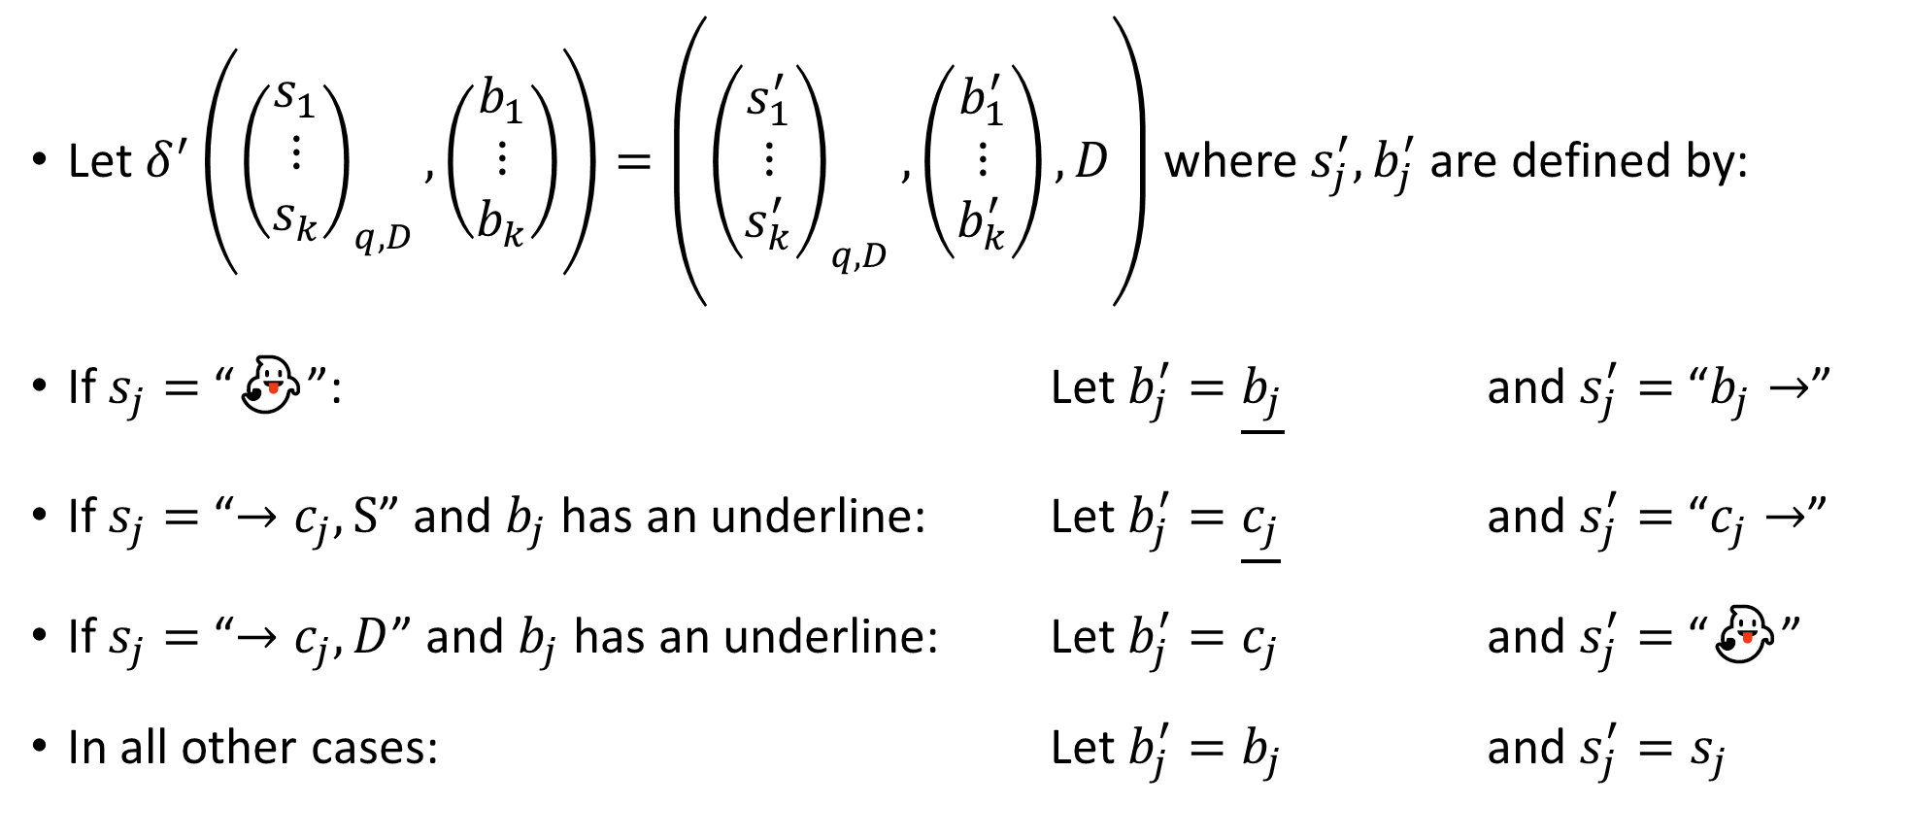

Simulating $k$ tapes with $1$ tape: Transitions
Let $δ^{′}\left({\left(\begin{aligned}s_{1} \\ ⋮ \\ s_{k}\end{aligned}\right)}_{q,D}, \left(\begin{matrix}b_{1} \\ ⋮ \\ b_{k}\end{matrix}\right)\right)=\left({\left(\begin{aligned}s_{1}^{′} \\ ⋮ \\ s_{k}^{′}\end{aligned}\right)}_{q,D},\left(\begin{matrix}b_{1}^{′} \\ ⋮ \\ b_{k}^{′}\end{matrix}\right),D\right)$ where $s_{j}^{′}, b_{j}^{′}$ are defined by:
If $s_{j}=$ “👻”: Let $b_{j}^{′}=\underline{b_{j}}$ and $s_{j}^{′}=$ “$b_{j}→$”
If $s_{j}=$“$→c_{j},\text{S}$” and $b_{j}$ has an underline: Let $b_{j}^{′}=\underline{c_{j}}$ and $s_{j}^{′}=$ “$c_{j}→$”
If $s_{j}=$“$→c_{j}, D$” and $b_{j}$ has an underline: Let $b_{j}^{′}=c_{j}$ and $s_{j}^{′}=$ “👻”
In all other cases: Let $b_{j}^{′}=b_{j}$ and $s_{j}^{′}=s_{j}$

Slide 15

Simulating $k$ tapes with $1$ tape: Transitions
Let $δ^{′}\left({\left(\begin{aligned}s_{1} \\ ⋮ \\ s_{k}\end{aligned}\right)}_{q,R}, ⊔\right)=\left({\left(\begin{aligned}s_{1}^{′} \\ ⋮ \\ s_{k}^{′}\end{aligned}\right)}_{q,L},\left(\begin{matrix}b_{1}^{′} \\ ⋮ \\ b_{k}^{′}\end{matrix}\right),L\right)$ where $s_{j}^{′}, b_{j}^{′}$ are defined by:
If $s_{j}=$ “👻”: Let $b_{j}^{′}= \underline{⊔}$ and $s_{j}^{′}=“⊔ →”$
In all other cases: Let $b_{j}^{′}= ⊔$ and $s_{j}^{′}=s_{j}$

Slide 16
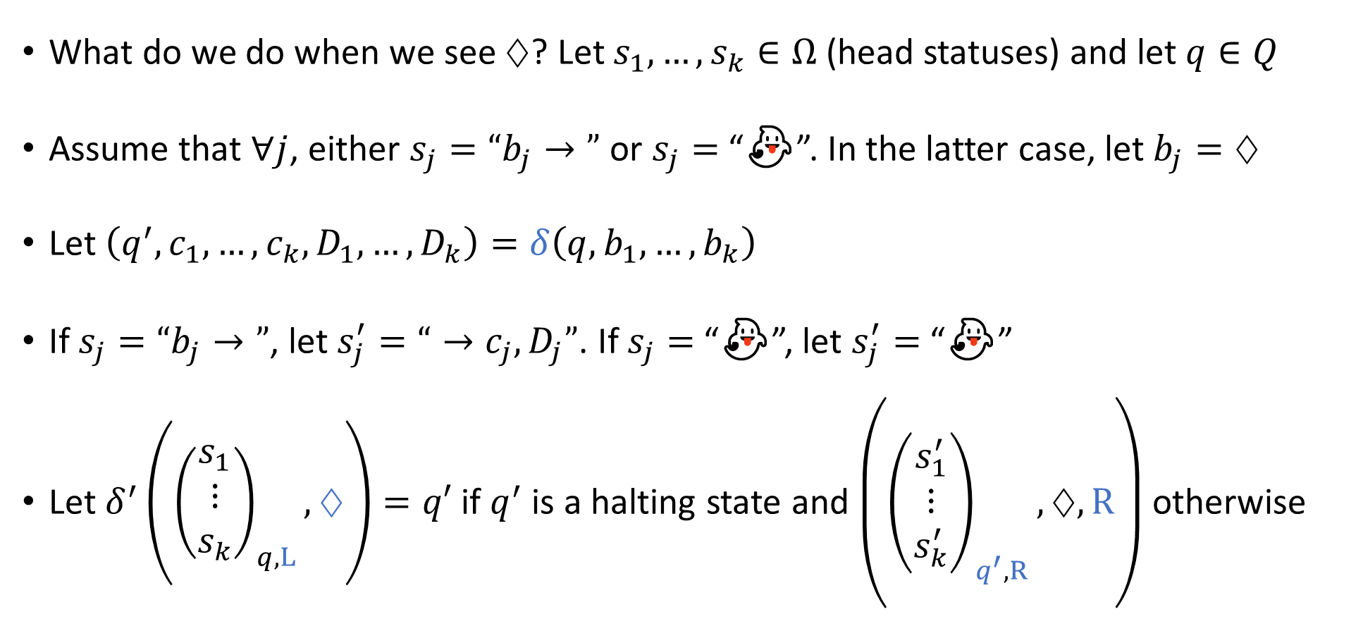

Simulating $k$ tapes with $1$ tape: Transitions
What do we do when we see $♢$? Let $s_{1},…, s_{k}∈Ω$ (head statuses) and let $q∈Q$
Assume that $∀j$, either $s_{j}=“b_{j}→”$ or $s_{j}=$ “👻”. In the latter case, let $b_{j}=♢$
Let $\left(q^{′},c_{1},…, c_{k},D_{1},…, D_{k}\right)=δ\left(q,b_{1},…, b_{k}\right)$
If $s_{j}=“b_{j}→”$, let $s_{j}^{′}=“→c_{j}, D_{j}”$. If $s_{j}=$ “👻”, let $s_{j}^{′}=$ “👻”
Let $δ^{′}\left({\left(\begin{aligned}s_{1} \\ ⋮ \\ s_{k}\end{aligned}\right)}_{q,L}, ♢\right)=q′$ if $q^{′}$ is a halting state and $\left({\left(\begin{aligned}s_{1}^{′} \\ ⋮ \\ s_{k}^{′}\end{aligned}\right)}_{q^{′},R},♢,R\right)$ otherwise

Slide 17

Simulating $k$ tapes with $1$ tape
That completes the definition of $M^{′}$
Exercise: Rigorously prove that $M^{′}$ decides $L$

Slide 18
TMs can simulate all “reasonable” machines
We could add various other bells and whistles to the basic TM model
The ability to observe the two neighboring cells
A tape that extends infinitely in both directions
A two-dimensional tape
None of these changes has any effect on the power of the model

Slide 19
The Church-Turing Thesis
Let $L$ be a language
Church-Turing Thesis:
There exists an “algorithm” / “procedure” for figuring out whether a given string is in $L$ if and only if there exists a Turing machine that decides $L$.
Intuitive notion
Mathematically precise notion

Slide 20
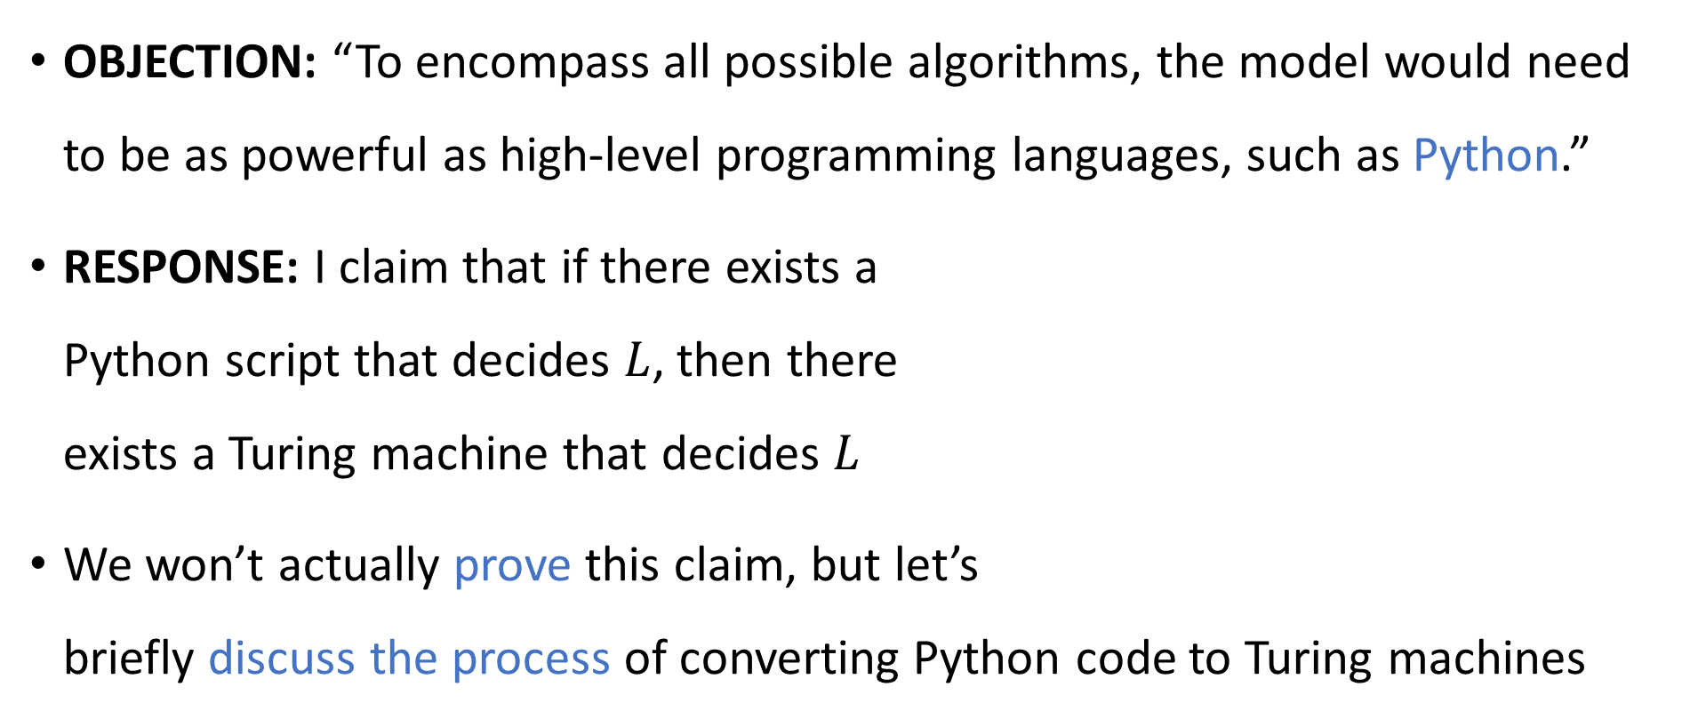
Are Turing machines powerful enough?
OBJECTION: “To encompass all possible algorithms, the model would need to be as powerful as high-level programming languages, such as Python.”
RESPONSE: I claim that if there exists a Python script that decides $L$, then there exists a Turing machine that decides $L$
We won’t actually prove this claim, but let’s briefly discuss the process of converting Python code to Turing machines
1 # Assumption: x, y, z are
2 # nonnegative integers
3 def f(x, y, z):
4 r = 0
5 while (r < y):
6 r = r + x
7 return (r < z)

Slide 21

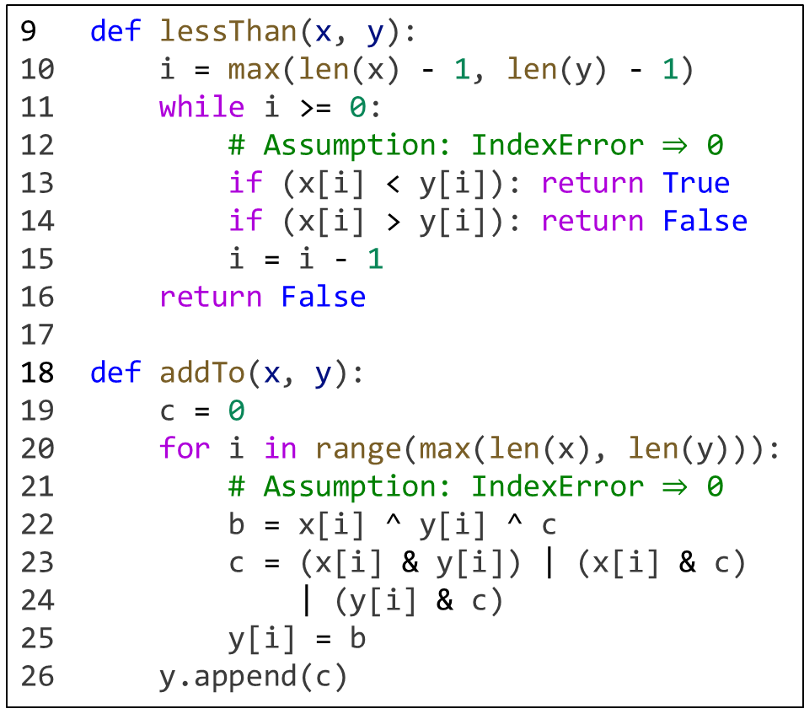
Step 1: Operate at the level of individual bits
9 def lessThan(x, y):
10 i = max(len(x) - 1, len(y) - 1)
11 while i >= 0:
12 # Assumption: IndexError $⇒$ 0 13 if (x[i] < y[i]): return True
14 if (x[i] > y[i]): return False
15 i = i - 1
16 return False
17
18 def addTo(x, y):
19 c = 0
20 for i in range(max(len(x), len(y))):
21 # Assumption: IndexError $⇒$ 0 22 b = x[i] ^ y[i] ^ c
23 c = (x[i] & y[i]) | (x[i] & c)
24 | (y[i] & c)
25 y[i] = b
26 y.append(c)
1 # Assumption: x, y, z are
2 # nonnegative integers
3 def f(x, y, z):
4 r = 0
5 while (r < y):
6 r = r + x
7 return (r < z)
$$⇓$$
1 # Assumption: x, y, z are
2 # lists of bits starting with
3 # the *least* significant
4 def f(x, y, z):
5 r = [0]
6 while (lessThan(r, y)):
7 addTo(x, r)
8 return lessThan(r, z)

Slide 22

Step 2: Eliminate subroutines
1 def f(x, y, z):
2 r = [0]
3 whileCondition = False
4 i = max(len(r) - 1, len(y) - 1)
5 while i >= 0:
6 if (r[i] < y[i]):
7 whileCondition = True
8 break
9 if (r[i] > y[i]):
10 whileCondition = False
11 break
12 i = i - 1 13 if (whileCondition):
14 c = 0
15 for i in range(max(len(x), len(r))):
16 b = x[i] ^ r[i] ^ c
c = (x[i] & r[i]) | (x[i] & c)
| (r[i] & c)
19 r[i] = b
20 r.append(c)
21 whileCondition = False
22 i = max(len(r) - 1, len(y) - 1)
23 while i >= 0:
24 if (r[i] < y[i]):
25 whileCondition = True
26 break
27 if (r[i] > y[i]):
28 whileCondition = False
29 break
30 i = i - 1
31 i = max(len(r) - 1, len(z) - 1)
32 while i >= 0:
33 if (r[i] < z[i]): return True
34 if (r[i] > z[i]): return False
35 i = i - 1
36 return False
1 # Assumption: x, y, z are
2 # lists of bits starting with
3 # the *least* significant
4 def f(x, y, z):
5 r = [0]
6 while (lessThan(r, y)):
7 addTo(x, r)
8 return lessThan(r, z)
$$⇒$$

Slide 23

Step 3: From code to Turing machines
Basic idea:
Variable $⇒$ Tape (assuming the variable holds a list of bits)
List index $⇒$ Head
Line of code $⇒$ State

Slide 24
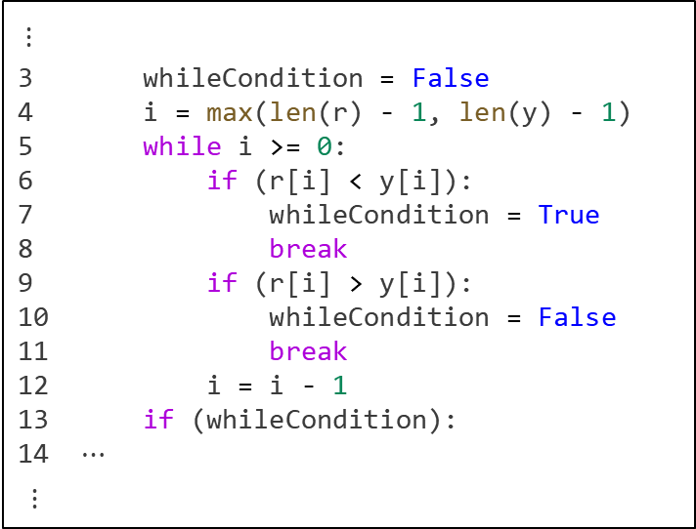
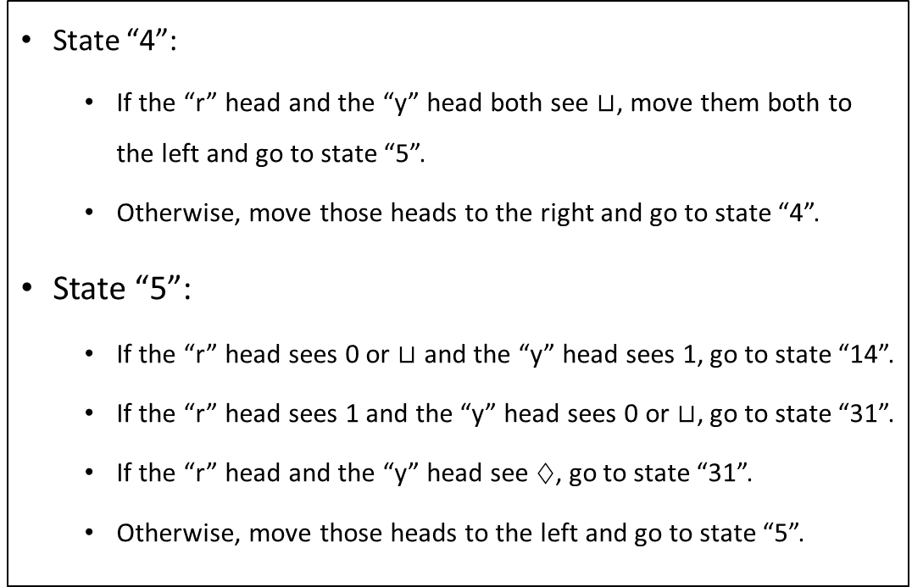

Step 3: From code to Turing machines
State “4”:
If the “r” head and the “y” head both see $⊔$, move them both to the left and go to state “5”.
Otherwise, move those heads to the right and go to state “4”.
State “5”:
If the “r” head sees 0 or $⊔$ and the “y” head sees 1, go to state “14”.
If the “r” head sees 1 and the “y” head sees 0 or $⊔$, go to state “31”.
If the “r” head and the “y” head see $♢$, go to state “31”.
Otherwise, move those heads to the left and go to state “5”.
$⋮$
3 whileCondition = False
4 i = max(len(r) - 1, len(y) - 1)
5 while i >= 0:
6 if (r[i] < y[i]):
7 whileCondition = True
8 break
9 if (r[i] > y[i]):
10 whileCondition = False
11 break
12 i = i - 1 13 if (whileCondition):
14 $⋯$
$⋮$
$$⇒$$

Slide 25
Turing machines as a programming language
You can think of the Turing machine model as a primitive programming language

