Slide 1
CMSC 28100 Introduction to Complexity Theory Autumn 2025 Instructor: William Hoza
⏳

Slide 2
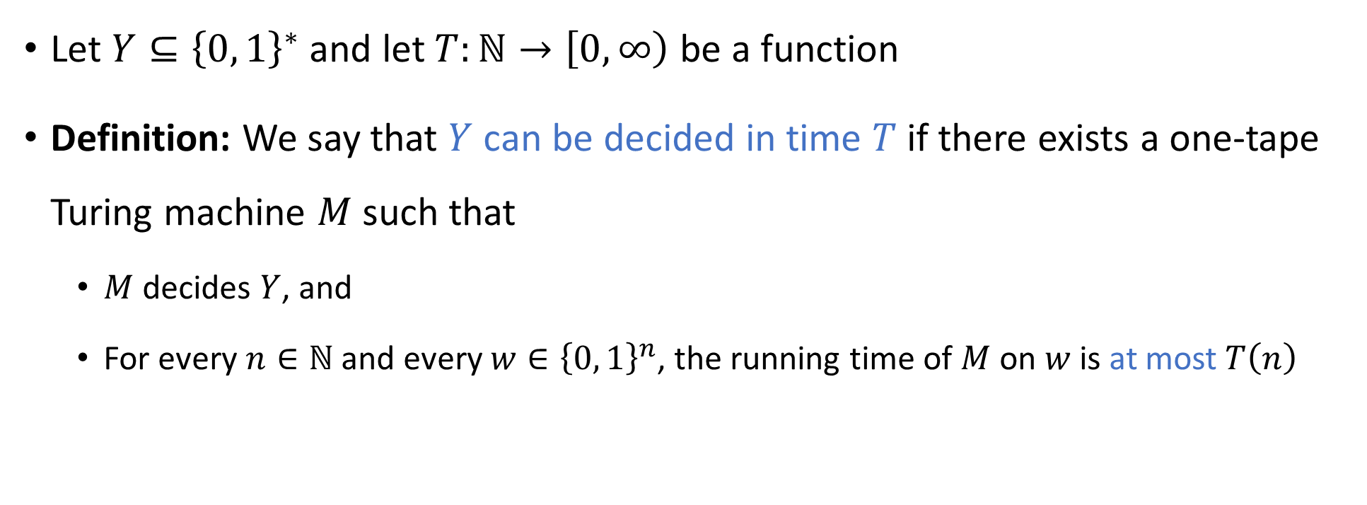
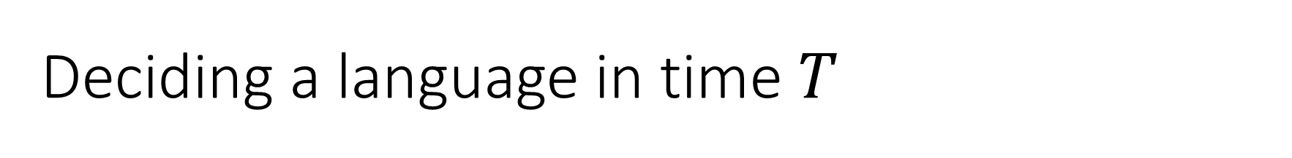
Deciding a language in time $T$
⏳
Let $Y⊆{\left\{0, 1\right\}}^{∗}$ and let $T:ℕ→\left[0, ∞\right)$ be a function
Definition: We say that $Y$ can be decided in time $T$ if there exists a one-tape Turing machine $M$ such that
$M$ decides $Y$, and
For every $n∈ℕ$ and every $w∈{\left\{0, 1\right\}}^{n}$, the running time of $M$ on $w$ is at most $T\left(n\right)$

Slide 3

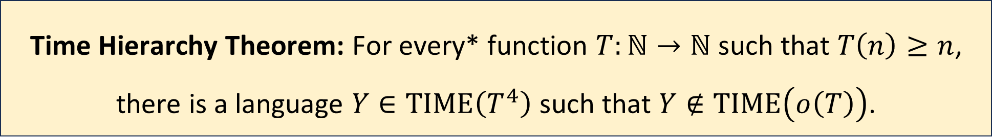
The Time Hierarchy Theorem
*assuming $T$ is a “reasonable” time complexity bound. We will come back to this
“$\text{TIME}\left(o\left(T\right)\right)$” means the set of languages that are decidable in time $o\left(T\right)$
“Given more time, we can solve more problems”
Time Hierarchy Theorem: For every* function $T:ℕ→ℕ$ such that $T\left(n\right)≥n$, there is a language $Y∈\text{TIME}\left(T^{4}\right)$ such that $Y∉\text{TIME}\left(o\left(T\right)\right)$.
Notes:
See the textbook for a tighter version of the theorem, where the bound is T log T instead of T^4

Slide 4

Proof of the Time Hierarchy Theorem
Let $Y=\left\{\left\langle M\right\rangle :M \text{rejects} \left\langle M\right\rangle \text{within} T\left(\left|\left\langle M\right\rangle \right|\right) \text{steps}\right\}$
On the next four slides, we will prove:
$Y∈\text{TIME}\left(T^{4}\right)$
$Y∉\text{TIME}\left(o\left(T\right)\right)$

Slide 5

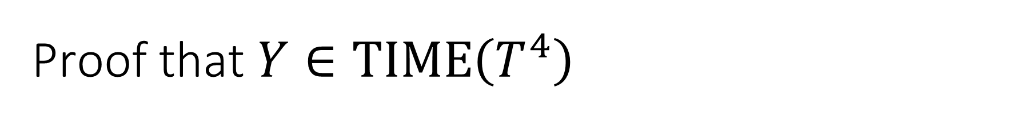

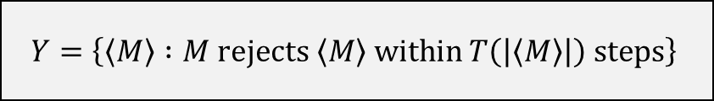
Proof that $Y∈\text{TIME}\left(T^{4}\right)$
$$Y=\left\{\left\langle M\right\rangle :M \text{rejects} \left\langle M\right\rangle \text{within} T\left(\left|\left\langle M\right\rangle \right|\right) \text{steps}\right\}$$
An algorithm that decides $Y$:
Time complexity in the TM model?
Given the input $\left\langle M\right\rangle$:
Simulate $M$ on $\left\langle M\right\rangle$ for $T\left(\left|\left\langle M\right\rangle \right|\right)$ steps
If it rejects within that time, accept
Otherwise, reject

Slide 6

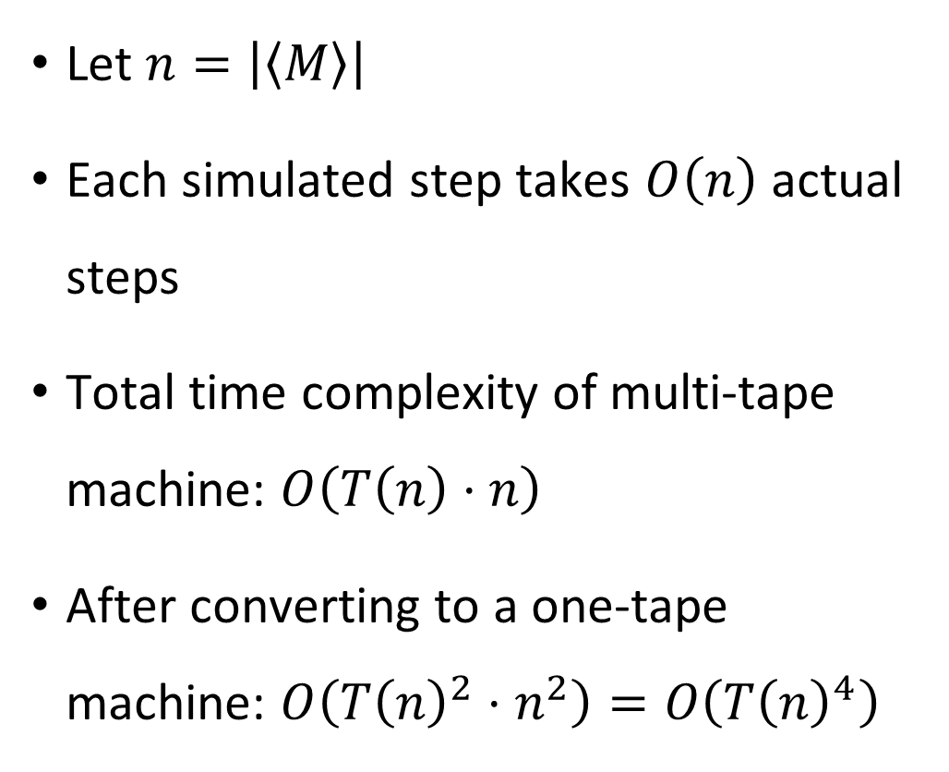

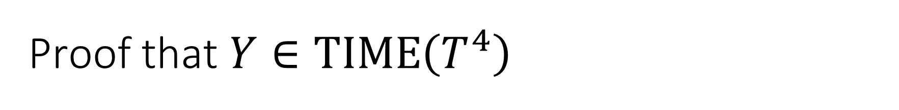



Proof that $Y∈\text{TIME}\left(T^{4}\right)$
$$Y=\left\{\left\langle M\right\rangle :M \text{rejects} \left\langle M\right\rangle \text{within} T\left(\left|\left\langle M\right\rangle \right|\right) \text{steps}\right\}$$
Let $n=\left|\left\langle M\right\rangle \right|$
Each simulated step takes $O\left(n\right)$ actual steps
Total time complexity of multi-tape machine: $O\left(T\left(n\right)⋅n\right)$
After converting to a one-tape machine: $O\left(T{\left(n\right)}^{2}⋅n^{2}\right)=O\left(T{\left(n\right)}^{4}\right)$
$$1^{k}0\left\langle δ\right\rangle$$
$$q$$
$$\left\langle δ\right\rangle$$
$$…\left\langle b_{i−2}\right\rangle \left\langle b_{i−1}\right\rangle \left\langle b_{i}\right\rangle \left\langle b_{i+1}\right\rangle \left\langle b_{i+2}\right\rangle …$$
$$1^{T\left(\left|\left\langle M\right\rangle \right|\right)}$$

Slide 7
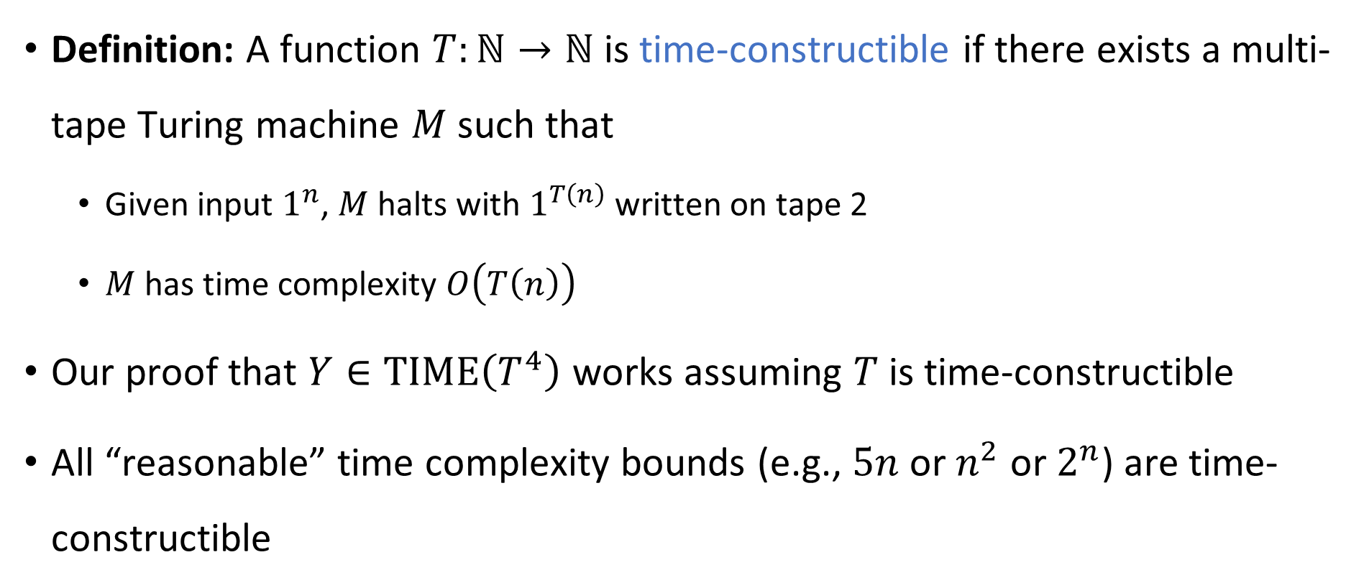
Time-constructible functions
Definition: A function $T:ℕ→ℕ$ is time-constructible if there exists a multi-tape Turing machine $M$ such that
Given input $1^{n}$, $M$ halts with $1^{T\left(n\right)}$ written on tape 2
$M$ has time complexity $O\left(T\left(n\right)\right)$
Our proof that $Y∈\text{TIME}\left(T^{4}\right)$ works assuming $T$ is time-constructible
All “reasonable” time complexity bounds (e.g., $5n$ or $n^{2}$ or $2^{n}$) are time-constructible

Slide 8
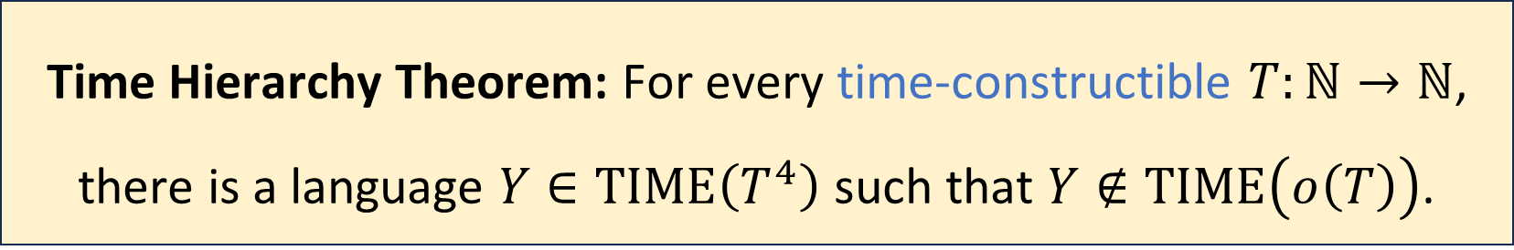
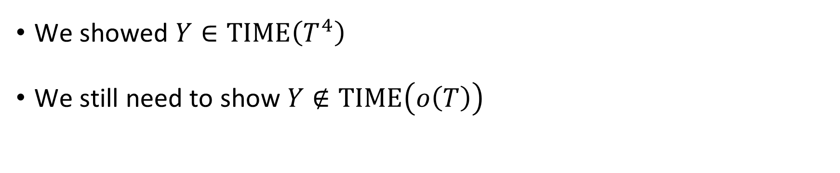

Time Hierarchy Theorem
$$Y=\left\{\left\langle M\right\rangle :M \text{rejects} \left\langle M\right\rangle \text{within} T\left(\left|\left\langle M\right\rangle \right|\right) \text{steps}\right\}$$
Time Hierarchy Theorem: For every time-constructible $T:ℕ→ℕ$, there is a language $Y∈\text{TIME}\left(T^{4}\right)$ such that $Y∉\text{TIME}\left(o\left(T\right)\right)$.
We showed $Y∈\text{TIME}\left(T^{4}\right)$
We still need to show $Y∉\text{TIME}\left(o\left(T\right)\right)$

Slide 9
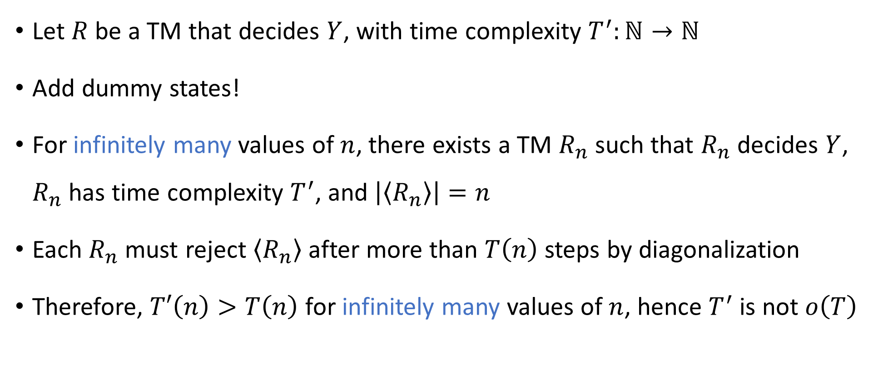
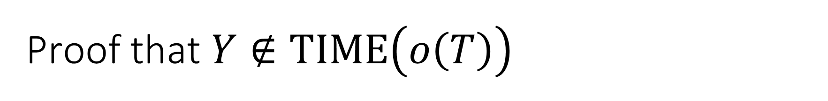
Proof that $Y∉\text{TIME}\left(o\left(T\right)\right)$
$$Y=\left\{\left\langle M\right\rangle :M \text{rejects} \left\langle M\right\rangle \text{within} T\left(\left|\left\langle M\right\rangle \right|\right) \text{steps}\right\}$$
Let $R$ be a TM that decides $Y$, with time complexity $T^{′}:ℕ→ℕ$
Add dummy states!
For infinitely many values of $n$, there exists a TM $R_{n}$ such that $R_{n}$ decides $Y$, $R_{n}$ has time complexity $T^{′}$, and $\left|\left\langle R_{n}\right\rangle \right|=n$
Each $R_{n}$ must reject $\left\langle R_{n}\right\rangle$ after more than $T\left(n\right)$ steps by diagonalization
Therefore, $T′\left(n\right)>T\left(n\right)$ for infinitely many values of $n$, hence $T^{′}$ is not $o\left(T\right)$

Slide 10


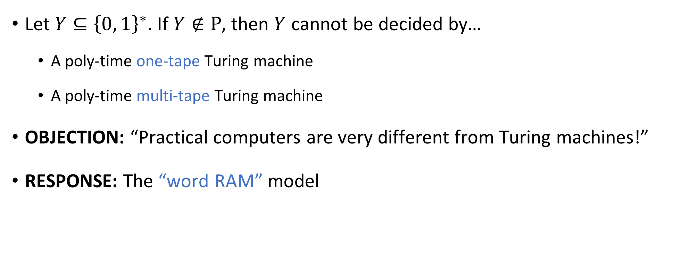
Robustness of $\text{P}$, revisited
Let $Y⊆{\left\{0, 1\right\}}^{∗}$. If $Y∉\text{P}$, then $Y$ cannot be decided by…
A poly-time one-tape Turing machine
A poly-time multi-tape Turing machine
OBJECTION: “Practical computers are very different from Turing machines!”
RESPONSE: The “word RAM” model

Slide 11
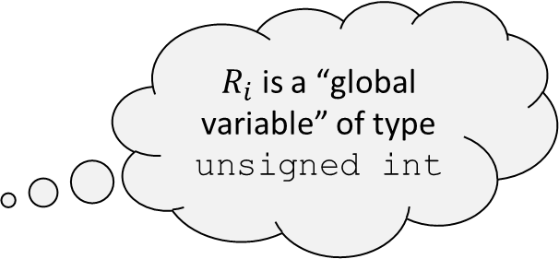
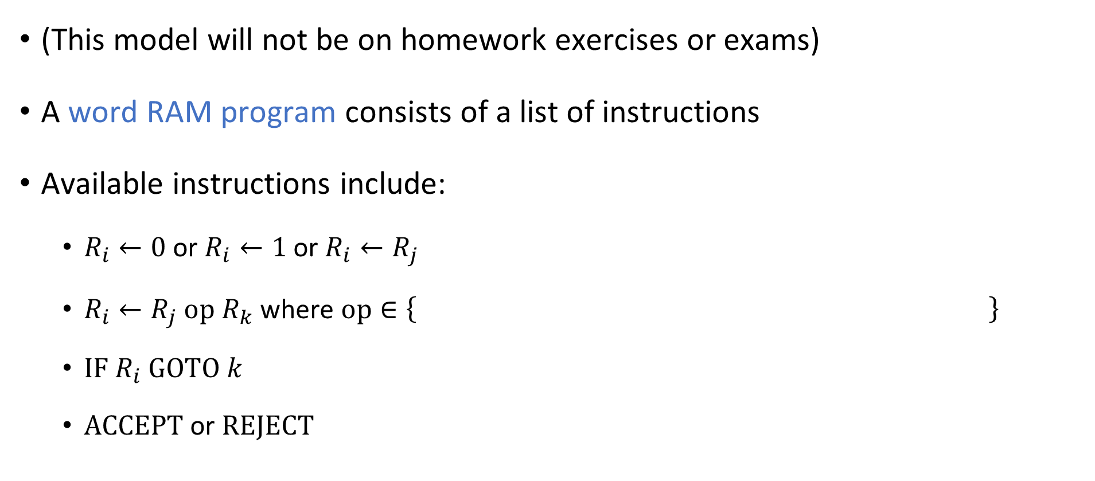
Word RAM model (RAM = Random Access Machine)
(This model will not be on homework exercises or exams)
A word RAM program consists of a list of instructions
Available instructions include:
$R_{i}←0$ or $R_{i}←1$ or $R_{i}←R_{j}$
$R_{i}←R_{j} \text{op} R_{k}$ where $\text{op}∈\left\{ \right\}$
$\text{IF} R_{i} \text{GOTO} k$
$\text{ACCEPT}$ or $\text{REJECT}$
$R_{i}$ is a “global variable” of type unsigned int
+, -, *, /, %, ==, <, >, &&, ||, &, |, ^, <<, >>
(The details are not completely standardized. This is just one reasonable version of the model)

Slide 12
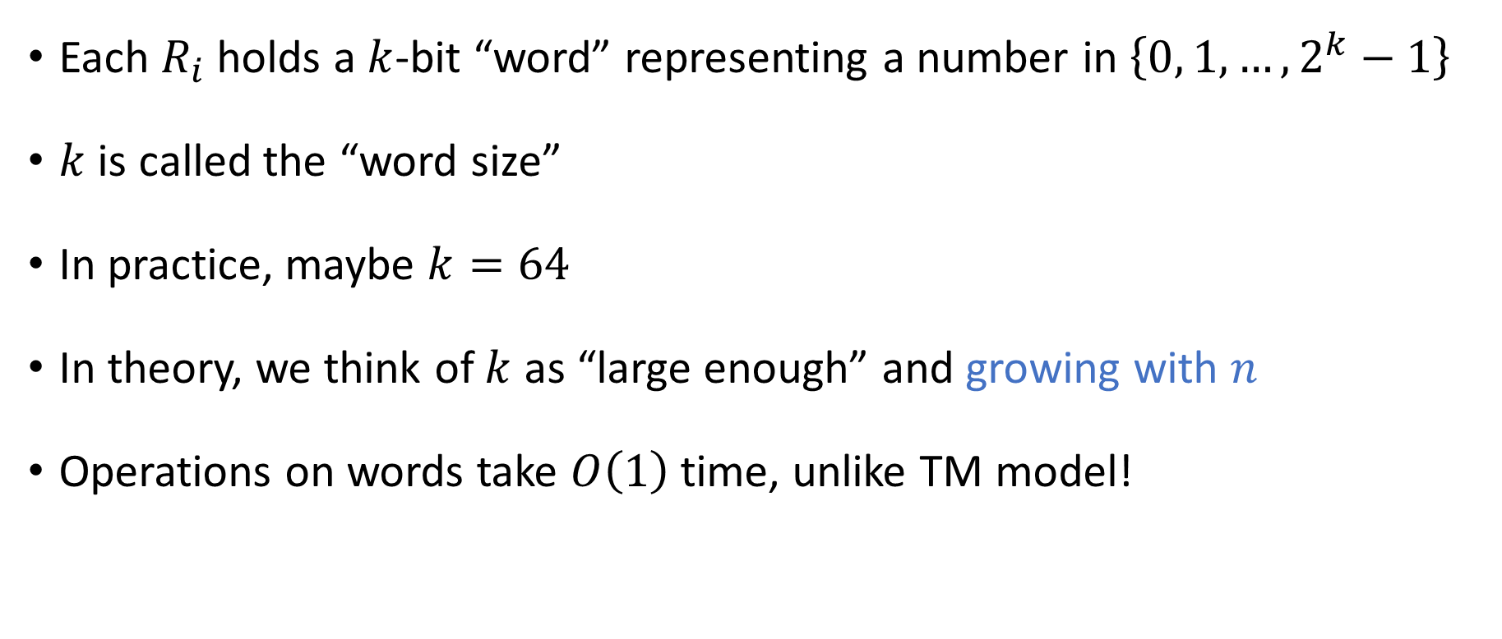
Word RAM model
Each $R_{i}$ holds a $k$-bit “word” representing a number in $\left\{0, 1, …, 2^{k}−1\right\}$
$k$ is called the “word size”
In practice, maybe $k=64$
In theory, we think of $k$ as “large enough” and growing with $n$
Operations on words take $O\left(1\right)$ time, unlike TM model!

Slide 13





Word RAM model
$$\text{MEMORY}$$
100
010
110
101
110
110
111
000
There is also a large memory (an array of words)
Instructions:
$R_{i}←\text{MEMORY}\left[R_{j}\right]$
$\text{MEMORY}\left[R_{i}\right]←R_{j}$
Instantly access any desired location in memory, unlike the TM model!
$$R_{1}$$
110
Control
$$R_{2}$$
101
Load/Store
$$R_{3}$$
110

Slide 14



Word RAM model
Let the input be $w∈{\left\{0, 1\right\}}^{n}$ and let the word size be $k≥\log\left(n+1\right)$
$\text{MEMORY}$ has $2^{k}$ cells
Initially, $\text{MEMORY}\left[0\right]=n$ and $\text{MEMORY}\left[i\right]=w_{i}$ for $1≤i≤n$
Example: $$w=100110$$
$$k=3$$
110
001
000
000
001
001
000
000
$$\text{MEMORY}$$

Slide 15
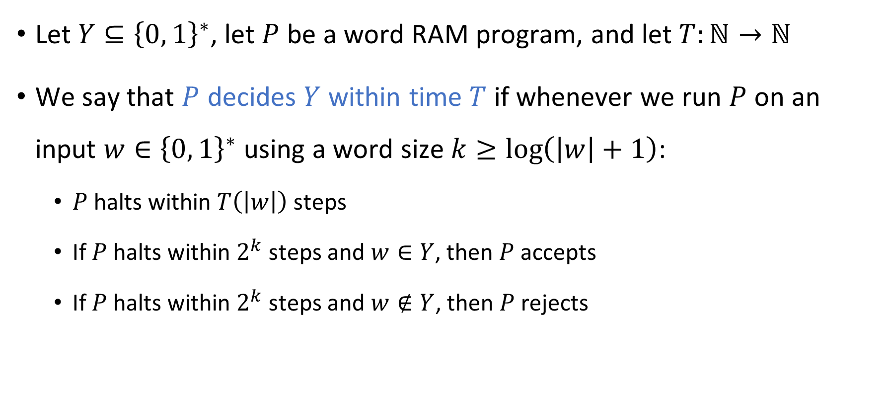

Word RAM model
⏳
Let $Y⊆{\left\{0, 1\right\}}^{∗}$, let $P$ be a word RAM program, and let $T:ℕ→ℕ$
We say that $P$ decides $Y$ within time $T$ if whenever we run $P$ on an input $w∈{\left\{0, 1\right\}}^{∗}$ using a word size $k≥\log\left(\left|w\right|+1\right)$:
$P$ halts within $T\left(\left|w\right|\right)$ steps
If $P$ halts within $2^{k}$ steps and $w∈Y$, then $P$ accepts
If $P$ halts within $2^{k}$ steps and $w∉Y$, then $P$ rejects
Computation is not reliable after $2^{k}$ steps
Notes:
Voids the warranty

Slide 16
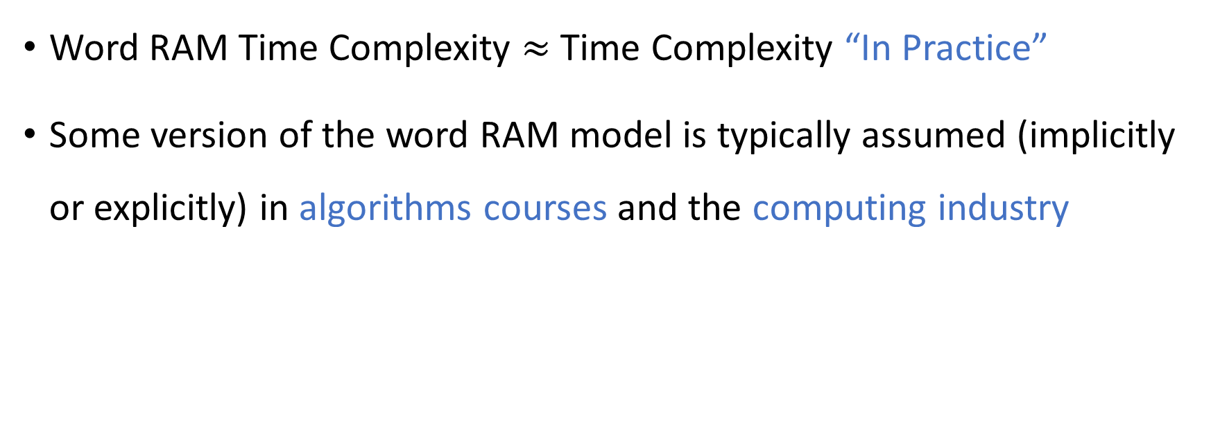
Word RAM model
Word RAM Time Complexity $≈$ Time Complexity “In Practice”
Some version of the word RAM model is typically assumed (implicitly or explicitly) in algorithms courses and the computing industry

Slide 17


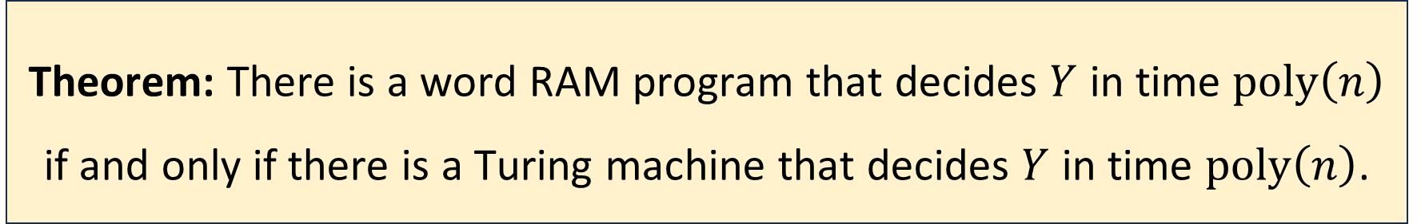
Robustness of $\text{P}$
Let $Y⊆{\left\{0, 1\right\}}^{∗}$
Proof omitted
Theorem: There is a word RAM program that decides $Y$ in time $\text{poly}\left(n\right)$ if and only if there is a Turing machine that decides $Y$ in time $\text{poly}\left(n\right)$.

Slide 18
Which problems can be solved through computation?

Slide 19
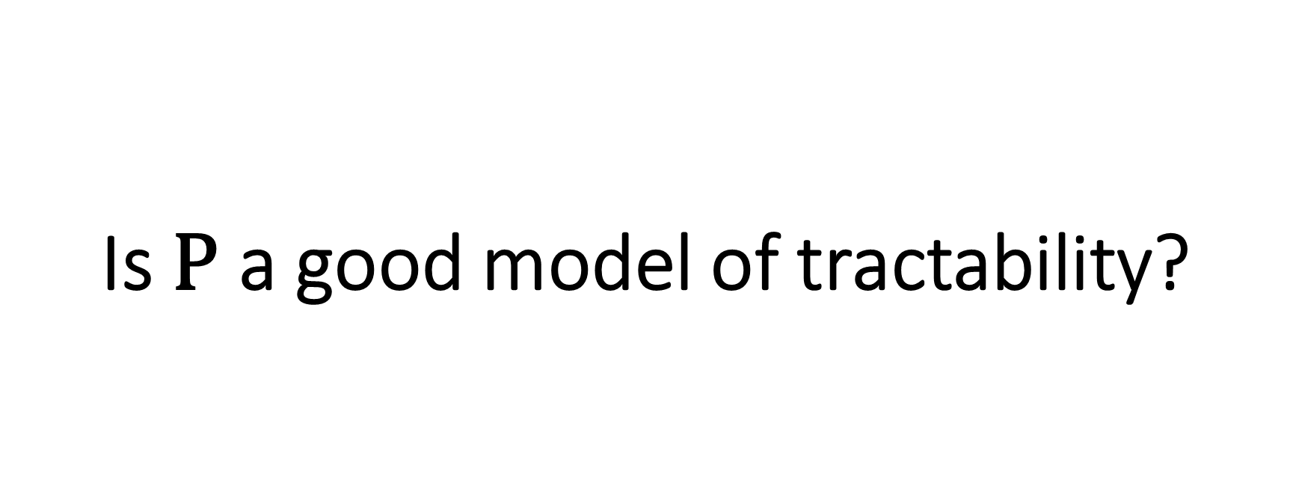
Is $\text{P}$ a good model of tractability?

Slide 20
Boolean logic
We have studied several rival models of computation
Turing machine, multi-tape Turing machine, word RAM, …
Next: Computation based on networks of logic gates
Closely related to practical electronics
Extremely important in theory, too!

Slide 21
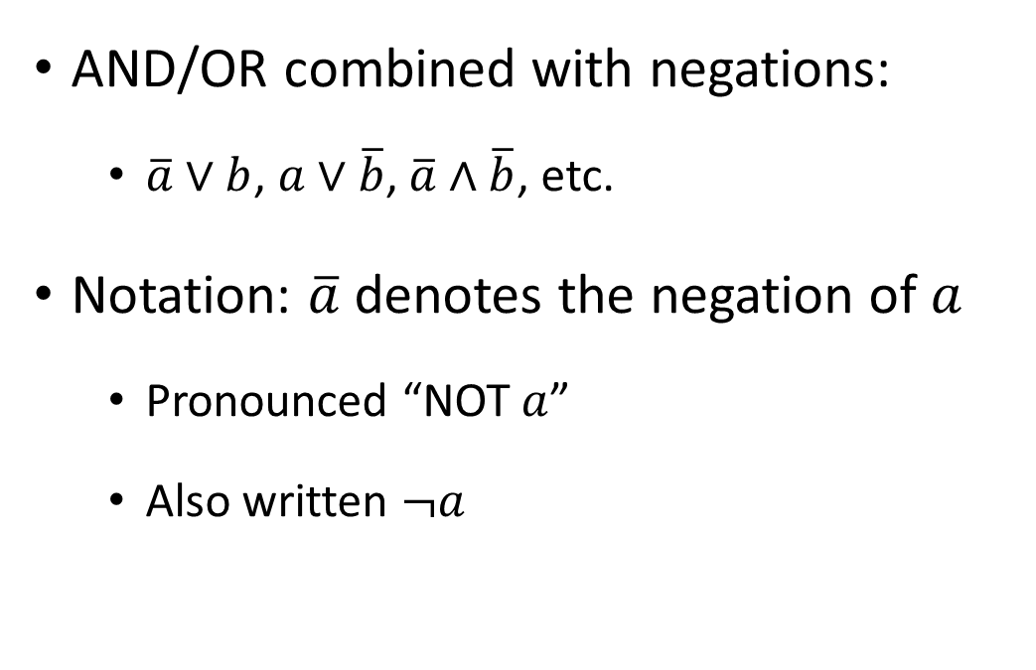

Binary logical operations
AND: $a∧b$
OR: $a∨b$
XOR: $a⊕b$
Equality: $a==b$
AND/OR combined with negations:
$\overline{a}∨b$, $a∨\overline{b}$, $\overline{a}∧\overline{b}$, etc.
Notation: $\overline{a}$ denotes the negation of $a$
Pronounced “NOT $a$”
Also written $¬a$

Slide 22

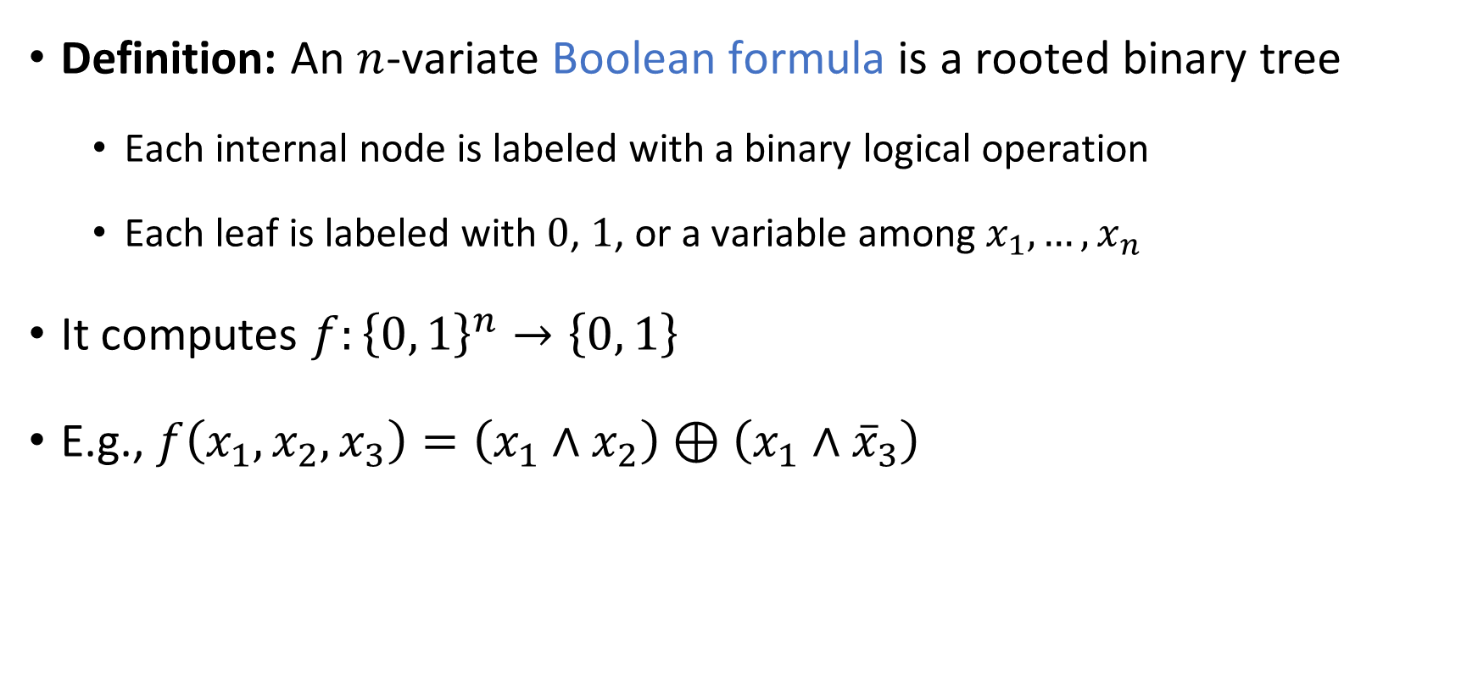







Boolean formulas
Definition: An $n$-variate Boolean formula is a rooted binary tree
Each internal node is labeled with a binary logical operation
Each leaf is labeled with $0$, $1$, or a variable among $x_{1},…,x_{n}$
It computes $f:{\left\{0, 1\right\}}^{n}→\left\{0, 1\right\}$
E.g., $f\left(x_{1},x_{2},x_{3}\right)=\left(x_{1}∧x_{2}\right)⊕\left(x_{1}∧{\overline{x}}_{3}\right)$
$$⊕$$
$$∧$$
$$∧$$
$$¬$$
$$x_{1}$$
$$x_{2}$$
$$x_{1}$$
$$x_{3}$$
Notes:
More specifically, this is a “Boolean formula over the full binary basis”

Slide 23










Boolean circuits
1
1
$$∨$$
0
0
$$∨$$
1
A Boolean circuit is like a Boolean formula, except that we permit vertices to have multiple outgoing wires
1
0
0
0
0
$$∧$$
$$∧$$
$$∧$$
1
0
1
0
1
0
1
0
1
1
1
$$⊕$$
1
$$⊕$$
1
1
1
1
0
1
0
1
$$x_{2}$$
$$x_{1}$$
$$x_{3}$$
1
1
0

