Slide 1
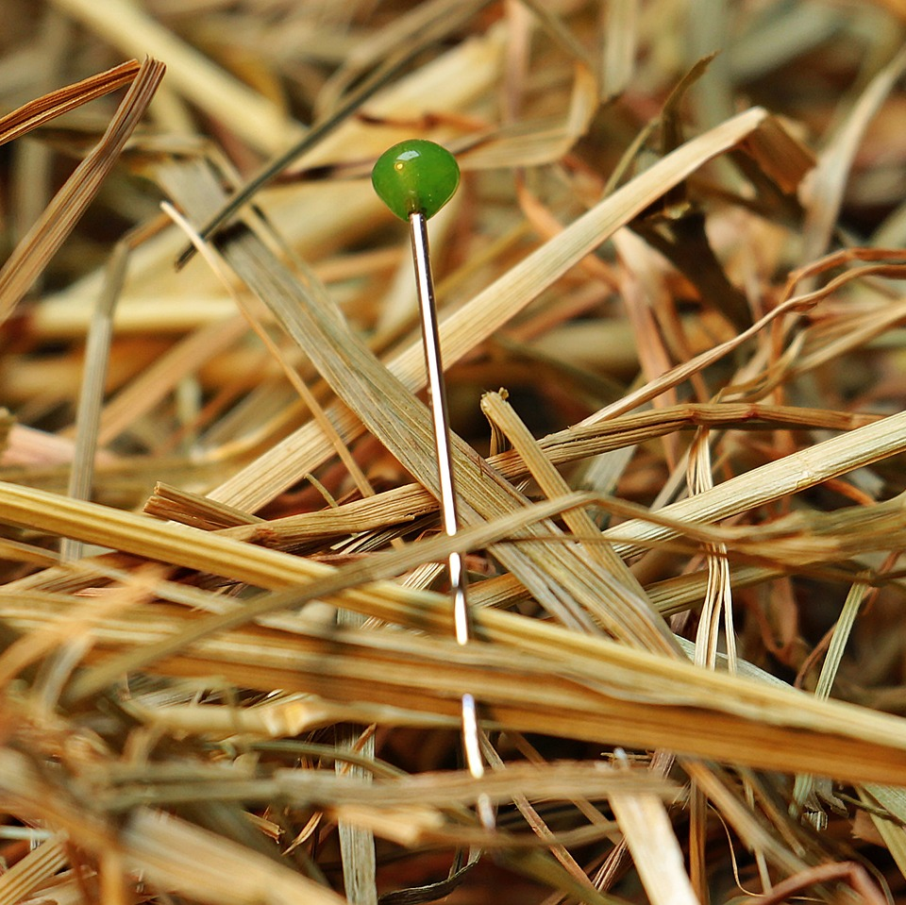
CMSC 28100 Introduction to Complexity Theory Spring 2025 Instructor: William Hoza

Slide 2
Homework
Exercises 1-4 are available in Canvas (due on Tuesday)
If you aren’t officially enrolled, send me an email
Office hours (Thursday, Friday, Monday) are a good place to find study partners / homework collaborators

Slide 3
Which problems can be solved through computation?

Slide 4
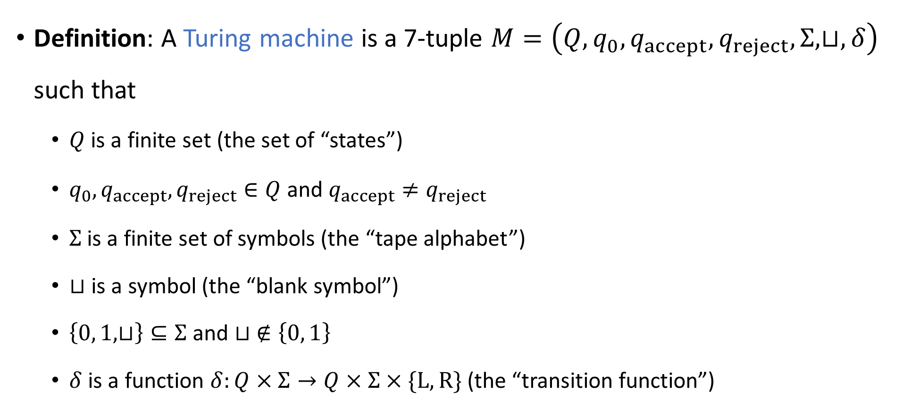
Defining Turing machines rigorously
Definition: A Turing machine is a 7-tuple $M=\left(Q,q_{0},q_{accept},q_{reject}, Σ,⊔,δ\right)$ such that
$Q$ is a finite set (the set of “states”)
$q_{0},q_{accept},q_{reject}∈Q$ and $q_{accept}≠q_{reject}$
$Σ$ is a finite set of symbols (the “tape alphabet”)
$⊔$ is a symbol (the “blank symbol”)
$\left\{0, 1, ⊔\right\}⊆Σ$ and $⊔ ∉\left\{0, 1\right\}$
$δ$ is a function $δ:Q×Σ→Q×Σ×\{\text{L}, \text{R}\}$ (the “transition function”)
⚠️Warning: The definition in the textbook is slightly different. Sorry! (The two models are equivalent.)

Slide 5





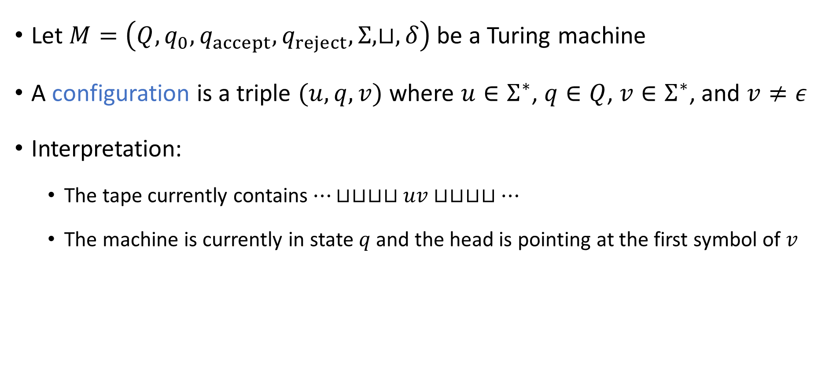









Configurations of a Turing machine
Let $M=\left(Q,q_{0},q_{accept},q_{reject}, Σ,⊔,δ\right)$ be a Turing machine
A configuration is a triple $(u, q, v)$ where $u∈Σ^{∗}$, $q∈Q$, $v∈Σ^{∗}$, and $v≠ε$
Interpretation:
The tape currently contains $⋯⊔⊔⊔⊔uv⊔⊔⊔⊔…$
The machine is currently in state $q$ and the head is pointing at the first symbol of $v$
$$⊔$$
$$⊔$$
$$u_{1}$$
$$u_{2}$$
$$⋯$$
$$u_{n}$$
$$v_{1}$$
$$v_{2}$$
$$⋯$$
$$v_{m}$$
$$⊔$$
$$⊔$$
$$⊔$$
$$q$$

Slide 6

The initial configuration
Let $w∈{\left\{0, 1\right\}}^{∗}$ be an input
The initial configuration of $M$ on $w$ is
$$\left\{\begin{aligned}q_{0}w \text{if} w≠ε \\ q_{0}⊔ \text{if} w=ε\end{aligned}\right.$$

Slide 7
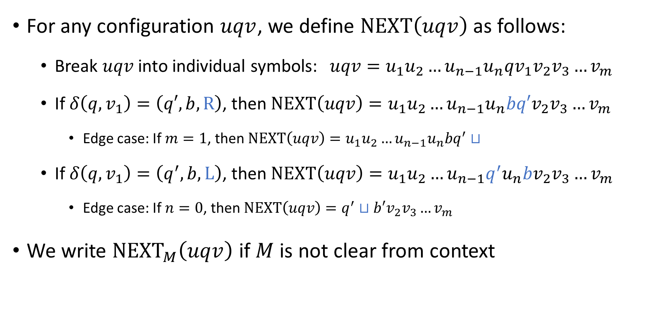
The “next” configuration
For any configuration $uqv$, we define $\text{NEXT}\left(uqv\right)$ as follows:
Break $uqv$ into individual symbols: $uqv=u_{1}u_{2}…u_{n−1}u_{n}qv_{1}v_{2}v_{3}…v_{m}$
If $δ\left(q,v_{1}\right)=\left(q′,b,\text{R}\right)$, then $\text{NEXT}\left(uqv\right)=u_{1}u_{2}…u_{n−1}u_{n}bq′v_{2}v_{3}…v_{m}$
Edge case: If $m=1$, then $\text{NEXT}\left(uqv\right)=u_{1}u_{2}…u_{n−1}u_{n}bq^{′}⊔$
If $δ\left(q, v_{1}\right)=\left(q^{′},b,\text{L}\right)$, then $\text{NEXT}\left(uqv\right)=u_{1}u_{2}…u_{n−1}q^{′}u_{n}bv_{2}v_{3}…v_{m}$
Edge case: If $n=0$, then $\text{NEXT}\left(uqv\right)=q^{′}⊔b′v_{2}v_{3}…v_{m}$
We write ${\text{NEXT}}_{M}\left(uqv\right)$ if $M$ is not clear from context

Slide 8
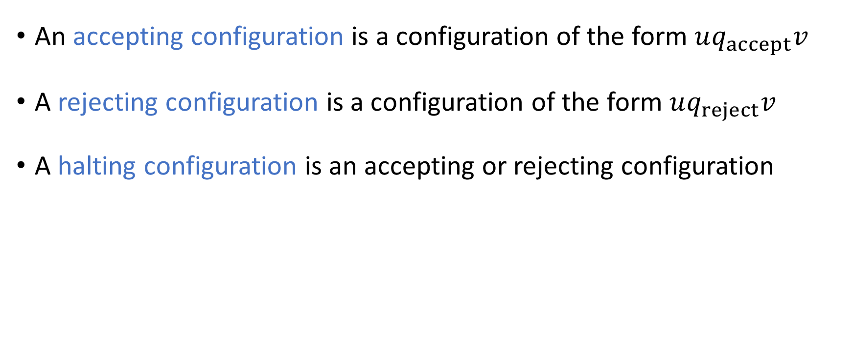
Halting configurations
An accepting configuration is a configuration of the form $uq_{accept}v$
A rejecting configuration is a configuration of the form $uq_{reject}v$
A halting configuration is an accepting or rejecting configuration

Slide 9
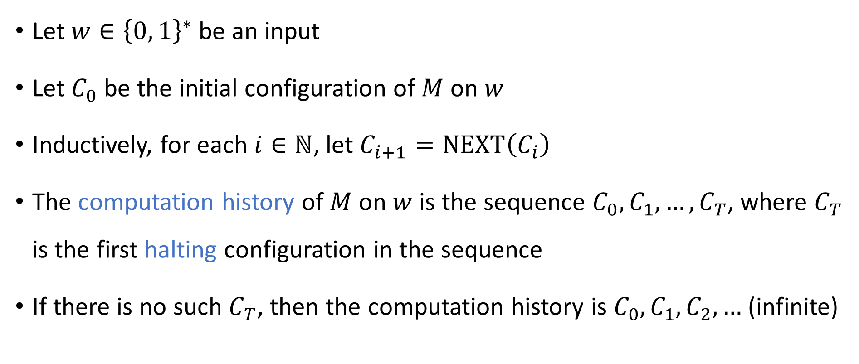
Computation history
Let $w∈{\left\{0, 1\right\}}^{∗}$ be an input
Let $C_{0}$ be the initial configuration of $M$ on $w$
Inductively, for each $i∈ℕ$, let $C_{i+1}=\text{NEXT}\left(C_{i}\right)$
The computation history of $M$ on $w$ is the sequence $C_{0},C_{1},…, C_{T}$, where $C_{T}$ is the first halting configuration in the sequence
If there is no such $C_{T}$, then the computation history is $C_{0},C_{1},C_{2},…$ (infinite)

Slide 10
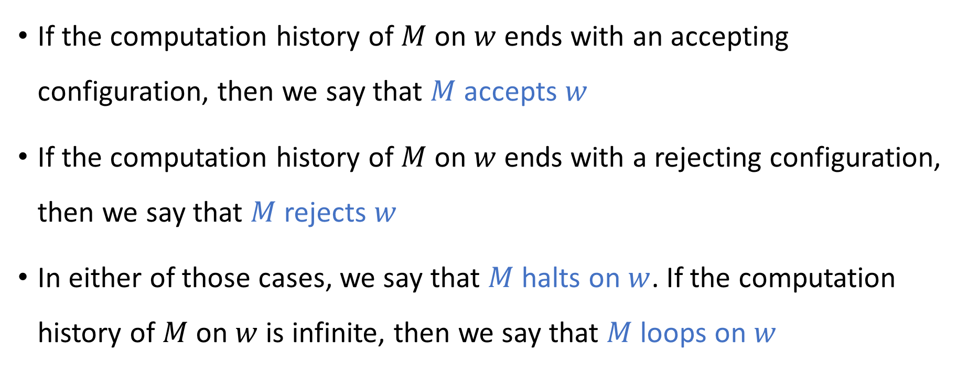
Accepting, rejecting, and looping
If the computation history of $M$ on $w$ ends with an accepting configuration, then we say that $M$ accepts $w$
If the computation history of $M$ on $w$ ends with a rejecting configuration, then we say that $M$ rejects $w$
In either of those cases, we say that $M$ halts on $w$. If the computation history of $M$ on $w$ is infinite, then we say that $M$ loops on $w$

Slide 11

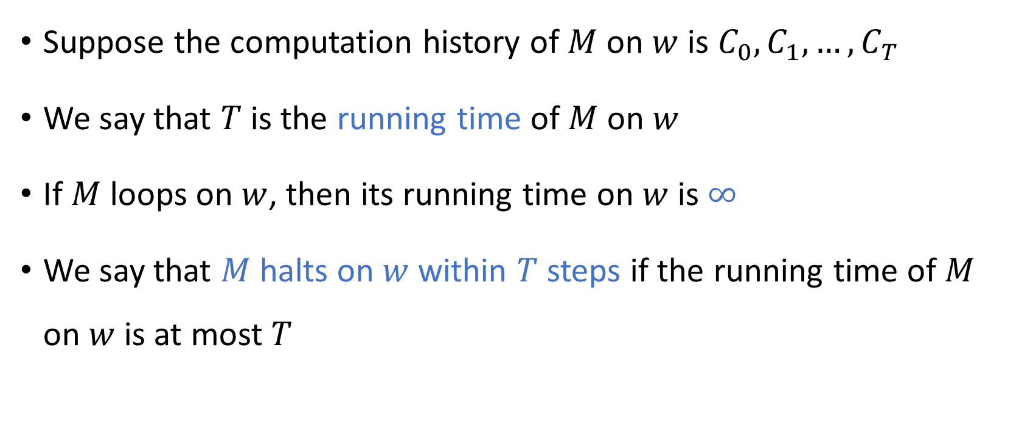
Time
Suppose the computation history of $M$ on $w$ is $C_{0},C_{1},…, C_{T}$
We say that $T$ is the running time of $M$ on $w$
If $M$ loops on $w$, then its running time on $w$ is $∞$
We say that $M$ halts on $w$ within $T$ steps if the running time of $M$ on $w$ is at most $T$

Slide 12
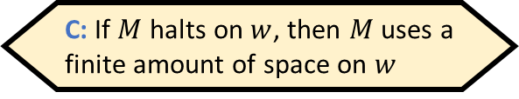

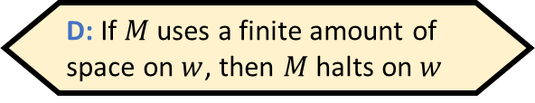
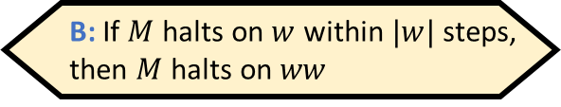
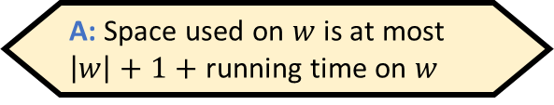
Space
The space used by $M$ on $w$ is the number of cells that are “used”
I.e., the head visits the cell OR the cell initially contains an input bit
(Can be $∞$)
Formally, let $C_{0},C_{1},…$ be the (finite or infinite) computation history of $M$ on $w$
Write $C_{i}=\left(u_{i},q_{i},v_{i}\right)$ where $u_{i}∈Σ^{∗}$, $q_{i}∈Q$, $v_{i}∈Σ^{∗}$
The space used by $M$ on $w$ is $\max_{i}{ \left|u_{i}v_{i}\right|}$
Which of the following statements is false?
A: Space used on $w$ is at most $\left|w\right|+1+$ running time on $w$
B: If $M$ halts on $w$ within $|w|$ steps, then $M$ halts on $ww$
C: If $M$ halts on $w$, then $M$ uses a finite amount of space on $w$
D: If $M$ uses a finite amount of space on $w$, then $M$ halts on $w$
Respond at PollEv.com/whoza or text “whoza” to 22333

Slide 13
Which problems can be solved through computation?

Slide 14

Languages
A binary language is a set $Y⊆{\left\{0, 1\right\}}^{∗}$
Each language $Y⊆{\left\{0, 1\right\}}^{∗}$ represents a distinct computational problem: “Given $w∈{\left\{0, 1\right\}}^{∗}$, figure out whether $w∈Y$”

Slide 15
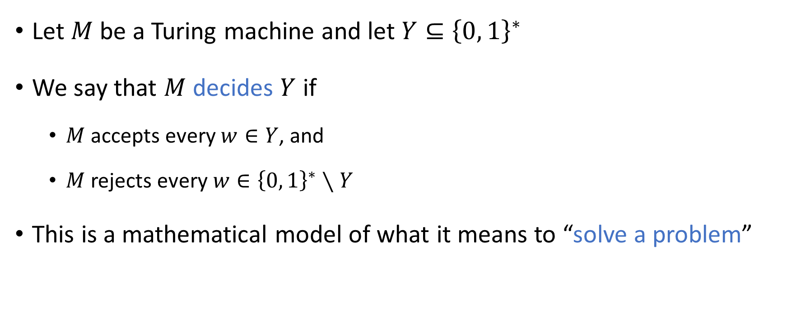
Deciding a language
Let $M$ be a Turing machine and let $Y⊆{\left\{0, 1\right\}}^{∗}$
We say that $M$ decides $Y$ if
$M$ accepts every $w∈Y$, and
$M$ rejects every $w∈{\left\{0, 1\right\}}^{∗}∖Y$
This is a mathematical model of what it means to “solve a problem”

Slide 16
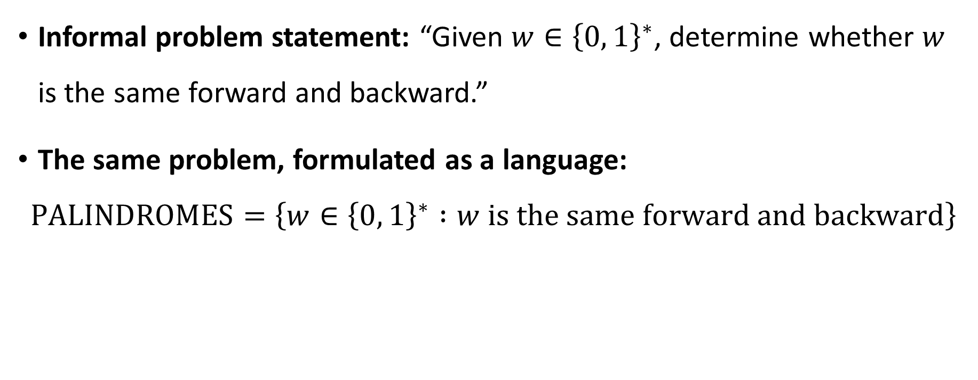
Example: Palindromes
Informal problem statement: “Given $w∈{\left\{0, 1\right\}}^{∗}$, determine whether $w$ is the same forward and backward.”
The same problem, formulated as a language:
$$\text{PALINDROMES}=\left\{w∈{\left\{0, 1\right\}}^{∗} :w \text{is} \text{the} \text{same} \text{forward} \text{and} \text{backward}\right\}$$

Slide 17

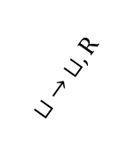
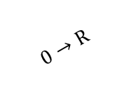



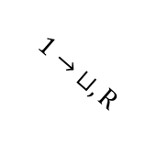
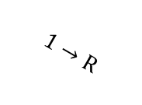


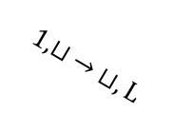

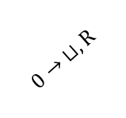



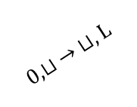

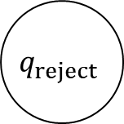


Example: A TM that decides $\text{PALINDROMES}$
$$0,1→\text{R}$$
$$r_{0}$$
$$⊔ →\text{L}$$
$$ℓ_{0}$$
$$0→ ⊔,\text{R}$$
$$0,⊔ → ⊔,\text{L}$$
$$1→\text{R}$$
$$q_{reject}$$
$$q_{0}$$
$$⊔ →\text{R}$$
$$ℓ$$
$$0,1←\text{L}$$
$$⊔ → ⊔,\text{R}$$
$$1→ ⊔,\text{R}$$
$$1,⊔ → ⊔,\text{L}$$
$$0→\text{R}$$
$$r_{1}$$
$$⊔ →\text{L}$$
$$ℓ_{1}$$
$$q_{accept}$$
$$0,1→\text{R}$$

Slide 18
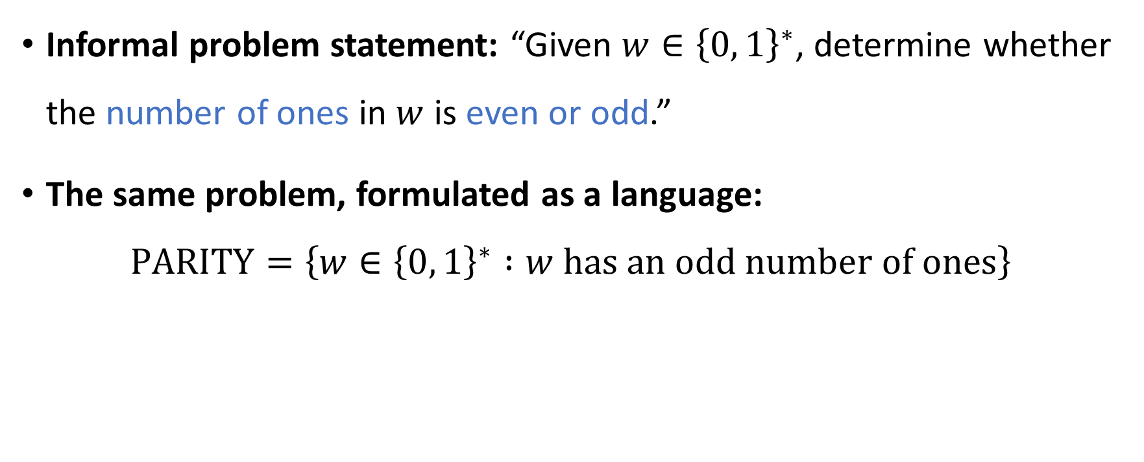
Example: Parity
Informal problem statement: “Given $w∈{\left\{0, 1\right\}}^{∗}$, determine whether the number of ones in $w$ is even or odd.”
The same problem, formulated as a language:
$$\text{PARITY}=\left\{w∈{\left\{0, 1\right\}}^{∗} :w \text{has} \text{an} \text{odd} \text{number} \text{of} \text{ones}\right\}$$

Slide 19


Example: A TM that decides $\text{PARITY}$
Let $M=\left(Q,q_{0},h_{1},h_{0},Σ,⊔,δ\right)$, where $Q=\left\{q_{0},q_{1},h_{0},h_{1}\right\}$, $Σ=\left\{0, 1, ⊔\right\}$, and
$$δ\left(q_{a},b\right)=\left\{\begin{aligned}\left(q_{a+b},b,\text{R}\right) \text{if} b∈\left\{0, 1\right\} \\ &\left(h_{a},b,\text{R}\right) \text{if} b= ⊔ \end{aligned}\right.$$
Claim: $M$ decides $\text{PARITY}≔\left\{w∈{\left\{0, 1\right\}}^{∗} :w \text{has} \text{an} \text{odd} \text{number} \text{of} \text{ones}\right\}$
Proof sketch: Let $C_{0},C_{1},…$ be the computation history of $M$ on $w∈{\left\{0, 1\right\}}^{n}$
By induction on $i$, we have $C_{i}=w_{1}w_{2}…w_{i}q_{w_{1}+…+w_{i}}w_{i+1}…w_{n}$ for all $i<n$
Consequently, $C_{n}=wq_{w_{1}+…+w_{i}}⊔$ and $C_{n+1}=w⊔h_{w_{1}+…+w_{n}}⊔$
(Addition is mod 2)

Slide 20
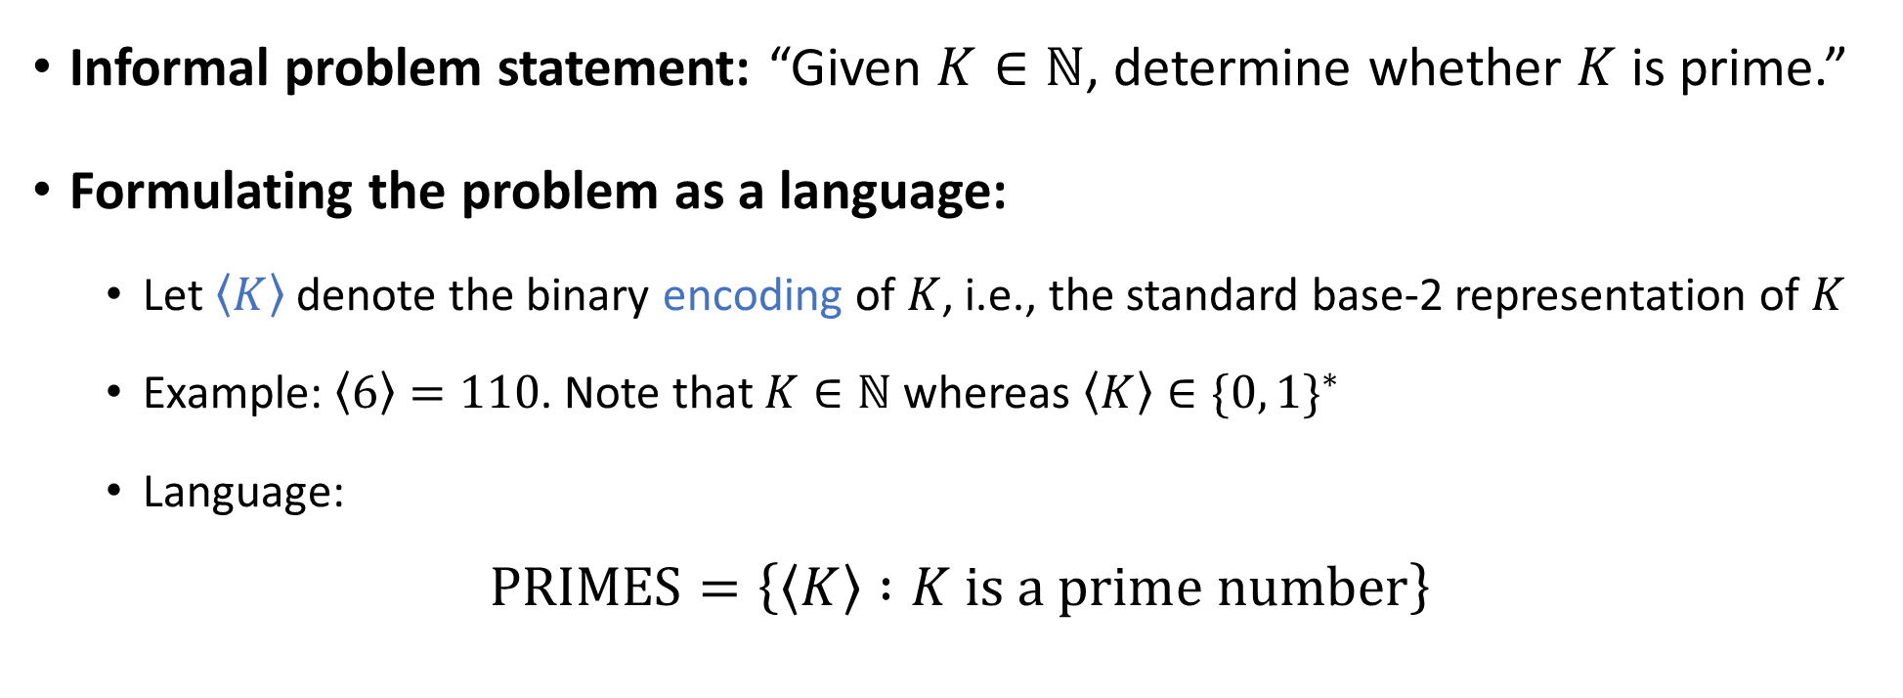
Example: Primality testing
Informal problem statement: “Given $K∈ℕ$, determine whether $K$ is prime.”
Formulating the problem as a language:
Let $\left\langle K\right\rangle$ denote the binary encoding of $K$, i.e., the standard base-2 representation of $K$
Example: $\left\langle 6\right\rangle =110$. Note that $K∈ℕ$ whereas $\left\langle K\right\rangle ∈\{0, 1\}^{∗}$
Language:
$$\text{PRIMES}=\left\{\left\langle K\right\rangle :K \text{is} \text{a} \text{prime} \text{number}\right\}$$

Slide 21
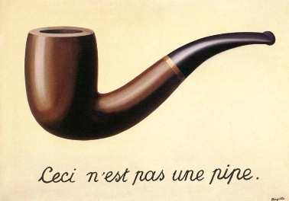
Encoding the input as a string
OBJECTION: “The fact that I have to encode the input before feeding it into a Turing machine seems fishy.”
RESPONSE: The same is true of human computation!
We say, “Given a natural number, determine whether it is prime,” but is it truly possible to “give” someone an abstract concept such as a number?
Being pedantic, we could speak more precisely and say, “Given a piece of text, determine whether it represents/encodes a prime number”
“This is not a pipe.”
(1929 painting by René Magritte)

Slide 22
Larger alphabets
OBJECTION: “Fine, the input needs to be encoded as a string. But why does it have to be a binary string? What about larger alphabets?”
RESPONSE 1: The Turing machine definition can be modified to handle inputs over other alphabets. We focus on binary inputs for simplicity’s sake
RESPONSE 2: We can always encode symbols from other alphabets in binary

Slide 23
Example: ASCII
[NUL] | [SOH] | [STX] | [ETX] | [EOT] | [ENQ] | [ACK] | [BEL] | [BS] | [HT] | [LF] | [VT] | [FF]
0000000 | 0000001 | 0000010 | 0000011 | 0000100 | 0000101 | 0000110 | 0000111 | 0001000 | 0001001 | 0001010 | 0001011 | 0001100
[CR] | [SO] | [SI] | [DLE] | [DC1] | [DC2] | [DC3] | [DC4] | [NAK] | [SYN] | [ETB] | [CAN] | [EM]
0001101 | 0001110 | 0001111 | 0010000 | 0010001 | 0010010 | 0010011 | 0010100 | 0010101 | 0010110 | 0010111 | 0011000 | 0011001
[SS] | [ESC] | [FS] | [GS] | [RS] | [US] | [SPACE] | ! | " | # | $ | % | &
0011010 | 0011011 | 0011100 | 0011101 | 0011110 | 0011111 | 0100000 | 0100001 | 0100010 | 0100011 | 0100100 | 0100101 | 0100110
' | ( | ) | * | + | , | - | . | / | 0 | 1 | 2 | 3
0100111 | 0101000 | 0101001 | 0101010 | 0101011 | 0101100 | 0101101 | 0101110 | 0101111 | 0110000 | 0110001 | 0110010 | 0110011
4 | 5 | 6 | 7 | 8 | 9 | : | ; | < | = | > | ? | @
0110100 | 0110101 | 0110110 | 0110111 | 0111000 | 0111001 | 0111010 | 0111011 | 0111100 | 0111101 | 0111110 | 0111111 | 1000000
A | B | C | D | E | F | G | H | I | J | K | L | M
1000001 | 1000010 | 1000011 | 1000100 | 1000101 | 1000110 | 1000111 | 1001000 | 1001001 | 1001010 | 1001011 | 1001100 | 1001101
N | O | P | Q | R | S | T | U | V | W | X | Y | Z
1001110 | 1001111 | 1010000 | 1010001 | 1010010 | 1010011 | 1010100 | 1010101 | 1010110 | 1010111 | 1011000 | 1011001 | 1011010
[ | \ | ] | ^ | _ | ` | a | b | c | d | e | f | g
1011011 | 1011100 | 1011101 | 1011110 | 1011111 | 1100000 | 1100001 | 1100010 | 1100011 | 1100100 | 1100101 | 1100110 | 1100111
h | i | j | k | l | m | n | o | p | q | r | s | t
1101000 | 1101001 | 1101010 | 1101011 | 1101100 | 1101101 | 1101110 | 1101111 | 1110000 | 1110001 | 1110010 | 1110011 | 1110100
u | v | w | x | y | z | { | | | } | ~ | [DEL]
1110101 | 1110110 | 1110111 | 1111000 | 1111001 | 1111010 | 1111011 | 1111100 | 1111101 | 1111110 | 1111111

Slide 24
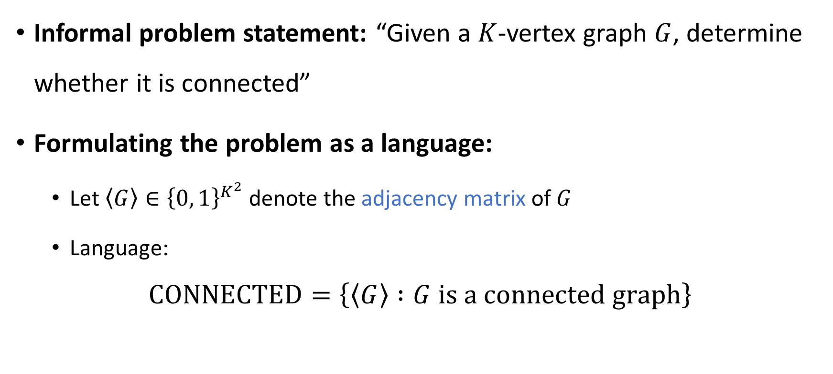
Another encoding example: Connectivity
Informal problem statement: “Given a $K$-vertex graph $G$, determine whether it is connected”
Formulating the problem as a language:
Let $\left\langle G\right\rangle ∈{\left\{0, 1\right\}}^{K^{2}}$ denote the adjacency matrix of $G$
Language:
$$\text{CONNECTED}=\left\{\left\langle G\right\rangle :G \text{is} \text{a} \text{connected} \text{graph}\right\}$$

Slide 25
Multiple possible encodings
OBJECTION: “Why are we using adjacency matrices instead of adjacency lists?”
RESPONSE: It doesn’t matter much which encoding we use, because it is not hard to convert between the two encodings

Slide 26
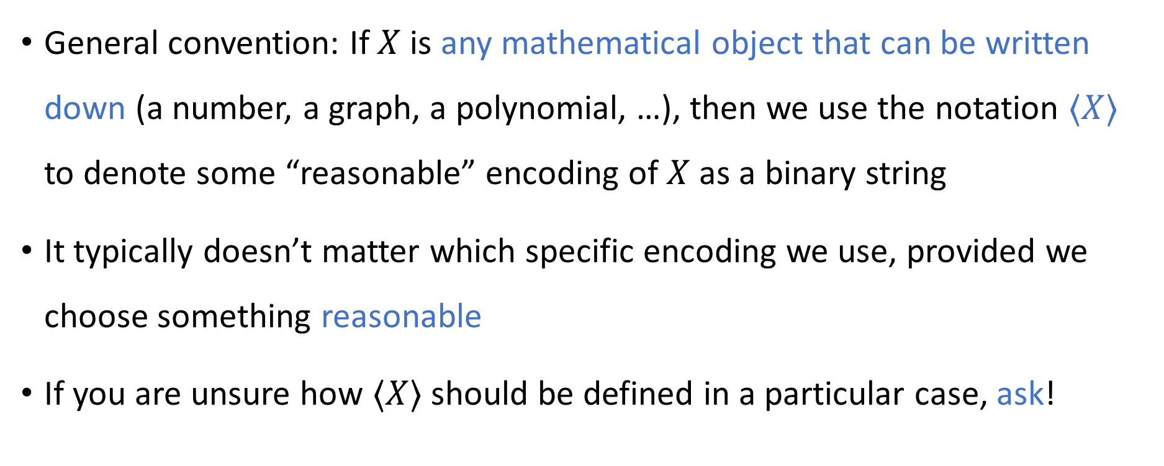
Encoding other things as strings
General convention: If $X$ is any mathematical object that can be written down (a number, a graph, a polynomial, …), then we use the notation $⟨X⟩$ to denote some “reasonable” encoding of $X$ as a binary string
It typically doesn’t matter which specific encoding we use, provided we choose something reasonable
If you are unsure how $⟨X⟩$ should be defined in a particular case, ask!

Slide 27
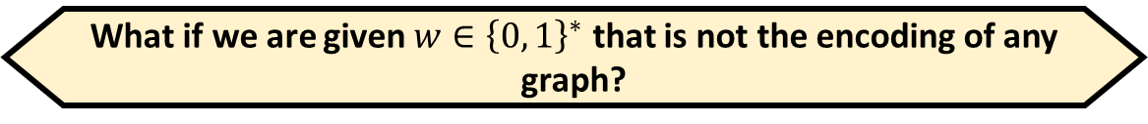

Invalid inputs
Informal problem statement: “Given a graph $G$, determine whether it is connected”
The same problem, formulated as a language:
$$\text{CONNECTED}=\left\{\left\langle G\right\rangle :G \text{is} \text{a} \text{connected} \text{graph}\right\}$$
Suppose we want to decide $\text{CONNECTED}$
If we are given $\left\langle G\right\rangle$ where $G$ is a connected graph, we should accept
If we are given $\left\langle G\right\rangle$ where $G$ is a disconnected graph, we should reject
What if we are given $w∈{\left\{0, 1\right\}}^{∗}$ that is not the encoding of any graph?
A: This situation cannot occur
B: It doesn’t matter what we do
C: We can accept or reject, but we must not loop
D: We must reject
Respond at PollEv.com/whoza or text “whoza” to 22333

