Slide 1
CMSC 28100 Introduction to Complexity Theory Winter 2024 Instructor: William Hoza
7 |  |  |  |  |  |  | 5 | 3
 |  |  |  |  |  |  |  | 4
 | 4 | 8 |  | 3 |  | 1 | 2
8 |  | 1 | 3 |  |  | 2 | 7 | 5
 | 9 |  | 1 |  |  |  | 4
 | 5 |  |  |  |  | 3
2 |  | 5 |  | 8 | 4
1 | 3 | 4 |  | 5

Slide 2
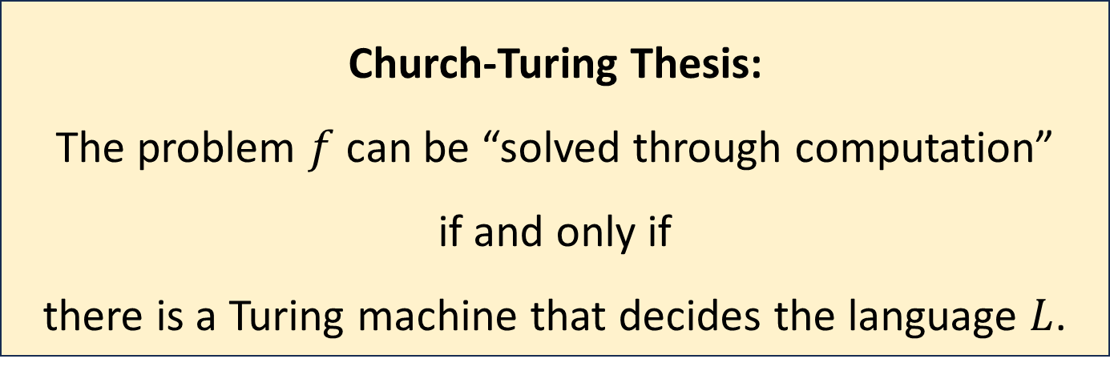
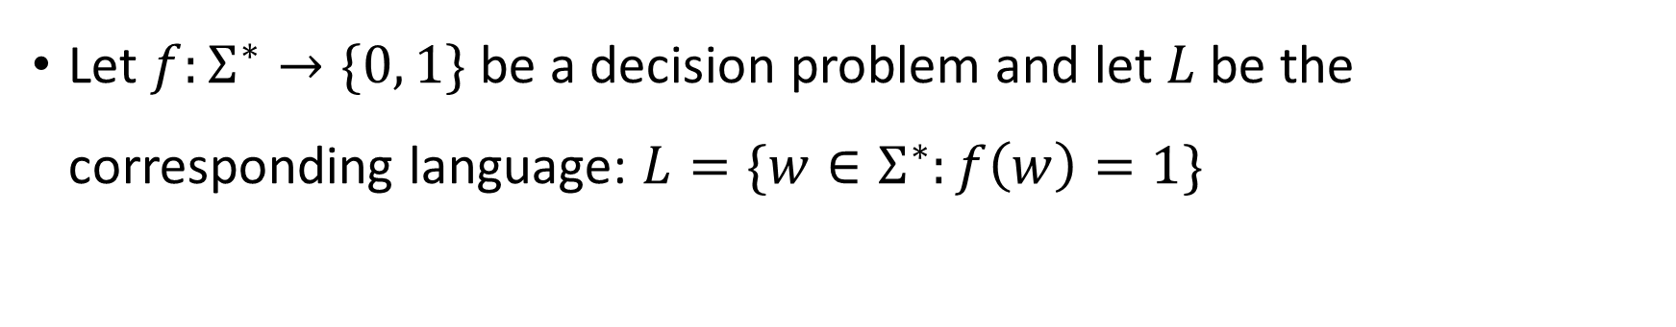
Church-Turing Thesis
Let $f:Σ^{∗}→\{0, 1\}$ be a decision problem and let $L$ be the corresponding language: $L=\{w∈Σ^{∗}:f\left(w\right)=1\}$
Church-Turing Thesis:
The problem $f$ can be “solved through computation”
if and only if
there is a Turing machine that decides the language $L$.
Intuitive notion
Mathematically precise notion

Slide 3
Are Turing machines powerful enough?
OBJECTION: “To encompass all possible algorithms, we should add various bells and whistles to the Turing machine model.”

Slide 4
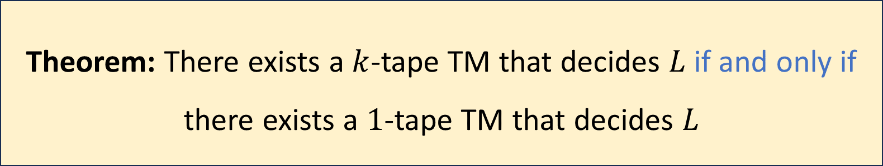

Multi-Tape Turing Machines
One more TM variant: $k$-tape TM
Each tape has its own head. Exercise: Write rigorous definitions
Let $k$ be a positive integer and let $L$ be a language
Theorem: There exists a $k$-tape TM that decides $L$ if and only if there exists a $1$-tape TM that decides $L$

Slide 5

Simulating $k$ tapes with one tape
#
1
#
0
1
$
0
$
$
1
0
#
1
1
#

Slide 6
Simulating $k$ tapes with one tape
#
1
#
0
1
$
0
$
$
1
0
#
1
1
#

Slide 7
TMs can simulate all “reasonable” machines
We could add various other bells and whistles to the basic TM model
The ability to jump to the beginning of the tape in a single step
Tape that extends infinitely in both directions
Two-dimensional tape
None of these changes has any effect on the power of the model

Slide 8

Church-Turing Thesis
Let $f:Σ^{∗}→\{0, 1\}$ be a decision problem and let $L$ be the corresponding language: $L=\{w∈Σ^{∗}:f\left(w\right)=1\}$
Church-Turing Thesis:
The problem $f$ can be “solved through computation”
if and only if
there is a Turing machine that decides the language $L$.
Intuitive notion
Mathematically precise notion

Slide 9
What about models with a different “flavor?”
You might have intuition about computation from your programming experiences
Writing down the transition function of a Turing machine feels a bit different than writing a program in Python / C / Java / etc.
Let’s (partially) bridge that gap

Slide 10


CMSC281: A primitive programming language
We will define a programming language. We begin with an example
Here is a CMSC281 program that reverses a given string $x_{1}∈\{0, 1\}^{∗}$:
(Note: CMSC281 will not be on problem sets or exams)
main : $x_{2}←\text{LAST}\left(x_{1}\right)$
: $x_{3}←x_{3}x_{2}$
: IF $x_{2}=1$ GOTO main
: IF $x_{2}=0$ GOTO main
: $x_{1}←x_{1}x_{3}$
: HALT

Slide 11
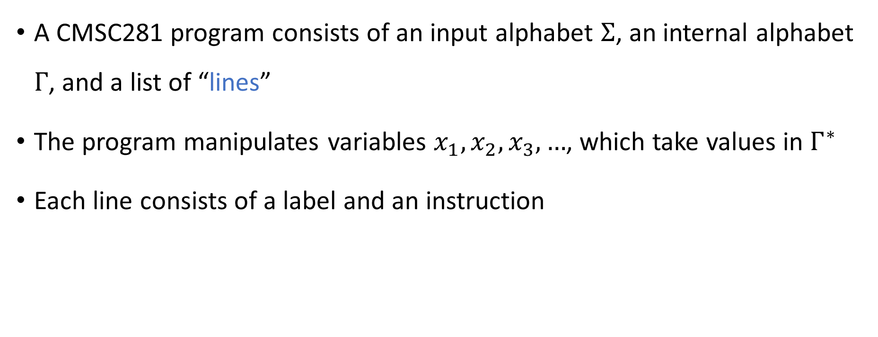
CMSC281: A primitive programming language
A CMSC281 program consists of an input alphabet $Σ$, an internal alphabet $Γ$, and a list of “lines”
The program manipulates variables $x_{1},x_{2},x_{3},…$, which take values in $Γ^{∗}$
Each line consists of a label and an instruction

Slide 12
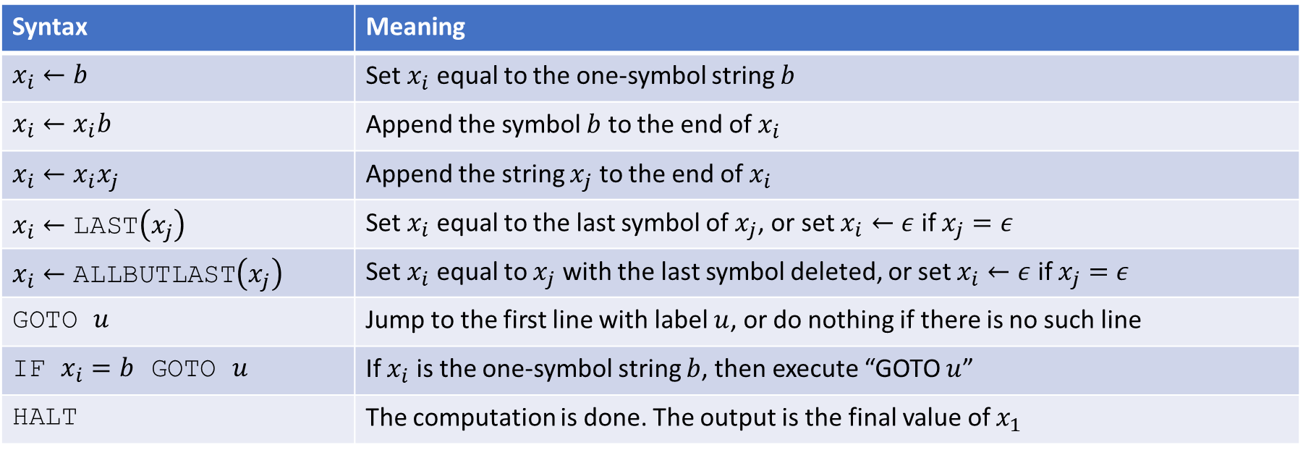
Instructions
There are eight basic instructions available (some are redundant)
Syntax | Meaning
$x_{i}←b$ | Set $x_{i}$ equal to the one-symbol string $b$
$x_{i}←x_{i}b$ | Append the symbol $b$ to the end of $x_{i}$
$x_{i}←x_{i}x_{j}$ | Append the string $x_{j}$ to the end of $x_{i}$
$x_{i}←\text{LAST}\left(x_{j}\right)$ | Set $x_{i}$ equal to the last symbol of $x_{j}$, or set $x_{i}←ε$ if $x_{j}=ε$
$x_{i}←\text{ALLBUTLAST}\left(x_{j}\right)$ | Set $x_{i}$ equal to $x_{j}$ with the last symbol deleted, or set $x_{i}←ε$ if $x_{j}=ε$
GOTO $u$ | Jump to the first line with label $u$, or do nothing if there is no such line
IF $x_{i}=b$ GOTO $u$ | If $x_{i}$ is the one-symbol string $b$, then execute “GOTO $u$”
HALT | The computation is done. The output is the final value of $x_{1}$

Slide 13
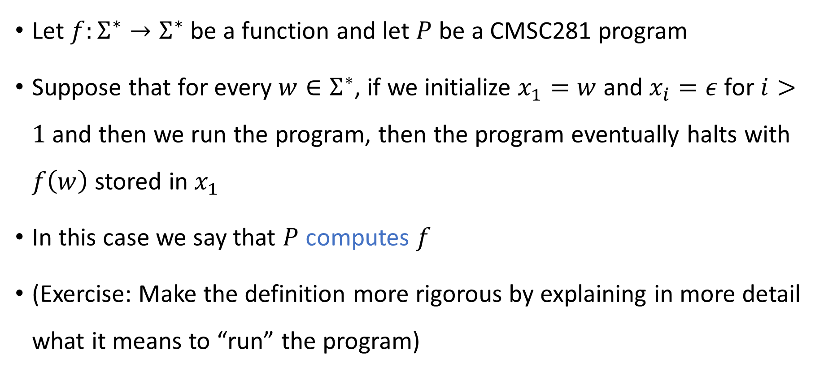
Behavior of the program
Let $f:Σ^{∗}→Σ^{∗}$ be a function and let $P$ be a CMSC281 program
Suppose that for every $w∈Σ^{∗}$, if we initialize $x_{1}=w$ and $x_{i}=ε$ for $i>1$ and then we run the program, then the program eventually halts with $f\left(w\right)$ stored in $x_{1}$
In this case we say that $P$ computes $f$
(Exercise: Make the definition more rigorous by explaining in more detail what it means to “run” the program)

Slide 14
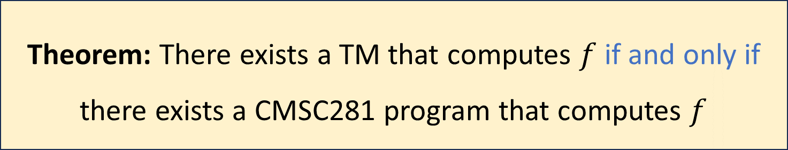

CMSC281 programs are equivalent to TMs
Let $f:Σ^{∗}→Σ^{∗}$ be a function and let $M$ be a TM
We say that $M$ computes $f$ if for every $w∈Σ^{∗},$ $M$ halts on $w$ with $f\left(w\right)$ written on its tape followed by blanks
Theorem: There exists a TM that computes $f$ if and only if there exists a CMSC281 program that computes $f$

Slide 15
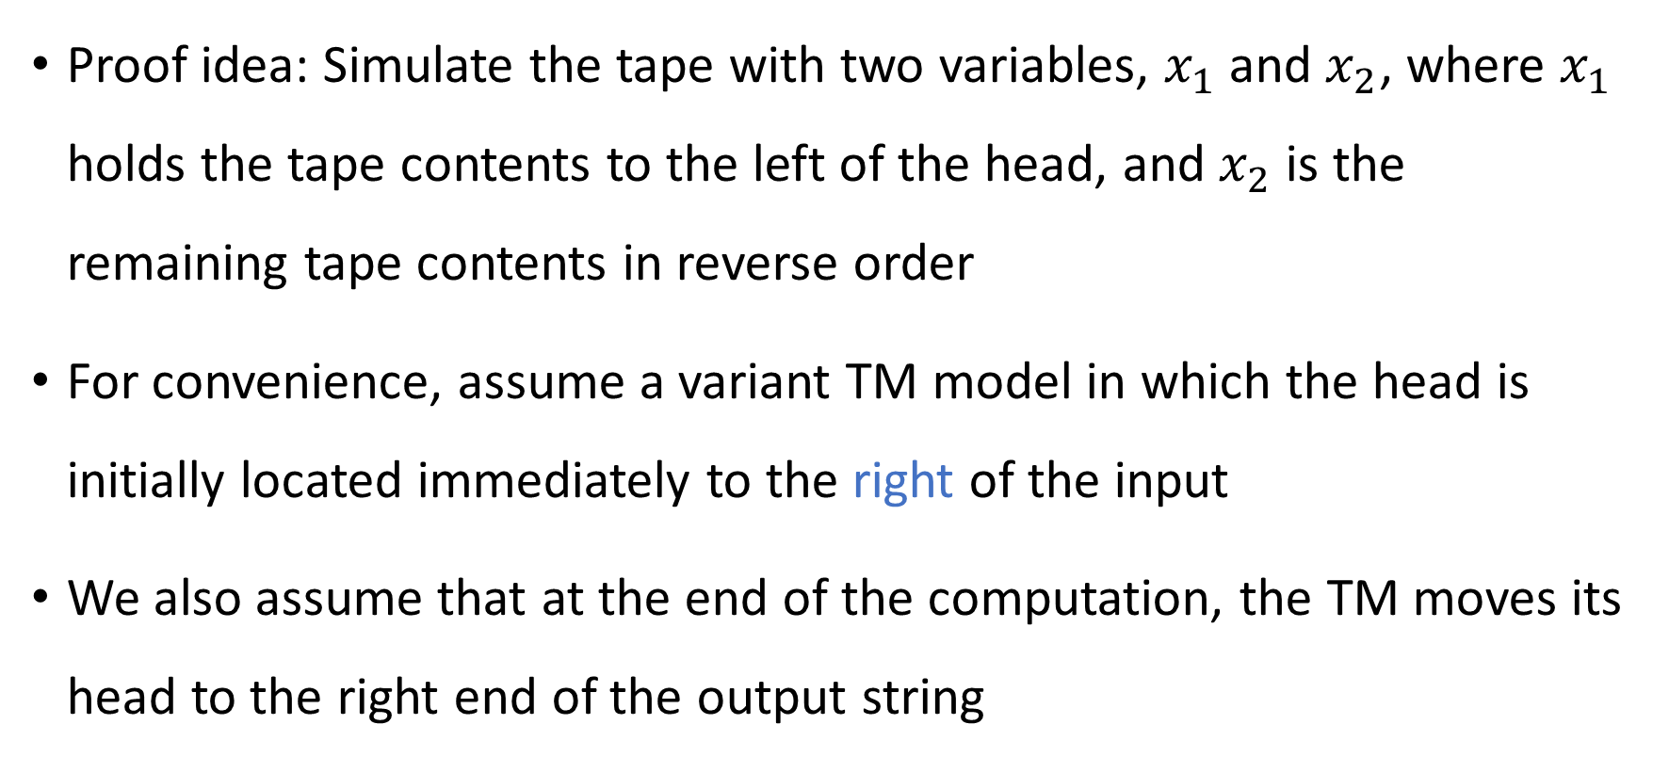
CMSC281 programs can simulate Turing machines
Proof idea: Simulate the tape with two variables, $x_{1}$ and $x_{2}$, where $x_{1}$ holds the tape contents to the left of the head, and $x_{2}$ is the remaining tape contents in reverse order
For convenience, assume a variant TM model in which the head is initially located immediately to the right of the input
We also assume that at the end of the computation, the TM moves its head to the right end of the output string

Slide 16

CMSC281 programs can simulate Turing machines
Let $M=\left(Q,Σ, Γ, δ, q_{0},q_{accept},q_{reject}\right)$ be the TM we wish to simulate
Our program begins with the instruction GOTO $q_{0}$

Slide 17
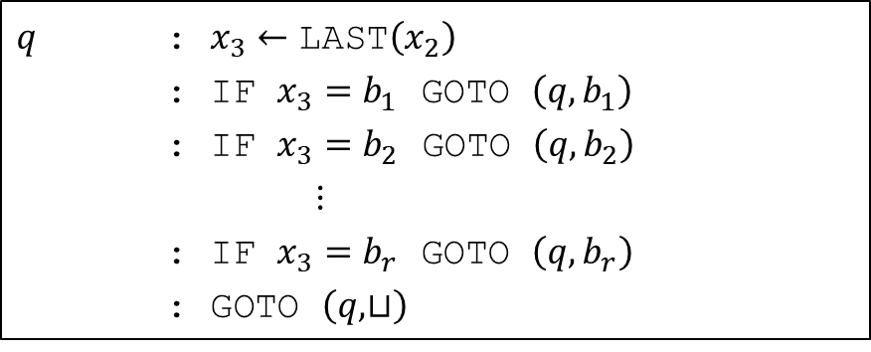

Simulating one step
Let $Γ=\{b_{1},…, b_{r}\}$
For each non-halting state $q∈Q$, we add the following block of code
$q$ : $x_{3}←\text{LAST}\left(x_{2}\right)$
: IF $x_{3}=b_{1}$ GOTO $\left(q,b_{1}\right)$
: IF $x_{3}=b_{2}$ GOTO $\left(q,b_{2}\right)$
$⋮$
: IF $x_{3}=b_{r}$ GOTO $\left(q,b_{r}\right)$
: GOTO $\left(q,⊔\right)$

Slide 18
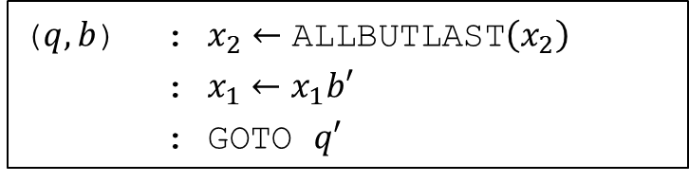




Simulating one step
For each non-halting $q∈Q$ and each $b∈Γ$, we add a block of code beginning with a line labeled $\left(q,b\right)$
Let $\left(q^{′},b^{′},D\right)=δ\left(q,b\right)$. Code block:
($q,b$) : $x_{3}←\text{LAST}\left(x_{1}\right)$
: $x_{1}←\text{ALLBUTLAST}\left(x_{1}\right)$
: $x_{2}←\text{ALLBUTLAST}\left(x_{2}\right)$
: $x_{2}←x_{2}b^{′}$
: $x_{2}←x_{2}x_{3}$
: GOTO $q′$
($q,b$) : $x_{2}←\text{ALLBUTLAST}\left(x_{2}\right)$
: $x_{1}←x_{1}b′$
: GOTO $q′$
OR
If $D=\text{R}$
If $D=\text{L}$

Slide 19


Halting
We also add the following two blocks
$q_{accept}$ : HALT
$q_{reject}$ : HALT

Slide 20
Turing-complete
Informally, we say that some kind of computational process (a physical device, a programming language, etc.) is “Turing-complete” if it can simulate any Turing machine
Familiar programming languages (C, Python, Lisp, etc.) are Turing-complete
If you can solve a computational problem in C, then you can also solve it in JavaScript

Slide 21
Turing machines can simulate CMSC281 programs
We will work with another programming language called CMSC281+
Step 1: We will show that CMSC281 programs can be simulated by CMSC281+ programs
Step 2: We will show that CMSC281+ programs can be simulated by Turing machines

Slide 22
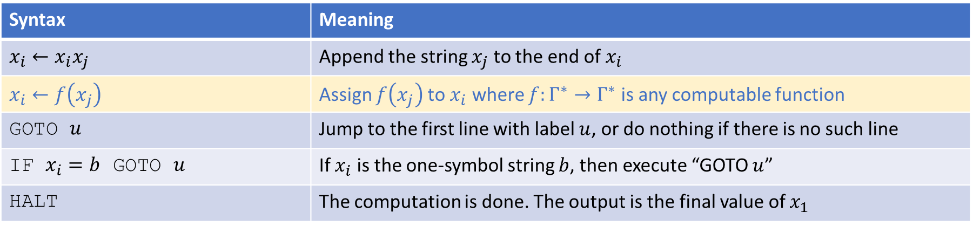
CMSC281+ programming language
CMSC281+ is like CMSC281 but with a different set of instructions:
“Computable” means there exists a TM that computes it
Syntax | Meaning
$x_{i}←x_{i}x_{j}$ | Append the string $x_{j}$ to the end of $x_{i}$
$x_{i}←f\left(x_{j}\right)$ | Assign $f\left(x_{j}\right)$ to $x_{i}$ where $f:Γ^{∗}→Γ^{∗}$ is any computable function
GOTO $u$ | Jump to the first line with label $u$, or do nothing if there is no such line
IF $x_{i}=b$ GOTO $u$ | If $x_{i}$ is the one-symbol string $b$, then execute “GOTO $u$”
HALT | The computation is done. The output is the final value of $x_{1}$

Slide 23

CMSC281+ can simulate CMSC281
Exercise: The following functions are computable
$f\left(x\right)=b$
$f\left(x\right)=xb$
$f\left(x\right)=\text{LAST}\left(x\right)$
$f\left(x\right)=\text{ALLBUTLAST}\left(x\right)$

Slide 24
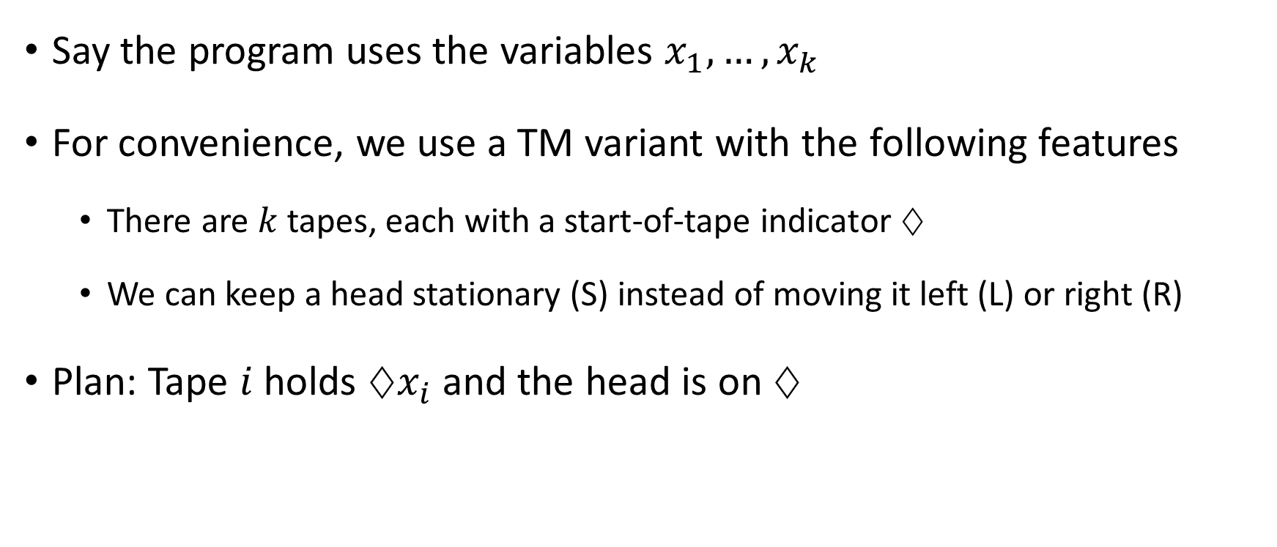
Turing machines can simulate CMSC281+
Say the program uses the variables $x_{1},…, x_{k}$
For convenience, we use a TM variant with the following features
There are $k$ tapes, each with a start-of-tape indicator $♢$
We can keep a head stationary (S) instead of moving it left (L) or right (R)
Plan: Tape $i$ holds $♢x_{i}$ and the head is on $♢$

Slide 25








Turing machines can simulate CMSC281+
Let the lines of the program be $ℓ_{0},…, ℓ_{k}$. Our TM structure:
$$q_{0}$$
$$⋯$$
$$q_{1}$$
$$⋯$$
$$⋮$$
$$q_{k}$$
$$⋯$$

Slide 26











Implementing $x_{i}←x_{i}x_{j}$
$$ab→ab, \text{RS}$$
$$ab→ab, \text{LL}$$
$$q_{r}$$
$$♢♢→♢♢, \text{RR}$$
$$⊔⊔ →⊔⊔,\text{LL}$$
$$a♢→a♢, \text{LS}$$
$$⊔b →bb,\text{RR}$$
$$♢♢→♢♢, \text{SS}$$
$$q_{r+1}$$
$$⋯$$

Slide 27




Implementing $\text{GOTO} u$
WLOG we assume that line $i$ has label $i$ for every $i$
$$q_{u}$$
$$⋯$$
$$q_{r}$$

Slide 28
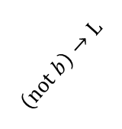












Implementing $\text{IF} x_{i}=b \text{GOTO}$ $u$
$$q_{u}$$
$$⋯$$
$$b→\text{L}$$
$$\left(\text{not}⊔\right)→\text{L}$$
$$q_{r}$$
$$♢→\text{R}$$
$$b→\text{R}$$
$$⊔ →\text{L}$$
$$\left(\text{not} b\right)→\text{L}$$
$$b→\text{L}$$
$$q_{r+1}$$
$$⋯$$

Slide 29
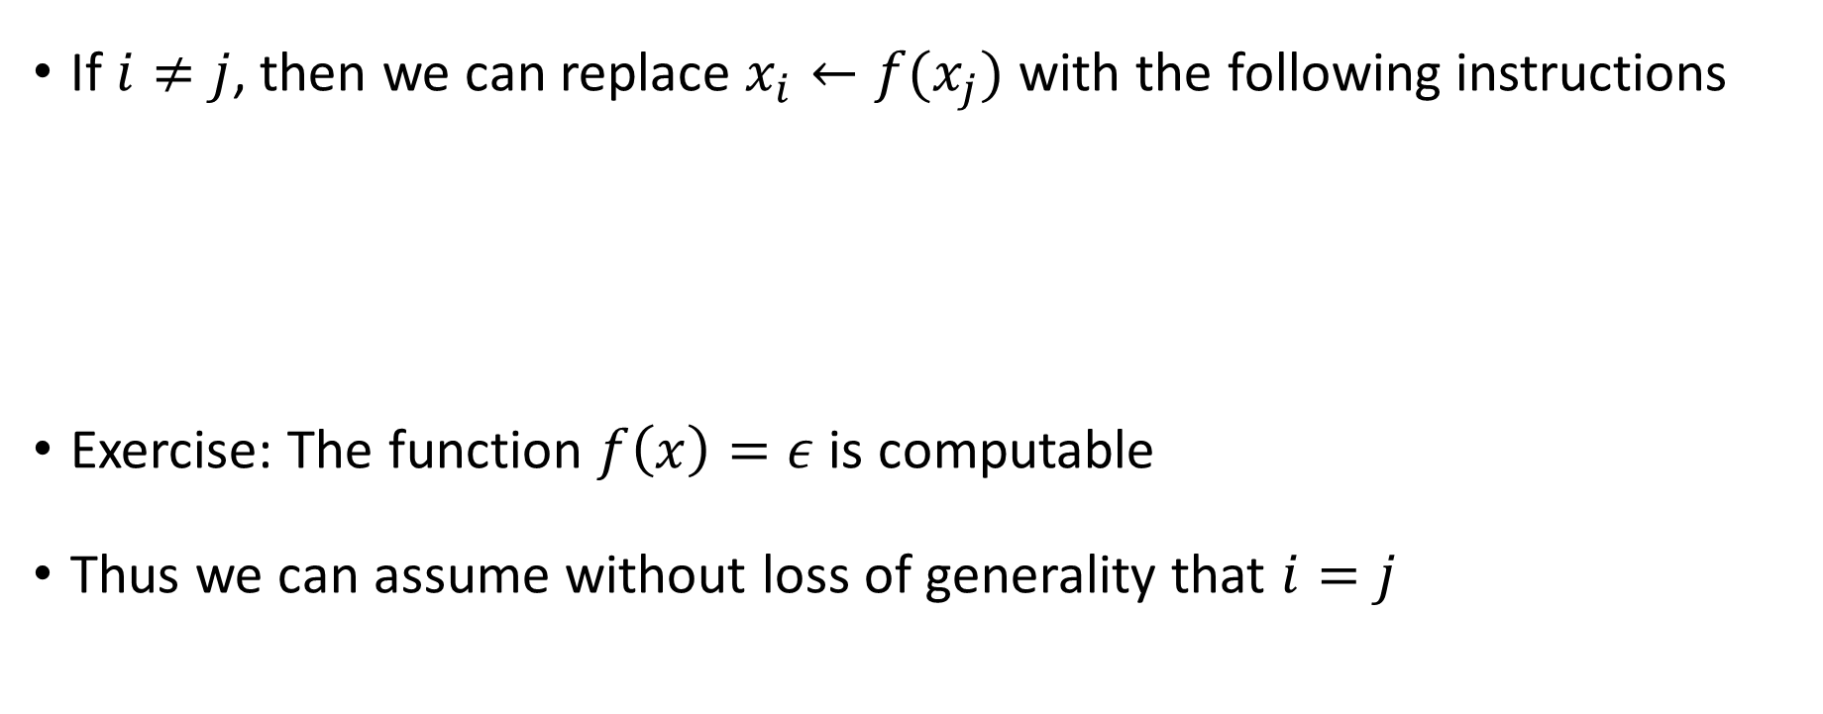

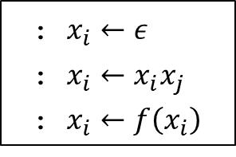
Implementing $x_{i}←f\left(x_{j}\right)$
If $i≠j$, then we can replace $x_{i}←f(x_{j})$ with the following instructions
Exercise: The function $f\left(x\right)=ε$ is computable
Thus we can assume without loss of generality that $i=j$
: $x_{i}←ε$
: $x_{i}←x_{i}x_{j}$
: $x_{i}←f\left(x_{i}\right)$

Slide 30

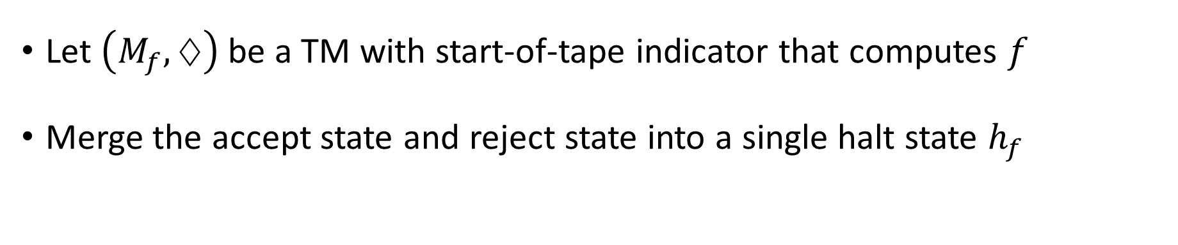











Implementing $x_{i}←f\left(x_{i}\right)$
Let $\left(M_{f},♢\right)$ be a TM with start-of-tape indicator that computes $f$
Merge the accept state and reject state into a single halt state $h_{f}$
$$M_{f}$$
$$b→b,\text{L}$$
$$q_{s}$$
$$♢→♢, \text{S}$$
$$q_{0}^{′}$$
$$⋯$$
$$h_{f}$$
$$b→b,\text{L}$$
$$♢→♢,\text{S}$$
$$q_{s+1}$$
$$⋯$$

Slide 31
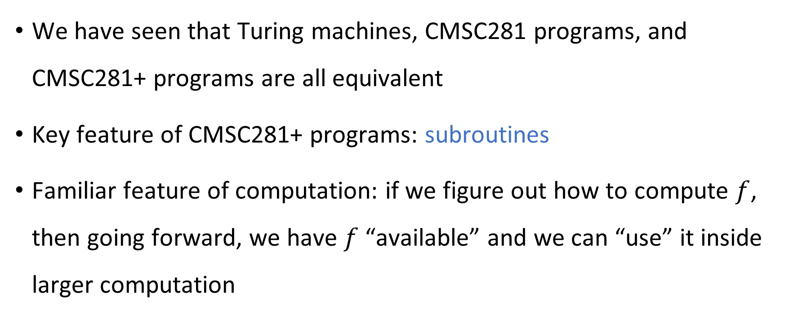
Subroutines
We have seen that Turing machines, CMSC281 programs, and CMSC281+ programs are all equivalent
Key feature of CMSC281+ programs: subroutines
Familiar feature of computation: if we figure out how to compute $f$, then going forward, we have $f$ “available” and we can “use” it inside larger computation

Slide 32
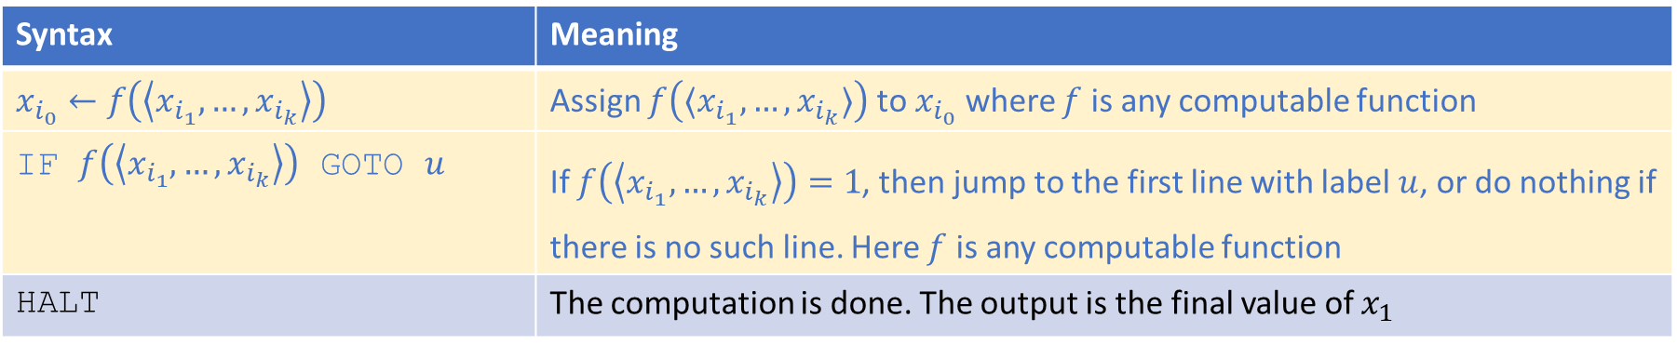
CMSC281++ programming language
CMSC281++ instructions:
Syntax | Meaning
$x_{i_{0}}←f\left(\left\langle x_{i_{1}},…, x_{i_{k}}\right\rangle \right)$ | Assign $f\left(⟨x_{i_{1}},…, x_{i_{k}}⟩\right)$ to $x_{i_{0}}$ where $f$ is any computable function
IF $f\left(\left\langle x_{i_{1}},…, x_{i_{k}}\right\rangle \right)$ GOTO $u$ | If $f\left(\left\langle x_{i_{1}},…, x_{i_{k}}\right\rangle \right)=1$, then jump to the first line with label $u$, or do nothing if there is no such line. Here $f$ is any computable function
HALT | The computation is done. The output is the final value of $x_{1}$

Slide 33
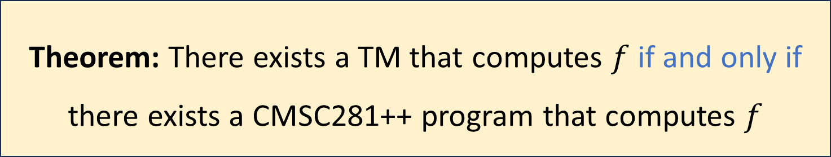

CMSC281++ programs are equivalent to TMs
Let $f:Σ^{∗}→Σ^{∗}$ be a function
Theorem: There exists a TM that computes $f$ if and only if there exists a CMSC281++ program that computes $f$

Slide 34
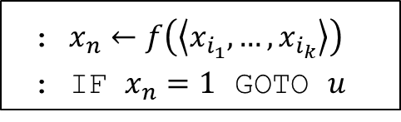


CMSC281+ can simulate CMSC281++
: $x_{n}←f\left(\left\langle x_{i_{1}},…, x_{i_{k}}\right\rangle \right)$
: IF $x_{n}=1$ GOTO $u$
Replace $\text{IF} f\left(\left\langle x_{i_{1}},…, x_{i_{k}}\right\rangle \right) \text{GOTO} u$ with:
Replace $x_{i_{0}}←f\left(\left\langle x_{i_{1}},…, x_{i_{k}}\right\rangle \right)$ with:
Recall encoding:
$\left\langle x_{i_{1}}, …, x_{i_{k}}\right\rangle =x_{i_{1}}\#x_{i_{2}}\#⋯\#x_{i_{k}}$
: $x_{n}←ε$
: $x_{n}←x_{n}x_{i_{1}}$
: $x_{n}←x_{n}\#$
: $x_{n}←x_{n}x_{i_{2}}$
: $x_{n}←x_{n}\#$
$⋮$
: $x_{n}←x_{n}x_{i_{k}}$
: $x_{i_{0}}←f\left(x_{n}\right)$

Slide 35
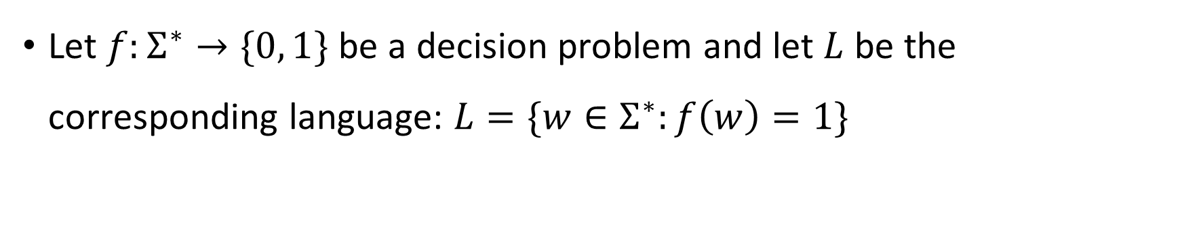
Church-Turing Thesis
Let $f:Σ^{∗}→\{0, 1\}$ be a decision problem and let $L$ be the corresponding language: $L=\{w∈Σ^{∗}:f\left(w\right)=1\}$
Church-Turing Thesis:
The problem $f$ can be “solved through computation”
if and only if
there is a Turing machine that decides the language $L$.
Intuitive notion
Mathematically precise notion

Slide 36
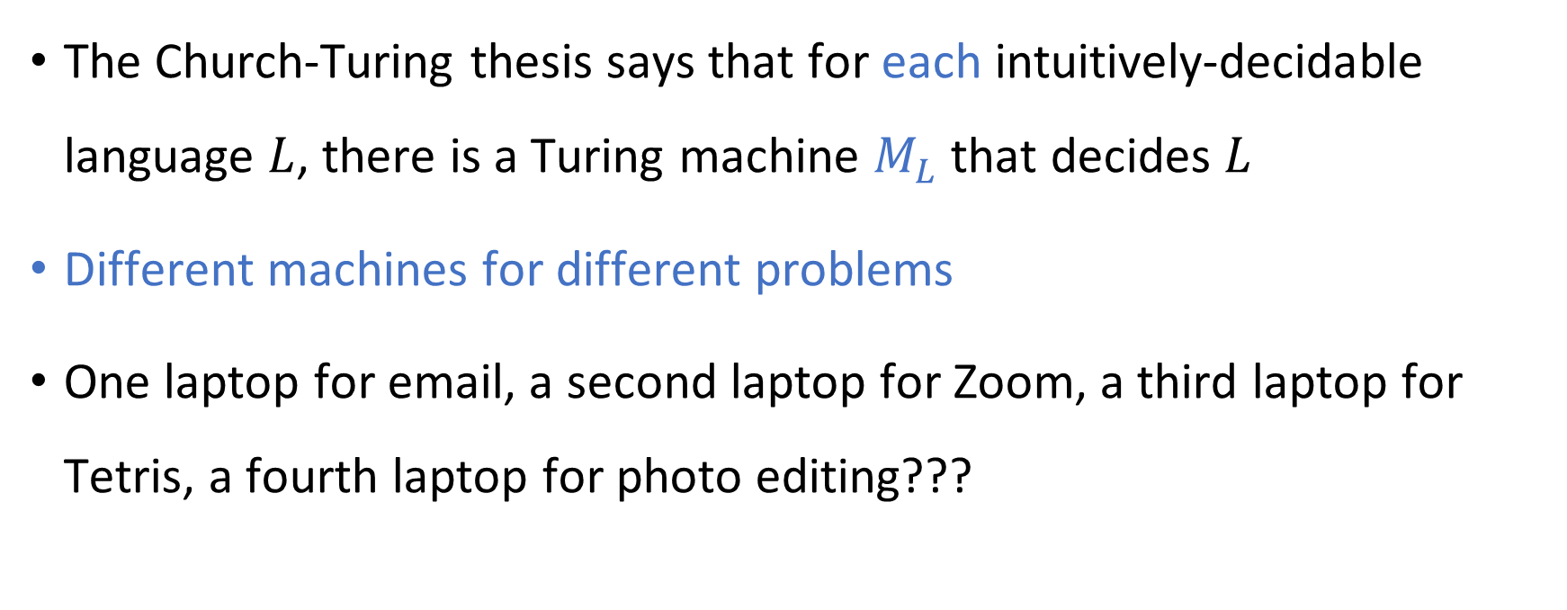
Turing machines vs. computers
The Church-Turing thesis says that for each intuitively-decidable language $L$, there is a Turing machine $M_{L}$ that decides $L$
Different machines for different problems
One laptop for email, a second laptop for Zoom, a third laptop for Tetris, a fourth laptop for photo editing???

Slide 37

Universal Turing machines
Theorem: There exists a Turing machine $U$ such that for every Turing machine $M$ and every input $w$:
If $M$ accepts $w$, then $U$ accepts $⟨M,w⟩$.
If $M$ rejects $w$, then $U$ rejects $⟨M,w⟩$.
If $M$ loops on input $w$, then $U$ loops on input $⟨M,w⟩$.

Slide 38
Universal Turing machines
If you are stranded on an alien planet and you are trying to build a computer, your job is to build a universal Turing machine
A universal Turing machine can be “programmed” to do anything that is computationally possible

