Slide 1

CMSC 28100 Introduction to Complexity Theory Spring 2024 Instructor: William Hoza

Slide 2
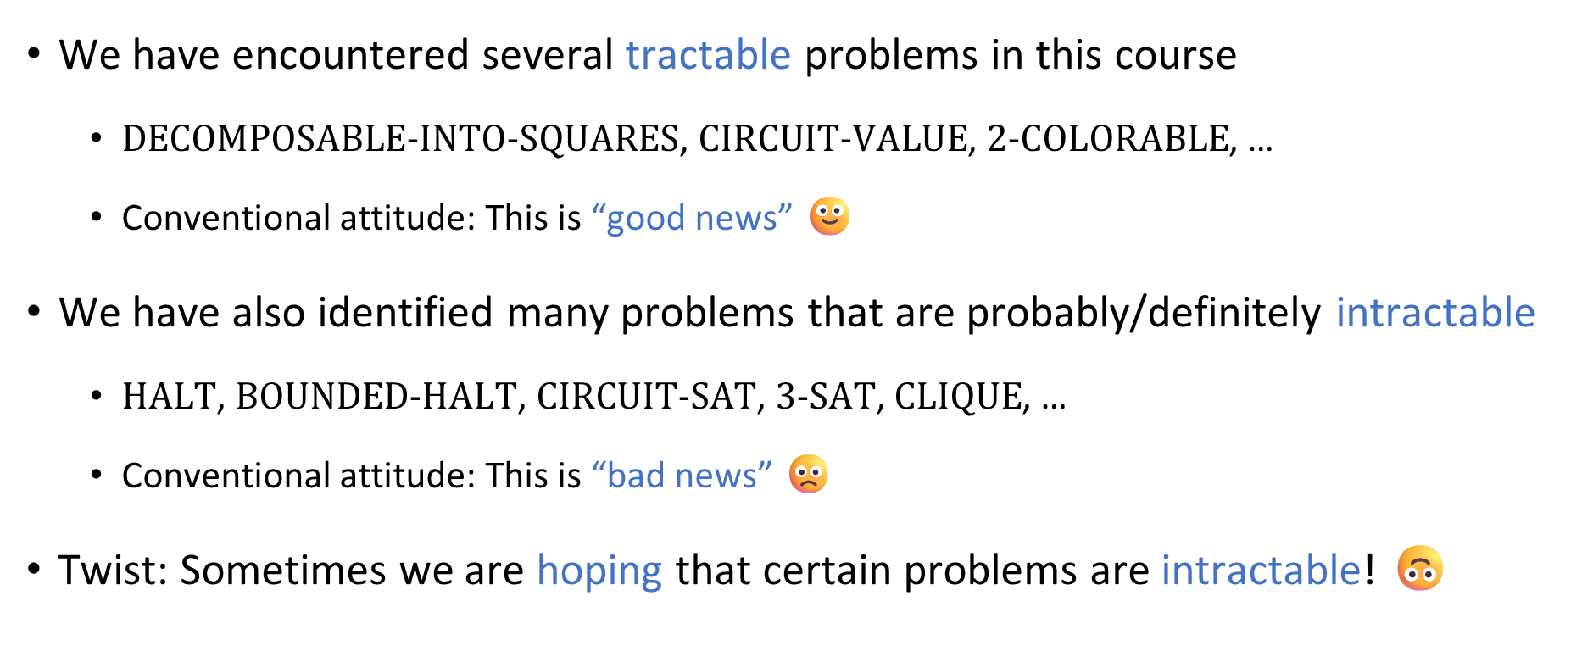
How to feel about intractability
We have encountered several tractable problems in this course
$\text{DECOMPOSABLE}\text{‑}\text{INTO}\text{‑}\text{SQUARES}$, $\text{CIRCUIT}\text{‑}\text{VALUE}$, $\text{2‑}\text{COLORABLE}$, …
Conventional attitude: This is “good news” 🙂
We have also identified many problems that are probably/definitely intractable
$\text{HALT}$, $\text{BOUNDED}\text{‑}\text{HALT}$, $\text{CIRCUIT}\text{‑}\text{SAT}$, $\text{3‑}\text{SAT}$, $\text{CLIQUE}$, …
Conventional attitude: This is “bad news” 🙁
Twist: Sometimes we are hoping that certain problems are intractable! 🙃

Slide 3
Cryptography

Slide 4

Secure communication
Public communication channel
😈
How can Bob send a private message to Alice?
E.g., credit card number
It seems impossible, because Alice and Eve receive all the same information from Bob!
A clever approach: Try to force Eve to solve an intractable problem
Online
store
Customer
Eve
Alice
Bob

Slide 5
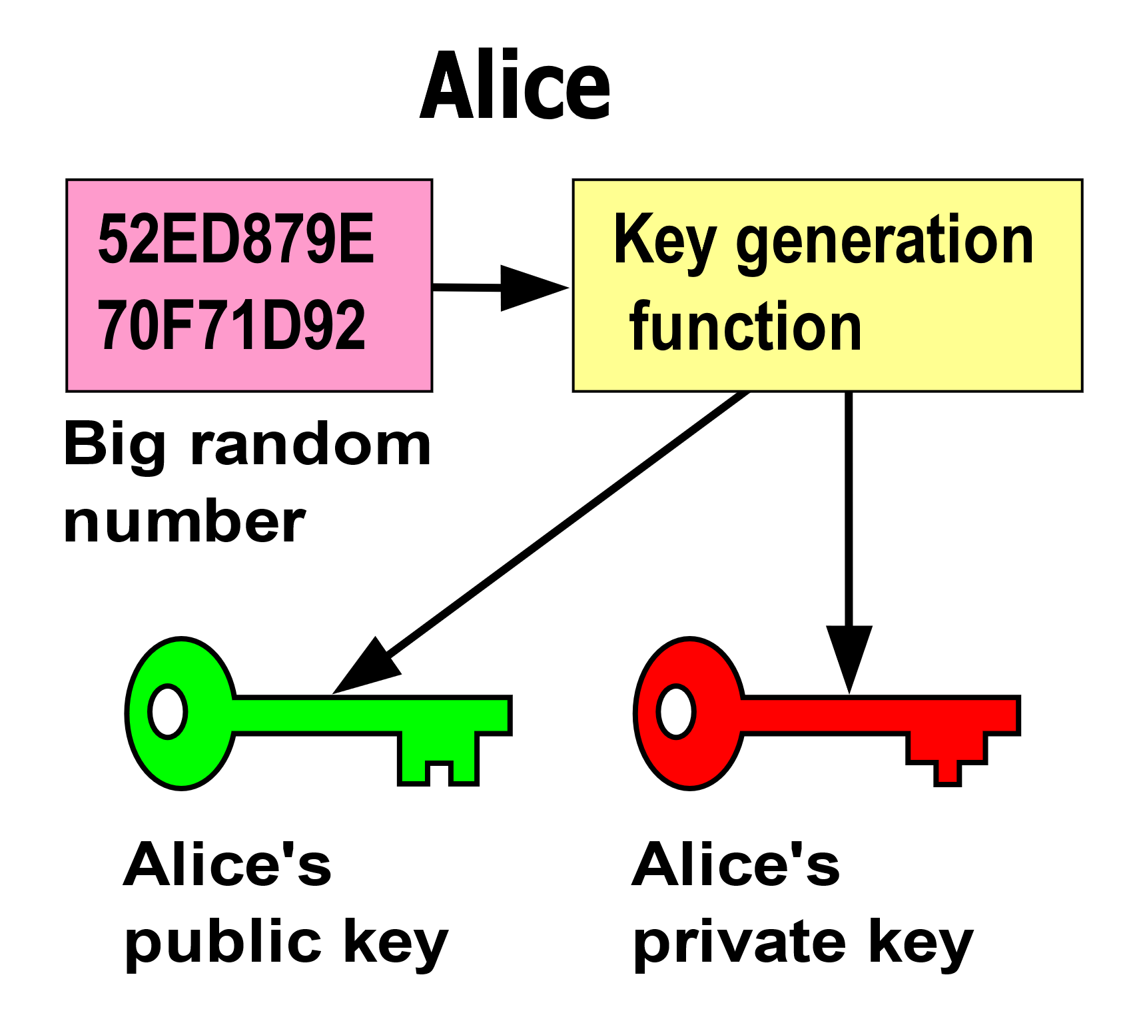
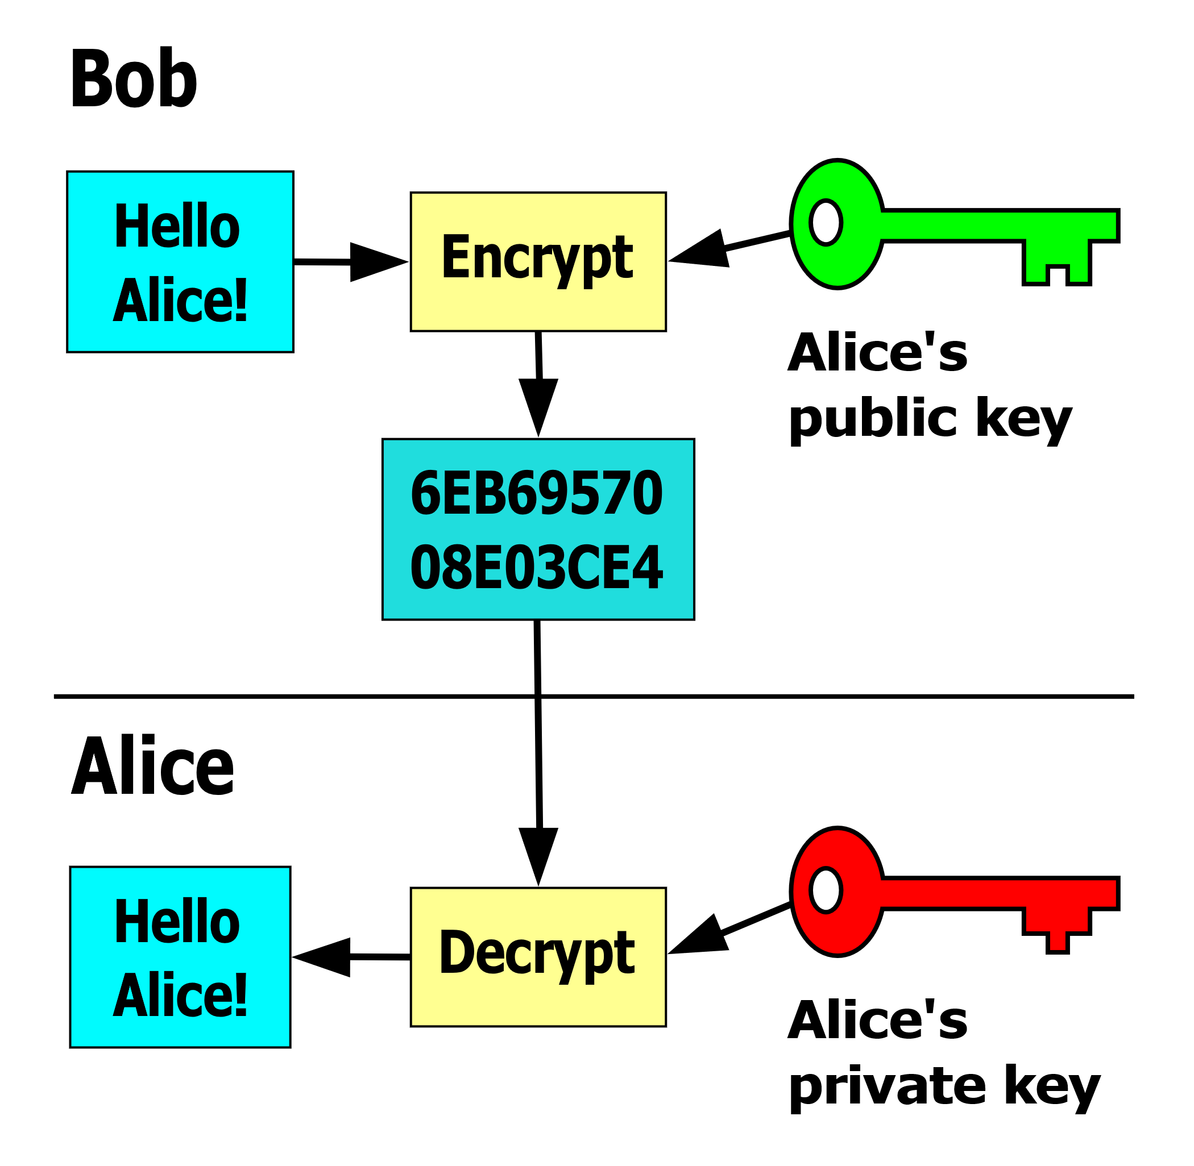
Public-key encryption
Alice’s advantage over Eve: Alice knows the private key and Eve doesn’t

Slide 6
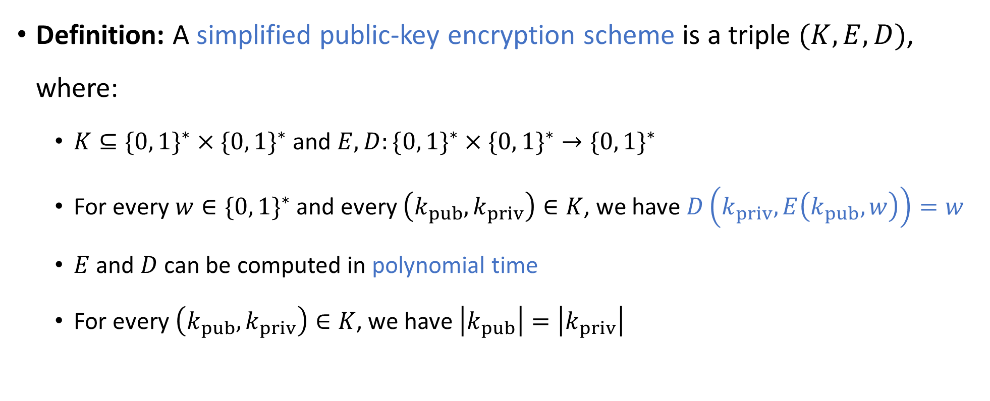
Public-key encryption scheme
“encrypt”
“keys”
“decrypt”
Definition: A simplified public-key encryption scheme is a triple $(K,E,D)$, where:
$K⊆\{0, 1\}^{∗}×\{0, 1\}^{∗}$ and $E,D:\{0, 1\}^{∗}×\{0, 1\}^{∗}→\{0, 1\}^{∗}$
For every $w∈\{0, 1\}^{∗}$ and every $\left(k_{pub},k_{priv}\right)∈K$, we have $D\left(k_{priv},E\left(k_{pub},w\right)\right)=w$
$E$ and $D$ can be computed in polynomial time
For every $\left(k_{pub},k_{priv}\right)∈K$, we have $\left|k_{pub}\right|=\left|k_{priv}\right|$
Notes:
Justification for the last condition: This means that E and D have the same time budget

Slide 7
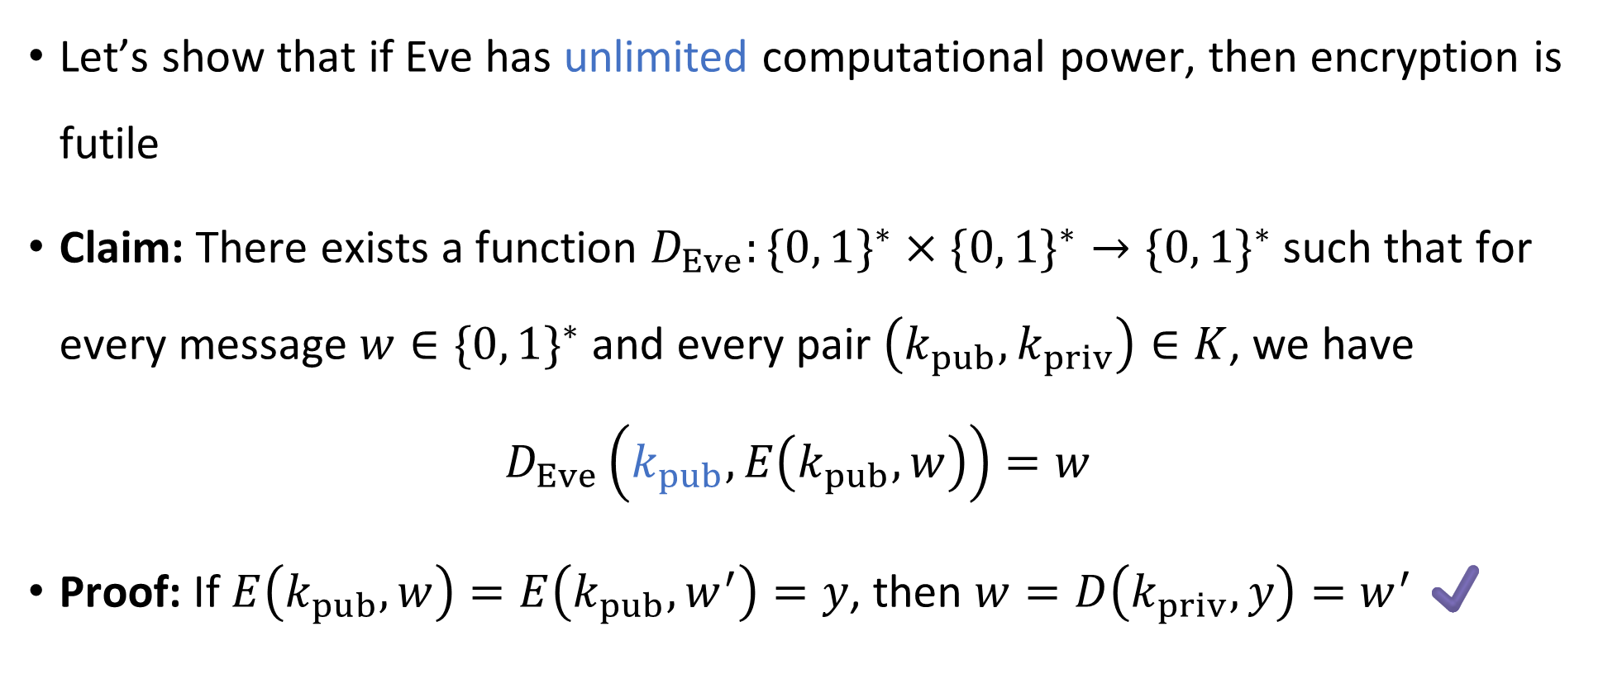
If Eve is computationally unbounded
Let’s show that if Eve has unlimited computational power, then encryption is futile
Claim: There exists a function $D_{Eve}:\{0, 1\}^{∗}×\{0, 1\}^{∗}→\{0, 1\}^{∗}$ such that for every message $w∈\{0, 1\}^{∗}$ and every pair $\left(k_{pub},k_{priv}\right)∈K$, we have
$$D_{Eve}\left(k_{pub},E\left(k_{pub},w\right)\right)=w$$
Proof: If $E\left(k_{pub},w\right)=E\left(k_{pub},w^{′}\right)=y$, then $w=D\left(k_{priv},y\right)=w^{′}$ ✔️

Slide 8
What if Eve is computationally bounded?
Amazing fact: There are known public-key encryption schemes such that decrypting without the private key seems to be intractable!
(*Better: There are schemes such that it is apparently intractable to “occasionally” “partially” decrypt without the private key. Making this precise is beyond the scope of our course)
Example: “RSA”
These amazing encryption schemes make our modern internet experience possible! Can we prove that they are secure?

Slide 9

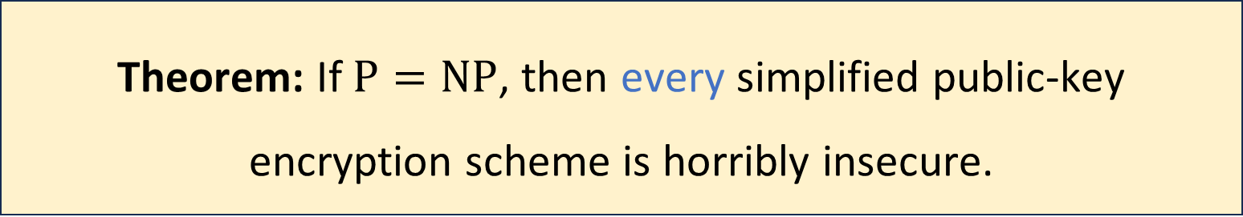
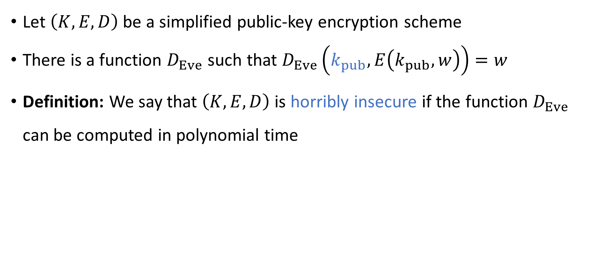
Cryptography and $\text{P}$ vs. $\text{NP}$
Let $\left(K, E, D\right)$ be a simplified public-key encryption scheme
There is a function $D_{Eve}$ such that $D_{Eve}\left(k_{pub}, E\left(k_{pub},w\right)\right)=w$
Definition: We say that $\left(K,E,D\right)$ is horribly insecure if the function $D_{Eve}$ can be computed in polynomial time
Theorem: If $\text{P}=\text{NP}$, then every simplified public-key encryption scheme is horribly insecure.
Notes:
A technicality: D_Eve isn’t completely well-defined, due to invalid public keys. “Horribly insecure” means that there exists a poly-time algorithm that computes D_Eve in the cases where it is well-defined.

Slide 10

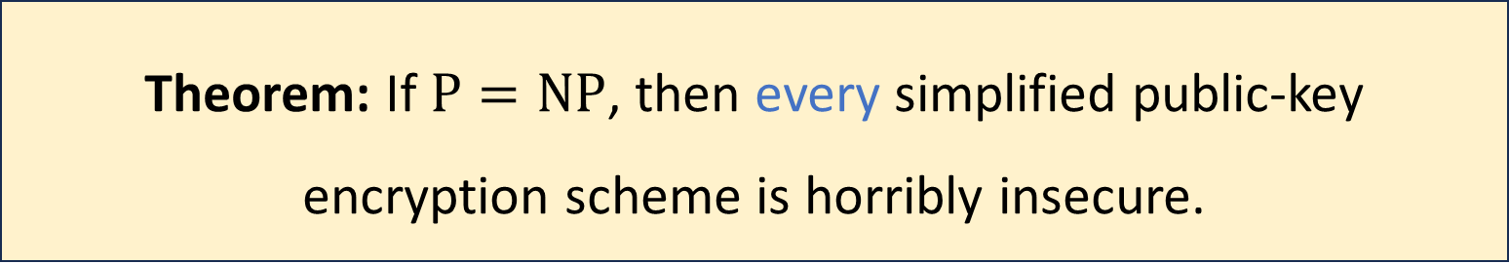
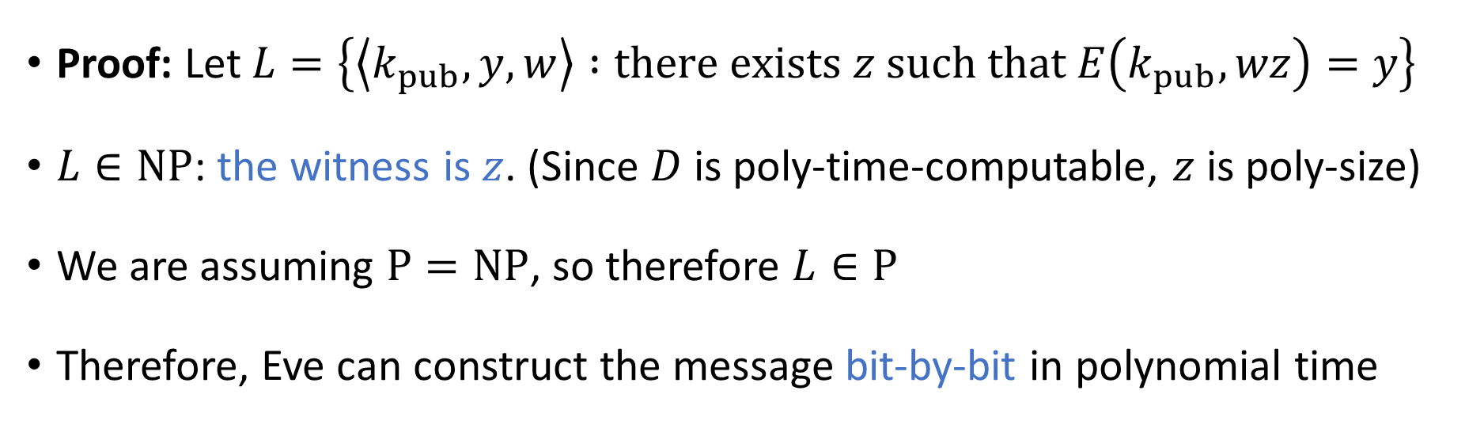
Cryptography and $\text{P}$ vs. $\text{NP}$
Theorem: If $\text{P}=\text{NP}$, then every simplified public-key encryption scheme is horribly insecure.
Proof: Let $L=\left\{\left\langle k_{pub},y,w\right\rangle :\text{there} \text{exists} z \text{such} \text{that} E\left(k_{pub},wz\right)=y\right\}$
$L∈\text{NP}$: the witness is $z$. (Since $D$ is poly-time-computable, $z$ is poly-size)
We are assuming $\text{P}=\text{NP}$, so therefore $L∈\text{P}$
Therefore, Eve can construct the message bit-by-bit in polynomial time

Slide 11

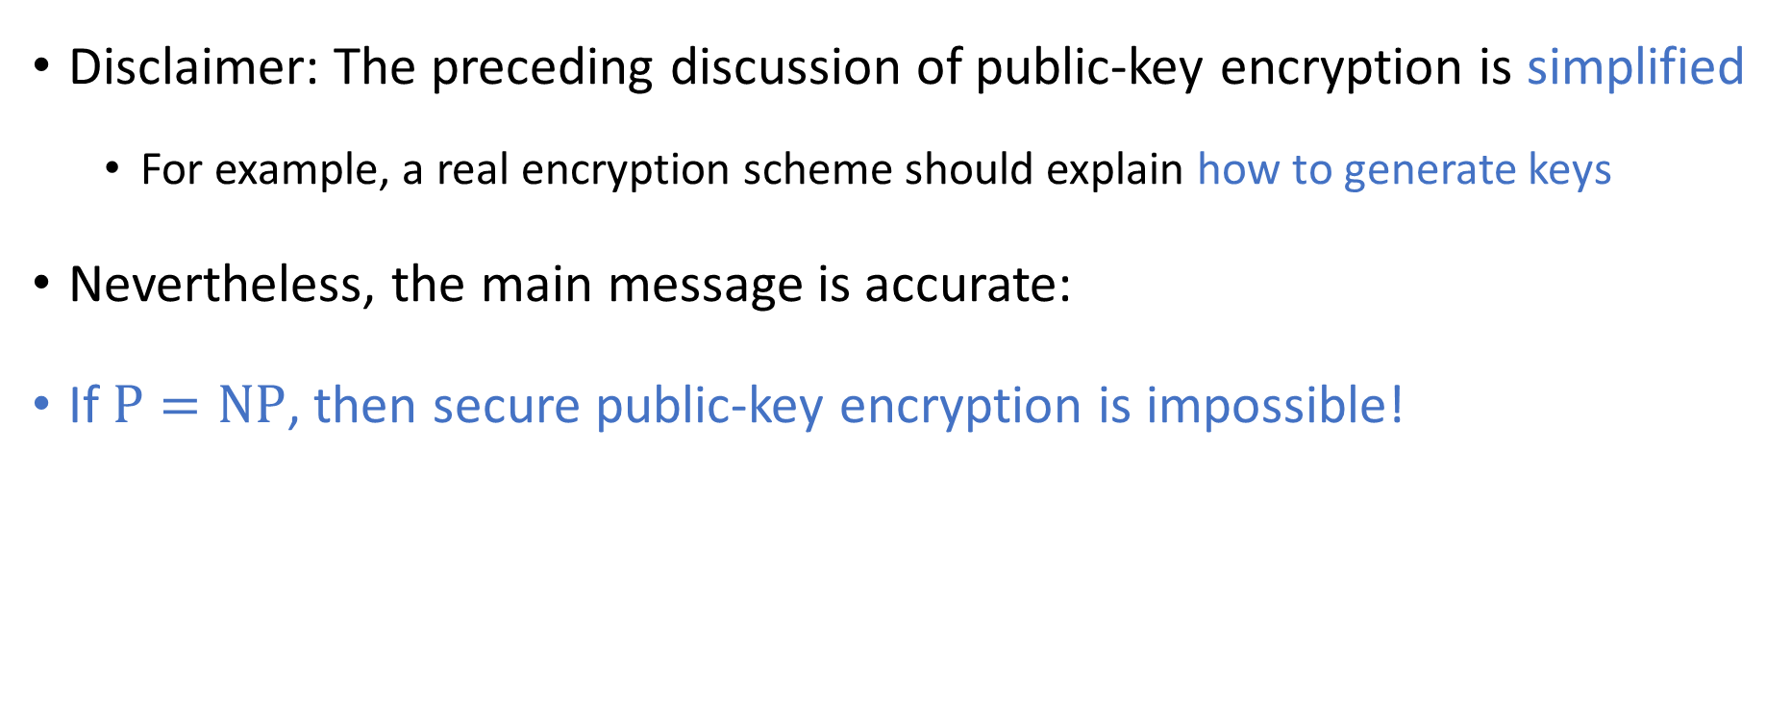
Cryptography and $\text{P}$ vs. $\text{NP}$
Disclaimer: The preceding discussion of public-key encryption is simplified
For example, a real encryption scheme should explain how to generate keys
Nevertheless, the main message is accurate:
If $\text{P}=\text{NP}$, then secure public-key encryption is impossible!
Notes:
See, e.g., “Introduction to Modern Cryptography” by Katz and Lindell if you want to see a proper definition of a secure public-key encryption scheme.

Slide 12
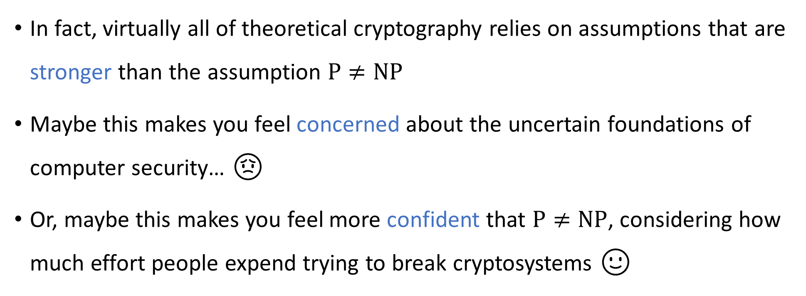
Cryptography and $\text{P}$ vs. $\text{NP}$
In fact, virtually all of theoretical cryptography relies on assumptions that are stronger than the assumption $\text{P}≠\text{NP}$
Maybe this makes you feel concerned about the uncertain foundations of computer security… 😟
Or, maybe this makes you feel more confident that $\text{P}≠\text{NP}$, considering how much effort people expend trying to break cryptosystems 🙂

Slide 13
Coping with intractability

Slide 14
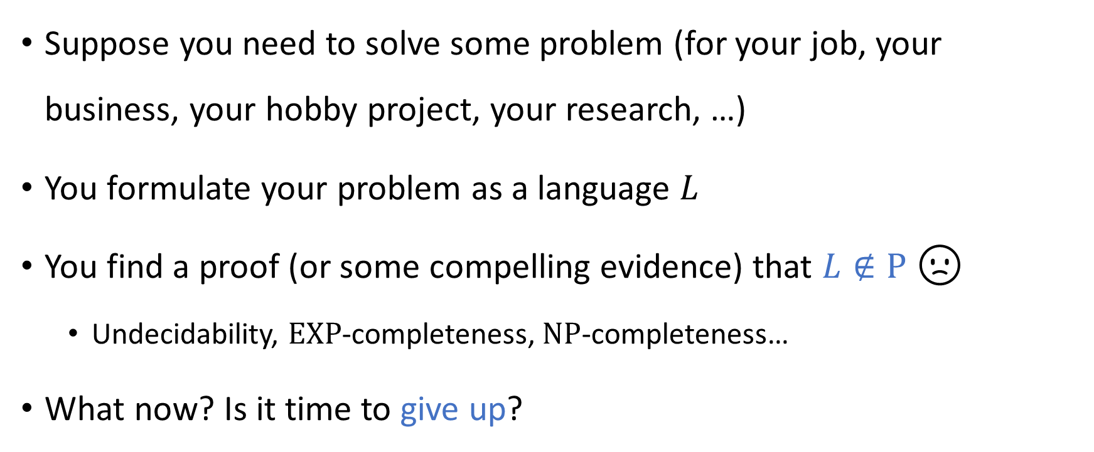
Facing intractability
Suppose you need to solve some problem (for your job, your business, your hobby project, your research, …)
You formulate your problem as a language $L$
You find a proof (or some compelling evidence) that $L∉\text{P}$ 🙁
Undecidability, $\text{EXP}$-completeness, $\text{NP}$-completeness…
What now? Is it time to give up?

Slide 15
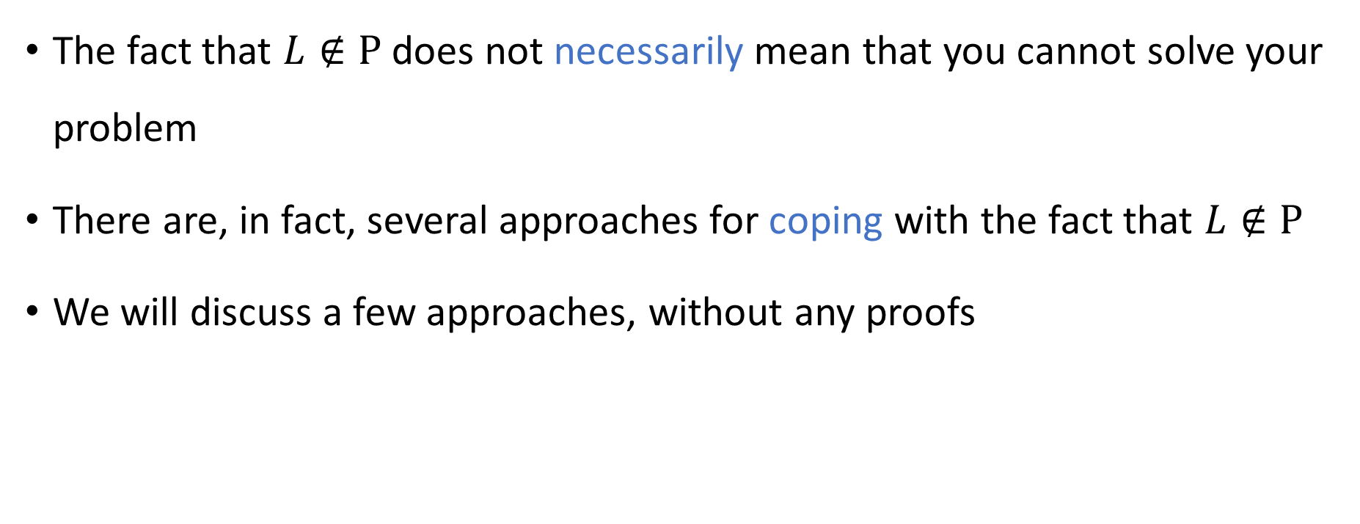
Coping with intractability
The fact that $L∉\text{P}$ does not necessarily mean that you cannot solve your problem
There are, in fact, several approaches for coping with the fact that $L∉\text{P}$
We will discuss a few approaches, without any proofs

Slide 16
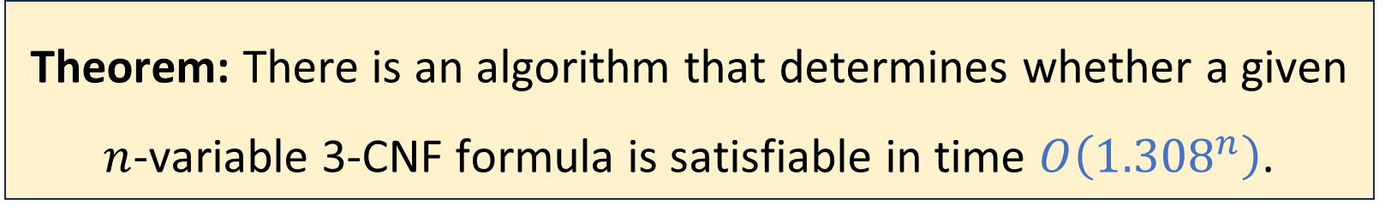
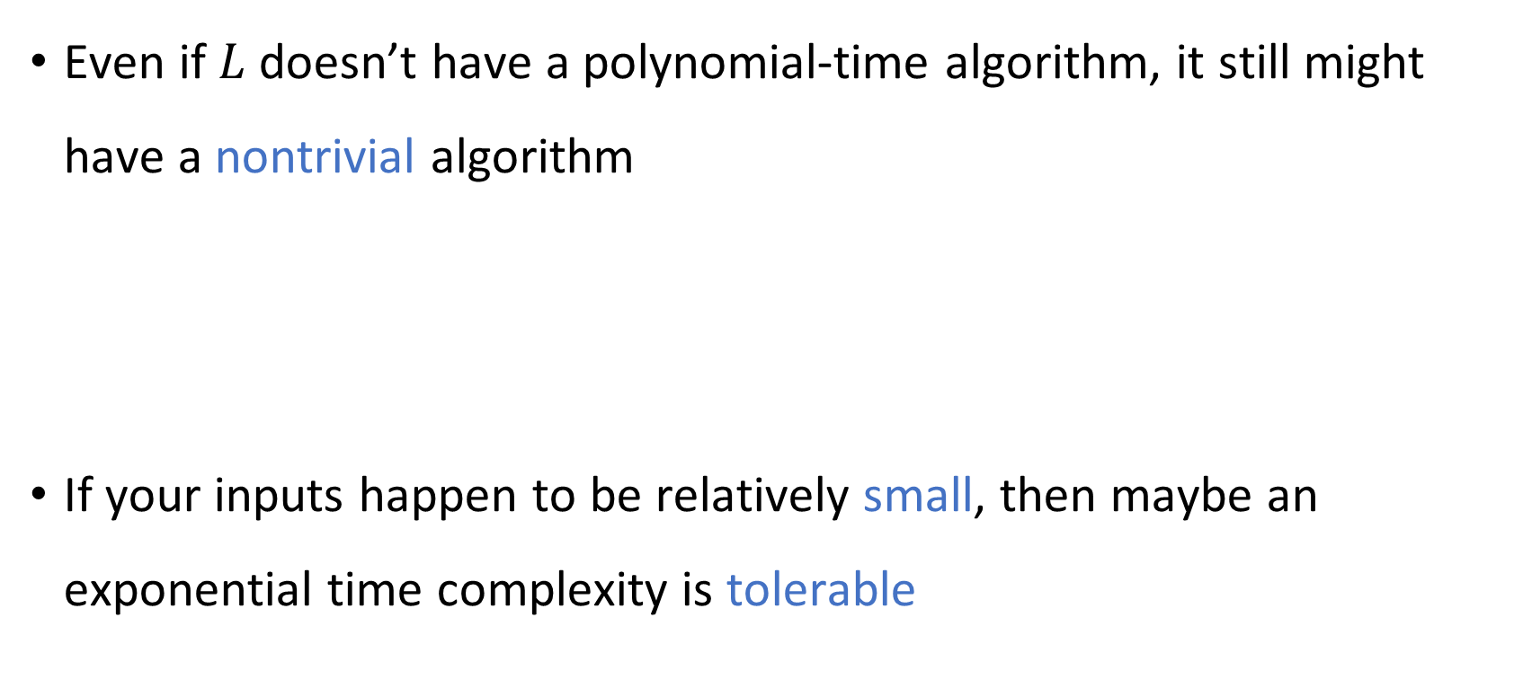
Nontrivial exponential-time algorithms
Even if $L$ doesn’t have a polynomial-time algorithm, it still might have a nontrivial algorithm
If your inputs happen to be relatively small, then maybe an exponential time complexity is tolerable
Theorem: There is an algorithm that determines whether a given $n$-variable 3-CNF formula is satisfiable in time $O\left({1.308}^{n}\right)$.

Slide 17
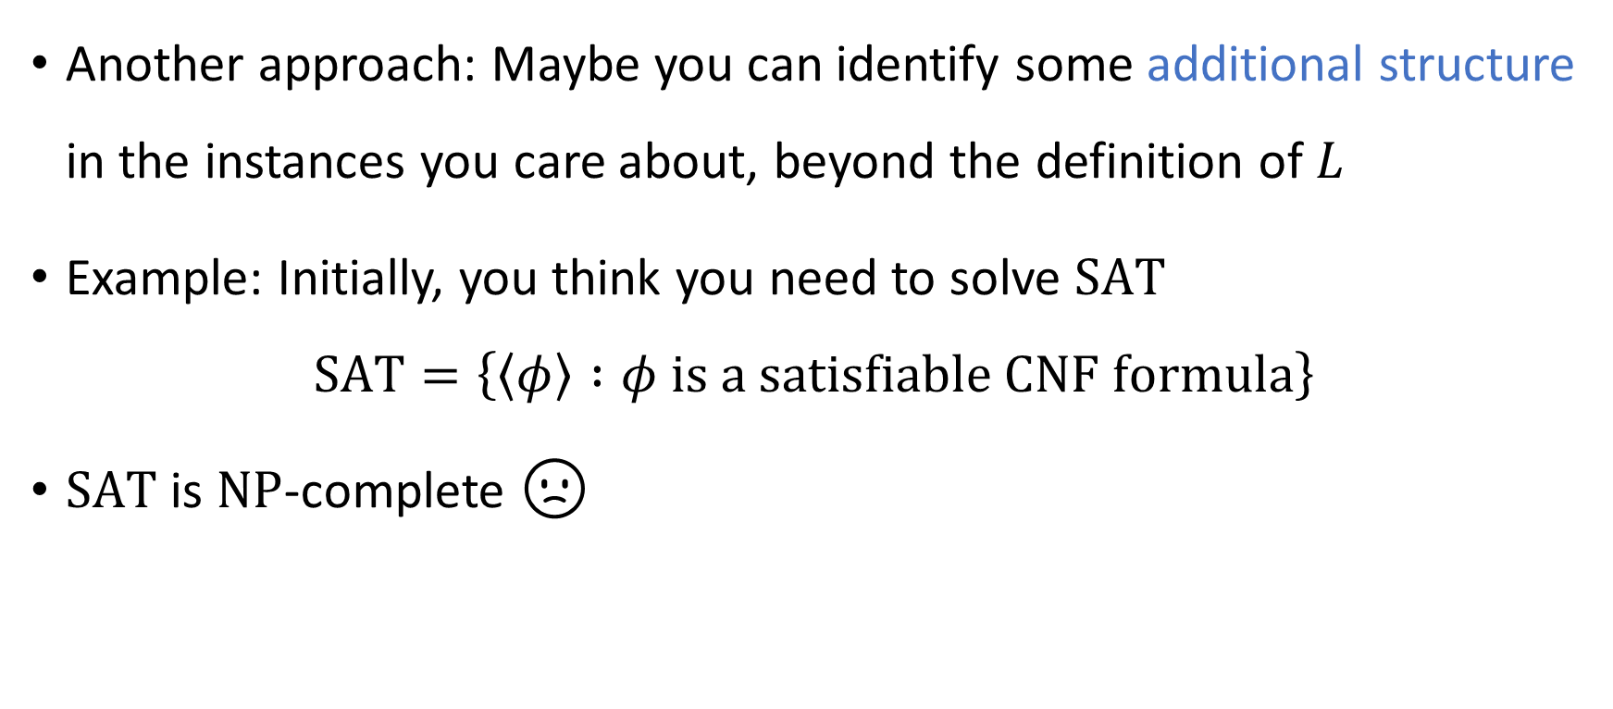
Structured inputs
Another approach: Maybe you can identify some additional structure in the instances you care about, beyond the definition of $L$
Example: Initially, you think you need to solve $\text{SAT}$
$$\text{SAT}=\left\{\left\langle φ\right\rangle :φ \text{is} \text{a} \text{satisfiable} \text{CNF} \text{formula}\right\}$$
$\text{SAT}$ is $\text{NP}$-complete 🙁

Slide 18
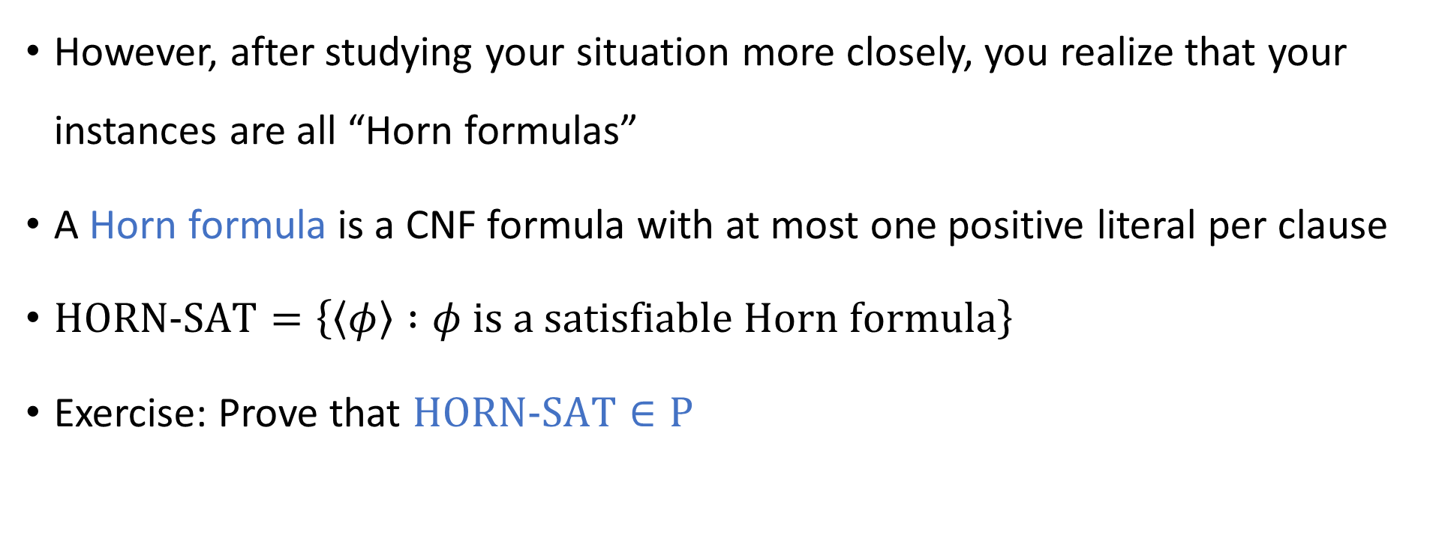
Structured inputs
However, after studying your situation more closely, you realize that your instances are all “Horn formulas”
A Horn formula is a CNF formula with at most one positive literal per clause
$\text{HORN}\text{‑}\text{SAT}=\left\{\left\langle φ\right\rangle :φ \text{is} \text{a} \text{satisfiable} \text{Horn} \text{formula}\right\}$
Exercise: Prove that $\text{HORN}\text{‑}\text{SAT}∈\text{P}$

Slide 19
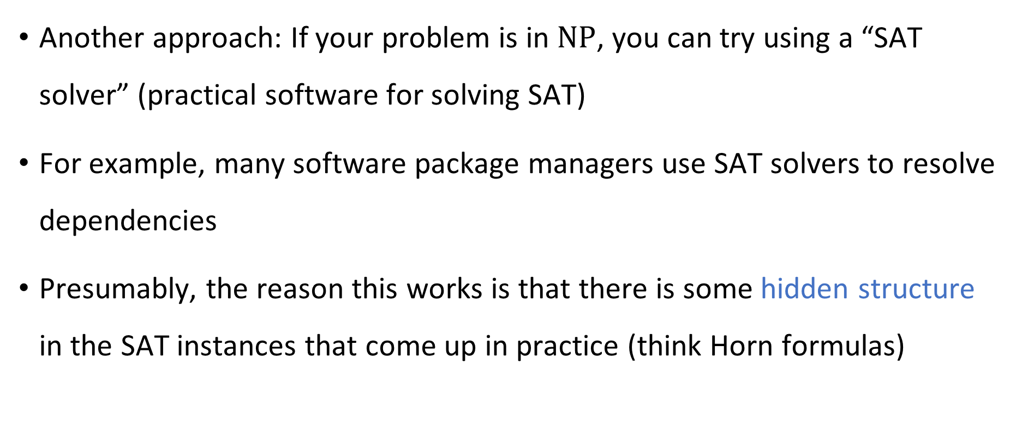
SAT solvers
Another approach: If your problem is in $\text{NP}$, you can try using a “SAT solver” (practical software for solving SAT)
For example, many software package managers use SAT solvers to resolve dependencies
Presumably, the reason this works is that there is some hidden structure in the SAT instances that come up in practice (think Horn formulas)

Slide 20
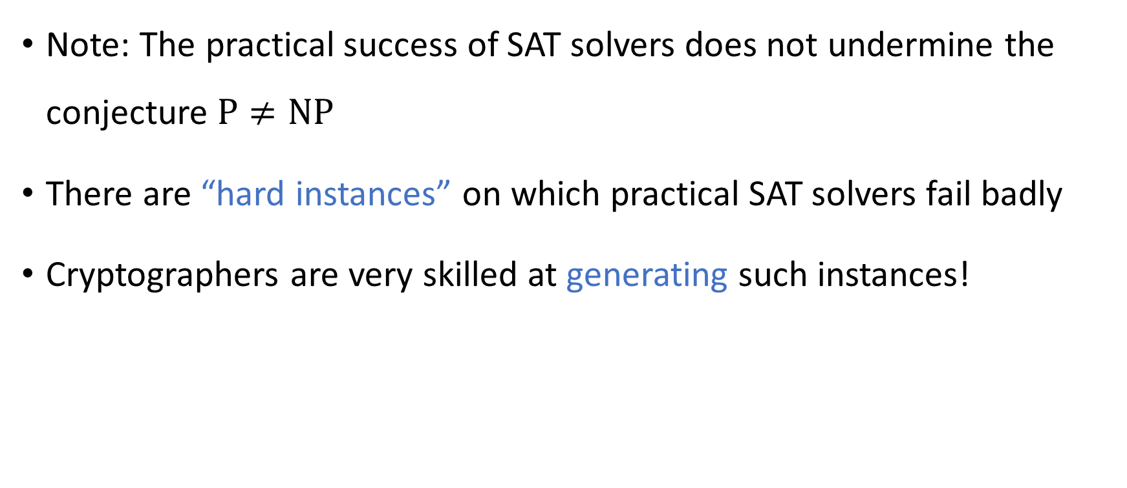
SAT solvers are not a panacea
Note: The practical success of SAT solvers does not undermine the conjecture $\text{P}≠\text{NP}$
There are “hard instances” on which practical SAT solvers fail badly
Cryptographers are very skilled at generating such instances!

Slide 21
Approximation algorithms
The next approach that we will discuss for coping with intractability is approximation algorithms
This approach only makes sense if you are trying to solve an optimization problem
Example: the Knapsack problem

Slide 22

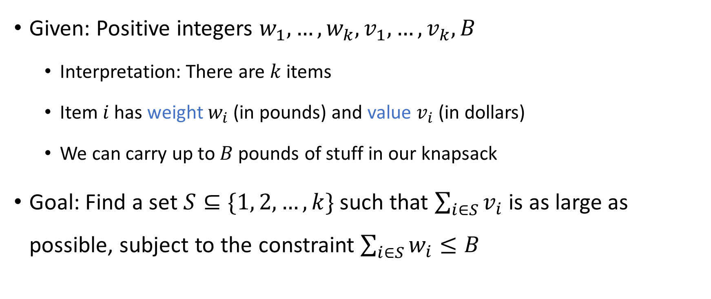
The Knapsack problem
Given: Positive integers $w_{1},…, w_{k}, v_{1},…, v_{k},B$
Interpretation: There are $k$ items
Item $i$ has weight $w_{i}$ (in pounds) and value $v_{i}$ (in dollars)
We can carry up to $B$ pounds of stuff in our knapsack
Goal: Find a set $S⊆\{1, 2, …, k\}$ such that $\sum_{i∈S}{v_{i}}$ is as large as possible, subject to the constraint $\sum_{i∈S}{w_{i}}≤B$

Slide 23


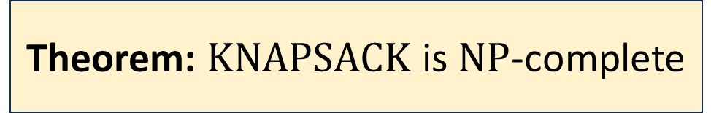
$\text{KNAPSACK}$ is $\text{NP}$-complete
$$\text{KNAPSACK}=\{\left\langle w_{1},…, w_{k}, v_{1},…, v_{k}, B, V\right\rangle :\text{there} \text{exists} S⊆\{1, 2, …, k\} \\ \text{such} \text{that} Σ_{i∈S} w_{i}≤B \text{and} Σ_{i∈S} v_{i}≥V\}$$
Theorem: $\text{KNAPSACK}$ is $\text{NP}$-complete

Slide 24
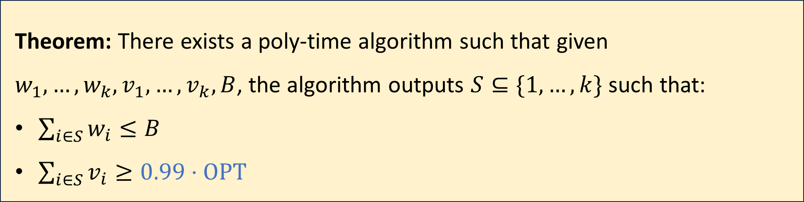
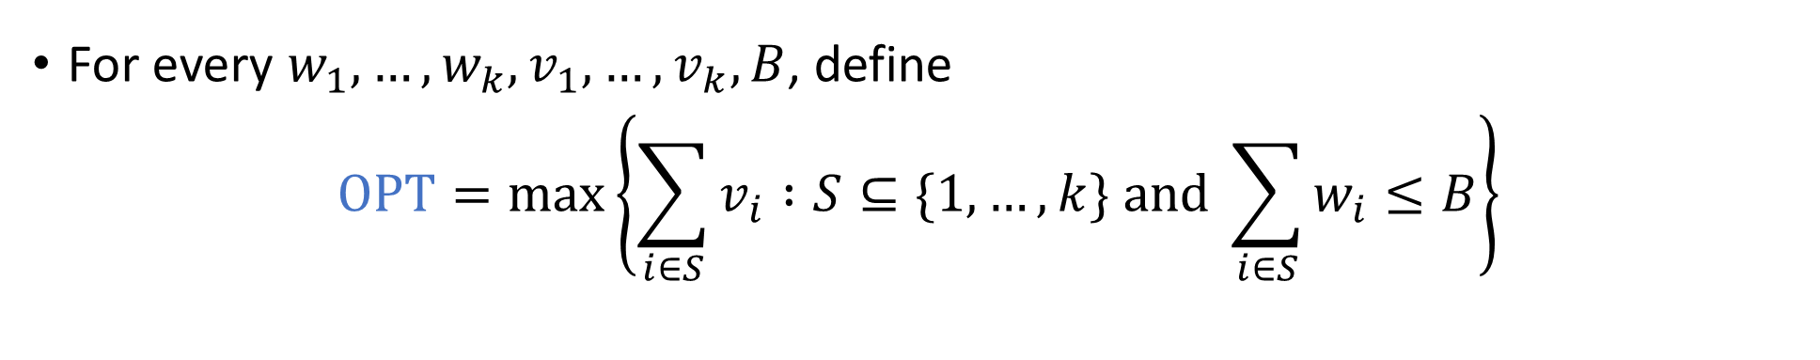
Approximation algorithms for Knapsack
For every $w_{1},…, w_{k}, v_{1},…, v_{k},B$, define
$$\text{OPT}=\max\left\{\sum_{i∈S}{v_{i}} :S⊆\{1, …, k\} \text{and} \sum_{i∈S}{w_{i}}≤B\right\}$$
Theorem: There exists a poly-time algorithm such that given $w_{1},…, w_{k}, v_{1},…, v_{k}, B$, the algorithm outputs $S⊆\{1, …, k\}$ such that:
$\sum_{i∈S}{w_{i}}≤B$
$\sum_{i∈S}{v_{i}}≥0.99⋅\text{OPT}$

Slide 25
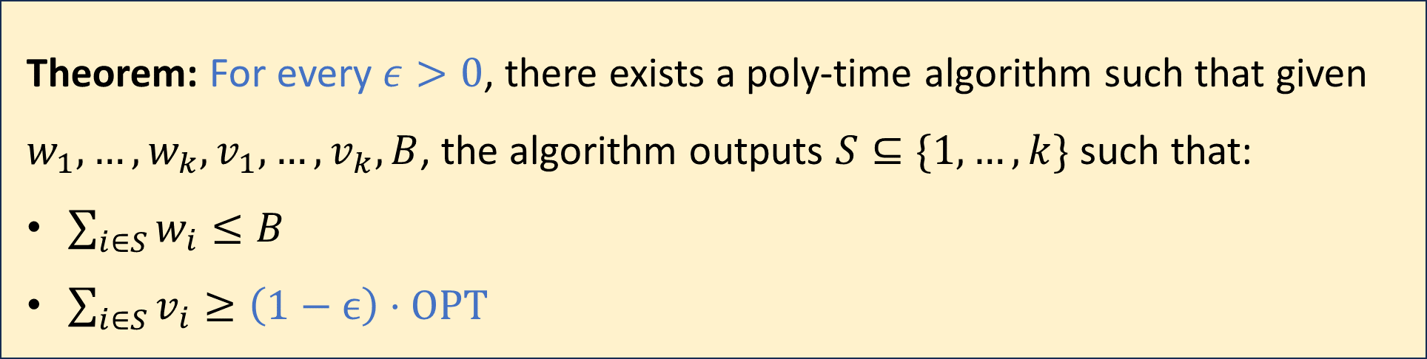

Approximation algorithms for Knapsack
For every $w_{1},…, w_{k}, v_{1},…, v_{k},B$, define
$$\text{OPT}=\max\left\{\sum_{i∈S}{v_{i}} :S⊆\{1, …, k\} \text{and} \sum_{i∈S}{w_{i}}≤B\right\}$$
Theorem: For every $ε>0$, there exists a poly-time algorithm such that given $w_{1},…, w_{k}, v_{1},…, v_{k}, B$, the algorithm outputs $S⊆\{1, …, k\}$ such that:
$\sum_{i∈S}{w_{i}}≤B$
$\sum_{i∈S}{v_{i}}≥\left(1−ϵ\right)⋅\text{OPT}$

Slide 26

Approximation algorithms are not a panacea
In some cases, approximation algorithms take some of the sting out of $\text{NP}$-completeness
However, in other cases, approximation algorithms are unhelpful!

Slide 27
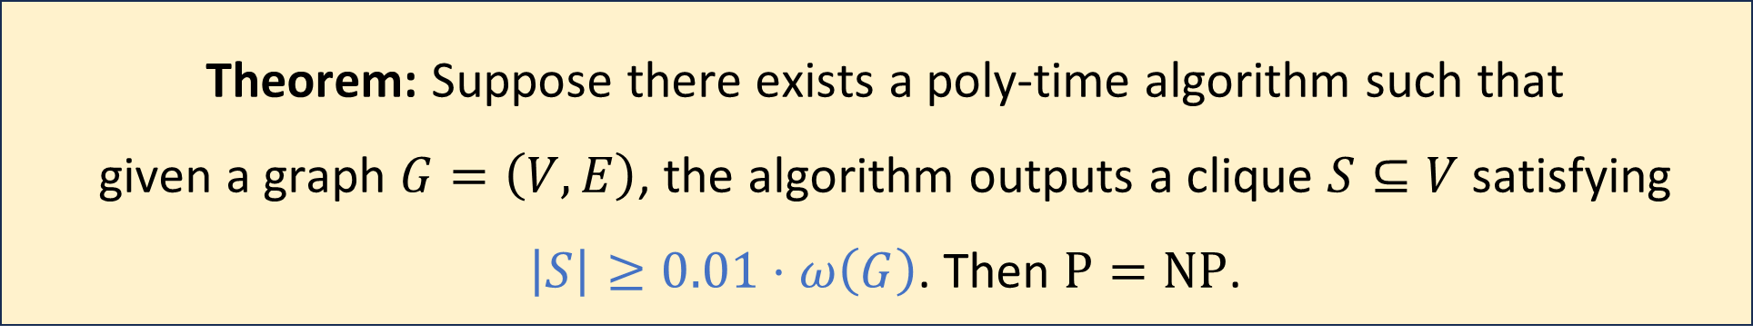

Inapproximability of the clique problem
For a graph $G$, let $ω\left(G\right)$ be the size of the largest clique in $G$
Theorem: Suppose there exists a poly-time algorithm such that given a graph $G=\left(V, E\right)$, the algorithm outputs a clique $S⊆V$ satisfying $\left|S\right|≥0.01⋅ω\left(G\right)$. Then $\text{P}=\text{NP}$.

Slide 28
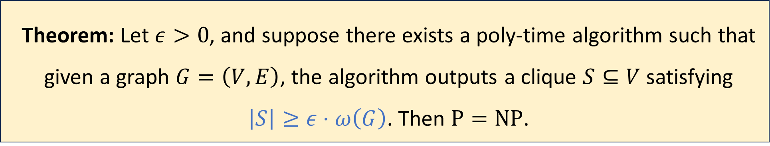
Inapproximability of the clique problem
For a graph $G$, let $ω\left(G\right)$ be the size of the largest clique in $G$
Theorem: Let $ε>0$, and suppose there exists a poly-time algorithm such that given a graph $G=\left(V, E\right)$, the algorithm outputs a clique $S⊆V$ satisfying $\left|S\right|≥ε⋅ω\left(G\right)$. Then $\text{P}=\text{NP}$.

Slide 29
Quantum computing
Another approach for coping with intractability: Quantum Computing
A quantum computer is a computational device that uses special features of quantum physics
A detailed discussion of quantum computing is outside the scope of this course
We will discuss only some key facts about quantum computing

Slide 30
Quantum computing
Quantum computers are, to some extent, hypothetical
So far, researchers have constructed rudimentary quantum computers
There are huge ongoing efforts to build fully-functional quantum computers

Slide 31
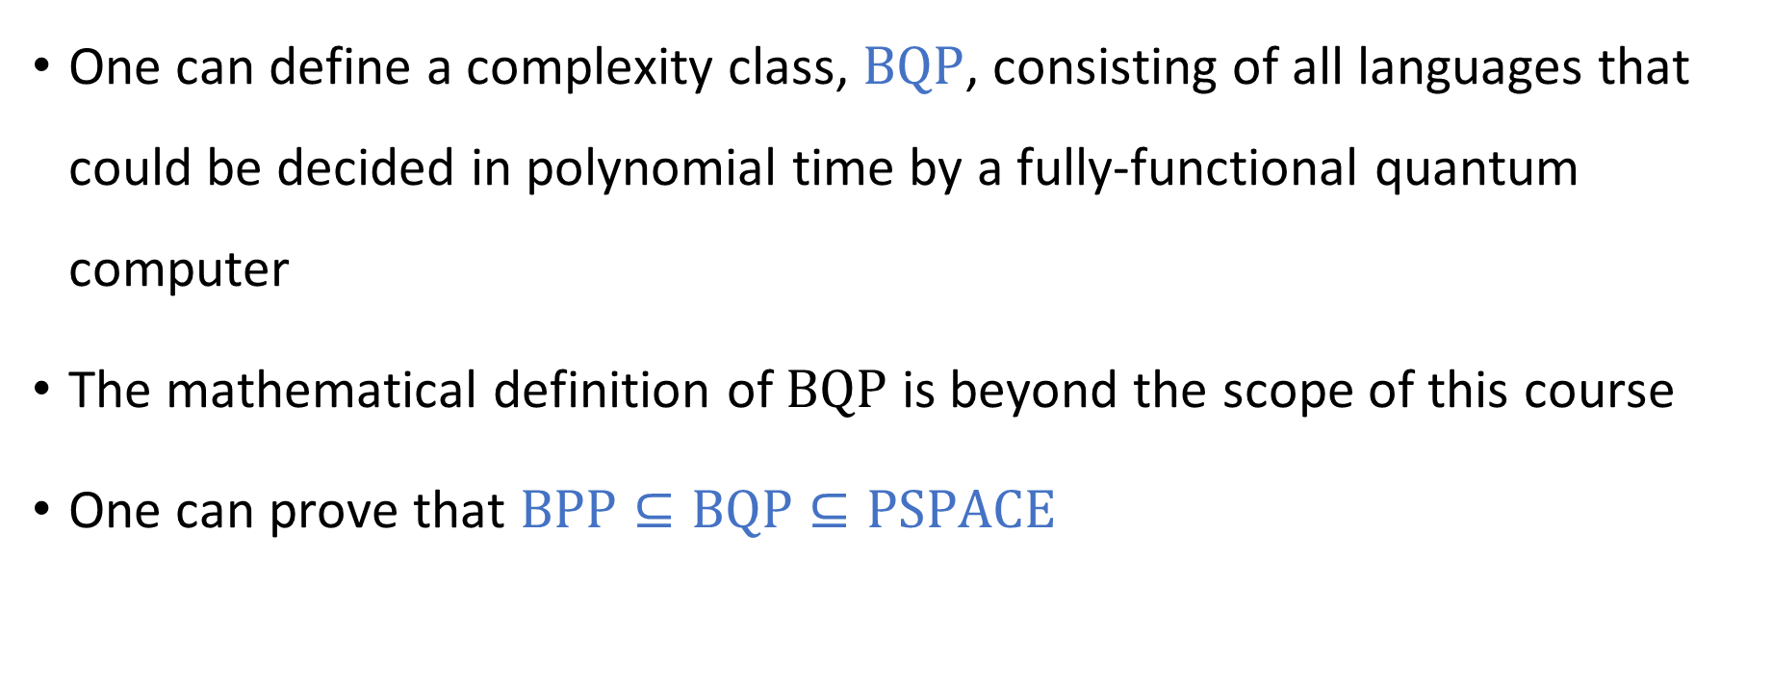
Quantum complexity theory
One can define a complexity class, $\text{BQP}$, consisting of all languages that could be decided in polynomial time by a fully-functional quantum computer
The mathematical definition of $\text{BQP}$ is beyond the scope of this course
One can prove that $\text{BPP}⊆\text{BQP}⊆\text{PSPACE}$

Slide 32
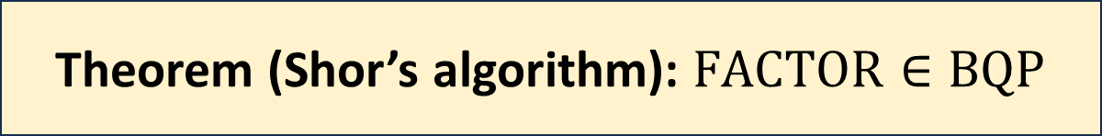
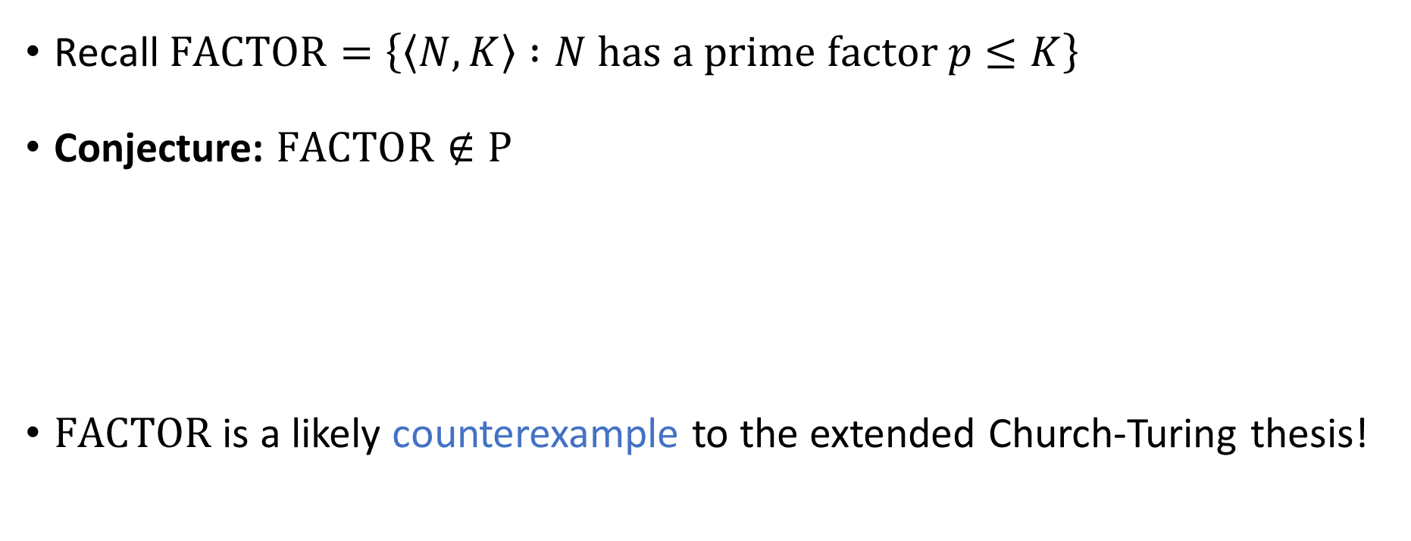
Shor’s algorithm
Recall $\text{FACTOR}=\left\{\left\langle N, K\right\rangle :N \text{has} \text{a} \text{prime} \text{factor} p≤K\right\}$
Conjecture: $\text{FACTOR}∉\text{P}$
$\text{FACTOR}$ is a likely counterexample to the extended Church-Turing thesis!
Theorem (Shor’s algorithm): $\text{FACTOR}∈\text{BQP}$

