Slide 1
CMSC 28100 Introduction to Complexity Theory Autumn 2025 Instructor: William Hoza
⏳

Slide 2
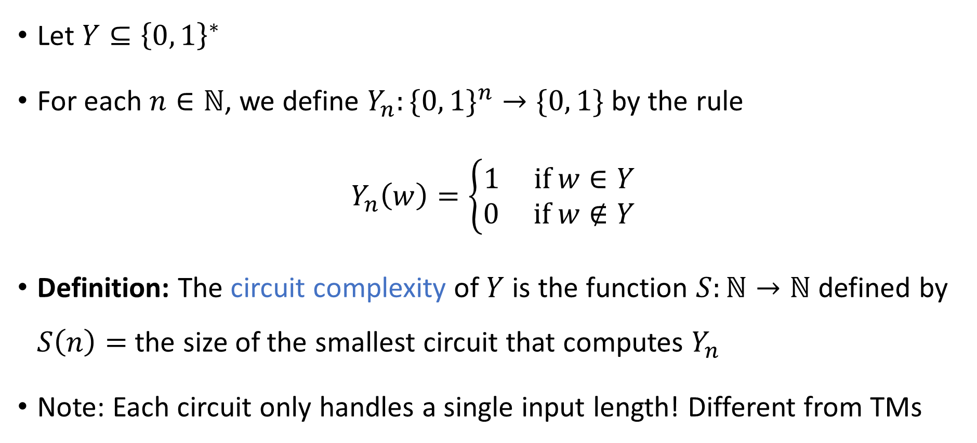
Circuit complexity of a binary language
Let $Y⊆{\left\{0, 1\right\}}^{∗}$
For each $n∈ℕ$, we define $Y_{n}:\{0, 1\}^{n}→\{0, 1\}$ by the rule
$$Y_{n}\left(w\right)=\left\{\begin{aligned}1 \text{if} w∈Y \\ 0 \text{if} w∉Y\end{aligned}\right.$$
Definition: The circuit complexity of $Y$ is the function $S:ℕ→ℕ$ defined by $S\left(n\right)=$ the size of the smallest circuit that computes $Y_{n}$
Note: Each circuit only handles a single input length! Different from TMs

Slide 3

Turing machines vs. circuits
Let $M$ be a Turing machine that decides a language $Y$
Let $T\left(n\right)$ be $M$’s time complexity; let $S\left(n\right)$ be $M$’s space complexity
Theorem: The circuit complexity of $Y$ is $O\left(T\left(n\right)⋅S\left(n\right)\right)$.

Slide 4






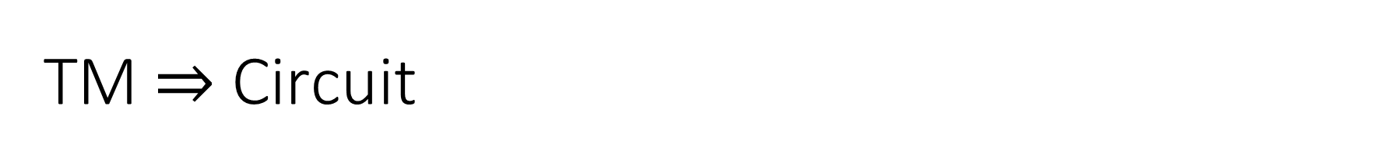









TM $⇒$ Circuit
Let $\text{NEXT}\left(c_{1}c_{2}…c_{ℓ}\right)=c_{1}^{′}c_{2}^{′}⋯c_{ℓ}^{′}$
There is a circuit $C_{M}$ that computes $\left\langle c_{i}^{′}\right\rangle$ given $\left\langle c_{i−1}\right\rangle$, $\left\langle c_{i}\right\rangle$, $\left\langle c_{i+1}\right\rangle$, $\left\langle c_{i+2}\right\rangle$
$$⟨c_{i}^{′}⟩$$
$$∨$$
$$∨$$
$$∧$$
$$∨$$
$$⊕$$
$$∨$$
$$∧$$
$$∨$$
$$⊕$$
$$∨$$
$$==$$
$$⟨c_{i−1}⟩$$
$${⟨c}_{i}⟩$$
$$⟨c_{i+1}⟩$$
$$\left\langle c_{i+2}\right\rangle$$

Slide 5
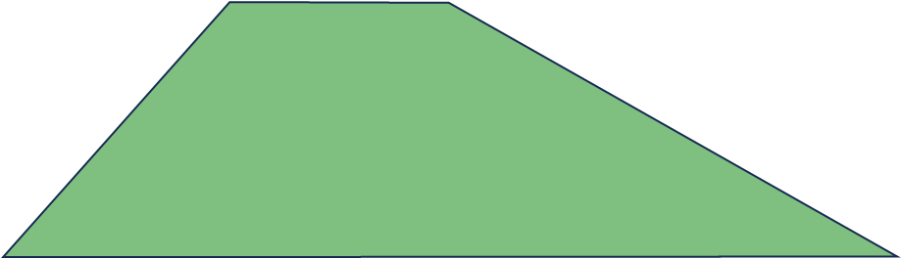
TM $⇒$ Circuit
Let $\text{NEXT}\left(c_{1}c_{2}…c_{ℓ}\right)=c_{1}^{′}c_{2}^{′}⋯c_{ℓ}^{′}$
There is a circuit $C_{M}$ that computes $\left\langle c_{i}^{′}\right\rangle$ given $\left\langle c_{i−1}\right\rangle$, $\left\langle c_{i}\right\rangle$, $\left\langle c_{i+1}\right\rangle$, $\left\langle c_{i+2}\right\rangle$
$$⟨c_{i}^{′}⟩$$
$$⟨c_{i−1}⟩$$
$${⟨c}_{i}⟩$$
$$⟨c_{i+1}⟩$$
$$\left\langle c_{i+2}\right\rangle$$

Slide 6











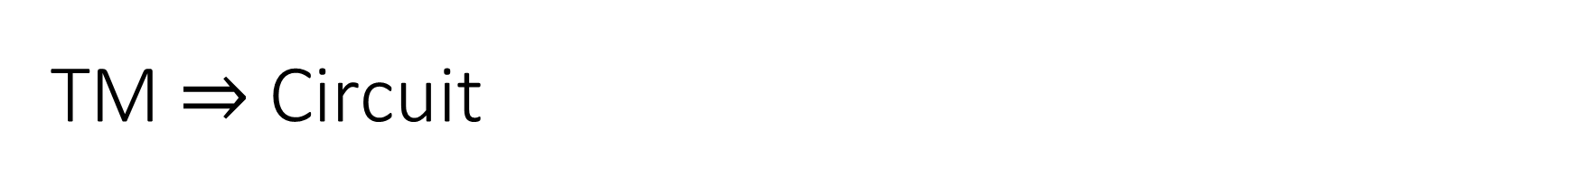









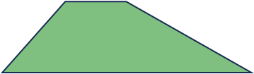













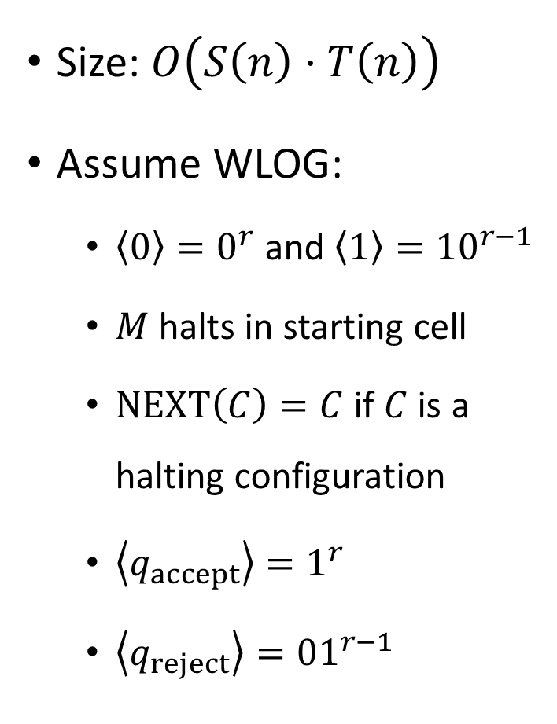




















TM $⇒$ Circuit
Encoding of final configuration of $M$ on $w$
$$Y_{n}\left(w\right)$$
Size: $O\left(S\left(n\right)⋅T\left(n\right)\right)$
Assume WLOG:
$\left\langle 0\right\rangle =0^{r}$ and $\left\langle 1\right\rangle ={10}^{r−1}$
$M$ halts in starting cell
$\text{NEXT}\left(C\right)=C$ if $C$ is a halting configuration
$\left\langle q_{accept}\right\rangle =1^{r}$
$\left\langle q_{reject}\right\rangle ={01}^{r−1}$
$$\left\langle ⊔\right\rangle$$
$$\left\langle ⊔\right\rangle$$
$$\left\langle ⊔\right\rangle$$
$$\left\langle ⊔\right\rangle$$
$$\left\langle ⊔\right\rangle$$
$$\left\langle ⊔\right\rangle$$
$$\left\langle ⊔\right\rangle$$
$$\left\langle ⊔\right\rangle$$
$$\left\langle ⊔\right\rangle$$
$$\left\langle ⊔\right\rangle$$
$$\left\langle ⊔\right\rangle$$
$$\left\langle ⊔\right\rangle$$
$$T(n)$$
$$\left\langle ⊔\right\rangle$$
$$\left\langle ⊔\right\rangle$$
$$\left\langle ⊔\right\rangle$$
$$\left\langle ⊔\right\rangle$$
$$\left\langle ⊔\right\rangle$$
$$\left\langle ⊔\right\rangle$$
$$\left\langle ⊔\right\rangle$$
$$\left\langle ⊔\right\rangle$$
$$\left\langle ⊔\right\rangle$$
$$\left\langle ⊔\right\rangle$$
$$\left\langle ⊔\right\rangle$$
$$\left\langle ⊔\right\rangle$$
$$\left\langle ⊔\right\rangle$$
$$\left\langle ⊔\right\rangle$$
$$\left\langle ⊔\right\rangle$$
$$\left\langle ⊔\right\rangle$$
$$\left\langle ⊔\right\rangle$$
$$\left\langle ⊔\right\rangle$$
$$\left\langle ⊔\right\rangle$$
$$\left\langle ⊔\right\rangle$$
$$\left\langle ⊔\right\rangle$$
$$\left\langle q_{0}\right\rangle$$
$$\left\langle ⊔\right\rangle$$
$$\left\langle w_{1}\right\rangle$$
$$\left\langle w_{2}\right\rangle$$
$$\left\langle w_{3}\right\rangle$$
$$\left\langle ⊔\right\rangle$$
$$\left\langle ⊔\right\rangle$$
$$\left\langle ⊔\right\rangle$$
$$\left\langle ⊔\right\rangle$$
$$0$$
$$0$$
$$0$$
$$0$$
$$0$$
$$0$$
$$w_{1}$$
$$w_{2}$$
$$w_{3}$$
$$O\left(S\left(n\right)\right)$$

Slide 7
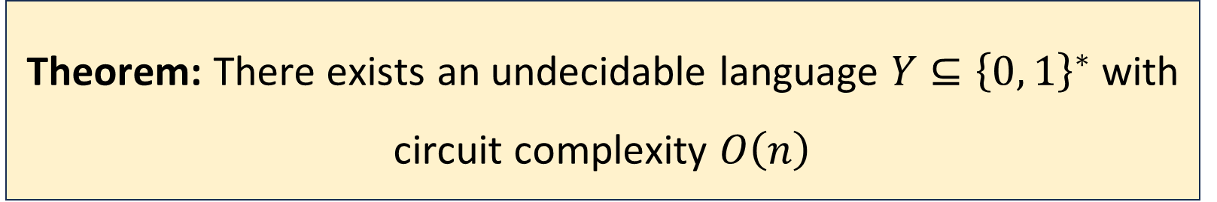

Turing machines vs. circuits
Let $Y⊆{\left\{0, 1\right\}}^{∗}$
We just proved: If $Y∈\text{P}$, then $Y$ has polynomial circuit complexity
Converse?
Theorem: There exists an undecidable language $Y⊆{\left\{0, 1\right\}}^{∗}$ with circuit complexity $O\left(n\right)$

Slide 8
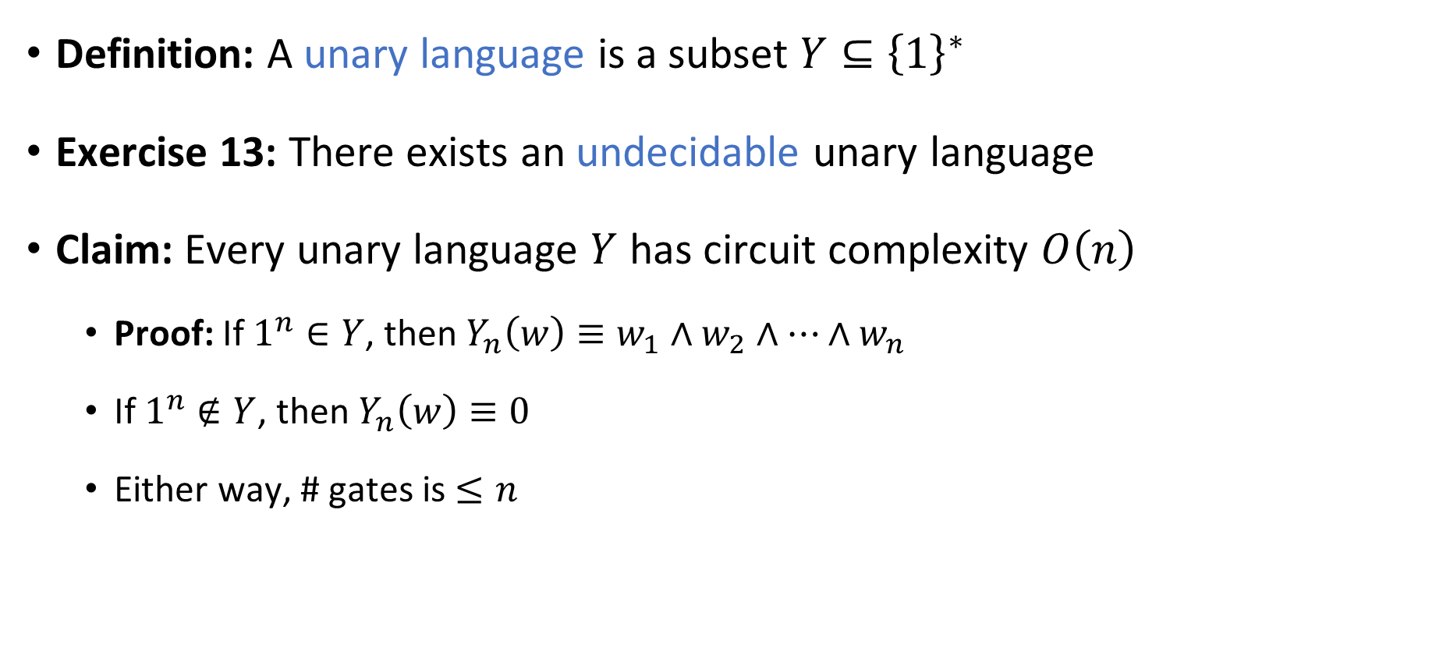
An undecidable language with small circuits
Definition: A unary language is a subset $Y⊆{\left\{1\right\}}^{∗}$
Exercise 13: There exists an undecidable unary language
Claim: Every unary language $Y$ has circuit complexity $O\left(n\right)$
Proof: If $1^{n}∈Y$, then $Y_{n}\left(w\right)≡w_{1}∧w_{2}∧⋯∧w_{n}$
If $1^{n}∉Y$, then $Y_{n}\left(w\right)≡0$
Either way, # gates is $≤n$

Slide 9
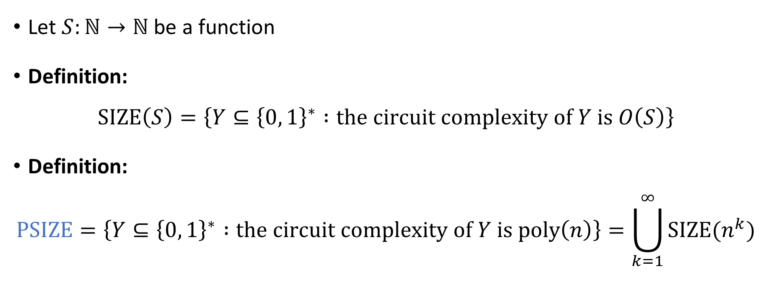

The complexity class $\text{PSIZE}$
Let $S:ℕ→ℕ$ be a function
Definition:
$$\text{SIZE}\left(S\right)=\left\{Y⊆{\left\{0, 1\right\}}^{∗} :\text{the} \text{circuit} \text{complexity} \text{of} Y \text{is} O\left(S\right)\right\}$$
Definition:
$$\text{PSIZE}=\left\{Y⊆{\left\{0, 1\right\}}^{∗} :\text{the} \text{circuit} \text{complexity} \text{of} Y \text{is} \text{poly}\left(n\right)\right\}=\bigcup_{k=1}^{∞}{\text{SIZE}(n^{k}})$$

Slide 10
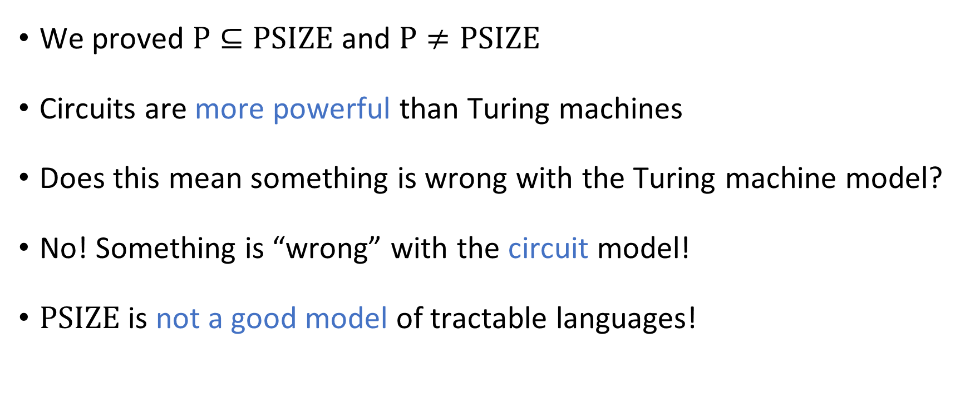



How to interpret $\text{PSIZE}$
$$\text{PSIZE}$$
$$\text{P}$$
We proved $\text{P}⊆\text{PSIZE}$ and $\text{P}≠\text{PSIZE}$
Circuits are more powerful than Turing machines
Does this mean something is wrong with the Turing machine model?
No! Something is “wrong” with the circuit model!
$\text{PSIZE}$ is not a good model of tractable languages!

Slide 11
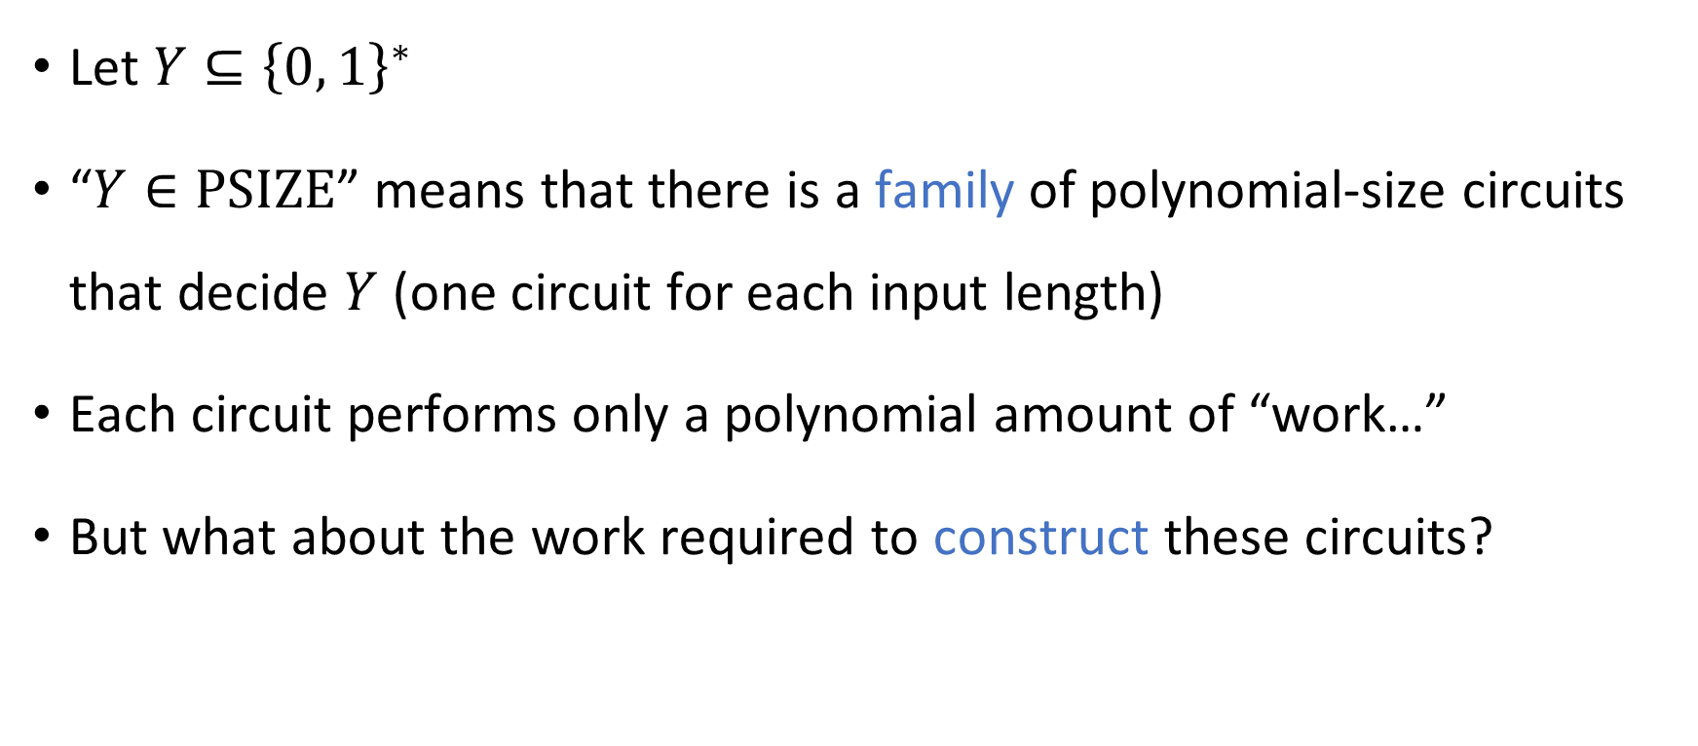
Nonuniformity
Let $Y⊆{\left\{0, 1\right\}}^{∗}$
“$Y∈\text{PSIZE}$” means that there is a family of polynomial-size circuits that decide $Y$ (one circuit for each input length)
Each circuit performs only a polynomial amount of “work…”
But what about the work required to construct these circuits?

Slide 12
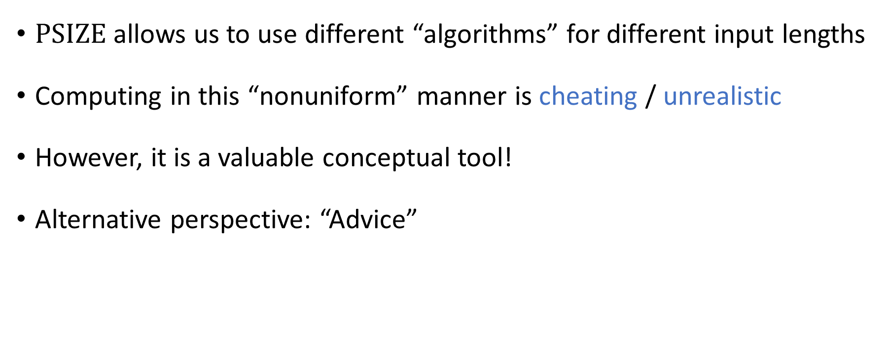
Nonuniformity
$\text{PSIZE}$ allows us to use different “algorithms” for different input lengths
Computing in this “nonuniform” manner is cheating / unrealistic
However, it is a valuable conceptual tool!
Alternative perspective: “Advice”

Slide 13

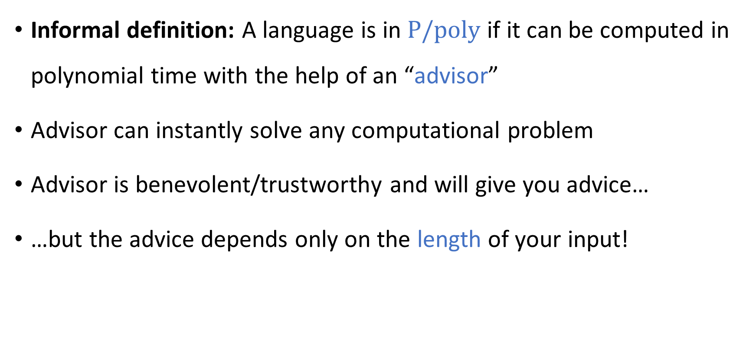
Computing with advice
Informal definition: A language is in $\text{P}/\text{poly}$ if it can be computed in polynomial time with the help of an “advisor”
Advisor can instantly solve any computational problem
Advisor is benevolent/trustworthy and will give you advice…
…but the advice depends only on the length of your input!

Slide 14
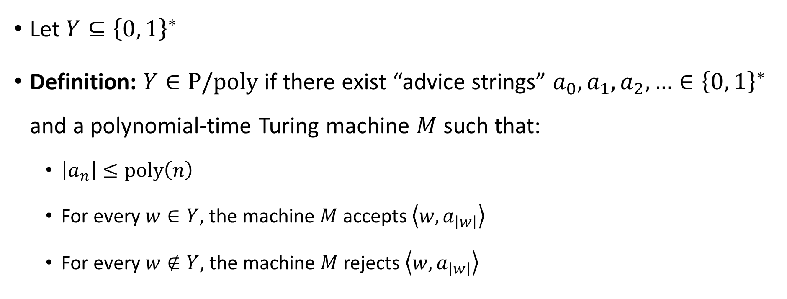
Computing with advice
Let $Y⊆{\left\{0, 1\right\}}^{∗}$
Definition: $Y∈\text{P}/\text{poly}$ if there exist “advice strings” $a_{0},a_{1},a_{2},…∈{\left\{0, 1\right\}}^{∗}$ and a polynomial-time Turing machine $M$ such that:
$\left|a_{n}\right|≤\text{poly}\left(n\right)$
For every $w∈Y$, the machine $M$ accepts $\left\langle w,a_{\left|w\right|}\right\rangle$
For every $w∉Y$, the machine $M$ rejects $\left\langle w,a_{\left|w\right|}\right\rangle$

Slide 15
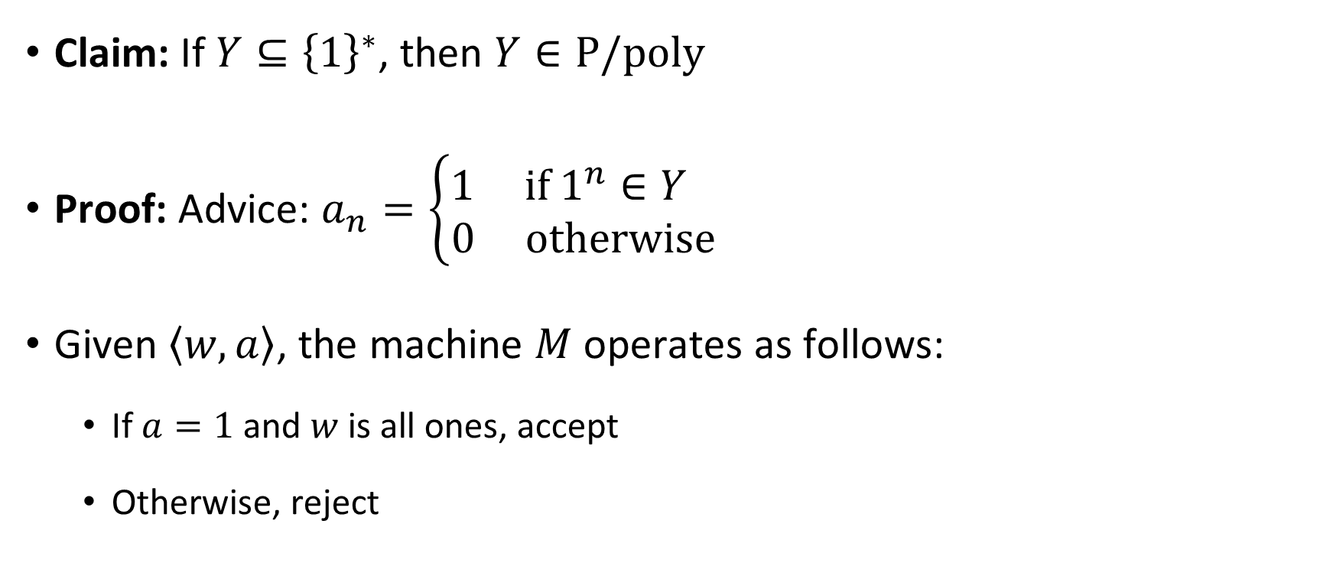
Example: Unary languages
Claim: If $Y⊆{\left\{1\right\}}^{∗}$, then $Y∈\text{P}/\text{poly}$
Proof: Advice: $a_{n}=\left\{\begin{aligned}1 \text{if} 1^{n}∈Y \\ 0 \text{otherwise}\end{aligned}\right.$
Given $\left\langle w,a\right\rangle$, the machine $M$ operates as follows:
If $a=1$ and $w$ is all ones, accept
Otherwise, reject

Slide 16













Circuits vs. advice
Theorem: $\text{PSIZE}=\text{P}/\text{poly}$
$$∨$$
$$∨$$
$$≅$$
$$∧$$
$$∧$$
$$∧$$
$$⊕$$
$$⊕$$
$$x_{1}$$
$$x_{2}$$
$$x_{3}$$
Step 1: Prove $\text{P}/\text{poly}⊆\text{PSIZE}$

Slide 17


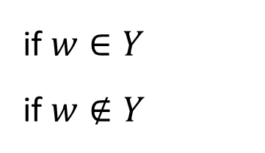


Proof that $\text{P}/\text{poly}⊆\text{PSIZE}$
Let $Y∈\text{P}/\text{poly}$ and let $n∈ℕ$
Goal: Design a circuit of size $\text{poly}\left(n\right)$ that decides $Y_{n}$
There is a poly-time Turing machine $M$ that decides $Y$ using advice
$$M$$
Accept
Reject
if $w∈Y$
if $w∉Y$
$$\left\langle w,a_{n}\right\rangle$$

Slide 18





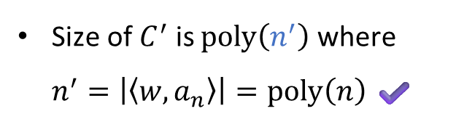










Proof that $\text{P}/\text{poly}⊆\text{PSIZE}$
Polynomial-Time Turing Machine $⇒$ Polynomial-Size Circuits
Final step: “hard-code” the advice $a_{n}$
Technicality: Use the encoding $\left\langle w,a\right\rangle =1^{\left|w\right|}0wa$
$$Y_{n}\left(w\right)$$
$$Y_{n}\left(w\right)$$
Size of $C^{′}$ is $\text{poly}\left(n^{′}\right)$ where $n^{′}=\left|\left\langle w,a_{n}\right\rangle \right|=\text{poly}\left(n\right)$ ✔️
$$C$$
$$C′$$
$$\left\langle w,a_{n}\right\rangle$$
$$1$$
$$1$$
$$1$$
$$0$$
$$w_{1}$$
$$w_{2}$$
$$w_{3}$$
$$1$$
$$0$$
$$1$$
$$0$$
$$a_{n}$$

Slide 19



Circuits vs. advice
Theorem: $\text{PSIZE}=\text{P}/\text{poly}$
$$∨$$
$$∨$$
$$≅$$
$$∧$$
$$∧$$
$$∧$$
$$⊕$$
$$⊕$$
$$x_{1}$$
$$x_{2}$$
$$x_{3}$$
Step 1: Prove $\text{P}/\text{poly}⊆\text{PSIZE}$ ✔️
Step 2: Prove $\text{PSIZE}⊆\text{P}/\text{poly}$

Slide 20
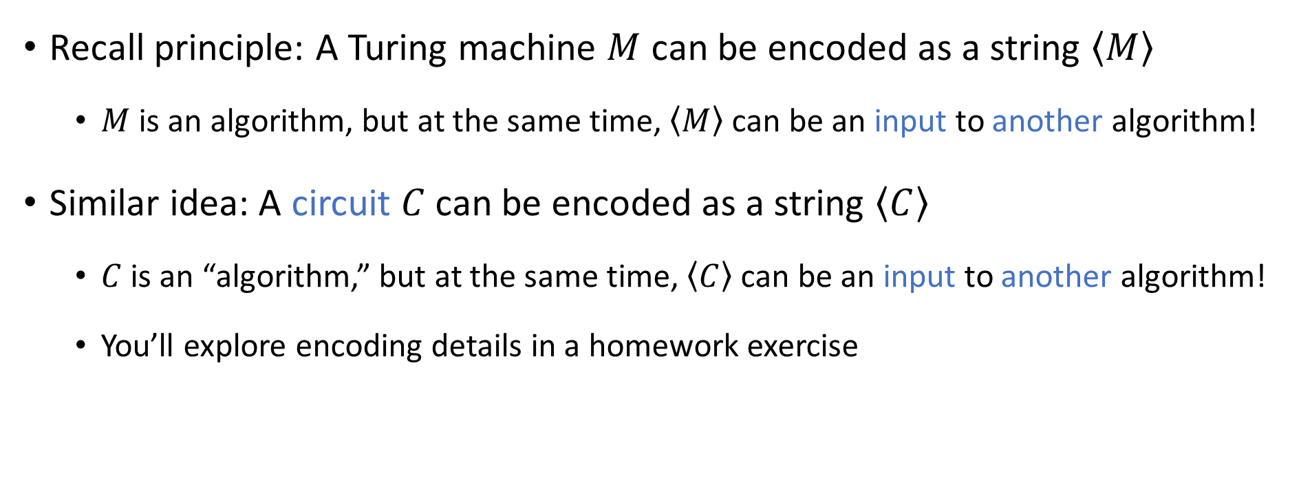
Code as data III
Recall principle: A Turing machine $M$ can be encoded as a string $\left\langle M\right\rangle$
$M$ is an algorithm, but at the same time, $\left\langle M\right\rangle$ can be an input to another algorithm!
Similar idea: A circuit $C$ can be encoded as a string $\left\langle C\right\rangle$
$C$ is an “algorithm,” but at the same time, $\left\langle C\right\rangle$ can be an input to another algorithm!
You’ll explore encoding details in a homework exercise

Slide 21
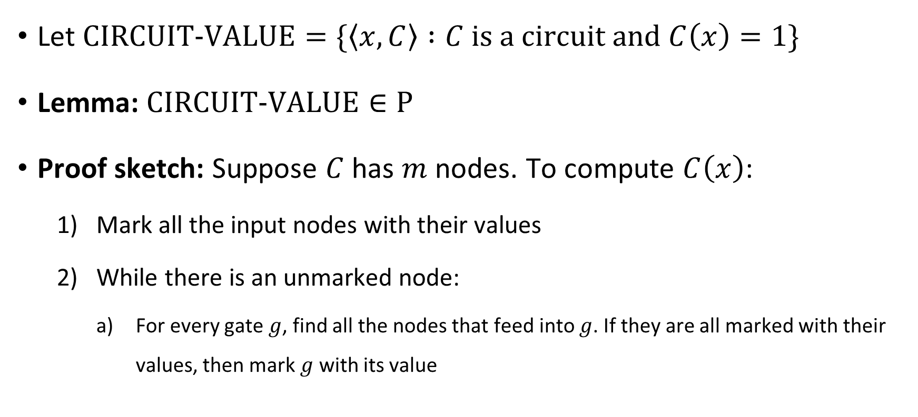
Circuit value problem
Let $\text{CIRCUIT}\text{‑}\text{VALUE}=\{\left\langle x,C\right\rangle :C \text{is} \text{a} \text{circuit} \text{and} C\left(x\right)=1\}$
Lemma: $\text{CIRCUIT}\text{‑}\text{VALUE}∈\text{P}$
Proof sketch: Suppose $C$ has $m$ nodes. To compute $C\left(x\right)$:
Mark all the input nodes with their values
While there is an unmarked node:
For every gate $g$, find all the nodes that feed into $g$. If they are all marked with their values, then mark $g$ with its value

Slide 22
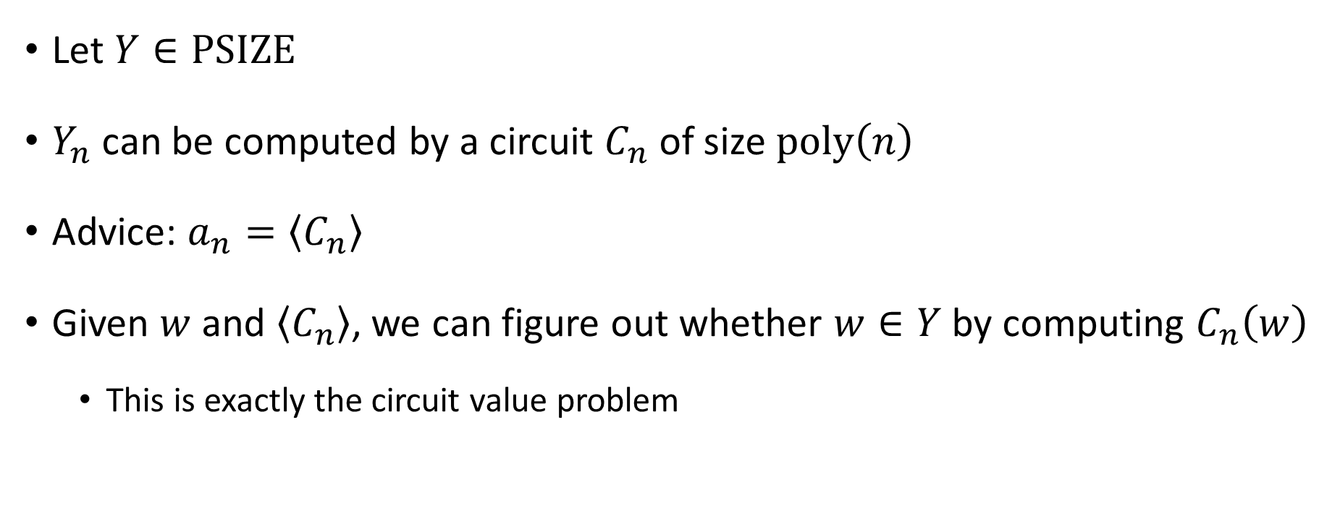

Proof that $\text{PSIZE}⊆\text{P}/\text{poly}$
Let $Y∈\text{PSIZE}$
$Y_{n}$ can be computed by a circuit $C_{n}$ of size $\text{poly}\left(n\right)$
Advice: $a_{n}=\left\langle C_{n}\right\rangle$
Given $w$ and $\left\langle C_{n}\right\rangle$, we can figure out whether $w∈Y$ by computing $C_{n}\left(w\right)$
This is exactly the circuit value problem

Slide 23

Circuits vs. advice
Theorem: $\text{PSIZE}=\text{P}/\text{poly}$
$$∨$$
$$∨$$
$$≅$$
$$∧$$
$$∧$$
$$∧$$
$$⊕$$
$$⊕$$
$$x_{1}$$
$$x_{2}$$
$$x_{3}$$
Step 1: Prove $\text{P}/\text{poly}⊆\text{PSIZE}$ ✔️
Step 2: Prove $\text{PSIZE}⊆\text{P}/\text{poly}$ ✔️

