Slide 1
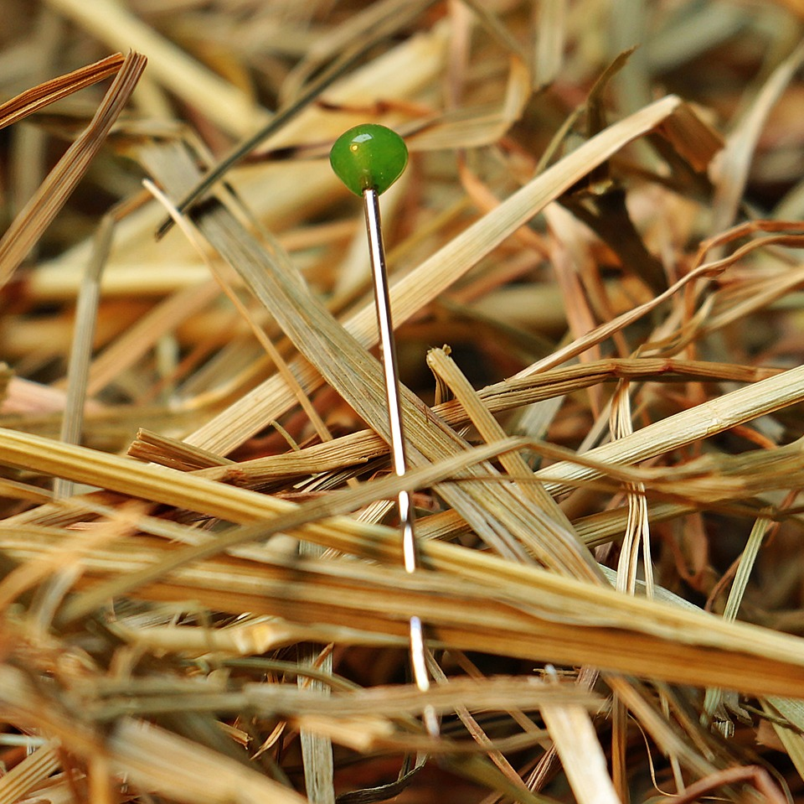
CMSC 28100 Introduction to Complexity Theory Spring 2025 Instructor: William Hoza

Slide 2
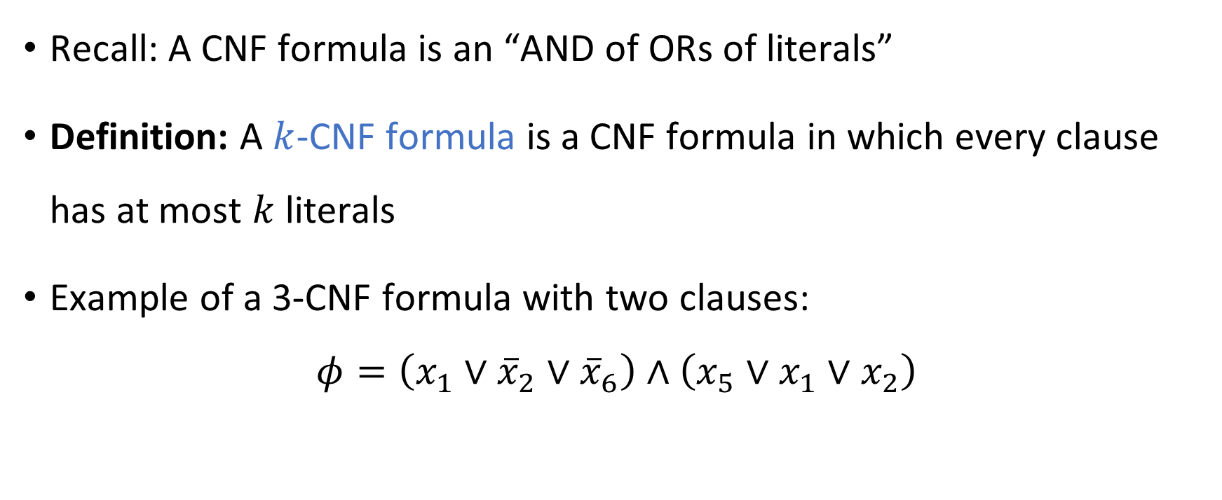
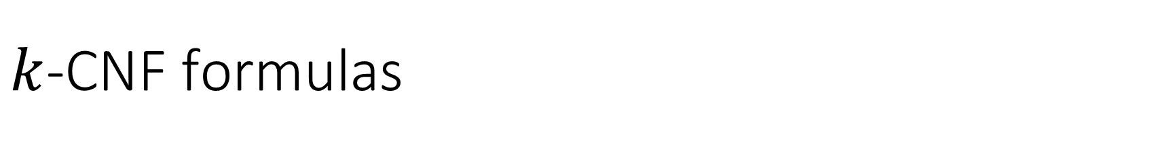
$k$-CNF formulas
Recall: A CNF formula is an “AND of ORs of literals”
Definition: A $k$-CNF formula is a CNF formula in which every clause has at most $k$ literals
Example of a 3-CNF formula with two clauses:
$$φ=\left(x_{1}∨{\overline{x}}_{2}∨{\overline{x}}_{6}\right)∧\left(x_{5}∨x_{1}∨x_{2}\right)$$

Slide 3


The Cook-Levin Theorem
Define $k\text{‑}\text{SAT}=\{\left\langle φ\right\rangle :φ \text{is} \text{a} \text{satisfiable} k\text{‑}\text{CNF} \text{formula}\}$
The Cook-Levin Theorem: $3\text{‑}\text{SAT}$ is $\text{NP}$-complete

Slide 4






$\text{NP}$-hard
$$\text{CIRCUIT}\text{‑}\text{SAT}$$
$$\text{3}\text{‑}\text{SAT}$$
$\text{NP}$-complete
$$\text{NP}$$
$$\text{P}$$

Slide 5


Chaining reductions together
$\text{3}\text{‑}\text{SAT}$ is the starting point for many $\text{NP}$-hardness proofs
We are finally ready to prove that $\text{CLIQUE}$ is $\text{NP}$-complete

Slide 6
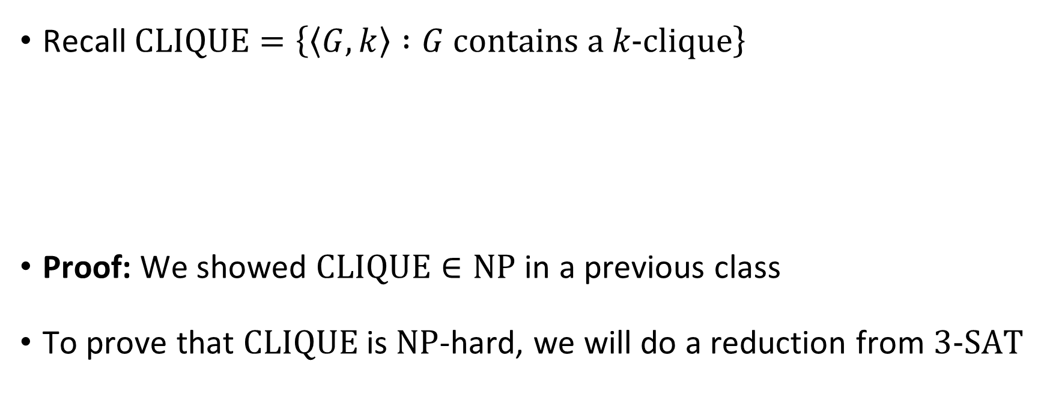


$\text{CLIQUE}$ is $\text{NP}$-complete
Recall $\text{CLIQUE}=\left\{\left\langle G,k\right\rangle :G \text{contains} \text{a} k‑\text{clique}\right\}$
Proof: We showed $\text{CLIQUE}∈\text{NP}$ in a previous class
To prove that $\text{CLIQUE}$ is $\text{NP}$-hard, we will do a reduction from $\text{3‑}\text{SAT}$
Theorem: $\text{CLIQUE}$ is $\text{NP}$-complete

Slide 7


Proof that $\text{3}\text{‑}\text{SAT}≤_{P}\text{CLIQUE}$
Let $φ$ be a $3$-CNF formula (an instance of $\text{3}\text{‑}\text{SAT}$)
Reduction: Given $\left\langle φ\right\rangle$, produce $⟨G,k⟩$
$k$ is the number of clauses in $φ$
$G$ is a graph on $≤3k$ vertices defined as follows

Slide 8






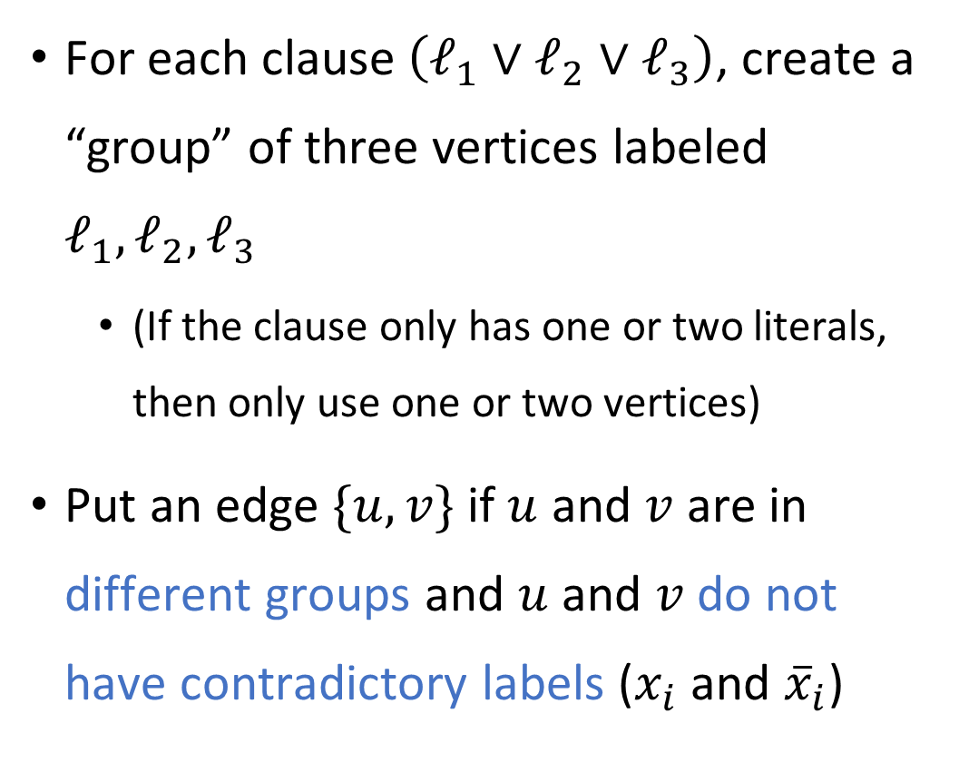








Reduction from $\text{3}\text{‑}\text{SAT}$ to $\text{CLIQUE}$
For each clause $\left(ℓ_{1}∨ℓ_{2}∨ℓ_{3}\right)$, create a “group” of three vertices labeled $ℓ_{1},ℓ_{2},ℓ_{3}$
(If the clause only has one or two literals, then only use one or two vertices)
Put an edge $\{u, v\}$ if $u$ and $v$ are in different groups and $u$ and $v$ do not have contradictory labels ($x_{i}$ and ${\overline{x}}_{i}$)
E.g., $φ=\left(x_{1}∨x_{2}∨{\overline{x}}_{5}\right)∧\left({\overline{x}}_{1}∨x_{4}∨x_{6}\right)$ $∧\left(x_{2}∨x_{4}∨{\overline{x}}_{3}\right)∧\left(x_{3}∨{\overline{x}}_{6}∨x_{1}\right)$
$$x_{1}$$
$$x_{2}$$
$${\overline{x}}_{5}$$
$${\overline{x}}_{1}$$
$$x_{2}$$
$$x_{4}$$
$$x_{4}$$
$$x_{6}$$
$${\overline{x}}_{3}$$
$$x_{3}$$
$${\overline{x}}_{6}$$
$$x_{1}$$

Slide 9











YES maps to YES
$$x_{1}$$
$$x_{2}$$
$${\overline{x}}_{5}$$
$${\overline{x}}_{1}$$
$$x_{2}$$
$$x_{4}$$
$$x_{4}$$
Suppose there exists $x$ such that $φ\left(x\right)=1$
In each clause, at least one literal is satisfied by $x$
Therefore, in each group, at least one vertex is “satisfied by $x$,” i.e., it is labeled by a literal that is satisfied by $x$
Let $S$ be a set consisting of one satisfied vertex from each group
Then $S$ is a $k$-clique (vertices in $S$ cannot have contradictory labels)
$$x_{6}$$
$${\overline{x}}_{3}$$
$$x_{3}$$
$${\overline{x}}_{6}$$
$$x_{1}$$

Slide 10
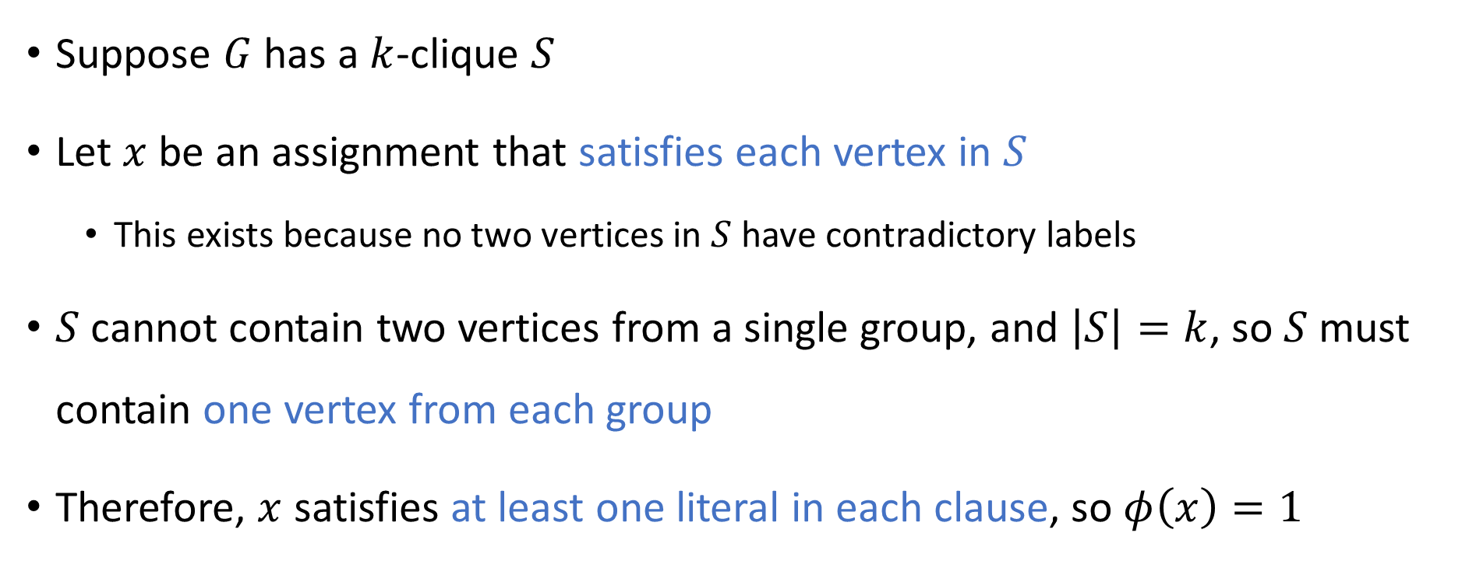
NO maps to NO
$$x_{1}$$
$$x_{2}$$
$${\overline{x}}_{5}$$
$${\overline{x}}_{1}$$
$$x_{2}$$
$$x_{4}$$
$$x_{4}$$
Suppose $G$ has a $k$-clique $S$
Let $x$ be an assignment that satisfies each vertex in $S$
This exists because no two vertices in $S$ have contradictory labels
$S$ cannot contain two vertices from a single group, and $\left|S\right|=k$, so $S$ must contain one vertex from each group
Therefore, $x$ satisfies at least one literal in each clause, so $φ\left(x\right)=1$
$$x_{6}$$
$${\overline{x}}_{3}$$
$$x_{3}$$
$${\overline{x}}_{6}$$
$$x_{1}$$

Slide 11

Poly-time computable
$$x_{1}$$
$$x_{2}$$
$${\overline{x}}_{5}$$
$${\overline{x}}_{1}$$
$$x_{2}$$
$$x_{4}$$
$$x_{4}$$
Hopefully it is clear that given $\left\langle φ\right\rangle$, one can construct $\left\langle G,k\right\rangle$ in polynomial time
$$x_{6}$$
$${\overline{x}}_{3}$$
$$x_{3}$$
$${\overline{x}}_{6}$$
$$x_{1}$$

Slide 12







$\text{NP}$-hard
$$\text{CIRCUIT}\text{‑}\text{SAT}$$
$$\text{CLIQUE}$$
$\text{NP}$-complete
$$\text{3}\text{‑}\text{SAT}$$
$$\text{NP}$$
$$\text{P}$$

Slide 13

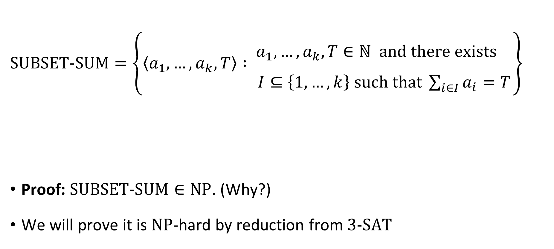
The subset sum problem
$\text{SUBSET}\text{‑}\text{SUM}=\left\{\left\langle a_{1},…, a_{k},T\right\rangle : \begin{matrix}a_{1},…, a_{k},T∈ℕ \text{and} \text{there} \text{exists}\begin{matrix} \\ \end{matrix} \\ I⊆\left\{1, …, k\right\} \text{such} \text{that} \sum_{i∈I}{a_{i}}=T\end{matrix}\right\}$
Proof: $\text{SUBSET}\text{‑}\text{SUM}∈\text{NP}$. (Why?)
We will prove it is $\text{NP}$-hard by reduction from $\text{3}\text{‑}\text{SAT}$
Theorem: $\text{SUBSET}\text{‑}\text{SUM}$ is $\text{NP}$-complete

Slide 14

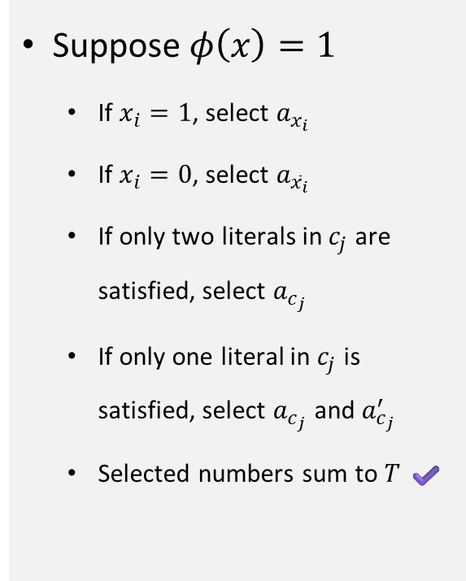



Proof that $\text{3}\text{‑}\text{SAT}≤_{P}\text{SUBSET}\text{‑}\text{SUM}$
Given $\left\langle φ\right\rangle$ with variables $x_{1},…,x_{n}$ and clauses $c_{1},…, c_{m}$, the reduction produces:
$$\begin{matrix} & x_{1} & x_{2} & ⋯ & x_{n} & c_{1} & c_{2} & ⋯ & c_{m} \\ & & & & & & & & \\ a_{x_{1}}= & 1 & 0 & ⋯ & 0 & 1 & 0 & ⋯ & 0 \\ a_{{\overline{x}}_{1}}= & 1 & 0 & ⋯ & 0 & 0 & 0 & ⋯ & 0 \\ a_{x_{2}}= & & 1 & ⋯ & 0 & 0 & 1 & ⋯ & 0 \\ a_{{\overline{x}}_{2}}= & & 1 & ⋯ & 0 & 1 & 0 & ⋯ & 0 \\ ⋮ & & & ⋱ & ⋮ & ⋮ & ⋮ & ⋮ & ⋮ \\ a_{x_{n}}= & & & & 1 & 1 & 0 & ⋯ & 1 \\ a_{{\overline{x}}_{n}}= & & & & 1 & 0 & 1 & ⋯ & 1 \\ & & & & & & & & \\ a_{c_{1}}= & & & & & 1 & 0 & ⋯ & 0 \\ a_{c_{1}}^{′}= & & & & & 1 & 0 & ⋯ & 0 \\ a_{c_{2}}= & & & & & & 1 & ⋯ & 0 \\ a_{c_{2}}^{′}= & & & & & & 1 & ⋯ & 0 \\ ⋮ & & & & & & & ⋱ & ⋮ \\ a_{c_{m}}= & & & & & & & & 1 \\ a_{c_{m}}^{′}= & & & & & & & & 1 \\ & & & & & & & & \\ T= & 1 & 1 & ⋯ & 1 & 3 & 3 & 3 & 3\end{matrix}$$
Does $x_{2}$ appear in $c_{2}$?
Suppose $φ\left(x\right)=1$
If $x_{i}=1$, select $a_{x_{i}}$
If $x_{i}=0$, select $a_{{\overline{x}}_{i}}$
If only two literals in $c_{j}$ are satisfied, select $a_{c_{j}}$
If only one literal in $c_{j}$ is satisfied, select $a_{c_{j}}$ and $a_{c_{j}}^{′}$
Selected numbers sum to $T$ ✔️
Does ${\overline{x}}_{n}$ appear in $c_{m}$?
Integers represented in base 8

Slide 15
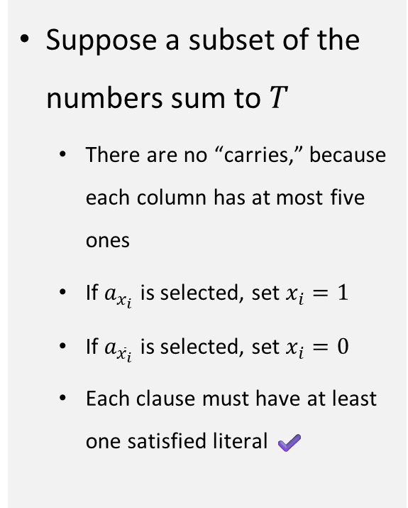

Proof that $\text{3}\text{‑}\text{SAT}≤_{P}\text{SUBSET}\text{‑}\text{SUM}$
Given $\left\langle φ\right\rangle$ with variables $x_{1},…,x_{n}$ and clauses $c_{1},…, c_{m}$, the reduction produces:
$$\begin{matrix} & x_{1} & x_{2} & ⋯ & x_{n} & c_{1} & c_{2} & ⋯ & c_{m} \\ & & & & & & & & \\ a_{x_{1}}= & 1 & 0 & ⋯ & 0 & 1 & 0 & ⋯ & 0 \\ a_{{\overline{x}}_{1}}= & 1 & 0 & ⋯ & 0 & 0 & 0 & ⋯ & 0 \\ a_{x_{2}}= & & 1 & ⋯ & 0 & 0 & 1 & ⋯ & 0 \\ a_{{\overline{x}}_{2}}= & & 1 & ⋯ & 0 & 1 & 0 & ⋯ & 0 \\ ⋮ & & & ⋱ & ⋮ & ⋮ & ⋮ & ⋮ & ⋮ \\ a_{x_{n}}= & & & & 1 & 1 & 0 & ⋯ & 1 \\ a_{{\overline{x}}_{n}}= & & & & 1 & 0 & 1 & ⋯ & 1 \\ & & & & & & & & \\ a_{c_{1}}= & & & & & 1 & 0 & ⋯ & 0 \\ a_{c_{1}}^{′}= & & & & & 1 & 0 & ⋯ & 0 \\ a_{c_{2}}= & & & & & & 1 & ⋯ & 0 \\ a_{c_{2}}^{′}= & & & & & & 1 & ⋯ & 0 \\ ⋮ & & & & & & & ⋱ & ⋮ \\ a_{c_{m}}= & & & & & & & & 1 \\ a_{c_{m}}^{′}= & & & & & & & & 1 \\ & & & & & & & & \\ T= & 1 & 1 & ⋯ & 1 & 3 & 3 & 3 & 3\end{matrix}$$
Does $x_{2}$ appear in $c_{2}$?
Suppose a subset of the numbers sum to $T$
There are no “carries,” because each column has at most five ones
If $a_{x_{i}}$ is selected, set $x_{i}=1$
If $a_{{\overline{x}}_{i}}$ is selected, set $x_{i}=0$
Each clause must have at least one satisfied literal ✔️
Does ${\overline{x}}_{n}$ appear in $c_{m}$?
Integers represented in base 8

Slide 16
Proof that $\text{3}\text{‑}\text{SAT}≤_{P}\text{SUBSET}\text{‑}\text{SUM}$
Given $\left\langle φ\right\rangle$ with variables $x_{1},…,x_{n}$ and clauses $c_{1},…, c_{m}$, the reduction produces:
$$\begin{matrix} & x_{1} & x_{2} & ⋯ & x_{n} & c_{1} & c_{2} & ⋯ & c_{m} \\ & & & & & & & & \\ a_{x_{1}}= & 1 & 0 & ⋯ & 0 & 1 & 0 & ⋯ & 0 \\ a_{{\overline{x}}_{1}}= & 1 & 0 & ⋯ & 0 & 0 & 0 & ⋯ & 0 \\ a_{x_{2}}= & & 1 & ⋯ & 0 & 0 & 1 & ⋯ & 0 \\ a_{{\overline{x}}_{2}}= & & 1 & ⋯ & 0 & 1 & 0 & ⋯ & 0 \\ ⋮ & & & ⋱ & ⋮ & ⋮ & ⋮ & ⋮ & ⋮ \\ a_{x_{n}}= & & & & 1 & 1 & 0 & ⋯ & 1 \\ a_{{\overline{x}}_{n}}= & & & & 1 & 0 & 1 & ⋯ & 1 \\ & & & & & & & & \\ a_{c_{1}}= & & & & & 1 & 0 & ⋯ & 0 \\ a_{c_{1}}^{′}= & & & & & 1 & 0 & ⋯ & 0 \\ a_{c_{2}}= & & & & & & 1 & ⋯ & 0 \\ a_{c_{2}}^{′}= & & & & & & 1 & ⋯ & 0 \\ ⋮ & & & & & & & ⋱ & ⋮ \\ a_{c_{m}}= & & & & & & & & 1 \\ a_{c_{m}}^{′}= & & & & & & & & 1 \\ & & & & & & & & \\ T= & 1 & 1 & ⋯ & 1 & 3 & 3 & 3 & 3\end{matrix}$$
Does $x_{2}$ appear in $c_{2}$?
Reduction can be performed in polynomial time ✔️
Does ${\overline{x}}_{n}$ appear in $c_{m}$?
Integers represented in base 8

Slide 17








$\text{NP}$-hard
$$\text{CIRCUIT}\text{‑}\text{SAT}$$
$$\text{CLIQUE}$$
$\text{NP}$-complete
$$\text{3}\text{‑}\text{SAT}$$
$$\text{SUBSET}\text{‑}\text{SUM}$$
$$\text{NP}$$
$$\text{P}$$

Slide 18

Hamiltonian paths
Let $G$ be a directed graph
Definition: A Hamiltonian path is a directed path that visits every vertex exactly once

Slide 19
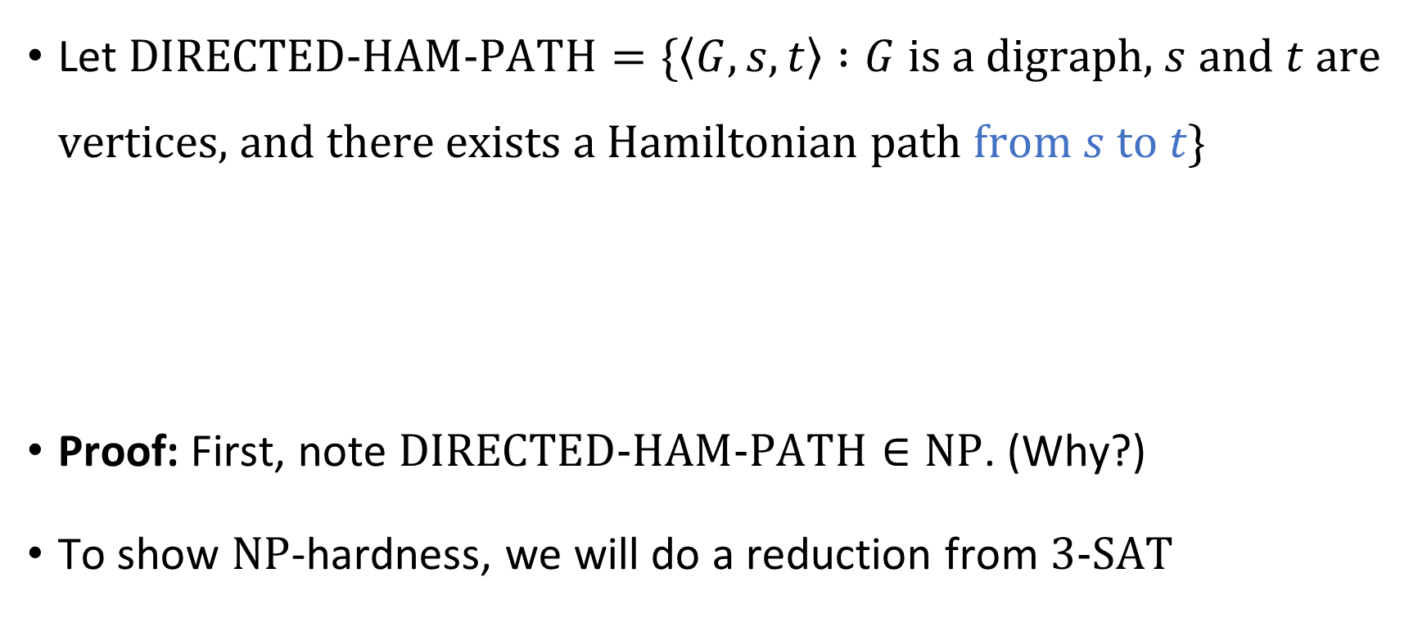


$\text{DIRECTED}\text{‑}\text{HAM}\text{‑}\text{PATH}$ is $\text{NP}$-complete
Let $\text{DIRECTED}\text{‑}\text{HAM}\text{‑}\text{PATH}=\{\left\langle G, s, t\right\rangle :G \text{is} \text{a} \text{digraph}\text{, }s \text{and} t \text{are} \text{vertices}\text{, }\text{and} \text{there} \text{exists} \text{a} \text{Hamiltonian} \text{path} \text{from} s \text{to} t\}$
Proof: First, note $\text{DIRECTED}\text{‑}\text{HAM}\text{‑}\text{PATH}∈\text{NP}$. (Why?)
To show $\text{NP}$-hardness, we will do a reduction from $\text{3}\text{‑}\text{SAT}$
Theorem: $\text{DIRECTED}\text{‑}\text{HAM}\text{‑}\text{PATH}$ is $\text{NP}$-complete

Slide 20


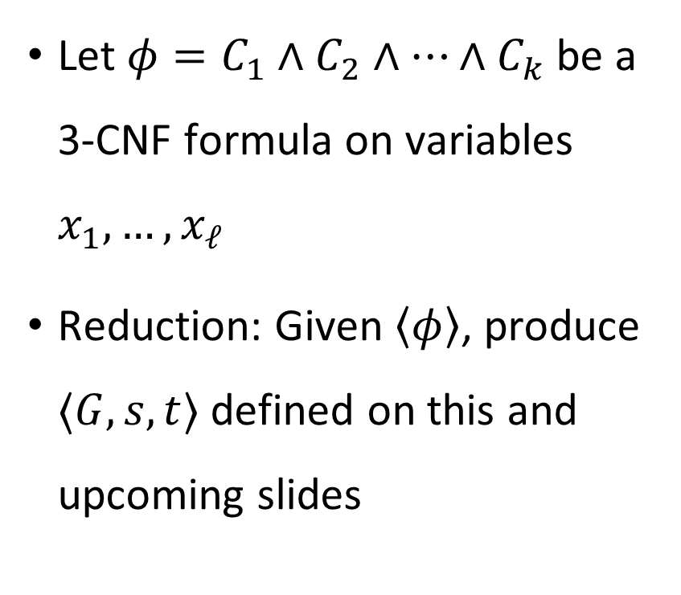










Proof that $\text{3}\text{‑}\text{SAT}≤_{P}\text{DIRECTED}\text{‑}\text{HAM}\text{‑}\text{PATH}$
$$s$$
Let $φ=C_{1}∧C_{2}∧…∧C_{k}$ be a 3-CNF formula on variables $x_{1},…, x_{ℓ}$
Reduction: Given $\left\langle φ\right\rangle$, produce $⟨G,s,t⟩$ defined on this and upcoming slides
$$C_{1}$$
$$x_{1}$$
$$C_{2}$$
$$x_{2}$$
$$C_{3}$$
$$⋮$$
$$⋮$$
$$x_{ℓ}$$
$$C_{k}$$
$$t$$
“variable gadgets”
“clause nodes”

Slide 21





Proof that $\text{3}\text{‑}\text{SAT}≤_{P}\text{DIRECTED}\text{‑}\text{HAM}\text{‑}\text{PATH}$
Poly-time computable ✔️
“positive detour”
FALSE ➡
$$C_{j}=(x_{i}∨…$$
⬅ TRUE
$$x_{i}$$
$$⋯$$
$C_{j^{′}}=({ \overline{x}}_{i} ∨…$
“detour separators”
“negative detour”
$6k−1$ nodes inside diamond (enough for all possible detours)

Slide 22



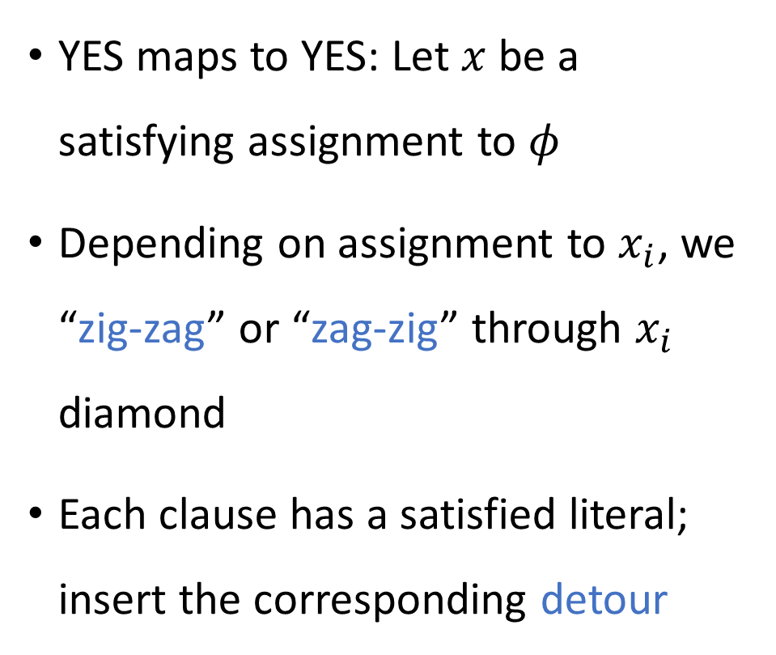














Proof that $\text{3}\text{‑}\text{SAT}≤_{P}\text{DIRECTED}\text{‑}\text{HAM}\text{‑}\text{PATH}$
$$s$$
YES maps to YES: Let $x$ be a satisfying assignment to $φ$
Depending on assignment to $x_{i}$, we “zig-zag” or “zag-zig” through $x_{i}$ diamond
Each clause has a satisfied literal; insert the corresponding detour
$$C_{1}$$
$$1$$
$$x_{1}$$
$$⋯$$
$$C_{2}$$
$$0$$
$$x_{2}$$
$$⋯$$
$$C_{3}$$
$$⋮$$
$$⋮$$
$$1$$
$$x_{ℓ}$$
$$⋯$$
$$C_{k}$$
$$t$$

Slide 23
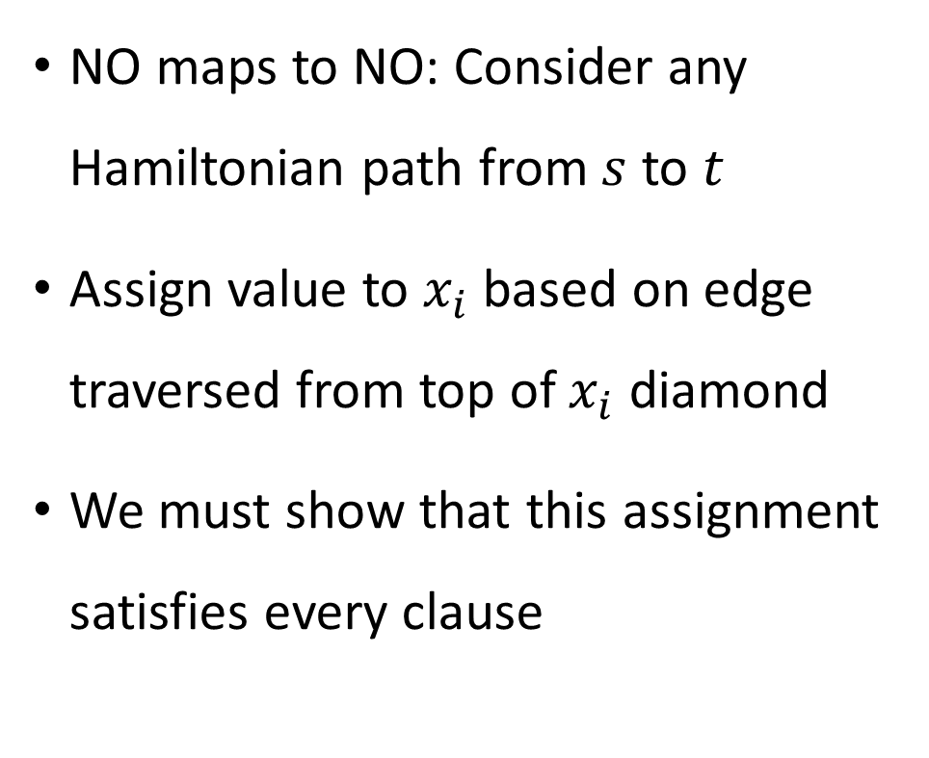

Proof that $\text{3}\text{‑}\text{SAT}≤_{P}\text{DIRECTED}\text{‑}\text{HAM}\text{‑}\text{PATH}$
$$s$$
NO maps to NO: Consider any Hamiltonian path from $s$ to $t$
Assign value to $x_{i}$ based on edge traversed from top of $x_{i}$ diamond
We must show that this assignment satisfies every clause
$$C_{1}$$
$$1$$
$$x_{1}$$
$$⋯$$
$$C_{2}$$
$$0$$
$$x_{2}$$
$$⋯$$
$$C_{3}$$
$$⋮$$
$$⋮$$
$$1$$
$$x_{ℓ}$$
$$⋯$$
$$C_{k}$$
$$t$$

Slide 24







Proof that $\text{3‑}\text{SAT}≤_{P}\text{DIRECTED}\text{‑}\text{HAM}\text{‑}\text{PATH}$
Consider any clause node $C_{j}$. Path visits $C_{j}$ from some $x_{i}$ diamond. WLOG, $C_{j}=(x_{i}∨…)$
Claim: The path goes from $C_{j}$ back to that same diamond ($x_{i}$)
Proof: The path must enter $a$ from the left. Therefore, the path must exit $a$ to the right. Therefore, the path must exit $c$ to the right, so the path must enter $c$ from $C_{j}$
$$C_{j}$$
$$⋯$$
$$a$$
$$b$$
$$c$$

Slide 25

Proof that $\text{3}\text{‑}\text{SAT}≤_{P}\text{DIRECTED}\text{‑}\text{HAM}\text{‑}\text{PATH}$
$$s$$
Consequence: If we traverse a “TRUE” edge, then we can only take “positive detours” in that diamond
If we traverse a “FALSE” edge, then we can only take “negative detours” in that diamond
Therefore, every clause is satisfied
$$C_{1}$$
$$x_{1}$$
$$⋯$$
$$C_{2}$$
$$x_{2}$$
$$⋯$$
$$C_{3}$$
$$⋮$$
$$⋮$$
$$x_{ℓ}$$
$$⋯$$
$$C_{k}$$
$$t$$

