Slide 1

CMSC 28100 Introduction to Complexity Theory Spring 2024 Instructor: William Hoza

Slide 2
Course Review

Slide 3
Which problems can be solved through computation?

Slide 4
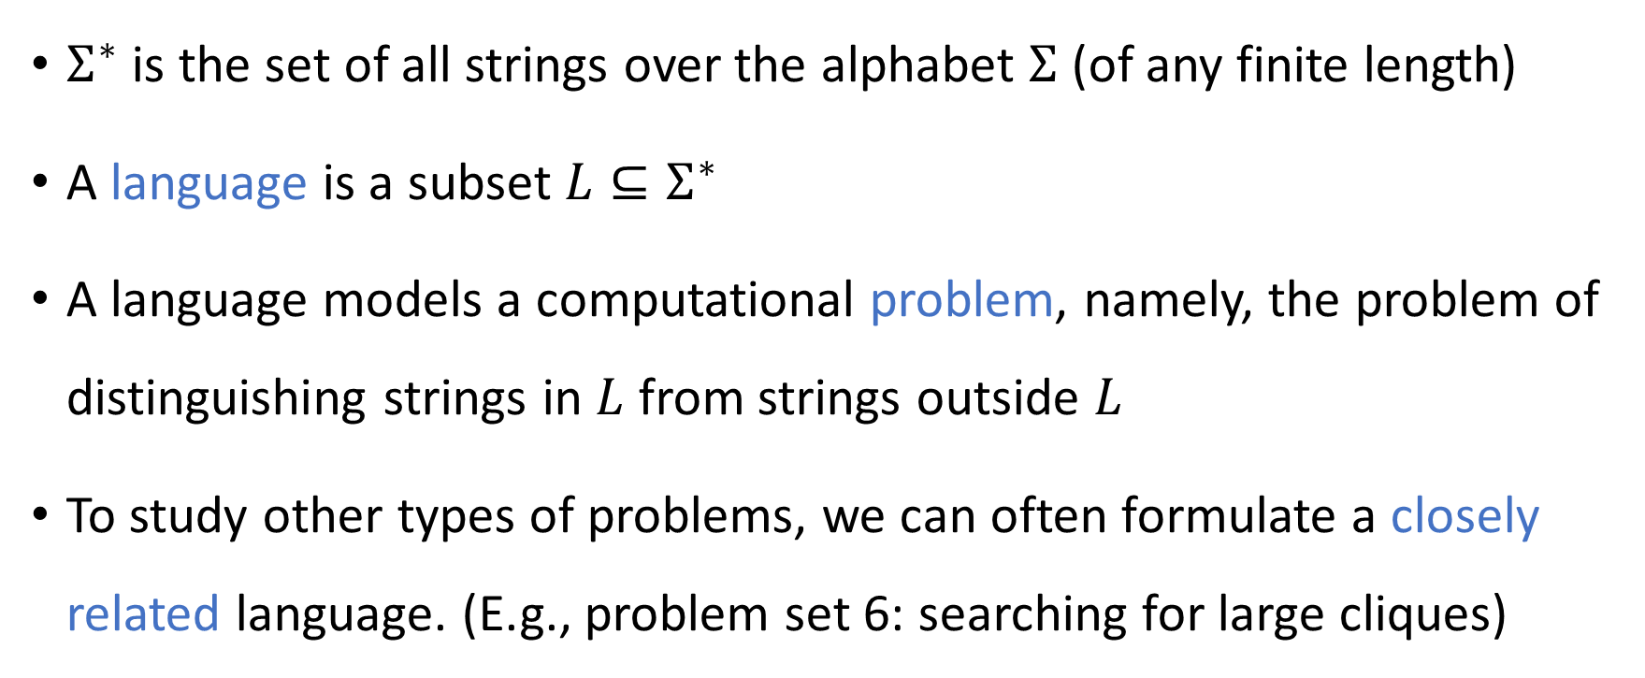
Strings and languages
$Σ^{∗}$ is the set of all strings over the alphabet $Σ$ (of any finite length)
A language is a subset $L⊆Σ^{∗}$
A language models a computational problem, namely, the problem of distinguishing strings in $L$ from strings outside $L$
To study other types of problems, we can often formulate a closely related language. (E.g., problem set 6: searching for large cliques)

Slide 5
Which problems can be solved through computation?

Slide 6

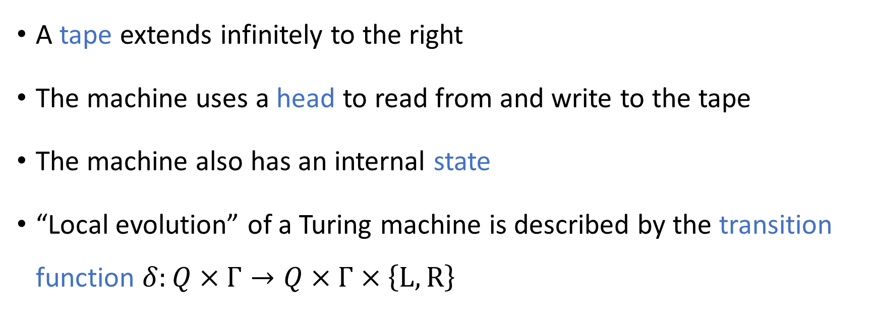


Turing machines
$$♢$$
1
1
0
$$⊔$$
$$⊔$$
A tape extends infinitely to the right
The machine uses a head to read from and write to the tape
The machine also has an internal state
“Local evolution” of a Turing machine is described by the transition function $δ:Q×Γ→Q×Γ×\left\{\text{L},\text{R}\right\}$

Slide 7
Which problems can be solved through computation?

Slide 8
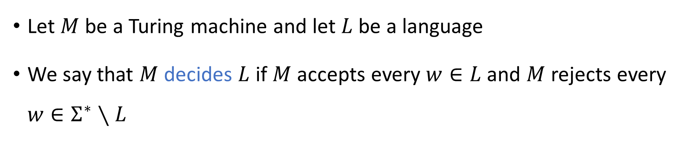
Deciding a language
Turing Machine
Accept
Reject
Run forever (“loop”)
Input
Let $M$ be a Turing machine and let $L$ be a language
We say that $M$ decides $L$ if $M$ accepts every $w∈L$ and $M$ rejects every $w∈Σ^{∗}∖L$

Slide 9
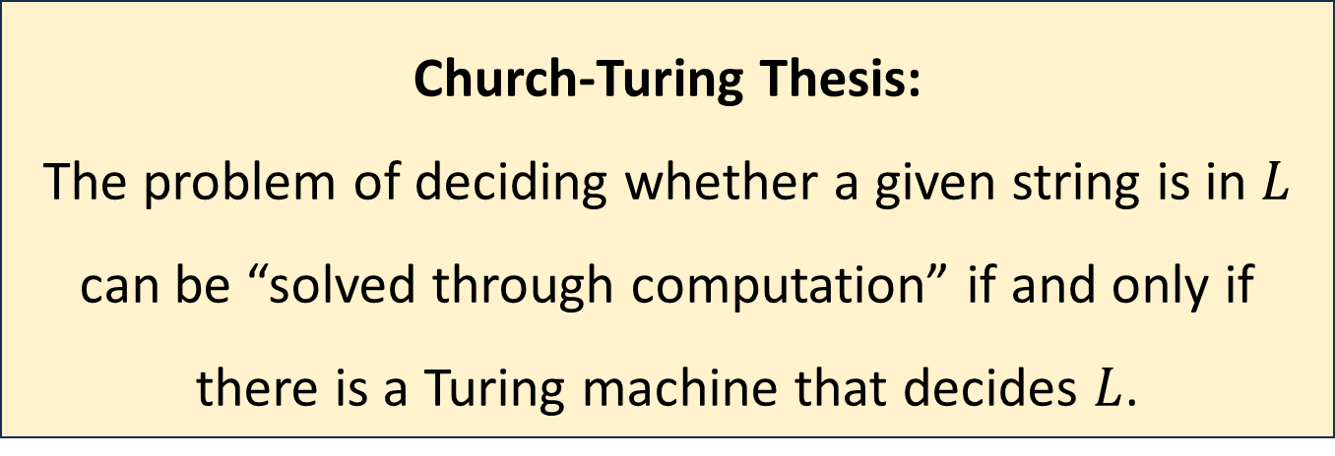

The Church-Turing Thesis
Let $L$ be a language
Church-Turing Thesis:
The problem of deciding whether a given string is in $L$ can be “solved through computation” if and only if there is a Turing machine that decides $L$.
Intuitive notion
Mathematically precise notion

Slide 10
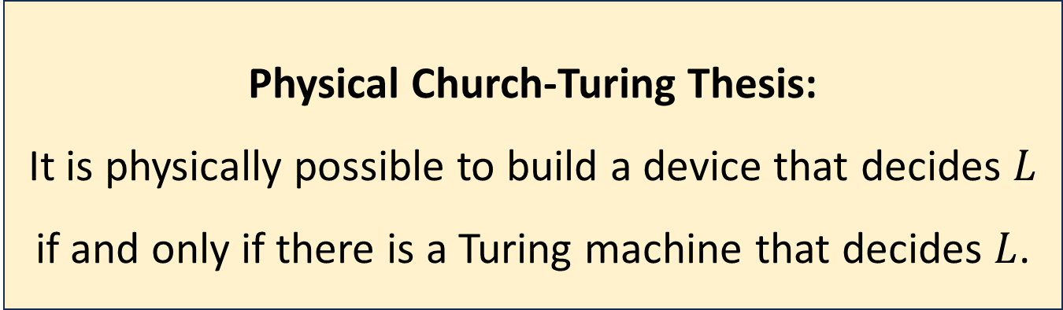
The Physical Church-Turing Thesis
Let $L$ be a language
Physical Church-Turing Thesis:
It is physically possible to build a device that decides $L$ if and only if there is a Turing machine that decides $L$.

Slide 11

Code as data
A Turing machine $M$ represents an algorithm
At the same time, a TM $M$ can be encoded as a string $\left\langle M\right\rangle$
This string $\left\langle M\right\rangle$ could be the input or output of a different algorithm!

Slide 12
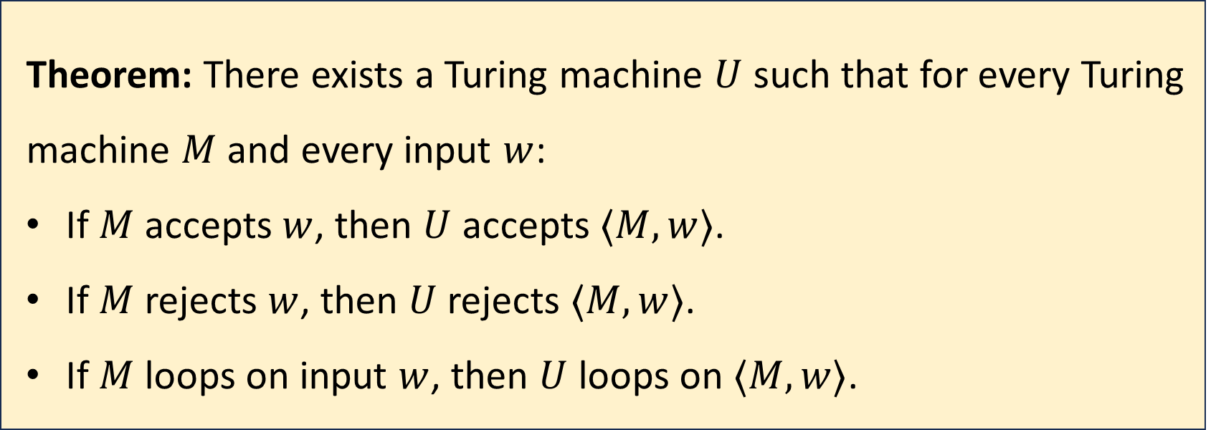
Universal Turing machines
Theorem: There exists a Turing machine $U$ such that for every Turing machine $M$ and every input $w$:
If $M$ accepts $w$, then $U$ accepts $⟨M,w⟩$.
If $M$ rejects $w$, then $U$ rejects $⟨M,w⟩$.
If $M$ loops on input $w$, then $U$ loops on $⟨M,w⟩$.

Slide 13
Universal Turing machines
If you are stranded on an alien planet and you are trying to build a computer, your job is to build a universal Turing machine
A universal Turing machine can be “programmed” to do anything that is computationally possible

Slide 14
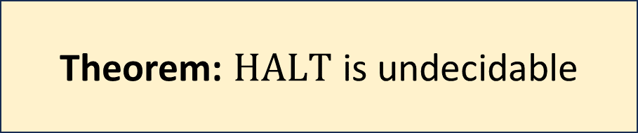

The halting problem
$\text{HALT}=\{\left\langle M,w\right\rangle :M \text{is} \text{a} \text{Turing} \text{machine} \text{that} \text{halts} \text{on} w\}$
Theorem: $\text{HALT}$ is undecidable

Slide 15





Reductions
A mapping reduction from $L_{1}$ to $L_{2}$ is a way of converting instances of $L_{1}$ into equivalent instances of $L_{2}$
“YES” maps to “YES”
“NO” maps to “NO”
$$L_{2}$$
$$L_{1}$$
$$Σ_{1}^{∗}$$
$$Σ_{2}^{∗}$$

Slide 16



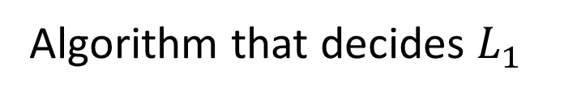


Using reductions to prove decidability
Algorithm that decides $L_{1}$
Algorithm that computes $f$
$$f\left(w\right)$$
Algorithm that decides $L_{2}$
$$w$$
Acc/Rej
The “mapping reduction” is $f$

Slide 17
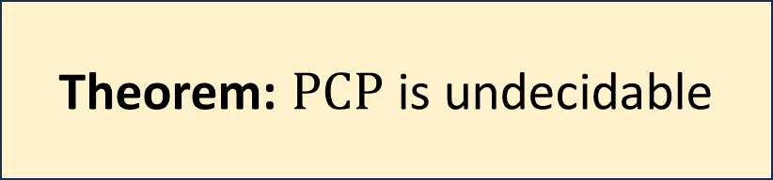
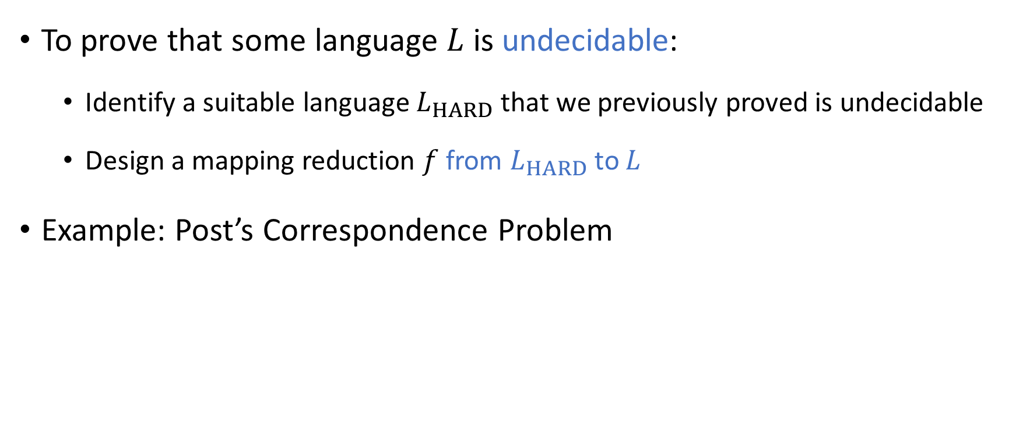
Undecidability via reductions
To prove that some language $L$ is undecidable:
Identify a suitable language $L_{HARD}$ that we previously proved is undecidable
Design a mapping reduction $f$ from $L_{HARD}$ to $L$
Example: Post’s Correspondence Problem
Theorem: $\text{PCP}$ is undecidable

Slide 18
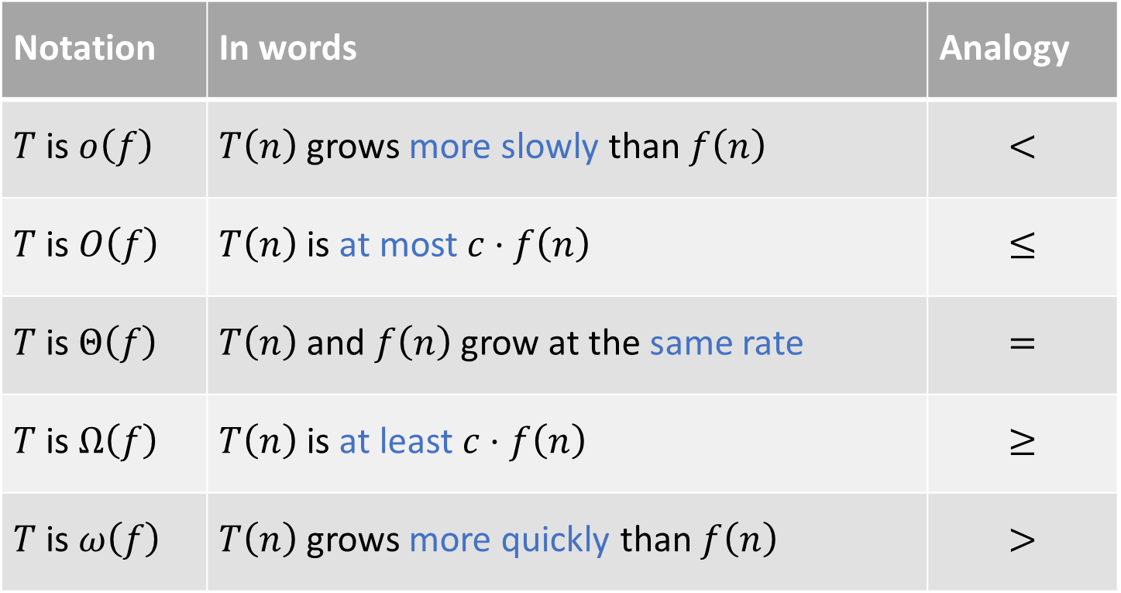
Asymptotic analysis
Notation | In words | Analogy
$T$ is $o\left(f\right)$ | $T\left(n\right)$ grows more slowly than $f\left(n\right)$ | $$<$$
$T$ is $O\left(f\right)$ | $T\left(n\right)$ is at most $c⋅f\left(n\right)$ | $$≤$$
$T$ is $Θ\left(f\right)$ | $T\left(n\right)$ and $f\left(n\right)$ grow at the same rate | $$=$$
$T$ is $Ω\left(f\right)$ | $T\left(n\right)$ is at least $c⋅f\left(n\right)$ | $$≥$$
$T$ is $ω\left(f\right)$ | $T\left(n\right)$ grows more quickly than $f\left(n\right)$ | $$>$$

Slide 19
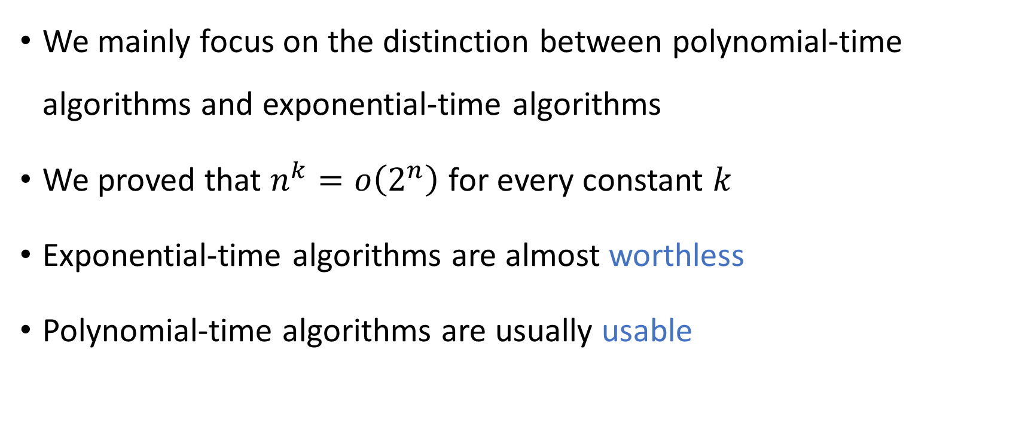
Polynomial-time computation
We mainly focus on the distinction between polynomial-time algorithms and exponential-time algorithms
We proved that $n^{k}=o\left(2^{n}\right)$ for every constant $k$
Exponential-time algorithms are almost worthless
Polynomial-time algorithms are usually usable

Slide 20
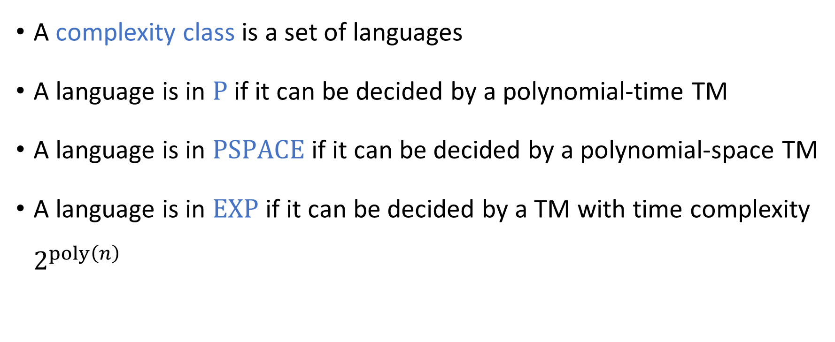
Complexity classes
A complexity class is a set of languages
A language is in $\text{P}$ if it can be decided by a polynomial-time TM
A language is in $\text{PSPACE}$ if it can be decided by a polynomial-space TM
A language is in $\text{EXP}$ if it can be decided by a TM with time complexity $2^{poly\left(n\right)}$

Slide 21






Randomized Turing machines
Input tape ➡
$$♢$$
1
1
0
$$⊔$$
$$⊔$$
Randomness tape ➡
$$♢$$

Slide 22
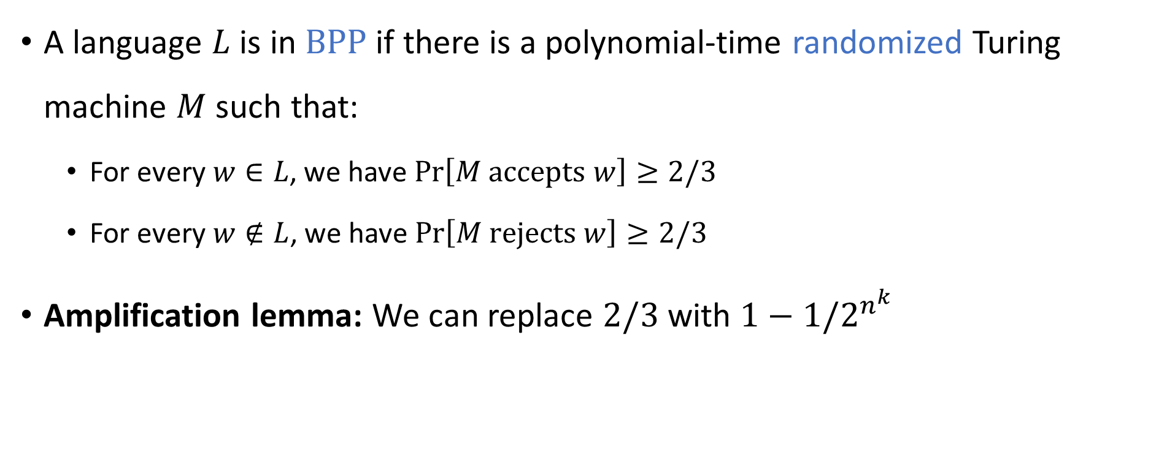

The complexity class $\text{BPP}$
A language $L$ is in $\text{BPP}$ if there is a polynomial-time randomized Turing machine $M$ such that:
For every $w∈L$, we have $\operatorname{Pr}\left[M \text{accepts} w\right]≥2/3$
For every $w∉L$, we have $\operatorname{Pr}\left[M \text{rejects} w\right]≥2/3$
Amplification lemma: We can replace $2/3$ with $1−1/2^{n^{k}}$

Slide 23
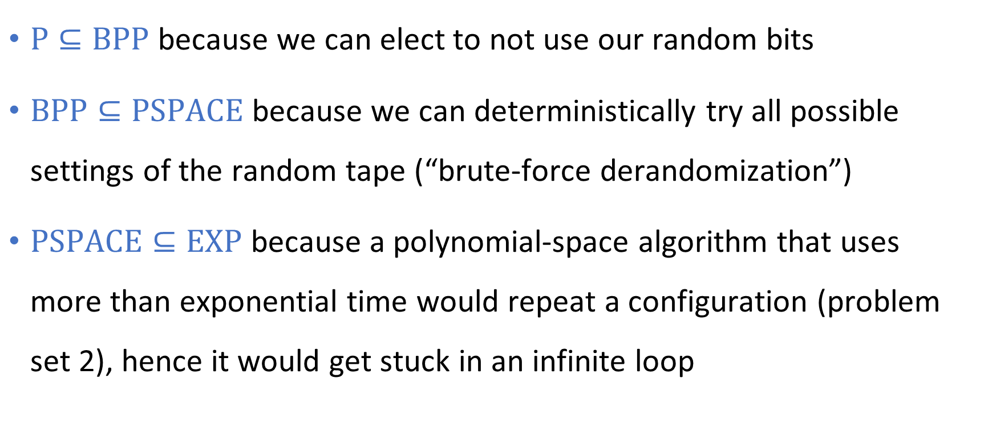

$\text{P}⊆\text{BPP}⊆\text{PSPACE}⊆\text{EXP}$
$\text{P}⊆\text{BPP}$ because we can elect to not use our random bits
$\text{BPP}⊆\text{PSPACE}$ because we can deterministically try all possible settings of the random tape (“brute-force derandomization”)
$\text{PSPACE}⊆\text{EXP}$ because a polynomial-space algorithm that uses more than exponential time would repeat a configuration (problem set 2), hence it would get stuck in an infinite loop

Slide 24




Decidable languages
$$\text{EXP}$$
$$\text{PSPACE}$$
$$\text{BPP}$$
$$\text{P}$$

Slide 25
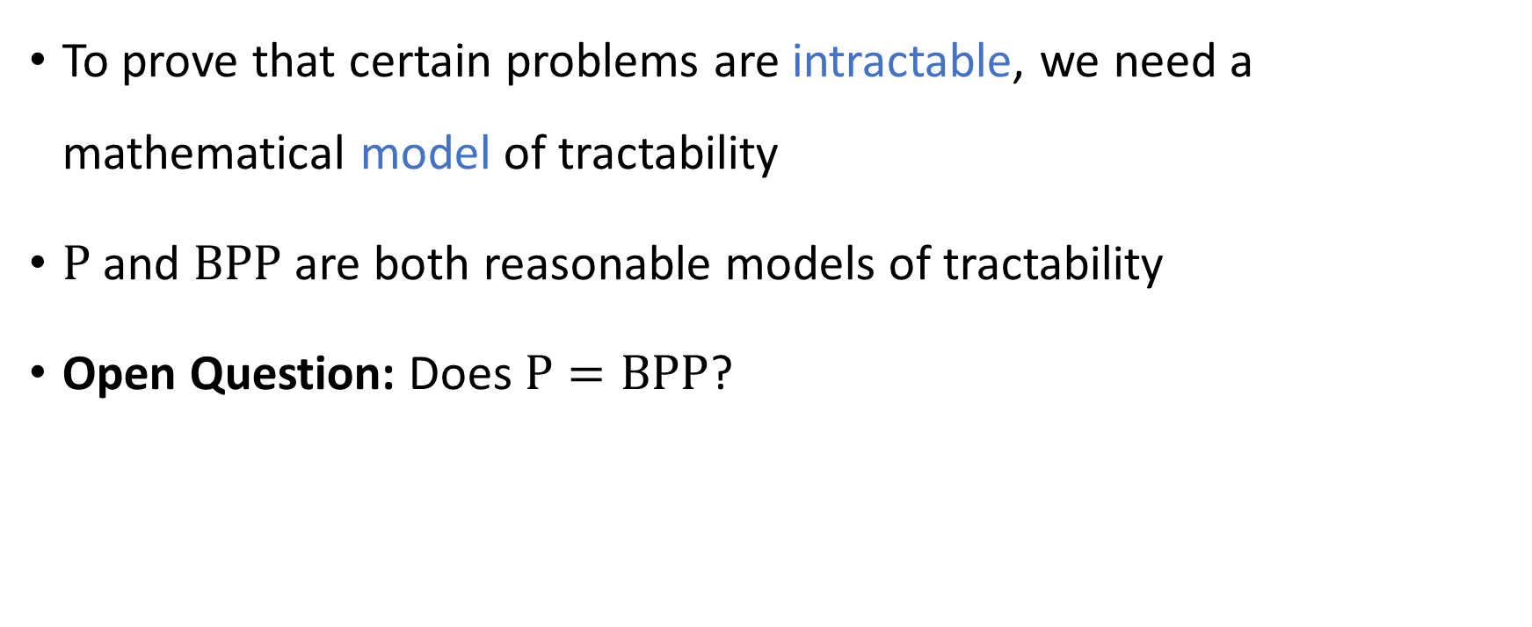
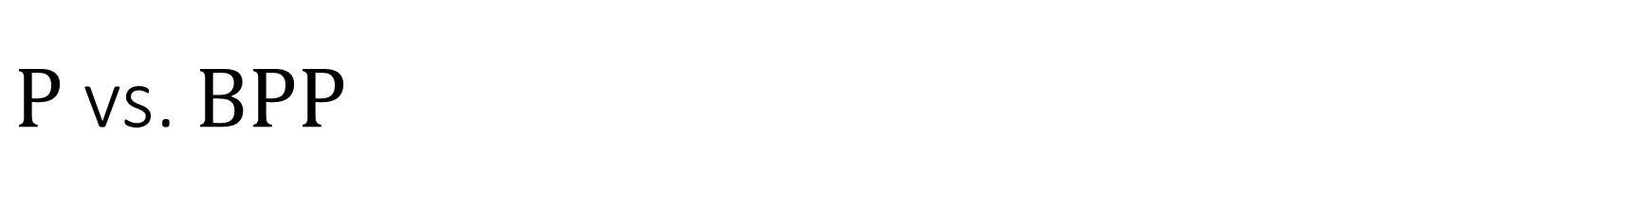
$\text{P}$ vs. $\text{BPP}$
To prove that certain problems are intractable, we need a mathematical model of tractability
$\text{P}$ and $\text{BPP}$ are both reasonable models of tractability
Open Question: Does $\text{P}=\text{BPP}$?

Slide 26




Communication complexity
Goal: Compute $f\left(x, y\right)$ using as little communication as possible
Communication channel
Alice holds $x$
Bob holds $y$

Slide 27


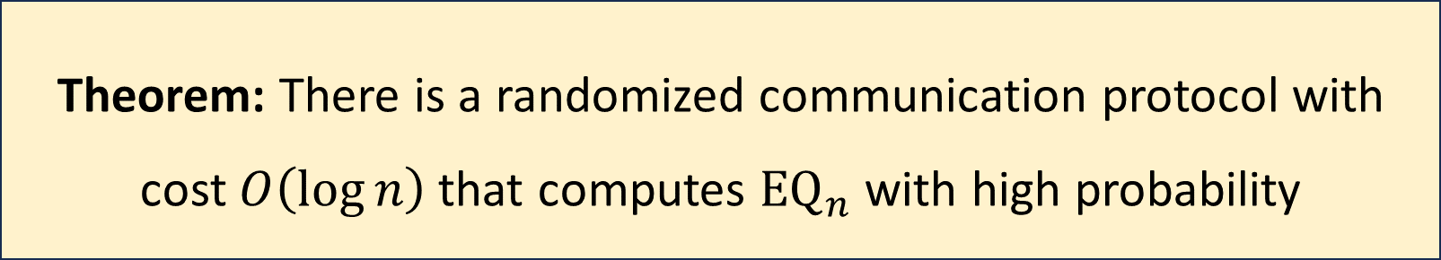
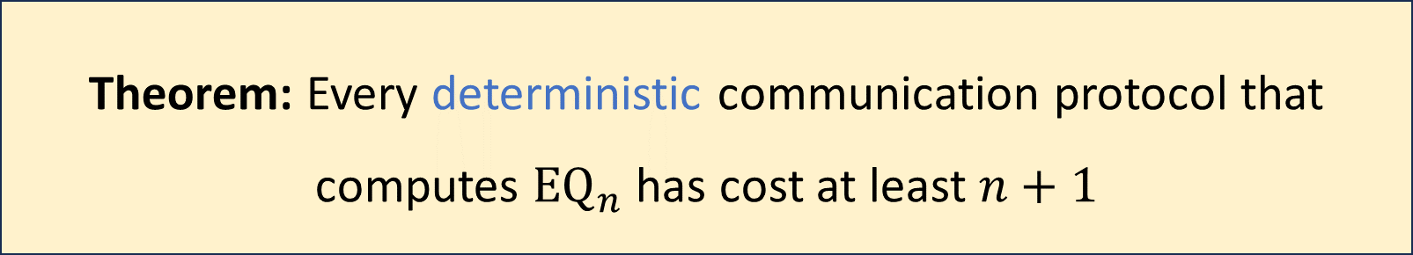
Communication complexity of ${\text{EQ}}_{n}$
${\text{EQ}}_{n}\left(x, y\right)=1⇔x=y$
Theorem: Every deterministic communication protocol that computes ${\text{EQ}}_{n}$ has cost at least $n+1$
Theorem: There is a randomized communication protocol with cost $O\left(\log{n}\right)$ that computes ${\text{EQ}}_{n}$ with high probability

Slide 28

$\text{P}$ vs. $\text{BPP}$
Communication complexity might suggest $\text{P}≠\text{BPP}$
However, we gathered some more “evidence” about the $\text{P}$ vs. $\text{BPP}$ question by studying Boolean logic: AND / OR / NOT operations

Slide 29
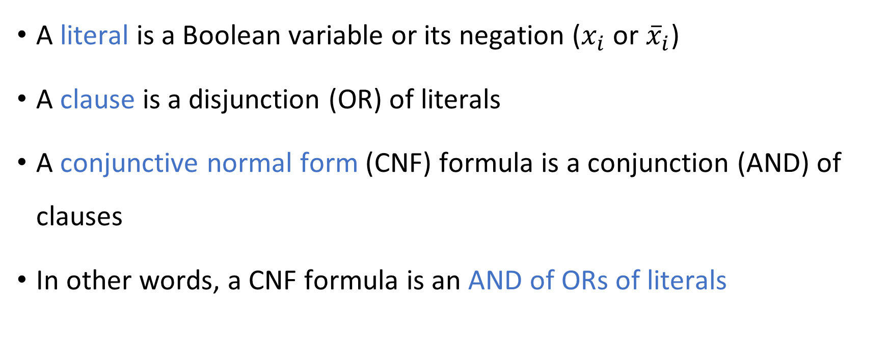
Conjunctive normal form
A literal is a Boolean variable or its negation ($x_{i}$ or ${\overline{x}}_{i}$)
A clause is a disjunction (OR) of literals
A conjunctive normal form (CNF) formula is a conjunction (AND) of clauses
In other words, a CNF formula is an AND of ORs of literals

Slide 30
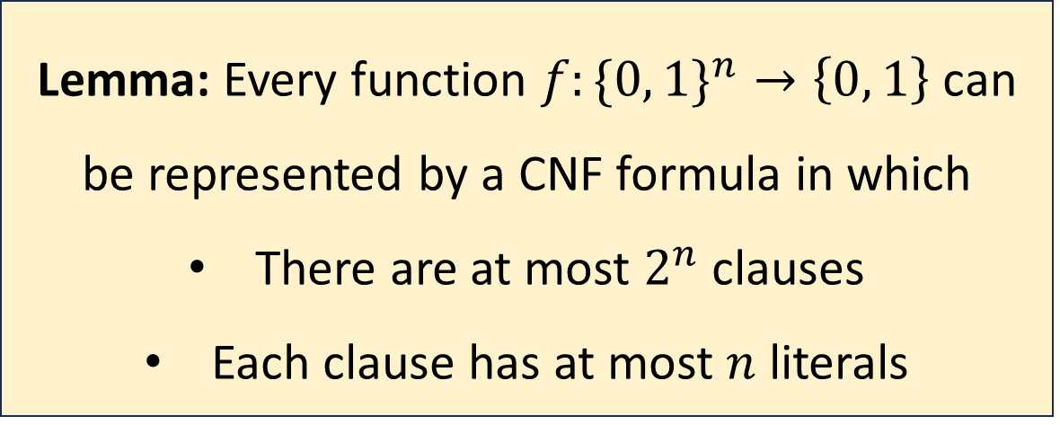
Conjunctive normal form
Lemma: Every function $f:\{0, 1\}^{n}→\left\{0, 1\right\}$ can be represented by a CNF formula in which
There are at most $2^{n}$ clauses
Each clause has at most $n$ literals

Slide 31
Boolean circuits
$$∨$$
A “circuit” is a network of AND/OR/NOT gates applied to Boolean variables
$$∧$$
$$∧$$
$$¬$$
$$¬$$
$$∨$$
$$∨$$
$$∧$$
$$∧$$
$$∧$$
$$∧$$
$$¬$$
$$¬$$
$$¬$$
$$¬$$
$$x_{1}$$
$$x_{2}$$
$$x_{3}$$
$$x_{4}$$

Slide 32
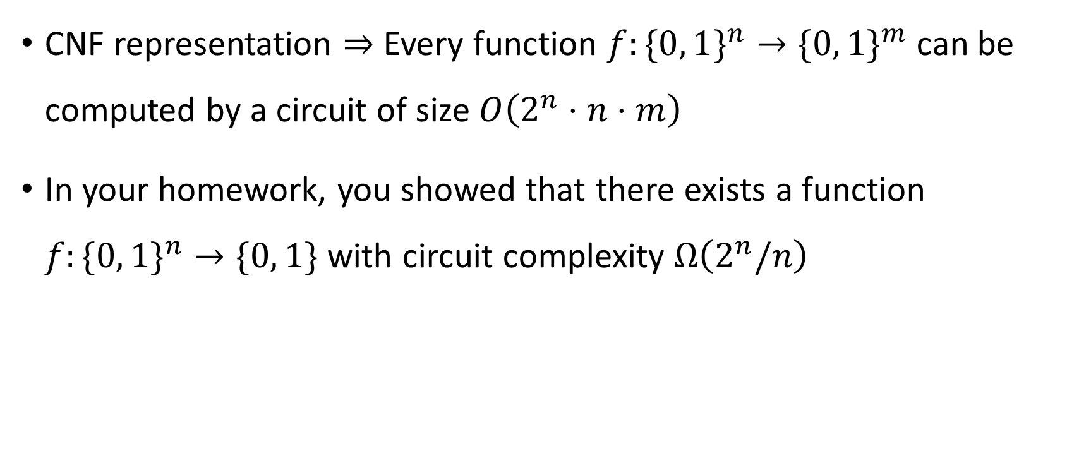
Circuit complexity
CNF representation $⇒$ Every function $f:\{0, 1\}^{n}→\{0, 1\}^{m}$can be computed by a circuit of size $O\left(2^{n}⋅n⋅m\right)$
In your homework, you showed that there exists a function $f:\{0, 1\}^{n}→\{0, 1\}$ with circuit complexity $Ω\left(2^{n}/n\right)$

Slide 33

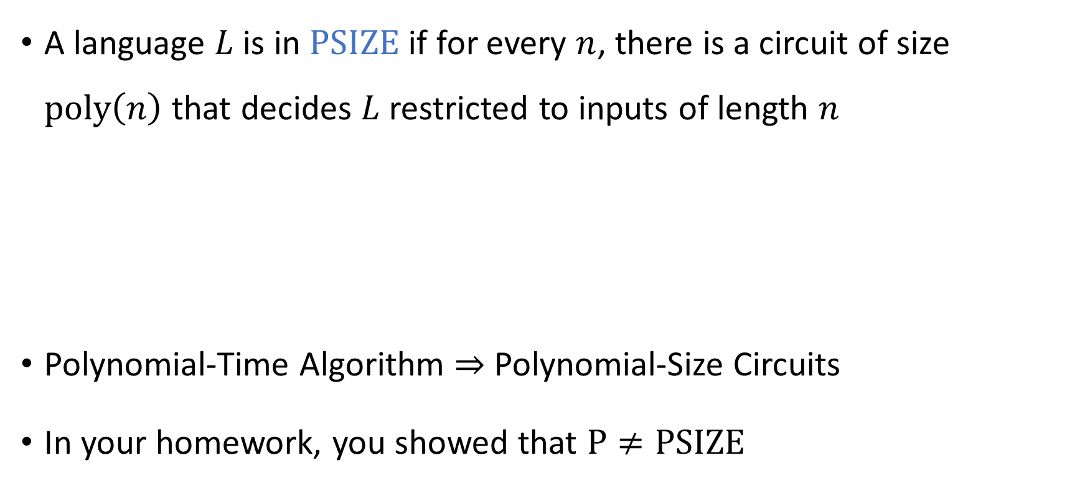
Polynomial-size circuits
A language $L$ is in $\text{PSIZE}$ if for every $n$, there is a circuit of size $\text{poly}\left(n\right)$ that decides $L$ restricted to inputs of length $n$
Polynomial-Time Algorithm $⇒$ Polynomial-Size Circuits
In your homework, you showed that $\text{P}≠\text{PSIZE}$
Theorem: $\text{P}⊆\text{PSIZE}$.

Slide 34

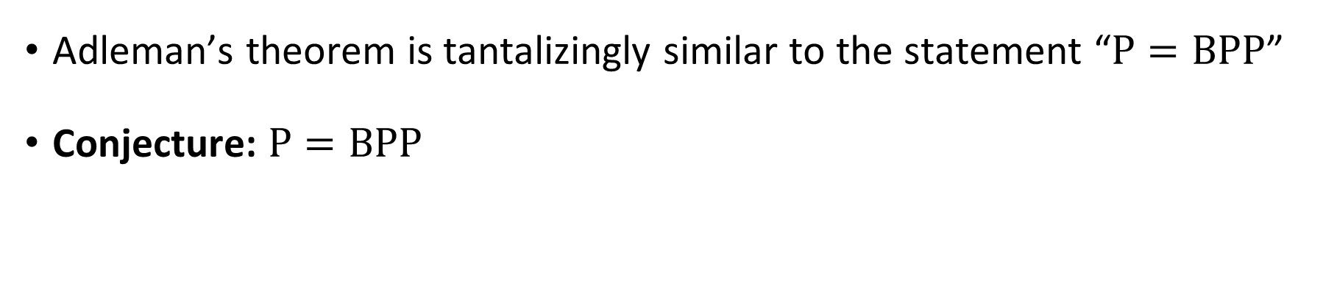
Adleman’s theorem
Adleman’s Theorem: $BP\text{P}⊆\text{PSIZE}$
Adleman’s theorem is tantalizingly similar to the statement “$\text{P}=\text{BPP}$”
Conjecture: $\text{P}=\text{BPP}$

Slide 35

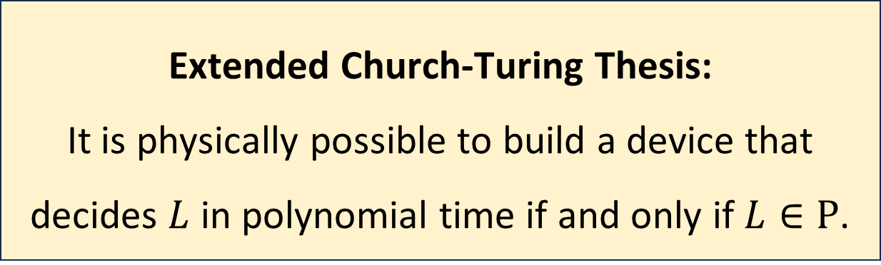
The Extended Church-Turing Thesis
Let $L$ be a language
The Extended Church-Turing thesis is probably false because of quantum computing
Extended Church-Turing Thesis:
It is physically possible to build a device that decides $L$ in polynomial time if and only if $L∈\text{P}$.

Slide 36
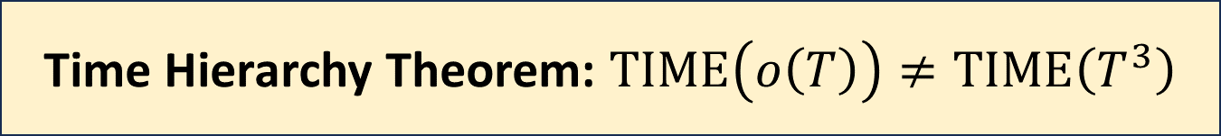

The Time Hierarchy Theorem
Let $T:ℕ→ℕ$ be any “reasonable” (time-constructible) function
Consequence: $\text{P}≠\text{EXP}$
Time Hierarchy Theorem: $\text{TIME}\left(o\left(T\right)\right)≠\text{TIME}\left(T^{3}\right)$

Slide 37
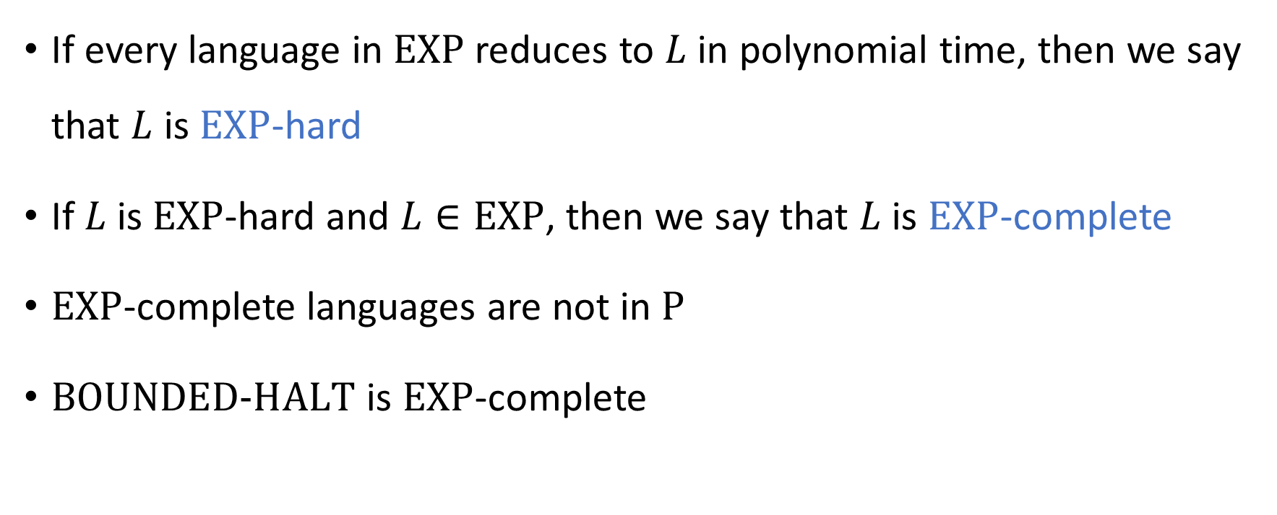
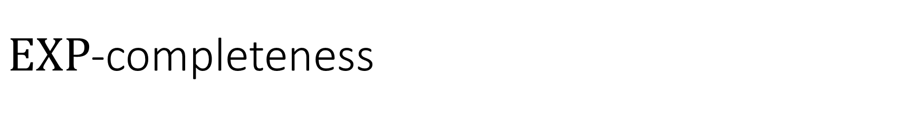
$\text{EXP}$-completeness
If every language in $\text{EXP}$ reduces to $L$ in polynomial time, then we say that $L$ is $\text{EXP}$-hard
If $L$ is $\text{EXP}$-hard and $L∈\text{EXP}$, then we say that $L$ is $\text{EXP}$-complete
$\text{EXP}$-complete languages are not in $\text{P}$
$\text{BOUNDED}\text{‑}\text{HALT}$ is $\text{EXP}$-complete

Slide 38


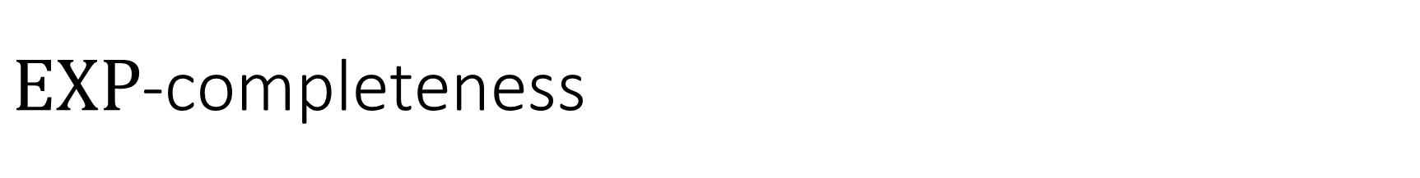



$\text{EXP}$-completeness
$\text{EXP}$-hard
$$\text{BOUNDED}\text{‑}\text{HALT}$$
$\text{EXP}$-complete
$$\text{EXP}$$
$$\text{P}$$

Slide 39
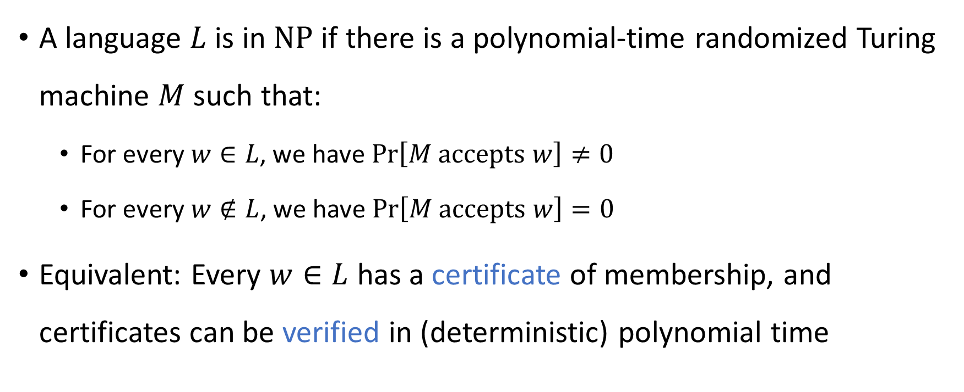

The complexity class $\text{NP}$
A language $L$ is in $\text{NP}$ if there is a polynomial-time randomized Turing machine $M$ such that:
For every $w∈L$, we have $\operatorname{Pr}\left[M \text{accepts} w\right]≠0$
For every $w∉L$, we have $\operatorname{Pr}\left[M \text{accepts} w\right]=0$
Equivalent: Every $w∈L$ has a certificate of membership, and certificates can be verified in (deterministic) polynomial time

Slide 40




$$\text{EXP}$$
$$\text{PSPACE}$$
$$\text{NP}$$
$$\text{P}$$

Slide 41
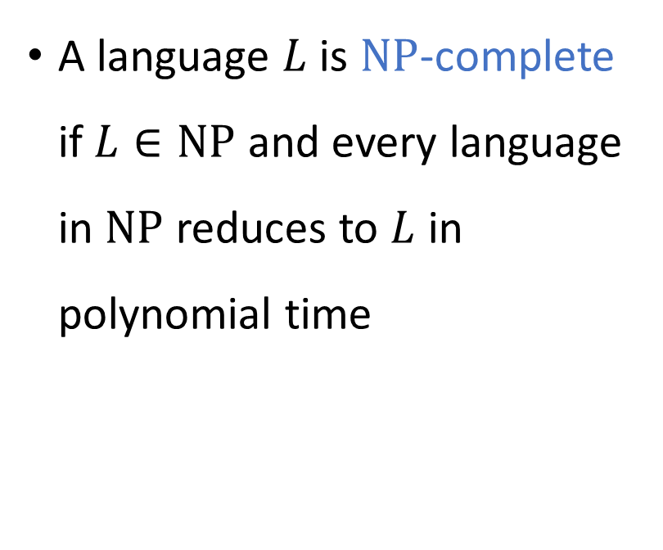

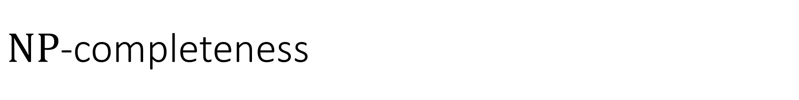


$\text{NP}$-completeness
$\text{NP}$-hard
A language $L$ is $\text{NP}$-complete if $L∈\text{NP}$ and every language in $\text{NP}$ reduces to $L$ in polynomial time
$\text{NP}$-complete
$$\text{NP}$$
$$\text{P}$$

Slide 42


Circuit satisfiability
$\text{CIRCUIT}\text{‑}\text{SAT}=\left\{\left\langle C\right\rangle :C \text{is} \text{a} \text{satisfiable} \text{circuit}\right\}$
Key idea: If $L∈\text{P}$, then not only does $L$ have polynomial-size circuits ($L∈\text{PSIZE}$), but in fact we can efficiently construct the circuits
Theorem: $\text{CIRCUIT}\text{‑}\text{SAT}$ is $\text{NP}$-complete

Slide 43

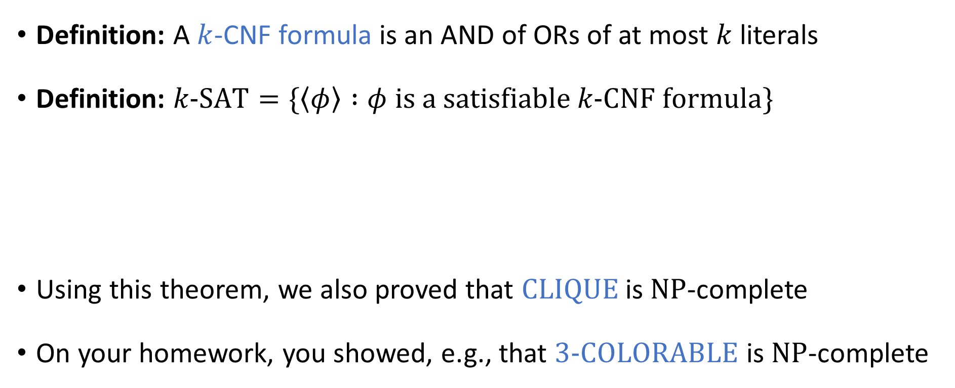
The Cook-Levin Theorem
Definition: A $k$-CNF formula is an AND of ORs of at most $k$ literals
Definition: $k\text{‑}\text{SAT}=\{\left\langle φ\right\rangle :φ \text{is} \text{a} \text{satisfiable} k\text{‑}\text{CNF} \text{formula}\}$
Using this theorem, we also proved that $\text{CLIQUE}$ is $\text{NP}$-complete
On your homework, you showed, e.g., that $\text{3‑}\text{COLORABLE}$ is $\text{NP}$-complete
The Cook-Levin Theorem: $3\text{‑}\text{SAT}$ is $\text{NP}$-complete

Slide 44
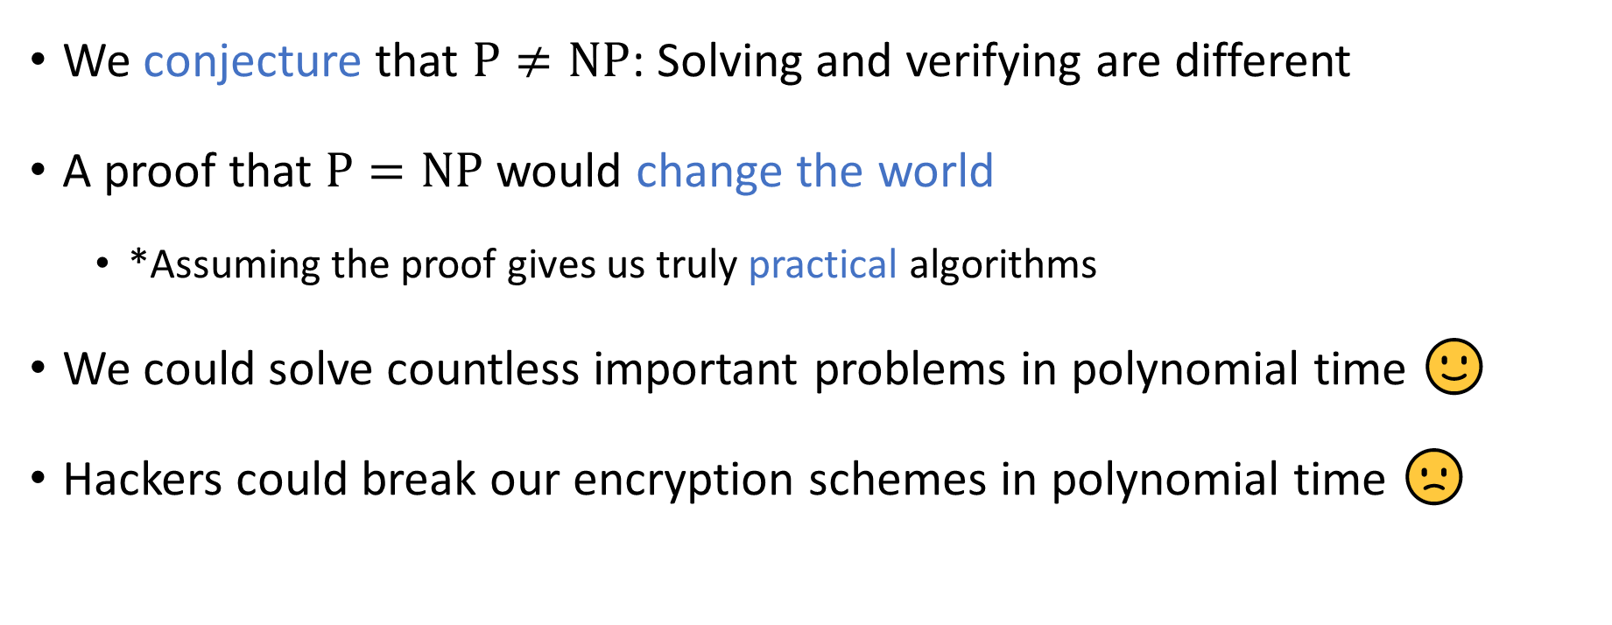

The $\text{P}$ vs. $\text{NP}$ problem
We conjecture that $\text{P}≠\text{NP}$: Solving and verifying are different
A proof that $\text{P}=\text{NP}$ would change the world
*Assuming the proof gives us truly practical algorithms
We could solve countless important problems in polynomial time 🙂
Hackers could break our encryption schemes in polynomial time 🙁

Slide 45
Lessons
Computation has intrinsic limitations
Mathematics and computer science form a powerful combination
Complexity theory enables us to formulate and study profound questions
Questions about the human condition
Questions about the physical universe

Slide 46
Thank you!
Teaching you has been a privilege
I hope you’ve enjoyed taking the course as much as I’ve enjoyed teaching it
Please fill out the College Course Feedback Form using My.UChicago (deadline is May 26)
See you next week for office hours and the final exam!

